Slide 1
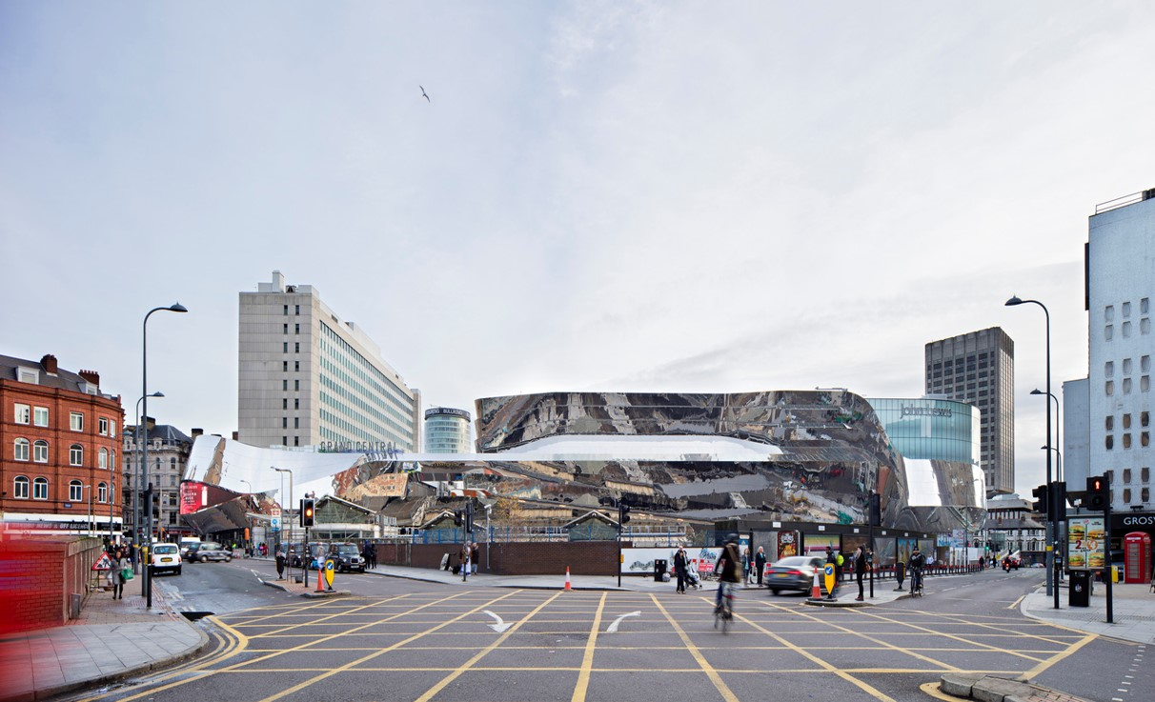
US. Modernist Houses
World Railway Stations II
(2014-2022)
1960-1980

Slide 2
World Railway Stations
The purpose of this presentation is to show you Contemporary Worldwide Railway Stations.
They were born from the imagination of the greatest architects and some of them have become an Iconic architecture of the 20th and 21th centuries.
In France, the introduction of the TGV has led to a revolution in rail transport and the construction of new futuristic stations not only in France, but in the world .

Slide 3
World Railway Stations
Union Station, SOM, CO, US.
South Station, CSDI, CN.
Rotterdam Station, Benthem Crouwel Architects, NL.
Grand Central, AZPML, GB.
Den Haag Central Station, Benthem Crouwel Architects, NL.
Arnhem Central Station, UNStudio, NL.
Onagawa Station, Shigeru Ban, JP.
Hub Station, Rafał Sieraczyński, PL.
Utrecht Central Station, Benthem Crouwel Architects, NL.
Napoli Afragola Station, Zaha Hadid, IT.

Slide 4
World Railway Stations 2
Montpellier TGV Station, Marc Mimram, FR.
Kenitra TGV Station, Silvio d’Ascia, MA.
Matera Centrale, Stefano Boeri, IT.
Assen Station, Powerhouse Company, NL.
Kaohsiung Station, Mecanoo, TW.

Slide 5
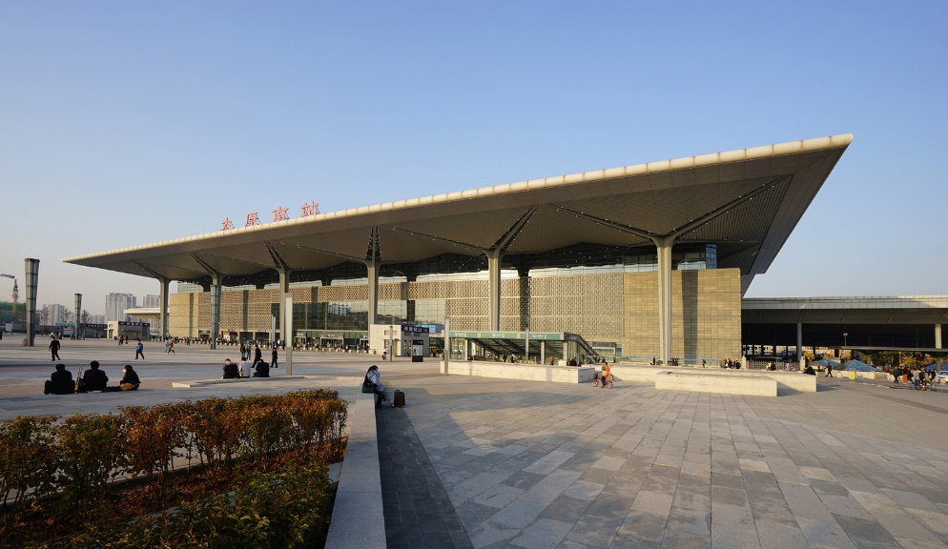
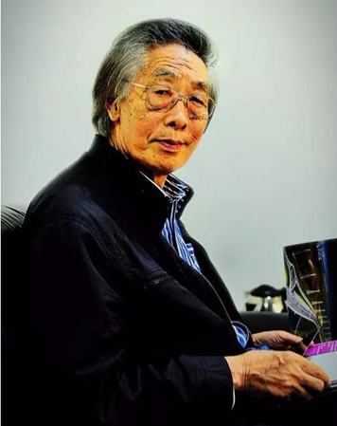
South Station, TaiYuan, CN (2014)
Yuan Peihuang

Slide 6
South Station, TaiYuan, CN (2014)
It is the work of CSADI architectural firm.
Steel structure is used for the roof of the main station building, which has absorbed the image of bracket sets and overhanging eaves for palaces in Tang Dynasty, thus expressing the beauty of forms of traditional buildings by modern structures. The ancient-style double-layer black brick curtain on the main façade of the station building manages to evoke the architectural details of Shanxi traditional residences. Natural lighting-in combination of the layout of the structural unit, the X-shaped translucent high-strength Makrolon skylight filters the direct sunlight to be even and soft indoor light.

Slide 7
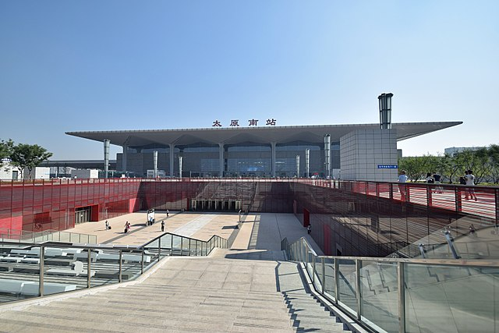
South Station, TaiYuan, CN (2014)

Slide 8
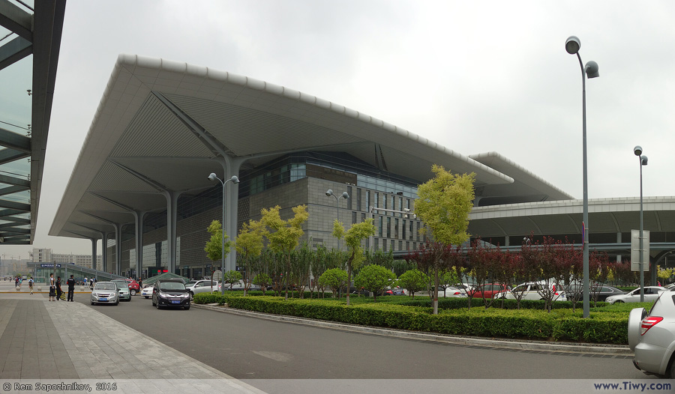
South Station, TaiYuan, CN (2014)

Slide 9
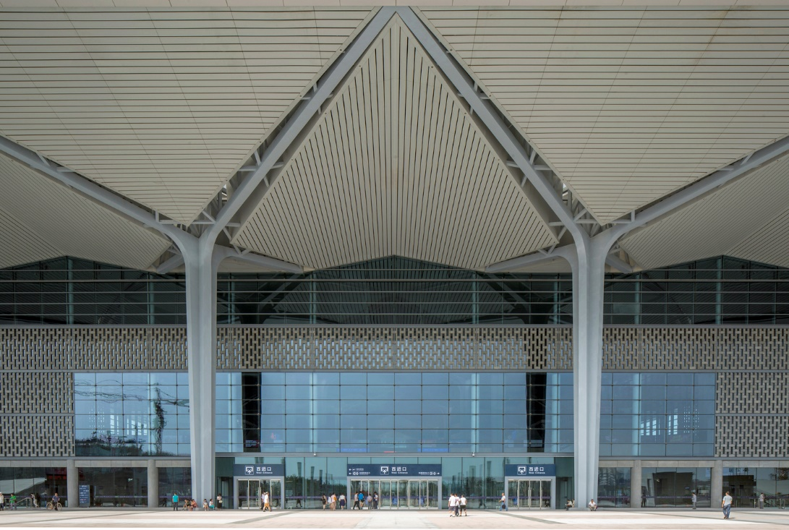
South Station, TaiYuan, CN (2014)

Slide 10
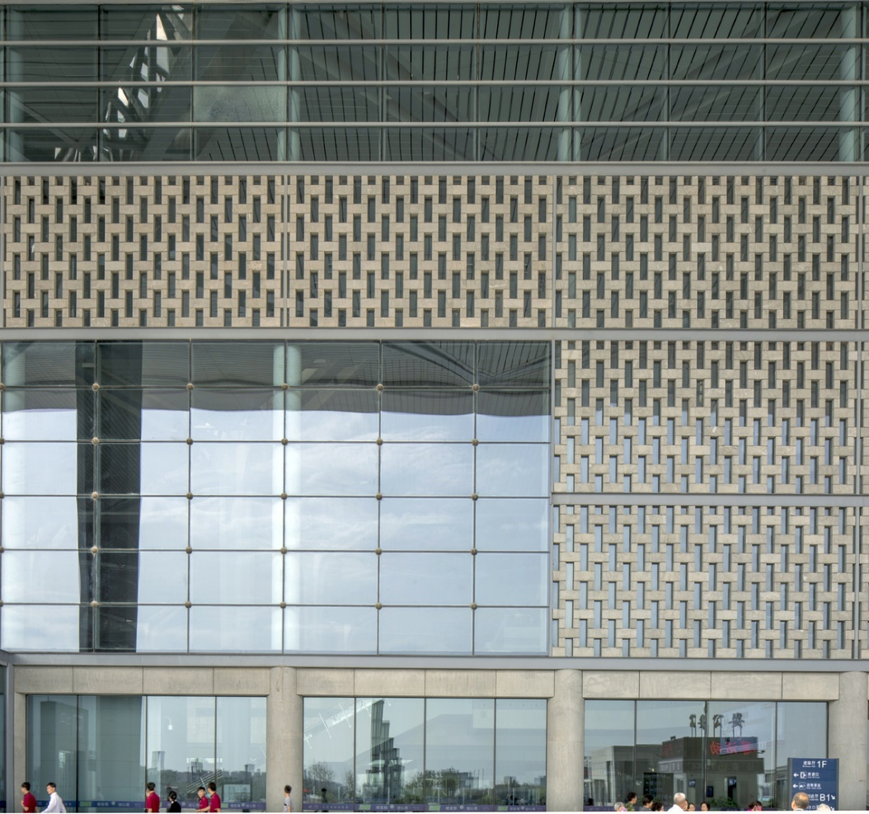
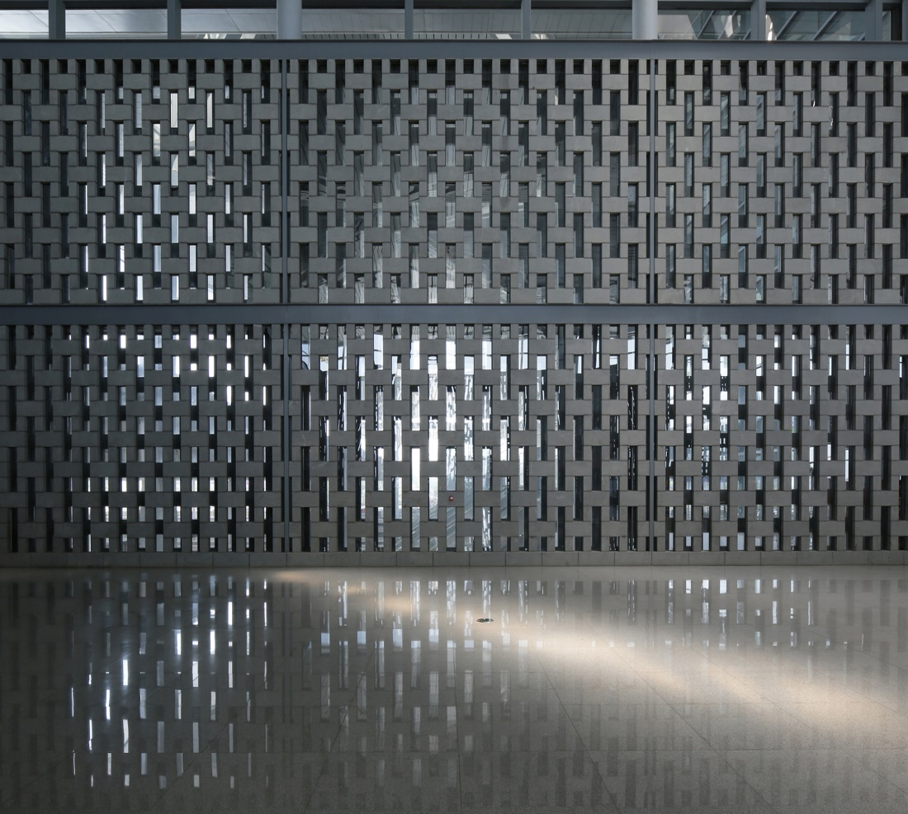
South Station, TaiYuan, CN (2014)

Slide 11
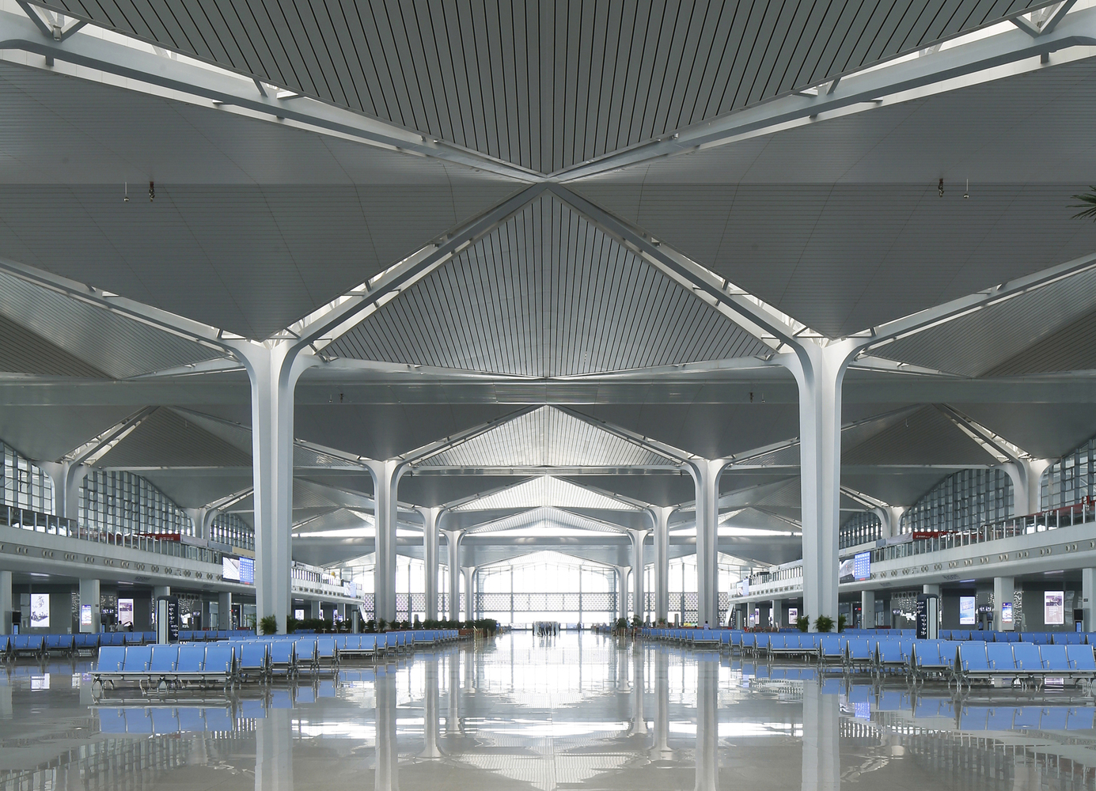
South Station, TaiYuan, CN (2014)

Slide 12
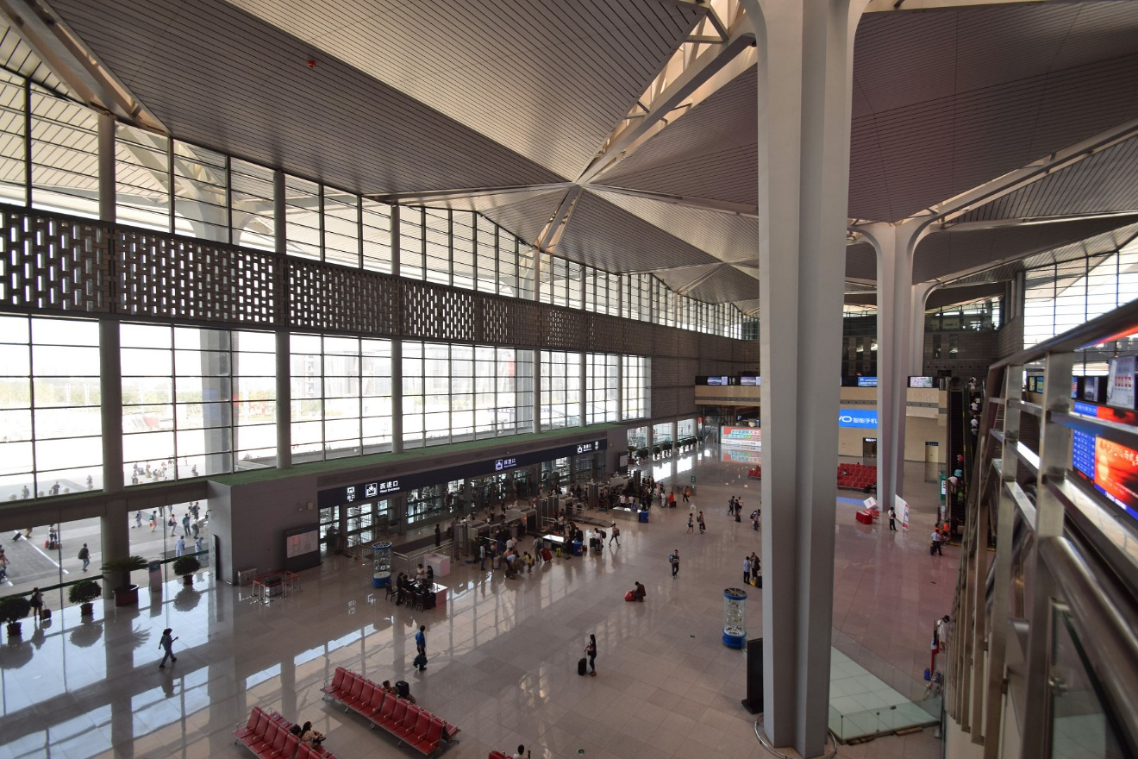
South Station, TaiYuan, CN (2014)

Slide 13
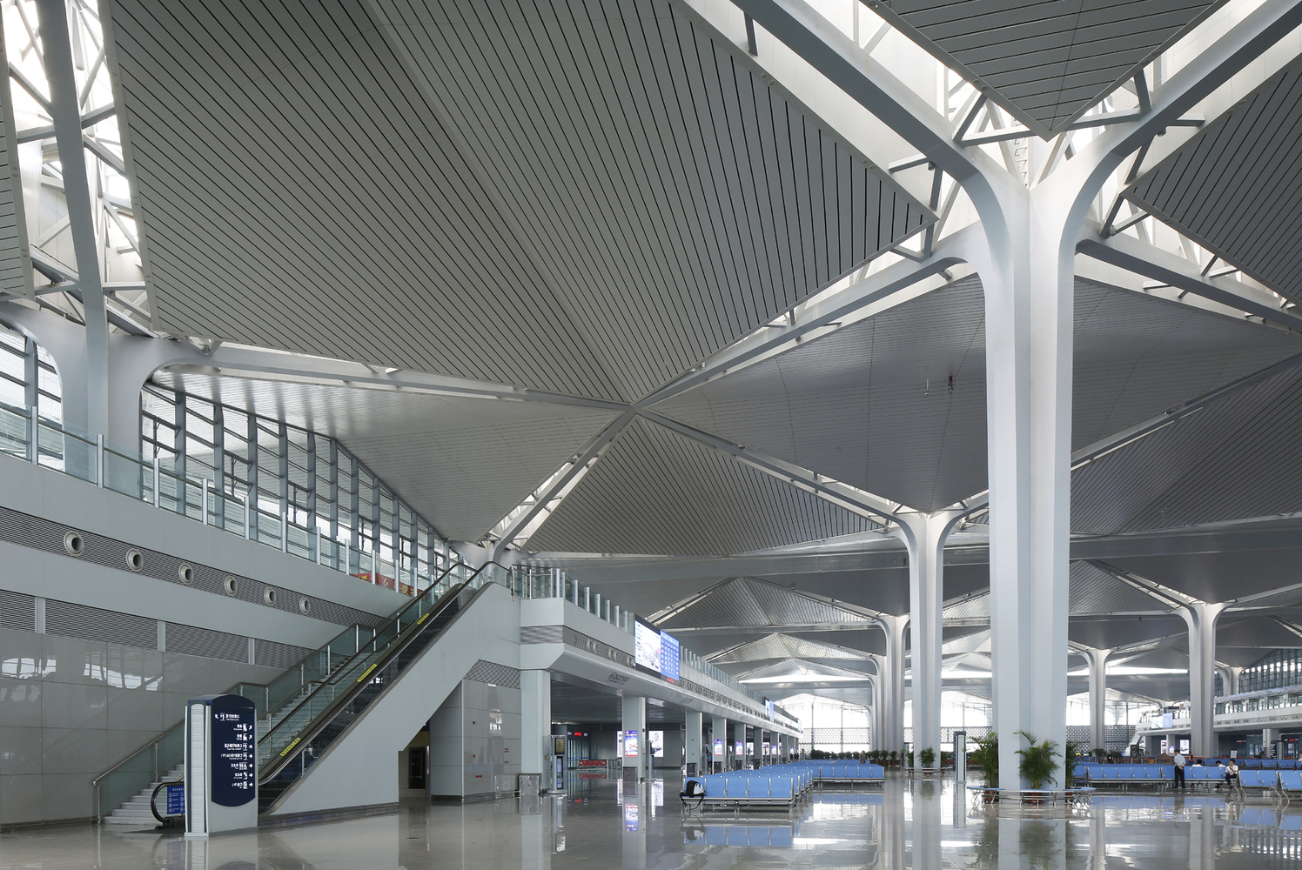
South Station, TaiYuan, CN (2014)

Slide 14
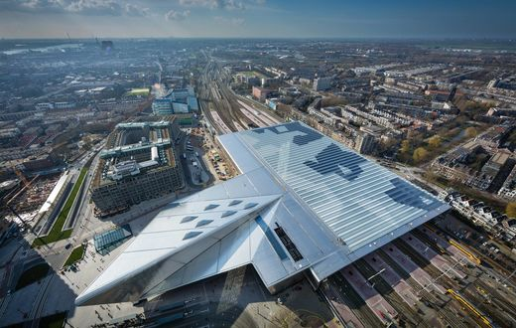
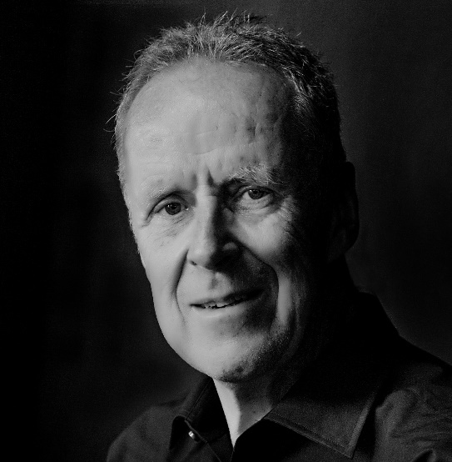
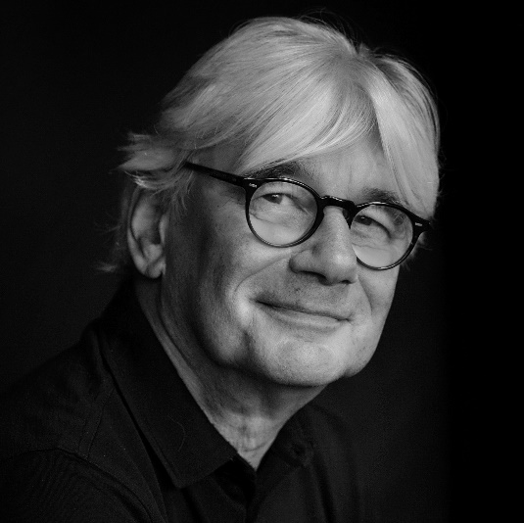
Central Station, Rotterdam, NL (2014)
Jan Benthem
Mels Crouwel

Slide 15
Central Station, Rotterdam, NL (2014)
It is the work of Benthem Crouwel Architects.
Together with the front façade and station canopy, the station forecourt creates a fanciful triangle that merges seamlessly with station hall. Here, the station derives its new international, metropolitan identity from the entrance lined with glass and wood. On the outside, the fully titanium-clad, iconic roof of the hall points towards the heart of the city.

Slide 16
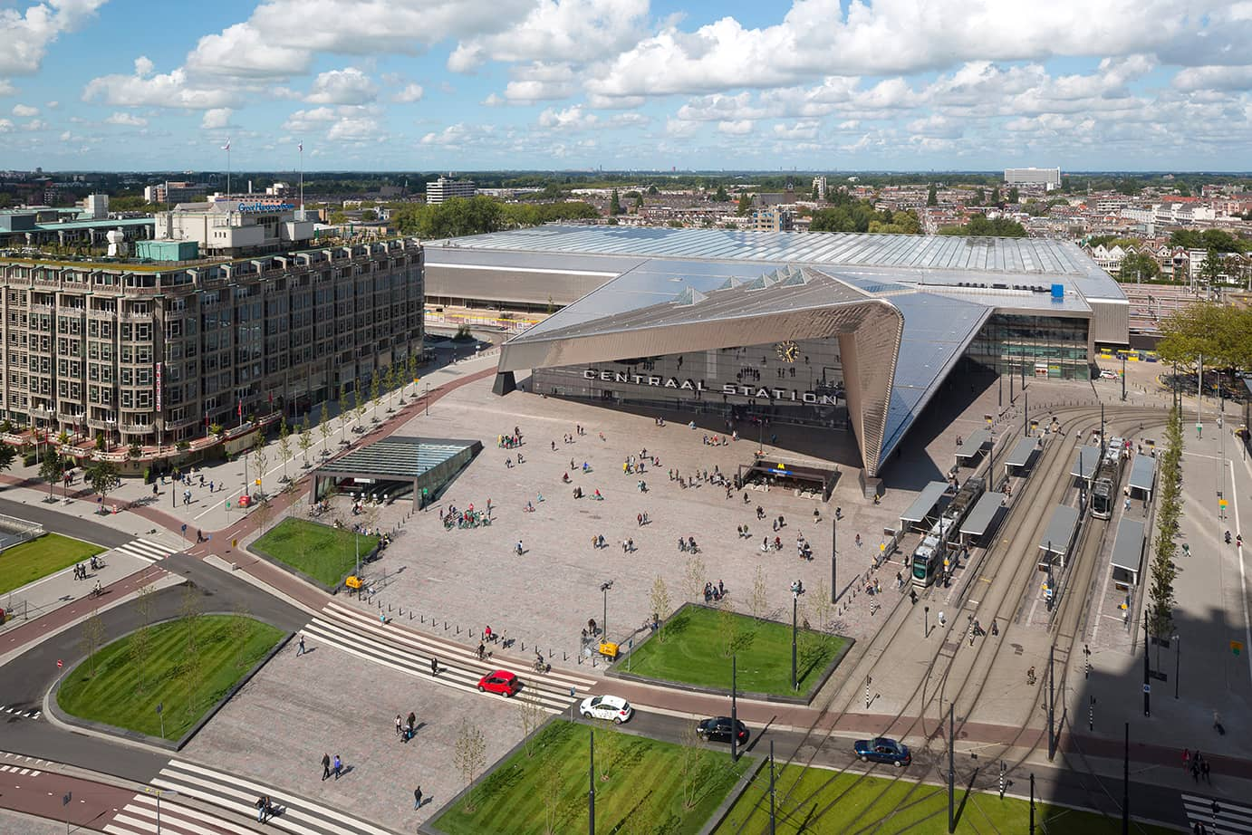
Central Station, Rotterdam, NL (2014)

Slide 17
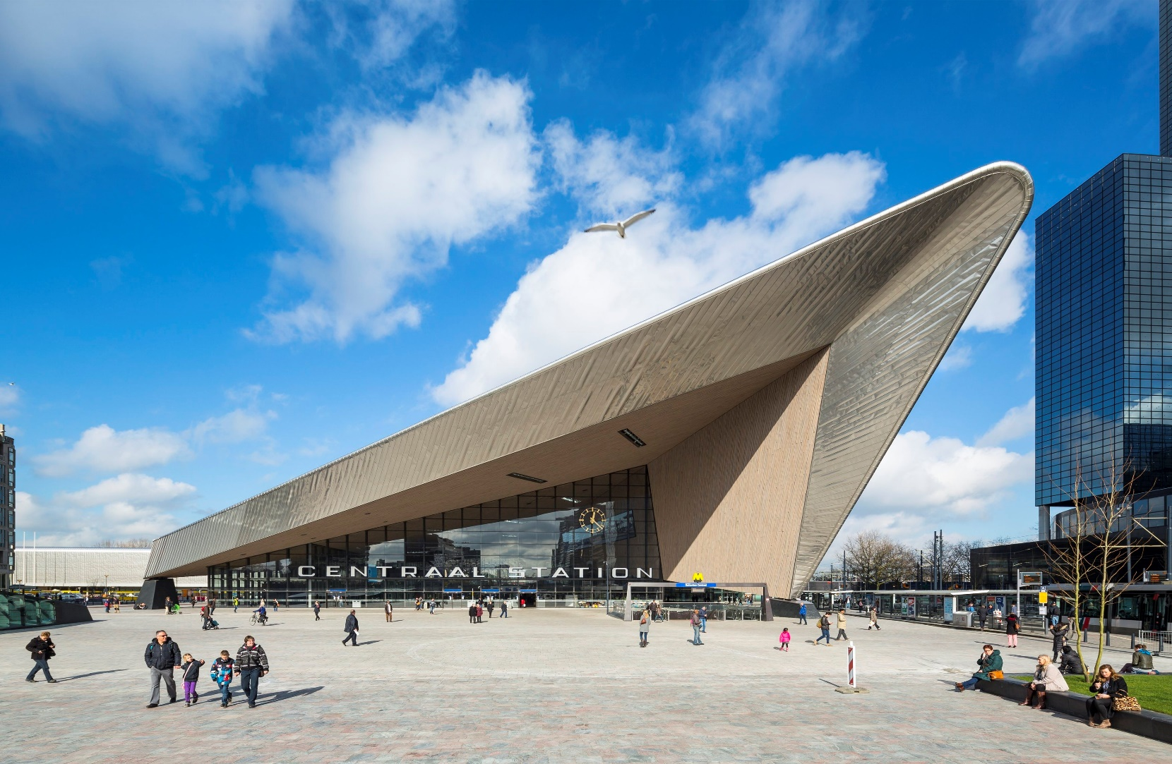
Central Station, Rotterdam, NL (2014)

Slide 18
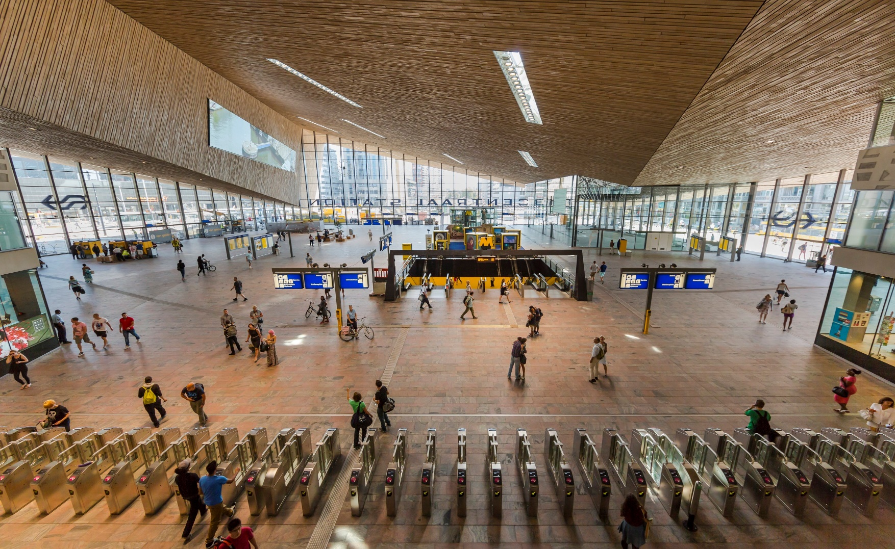
Central Station, Rotterdam, NL (2014)

Slide 19
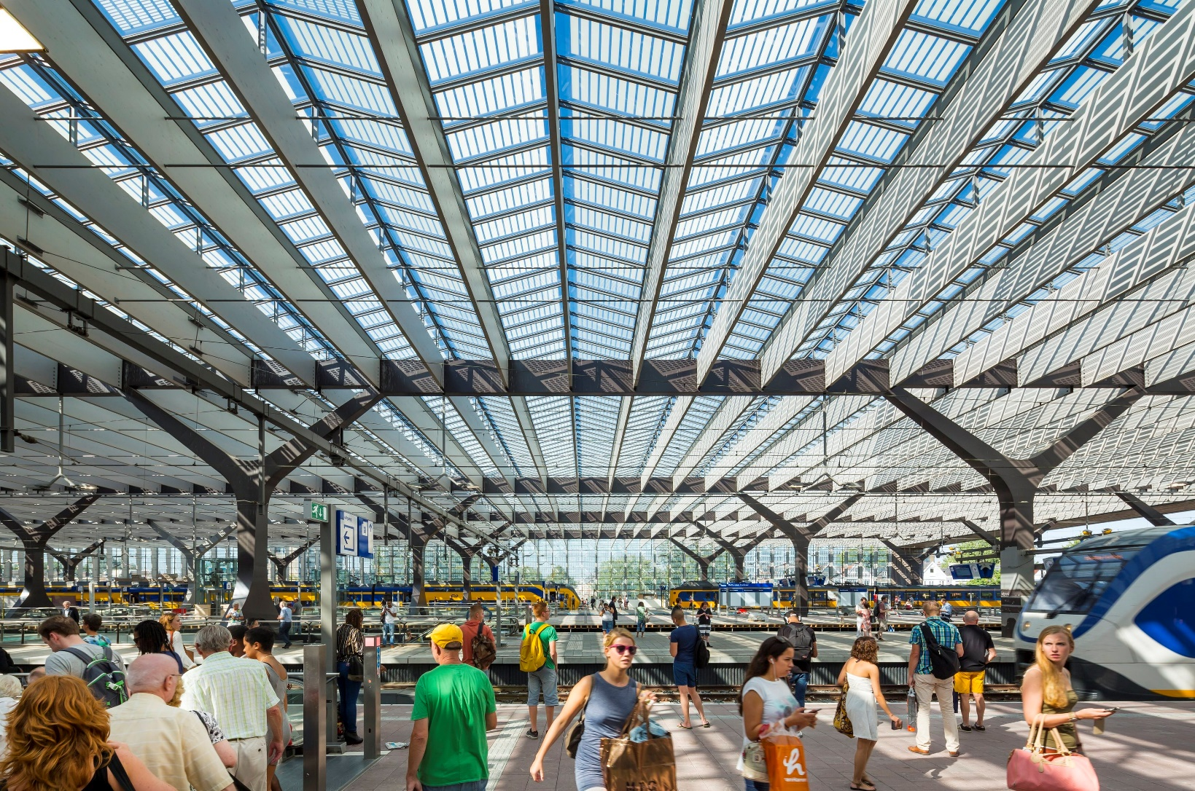
Central Station, Rotterdam, NL (2014)

Slide 20
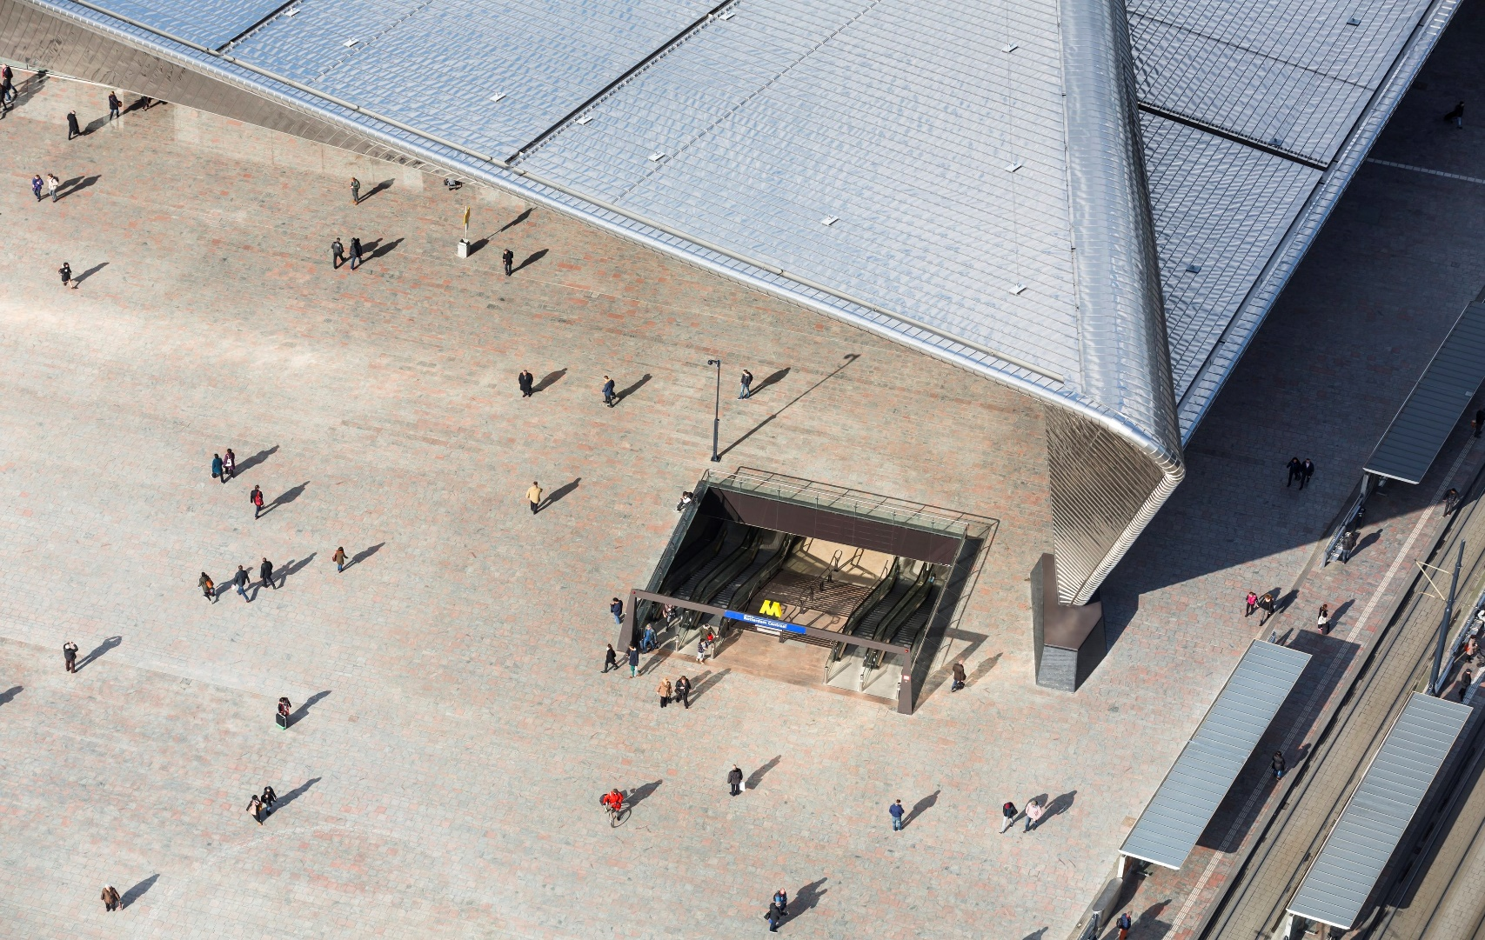
Central Station, Rotterdam, NL (2014)

Slide 21
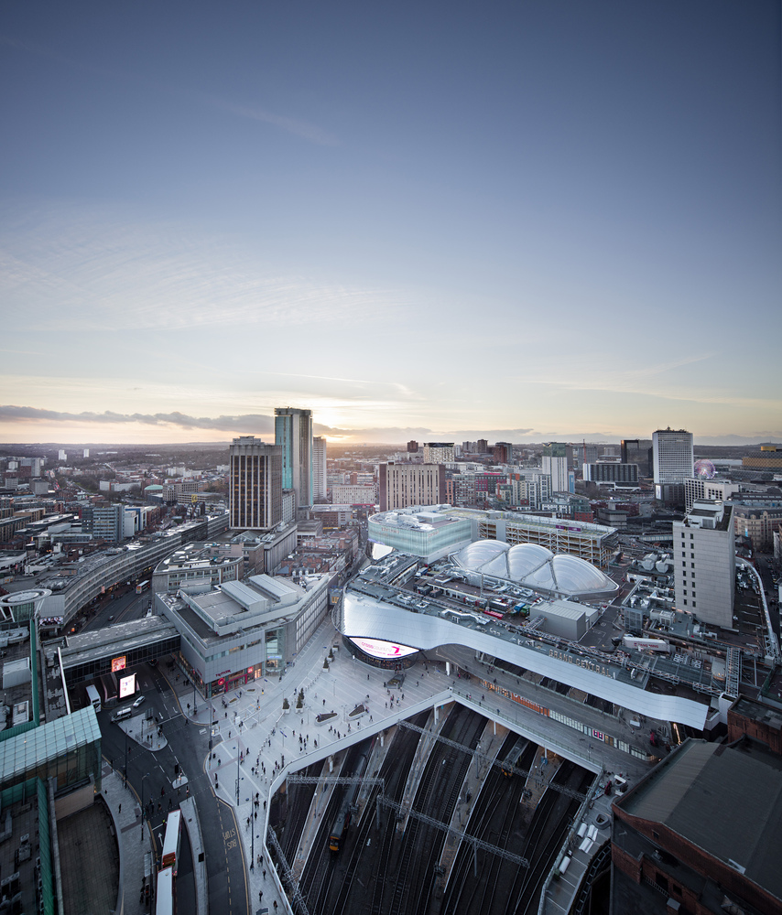
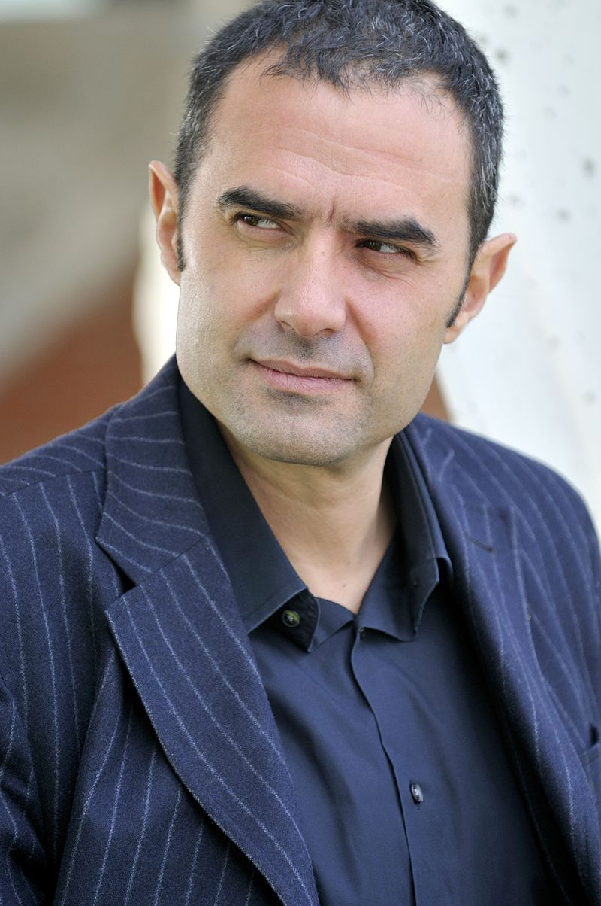
Grand Central, Birmingham, GB (2015)
Alejandro Zaera-Polo
Maider Llaguno

Slide 22
Grand Central, Birmingham, GB (2015)
It is the work of AZPML architectural firm.
The bifurcating, undulating, smooth forms of the track field have been transferred and embedded into the geometry of the building to ornate the city. By turning the external rain screen into a warping, reflective stainless steel surface, New Street Station will be designed to produce controlled reflection of the surrounding urban field. To highlight the four main access points, large eye-shaped media screens have been integrated in the façade. The field of reflections which constitutes the external envelope of the building, and produces a consistent identity, differentiates depending on the opportunities on each side of the building.

Slide 23
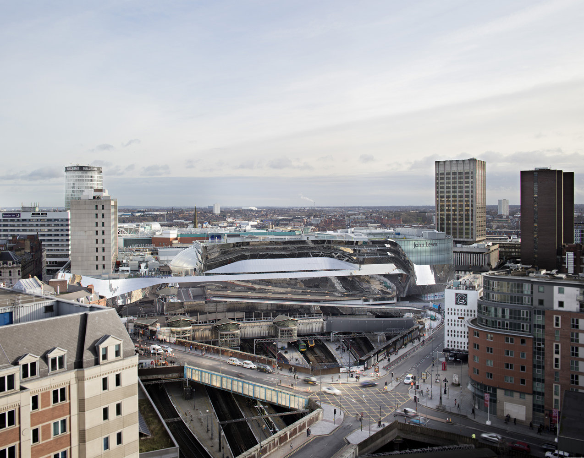
Grand Central, Birmingham, GB (2015)

Slide 24
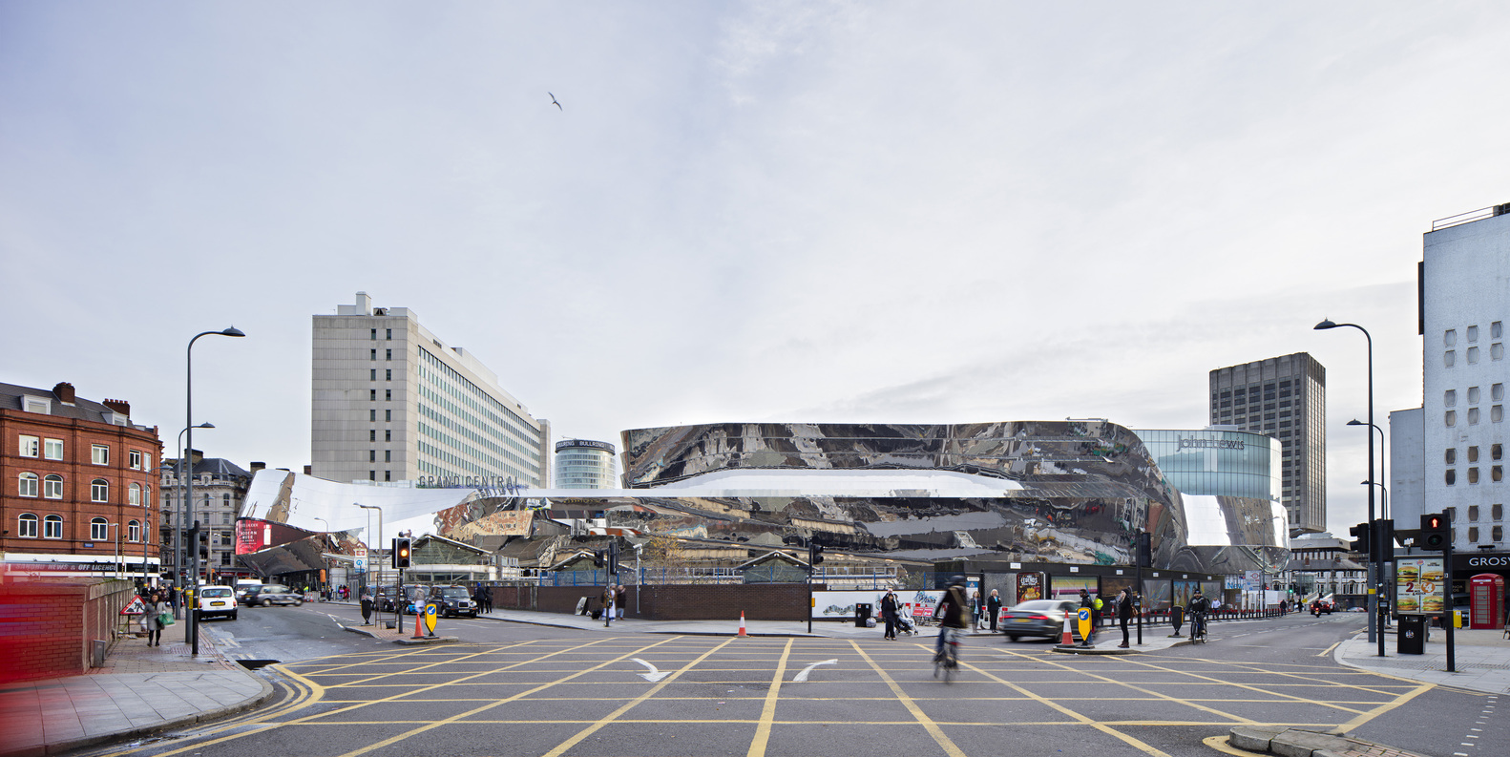
Grand Central, Birmingham, GB (2015)

Slide 25
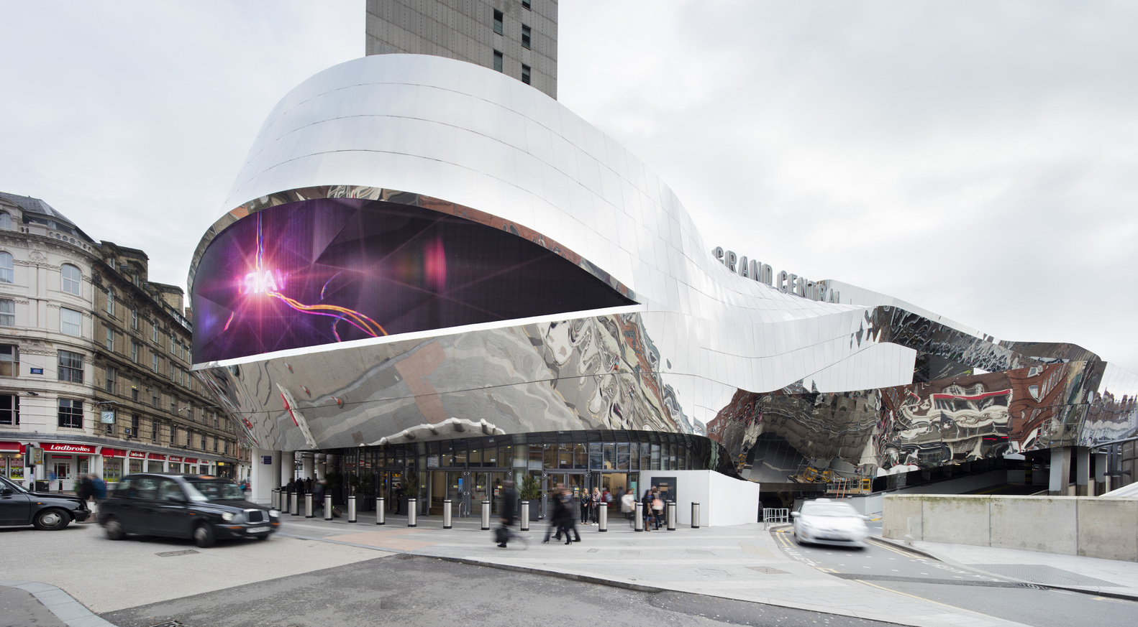
Grand Central, Birmingham, GB (2015)

Slide 26
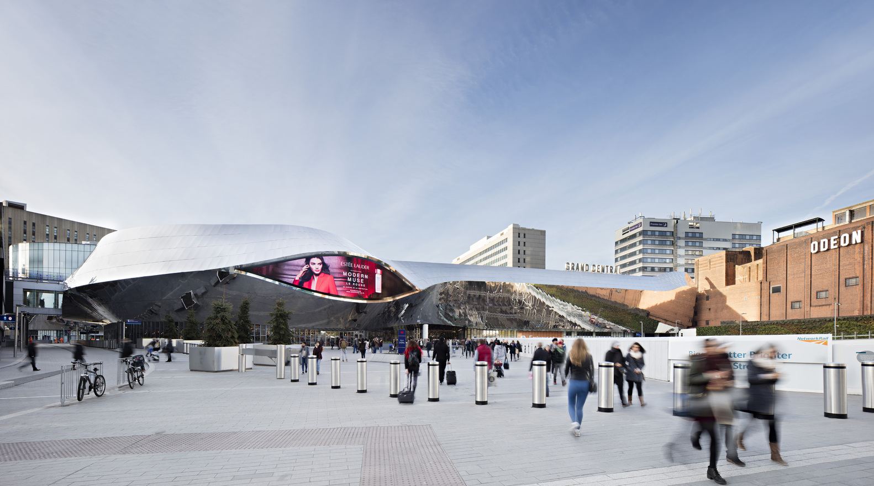
Grand Central, Birmingham, GB (2015)

Slide 27
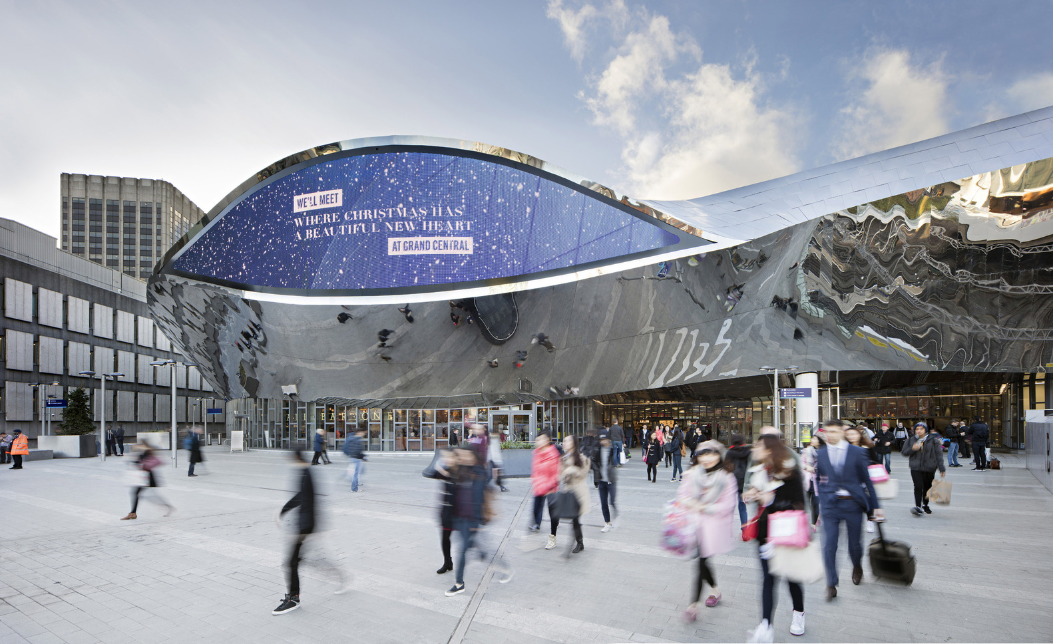
Grand Central, Birmingham, GB (2015)

Slide 28
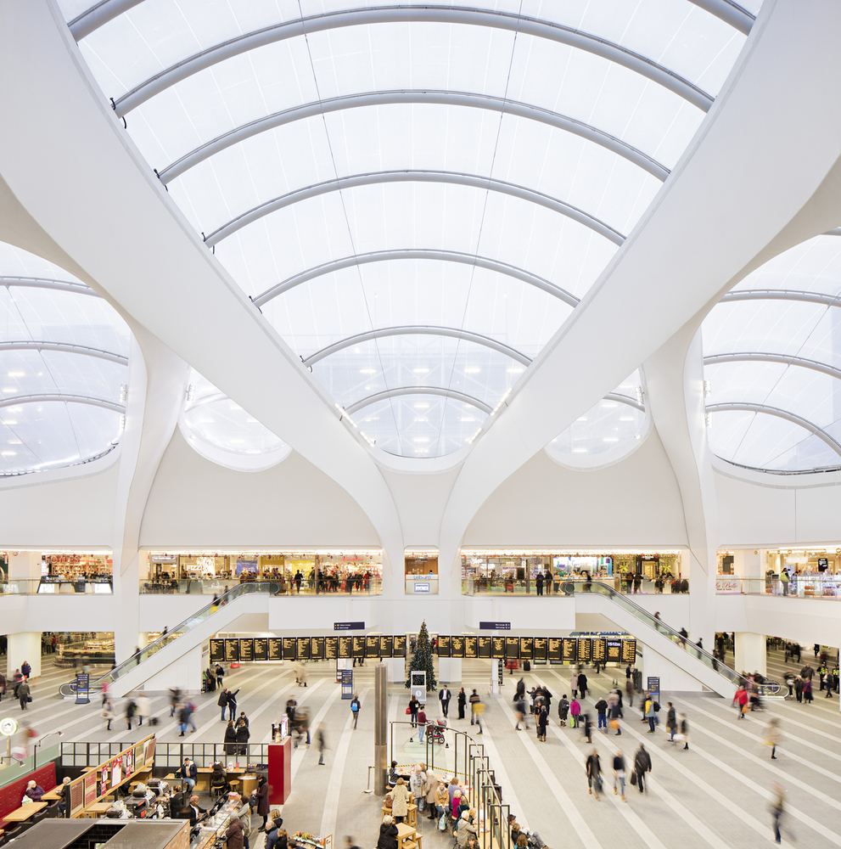
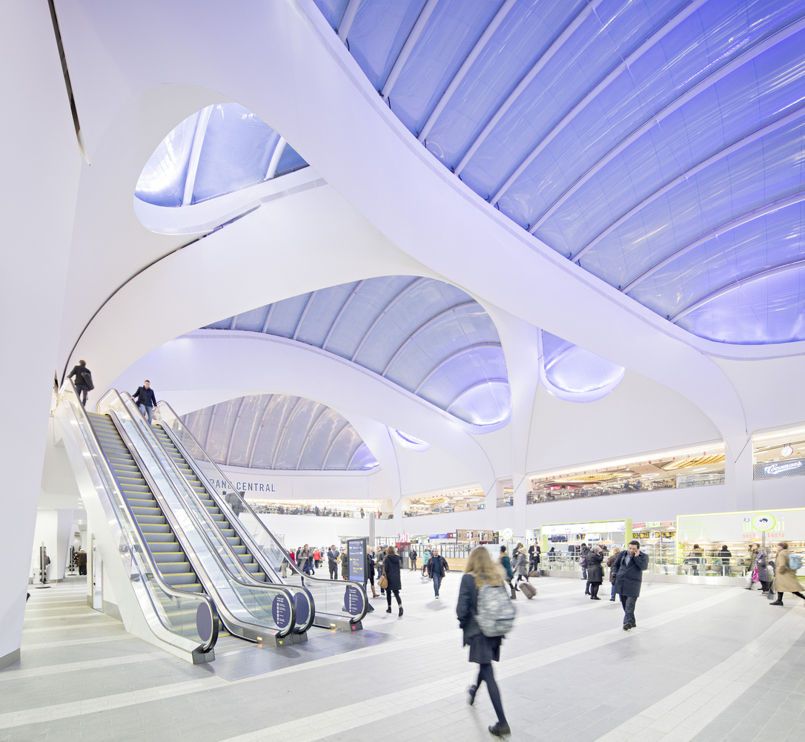
Grand Central, Birmingham, GB (2015)

Slide 29
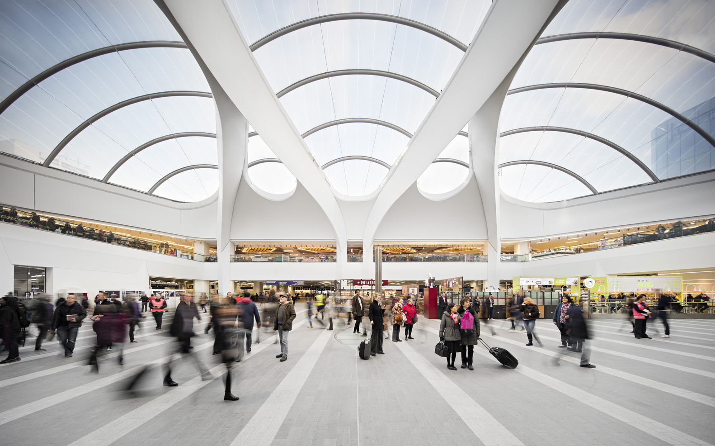
Grand Central, Birmingham, GB (2015)

Slide 30
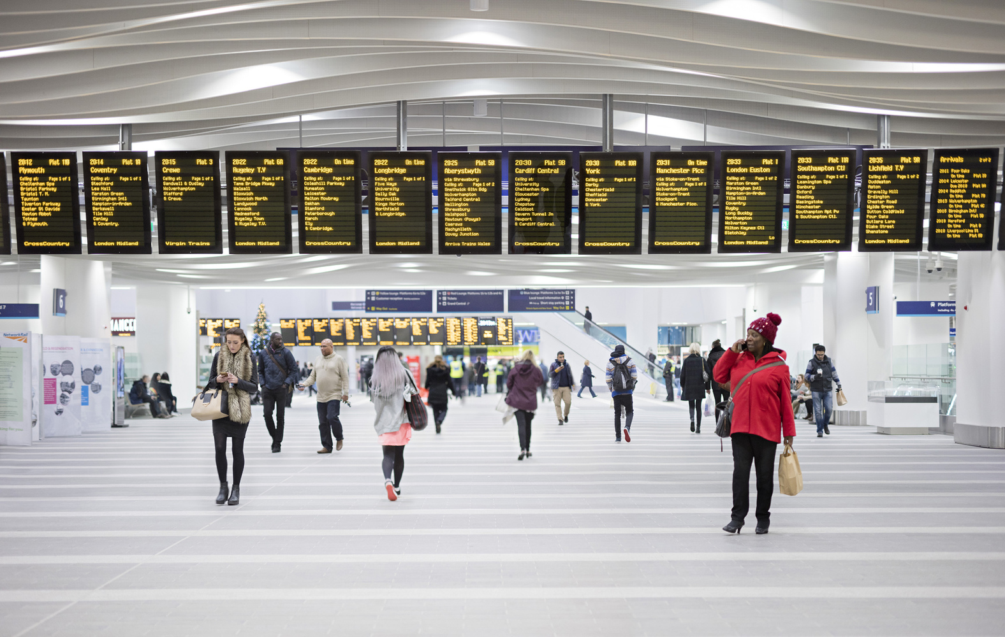
Grand Central, Birmingham, GB (2015)

Slide 31
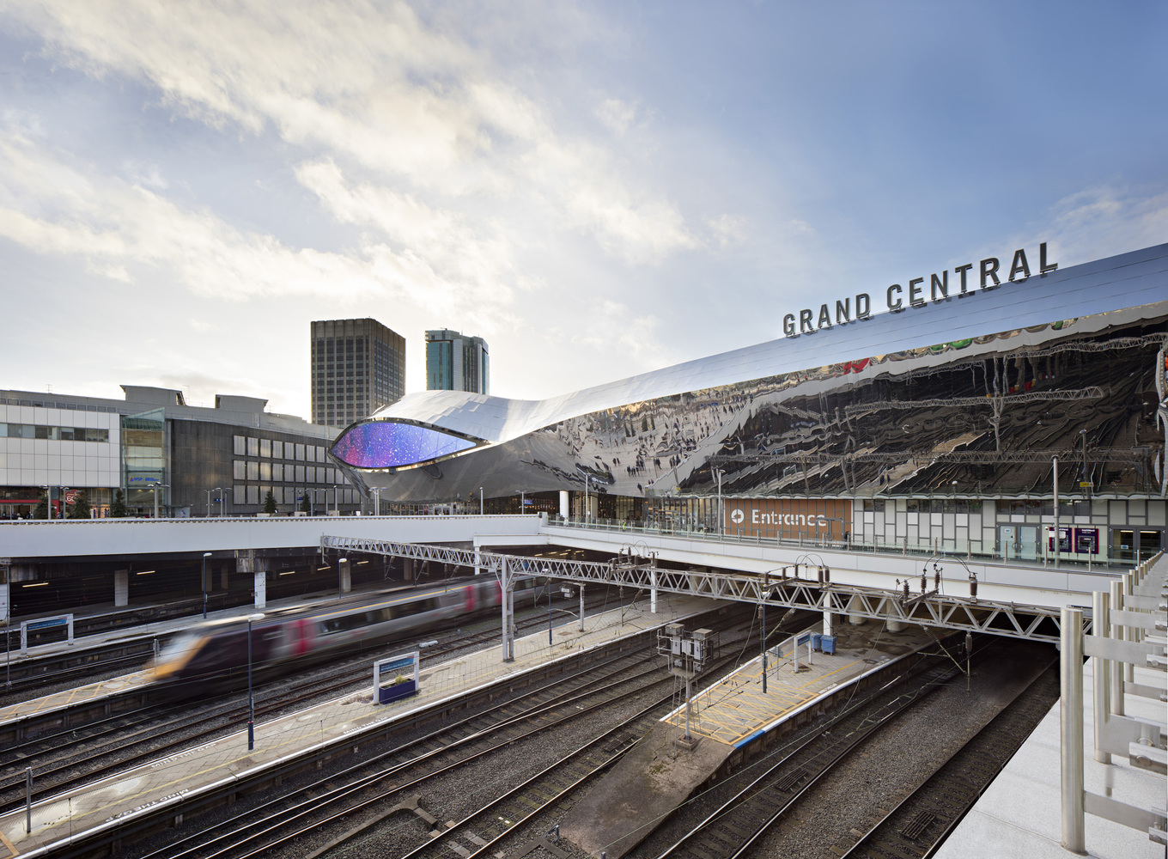
Grand Central, Birmingham, GB (2015)

Slide 32
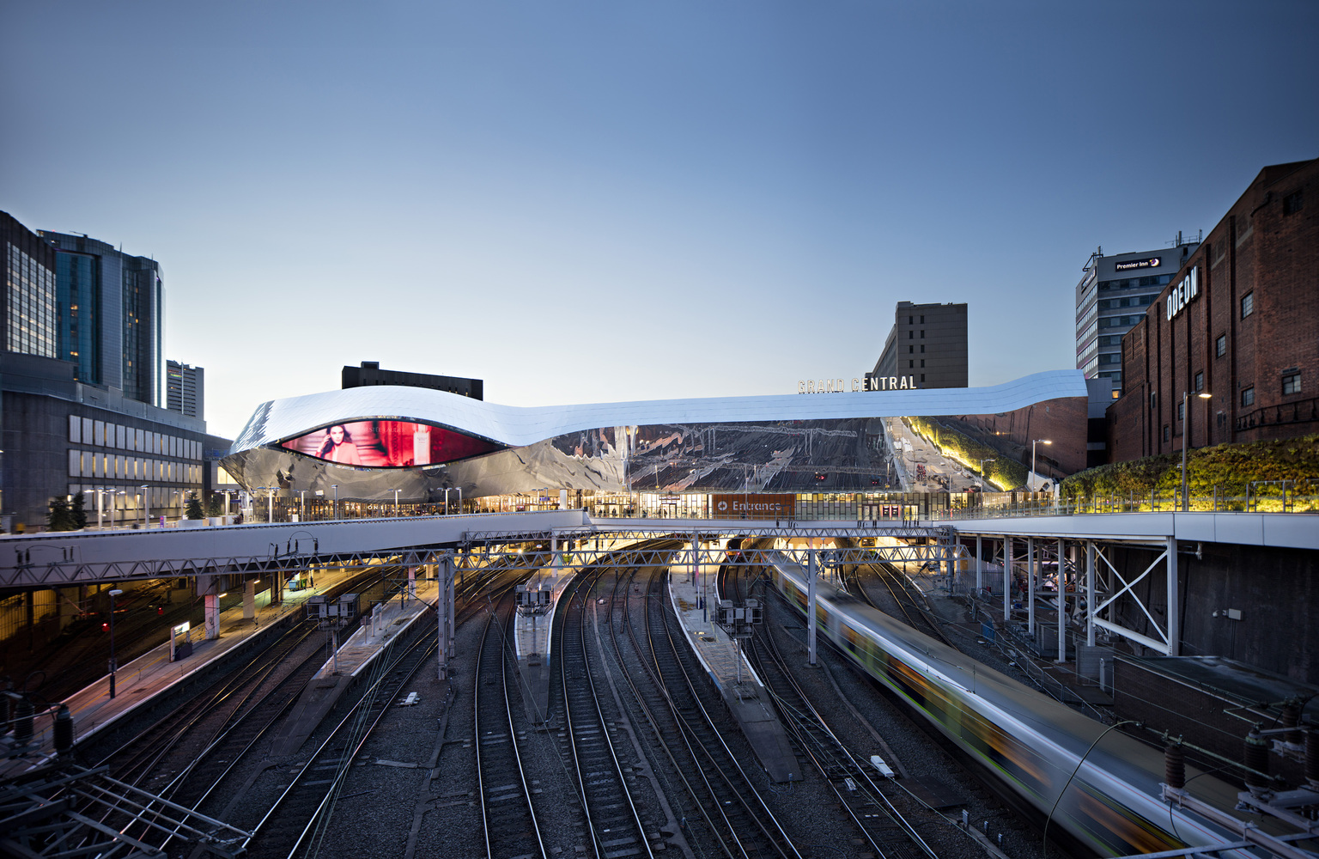
Grand Central, Birmingham, GB (2015)

Slide 33
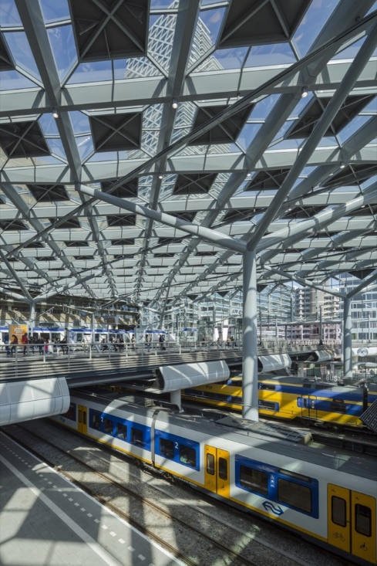
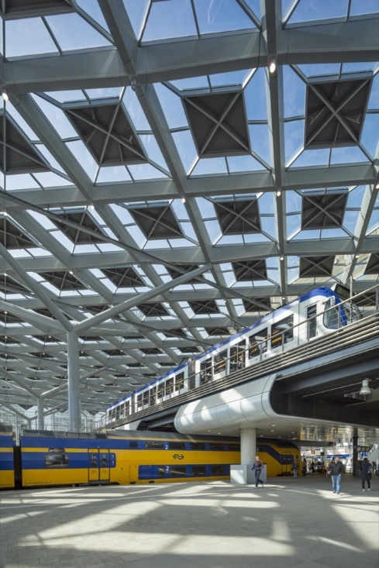
Central Station, Den Haag, NL (2015)
Jan Benthem
Mels Crouwel

Slide 34
Central Station, Den Haag, NL (2015)
It is the work of Benthem Crouwel Architects.
The station building, which measures 120 by 96 m and is 22 m tall, is almost entirely of glass. Eight elegant columns support the station roof, which is the size of two football pitches. The diagrid structure of the glass roof represents the four-sidedness of the building and the direction of the routing, while also stabilizing the rectangular hall volume. The canopy is composed of diamond-shaped roof cupolas on a web of criss-crossing eaves with integrated lighting. The patterned roof produces a spectacular play of shadows, resembling the effect of lush sycamore trees.

Slide 35
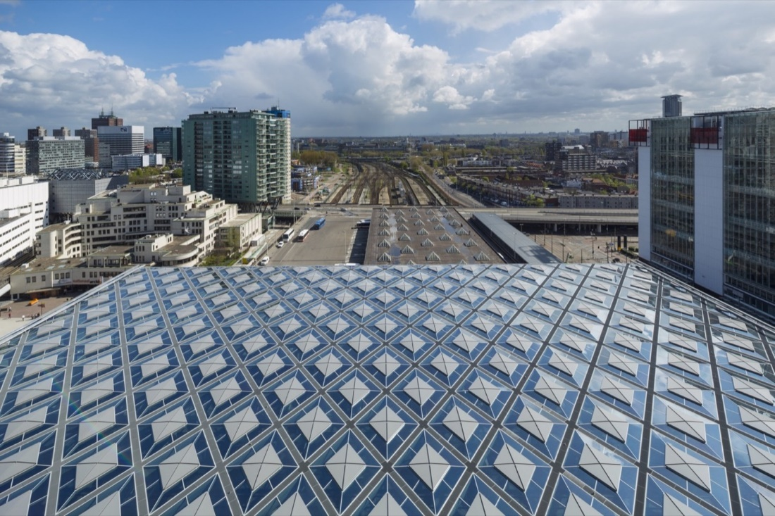
Central Station, Den Haag, NL (2015)

Slide 36
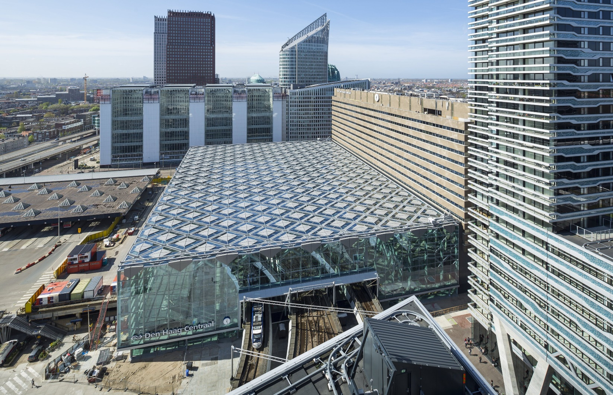
Central Station, Den Haag, NL (2015)

Slide 37
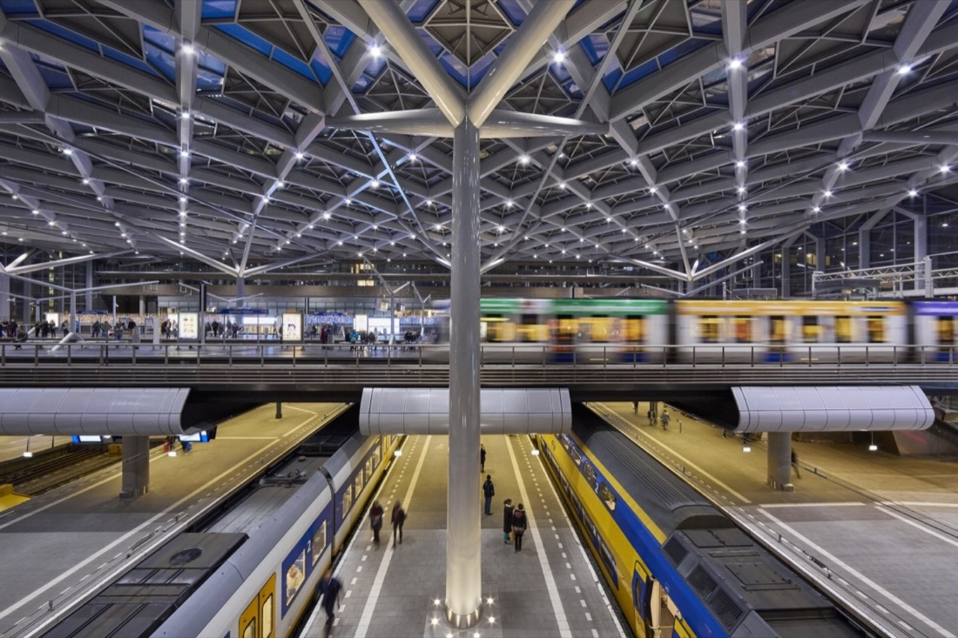
Central Station, Den Haag, NL (2015)

Slide 38
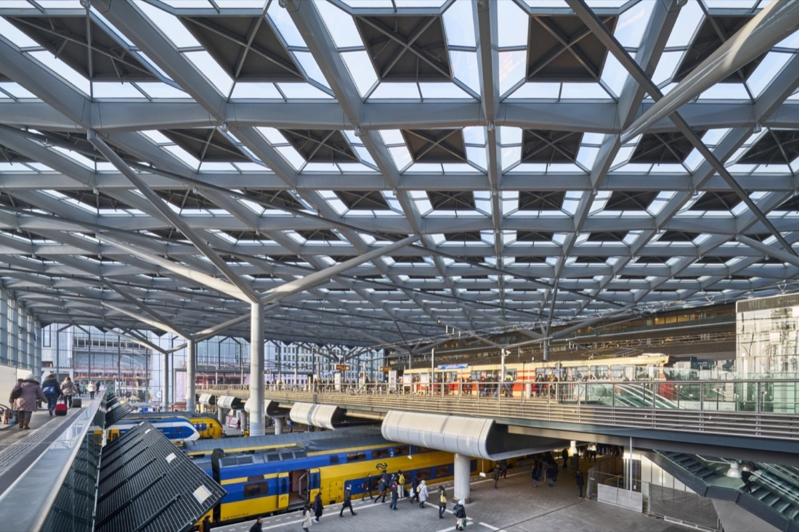
Central Station, Den Haag, NL (2015)

Slide 39
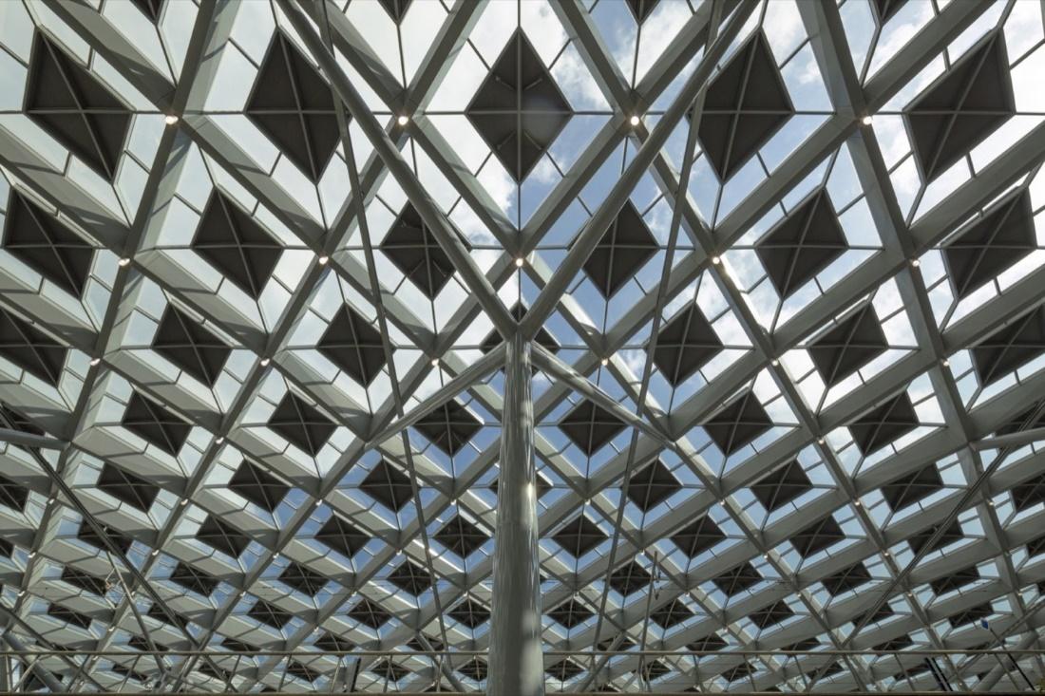
Central Station, Den Haag, NL (2015)

Slide 40
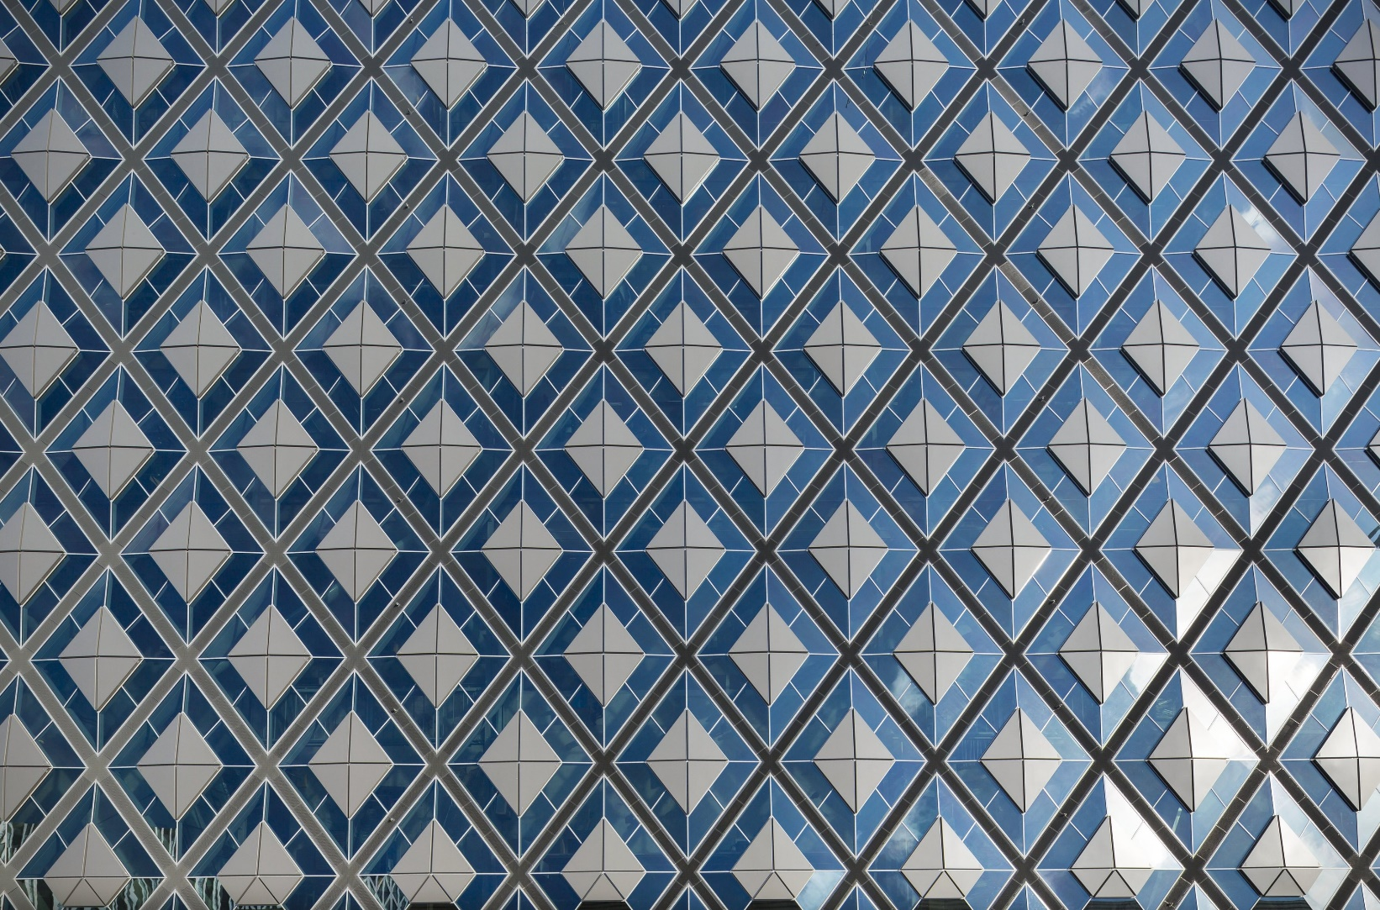
Central Station, Den Haag, NL (2015)

Slide 41
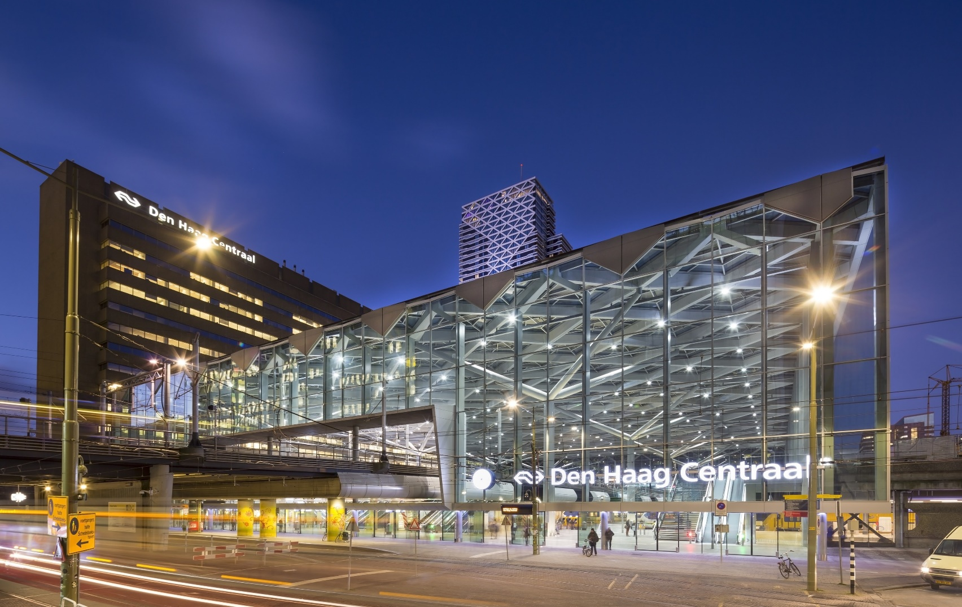
Central Station, Den Haag, NL (2015)

Slide 42
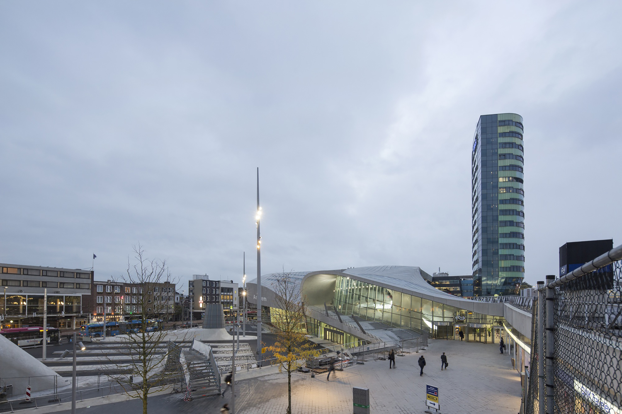
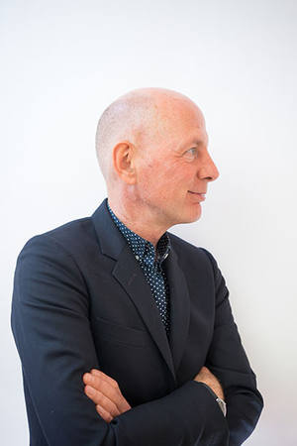
Central Station, Arnhem, NL (2015)
Bert Van Berkel

Slide 43
Central Station, Arnhem, NL (2015)
It was designed by UNStudio (Ben van Berkel).
It is a dramatic twisting structural roof geometry, which enables column-free spans of up to 60m in the transfer hall.
Taking references from the continuous inside/outside surface of a Klein Bottle, UNStudio aimed to blur distinctions between the inside and outside of the terminal by continuing the urban landscape into the interior of the transfer hall, where ceilings, walls and floors all seamlessly transition into one another.

Slide 44
Central Station, Arnhem, NL (2015)
Integrating the naturally sloping landscape distinctive to Arnhem, UNStudio conceived the Terminal Station as a flowing, utilitarian landscape of different functions stacked up to four storeys above ground and two below.
In the development of the design, the practice used a series of conceptual structural tools to mold the geometry of the terminal landscape to accommodate the different programme functions. These include the use of ‘V-walls’, a load-bearing concrete structure that absorbs the differences in the required grids and provides daylight to the below ground levels.

Slide 45
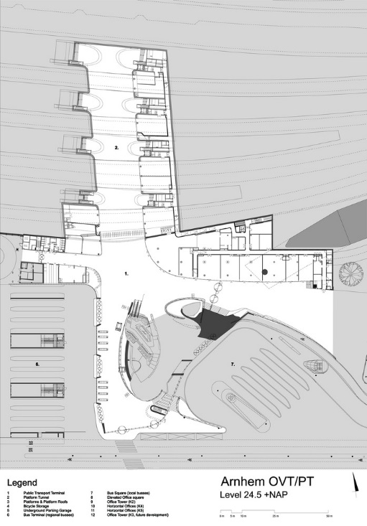
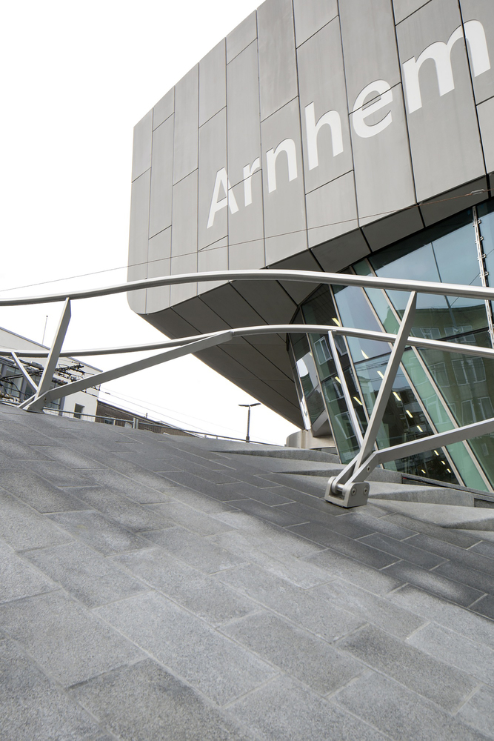
Central Station, Arnhem, NL (2015)

Slide 46
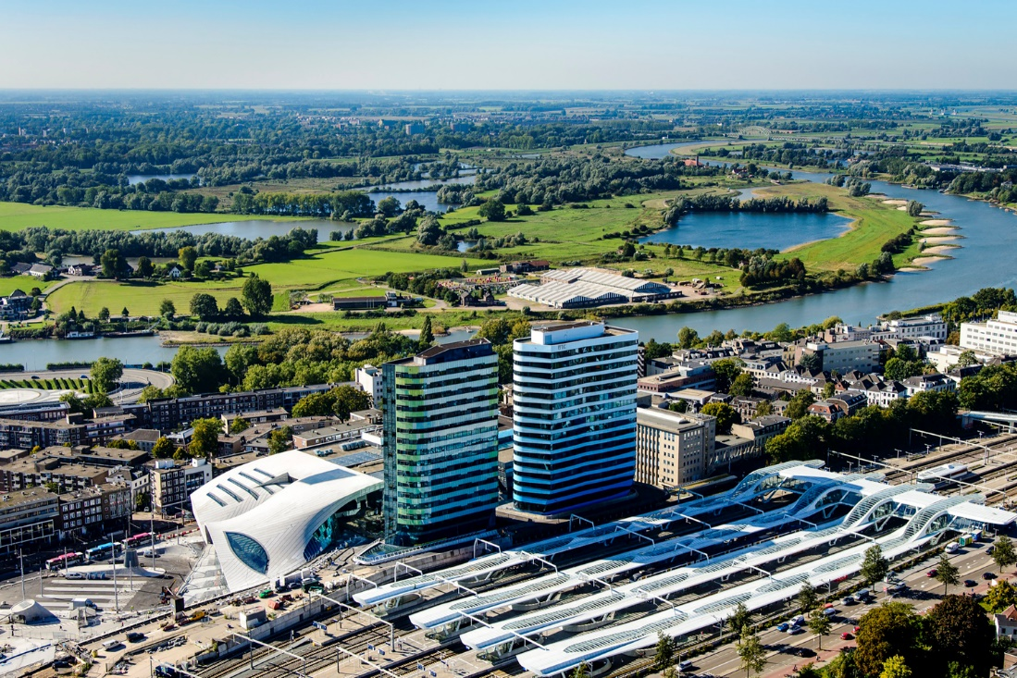
Central Station, Arnhem, NL (2015)

Slide 47
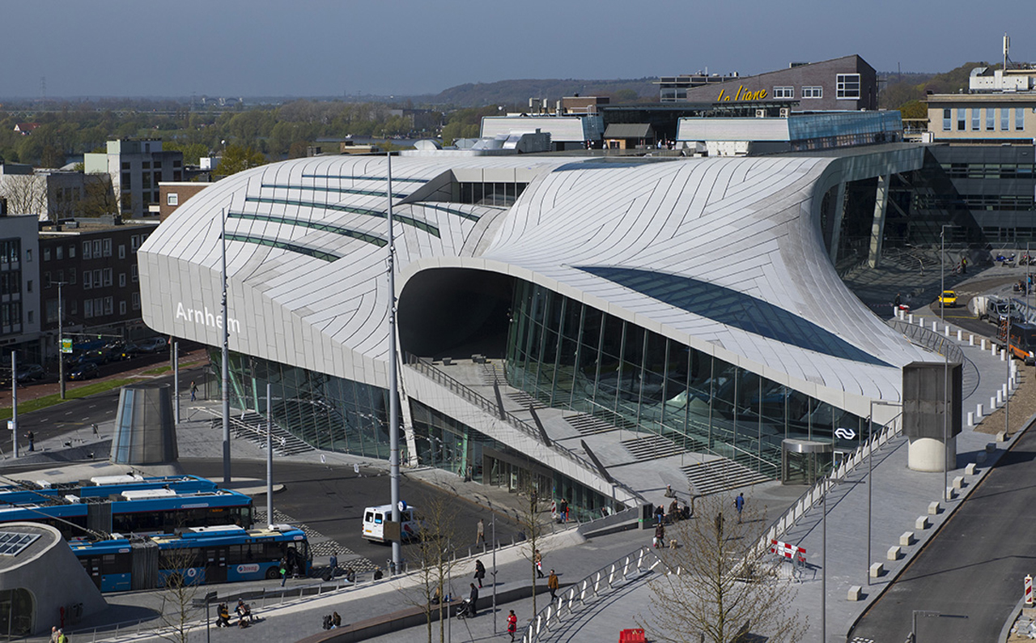
Central Station, Arnhem, NL (2015)

Slide 48
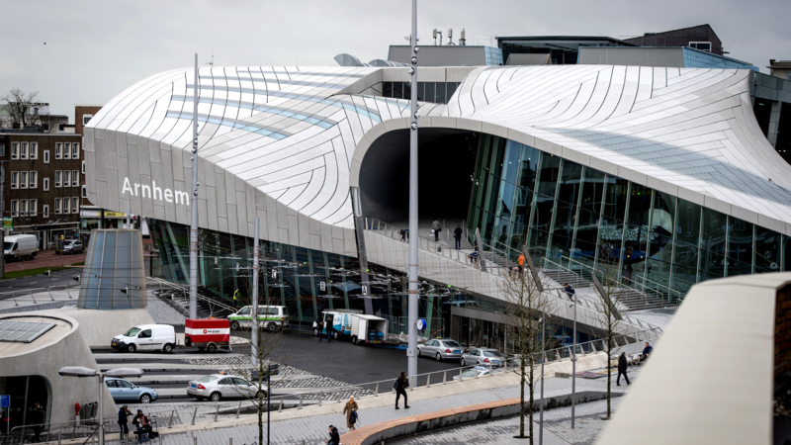
Central Station, Arnhem, NL (2015)

Slide 49
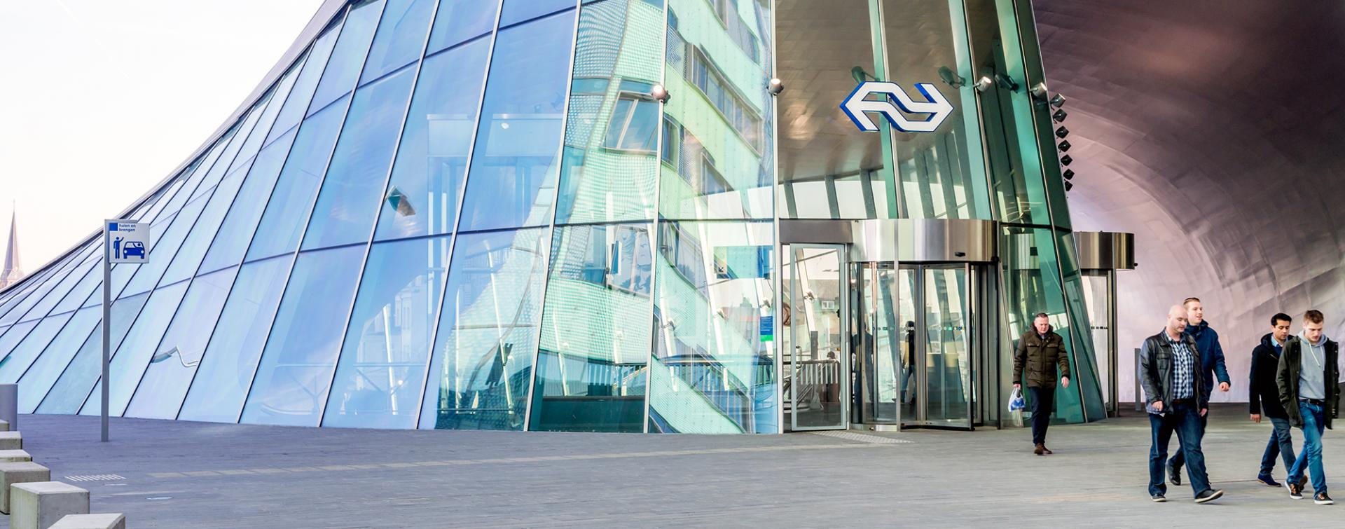
Central Station, Arnhem, NL (2015)

Slide 50
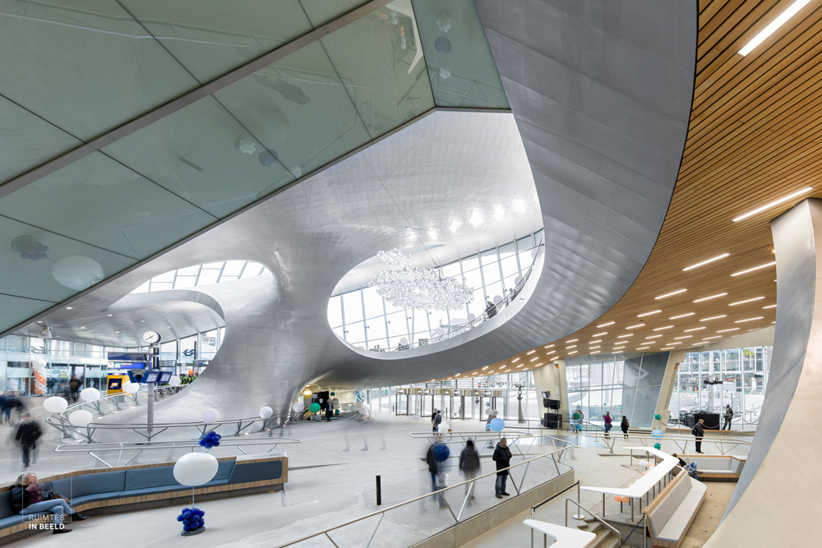
Central Station, Arnhem, NL (2015)

Slide 51
Central Station, Arnhem, NL (2015)

Slide 52
Central Station, Arnhem, NL (2015)

Slide 53
Central Station, Arnhem, NL (2015)

Slide 54
Central Station, Arnhem, NL (2015)

Slide 55
Onagawa Station, Onagawa, JP (2015)
Shigeru Ban

Slide 56
Onagawa Station, Onagawa, JP (2015)
It is the work of Shigeru Ban.
This new station building is relocated and built approximately 150m inland from the old station building which was destroyed by the tsunami on March 11th, 2011.
The 3-story station building consists of the station, retail shops, and waiting areas on the 1st floor, a municipal hot spring facility on the 2nd floor, and a viewing deck on the 3rd floor. As a symbol of our thoughts and prayers towards the rebuilding efforts of this disaster-stricken area, the design of the roof is based on an image of a bird with its wings spread soaring towards a bright future.

Slide 57
Onagawa Station, Onagawa, JP (2015)

Slide 58
Onagawa Station, Onagawa, JP (2015)

Slide 59
Onagawa Station, Onagawa, JP (2015)

Slide 60
Onagawa Station, Onagawa, JP (2015)

Slide 61
Onagawa Station, Onagawa, JP (2015)

Slide 62
Onagawa Station, Onagawa, JP (2015)

Slide 63
Onagawa Station, Onagawa, JP (2015)

Slide 64
Onagawa Station, Onagawa, JP (2015)

Slide 65
Onagawa Station, Onagawa, JP (2015)

Slide 66
Onagawa Station, Onagawa, JP (2015)

Slide 67
Onagawa Station, Onagawa, JP (2015)

Slide 68
Hub Station, Solec Kujowski, PL (2016)
Rafał Sieraczyński

Slide 69
Hub Station, Solec Kujowski, PL (2016)
It is the work of the architect Rafał Sieraczyński.
The transport hub is part of BiT City - the modern high-speed rail network connecting the two capital cities of Kujawsko-Pomorskie region in Poland: Bydgoszcz and Toruń. The hub is located, more or less, in the middle of the distance between the two cities, was the last stage in the construction of the „BiT City” network. The main idea of the project was to cover the place and it's functions (a bus station, railway platforms, a service point for travelers) under one, uniformed roof.

Slide 70
Hub Station, Solec Kujowski, PL (2016)

Slide 71
Hub Station, Solec Kujowski, PL (2016)

Slide 72
Hub Station, Solec Kujowski, PL (2016)

Slide 73
Hub Station, Solec Kujowski, PL (2016)

Slide 74
Hub Station, Solec Kujowski, PL (2016)

Slide 75
Hub Station, Solec Kujowski, PL (2016)

Slide 76
Hub Station, Solec Kujowski, PL (2016)

Slide 77
Hub Station, Solec Kujowski, PL (2016)

Slide 78
Hub Station, Solec Kujowski, PL (2016)

Slide 79
Central Station, Utrecht, NL (2016)
Jan Benthem
Mels Crouwel

Slide 80
Central Station, Utrecht, NL (2016)
It is the work of Benthem Crouwel Architects.
The original flat roof of Central Station as a wave that radiates a dynamic movement and also functions as a natural way finder. Transverse to the tracks, in the longitudinal direction of the hall, the wave refers to the entrances and exits. The wave has 3 undulations: the highest above the train station, the lower ones on each side contain the tram and bus stations. The undulating movement is emphasized by the continuous LED lights on the ceiling. Thanks to the significant wavy shape of the steel roof - and a relative low-rise building (18 m high) - the station is clearly recognizable among the neighboring buildings and offices.

Slide 81
Central Station, Utrecht, NL (2016)

Slide 82
Central Station, Utrecht, NL (2016)

Slide 83
Central Station, Utrecht, NL (2016)

Slide 84
Central Station, Utrecht, NL (2016)

Slide 85
Central Station, Utrecht, NL (2016)

Slide 86
Central Station, Utrecht, NL (2016)

Slide 87
Central Station, Utrecht, NL (2016)

Slide 88
Central Station, Utrecht, NL (2016)

Slide 89
Afragola Station, Napoli, IT (2017)
Zaha Hadid

Slide 90
Afragola Station, Napoli, IT (2017)
It is the work of Zaha Hadid Architects.
The station has been constructed as a reinforced concrete base that supports an elevated concourse of steel ribs clad in Corian with a glazed roof.
The concrete used within the station is a specific composition that provides optimum performance, with curved structural concrete elements built using technologies like wooden formwork replaced by prefabricated steel units, and double-curves realized with formwork created from CNC milled polystyrene models.

Slide 91
Afragola Station, Napoli, IT (2017)
Designed as an extrusion of a trapezoid along a 450m curved path, the elevated concourse is made of 200 differently shaped steel ribs that are clad in Corian with a glazed roof.
The design enlarges the public walkway over the eight railway tracks to such a degree that this walkway becomes the station’s main passenger concourse – a bridge housing all the services and facilities for departing, arriving and connecting passengers, with direct access to all platforms below.

Slide 92
Afragola Station, Napoli, IT (2017)

Slide 93
Afragola Station, Napoli, IT (2017)

Slide 94
Afragola Station, Napoli, IT (2017)

Slide 95
Afragola Station, Napoli, IT (2017)

Slide 96
Afragola Station, Napoli, IT (2017)

Slide 97
Afragola Station, Napoli, IT (2017)

Slide 98
Afragola Station, Napoli, IT (2017)

Slide 99
Afragola Station, Napoli, IT (2017)

Slide 100
Afragola Station, Napoli, IT (2017)

Slide 101
Afragola Station, Napoli, IT (2017)

Slide 102
TGV Station, Montpellier, FR (2018)
Marc Mimram

Slide 103
TGV Station, Montpellier, FR (2018)
It is the work of Marc Mimram.
Marc Mimram drew his inspiration from the Mediterranean landscapes to design his perforated roof in BFUP Ductal, which will filter direct light from the south into the station.
The roof is composed of 115 prefabricated modular palms made of Ductal®. Each unit is five centimeters thick with a remarkable reach of more than 18 meters, made possible by the strength and durability of the BFUP Ductal®, even on very thin panels. The fins are randomly perforated, following the course of the sun throughout the day.

Slide 104
TGV Station, Montpellier, FR (2018)

Slide 105
TGV Station, Montpellier, FR (2018)

Slide 106
TGV Station, Montpellier, FR (2018)

Slide 107
TGV Station, Montpellier, FR (2018)

Slide 108
TGV Station, Montpellier, FR (2018)

Slide 109
TGV Station, Montpellier, FR (2018)

Slide 110
TGV Station, Montpellier, FR (2018)

Slide 111
TGV Station, Montpellier, FR (2018)

Slide 112
TGV Station, Montpellier, FR (2018)

Slide 113
TGV Station, Kenitra, MA (2019)
Silvio d’Ascia

Slide 114
TGV Station, Kenitra, MA (2019)
It is the work of the architect Silvio d’Ascia.
The facade of the station is an imposing screen on the cityscape, like an moucharabieh, permeable to the flow of foot traffic crossing the plaza and the passenger building. 200 m long – the length of a standard high-speed train (TGV) – and a height of 12 m, it is composed of more than 800 triangular blocks of fiber-reinforced, ultra-high performing concrete overlooking the broad marble and concrete plaza, on the historic city side, thanks to 8 imposing arches of varying geometries. This enlargement of the moucharabieh architectural element offers a way of dealing with the strong seasonal variations of the station’s outdoor temperatures. This active and porous skin naturally filters light and air to ensure comfortable interior temperatures. Shadows cast by the functional blocks onto the gray marble floor and the glazed surfaces of the facades, evolving with the season and the time of day, are the poetic result of the natural thermal regulation ensured by the moucharabieh feature.

Slide 115
TGV Station, Kenitra, MA (2019)

Slide 116
TGV Station, Kenitra, MA (2019)

Slide 117
TGV Station, Kenitra, MA (2019)

Slide 118
TGV Station, Kenitra, MA (2019)

Slide 119
TGV Station, Kenitra, MA (2019)

Slide 120
TGV Station, Kenitra, MA (2019)

Slide 121
TGV Station, Kenitra, MA (2019)

Slide 122
TGV Station, Kenitra, MA (2019)

Slide 123
TGV Station, Kenitra, MA (2019)

Slide 124
Matera Centrale, Matera, IT (2019)
Stefano Boeri

Slide 125
Matera Centrale, Matera, IT (2019)
It is the work of the architect Stefano Boeri.
On an aesthetic level, great attention has been paid to the main material used for the façades, in this case slabs of locally quarried stone. The construction system is based on multi-layer panels obtained by the coupling of a 12 mm stone covering with a layer of lightened material of the same thickness. The roof shelter in the square is highly noticeable on account of its intrados, made using partially reflecting metal panels which thanks to the diamond-style geometry provide a fragmented vision of the surrounding urban space, offering new perspectives, plays of lights and surprising reflections. The twelve thin steel columns will rise from the iron floor, reach the height of the underground tunnel at about 6 m and continue to a further 12 m above ground level, supporting the cover as if it were a large contemporary temple.

Slide 126
Matera Centrale, Matera, IT (2019)

Slide 127
Matera Centrale, Matera, IT (2019)

Slide 128
Matera Centrale, Matera, IT (2019)

Slide 129
Matera Centrale, Matera, IT (2019)

Slide 130
Matera Centrale, Matera, IT (2019)

Slide 131
Matera Centrale, Matera, IT (2019)

Slide 132
Matera Centrale, Matera, IT (2019)

Slide 133
Matera Centrale, Matera, IT (2019)

Slide 134
Assen Station, Assen, NL (2020)
Nanne de Ru

Slide 135
Assen Station, Assen, NL (2020)
It is the work of Powerhouse Company firm.
The impressive triangular geometry of the roof gives the building a strong identity, organizes the program and also makes a connection with the urban context. The wooden roof creates an inviting atmosphere for travelers. Windows in the middle of the roof allow a play of sunlight on the platforms and in the station hall. The wooden roof is 10 m high and has three uneven sides with lengths of 78, 88, and 90 m. A green sedum roof surface has been added along the edges for buffering rainwater. The columns and roof edges are finished in a coated metal finish in a champagne color that harmonizes with the wooden beams. The buildings have brick facades with rounded corners. The purple-red toned facing bricks match the red carpet of brick pavers and the red porphyry of the station floor.

Slide 136
Assen Station, Assen, NL (2020)

Slide 137
Assen Station, Assen, NL (2020)

Slide 138
Assen Station, Assen, NL (2020)

Slide 139
Assen Station, Assen, NL (2020)

Slide 140
Assen Station, Assen, NL (2020)

Slide 141
Assen Station, Assen, NL (2020)

Slide 142
Assen Station, Assen, NL (2020)

Slide 143
Assen Station, Assen, NL (2020)

Slide 144
Assen Station, Assen, NL (2020)

Slide 145
Assen Station, Assen, NL (2020)

Slide 146
Assen Station, Assen, NL (2020)

Slide 147
Kaohsiung Station, Sanmin, TW (2022)
Francine Houben

Slide 148
Kaohsiung Station, Sanmin, TW (2022)
It is the work of Mecanoo architectural firm.
The station includes seven subterranean stations along a 9.75 km railway tunnel. The station’s large curvilinear shaped canopy reaches out to the city in a powerful gesture. With a cycling path running east west on top, the station’s multi-layered landscape introduces a generous amount of public space into the city center.

Slide 149
Kaohsiung Station, Sanmin, TW (2022)

Slide 150
Kaohsiung Station, Sanmin, TW (2022)

Slide 151
Kaohsiung Station, Sanmin, TW (2022)

Slide 152
Kaohsiung Station, Sanmin, TW (2022)

Slide 153
Kaohsiung Station, Sanmin, TW (2022)

Slide 154
Kaohsiung Station, Sanmin, TW (2022)

Slide 155
Kaohsiung Station, Sanmin, TW (2022)

Slide 156
Kaohsiung Station, Sanmin, TW (2022)
THE END

