Slide 1
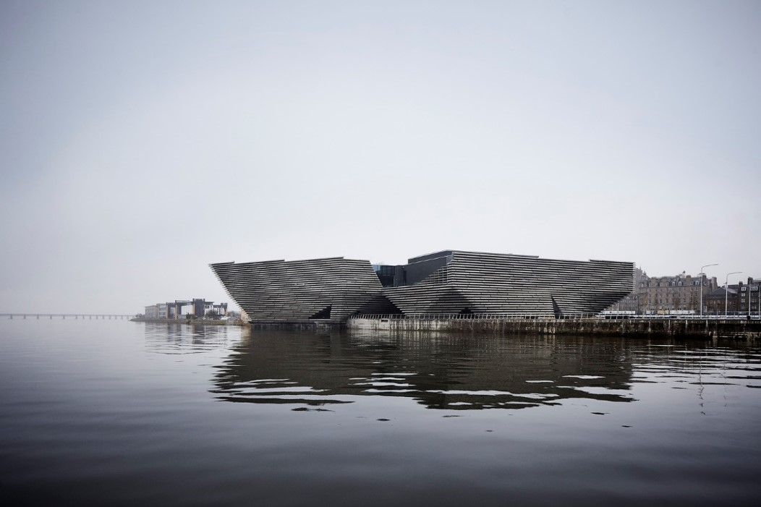
World Museums XIX
2018

Slide 2
World Contemporary Museums XIX
The objective is to show you different museums of contemporary architecture around the world except U.S. : these do not only house contemporary art but also art or history since prehistoric times.
The greatest architects of the last five years contributed to the construction of these museums with architectures that were certainly different but also adapted to the place and sometimes to the works they contain.

Slide 3
World Contemporary Museums
Museum of Troy, Canakkale, TR 2018.
Louvre, Abu Dhabi, AE 2018.
Museum of Modern Art, Vilnius, LT 2018.
Victoria & Albert Museum, Dundee, GB 2018.
China Design Museum, Hangzhou, CN 2018.
Musée de la Romanité, Nîmes, FR 2018.
Lumen Museum, Bolzano, IT 2018.
Zhejiang Museum Natural History, Hangzhou, CN 2018.
Tibet Intangible Cultural Heritage M., Lhasa, CN 2018.
National Museum of Prehistory, Tainan, TW 2018.

Slide 4
World Contemporary Museums 2
National Museum of Qatar, Doha, QA 2018.
Museo Cais do Sertão, Recife, BR 2018.
Bihar Museum, Patna, IN 2018.
Lisser Art Museum, Lisse, NL 2018.

Slide 5
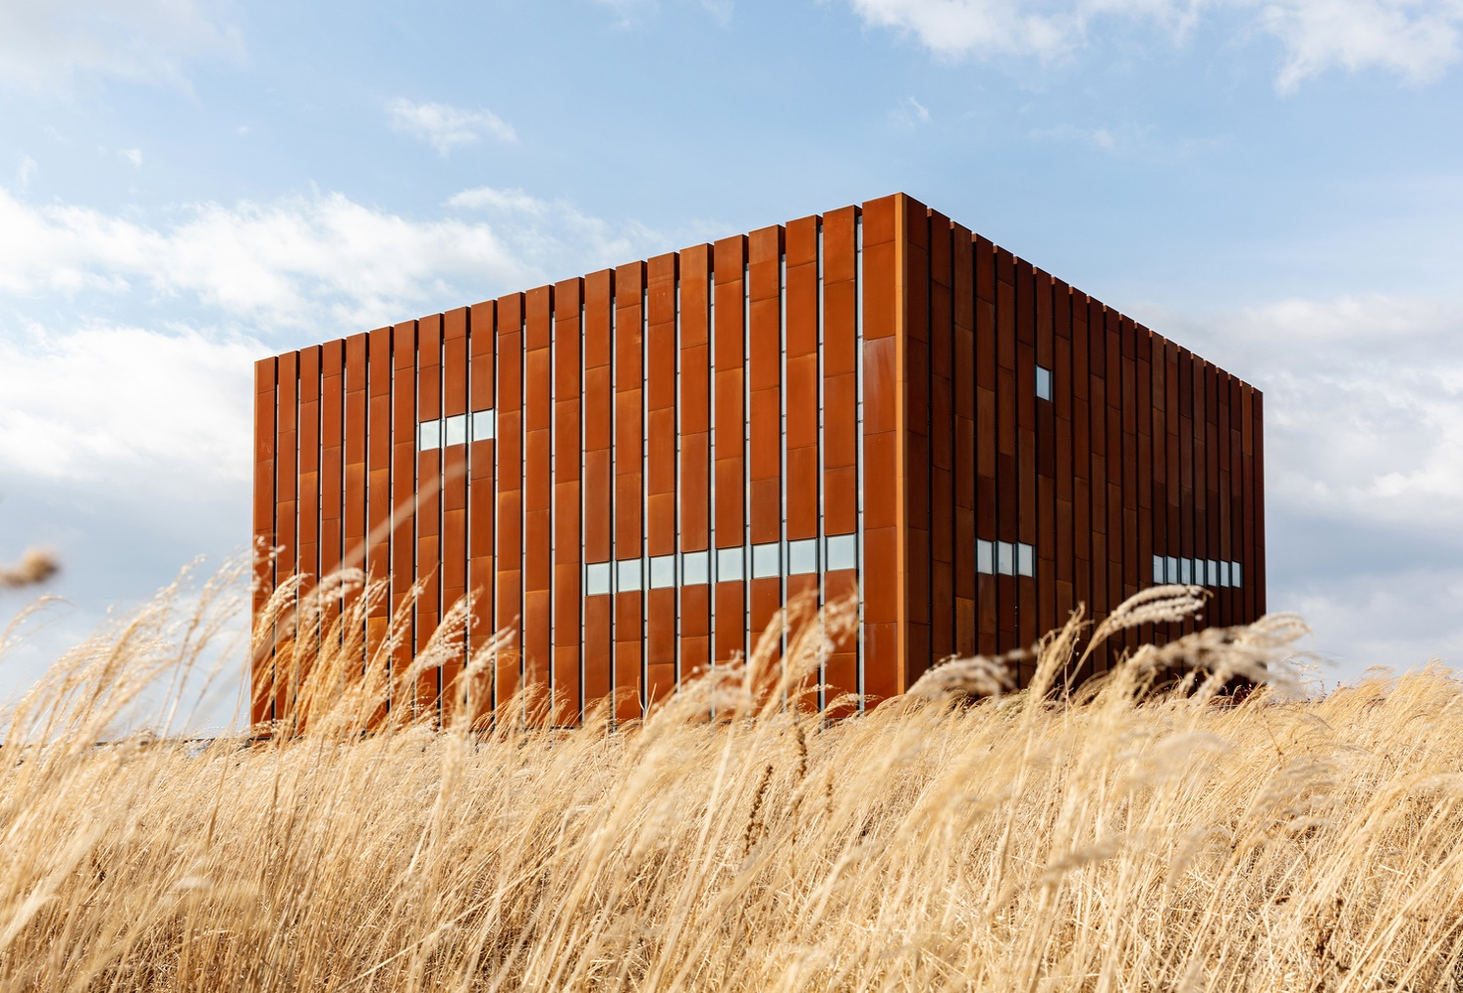
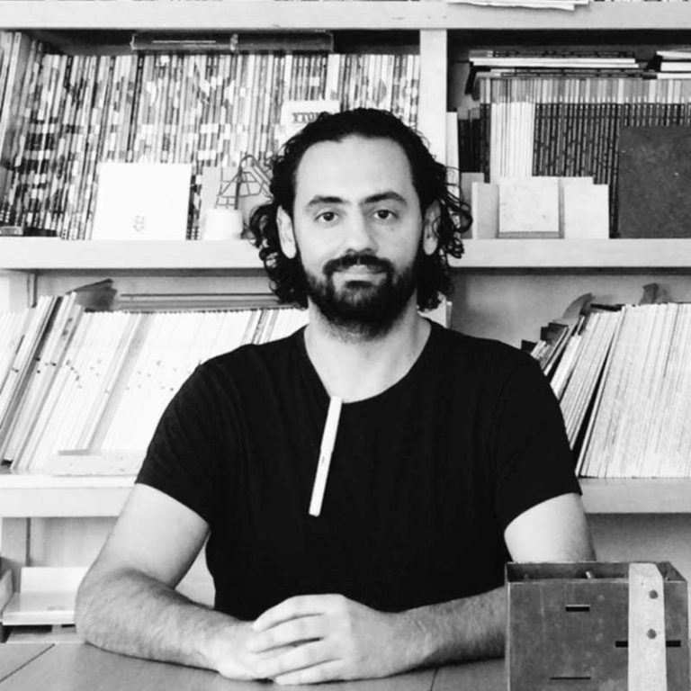
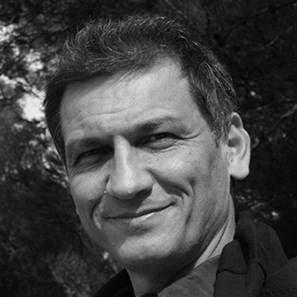
Museum of Troy, Canakkale, TR (2018)
Omer Selçuk Baz
Okan Bal

Slide 6
Museum of Troy, Canakkale, TR (2018)
It is the work of Yalin Architectural Design firm.
The museum is a robust cubic form of 32 by 32 meters, wrapped it in a metal (corten) coated shell that rusts in time evoking the connection between past and present.
The 2000 sqm exhibition space is located within the cube and divided into 4 floors and a terrace accessible by ramps. The visitor descends in the cube along a wide ramp, leaving the Trojan landscape behind, and arrives at an underground band encircling the rust red, earth-colored exhibition cube rising through the transparent roof.
The exhibition is divided into 4 floors: Troad and its Cultures, Bronze Age Troy, Iliad and the Troad in the Classical Age, History of Archeology at Troy. T

Slide 7
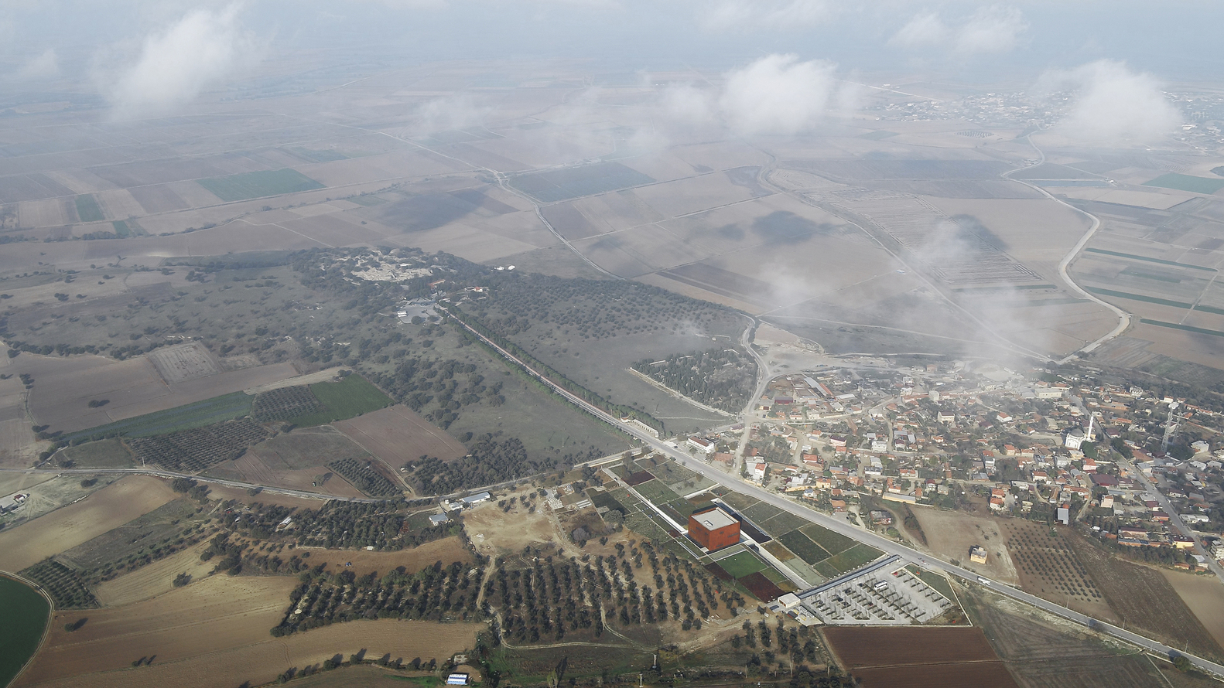
Museum of Troy, Canakkale, TR (2018)

Slide 8
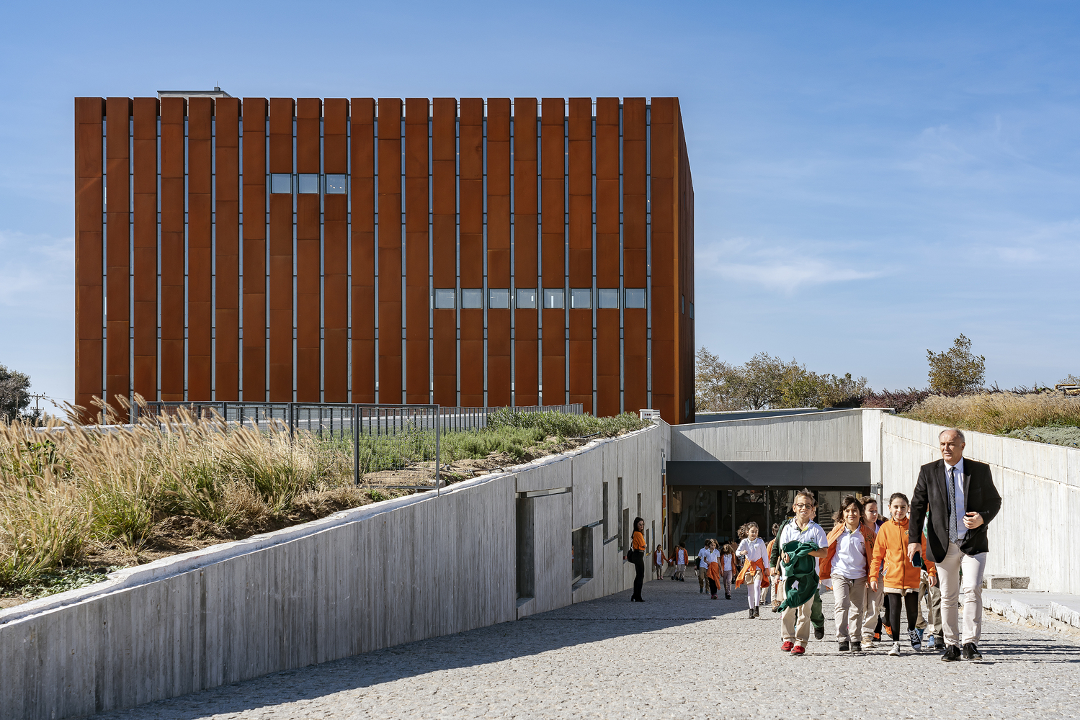
Museum of Troy, Canakkale, TR (2018)

Slide 9
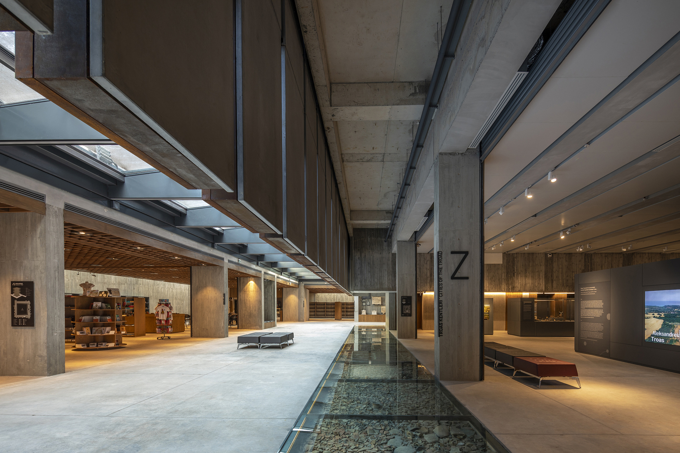
Museum of Troy, Canakkale, TR (2018)

Slide 10
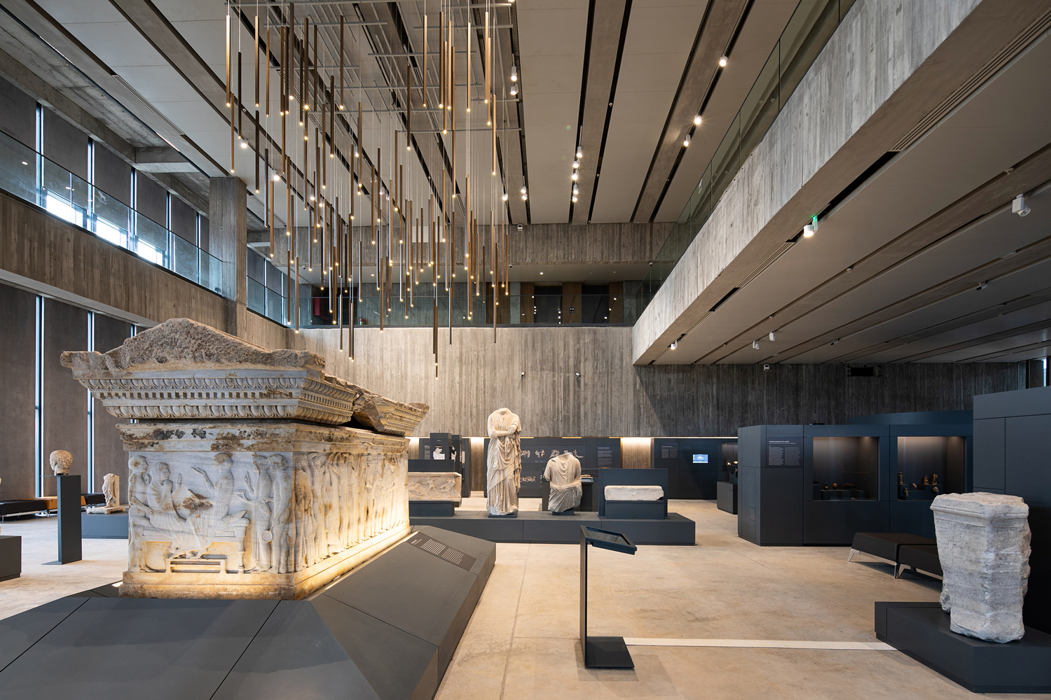
Museum of Troy, Canakkale, TR (2018)

Slide 11
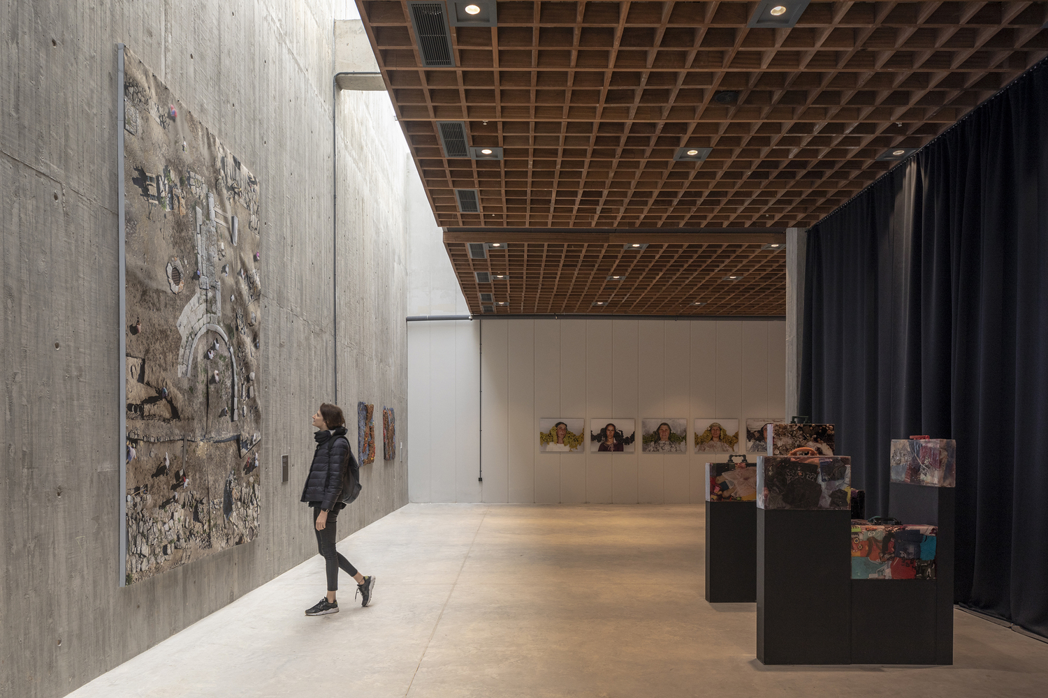
Museum of Troy, Canakkale, TR (2018)

Slide 12
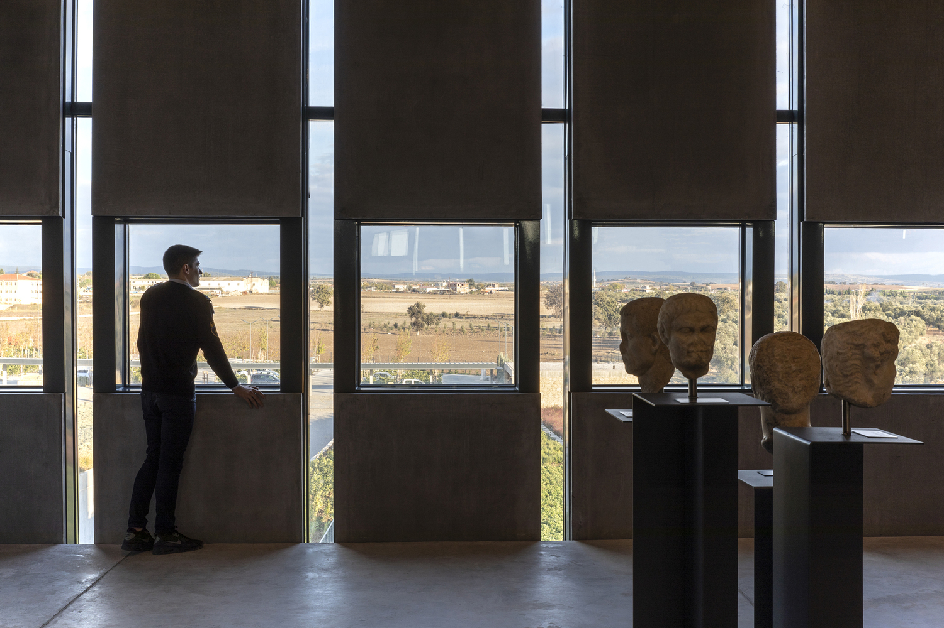
Museum of Troy, Canakkale, TR (2018)

Slide 13
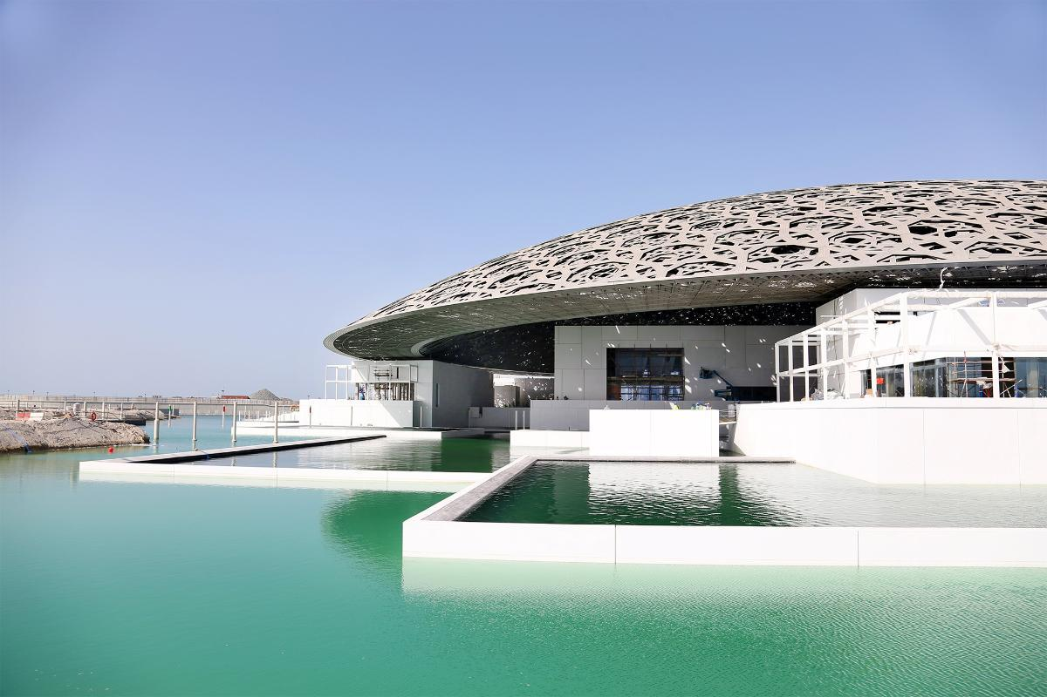
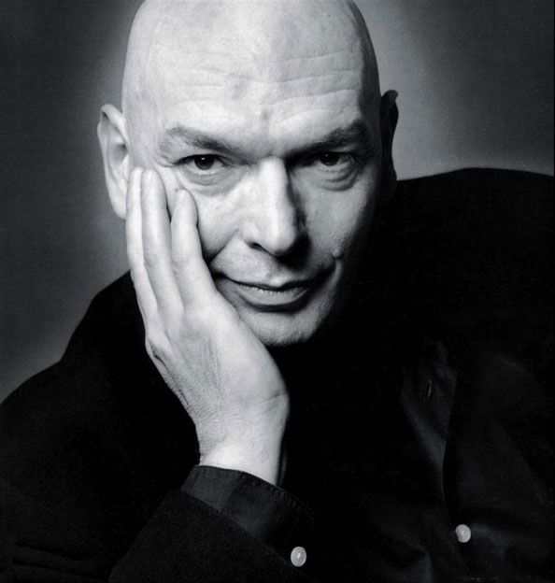
Louvre, Abu Dhabi, AE (2018)
Jean Nouvel

Slide 14
Louvre, Abu Dhabi, AE (2018)
It is the work of the architect Jean Nouvel.
The centerpiece is a huge silvery dome that appears to float above the entire museum city.
A dome 180 meters in diameter, offering horizontal, perfectly radiating geometry, a randomly perforated woven material, providing shade punctuated by bursts of sun. The dome gleams in the Abu Dhabi sunshine. At night, this protected landscape is an oasis of light under a starry dome.
In total, 55 individual buildings, including 23 galleries, make up this museum city. The façades of the buildings are made up of 3,900 panels of ultra-high performance fiber concrete (UHPC).

Slide 15
Louvre, Abu Dhabi, AE (2018)
The dome consists of eight different layers: four outer layers clad in stainless steel and four inner layers clad in aluminium separated by a steel frame five meters high. The frame is made of 10,000 structural components pre-assembled into 85 super-sized elements, each weighing up to 50 tones.
Each ray of light must penetrate the eight layers before appearing then disappearing. The result is a cinematic effect as the sun’s path progresses throughout the day. At night, it forms 7,850 stars visible from both inside and out.

Slide 16
Louvre, Abu Dhabi, AE (2018)
The dome is supported by only four permanent piers, each 110 meters apart. These are hidden within the museum buildings to give the impression that the dome is floating. The interior dome elevation is 29 meters from the ground floor to the underside of the cladding.
The sea enters under the dome to provide freshness and allows thanks to the filtration of the sun to obtain a temperate microclimate necessary in this region.

Slide 17
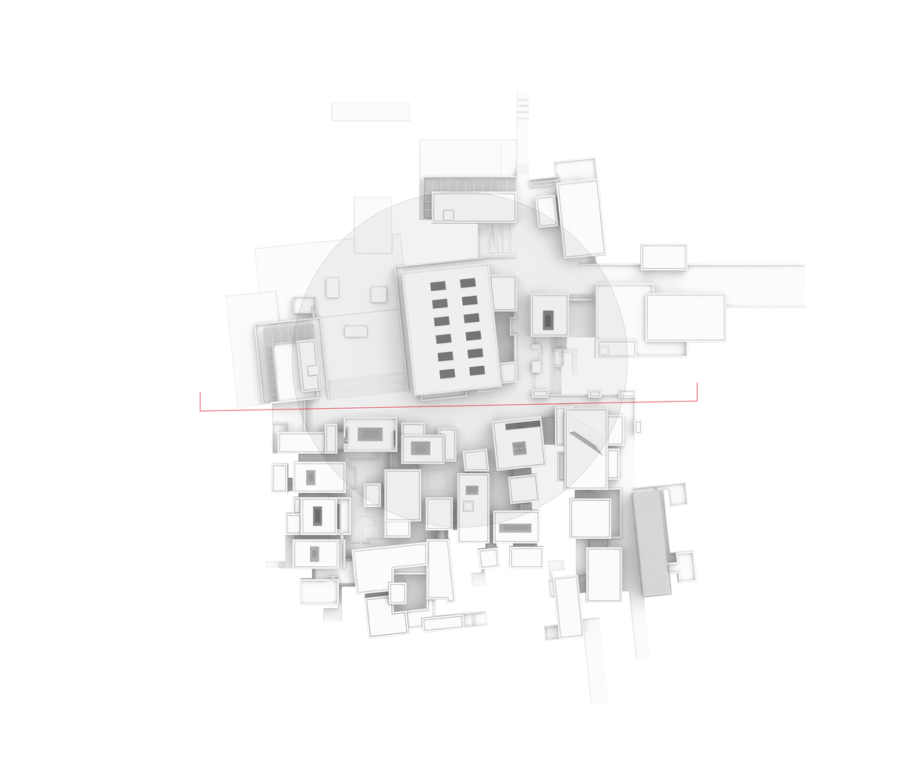
Louvre, Abu Dhabi, AE (2018)

Slide 18
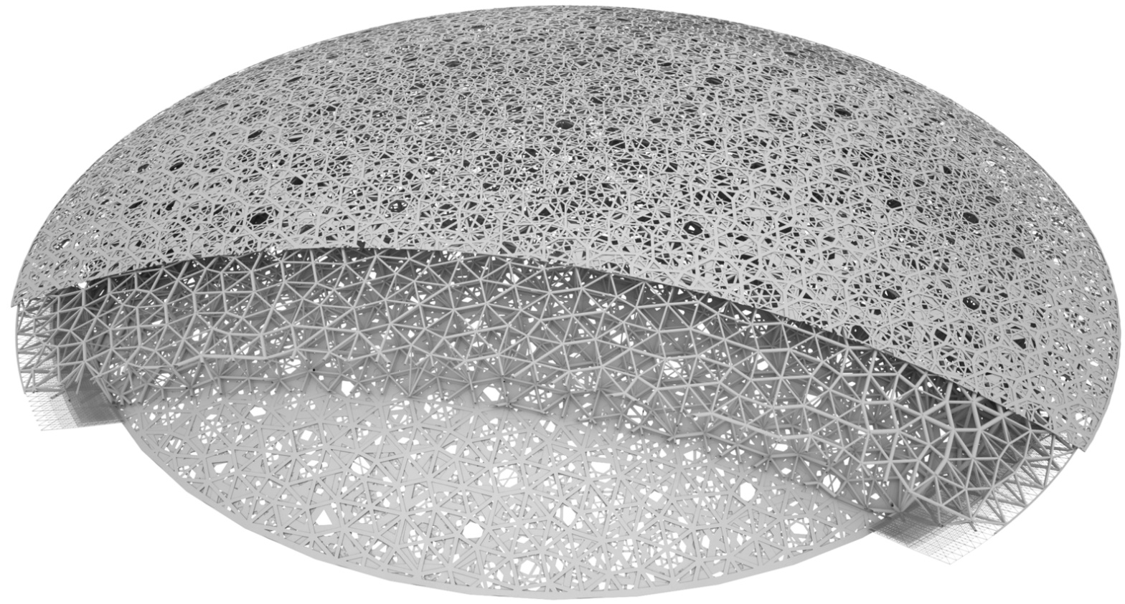
Louvre, Abu Dhabi, AE (2018)

Slide 19
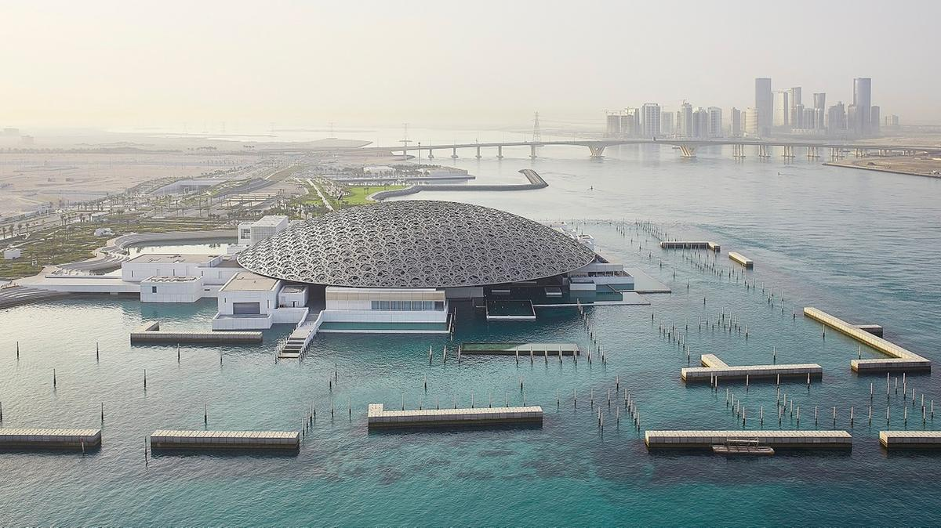
Louvre, Abu Dhabi, AE (2018)

Slide 20
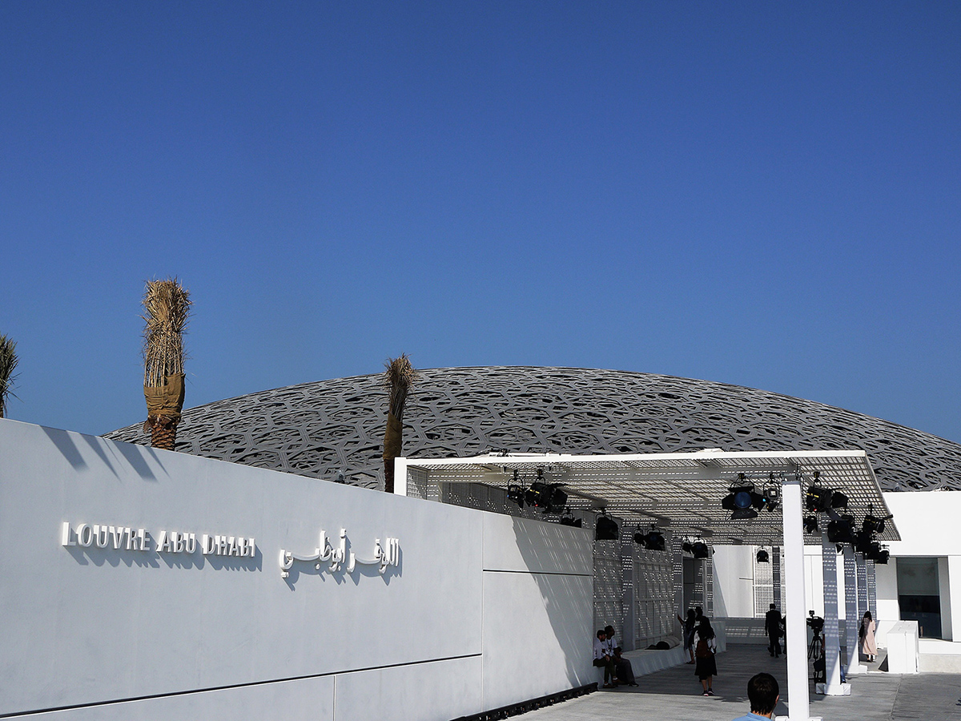
Louvre, Abu Dhabi, AE (2018)

Slide 21
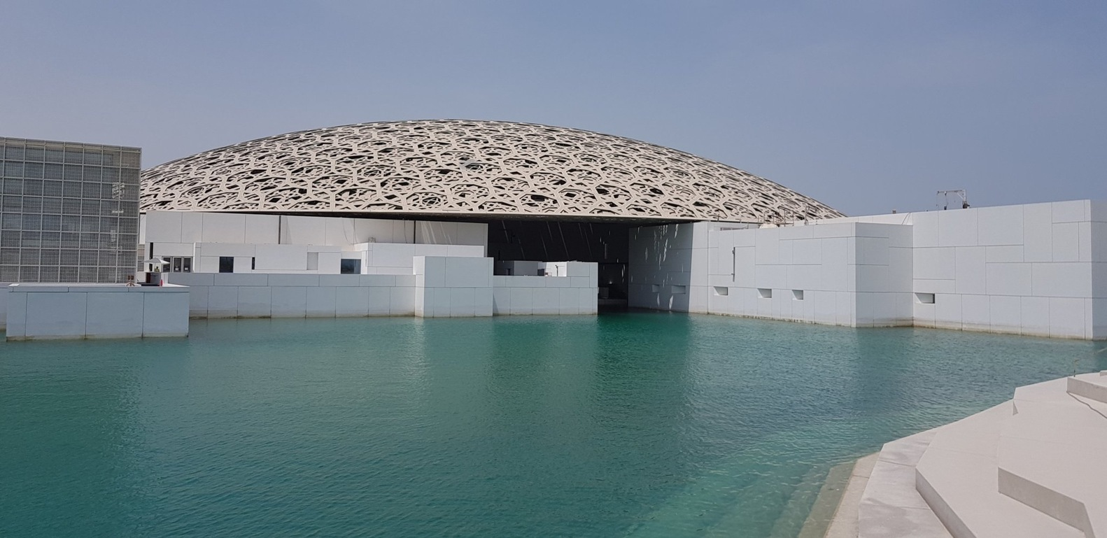
Louvre, Abu Dhabi, AE (2018)

Slide 22
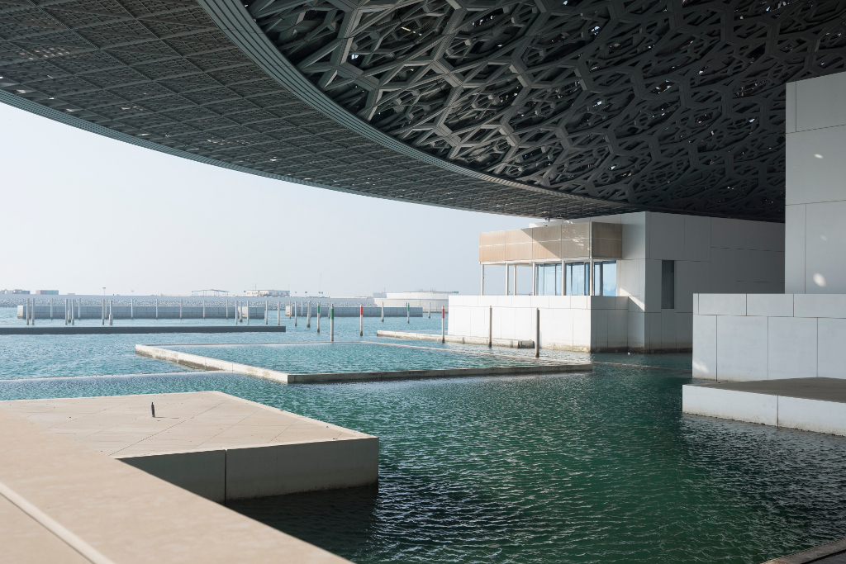
Louvre, Abu Dhabi, AE (2018)

Slide 23
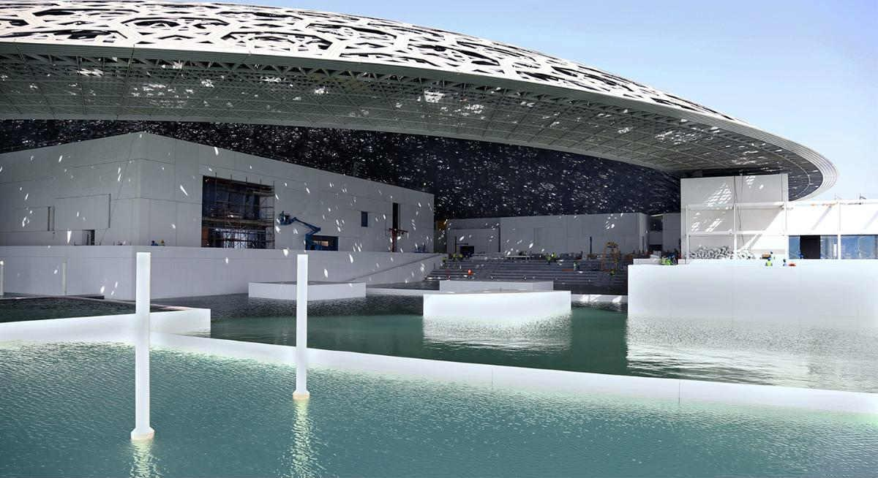
Louvre, Abu Dhabi, AE (2018)

Slide 24
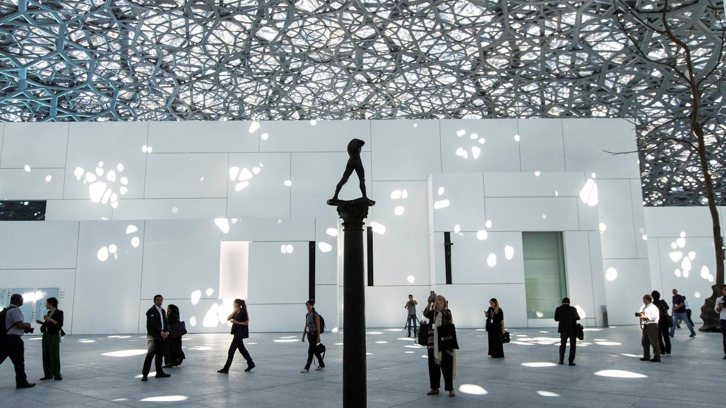
Louvre, Abu Dhabi, AE (2018)

Slide 25
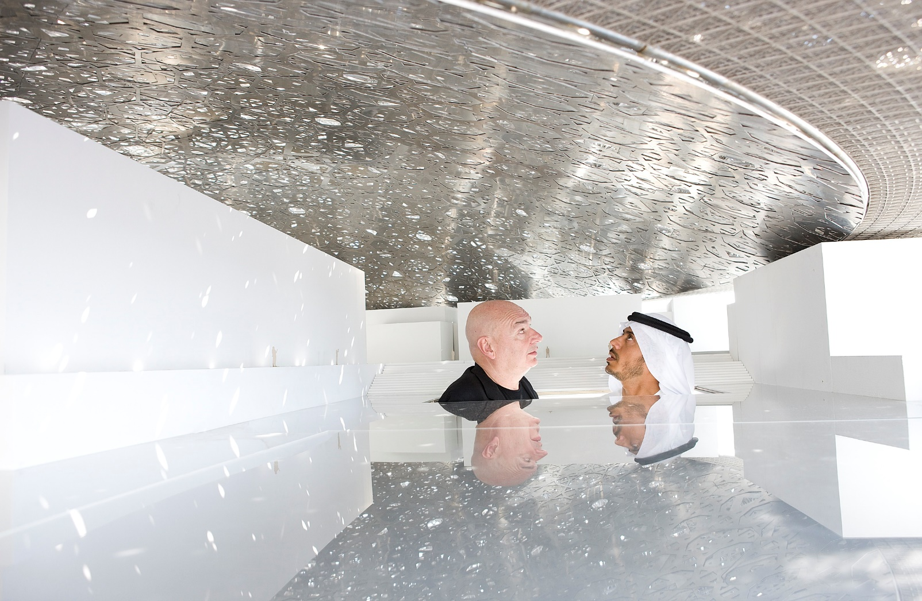
Louvre, Abu Dhabi, AE (2018)

Slide 26
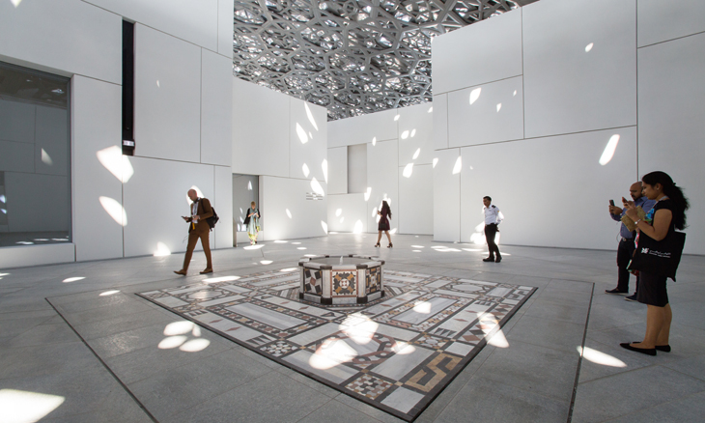
Louvre, Abu Dhabi, AE (2018)

Slide 27
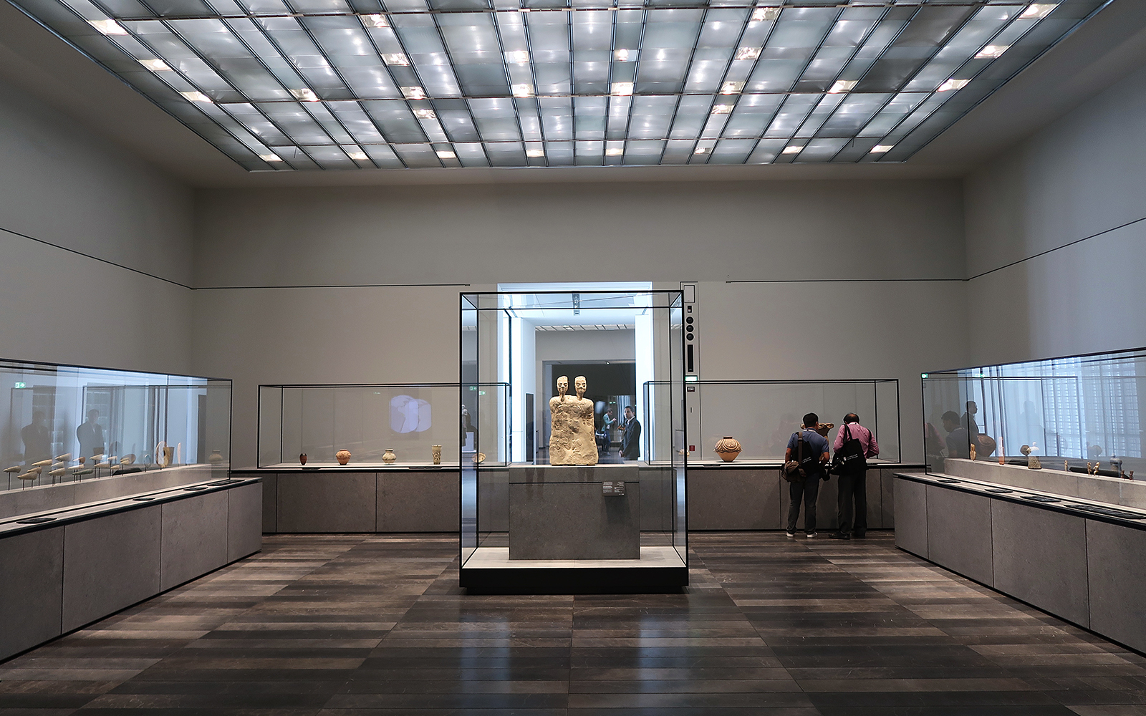
Louvre, Abu Dhabi, AE (2018)

Slide 28
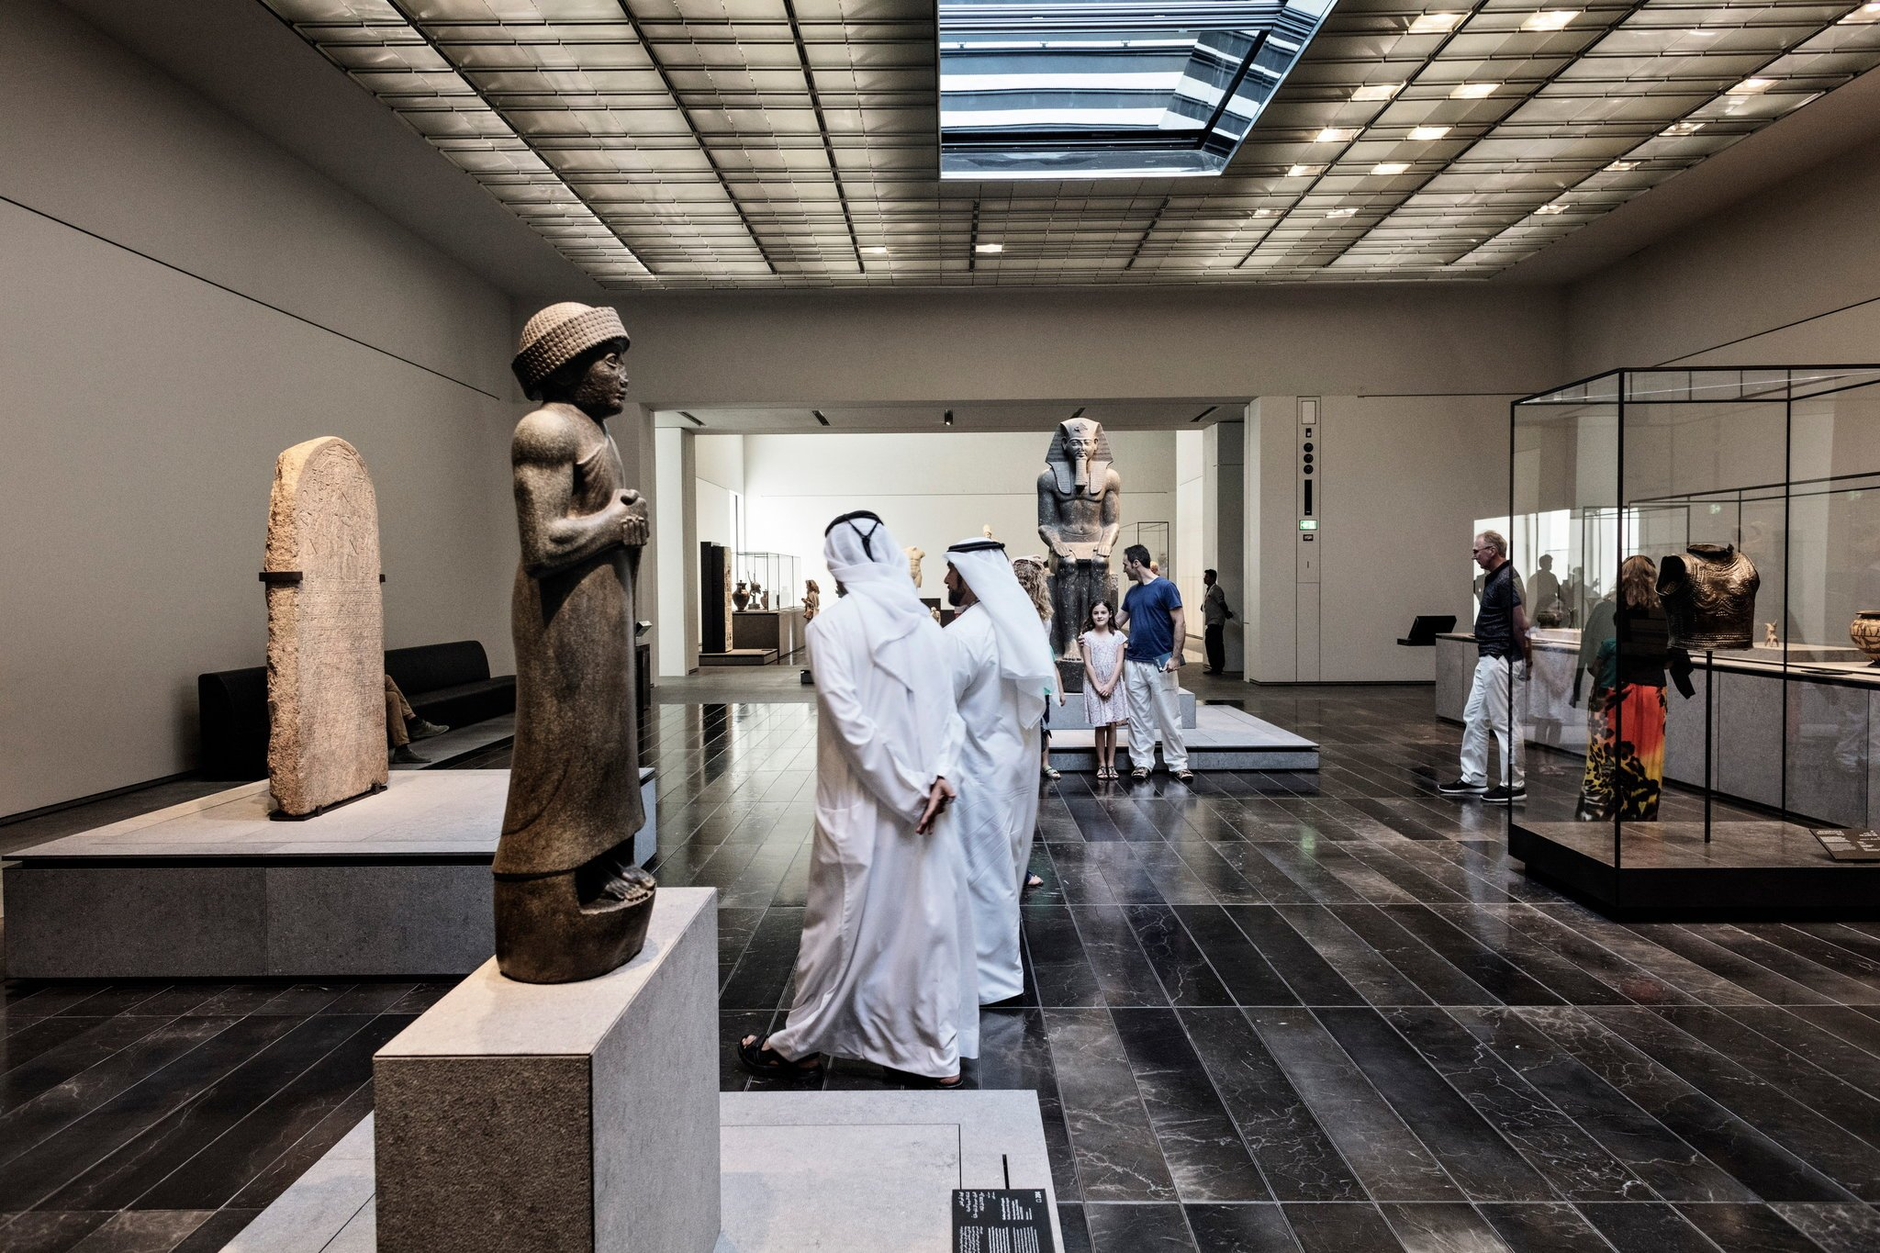
Louvre, Abu Dhabi, AE (2018)

Slide 29
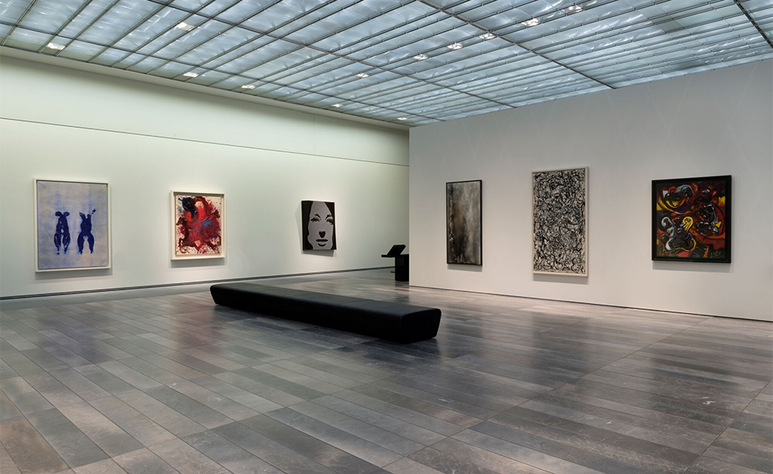
Louvre, Abu Dhabi, AE (2018)

Slide 30
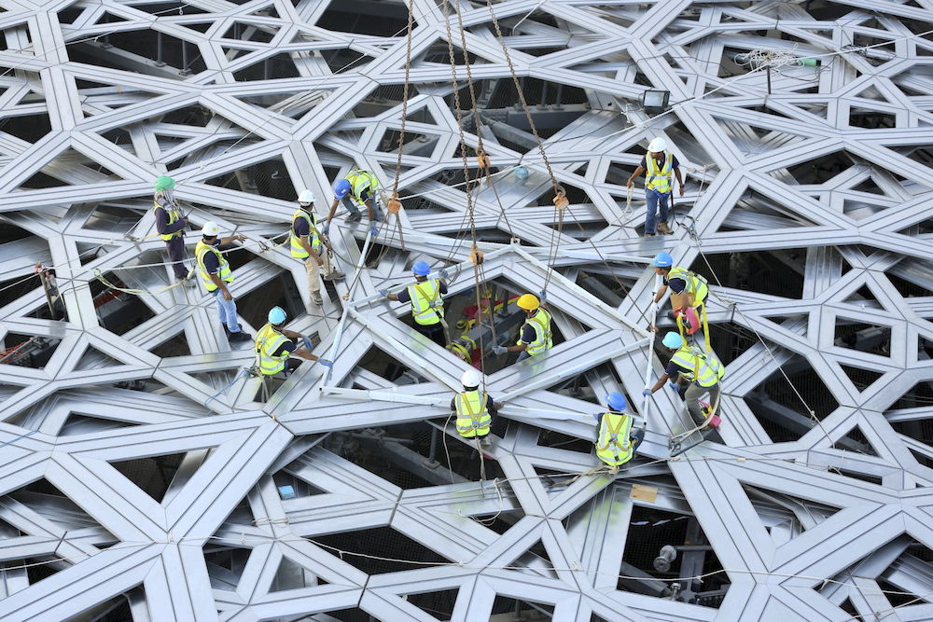
Louvre, Abu Dhabi, AE (2018)

Slide 31
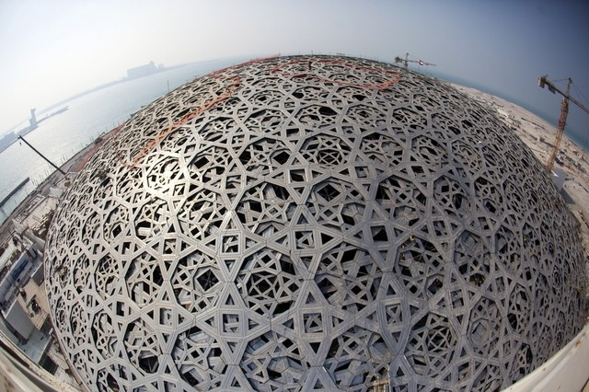
Louvre, Abu Dhabi, AE (2018)

Slide 32
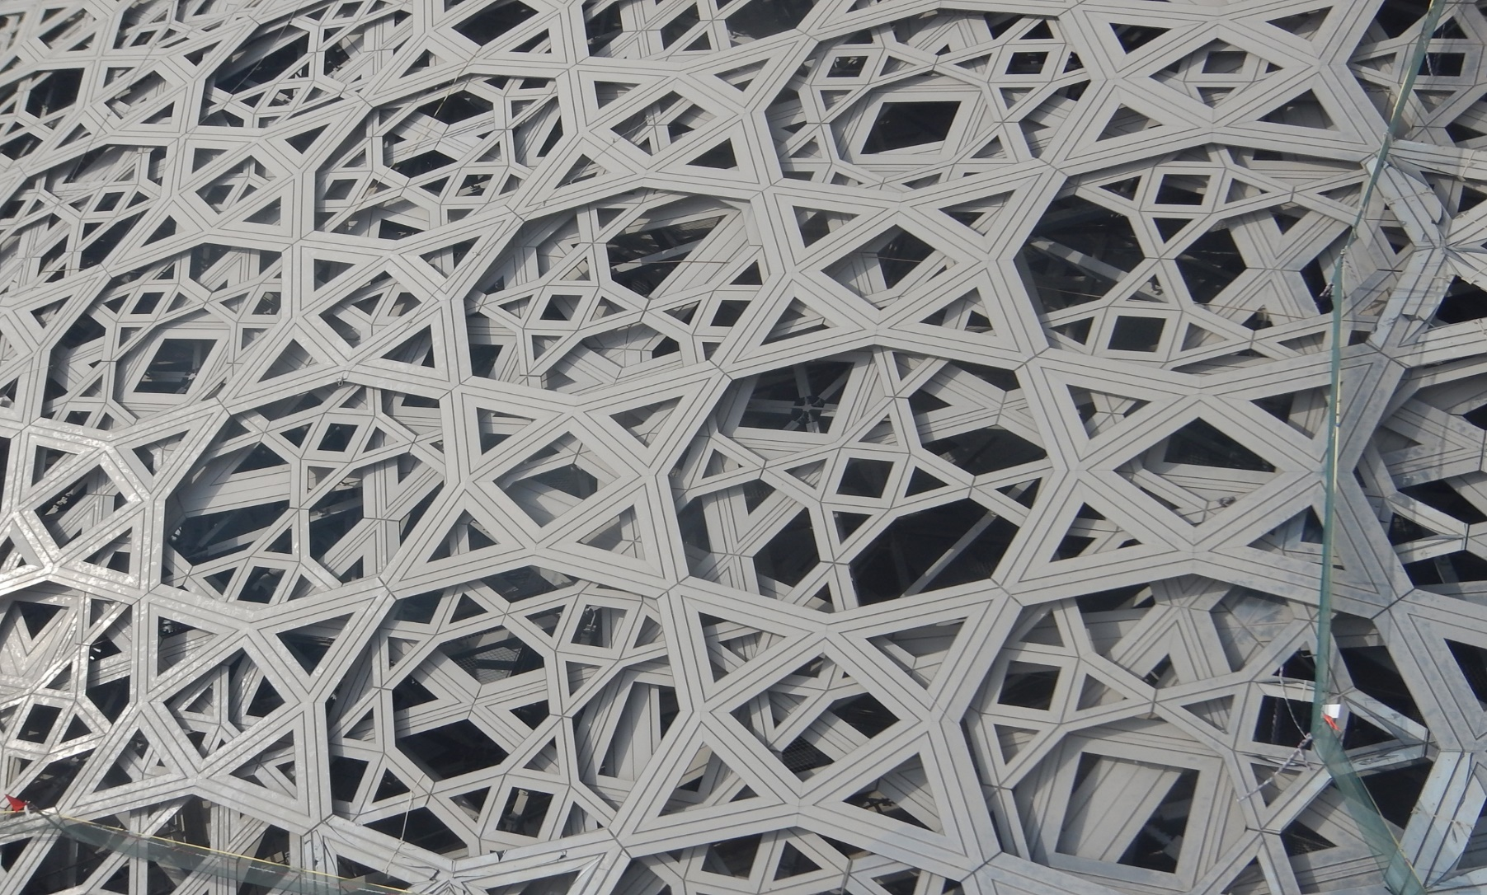
Louvre, Abu Dhabi, AE (2018)

Slide 33
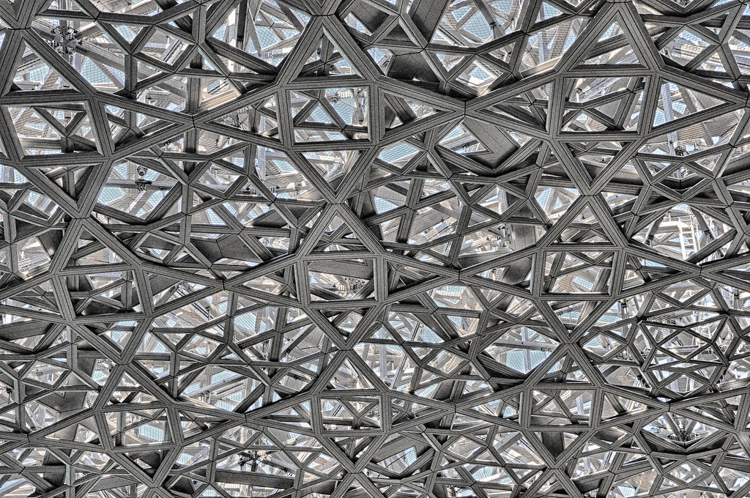
Louvre, Abu Dhabi, AE (2018)

Slide 34
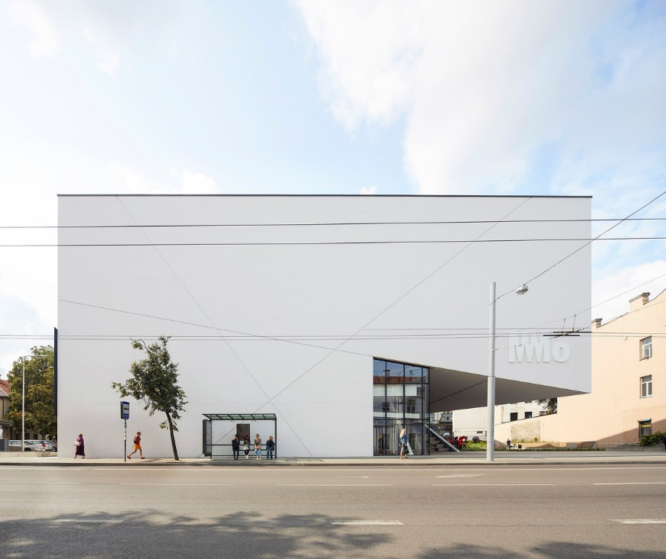
Museum Modern Art, Vilnius, LT (2018)
Daniel Libeskind

Slide 35
Museum Modern Art, Vilnius, LT (2018)
It is the work of the architect Daniel Libeskind.
The MO Museum is conceived as a cultural “gateway” connecting the 18th century grid to the medieval walled city.
The rectilinear exterior façade is clad in luminous, white plaster that references the local materials of the city. As visitors approach the museum, they encounter a dramatic open stair that intersects the museum on a diagonal axis creating an expressive counterpoint to the minimalist façade.

Slide 36
Museum Modern Art, Vilnius, LT (2018)
The stair cuts the façade open connecting the street with the upper levels of the museum giving way to an openness that flows between inside and out.
At the top of the exterior stair is a stepped open air terraced roof that serves as a gathering area and place for public performances and talks. A five meter cantilevered fully glazed wall allows views from the galleries to the public terrace.
On the northern side of the building, visitors will enter though a two-story (8 meter tall) glazed entrance into a light filled lobby. Geometric interior skylights cut through the building ushering in daylight to the lower floors and allowing views to the upper floors.

Slide 37
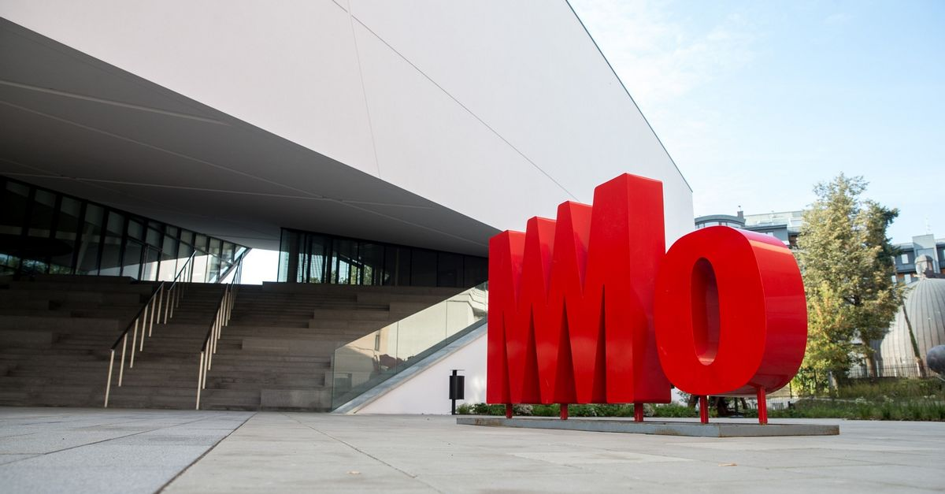
Museum Modern Art, Vilnius, LT (2018)

Slide 38
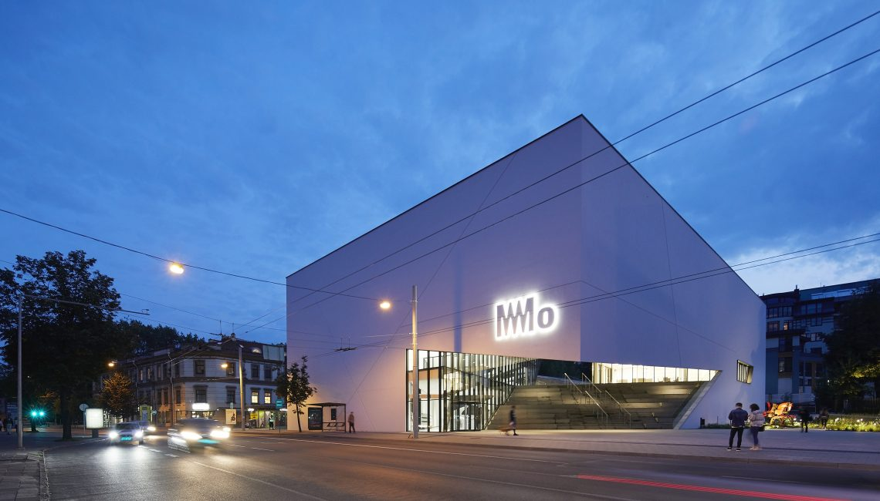
Museum Modern Art, Vilnius, LT (2018)

Slide 39
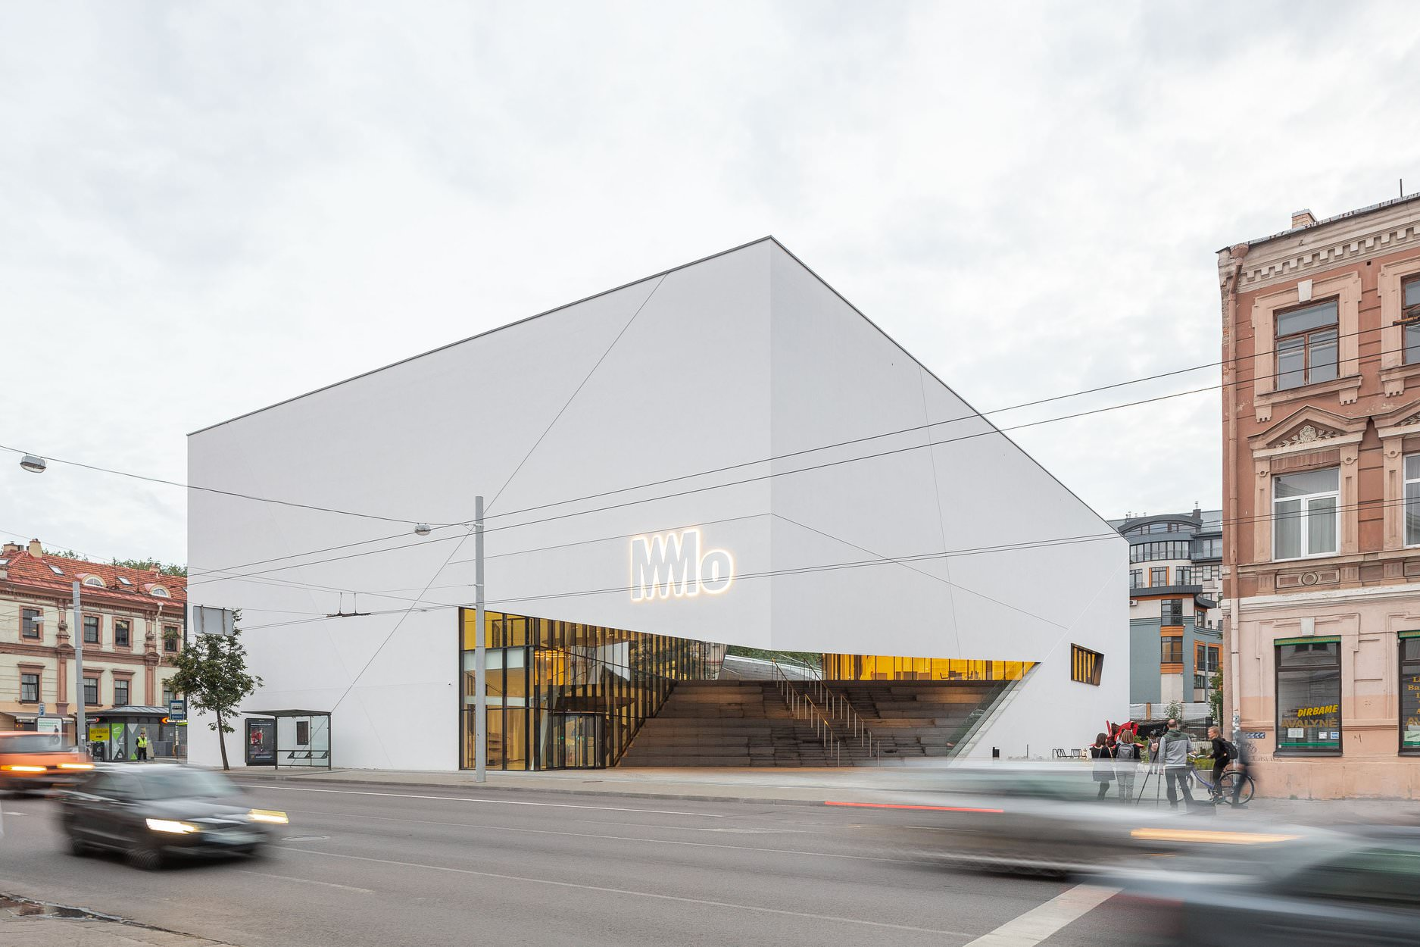
Museum Modern Art, Vilnius, LT (2018)

Slide 40
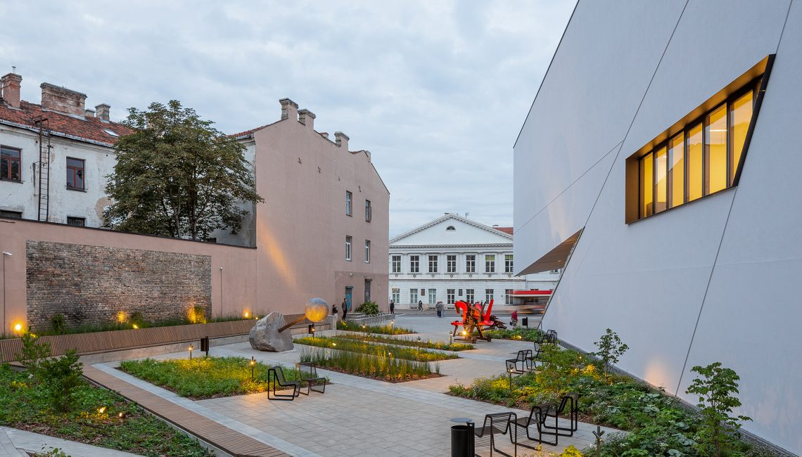
Museum Modern Art, Vilnius, LT (2018)

Slide 41
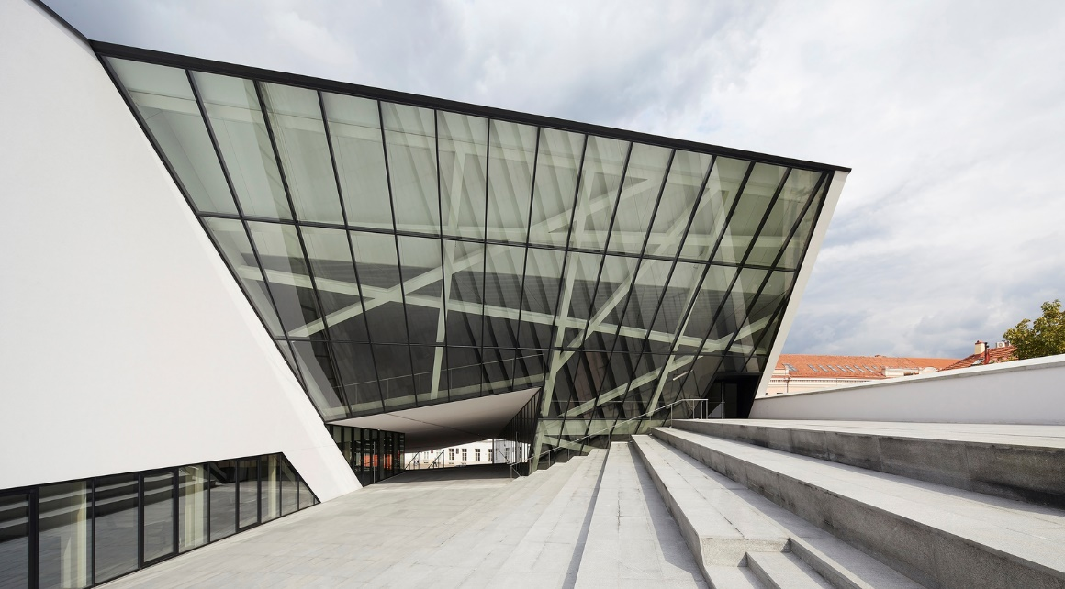
Museum Modern Art, Vilnius, LT (2018)

Slide 42
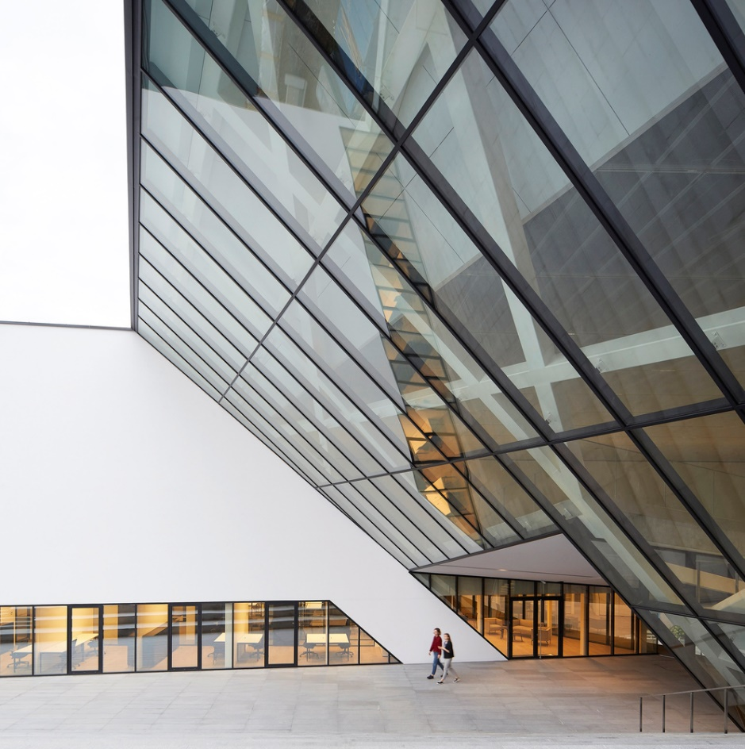
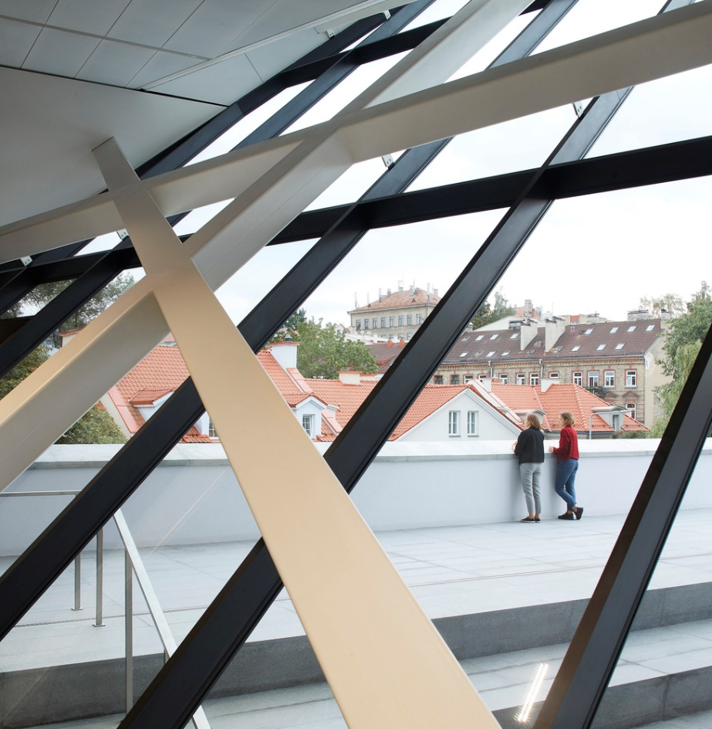
Museum Modern Art, Vilnius, LT (2018)

Slide 43
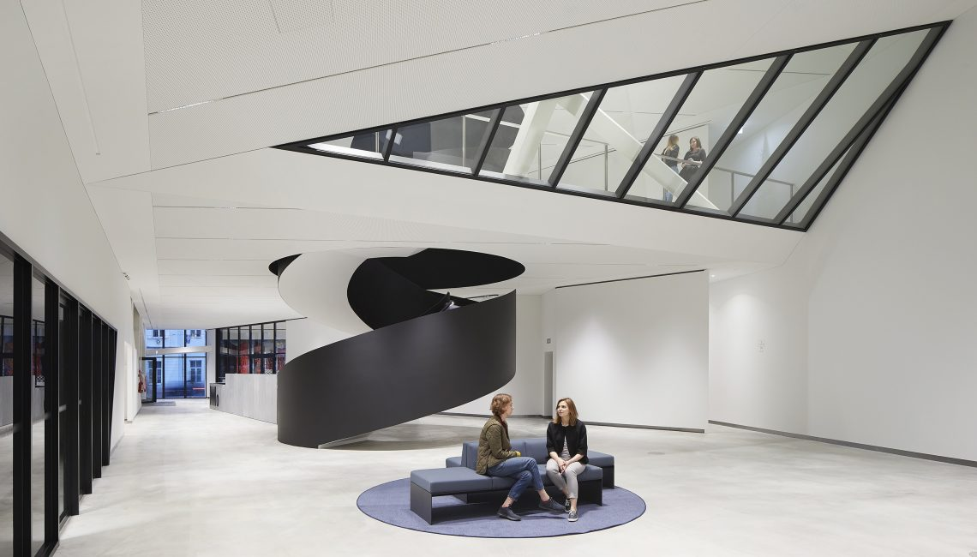
Museum Modern Art, Vilnius, LT (2018)

Slide 44
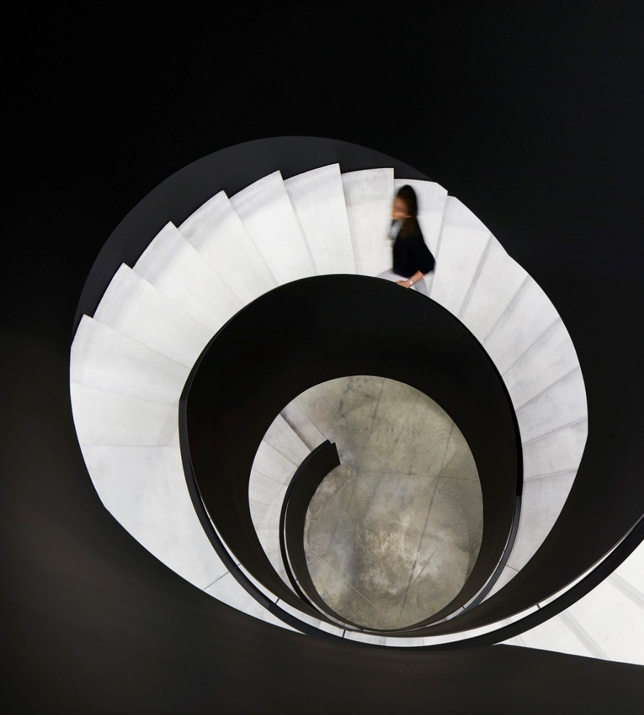
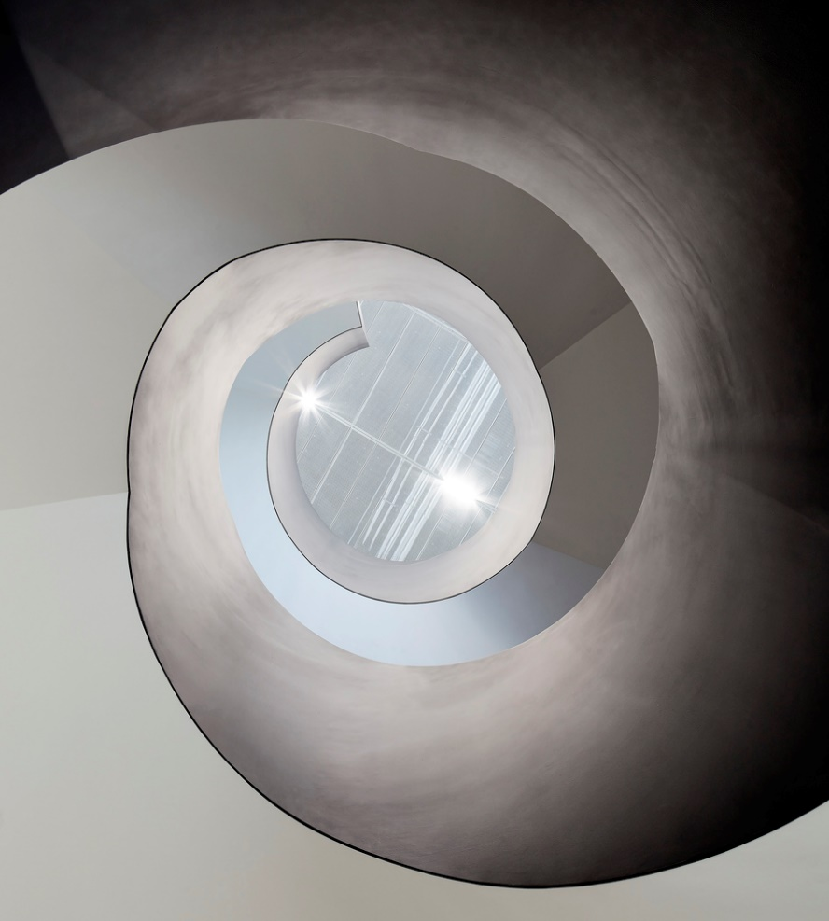
Museum Modern Art, Vilnius, LT (2018)

Slide 45
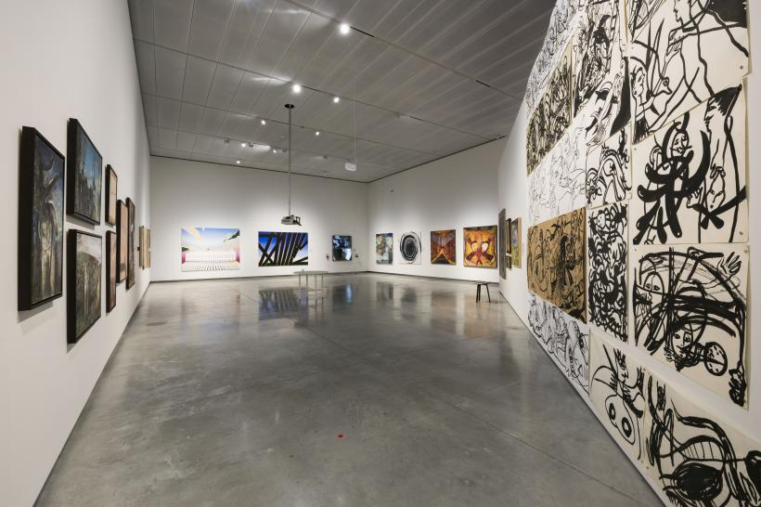
Museum Modern Art, Vilnius, LT (2018)

Slide 46
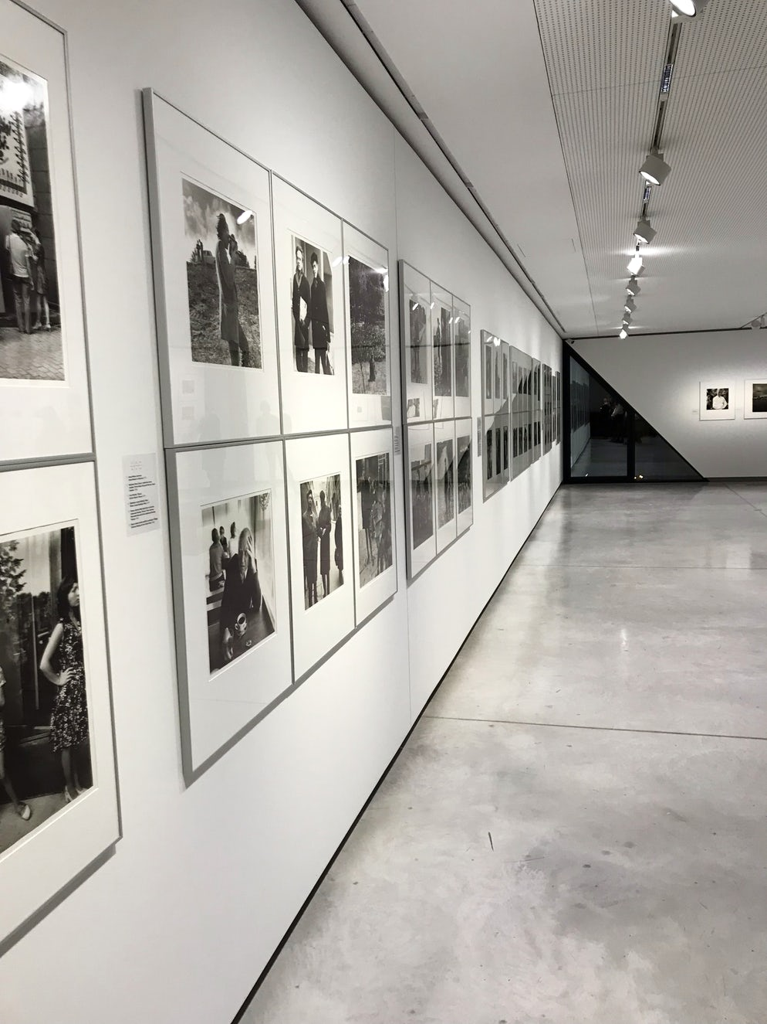
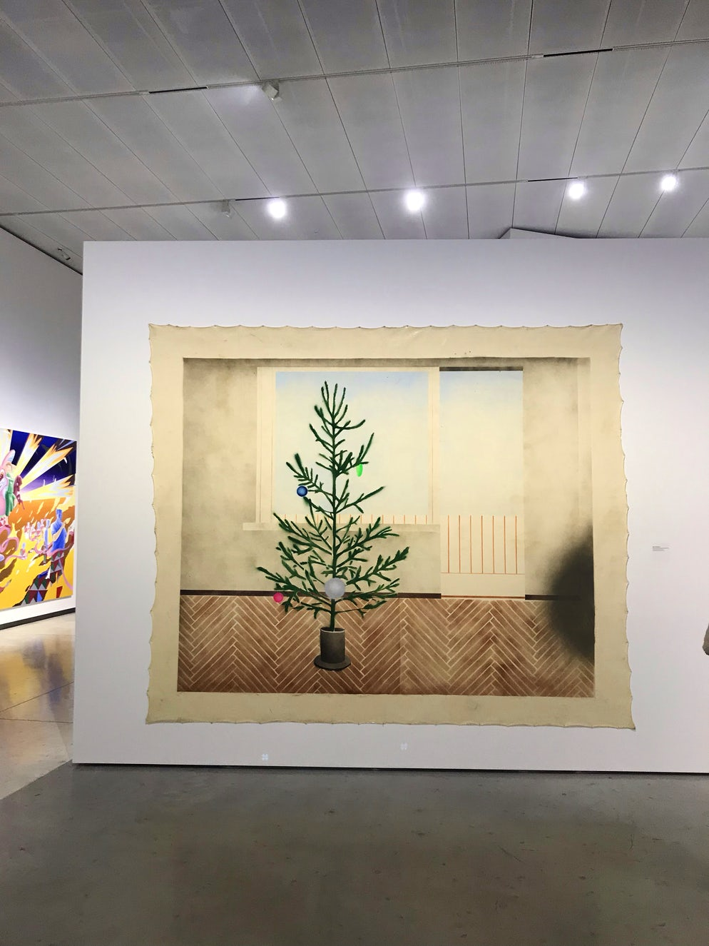
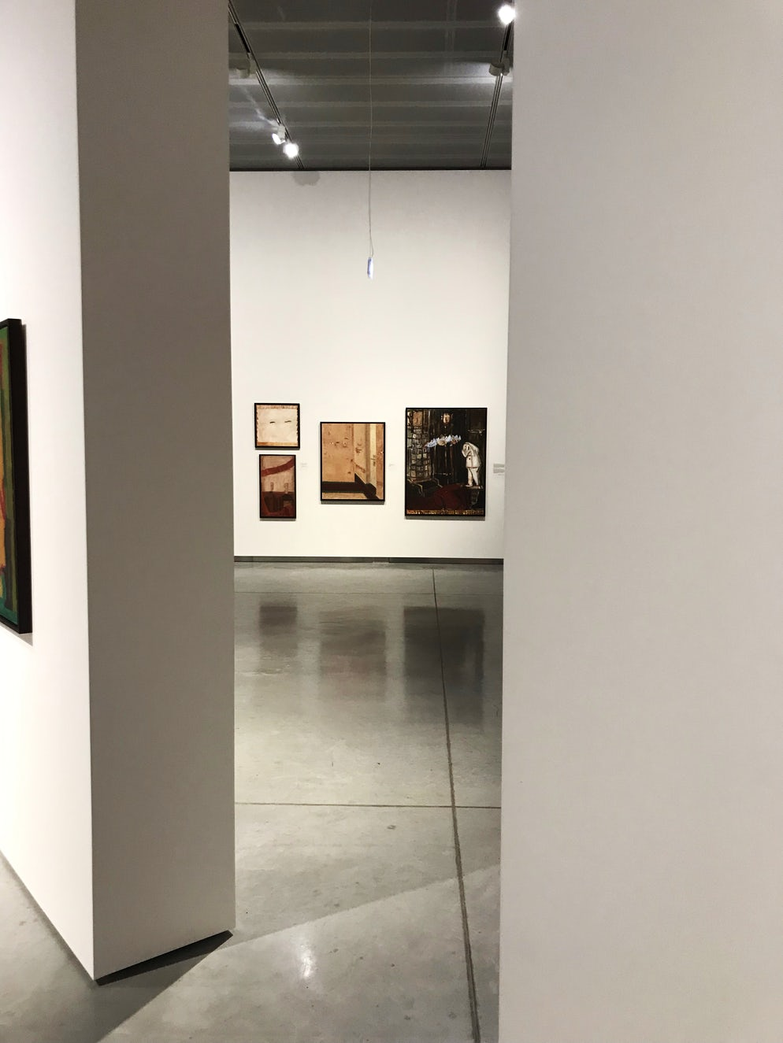
Museum Modern Art, Vilnius, LT (2018)

Slide 47
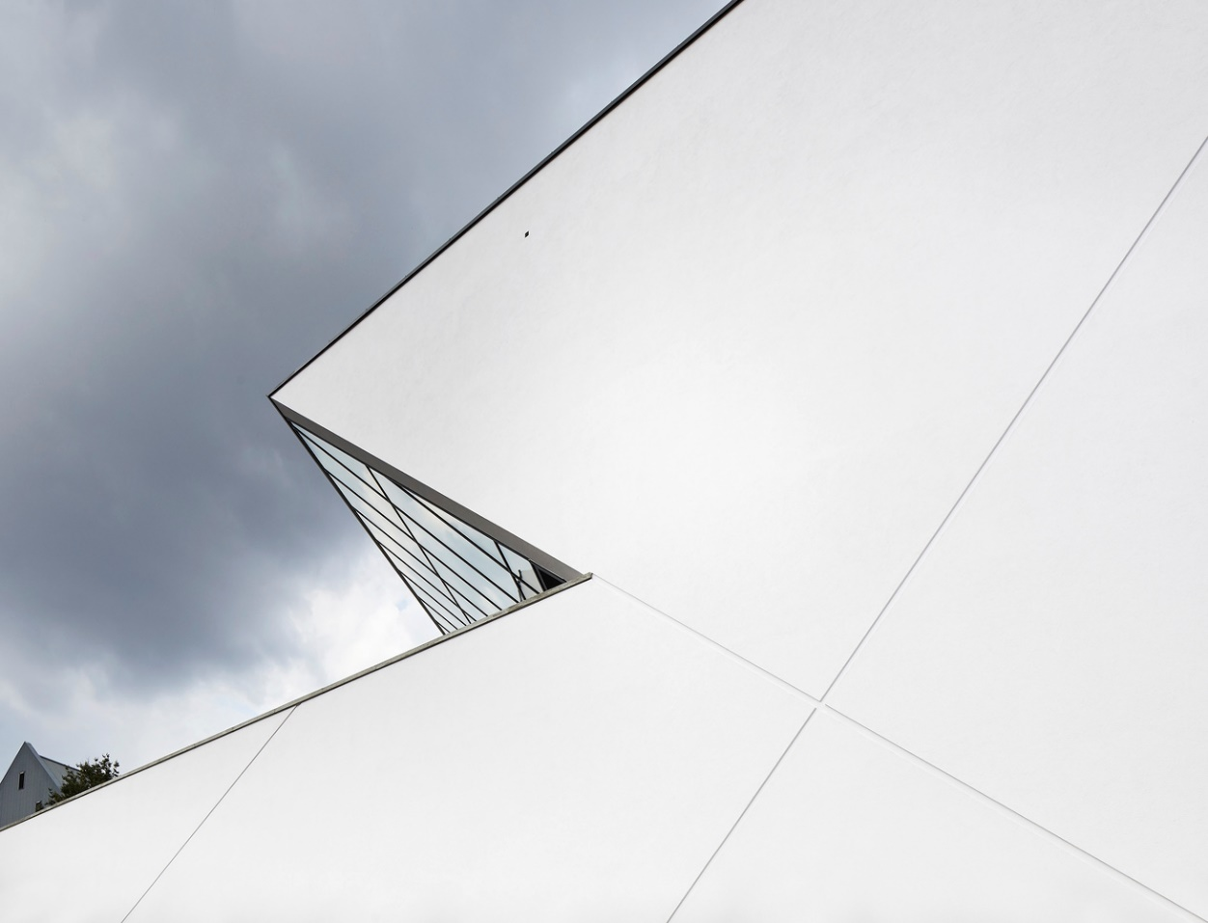
Museum Modern Art, Vilnius, LT (2018)

Slide 48
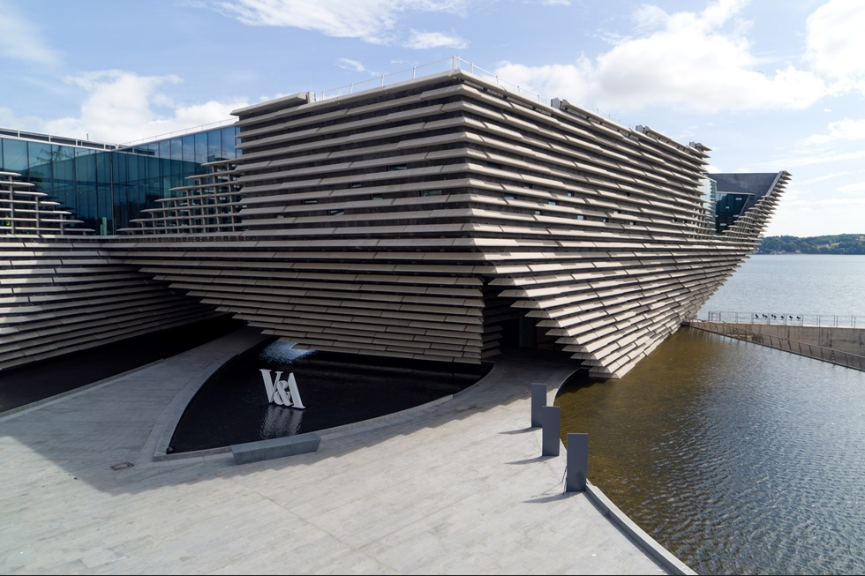
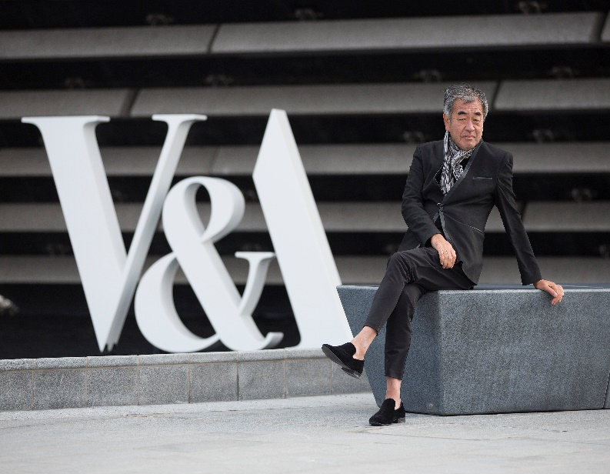
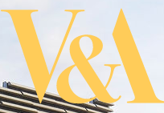
Victoria & Albert Museum,Dundee,GB(2018)
Kengo Kuma

Slide 49
Victoria & Albert Museum,Dundee,GB(2018)
It is the work of the architect Kengo Kuma.
Curving concrete walls (there are no straight external walls) hold 2,500 pre-cast rough stone panels, weighing up to 3000 kg each and spanning up to 4m wide, to create the appearance of a Scottish cliff face. There are 21 separate wall sections. V&A Dundee is an impressive 8,000m² building, with 1,650m² of gallery space.
A large horizontal “hole” was provided in the centre of the building. This “hole” represents an attempt to connect Union Street which runs through the centre of Dundee with the beautiful natural scenery of the River Tay.

Slide 50
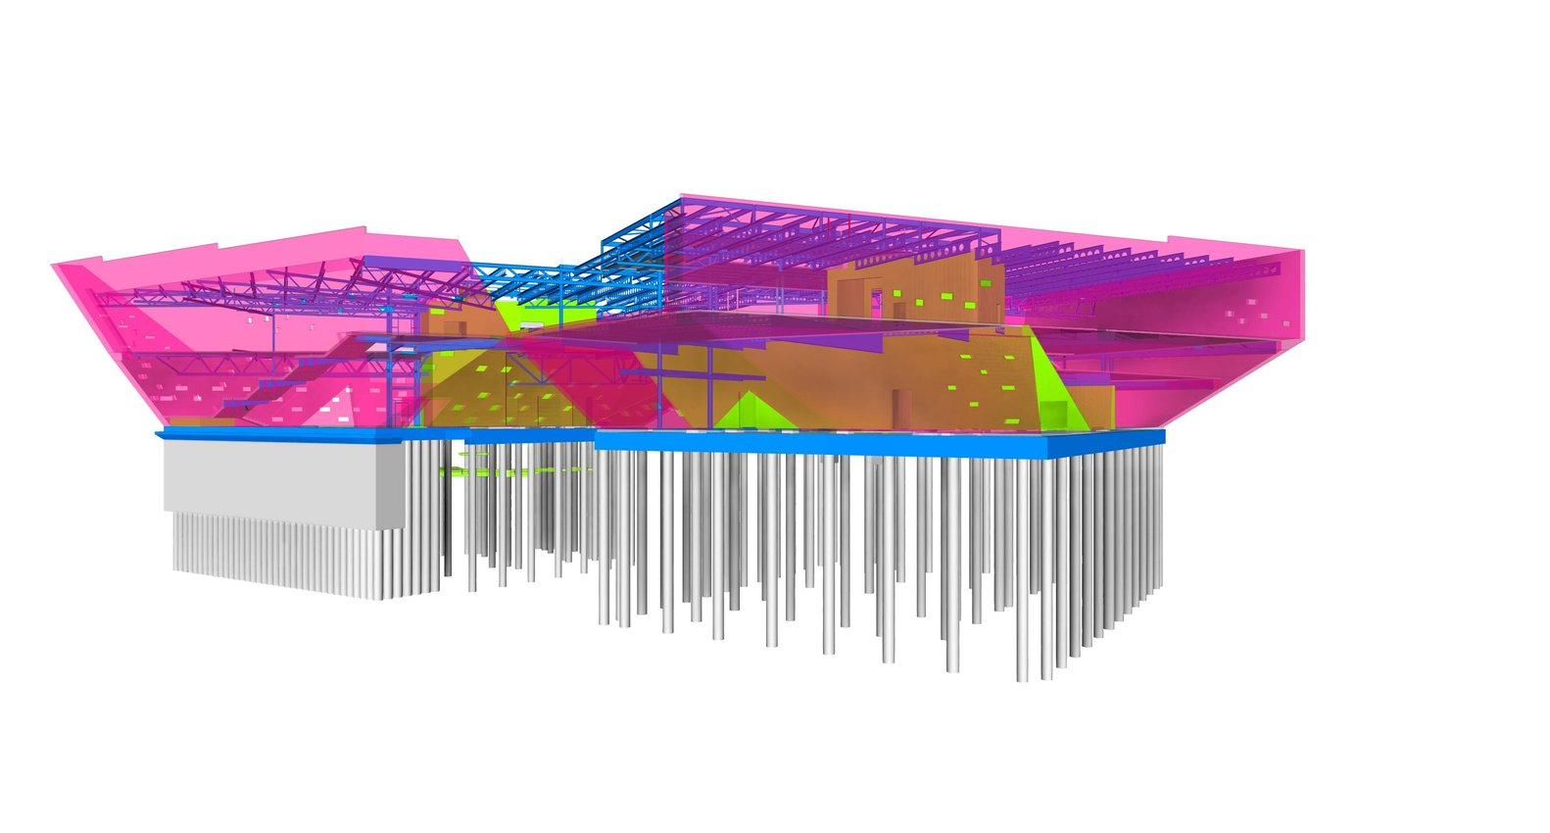
Victoria & Albert Museum,Dundee,GB(2018)

Slide 51
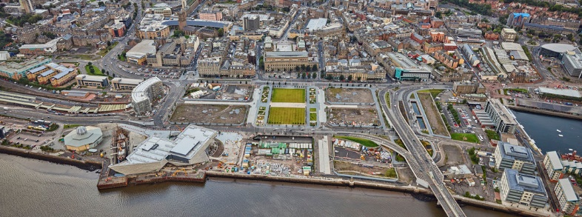
Victoria & Albert Museum,Dundee,GB(2018)

Slide 52
Victoria & Albert Museum,Dundee,GB(2018)

Slide 53
Victoria & Albert Museum,Dundee,GB(2018)

Slide 54
Victoria & Albert Museum,Dundee,GB(2018)

Slide 55
Victoria & Albert Museum,Dundee,GB(2018)

Slide 56
Victoria & Albert Museum,Dundee,GB(2018)

Slide 57
Victoria & Albert Museum,Dundee,GB(2018)

Slide 58
Victoria & Albert Museum,Dundee,GB(2018)

Slide 59
Victoria & Albert Museum,Dundee,GB(2018)

Slide 60
Victoria & Albert Museum,Dundee,GB(2018)

Slide 61
Victoria & Albert Museum,Dundee,GB(2018)

Slide 62
Victoria & Albert Museum,Dundee,GB(2018)

Slide 63
China Design Museum, Hangzhou, CN (2018)
Alvaro Siza
Carlos Castanheira

Slide 64
China Design Museum, Hangzhou, CN (2018)
It is the work of Alvaro Siza & Carlos Castanheira.
The ground floor contains the entrance, public and rest areas, distributions, temporary exhibition halls, and auditoriums. The top floor of this volume is for the permanent exhibition of the Bauhaus collection.
Red Agra sandstone from India will define the volumes and the exterior cladding. Some of the planes, especially inside the triangular volume, will be clad with white marble. The frames will be in be aluminum/wood.

Slide 65
China Design Museum, Hangzhou, CN (2018)

Slide 66
China Design Museum, Hangzhou, CN (2018)

Slide 67
China Design Museum, Hangzhou, CN (2018)

Slide 68
China Design Museum, Hangzhou, CN (2018)

Slide 69
China Design Museum, Hangzhou, CN (2018)

Slide 70
China Design Museum, Hangzhou, CN (2018)

Slide 71
China Design Museum, Hangzhou, CN (2018)

Slide 72
China Design Museum, Hangzhou, CN (2018)

Slide 73
China Design Museum, Hangzhou, CN (2018)

Slide 74
China Design Museum, Hangzhou, CN (2018)

Slide 75
China Design Museum, Hangzhou, CN (2018)

Slide 76
China Design Museum, Hangzhou, CN (2018)

Slide 77
China Design Museum, Hangzhou, CN (2018)

Slide 78
China Design Museum, Hangzhou, CN (2018)

Slide 79
China Design Museum, Hangzhou, CN (2018)

Slide 80
Musée de la Romanité, Nîmes, FR (2018)
Elisabeth de Portzamparc

Slide 81
Musée de la Romanité, Nîmes, FR (2018)
It is the work of Elisabeth de Portzamparc.
The Museum offers ascending promenade. This ascension begins from the main hall; the visitor is attracted by the generous curves of the “Chambord” stairs.
The visit continues with a series of ramps offering higher viewpoints on the collections. Wide windows open the inside space to the garden and to the Arenas.
The rooftop and its terrace mark the last step of this tour, offering an outstanding pano­rama on over twenty centuries of Nimes History.

Slide 82
Musée de la Romanité, Nîmes, FR (2018)
Two geometries, two materials, 2 shapes interact: to the great stone volume and to the magnificence of the vertical arches passed down to us through the centuries, the museum answers by its light and luminous presence, its contemporary and fluid architecture, creating a dia­phanous response composed of horizontal drapery that seems to float over the site and its archaeological garden.
At the center of a wide interior street connecting the square to the archaeological garden , a 17 meter in high atrium reveals a scenography of the fragments of the “Source”, inviting us to discover the museum.

Slide 83
Musée de la Romanité, Nîmes, FR (2018)
The façade is made of a double skin that wraps the museum on its four sides. The structure takes the form of the folds of the mosaic and supports 6708 glass slides covering an area of 2500m2.
The collections inspired his design, the glass squares subtly evoke Roman mosaics recalling the splendid pieces in the collection (Penthée mosaic...).
The glass reflects the sky, the light, prints subtle variations of reflections according to the angle, inclinations and different times of the day.

Slide 84
Musée de la Romanité, Nîmes, FR (2018)

Slide 85
Musée de la Romanité, Nîmes, FR (2018)

Slide 86
Musée de la Romanité, Nîmes, FR (2018)

Slide 87
Musée de la Romanité, Nîmes, FR (2018)

Slide 88
Musée de la Romanité, Nîmes, FR (2018)

Slide 89
Musée de la Romanité, Nîmes, FR (2018)

Slide 90
Musée de la Romanité, Nîmes, FR (2018)

Slide 91
Musée de la Romanité, Nîmes, FR (2018)

Slide 92
Musée de la Romanité, Nîmes, FR (2018)

Slide 93
Musée de la Romanité, Nîmes, FR (2018)

Slide 94
Musée de la Romanité, Nîmes, FR (2018)

Slide 95
Musée de la Romanité, Nîmes, FR (2018)

Slide 96
Musée de la Romanité, Nîmes, FR (2018)

Slide 97
Musée de la Romanité, Nîmes, FR (2018)

Slide 98
Lumen Museum, Bolzano, IT (2018)
Gerhard Mahlknecht

Slide 99
Lumen Museum, Bolzano, IT (2018)
It is the work of the architect Gerhard Mahlknecht.
Located at the summit of the region Kronplatz (in South Tyrol), 1,800 square meters are dedicated to mountain photography. The Lumen museum occupies the site of a former funicular station.
A significant intervention made by Mahlknecht is the addition of an elevated structure housing the new restaurant : the addition comprises a pair of fair-faced concrete slabs sandwiching glass walls.
The glazing and the structure's position cantilevering from the mountainside enhance the feeling of floating within the alpine scenery.

Slide 100
Lumen Museum, Bolzano, IT (2018)

Slide 101
Lumen Museum, Bolzano, IT (2018)

Slide 102
Lumen Museum, Bolzano, IT (2018)

Slide 103
Lumen Museum, Bolzano, IT (2018)

Slide 104
Lumen Museum, Bolzano, IT (2018)

Slide 105
Lumen Museum, Bolzano, IT (2018)

Slide 106
Lumen Museum, Bolzano, IT (2018)

Slide 107
Lumen Museum, Bolzano, IT (2018)

Slide 108
Lumen Museum, Bolzano, IT (2018)

Slide 109
Lumen Museum, Bolzano, IT (2018)

Slide 110
Lumen Museum, Bolzano, IT (2018)

Slide 111
Lumen Museum, Bolzano, IT (2018)

Slide 112
Lumen Museum, Bolzano, IT (2018)

Slide 113
Zhejiang Museum, Hangzhou, CN (2018)
David Chipperfield

Slide 114
Zhejiang Museum, Hangzhou, CN (2018)
It is the work of the architect David Chipperfield.
The new museum is set on a sloping site in a large natural park surrounded by bamboo forests and overlooking rice fields in the valley below. A staggered composition of eight, single-storey, bar-shaped pavilions step down the hillside.
They follow the natural topography, minimizing the visual impact on the landscape, and frame an open garden. A loggia, or covered walkway, loops around this central space, mediating between the external and internal areas of the museum.

Slide 115
Zhejiang Museum, Hangzhou, CN (2018)
At the northernmost point, an entrance pavilion welcomes visitors and offers views over the central garden and landscape beyond. Located on either side of the garden, each exhibition hall can be accessed directly or in sequence following the stepped loggia. The southernmost pavilion, housing education facilities, faces out towards a lake at the lowest end of the site.
The solid forms of the pavilions are embedded within the dense landscaping of the central garden and the surrounding parkland. The planting extends onto the green roofs of the building complex which is rendered in red ochre to match the clay earth of the hillside site, reinforcing the relationship between the museum and the landscape.

Slide 116
Zhejiang Museum, Hangzhou, CN (2018)

Slide 117
Zhejiang Museum, Hangzhou, CN (2018)

Slide 118
Zhejiang Museum, Hangzhou, CN (2018)

Slide 119
Zhejiang Museum, Hangzhou, CN (2018)

Slide 120
Zhejiang Museum, Hangzhou, CN (2018)

Slide 121
Zhejiang Museum, Hangzhou, CN (2018)

Slide 122
Zhejiang Museum, Hangzhou, CN (2018)

Slide 123
Zhejiang Museum, Hangzhou, CN (2018)

Slide 124
Zhejiang Museum, Hangzhou, CN (2018)

Slide 125
Zhejiang Museum, Hangzhou, CN (2018)

Slide 126
Tibet Heritage Museum, Lhasa, CN (2018)
Cheng Xiao

Slide 127
Tibet Heritage Museum, Lhasa, CN (2018)
It is the work of Shenzhen Huahui Design firm.
The site of the building is on a slight slope facing the old city proper of Lhasa.
Inspired by the prototype of zigzag footpath of Potala Palace, it is transformed into a spatial circulation rising from the entrance of the site to the building and spiraling up inside the museum (concept of Heavenly Road).
After appreciating the rich intangible cultural heritage of Tibet through a hard climb, visitors will finally reach the ending point where they can overlook the Potala Palace across both time and space.

Slide 128
Tibet Heritage Museum, Lhassa, CN (2018)

Slide 129
Tibet Heritage Museum, Lhassa, CN (2018)

Slide 130
Tibet Heritage Museum, Lhassa, CN (2018)

Slide 131
Tibet Heritage Museum, Lhassa, CN (2018)

Slide 132
Tibet Heritage Museum, Lhassa, CN (2018)

Slide 133
Tibet Heritage Museum, Lhassa, CN (2018)

Slide 134
Tibet Heritage Museum, Lhassa, CN (2018)

Slide 135
Tibet Heritage Museum, Lhassa, CN (2018)

Slide 136
Tibet Heritage Museum, Lhassa, CN (2018)

Slide 137
Tibet Heritage Museum, Lhassa, CN (2018)

Slide 138
Tibet Heritage Museum, Lhassa, CN (2018)

Slide 139
Museum of Prehistory, Tainan, TW (2018)
Kris Yao

Slide 140
Museum of Prehistory, Tainan, TW (2018)
It is the work of the architect Kris Yao.
The building geometry follows two sets of axes. One points due north, cohering to the direction of ancient burials, is the order of the past. The other axis, rotating 19° from the main axis, follows the present-day city grid, is the order we have now on hand.
The building’s external wall is covered mostly with rough surface basalt, and at nighttime the contrast of faint light filtering through them creates a mysterious, poetic contrast with the coarse texture of the stone.

Slide 141
Museum of Prehistory, Tainan, TW (2018)

Slide 142
Museum of Prehistory, Tainan, TW (2018)

Slide 143
Museum of Prehistory, Tainan, TW (2018)

Slide 144
Museum of Prehistory, Tainan, TW (2018)

Slide 145
Museum of Prehistory, Tainan, TW (2018)

Slide 146
Museum of Prehistory, Tainan, TW (2018)

Slide 147
Museum of Prehistory, Tainan, TW (2018)

Slide 148
Museum of Prehistory, Tainan, TW (2018)

Slide 149
Museum of Prehistory, Tainan, TW (2018)

Slide 150
Museum of Prehistory, Tainan, TW (2018)

Slide 151
Museum of Prehistory, Tainan, TW (2018)

Slide 152
Museum of Prehistory, Tainan, TW (2018)

Slide 153
Museo Cais do Sertão, Recife, BR (2018)
Marcelo Ferraz
Francisco Fanucci

Slide 154
Museo Cais do Sertão, Recife, BR (2018)
It is the work of Brasil Arquitetura firm.
The architectural project was developed re-adapting one of the warehouses (2.500m²) and creating a new building (5.000m²) connected to it, reinforcing the elongated layout of the constructions of the port.
The most important architectural element is the giant Cobogo facade, made of precast brise-soleil components, designed especially for the project. The Cobogo is made of geopolymer concrete and works as a large white lace, pale in contrast to the structural yellow concrete with ochre pigments or the cracked patterns of dry soil.

Slide 155
Museo Cais do Sertão, Recife, BR (2018)

Slide 156
Museo Cais do Sertão, Recife, BR (2018)

Slide 157
Museo Cais do Sertão, Recife, BR (2018)

Slide 158
Museo Cais do Sertão, Recife, BR (2018)

Slide 159
Museo Cais do Sertão, Recife, BR (2018)

Slide 160
Museo Cais do Sertão, Recife, BR (2018)

Slide 161
Museo Cais do Sertão, Recife, BR (2018)

Slide 162
Museo Cais do Sertão, Recife, BR (2018)

Slide 163
Museo Cais do Sertão, Recife, BR (2018)

Slide 164
Museo Cais do Sertão, Recife, BR (2018)

Slide 165
Museo Cais do Sertão, Recife, BR (2018)

Slide 166
Bihar Museum, Patna, IN (2018)
Fumihiko Maki

Slide 167
Bihar Museum, Patna, IN (2018)
It is the work of the architect Fumihiko Maki.
The Museum’s exterior is characterized by extensive use of weathering steel, a durable material that complements its context and creates a dignified contrast to the surrounding greenery. It is supplemented with stone, terracotta, and glass finishes - a modern material palette with clear connections to Bihar’s past and future. The pillar’s mix of metals has retained it rust-free. Hence, Maki and Associates sought to use Corten steel plates as cladding to enhance my building in a permanent way, reminding people of the origins of metallurgy in this region.

Slide 168
Bihar Museum, Patna, IN (2018)

Slide 169
Bihar Museum, Patna, IN (2018)

Slide 170
Bihar Museum, Patna, IN (2018)

Slide 171
Bihar Museum, Patna, IN (2018)

Slide 172
Bihar Museum, Patna, IN (2018)

Slide 173
Bihar Museum, Patna, IN (2018)

Slide 174
Bihar Museum, Patna, IN (2018)

Slide 175
Bihar Museum, Patna, IN (2018)

Slide 176
Bihar Museum, Patna, IN (2018)

Slide 177
Bihar Museum, Patna, IN (2018)

Slide 178
Bihar Museum, Patna, IN (2018)

Slide 179
Bihar Museum, Patna, IN (2018)

Slide 180
Bihar Museum, Patna, IN (2018)

Slide 181
Lisser Art Museum, Lisse, NL (2018)
Arie Korbee

Slide 182
Lisser Art Museum, Lisse, NL (2018)
It is the work of KVDK architecten.
The building consists of two main volumes. One volume is embedded in the dike and supports the upper, floating volume. The cantilever is borne aloft by just four, tree-like columns. The understated, monolithic materialization of the exterior, which is attuned to the surrounding wood, consists of elongated, earth colored Petersen bricks. The acute-angled long elevation runs parallel to the road to the south of the museum. At the entrance, the dike core opens up in a generous welcoming gesture via a glass curtain wall placed between the huge awning and the cutaway dike. The experience of being inside a dike is reinforced upon entering where a floor of terracotta colored bricks leads the visitor between two rough dark stone walls towards the daylight and the lighter materialization of the upper floors.

Slide 183
Lisser Art Museum, Lisse, NL (2018)

Slide 184
Lisser Art Museum, Lisse, NL (2018)

Slide 185
Lisser Art Museum, Lisse, NL (2018)

Slide 186
Lisser Art Museum, Lisse, NL (2018)

Slide 187
Lisser Art Museum, Lisse, NL (2018)

Slide 188
Lisser Art Museum, Lisse, NL (2018)

Slide 189
Lisser Art Museum, Lisse, NL (2018)

Slide 190
Lisser Art Museum, Lisse, NL (2018)
THE END

