Slide 1
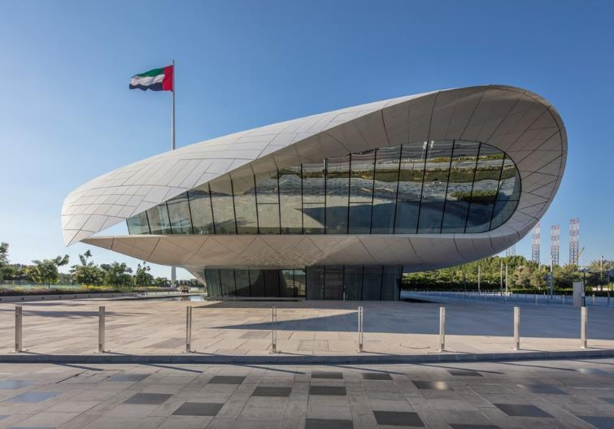
World Museums XVIII
2017

Slide 2
World Contemporary Museums XVIII
The objective is to show you different museums of contemporary architecture around the world except U.S. : these do not only house contemporary art but also art or history since prehistoric times.
The greatest architects of the last five years contributed to the construction of these museums with architectures that were certainly different but also adapted to the place and sometimes to the works they contain.

Slide 3
World Contemporary Museums
II World War Museum, Gdansk, PL 2017.
Xie Zilong Photography Museum, Hunan, CN 2017.
Tiandi Art Museum, Chongqing, CN 2017.
Etihad Museum, Dubaï, AE 2017.
Zeitz MOCAA, Capetown, ZA 2017.
Palestinian Museum, Birzeit, PS 2017.
Tirpitz Museum, Blavand, DK 2017.
Musée Yves St Laurent, Marrakech, MA 2017.
Kunsthalle, Mannheim, DE 2017.
Xing Kiln Museum, Jingtai, CN 2017.

Slide 4
World Contemporary Museums 2
Tonofenfabrik Museum, Lahr, DE 2017.
Museu da Fotografia, Fortaleza, BR 2017.
Mokyeonri, Incheon, KR 2017.

Slide 5
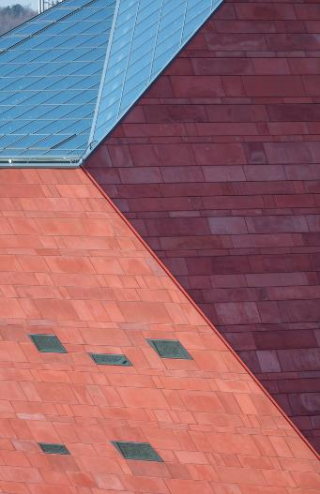
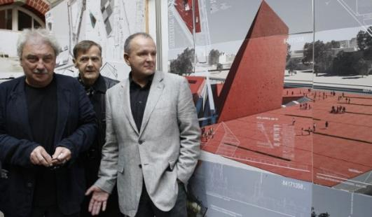
II World War Museum, Gdansk, PL (2017)

Slide 6
II World War Museum, Gdansk, PL (2017)
This is the work of the Kwadrat firm.
The project includes 3 distinct but connected parts, with the underground space dedicated to the past, the place in the present, the tower in the future.
The monolithic tower has surfaces with angles equal to 45° to the vertical, giving it a dynamic appearance that changes when viewed from different directions. 3 of its 4 trapezoidal facades are covered with red terracotta panels, while the 4th side and the folded roof are filled with glazing that allows natural light to enter the interior.

Slide 7
II World War Museum, Gdansk, PL (2017)
A corridor with a narrow skylight at the top guides visitors through a series of austere exhibition rooms with a palette of details in concrete, steel and oak.
At the level of the square, a bridge connects the tower with a long and narrow volume containing offices. A footbridge under the bridge is lined with gabion cages filled with red brick and Gdansk rubble, and another wedge-shaped structure emerges from the square containing the entrance to a car park. in. This volume and the offices are covered with the same red tiles as the tower.

Slide 8
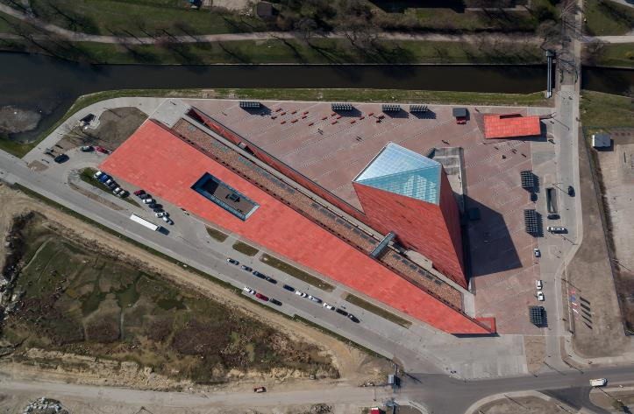
II World War Museum, Gdansk, PL (2017)

Slide 9
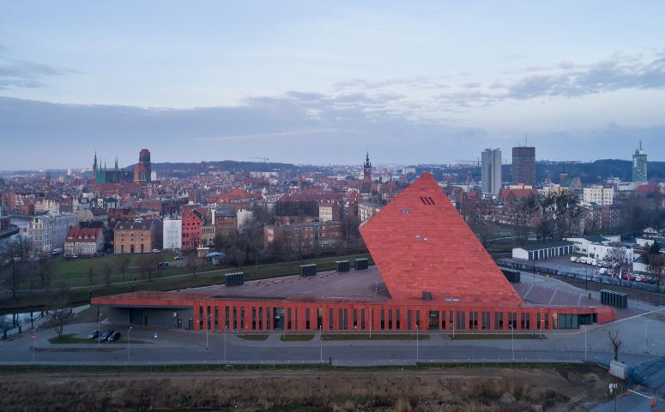
II World War Museum, Gdansk, PL (2017)

Slide 10
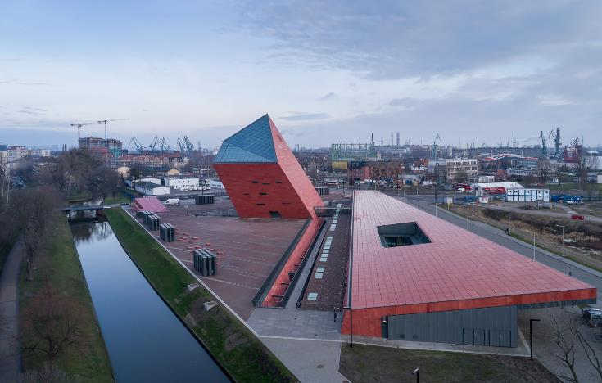
II World War Museum, Gdansk, PL (2017)

Slide 11
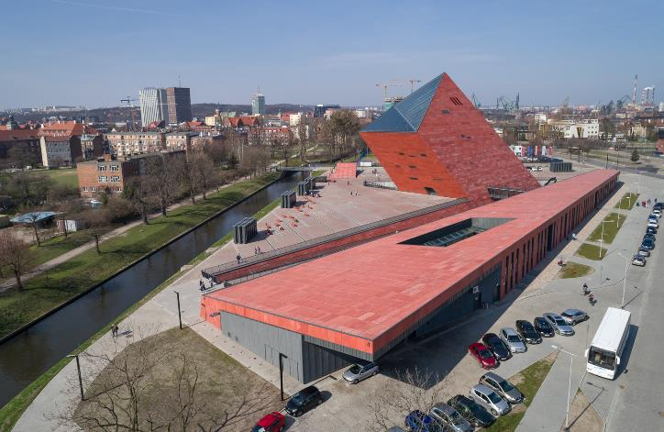
II World War Museum, Gdansk, PL (2017)

Slide 12
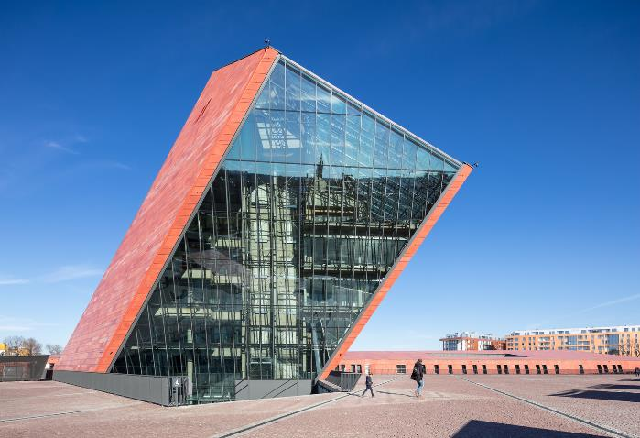
II World War Museum, Gdansk, PL (2017)

Slide 13
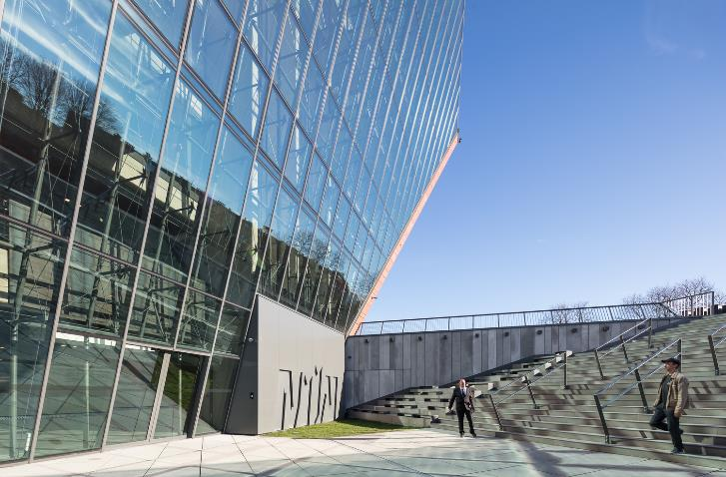
II World War Museum, Gdansk, PL (2017)

Slide 14
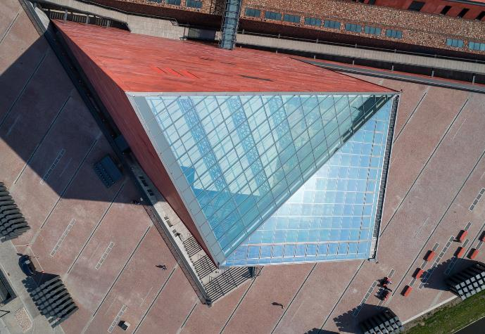
II World War Museum, Gdansk, PL (2017)

Slide 15
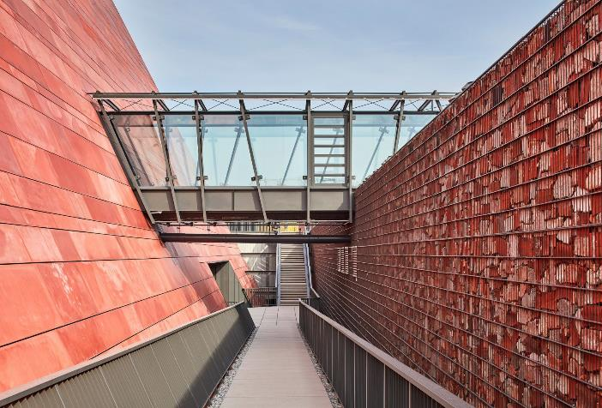
II World War Museum, Gdansk, PL (2017)

Slide 16
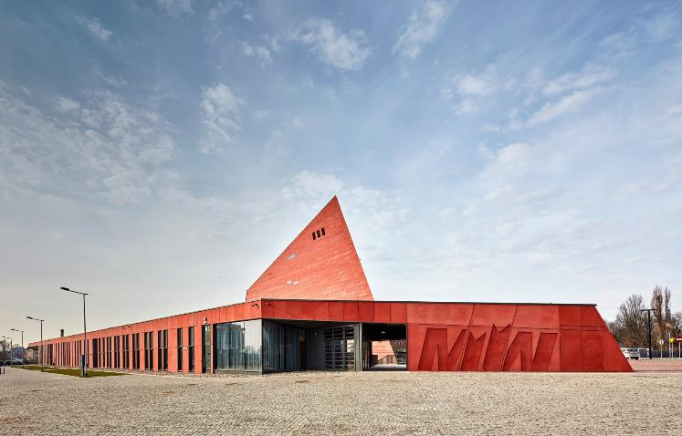
II World War Museum, Gdansk, PL (2017)

Slide 17
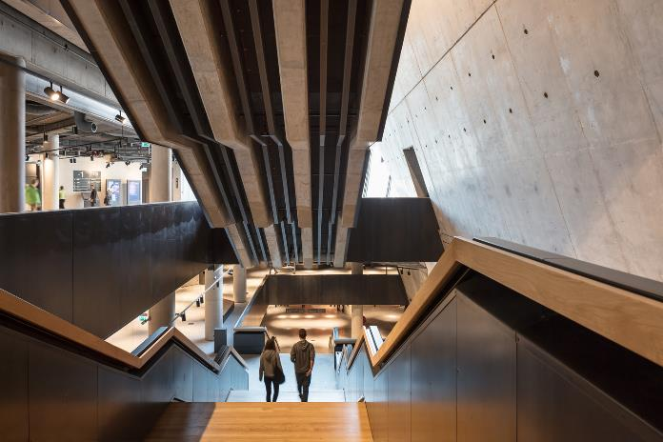
II World War Museum, Gdansk, PL (2017)

Slide 18
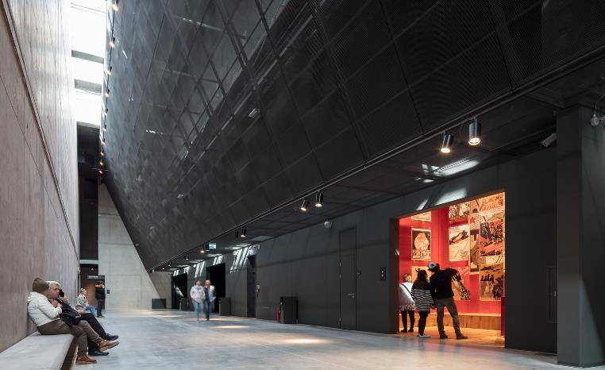
II World War Museum, Gdansk, PL (2017)

Slide 19
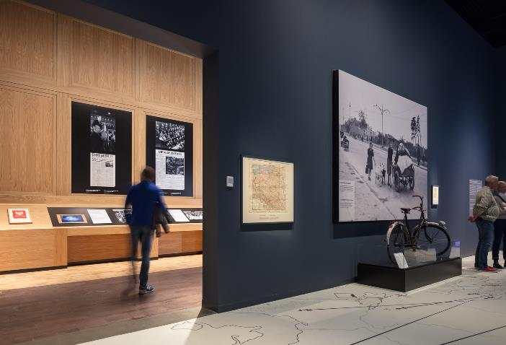
II World War Museum, Gdansk, PL (2017)

Slide 20
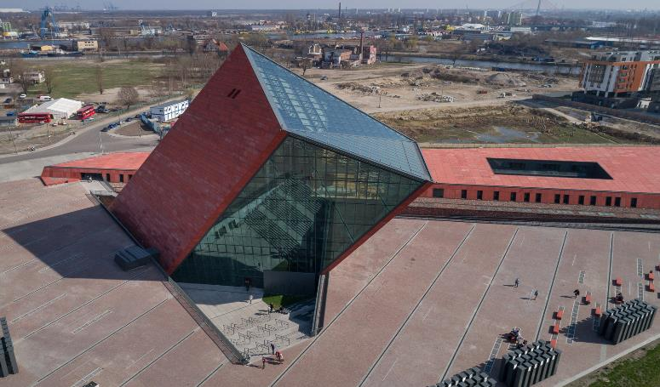
II World War Museum, Gdansk, PL (2017)

Slide 21
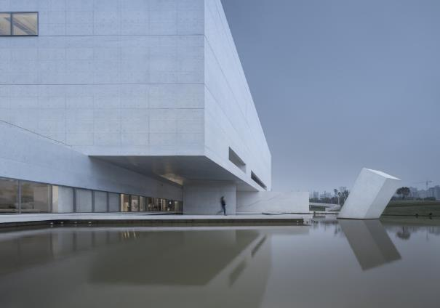
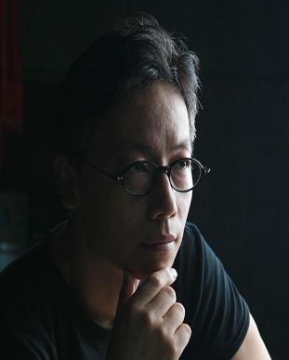
Zilong Photography Museum, Hunan, CN (2017)
Chunyu Wei

Slide 22
Zilong Photography Museum, Hunan, CN (2017)
This is the work of Regional Studio.
One of the specific features of this building is the use of very pure white concrete using white cement made from white sand aggregate and avoiding any mineral additives: white is still the expression of "emptiness" to a certain extent, which not only emphasizes art in the museum.
It is inspired by the metaphysical work of Giorgio de Chirico, mixing light and shadow.

Slide 23
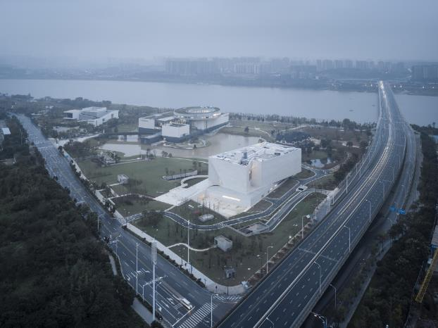
Zilong Photography Museum, Hunan, CN (2017)

Slide 24
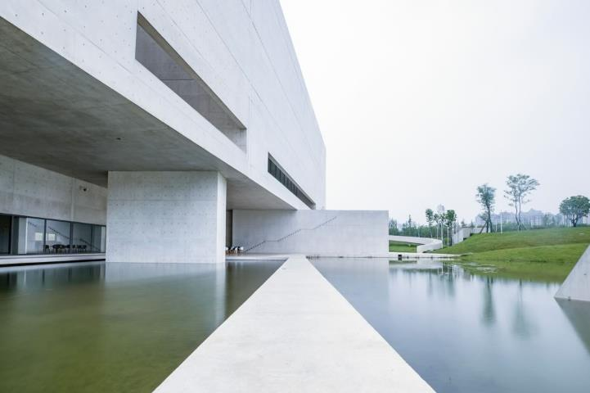
Zilong Photography Museum, Hunan, CN (2017)

Slide 25
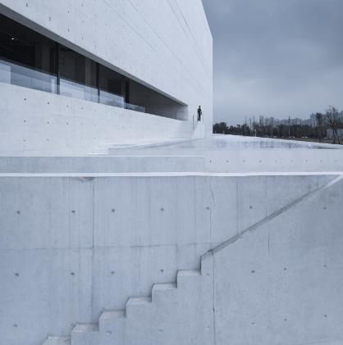
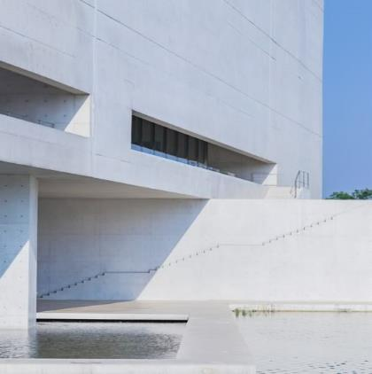
Zilong Photography Museum, Hunan, CN (2017)

Slide 26
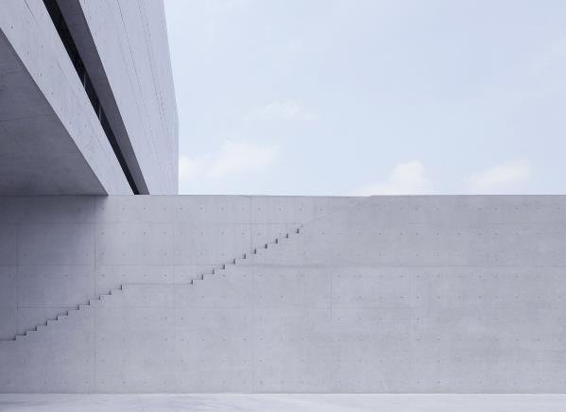
Zilong Photography Museum, Hunan, CN (2017)

Slide 27
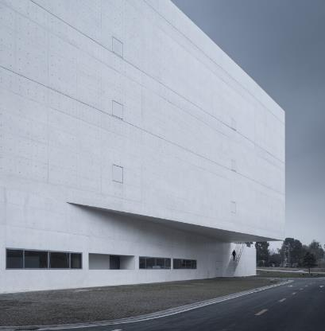
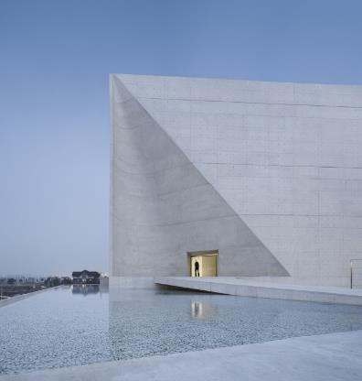
Zilong Photography Museum, Hunan, CN (2017)

Slide 28
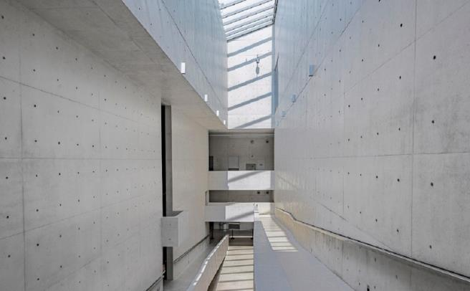
Zilong Photography Museum, Hunan, CN (2017)

Slide 29
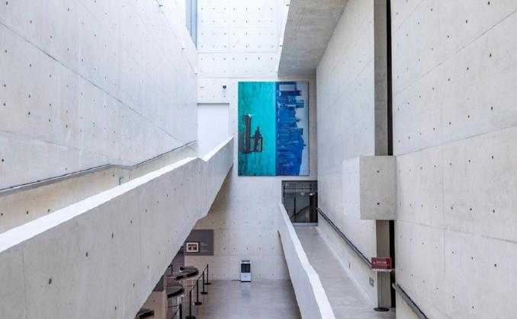
Zilong Photography Museum, Hunan, CN (2017)

Slide 30
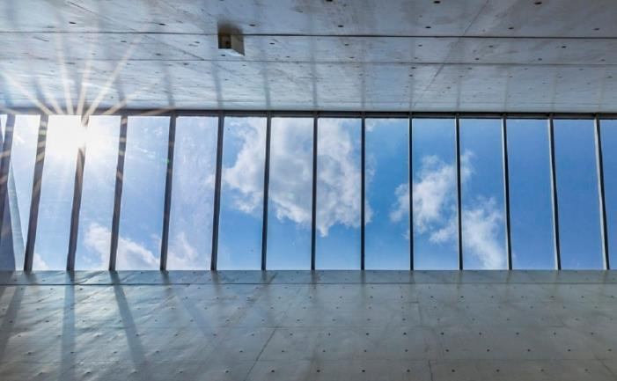
Zilong Photography Museum, Hunan, CN (2017)

Slide 31
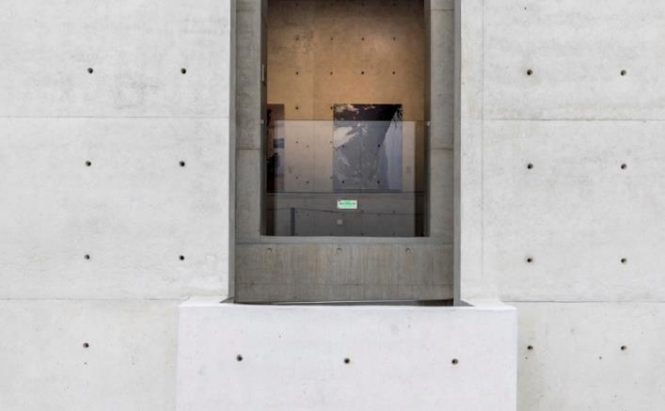
Zilong Photography Museum, Hunan, CN (2017)

Slide 32
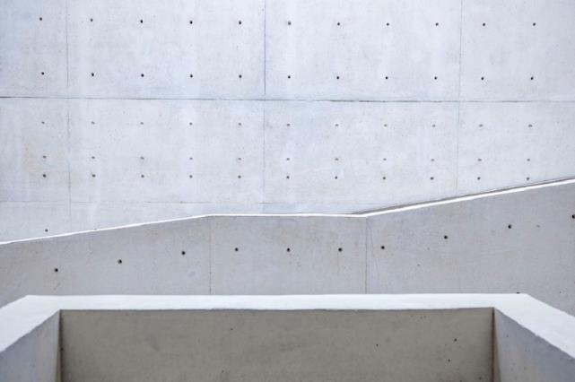
Zilong Photography Museum, Hunan, CN (2017)

Slide 33
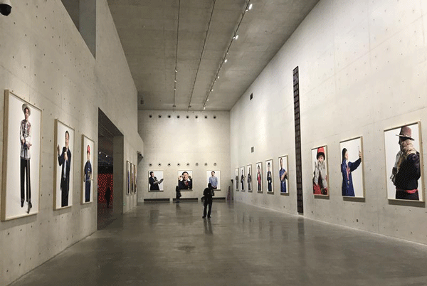
Zilong Photography Museum, Hunan, CN (2017)

Slide 34
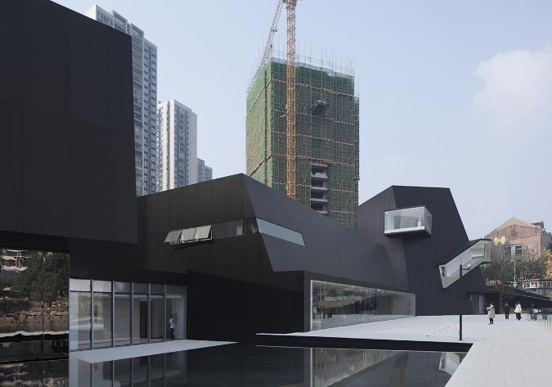
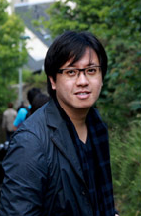
Tiandi Art Museum, Chongqing, CN (2017)
Cheng Xiao

Slide 35
Tiandi Art Museum, Chongqing, CN (2017)
It is the work of the architect Cheng Xiao.
The building's overall layout complied with the topography and was divided into three volumes based on different functions.
This building is the object of a real architectural walk through its 3 volumes connected by continuous paths, glass corridors, linked to the landscape.
The three volumes are linked together through a wing space, two of which form two half closed yards with the volume, one is connected with a pool to form a sunken yard, the other is linked with a square to hold small gathering activities for people in the park.

Slide 36
Tiandi Art Museum, Chongqing, CN (2017)
These 3 volumes contain the Contemporary Art Gallery designed with double height spaces (top), a demonstration centre linked to the Tiandi brand on one level with the lake (wide) and a Café House located on the 2nd floor with a complete view of the lake (high).
In this design, we used the contrast of white walls and black stairs to weaken the internal space form.

Slide 37
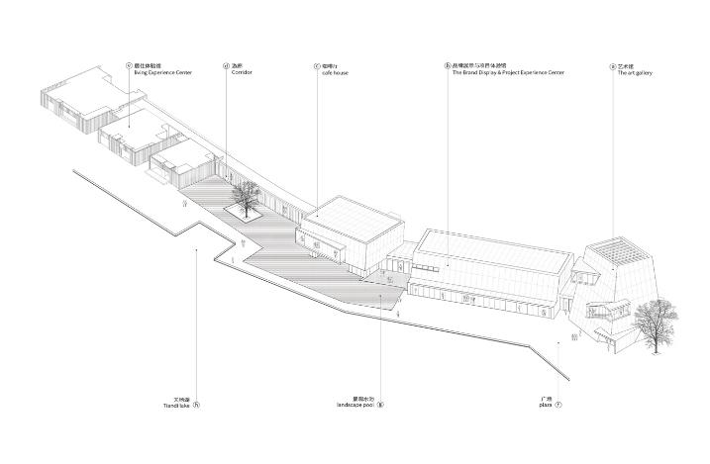
Tiandi Art Museum, Chongqing, CN (2017)

Slide 38
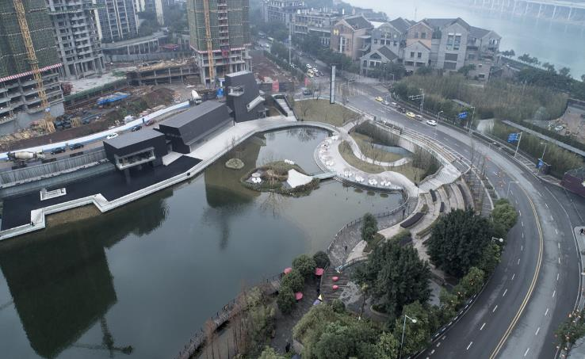
Tiandi Art Museum, Chongqing, CN (2017)

Slide 39
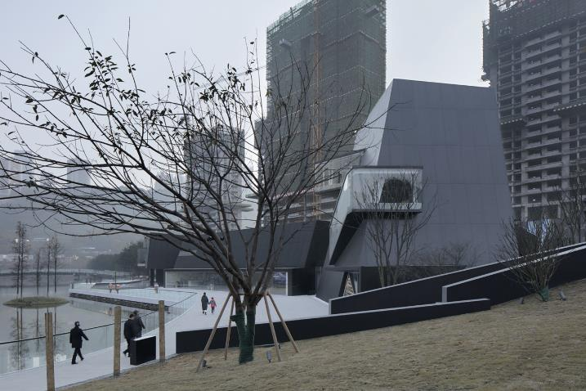
Tiandi Art Museum, Chongqing, CN (2017)

Slide 40
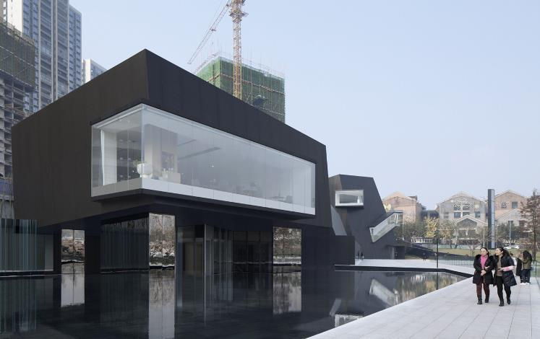
Tiandi Art Museum, Chongqing, CN (2017)

Slide 41
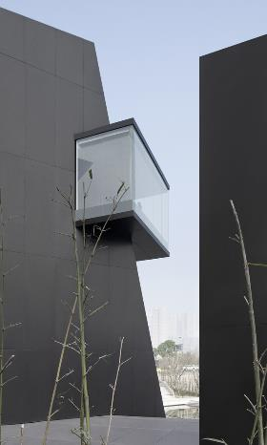
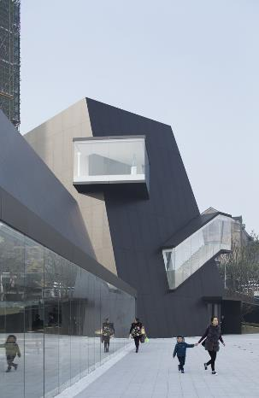
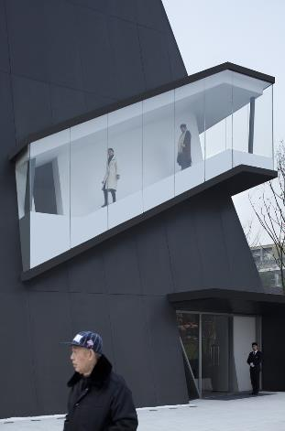
Tiandi Art Museum, Chongqing, CN (2017)

Slide 42
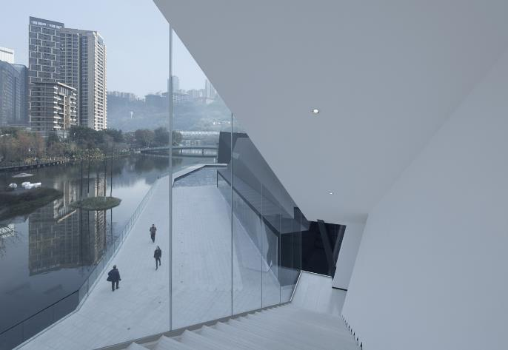
Tiandi Art Museum, Chongqing, CN (2017)

Slide 43
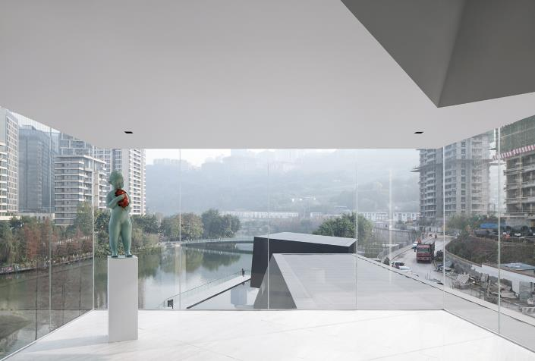
Tiandi Art Museum, Chongqing, CN (2017)

Slide 44
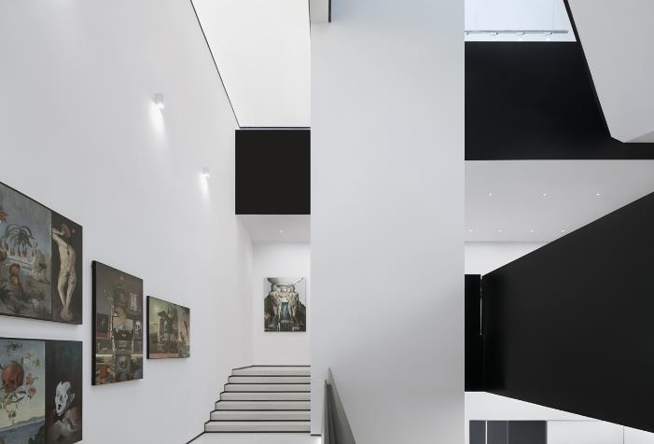
Tiandi Art Museum, Chongqing, CN (2017)

Slide 45
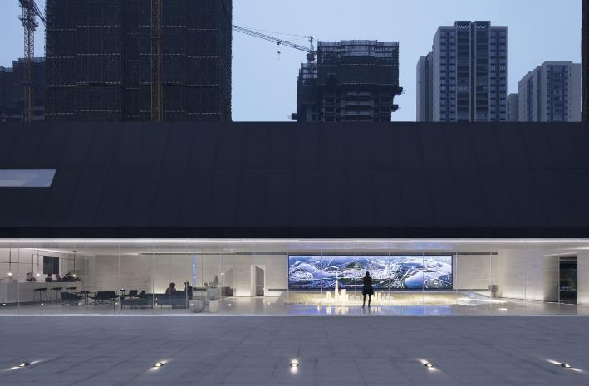
Tiandi Art Museum, Chongqing, CN (2017)

Slide 46
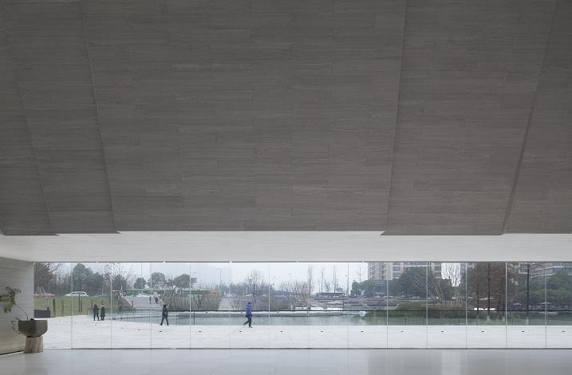
Tiandi Art Museum, Chongqing, CN (2017)

Slide 47
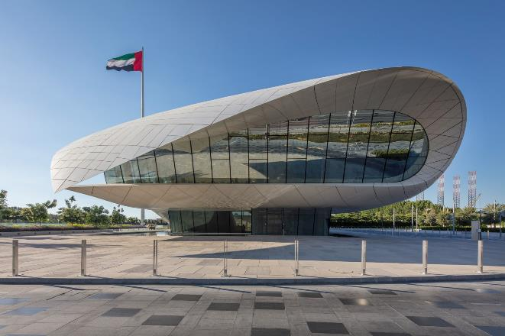
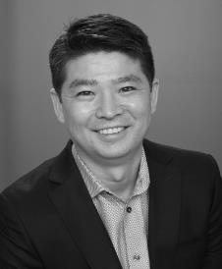
Etihad Museum, Dubaï, AE (2017)
Jason Moriyama

Slide 48
Etihad Museum, Dubaï, AE (2017)
It is the work of the architecture firm Moriyama and Teshima.
The Museum honours the signature in 1971 of the document that created the United Arab Emirates.
The undulating parabolic curves of the entrance pavilion representing the parchment on which the unification agreement was written and its tapering golden columns representing the pens with which the document was signed.
Skylights of various shapes and sizes illuminate the vast underground spaces leading to the Circular Union House, the site of the signing ceremony.

Slide 49
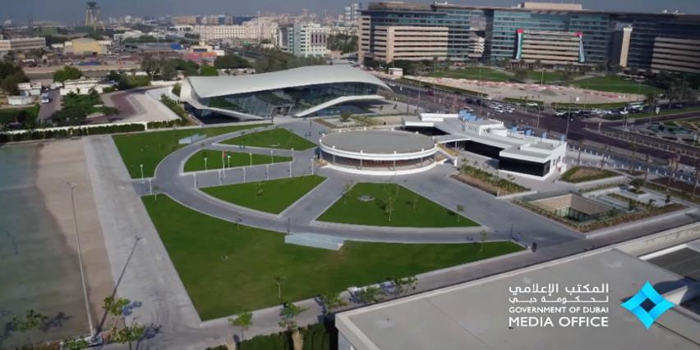
Etihad Museum, Dubaï, AE (2017)

Slide 50
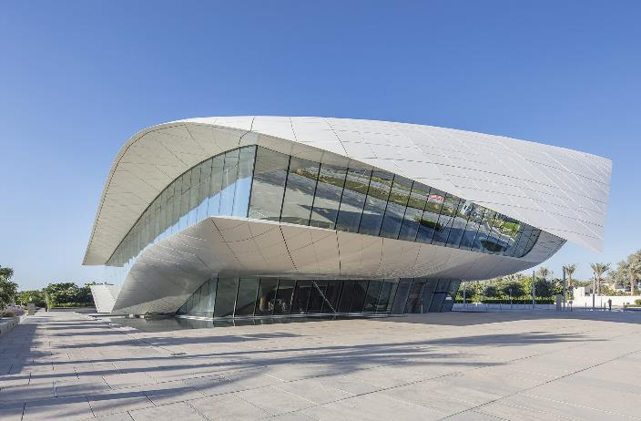
Etihad Museum, Dubaï, AE (2017)

Slide 51
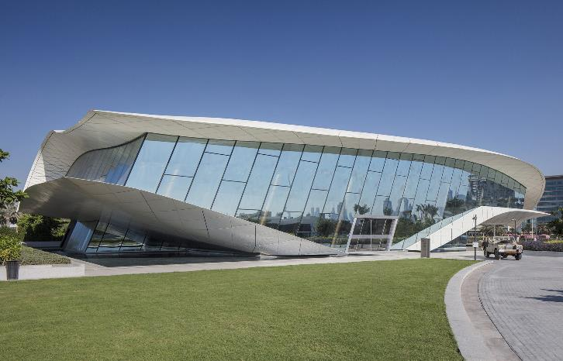
Etihad Museum, Dubaï, AE (2017)

Slide 52
Etihad Museum, Dubaï, AE (2017)

Slide 53
Etihad Museum, Dubaï, AE (2017)

Slide 54
Etihad Museum, Dubaï, AE (2017)

Slide 55
Etihad Museum, Dubaï, AE (2017)

Slide 56
Etihad Museum, Dubaï, AE (2017)

Slide 57
Etihad Museum, Dubaï, AE (2017)

Slide 58
Zeitz MOCAA, Capetown, ZA (2017)
Thomas Heatherwick

Slide 59
Zeitz MOCAA, Capetown, ZA (2017)
It is the work of the architect Thomas Heatherwick.
The Zeitz Museum of Contemporary Art Africa (Zeitz MOCAA) is the world’s largest museum dedicated to contemporary art from Africa.
The museum is housed in 9,500 sq meters of custom designed space, spread over nine floors, carved out of the monumental structure of the historic Grain Silo Complex. The silo, disused since 1990, stands as a monument to the industrial past of Capetown. It’s split into two buildings: there’s the elevator or grading tower, and the storage annex next to it (block of 42 tightly-packed silos).

Slide 60
Zeitz MOCAA, Capetown, ZA (2017)
The solution developed by Heatherwick Studio is to carve galleries and a central circulation space from the silos’ cellular concrete structure.
The galleries and the space of the atrium in the centre of the museum have been sculpted into the dense cellular structure of the 42 tubes that make up the silo. The perimeter tubes were cut, converted into 5 gallery floors.
The adjoining classification tower was also cut and surmounted by 4 floors of kaleidoscopic windows.

Slide 61
Zeitz MOCAA, Capetown, ZA (2017)

Slide 62
Zeitz MOCAA, Capetown, ZA (2017)

Slide 63
Zeitz MOCAA, Capetown, ZA (2017)

Slide 64
Zeitz MOCAA, Capetown, ZA (2017)

Slide 65
Zeitz MOCAA, Capetown, ZA (2017)

Slide 66
Zeitz MOCAA, Capetown, ZA (2017)

Slide 67
Zeitz MOCAA, Capetown, ZA (2017)

Slide 68
Zeitz MOCAA, Capetown, ZA (2017)

Slide 69
Zeitz MOCAA, Capetown, ZA (2017)

Slide 70
Zeitz MOCAA, Capetown, ZA (2017)

Slide 71
Zeitz MOCAA, Capetown, ZA (2017)

Slide 72
Zeitz MOCAA, Capetown, ZA (2017)

Slide 73
Zeitz MOCAA, Capetown, ZA (2017)

Slide 74
Zeitz MOCAA, Capetown, ZA (2017)

Slide 75
Palestinian Museum, Birzeit, PS (2017)

Slide 76
Palestinian Museum, Birzeit, PS (2017)
This is the work of Heneghan Peng firm.
The building itself emerges from the landscape to create a strong profile for the top of the hill, both integrated into the landscape and creating an assertive shape that has a distinctive identity.
One storey high, it extends along the hill from south to north overlooking the gardens to the west.
It is surrounded by a cascade of terraces telling a diversity of stories: citrus fruits brought through trade routes, indigenous aromatic herbs, olive trees, fig trees, pomegranates, apricots, almonds, carob trees.

Slide 77
Palestinian Museum, Birzeit, PS (2017)

Slide 78
Palestinian Museum, Birzeit, PS (2017)

Slide 79
Palestinian Museum, Birzeit, PS (2017)

Slide 80
Palestinian Museum, Birzeit, PS (2017)

Slide 81
Palestinian Museum, Birzeit, PS (2017)

Slide 82
Palestinian Museum, Birzeit, PS (2017)

Slide 83
Palestinian Museum, Birzeit, PS (2017)

Slide 84
Palestinian Museum, Birzeit, PS (2017)

Slide 85
Palestinian Museum, Birzeit, PS (2017)

Slide 86
Palestinian Museum, Birzeit, PS (2017)

Slide 87
Palestinian Museum, Birzeit, PS (2017)

Slide 88
Palestinian Museum, Birzeit, PS (2017)

Slide 89
Palestinian Museum, Birzeit, PS (2017)

Slide 90
Palestinian Museum, Birzeit, PS (2017)

Slide 91
Palestinian Museum, Birzeit, PS (2017)

Slide 92
Palestinian Museum, Birzeit, PS (2017)

Slide 93
Tirpitz Museum, Blavand, DK (2017)
Bjarke Ingels

Slide 94
Tirpitz Museum, Blavand, DK (2017)
It is the work of the architect Bjarke Ingels.
Upon arrival, visitors will first see the bunker until they approach through the heath-lined pathways and find the walls cut into the dunes from all sides and descend to meet in a central clearing.
This allows access to the 4 underground galleries which have an abundance of natural light though they are literally carved into the sand. The opening of the museum contrasts with the concrete monolith of the bunker.

Slide 95
Tirpitz Museum, Blavand, DK (2017)

Slide 96
Tirpitz Museum, Blavand, DK (2017)

Slide 97
Tirpitz Museum, Blavand, DK (2017)

Slide 98
Tirpitz Museum, Blavand, DK (2017)

Slide 99
Tirpitz Museum, Blavand, DK (2017)

Slide 100
Tirpitz Museum, Blavand, DK (2017)

Slide 101
Tirpitz Museum, Blavand, DK (2017)

Slide 102
Tirpitz Museum, Blavand, DK (2017)

Slide 103
Tirpitz Museum, Blavand, DK (2017)

Slide 104
Tirpitz Museum, Blavand, DK (2017)

Slide 105
Tirpitz Museum, Blavand, DK (2017)

Slide 106
Tirpitz Museum, Blavand, DK (2017)

Slide 107
Tirpitz Museum, Blavand, DK (2017)

Slide 108
Tirpitz Museum, Blavand, DK (2017)

Slide 109
Musée St Laurent, Marrakech, MA (2017)
Karl Fournier & Olivier Marty

Slide 110
Musée St Laurent, Marrakech, MA (2017)
This is the work of KO architecture: Karl Fournier and Olivier Marty.
This set with its very pure geometry, which combines curves and straight lines and succession of loops and clear cuts. From the outside, the building looks like an assembly of cubes, allegorically dressed in brick lace, a motif that recalls the weave of a fabric.
The brick used comes from the surroundings of Tetouan is simply a facing material because the structures are made of reinforced concrete.

Slide 111
Musée St Laurent, Marrakech, MA (2017)

Slide 112
Musée St Laurent, Marrakech, MA (2017)

Slide 113
Musée St Laurent, Marrakech, MA (2017)

Slide 114
Musée St Laurent, Marrakech, MA (2017)

Slide 115
Musée St Laurent, Marrakech, MA (2017)

Slide 116
Musée St Laurent, Marrakech, MA (2017)

Slide 117
Musée St Laurent, Marrakech, MA (2017)

Slide 118
Musée St Laurent, Marrakech, MA (2017)

Slide 119
Musée St Laurent, Marrakech, MA (2017)

Slide 120
Musée St Laurent, Marrakech, MA (2017)

Slide 121
Musée St Laurent, Marrakech, MA (2017)

Slide 122
Kunsthalle, Mannheim, DE (2017)
M. Von Gerkan
Volkwin Marg

Slide 123
Kunsthalle, Mannheim, DE (2017)
This is the work of gmp Architekten.
7 exhibition spaces frame a central atrium covered by a 22 m high glass roof. 13 galleries of varying sizes - called cubes - are connected by bridges, stairs and terraces, giving a space of 3,600 m2 dedicated to modern art.
Huge windows offer interior and exterior views from all sides and integrate the Kunsthalle into the city. A transparent metal arch encloses the building in a spectacular way.

Slide 124
Kunsthalle, Mannheim, DE (2017)
The atrium is the orientation and starting point for circular tours through the exhibition spaces on three levels, two of which are connected to the Art Nouveau building.
The facades are covered with a transparent metal mesh with a bronze coating that defines the building's exterior shape and creates a respectful dialogue with the sandstone color of neighboring buildings. Different degrees of transparency are obtained with different mesh widths.

Slide 125
Kunsthalle, Mannheim, DE (2017)

Slide 126
Kunsthalle, Mannheim, DE (2017)

Slide 127
Kunsthalle, Mannheim, DE (2017)

Slide 128
Kunsthalle, Mannheim, DE (2017)

Slide 129
Kunsthalle, Mannheim, DE (2017)

Slide 130
Kunsthalle, Mannheim, DE (2017)

Slide 131
Kunsthalle, Mannheim, DE (2017)

Slide 132
Kunsthalle, Mannheim, DE (2017)

Slide 133
Kunsthalle, Mannheim, DE (2017)

Slide 134
Kunsthalle, Mannheim, DE (2017)

Slide 135
Kunsthalle, Mannheim, DE (2017)

Slide 136
Kunsthalle, Mannheim, DE (2017)

Slide 137
Kunsthalle, Mannheim, DE (2017)

Slide 138
Xing Kiln Museum, Jingtai, CN (2017)

Slide 139
Xing Kiln Museum, Jingtai, CN (2017)
It i the work of YCA firm (Yanchuan Liu).
The museum is about Xing white porcelain.
The exhibition space open to public is like seven pieces of rustic porcelain floating above the water; below the pool is a continuous space containing the entrance and main exhibition hall.
Visitors walking along the square open gallery, wherever they are, will be attracted by the bowl-shaped forms in the middle. During the summer walk, they can appreciate the ripples of light reflected from the clear water at the bottom of the curved outer wall.

Slide 140
Xing Kiln Museum, Jingtai, CN (2017)

Slide 141
Xing Kiln Museum, Jingtai, CN (2017)

Slide 142
Xing Kiln Museum, Jingtai, CN (2017)

Slide 143
Xing Kiln Museum, Jingtai, CN (2017)

Slide 144
Xing Kiln Museum, Jingtai, CN (2017)

Slide 145
Xing Kiln Museum, Jingtai, CN (2017)

Slide 146
Xing Kiln Museum, Jingtai, CN (2017)

Slide 147
Xing Kiln Museum, Jingtai, CN (2017)

Slide 148
Xin Kiln Museum, Jingtai, CN (2017)

Slide 149
Tonofenfabrik Museum, Lahr, DE (2017)
Shih-Fu Peng
Róisín Heneghan

Slide 150
Tonofenfabrik Museum, Lahr, DE (2017)
It is the work of Heneghan Peng architects.
The old industrial brick building was not only transformed into a modern museum, but the somewhat incomplete ‘L’ shaped volume has been completed by a new stair tower. A final quadrant, a new stair, completes the L-shaped building and gives a natural flowing movement, a continuous experience, through the Museum. The new stair winds itself up along the west façade looping together the floors of the Museum. The stairwell with its red concrete provides a counterpoint and rest space to the bright exhibition spaces.

Slide 151
Tonofenfabrik Museum, Lahr, DE (2017)

Slide 152
Tonofenfabrik Museum, Lahr, DE (2017)

Slide 153
Tonofenfabrik Museum, Lahr, DE (2017)

Slide 154
Tonofenfabrik Museum, Lahr, DE (2017)

Slide 155
Tonofenfabrik Museum, Lahr, DE (2017)

Slide 156
Museu da Fotografia, Fortaleza, BR (2017)
Marcus Novais

Slide 157
Museu da Fotografia, Fortaleza, BR (2017)
It is the work of the architect Marcus Novais.
The concept was to value this cantilevered volume as main element of the façade, with a ventilated façade of metallic structure and perforated aluminum composite material sheets (A.C.M.) as coating, which aside from protecting from the intense heat from the sun. The building has a total of 5 floors. In the main access, there is a generous staircase that marks the entrance axis of the Museum. The permanent exhibition occupies the 1st and 2nd floors, with identical plans, spaces are completely sober in the exhibition areas. On the 3rd floor there is a partially covered terrace overlooking the city. Most of the old building openings were sealed, but a central atrium was maintained and walkways were built on it.

Slide 158
Museu da Fotografia, Fortaleza, BR (2017)

Slide 159
Museu da Fotografia, Fortaleza, BR (2017)

Slide 160
Museu da Fotografia, Fortaleza, BR (2017)

Slide 161
Museu da Fotografia, Fortaleza, BR (2017)

Slide 162
Museu da Fotografia, Fortaleza, BR (2017)

Slide 163
Museu da Fotografia, Fortaleza, BR (2017)

Slide 164
Museu da Fotografia, Fortaleza, BR (2017)

Slide 165
Museu da Fotografia, Fortaleza, BR (2017)

Slide 166
Mokyeonri, Incheon, KR (2017)
Eunju Han

Slide 167
Mokyeonri, Incheon, KR (2017)
It is the work of Softarchitecturelab firm.
The building features a striking, angular form, with a pointed corner facing the adjacent car park extending over an entrance incorporated into a glazed surface on the ground floor. Cylindrical pillars support a pair of concrete slabs that form the floor and roof of the upper level. The interactive wooden screen occupies a void between these 2 surfaces at the corner of the building. The screen is formed of 6-sided leaves made from a hardwood called merbau and attached at a single point to metal frames. On the opposite side of the upper floor, a similar screen is positioned around the edge of a deck that can be seen from inside the building's main circulation area. This screen incorporates a pulley system driven by a motor so the distances between the vertical elements can be manually adjusted. A double-height void containing a staircase connecting the 2 floors is topped with a ceiling featuring Japanese cypress battens.

Slide 168
Mokyeonri, Incheon, KR (2017)

Slide 169
Mokyeonri, Incheon, KR (2017)

Slide 170
Mokyeonri, Incheon, KR (2017)

Slide 171
Mokyeonri, Incheon, KR (2017)

Slide 172
Mokyeonri, Incheon, KR (2017)

Slide 173
Mokyeonri, Incheon, KR (2017)

Slide 174
Mokyeonri, Incheon, KR (2017)

Slide 175
Mokyeonri, Incheon, KR (2017)

Slide 176
Mokyeonri, Incheon, KR (2017)

Slide 177
Mokyeonri, Incheon, KR (2017)

Slide 178
Mokyeonri, Incheon, KR (2017)

Slide 179
Mokyeonri, Incheon, KR (2017)

Slide 180
Mokyeonri, Incheon, KR (2017)

Slide 181
Tonofenfabrik Museum, Lahr, DE (2017)
THE END

