Slide 1
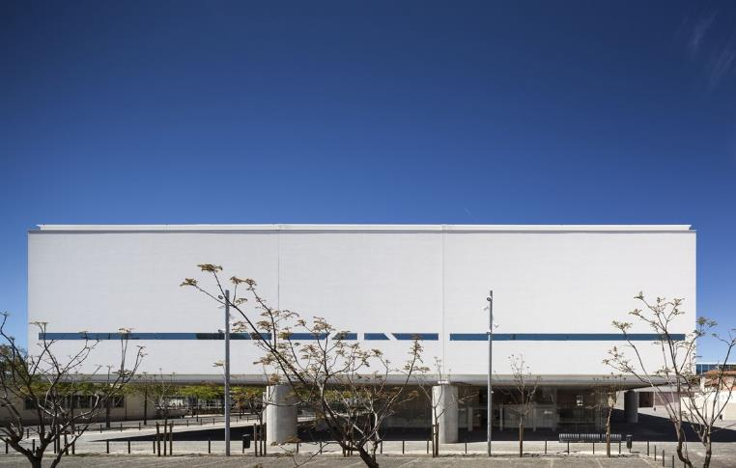
World Museums XVI
2015

Slide 2
World Contemporary Museums XVI
The objective is to show you different museums of contemporary architecture around the world except U.S. : these do not only house contemporary art but also art or history since prehistoric times.
The greatest architects of the last decade contributed to the construction of these museums with architectures that were certainly different but also adapted to the place and sometimes to the works they contain.

Slide 3
World Contemporary Museums
Nadir Afonso Art Museum, Chaves, PT 2015.
The Bihar Museum, Patna, IN 2015.
Pachacamac Site Museum, Lurin, PE 2015.
Grimmwelt, Kassel, DE 2015.
Three Ancestors Cultural Museum, Zhuo Lu, CN 2015.
Len Lye Centre, New Plymouth, NZ 2015.
Yunnan Museum, Kunming Shi, CN 2015.
Messner Mountain Museum, Bolzano, IT 2015.
Currency Museum, Luanda, OA 2015.
Space Lee Ufan, Busan, KR 2015.

Slide 4
World Contemporary Museums 2
Discovery Museum, Kerkrade, NL 2015.
Museu, Congonhas, BR 2015.
Museu dos Coches, Lisboa, PT 2015.

Slide 5
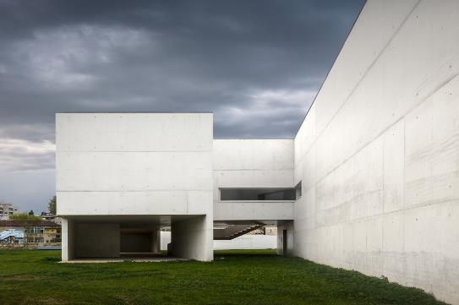
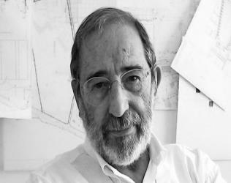
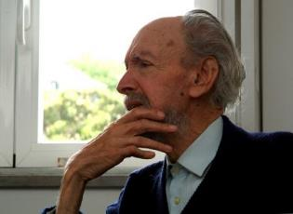
Museu Nadir Afonso, Chaves, PT (2015)
Alvaro Siza Vieira
Nadir Afonso

Slide 6
Museu Nadir Afonso, Chaves, PT (2015)
It is the work of the architect Alvaro Siza Vieira.
In order to avoid flooding, the entire building is lifted off the ground. Its volumes of immaculate white concrete raised transversely by walls, allowing a permeable transition between these structural slats.
Direct access is guaranteed by a light ramp with a non-floodable elevation. The two main exhibition spaces are developed in parallel, one lit by a continuous skylight and the other open onto the river through a 59m long window.

Slide 7
Museu Nadir Afonso, Chaves, PT (2015)
The building will be constructed with structural exposed white concrete walls; the roof is landscaped on almost its entire length, and the technical spaces are clad in Zincalum plates (made from steel plates coated with aluminium-zinc).
The interior finishes are wood flooring, drywall on walls and ceilings and white marble in water areas. The interior window frames are wood and stainless steel, while the exterior frames are wood and aluminum.

Slide 8
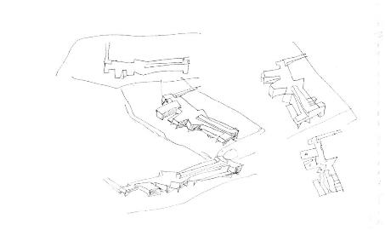
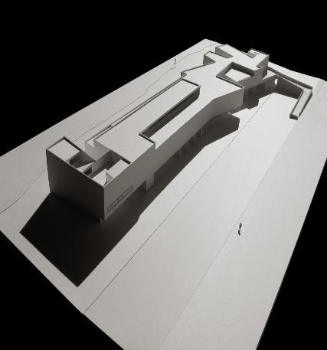
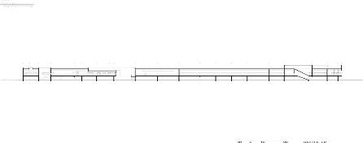
Museu Nadir Afonso, Chaves, PT (2015)

Slide 9
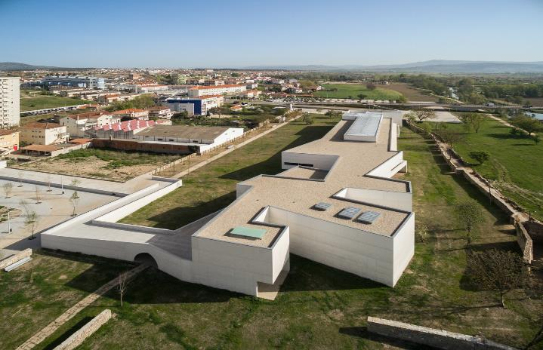
Museu Nadir Afonso, Chaves, PT (2015)

Slide 10
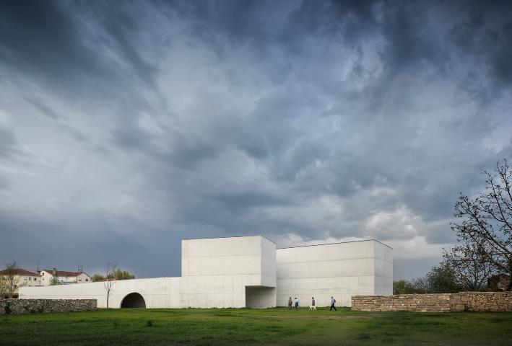
Museu Nadir Afonso, Chaves, PT (2015)

Slide 11
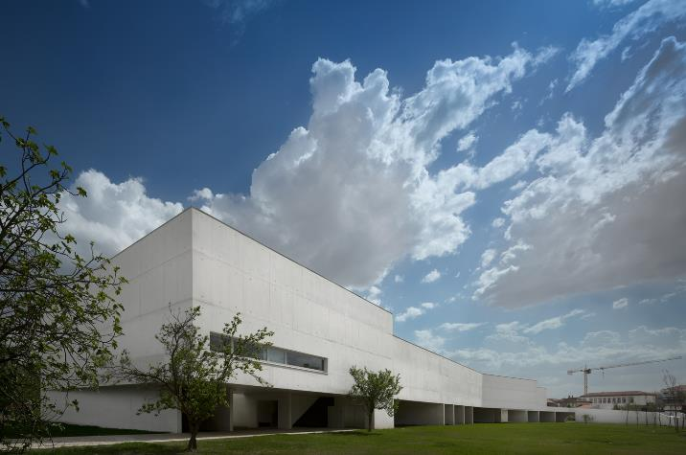
Museu Nadir Afonso, Chaves, PT (2015)

Slide 12
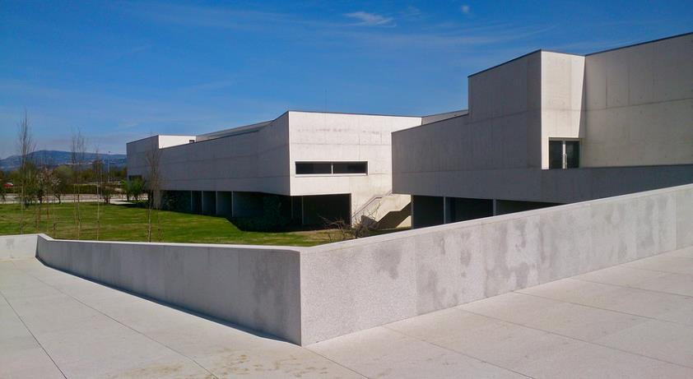
Museu Nadir Afonso, Chaves, PT (2015)

Slide 13
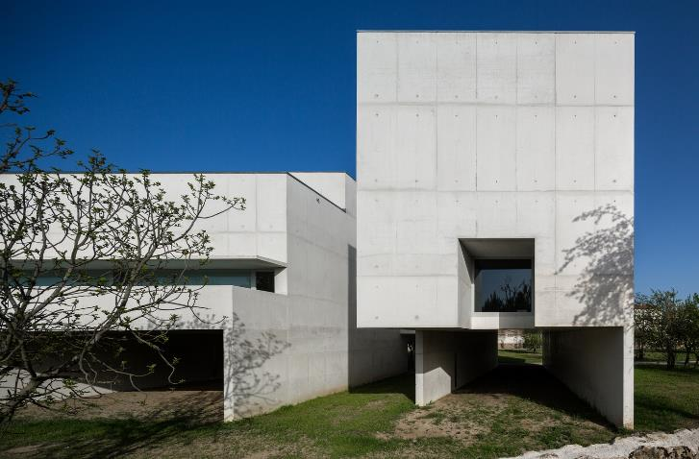
Museu Nadir Afonso, Chaves, PT (2015)

Slide 14
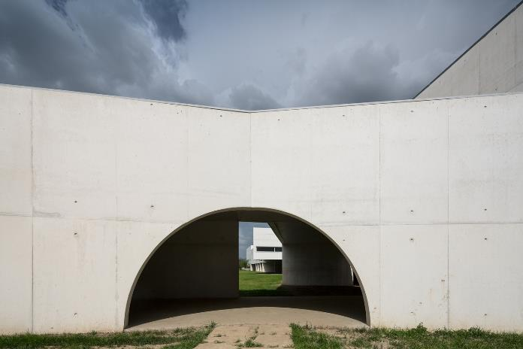
Museu Nadir Afonso, Chaves, PT (2015)

Slide 15
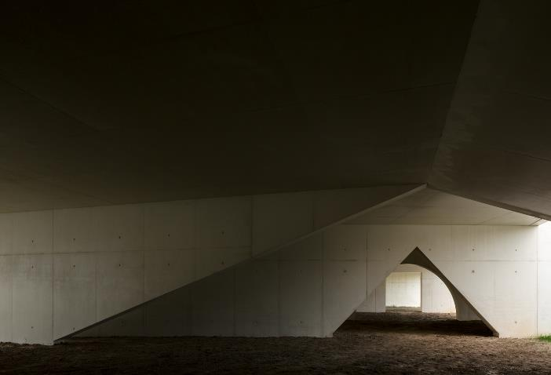
Museu Nadir Afonso, Chaves, PT (2015)

Slide 16
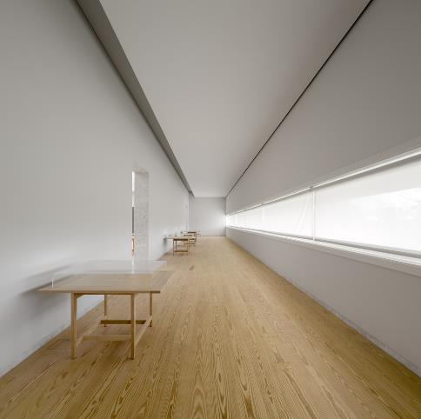
Museu Nadir Afonso, Chaves, PT (2015)

Slide 17
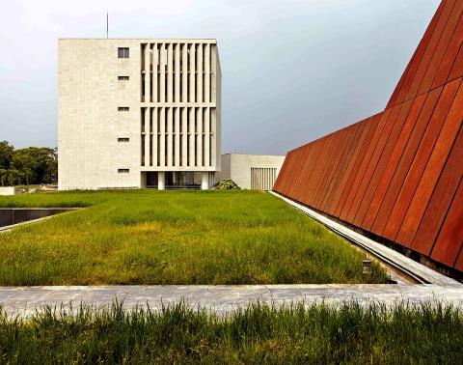
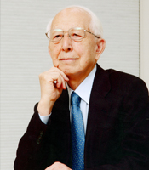
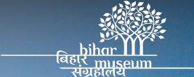
The Bihar Museum, Patna, IN (2015)
Fumihiko Maki

Slide 18
The Bihar Museum, Patna, IN (2015)
It is the work of the architect Fumihiko Maki.
The Bihar Museum was designed as a "campus": an interconnected landscape of buildings and outdoor spaces that maintains a modest (2 floors) but dynamic profile, in harmony with existing site conditions.
Each program zone has been given a distinct presence and recognizable form within the complex.
In addition to stone, terracotta and glass, the Museum's exterior is characterized by the intensive use of Corten steel in relation to the region's metallurgical past.

Slide 19
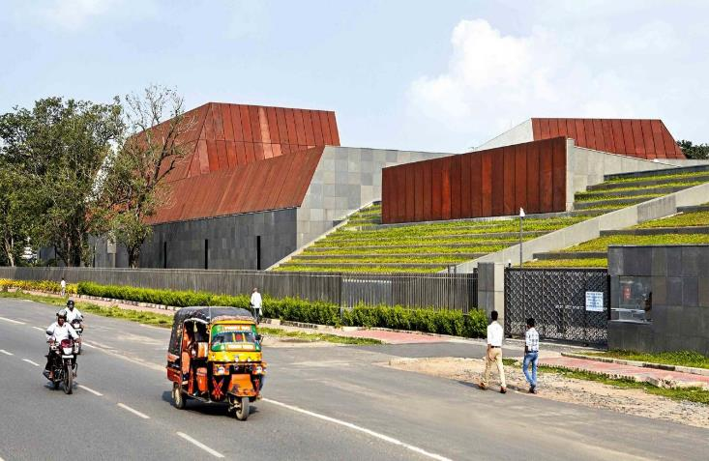
The Bihar Museum, Patna, IN (2015)

Slide 20
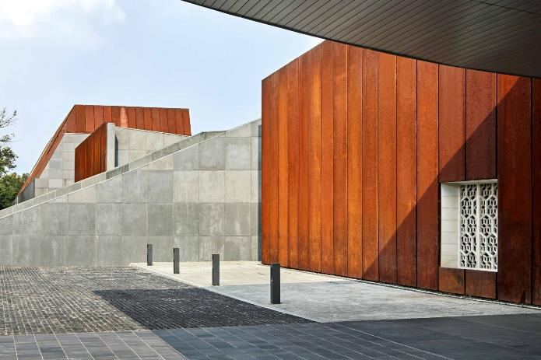
The Bihar Museum, Patna, IN (2015)

Slide 21
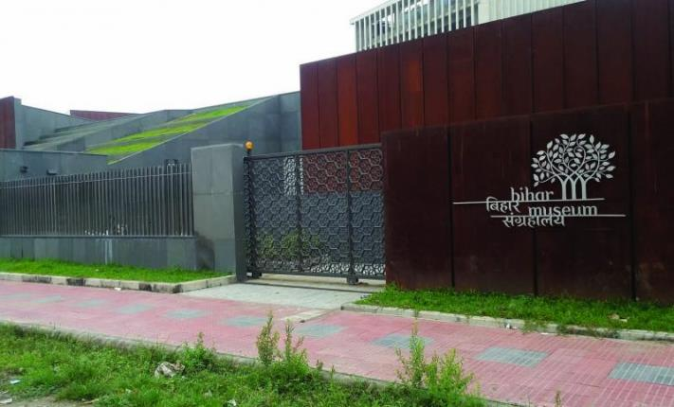
The Bihar Museum, Patna, IN (2015)

Slide 22
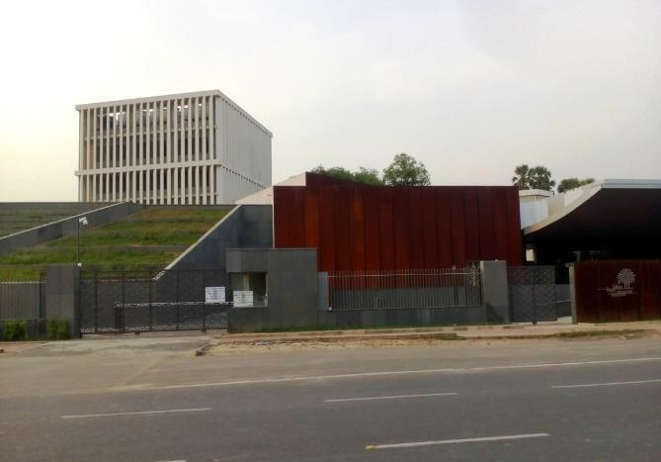
The Bihar Museum, Patna, IN (2015)

Slide 23
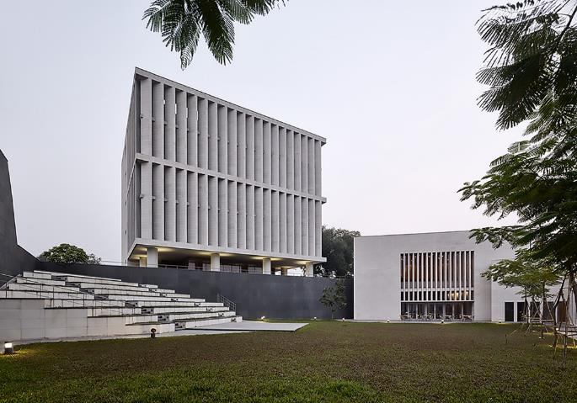
The Bihar Museum, Patna, IN (2015)

Slide 24
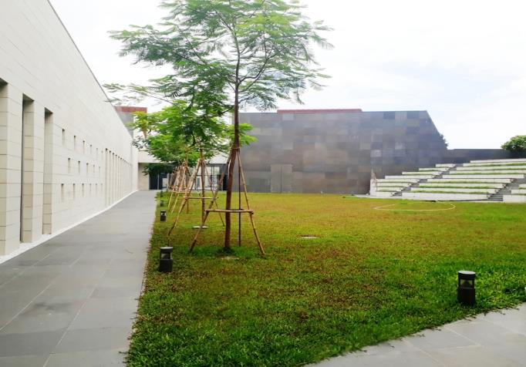
The Bihar Museum, Patna, IN (2015)

Slide 25
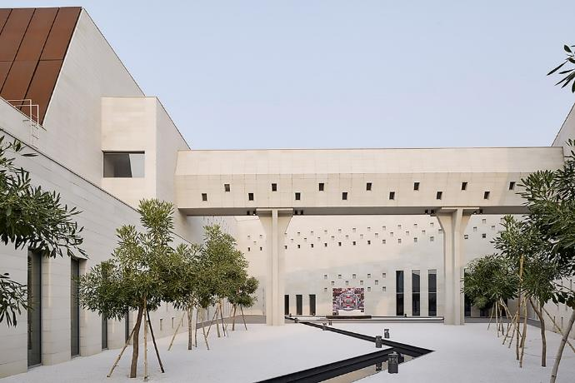
The Bihar Museum, Patna, IN (2015)

Slide 26
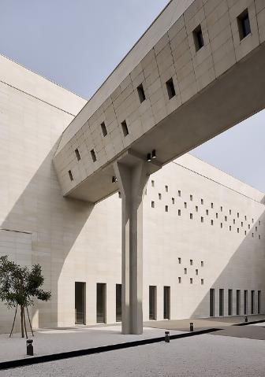
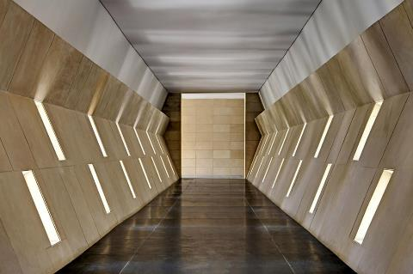
The Bihar Museum, Patna, IN (2015)

Slide 27
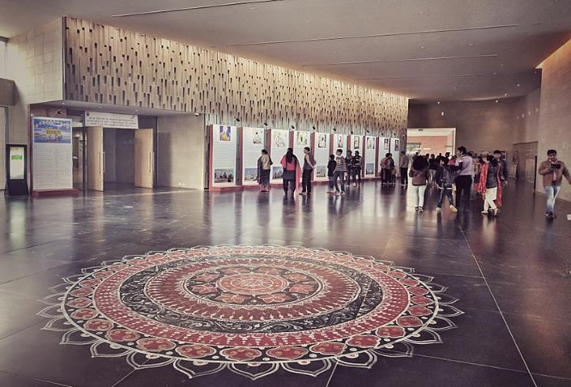
The Bihar Museum, Patna, IN (2015)

Slide 28
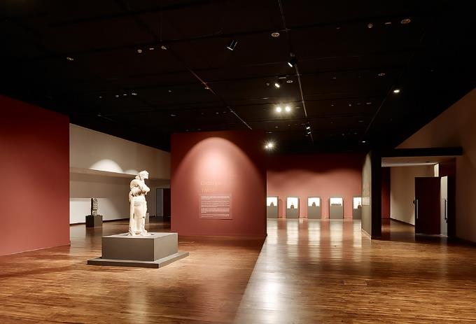
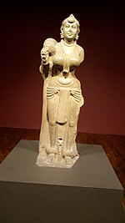
The Bihar Museum, Patna, IN (2015)
Didarganj
Yakshi

Slide 29
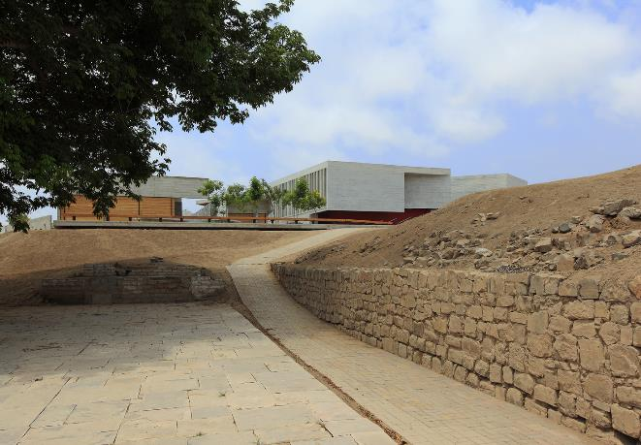
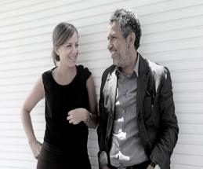
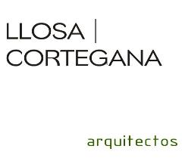
Museo Pachacamac, Lurin, PE (2015)
Patricia Llosa
Rodolfo Cortegana

Slide 30
Museo Pachacamac, Lurin, PE (2015)
It is the work of the architects Llosa/Cortegana.
The museum, with a contemporary formal proposal, fits into the archaeological landscape without damaging it.
The project is composed of 2 differentiated zones: the first for a building intended for exhibition use consisting of a single level, divided into permanent and temporary exhibitions and the second for a service building, located on a lower level.
The museum contains about 6590 pre-Hispanic cultural objects registered in the National Register.

Slide 31
Museo Pachacamac, Lurin, PE (2015)
Therefore, the museum emerges from a lightness that contrasts to the massive pre-Hispanic elements, its wall structures define its trace and its pathways defined by its large scale walls are in constant tension with the Sanctuary. The Museum tries to turn its sacred territory into a museum piece itself.
Volumes are folded in an earthquake gesture, (Pachacamac was known as the Earthquakes God) and stressed between their external pathway ramp gaps, associated with the pre Hispanic streets.

Slide 32
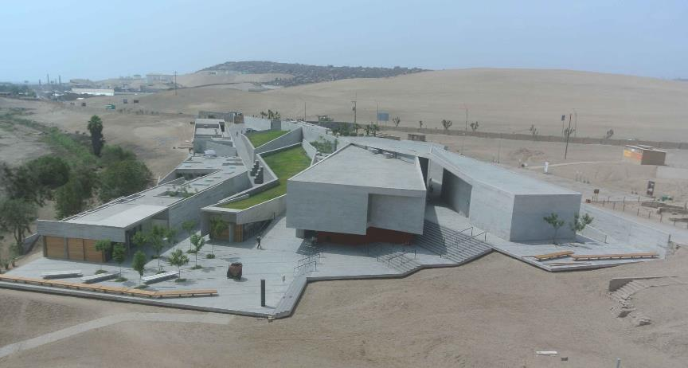
Museo Pachacamac, Lurin, PE (2015)

Slide 33
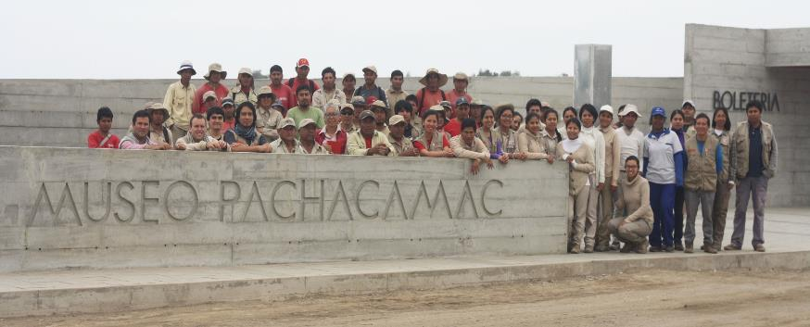
Museo Pachacamac, Lurin, PE (2015)

Slide 34
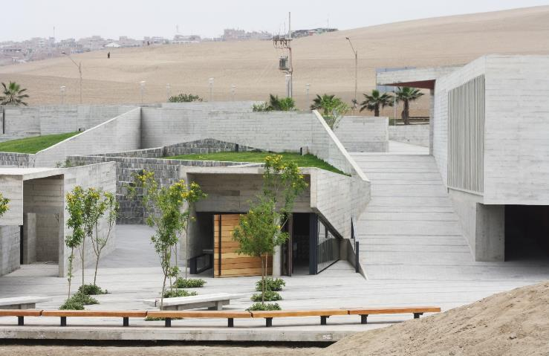
Museo Pachacamac, Lurin, PE (2015)

Slide 35
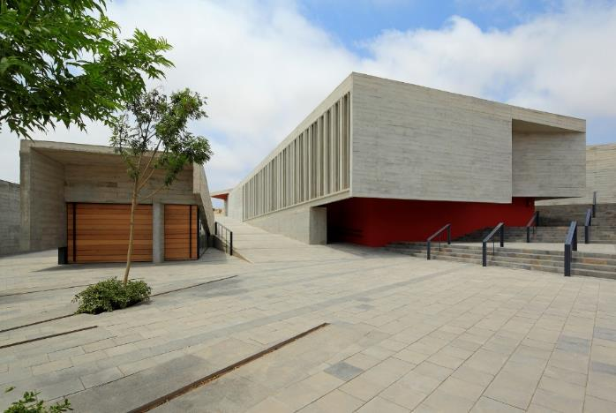
Museo Pachacamac, Lurin, PE (2015)

Slide 36
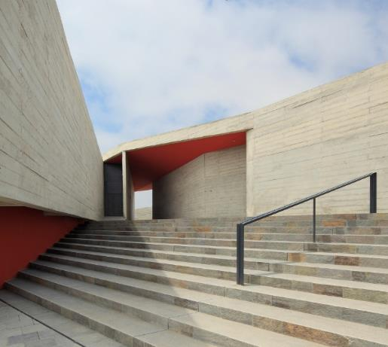
Museo Pachacamac, Lurin, PE (2015)

Slide 37
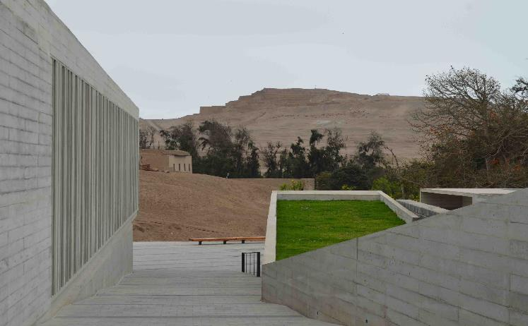
Museo Pachacamac, Lurin, PE (2015)

Slide 38
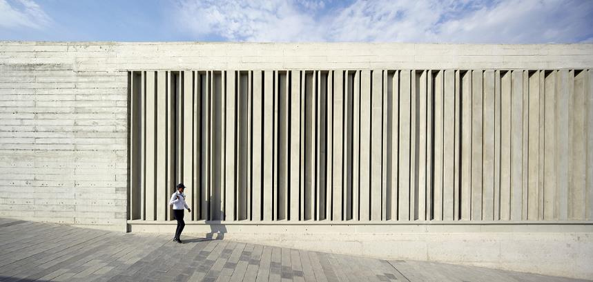
Museo Pachacamac, Lurin, PE (2015)

Slide 39
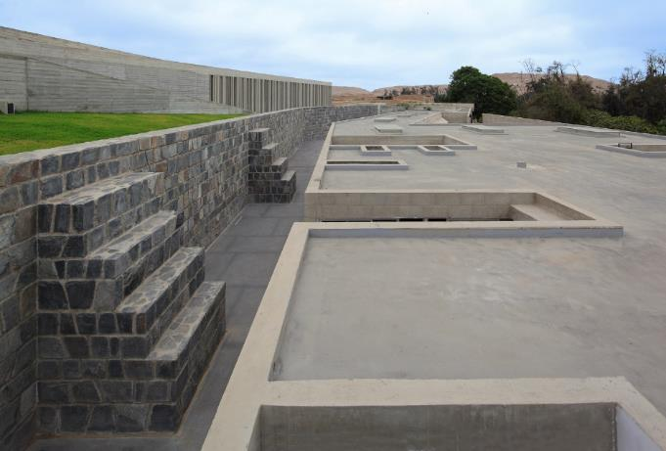
Museo Pachacamac, Lurin, PE (2015)

Slide 40
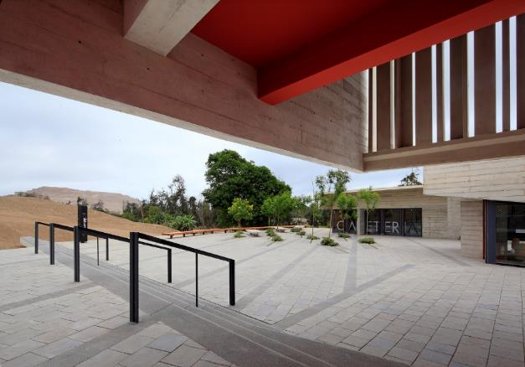
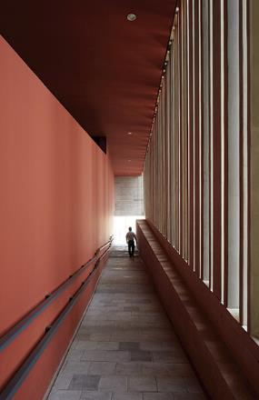
Museo Pachacamac, Lurin, PE (2015)

Slide 41
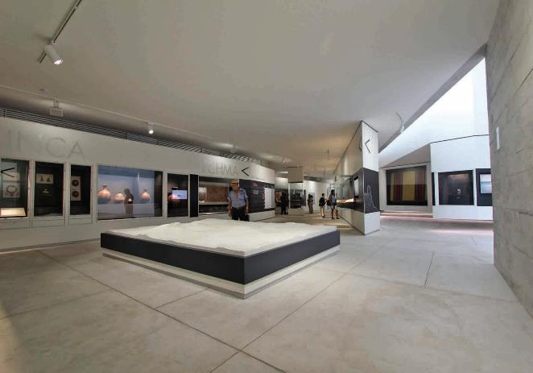
Museo Pachacamac, Lurin, PE (2015)

Slide 42
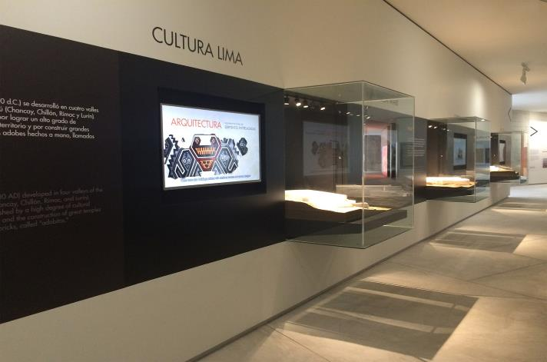
Museo Pachacamac, Lurin, PE (2015)

Slide 43
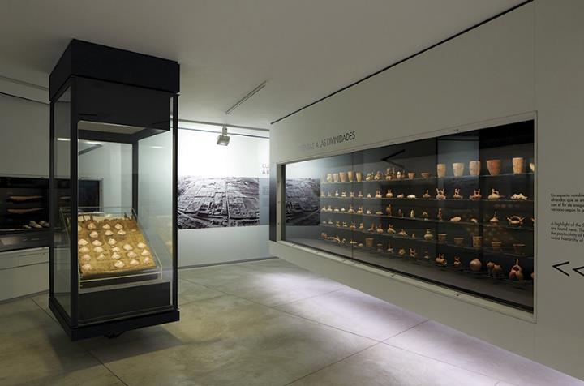
Museo Pachacamac, Lurin, PE (2015)

Slide 44
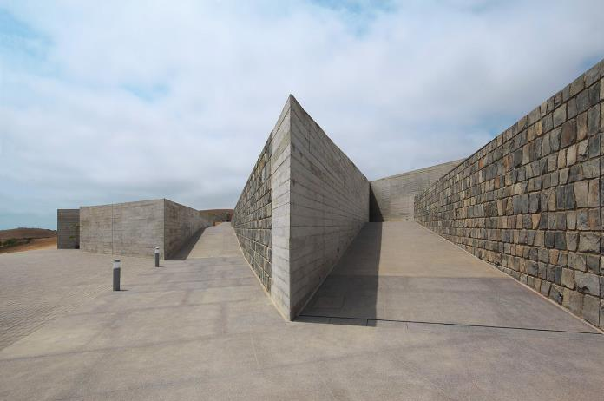
Museo Pachacamac, Lurin, PE (2015)

Slide 45
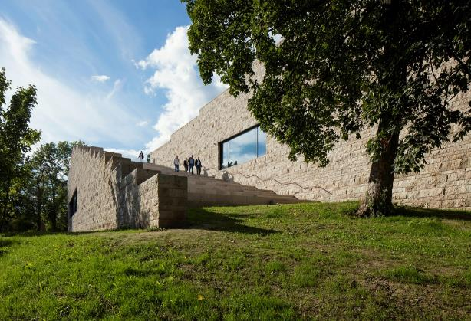
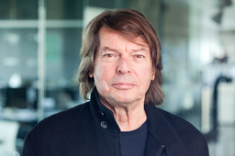
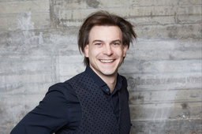
Grimmwelt, Kassel, DE (2015)
Klaus Kada
Kilian Kada
Gerhard Wittfeld

Slide 46
Grimmwelt, Kassel, DE (2015)
This is the work of the architecture firm Kadawittfeldarchitektur.
This museum is integrated into the existing topography: its accessible roof terrace reminds us of the previous terraces.
The reinforced concrete structure has an outer leaf of light colored natural stone (Gauinger Travertine), roughly split with courses of varied height : this reminds us of the fragments of walls and old stone steps that existed before.
Visitors experience a place with diverse atmosphere and one that focusses on German linguistics as well as the collection of the Grimms’ Fairy Tales.

Slide 47
Grimmwelt, Kassel, DE (2015)

Slide 48
Grimmwelt, Kassel, DE (2015)

Slide 49
Grimmwelt, Kassel, DE (2015)

Slide 50
Grimmwelt, Kassel, DE (2015)

Slide 51
Grimmwelt, Kassel, DE (2015)

Slide 52
Grimmwelt, Kassel, DE (2015)

Slide 53
Grimmwelt, Kassel, DE (2015)

Slide 54
Grimmwelt, Kassel, DE (2015)
Jacob & Wilhelm Grimm

Slide 55
Grimmwelt, Kassel, DE (2015)

Slide 56
Grimmwelt, Kassel, DE (2015)

Slide 57
3 Ancestors Cultural Museum,Zhuo Lu, CN (2015)
He Jing Tang

Slide 58
3 Ancestors Cultural Museum,Zhuo Lu, CN (2015)
There is the melting pot for the three Chinese legendary ancestors of Huangdi, Yandi, and Chiyou.
The three collective Chinese cultural layers of Hongshan, Yangshao and Hetao were integrated from here.
By using the natural rough stones on the surface of the building, the museum is echoing the environmental characteristics of the ancient civilization. Just as the unearthed stone artifact, this new construction will lead you into the exploration of the ancient civilization.
The whole architectural model, including the 3 individual blocks and the central courtyard, is echoing the herring-boned building pattern in the 3 ancestor period, so as the semi-subterranean dwellings.

Slide 59
3 Ancestors Cultural Museum,Zhuo Lu, CN (2015)

Slide 60
3 Ancestors Cultural Museum,Zhuo Lu, CN (2015)

Slide 61
3 Ancestors Cultural Museum,Zhuo Lu, CN (2015)

Slide 62
3 Ancestors Cultural Museum,Zhuo Lu, CN (2015)

Slide 63
3 Ancestors Cultural Museum,Zhuo Lu, CN (2015)

Slide 64
3 Ancestors Cultural Museum,Zhuo Lu, CN (2015)

Slide 65
3 Ancestors Cultural Museum,Zhuo Lu, CN (2015)

Slide 66
3 Ancestors Cultural Museum,Zhuo Lu, CN (2015)

Slide 67
Len Lye Center, New Plymouth, NZ (2015)
Andrew Patterson

Slide 68
Len Lye Center, New Plymouth, NZ (2015)
This is the work of Pattersons Associates.
The shimmering, iridescent colonnade facade, manufactured locally using stainless steel - Taranaki’s ‘local stone’ - links both Lye’s innovations in kinetics and light as well as the region’s industrial innovation
The exterior creates different reflections during each day and season.
Light is drawn inside through the openings between the columns, which create patterns of moving light.

Slide 69
Len Lye Center, New Plymouth, NZ (2015)

Slide 70
Len Lye Center, New Plymouth, NZ (2015)

Slide 71
Len Lye Center, New Plymouth, NZ (2015)

Slide 72
Len Lye Center, New Plymouth, NZ (2015)

Slide 73
Len Lye Center, New Plymouth, NZ (2015)
Len Lye

Slide 74
Len Lye Center, New Plymouth, NZ (2015)

Slide 75
Yunnan Museum, Kunming Shi, CN (2015)
Yim Rocco

Slide 76
Yunnan Museum, Kunming Shi, CN (2015)
It is the work of the architect Yim Rocco.
The shape refers to the natural landscape of Yunnan, the famous "stone forest" of Shilin.
The entrance experience to the museum is to be through a narrow passage, designed to induce the sensation of meandering through the stone forest, before one is suddenly confronted with the vastness of the central atrium space.
The exterior volume is marked vertically with a datum line that implies a distinction between exhibition and support spaces, which also recalls similar horizontal strata found in the natural Yunnan rock formations.
Natural light filters through the double aluminium outer facade.

Slide 77
Yunnan Museum, Kunming Shi, CN (2015)

Slide 78
Yunnan Museum, Kunming Shi, CN (2015)

Slide 79
Yunnan Museum, Kunming Shi, CN (2015)

Slide 80
Yunnan Museum, Kunming Shi, CN (2015)

Slide 81
Yunnan Museum, Kunming Shi, CN (2015)

Slide 82
Yunnan Museum, Kunming Shi, CN (2015)

Slide 83
Yunnan Museum, Kunming Shi, CN (2015)

Slide 84
Messner Mountain Museum, Bolzano, IT (2015)
Zaha Hadid
Reinhold Messner

Slide 85
Messner Mountain Museum, Bolzano, IT (2015)
It is the work of the architect Zaha Hadid.
Reflecting the lighter colors and tones of the jagged limestone peaks of the surrounding Dolomites, the exterior panels are formed from a lighter shade of glass-reinforced fiber concrete and fold within the museum to meet the darker interior panels that have the luster and coloration of anthracite found deep below the surface.
A series of staircases, like waterfalls in a mountain stream, cascade through the museum to connect the exhibition spaces a

Slide 86
Messner Mountain Museum, Bolzano, IT (2015)
Constructed from in-situ reinforced concrete, the museum‘s structure has walls between 40-50cm, while its roof supporting the replaced earth and rock that embeds the museum into the mountain, is up to 70cm thick.
The majority of the museum’s exterior and interior panels are also made from in-situ concrete, with a formwork of tapered surfaces used to generate the peaks and abutments of the exterior panels that convey the rock and ice formations of the surrounding landscape. Almost 400 internal and external panels were prefabricated, with the more complex curved elements.

Slide 87
Messner Mountain Museum, Bolzano, IT (2015)

Slide 88
Messner Mountain Museum, Bolzano, IT (2015)

Slide 89
Messner Mountain Museum, Bolzano, IT (2015)

Slide 90
Messner Mountain Museum, Bolzano, IT (2015)

Slide 91
Messner Mountain Museum, Bolzano, IT (2015)

Slide 92
Messner Mountain Museum, Bolzano, IT (2015)

Slide 93
Messner Mountain Museum, Bolzano, IT (2015)

Slide 94
Messner Mountain Museum, Bolzano, IT (2015)

Slide 95
Messner Mountain Museum, Bolzano, IT (2015)

Slide 96
Messner Mountain Museum, Bolzano, IT (2015)

Slide 97
Messner Mountain Museum, Bolzano, IT (2015)

Slide 98
Messner Mountain Museum, Bolzano, IT (2015)

Slide 99
Currency Museum, Luanda, OA (2015)
Alexandre
Costa Lopes
Antonio
Costa Lopes

Slide 100
Currency Museum, Luanda, OA (2015)
It is the work of the architects Alexandre & Antonio Costa Lopes.
The new museum, with about 4.800 sqm, reveals itself in the stereotomy generated by excavation, with its entry announced by the stairs void and the metallic parasols that generate shadow and urban scale.
The program was pretext for 2 major interventions. On one hand, it disposes the museum spaces below ground, becoming more reserved and quiet. On the other, its roof establishes a new urban square that both denotes the museum and enables the celebration of public space.

Slide 101
Currency Museum, Luanda, OA (2015)

Slide 102
Currency Museum, Luanda, OA (2015)

Slide 103
Currency Museum, Luanda, OA (2015)

Slide 104
Currency Museum, Luanda, OA (2015)

Slide 105
Currency Museum, Luanda, OA (2015)

Slide 106
Currency Museum, Luanda, OA (2015)

Slide 107
Currency Museum, Luanda, OA (2015)

Slide 108
Currency Museum, Luanda, OA (2015)

Slide 109
Currency Museum, Luanda, OA (2015)

Slide 110
Currency Museum, Luanda, OA (2015)

Slide 111
Culture Center, Qujing, CN (2015)
Yingfan Zhang
Xiaojun Bu

Slide 112
Culture Center, Qujing, CN (2015)
It is the work of Atelier Alter firm.
The museum is entered through center of building mass. Audiences are elevated to a concrete plateau, as they begin their exhibition routes at a strategic point in space. A vertical plaza is defined by processional steps and its echoing suspended roof. The graduate suspension of the enormous roof presents an “anti-gravity” architecture statement that puts the audiences in awe. One could experience the immensity of space and time the city occupies. The strong presence of the void reinstates the gravitas of the museum’s subject matter: a profound history dates back over 4,000 billion years. A vertical landscape made of concrete drapes down from roof to the ground. As audiences penetrate the landscape and reach to the exhibition zone, geography and humanity converge at that very moment.

Slide 113
Culture Center, Qujing, CN (2015)

Slide 114
Culture Center, Qujing, CN (2015)

Slide 115
Culture Center, Qujing, CN (2015)

Slide 116
Culture Center, Qujing, CN (2015)

Slide 117
Culture Center, Qujing, CN (2015)

Slide 118
Culture Center, Qujing, CN (2015)

Slide 119
Culture Center, Qujing, CN (2015)

Slide 120
Culture Center, Qujing, CN (2015)

Slide 121
Space Lee Ufan, Busan, KR (2015)

Slide 122
Space Lee Ufan, Busan, KR (2015)
It is the work of Kaga Architects firm.
The sculpture is in a simple concrete box form. The darker shades on the curtain wall facade become an image and device to express an internal space potent with allusions. The exposed concrete wall on the rear becomes a wall of silence that embraces the concrete structure of the overpass and the ongoing flow of traffic. The first floor houses four large halls and two passageways, as well as an ancillary room for a sculptural installation. The second floor is composed of a large hall with five paintings and two passageways.

Slide 123
Space Lee Ufan, Busan, KR (2015)

Slide 124
Space Lee Ufan, Busan, KR (2015)

Slide 125
Space Lee Ufan, Busan, KR (2015)

Slide 126
Space Lee Ufan, Busan, KR (2015)

Slide 127
Space Lee Ufan, Busan, KR (2015)

Slide 128
Space Lee Ufan, Busan, KR (2015)

Slide 129
Space Lee Ufan, Busan, KR (2015)

Slide 130
Discovery Museum, Kerkrade, NL (2015)

Slide 131
Discovery Museum, Kerkrade, NL (2015)
It is the work of Shift Architecture firm.
It is a trinity of complimentary museums: Continium, Cube and Columbus, combining technology, science and design in one museum district. Continium is a discovery center for science and technology, while Cube is a design museum consisting of design expos and exploratory labs. Columbus houses a unique Earth Theatre shaped as an inverse planetarium. Cube, the design museum, is truly a cube of 21x21x21 m. A glass plinth creates the illusion of a volume floating above the red underground landscape. Cube’s structure consists of prefab concrete elements which are exposed on the inside. Cube is draped in a reflective curtain of coated steel that emphasizes the vertical character of the museum.

Slide 132
Discovery Museum, Kerkrade, NL (2015)
The curtain effect is obtained by the random placement of vertical profiles of three varying folds that each reflect the light differently. The facade is cut open by 2 identical windows: one vertical that reveals the stacked exhibition floors, and one horizontal that provides the multifunctional space on the top floor. Columbus is a spherical building, half above ground and half underground. The lower half accommodates the Earth Theatre, where a spectacular, 16m wide and 9 m deep, hollow projection sphere can be viewed from two rings of glass balconies. This inverted planetarium offers visitors the experience of an astronaut looking back towards planet earth. Columbus’ cupola is made of two shells of shotcrete.

Slide 133
Discovery Museum, Kerkrade, NL (2015)
The bridge-like structure of the beam allows for maximum transparency between the public walkway on ground level and the underground entrance hall. Truss beams along both longitudinal walls are supported on just a few randomly placed columns in combination with functional elements such as the elevator shaft.. The beam is clad in a black modular facade with protruding ribs creating a heaviness that strengthens the idea of a volume floating in space. All stairs, walls and floors of the excavated landscape are made of a uniform red concrete to emphasize the connective character of the space. The walls were poured in a formwork of rough wooden planks adding a tactile quality that contrasts with the abstract volumes above ground. The excavation out of red concrete, combined with the experience of descending below ground, refer to the mining past of Kerkrade.

Slide 134
Discovery Museum, Kerkrade, NL (2015)

Slide 135
Discovery Museum, Kerkrade, NL (2015)

Slide 136
Discovery Museum, Kerkrade, NL (2015)

Slide 137
Discovery Museum, Kerkrade, NL (2015)

Slide 138
Discovery Museum, Kerkrade, NL (2015)

Slide 139
Discovery Museum, Kerkrade, NL (2015)

Slide 140
Discovery Museum, Kerkrade, NL (2015)

Slide 141
Discovery Museum, Kerkrade, NL (2015)

Slide 142
Discovery Museum, Kerkrade, NL (2015)

Slide 143
Discovery Museum, Kerkrade, NL (2015)

Slide 144
Museu, Congonhas, BR (2015)
Gustavo Penna

Slide 145
Museu, Congonhas, BR (2015)
It is the work of the architect Gustavo Penna.
There is a long and smooth curvature of the building, which spreads itself on the slope, in a concave shape. The immense foundation built in stone, the fluid upper portion and the walls whitewashed and painted with mineral paint are the main features. Occupying 3,500 m² of built area, the museum is divided into 3 floors: on the main level are the reception and the permanent exhibition room, composed of 4 spaces: the introductory room, the exhibition corridor, the exhibition hall, and also a store and a café.

Slide 146
Museu, Congonhas, BR (2015)

Slide 147
Museu, Congonhas, BR (2015)

Slide 148
Museu, Congonhas, BR (2015)

Slide 149
Museu, Congonhas, BR (2015)

Slide 150
Museu, Congonhas, BR (2015)

Slide 151
Museu, Congonhas, BR (2015)

Slide 152
Museu, Congonhas, BR (2015)

Slide 153
Museu, Congonhas, BR (2015)

Slide 154
Museu, Congonhas, BR (2015)

Slide 155
Museu, Congonhas, BR (2015)

Slide 156
Museu dos Coches, Lisboa, PT (2015)
Paulo Mendes da Rocha

Slide 157
Museu dos Coches, Lisboa, PT (2015)
It is the work of the architect Paulo Mendes da Rocha.
The construction is proposed dual mode, the main pavilion, a suspended ship for exhibitions, and an annex which includes a reception, administration, restaurant, auditorium. The new Coach Museum building comprises a main hall with a suspended nave and an annex, which is connected by an overpass, enabling circulation from one building to the other. The building is defined by the reinforced concrete foundations, with a relative concentration of the loads, as recommended by soil conditions, supporting coated steel trusses, configuring the great walls of the museum. The new museum encompasses premises for the permanent and temporary exhibitions, reception halls, and a workshop for conservation and restoration.

Slide 158
Museu dos Coches, Lisboa, PT (2015)

Slide 159
Museu dos Coches, Lisboa, PT (2015)

Slide 160
Museu dos Coches, Lisboa, PT (2015)

Slide 161
Museu dos Coches, Lisboa, PT (2015)

Slide 162
Museu dos Coches, Lisboa, PT (2015)

Slide 163
Museu dos Coches, Lisboa, PT (2015)

Slide 164
Museu dos Coches, Lisboa, PT (2015)

Slide 165
Museu dos Coches, Lisboa, PT (2015)

Slide 166
Museu dos Coches, Lisboa, PT (2015)

Slide 167
Museu dos Coches, Lisboa, PT (2015)

Slide 168
Museu dos Coches, Lisboa, PT (2015)

Slide 169
Museu dos Coches, Lisboa, PT (2015)

Slide 170
Museu dos Coches, Lisboa, PT (2015)

Slide 171
Museu dos Coches, Lisboa, PT (2015)

Slide 172
Museu dos Coches, Lisboa, PT (2015)

Slide 173
Museu dos Coches, Lisboa, PT (2015)

Slide 174
Museu dos Coches, Lisboa, PT (2015)

Slide 175
Museu dos Coches, Lisboa, PT (2015)
THE END

