Slide 1
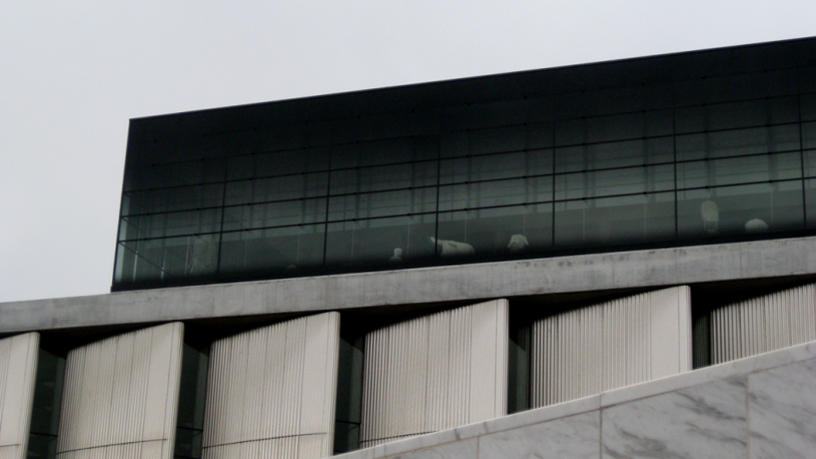
World Museums X
2009

Slide 2
World Contemporary Museums X
The objective is to show you different museums of contemporary architecture around the world except U.S. : these do not only house contemporary art but also art or history since prehistoric times.
The greatest architects of the 21th century contributed to the construction of these museums with architectures that were certainly different but also adapted to the place and sometimes to the works they contain.

Slide 3
World Contemporary Museums
Museo de la Memoria Andalucia, Granada, ES 2009.
Acropolis Museum, Athens, GR 2009.
Museo Paula Rego, Cascais, PT 2009.
Brandhorst Museum, Munich, DE 2009.
Mimesis Museum, Paju, KR 2009.
Madinat Al Zahra Museum, Cordoba, ES 2009.
Museo de la Memoria, Santiago, CL 2009.
Côa Parque Museu, Guarda, PT 2009.
Porsche Museum, Stuttgart, DE 2009.
Center of the Arts, Herning, DK 2009.
Dornier Museum, Friedrichshafen, DE 2009.
Salt Museum, Salins, FR 2009.

Slide 4
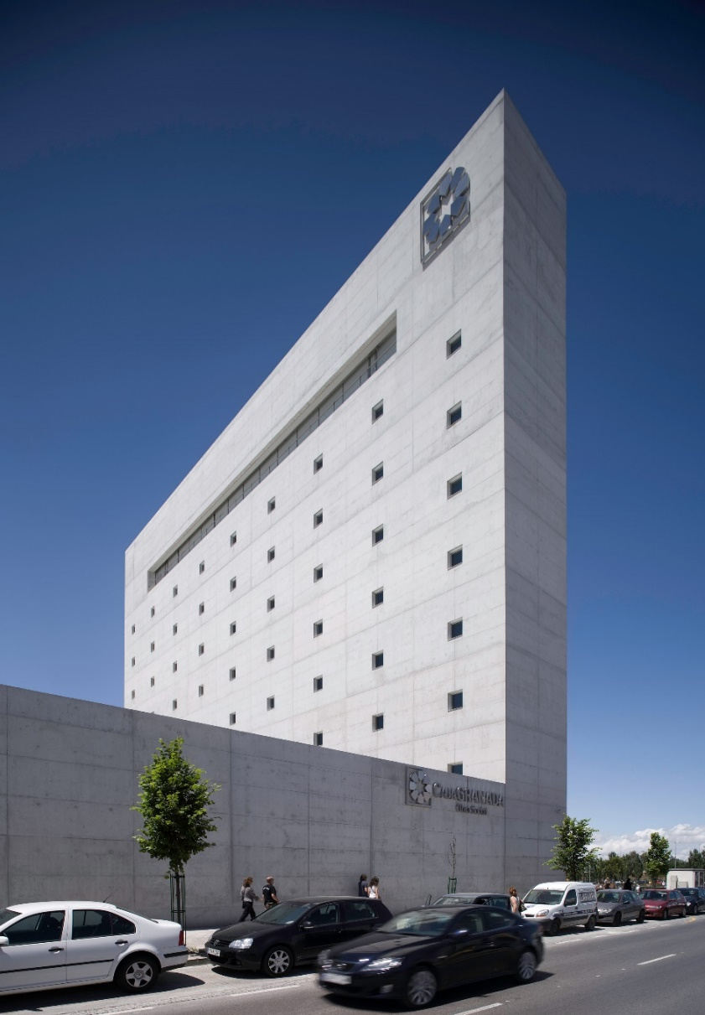
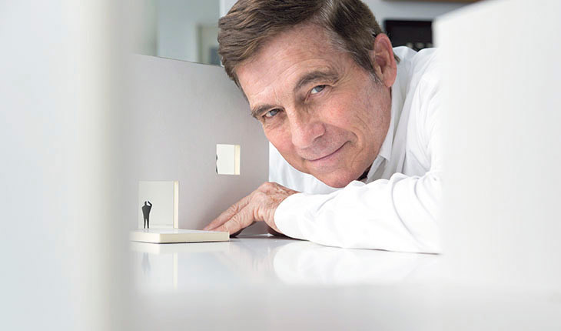
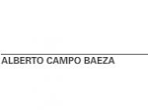
Museo de la Memoria, Granada, ES (2009)
Alberto Campo Baeza

Slide 5
Museo de la Memoria, Granada, ES (2009)
It is the work of the architect Alberto Campo Baeza.
The building consists of 2 parts: a horizontal part (60x120m) developed on 3 floors, 2 of them underground, and houses the museum's own programme and a vertical part (4m thick) housing the offices and the media library.
The strongest element is located in the first part: an elliptical courtyard, whose diameter is equal to that of the courtyard of Charles V's palace in the Alhambra enclosure, in which circular ramps lead to the 3 levels.

Slide 6
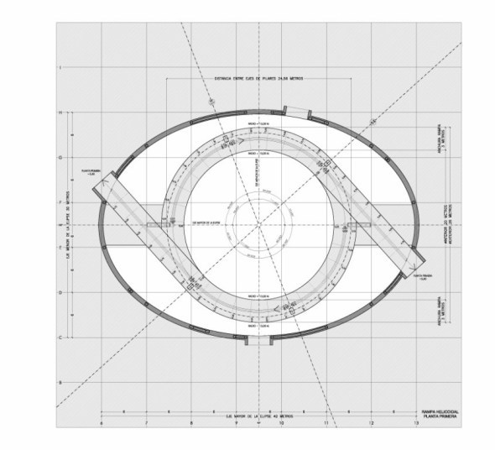
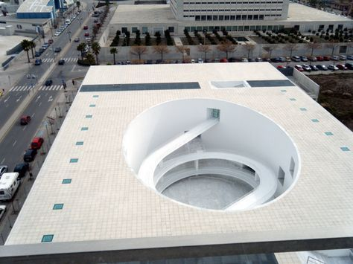
Museo de la Memoria, Granada, ES (2009)

Slide 7
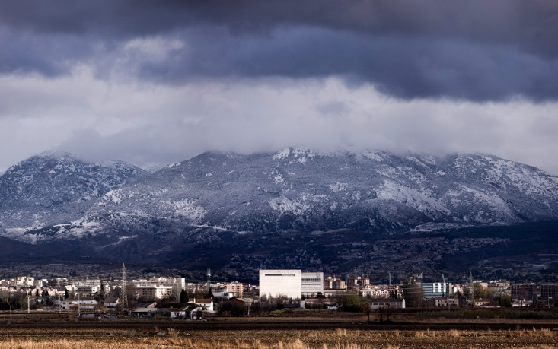
Museo de la Memoria, Granada, ES (2009)

Slide 8
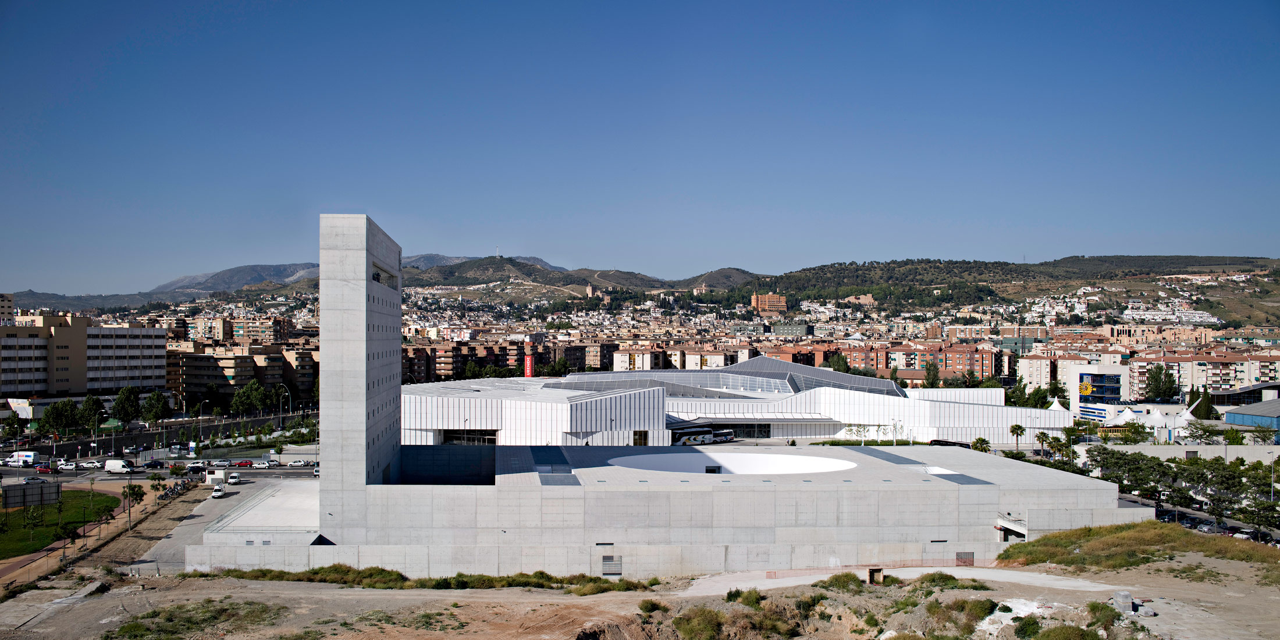
Museo de la Memoria, Granada, ES (2009)

Slide 9
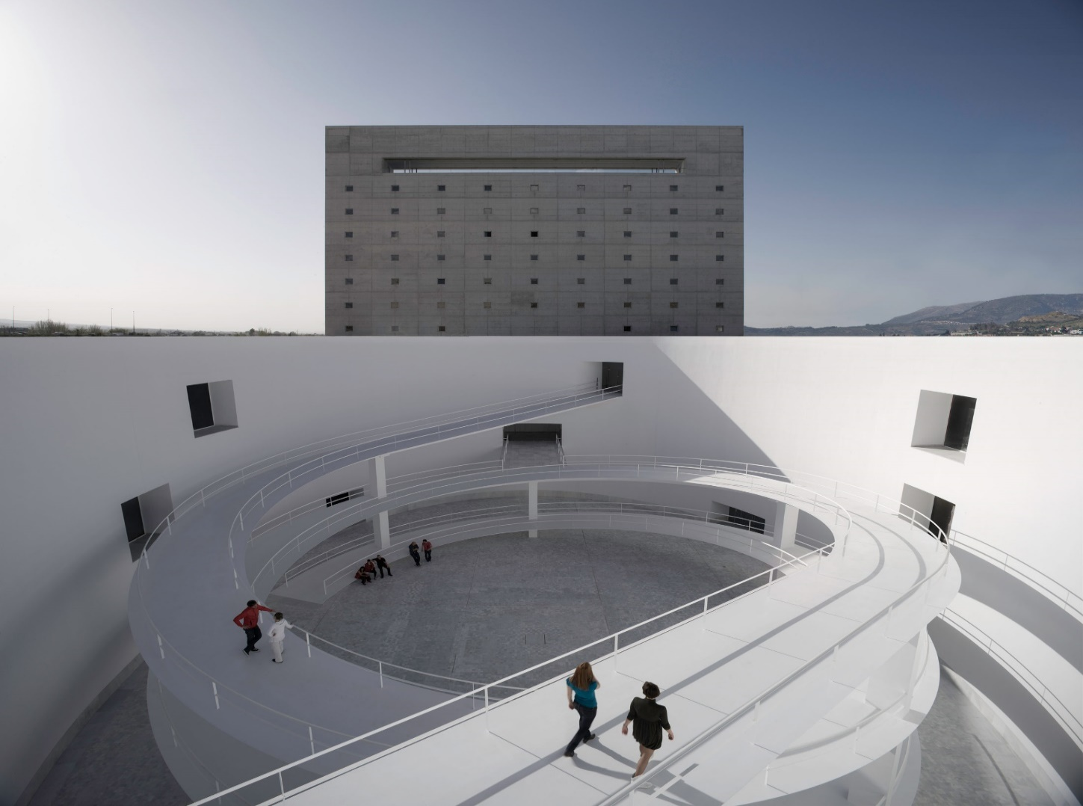
Museo de la Memoria, Granada, ES (2009)

Slide 10
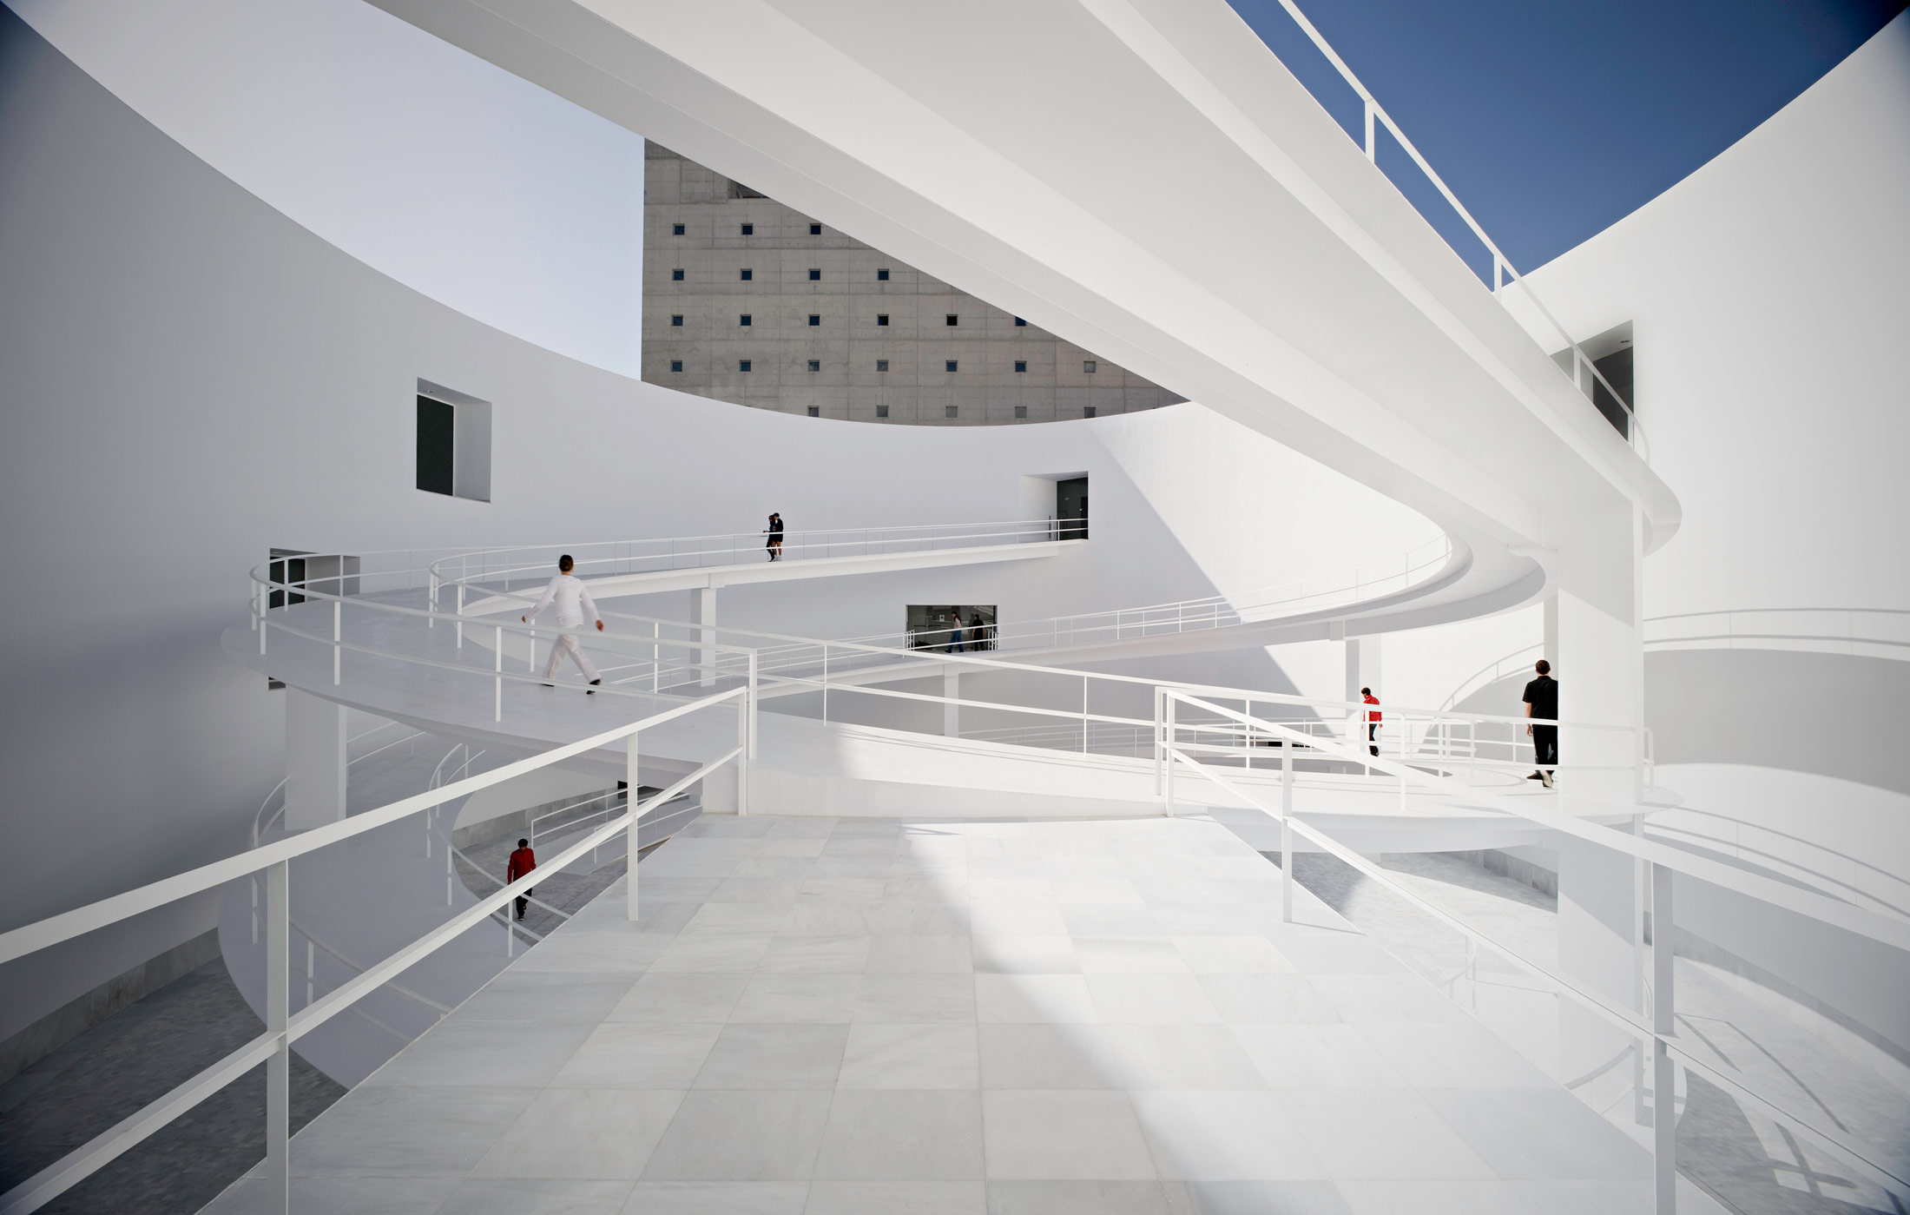
Museo de la Memoria, Granada, ES (2009)

Slide 11
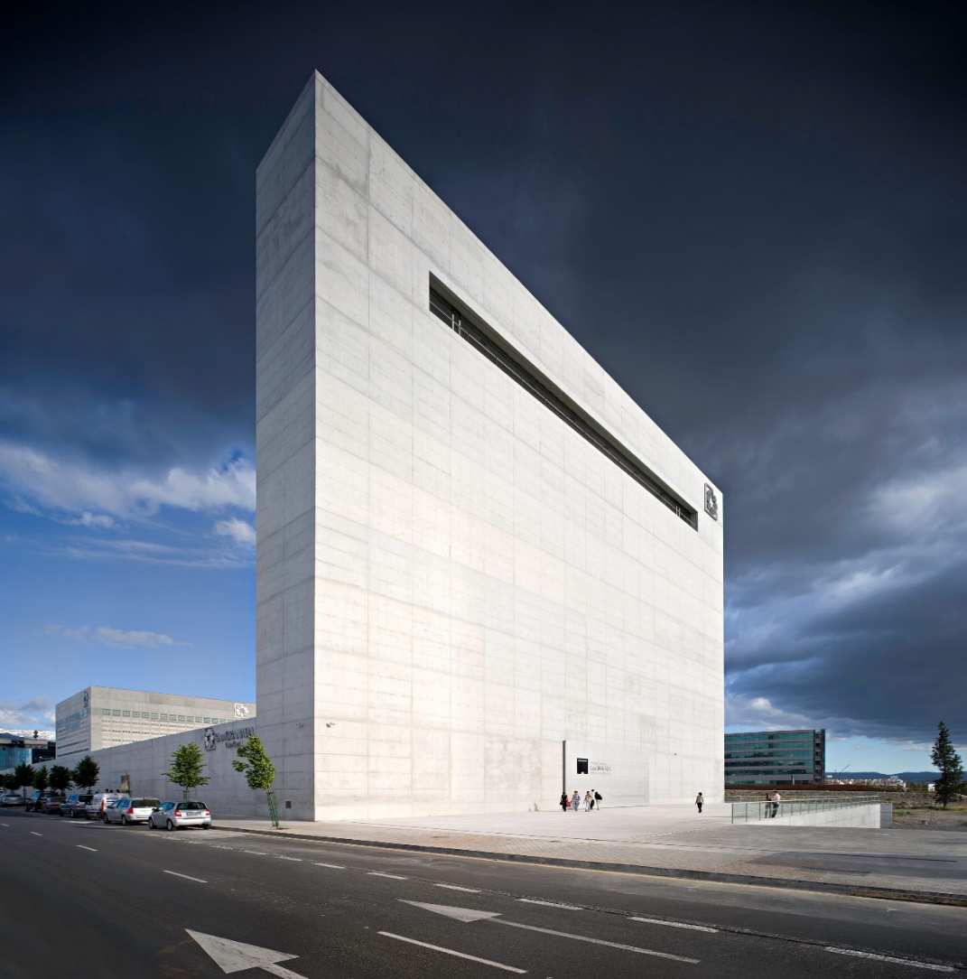
Museo de la Memoria, Granada, ES (2009)

Slide 12
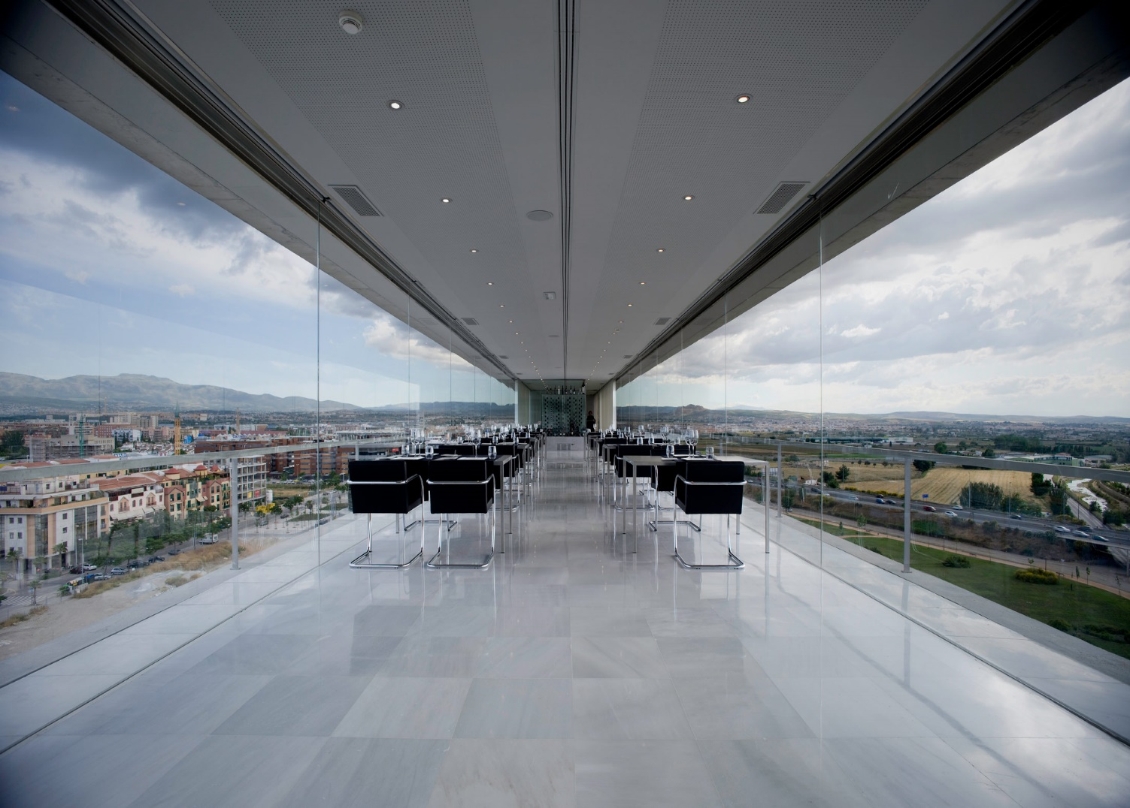
Museo de la Memoria, Granada, ES (2009)

Slide 13
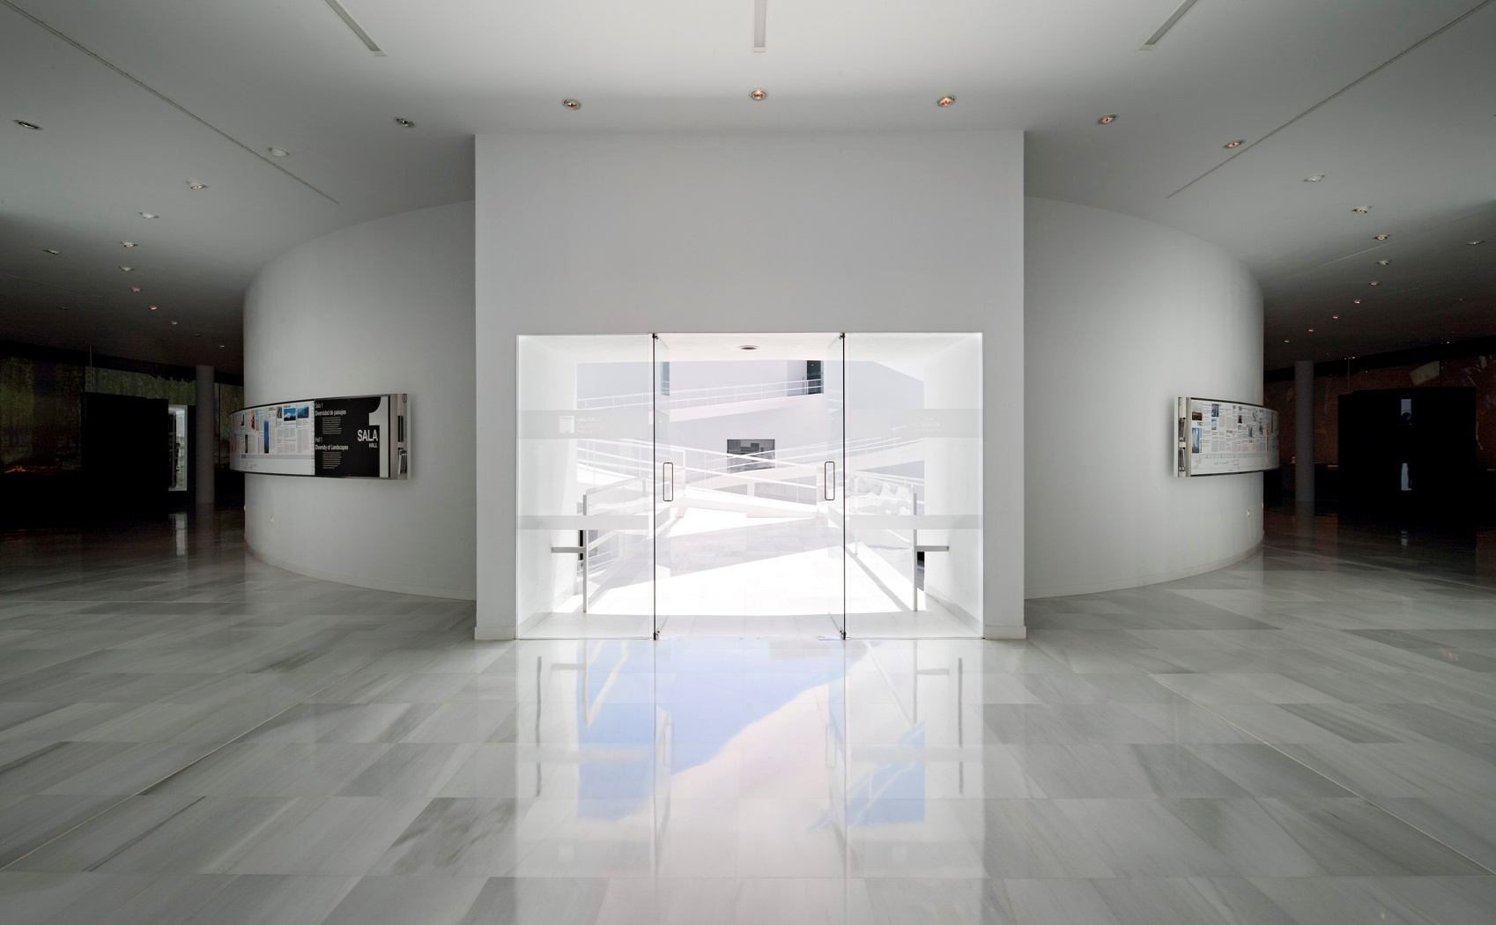
Museo de la Memoria, Granada, ES (2009)

Slide 14
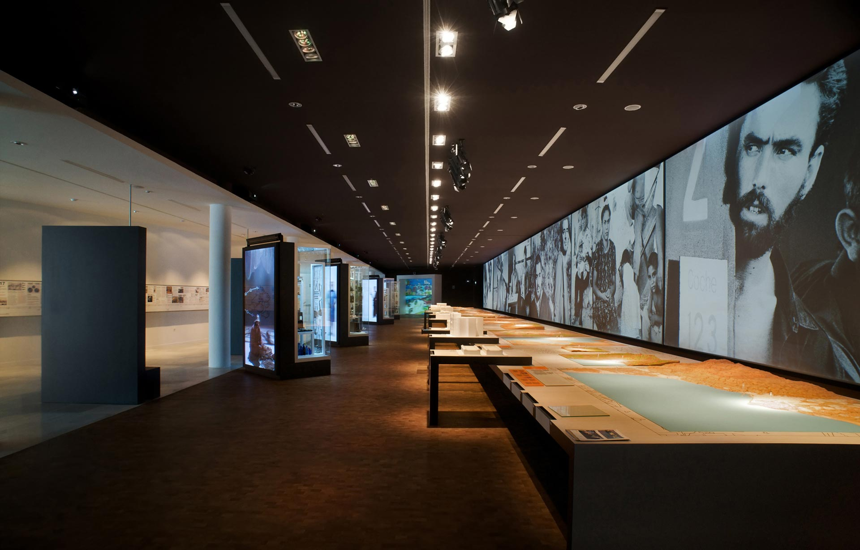
Museo de la Memoria, Granada, ES (2009)

Slide 15
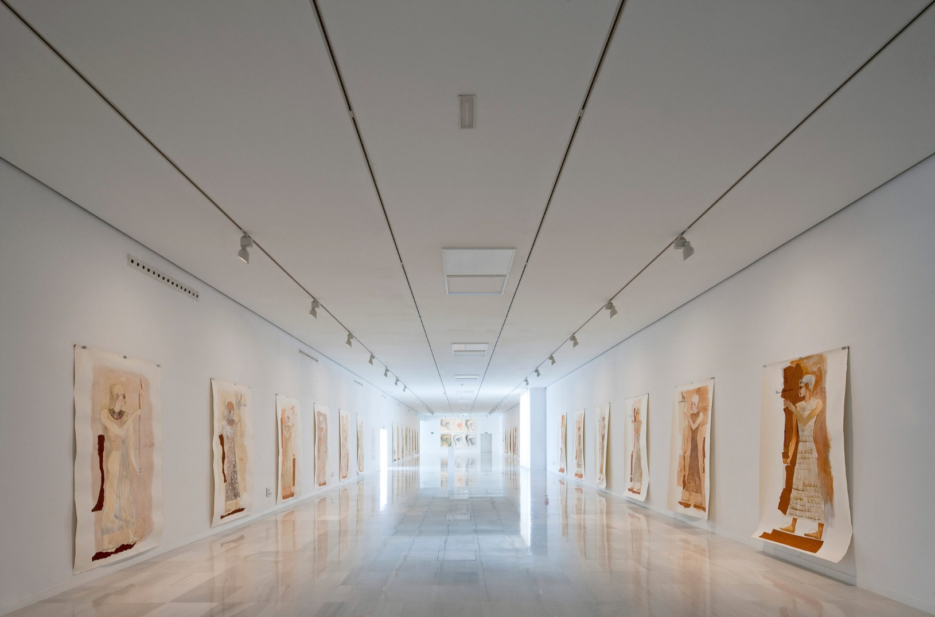
Museo de la Memoria, Granada, ES (2009)

Slide 16
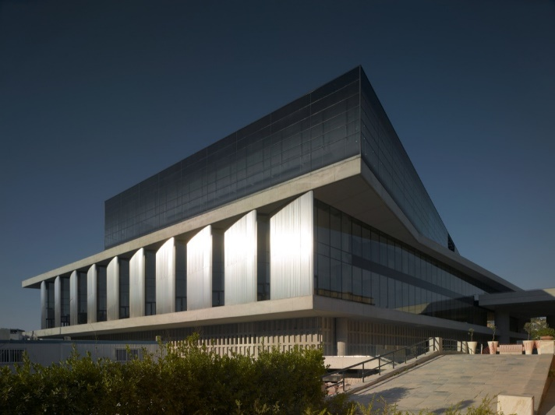
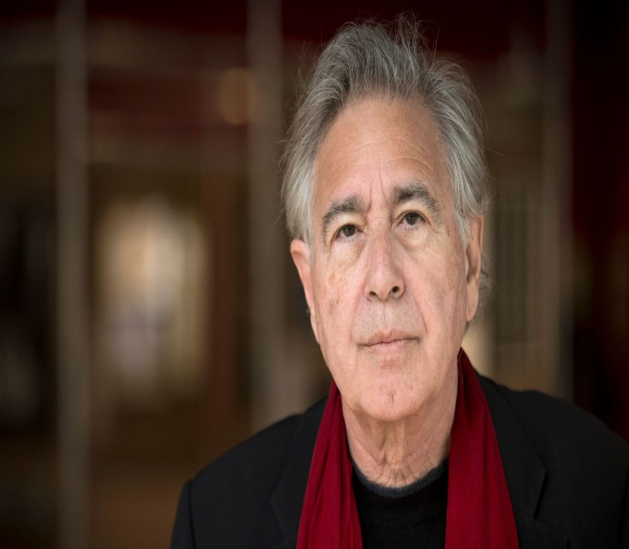
Acropolis Museum, Athens, GR (2009)
Bernard Tschumi

Slide 17
Acropolis Museum, Athens, GR (2009)
It is the work of the architect Bernard Tschumi.
The museum is articulated into a base, a middle and a top corresponding to different functions.
The base of the museum floats on stilts on existing archaeological excavations, protecting the site with a network of columns placed in negotiation with archaeologists (part of the city from the 4th to 7th century).
A spectacular double-height room supported by large columns forms the middle.

Slide 18
Acropolis Museum, Athens, GR (2009)
The top, which consists of the rectangular gallery of the Parthenon arranged around an inner courtyard, rotates gently to orient the marbles of the frieze exactly as they were in the Parthenon centuries ago.
The materials used are glass for facades and floors, concrete for the structure and columns and marble for some floors.

Slide 19
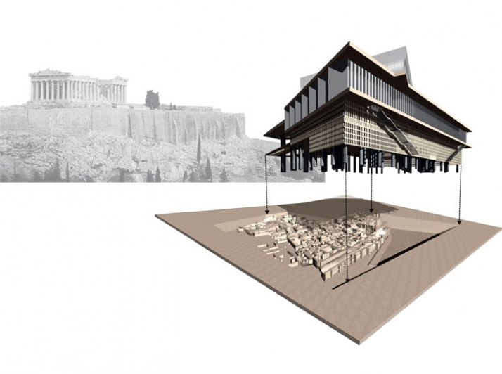
Acropolis Museum, Athens, GR (2009)

Slide 20
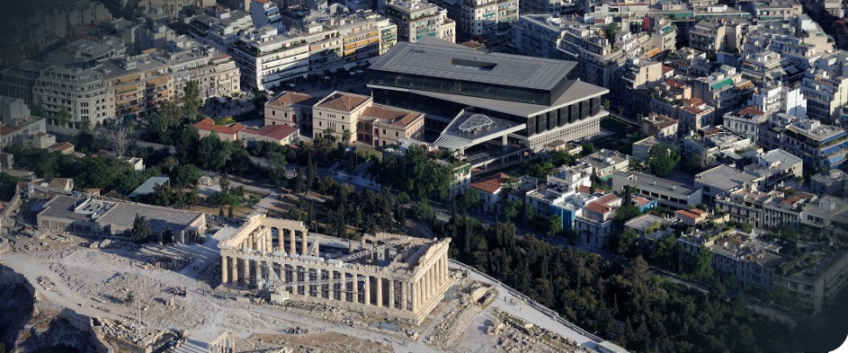
Acropolis Museum, Athens, GR (2009)

Slide 21
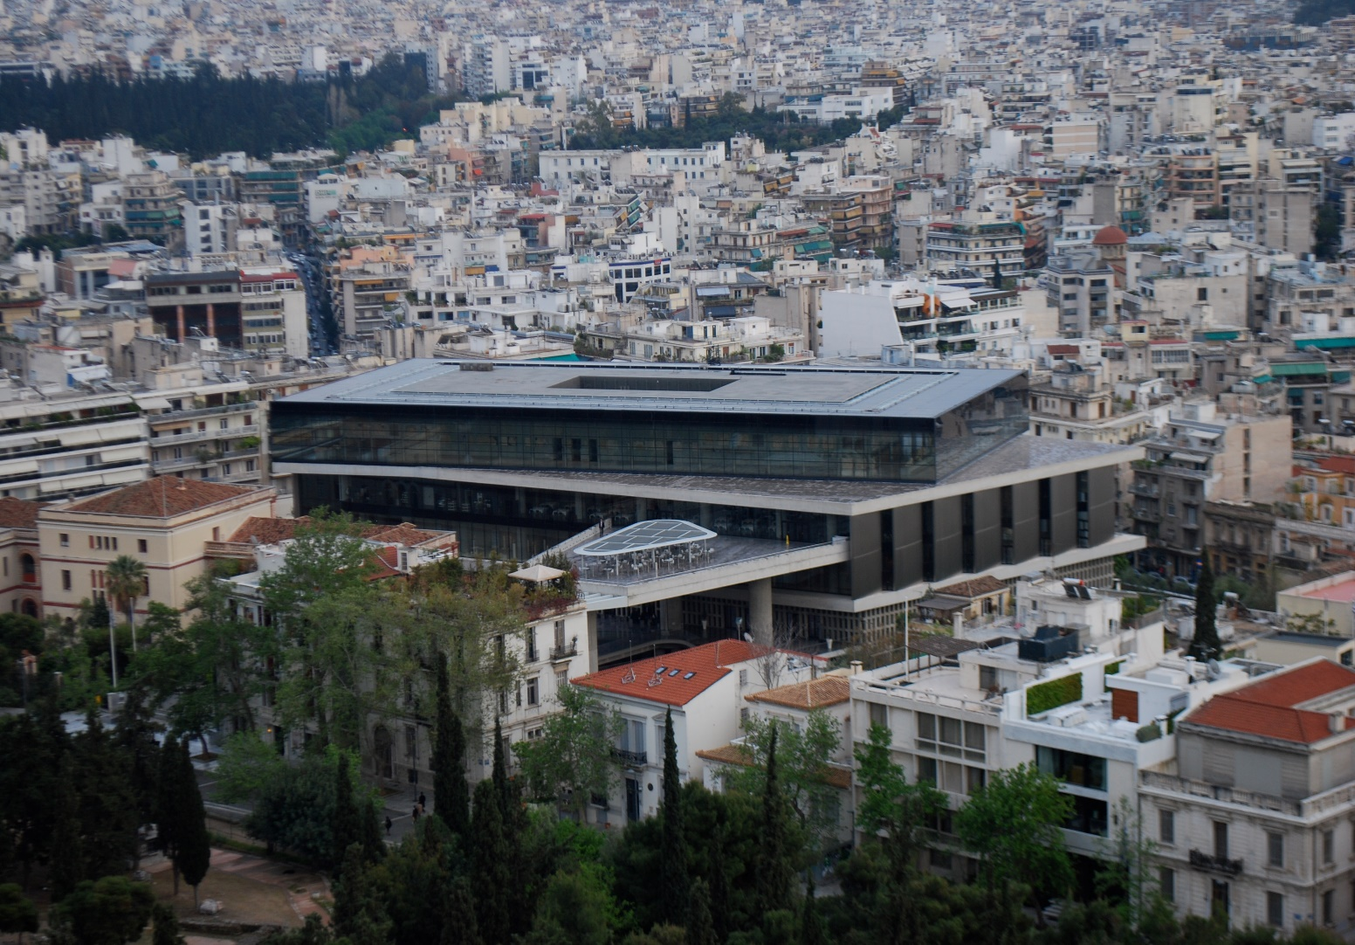
Acropolis Museum, Athens, GR (2009)

Slide 22
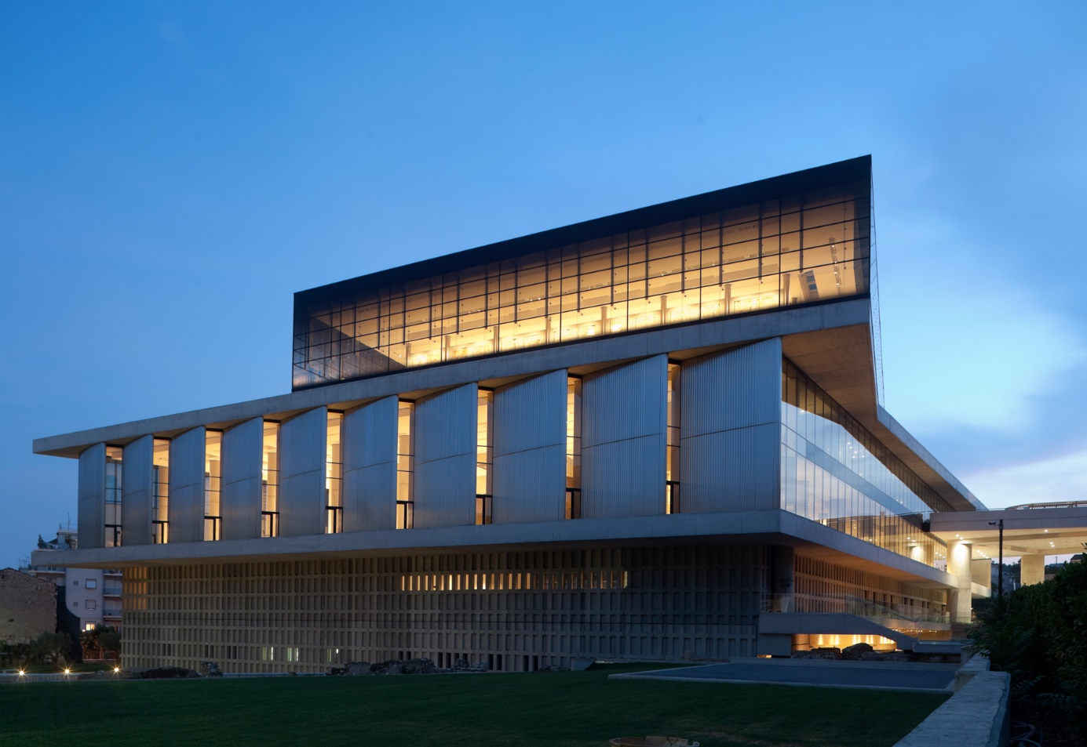
Acropolis Museum, Athens, GR (2009)

Slide 23
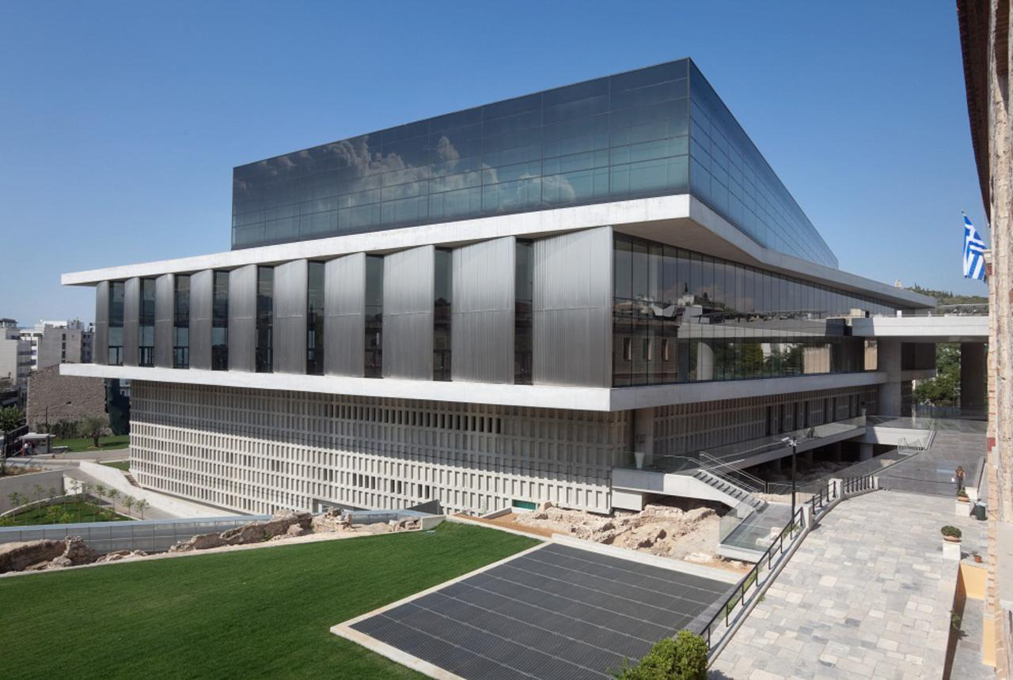
Acropolis Museum, Athens, GR (2009)

Slide 24
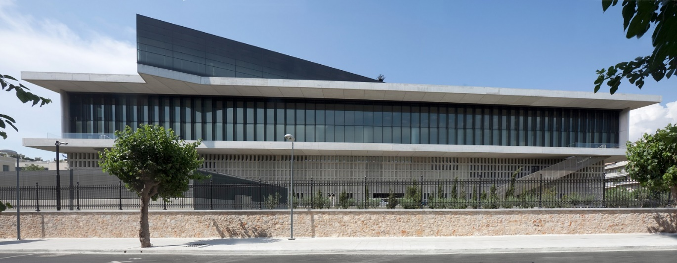
Acropolis Museum, Athens, GR (2009)

Slide 25
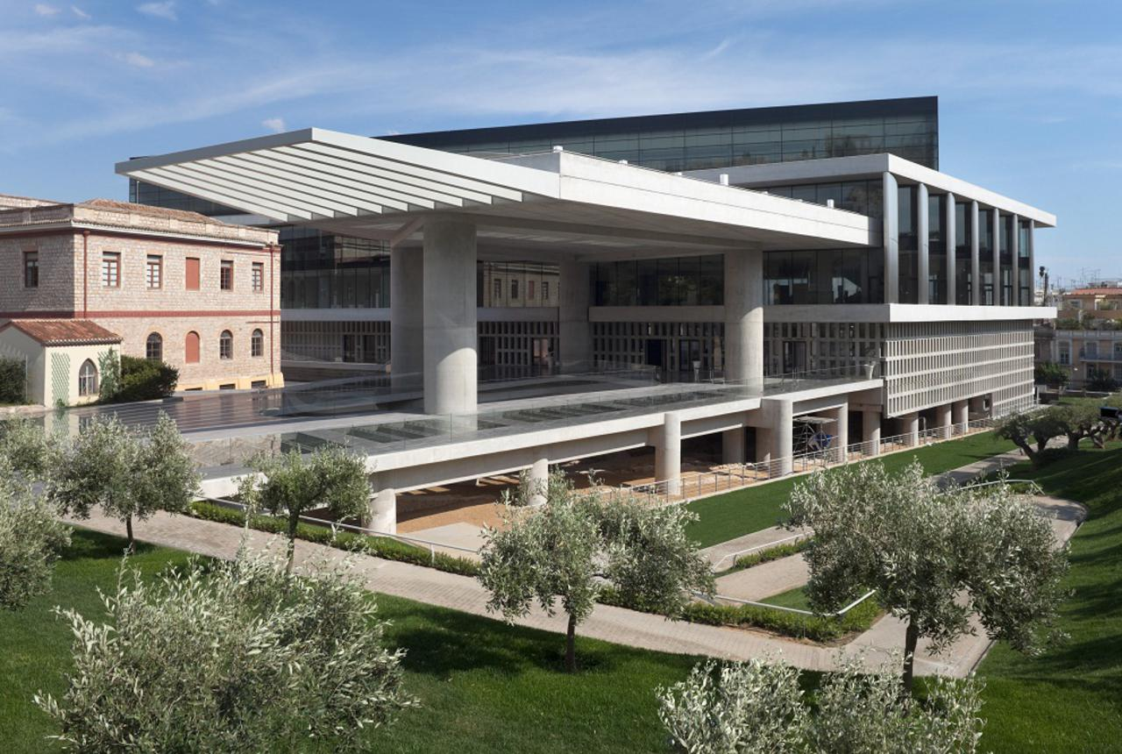
Acropolis Museum, Athens, GR (2009)

Slide 26
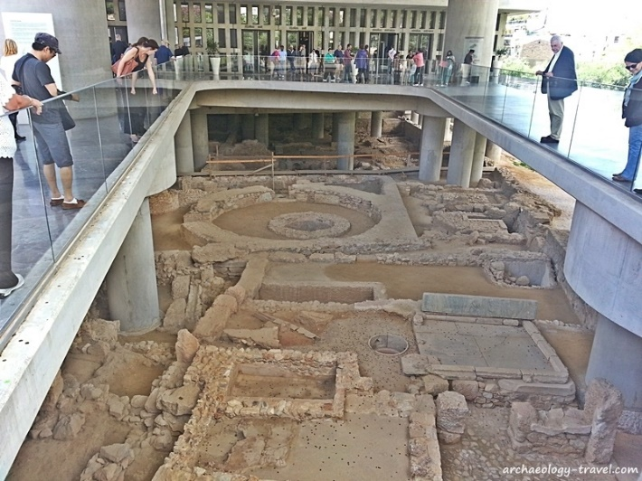
Acropolis Museum, Athens, GR (2009)

Slide 27
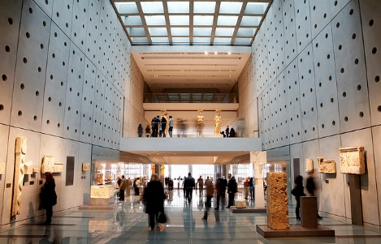
Acropolis Museum, Athens, GR (2009)

Slide 28
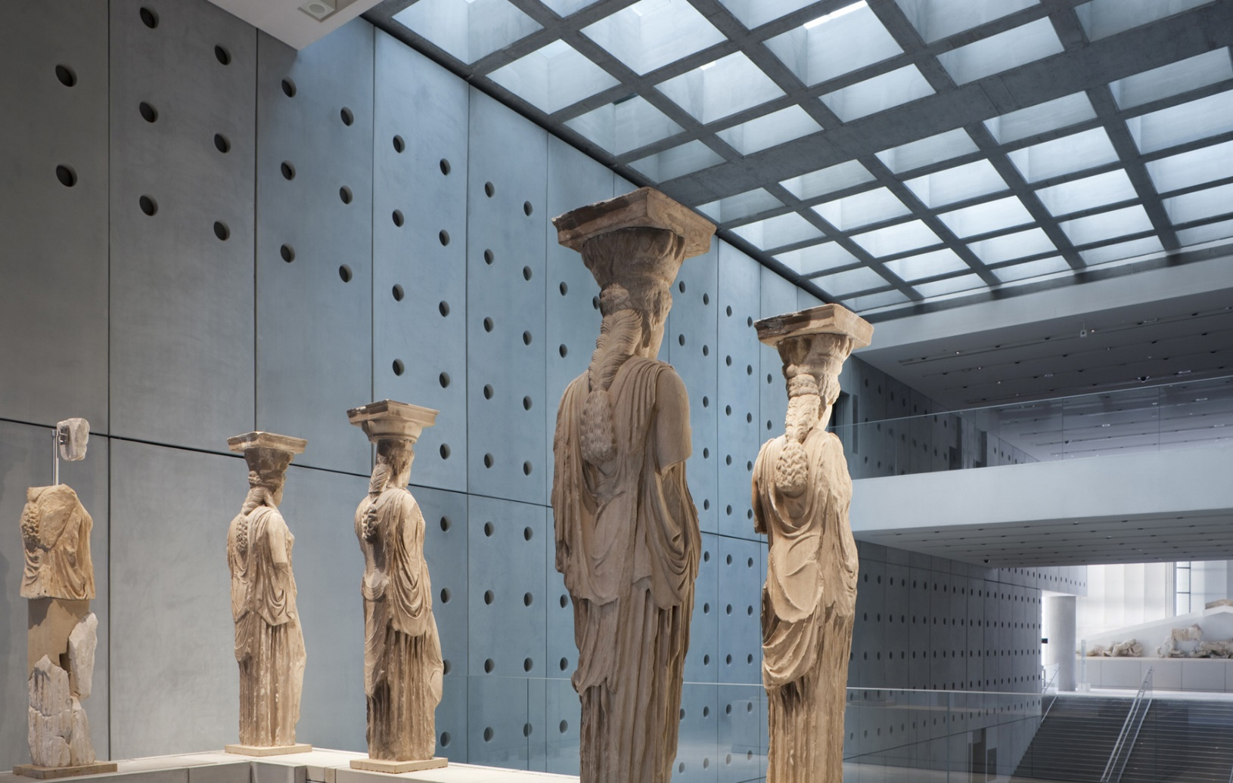
Acropolis Museum, Athens, GR (2009)

Slide 29
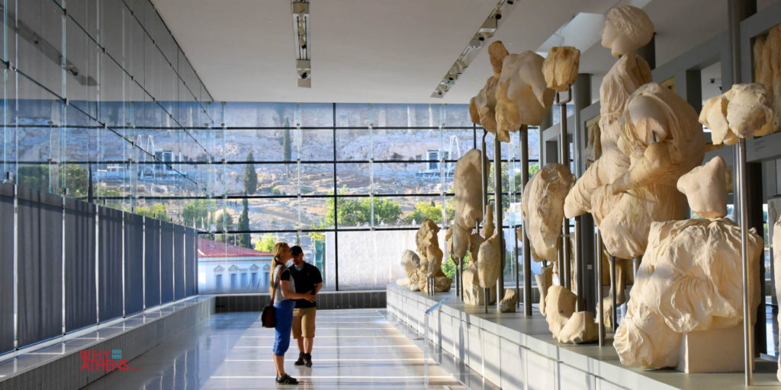
Acropolis Museum, Athens, GR (2009)

Slide 30
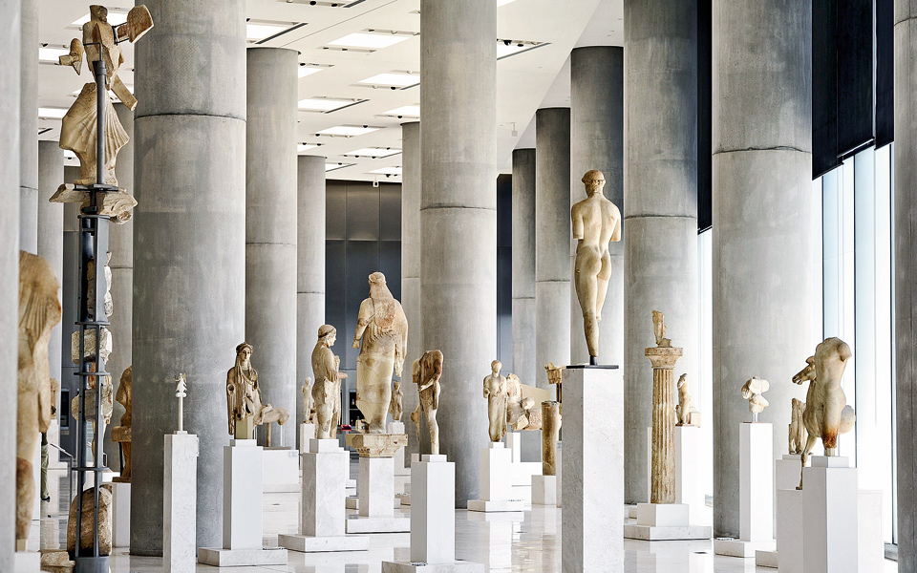
Acropolis Museum, Athens, GR (2009)

Slide 31
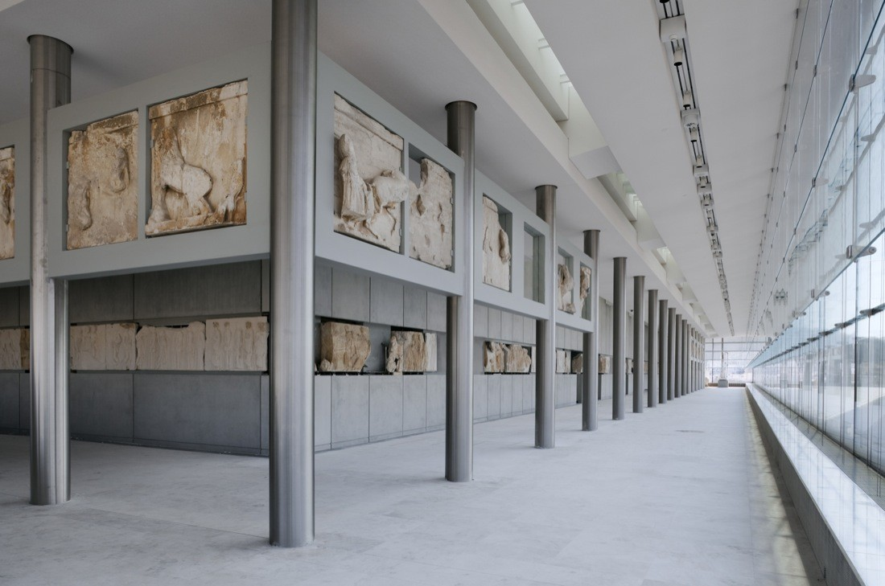
Acropolis Museum, Athens, GR (2009)

Slide 32
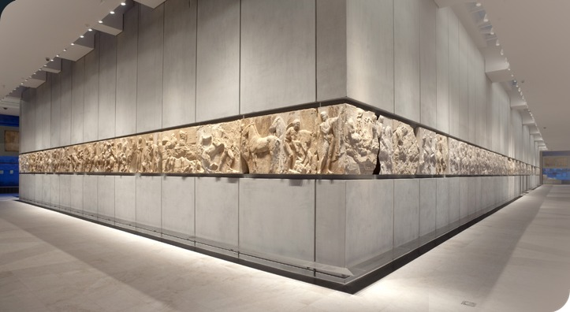
Acropolis Museum, Athens, GR (2009)

Slide 33
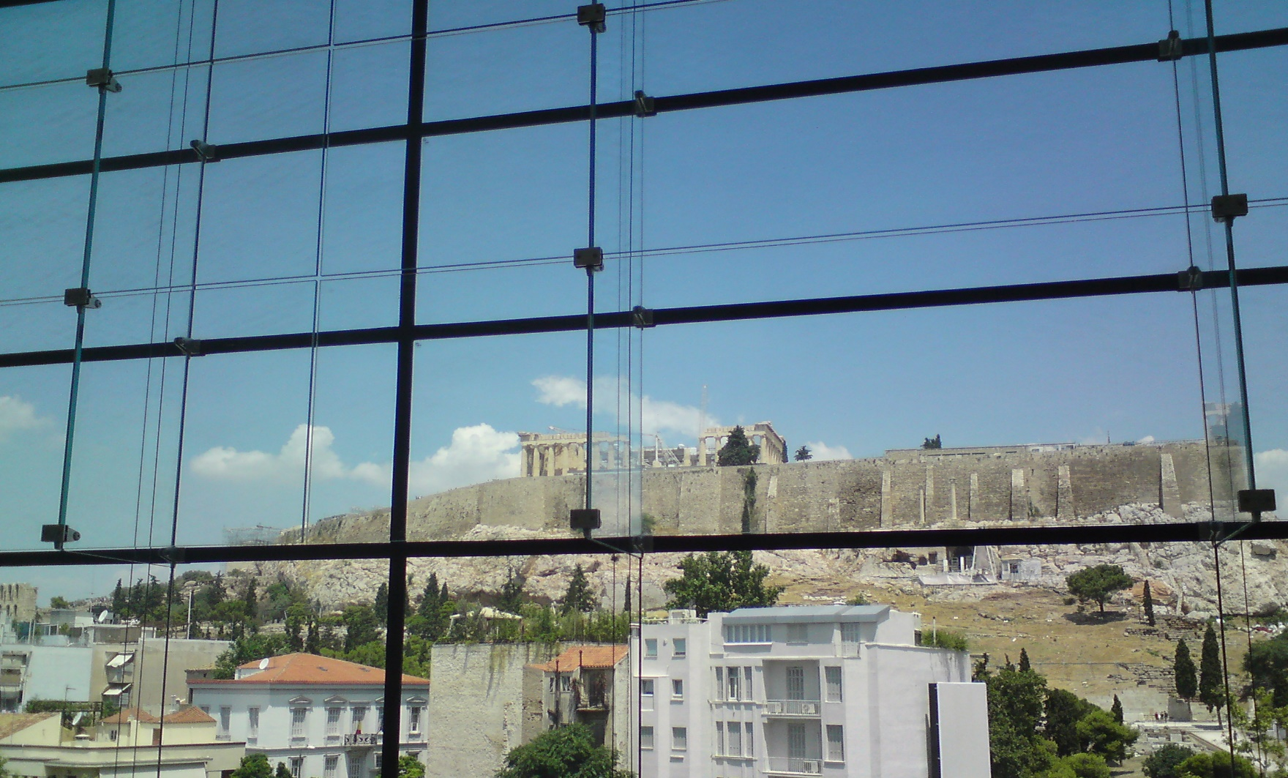
Acropolis Museum, Athens, GR (2009)

Slide 34
Acropolis Museum, Athens, GR (2009)

Slide 35
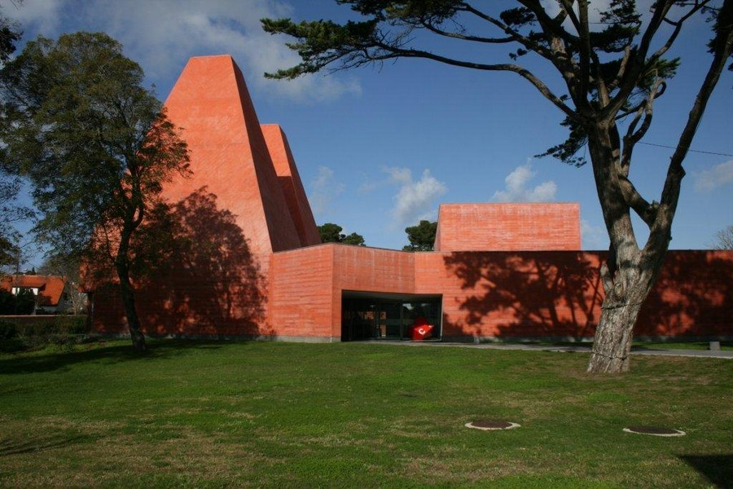
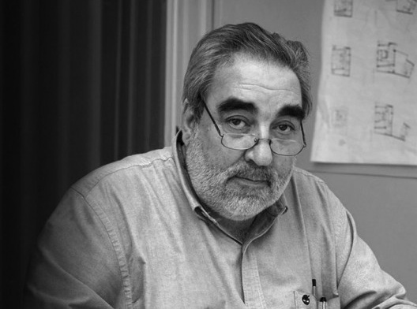
Museu Paula Rego, Cascais, PT (2009)
Eduardo Soto de Moura

Slide 36
Museu Paula Rego, Cascais, PT (2009)
It is the work of the Portuguese architect Eduardo Souto de Moura.
The land and trees which previously existed at the site are incorporated as fundamental elements, while four wings, of varying heights and sizes, make up the building.
Composed of several buildings of different heights, including 2 pyramids that do not exceed the height of the surrounding trees, this museum is made of concrete whose red color voluntarily differs from the greenery surrounding it by keeping as many trees as possible that existed before.
The 2 pyramids serve as a library and restaurant room and the other buildings as an exhibition room.

Slide 37
Museu Paula Rego, Cascais, PT (2009)
These pyramids were inspired by the characteristic shape of the National Palace of Sintra which again has two district chimney towers.
This leads the visitor to ask an interesting question, where does all of the natural light come from as the building appears to be a windowless structure from the outside. The windows have been position as to blend in with the overall structure and not to be a focal point, so either at ground level on the corners of the complex.
The building's interior has 750m2 of exhibition space, is decorated in neutral shades and paved with the blue-grey marble of Cascais.

Slide 38
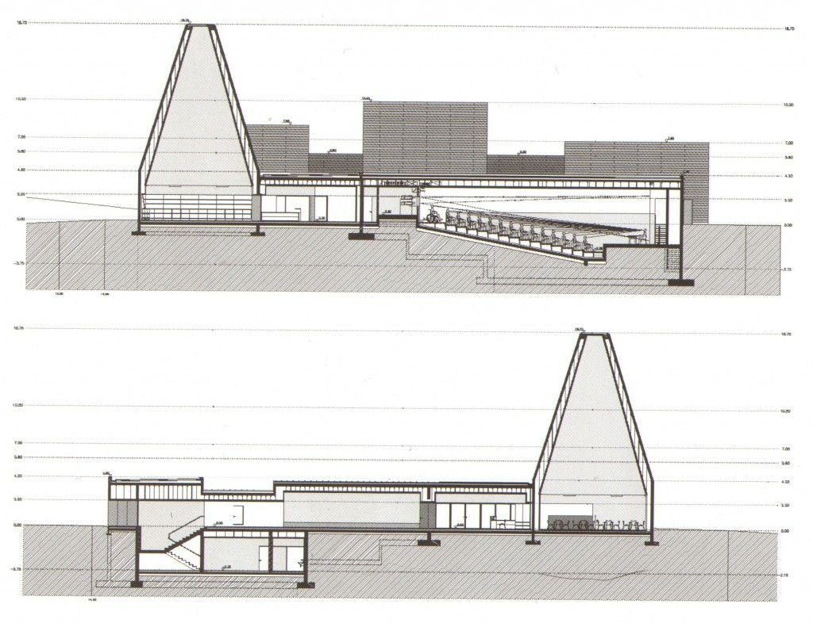
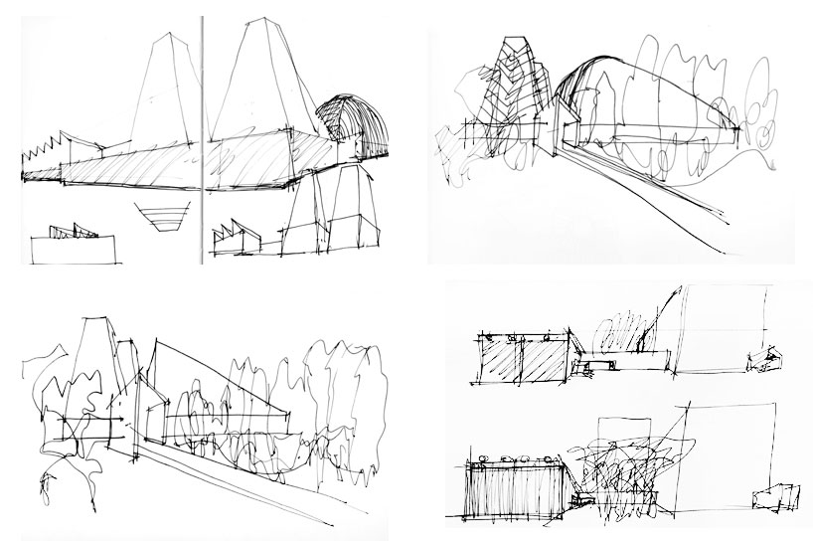
Museu Paula Rego, Cascais, PT (2009)

Slide 39
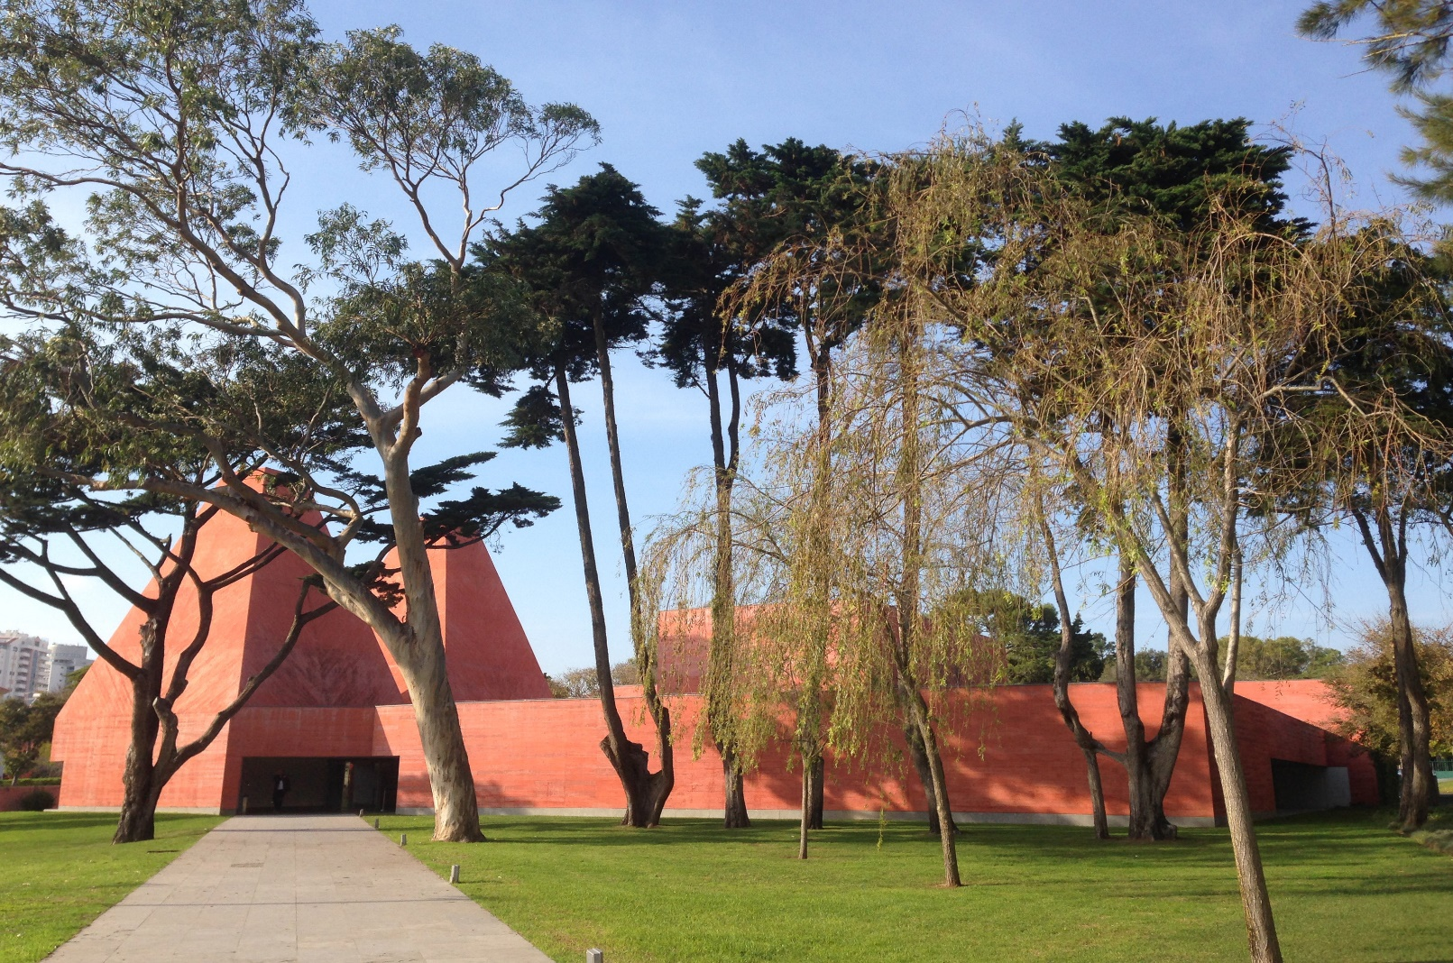
Museu Paula Rego, Cascais, PT (2009)

Slide 40
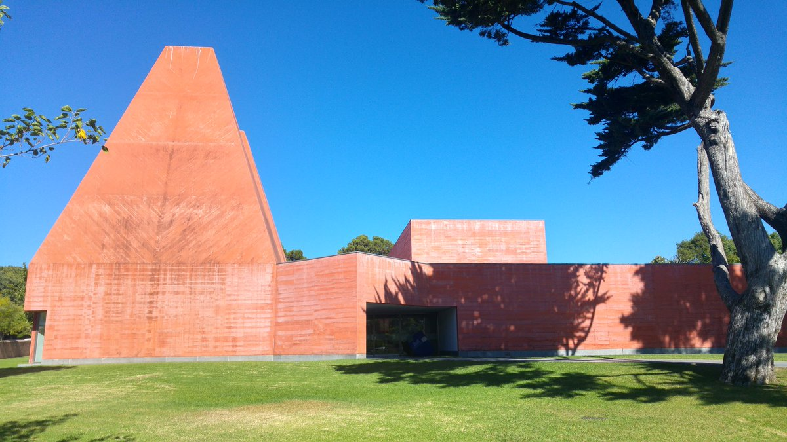
Museu Paula Rego, Cascais, PT (2009)

Slide 41
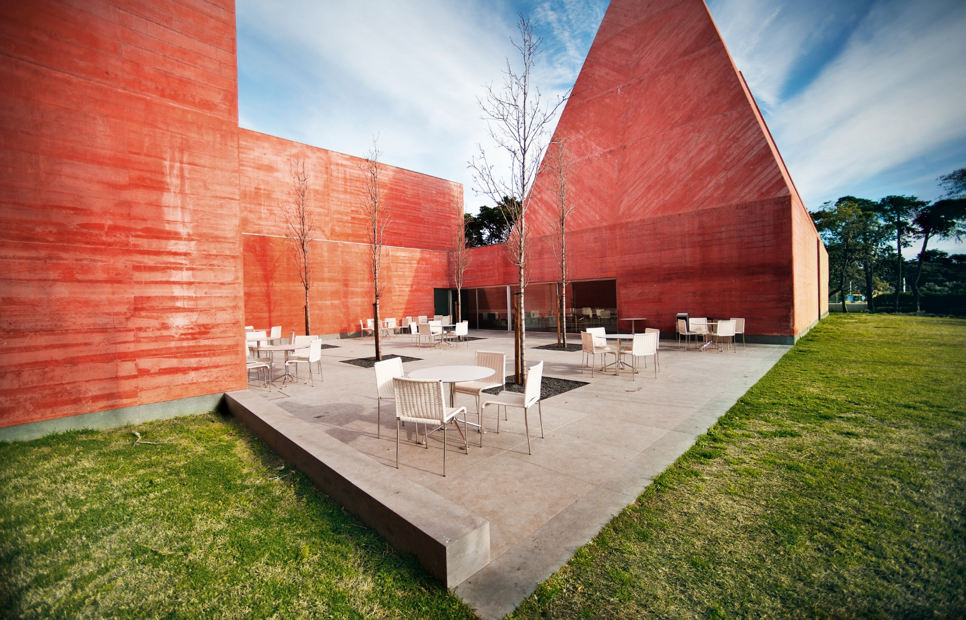
Museu Paula Rego, Cascais, PT (2009)

Slide 42
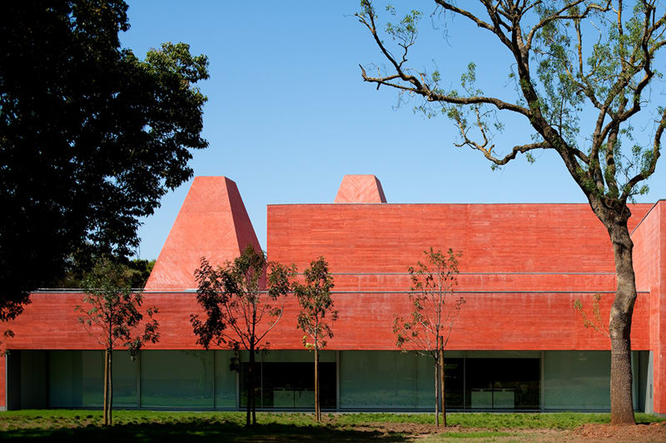
Museu Paula Rego, Cascais, PT (2009)

Slide 43
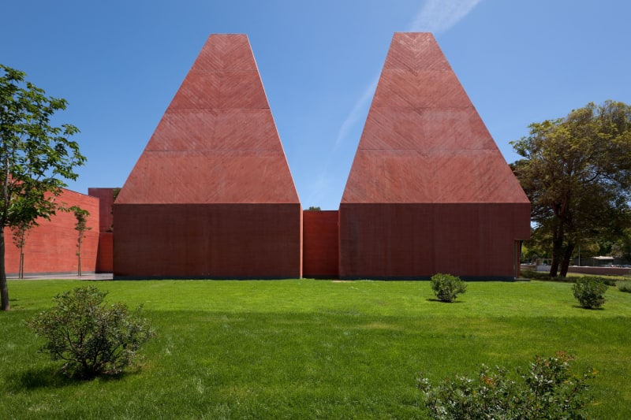
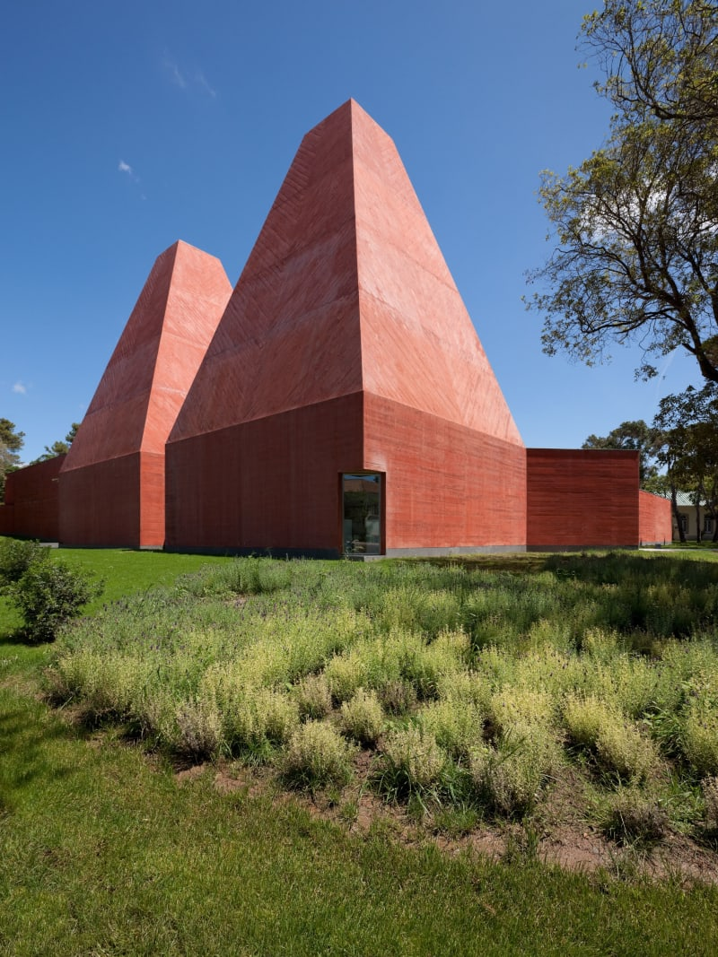
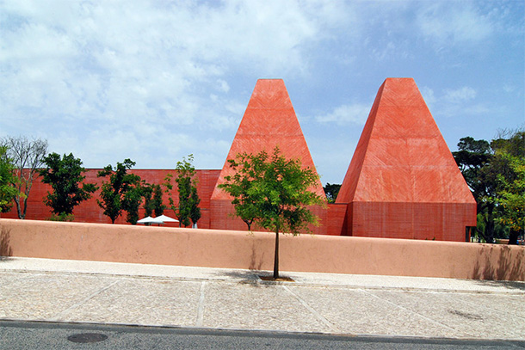
Museu Paula Rego, Cascais, PT (2009)

Slide 44
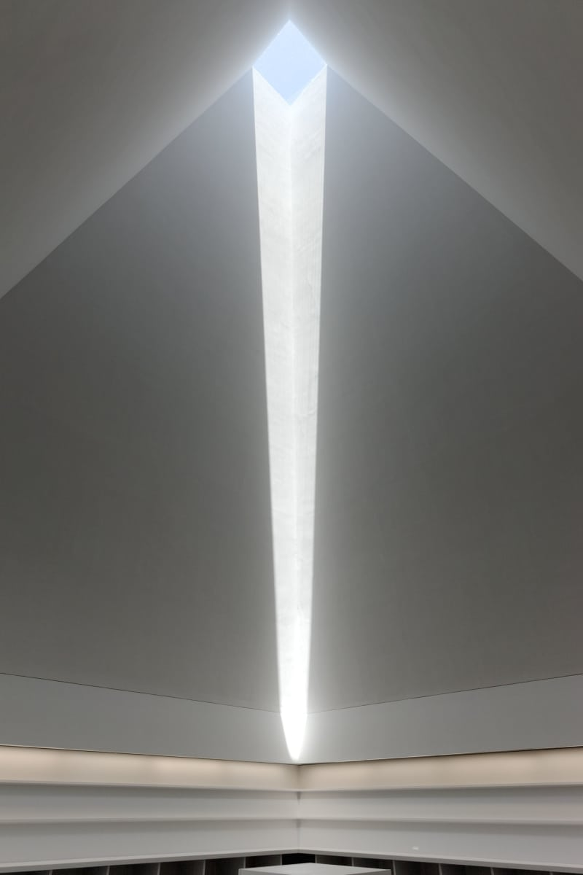
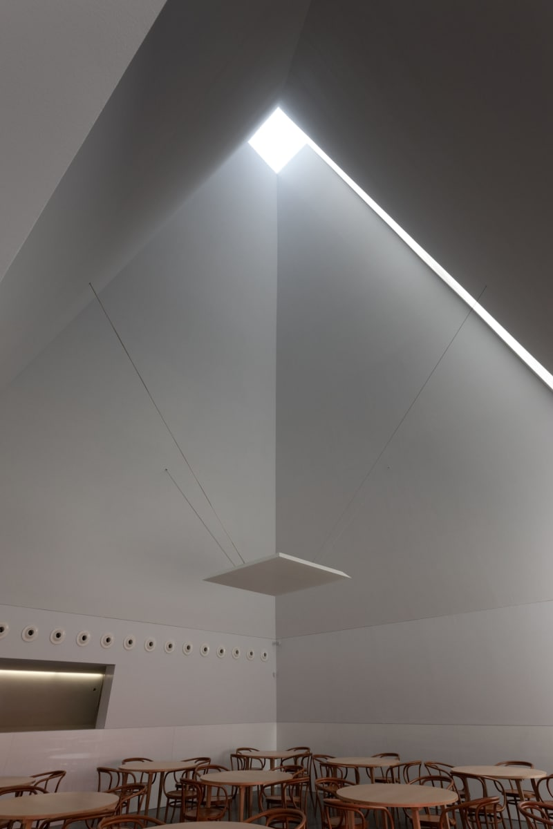
Museu Paula Rego, Cascais, PT (2009)

Slide 45
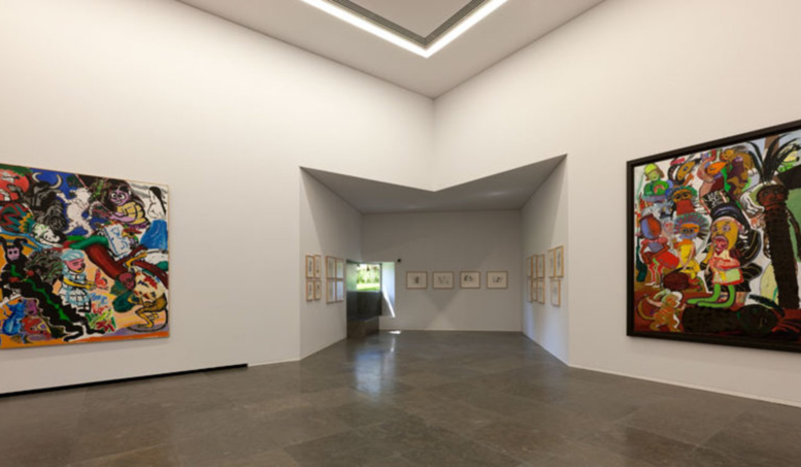
Museu Paula Rego, Cascais, PT (2009)

Slide 46
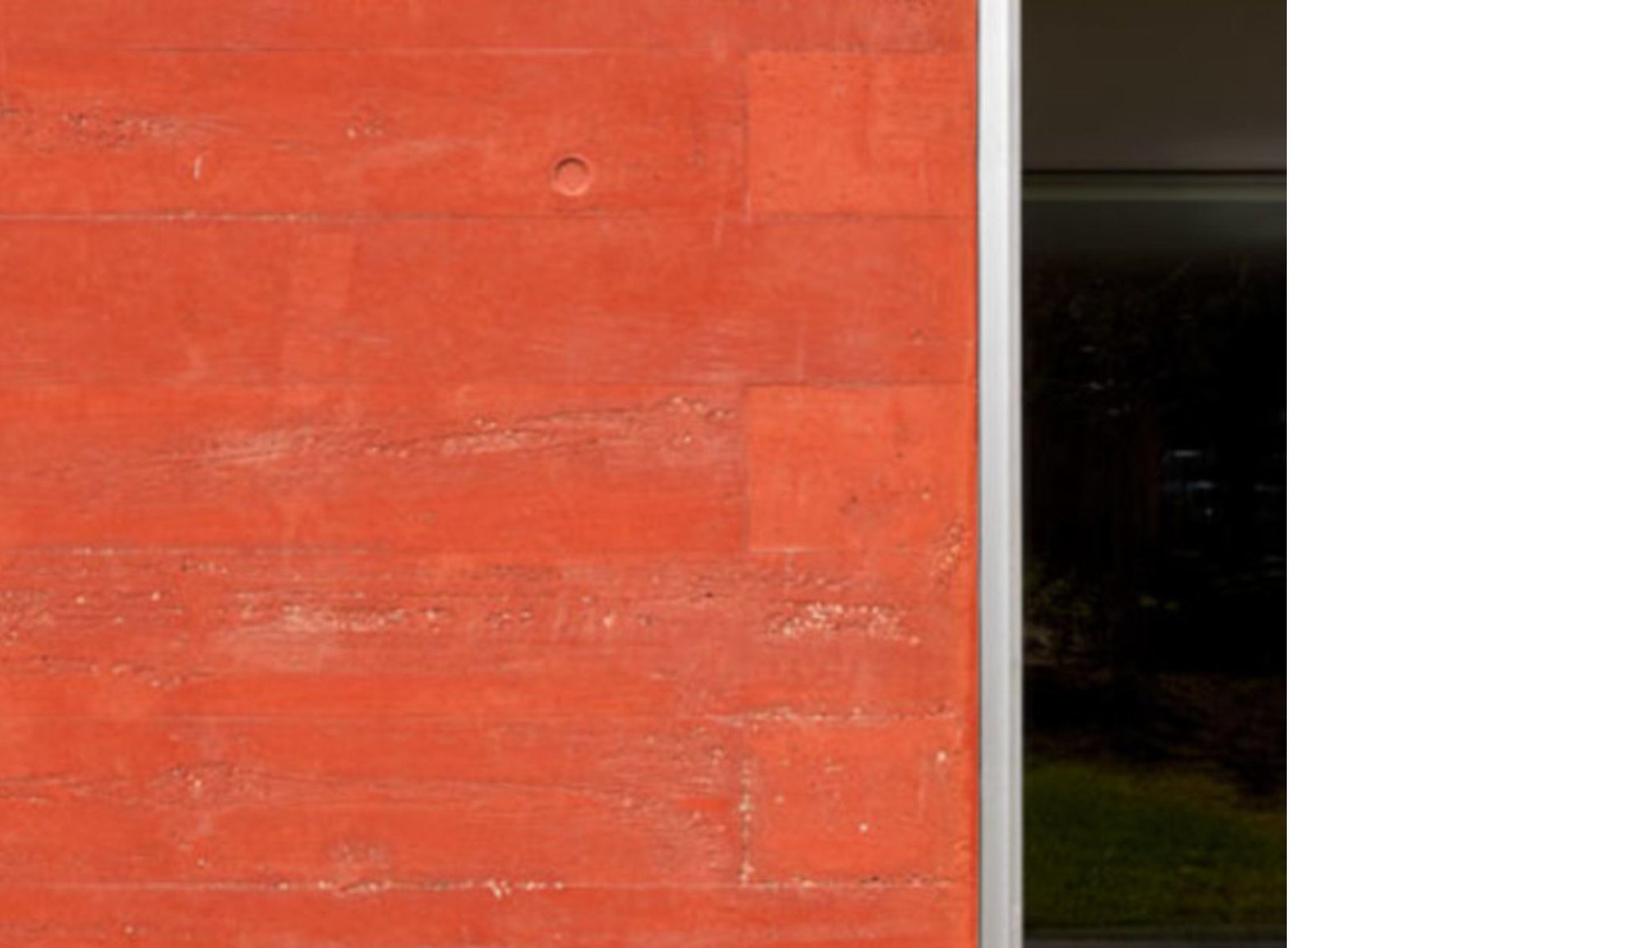
Museu Paula Rego, Cascais, PT (2009)

Slide 47
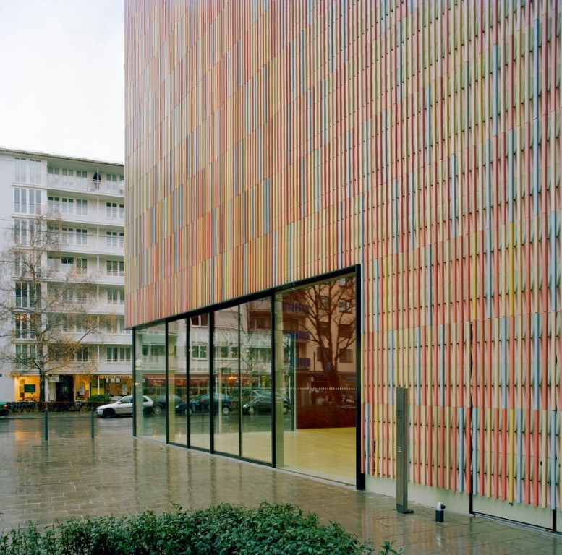
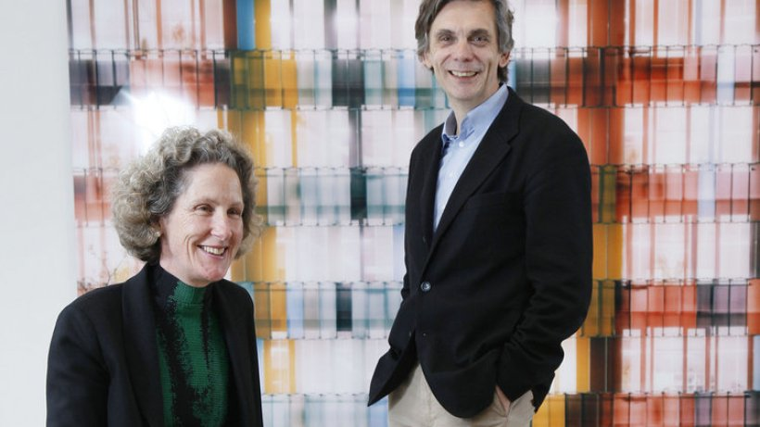
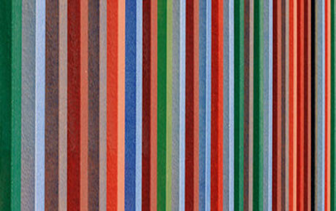
Brandhorst Museum, Munich, DE (2009)
Louisa Hutton & Matthias Sauerbruch

Slide 48
Brandhorst Museum, Munich, DE (2009)
It is the work of architects Matthias Sauerbruch and Louisa Hutton.
The building is a two storey rectangular structure abutting a trapezium shaped section that widens to the North. The precise contours of both parts are linked by a continuous ribbon glazing that culminates in the generous glazed area at the main entrance.
All galeries have white walls and wooden floorboards of solid Danish oak which provide a neutral backward for the artworks.

Slide 49
Brandhorst Museum, Munich, DE (2009)
The façade looks like an abstract painting.
What characterizes the building: the outer skin is made up of 36,000 ceramic rods in an assortment of 23 custom colors and is lined internally with a perforated aluminum metal skin coated in 2 colors.
From a distance, the group of different colors blend in neutral shades, each with a different brilliance.
It accentuates the impression optically that the building is made of 3 separate, interlocked volumes.
The sunlight shining on the facade projects a pattern of shadows that moves throughout the day.

Slide 50
Brandhorst Museum, Munich, DE (2009)

Slide 51
Brandhorst Museum, Munich, DE (2009)

Slide 52
Brandhorst Museum, Munich, DE (2009)

Slide 53
Brandhorst Museum, Munich, DE (2009)

Slide 54
Brandhorst Museum, Munich, DE (2009)

Slide 55
Brandhorst Museum, Munich, DE (2009)

Slide 56
Brandhorst Museum, Munich, DE (2009)

Slide 57
Brandhorst Museum, Munich, DE (2009)

Slide 58
Brandhorst Museum, Munich, DE (2009)

Slide 59
Brandhorst Museum, Munich, DE (2009)

Slide 60
Brandhorst Museum, Munich, DE (2009)

Slide 61
Mimesis Museum, Paju, KR (2009)
Alvaro Siza

Slide 62
Mimesis Museum, Paju, KR (2009)
It is the work of the architect Alvaro Siza.
It is a light grey concrete building with a sinuous 2-winged plan that revolves around a courtyard while keeping the surrounding cherry trees.
It includes a ground floor containing the reception, distribution and temporary exhibition areas, mezzanines containing the administrative areas and exhibition areas on the top floor: these are naturally lit by overhead light from roof dormers. The walls and ceilings are whitewashed, the floors in marble and oak.
Light, always light, so carefully studied. Both natural and artificial is seen as essential. Allowing to see without being seen.

Slide 63
Mimesis Museum, Paju, KR (2009)

Slide 64
Mimesis Museum, Paju, KR (2009)

Slide 65
Mimesis Museum, Paju, KR (2009)

Slide 66
Mimesis Museum, Paju, KR (2009)

Slide 67
Mimesis Museum, Paju, KR (2009)

Slide 68
Mimesis Museum, Paju, KR (2009)

Slide 69
Mimesis Museum, Paju, KR (2009)

Slide 70
Mimesis Museum, Paju, KR (2009)

Slide 71
Mimesis Museum, Paju, KR (2009)

Slide 72
Mimesis Museum, Paju, KR (2009)

Slide 73
Mimesis Museum, Paju, KR (2009)

Slide 74
Mimesis Museum, Paju, KR (2009)

Slide 75
Mimesis Museum, Paju, KR (2009)

Slide 76
Madinat Al Zahra Museo,Cordoba, ES (2009)
Enrique Sobejano
Fuensata Nieto

Slide 77
Madinat Al Zahra Museo,Cordoba, ES (2009)
It is the work of architects Enrique Sobejano and Fuensata Nieto.
The project unveils the floor plan of an underground museum which articulates its spaces around a sequence of solid and void spaces, covered areas and courtyards that guide visitors along their itinerary. The main hall leads to a large courtyard with a square plan which, as a cloister, organizes the main public spaces around it. A deep, elongated courtyard articulates the private use areas: administration, conservation workshops and research areas. A last courtyard is the extension towards the exterior of the museum exhibition areas. The concrete walls and corten steel roofs reflect with the white and the red the colors of the stuccoed walls of the Caliphal city.

Slide 78
Madinat Al Zahra Museo,Cordoba, ES (2009)

Slide 79
Madinat Al Zahra Museo,Cordoba, ES (2009)

Slide 80
Madinat Al Zahra Museo,Cordoba, ES (2009)

Slide 81
Madinat Al Zahra Museo,Cordoba, ES (2009)

Slide 82
Madinat Al Zahra Museo,Cordoba, ES (2009)

Slide 83
Madinat Al Zahra Museo,Cordoba, ES (2009)

Slide 84
Madinat Al Zahra Museo,Cordoba, ES (2009)

Slide 85
Madinat Al Zahra Museo,Cordoba, ES (2009)

Slide 86
Madinat Al Zahra Museo,Cordoba, ES (2009)

Slide 87
Madinat Al Zahra Museo,Cordoba, ES (2009)

Slide 88
Madinat Al Zahra Museo,Cordoba, ES (2009)

Slide 89
Madinat Al Zahra Museo,Cordoba, ES (2009)

Slide 90
Museo de la Memoria, Santiago, CL (2009)
Mario Figueroa
Lucas Fehr

Slide 91
Museo de la Memoria, Santiago, CL (2009)
It is the work of architects Mario Figueroa, Lucas Fehr and Carlos Dias.
The museum is in the form of a pre-patinated copper-coated glass and steel box (18 m wide, 80 m long and 15 m high) mounted on sturdy concrete bases.
Visitors enter from the south via a gently sloping concrete ramp sliding under the museum body (between the concrete bases).
Inside, the internal Vierendeel steel beams are visible.

Slide 92
Museo de la Memoria, Santiago, CL (2009)

Slide 93
Museo de la Memoria, Santiago, CL (2009)

Slide 94
Museo de la Memoria, Santiago, CL (2009)

Slide 95
Museo de la Memoria, Santiago, CL (2009)

Slide 96
Museo de la Memoria, Santiago, CL (2009)

Slide 97
Museo de la Memoria, Santiago, CL (2009)

Slide 98
Museo de la Memoria, Santiago, CL (2009)

Slide 99
Museo de la Memoria, Santiago, CL (2009)

Slide 100
Museo de la Memoria, Santiago, CL (2009)

Slide 101
Museo de la Memoria, Santiago, CL (2009)

Slide 102
Museo de la Memoria, Santiago, CL (2009)

Slide 103
Museo de la Memoria, Santiago, CL (2009)

Slide 104
Côa Parque Museu, Guarda, PT (2009)
Camilo Rebelo
Tiago Pimentel

Slide 105
Côa Parque Museu, Guarda, PT (2009)
It is the work of architects Camilo Rebelo and Tiago Pimentel.
This museum takes into account the topography of the sloping terrain on which it is located: the arrival is at the top and a platform/terrace has been created to enjoy the immense landscape.
At the highest level of the terrain, the monolithic triangular shape is a direct result of the confluence of the valley.
The composition of the facade results from the use of mineral pigments in the composition of the concrete that was also object of surface treatment mimicking the natural irregularities of the metamorphic rocks in the region.

Slide 106
Côa Parque Museu, Guarda, PT (2009)

Slide 107
Côa Parque Museu, Guarda, PT (2009)

Slide 108
Côa Parque Museu, Guarda, PT (2009)

Slide 109
Côa Parque Museu, Guarda, PT (2009)

Slide 110
Côa Parque Museu, Guarda, PT (2009)

Slide 111
Côa Parque Museu, Guarda, PT (2009)

Slide 112
Côa Parque Museu, Guarda, PT (2009)

Slide 113
Côa Parque Museu, Guarda, PT (2009)

Slide 114
Côa Parque Museu, Guarda, PT (2009)

Slide 115
Côa Parque Museu, Guarda, PT (2009)

Slide 116
Côa Parque Museu, Guarda, PT (2009)

Slide 117
Côa Parque Museu, Guarda, PT (2009)

Slide 118
Côa Parque Museu, Guarda, PT (2009)

Slide 119
Porsche Museum, Stuttgart, DE (2009)
Roman Delugan & Elke Delugan-Meissl

Slide 120
Porsche Museum, Stuttgart, DE (2009)
The building designed by Delugan Meissl is a bold statement. Supported on just three V-shaped columns, the museum’s dominant main structure seems to float above the ground like a monolith.
From every angle, the shapes of the monolith and base building look different thanks to their polygonal forms and the variation in the structures and windows. Its reflective soffit absorbs the architectural landscape below.
The glazed main façade of the 23 meter high museum adorned with Porsche logo faces north, greeting those heading into the center city by car.

Slide 121
Porsche Museum, Stuttgart, DE (2009)

Slide 122
Porsche Museum, Stuttgart, DE (2009)

Slide 123
Porsche Museum, Stuttgart, DE (2009)

Slide 124
Porsche Museum, Stuttgart, DE (2009)

Slide 125
Porsche Museum, Stuttgart, DE (2009)

Slide 126
Porsche Museum, Stuttgart, DE (2009)

Slide 127
Porsche Museum, Stuttgart, DE (2009)

Slide 128
Porsche Museum, Stuttgart, DE (2009)

Slide 129
Porsche Museum, Stuttgart, DE (2009)

Slide 130
Porsche Museum, Stuttgart, DE (2009)

Slide 131
Porsche Museum, Stuttgart, DE (2009)

Slide 132
Porsche Museum, Stuttgart, DE (2009)

Slide 133
Center of the Arts, Herning, DK (2009)
Steven Holl

Slide 134
Center of the Arts, Herning, DK (2009)
It is the work of the architect Steven Holl.
The design fuses landscape and architecture in a one-level building that will include permanent and temporary exhibition galleries, a 150-seat auditorium, music rehearsal rooms.
The shape of the building which resembles a collection of shirtsleeves viewed from above, through the wall finishes. Fabric tarps were inserted into the formwork to yield a fabric texture to the buildings exterior walls of white concrete (with a wrinkled textile surface). The references to textile continue inside where one is met by the curved ceiling resembling tent canvas.

Slide 135
Center of the Arts, Herning, DK (2009)

Slide 136
Center of the Arts, Herning, DK (2009)

Slide 137
Center of the Arts, Herning, DK (2009)

Slide 138
Center of the Arts, Herning, DK (2009)

Slide 139
Center of the Arts, Herning, DK (2009)

Slide 140
Center of the Arts, Herning, DK (2009)

Slide 141
Center of the Arts, Herning, DK (2009)

Slide 142
Center of the Arts, Herning, DK (2009)

Slide 143
Center of the Arts, Herning, DK (2009)

Slide 144
Center of the Arts, Herning, DK (2009)

Slide 145
Center of the Arts, Herning, DK (2009)

Slide 146
Center of the Arts, Herning, DK (2009)

Slide 147
Dornier Museum,Friedrichshafen, DE (2009)
Markus Allmann
Amandus Sattler
Ludwig Wappner

Slide 148
Dornier Museum,Friedrichshafen, DE (2009)
It is the work of Allmann Sattler Wappner Architekten firm.
The shape of the museum is derived from the direct access of the exhibited airplanes to the runways. Translucent, curved facades delimitate the interior space and guide the way to the tarmac.
The end faces oriented towards the airport are closed by transparent gates. The exhibition space volume features curved perimeter surfaces in the north and south, projecting the contour of the runway upward to the rectangular roof structure. In the west and east, the lateral perimeter permits a transition from roof to façade to the runway.

Slide 149
Dornier Museum,Friedrichshafen, DE (2009)
The curved longitudinal perimeter surfaces are segmented imperceptibly by polycarbonate panels. The assembly system of the full-height, transparent panels enables avoiding construction-based divisions in the building exterior. This construction material, primarily used in industrial construction, conveys lightness and formability.
Along the southern facade, a dot raster pattern is applied to the perimeter surface, reducing sunlight intake. The raster pattern obscures the linear structure of the polycarbonate panels. The absence of a clearly recognizable structure conveys the image of a wall to the observer; the progressing impression of transparency however signals permeability. Along the north facade, polycarbonate panels are applied without further treatment.

Slide 150
Dornier Museum,Friedrichshafen, DE (2009)

Slide 151
Dornier Museum,Friedrichshafen, DE (2009)

Slide 152
Dornier Museum,Friedrichshafen, DE (2009)

Slide 153
Dornier Museum,Friedrichshafen, DE (2009)

Slide 154
Dornier Museum,Friedrichshafen, DE (2009)

Slide 155
Dornier Museum,Friedrichshafen, DE (2009)

Slide 156
Dornier Museum,Friedrichshafen, DE (2009)

Slide 157
Dornier Museum,Friedrichshafen, DE (2009)

Slide 158
Salt Museum, Salins, FR (2009)
Michel Malcotti, Catherine Roussey
Thierry Gheza

Slide 159
Salt Museum, Salins, FR (2009)
It is the work of the architects Michel Malcotti, Catherine Roussey and Thierry Gheza.
The museum project was kept separate from its context right from the start, creating an additional interior within the interior of the building containing the museum itinerary and filtering spaces for links between different levels. This restoration philosophy is expressed on the outside in an irreverently attractive element: a new parallelepiped that juts far out of the northern wall, made of Indaten® construction steel sheeting, recommended for its protective surface patina that makes it particularly resistant to corrosion by atmospheric agents.

Slide 160
Salt Museum, Salins, FR (2009)

Slide 161
Salt Museum, Salins, FR (2009)

Slide 162
Salt Museum, Salins, FR (2009)

Slide 163
Salt Museum, Salins, FR (2009)

Slide 164
Salt Museum, Salins, FR (2009)

Slide 165
Salt Museum, Salins, FR (2009)

Slide 166
Salt Museum, Salins, FR (2009)

Slide 167
Salt Museum, Salins, FR (2009)

Slide 168
Salt Museum, Salins, FR (2009)
THE END

