Slide 1
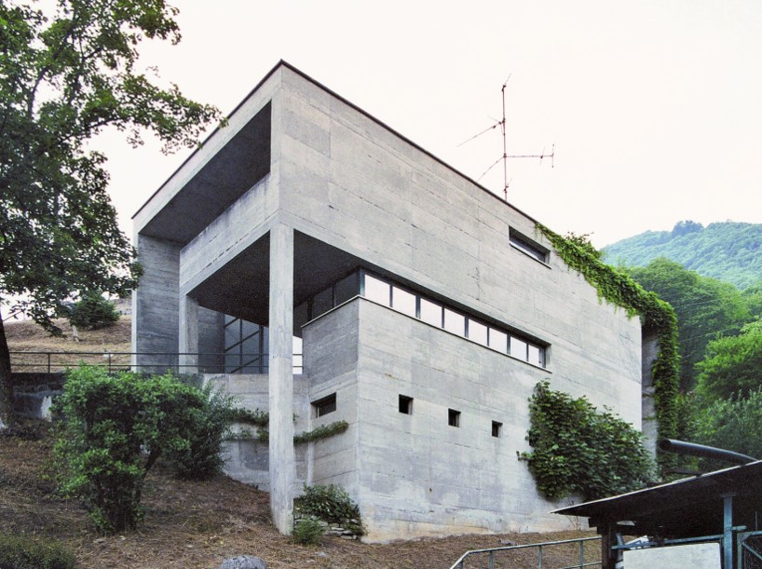
World Iconic Houses VIII
1975-1980

Slide 2
Iconic Houses in the World
The purpose of this presentation is to show you the most exceptional houses in the world (except US) due to great architects.
Some of them have become icons of contemporary architecture and are recognized and protected as such.
They remain unique either by their constructive principle, or by their location, or by their theoretical importance, or by their perfect integration into the landscape.

Slide 3
Iconic Houses in the World
Some of these iconic houses are in an international network ¨iconichouses.org¨ : for that they must be open to the public must be in their original state or restored in as authentic a state as possible, close to the original and designed by an architect who had an important role in the XX century.
It acts for their conservation, their restoration, the collection of documents concerning them.

Slide 4
Iconic Houses in the World
Many of the houses presented in this slide show (before the year 2000) were found on the OfHouses website (Old Forgotten Houses) which lists houses with architectural interest or singular architecture around the world with many illustrations. If they are shown here, it is because they are already considered as iconic.

Slide 5
Iconic Houses in the World 1
Casa Sperimentale, Giuseppe Perugini, IT.
Fukumura Box, Mayumi Miyawaki, JP.
Hopkins House, Patty & Michael Hopkins, GB.
JSN Residência, João Filgueiras Lima, BR.
Casa Gribaudo, Andrea Bruno, IT.
Casa Galvagni, Mario Galvagni, IT.
Casa Hastings, J. Baracco & F. Vella, PE.
Uehara House, Kazuo Shinohara, JP.
Nomiyama House, Kazuo Shinohara, JP.
Wandich House, Jim Strasman, CA.

Slide 6
Iconic Houses in the World 2
Casa Bianchi, Mario Botta, CH.
Casa Kalmann, Luigi Snozzi, CH.
Yamakawa Villa, Riken Yamamoto , JP.
Carvalhal Residence, Decio Tozzi, BR.
Morris Residence, Morris and Steedman, GB.
Silver Triangle House, Itsuko Hasegawa, JP.
Villa Ottolenghi, Carlo Scarpa, IT.
Residencia Borges, João Filgueiras Lima, BR.
Haus Schütte, Heinz Bienefeld, DE.
Maki House, Fumihiko Maki, JP.

Slide 7
Iconic Houses in the World 3
Halfway House, Stanley Saitowitz, ZA.
Maison Dick, Jean Nouvel, FR.
Casa Bola, Eduardo Longo, BR.
Blue House, J. Herzog & P. de Meuron, CH.
Blanco House, Antonio González Cordón, ES.
Toy Block House I, Takefumi Aida, JP.
Maison Bernard, Antti Lovag, FR.

Slide 8
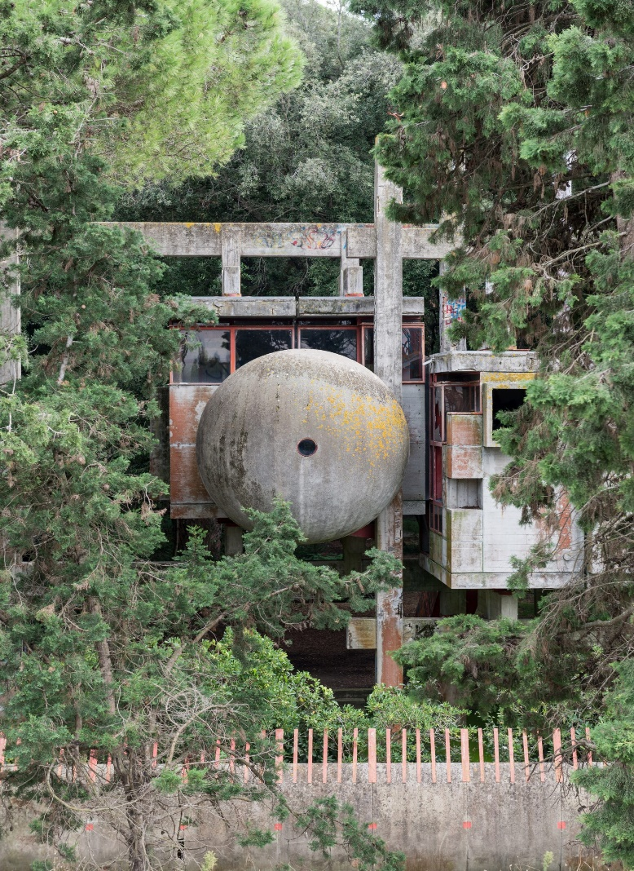
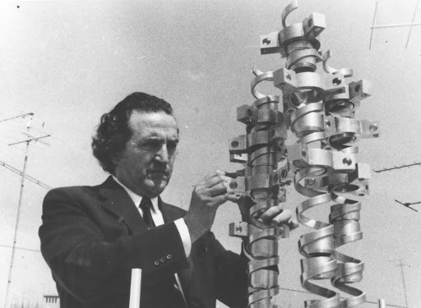
Casa Sperimentale, Fregene, IT (1975)
Giuseppe Perugini
Raynaldo Perugini

Slide 9
Casa Sperimentale, Fregene, IT (1975)
It is the work of the architects Giuseppe & Raynaldo Perugini (Father & son) : it was their own house for weekend occupation.
The house consists of three independent buildings: the main house Casa Sperimentale, the Sphere, a separate guest house, and a curved concrete perimeter fence which surrounds the site.
The home is elevated and built around the surrounding pine forest. It’s only accessible by one bright red staircase, which functioned as a drawbridge and could be lifted to cut off the outside world. The building is characterized by raw concrete modules and beams which are sliding into each other. Everything is floating above the ground on an alike interlaced pile construction. With its concrete branches, it reflects the structure of the forest.

Slide 10
Casa Sperimentale, Fregene, IT (1975)
The main beams are flanked by secondary beams positioned above and below the modules that support the weight of these through particular cruciform elements in steel painted red. The main beams have variable heights and in some points the overhang of a beam is supported by a beam above with special hooks, also in steel. The doors and windows, painted red like all the iron elements of the house, resume the general composition of the house, repeating the motif of the cube, both projecting outwards and returning inside the house.
Spherical rooms hang from the main frame or sit separately in the grounds under the main structure, where box-like rooms sit in a concrete frame.

Slide 11
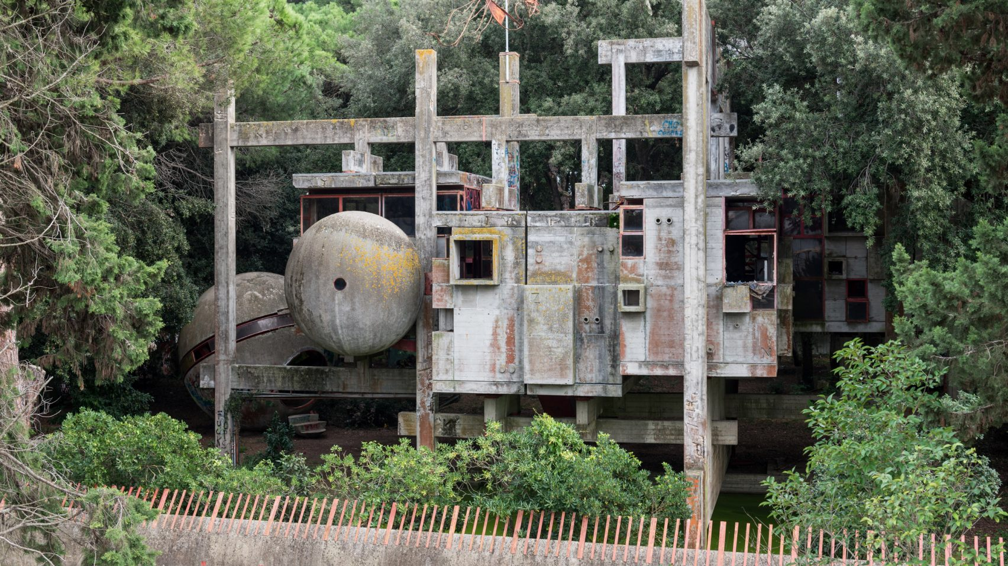
Casa Sperimentale, Fregene, IT (1975)

Slide 12
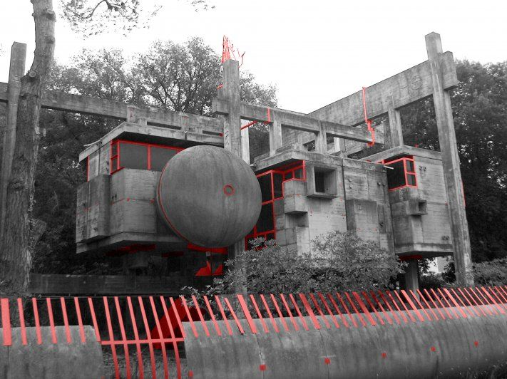
Casa Sperimentale, Fregene, IT (1975)

Slide 13
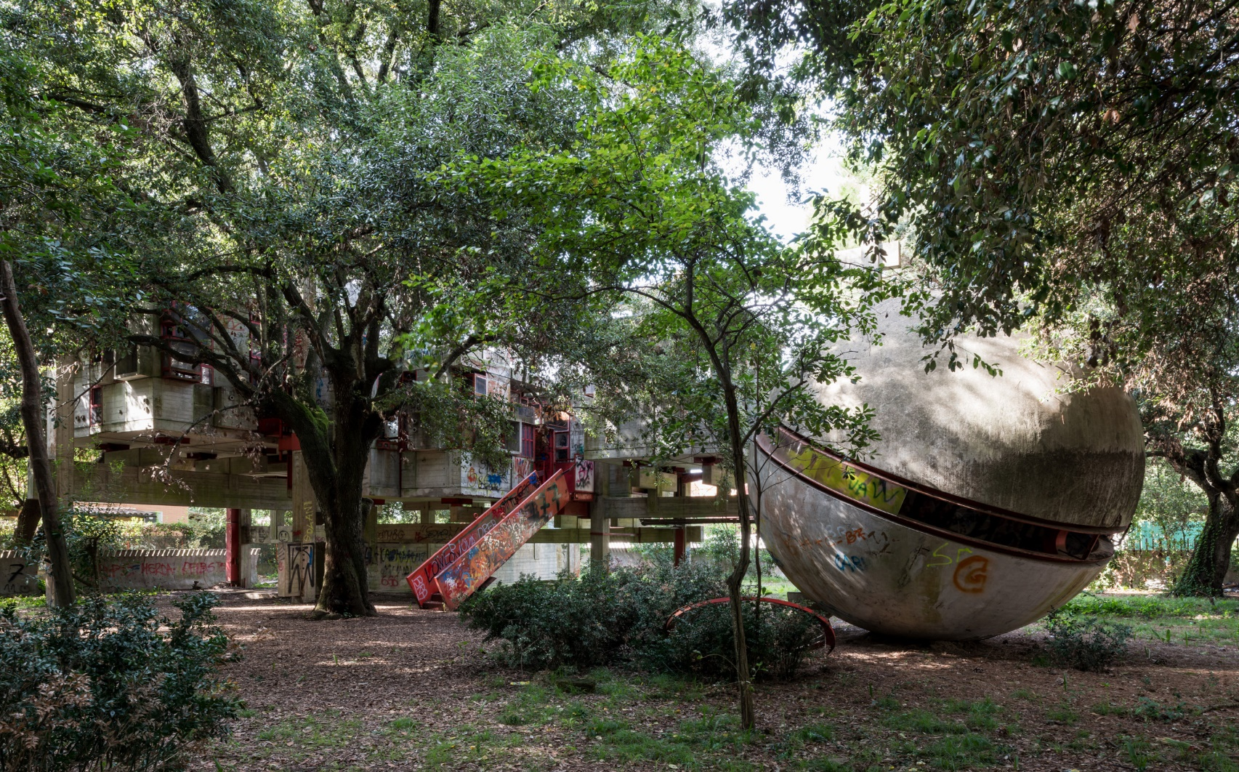
Casa Sperimentale, Fregene, IT (1975)

Slide 14
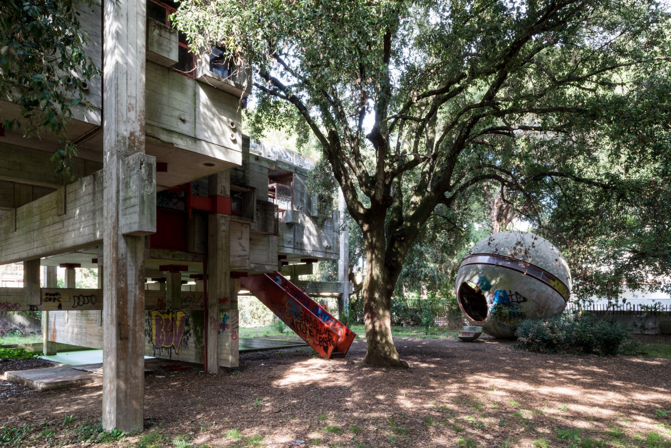
Casa Sperimentale, Fregene, IT (1975)

Slide 15
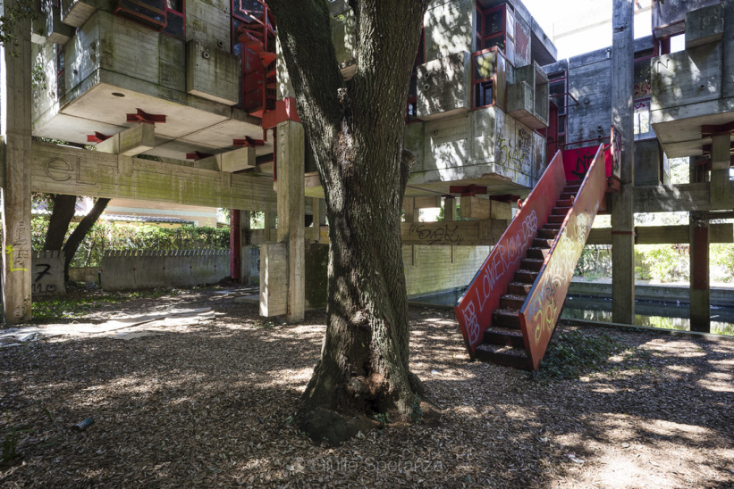
Casa Sperimentale, Fregene, IT (1975)

Slide 16
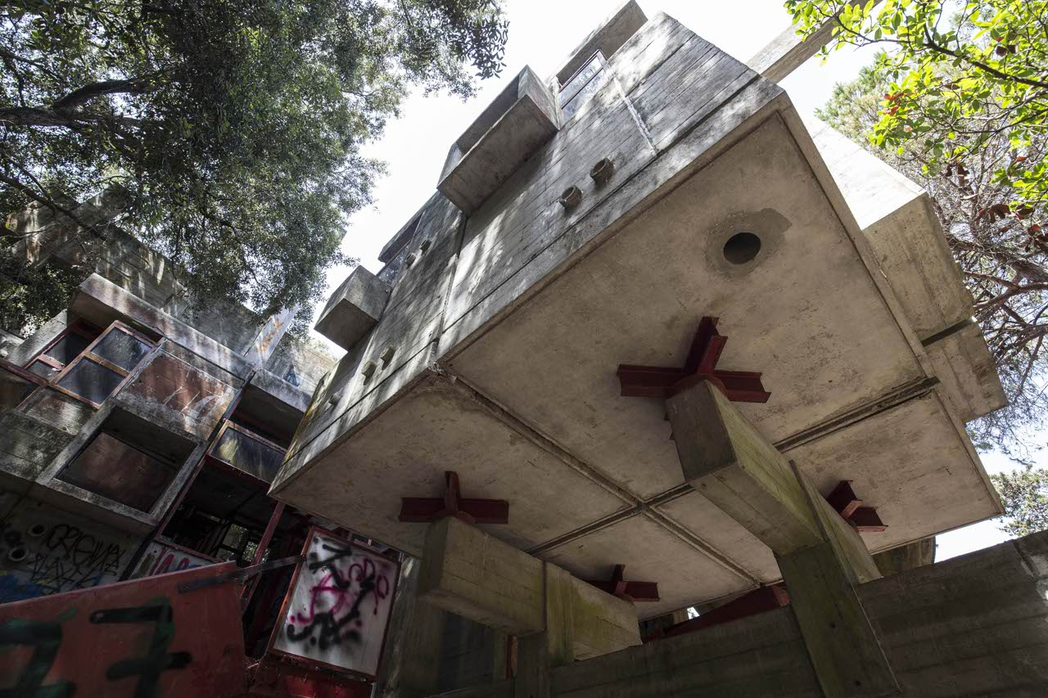
Casa Sperimentale, Fregene, IT (1975)

Slide 17
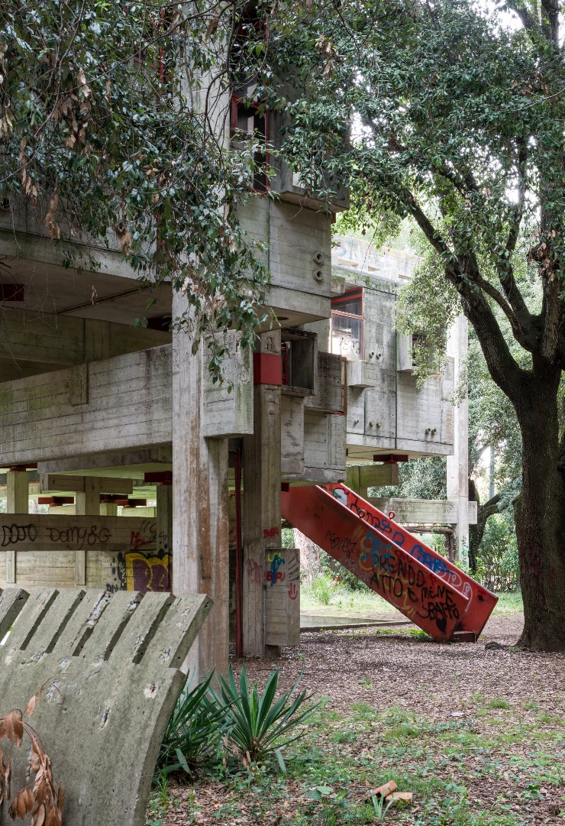
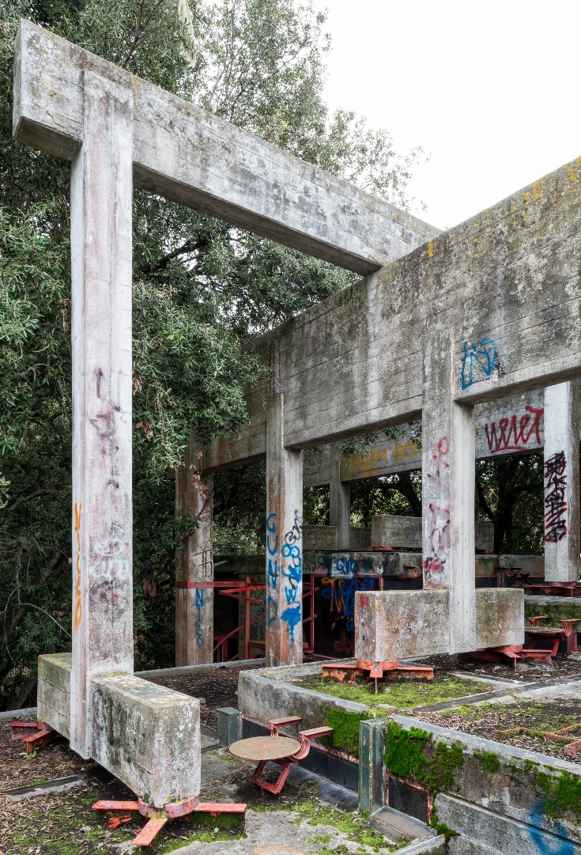
Casa Sperimentale, Fregene, IT (1975)

Slide 18
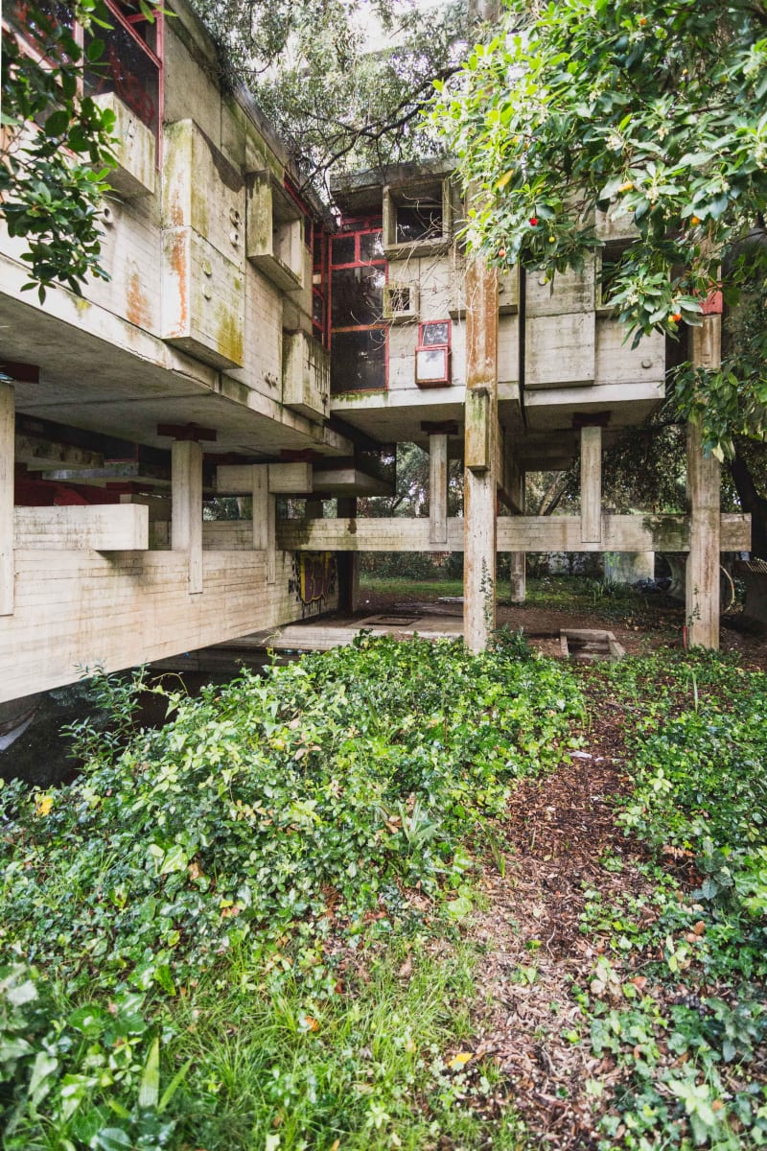
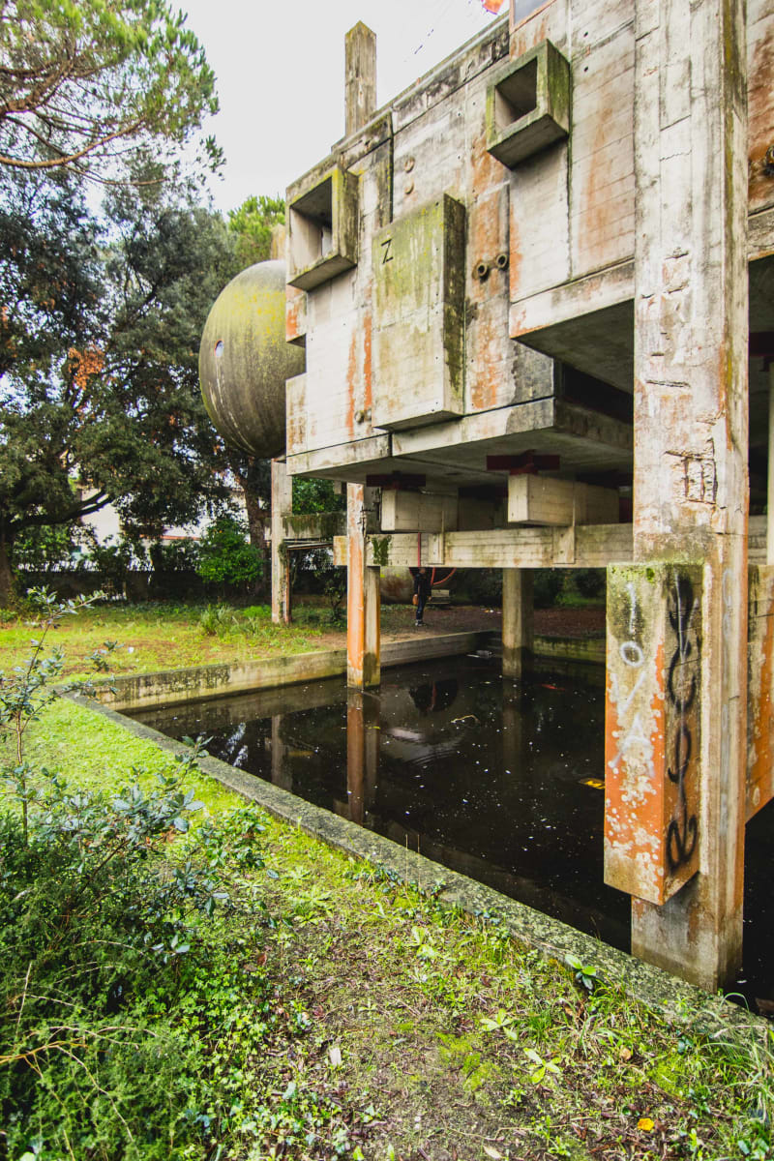
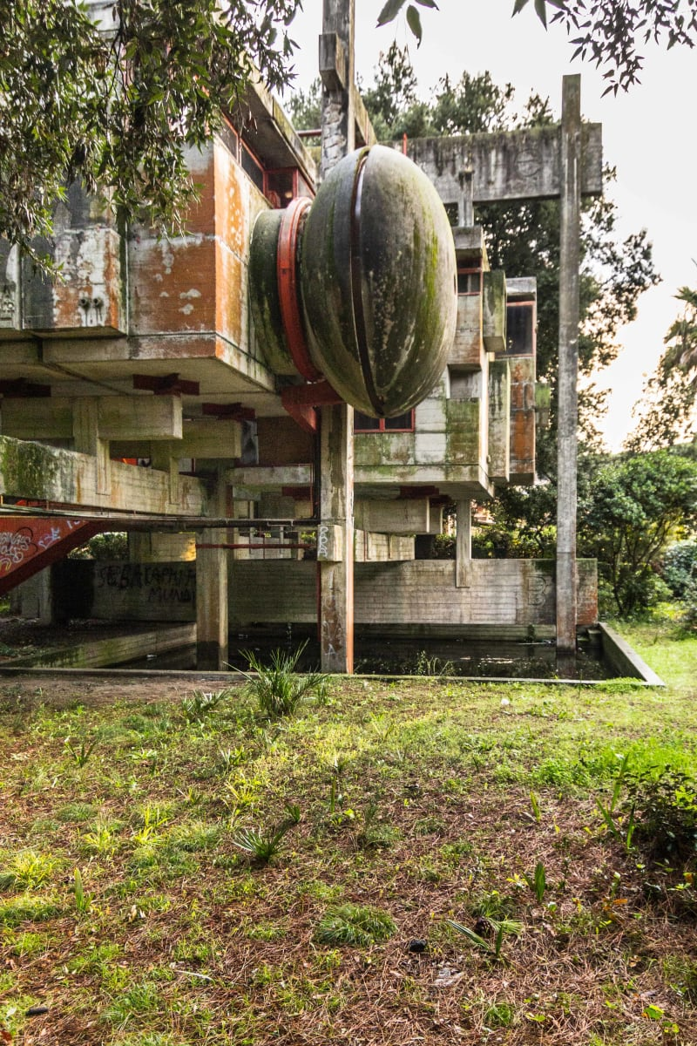
Casa Sperimentale, Fregene, IT (1975)

Slide 19
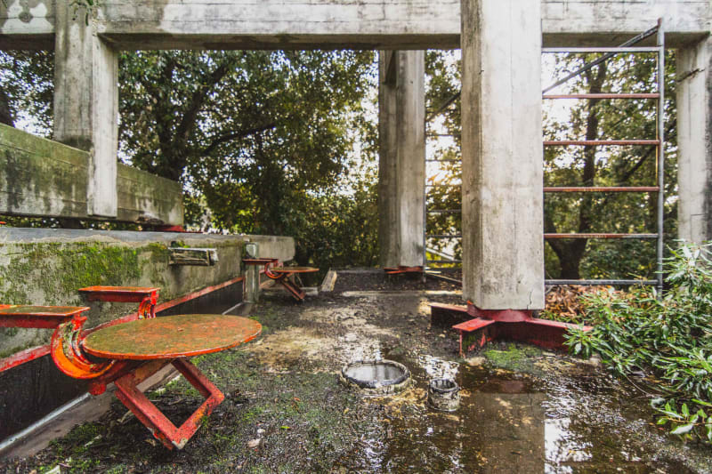
Casa Sperimentale, Fregene, IT (1975)

Slide 20
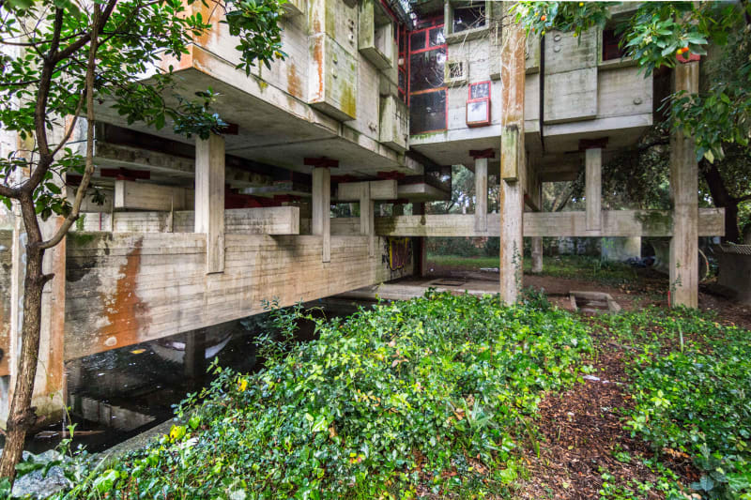
Casa Sperimentale, Fregene, IT (1975)

Slide 21
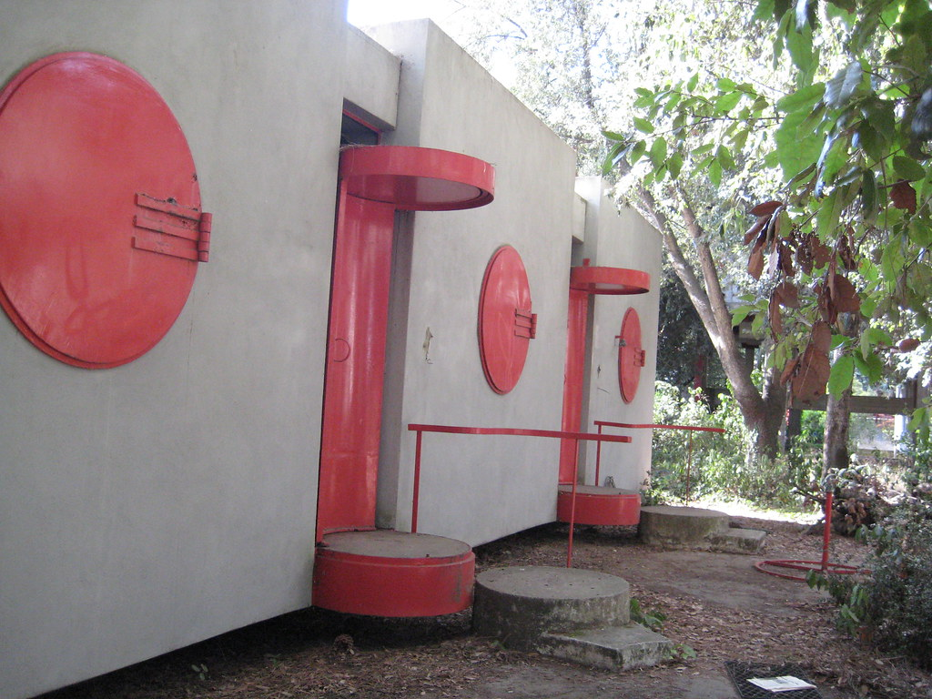
Casa Sperimentale, Fregene, IT (1975)

Slide 22
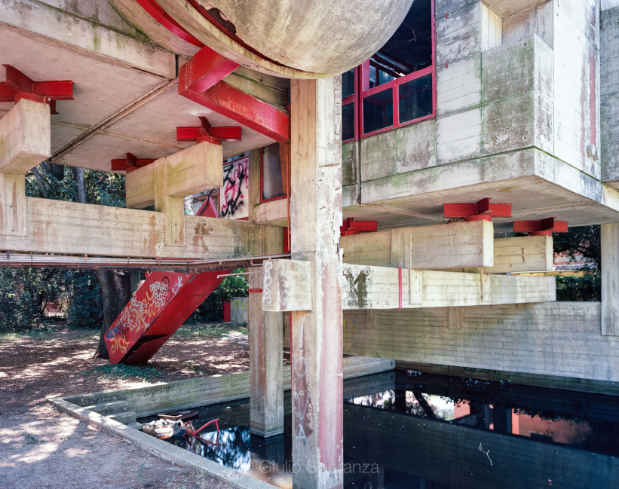
Casa Sperimentale, Fregene, IT (1975)

Slide 23
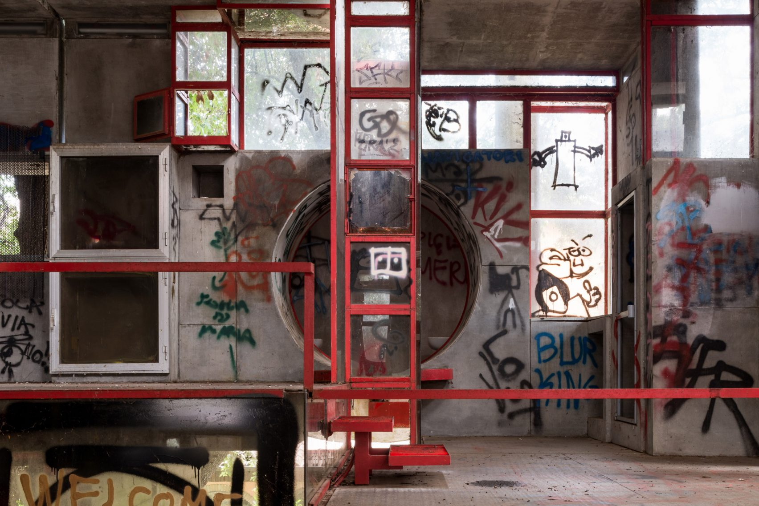
Casa Sperimentale, Fregene, IT (1975)

Slide 24
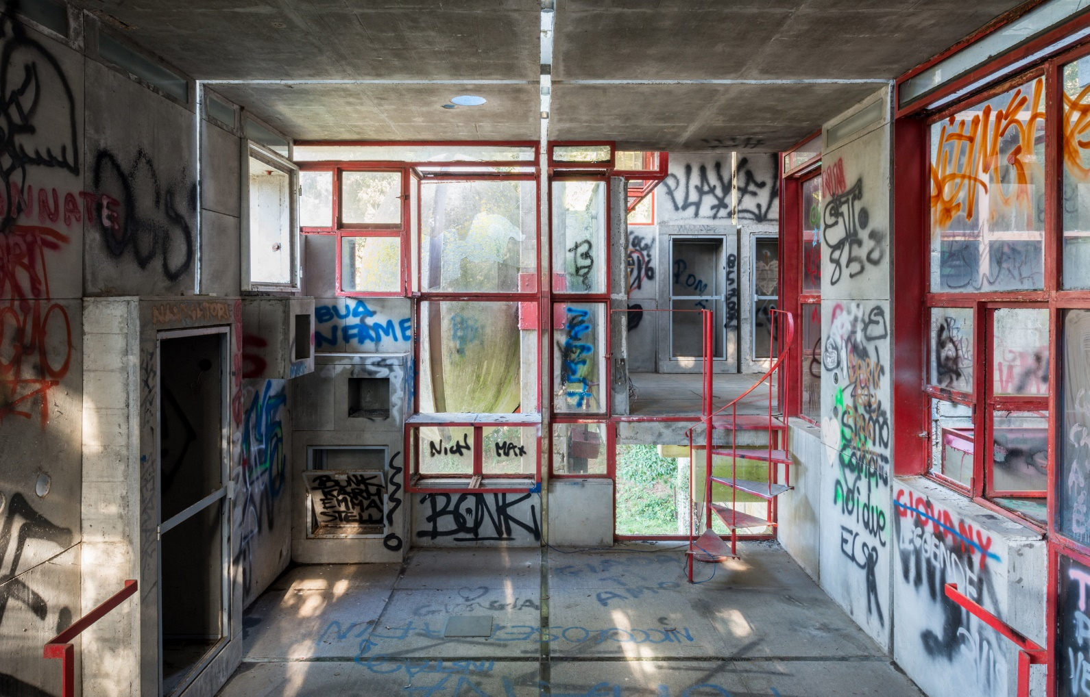
Casa Sperimentale, Fregene, IT (1975)

Slide 25
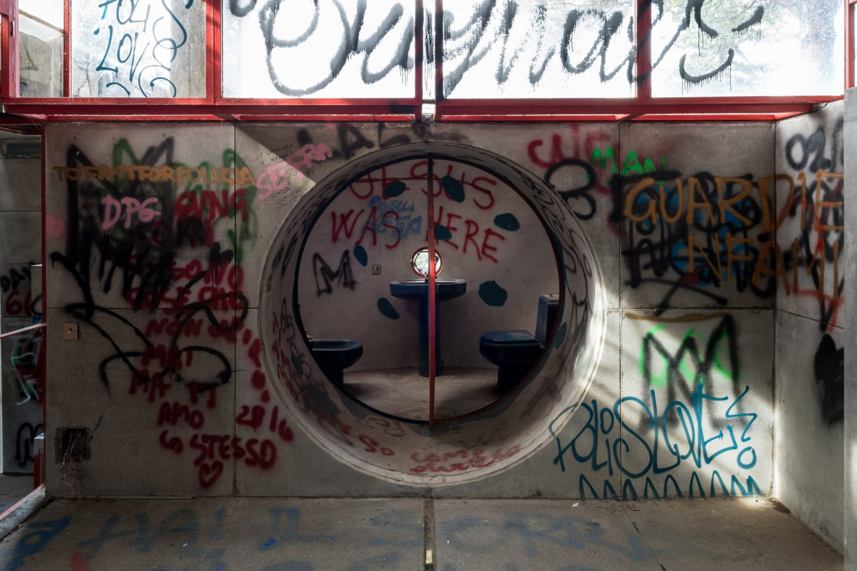
Casa Sperimentale, Fregene, IT (1975)

Slide 26
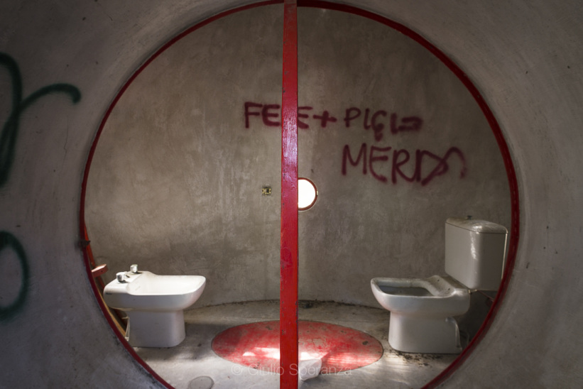
Casa Sperimentale, Fregene, IT (1975)

Slide 27
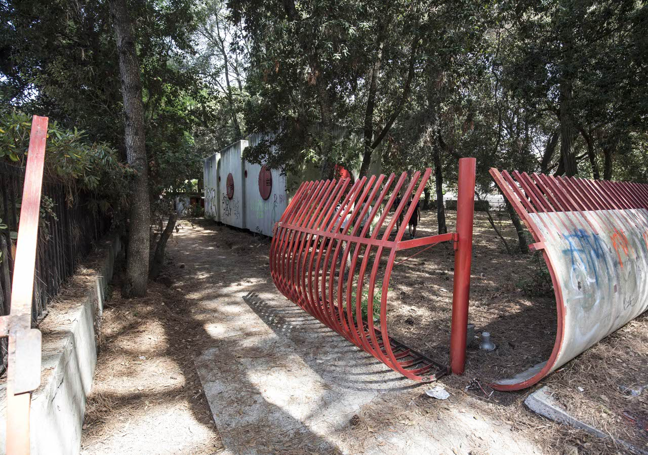
Casa Sperimentale, Fregene, IT (1975)

Slide 28
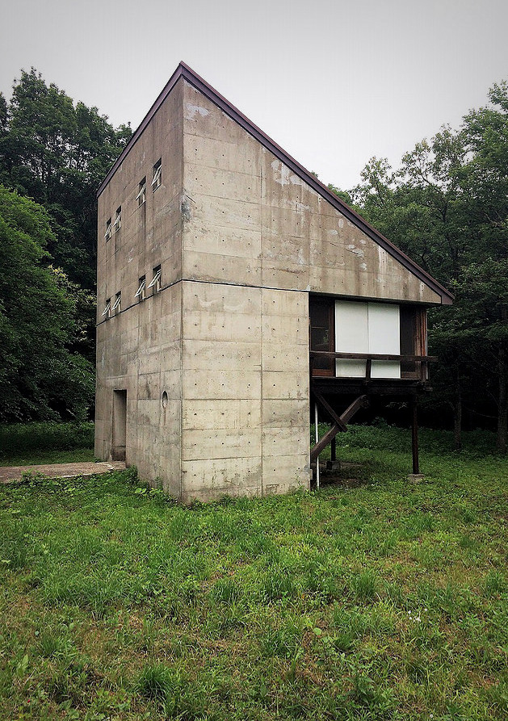
Fukumura Box, Nasu, JP (1975)
Mayumi Miyawaki

Slide 29
Fukumura Box, Nasu, JP (1975)
It is the work of the architect Mayumi Miyawaki.
This house with a simple shape (triangle) that can be found outside and inside is built in concrete. To this concrete structure is added another wooden structure in cantilever and supported by three pillars containing the living rooms (living room, kitchen)

Slide 30
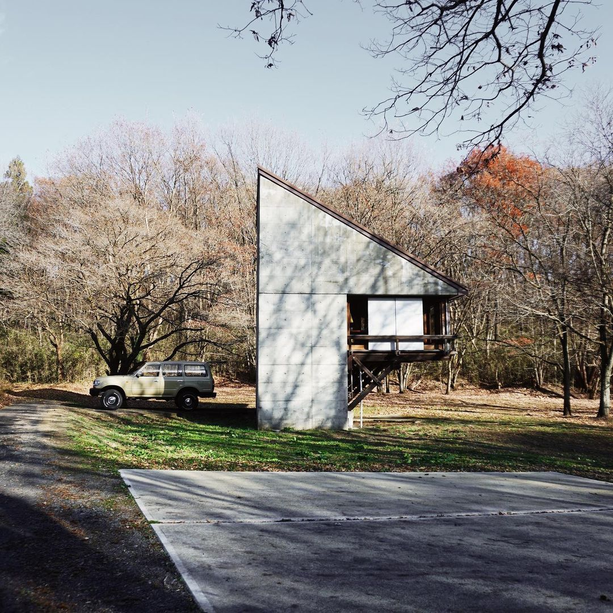
Fukumura Box, Nasu, JP (1975)

Slide 31
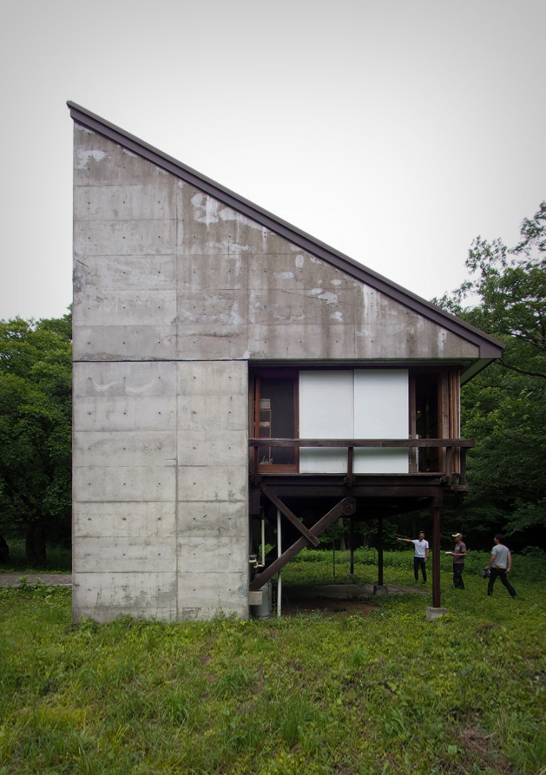
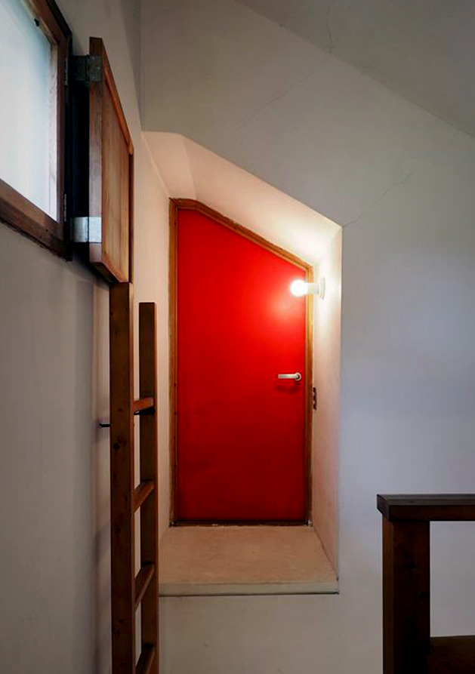
Fukumura Box, Nasu, JP (1975)

Slide 32
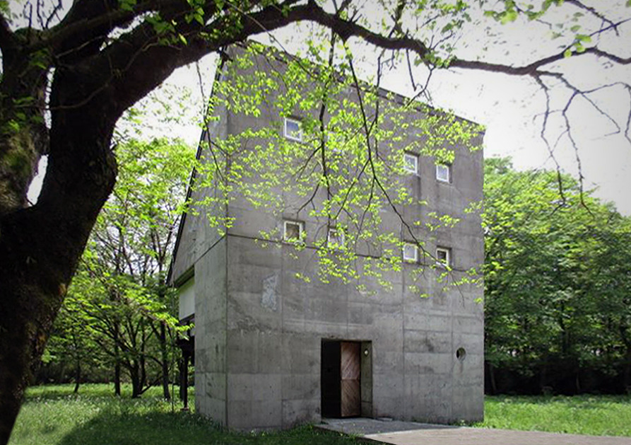
Fukumura Box, Nasu, JP (1975)

Slide 33
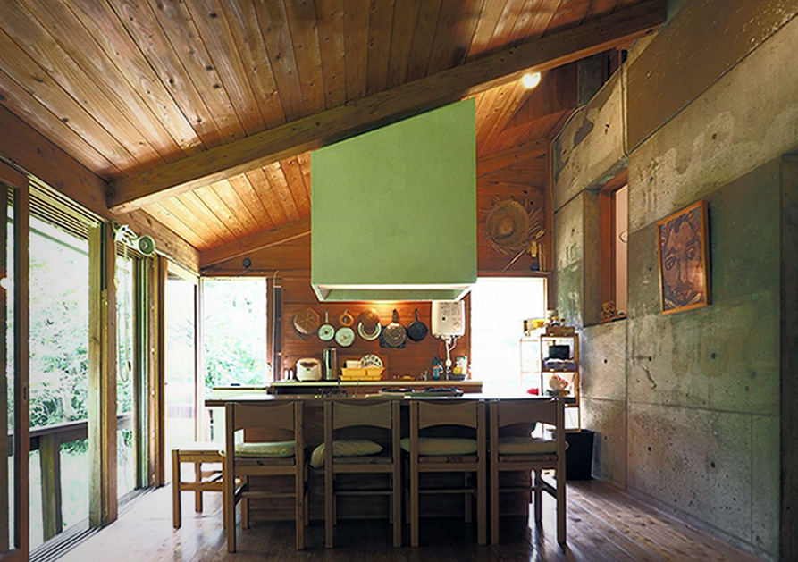
Fukumura Box, Nasu, JP (1975)

Slide 34
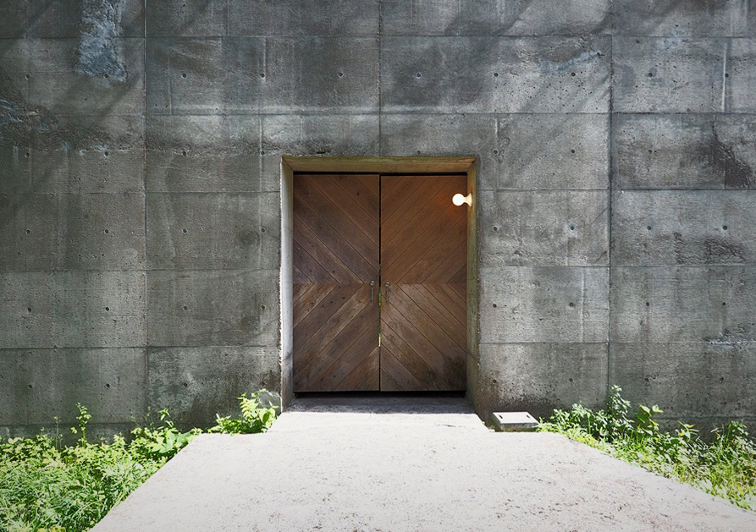
Fukumura Box, Nasu, JP (1975)

Slide 35
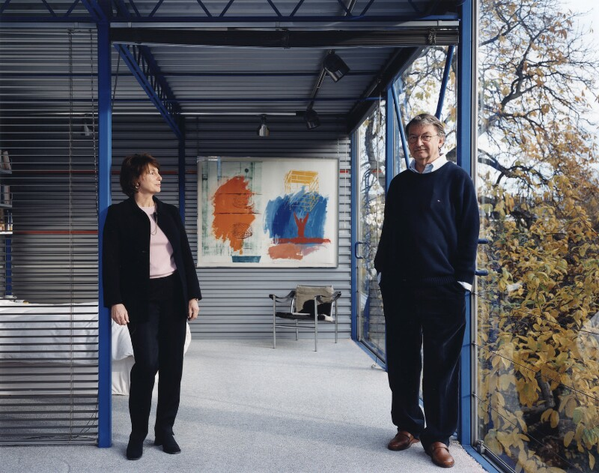
Hopkins House, London, GB (1976)
Patty & Michael
Hopkins

Slide 36
Hopkins House, London, GB (1976)
It is the own house (and office) of the architects Michael & Patty Hopkins.
From the front, the house appears to be single-storey, because the site is 2.5 m below the road. The main entrance is at first-floor across a footbridge, spanning a slope down to the garden level. A small-scale structural steel grid of 2 m x 4 m was chosen, which meant the components could be small and light. Perimeter columns at 2 m centres support the cladding and glazing, without sub-frames. Metal decking for both the floor and roof is supported on a two-way grid of lattice trusses on freestanding columns.

Slide 37
Hopkins House, London, GB (1976)
Side walls are of an insulated metal decking sandwich, and front and back walls have full-height sliding glass doors, with no vertical frames.
The internal planning is open and flexible. Venetian blinds hanging between the internal columns define the various living functions, while prefabricated melamine partitions enclose the bedrooms and shower rooms. The two levels are connected by an open spiral staircase. The basic strategy and cost restraints have produced a building of simplicity and refinement.

Slide 38
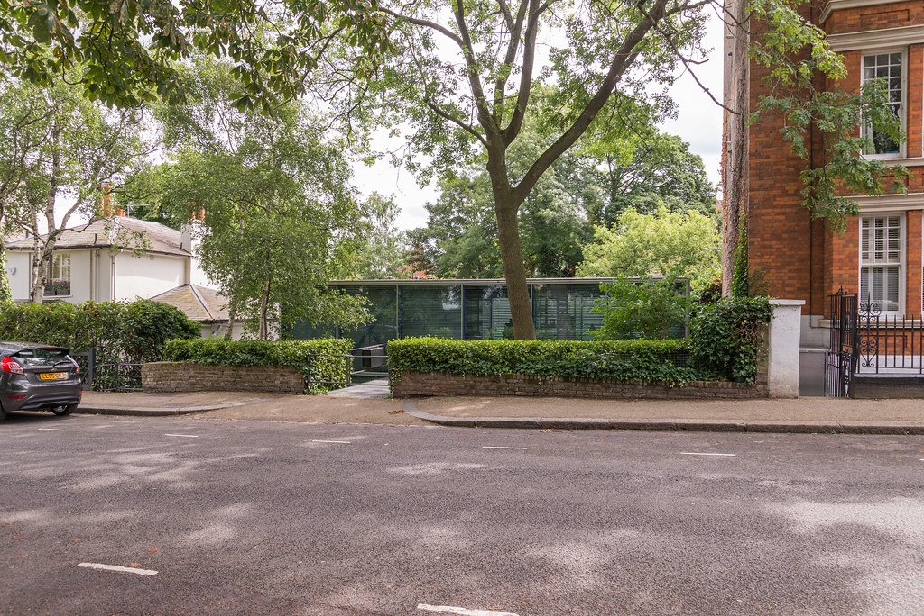
Hopkins House, London, GB (1976)

Slide 39
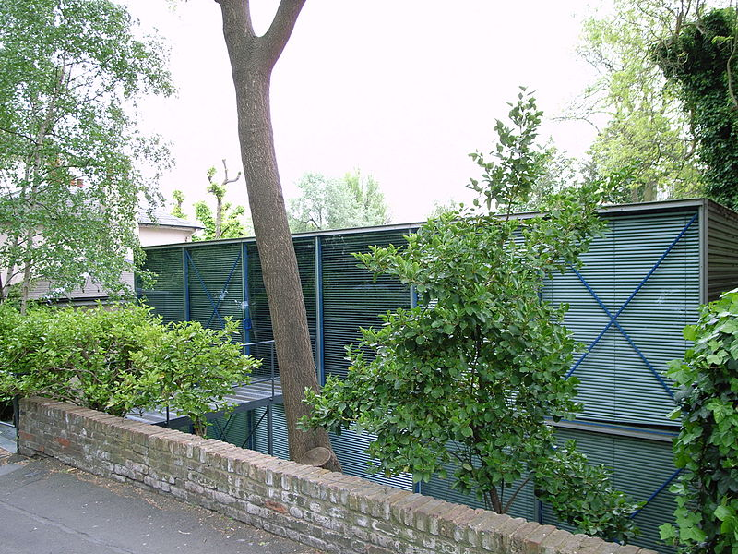
Hopkins House, London, GB (1976)

Slide 40
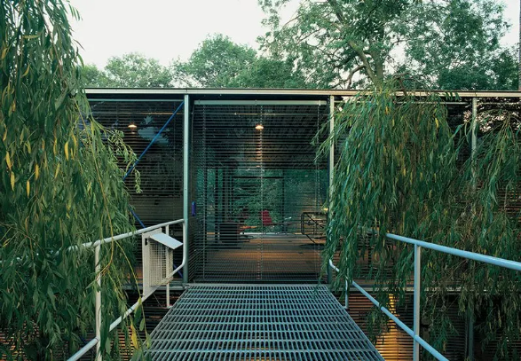
Hopkins House, London, GB (1976)

Slide 41
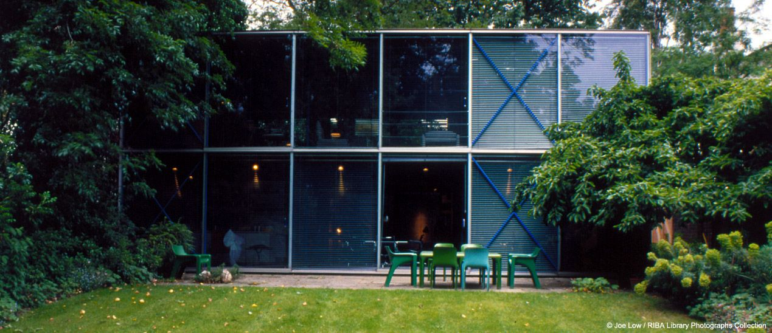
Hopkins House, London, GB (1976)

Slide 42
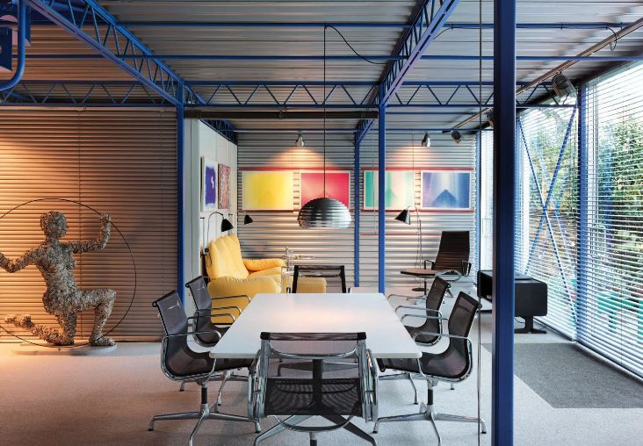
Hopkins House, London, GB (1976)

Slide 43
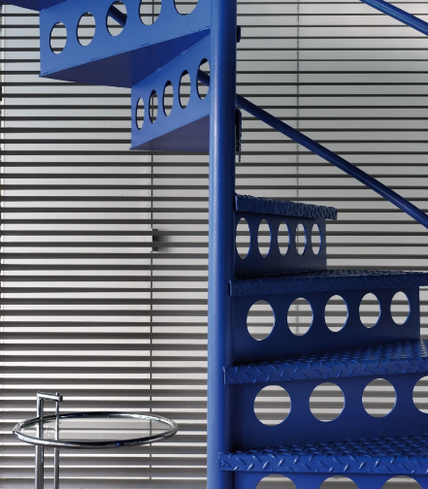
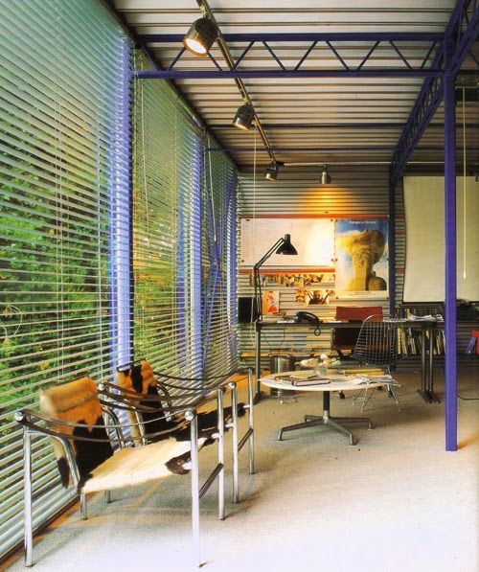
Hopkins House, London, GB (1976)

Slide 44
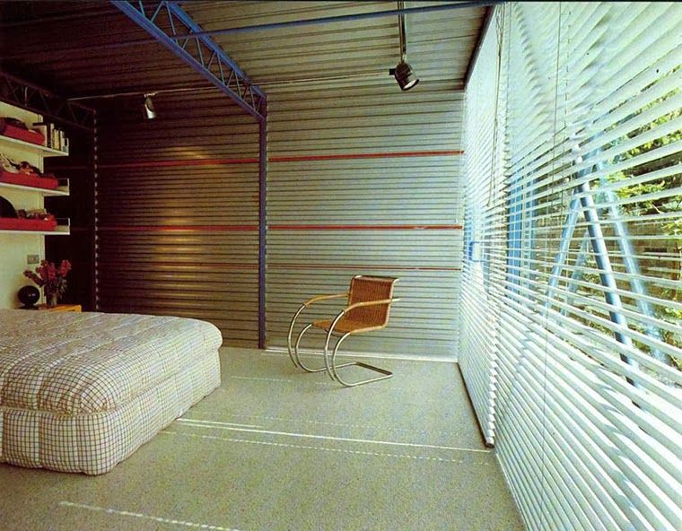
Hopkins House, London, GB (1976)

Slide 45
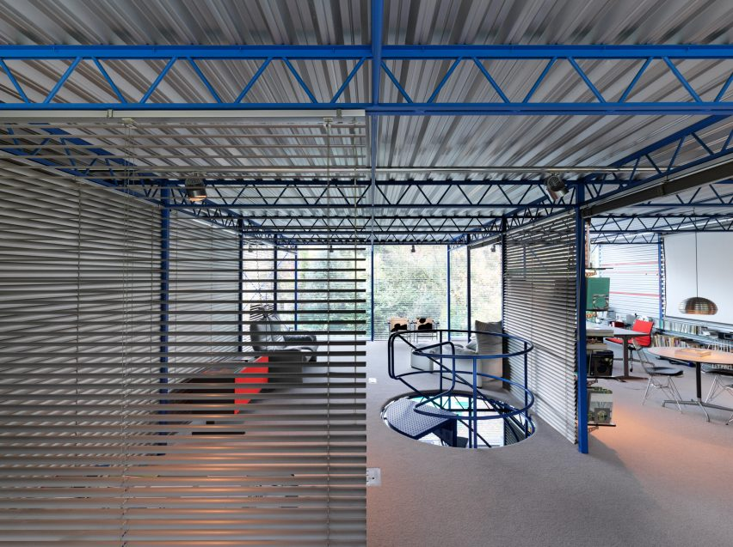
Hopkins House, London, GB (1976)

Slide 46
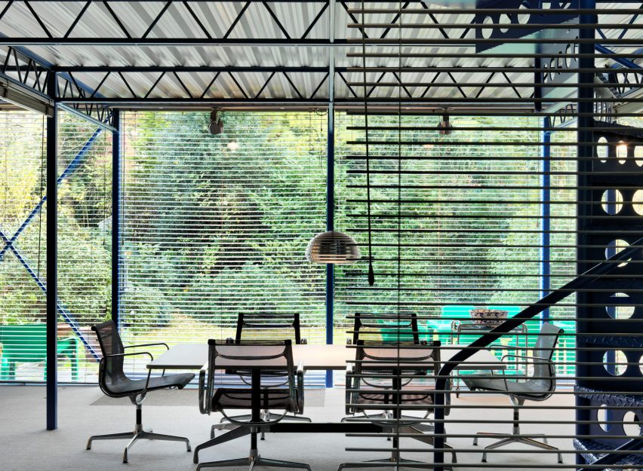
Hopkins House, London, GB (1976)

Slide 47
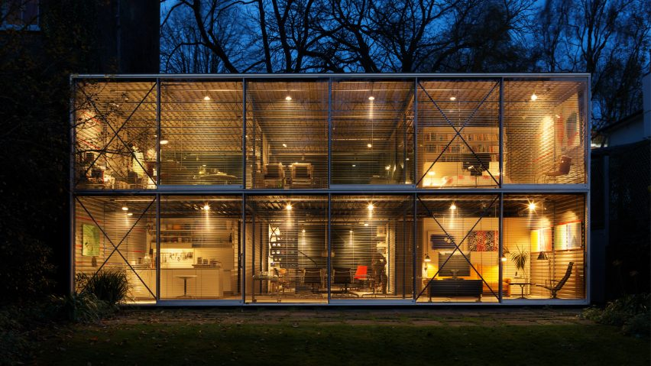
Hopkins House, London, GB (1976)

Slide 48
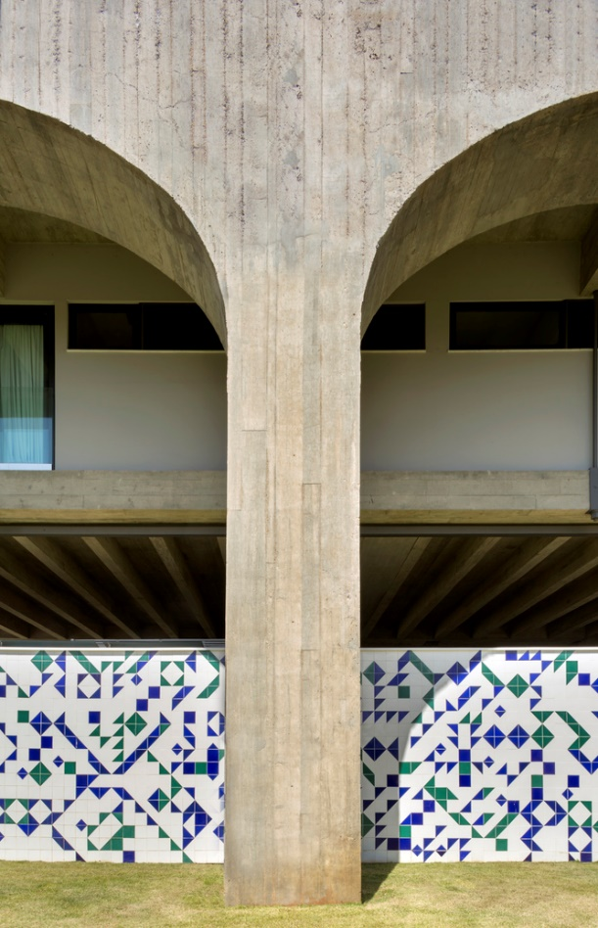
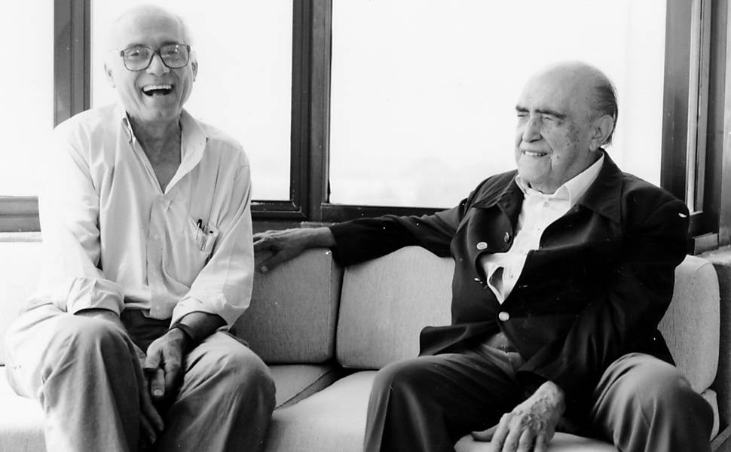
JSN Residência, Brasilia, BR (1976)
João Filgueiras Lima with Oscar Niemeyer

Slide 49
JSN Residência, Brasilia, BR (1976)
It is the work of the architect João Filgueiras Lima.
The residence rests on a reinforced concrete skeleton with only four supporting pillars with rod-bound roof slabs, which makes the house move up to two centimeters a day, from which the ceiling of the living space is suspended. The access to the upper floor is moved to a stair tower, which docks to the rear of the house as an additional building volume. This results in a very open ground floor and a residential floor above it, which is divided into individual living spaces by partitioning walls.

Slide 50
JSN Residência, Brasilia, BR (1976)
Led by architect Lutero Leme in 2019, from the Arquitécnika studio, in Brasília, the project aimed for the revitalization of a Brutalist residence. Aesthetically, decorative sculpted elements were used to separate rooms and allow natural ventilation. In the finishing touches, exposed concrete, wood, marble and granite. All rooms in the house have large glass panels with a wide view to the outside. The living room, with glass room dividers which allow for a 270 degree vision, promotes a beautiful view of the garden.

Slide 51
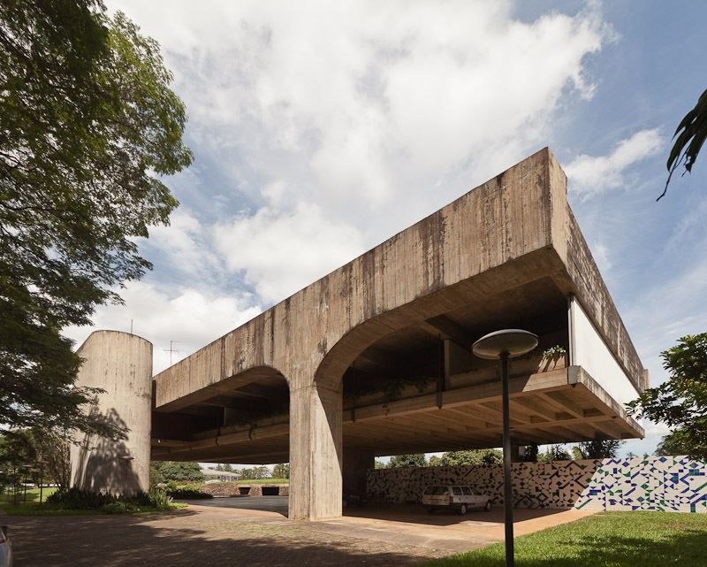
JSN Residência, Brasilia, BR (1976)

Slide 52
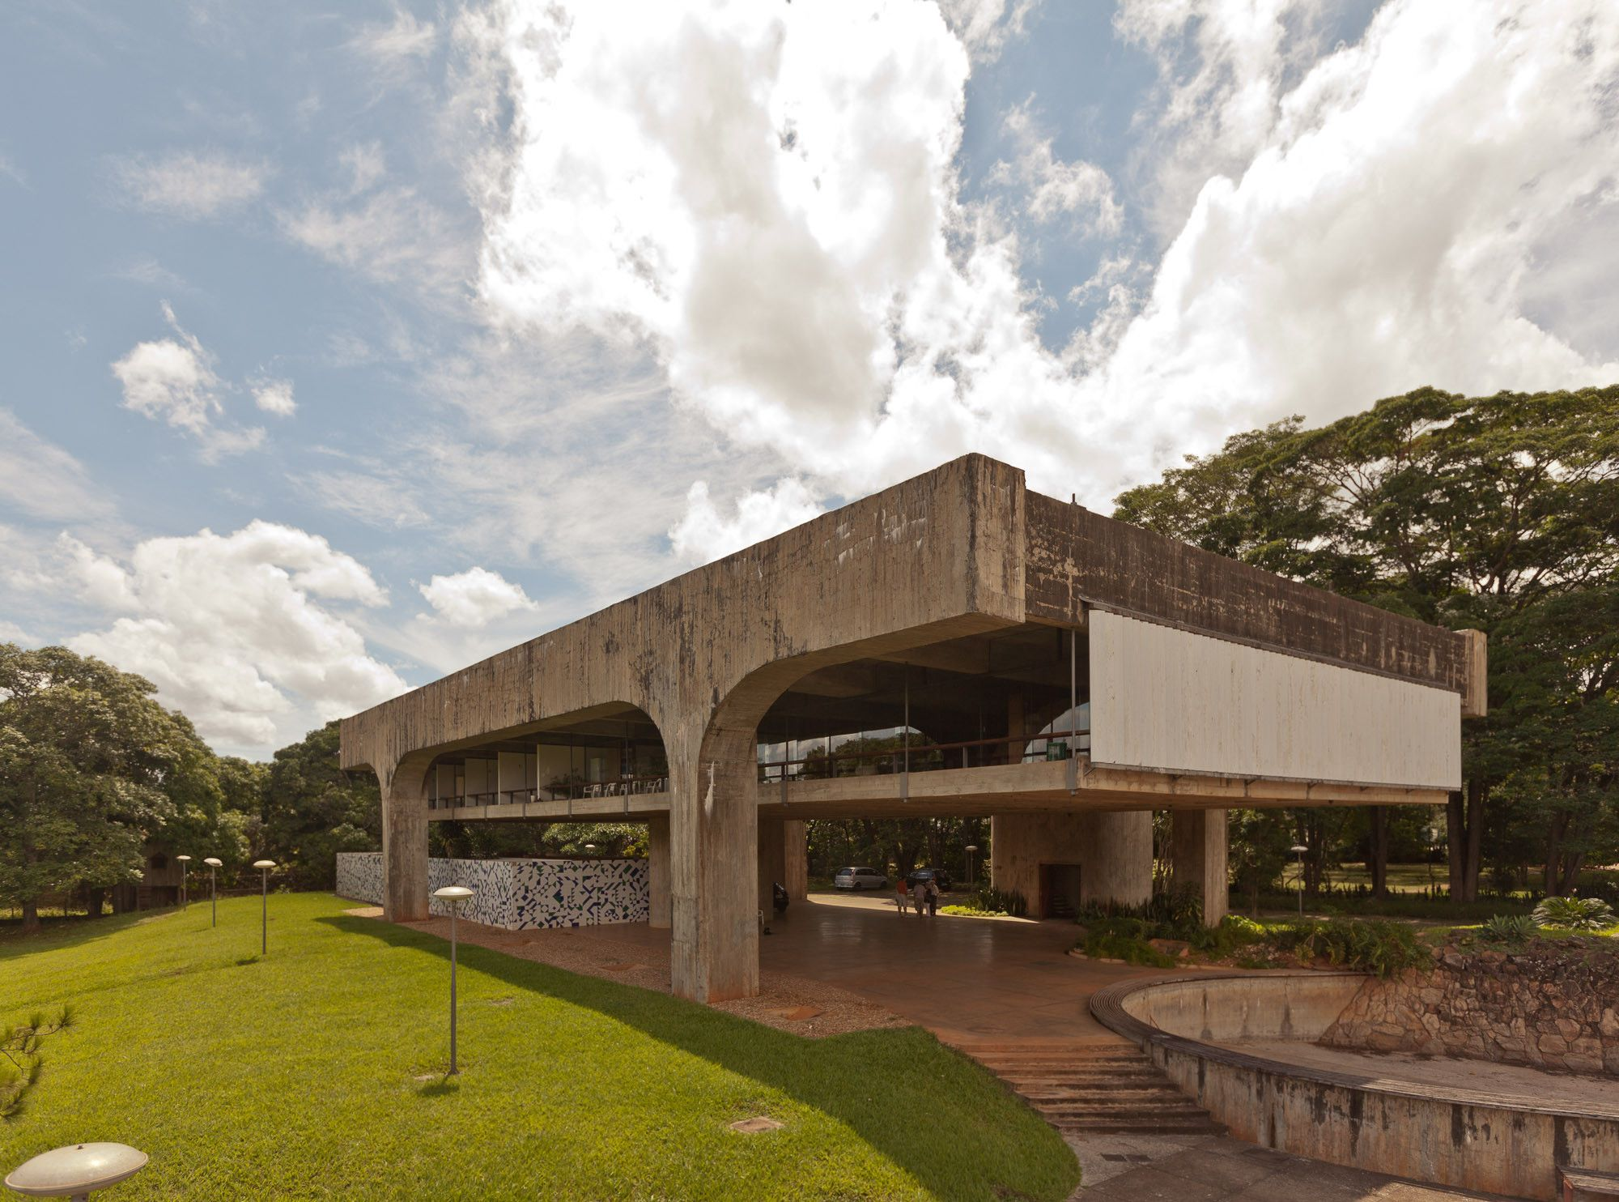
JSN Residência, Brasilia, BR (1976)

Slide 53
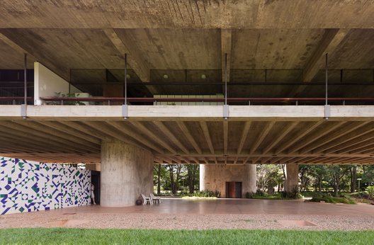
JSN Residência, Brasilia, BR (1976)

Slide 54
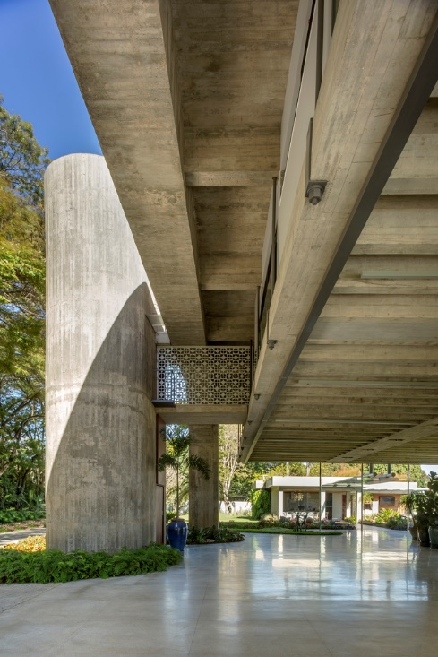
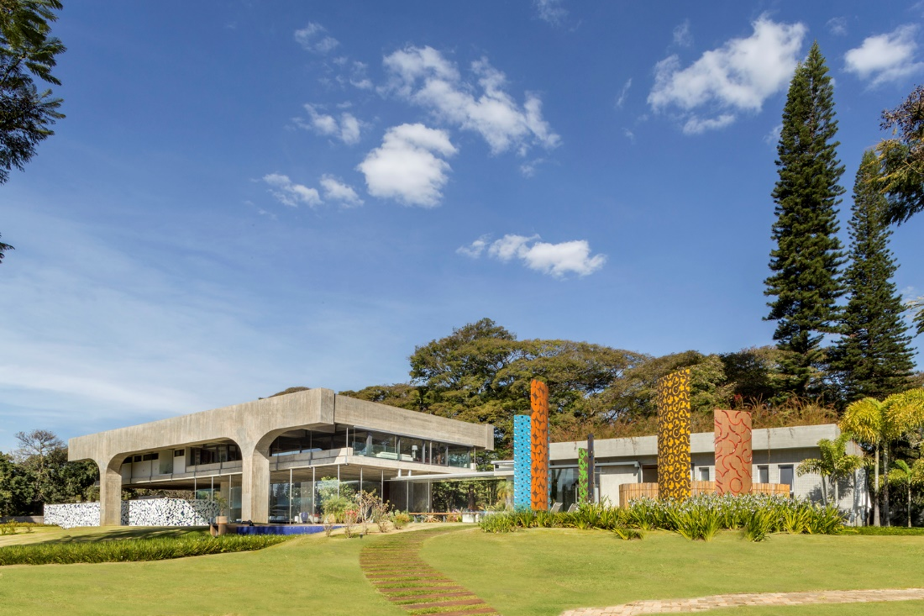
JSN Residência, Brasilia, BR (2019)

Slide 55
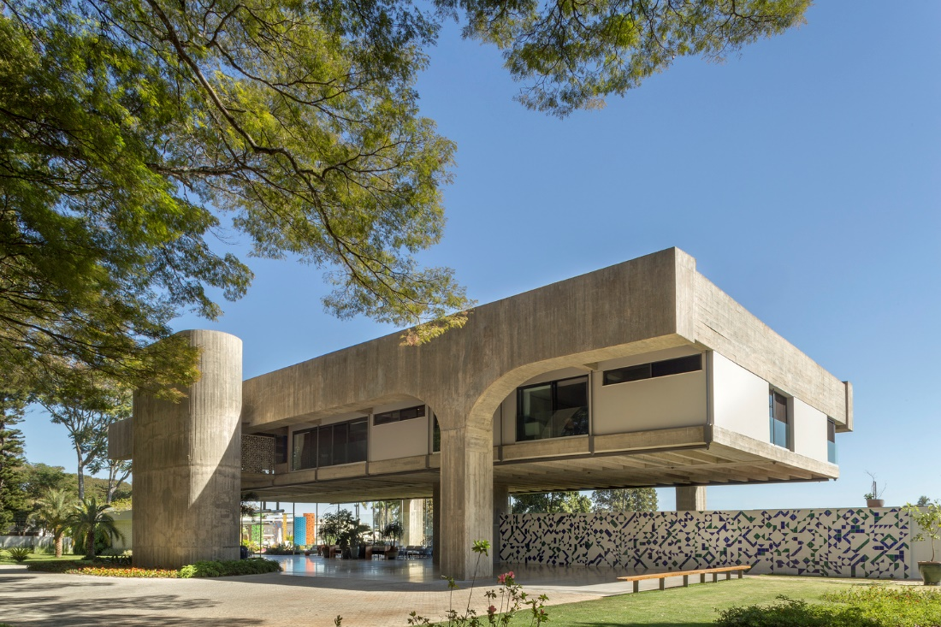
JSN Residência, Brasilia, BR (2019)

Slide 56
JSN Residência, Brasilia, BR (2019)

Slide 57
JSN Residência, Brasilia, BR (2019)

Slide 58
JSN Residência, Brasilia, BR (2019)

Slide 59
JSN Residência, Brasilia, BR (2019)

Slide 60
JSN Residência, Brasilia, BR (2019)

Slide 61
JSN Residência, Brasilia, BR (2019)

Slide 62
JSN Residência, Brasilia, BR (2019)

Slide 63
JSN Residência, Brasilia, BR (2019)

Slide 64
Casa Gribaudo, Torino, IT (1976)
Andrea Bruno

Slide 65
Casa Gribaudo, Torino, IT (1976)
It is the work of the architect Andrea Bruno.
The house is made of exposed reinforced concrete (elegantly sculpted exposed concrete) with cubes protruding irregularly from the façade. No pillars, but only two load-bearing structures on the sides, large windows overlooking the city and narrow cutouts in the concrete Inside, three levels furnished according to the design and a staircase-bookcase that is a sculpture in itself.

Slide 66
Casa Gribaudo, Torino, IT (1976)

Slide 67
Casa Gribaudo, Torino, IT (1976)

Slide 68
Casa Gribaudo, Torino, IT (1976)

Slide 69
Casa Gribaudo, Torino, IT (1976)

Slide 70
Casa Gribaudo, Torino, IT (1976)

Slide 71
Casa Gribaudo, Torino, IT (1976)

Slide 72
Casa Gribaudo, Torino, IT (1976)

Slide 73
Casa Galvagni, Carbuta, IT (1976)
Mario Galvagni

Slide 74
Casa Galvagni, Carbuta, IT (1976)
It is the own house of the architect Mario Galvagni.
It was an old and beautiful abandoned rural peasant house. It is an organic futuristic style and an architecture layered on the existing one starting from the system of "natural light conveyors": "shell" elements made of cement plastered metal mesh placed in the old openings, but oriented according to the light intensity conveyed towards the interior living spaces.

Slide 75
Casa Galvagni, Carbuta, IT (1976)

Slide 76
Casa Galvagni, Carbuta, IT (1976)

Slide 77
Casa Galvagni, Carbuta, IT (1976)

Slide 78
Casa Galvagni, Carbuta, IT (1976)

Slide 79
Casa Galvagni, Carbuta, IT (1976)

Slide 80
Casa Hastings, Lima, PE (1976)
Juvenal Baracco
Franco Vella

Slide 81
Casa Hastings, Lima, PE (1976)
It is the work of the architects Juvenal Baracco & Franco Vella.
It is a building based on recessed prisms of varying heights prolonging the verticality of the cliff. The material used is poured concrete, formed into vertical wooden forms and finished with a layer of ochre fixed with cement, and the ceilings are made of concrete slabs lightened at sight. The windows are made of aluminum and gray glass and the doors are made of wood, purchased in demolitions of old houses and adapted. The house is organized internally as a small urban structure (vertically), with a route organized according to a sequence of narrow and dark circulation spaces, through stairs or corridors and intermediate or arrival spaces very bright.

Slide 82
Casa Hastings, Lima, PE (1976)

Slide 83
Casa Hastings, Lima, PE (1976)

Slide 84
Casa Hastings, Lima, PE (1976)

Slide 85
Casa Hastings, Lima, PE (1976)

Slide 86
Casa Hastings, Lima, PE (1976)

Slide 87
Casa Hastings, Lima, PE (1976)

Slide 88
Casa Hastings, Lima, PE (1976)

Slide 89
Casa Hastings, Lima, PE (1976)

Slide 90
Casa Hastings, Lima, PE (1976)

Slide 91
Uehara House, Tokyo, JP (1976)
Kazuo Shinohara

Slide 92
Uehara House, Tokyo, JP (1976)
It is the work of the architect Kazuo Shinohara.
The overhead roof is a beamless slab supported by 6 columns with unequal pairs of perpendicular diagonal braces. Over the carport, a corner section of wall is suspended from the upper ends of the larger braces, and only here does the 2nd floor translate as a cantilevered concrete slab. In the rest of the house, the walls rise directly from floor to roof. Since the remainder of the 2nd storey floor is framed in wood, it was possible to execute the 2-storey walls in a single pour. On the inner side, plywood to which insulation had been cemented was used as formwork, and this constitutes the interior walls, later on painted.

Slide 93
Uehara House, Tokyo, JP (1976)
The partial cantilevered structure was necessary to provide space to park 2 cars outside the 1st floor work area and studio. Because of a building restriction, the height of the street façade was limited to 5 m, but use of a beamless slab enabled the provision of adequate ceiling heights. At the same time, the braces needed for the roof slab created problems in the floor plan, and particularly in the area around the freestanding central post, where a massive 45-degree brace runs directly in between the top of the entrance stairway and the living room. The ground floor was a studio for an art photographer and the upper storey is composed principally of the standard living-dining-kitchen space.

Slide 94
Uehara House, Tokyo, JP (1976)

Slide 95
Uehara House, Tokyo, JP (1976)

Slide 96
Uehara House, Tokyo, JP (1976)

Slide 97
Uehara House, Tokyo, JP (1976)

Slide 98
Uehara House, Tokyo, JP (1976)

Slide 99
Uehara House, Tokyo, JP (1976)

Slide 100
Uehara House, Tokyo, JP (1976)

Slide 101
Uehara House, Tokyo, JP (1976)

Slide 102
Nomiyama House, Itoshima, JP (1976)
Kazuo Shinohara
Gyoji Nomiyama

Slide 103
Nomiyama House, Itoshima, JP (1976)
It is the work of the architect Kazuo Shinohara for the artist Gyoji Nomiyama.
This imposing concrete house is also a painter's studio: the high blind walls of the studio only lit by a zenithal light through a large porthole can accommodate large paintings. Shinohara Kazuo reversed the concept of the enclosed Cube and designed an exterior cubic frame opened to an ideal landscape of mountain and water (sansui). The fissure and Cube compose a kind of spatial instrument that borrows the landscape (shakkei).

Slide 104
Nomiyama House, Itoshima, JP (1976)

Slide 105
Nomiyama House, Itoshima, JP (1976)

Slide 106
Nomiyama House, Itoshima, JP (1976)

Slide 107
Nomiyama House, Itoshima, JP (1976)

Slide 108
Nomiyama House, Itoshima, JP (1976)

Slide 109
Wandich House, Stoney Lake, CA (1976)
Jim Strasman

Slide 110
Wandich House, Stoney Lake, CA (1976)
It is the work of the architect Jim Strasman.
It was designed to intrude as little as possible on the existing landscape. This was achieved by partially lifting the residence off of the ground. The supports, two concrete structures on either side that contain the bedrooms, create a bridge containing the living areas, dining room and kitchen. The glass and steel bridge, partly cantilevered over the lake, also provides an optimum vantage point to enjoy every view of the surrounding environment: thick woods to the North, the lake and green hillside farms to the South.

Slide 111
Wandich House, Stoney Lake, CA (1976)

Slide 112
Wandich House, Stoney Lake, CA (1976)

Slide 113
Wandich House, Stoney Lake, CA (1976)

Slide 114
Wandich House, Stoney Lake, CA (1976)

Slide 115
Wandich House, Stoney Lake, CA (1976)

Slide 116
Wandich House, Stoney Lake, CA (1976)

Slide 117
Wandich House, Stoney Lake, CA (1976)

Slide 118
Wandich House, Stoney Lake, CA (1976)

Slide 119
Casa Bianchi, Ligornetto, CH (1976)
Mario Botta

Slide 120
Casa Bianchi, Ligornetto, CH (1976)
It is the work of the architect Mario Botta.
The house is characterized by a wall made of alternate colored bands. The north facade, towards the countryside, is compact and cut in the centre by one vertical strip of glass panels that let in the day light. The different rooms give onto the central space in correspondance with the south facade. The house is on 3 levels : the portico, the entrance and the cellars on the ground floor; the large living area and the children’s bedrooms on the 1st floor; the master bedroom and the study on the 2nd floor.

Slide 121
Casa Bianchi, Ligornetto, CH (1976)

Slide 122
Casa Bianchi, Ligornetto, CH (1976)

Slide 123
Casa Bianchi, Ligornetto, CH (1976)

Slide 124
Casa Bianchi, Ligornetto, CH (1976)

Slide 125
Casa Bianchi, Ligornetto, CH (1976)

Slide 126
Casa Kalmann, Minusio, CH (1976)
Luigi Snozzi

Slide 127
Casa Kalmann, Minusio, CH (1976)
It is the work of the architect Luigi Snozzi.
Kalmann's house is a concrete box, with an open end reminiscent of Le Corbusier's maison Citröhan. The house is organized around a curved retaining wall, which distorts the open end of the box and extends to form a pergola overlooking Lake Maggiore. The staircase runs through a 3-story-high light-filled void along this retaining wall (the entrance is at basement level). There is no distinction between pillars and walls - all surfaces are concrete, except for the floor made of red tiles.

Slide 128
Casa Kalmann, Minusio, CH (1976)

Slide 129
Casa Kalmann, Minusio, CH (1976)

Slide 130
Casa Kalmann, Minusio, CH (1976)

Slide 131
Casa Kalmann, Minusio, CH (1976)

Slide 132
Yamakawa Villa, Yatsugatake, JP (1977)
Riken Yamamoto

Slide 133
Yamakawa Villa, Yatsugatake, JP (1977)
It is the work of the architect Riken Yamamoto.
A number of rooms stand, separated from one another, in the middle of the woods, and a single roof covers them all. A gabled roof was the only roof form I could think of at the time. The idea of dispersing the rooms on the deck seemed to me completely new. Small windows in the rooms afford views. We wanted the windows to be as small as possible. The villa would be used mainly as a summer retreat; it would not be used in winter. Those were his only conditions. We therefore designed a house that seemed to be all terrace.

Slide 134
Yamakawa Villa, Yatsugatake, JP (1977)

Slide 135
Yamakawa Villa, Yatsugatake, JP (1977)

Slide 136
Yamakawa Villa, Yatsugatake, JP (1977)

Slide 137
Yamakawa Villa, Yatsugatake, JP (1977)

Slide 138
Carvalhal Residence, Sao Paulo, BR (1977)
Decio Tozzi

Slide 139
Carvalhal Residence, Sao Paulo, BR (1977)
It is the work of the architect Decio Tozzi.
The emphasis of the architectural composition in this project was ultimately not on the content with traditional spatial organization, but on the form in relation to the landscape. It is a semi-buried house with brick walls, an old technique well adapted to the region and where the color of the brick also fits well with the idea of topography and landscape.

Slide 140
Carvalhal Residence, Sao Paulo, BR (1977)

Slide 141
Carvalhal Residence, Sao Paulo, BR (1977)

Slide 142
Carvalhal Residence, Sao Paulo, BR (1977)

Slide 143
Carvalhal Residence, Sao Paulo, BR (1977)

Slide 144
Carvalhal Residence, Sao Paulo, BR (1977)

Slide 145
Carvalhal Residence, Sao Paulo, BR (1977)

Slide 146
Carvalhal Residence, Sao Paulo, BR (1977)

Slide 147
Carvalhal Residence, Sao Paulo, BR (1977)

Slide 148
Morris Residence, Edinburgh, GB (1977)
J. Morris

Slide 149
Morris Residence, Edinburgh, GB (1977)
It is the own house of the architect James Morris.
The house incorporates many of the domestic innovations incorporated in earlier homes such as large glazed panels, both ceiling and under-floor heating and is designed with the living spaces on the first floor. The two floors of the house are encased in glass. The open space on the second floor is split to form a drawing room, library, gallery and billiard room with a balcony projecting over the conservatory and pool.

Slide 150
Morris Residence, Edinburgh, GB (1977)

Slide 151
Morris Residence, Edinburgh, GB (1977)

Slide 152
Morris Residence, Edinburgh, GB (1977)

Slide 153
Morris Residence, Edinburgh, GB (1977)

Slide 154
Morris Residence, Edinburgh, GB (1977)

Slide 155
Silver Triangle House, Yaizu, JP (1977)
Itsuko Hasegawa

Slide 156
Silver Triangle House, Yaizu, JP (1977)
It is the work of the architect Itsuko Hasegawa.
The house stands on a suburban site facing a national autoroute. But no concern for the special condition of the site seems to have played a role in determining this purely geometric form. This autonomous form rejects any form of assimilation into its surroundings. The self-sufficiency of the form of the house is a sufficient condition for the defamiliarization of the scene in a cityscape without quality.

Slide 157
Silver Triangle House, Yaizu, JP (1977)

Slide 158
Silver Triangle House, Yaizu, JP (1977)

Slide 159
Silver Triangle House, Yaizu, JP (1977)

Slide 160
Silver Triangle House, Yaizu, JP (1977)

Slide 161
Villa Ottolenghi, Bardolino, IT (1978)
Carlo Scarpa

Slide 162
Villa Ottolenghi, Bardolino, IT (1978)
It is the work of the architect Carlo Scarpa.
The morphological configuration of the area, bounded on the west by a steep slope, to the north and east by an embankment, has in fact suggested to the man to bury most of the house in the ground and to play with interesting design ideas. The roof that becomes a habitable place, he most striking of them is inspired by the farmyard of the Veneto farms, a brick surface with irregular pattern from which to admire the splendid surrounding landscape as if there were no borders, as if the real roof it was heaven.

Slide 163
Villa Ottolenghi, Bardolino, IT (1978)
The surfaces of the windows reflect the mirrors of water (typical compositional element of Scarpa's architecture) multiply the walls of the house, as happens in the Venetian palaces.
The nine giant cylindrical pillars, built with cement, Prun and Trani stone , which support the roof, shape the living room and underline changes in height between living areas, kitchen, dining room and bathroom that otherwise seem to lack separation. The massive, layered columns take up a tremendous amount of space often at awkward locations. Scarpa labored over their positioning, suggesting that this disruption of convenience is deliberate.

Slide 164
Villa Ottolenghi, Bardolino, IT (1978)

Slide 165
Villa Ottolenghi, Bardolino, IT (1978)

Slide 166
Villa Ottolenghi, Bardolino, IT (1978)

Slide 167
Villa Ottolenghi, Bardolino, IT (1978)

Slide 168
Villa Ottolenghi, Bardolino, IT (1978)

Slide 169
Villa Ottolenghi, Bardolino, IT (1978)

Slide 170
Villa Ottolenghi, Bardolino, IT (1978)

Slide 171
Villa Ottolenghi, Bardolino, IT (1978)

Slide 172
Villa Ottolenghi, Bardolino, IT (1978)

Slide 173
Villa Ottolenghi, Bardolino, IT (1978)

Slide 174
Villa Ottolenghi, Bardolino, IT (1978)

Slide 175
Villa Ottolenghi, Bardolino, IT (1978)

Slide 176
Villa Ottolenghi, Bardolino, IT (1978)

Slide 177
Villa Ottolenghi, Bardolino, IT (1978)

Slide 178
Villa Ottolenghi, Bardolino, IT (1978)

Slide 179
Villa Ottolenghi, Bardolino, IT (1978)

Slide 180
Villa Ottolenghi, Bardolino, IT (1978)

Slide 181
Villa Ottolenghi, Bardolino, IT (1978)

Slide 182
Residencia Borges, Brasilia, BR (1978)
João Filgueiras Lima

Slide 183
Residencia Borges, Brasilia, BR (1978)
It is the work of the architect João Filgueiras Lima.
The construction system is the dominant theme : the brick vaults with the exception of the central body, where they were replaced by pre-molded caissons of reinforced mortar. The central space, with its almost 8m high ceiling contains the living room and study room, interspersed with gardens and a water mirror. As if completing the historic typology, it is broken up by side wings that extend lengthwise, with lower ceilings, one facing south, reserved for the service and dining rooms, and the other facing north, where the bedrooms (7) and the main living room are. The extensive glass panels encloses the northeast, southwest, and northwest facades.

Slide 184
Residencia Borges, Brasilia, BR (1978)

Slide 185
Residencia Borges, Brasilia, BR (1978)

Slide 186
Residencia Borges, Brasilia, BR (1978)

Slide 187
Residencia Borges, Brasilia, BR (1978)

Slide 188
Residencia Borges, Brasilia, BR (1978)

Slide 189
Residencia Borges, Brasilia, BR (1978)

Slide 190
Residencia Borges, Brasilia, BR (1978)

Slide 191
Residencia Borges, Brasilia, BR (1978)

Slide 192
Residencia Borges, Brasilia, BR (1978)

Slide 193
Residencia Borges, Brasilia, BR (1978)

Slide 194
Residencia Borges, Brasilia, BR (1978)

Slide 195
Residencia Borges, Brasilia, BR (1978)

Slide 196
Residencia Borges, Brasilia, BR (1978)

Slide 197
Haus Schütte, Köln, DE (1978)
Heinz Bienefeld

Slide 198
Haus Schütte, Köln, DE (1978)
It is the work of the architect Heinz Bienefeld.
The home has an introverted character, orienting around an atrium with a closed street wall. On the garden side, it is on the contrary a glass curtain wall that will bring warmth and light to the living room. The facades are made of red brick facing backwards so the visible side had more texture. The pavement in front of the house is made of the same material as a facade, which gives the house a sense of belonging in its environment. The walls are made of solid brickwork that are also unfinished on the inside.

Slide 199
Haus Schütte, Köln, DE (1978)

Slide 200
Haus Schütte, Köln, DE (1978)

Slide 201
Haus Schütte, Köln, DE (1978)

Slide 202
Haus Schütte, Köln, DE (1978)

Slide 203
Haus Schütte, Köln, DE (1978)

Slide 204
Haus Schütte, Köln, DE (1978)

Slide 205
Haus Schütte, Köln, DE (1978)

Slide 206
Haus Schütte, Köln, DE (1978)

Slide 207
Maki House, Tokyo, JP (1978)
Fumihiko Maki

Slide 208
Maki House, Tokyo, JP (1978)
It is the own house of the architect Fumihiko Maki.
It is his first (and only) built house in Tokyo because the architect also is not very much interested in designing single family houses. The house is made of concrete, but the architect also knows how to integrate mosaic, anodized aluminum and wood in the interior design. It is a simple cubic form in the respect of the neighboring constructions.

Slide 209
Maki House, Tokyo, JP (1978)

Slide 210
Maki House, Tokyo, JP (1978)

Slide 211
Maki House, Tokyo, JP (1978)

Slide 212
Halfway House, Midrand, ZA (1985)
Stanley Saitowitz

Slide 213
Halfway House, Midrand, ZA (1985)
It is the work of the architect Stanley Saitowitz.
The terraces are continuous and sweep up along the rim of the circle as roofs, weaving the ground into the sky, containing in its thickness the sheltered habitable part. The trusses open the roof to the air, whose hollowness supports the space. The circle of the buildings walling the oasis are the house, workshop and garage, the cottage, 3 huts loosely woven with the earth.

Slide 214
Halfway House, Midrand, ZA (1985)

Slide 215
Halfway House, Midrand, ZA (1985)

Slide 216
Halfway House, Midrand, ZA (1985)

Slide 217
Halfway House, Midrand, ZA (1985)

Slide 218
Halfway House, Midrand, ZA (1985)

Slide 219
Halfway House, Midrand, ZA (1985)

Slide 220
Halfway House, Midrand, ZA (1985)

Slide 221
Maison Dick, Troyes, FR (1979)

Slide 222
Maison Dick, Troyes, FR (1979)
To mark the difference, Jean Nouvel creates arcades on the exterior walls of the living room and the kitchen. These elements, which have no technical necessity or decorative purpose, show the internal volumes of the house.
Symbol of anger against censorship, the use of red bricks provides deliberately a contrast with the others, mostly brown.

Slide 223
Maison Dick, Troyes, FR (1979)
The roof of the living room, the corridor, the windows of the children's bedrooms, the external junction between the green bedroom and the yellow bedroom are covered by zinc.
Regarding the interior walls of the main rooms, they are, like the exterior walls, covered with bricks. This unity of the vertical portions echoes the unity of the horizontal portions. Indeed, the exterior terraces and the interior floors are all coated with the same material (sandstone tiles). The only nuances lie in the size of the tiles and the presence of a pattern layout in the living room.

Slide 224
Maison Dick, Troyes, FR (1979)

Slide 225
Maison Dick, Troyes, FR (1979)

Slide 226
Maison Dick, Troyes, FR (1979)

Slide 227
Maison Dick, Troyes, FR (1979)

Slide 228
Maison Dick, Troyes, FR (1979)

Slide 229
Maison Dick, Troyes, FR (1979)

Slide 230
Maison Dick, Troyes, FR (1979)

Slide 231
Casa Bola, Sao Paulo, BR (1979)
Eduardo Longo

Slide 232
Casa Bola, Sao Paulo, BR (1979)
It is the own house of the architect Eduardo Longo.
The circular shape proved to be advantageous due to the economy of material, high resistance and the possibility of making better use of the terrain. The new housing, however, could reach only 8m in diameter without invading the neighbor's area.
The construction of Casa Bola relied on metallic weave and reinforced mortar (concrete without stone), which brought firmness to the residence. Long was also concerned with coating the structure with thermal insulation and ensuring the entry of light through large windows, especially in the rooms.

Slide 233
Casa Bola, Sao Paulo, BR (1979)
The architect decided at the last moment to cover the model with aluminum plates - giving something spatial to the façade. The building's floors are also materialized with steel tubes welded over the spherical structure and then closed with reinforced mortar.
On the spherical tubular structure an iron mesh of three sixteenths of an inch is welded and on it a stucco screen, to then begin the closing of the house with reinforced mortar. All the walls, all the fixed furniture, and most of the equipment of the building are materialized with this technique.
The three floors of the new house represented 135 m² of floor and ended up being divided according to the traditional format of the time.

Slide 234
Casa Bola, Sao Paulo, BR (1979)

Slide 235
Casa Bola, Sao Paulo, BR (1979)

Slide 236
Casa Bola, Sao Paulo, BR (1979)

Slide 237
Casa Bola, Sao Paulo, BR (1979)

Slide 238
Casa Bola, Sao Paulo, BR (1979)

Slide 239
Casa Bola, Sao Paulo, BR (1979)

Slide 240
Casa Bola, Sao Paulo, BR (1979)

Slide 241
Casa Bola, Sao Paulo, BR (1979)

Slide 242
Casa Bola, Sao Paulo, BR (1979)

Slide 243
Casa Bola, Sao Paulo, BR (1979)

Slide 244
Casa Bola, Sao Paulo, BR (1979)

Slide 245
Blue House, Oberwil, CH (1979)
Jacques Herzog & Pierre de Meuron

Slide 246
Blue House, Oberwil, CH (1979)
It is the work of Jacques Herzog & Pierre de Meuron.
The curvature of the northern concrete block wall appears to give the building more volume and weight; an impression that is, however, revoked by the thin layer of ultramarine paint. The impression of fragility is also emphasized by the manifestation of the construction joint on the street facade with its eccentrically placed, prefabricated reinforced-concrete window opening. The building opens towards the garden by means of a loggia-like balcony. On the inside a filigreed, curved metal staircase leads to the attic.

Slide 247
Blue House, Oberwil, CH (1979)

Slide 248
Blue House, Oberwil, CH (1979)

Slide 249
Blue House, Oberwil, CH (1979)

Slide 250
Blue House, Oberwil, CH (1979)

Slide 251
Blanco House, Sevilla, ES (1979)
Antonio González Cordón

Slide 252
Blanco House, Sevilla, ES (1979)
It is the work of the architect Antonio González Cordón.
The architecture is part of and is infected with this culture of lower Andalusia, the haciendas refer to that character of an ideal place open and festive by day and closed fortress at night. The pools of water, the ruins and the olive trees are part of this immemorial landscape. The farmyard, carriage yard or neighborhood is the natural place of life.

Slide 253
Blanco House, Sevilla, ES (1979)

Slide 254
Blanco House, Sevilla, ES (1979)

Slide 255
Blanco House, Sevilla, ES (1979)

Slide 256
Blanco House, Sevilla, ES (1979)

Slide 257
Blanco House, Sevilla, ES (1979)

Slide 258
Blanco House, Sevilla, ES (1979)

Slide 259
Blanco House, Sevilla, ES (1979)

Slide 260
Blanco House, Sevilla, ES (1979)

Slide 261
Blanco House, Sevilla, ES (1979)

Slide 262
Toy Block House I, Hōfu, JP (1979)
Takefumi Aida

Slide 263
Toy Block House I, Hōfu, JP (1979)
It is the work of the architect Takefumi Aida.
All the Toy houses are based on elementary solids like cubes, cylinders prisms and parallelepipeds joined together avoiding penetrations or overlapping between them. The results are building that look like huge toys constructions. In the Toy Blocks House I, the scale of the blocks corresponds with the main parts of the building. The roof is clearly a simple triangle prism and the two volumes of the house are two parallelepipeds joined by cubes and more elementary solids. Also the forms are elementary and they remember the typical house archetype.

Slide 264
Toy Block House I, Hōfu, JP (1979)

Slide 265
Toy Block House I, Hōfu, JP (1979)

Slide 266
Toy Block House I, Hōfu, JP (1979)

Slide 267
Toy Block House I, Hōfu, JP (1979)

Slide 268
Toy Block House I, Hōfu, JP (1979)

Slide 269
Maison Bernard, Théoule-sur-Mer, FR (1979)
Antti Lovag
Odile Decq

Slide 270
Maison Bernard, Théoule-sur-Mer, FR (1979)
Experimental villa built by Antti Lovag, architect and ¨habitologue¨ from concrete sails associated with metal structures.
Disappearing in the surrounding nature, it marries the relief and was renovated by Odile Decq between 2010 and 2015 .
¨Architecture doesn't interest me. It is man, human space, that interests me; creating an envelope around man's needs. I work like a tailor, I make custom envelopes. Deformable envelopes at will.¨ Antti Lovag.

Slide 271
Maison Bernard, Théoule-sur-Mer, FR (1979)

Slide 272
Maison Bernard, Théoule-sur-Mer, FR (1979)

Slide 273
Maison Bernard, Théoule-sur-Mer, FR (1979)

Slide 274
Maison Bernard, Théoule-sur-Mer, FR (1979)

Slide 275
Villa Ottolenghi, Bardolino, IT (1978)
THE END

