Slide 1
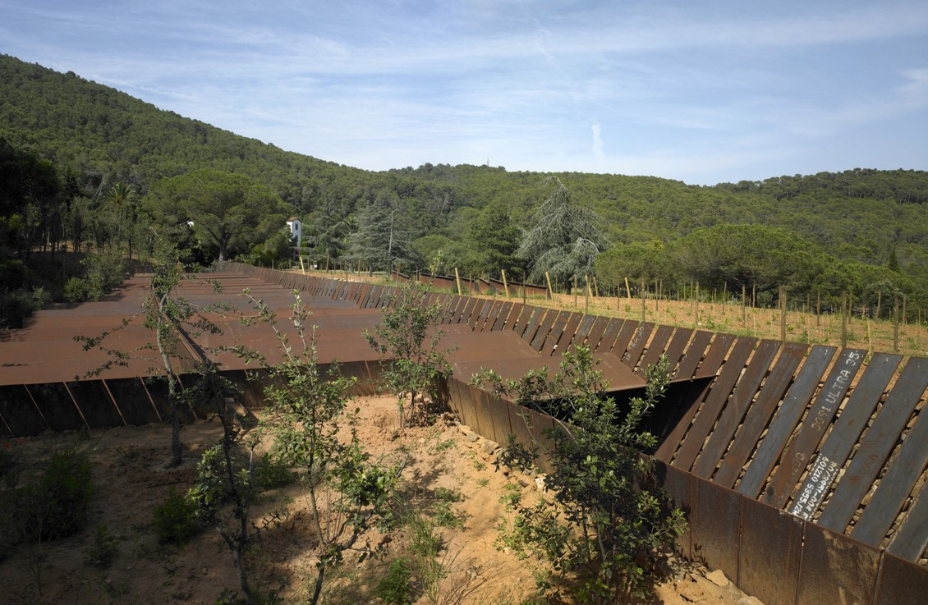
World Modern Wineries IV

Slide 2
World Modern Wineries
The aim is to show you different wineries of contemporary architecture throughout Spain. All the ‘grands crus’ compete with each other to build new cellars or new vats.
The greatest architects of the 21th century contributed to the building of these wineries with architectures certainly different but also adapted to the place and sometimes to the works they contain.

Slide 3
World Modern Wineries 1
Bodegas Ysios, Laguardia, ES (2001).
Chivite Winery, Arinzano, ES (2002).
Finca Antigua, Los Hinojosos, ES (2003).
Campo Viejo Winery, Logroño, ES (2003).
Viña Real, Laguardia, ES (2004).
Celler Brugarol, Palamós, ES (2007).
Terra Remota, Girona, ES (2008).
Protos Winery, Peñafiel, ES (2008).
14 Viñas Winery, Picón, ES (2008).

Slide 4
World Modern Wineries 2
Mas Rodó Winery, La Torre, ES (2008).
Bodegas Portia, Gumiel, ES (2010).
Finca Montepedroso, Rueda, ES (2012).
Mont-Ras Winery, Mont-Ras, ES (2016).
Beronia Winery, Rueda, ES (2018).
Clos Pachem Winery, Gratallops, ES (2019).
Beronia Winery, Ollauri, ES (2021).

Slide 5
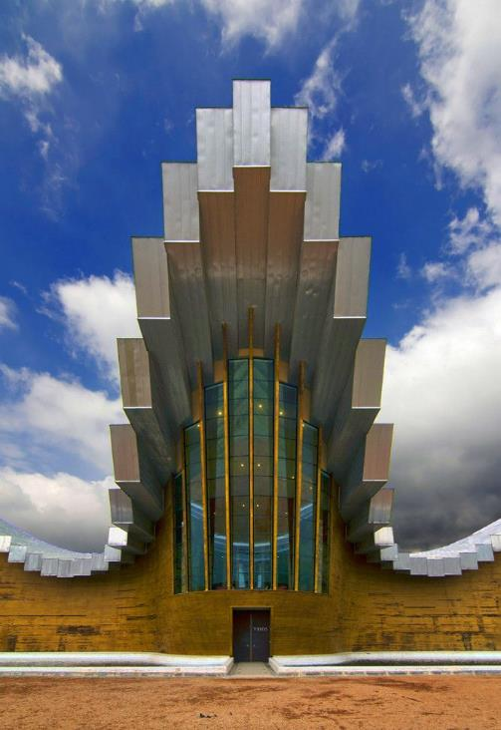
Bodegas Ysios, Laguardia, ES (2001)
Santiago Calatreva

Slide 6
Bodegas Ysios, Laguardia, ES (2001)
It is the work of the architect Santiago Calatreva.
Two 196-m-long concrete, load-bearing walls, placed 26 m apart, trace a sinusoidal shape in both plan and elevation. The southern facade is clad with horizontally placed cedar slats that, reflected in the pools, resemble a row of wine barrels. The pools are tiled with white broken ceramics. The aluminum roof paneling creates a material contrast to the warm wood of the facade. The roof, composed of a series of laminated wooden beams, supported on the staggered sinusoidal cornice of the lateral walls, is treated as a continuation of the facades. The result is a ruled surface wave, which combines concave and convex surfaces as it evolves along the longitudinal axis.

Slide 7
Bodegas Ysios, Laguardia, ES (2001)
The building is outlined as a simple rectangular plan, along an east-west axis, to accommodate the linear program for the wine making process. Two entrances in the side facades emphasize this linearity. The facade to the north is precast concrete panels with few narrow openings. The eastern and western facades are clad in fret aluminum plates. In the center of the building the roof protrudes in a continuous volume over the Visitors Center that is conceived as a balcony overlooking the winery and the vineyards. A granite bridge across the pools give access to the vineyards.

Slide 8
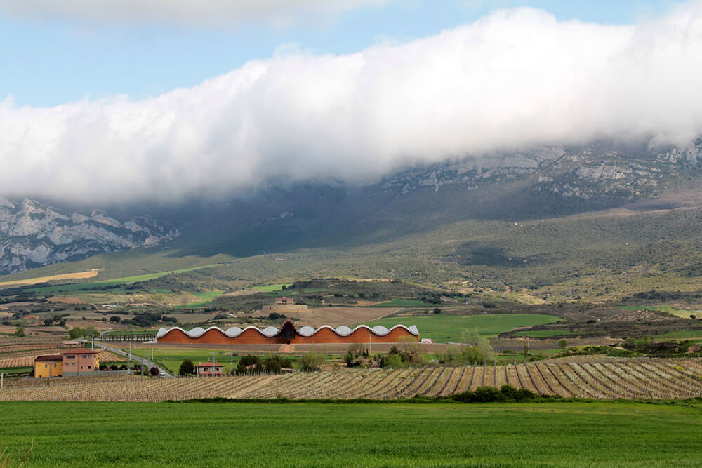
Bodegas Ysios, Laguardia, ES (2001)

Slide 9
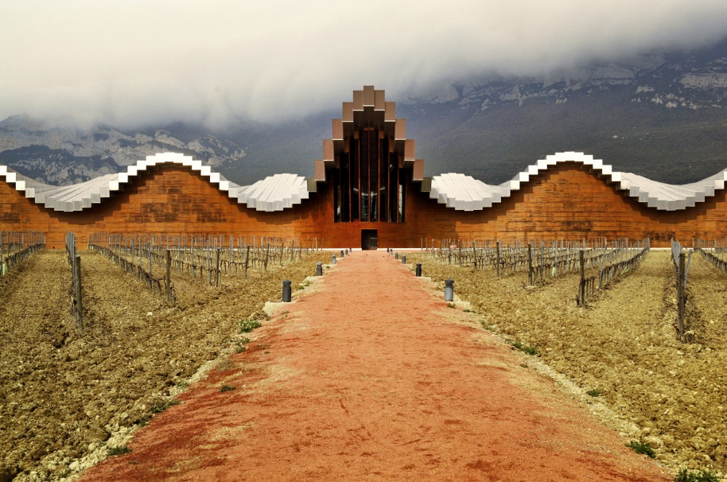
Bodegas Ysios, Laguardia, ES (2001)

Slide 10
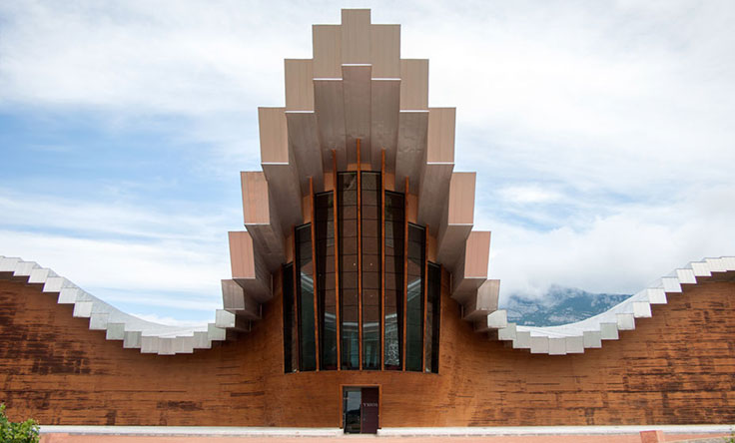
Bodegas Ysios, Laguardia, ES (2001)

Slide 11
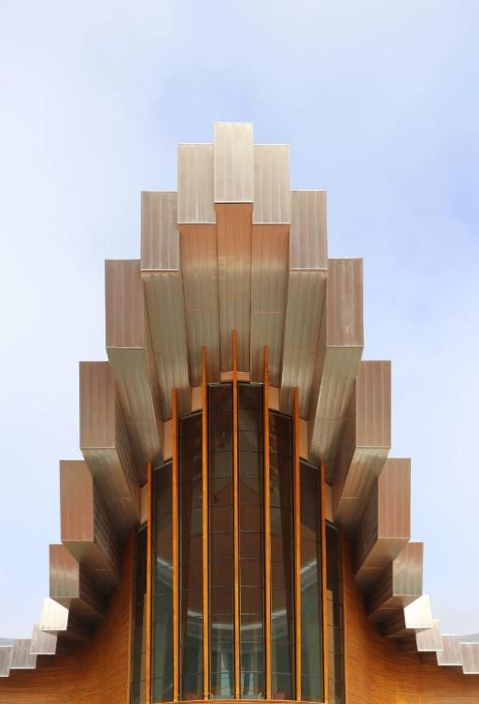
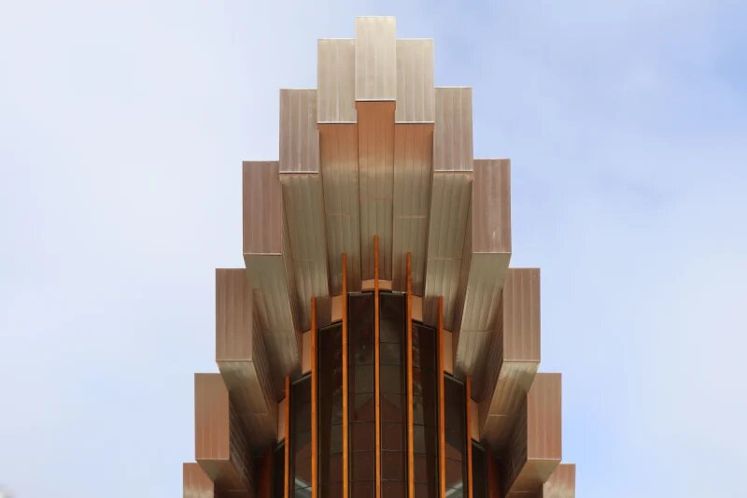
Bodegas Ysios, Laguardia, ES (2001)

Slide 12
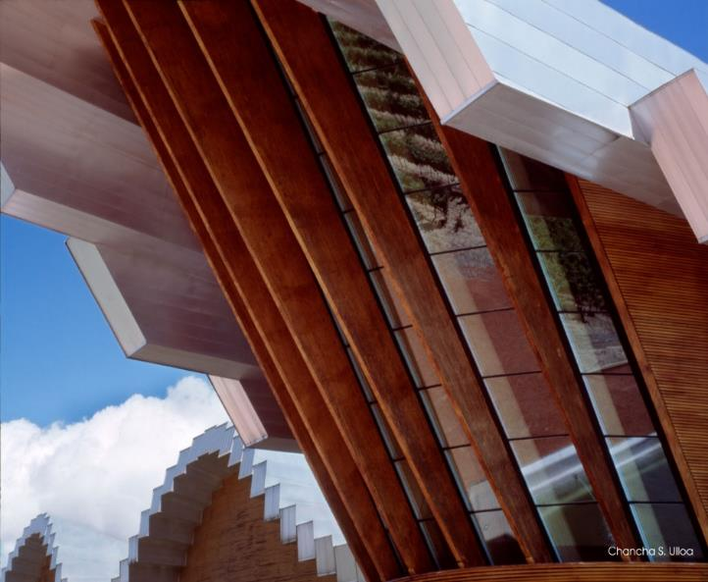
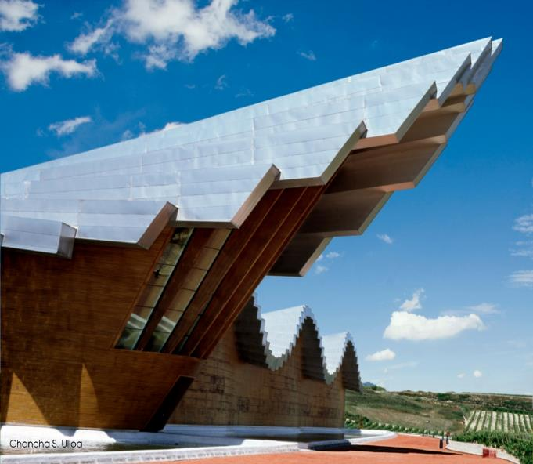
Bodegas Ysios, Laguardia, ES (2001)

Slide 13
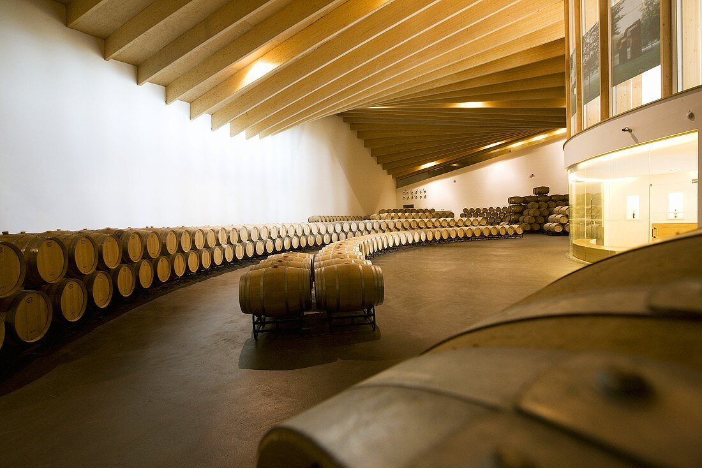
Bodegas Ysios, Laguardia, ES (2001)

Slide 14
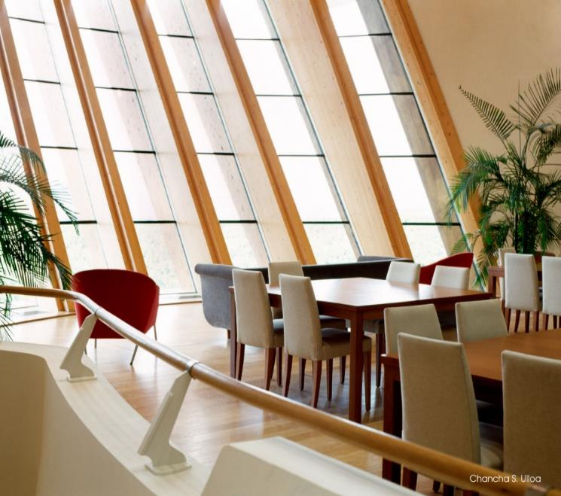
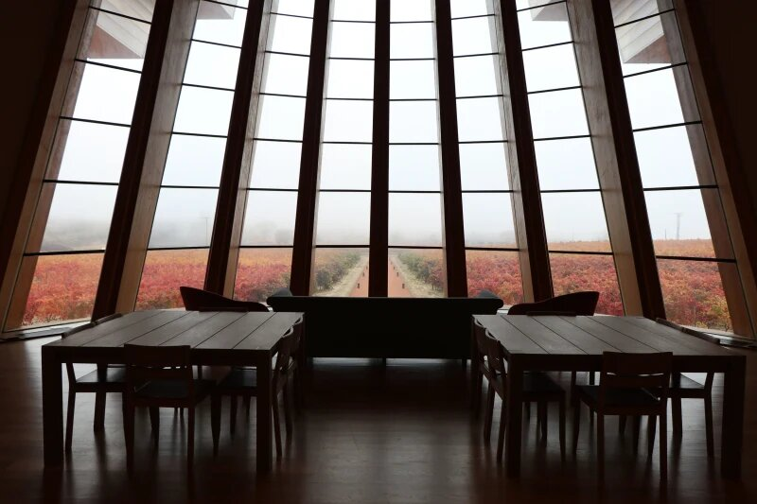
Bodegas Ysios, Laguardia, ES (2001)

Slide 15
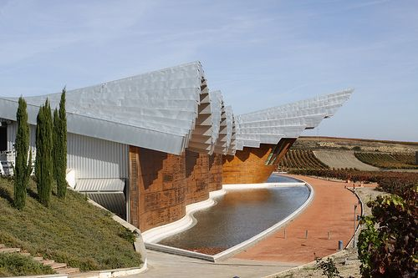
Bodegas Ysios, Laguardia, ES (2001)

Slide 16
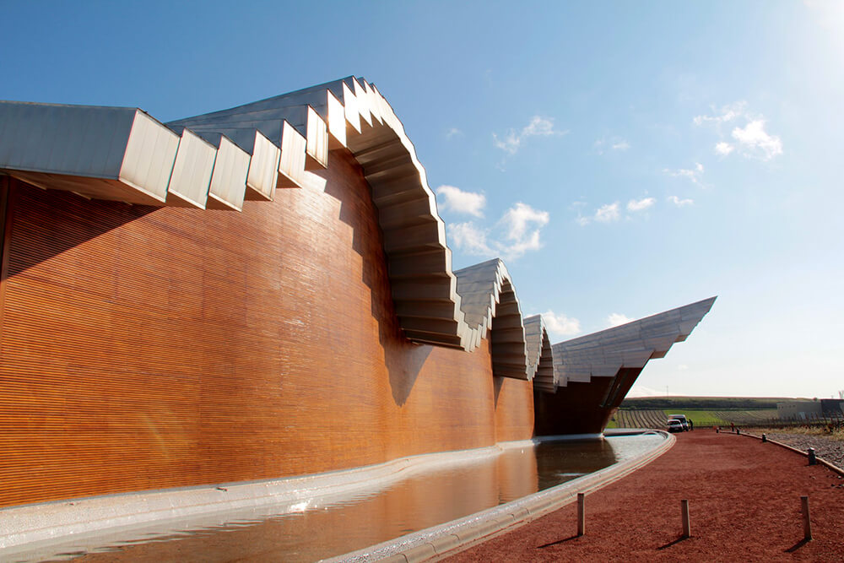
Bodegas Ysios, Laguardia, ES (2001)

Slide 17
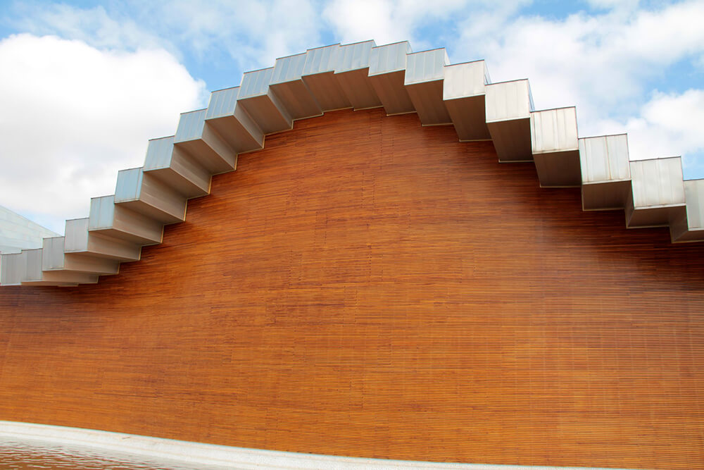
Bodegas Ysios, Laguardia, ES (2001)

Slide 18
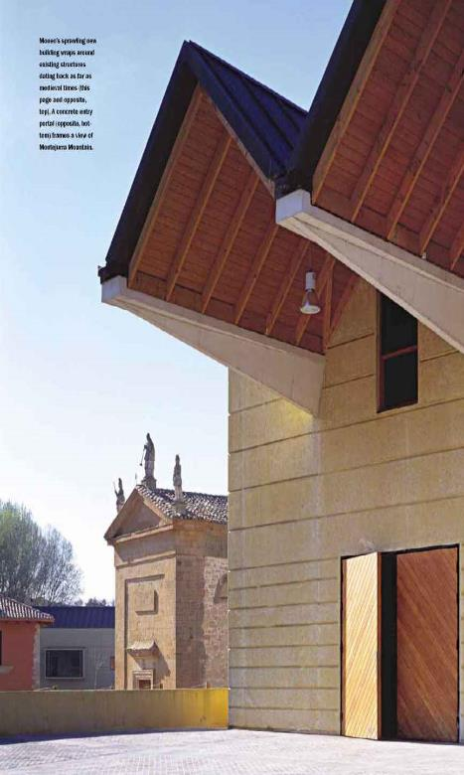
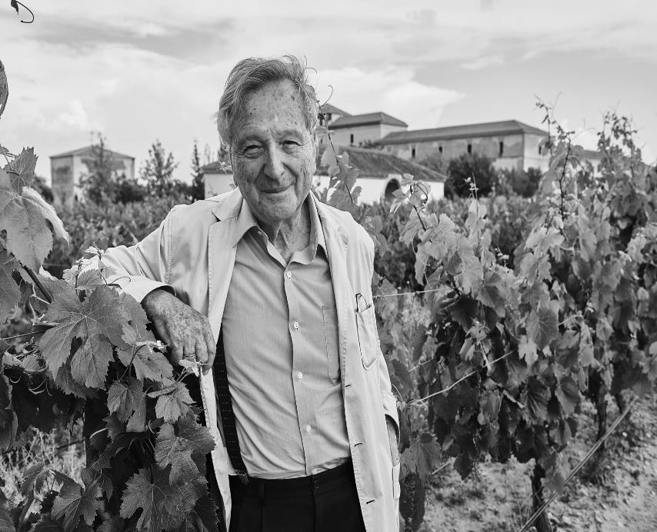
Chivite Winery, Arinzano, ES (2002)
Rafael Moneo

Slide 19
Chivite Winery, Arinzano, ES (2002)
It is the work of the architect Rafael Moneo.
Moneo conceived of the building as a backdrop to the freestanding historic structures, embracing them on three sides. Its longest arm is set against a low escarpment that defines the riverside terrace on which the buildings stand. The walls are sandblasted concrete that matches the stony soil in texture and color and has the same kind of white pebbly aggregates. Moneo expects the walls to acquire a stonelike patina over time, while the copper roofs will oxidize, blending with the foliage of the holm oaks behind them. The three wings of the building organize the production process in a linear sequence, from the loading of grapes at one end of the structure to the shipping dock and wine-tasting room at the other, an arrangement that clearly structures visitors' tours through the winery.

Slide 20
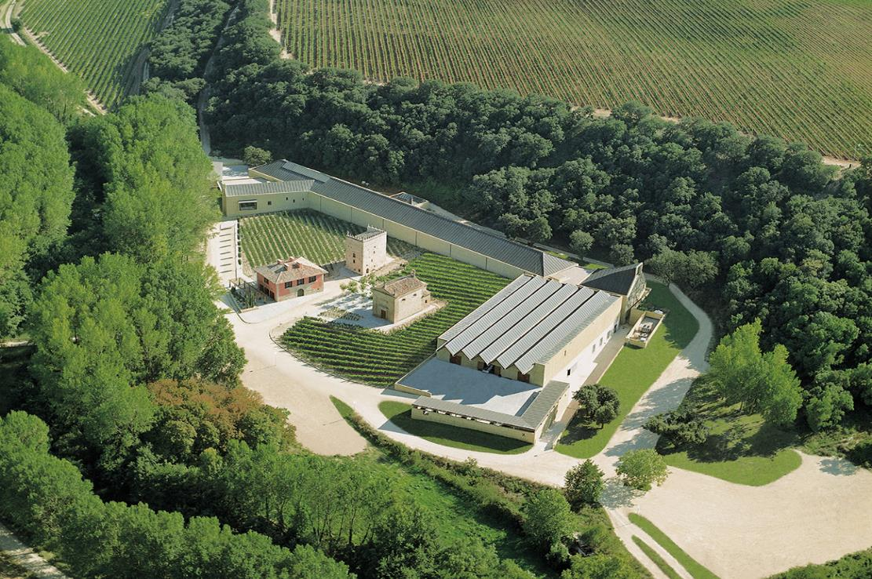
Chivite Winery, Arinzano, ES (2002)

Slide 21
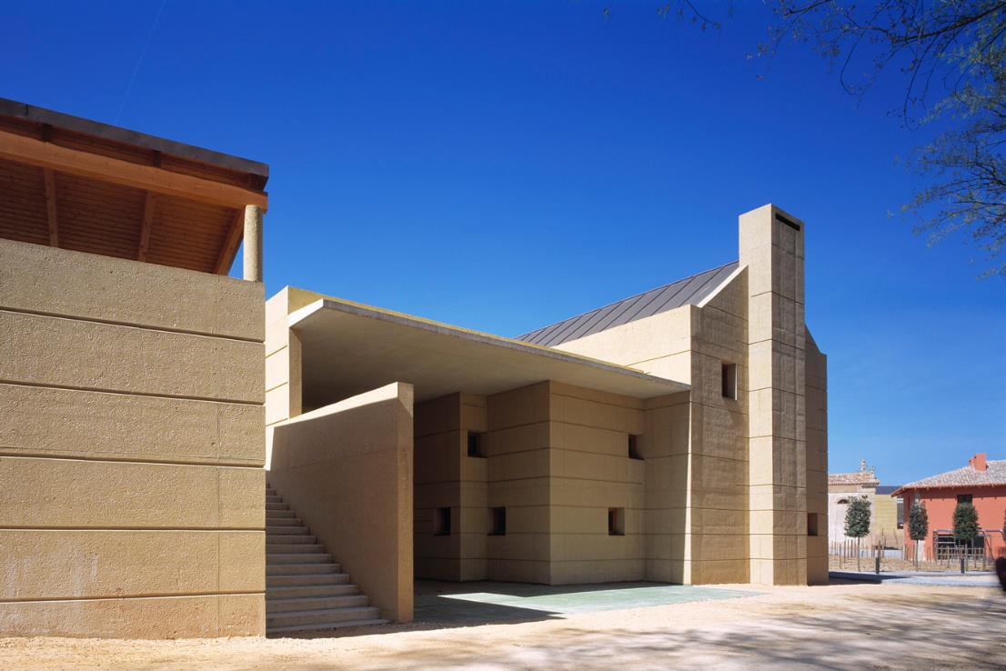
Chivite Winery, Arinzano, ES (2002)

Slide 22
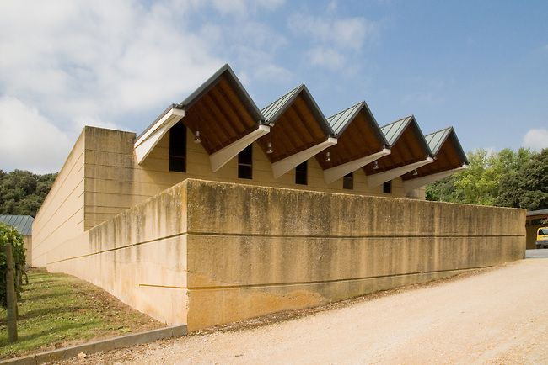
Chivite Winery, Arinzano, ES (2002)

Slide 23
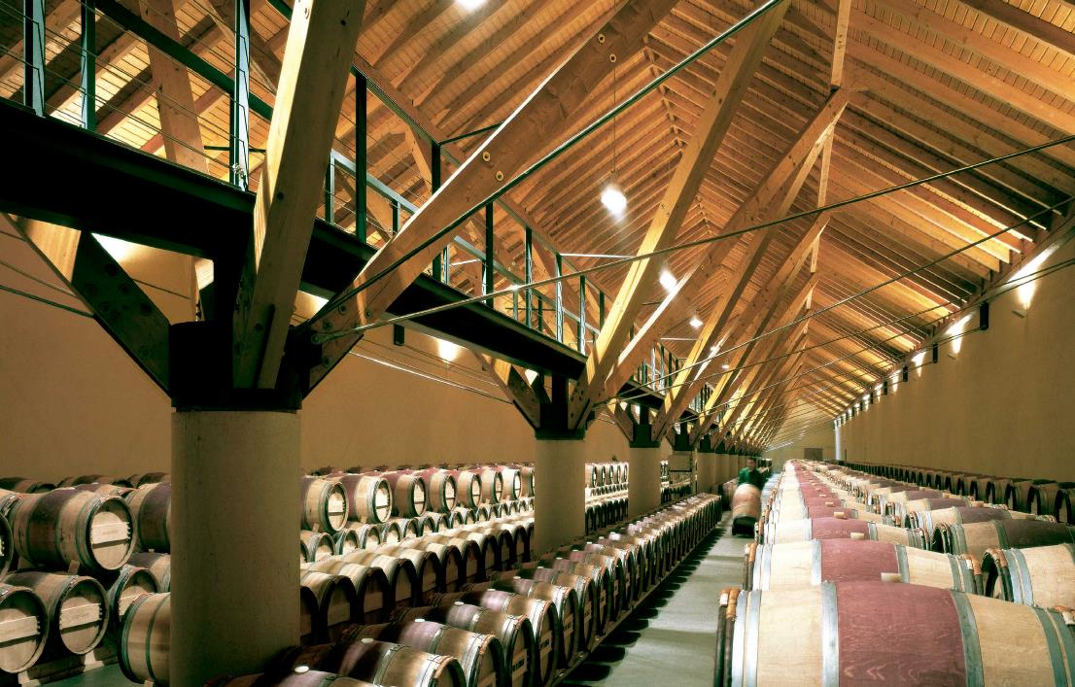
Chivite Winery, Arinzano, ES (2002)

Slide 24
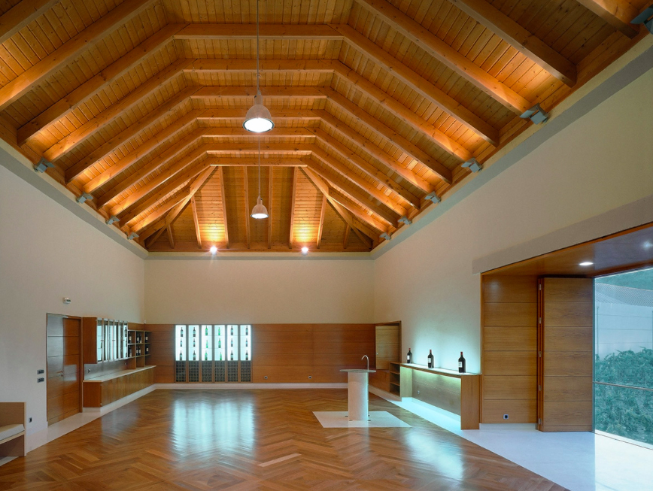
Chivite Winery, Arinzano, ES (2002)

Slide 25
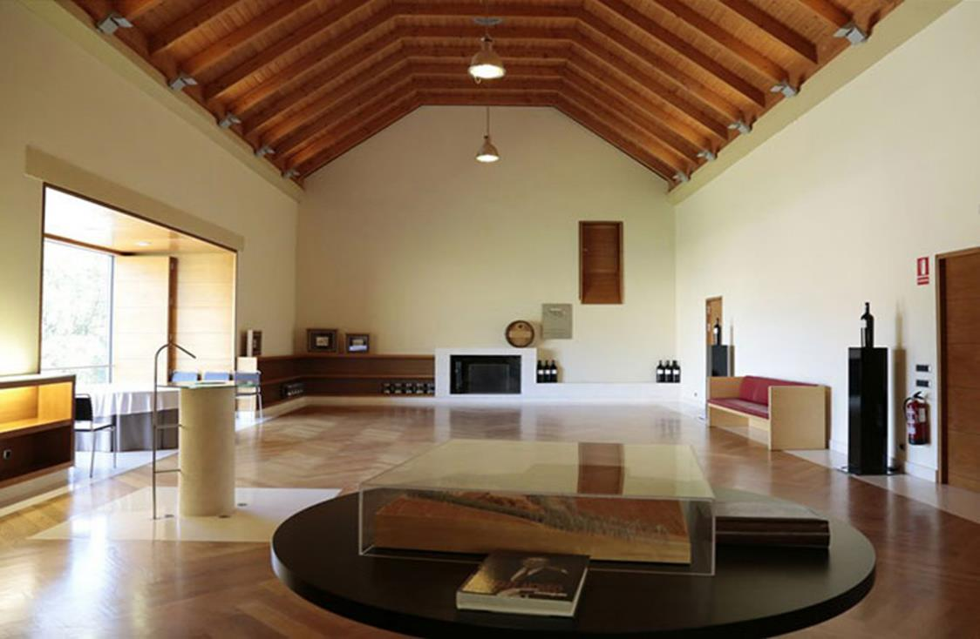
Chivite Winery, Arinzano, ES (2002)

Slide 26
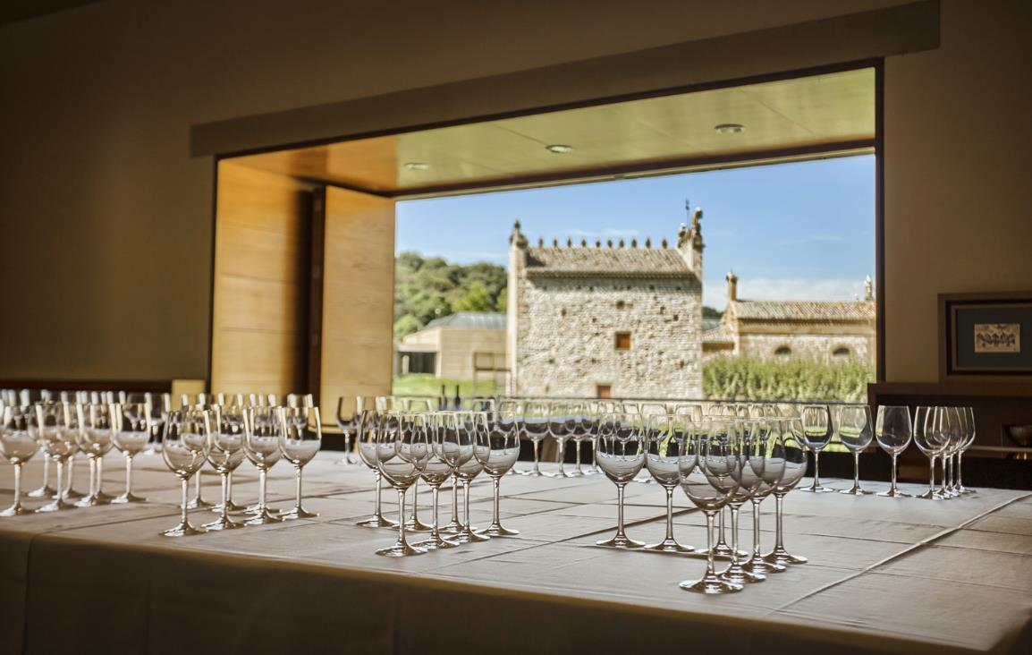
Chivite Winery, Arinzano, ES (2002)

Slide 27
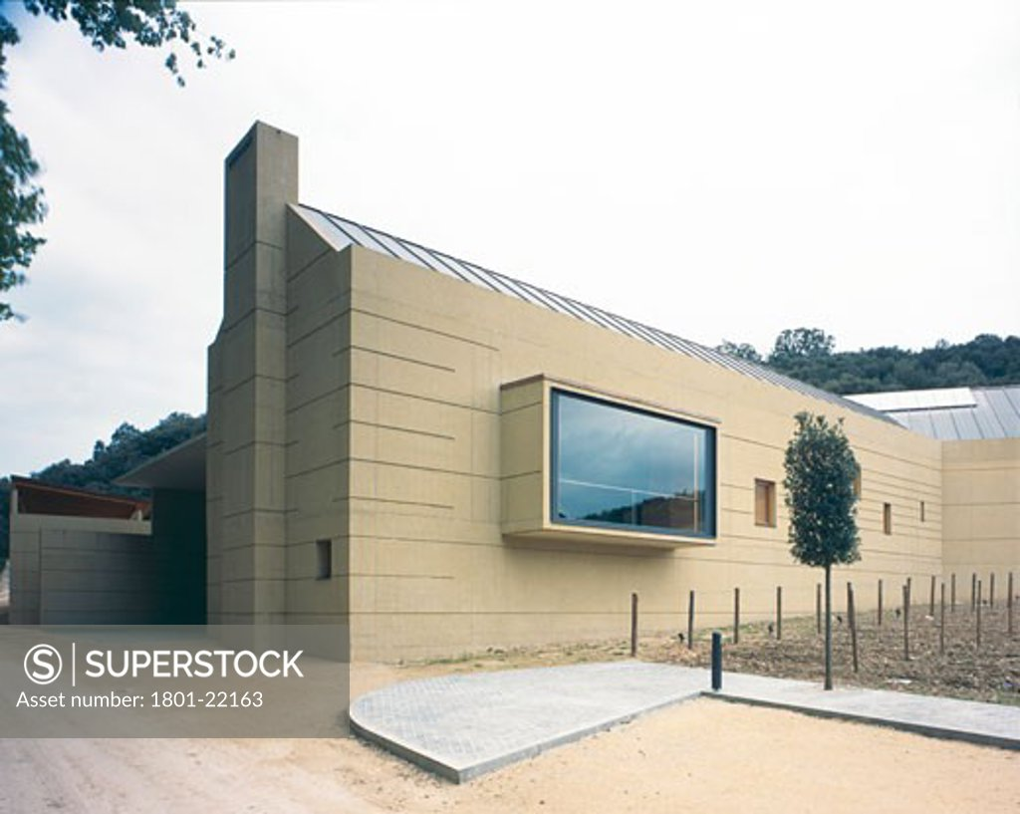
Chivite Winery, Arinzano, ES (2002)

Slide 28
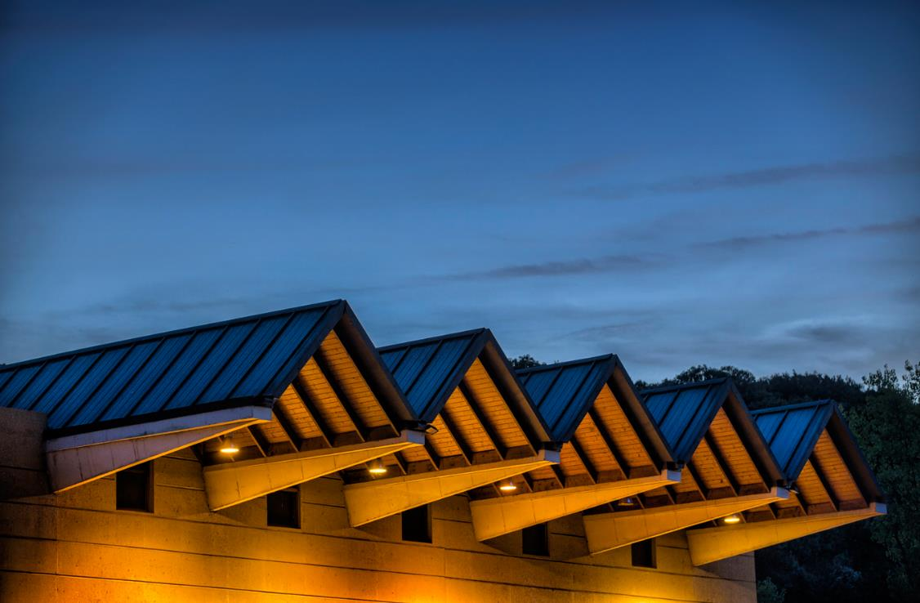
Chivite Winery, Arinzano, ES (2002)

Slide 29
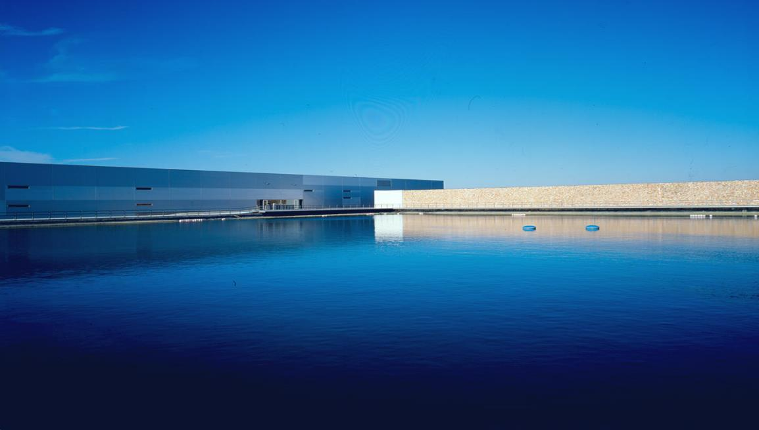
Finca Antigua, Los Hinojosos, ES (2003)

Slide 30
Finca Antigua, Los Hinojosos, ES (2003)
It is the work of 3.14GA architectural firm.
Perched on a hill between the provinces of Cuenca and Toledo, enjoy the world of wine and architecture by visiting this modern, avant-garde and efficient winery in the heart of D.O. La Mancha. In its spectacular building, surrounded by vineyards and a cool pool of water, you will find the latest technological innovations while respecting the artisan care in production, resulting in a winery fully consistent with the style of wine that is produced. The winery's surroundings are complemented by an irrigation reservoir that blends in perfectly with the architectural ensemble.

Slide 31
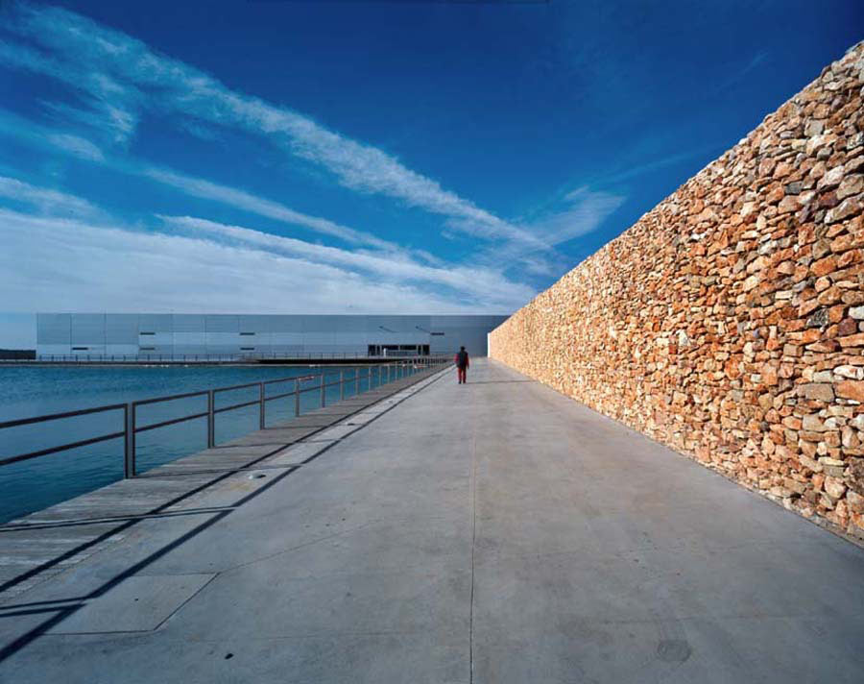
Finca Antigua, Los Hinojosos, ES (2003)

Slide 32
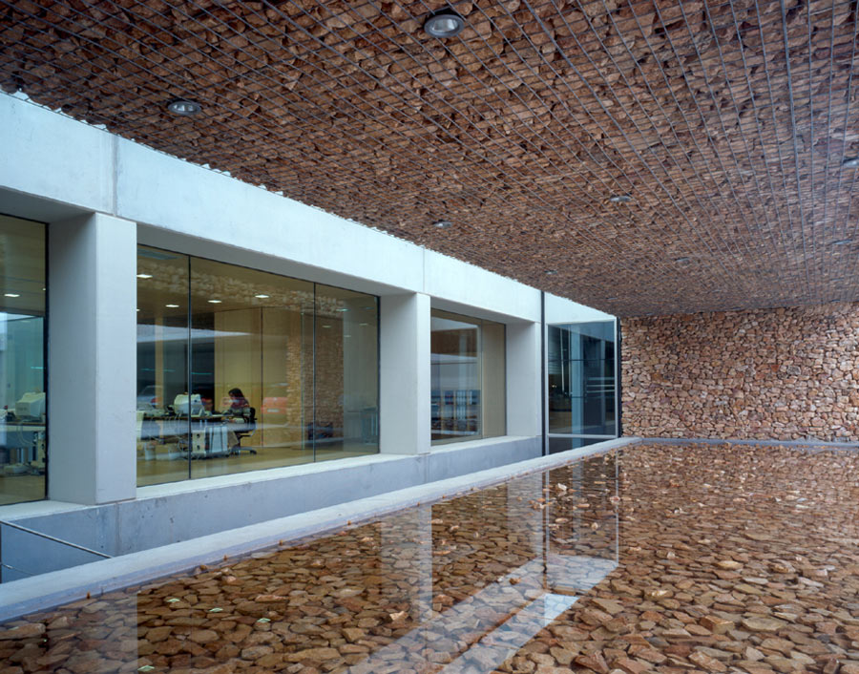
Finca Antigua, Los Hinojosos, ES (2003)

Slide 33
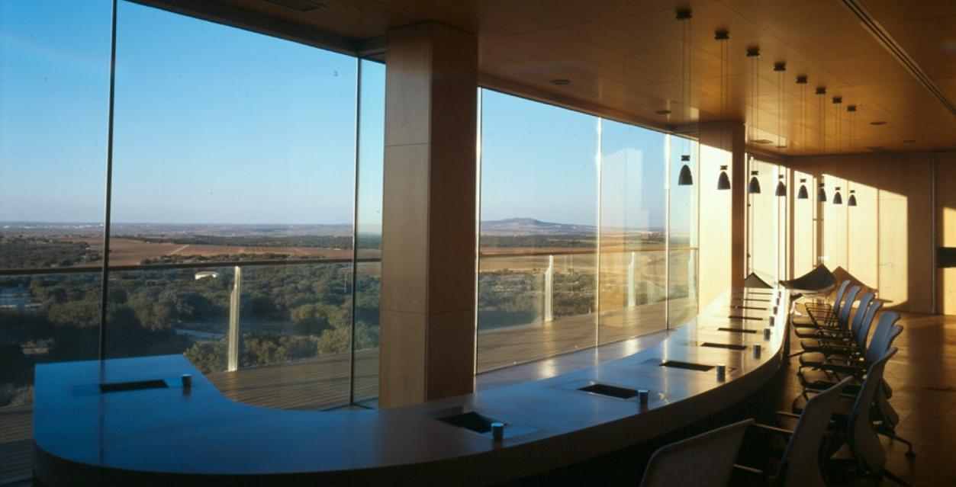
Finca Antigua, Los Hinojosos, ES (2003)

Slide 34
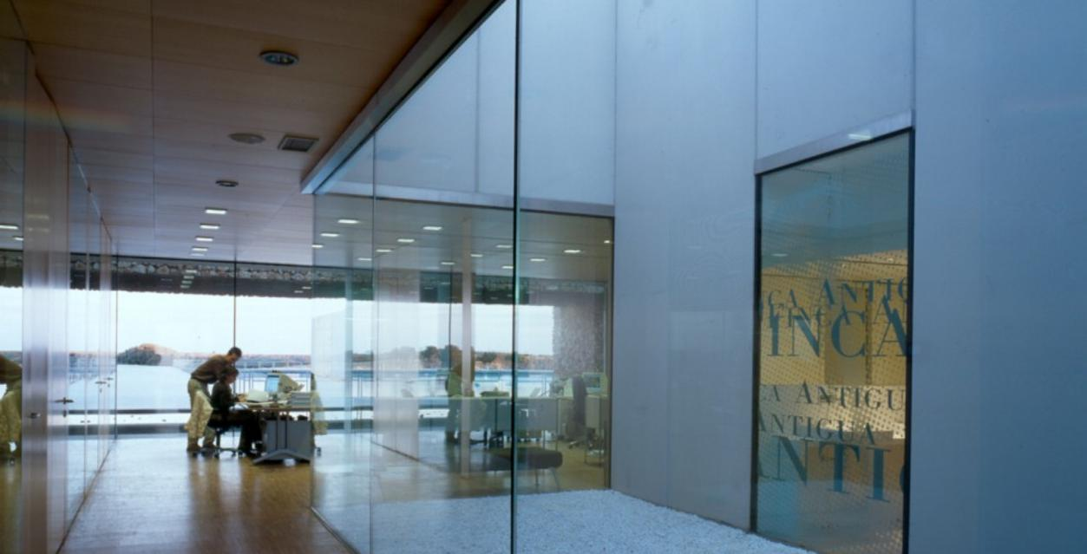
Finca Antigua, Los Hinojosos, ES (2003)

Slide 35
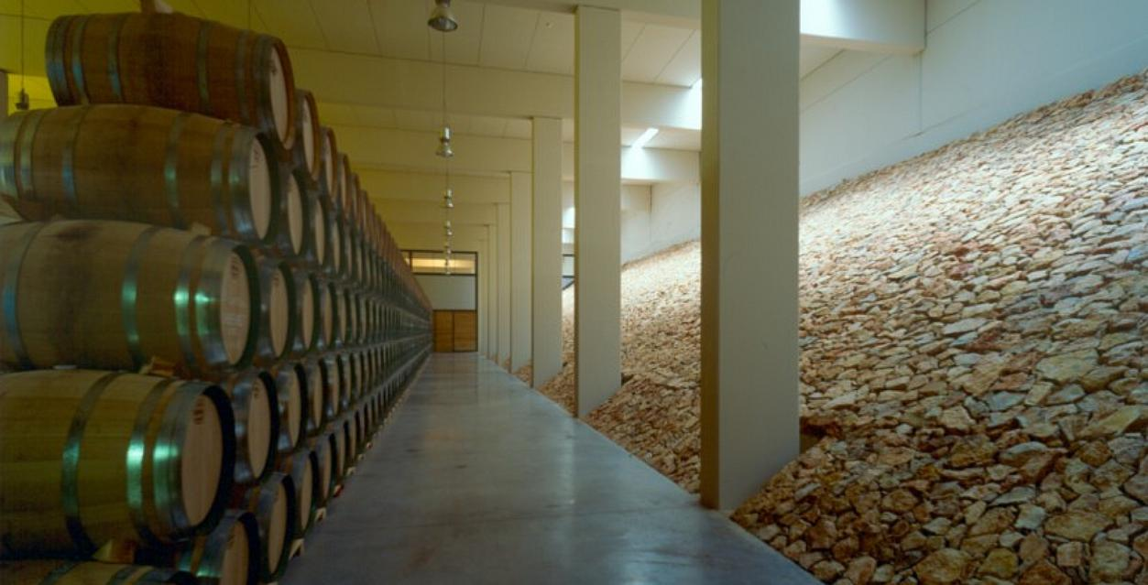
Finca Antigua, Los Hinojosos, ES (2003)

Slide 36
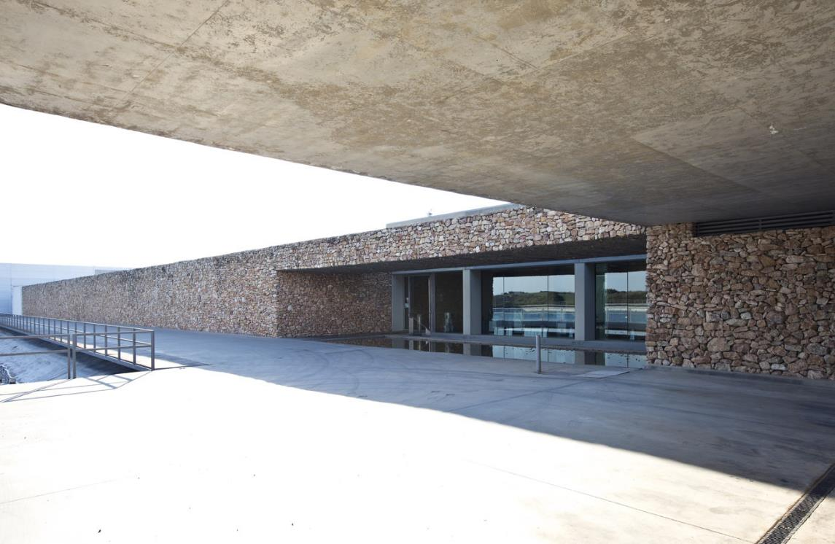
Finca Antigua, Los Hinojosos, ES (2003)

Slide 37
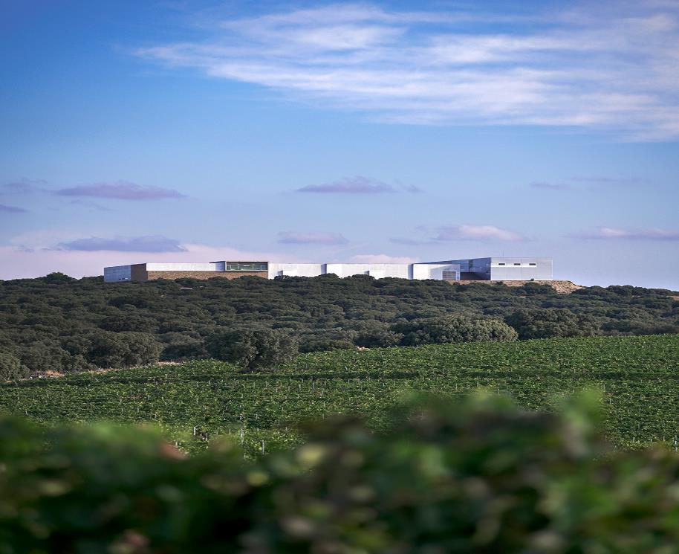
Finca Antigua, Los Hinojosos, ES (2003)

Slide 38
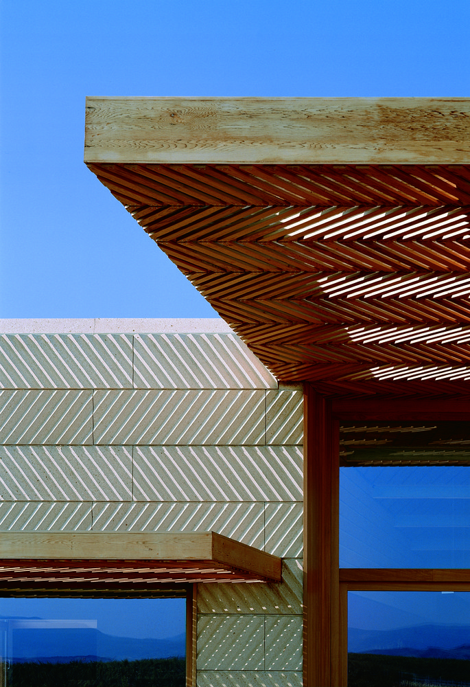
Campo Viejo Winery, Logroño, ES (2003)
Ignacio Quemada

Slide 39
Campo Viejo Winery, Logroño, ES (2003)
It is the work of the architect Ignacio Quemada.
The administrative and visitors' buildings (two clear volumes of stone and wood) overlook the vineyard like a château, whilst the cellar, hidden from the vineyard, is built into the hill like a work of land art. Located at the edge of the plateau, the buried construction peeps out for some air and light, configuring the profile of the hill, timidly merging with the landscape. The earthy concrete facades, red like parts of the layers that appeared with the digging, are stacked up in horizontal strata, disproportionate in scale and tectonically intense.

Slide 40
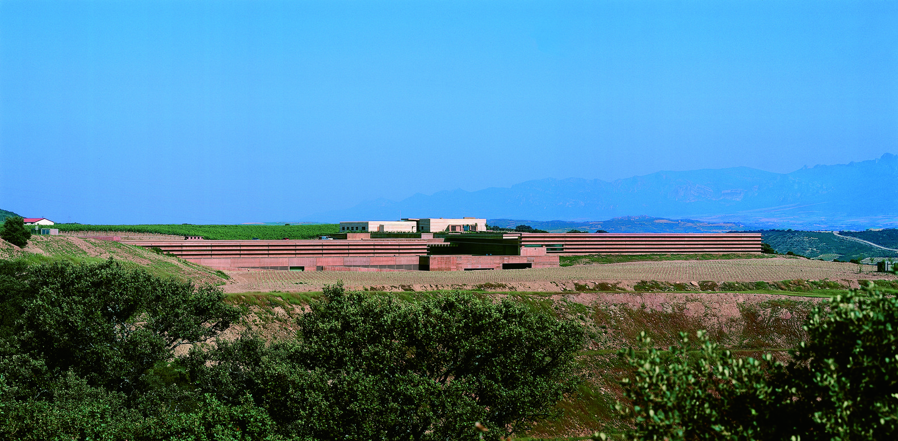
Campo Viejo Winery, Logroño, ES (2003)

Slide 41
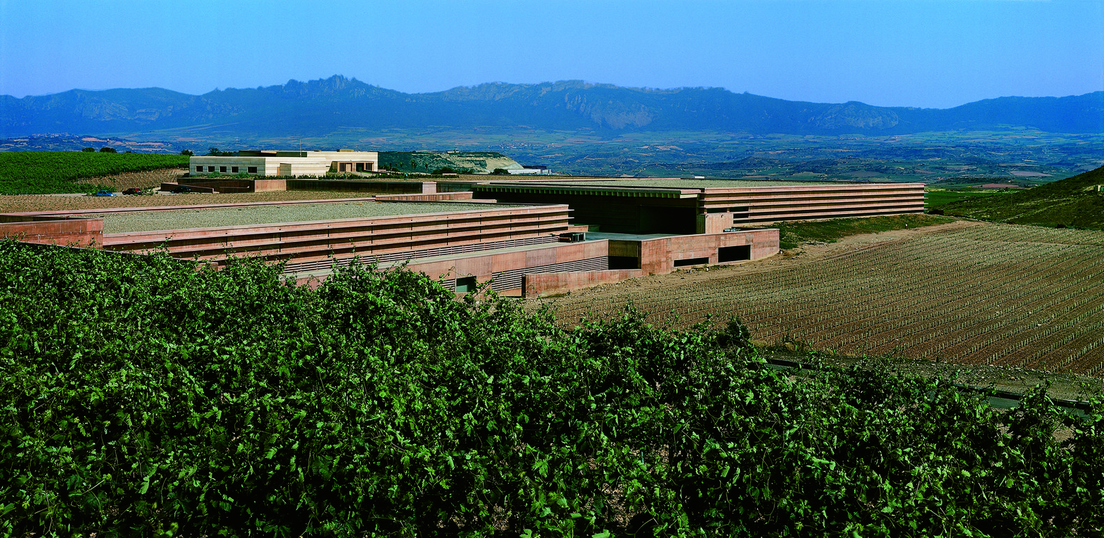
Campo Viejo Winery, Logroño, ES (2003)

Slide 42
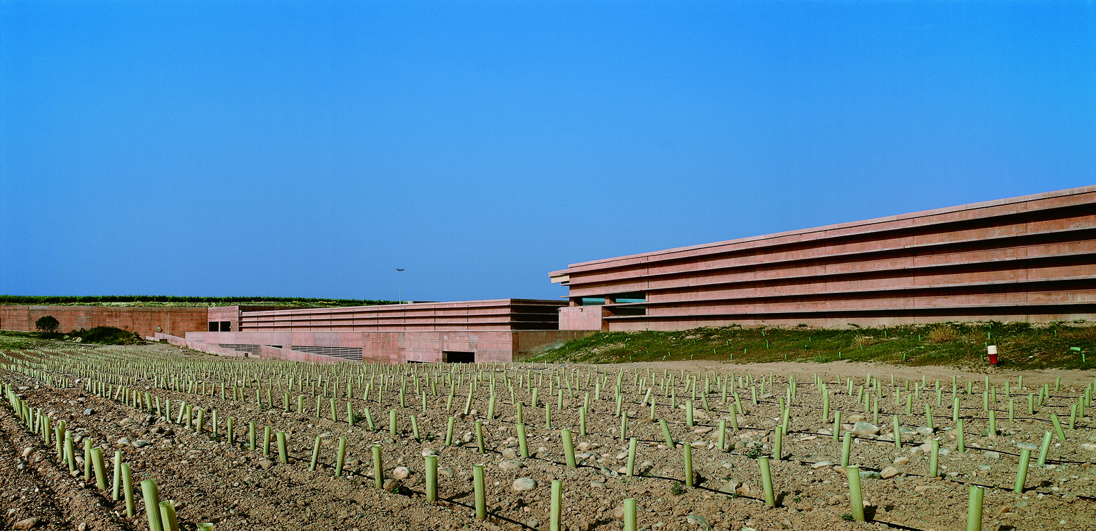
Campo Viejo Winery, Logroño, ES (2003)

Slide 43
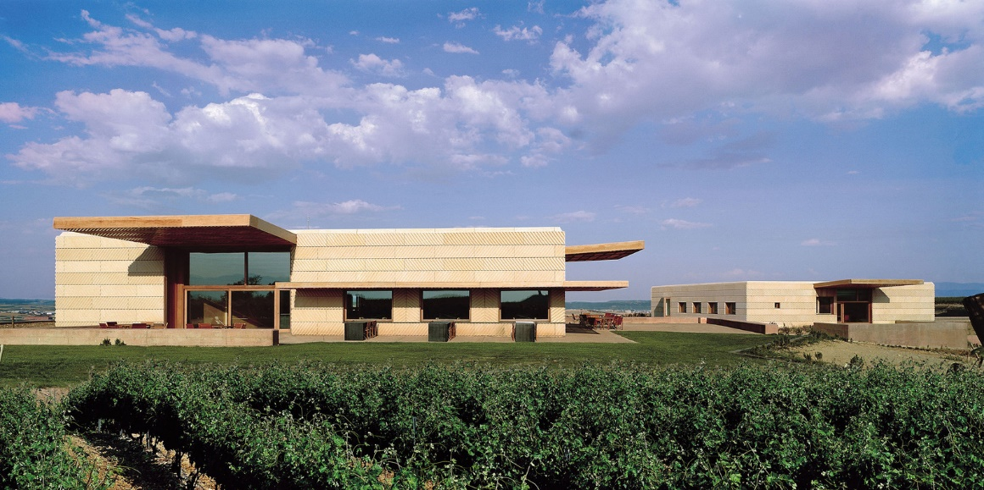
Campo Viejo Winery, Logroño, ES (2003)

Slide 44
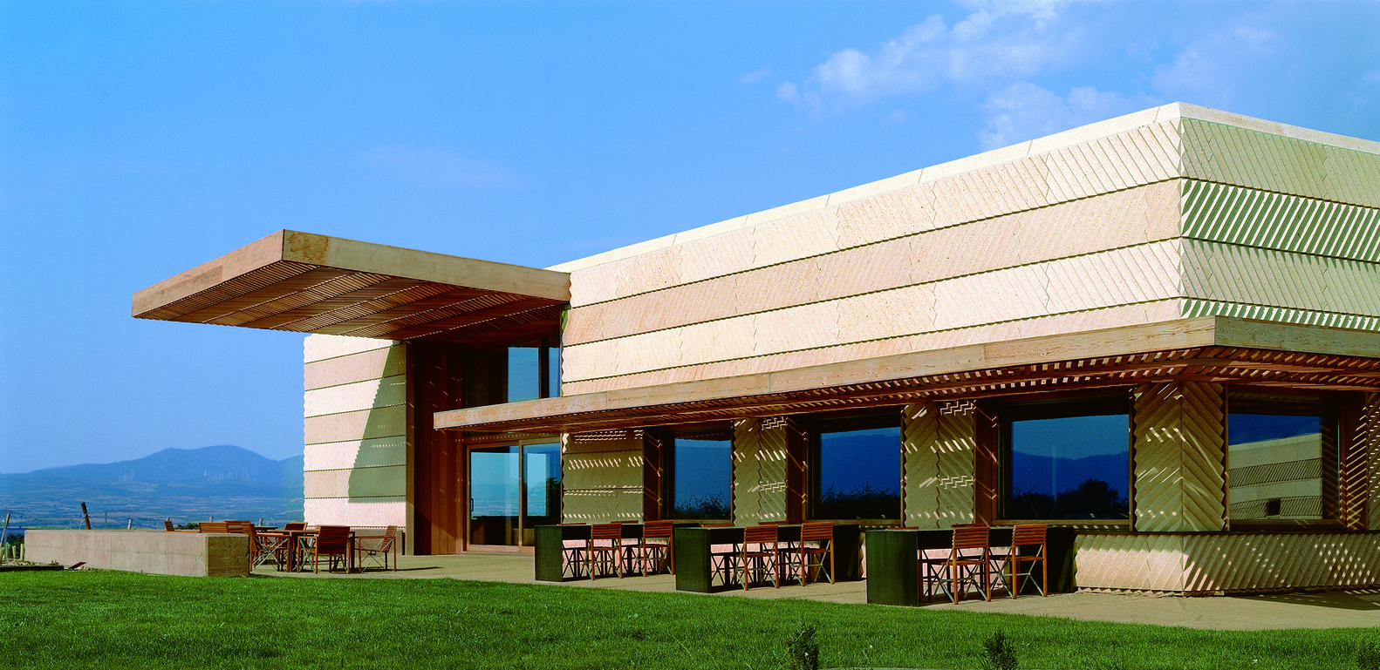
Campo Viejo Winery, Logroño, ES (2003)

Slide 45
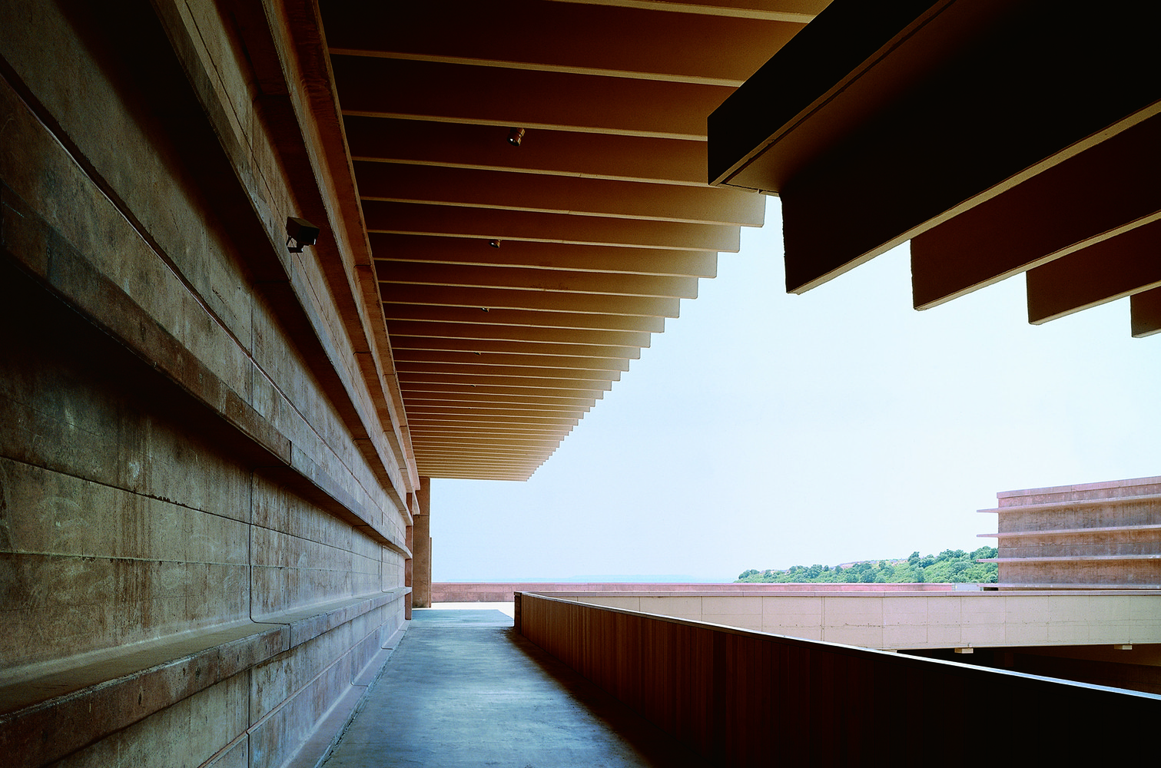
Campo Viejo Winery, Logroño, ES (2003)

Slide 46
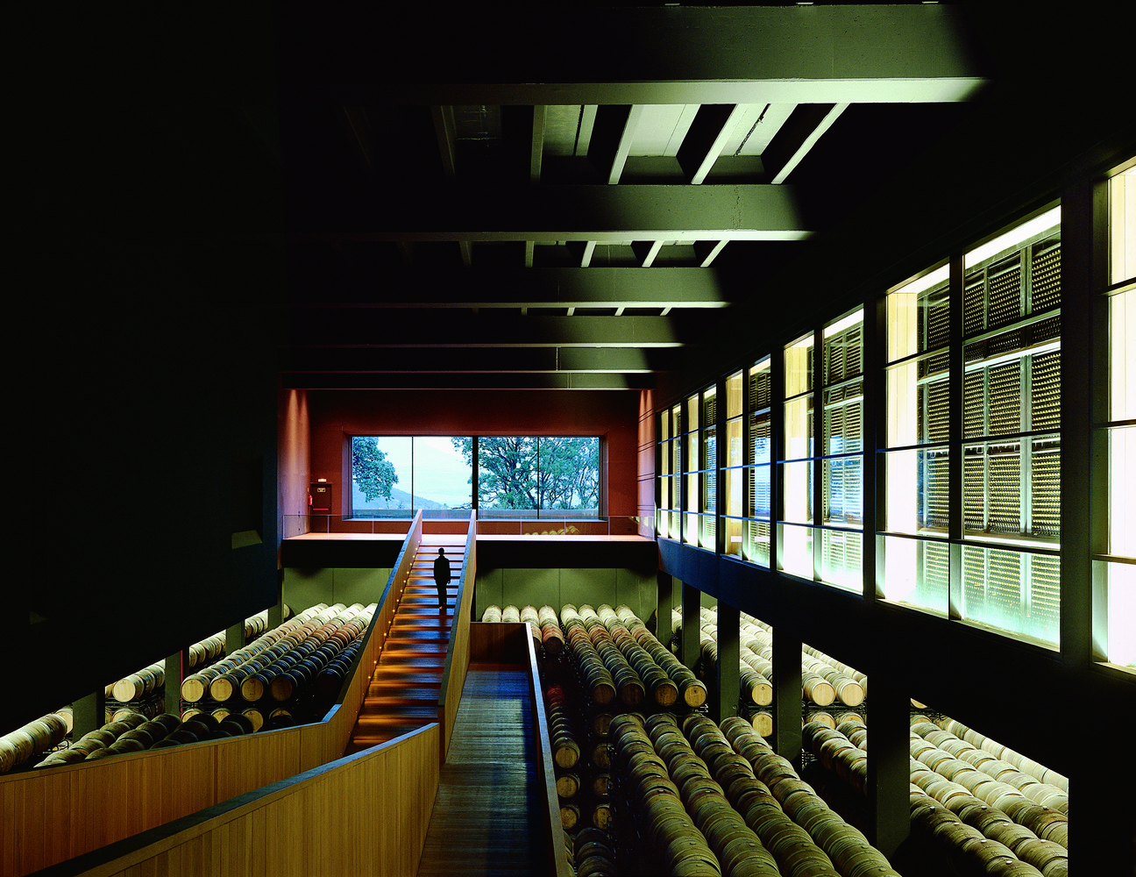
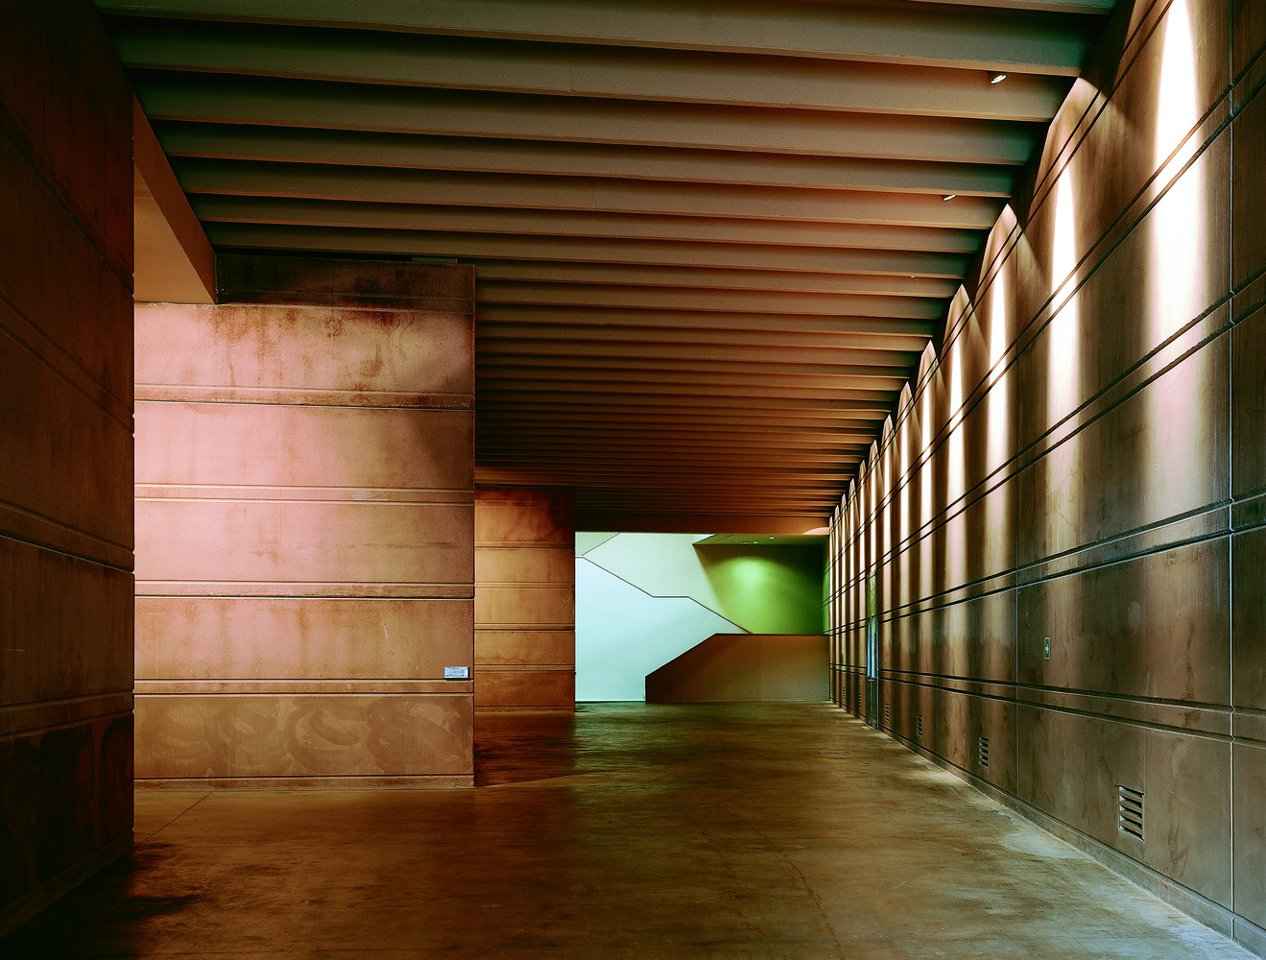
Campo Viejo Winery, Logroño, ES (2003)

Slide 47
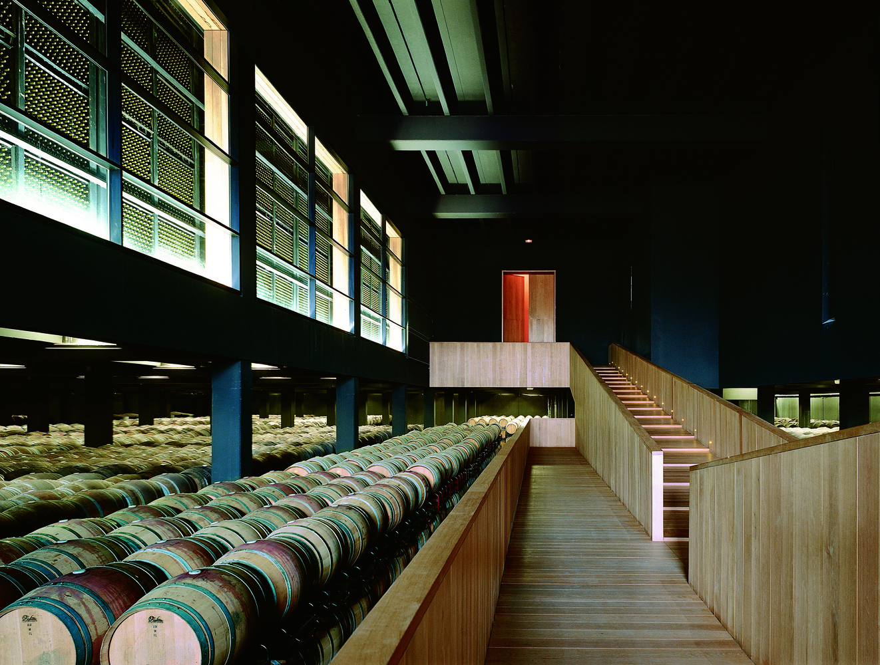
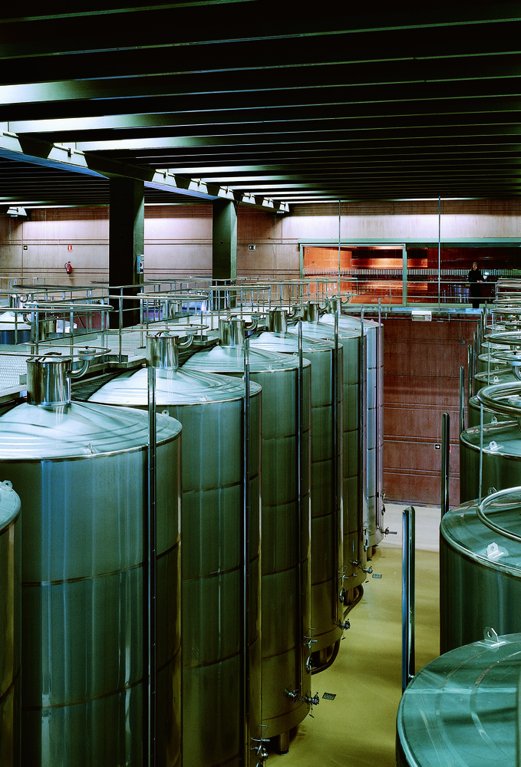
Campo Viejo Winery, Logroño, ES (2003)

Slide 48
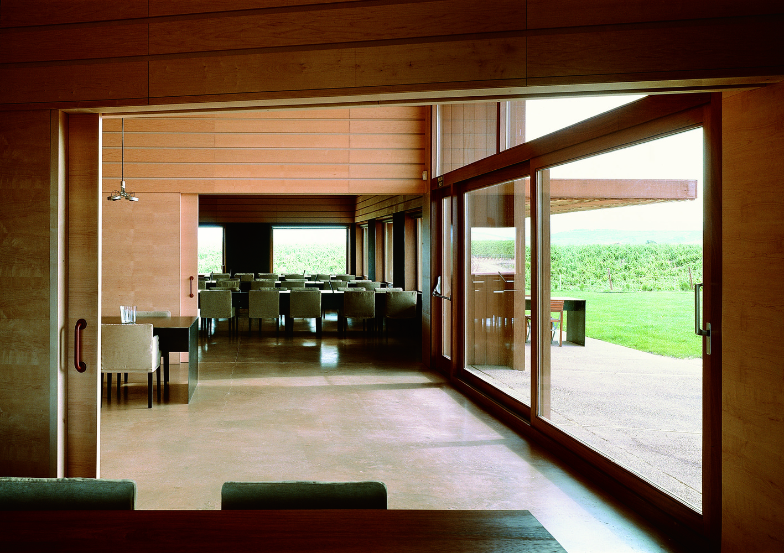
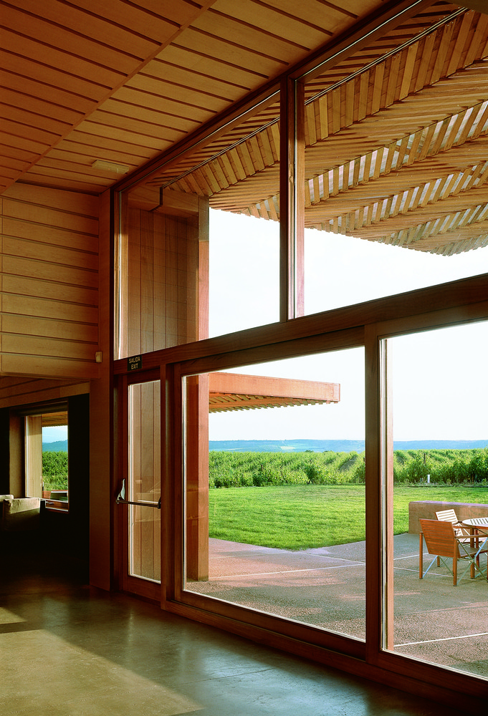
Campo Viejo Winery, Logroño, ES (2003)

Slide 49
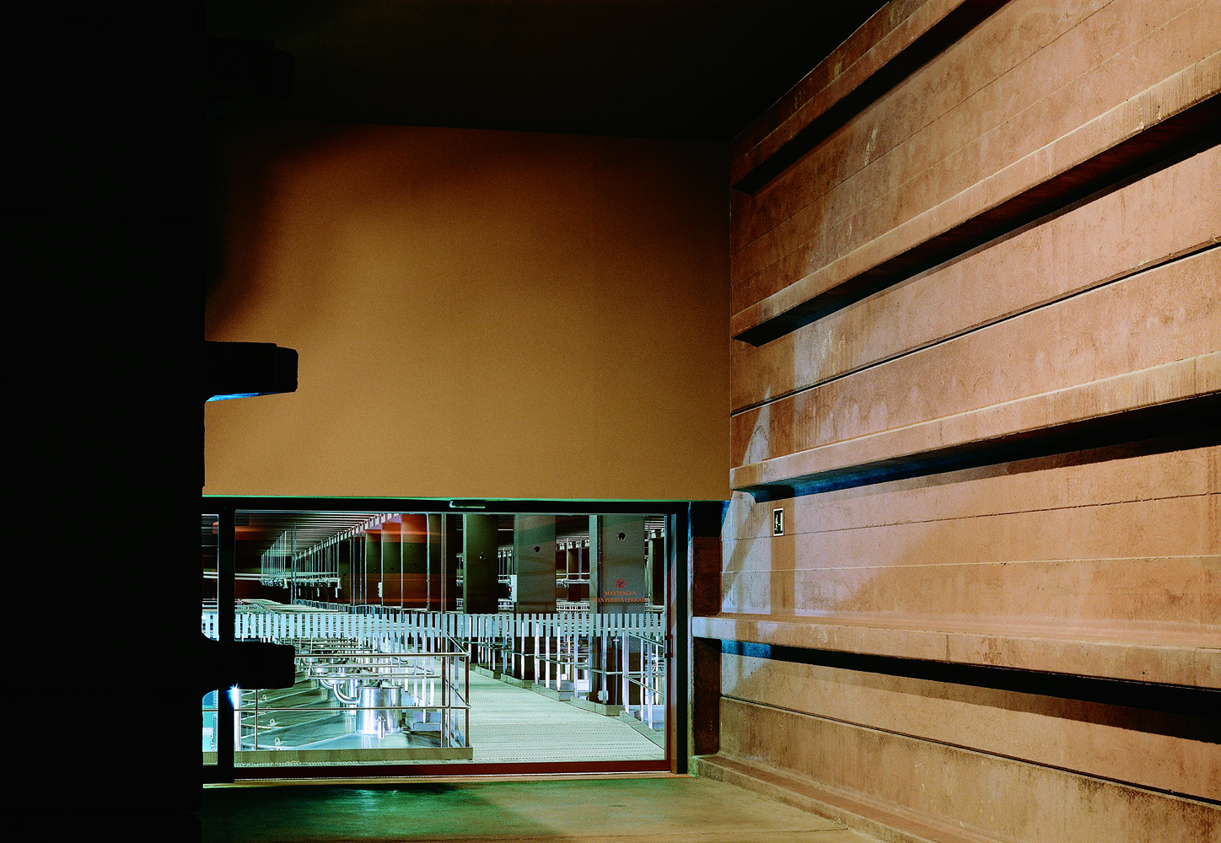
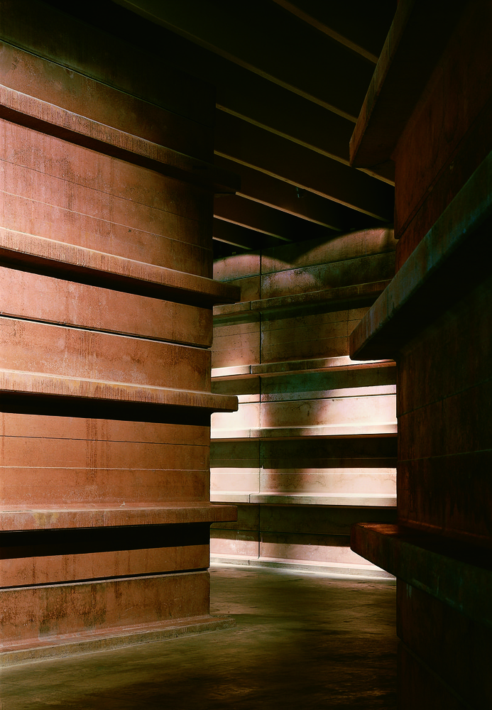
Campo Viejo Winery, Logroño, ES (2003)

Slide 50
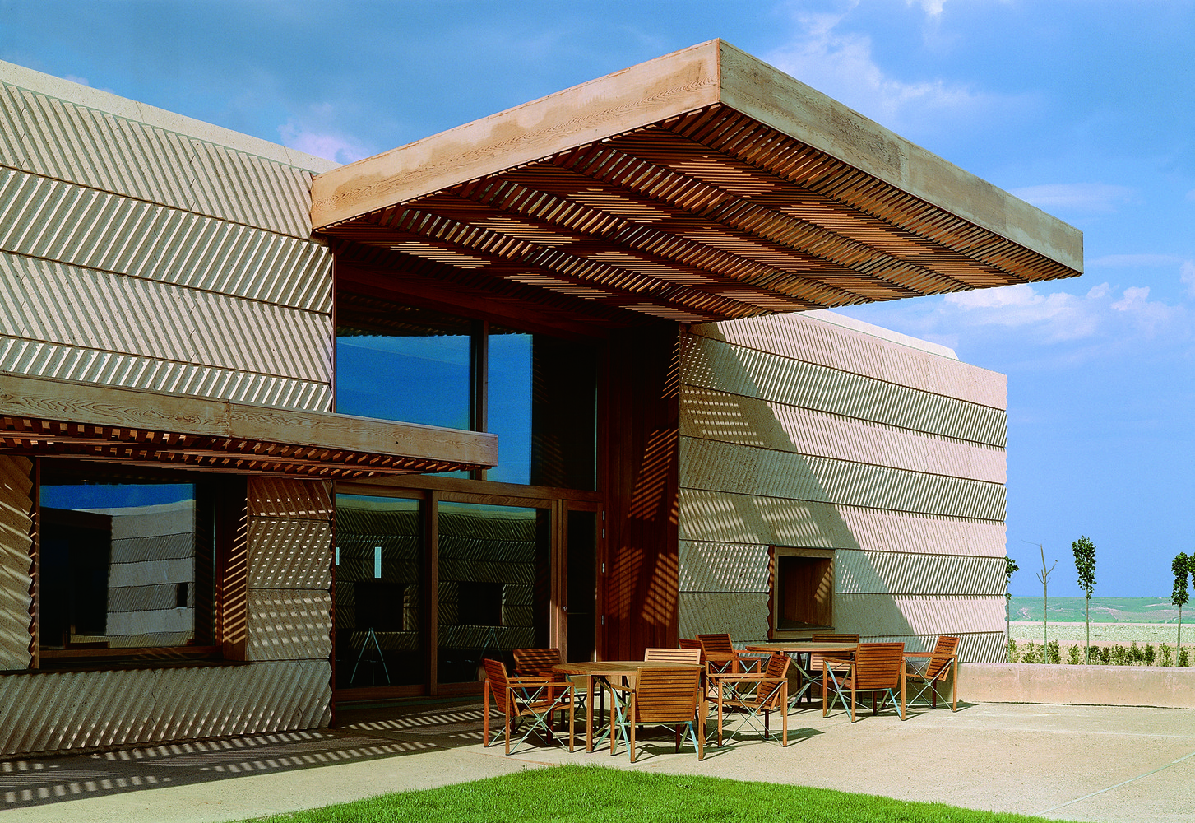
Campo Viejo Winery, Logroño, ES (2003)

Slide 51
Viña Real, Laguardia, ES (2004)
Philippe Mazières

Slide 52
Viña Real, Laguardia, ES (2004)
It is the work of the architect Philippe Mazières.
The silhouette of the building is slightly reminiscent of a wine barrel; the first of the two floors is completely dedicated to the actual process of winemaking; the other - the basement six meters underground - is for storing the barrels of wine. It is built of concrete, cedar and stainless steel on the hill of Cerro de la Mesa, but the caves where the wine is stored were carved from the rock

Slide 53
Viña Real, Laguardia, ES (2004)

Slide 54
Viña Real, Laguardia, ES (2004)

Slide 55
Viña Real, Laguardia, ES (2004)

Slide 56
Viña Real, Laguardia, ES (2004)

Slide 57
Viña Real, Laguardia, ES (2004)

Slide 58
Viña Real, Laguardia, ES (2004)

Slide 59
Celler Brugarol, Palamós, ES (2007)
R. Aranda C. Pigem R. Vilalta

Slide 60
Celler Brugarol, Palamós, ES (2007)
It is the work of RCR Arquitectes firm.
It is designed in such a way that part of it is underground, thus creating a union where landscape and buildings become one. A promenade is defined by tilted recycled steel sheets with slits between them to allow natural light to penetrate. Visitors descend into the underground world of wine where there are large recycled steel vats, suspended barrels and bottles in racks. The inertia of this excavated environment is used to avoid energy consumption in its environmental qualities, whose singular perception is the result of its spatial geometry and materials, steel and stones, that surround you in an underground world, cool, isolated

Slide 61
Celler Brugarol, Palamós, ES (2007)

Slide 62
Celler Brugarol, Palamós, ES (2007)

Slide 63
Celler Brugarol, Palamós, ES (2007)

Slide 64
Celler Brugarol, Palamós, ES (2007)

Slide 65
Celler Brugarol, Palamós, ES (2007)

Slide 66
Celler Brugarol, Palamós, ES (2007)

Slide 67
Celler Brugarol, Palamós, ES (2007)

Slide 68
Celler Brugarol, Palamós, ES (2007)

Slide 69
Celler Brugarol, Palamós, ES (2007)

Slide 70
Celler Brugarol, Palamós, ES (2007)

Slide 71
Celler Brugarol, Palamós, ES (2007)

Slide 72
Celler Brugarol, Palamós, ES (2007)

Slide 73
Celler Brugarol, Palamós, ES (2007)

Slide 74
Celler Brugarol, Palamós, ES (2007)

Slide 75
Terra Remota, Girona, ES (2008)
Marifé Bellaubi
Yago Sarri

Slide 76
Terra Remota, Girona, ES (2008)
It is the work of Untaller architectural firm.
The winery is broken up into three semi-buried interconnected bodies that extend in a graded manner over a north-facing slope. The upper body houses the grape reception space and contains the winemaking cellar. The intermediate body corresponds to the storage and bottling cellar. It features working walkways above tanks situated another four meters further down. Finally, the lower body has a single height and contains the dry materials and bottle stores, the office space and the reception hall. The walls of the winery are in reinforced concrete, the forgings of the roofs are made from alveolar panels and the paving is in polished concrete.

Slide 77
Terra Remota, Girona, ES (2008)

Slide 78
Terra Remota, Girona, ES (2008)

Slide 79
Terra Remota, Girona, ES (2008)

Slide 80
Terra Remota, Girona, ES (2008)

Slide 81
Terra Remota, Girona, ES (2008)

Slide 82
Terra Remota, Girona, ES (2008)

Slide 83
Terra Remota, Girona, ES (2008)

Slide 84
Terra Remota, Girona, ES (2008)

Slide 85
Terra Remota, Girona, ES (2008)

Slide 86
Terra Remota, Girona, ES (2008)

Slide 87
Terra Remota, Girona, ES (2008)

Slide 88
Protos Winery, Peñafiel, ES (2008)
Richard Rogers

Slide 89
Protos Winery, Peñafiel, ES (2008)
It is the work of the architect Richard Rogers.
This structure is made of parabolic arches of laminated wood. The roof is the most noteworthy visual feature of the outside of the winery. Therefore, it was designed with these five vaulted bays oriented towards the Castle. In the treatment of the roof materials and construction, using large format terracotta pieces, it represents a contemporary reinterpretation of typical vernacular roofs. The base is anchored to the ground, smoothing it out to create the support framework for the light structure that rests on its upper horizontal plane. There are two separate planes on the base: the cellar level, which is completely underground, and the production level, partially buried up to a height of 4.5m, at which point an upper surface area is defined, accessible at street level through the main entrance.

Slide 90
Protos Winery, Peñafiel, ES (2008)
On the outside, the base has perimeter walls and stone cladding, to reinforce the idea of a volume anchored to the ground. The light structure was designed as a vaulted structure broken down into five large bays with 18-meter spans articulated in the section and plan views. This construction is designed as a modular structure system of parabolic arches made of laminated wood, which support a roof composed of five vaults of differing length using stainless steel structural components. The vaults, which are also parabolic, are composed of a secondary structure of laminated wood beams and a wall plate also made of laminated wood boards. Finally, the roof is covered with a system of large format terracotta panels.

Slide 91
Protos Winery, Peñafiel, ES (2008)

Slide 92
Protos Winery, Peñafiel, ES (2008)

Slide 93
Protos Winery, Peñafiel, ES (2008)

Slide 94
Protos Winery, Peñafiel, ES (2008)

Slide 95
Protos Winery, Peñafiel, ES (2008)

Slide 96
Protos Winery, Peñafiel, ES (2008)

Slide 97
Protos Winery, Peñafiel, ES (2008)

Slide 98
Protos Winery, Peñafiel, ES (2008)

Slide 99
Protos Winery, Peñafiel, ES (2008)

Slide 100
Protos Winery, Peñafiel, ES (2008)

Slide 101
Protos Winery, Peñafiel, ES (2008)

Slide 102
Protos Winery, Peñafiel, ES (2008)

Slide 103
Protos Winery, Peñafiel, ES (2008)

Slide 104
14 Viñas Winery, Picón, ES (2008)
Sol Madridejos & Juan Carlos Sancho

Slide 105
14 Viñas Winery, Picón, ES (2008)
It is the work of S.M.A.O. architectural firm.
The winery is located on the top of a smooth hill that dominates the landscape and the wineyard which south. Half buried, this front back condition polarizes the project and differentiates in a clear way the north face from the south. The project comes up as a rectangular compact piece of 85.5 m. X 23.10 m. The base is organized in two levels, a low concrete level of a massive character and the upper level lighter and metallic of a clearly tectonic character. The pleated metallic skin made of reflective aluminum, covers the base and provides the façades with a mimetic character. The folded sheet interacts with the landscape, allowing a double game of harmony and dialogue with the surroundings.

Slide 106
14 Viñas Winery, Picón, ES (2008)

Slide 107
14 Viñas Winery, Picón, ES (2008)

Slide 108
14 Viñas Winery, Picón, ES (2008)

Slide 109
14 Viñas Winery, Picón, ES (2008)

Slide 110
14 Viñas Winery, Picón, ES (2008)

Slide 111
14 Viñas Winery, Picón, ES (2008)

Slide 112
Mas Rodó Winery, La Torre, ES (2008)
Carles Sala
Relja Ferusic

Slide 113
Mas Rodó Winery, La Torre, ES (2008)
It is the work of Sala Ferusic architectural firm.
The Mas Rodó winery consists of a refurbishment and transformation of an agricultural warehouse. Over an original masonry skirting, the new wooden and steel façade redefines the volume of the building and takes comfort among nature and history. Two volumes brake the opacity of the building and relate the exterior and the interior, that is, the vineyard and the wine: the window of the tasting room in the south, over the fields, and the porch in the west, for the entrance for grape harvest. Covered in Corten steel, both inject the interior with brightness and landscape through a spring-like Pantone 375C color.

Slide 114
Mas Rodó Winery, La Torre, ES (2008)

Slide 115
Mas Rodó Winery, La Torre, ES (2008)

Slide 116
Mas Rodó Winery, La Torre, ES (2008)

Slide 117
Mas Rodó Winery, La Torre, ES (2008)

Slide 118
Mas Rodó Winery, La Torre, ES (2008)

Slide 119
Mas Rodó Winery, La Torre, ES (2008)

Slide 120
Mas Rodó Winery, La Torre, ES (2008)

Slide 121
Mas Rodó Winery, La Torre, ES (2008)

Slide 122
Mas Rodó Winery, La Torre, ES (2008)

Slide 123
Bodegas Portia, Gumiel, ES (2010)
Sir Norman Foster

Slide 124
Bodegas Portia, Gumiel, ES (2010)
It is the work of the architect Sir Norman Foster.
The building's trefoil plan expresses the 3 main stages of production: fermentation in steel vats; ageing in oak barrels; and maturation in bottles; at its core is an operations hub, from which all stages of the production process can be controlled. After harvesting, the grapes are delivered to the winery via a road that rises on to the roof, where they are dropped directly into the hopper. The roof canopy shades the glazed atria and exposed vats and incorporates photovoltaics. The structure is clad in Corten steel shingles, whose colour complements the natural tones of the vineyards.

Slide 125
Bodegas Portia, Gumiel, ES (2010)

Slide 126
Bodegas Portia, Gumiel, ES (2010)

Slide 127
Bodegas Portia, Gumiel, ES (2010)

Slide 128
Bodegas Portia, Gumiel, ES (2010)

Slide 129
Bodegas Portia, Gumiel, ES (2010)

Slide 130
Bodegas Portia, Gumiel, ES (2010)

Slide 131
Bodegas Portia, Gumiel, ES (2010)

Slide 132
Bodegas Portia, Gumiel, ES (2010)

Slide 133
Bodegas Portia, Gumiel, ES (2010)

Slide 134
Bodegas Portia, Gumiel, ES (2010)

Slide 135
Finca Montepedroso, Rueda, ES (2012)

Slide 136
Finca Montepedroso, Rueda, ES (2012)
It is the work of 3.14GA architectural firm.
The building is located on the top of the plateau with a height of 4.35 m. Underground and occupying about half of the building floor plan, a basement is built for the production of grapes of 7m height. The whole building is constructed in concrete and glass, and a central volume compact of tile brick is added for housing the tasting room and internal service areas. A wood-based interior of American oak and white plywoods solves the tasting table, offices, exhibition halls, dining rooms or sales room.

Slide 137
Finca Montepedroso, Rueda, ES (2012)

Slide 138
Finca Montepedroso, Rueda, ES (2012)

Slide 139
Finca Montepedroso, Rueda, ES (2012)

Slide 140
Finca Montepedroso, Rueda, ES (2012)

Slide 141
Finca Montepedroso, Rueda, ES (2012)

Slide 142
Finca Montepedroso, Rueda, ES (2012)

Slide 143
Finca Montepedroso, Rueda, ES (2012)

Slide 144
Finca Montepedroso, Rueda, ES (2012)

Slide 145
Finca Montepedroso, Rueda, ES (2012)

Slide 146
Finca Montepedroso, Rueda, ES (2012)

Slide 147
Finca Montepedroso, Rueda, ES (2012)

Slide 148
Finca Montepedroso, Rueda, ES (2012)

Slide 149
Mont-Ras Winery, Mont-Ras, ES (2016)
Victor Rahola
Jorge Vidal

Slide 150
Mont-Ras Winery, Mont-Ras, ES (2016)
It is the work of the architects Jorge Vidal & Victor Rahola.
For the wine production there are four main spaces with three other ones between them, these last ones are the services spaces with all the facilities and storage. The building is a platform inside the earth. Its roof is a garden that lies on top of the concrete volts which its optimized calculations have drawn a section of hyperbolic arches. At the same time the platform is the water keeper for its re-use. The external walls are designed with the ideal shape having in consideration its material (the brick) to send all the efforts to the structure.

Slide 151
Mont-Ras Winery, Mont-Ras, ES (2016)

Slide 152
Mont-Ras Winery, Mont-Ras, ES (2016)

Slide 153
Mont-Ras Winery, Mont-Ras, ES (2016)

Slide 154
Mont-Ras Winery, Mont-Ras, ES (2016)

Slide 155
Mont-Ras Winery, Mont-Ras, ES (2016)

Slide 156
Mont-Ras Winery, Mont-Ras, ES (2016)

Slide 157
Mont-Ras Winery, Mont-Ras, ES (2016)

Slide 158
Mont-Ras Winery, Mont-Ras, ES (2016)

Slide 159
Mont-Ras Winery, Mont-Ras, ES (2016)

Slide 160
Mont-Ras Winery, Mont-Ras, ES (2016)

Slide 161
Mont-Ras Winery, Mont-Ras, ES (2016)

Slide 162
Beronia Winery, Rueda, ES (2018)
Jesús María Susperregui

Slide 163
Beronia Winery, Rueda, ES (2018)
It is the work of IDOM architectural firm.
The entrance is situated at a high point of the plot. This, along with the half-buried winery set-up, allows for the social and administrative programme to be on a different level to that of the production one, segregating uses by levels. The production area is conceived as a single unit that revolves around a central nucleus governed by a sculptured stairwell. Around it, there’s the laboratory, the cask room and the tasting room, leaving the concrete tanks to one side and the stainless steel ones on the other. The structure of the winery was solved by 6 wall porticoes and great concrete beams that clear a 10 m span, which support double-T prefab slabs up to 14m long. The latter are responsible for giving the interior space and exterior volume a unitary image, giving the winery its identity.

Slide 164
Beronia Winery, Rueda, ES (2018)

Slide 165
Beronia Winery, Rueda, ES (2018)

Slide 166
Beronia Winery, Rueda, ES (2018)

Slide 167
Beronia Winery, Rueda, ES (2018)

Slide 168
Beronia Winery, Rueda, ES (2018)

Slide 169
Beronia Winery, Rueda, ES (2018)

Slide 170
Beronia Winery, Rueda, ES (2018)

Slide 171
Beronia Winery, Rueda, ES (2018)

Slide 172
Beronia Winery, Rueda, ES (2018)

Slide 173
Beronia Winery, Rueda, ES (2018)

Slide 174
Clos Pachem Winery, Gratallops, ES (2019)
D.L. Ibanez J.R. Ulldemolins X.R. Majo R.T. Gali

Slide 175
Clos Pachem Winery, Gratallops, ES (2019)
It is the work of Harquitectes firm.
The interior is a big three-story high space where the wine fermentation vats are located. This is the heart of the project, the space that really defines the winery. All the other spaces are articulated around it. It contains a large volume of fresh air, insulated by deep walls, up to 1.75 m. thick. The building is cooled by a system of load-bearing brick walls with multiple layers set between pilasters, generating pockets of circulating air between the walls. Smaller rooms within these large walls house the winery’s complementary activities. On the ground floor, a series of chapel-like cavities follow the rhythm of the walls’ structural pilasters around the perimeter of the central space.

Slide 176
Clos Pachem Winery, Gratallops, ES (2019)
Here there is a thermal transition into the cellar along the gentle slope that leads into the inner level of the building and the roadway at the rear as well, with several steps to resolve the height difference. This partly outdoor route follows a succession of roofs with different heights, combined with slabs that form broad landings between the steps. Rainwater builds upon the green roofs until it spills over from one to the next, descending ever more slowly as it flows through the passage, helping to freshen the atmosphere and water the vegetation along the way. The most technologically demanding spaces —the barrel zone and the storeroom for bottled wine— need perfectly stable moisture and temperature regime. For this reason, they are in the basement, in direct contact with the ground.

Slide 177
Clos Pachem Winery, Gratallops, ES (2019)

Slide 178
Clos Pachem Winery, Gratallops, ES (2019)

Slide 179
Clos Pachem Winery, Gratallops, ES (2019)

Slide 180
Clos Pachem Winery, Gratallops, ES (2019)

Slide 181
Clos Pachem Winery, Gratallops, ES (2019)

Slide 182
Clos Pachem Winery, Gratallops, ES (2019)

Slide 183
Clos Pachem Winery, Gratallops, ES (2019)

Slide 184
Clos Pachem Winery, Gratallops, ES (2019)

Slide 185
Clos Pachem Winery, Gratallops, ES (2019)

Slide 186
Beronia Winery, Ollauri, ES (2021)
Jesús María Susperregui

Slide 187
Beronia Winery, Ollauri, ES (2021)
It is the work of IDOM architectural firm.
The winery is structured around 2 large program blocks. The productive program, below ground level and the social and wine tourism program, above ground level. The first, strictly functional, is organized into 3 packages (tanks, barrels and cages) that are articulated in a linear process. These pieces are adapted to the terrain, formalizing themselves in rectangular buildings, whose position and dimension were optimized to adapt to the geology of the area, avoiding the subsoil rock and balancing the earthworks. The social programme is located above ground level and is in a close visual relationship with the landscape and the production process, without interfering.

Slide 188
Beronia Winery, Ollauri, ES (2021)

Slide 189
Beronia Winery, Ollauri, ES (2021)

Slide 190
Beronia Winery, Ollauri, ES (2021)

Slide 191
Beronia Winery, Ollauri, ES (2021)

Slide 192
Beronia Winery, Ollauri, ES (2021)

Slide 193
Beronia Winery, Ollauri, ES (2021)

Slide 194
Beronia Winery, Ollauri, ES (2021)

Slide 195
Beronia Winery, Ollauri, ES (2021)

Slide 196
Beronia Winery, Ollauri, ES (2021)
THE END

