Slide 1
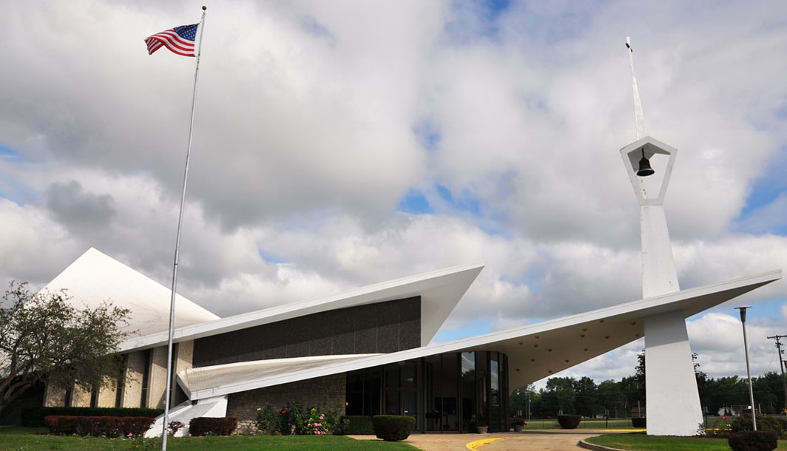
US. Modernist Houses
US Modern Religious Architecture III
1964-1968
1960-1980

Slide 2
US Modern Religious Architecture III
The purpose of this presentation is to show you Contemporary as Temples, Abbeys, Cathedrals, Churches, Chapels or Synagogues.
They were born from the imagination of the greatest architects of the 20th and 21th centuries.
Whatever their size or the religions they represent, these religious buildings have in common to bring, in addition to their unique or spectacular architecture, calm, peace and serenity.

Slide 3
US Modern Religious Architecture
North Christian Church, Columbus, IN (1964).
Unitarian Universalist Church, Arlington, VA (1964).
First Baptist Church, Columbus, IN (1965).
First Presbyterian Church, Deaborn, MI (1965).
St Francis de Sales, Muskegon, MI (1966).
University Chapel, Tuskegee, AL (1967).
Tribeca Synagogue, New-York, NY (1967).
St Matthew Church, Zilwaukee, MI (1967).
United Church of Roweyton, Norwalk, CT (1967).
Church of the Crucifixion, New-York, NY (1967).
Temple Beth Zion, Buffalo, NY (1967).
St Paul by the Sea, Jacksonville, FL (1967).

Slide 4
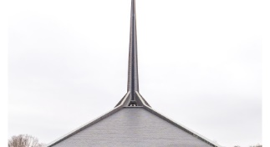
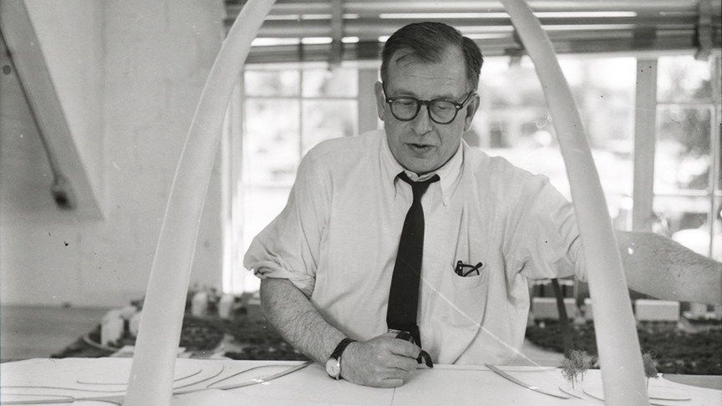
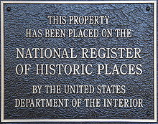
North Christian Church,Colombus, IN (1964)
Eero Saarinen

Slide 5
North Christian Church,Colombus, IN (1964)
It is the work of Eero Saarinen.
The building is hexagonal in shape, with a central metal spire that is 192 feet (59 m) high. Below the spire, there is an oculus that admits light into the main level. The sanctuary is located at the center of the building, with the Lord's Table located in the center of the sanctuary. Rows of pews surround the altar in a hexagon.
From each corner of the hexagon, massive piers support the structural ribs of the roof.
The lower level contains classrooms, an auditorium, a kitchen, and an activities area.

Slide 6
North Christian Church,Colombus, IN (1964)
Inside, the sculpted lines of a cast-in-place concrete ceiling beautifully mirror the angular geometries of the plan and cast a heavy presence over the worshipping space below.
The grey slate floors, dark mahogany pews, and eerie natural lighting instill a sense of awe in the visitor. The primary light source into the sanctuary is the oculus at the base of the spire, directly above the Communion table (consisting of 12 pedestals symbolic of the 12 disciples).
From the outside of the building, the spire symbolized reaching upwards to God; on the inside, it created an enclosed soaring space for the congregation. At the top of the spire is a 5' 30" gold leaf cross, symbolizing Christ's sacrifice.

Slide 7
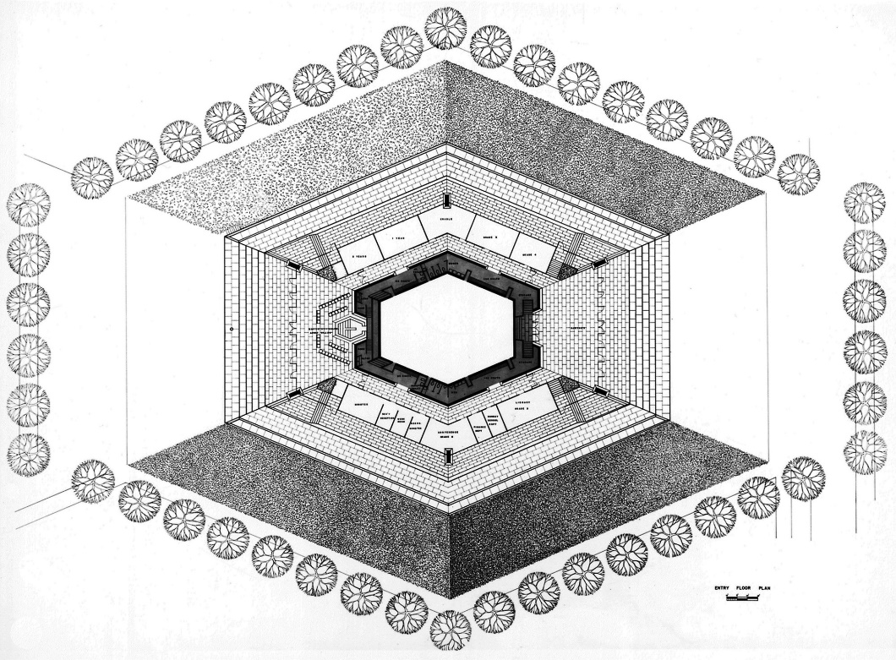
North Christian Church,Colombus, IN (1964)

Slide 8
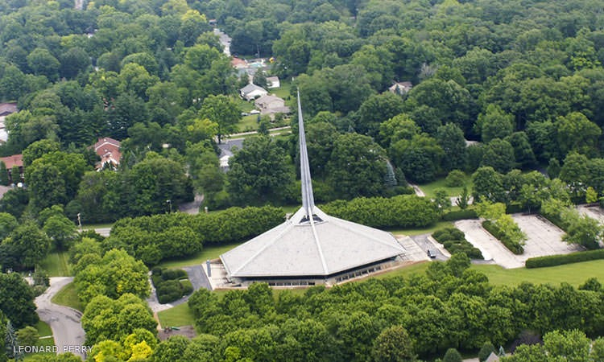
North Christian Church,Colombus, IN (1964)

Slide 9
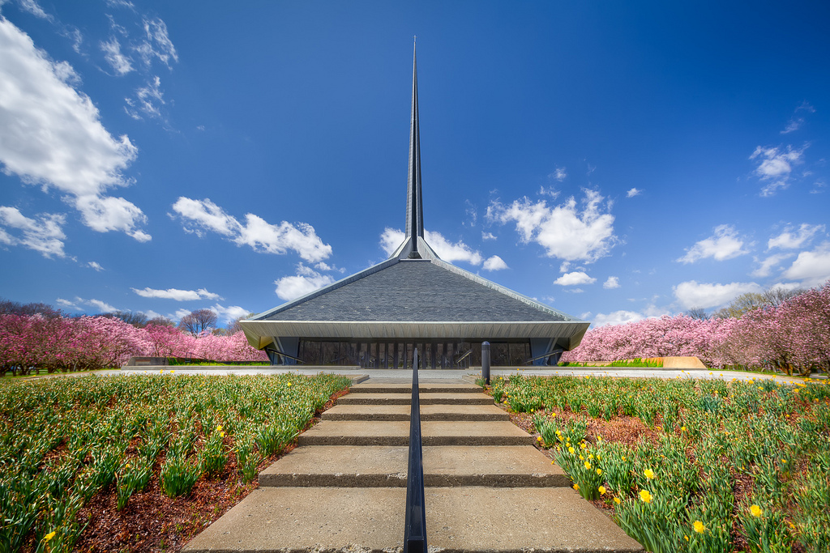
North Christian Church,Colombus, IN (1964)

Slide 10
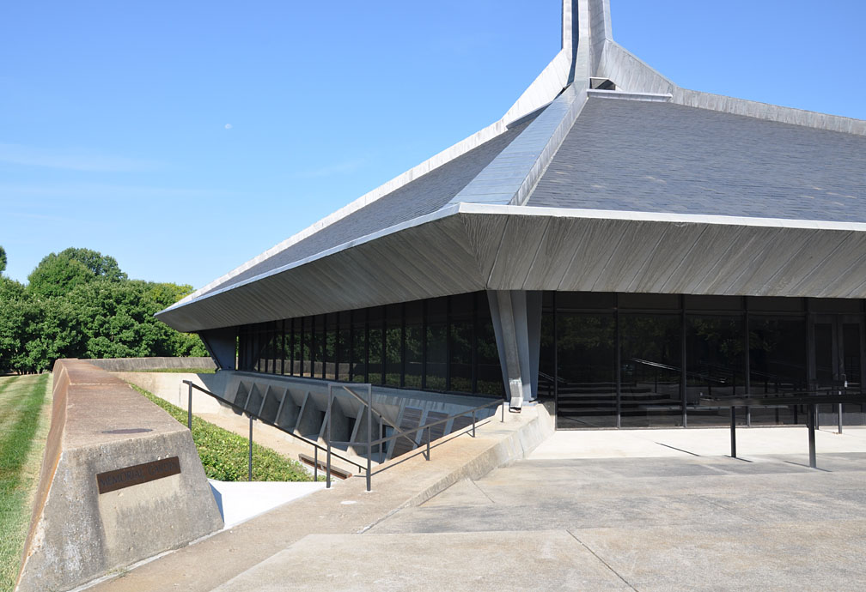
North Christian Church,Colombus, IN (1964)

Slide 11
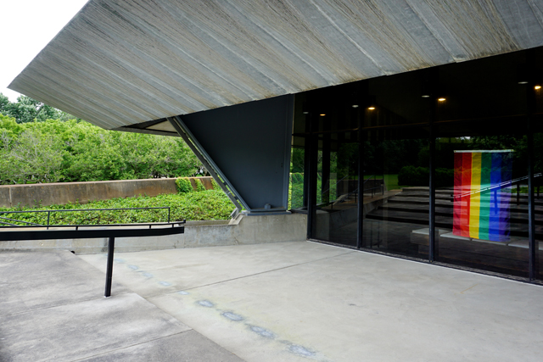
North Christian Church,Colombus, IN (1964)

Slide 12
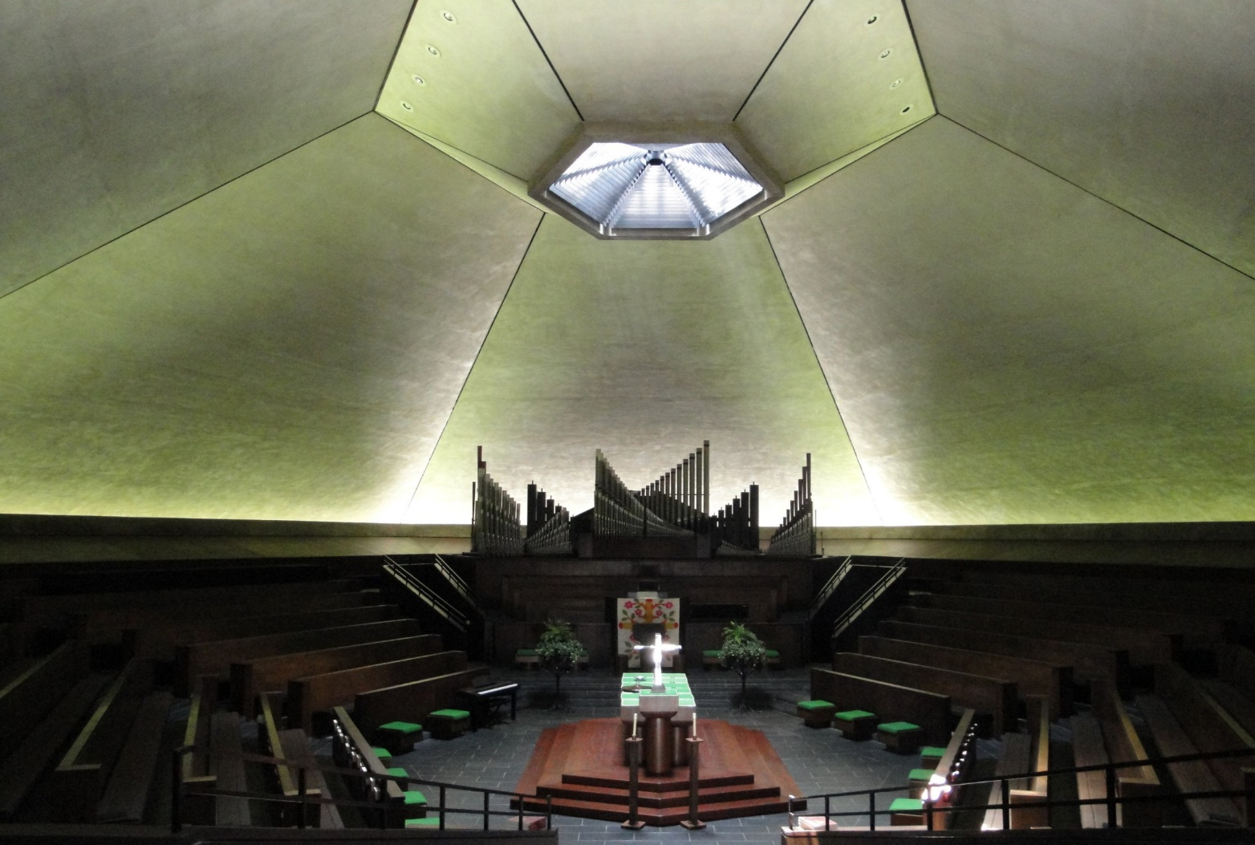
North Christian Church,Colombus, IN (1964)

Slide 13
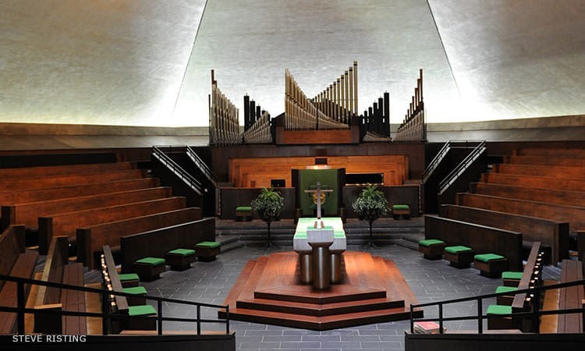
North Christian Church,Colombus, IN (1964)

Slide 14
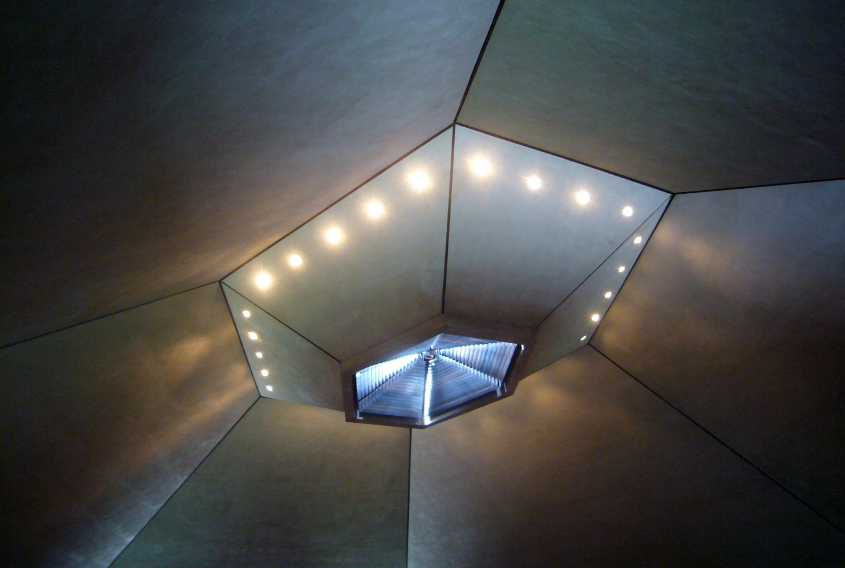
North Christian Church,Colombus, IN (1964)

Slide 15
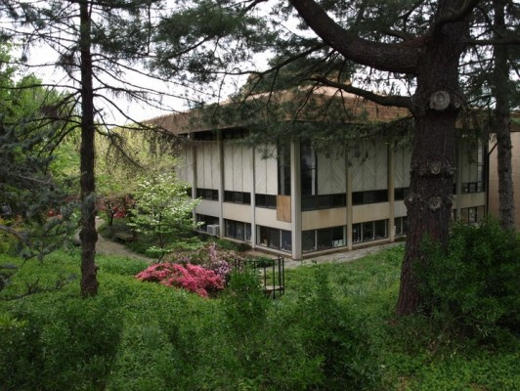
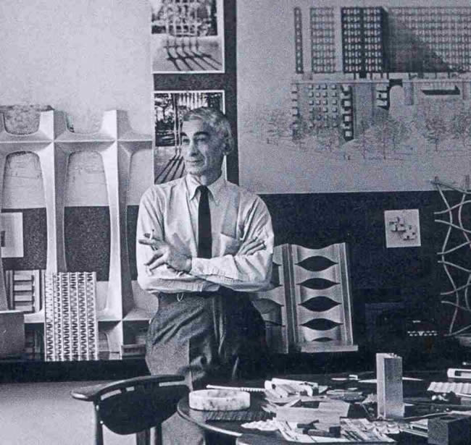
Unitarian Universalist Church,Arlington,VA (1964)
Charles M. Goodman

Slide 16
Unitarian Universalist Church,Arlington,VA (1964)
It is the work of the architect Carles M. Goodman.
Carved out of its site’s sloping landscape, the two-story Sanctuary features pre-cast concrete construction, a prominent overhanging canopy roof, and wrapping clerestory windows.
Set on a stacked, concrete block foundation, the building isconstructed entirely of pre-cast concrete components, most notably the large, corrugated panels that span each elevation. The corrugation of the concrete wall panels provides visual interest to the otherwise ordered, almost brutal aesthetic of the building.

Slide 17
Unitarian Universalist Church,Arlington,VA (1964)
The Sanctuary is topped by a prominent, concrete, flat roof that is completed with wide overhangs and over-sized concrete rainspouts at the east and west (side) elevations. The building is highlighted by square, fixed-light clerestory windows that wrap around the building beneath the roofline, and by narrow, fixed-light windows that pierce each elevation at the first story.
The elevations are dominated by the large, corrugated concrete wall panels that are symmetrically spaced across each elevation. The east and west elevations consist of five equal bays and the north and south elevations were designed with three bays, with a large central bay flanked by two smaller bays

Slide 18
Unitarian Universalist Church,Arlington,VA (1964)
Tall, pre-cast concrete columns that are spaced 16 feet on center and stretch from the ground to the underside of the overhanging roof define each bay.
The first story is defined by horizontal, double-corrugated, pre-cast concrete pieces that act as beams and lintels for the pre-cast panels. Two narrow, single-light fixed windows pierce each panel, with one each set to the inside of the defining columns. These windows extend the full height of the first story and are defined by the horizontal structural members.

Slide 19
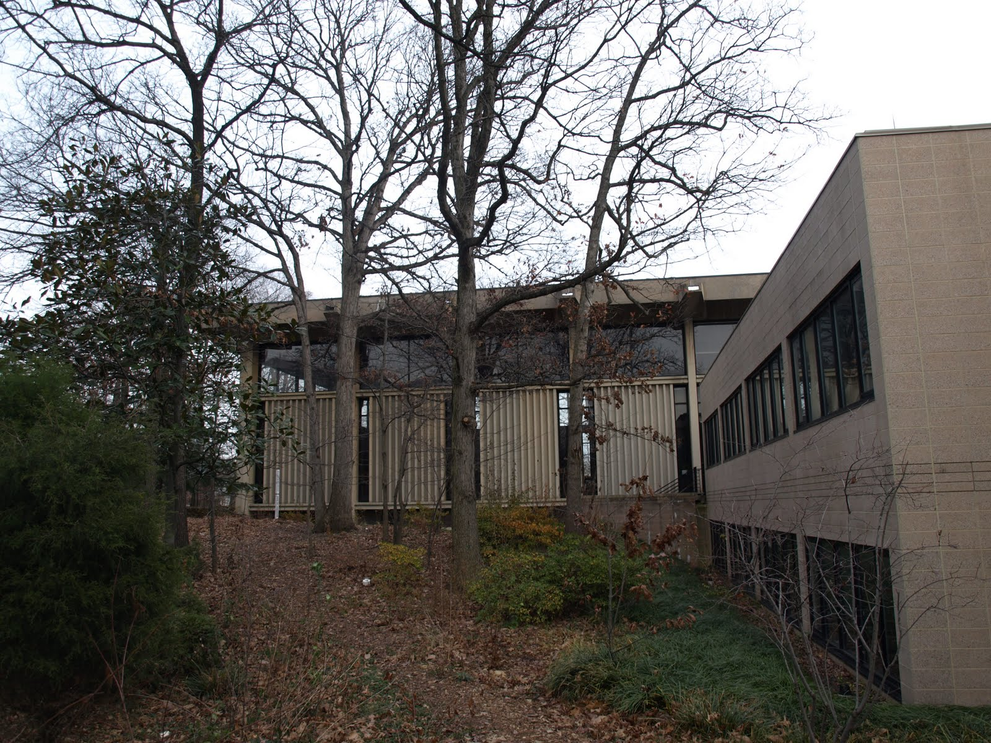
Unitarian Universalist Church,Arlington,VA (1964)

Slide 20
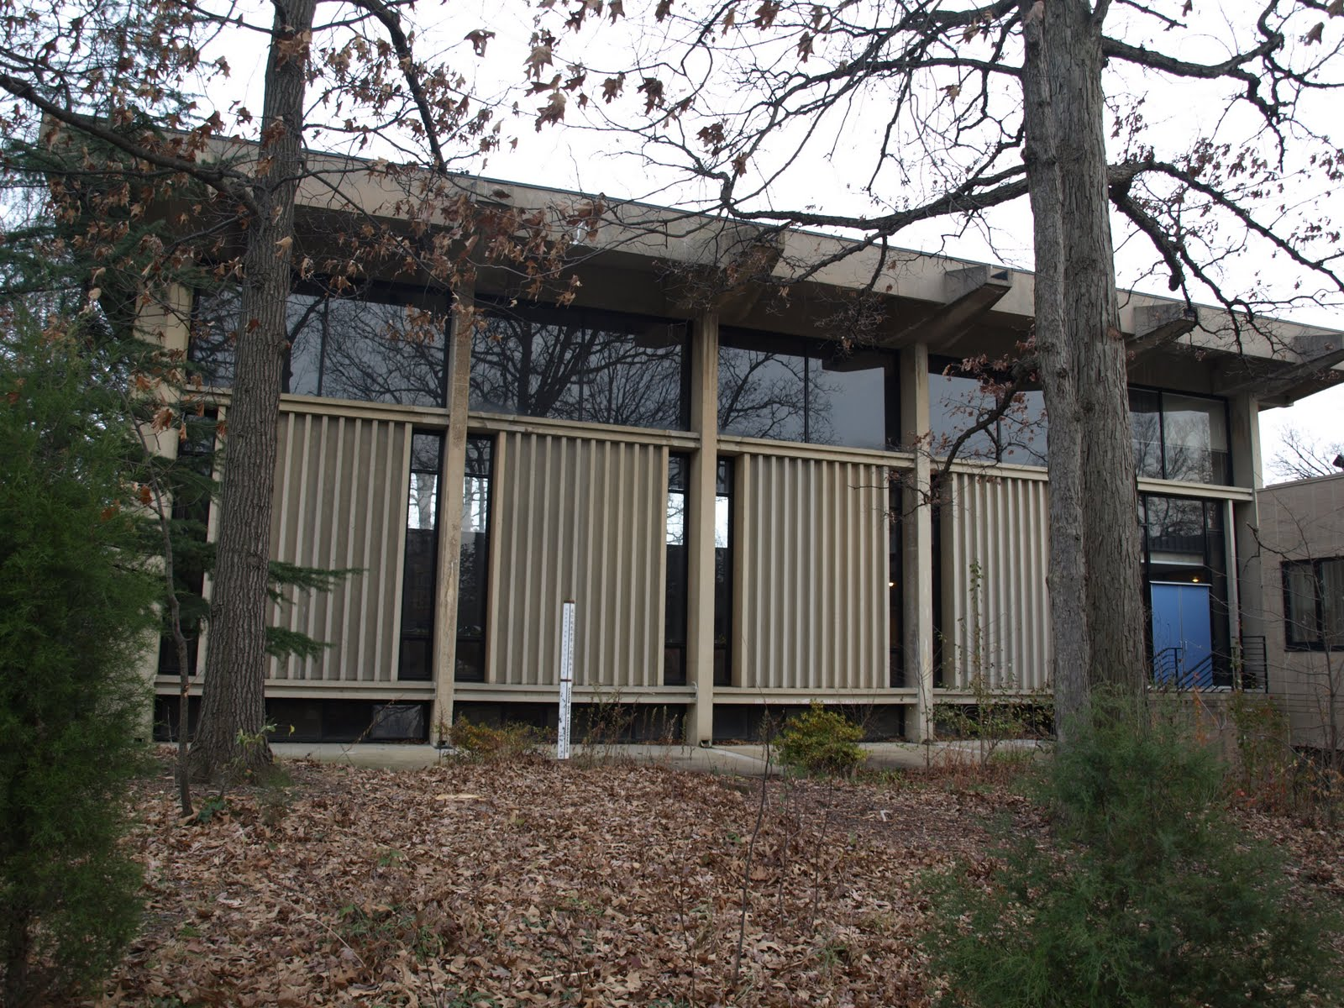
Unitarian Universalist Church,Arlington,VA (1964)

Slide 21
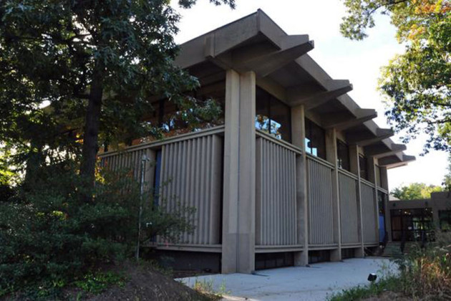
Unitarian Universalist Church,Arlington,VA (1964)

Slide 22
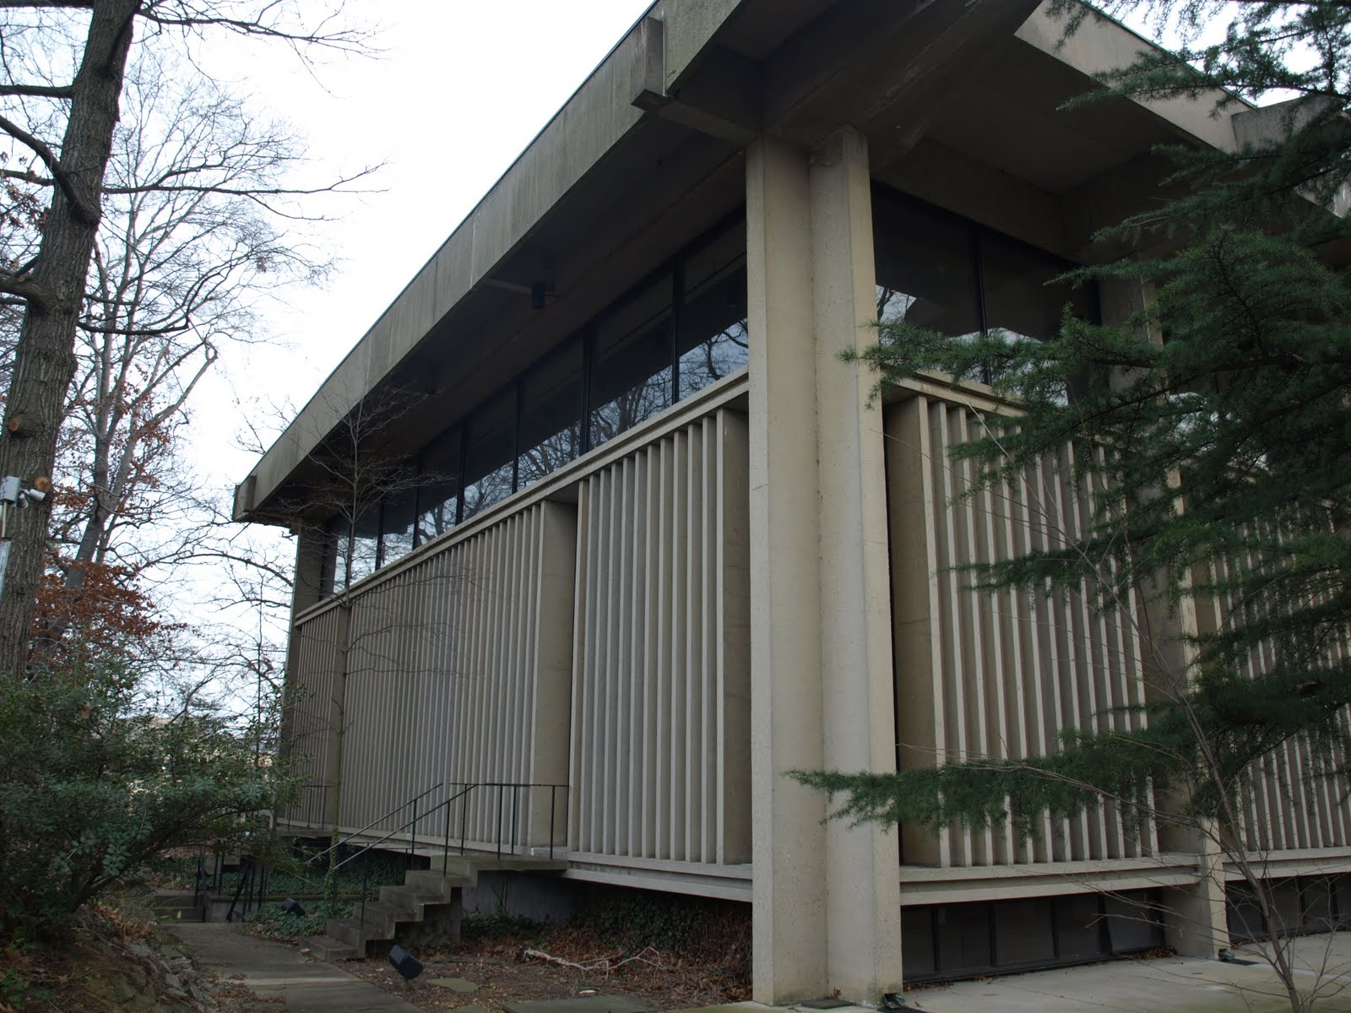
Unitarian Universalist Church,Arlington,VA (1964)

Slide 23
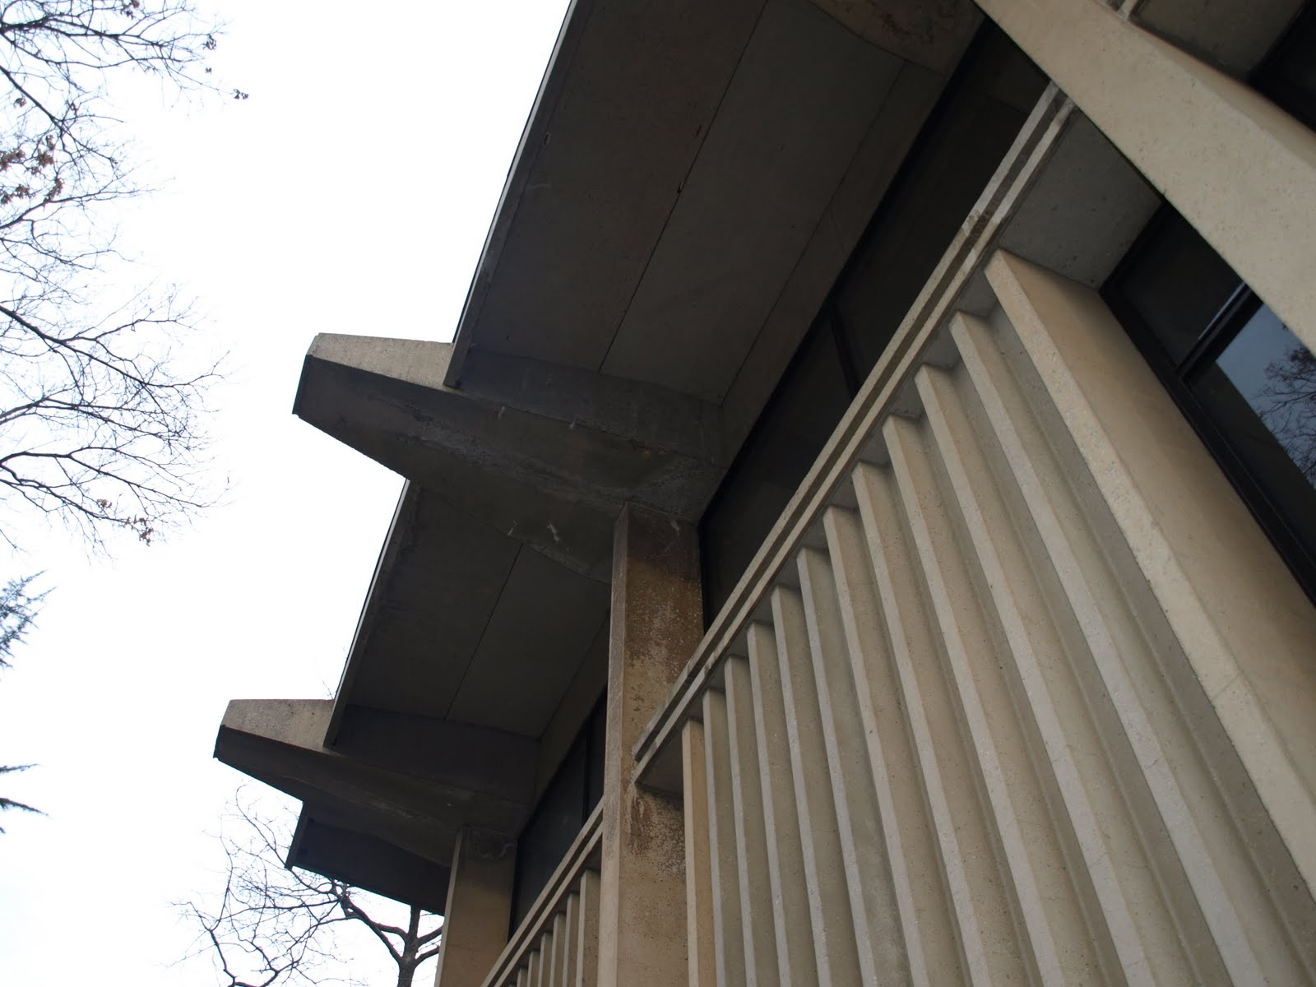
Unitarian Universalist Church,Arlington,VA (1964)

Slide 24
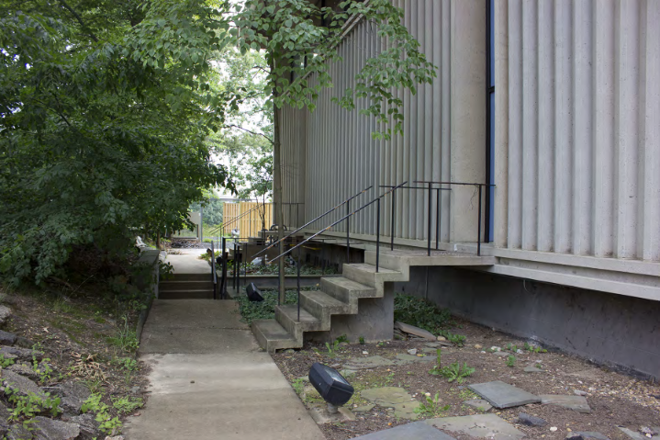
Unitarian Universalist Church,Arlington,VA (1964)

Slide 25
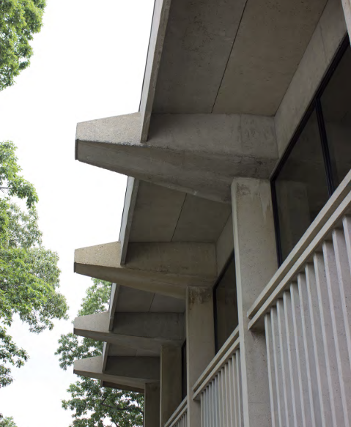
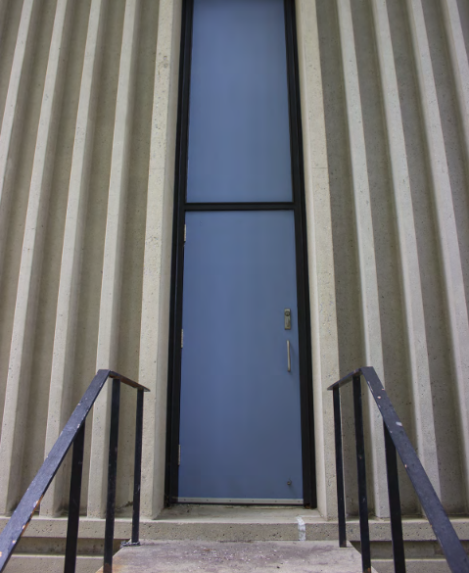
Unitarian Universalist Church,Arlington,VA (1964)

Slide 26
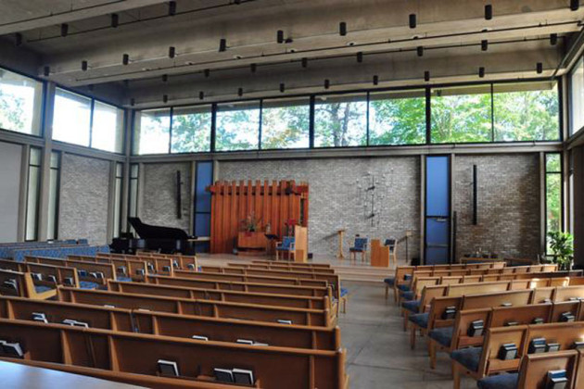
Unitarian Universalist Church,Arlington,VA (1964)

Slide 27
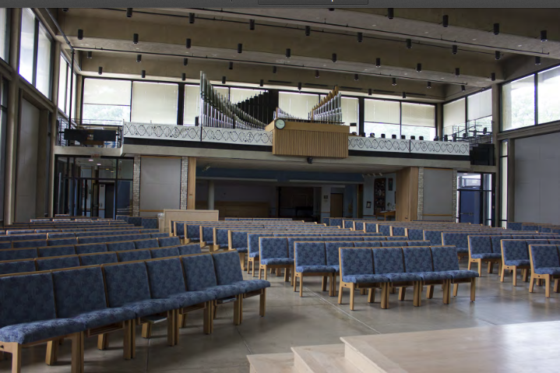
Unitarian Universalist Church,Arlington,VA (1964)

Slide 28
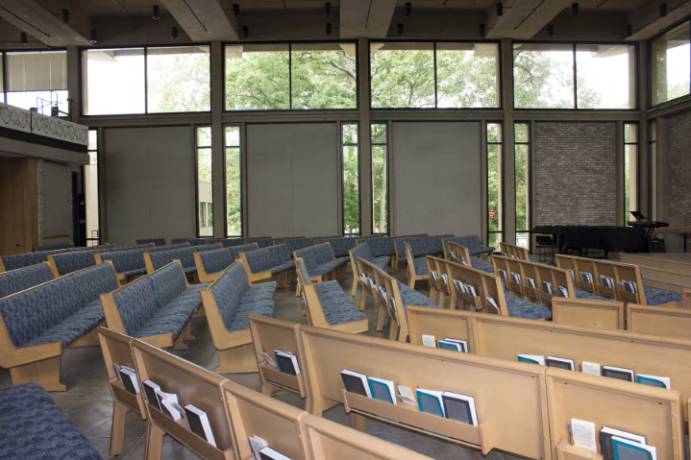
Unitarian Universalist Church,Arlington,VA (1964)

Slide 29
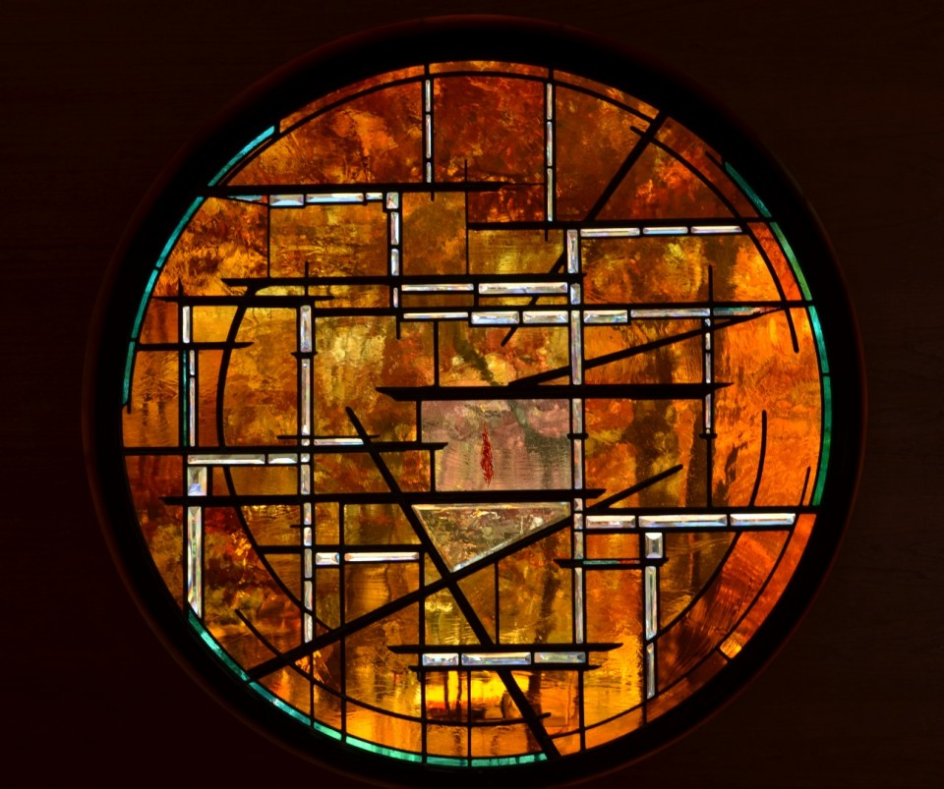
Unitarian Universalist Church,Arlington,VA (1964)

Slide 30
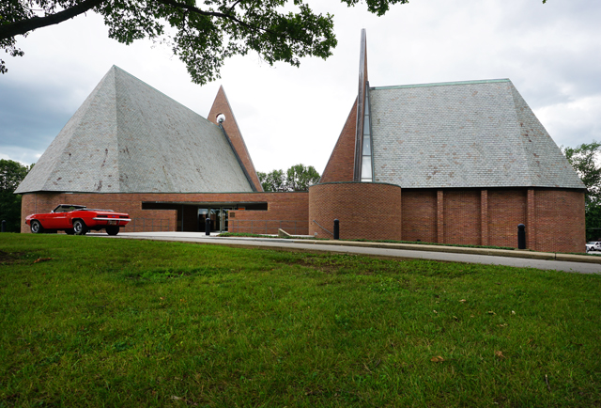
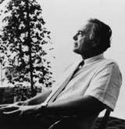
First Baptist Church, Columbus, IN (1965)
Harry Weese

Slide 31
First Baptist Church, Columbus, IN (1965)
It is the work of the architect Harry Weese.
The lower level contains 25 classrooms, 4 restrooms and the heating plant. A kind of “moat” surrounds the lower level allowing room for small windows bringing natural light into the rooms.
The upper level consists of the sanctuary (seating 500) and a chapel (seating 100). The chapel is a miniature version of the sanctuary set at a perpendicular angle.
The Courtyard is directly accessible from both levels and provides an outdoor gathering area for fellowship and refreshment.

Slide 32
First Baptist Church, Columbus, IN (1965)
The high A-framed sanctuary space with vaulted wood ceilings is windowless on the sides to shut out distractions. Hidden windows under the eaves provide indirect natural light as well as ventilation. The ceilings are 49 feet high at the peak and constructed of exposed tongue and groove decking supported by laminated wood beams.
One of the prominent interior features is the wall of pierced brick at the front of the sanctuary formed by the flat non-dimensional triangular wall which also serves as the bell tower.

Slide 33
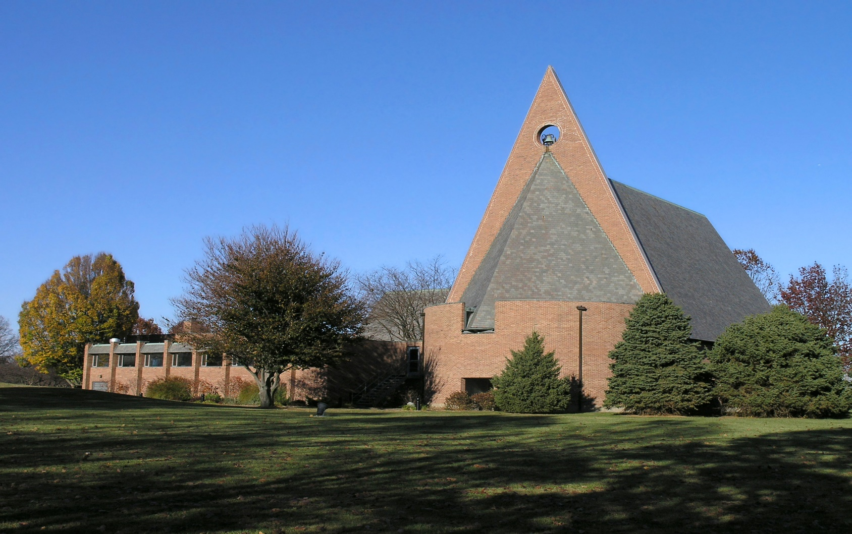
First Baptist Church, Columbus, IN (1965)

Slide 34
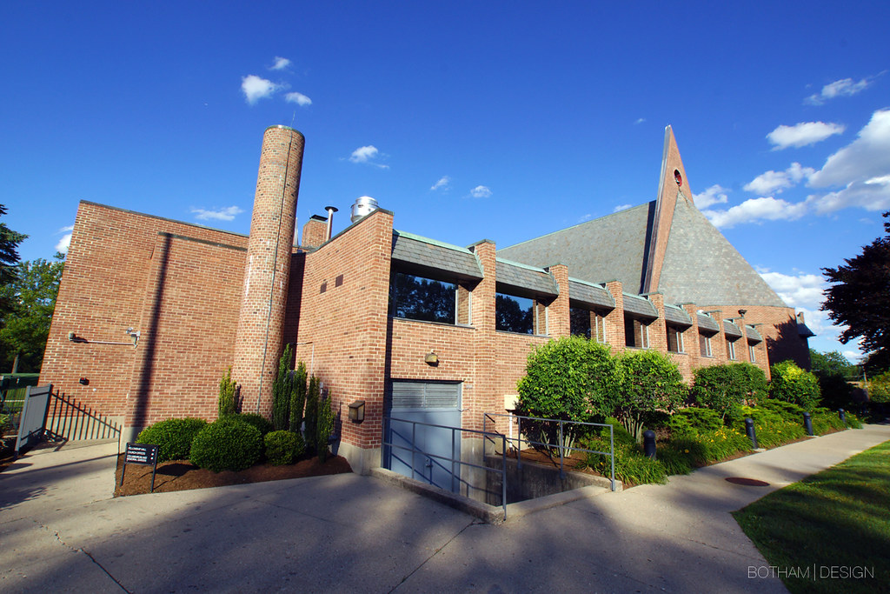
First Baptist Church, Columbus, IN (1965)

Slide 35
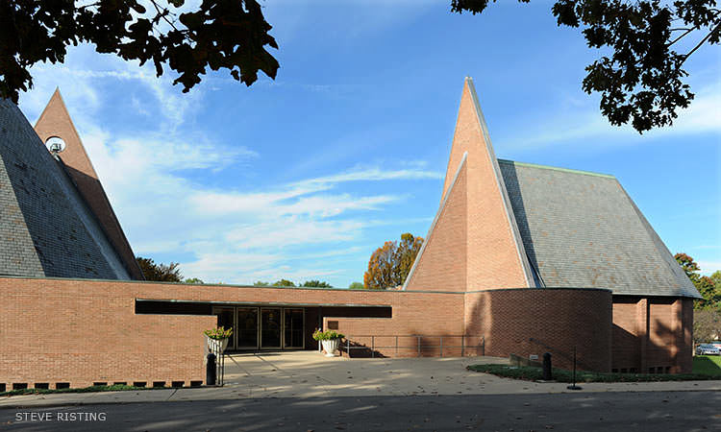
First Baptist Church, Columbus, IN (1965)

Slide 36
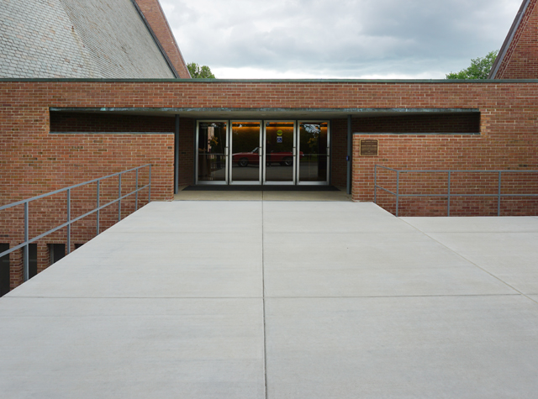
First Baptist Church, Columbus, IN (1965)

Slide 37
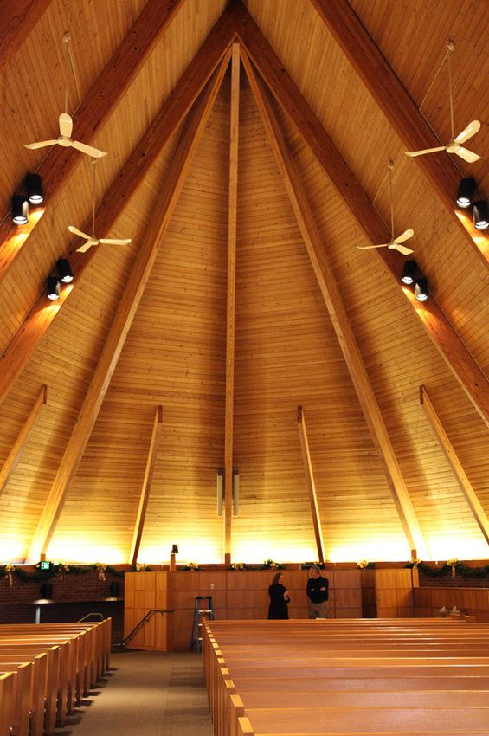
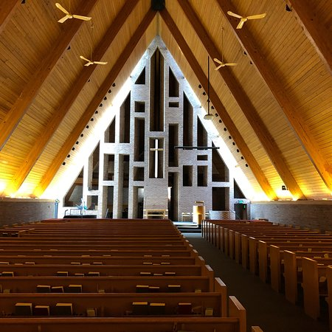
First Baptist Church, Columbus, IN (1965)

Slide 38
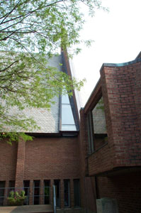
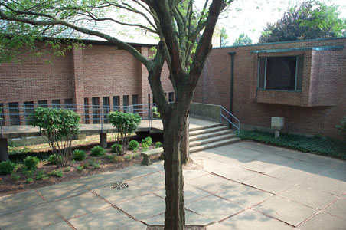
First Baptist Church, Columbus, IN (1965)

Slide 39
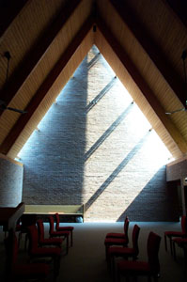
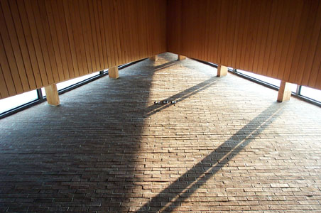
First Baptist Church, Columbus, IN (1965)

Slide 40
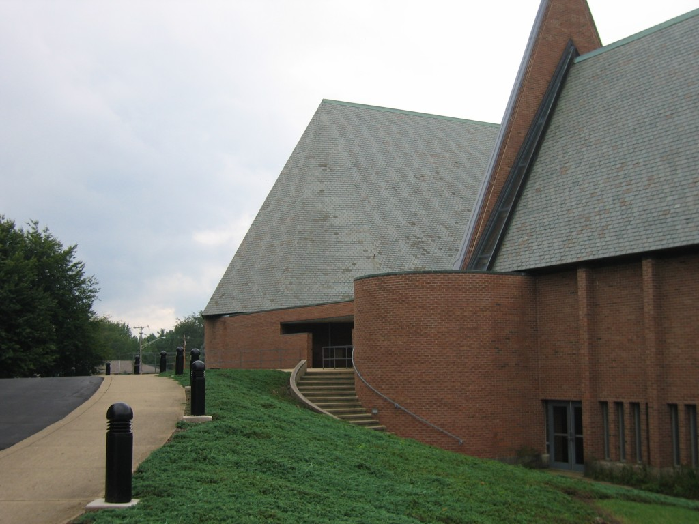
First Baptist Church, Columbus, IN (1965)

Slide 41
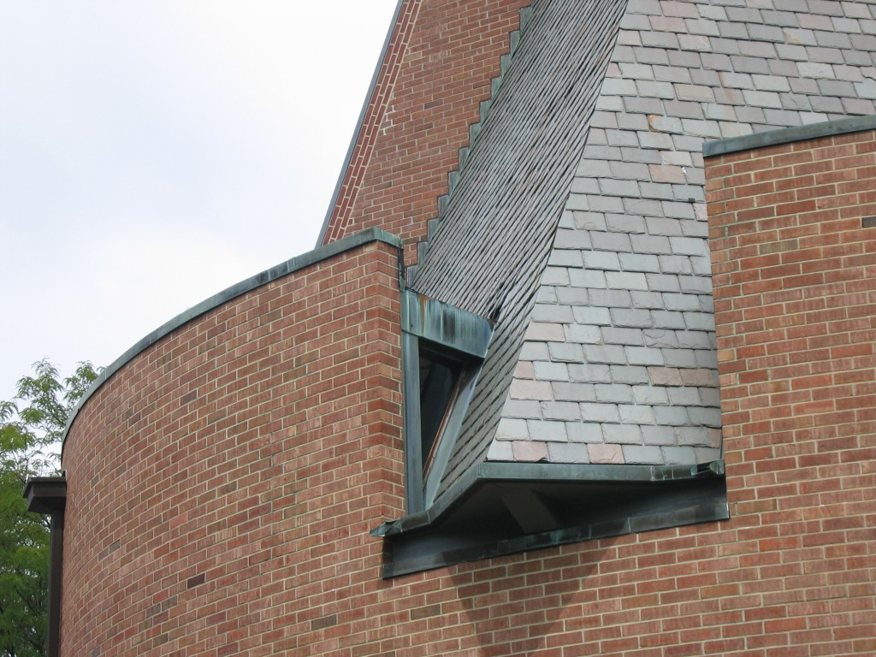
First Baptist Church, Columbus, IN (1965)

Slide 42
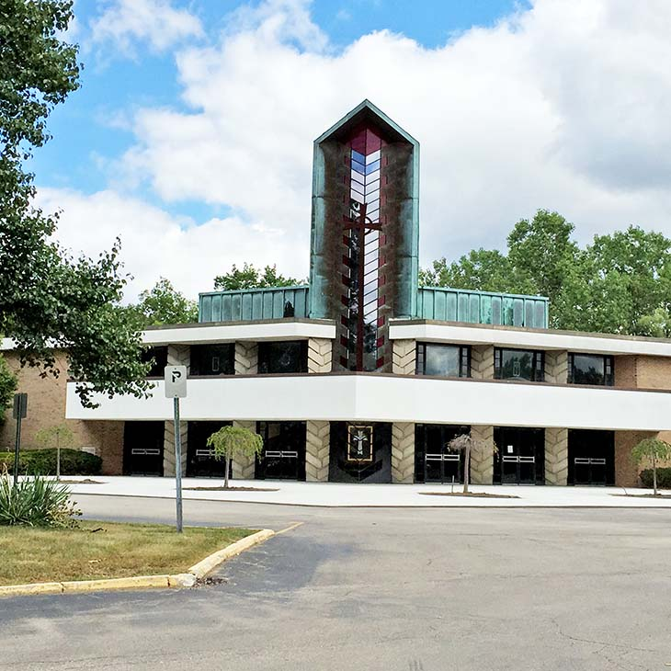
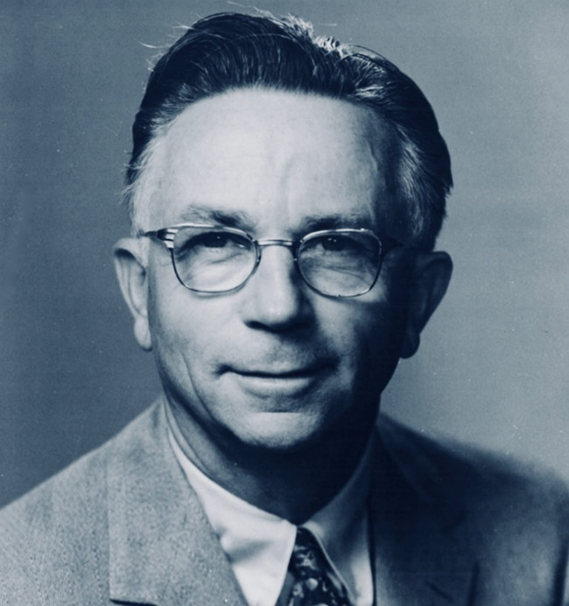
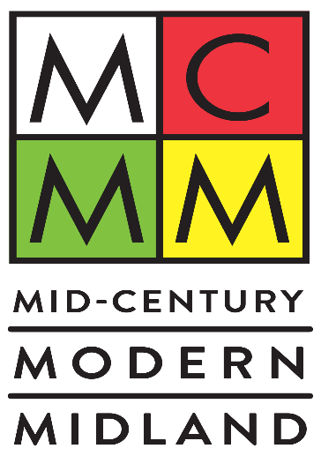
First Presbyterian Church, Deaborn, MI (1965)
Alden B. Dow

Slide 43
First Presbyterian Church, Deaborn, MI (1965)
It is the work of the architect Alden B. Dow.
In his design Mr. Dow used the triangular module throughout the building to reflect the Trinity of the Christian faith. Above the outside entrance stands a 26-foot tall redwood cross.
Once inside, the sanctuary ceiling rises in three planes to a height of 45 feet. Within the nave the congregation is grouped around the altar; the choirs are part of the worshipers seated on the upper level and above the narthex.

Slide 44
First Presbyterian Church, Deaborn, MI (1965)
Among the most distinctive features of the church are the many three-sided structural columns made of pre-cast concrete with a unique raised herringbone pattern on all sides.
Also of particular note is the beautiful chapel with its richly textured wall of concrete blocks laid in angled beds and pierced with triangular bits of colored glass.

Slide 45
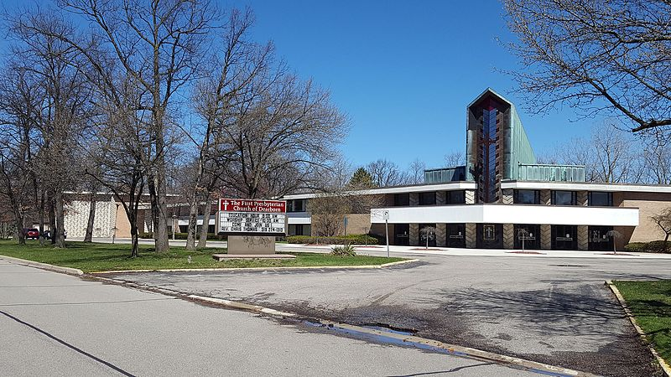
First Presbyterian Church, Deaborn, MI (1965)

Slide 46
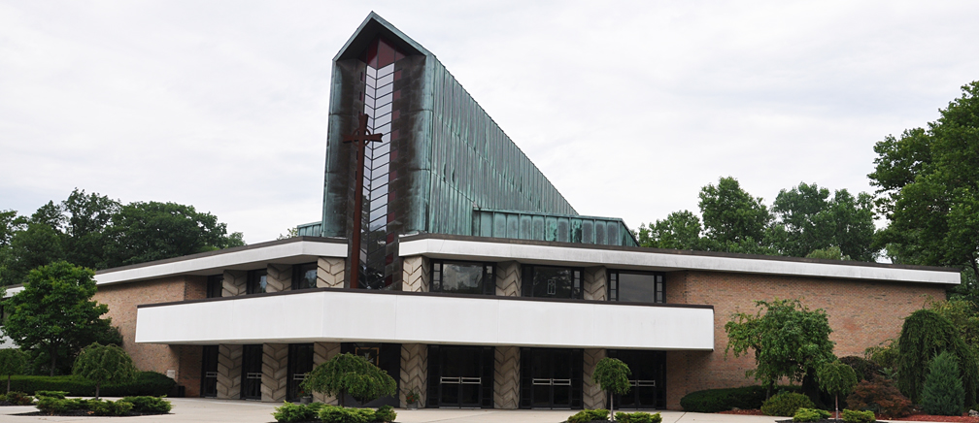
First Presbyterian Church, Deaborn, MI (1965)

Slide 47
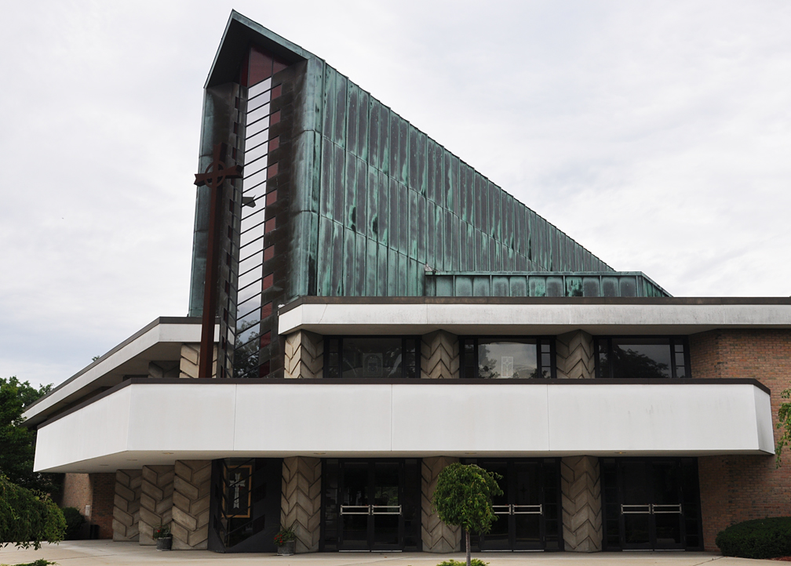
First Presbyterian Church, Deaborn, MI (1965)

Slide 48
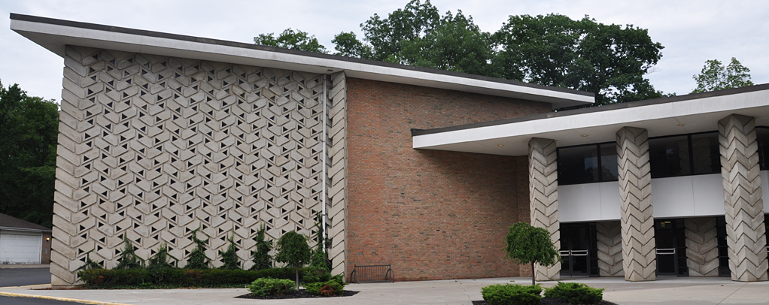
First Presbyterian Church, Deaborn, MI (1965)

Slide 49
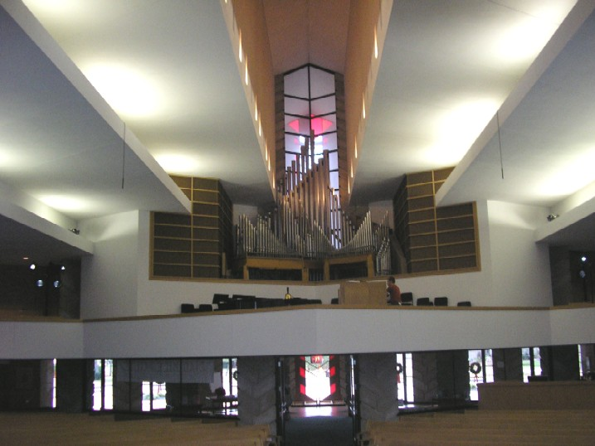
First Presbyterian Church, Deaborn, MI (1965)

Slide 50
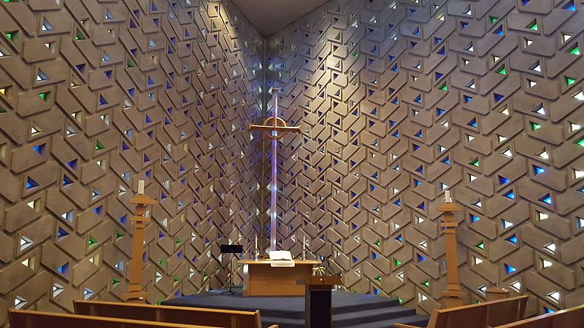
First Presbyterian Church, Deaborn, MI (1965)

Slide 51
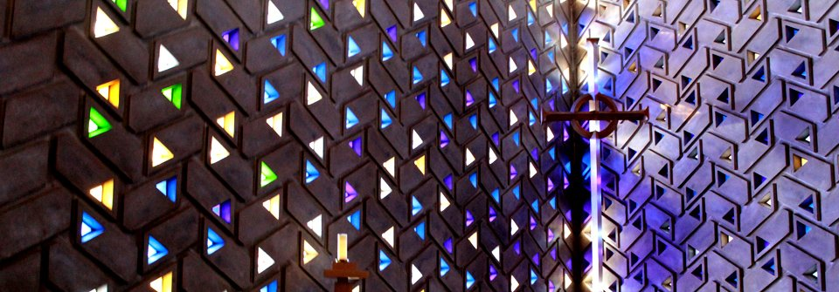
First Presbyterian Church, Deaborn, MI (1965)

Slide 52
St Francis de Sales Church, Muskegon, MI (1966)
Marcel Breuer

Slide 53
St Francis de Sales Church, Muskegon, MI (1966)
It is the work of the architect Marcel Breuer.
The facade of the church evolves from a simple trapezoidal plan, narrow at its base and widening as it rises some 75 feet in height. In the center of the vast gray expanse of the front wall is a bold cross set in relief. Above this, the church's bells are suspended between 2 concrete arms that cantilever out from the roof ridge.
The gray concrete of the facade has a smooth finish created by the subtle texture of the grained surfaces of the wood forms.

Slide 54
St Francis de Sales Church, Muskegon, MI (1966)
By contrast the deep ribbed finish of the hyperbolic paraboloid sidewalls was created by staggering the edges of regular boards that served as the formwork.
The original one-story narthex that extended from the base of the facade has been expanded by the construction of 2 wings that extend out in each direction and contain various support spaces for the church.
The rectory is a one-story, rectangular wing with a central courtyard located at the rear of the building. The primary elevation of the rectory has a screen wall of hollow clay tile that provides privacy and shade from direct sunlight to the occupants.

Slide 55
St Francis de Sales Church, Muskegon, MI (1966)

Slide 56
St Francis de Sales Church, Muskegon, MI (1966)

Slide 57
St Francis de Sales Church, Muskegon, MI (1966)

Slide 58
St Francis de Sales Church, Muskegon, MI (1966)

Slide 59
St Francis de Sales Church, Muskegon, MI (1966)

Slide 60
St Francis de Sales Church, Muskegon, MI (1966)

Slide 61
St Francis de Sales Church, Muskegon, MI (1966)

Slide 62
University Chapel, Tuskegee, AL (1967)
Paul Rudolph

Slide 63
University Chapel, Tuskegee, AL (1967)
It is the work of the architect Paul Rudolph.
But due to cost estimates for a concrete structure exceeding the project budget, the new chapel was redesigned as a steel-framed, brick-clad building. While cost drove the design change, brick (as opposed to another material) was selected by Rudolph for its monolithic visual effect. Perhaps due to the tradition of brick campus buildings, it has remained the finish of choice at Tuskegee.

Slide 64
University Chapel, Tuskegee, AL (1967)
On both the exterior and interior, the chapel’s irregularly angled walls are finished in a coral-toned brick and mortar. While the structure contains no right angles, its 1,200-seat sanctuary (half the capacity of the original chapel) is approximately 80 feet wide by 170 feet long, with an average ceiling height of 40 feet.
The brick hue of the walls is matched in the sanctuary and the rest of the structure by its woven carpet, lacquered wooden pews, tiled floors, and copper doors—creating a visual consistency throughout. The main entry, set within and defined by a recessed porch with raking roof, transitions to the low, sloping ceiling of the narthex, which then explodes spatially in verticality and light as one moves into the nave.

Slide 65
University Chapel, Tuskegee, AL (1967)
Natural light fills this main space from continuous skylights, located at the intersection of the sloping ceiling and brick side walls, which fan outward and upward from the front to the rear. A balcony is nestled at the rear, forming the narthex ceiling, and cantilevers out over the sanctuary below.
Instead of a stand-alone cultural arts building, works of art were commissioned for the chapel and displayed throughout the main and lower levels. Examples include exact replicas of the stained glass “Singing Windows” of the original chapel, located in the narthex; copper relief panels above the chapel main entry doors.

Slide 66
University Chapel, Tuskegee, AL (1967)

Slide 67
University Chapel, Tuskegee, AL (1967)

Slide 68
University Chapel, Tuskegee, AL (1967)

Slide 69
University Chapel, Tuskegee, AL (1967)

Slide 70
University Chapel, Tuskegee, AL (1967)

Slide 71
University Chapel, Tuskegee, AL (1967)

Slide 72
University Chapel, Tuskegee, AL (1967)

Slide 73
University Chapel, Tuskegee, AL (1967)

Slide 74
Tribeca Synagogue,New-York, NY (1967)
William N. Breger

Slide 75
Tribeca Synagogue,New-York, NY (1967)
It is the work of the architect William N. Breger.
The Tribeca Synagogue has a convex wave set back from the street.
The bowing façade evokes the flame of the burning bush, while the windowless sanctuary receives illumination from a skylight high above the bimah. Viewed from any direction, the building appears to float above its lot, suspended between two adjacent cast-iron structures.
Breger paid special attention to the building acoustics to allow for good sound quality without the need for electrical amplification, use of which is prohibited on Shabbat.

Slide 76
Tribeca Synagogue,New-York, NY (1967)

Slide 77
Tribeca Synagogue,New-York, NY (1967)

Slide 78
Tribeca Synagogue,New-York, NY (1967)

Slide 79
Tribeca Synagogue,New-York, NY (1967)

Slide 80
Tribeca Synagogue,New-York, NY (1967)

Slide 81
St Matthew Church, Zilwaukee, MI (1967)

Slide 82
St Matthew Church, Zilwaukee, MI (1967)
It is the work of Morris & Wesolek firm.
The building is a poured concrete roof resting on 2 saddlelike hyperbolic paraboloids. The roof begins right at the ground level and rises to a height of 54’ over the altar of sacrifice.
The walls of the main part of the church are of aggregate faced concrete panels. The walls of front entrance are of Bayport stone.
The side walls of the church are in a louvered type arrangement with narrow walls of faceted stainless glass laid in apoxy which go from the floor to the ceiling.

Slide 83
St Matthew Church, Zilwaukee, MI (1967)

Slide 84
St Matthew Church, Zilwaukee, MI (1967)

Slide 85
St Matthew Church, Zilwaukee, MI (1967)

Slide 86
St Matthew Church, Zilwaukee, MI (1967)

Slide 87
St Matthew Church, Zilwaukee, MI (1967)

Slide 88
United Church of Roweyton, Norwalk, CT (1967)

Slide 89
United Church of Roweyton, Norwalk, CT (1967)
It is the work of the architect Joseph P. Salerno.
The free form enclosing the 300-member congregation is an eloquent envelope that ascends ninety feet above the floor in an effortless arabesque, culminating in a shaft of light.
The wood is used for the structure : the individually shaped laminated ribs and the planking in compound curves reflect the origin of the material. Inside we can find a semi-circular seating pattern.

Slide 90
United Church of Roweyton, Norwalk, CT (1967)

Slide 91
United Church of Roweyton, Norwalk, CT (1967)

Slide 92
United Church of Roweyton, Norwalk, CT (1967)

Slide 93
United Church of Roweyton, Norwalk, CT (1967)

Slide 94
United Church of Roweyton, Norwalk, CT (1967)

Slide 95
United Church of Roweyton, Norwalk, CT (1967)

Slide 96
United Church of Roweyton, Norwalk, CT (1967)

Slide 97
Church of Crucifixion, New-York, NY (1967)

Slide 98
Church of Crucifixion, New-York, NY (1967)
It is the work of the architect Costas Machlouzarides.
The first distinctive characteristic of the church are the 4 cylindrical sections of the main façades. Each curved section serves as a programmatic partition containing the 4 principal elements of the church. the baptistery, the shrine, the chapel, and the altar. Discretely dividing the curved bays and the roof above are narrow slivers of windows that provide defuse indirect lighting for the interior.
The second distinctive feature of the church is its air foil shaped cantilevered roof that is reminiscent of La Corbusier’s famous Notre Dame de Haut in Ronchamp. The roof has a flat top and a parabolic bottom that seems to project into the mass of the building below.

Slide 99
Church of Crucifixion, New-York, NY (1967)

Slide 100
Church of Crucifixion, New-York, NY (1967)

Slide 101
Church of Crucifixion, New-York, NY (1967)

Slide 102
Church of Crucifixion, New-York, NY (1967)

Slide 103
Church of Crucifixion, New-York, NY (1967)

Slide 104
Temple Beth Zion, Buffalo, NY (1967)
Max Abramovitz

Slide 105
Temple Beth Zion, Buffalo, NY (1967)
It is the work of the architect Max Abramovitz.
Identified by its scalloped poured concrete walls adorned with Alabama limestone, the Sanctuary dominates the building grounds. The building’s massive walls angle outward toward the sky at 15 degrees, in the form of arms held in prayer, and each of the ten scallops (on either side) represent the ten commandments.
The west entrance is distinguished by colorful stained glass windows and a large overhang, covering part of the expansive concrete landscape. The east entrance also has a large stained glass window above, however, this entrance leads to the museum.

Slide 106
Temple Beth Zion, Buffalo, NY (1967)
Monolithic concrete walls with exposed aggregate and fastener holes reference typical simplistic, unadorned brutalist material approach, and allowing the symbolism to read through the form.
The walls are supported below by a foundation pedestal 50 feet below grade. The walls are three feet thick at the base, and 11 inches thick at its highest point. The interior surface of the walls were bush-hammered to remove 1/4” to obtain the rough antique appearance. Alabama limestone veneer was applied to the exterior surface of the exterior walls.
The juxtaposition of the skylights along the concrete walls compliments the architect's intent to emphasize the presence of God in the building, and reinforce the traditional outdoor worshiping style.

Slide 107
Temple Beth Zion, Buffalo, NY (1967)

Slide 108
Temple Beth Zion, Buffalo, NY (1967)

Slide 109
Temple Beth Zion, Buffalo, NY (1967)

Slide 110
Temple Beth Zion, Buffalo, NY (1967)

Slide 111
Temple Beth Zion, Buffalo, NY (1967)

Slide 112
Temple Beth Zion, Buffalo, NY (1967)

Slide 113
Temple Beth Zion, Buffalo, NY (1967)

Slide 114
Temple Beth Zion, Buffalo, NY (1967)

Slide 115
Temple Beth Zion, Buffalo, NY (1967)

Slide 116
St Paul by the Sea,Jacksonville,FL (1967)
Blake Ellis

Slide 117
St Paul by the Sea,Jacksonville,FL (1967)
It is the work of the architect Blake Ellis.
The creative use of curved planes and surfaces evokes an intimate and spiritual connection with the nearby ocean. The concrete walls provide a durable and decorative exterior while insulating the interior. The building design evokes both a sense of marine life at the beach and the catacombs where the first Christians worshipped.

Slide 118
St Paul by the Sea,Jacksonville,FL (1967)

Slide 119
St Paul by the Sea,Jacksonville,FL (1967)

Slide 120
St Paul by the Sea,Jacksonville,FL (1967)

Slide 121
St Paul by the Sea,Jacksonville,FL (1967)

Slide 122
St Paul by the Sea,Jacksonville,FL (1967)

Slide 123
St Paul by the Sea,Jacksonville,FL (1967)

Slide 124
Temple Beth Zion, Buffalo, NY (1967)
THE END

