Slide 1
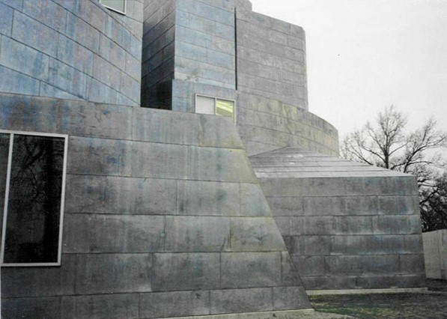
US Contemporary Museums V
1986-1994

Slide 2
US Contemporary Museums V
The aim is to show you different museums public or private of contemporary architecture throughout the U.S.A. : these do not only house contemporary art but also science.
The greatest architects of the 20th century contributed to the building of these museums with architectures certainly different but also adapted to the place and sometimes to the works they contain.

Slide 3
US Contemporary Museums
M.O.C.A. Grand, Los Angeles, CA 1986.
NSU Art Museum, Fort Lauderdale, FL 1986.
The Menil Collection, Houston, TX 1987.
L.A.C.M.A., Los Angeles, CA 1988.
Deer Valley Rock, Phœnix, AZ 1988.
Wexner Center for Arts, Columbus, OH 1989.
Hammer Museum, Los Angeles, CA 1990.
I.C.A., Philadelphia, PA 1991.
Center Visual Arts, Toledo, OH 1992.
American Heritage Center, Laramie, WY 1993.

Slide 4
US Contemporary Museums 2
The Davis Museum, Wellesley, MA 1993.
Weisman Art Museum, Minneapolis, MN 1993.
Museum of Tolerance, Los Angeles, CA 1993.
Kemper Museum, Kansas City, MO 1994.
M.O.C.A. North Museum, Miami, FL 1994.
Joslyn Art Museum, Omaha, NE 1994.

Slide 5
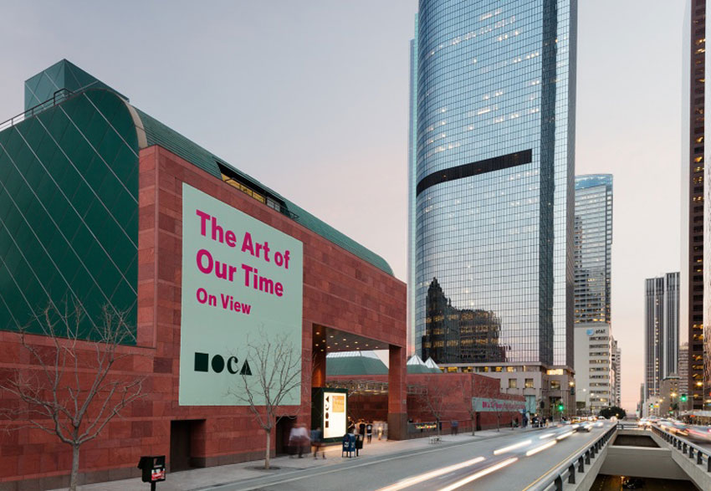
M.O.C.A. Grand, Los Angeles, CA (1986)
Arata Isozaki

Slide 6
M.O.C.A. Grand, Los Angeles, CA (1986)
The Japanese Arata Isozaki designed the museum in red sandstone contrasting with the glass and steel buildings surrounding it.
The building is built around a terraced courtyard. The galleries are below ground level, most with zenithal lighting through pyramid-shaped skylights. Above the courtyard, the only building that stands out is the section dedicated to administration, with a semi-circular dome-shaped roof.

Slide 7
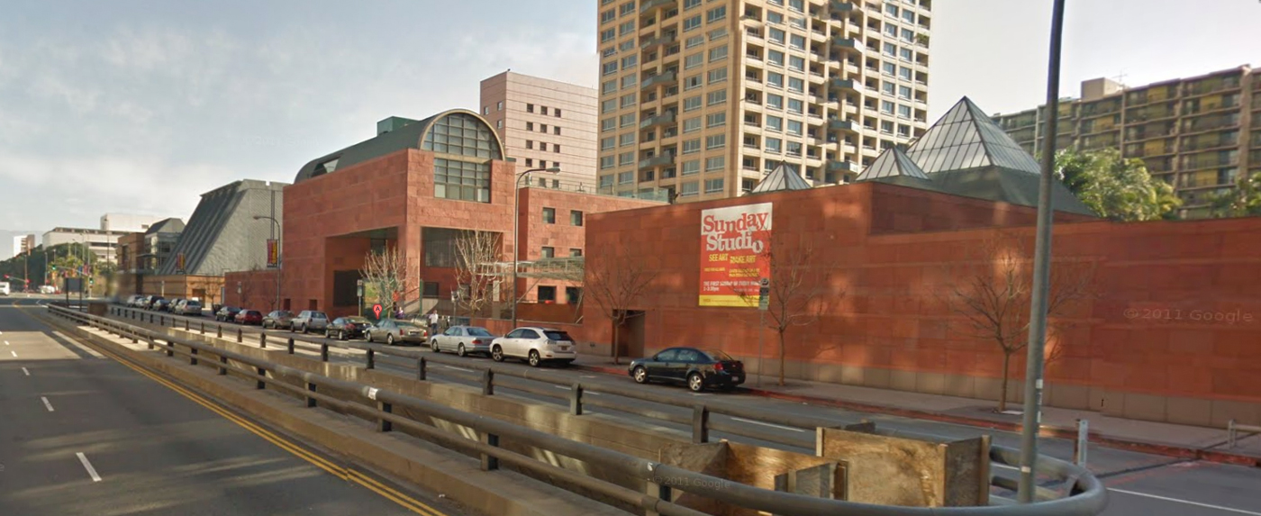
M.O.C.A. Grand, Los Angeles, CA (1986)

Slide 8
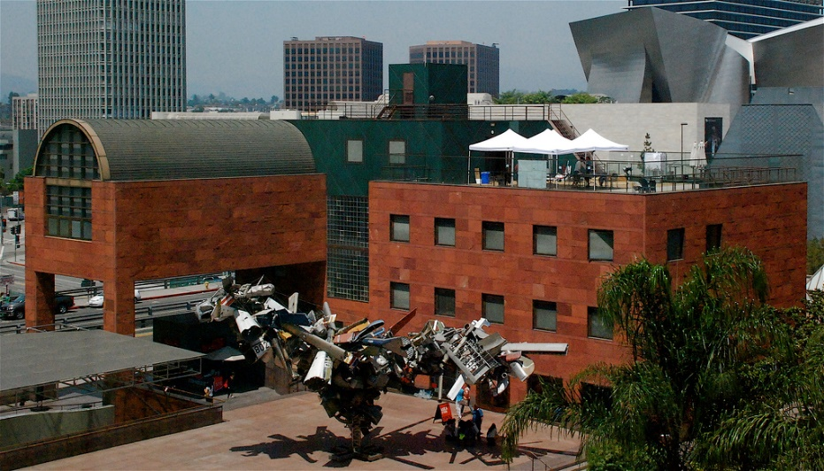
M.O.C.A. Grand, Los Angeles, CA (1986)

Slide 9
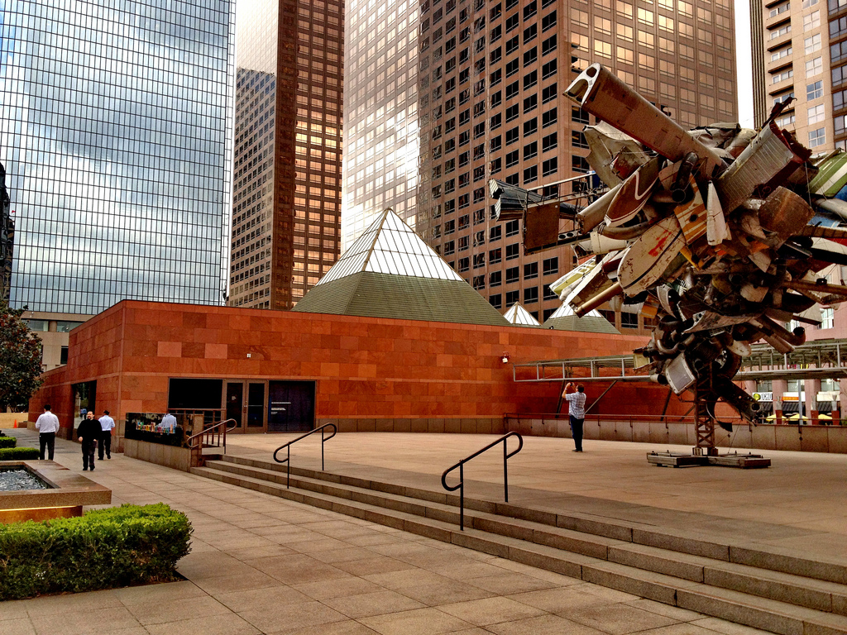
M.O.C.A. Grand, Los Angeles, CA (1986)

Slide 10
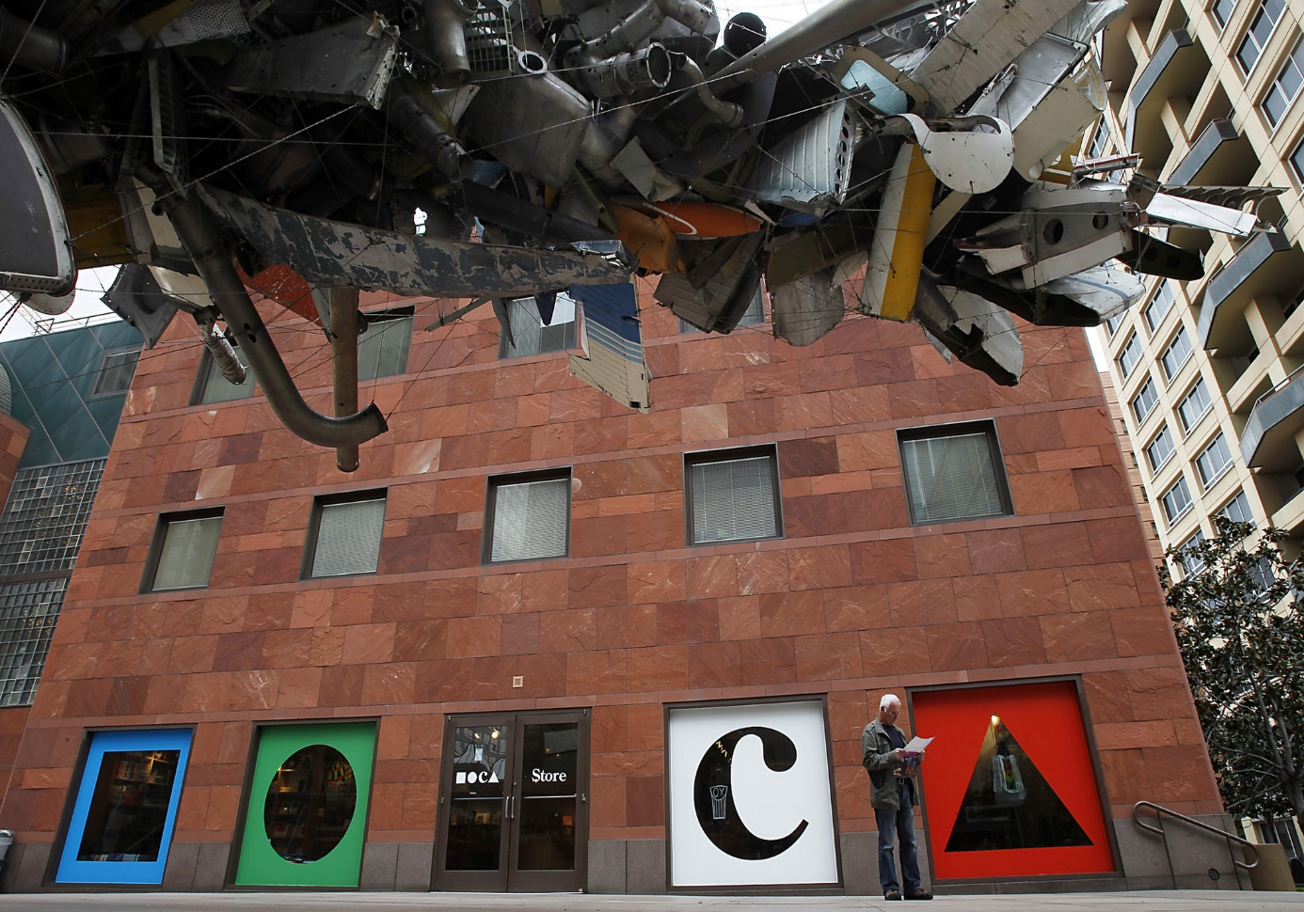
M.O.C.A. Grand, Los Angeles, CA (1986)
Mark Thompson's Airplane Parts, Nancy Rubbins, 2001

Slide 11
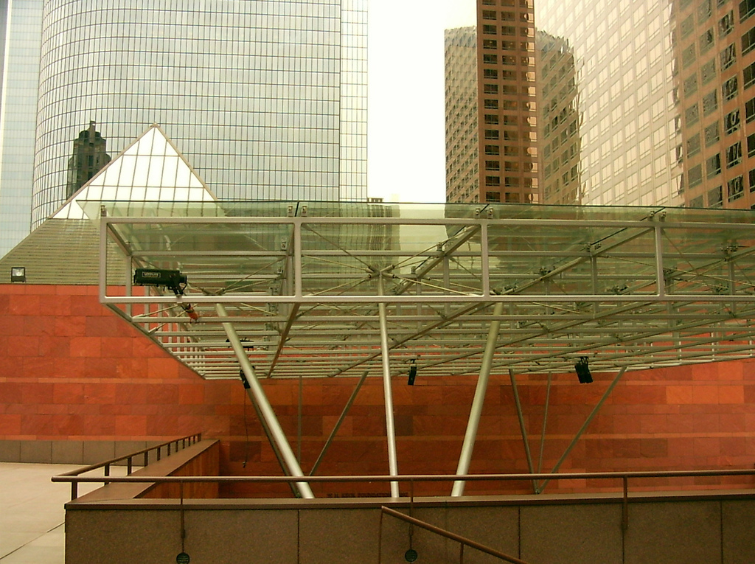
M.O.C.A. Grand, Los Angeles, CA (1986)

Slide 12
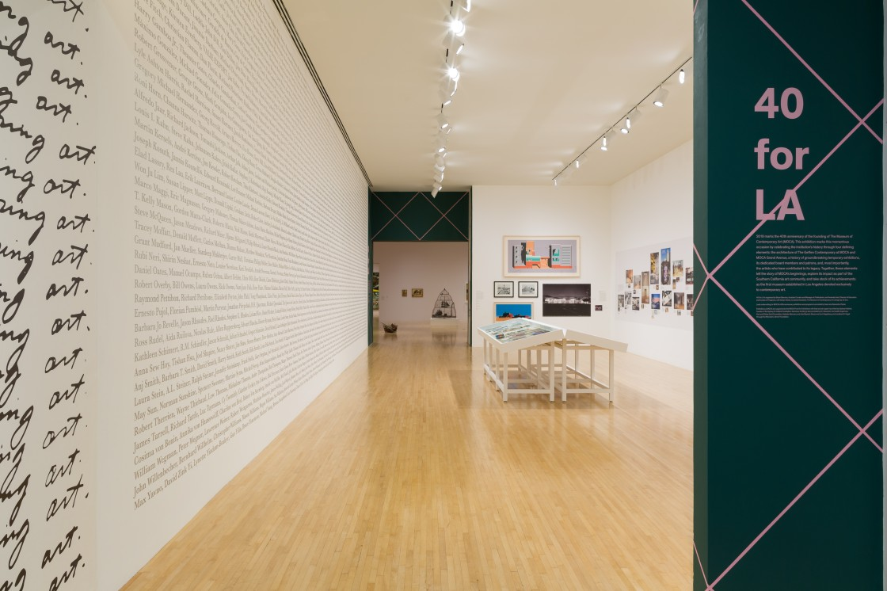
M.O.C.A. Grand, Los Angeles, CA (1986)

Slide 13
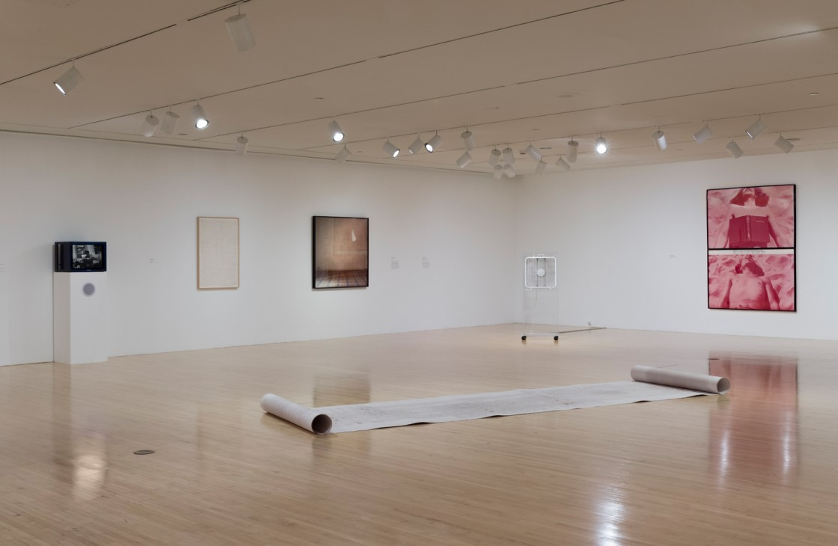
M.O.C.A. Grand, Los Angeles, CA (1986)

Slide 14
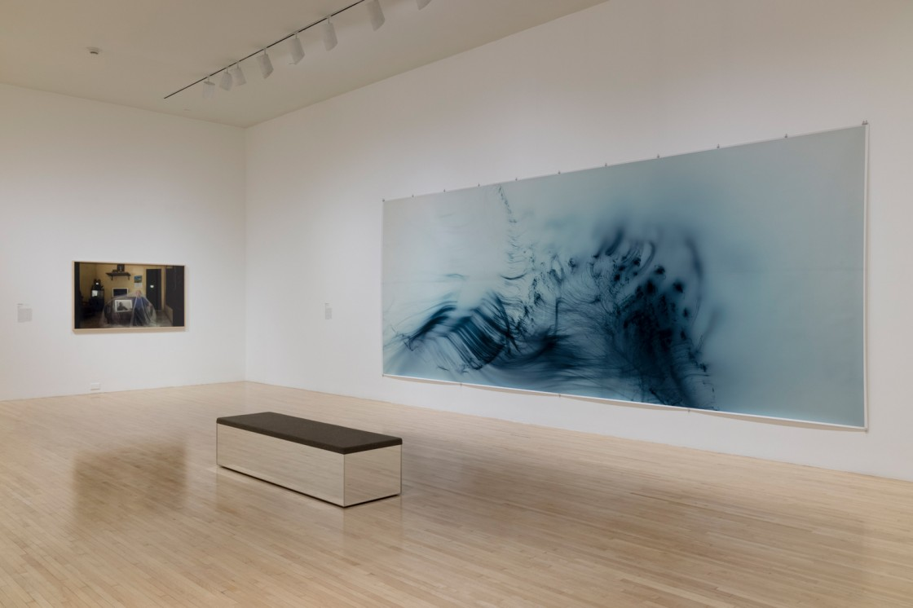
M.O.C.A. Grand, Los Angeles, CA (1986)

Slide 15
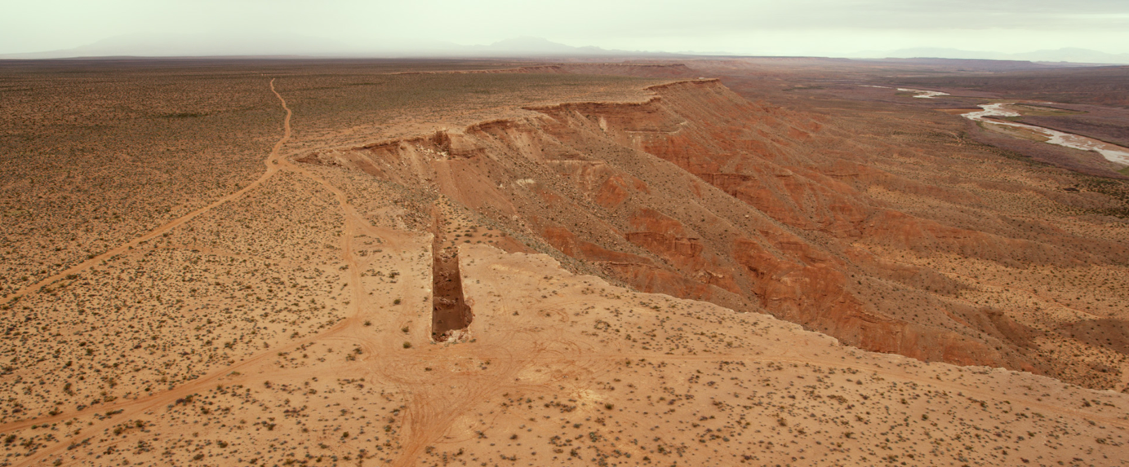
M.O.C.A., Los Angeles, CA (1986)
Double Negative, Michael Heizer, Moapa Valley, 1970

Slide 16
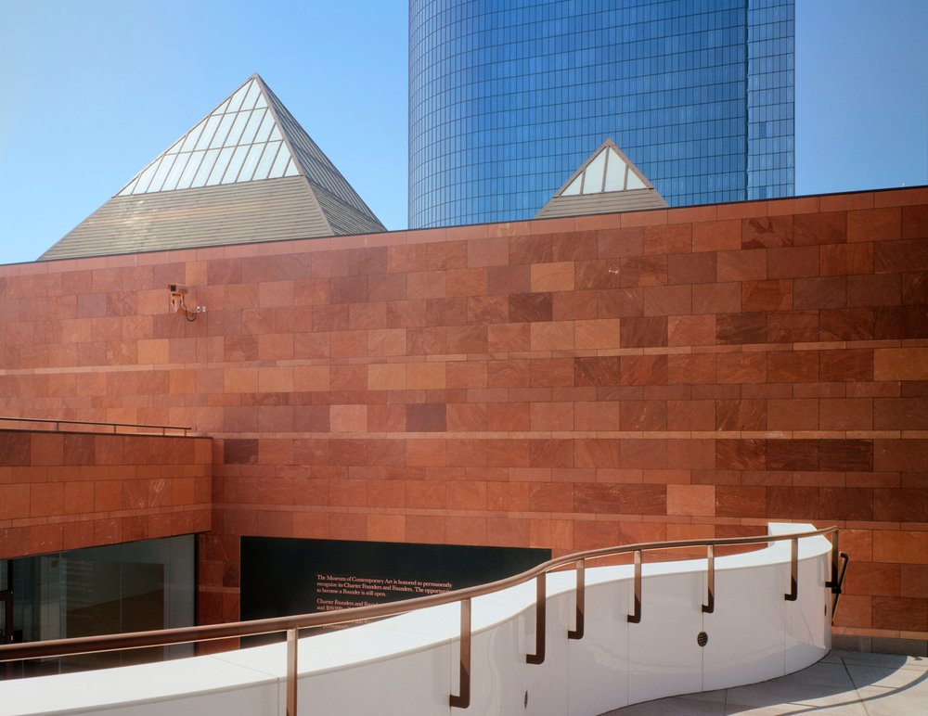
M.O.C.A. Grand, Los Angeles, CA (1986)

Slide 17
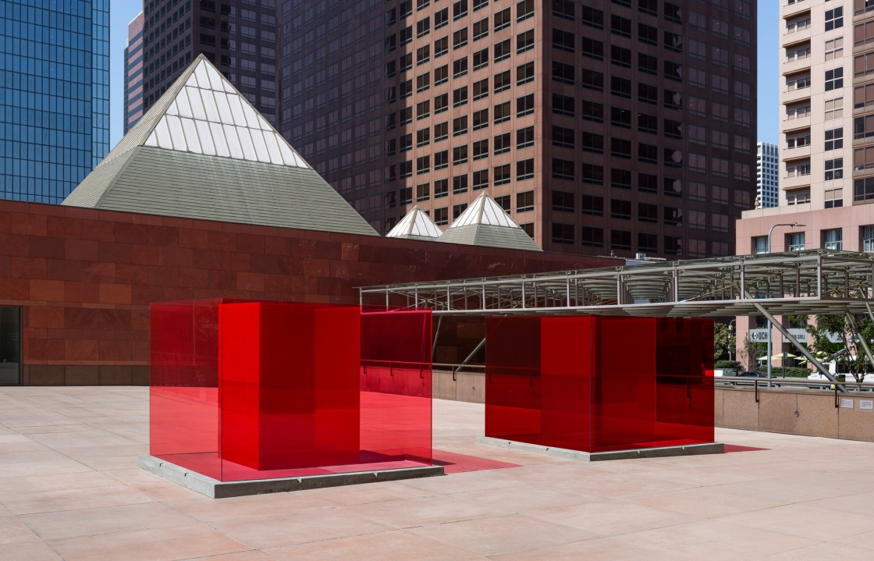
M.O.C.A. Grand, Los Angeles, CA (1986)
Bill and Coo, Larry Bell, 2019

Slide 18
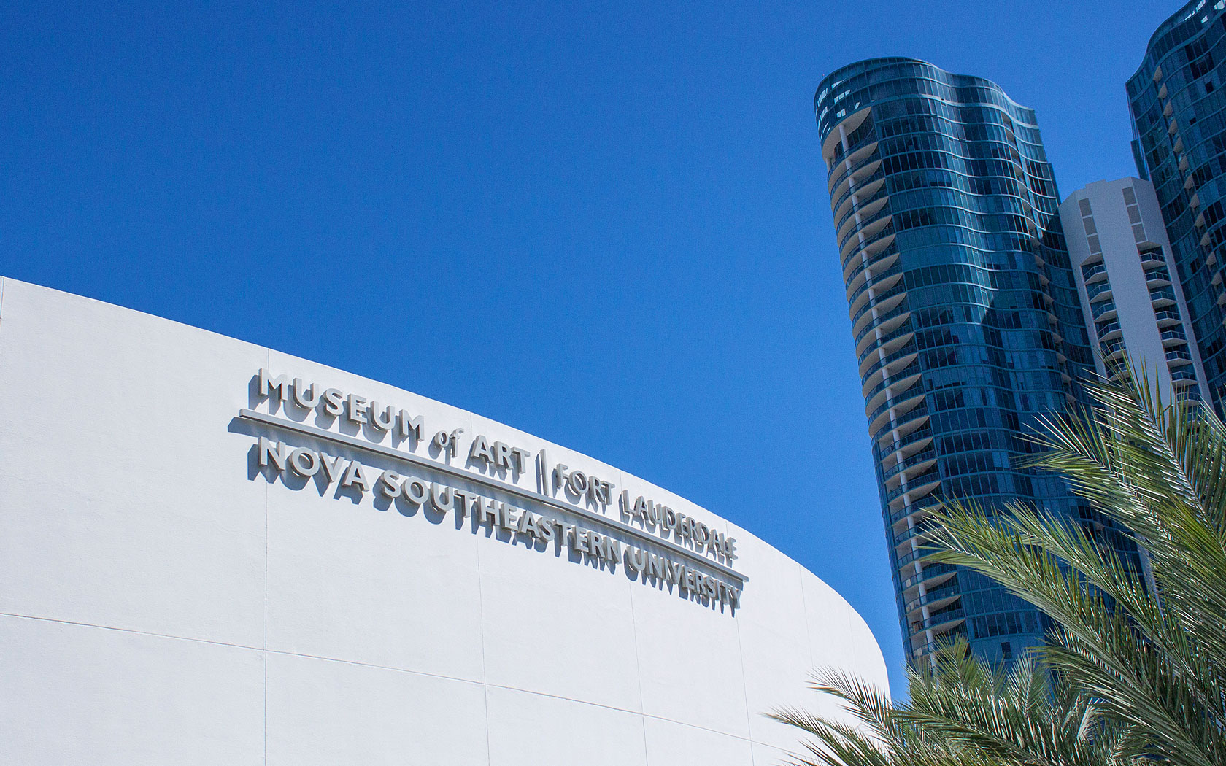
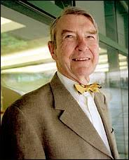
NSU Art Museum,Fort Lauderdale, FL (1986)
E.L. Barnes

Slide 19
NSU Art Museum,Fort Lauderdale, FL (1986)
It is the work of the architect Edward Larrabee Barnes.
NSU Art Museum’s 83,000 square-foot building contains 25,000 square feet of exhibition space, a 256-seat auditorium, Museum Store and Cafe.
The main exhibition area comprises 21,000 square feet (2,000 m²); a sculpture terrace on the second floor adds an additional 2,800 square feet (260 m²) of space.

Slide 20
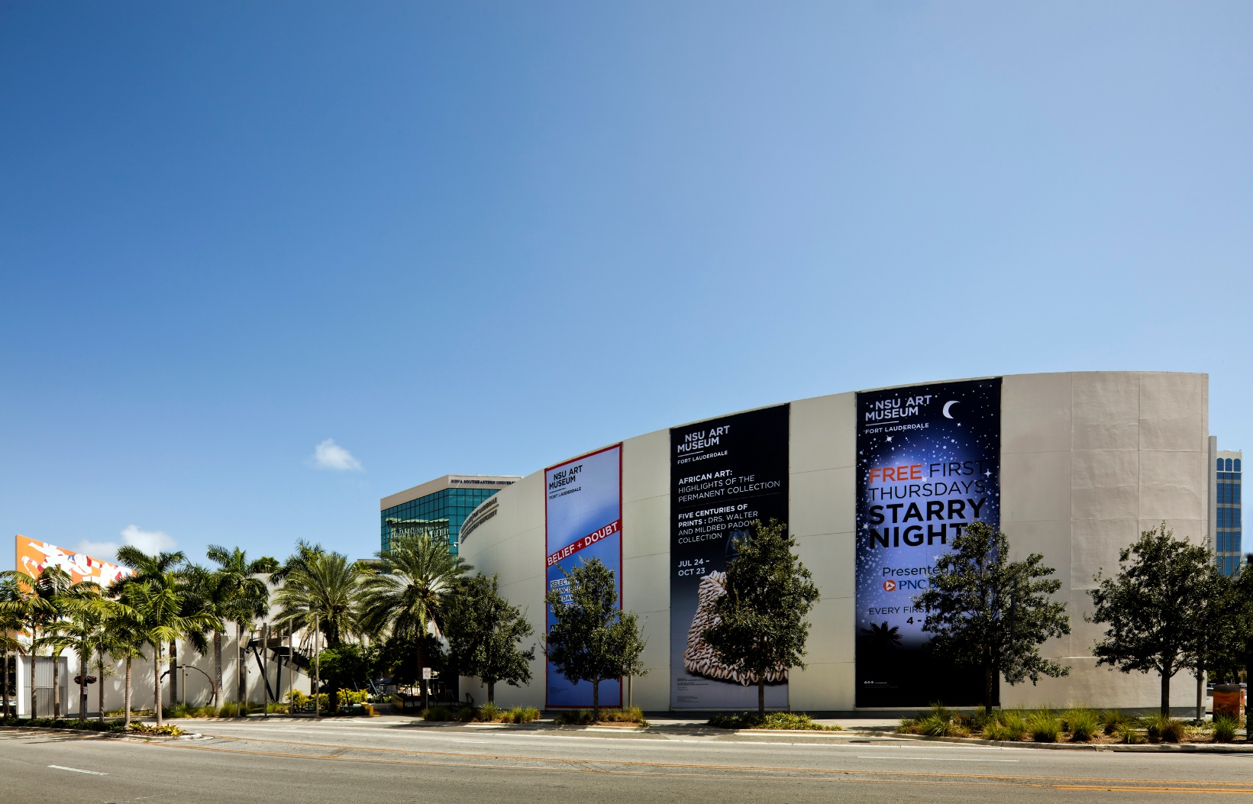
NSU Art Museum,Fort Lauderdale, FL (1986)

Slide 21
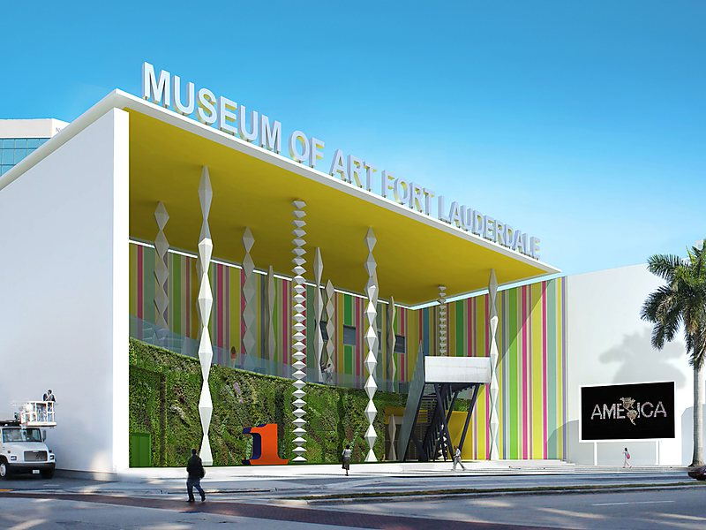
NSU Art Museum,Fort Lauderdale, FL (1986)

Slide 22
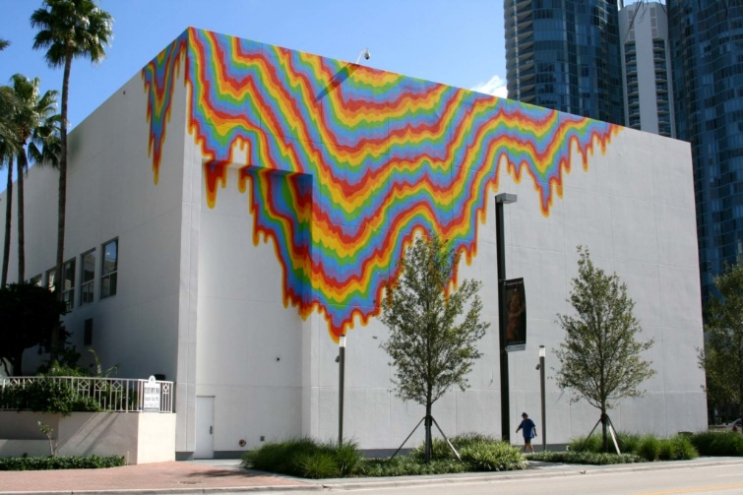
NSU Art Museum,Fort Lauderdale, FL (1986)
Acid Free, Jen Stark, 2011

Slide 23
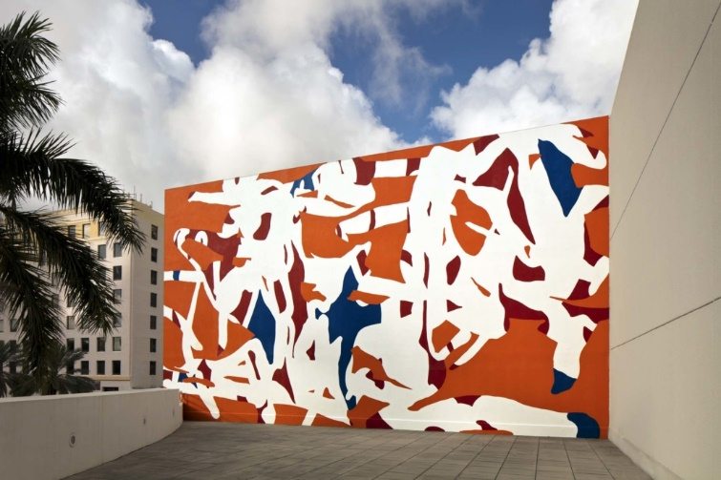
NSU Art Museum,Fort Lauderdale, FL (1986)
Band, Arturo Herrera , 2011

Slide 24
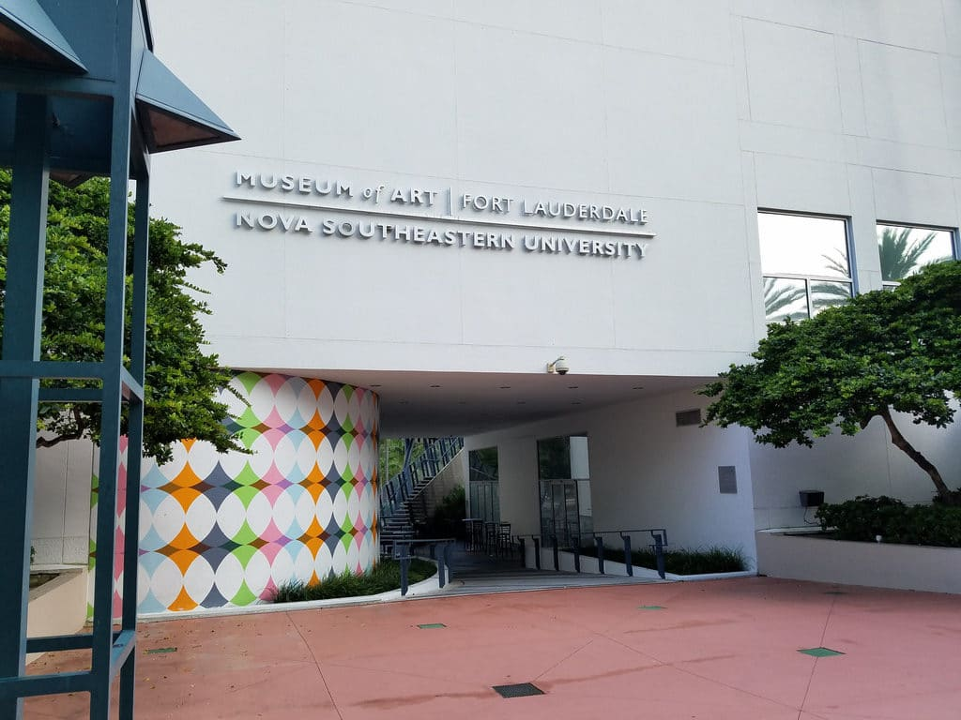
NSU Art Museum,Fort Lauderdale, FL (1986)

Slide 25
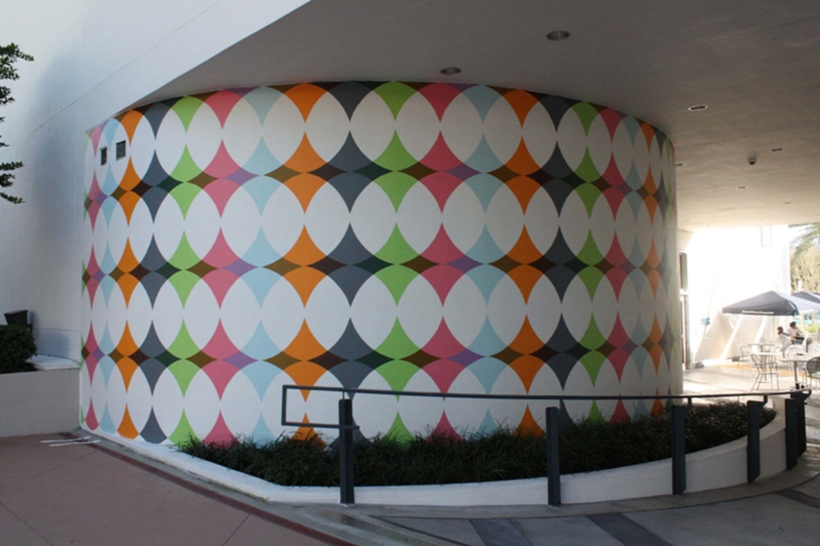
NSU Art Museum,Fort Lauderdale, FL (1986)
Watching the wheels Go Round and round, R & R Studios, 2011

Slide 26
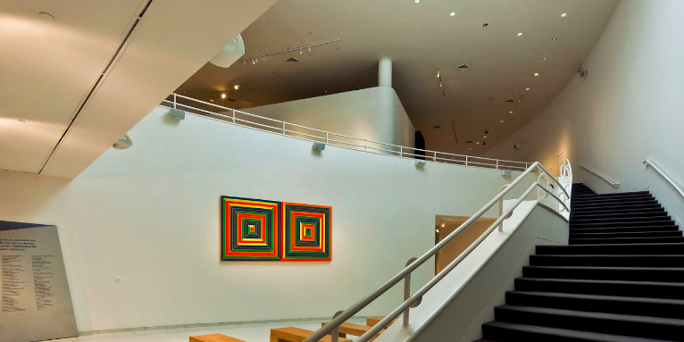
NSU Art Museum,Fort Lauderdale, FL (1986)

Slide 27
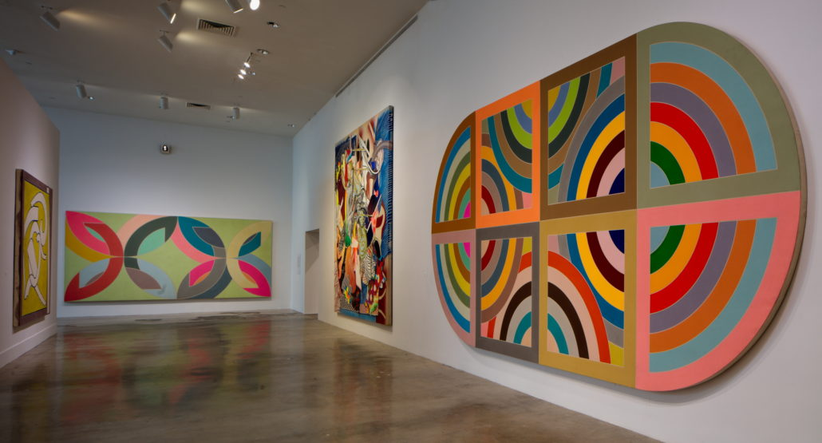
NSU Art Museum, Fort Lauderdale, FL (1986)
Franck Stella

Slide 28
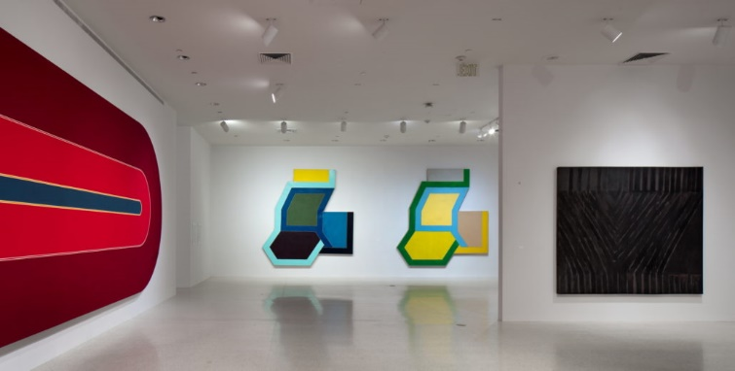
NSU Art Museum,Fort Lauderdale, FL (1986)
Franck Stella

Slide 29
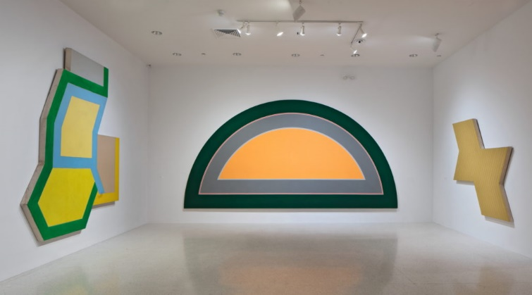
NSU Art Museum,Fort Lauderdale, FL (1986)
Franck Stella

Slide 30
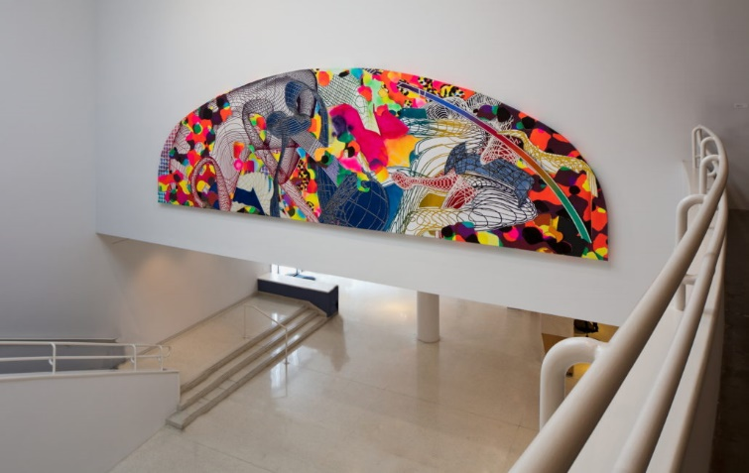
NSU Art Museum,Fort Lauderdale, FL (1986)
Franck Stella

Slide 31
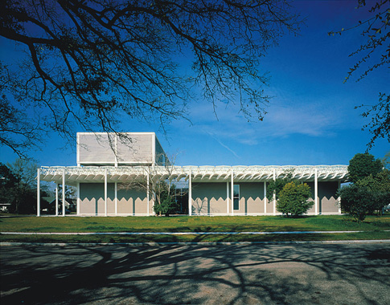
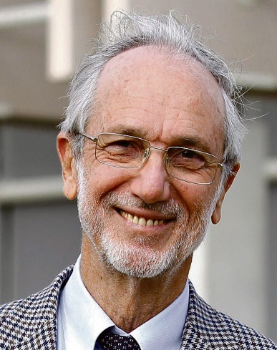
Menil Collection, Houston, TX (1987)
Renzo Piano

Slide 32
Menil Collection, Houston, TX (1987)
It is the work of the architect Renzo Piano.
At the request of its founder Dominique de Menil, the museum is perfectly integrated into its environment by its measured height and by its colour (Menil grey) like all the buildings surrounding it.
It is divided into two distinct parts. On the ground floor, the spaces of the public gallery and on the first floor the archive rooms not open to the public.

Slide 33
Menil Collection, Houston, TX (1987)
The founder also wanted a maximum of natural light to illuminate her works.
In order to control and modulate natural and artificial light, it was necessary to create a 25 mm thick curved Ferro cement structural element, known as a "sheet".
Replicated 291 times, these leaves have become the inner layer of the roof whose main function is to filter daylight. Each sheet is held in place on a steel grid.

Slide 34
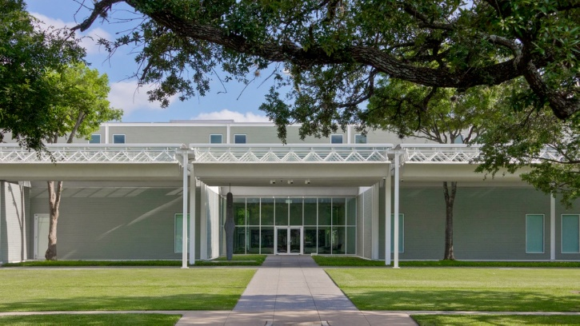
Menil Collection, Houston, TX (1987)

Slide 35
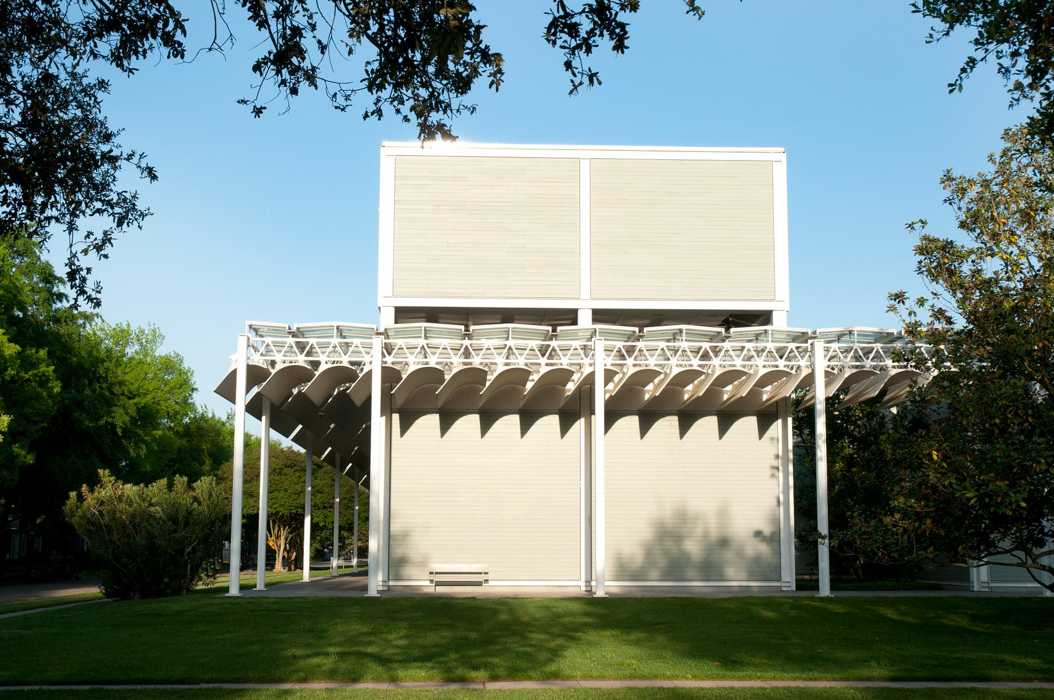
Menil Collection, Houston, TX (1987)

Slide 36
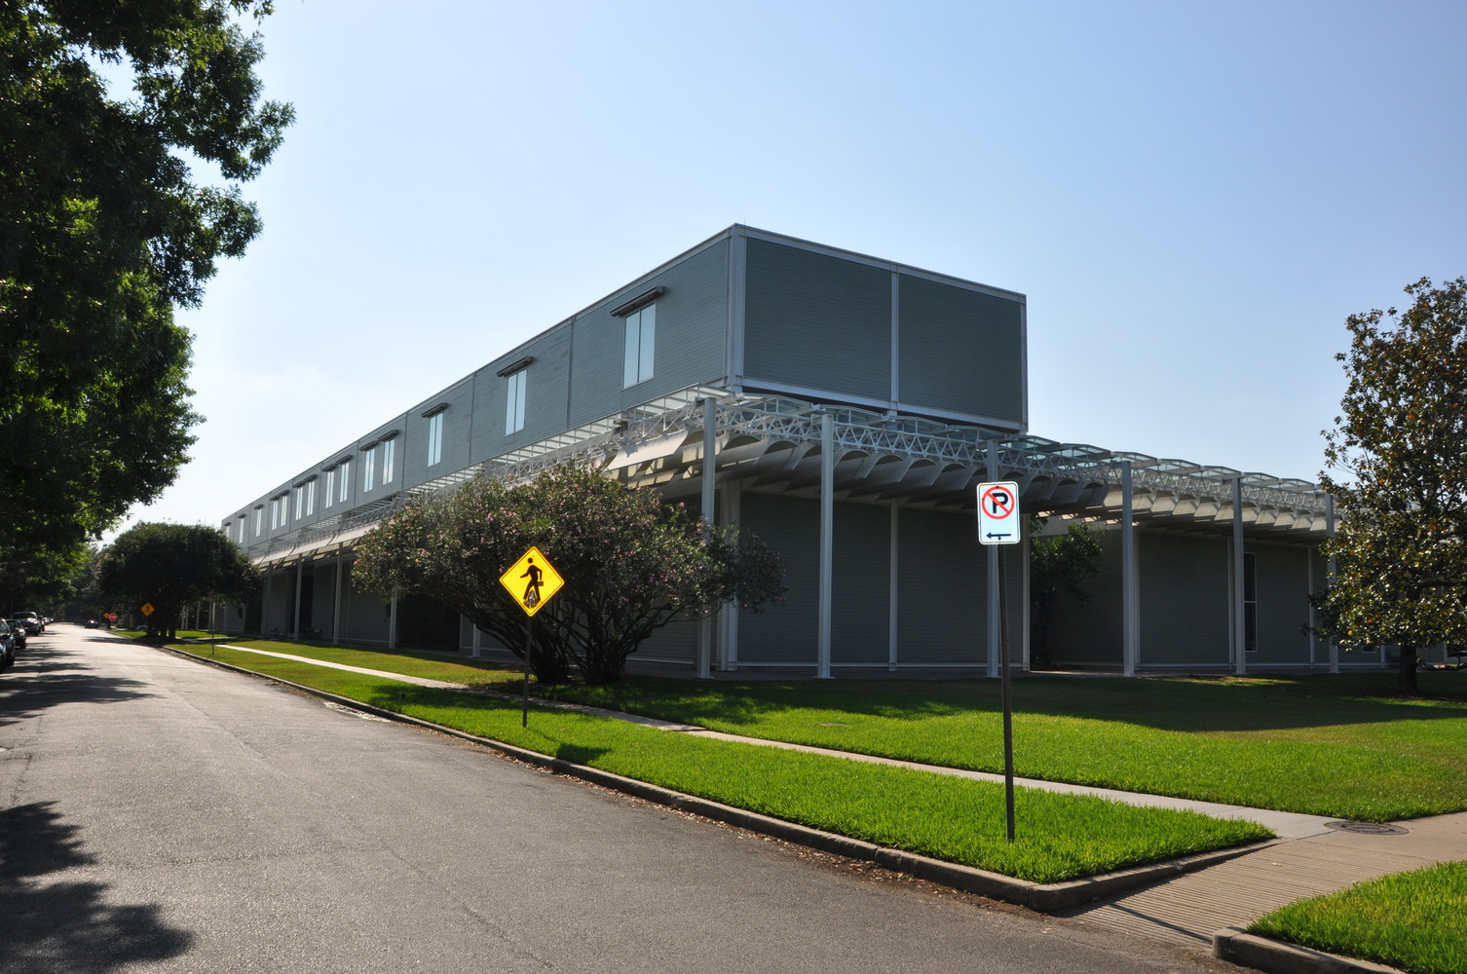
Menil Collection, Houston, TX (1987)

Slide 37
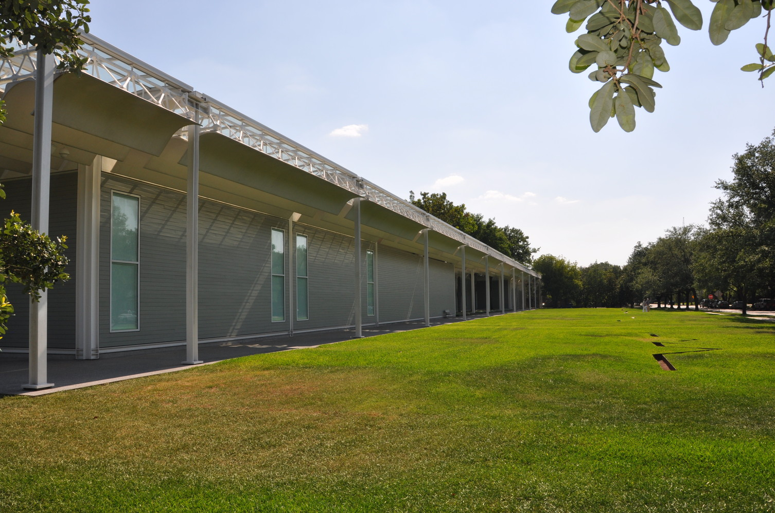
Menil Collection, Houston, TX (1987)

Slide 38
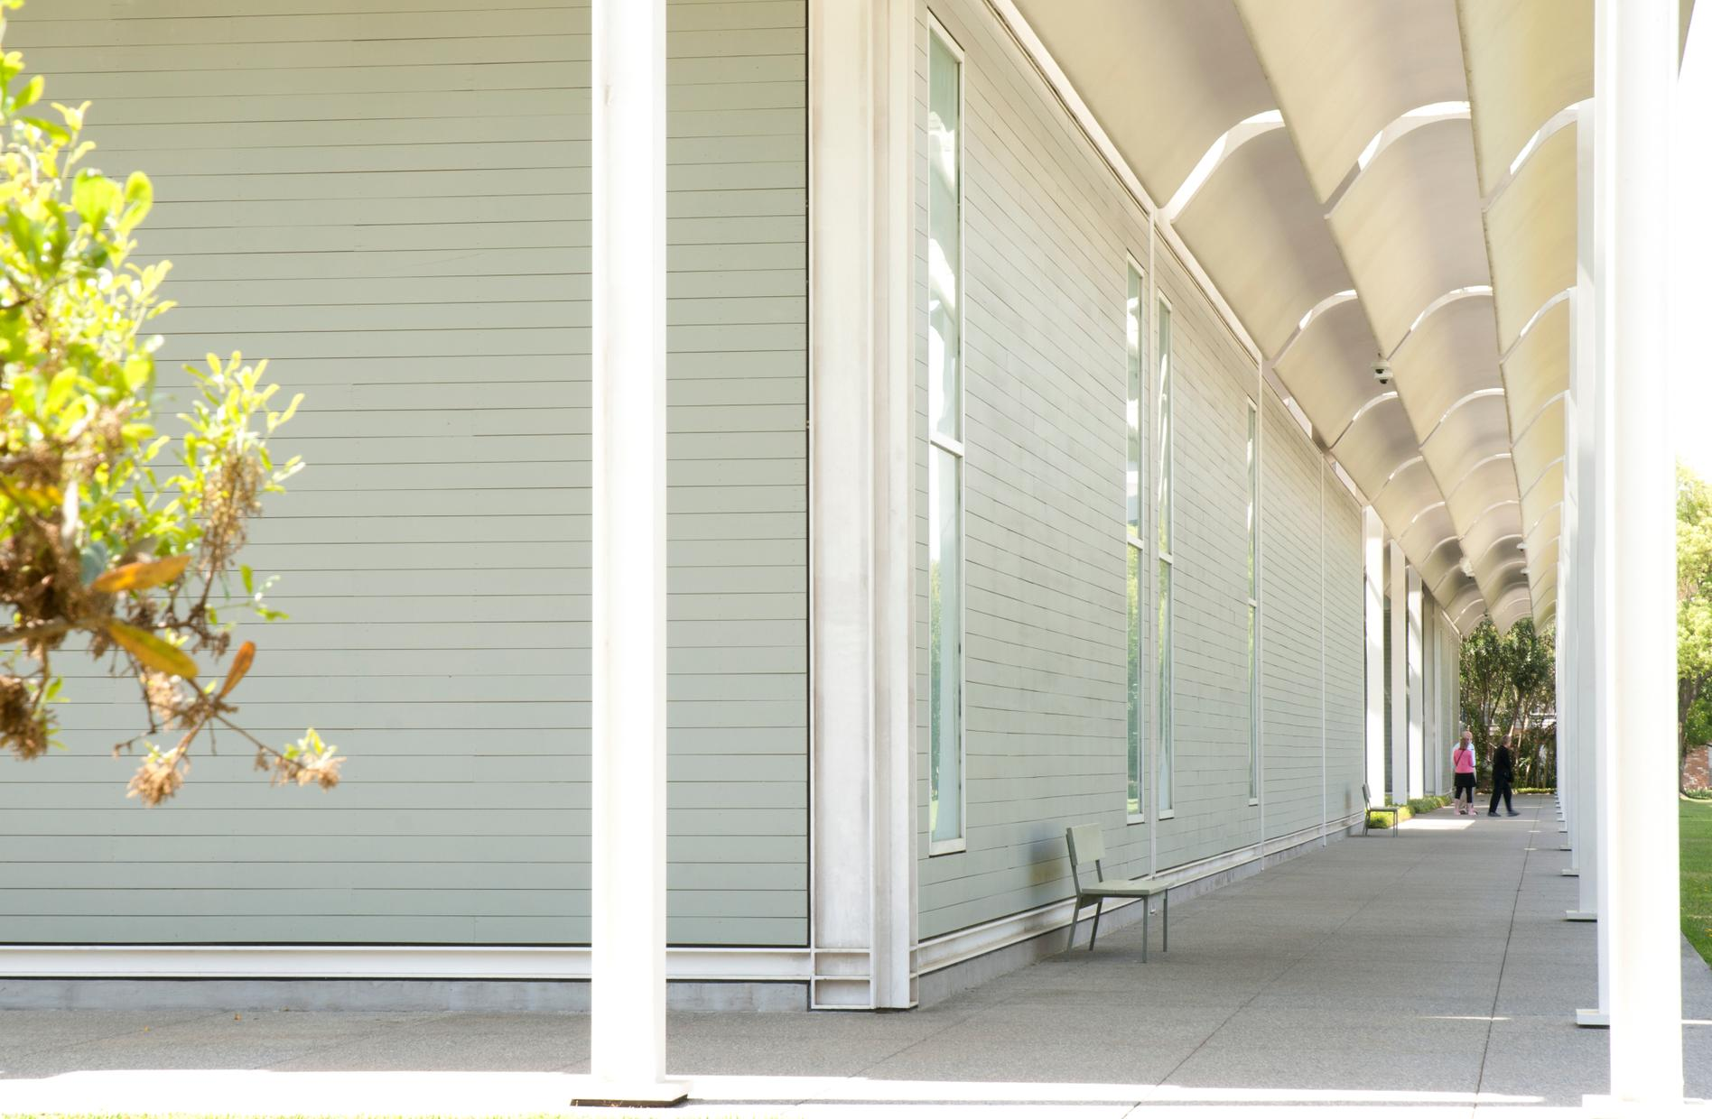
Menil Collection, Houston, TX (1987)

Slide 39
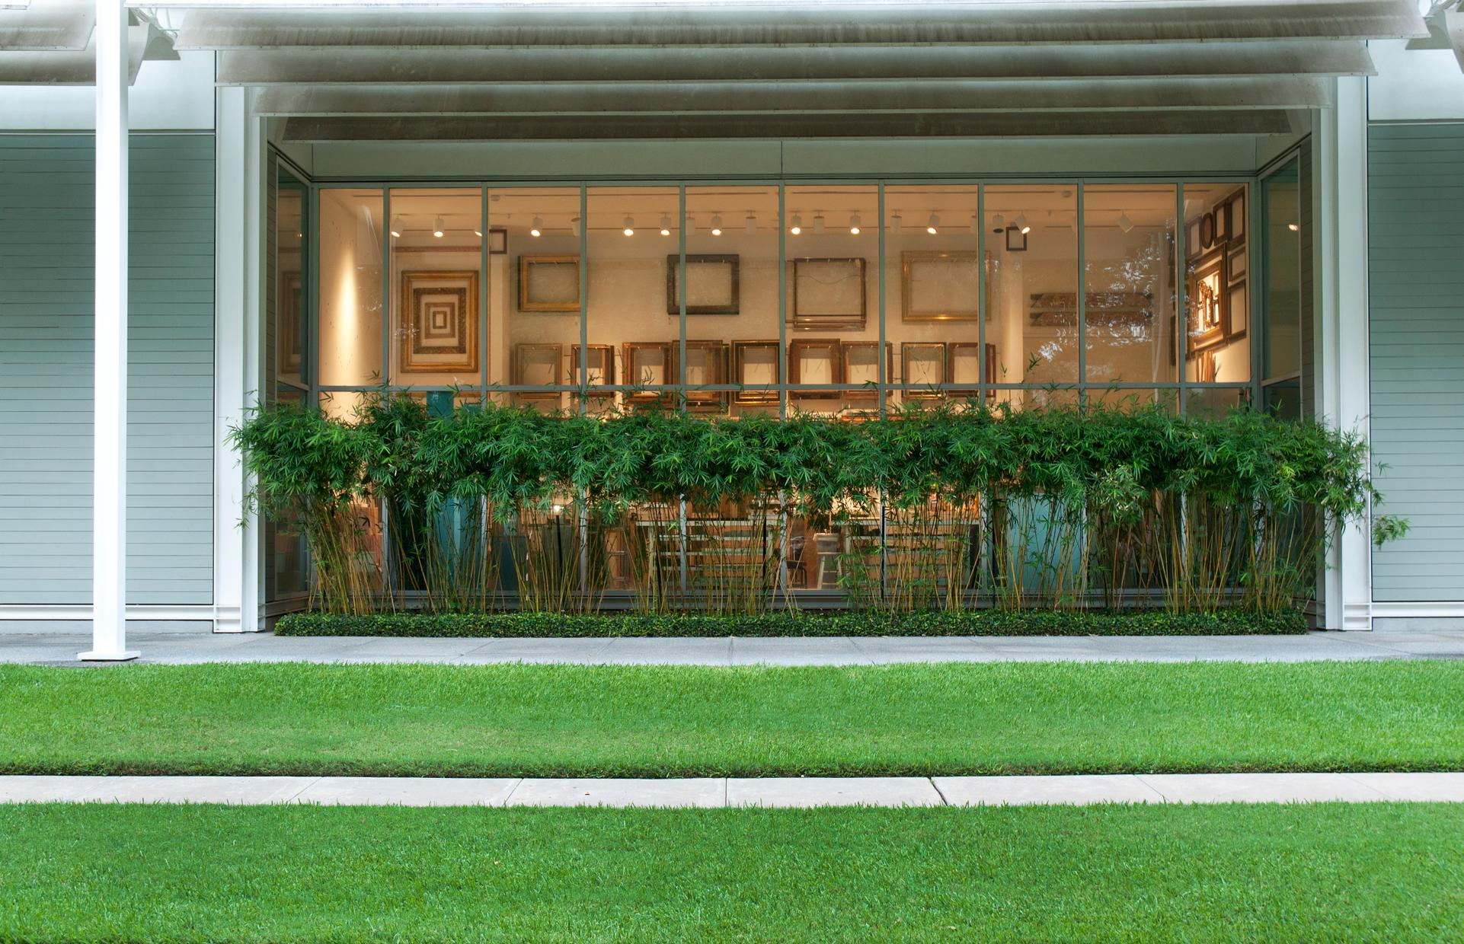
Menil Collection, Houston, TX (1987)

Slide 40
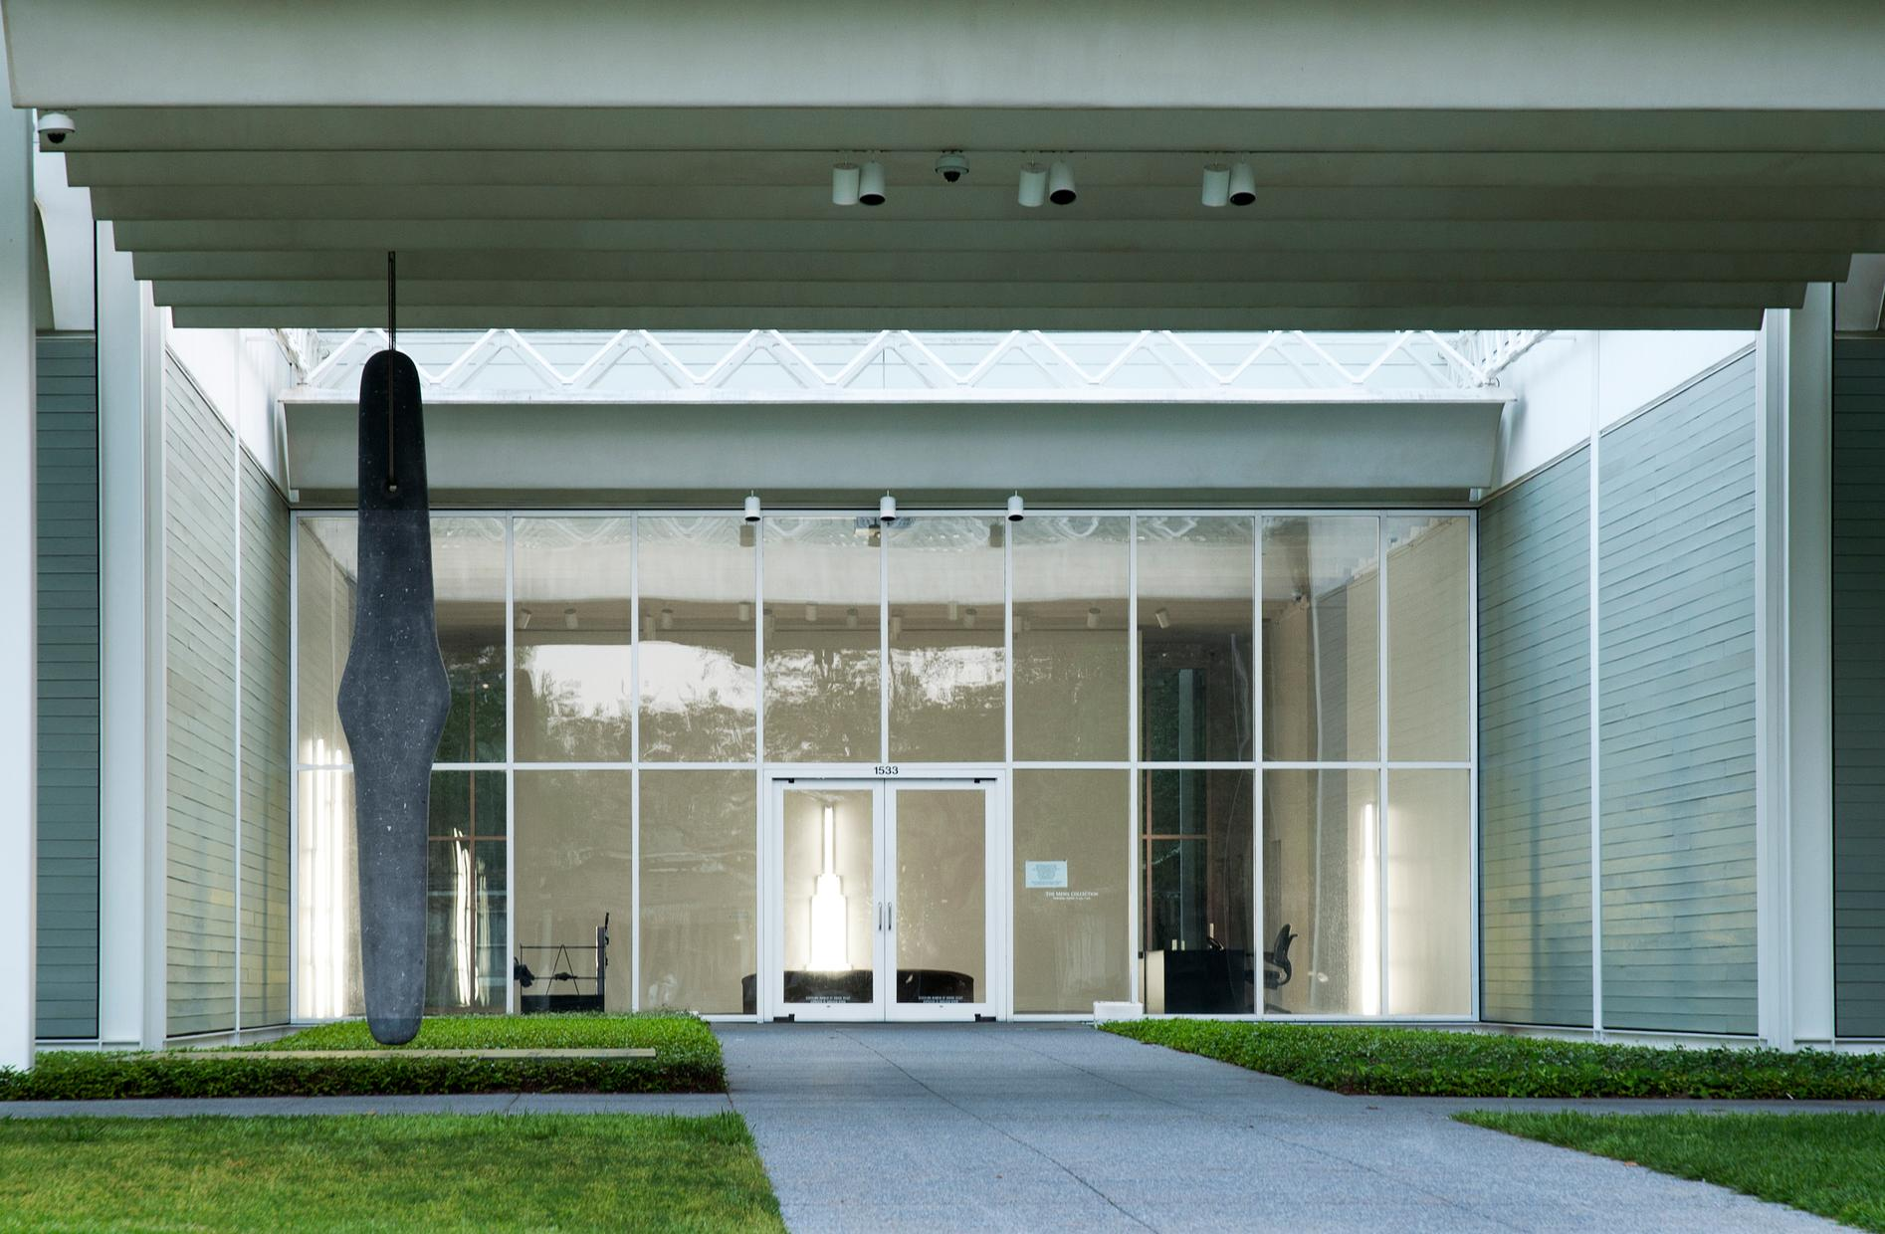
Menil Collection, Houston, TX (1987)

Slide 41
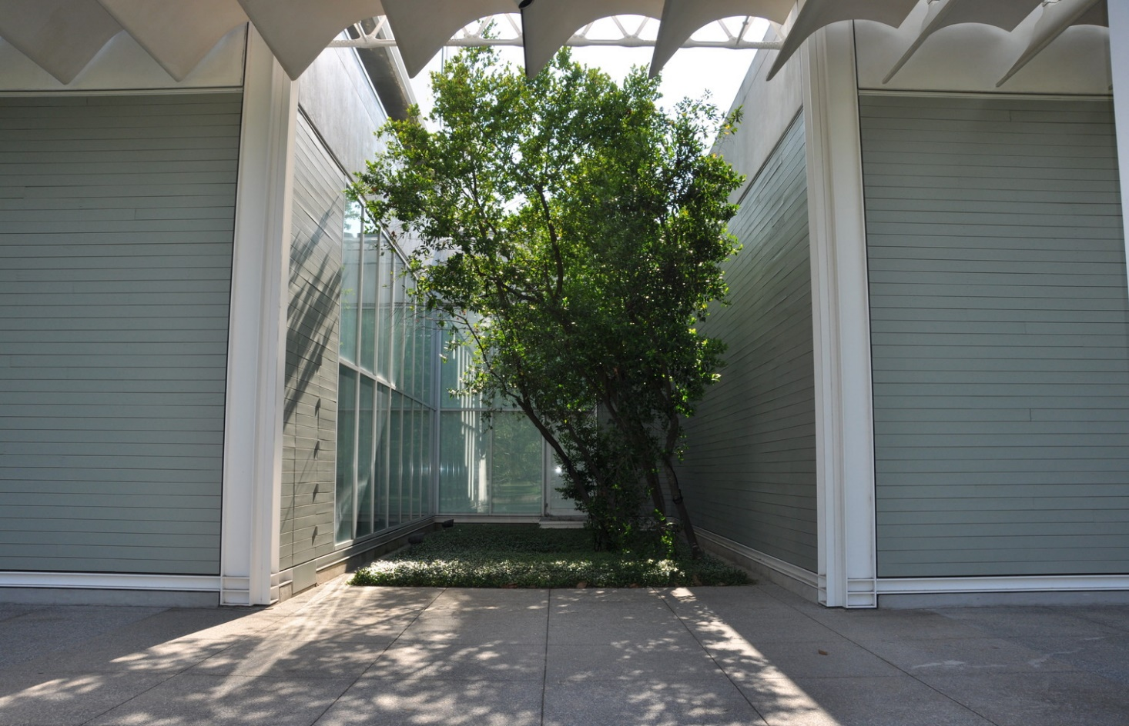
Menil Collection, Houston, TX (1987)

Slide 42
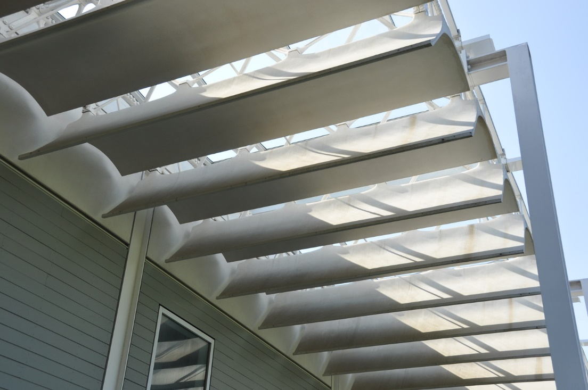
Menil Collection, Houston, TX (1987)

Slide 43
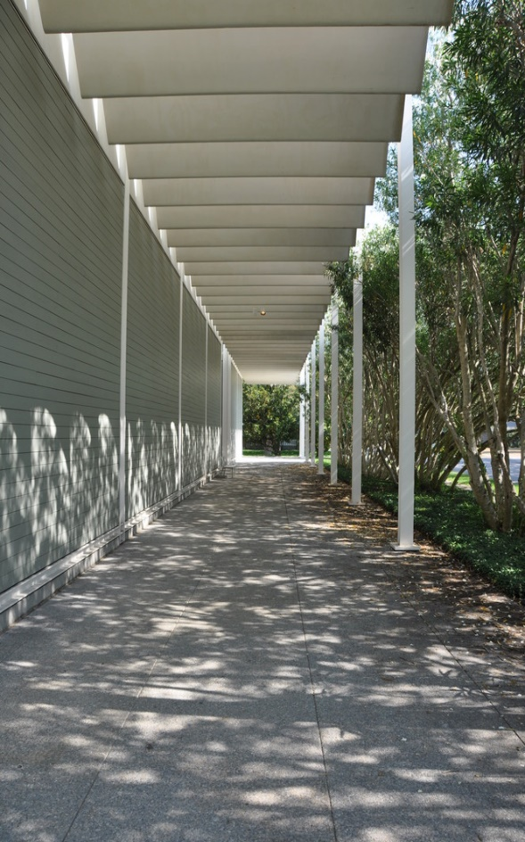
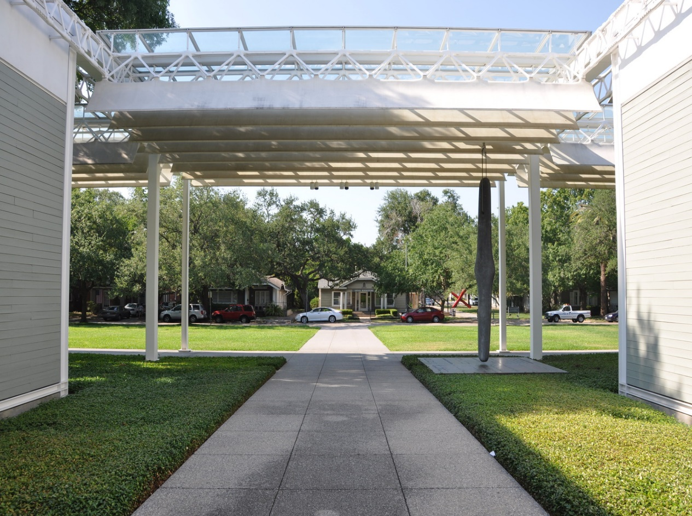
Menil Collection, Houston, TX (1987)

Slide 44
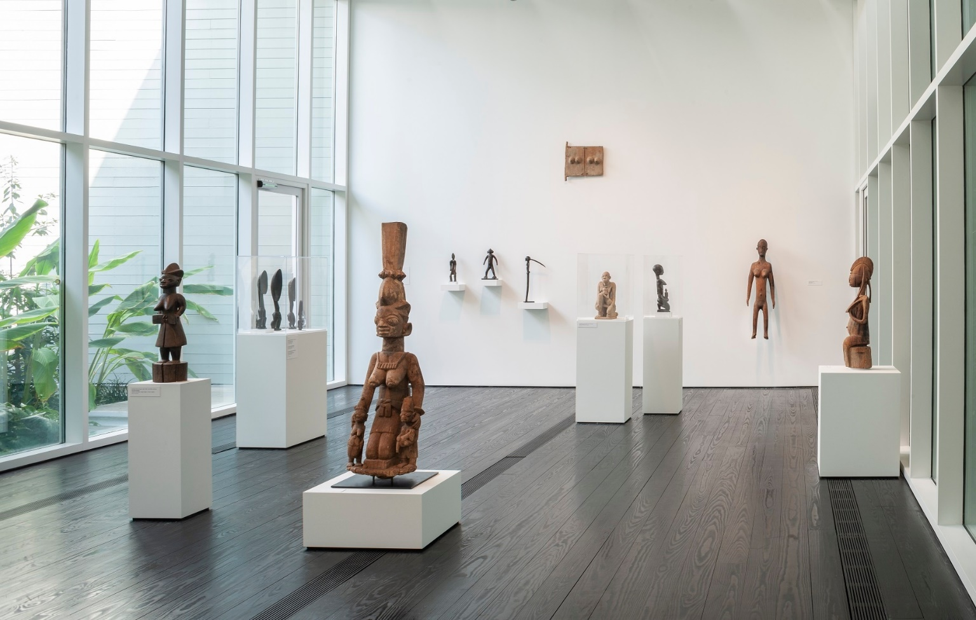
Menil Collection, Houston, TX (1987)

Slide 45
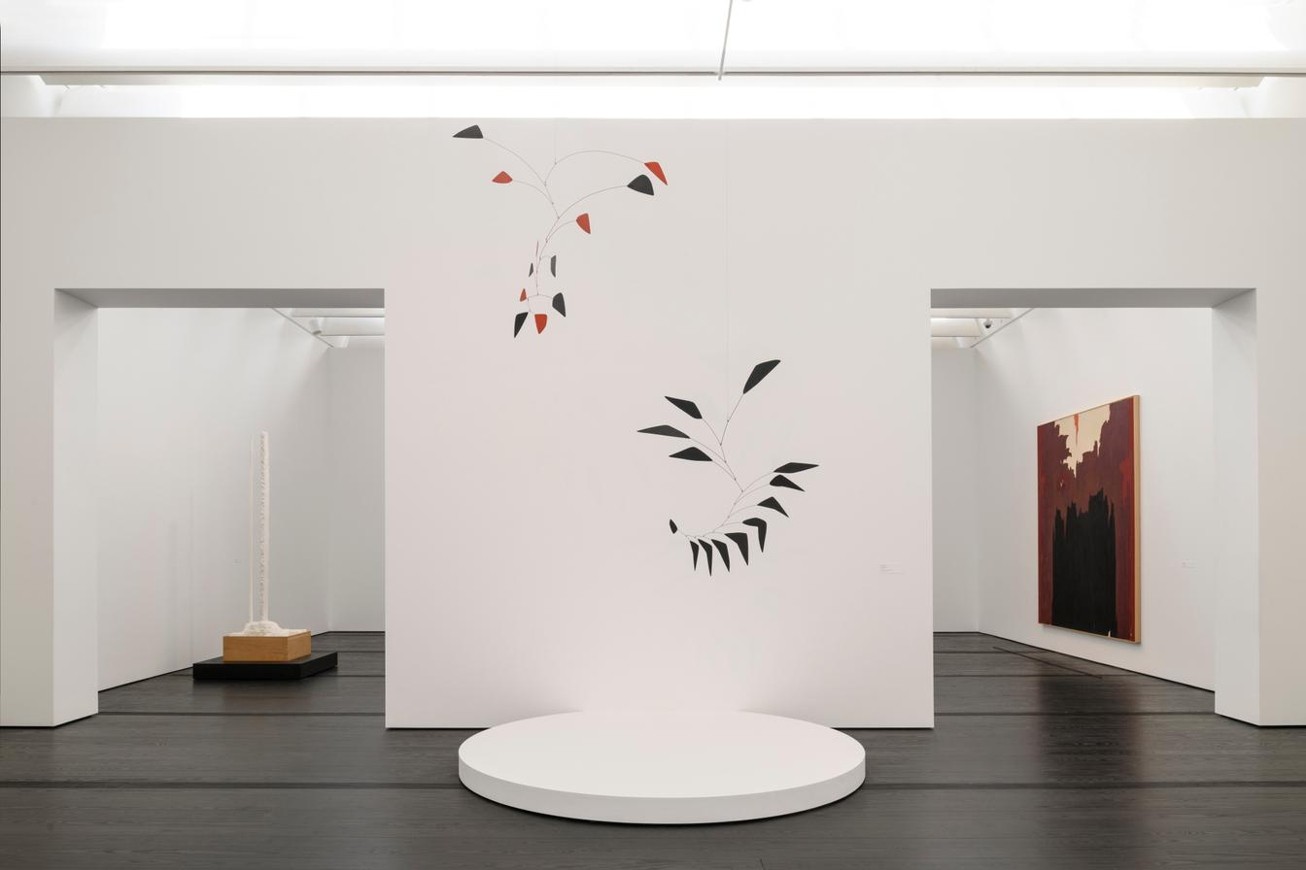
Menil Collection, Houston, TX (1987)

Slide 46
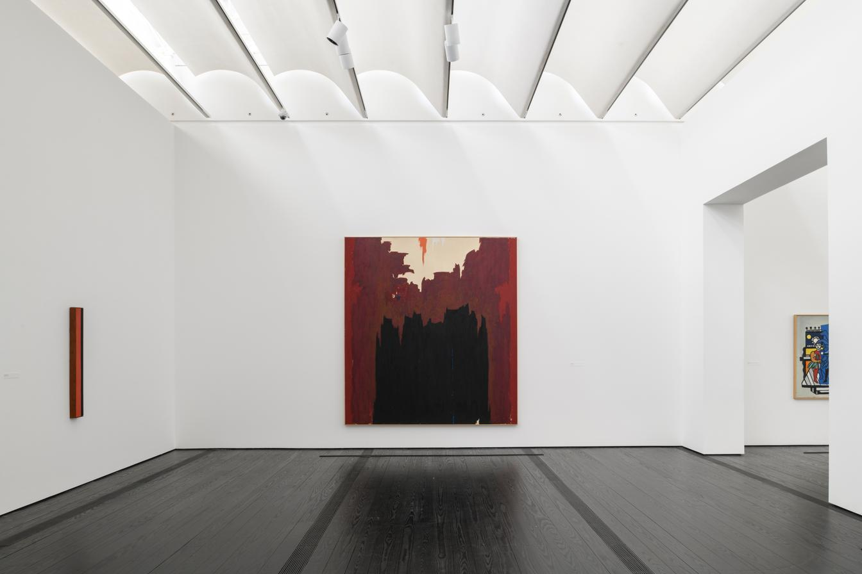
Menil Collection, Houston, TX (1987)

Slide 47
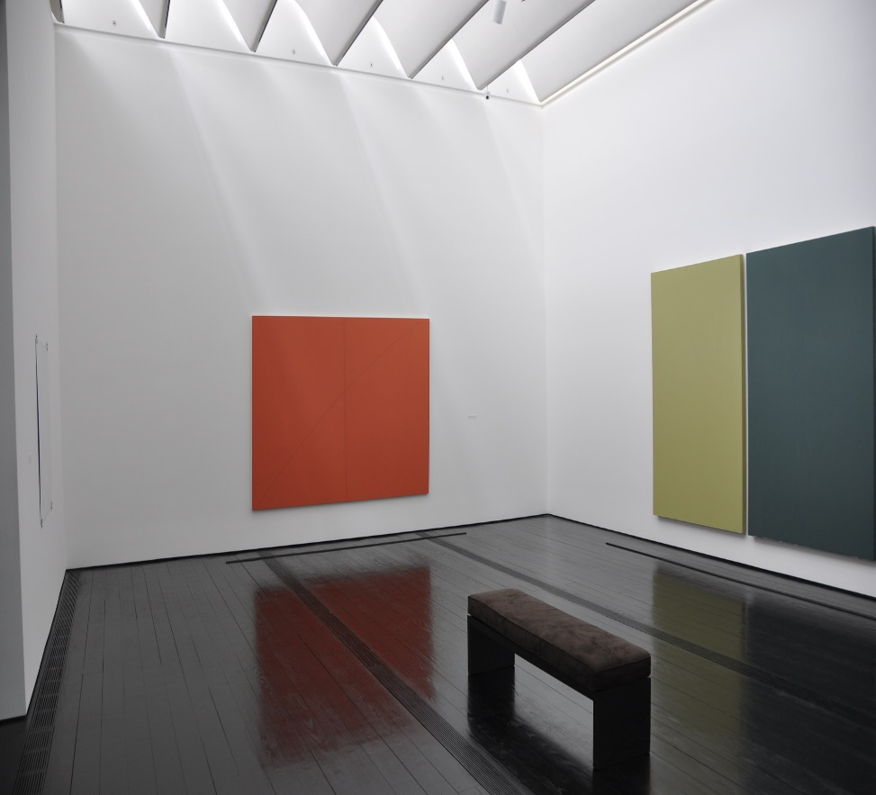
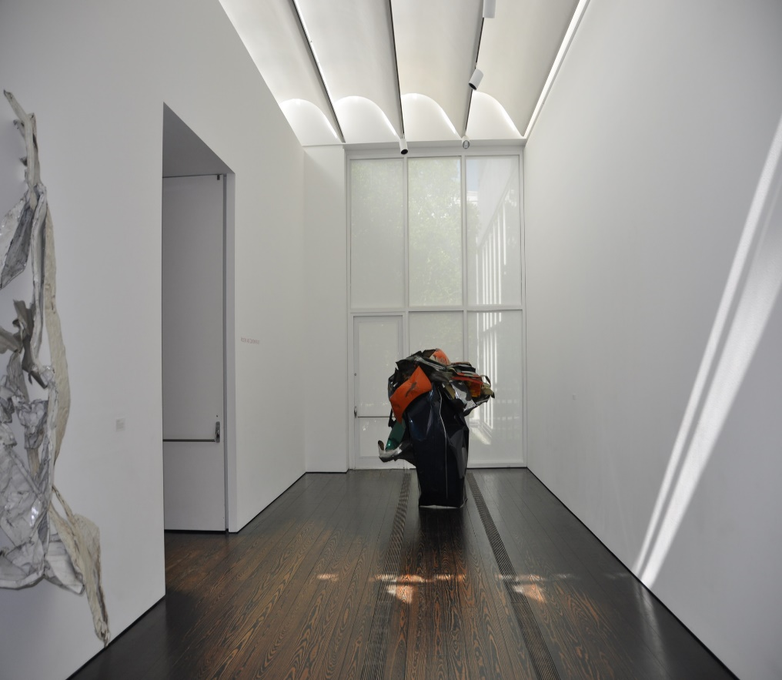
Menil Collection, Houston, TX (1987)

Slide 48
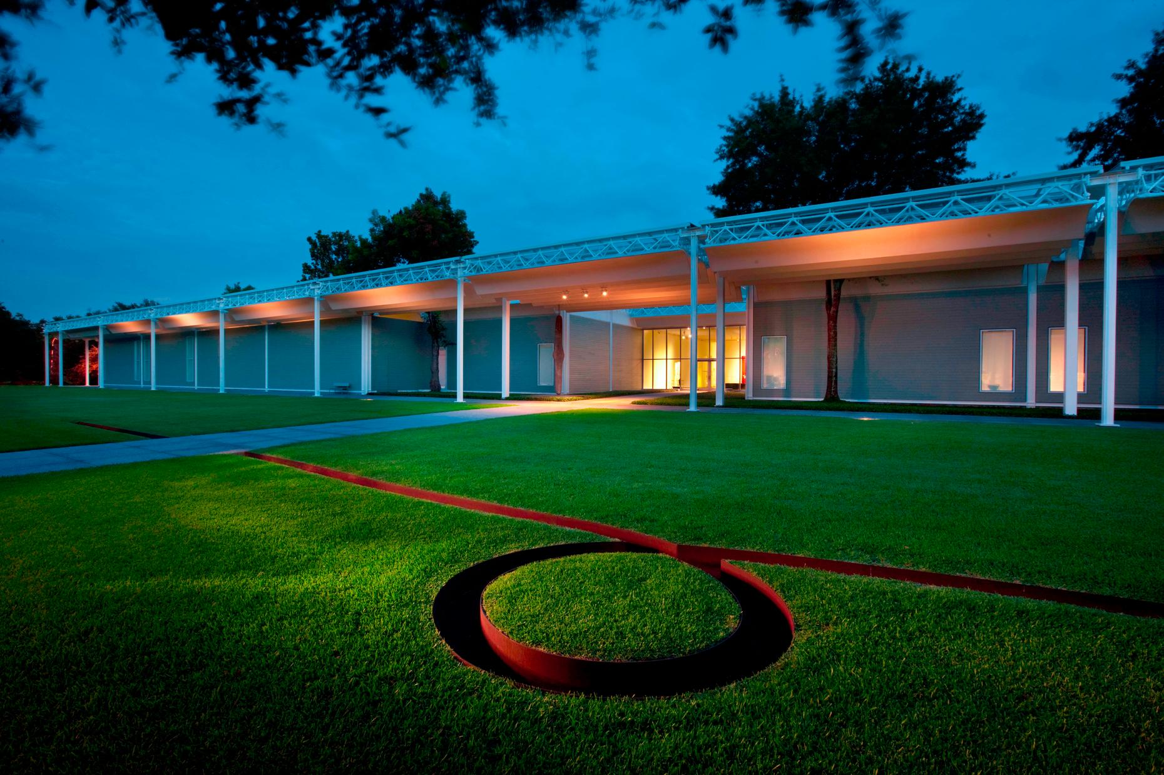
Menil Collection, Houston, TX (1987)

Slide 49
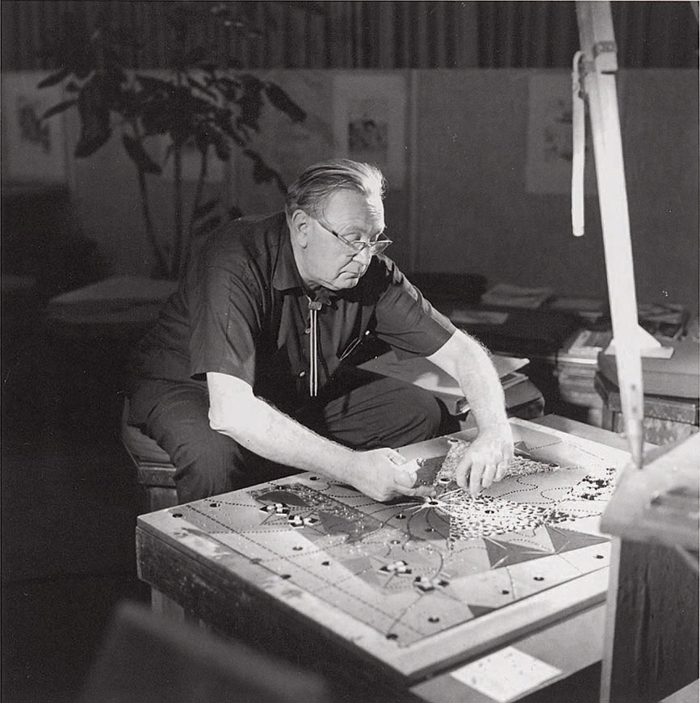
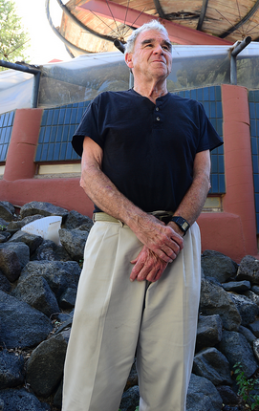
L.A.C.M.A., Los Angeles, CA (1988)
Pavilion for Japanese Art (1988)
Bruce Goff
Bart Prince

Slide 50
L.A.C.M.A., Los Angeles, CA (1988)
It is the work of the architects Bruce Goff & Bart Prince
The 32,100-sqf building is notable for its translucent fiberglass panels, which allow paintings to be lit safely and naturally by soft sunlight. The effect approximates the original viewing conditions for these paintings and allows gold leaf to reflect, creating dimensional levels within works of art not visible under artificial lighting. The small building has been pushed into the spotlight, its rib-like headdress, translucent panels, and stony centerpiece shining against a temporary backdrop of rubble. The roof structures of the galleries are suspended by cables to allow for non loadbearing translucent perimeter walls for ideal lighting conditions for the art. The pavilion also features a prow-shaped roof and cylindrical towers.

Slide 51
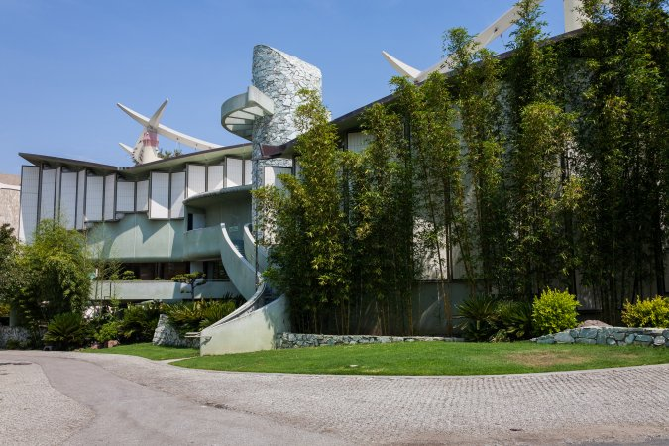
L.A.C.M.A., Los Angeles, CA (1988)

Slide 52
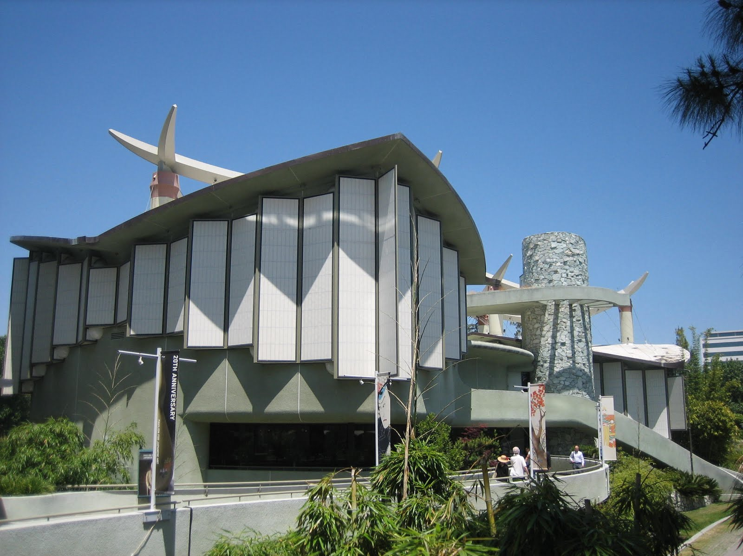
L.A.C.M.A., Los Angeles, CA (1988)

Slide 53
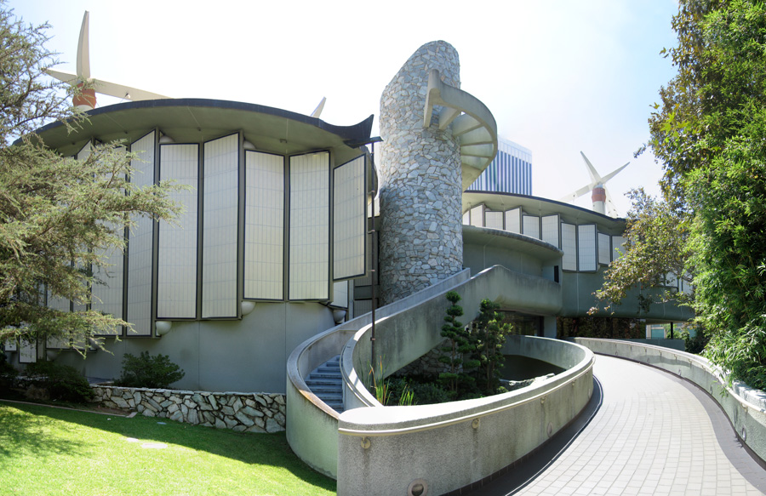
L.A.C.M.A., Los Angeles, CA (1988)

Slide 54
L.A.C.M.A., Los Angeles, CA (1988)

Slide 55
L.A.C.M.A., Los Angeles, CA (1988)

Slide 56
Deer Valley Rock, Phœnix, AZ (1988)
Will Bruder

Slide 57
Deer Valley Rock, Phœnix, AZ (1988)
An interpretive center offers exhibition, research, classroom and curatorial space for the study of ideas and materials related to rock art, the Center’s architectural strength come from it geometry and creative use of dark purple black copper slag encrusted concrete panels and weathered steel trellises. The funnel like, boomerang shaped plan geometry serves as a metaphorical ‘time machine’ taking the visitor from the surrounding suburban sprawl of Phoenix to a desert sanctuary.

Slide 58
Deer Valley Rock, Phœnix, AZ (1988)

Slide 59
Deer Valley Rock, Phœnix, AZ (1988)

Slide 60
Deer Valley Rock, Phœnix, AZ (1988)

Slide 61
Deer Valley Rock, Phœnix, AZ (1988)

Slide 62
Deer Valley Rock, Phœnix, AZ (1988)

Slide 63
Deer Valley Rock, Phœnix, AZ (1988)

Slide 64
Deer Valley Rock, Phœnix, AZ (1988)

Slide 65
Wexner Center, Columbus, OH (1989)
Peter Eisenman

Slide 66
Wexner Center, Columbus, OH (1989)
It's the work of architect Peter Eisenman.
The Ohio State University campus is located on a grid that is approximately 12 degrees from the Columbus city grid: the long steel scaffolding structure, which serves as a footbridge through the complex, is placed on the city grid, giving the impression of cutting a diagonal strip across the campus and through the building. The walls of the rooms inside are located either on the city network or on the campus network, which means that the internal organisation accentuates the duality between city and campus.

Slide 67
Wexner Center, Columbus, OH (1989)
Even the granite patterns in the floor, the fluorescent lights on the ceiling and the carpet colors play on the diagonal relationship between the two grids.
The brick turret segments recall an armory that stood here until 1958, when it was demolished after a fire. It is not the comforting use of historical form, but partial, broken or split elements that evoke it.
Placed parallel to the external scaffolding, the galleries have few large walls to hang, they are interrupted by columns.

Slide 68
Wexner Center, Columbus, OH (1989)

Slide 69
Wexner Center, Columbus, OH (1989)

Slide 70
Wexner Center, Columbus, OH (1989)

Slide 71
Wexner Center, Columbus, OH (1989)

Slide 72
Wexner Center, Columbus, OH (1989)

Slide 73
Wexner Center, Columbus, OH (1989)

Slide 74
Wexner Center, Columbus, OH (1989)

Slide 75
Wexner Center, Columbus, OH (1989)

Slide 76
Wexner Center, Columbus, OH (1989)

Slide 77
Wexner Center, Columbus, OH (1989)

Slide 78
Wexner Center, Columbus, OH (1989)

Slide 79
Hammer Museum, Los Angeles, CA (1990)
Edward L. Barnes

Slide 80
Hammer Museum, Los Angeles, CA (1990)
Designed by New York-based Edward Larrabee Barnes, the Hammer Museum turns a blank, cold face to its surrounding streets. A high wall of horizontally striped Carrara marble screens the museum and its interior courtyard from public view.
The only hint that something interesting may be going on behind the wall is found at the rear of the site, on Lindbrook Drive. Above this secondary entrance is a wide, flat arch--shaped like a semi-circular "eyebrow"--that allows an oblique view from the street into the upper level of the courtyard.

Slide 81
Hammer Museum, Los Angeles, CA (1990)
The courtyard itself, museum's true centerpiece, lined by wide arcades and terraces, is an awkward rectangle broken into two off-center sections. Its odd proportions make it seem as if it were a leftover space, an afterthought in the process of design rather than the museum's main feature.
Barnes' design restraint pays off in the galleries, which are well-proportioned and pleasantly lit by a mixture of natural and artificial light.
To maintain a steady level of illumination in the galleries, track lighting supplements louvered skylights controlled by photo-electric roof sensors.

Slide 82
Hammer Museum, Los Angeles, CA (1990)

Slide 83
Hammer Museum, Los Angeles, CA (1990)

Slide 84
Hammer Museum, Los Angeles, CA (1990)

Slide 85
Hammer Museum, Los Angeles, CA (1990)

Slide 86
Hammer Museum, Los Angeles, CA (1990)

Slide 87
Hammer Museum, Los Angeles, CA (1990)

Slide 88
Hammer Museum, Los Angeles, CA (1990)

Slide 89
Hammer Museum, Los Angeles, CA (1990)

Slide 90
Hammer Museum, Los Angeles, CA (1990)

Slide 91
I.C.A., Philadelphia, PA (1991)
Adèle Naudé Santos

Slide 92
I.C.A., Philadelphia, PA (1991)
It was designed by the architect Adèle Naudé Santos.
A large glass-enclosed lobby welcomes visitors from the campus as well as from the surrounding city and provides access to the gallery.
Overshadowed by adjacent dormitory towers and underlain by subway tunnels, the site proved to be the greatest design challenge. The limestone base of the building was extended around the base of the towers, creating new access ramps to the towers and visually enlarging the presence of the ICA.

Slide 93
I.C.A., Philadelphia, PA (1991)

Slide 94
I.C.A., Philadelphia, PA (1991)

Slide 95
I.C.A., Philadelphia, PA (1991)

Slide 96
I.C.A., Philadelphia, PA (1991)

Slide 97
I.C.A., Philadelphia, PA (1991)

Slide 98
I.C.A., Philadelphia, PA (1991)

Slide 99
I.C.A., Philadelphia, PA (1991)

Slide 100
I.C.A., Philadelphia, PA (1991)

Slide 101
Center Visual Arts, Toledo, OH (1992)
Frank Gehry

Slide 102
Center Visual Arts, Toledo, OH (1992)
It is the work of the architect Frank Gehry.
Composed of a central block and wings, the CVA is transformed into a V-shaped plan angling toward Monroe Street.
Its complex play of forms is generated by varying rooflines, some deeply set windows, overhanging floors, forms that seem to rotate, and curved and straight walls sheathed in lead-coated copper.
By contrast, the quieter entrance façade features simple architectural forms which frame a courtyard bounded by a three-story wall of tinted green glass.

Slide 103
Center Visual Arts, Toledo, OH (1992)

Slide 104
Center Visual Arts, Toledo, OH (1992)

Slide 105
Center Visual Arts, Toledo, OH (1992)

Slide 106
Center Visual Arts, Toledo, OH (1992)

Slide 107
Center Visual Arts, Toledo, OH (1992)

Slide 108
Center Visual Arts, Toledo, OH (1992)

Slide 109
Center Visual Arts, Toledo, OH (1992)

Slide 110
Center Visual Arts, Toledo, OH (1992)

Slide 111
Center Visual Arts, Toledo, OH (1992)

Slide 112
Center Visual Arts, Toledo, OH (1992)

Slide 113
American Heritage Center, Laramie, WY (1993)
Antoine Predock

Slide 114
American Heritage Center, Laramie, WY (1993)
It is the work of the architect Antoine Predock.
The museum has the shape of a cone : openings in the cone are abrupt and limited.
The entire structure is set on a man made mesa, a surrogate landform that absorbs archival and curatorial spaces below the public realm.
At the core of the cone is a hearth with a timber armature that guides the flue up through the cone to the sky. The floor levels wind around the hearth, each level rotating, creating a spiraling ascent to the sky-lit aerie. Smoke issues from its apex.

Slide 115
American Heritage Center, Laramie, WY (1993)

Slide 116
American Heritage Center, Laramie, WY (1993)

Slide 117
American Heritage Center, Laramie, WY (1993)

Slide 118
American Heritage Center, Laramie, WY (1993)

Slide 119
American Heritage Center, Laramie, WY (1993)

Slide 120
American Heritage Center, Laramie, WY (1993)

Slide 121
American Heritage Center, Laramie, WY (1993)

Slide 122
American Heritage Center, Laramie, WY (1993)

Slide 123
American Heritage Center, Laramie, WY (1993)

Slide 124
American Heritage Center, Laramie, WY (1993)

Slide 125
American Heritage Center, Laramie, WY (1993)

Slide 126
American Heritage Center, Laramie, WY (1993)

Slide 127
Davis Museum, Wellesley, MA (1993)
Rafael Moneo

Slide 128
Davis Museum, Wellesley, MA (1993)
It is the work of the architect Rafael Moneo.
The museum is contained in 3 simple interconnected cubic masses. The flat roofs of the two lower blocks are juxtaposed with the simple sawtooth dormers that define the top of the larger central part of the complex, flooding the gallery of the top floor with zenithal light.
The building is rendered in a sober palette of bricks and exposed concrete. Several simple metallic accents are inserted into the masonry facades of the building.

Slide 129
Davis Museum, Wellesley, MA (1993)

Slide 130
Davis Museum, Wellesley, MA (1993)

Slide 131
Davis Museum, Wellesley, MA (1993)

Slide 132
Davis Museum, Wellesley, MA (1993)

Slide 133
Davis Museum, Wellesley, MA (1993)

Slide 134
Davis Museum, Wellesley, MA (1993)

Slide 135
Davis Museum, Wellesley, MA (1993)

Slide 136
Davis Museum, Wellesley, MA (1993)

Slide 137
Weisman Museum, Minneapolis, MN (1993)
Frank Gehry

Slide 138
Weisman Museum, Minneapolis, MN (1993)
It is the work of the architect Frank Gehry.
The building presents 2 faces, depending on which side it is viewed from. To the south and east, it presents a brick facade that blends with the historic buildings. To the north and west, it is an abstraction of a fish and waterfall in curving and angular brushed steel sheets.
The space is filled with light, which also comes from windows located on the rooftop. This is a common touch for Gehry. His designs are always a fusion of voluminous complex shapes, unconventional materials and lighting, both natural and artificial. In addition to the existing building, the museum got new galleries on the eastern side of the campus, studio and walking area - on the west.

Slide 139
Weisman Museum, Minneapolis, MN (1993)

Slide 140
Weisman Museum, Minneapolis, MN (1993)

Slide 141
Weisman Museum, Minneapolis, MN (1993)

Slide 142
Weisman Museum, Minneapolis, MN (1993)

Slide 143
Weisman Museum, Minneapolis, MN (1993)

Slide 144
Weisman Museum, Minneapolis, MN (1993)

Slide 145
Weisman Museum, Minneapolis, MN (1993)

Slide 146
Weisman Museum, Minneapolis, MN (1993)

Slide 147
Weisman Museum, Minneapolis, MN (1993)

Slide 148
Weisman Museum, Minneapolis, MN (1993)

Slide 149
Weisman Museum, Minneapolis, MN (1993)

Slide 150
Weisman Museum, Minneapolis, MN (1993)

Slide 151
Museum of Tolerance, Los Angeles, CA (1993)
Maxwell Starkman

Slide 152
Museum of Tolerance, Los Angeles, CA (1993)
It is the work of the architect Maxwell Starkman.
The architect’s four-story design complex included the 36,000-sqf Holocaust museum, an auditorium, seminar rooms, a research library and archive, and a film and video studio. The Museum of Tolerance is an inspiring and significant example of a new trend in museum design: it is an ‘experiential’ museum. ‘Experiential’ museums aim to convey their message through total immersion. Renovation efforts transformed the dated museum into a destination reflective of the center’s humanitarian reach.

Slide 153
Museum of Tolerance, Los Angeles, CA (1993)

Slide 154
Museum of Tolerance, Los Angeles, CA (1993)

Slide 155
Museum of Tolerance, Los Angeles, CA (1993)

Slide 156
Museum of Tolerance, Los Angeles, CA (1993)

Slide 157
Museum of Tolerance, Los Angeles, CA (1993)

Slide 158
Museum of Tolerance, Los Angeles, CA (1993)

Slide 159
Museum of Tolerance, Los Angeles, CA (1993)

Slide 160
Museum of Tolerance, Los Angeles, CA (1993)

Slide 161
Kemper Museum, Kansas City, MO (1994)
Gunnar Birkerts

Slide 162
Kemper Museum, Kansas City, MO (1994)
It is the work of Gunnar Birkerts.
A large central atrium, culminates in an articulated skylight 22 feet high. Extended from either side of the atrium are 2 wings. Works of art are always on view in the atrium and the corridors of each wing. Much like a 3-D puzzle of craftsmanship, thousands of man hours went into detailing and interlocking more than 6000 stainless steel roof panels. Works of art are always on view in the atrium and the corridors of each wing.

Slide 163
Kemper Museum, Kansas City, MO (1994)

Slide 164
Kemper Museum, Kansas City, MO (1994)

Slide 165
Kemper Museum, Kansas City, MO (1994)

Slide 166
Kemper Museum, Kansas City, MO (1994)

Slide 167
Kemper Museum, Kansas City, MO (1994)

Slide 168
Kemper Museum, Kansas City, MO (1994)

Slide 169
Kemper Museum, Kansas City, MO (1994)

Slide 170
Kemper Museum, Kansas City, MO (1994)

Slide 171
Kemper Museum, Kansas City, MO (1994)

Slide 172
Kemper Museum, Kansas City, MO (1994)

Slide 173
M.O.C.A. North Miami, Miami, FL (1994)
Charles Gwathmey

Slide 174
M.O.C.A. North Miami, Miami, FL (1994)
It is the work of Charles Gwathmey.
The building is composed of four articulated and interconnected elements, which are assembled as a composition of cubist objects to form a dynamic visual collage that provokes curiosity, engagement and an appreciation of both art and architecture.
The structure frames an exterior sculpture courtyard, which provides pedestrian circulation to all parts of the museum. The public plaza is outlined by a 28-foot grid of 40-foot-high palm trees at 125th street, and by the reflecting pool, studio and museum entry arcade on the south side. The materials are painted stucco, ground faced concrete block, galvanized corrugated metal panels and steel.

Slide 175
M.O.C.A. North M., Miami, FL (1994)

Slide 176
M.O.C.A. North Miami, Miami, FL (1994)

Slide 177
M.O.C.A. North Miami, Miami, FL (1994)

Slide 178
M.O.C.A. North Miami, Miami, FL (1994)

Slide 179
M.O.C.A. North Miami, Miami, FL (1994)

Slide 180
M.O.C.A. North Miami, Miami, FL (1994)

Slide 181
M.O.C.A. North Miami, Miami, FL (1994)

Slide 182
Joslyn Art Museum, Omaha, NE (1994)
Sir Norman Foster

Slide 183
Joslyn Art Museum, Omaha, NE (1994)
It is the work of the architect Sir Norman Foster.
Clad in the same Etowah Fleuri (Georgia Pink) marble found on the exterior of the original building, the Walter & Suzanne Scott Pavilion is a solid rectangular form, minimally articulated but similarly proportioned, and parallel — a shadow, as it were — to the original building, to which it is linked by a great glass atrium running almost the full length of the north facade. 7 additional galleries, with over 14,000 sqf of spectacular space for special exhibitions were added. The 6,000-sqf Conagra Brands Atrium, located between and parallel to the 2 buildings and within the Scott Pavilion, reaches 45 ft high, 30 ft wide, and 200 ft long. Encased in glass, it serves as a magnificent link from the original building to the new marble structure. The floor of the atrium is opulent Verde Lavras (gray-green) granite.

Slide 184
Joslyn Art Museum, Omaha, NE (1994)

Slide 185
Joslyn Art Museum, Omaha, NE (1994)

Slide 186
Joslyn Art Museum, Omaha, NE (1994)

Slide 187
Joslyn Art Museum, Omaha, NE (1994)

Slide 188
Joslyn Art Museum, Omaha, NE (1994)

Slide 189
Joslyn Art Museum, Omaha, NE (1994)

Slide 190
M.O.C.A. North Miami, Miami, FL (1994)
THE END

