Slide 1
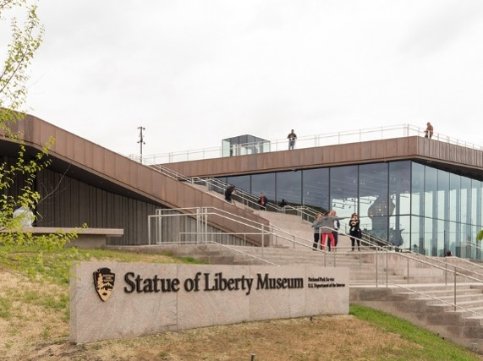
US Contemporary Museums XVII
2019

Slide 2
US Contemporary Museums XVII
The aim is to show you different museums public or private of contemporary architecture throughout the U.S.A. : these do not only house contemporary art but also science since Prehistory.
The greatest architects of the 21th century contributed to the building of these museums with architectures certainly different but also adapted to the place and sometimes to the works they contain.

Slide 3
US Contemporary Museums
International Spy Museum, Washington D.C. 2019.
Statue of Liberty Museum, New-York, NY 2019.
Holocaust Museum, Dallas, TX 2019.
Ruby City, San Antonio, TX 2019.
MoMA West & East end, New-York, NY 2019.
Burke Museum, Seattle, WA 2019.
Benton Museum of Art, Claremont, CA 2019.

Slide 4
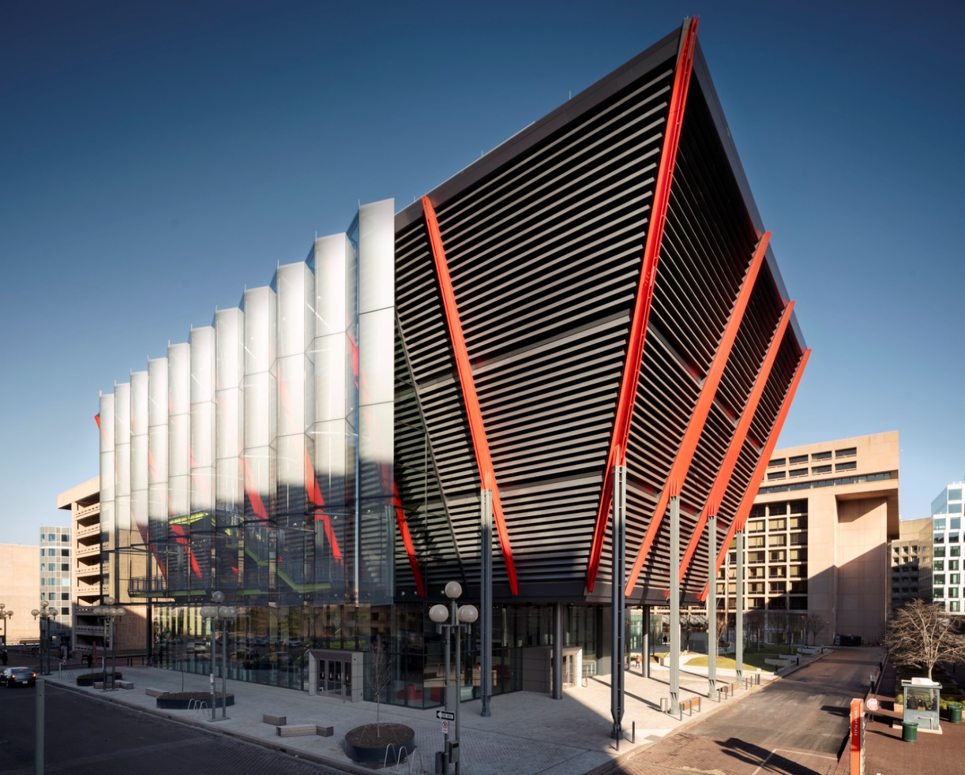
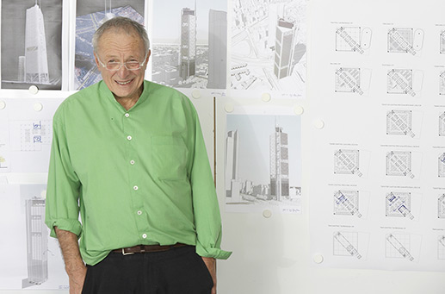
Spy Museum, Washington D.C. (2019)
Richard Rogers

Slide 5
Spy Museum, Washington D.C. (2019)
It is the work of the architect Richard Rogers.
The building reaches the city’s height limit of 130 ft from grade in just 7 stories. Its most prominent features are the angled facades of the exhibit floors on the south and west sides of the site, encased in a black box.
The lobby and retail facilities are located within the double-height ground level space, with a mezzanine that holds an educational space for student and teacher workshops. Above the ground-level lobby are the museum’s three main exhibition areas featuring floor heights of up to 20 ft.

Slide 6
Spy Museum, Washington D.C. (2019)
A metal staircase connecting these floors is suspended along the outside of the metal- panelled west facade and enclosed in a suspended glass atrium called the ‘Veil.’
The steel structure found within the events box gives the museum 60-ft spans with floor-to-ceiling windows arranged in a 180- degree span around the building. With its large and slender, structural-steel beams, this type of architecturally expressed structural steel is unlike any other in the district.

Slide 7
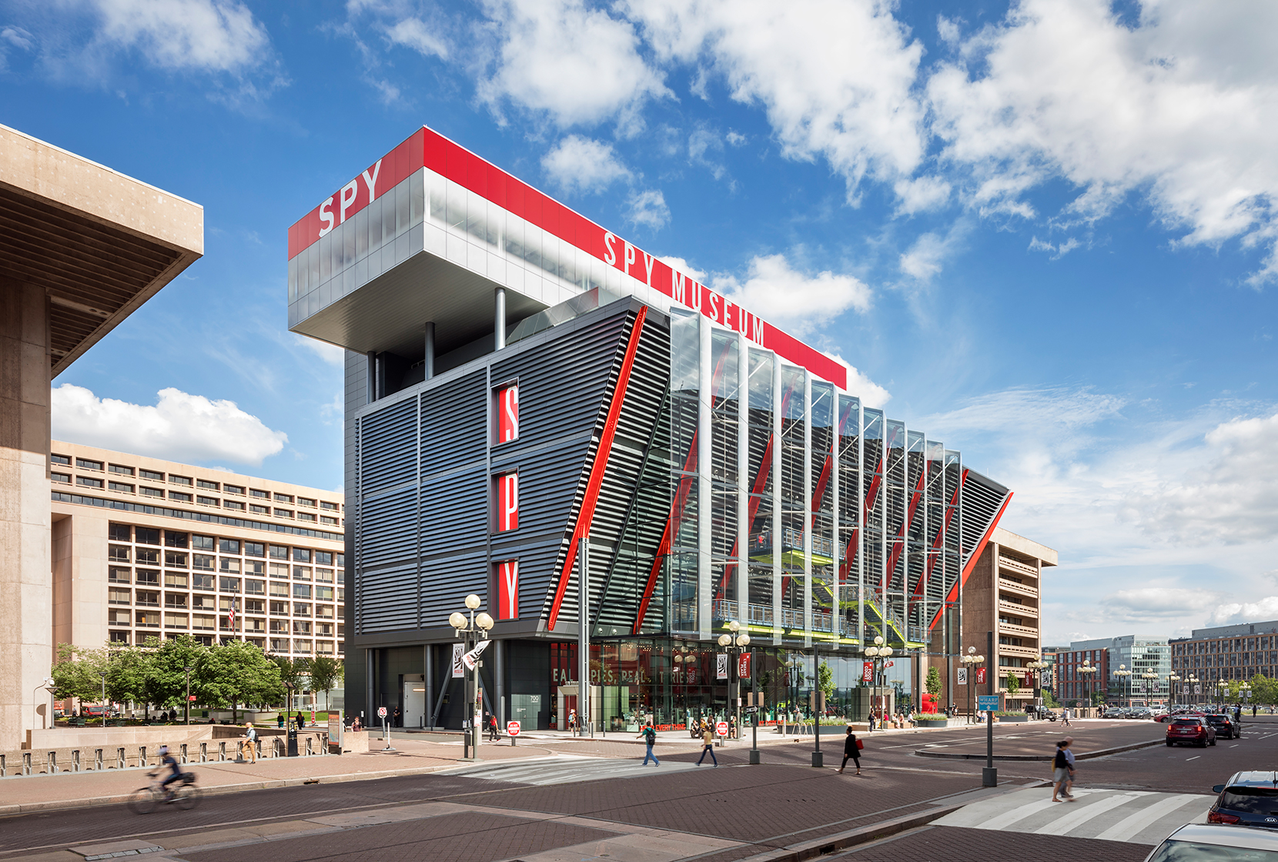
Spy Museum, Washington D.C. (2019)

Slide 8
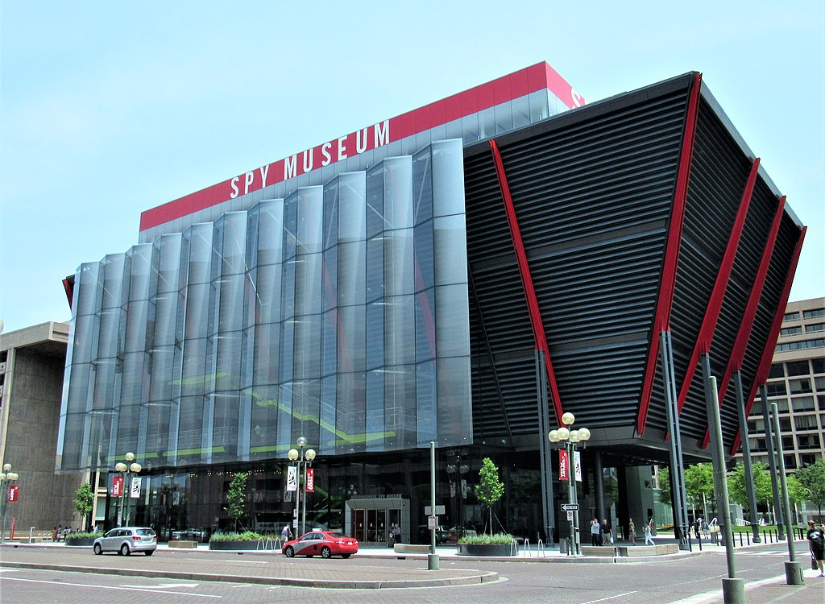
Spy Museum, Washington D.C. (2019)

Slide 9
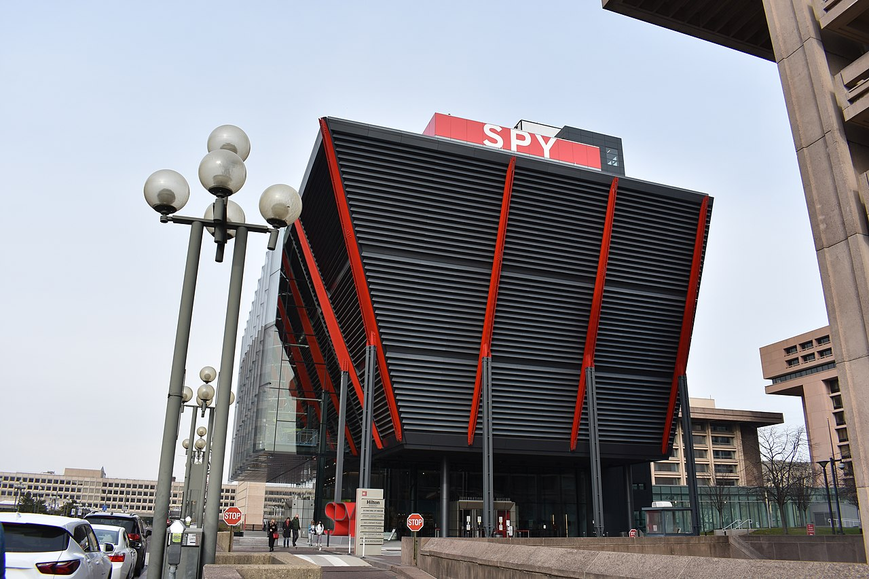
Spy Museum, Washington D.C. (2019)

Slide 10
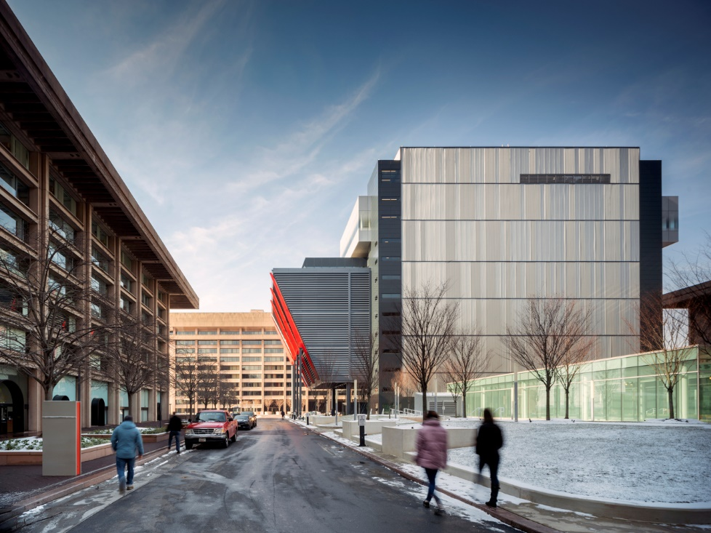
Spy Museum, Washington D.C. (2019)

Slide 11
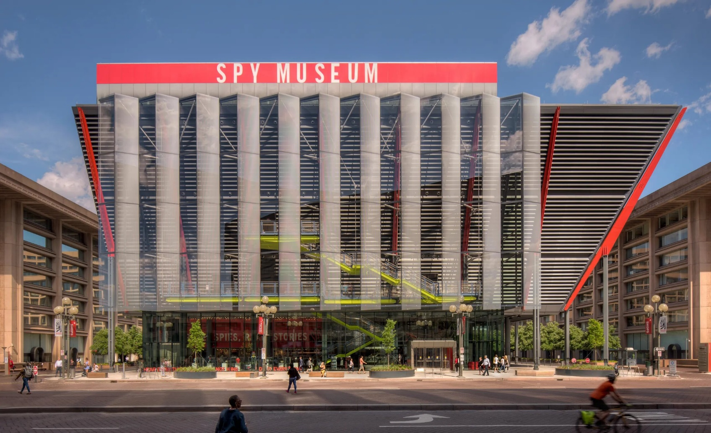
Spy Museum, Washington D.C. (2019)

Slide 12
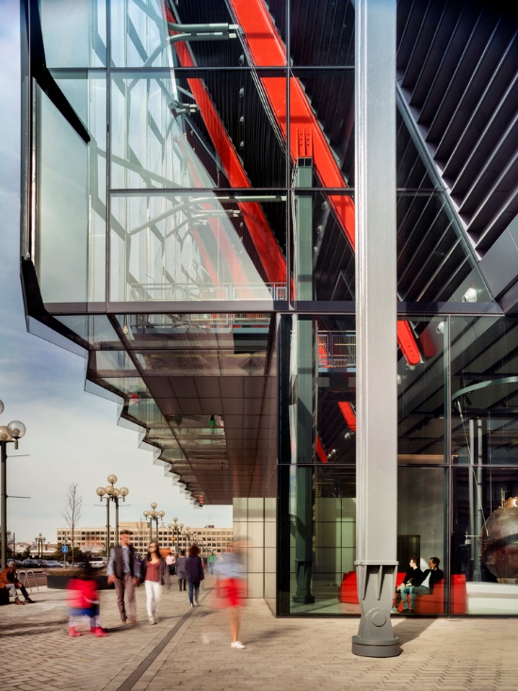
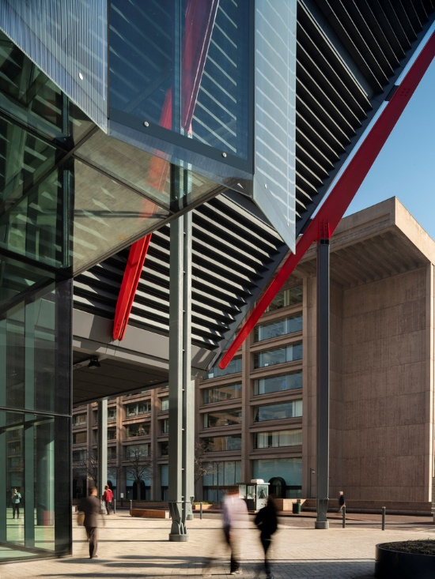
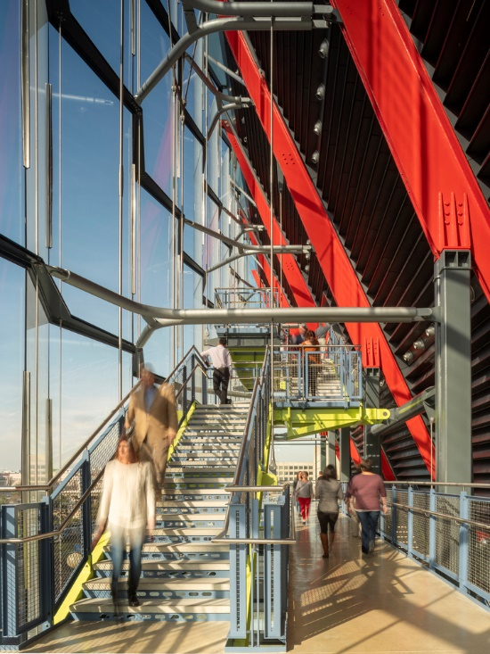
Spy Museum, Washington D.C. (2019)

Slide 13
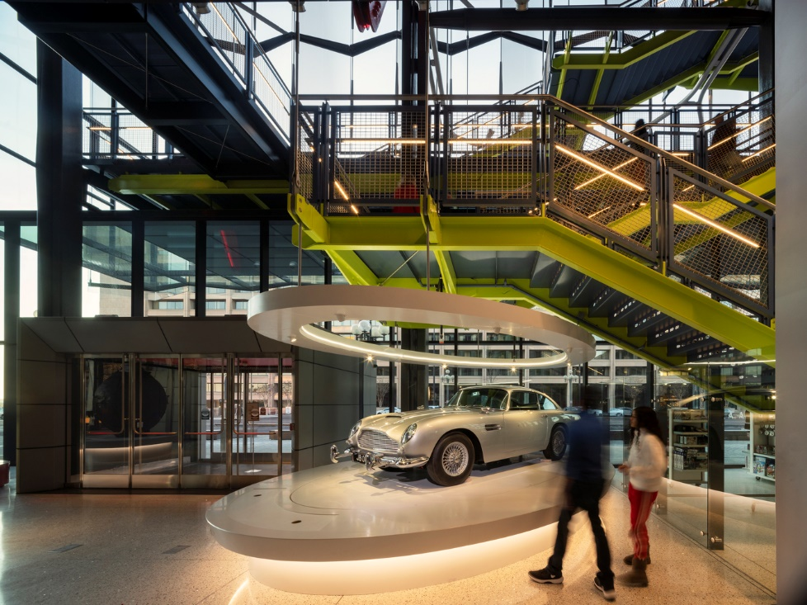
Spy Museum, Washington D.C. (2019)

Slide 14
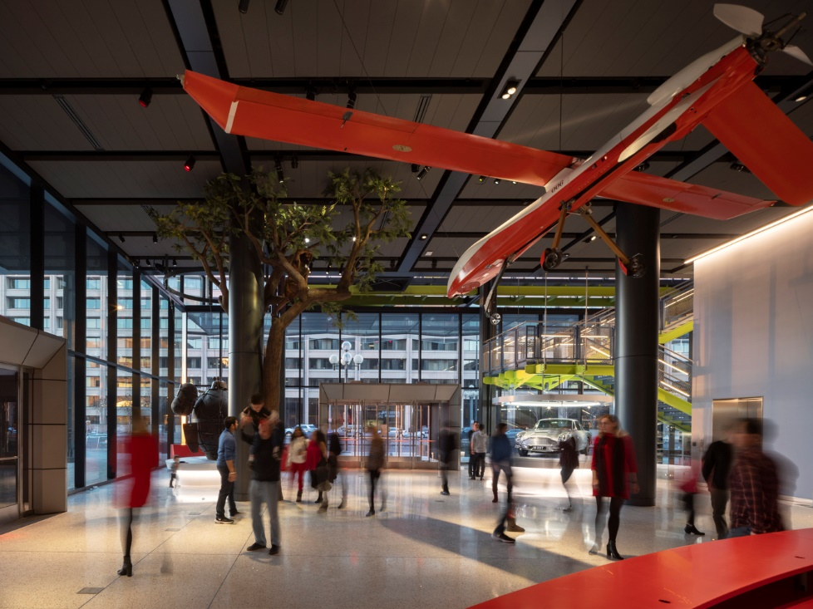
Spy Museum, Washington D.C. (2019)

Slide 15
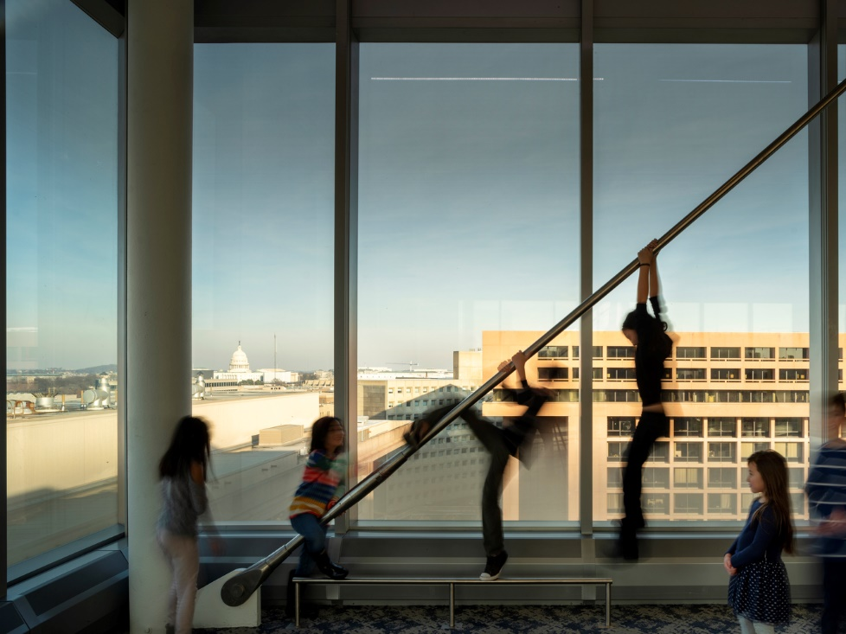
Spy Museum, Washington D.C. (2019)

Slide 16
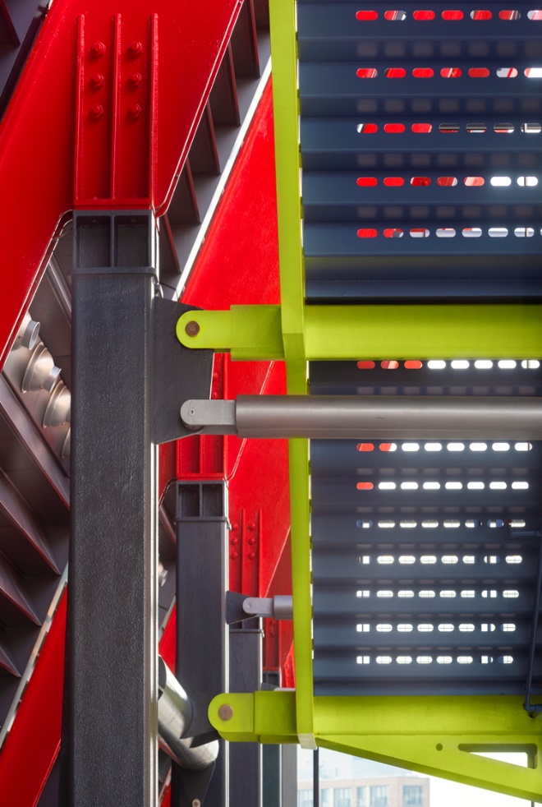
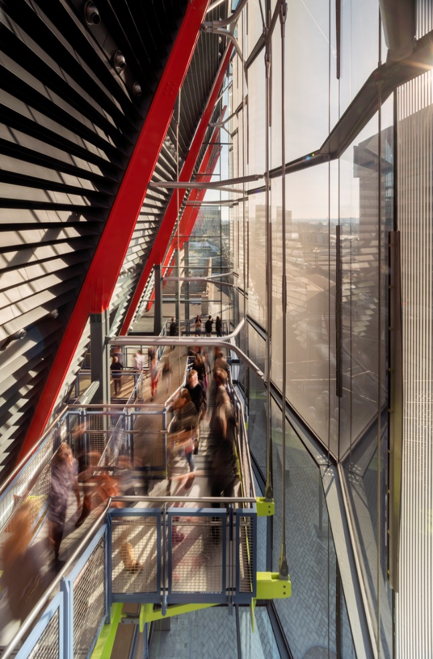
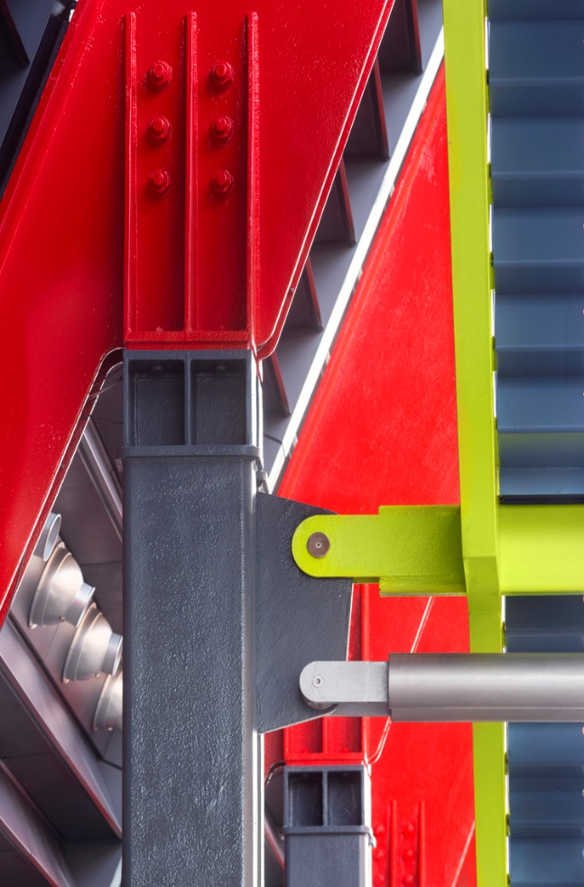
Spy Museum, Washington D.C. (2019)

Slide 17
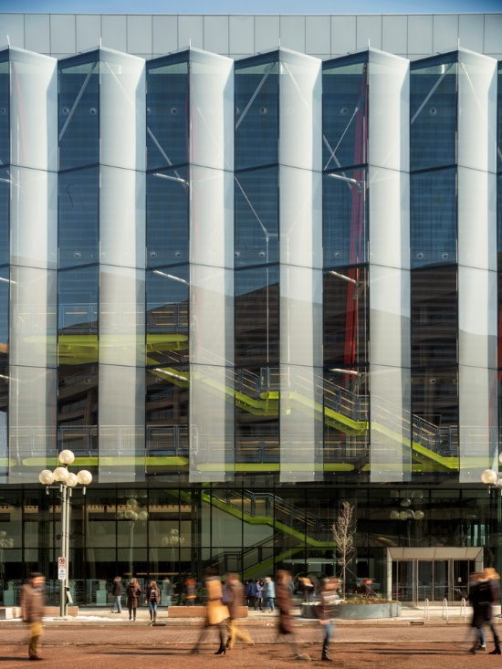
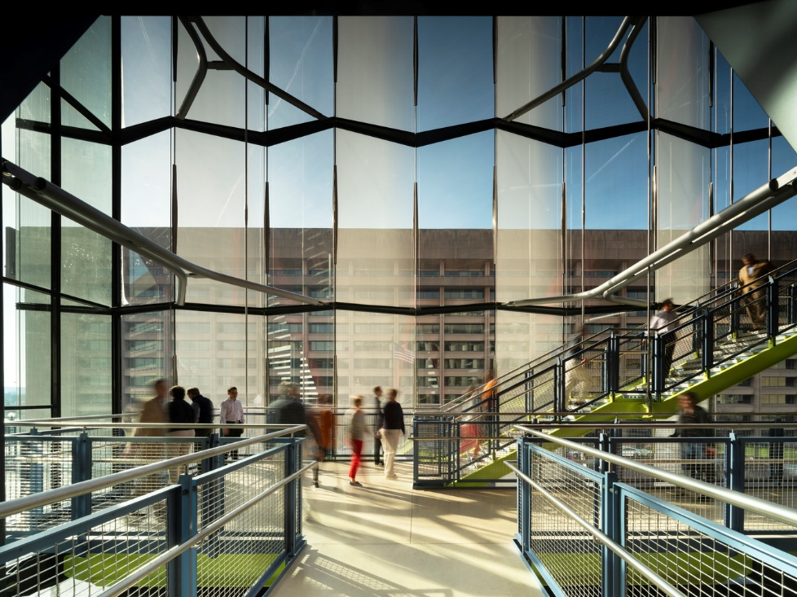
Spy Museum, Washington D.C. (2019)

Slide 18
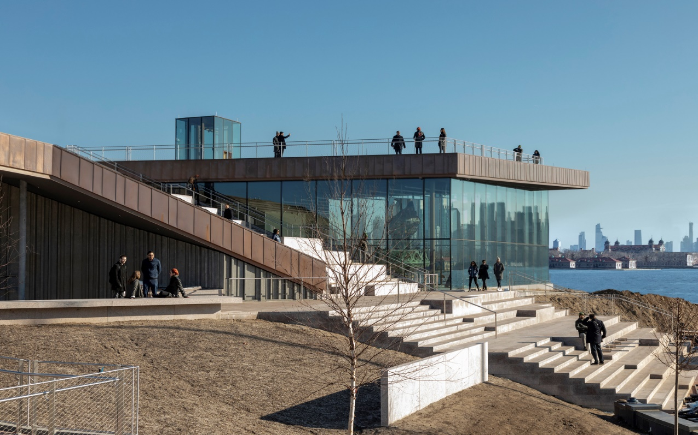
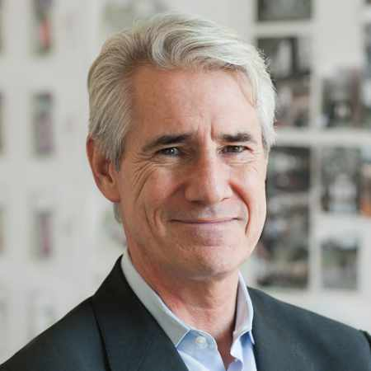
Statue of Liberty Museum, New-York, NY (2019)
Nicholas Garrison

Slide 19
Statue of Liberty Museum, New-York, NY (2019)
It is the work of fxcollaborative firm.
The museum anchors the main axis that connects the Museum to the Statue, and extends this axis via a sweeping granite staircase that leads to its roof.
The visitor experience culminates in a dramatic granite roof terrace that provides unobstructed views of Lady Liberty, the Manhattan skyline, and New York Harbor.
The design eschews formality in favor of an asymmetrical design that embraces its dramatic setting and changes form as visitors move in, on, and around it, much as the idea of liberty is a diverse and pluralistic concept.

Slide 20
Statue of Liberty Museum, New-York, NY (2019)
The planted roofs incorporate native vegetation that super-insulates the building by capturing and filtering storm water.
Around the building, the grounds are planted with native meadow grasses that create a natural habitat for wildlife and migrating birds.
The building’s elevation above the 500- year flood plain prevents damage from extreme weather events, such as Hurricane Sandy, which shut down power on the Island in 2012. The museum emerges as a new geology that is deeply integrated with nature.

Slide 21
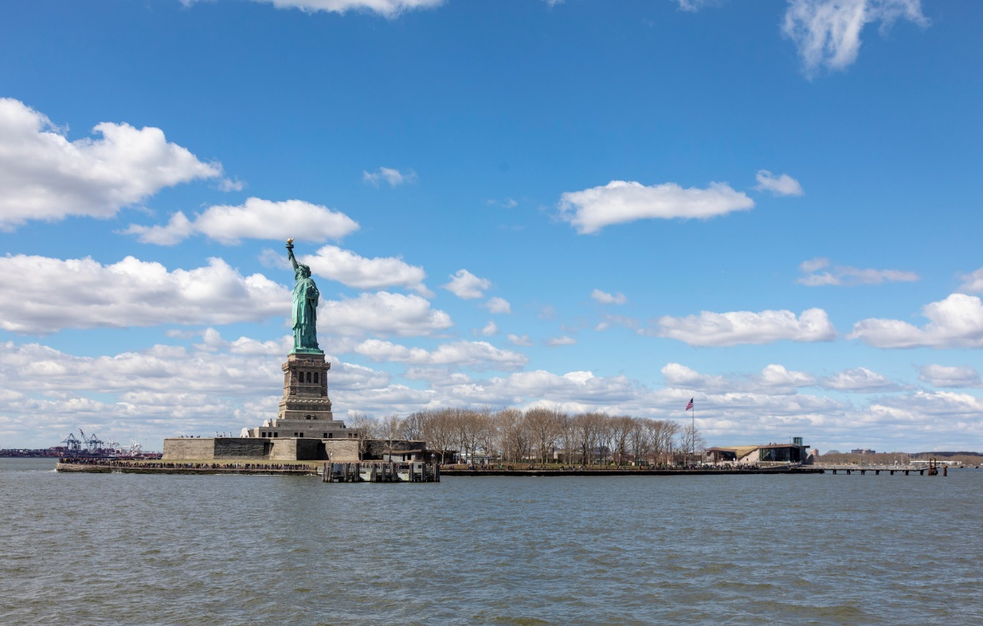
Statue of Liberty Museum, New-York, NY (2019)

Slide 22
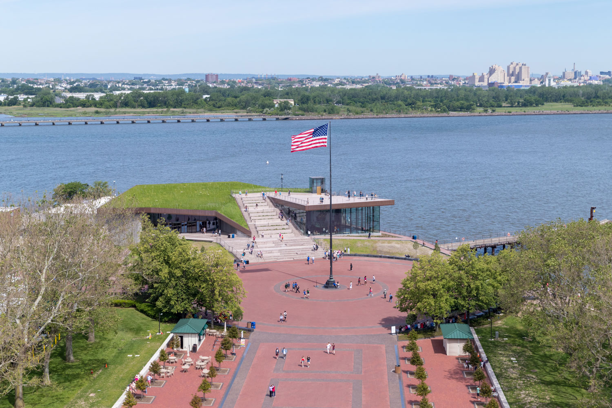
Statue of Liberty Museum, New-York, NY (2019)

Slide 23
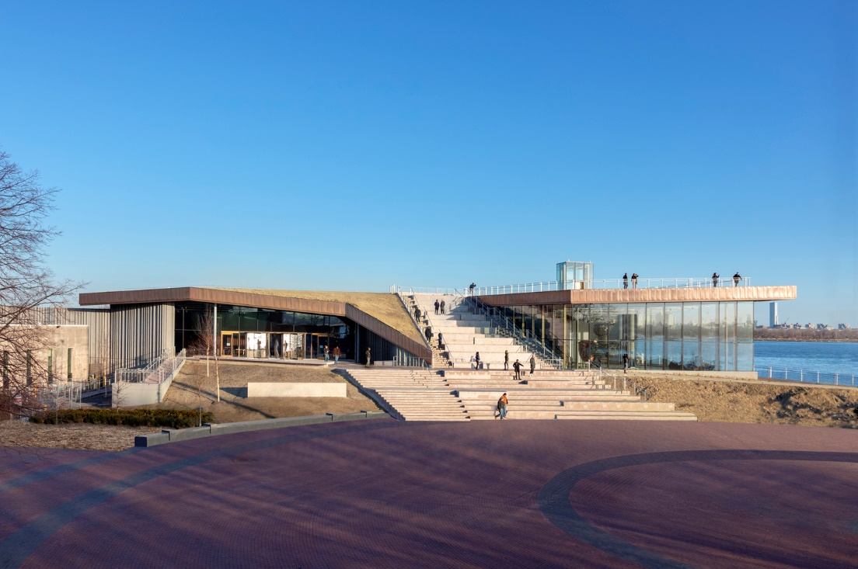
Statue of Liberty Museum, New-York, NY (2019)

Slide 24
Statue of Liberty Museum, New-York, NY (2019)

Slide 25
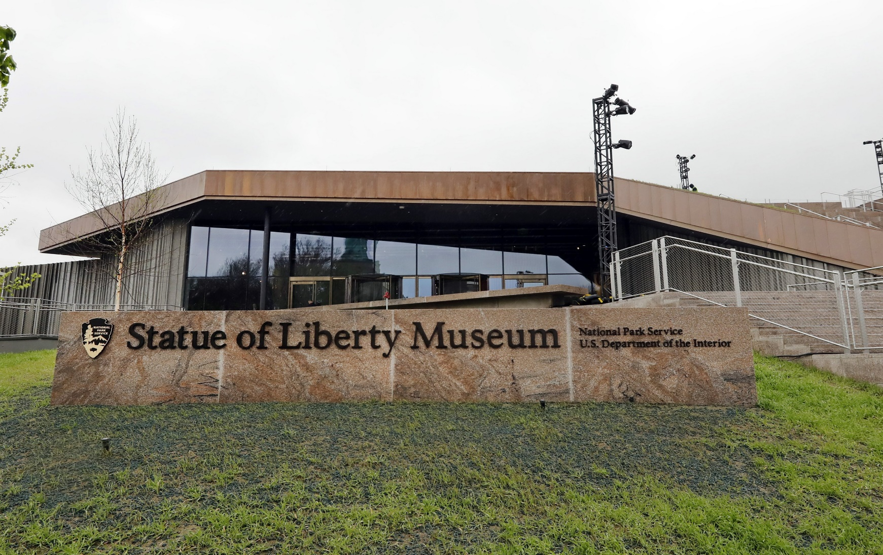
Statue of Liberty Museum, New-York, NY (2019)

Slide 26
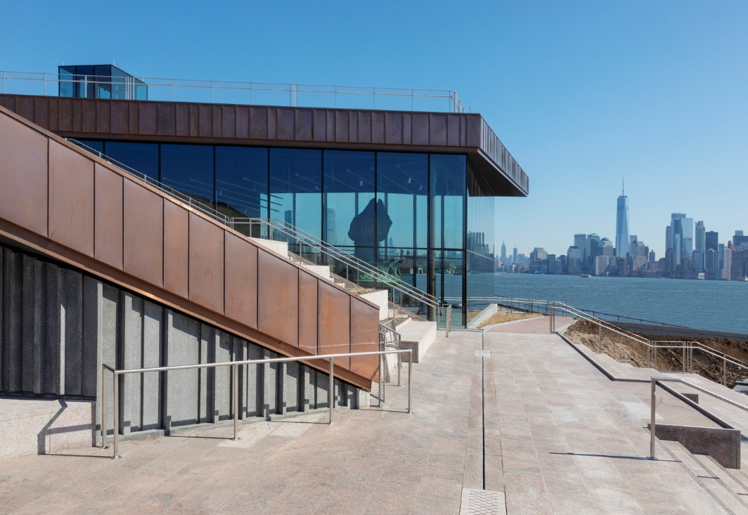
Statue of Liberty Museum, New-York, NY (2019)

Slide 27
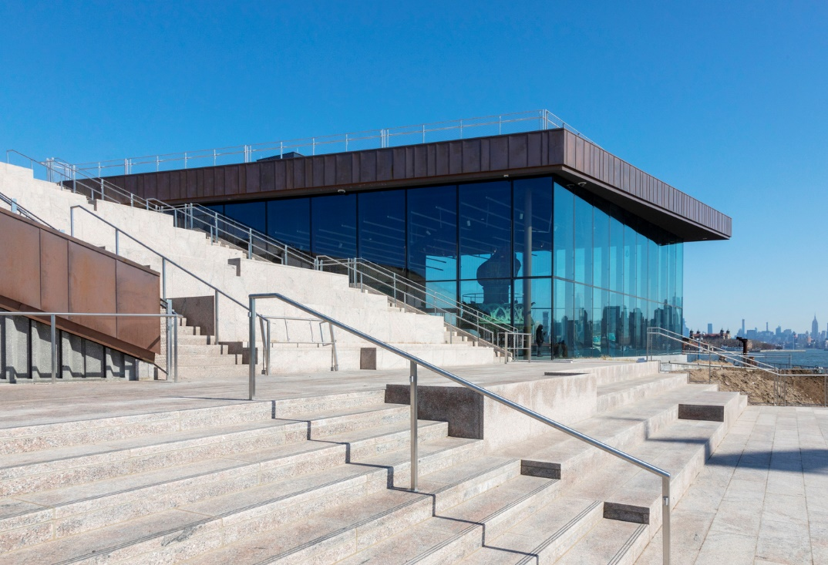
Statue of Liberty Museum, New-York, NY (2019)

Slide 28
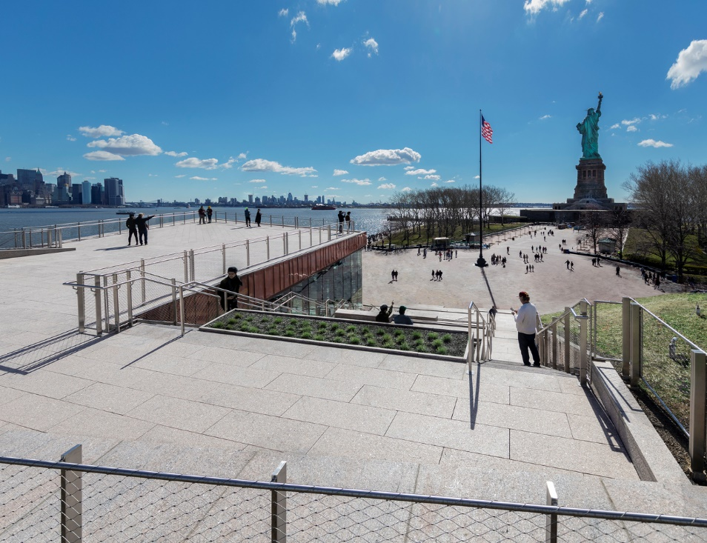
Statue of Liberty Museum, New-York, NY (2019)

Slide 29
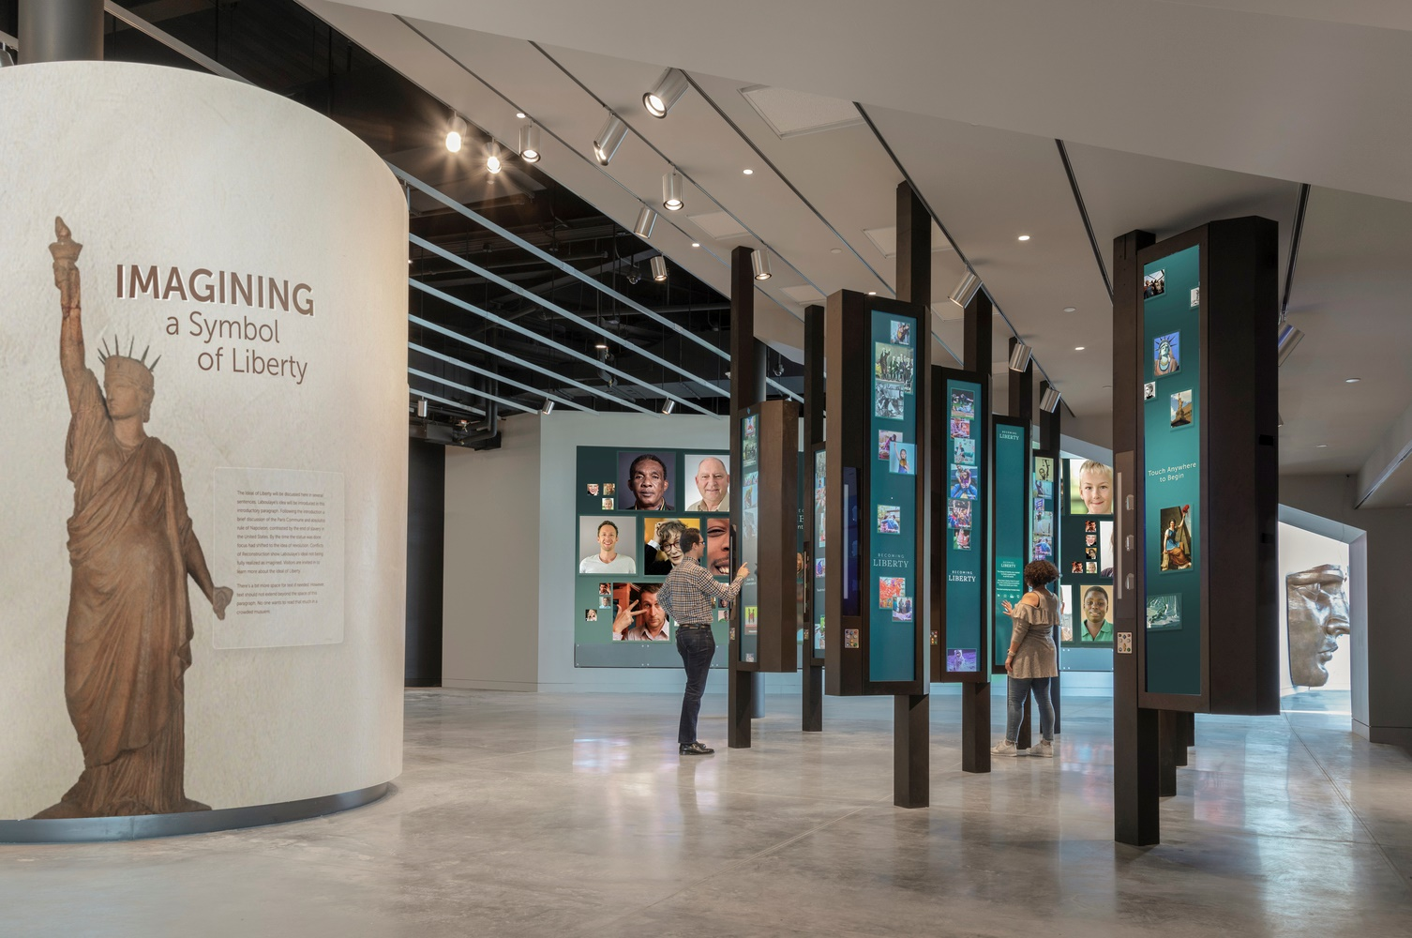
Statue of Liberty Museum, New-York, NY (2019)

Slide 30
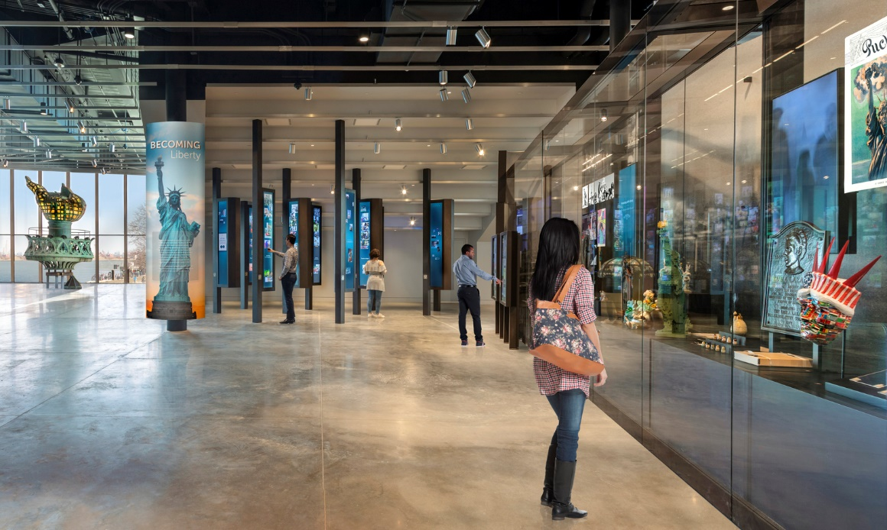
Statue of Liberty Museum, New-York, NY (2019)

Slide 31
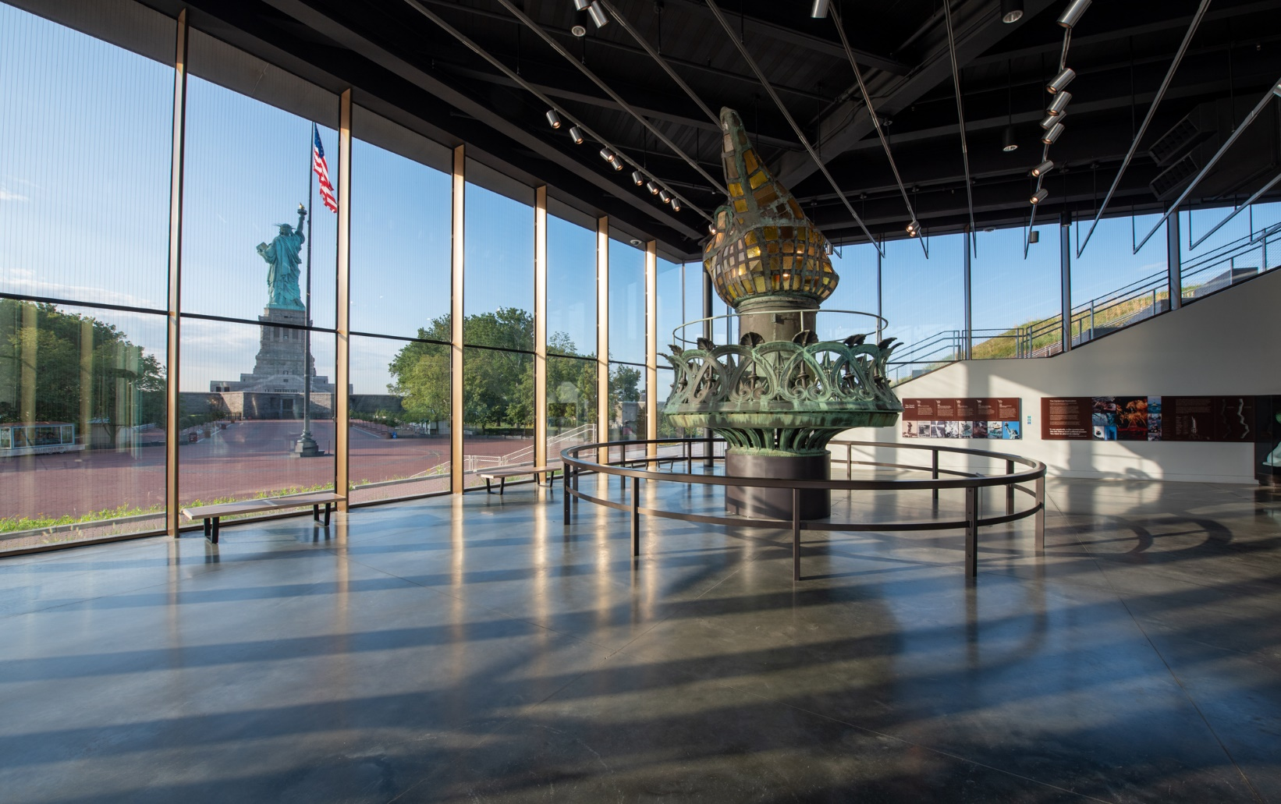
Statue of Liberty Museum, New-York, NY (2019)

Slide 32
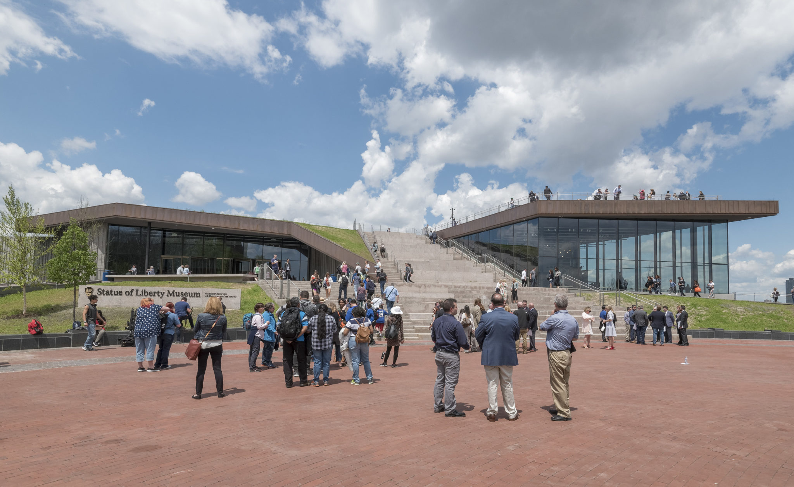
Statue of Liberty Museum, New-York, NY (2019)

Slide 33
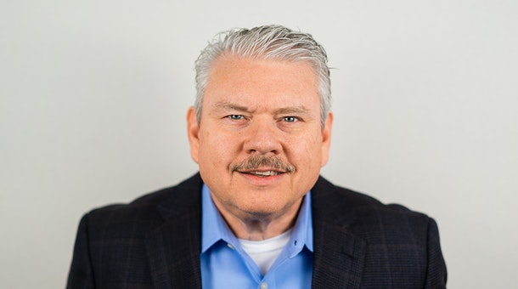
Holocaust Museum, Dallas, TX (2019)
Mark Holsinger
Randy Mc Cown
Steve Brookover

Slide 34
Holocaust Museum, Dallas, TX (2019)
It is the work of OMNIPLAN firm.
The architecture is essentially reflective of this notion of a journey – expressive of movement from arrival to departure, designed to provide an intuitive path for all visitors so that the focus is on the experience that is removed from everyday distractions.
The exhibit space is elevated above the support spaces and clad in metal skin. With its exterior clad in copper, which will acquire a natural patina over time, the museum will become an architectural legacy distinct and impactful.

Slide 35
Holocaust Museum, Dallas, TX (2019)
The common area is centralized to connect all spaces and provide a powerful courtyard-lobby connection. The exhibits are intentional black-box spaces and contrast with the light-filled lobby creating a dichotomy of light and darkness, of hope and tragedy.
The design of the building seeks to limit the amount of direct sunlight on the large expanses of glass. The wings of U-shaped parti shields the large curtain wall opening to the courtyard from the sun while the west wing overhangs the entry curtain wall limiting the effects of the western sun exposure.

Slide 36
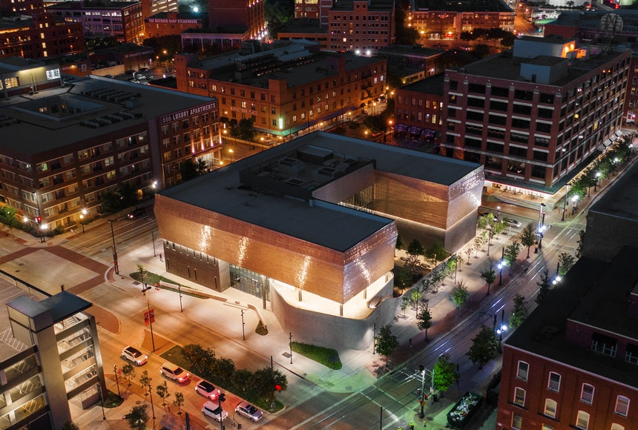
Holocaust Museum, Dallas, TX (2019)

Slide 37
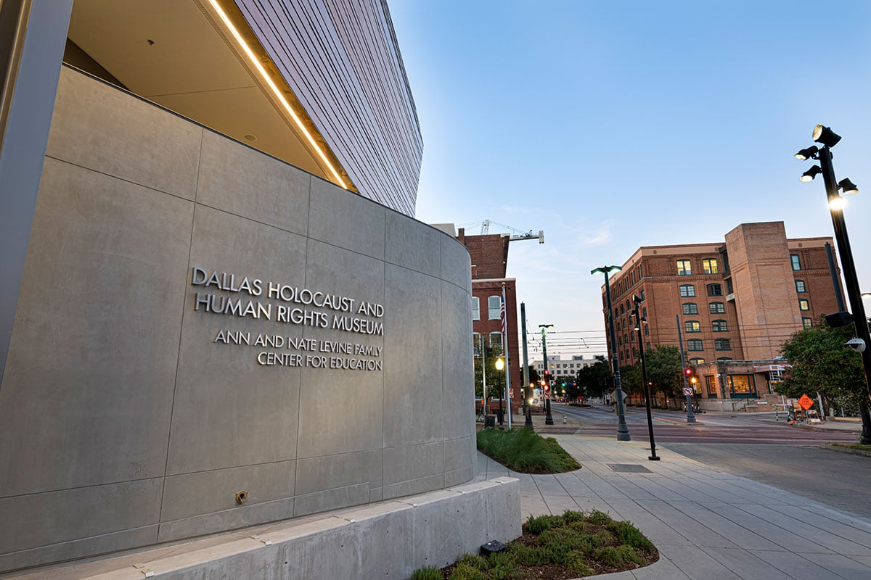
Holocaust Museum, Dallas, TX (2019)

Slide 38
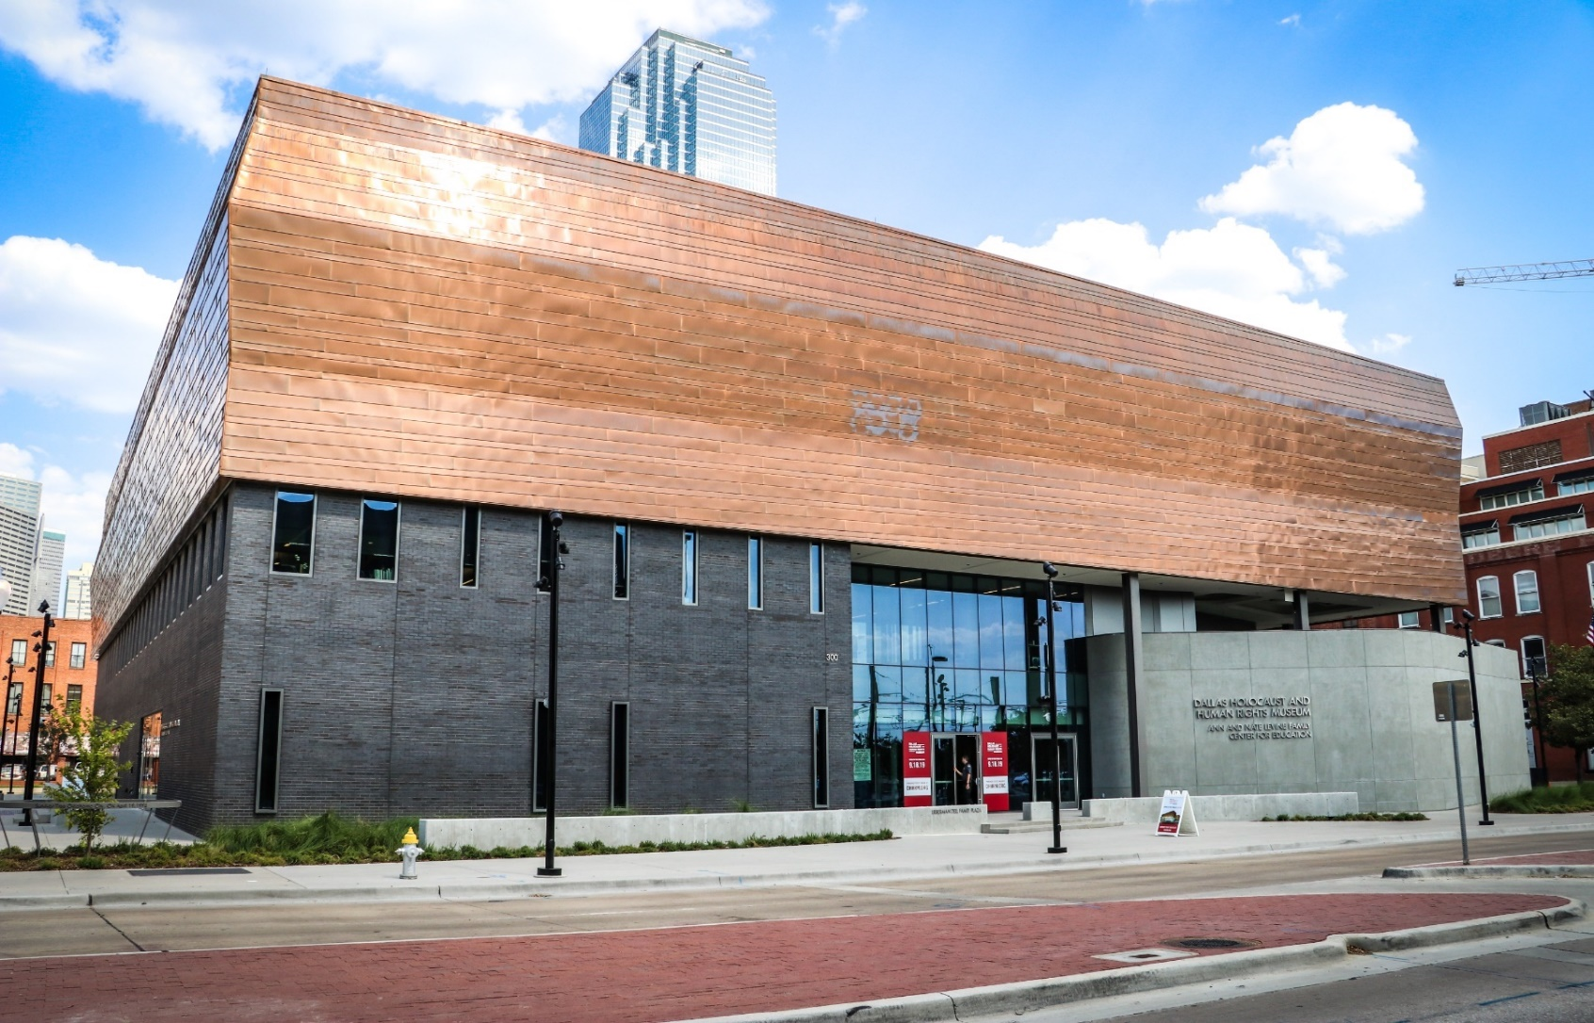
Holocaust Museum, Dallas, TX (2019)

Slide 39
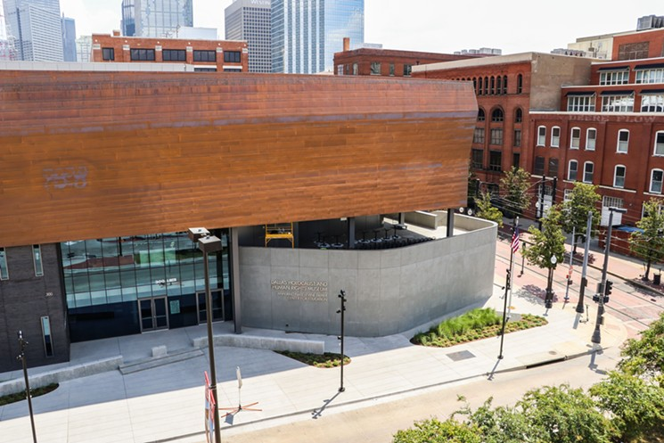
Holocaust Museum, Dallas, TX (2019)

Slide 40
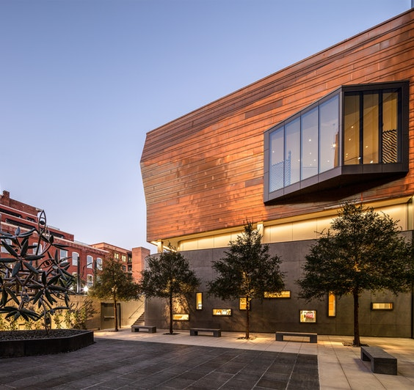
Holocaust Museum, Dallas, TX (2019)

Slide 41
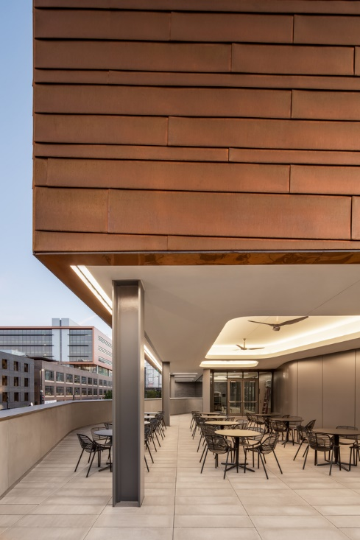
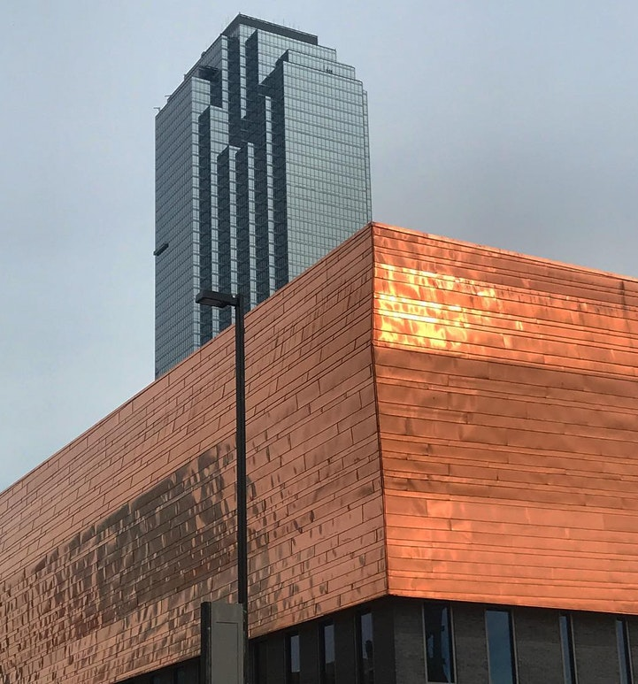
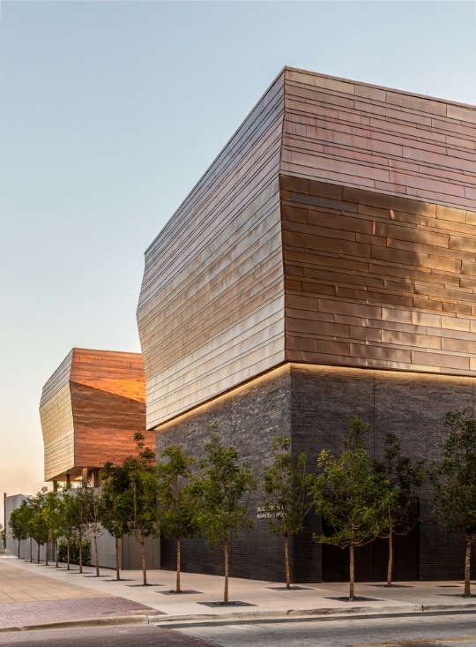
Holocaust Museum, Dallas, TX (2019)

Slide 42
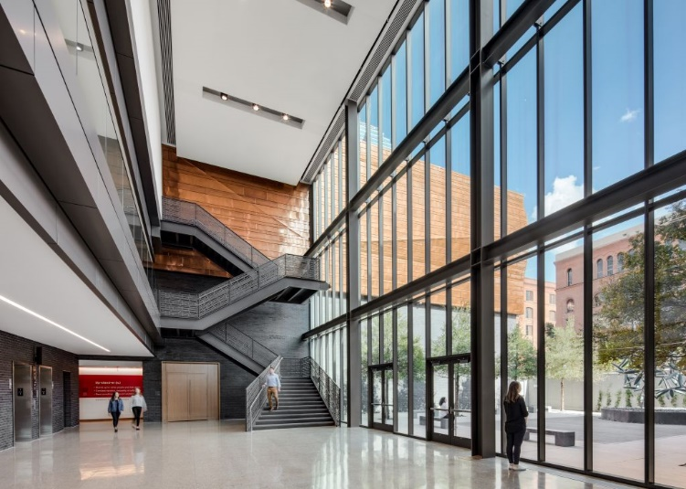
Holocaust Museum, Dallas, TX (2019)

Slide 43
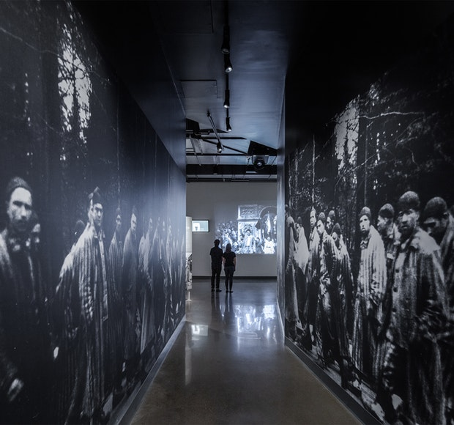
Holocaust Museum, Dallas, TX (2019)

Slide 44
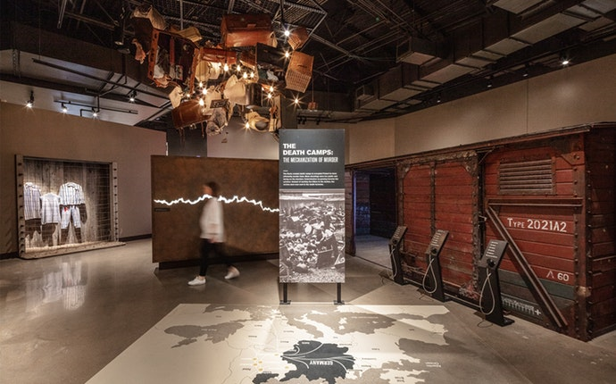
Holocaust Museum, Dallas, TX (2019)

Slide 45
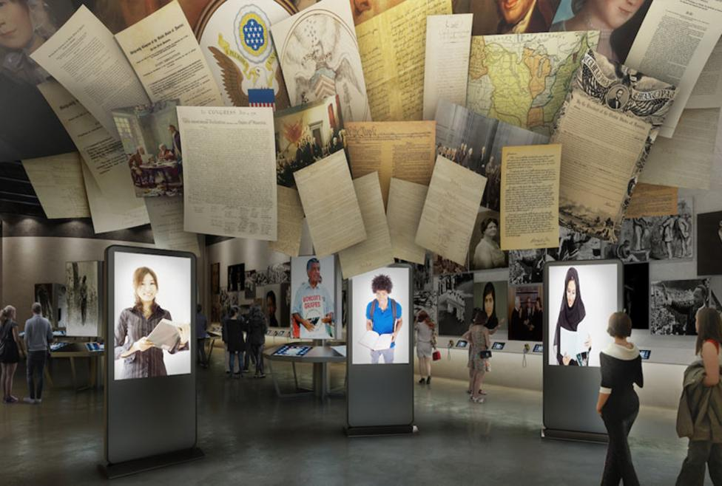
Holocaust Museum, Dallas, TX (2019)

Slide 46
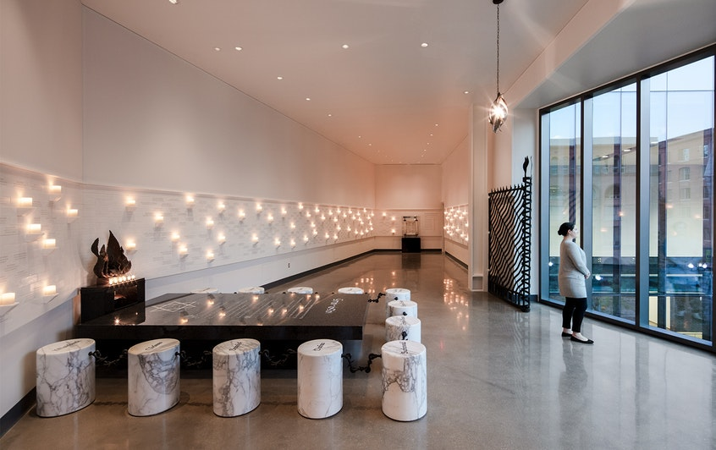
Holocaust Museum, Dallas, TX (2019)

Slide 47
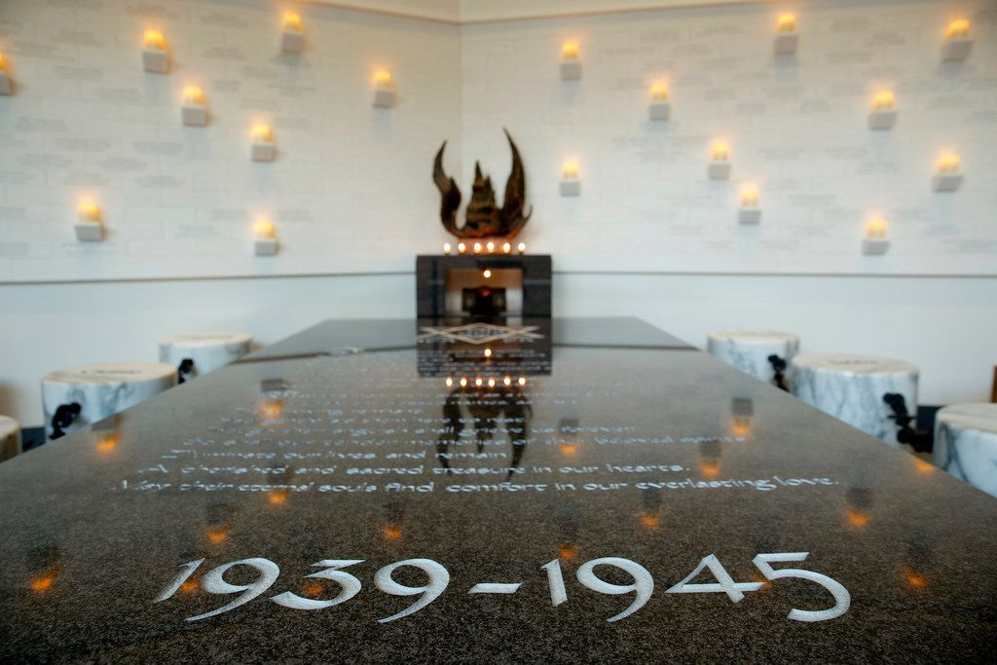
Holocaust Museum, Dallas, TX (2019)

Slide 48
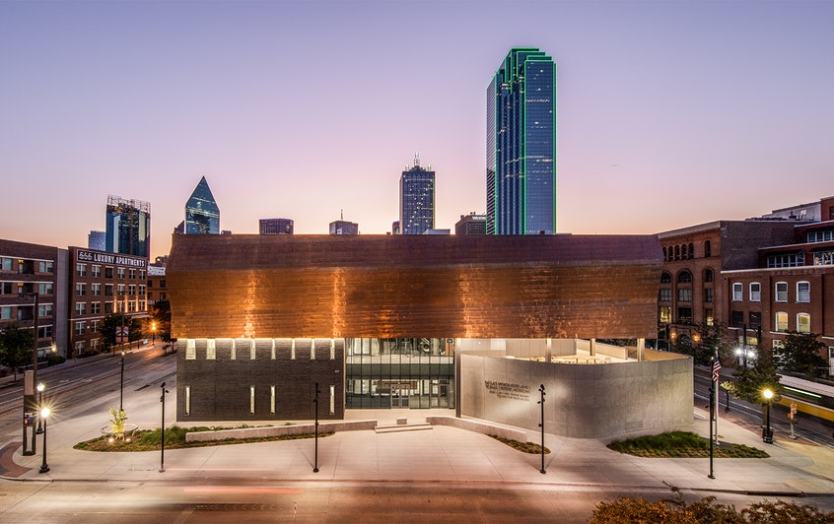
Holocaust Museum, Dallas, TX (2019)

Slide 49
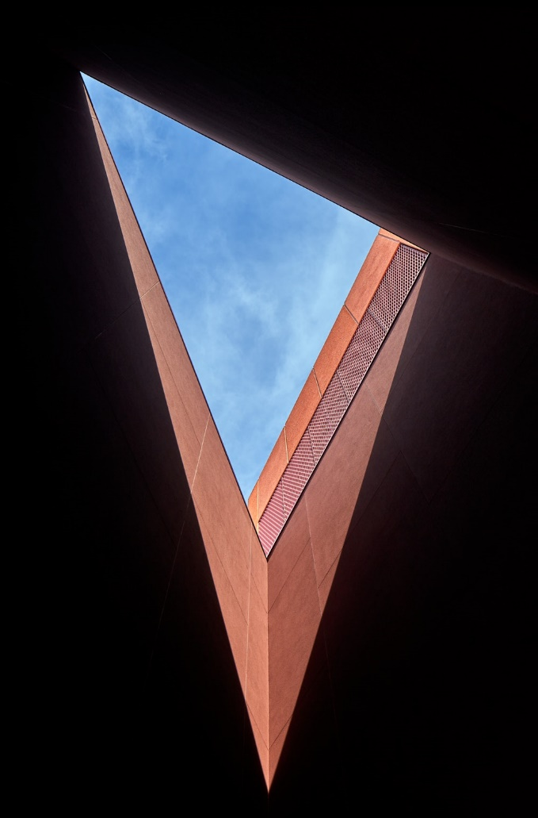
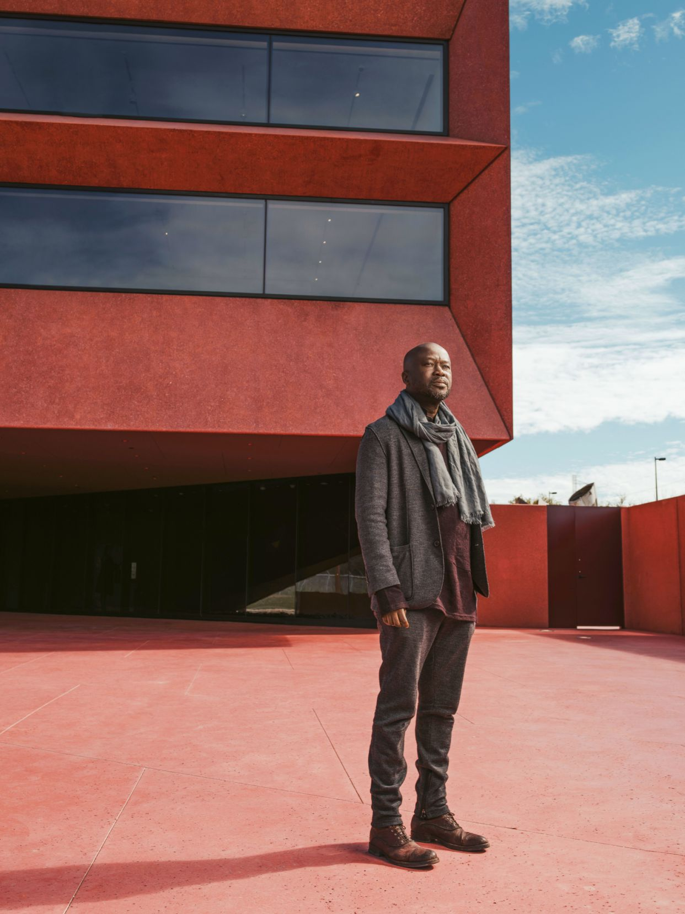
Ruby City, San Antonio, TX (2019)
Sir David Adjaye

Slide 50
Ruby City, San Antonio, TX (2019)
It is the work of the architect Sir David Adjaye.
The faceted exterior is completely clad in the red-toned precast concrete panels, polished for the first three meters up and rough thereafter, encrusted with varying shades of red glass. Two lanterns adorn the top of the structure, creating an animated roofline made to draw in natural light to the galleries.
Outside, the structure seems to refract as visitors move around it, its angular shape shifting from monumental to intimate. Inside, three naturally lit galleries nod to historic artists’ studios, with a gabled roof in one and clerestory windows in another.

Slide 51
Ruby City, San Antonio, TX (2019)
Linda Pace : Ruby City

Slide 52
Ruby City, San Antonio, TX (2019)

Slide 53
Ruby City, San Antonio, TX (2019)

Slide 54
Ruby City, San Antonio, TX (2019)

Slide 55
Ruby City, San Antonio, TX (2019)

Slide 56
Ruby City, San Antonio, TX (2019)

Slide 57
Ruby City, San Antonio, TX (2019)

Slide 58
Ruby City, San Antonio, TX (2019)

Slide 59
Ruby City, San Antonio, TX (2019)

Slide 60
Ruby City, San Antonio, TX (2019)

Slide 61
Ruby City, San Antonio, TX (2019)

Slide 62
Ruby City, San Antonio, TX (2019)

Slide 63
MoMA West & East end,New-York,NY (2019)
C. Renfro E. Diller R. Scofidio

Slide 64
MoMA West & East end,New-York,NY (2019)
It is the work of Diller, Scofidio & Renfro firm.
The completed renovation of the east end includes the reconfiguration of 15,000 square feet to create two spacious galleries on the third floor that allow more flexibility for installing the collection and special exhibitions.
The design enlarges and opens up the main lobby into a light-filled, double-height space.
The new western portion of the Museum will be dedicated almost entirely to the display of art. The expansion to the west end of the site will feature a stack of vertically interlocking galleries of varying heights.

Slide 65
MoMA West & East end,New-York,NY (2019)
A new custom entry canopy welcomes visitors into a double height space from 53rd street : the open lobby is equipped to host installations of art, on a ground floor free and open to all.
The Flagship Museum Store will be lowered one level, making it a new double-height space.
The blade stair marks the threshold to the new expansion of the museum and acts as a palette cleanser. This stair’s minimal expression was achieved through a number of structural innovations – a six-inch thin vertical spine hangs from the roof structure to structurally support the stairs and landings, leaving the structure free of any lateral bracing.

Slide 66
MoMA West & East end,New-York,NY (2019)

Slide 67
MoMA West & East end,New-York,NY (2019)

Slide 68
MoMA West & East end,New-York,NY (2019)

Slide 69
MoMA West & East end,New-York,NY (2019)

Slide 70
MoMA West & East end,New-York,NY (2019)

Slide 71
MoMA West & East end,New-York,NY (2019)

Slide 72
MoMA West & East end,New-York,NY (2019)

Slide 73
MoMA West & East end,New-York,NY (2019)

Slide 74
MoMA West & East end,New-York,NY (2019)

Slide 75
MoMA West & East end,New-York,NY (2019)

Slide 76
MoMA West & East end,New-York,NY (2019)

Slide 77
Burke Museum, Seattle, WA (2019)
Tom Kundig

Slide 78
Burke Museum, Seattle, WA (2019)
It is the work of the architect Tom Kundig.
Large areas of glazing maximize transparency and expose the interior experience.
The design further breaks down traditional museum barriers between public and “back-of-house” spaces, integrating collections and research labs with traditional galleries and enabling visitors and the surrounding community to engage with the process of scientific discovery in a true working museum. A 24-foot-by-20-foot pivoting window wall continues this emphasis on transparency to literally open the Burke to the nature of a new outdoor courtyard.

Slide 79
Burke Museum, Seattle, WA (2019)

Slide 80
Burke Museum, Seattle, WA (2019)

Slide 81
Burke Museum, Seattle, WA (2019)

Slide 82
Burke Museum, Seattle, WA (2019)

Slide 83
Burke Museum, Seattle, WA (2019)

Slide 84
Burke Museum, Seattle, WA (2019)

Slide 85
Burke Museum, Seattle, WA (2019)

Slide 86
Burke Museum, Seattle, WA (2019)

Slide 87
Burke Museum, Seattle, WA (2019)

Slide 88
Burke Museum, Seattle, WA (2019)

Slide 89
Burke Museum, Seattle, WA (2019)

Slide 90
Burke Museum, Seattle, WA (2019)

Slide 91
Benton Museum of Art, Claremont, CA (2019)
Rodolfo Machado
Jorge Silvetti

Slide 92
Benton Museum of Art, Claremont, CA (2019)
It is the work of Machado Silvetti firm.
This is a visually porous museum where passersby can get a glimpse of the art world inside and visitors on the interior are often in contact with the landscapes and light of Southern California. Cast-in-place concrete is the primary structural, thermal and exterior façade solution. Pomona College has a long history of cast-in-place concrete and here at the Benton the concrete is rendered in its most essential states-board formed and smooth-and is contrasted against stained heavy timbers that interact with the concrete as portico, porch, arcade, threshold and embedded ornamentation.

Slide 93
Benton Museum of Art, Claremont, CA (2019)

Slide 94
Benton Museum of Art, Claremont, CA (2019)

Slide 95
Benton Museum of Art, Claremont, CA (2019)

Slide 96
Benton Museum of Art, Claremont, CA (2019)

Slide 97
Benton Museum of Art, Claremont, CA (2019)

Slide 98
Benton Museum of Art, Claremont, CA (2019)

Slide 99
Benton Museum of Art, Claremont, CA (2019)

Slide 100
Benton Museum of Art, Claremont, CA (2019)

Slide 101
Benton Museum of Art, Claremont, CA (2019)

Slide 102
Burke Museum, Seattle, WA (2019)
THE END

