Slide 1
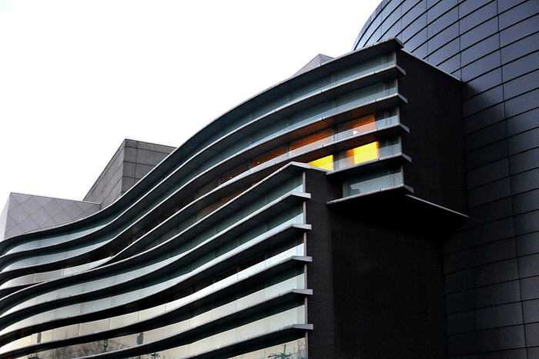
World Operas & Perfomance Halls I (1950-2000)

Slide 2
Operas & Performance Halls
The aim is to show you different 0peras and Performance Halls of contemporary architecture throughout the world (except US).
The greatest architects of the 20th century contributed to the building of these operas with architectures certainly different but also adapted to the place and sometimes to the works they contain.
This selection contains many theatres because they offer the opportunity to attend many operas or lyrics.

Slide 3
Operas & Performance Halls 1
Royal Festival Hall, London, GB 1951.
Auditorio Nacional, Mexico, MX 1952.
Turku Concert Hall, Turku, FI 1952.
Oper Köln, Köln, DE 1957-1962.
Beethoven Halle, Bonn, DE 1959.
Musiktheater, Gelsenkirchen, DE 1959.
Deutsche Oper, Berlin, DE 1961.
Théâtre, Caen, FR 1963.
Philharmonic Concert Hall, Berlin, DE 1963.
Grand Théâtre, Luxembourg, LU 1964.

Slide 4
Operas & Performance Halls 2
Opernhaus, Dortmund, DE 1966.
Centennial Concert Hall, Winnipeg, CA 1968.
Finlandia Hall, Helsinski, FI 1971.
Sidney Opera, Sidney, AU 1973.
Perth Concert Hall, Perth, AU 1973.
Bruckner Haus, Linz, AT 1974.
Opera House, Vilnius, LT 1974.
Badisches Staatstheater, Karlsruhe, DE 1975.
Royal National Theatre, London, GB 1976.

Slide 5
Operas & Performance Halls 3
Aarhus Concert Hall, Aarhus, DK 1982.
Teatro Teresa Carreño, Caracas, VE 1983.
Auditorio Nacional, Madrid, ES 1988.
Opéra Bastille, Paris, FR 1989.
Athens Concert Hall, Athens, GR 1991.
La Grange au Lac, Evian, FR 1993.
Kyoto Concert Hall, Kyoto, JP 1995.
Grand Théâtre de Provence, Aix, FR 1997.

Slide 6
Operas & Performance Halls 4
Grand Théâtre, Shangai, CN 1998.
Auditorium, Dijon, FR 1998.
Konzertsaal, KKL, Lucerne, CH 1998.
Kursaal, San Sebastian, ES 1999.
Nikolaisaal, Postdam, DE 2000.
The Lowry, Salford, GB 2000.
Sibelius Hall, Lahti, FI 2000.

Slide 7
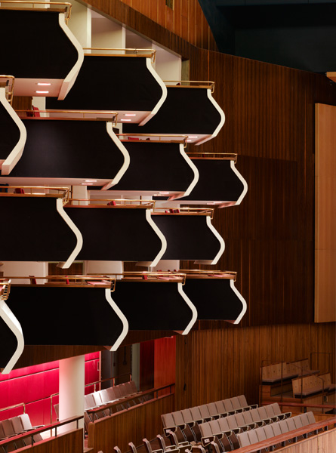
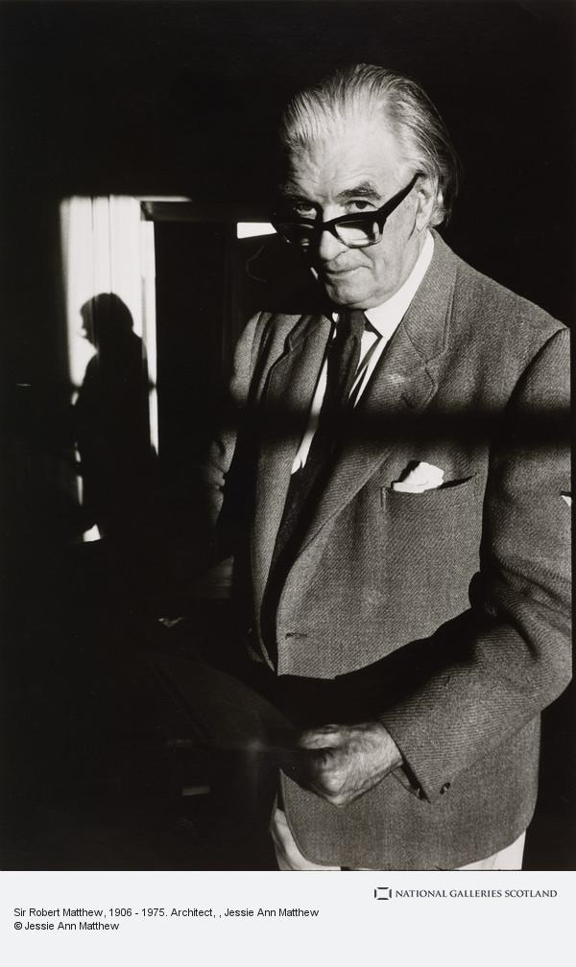
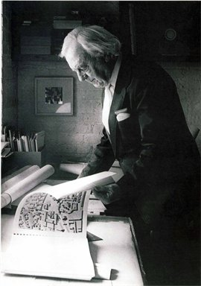
Royal Festival Hall, London, GB (1951)
Sir Robert Matthew
Sir Leslie Martin

Slide 8
Royal Festival Hall, London, GB (1951)
The building was designed by Sir Robert Matthew and Sir Leslie martin.
The exterior of the building was bright white, intended to contrast with the blackened city surrounding it. Large areas of glass on its façade meant that light coursed freely throughout the interior, and at night, the glass let the light from inside flood out onto the river, in contrast to the darkness.
The hall they built used modernism’s favorite material, reinforced concrete, alongside more luxurious elements including beautiful woods and Derbyshire fossilized limestone.

Slide 9
Royal Festival Hall, London, GB (1951)
The hall originally seated 2,901. The cantilevered boxes are often described as looking like drawers pulled out in a hurried burglary, but none has a compromised sightline.
The building underwent a substantial renovation between 2005 and 2007 aimed at improving the poor acoustics : the wooden wall panels of the Hall were relined to change their acoustic qualities and the undulating plaster ceiling panels were completely reconstructed using more robust materials to provide greater warmth of sound and support for bass frequencies.

Slide 10
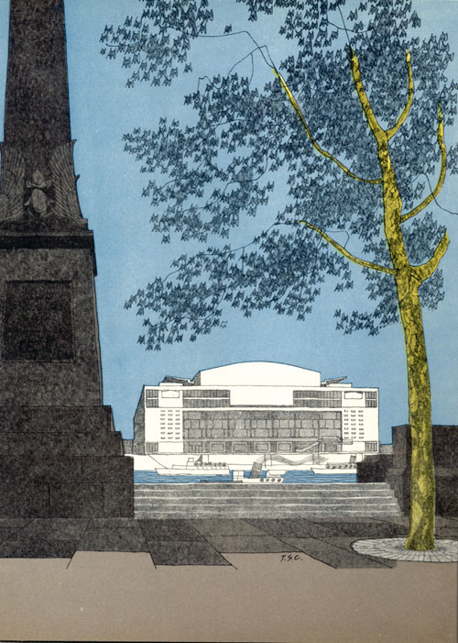
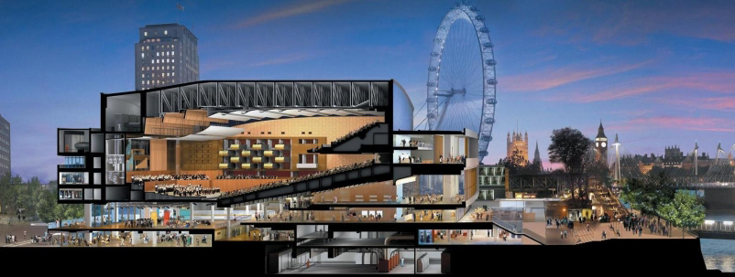
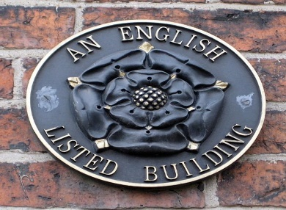
Royal Festival Hall, London, GB (1951)

Slide 11
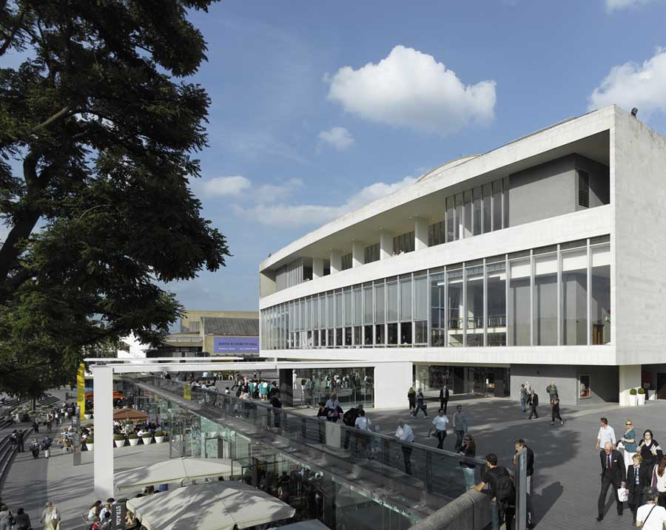
Royal Festival Hall, London, GB (1951)

Slide 12
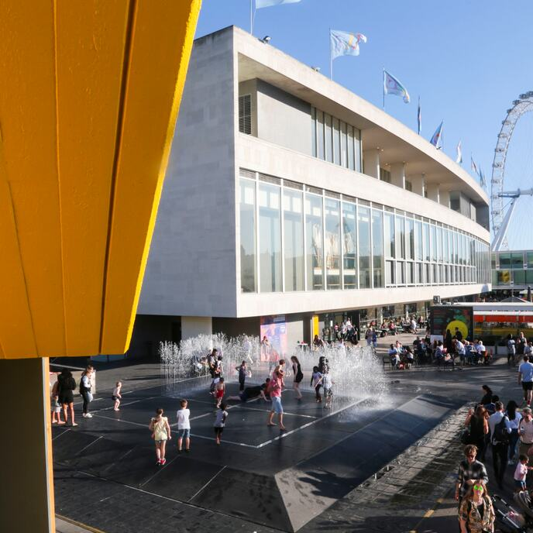
Royal Festival Hall, London, GB (1951)

Slide 13
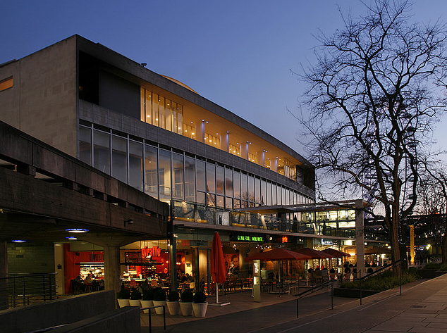
Royal Festival Hall, London, GB (1951)

Slide 14
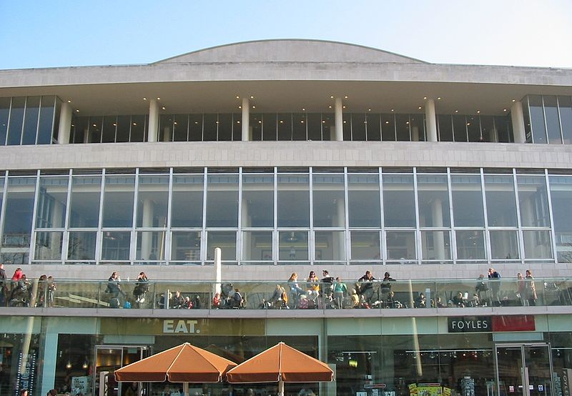
Royal Festival Hall, London, GB (1951)

Slide 15
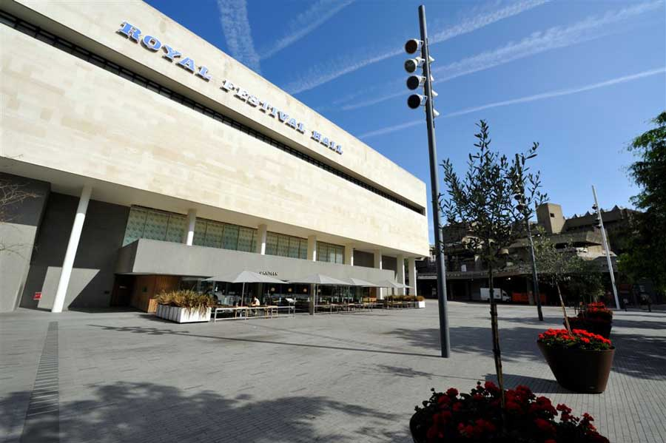
Royal Festival Hall, London, GB (1951)

Slide 16
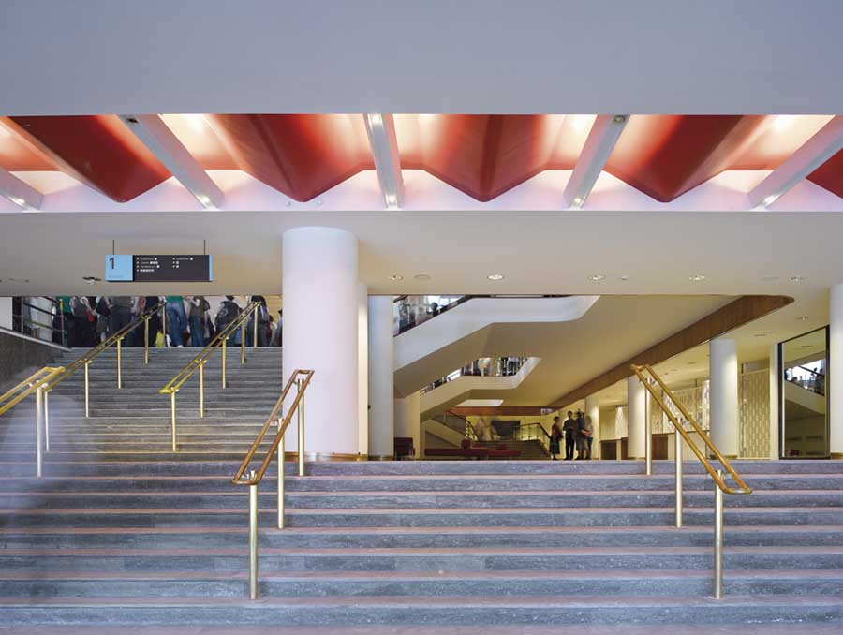
Royal Festival Hall, London, GB (1951)

Slide 17
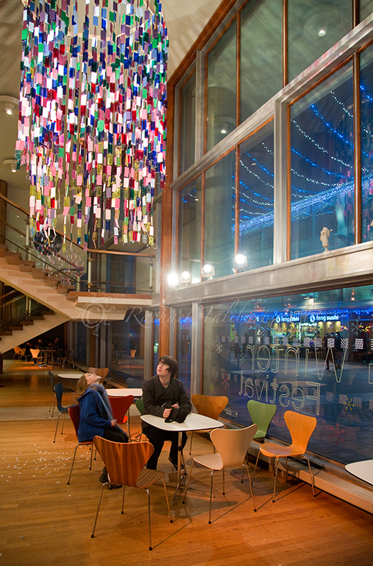
Royal Festival Hall, London, GB (1951)

Slide 18
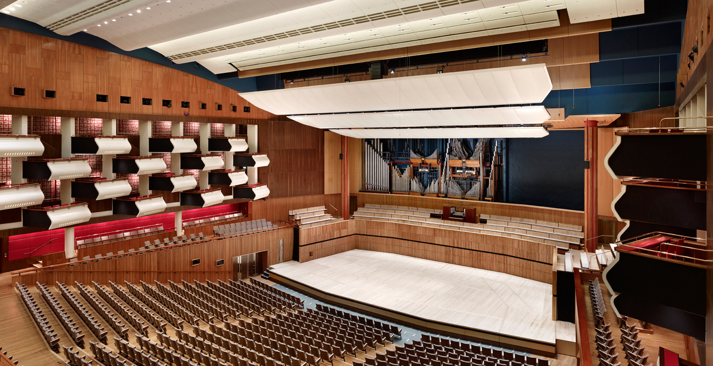
Royal Festival Hall, London, GB (1951)

Slide 19
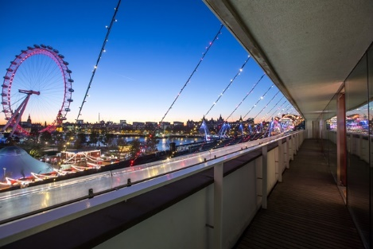
Royal Festival Hall, London, GB (1951)

Slide 20
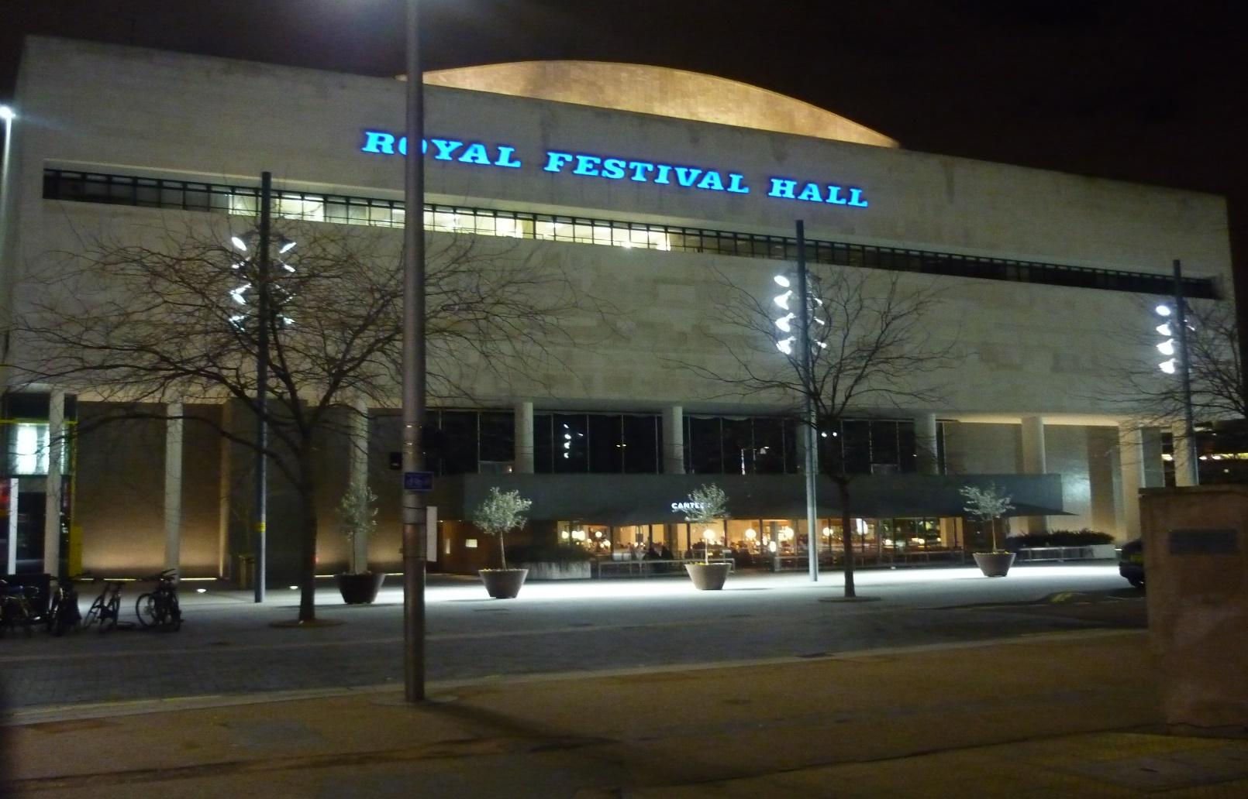
Royal Festival Hall, London, GB (1951)

Slide 21
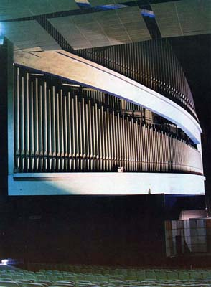
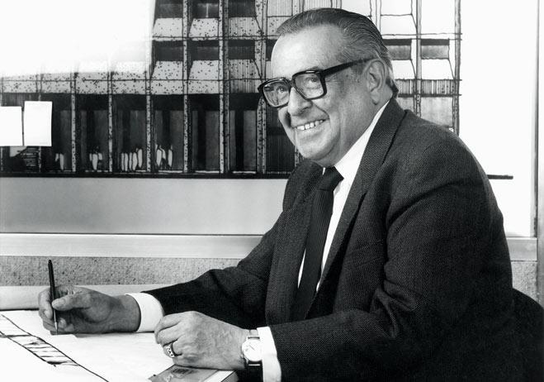
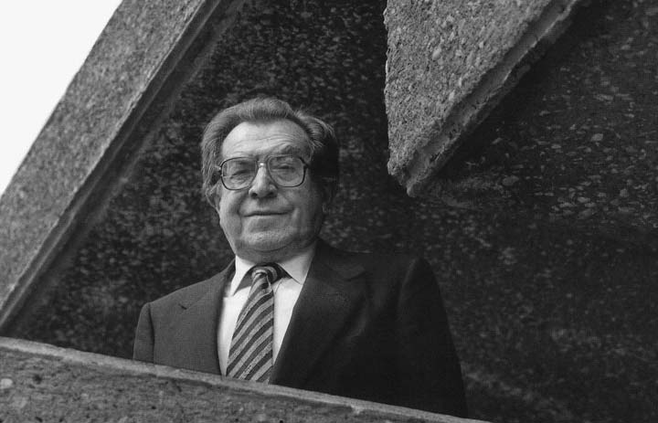
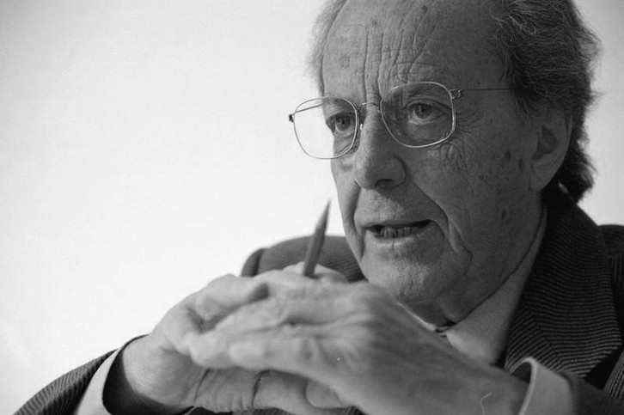
Auditorio Nacional, Mexico, MX (1952)
Abraham Zabludovsky Kraveski
Pedro Ramirez Vasquez
Teodoro Gonzales de Léon

Slide 22
Auditorio Nacional, Mexico, MX (1952)
It was designed in 1952 by Mexican architects Pedro Ramírez Vázquez and Gonzalo Ramírez del Sordo, and remodeled in 1990 by Abraham Zabludovsky and Teodoro González de León.
Initially to promote equestrian activities in a covered area, the project includes a main theatre. The iron riveted structure that was built was erected using the same technique used in the Eiffel Tower. After 18 months of work, a building capable of meeting all the requirements of the entertainment industry has emerged. With its reopening in 1991, the Auditorio Nacional has opened a new stage for concerts.

Slide 23
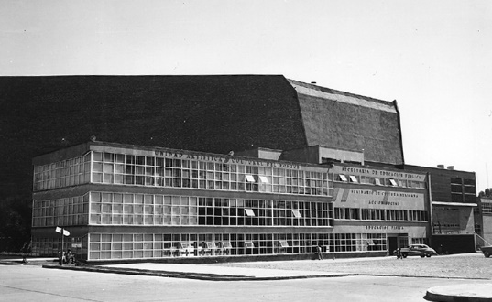
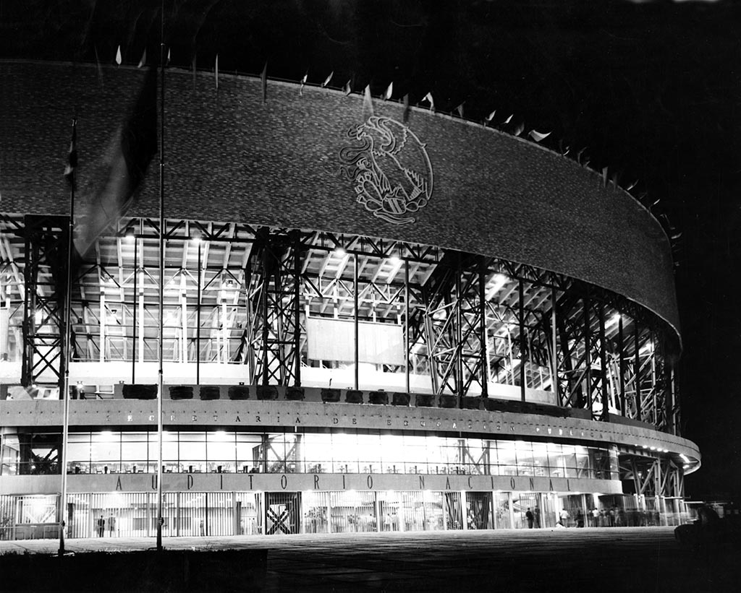
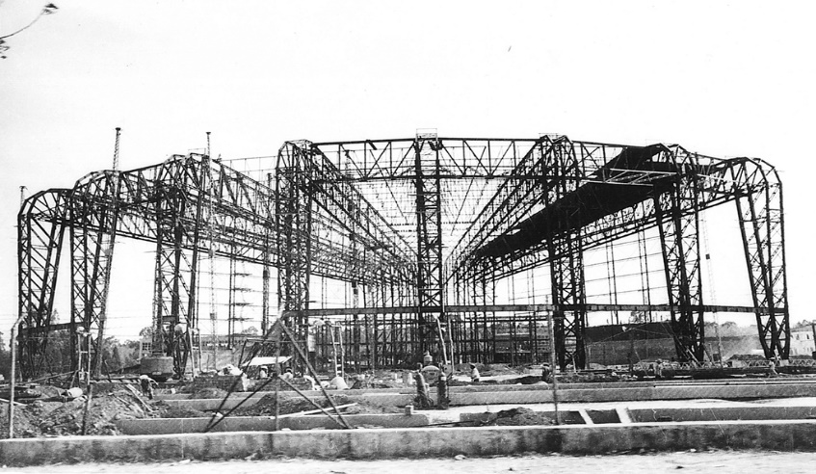
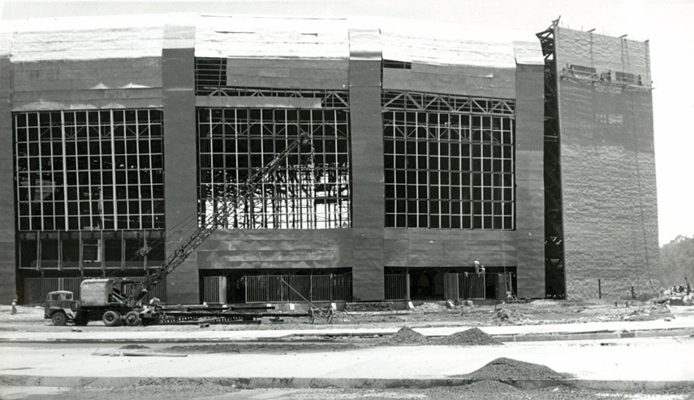
Auditorio Nacional, Mexico, MX (1952)

Slide 24
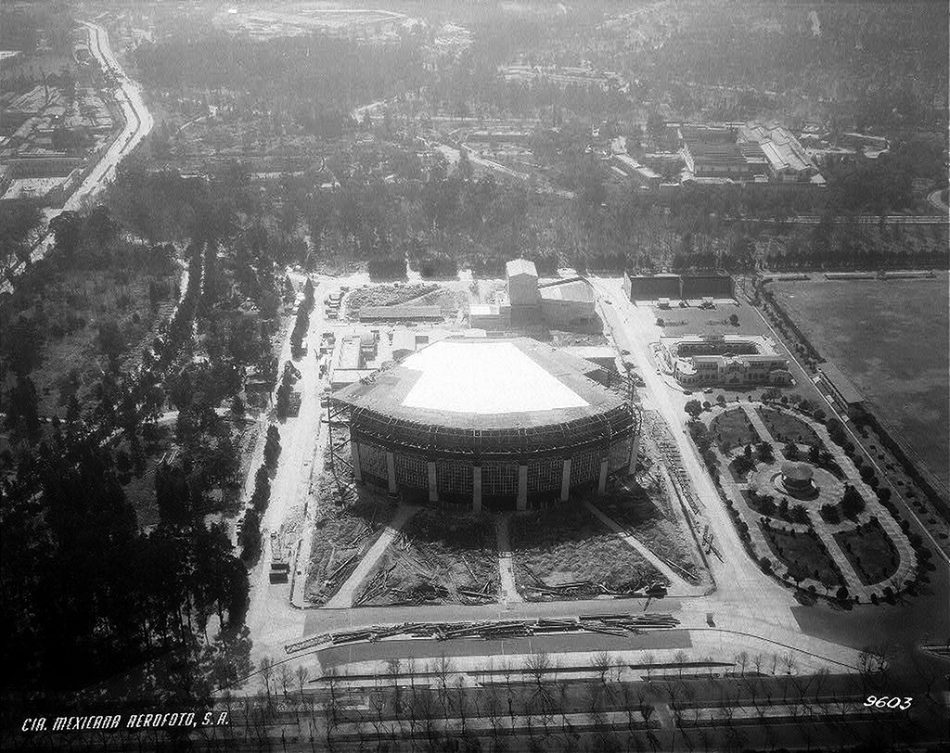
Auditorio Nacional, Mexico, MX (1952)

Slide 25
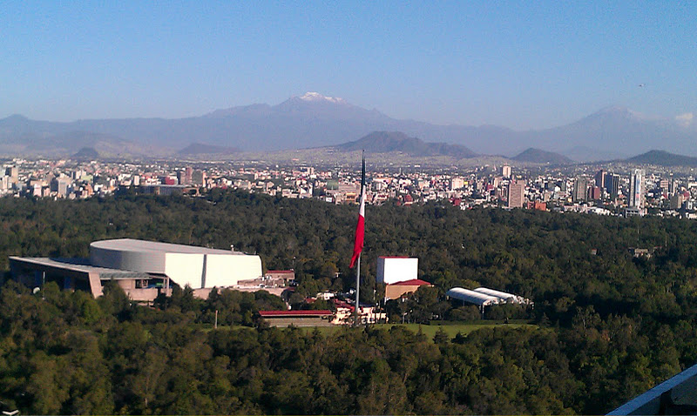
Auditorio Nacional, Mexico, MX (1952)

Slide 26
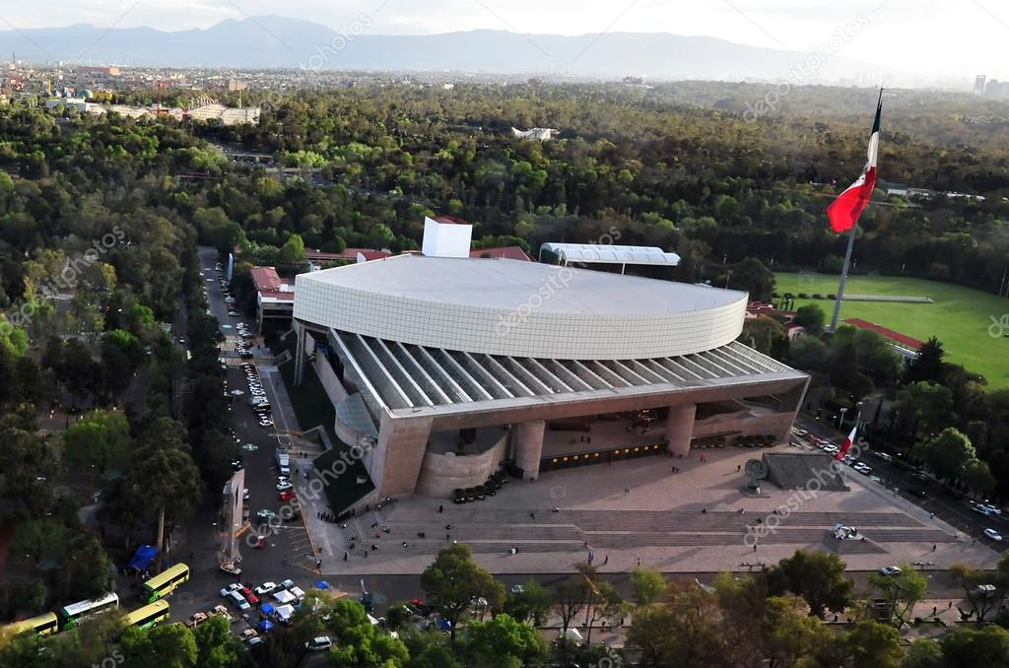
Auditorio Nacional, Mexico, MX (1952)

Slide 27
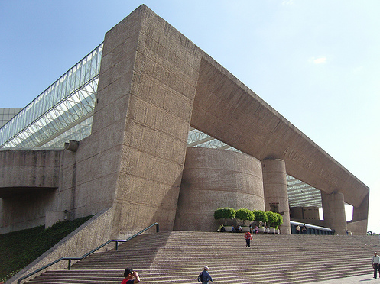
Auditorio Nacional, Mexico, MX (1952)

Slide 28
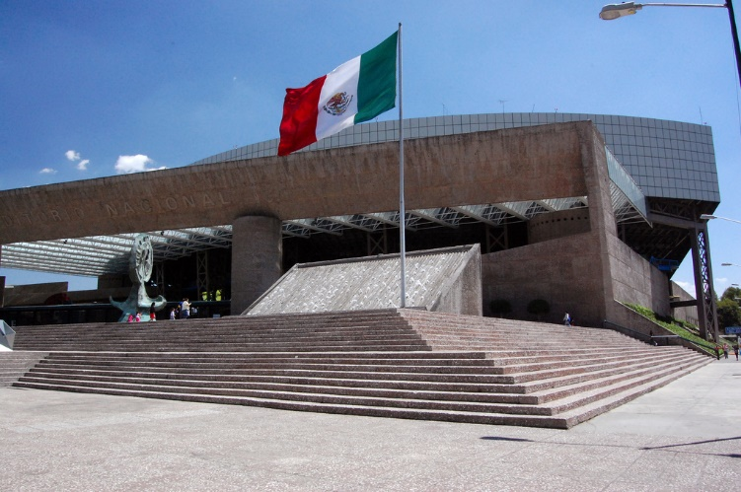
Auditorio Nacional, Mexico, MX (1952)

Slide 29
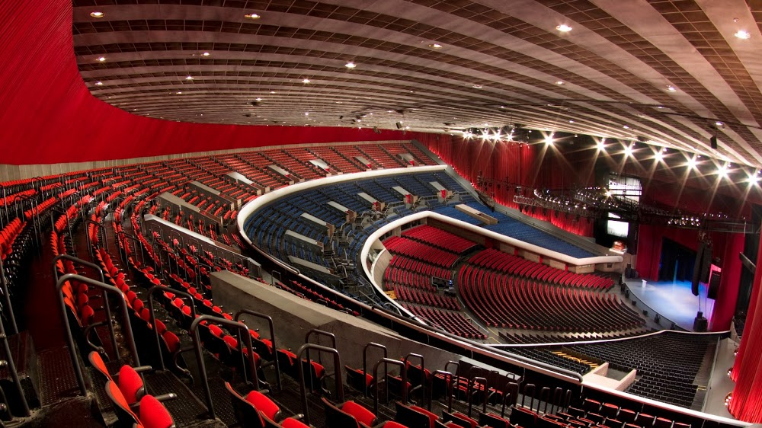
Auditorio Nacional, Mexico, MX (1952)

Slide 30
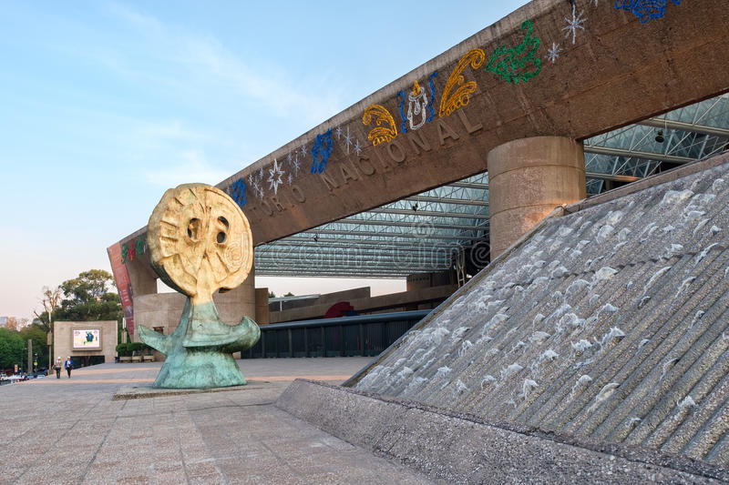
Auditorio Nacional, Mexico, MX (1952)

Slide 31
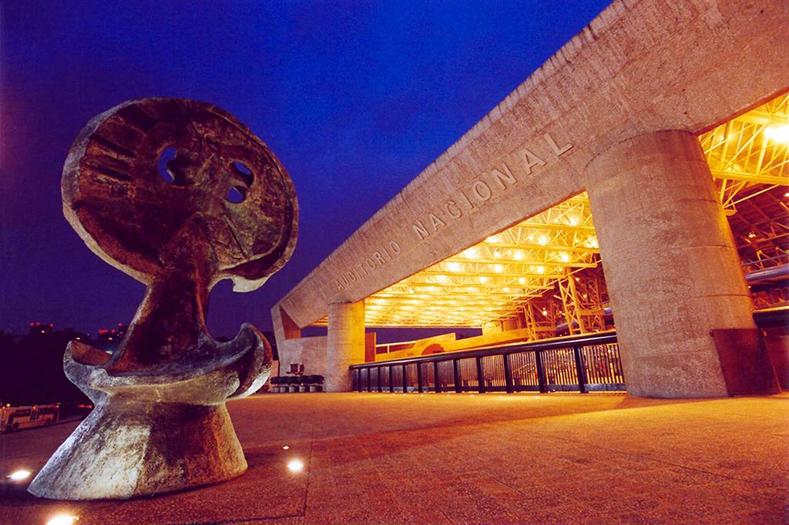
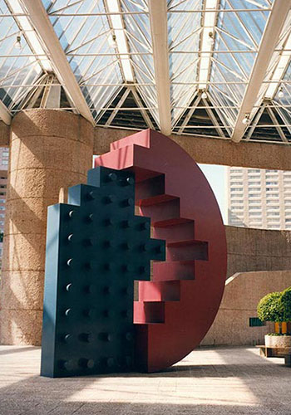
Auditorio Nacional, Mexico, MX (1952)
Juan Soriano : La Luna
Vicente Rojo : Escenario 750

Slide 32
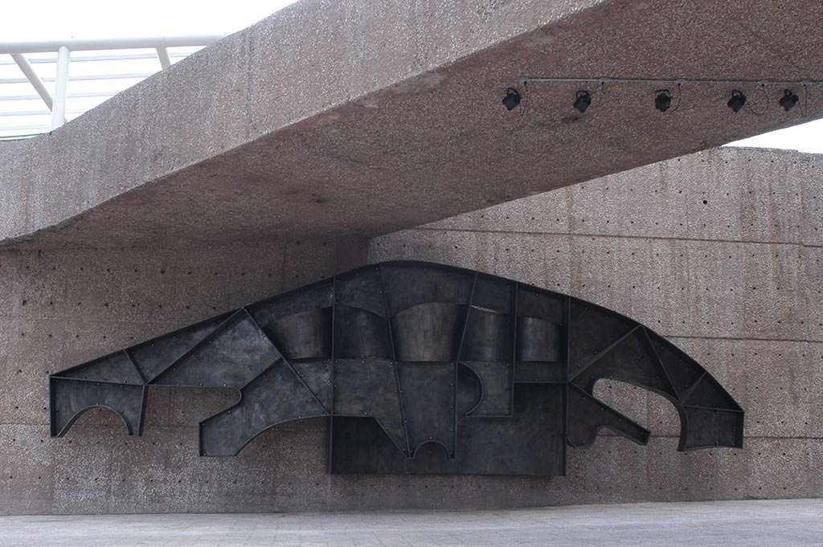
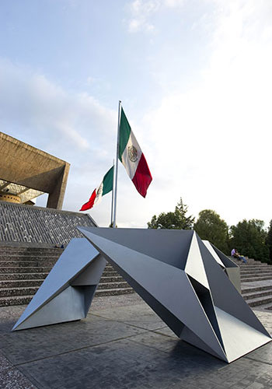
Auditorio Nacional, Mexico, MX (1952)
Manuel Felguérez : Teorema Inmóvil
Teodoro González de León :
Tres figuras áureas

Slide 33
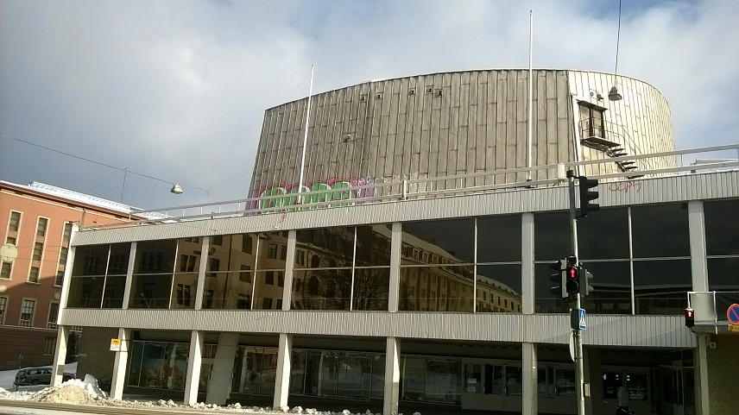
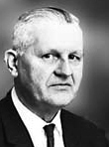
Turku Concert H., Turku, FI (1952)
R.V. Luukkonen

Slide 34
Turku Concert H., Turku, FI (1952)
The Turku Concert Hall was designed by architect Risto-Veikko Luukkonen.
It is the first hall in the country that was designed and built mainly for concert purposes. The architecture of the Concert Hall represents functionalist style, and the clean-cut building is a fine example of a successful combination of functionality and architectural planning.
There are 1002 seats in the hall designed by Luukkonen. The acoustic planning of the hall was the responsibility of special expert in acoustics, Chief Engineer Paavo Arni.

Slide 35
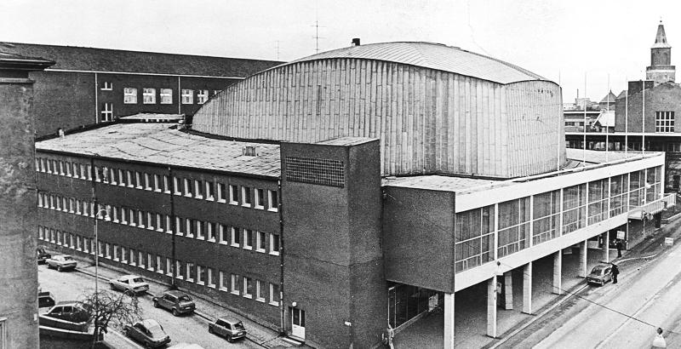
Turku Concert H., Turku, FI (1952)

Slide 36
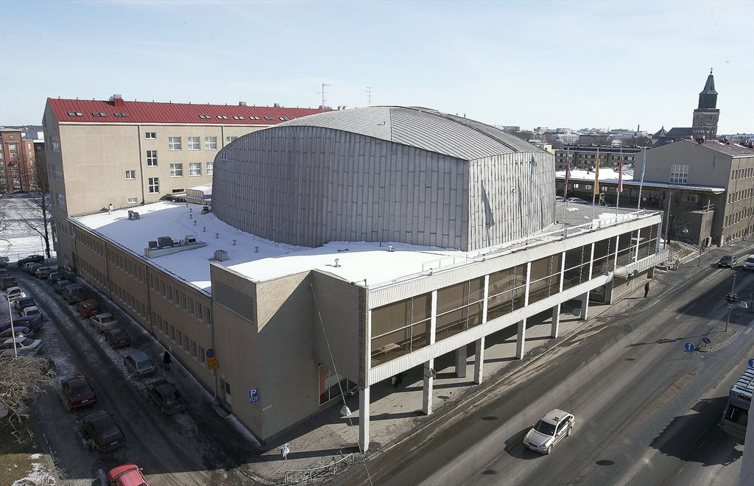
Turku Concert H., Turku, FI (1952)

Slide 37
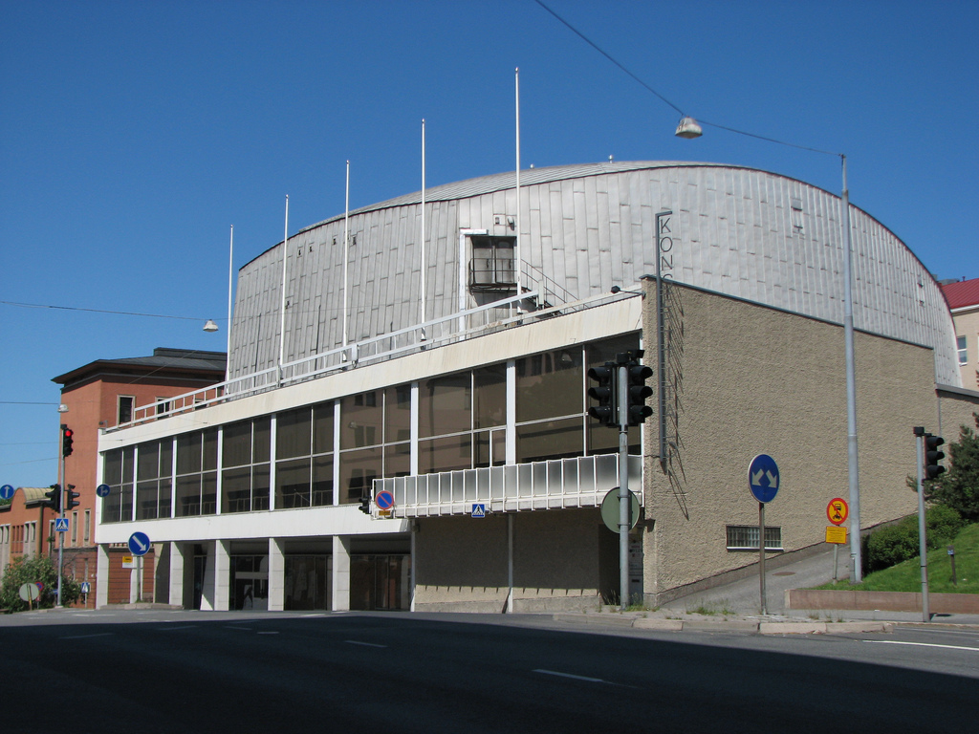
Turku Concert H., Turku, FI (1952)

Slide 38
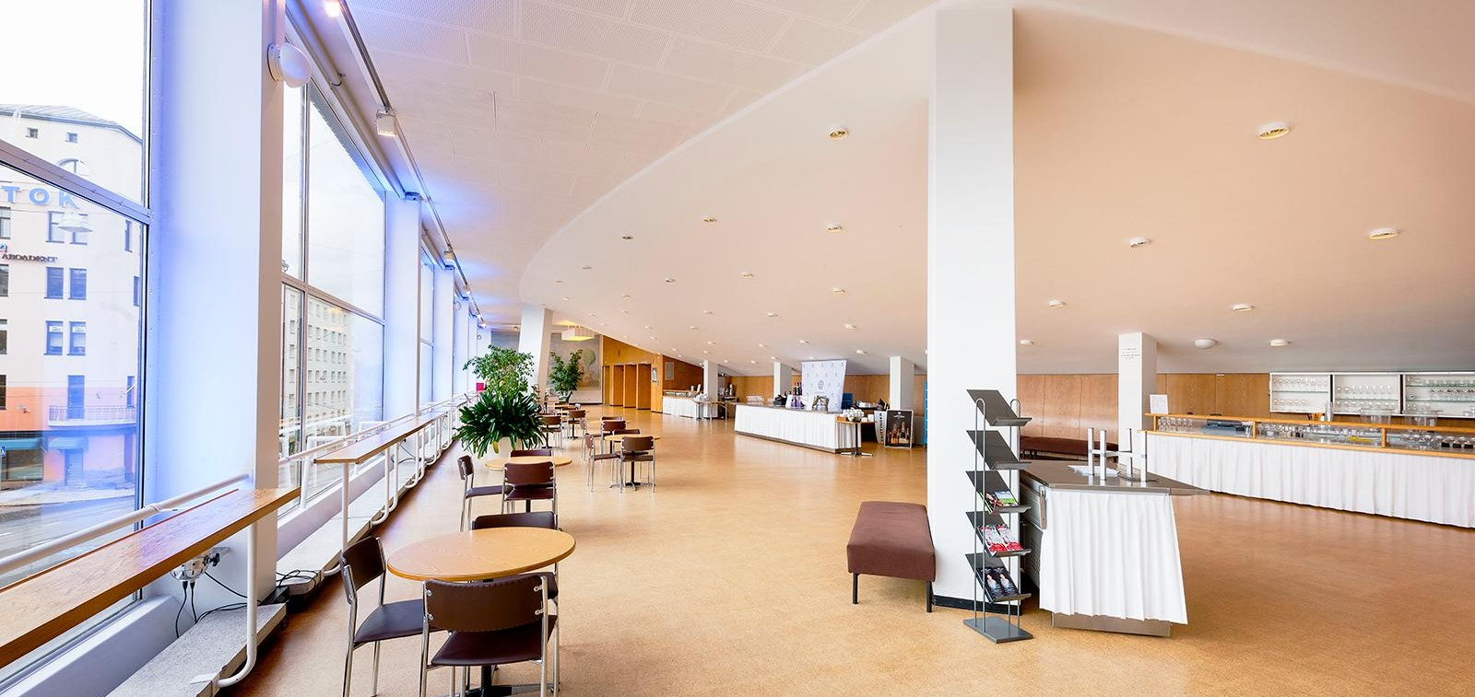
Turku Concert H., Turku, FI (1952)

Slide 39
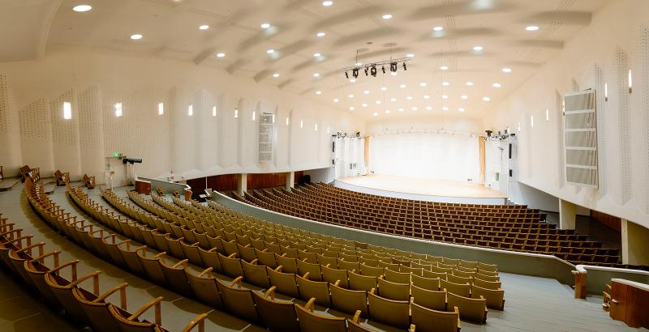
Turku Concert H., Turku, FI (1952)

Slide 40
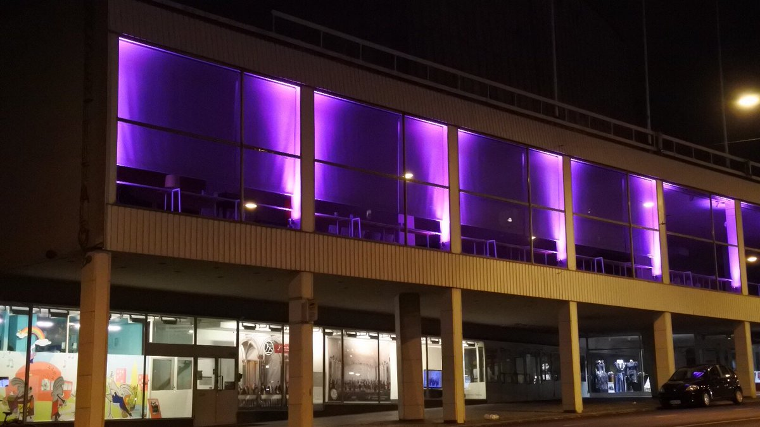
Turku Concert H., Turku, FI (1952)

Slide 41
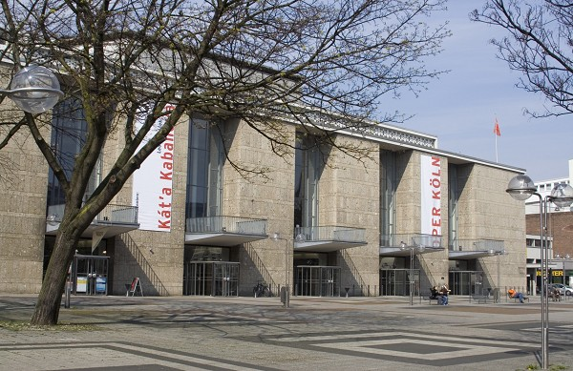
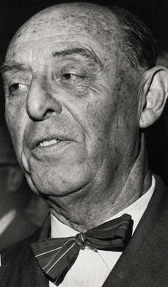
Oper Köln, Köln, DE (1957-1962)
Wilhelm Riphahn

Slide 42
Oper Köln, Köln, DE (1957-1962)
The house has a seating capacity of 1,300 and an orchestra pit which can accommodate 100 musicians. It is part of an arts complex on Offenbachplatz which includes the Schauspiel Köln (Cologne Playhouse), also designed by Wilhelm Riphahn and built in 1962.
This ensemble will be made up of four different stage houses: the opera with space for over 1,200 spectators, the theatre with around 700 seats, Kleines Haus with 200 seats, and the children’s opera also with 200 seats.
At the end of the 2009/2010 season, both theatres closed for extensive refurbishment and redevelopment.

Slide 43
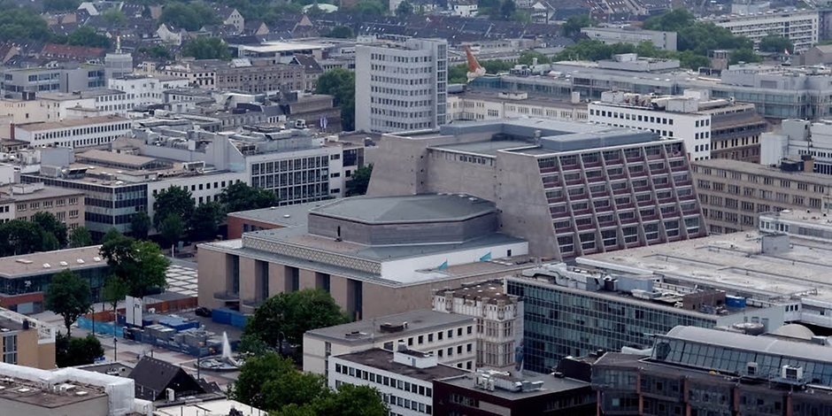
Oper Köln, Köln, DE (1957-1962)

Slide 44
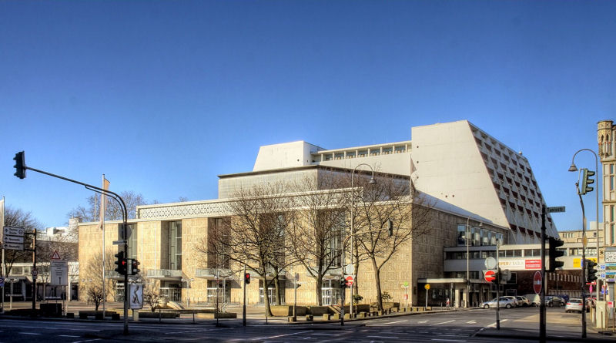
Oper Köln, Köln, DE (1957-1962)

Slide 45
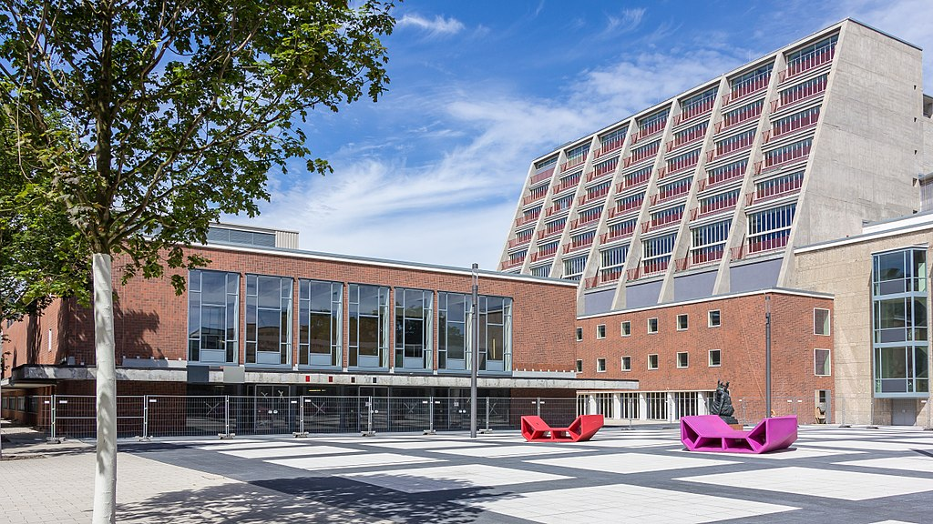
Oper Köln, Köln, DE (1957-1962)

Slide 46
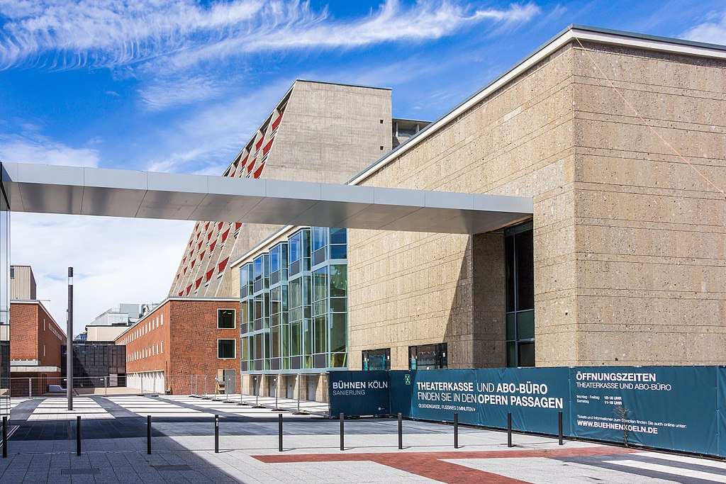
Oper Köln, Köln, DE (1957-1962)

Slide 47
Oper Köln, Köln, DE (1957-1962)

Slide 48
Oper Köln, Köln, DE (1957-1962)

Slide 49
Oper Köln, Köln, DE (1957-1962)

Slide 50
Oper Köln, Köln, DE (1957-1962)

Slide 51
Oper Köln, Köln, DE (1957-1962)

Slide 52
Oper Köln, Köln, DE (1957-1962)

Slide 53
Oper Köln, Köln, DE (1957-1962)

Slide 54
Oper Köln, Köln, DE (1957-1962)

Slide 55
Beethovenhalle, Bonn, DE (1959)
Siegfried Wolske

Slide 56
Beethovenhalle, Bonn, DE (1959)
It is the work of Siegfried Wolske.
The complex of buildings in the Beethoven Hall consists of a group of irregularly deformed cubes, with different roof slopes, arranged around the large hall topped by a cupola. The central building body is the dome, which rises like a wave of the Rhine. Its height is 25 m above the foundations. It covers the room 36 m wide and 49 m long. It is a self-supporting steel structure covered with copper.

Slide 57
Beethovenhalle, Bonn, DE (1959)
The components of the complex are separated from each other but are ordered by the dome. The centre of the complex has a non-axial asymmetrical plane. To the south of the large hall is a large 500 m2 studio on an oblique fan-shaped plan to the east and a 192 m2 large chamber music room on a trapezoidal plan to the west.
The plan shape of the room is elliptical, with curved or rectilinear cut sections in many places. The large room is covered in uniformly matt ochre wood.
The "flattened spheroidal " ceiling under the dome has a suspended surface of geometric relief bodies inside.

Slide 58
Beethovenhalle, Bonn, DE (1959)

Slide 59
Beethovenhalle, Bonn, DE (1959)

Slide 60
Beethovenhalle, Bonn, DE (1959)

Slide 61
Beethovenhalle, Bonn, DE (1959)

Slide 62
Beethovenhalle, Bonn, DE (1959)

Slide 63
Beethovenhalle, Bonn, DE (1959)

Slide 64
Beethovenhalle, Bonn, DE (1959)

Slide 65
Beethovenhalle, Bonn, DE (1959)

Slide 66
Musiktheater, Gelsenkirchen, DE (1959)
Werner Ruhnau

Slide 67
Musiktheater, Gelsenkirchen, DE (1959)
Built under the direction of architect and urban planner Werner Ruhnau, the complex comprises two halls, the Grande (1004 seats and a stage area of 450 m²) and the Petite Maison ( 336 seats and a stage area of 180 m²).
The base, covered with black tiles, supports the Grande Maison. The south façade is largely dissolved in glass surfaces. The vertical glass façade is divided by white profiles, behind which are the supports that are not visible from the outside. Black bars divide the glass façade horizontally.

Slide 68
Musiktheater, Gelsenkirchen, DE (1959)
The platforms and stairs are symmetrical. At the heart of the Grande Maison are the glass half cylinder and the stage house. The interior of the Grande Maison is divided into 3 floors. In the podium area under the glass façade are symmetrically arranged changing rooms, on the end walls of which is suspended a sponge relief by the French artist Yves Klein.
In the foyer, the floor is covered with Sauerland slate grey Kattenfels and the ceiling is covered with black plaster absorbing sounds. In the auditorium, the ceiling is black, just like the wall.

Slide 69
Musiktheater, Gelsenkirchen, DE (1959)
La Petite Maison forms a counterpoint to the main building.
Natural dark grey stone slabs decorate the exterior wall of the Petite Maison. On the south wall is hung the large relief of steel tubes grouped on two levels by Norbert Kricke. A glass wall is also visible from the west side.
The concrete relief (3 × 22 m) on the outer wall of the counter hall was designed by the English sculptor Robert Adams.

Slide 70
Musiktheater, Gelsenkirchen, DE (1959)

Slide 71
Musiktheater, Gelsenkirchen, DE (1959)

Slide 72
Musiktheater, Gelsenkirchen, DE (1959)

Slide 73
Musiktheater, Gelsenkirchen, DE (1959)

Slide 74
Musiktheater, Gelsenkirchen, DE (1959)

Slide 75
Musiktheater, Gelsenkirchen, DE (1959)

Slide 76
Musiktheater, Gelsenkirchen, DE (1959)

Slide 77
Musiktheater, Gelsenkirchen, DE (1959)

Slide 78
Musiktheater, Gelsenkirchen, DE (1959)

Slide 79
Musiktheater, Gelsenkirchen, DE (1959)

Slide 80
Musiktheater, Gelsenkirchen, DE (1959)
Robert Adams
Norbert Kricke

Slide 81
Deutsche Oper, Berlin, DE (1961)
Fritz Bornemann

Slide 82
Deutsche Oper, Berlin, DE (1961)
Architect Fritz Bornemann designed a massive exterior wall at the six-lane Bismarckstraße, on which the building is located. The wall completely protects the auditorium from street noise. The supporting effect of this main façade allows bare glass side facades and stairs without columns, which aims at lightness and transparency.
The auditorium is not a horseshoe-shaped U-shaped theatre, but rather wide and slightly curved, with cantilevered balconies.
The excellent sightlines and acoustic properties afford a musical theatre of exceptional status that almost 2000 visitors can experience every night.

Slide 83
Deutsche Oper, Berlin, DE (1961)

Slide 84
Deutsche Oper, Berlin, DE (1961)

Slide 85
Deutsche Oper, Berlin, DE (1961)

Slide 86
Deutsche Oper, Berlin, DE (1961)

Slide 87
Deutsche Oper, Berlin, DE (1961)

Slide 88
Deutsche Oper, Berlin, DE (1961)

Slide 89
Deutsche Oper, Berlin, DE (1961)

Slide 90
Deutsche Oper, Berlin, DE (1961)

Slide 91
Deutsche Oper, Berlin, DE (1961)

Slide 92
Deutsche Oper, Berlin, DE (1961)

Slide 93
Deutsche Oper, Berlin, DE (1961)

Slide 94
Théâtre, Caen, FR (1961)
Alain Bourbonnais
François Carpentier

Slide 95
Théâtre, Caen, FR (1961)
It is the work of Alain Bourbonnais & François Carpentier.
The room, with its two semi-circular balconies, is inspired by and retains the spirit of the "Italian-style theatres" whose horseshoe-shaped form it takes, the evolution of construction techniques allowing in this configuration the inclination of the parterre and the suppression of the colonnades at the edge of the balconies.
The main entrance is enlarged to let in more natural light. In the evening, a large Teflon awning, stretched outwards, reflects an artificial light to create a luminous halo, designed as an invitation to enter the halls.

Slide 96
Théâtre, Caen, FR (1961)
The room sees the installation of a unique lighting in Europe. Using an optical fiber process, more than 1,060 light points - as many as chairs - scatter the original ceiling (which has been kept and repainted in a dark color) and give the illusion of a starry sky.
The façade, treated in depth, has lost its false aspect of Caen stone to the benefit of the beige of Etavaux, the color of the gravel of the Etavaux quarry (near Saint-André-sur-Orne).

Slide 97
Théâtre, Caen, FR (1961)

Slide 98
Théâtre, Caen, FR (1961)

Slide 99
Théâtre, Caen, FR (1961)

Slide 100
Théâtre, Caen, FR (1961)

Slide 101
Philarmonic Conc. H., Berlin, DE (1963)
Hans Scharoun

Slide 102
Philarmonic Conc. H., Berlin, DE (1963)
Herbert Von Karajan (Left) Hans Scharoun (Center)
Edgar Wisniewski

Slide 103
Philarmonic Conc. H., Berlin, DE (1963)
The Berlin Philharmonic (Berliner Philharmonie), including a symphonic concert hall designed by Hans Scharoun and inaugurated in 1963, and a chamber music hall designed by Edgar Wisniewski after a Scharoun project and inaugurated in 1987.
The large hall is a kind of pentagon-shaped capital, 60 meters wide and 50 meters deep. In the center is the podium, itself in the shape of a slightly crushed pentagon; the spectators are set up around it in several groups of steps that rise towards the walls. The layout is asymmetrical and irregular, as if it were the product of nature, and should even evoke a valley with vineyard terraces.

Slide 104
Philarmonic Conc. H., Berlin, DE (1963)
Moreover, many of the "terraces" are not exactly horizontal and lean slightly, which shows the importance of the maritime universe in the work of Scharoun, a native of Bremen; this is also found in the color of the walls, in very dark ochre wood, which evokes those of a cabin on board a ship.
The hall has 2440 seats: about 1300 in front of the orchestra, 270 behind, 300 on each side, and about 200 on the podium itself.
At the place of the windows, sections of walls with hundreds of small holes let the light pass through according to a gradation of colors, warm in the North and cold in the South.

Slide 105
Philarmonic Conc. H., Berlin, DE (1963)
The chamber music room (Kammermusiksaal) is designed according to the same principle as the large room, in obviously smaller dimensions. While the shape of the large hall derives from a pentagon, its own is hexagonal: the stage is a hexagon, and two series of steps extend from each side to the partition.
The foyers of the large hall and the chamber music room, which are in fact a large hall, also illustrate the principles of organic architecture.

Slide 106
Philarmonic Conc. H., Berlin, DE (1963)

Slide 107
Philarmonic Conc. H., Berlin, DE (1963)

Slide 108
Philarmonic Conc. H., Berlin, DE (1963)

Slide 109
Philarmonic Conc. H., Berlin, DE (1963)
Berliner Philharmonie

Slide 110
Philarmonic Conc. H., Berlin, DE (1963)

Slide 111
Philarmonic Conc. H., Berlin, DE (1963)

Slide 112
Philarmonic Conc. H., Berlin, DE (1963)

Slide 113
Philarmonic Conc. H., Berlin, DE (1963)

Slide 114
Philarmonic Conc. H., Berlin, DE (1963)

Slide 115
Philarmonic Conc. H., Berlin, DE (1963)

Slide 116
Philarmonic Conc. H., Berlin, DE (1963)

Slide 117
Philarmonic Conc. H., Berlin, DE (1963)

Slide 118
Philarmonic Conc. H., Berlin, DE (1963)

Slide 119
Philarmonic Conc. H., Berlin, DE (1987)
Kammermusiksaal

Slide 120
Philarmonic Conc. H., Berlin, DE (1987)

Slide 121
Philarmonic Conc. H., Berlin, DE (1963)

Slide 122
Philarmonic Conc. H., Berlin, DE (1987)

Slide 123
Philarmonic Conc. H., Berlin, DE (1987)

Slide 124
Grand Théâtre, Luxembourg, LU (1964)
Alain Bourbonnais

Slide 125
Grand Théâtre, Luxembourg, LU (1964)
In December 1958, after the need for a properly designed theatre building had become a priority, a competition was launched with a view to completing the construction work for the millennium celebrations in 1963. The winner was Alain Bourbonnais, a Parisian architect.
The theatre consists of 2 auditoriums: the main theatre with 943 seats and the studio which has up to 400 seats but can be compartmentalized.
The theatre can be seen as a monolithic block, which by the geometric patterns also resembles a beehive.

Slide 126
Grand Théâtre, Luxembourg, LU (1964)

Slide 127
Grand Théâtre, Luxembourg, LU (1964)

Slide 128
Grand Théâtre, Luxembourg, LU (1964)

Slide 129
Grand Théâtre, Luxembourg, LU (1964)

Slide 130
Grand Théâtre, Luxembourg, LU (1964)

Slide 131
Grand Théâtre, Luxembourg, LU (1964)

Slide 132
Grand Théâtre, Luxembourg, LU (1964)

Slide 133
Grand Théâtre, Luxembourg, LU (1964)

Slide 134
Opernhaus, Dortmund, DE (1966)

Slide 135
Opernhaus, Dortmund, DE (1966)
It is the work of the architects Heinrich Rosskotten and Edgar Tritthart.
The design separates the functions of the stage and technical areas in the Bühnenhaus (stage house), which is dominated by straight lines, from the auditorium under a thin-shell structure roof.
The main motif that characterizes the auditorium is a 17-m-high concrete shell that is supported at only three points and seems to shimmer through a partly-glassed base construction with an area of some 1,800 sqm.

Slide 136
Opernhaus, Dortmund, DE (1966)

Slide 137
Opernhaus, Dortmund, DE (1966)

Slide 138
Opernhaus, Dortmund, DE (1966)

Slide 139
Opernhaus, Dortmund, DE (1966)

Slide 140
Opernhaus, Dortmund, DE (1966)

Slide 141
Opernhaus, Dortmund, DE (1966)

Slide 142
Opernhaus, Dortmund, DE (1966)

Slide 143
Opernhaus, Dortmund, DE (1966)

Slide 144
Opernhaus, Dortmund, DE (1966)

Slide 145
Cent. Concert H., Winnipeg, CA (1968)
Leslie Russell, Cecil Blankstein, Lawrence Green
D. Carter
H. Moody
C. Blankstein

Slide 146
Cent. Concert H., Winnipeg, CA (1968)
It is the work of Green, Blankstein, Russell Assoc., Moody, Moore, Whenham & Partners, Smith, Carter, Searle Associates.
The exterior design presents a balance of orthogonal lines and angles, glass and masonry, light cream and dark charcoal tones. The building’s coloration complements and parallels those of the Winnipeg City Hall across the street, which also features Tyndall stone and deep grey masonry.
The theatre itself seats 2,305 and has a proscenium stage 24 meters wide, 12 meters deep and over 33 meters tall which can accommodate a full orchestra and a choir of 700.

Slide 147
Cent. Concert H., Winnipeg, CA (1968)
This elevation is anchored on its north and south ends by two tall Tyndall stone towers which project above the roof-line. Perhaps the most distinctive element of the façade is the set of forty-five eyelid-like concrete window covers. These unique, sun-shading awnings, with their origami-like folds, are an example of the modernist exploitation of the plastic possibilities of concrete, here by means of linked sections of pre-cast material.
Flanking this section are two enormous three-storey windows, which cast light upon the dramatic multi-level floating staircases inside.

Slide 148
Cent. Concert H., Winnipeg, CA (1968)
The entrance to the building is sheltered by a large five-section canopy built of a cream-toned concrete matching the awnings above. This detail is suspended by six simple columns which, given their dark tone and recessed placement, cause them to nearly vanish from sight and thus lend the heavy canopy a floating quality.
Beyond the dramatic awnings, perhaps the most notable element of the Concert Hall’s front facade are the glass pyramidal forms which sit between segments of this canopy and whose sharply projecting shapes adds an energetic rhythm to the overall structure.

Slide 149
Cent. Concert H., Winnipeg, CA (1968)
The ground level features large windows which link the interior corridors to the urban exterior. Pilasters continue from this level to the top of the building, holding between them two-storey windows cradled on their sides by Tyndall stone frames which angle inward.
The back section of the building, which holds the stage and associated areas, is clad in large expanses of Tyndall stone and is capped with the hall’s striking, tan-coloured, angled roof.

Slide 150
Cent. Concert H., Winnipeg, CA (1968)

Slide 151
Cent. Concert H., Winnipeg, CA (1968)

Slide 152
Cent. Concert H., Winnipeg, CA (1968)

Slide 153
Cent. Concert H., Winnipeg, CA (1968)

Slide 154
Cent. Concert H., Winnipeg, CA (1968)

Slide 155
Cent. Concert H., Winnipeg, CA (1968)

Slide 156
Cent. Concert H., Winnipeg, CA (1968)

Slide 157
Cent. Concert H., Winnipeg, CA (1968)

Slide 158
Cent. Concert H., Winnipeg, CA (1968)

Slide 159
Cent. Concert H., Winnipeg, CA (1968)

Slide 160
Finlandia Hall, Helsinski, FI (1971)
Alvar Aalto

Slide 161
Finlandia Hall, Helsinski, FI (1971)
It was designed by Alvar Aalto.
The main feature of the Finlandia Hall building is a tower like section with a sloping roof. Alvar Aalto’s idea behind the design was that a high empty space would provide better acoustics.
A center mass, clad in Carrara marble organized in a vertical running bond, rises spire like from the building. The tallest volume of the composition provides an acoustical plenum over a 1,700-seat auditorium, a space that manages to be intimate, monumental, and informal all at the same time.

Slide 162
Finlandia Hall, Helsinski, FI (1971)
The interior design of the building is a tribute to detail. The design of each lamp, piece of furniture, panel, flooring material and decorative board reflects the mature approach resulting from Aalto’s long career as an architect.
The commonality of the project comes from the building's material expression, as the prevalent use of the white Carrara marble not only becomes a contrasting element to the black granite interior, but more importantly generates an influential link to Mediterranean classicism culture.

Slide 163
Finlandia Hall, Helsinski, FI (1971)

Slide 164
Finlandia Hall, Helsinski, FI (1971)

Slide 165
Finlandia Hall, Helsinski, FI (1971)

Slide 166
Finlandia Hall, Helsinski, FI (1971)

Slide 167
Finlandia Hall, Helsinski, FI (1971)

Slide 168
Finlandia Hall, Helsinski, FI (1971)

Slide 169
Finlandia Hall, Helsinski, FI (1971)

Slide 170
Finlandia Hall, Helsinski, FI (1971)

Slide 171
Finlandia Hall, Helsinski, FI (1971)

Slide 172
Finlandia Hall, Helsinski, FI (1971)

Slide 173
Finlandia Hall, Helsinski, FI (1971)

Slide 174
Finlandia Hall, Helsinski, FI (1971)

Slide 175
Finlandia Hall, Helsinski, FI (1971)

Slide 176
Finlandia Hall, Helsinski, FI (1971)

Slide 177
Finlandia Hall, Helsinski, FI (1971)

Slide 178
Finlandia Hall, Helsinski, FI (1971)

Slide 179
Finlandia Hall, Helsinski, FI (1971)

Slide 180
Finlandia Hall, Helsinski, FI (1971)

Slide 181
Sidney Opera H., Sidney, AU (1973)
Peter Hall
Jorn Utzon

Slide 182
Sidney Opera H., Sidney, AU (1973)
It is the work of the Danish architect Jorn Utzon.
This iconic building has become the symbol of Sidney and Australia.
Several challenges were met during its construction: first of all, its location on loose alluvial deposits impregnated with seawater (instead of the planned Hawkesbury sandstone); some 700 steel concrete wells, each 1 meter in diameter, were drilled in the perimeter and in the northern half of the site. Mass concrete foundations filled the unstable rock in the central zone.

Slide 183
Sidney Opera H., Sidney, AU (1973)
The second major problem was the still unknown weight of the roof: the single span concrete beams, 49 m long, are visible under the monumental steps.
The sculptural shape of the building is organized in 2 series of 3 partially overlapping shells: the shells of the roof are obtained from 1/4 of a single sphere with a diameter of 75 m, supported by curved concrete ribs, composed of lattice elements welded and installed one after the other.

Slide 184
Sidney Opera H., Sidney, AU (1973)
The rafters, supports of the shells, come from the same sphere, allowing the use of symmetrical and repetitive structural elements, and explains the reproducibility of the tiles, all identical. After three years of testing, the 1,056,006 white ceramic tiles are produced by Höganäs in Sweden.
The interior decoration is made of pink granite extracted from the quarries of Tarana (N. South Wales).The building was completed by Australian architect Peter Hall following the resignation of Jorn Utzon.

Slide 185
Sidney Opera H., Sidney, AU (1973)

Slide 186
Sidney Opera H., Sidney, AU (1973)

Slide 187
Sidney Opera H., Sidney, AU (1973)

Slide 188
Sidney Opera H., Sidney, AU (1973)

Slide 189
Sidney Opera H., Sidney, AU (1973)

Slide 190
Sidney Opera H., Sidney, AU (1973)

Slide 191
Sidney Opera H., Sidney, AU (1973)

Slide 192
Perth Concert Hall, Perth, AU (1973)
Don Bailey
Jefferey Howlett

Slide 193
Perth Concert Hall, Perth, AU (1973)
Perth Concert Hall was designed by architects Jefferey Howlett and Don Bailey.
It is an example of brutalist architecture, with its solid opaque interior, giant projecting roof, and use of white off-form concrete.
The main auditorium of the hall seats 1,729 people, as well as a 160-person choir gallery and a 3000-pipe organ.
Acoustically, the venue is considered one of the best in Australia, with the design overseen by the New Zealand acoustician Sir Harold Marshall.

Slide 194
Perth Concert Hall, Perth, AU (1973)

Slide 195
Perth Concert Hall, Perth, AU (1973)

Slide 196
Perth Concert Hall, Perth, AU (1973)

Slide 197
Perth Concert Hall, Perth, AU (1973)

Slide 198
Perth Concert Hall, Perth, AU (1973)

Slide 199
Perth Concert Hall, Perth, AU (1973)

Slide 200
Perth Concert Hall, Perth, AU (1973)

Slide 201
Perth Concert Hall, Perth, AU (1973)

Slide 202
Bruckner Haus, Linz, AT (1974)
Kaija and Heikki Siren

Slide 203
Bruckner Haus, Linz, AT (1974)
The building was designed by Finnish architects Heikki and Kaija Siren.
Bruckner Haus has 2 halls : large (Brucknersaal) : 1,420 seats, middle (Stiftersaal) : 352 seats.
The special acoustics of the large hall are made up by the wood cladding. The wood thickness is at least 6 cm and the different structure of the wood directs the sound. In addition, the sound is distributed by hanging aprons. The reverberation time of 1.7 seconds is also an impressive reference for a modern concert hall.
A special eye-catcher of the Middle Hall is the hand-woven carpet of the Korean artist Anne Tredjan - a work of art on the back of the theater, measuring 42m2 and a state weight of 350kg.

Slide 204
Bruckner Haus, Linz, AT (1974)

Slide 205
Bruckner Haus, Linz, AT (1974)

Slide 206
Bruckner Haus, Linz, AT (1974)

Slide 207
Bruckner Haus, Linz, AT (1974)

Slide 208
Bruckner Haus, Linz, AT (1974)
Brucknersaal

Slide 209
Bruckner Haus, Linz, AT (1974)
Stiftersaal

Slide 210
Bruckner Haus, Linz, AT (1974)

Slide 211
Opera House, Vilnius, LT (1974)
Elena Nijolė Bučiūtė

Slide 212
Opera House, Vilnius, LT (1974)
It is the work of Elena Nijolė Bučiūtė.
The theatre in Vilnius was inspired by architecture typical of Catholic churches: the upbeat atmosphere of the opera reminded the architect of the atmosphere close to that of a Catholic festive procession. The theatre composition implemented in the form of a glazed parallelepiped with a massive stage box over it can be called a fairly standard solution for late Soviet architecture; however, we can still see re-examined motives of church architecture (one of the facades is decorated with red brick).
In the theatre interior the architect also tried to infuse the solemn characteristic of Catholic Church service by means of shiny copper surfaces, muted light, lush chandeliers, simple playfulness of yellow glass & brass.

Slide 213
Opera House, Vilnius, LT (1974)

Slide 214
Opera House, Vilnius, LT (1974)

Slide 215
Opera House, Vilnius, LT (1974)

Slide 216
Opera House, Vilnius, LT (1974)

Slide 217
Opera House, Vilnius, LT (1974)

Slide 218
Opera House, Vilnius, LT (1974)

Slide 219
Opera House, Vilnius, LT (1974)

Slide 220
Opera House, Vilnius, LT (1974)

Slide 221
Opera House, Vilnius, LT (1974)

Slide 222
Opera House, Vilnius, LT (1974)

Slide 223
Badisches Staatst., Karlsruhe, DE (1975)
Helmüt Batzner

Slide 224
Badisches Staatst., Karlsruhe, DE (1975)
It is the work of Helmüt Batzner.
It contains : the Große Haus with 1000 seats and the Kleine Haus with 385 seats.
The architecture of the existing 20,000m2 building is expressionistic, composed as a series of strata culminating in the sloped form of the fly tower, epitomizes the aesthetic of mid-1970s major cultural buildings. Internally the main 1000 seat theatre is a dramatic asymmetric space and the foyers combine as a series of interlocked spaces and decks which create a complex layered landscape through which the multiple stair clusters are threaded.

Slide 225
Badisches Staatst., Karlsruhe, DE (1975)

Slide 226
Badisches Staatst., Karlsruhe, DE (1975)

Slide 227
Badisches Staatst., Karlsruhe, DE (1975)

Slide 228
Badisches Staatst., Karlsruhe, DE (1975)

Slide 229
Badisches Staatst., Karlsruhe, DE (1975)

Slide 230
Royal Nat. Theatre, London, GB (1976)
Sir Denys Lasdun

Slide 231
Royal Nat. Theatre, London, GB (1976)
It was designed by Sir Denys Lasdun.
The exterior form of the of the building is dominated by the fly towers for the Open Theatre and the proscenium theatre. These two vertical features are connected by horizontal bands of outdoor terraces that stretch across the width of the site, which Lasdun referred to as “strata.”
The open-stage theatre, the Olivier, named after the theatre's first artistic director, Laurence Olivier, is shaped like a giant ancient amphitheater and occupies a large area away from the bridge that runs along one side of the site, while the smaller Proscenium theatre, with an arch over the stage, sits on the bridge.

Slide 232
Royal Nat. Theatre, London, GB (1976)
The multifaceted fly tower for the Open Theatre, the taller of the two, is oriented 45 degrees from the orthogonal grid of the rest of the structure, in conversation with both the Waterloo Bridge to the west, and Somerset House across the river to the north.
The horizontality is further reinforced through the dark shadows created by the deeply recessed glass facades at each level. The strata are only interrupted by two smaller sets of double towers that serve as vertical circulation, and as an indication of the main entrance.

Slide 233
Royal Nat. Theatre, London, GB (1976)
The formal language extends to the interior, where the terrace strata transform into theatre balconies. Even the board-form concrete extends to the interior of the theatres, where the textures are exaggerated to baffle sound.
The Historic Buildings and Monuments Commission for England gave the National Theatre building a Grade II heritage listing in 1994, only 18 years after it was completed.

Slide 234
Royal Nat. Theatre, London, GB (1976)

Slide 235
Royal Nat. Theatre, London, GB (1976)

Slide 236
Royal Nat. Theatre, London, GB (1976)

Slide 237
Royal Nat. Theatre, London, GB (1976)
Axis view of Royal National Theatre to Olivier Theatre fly tower

Slide 238
Royal Nat. Theatre, London, GB (1976)

Slide 239
Royal Nat. Theatre, London, GB (1976)

Slide 240
Royal Nat. Theatre, London, GB (1976)

Slide 241
Royal Nat. Theatre, London, GB (1976)

Slide 242
Royal Nat. Theatre, London, GB (1976)

Slide 243
Royal Nat. Theatre, London, GB (1976)

Slide 244
Royal Nat. Theatre, London, GB (1976)

Slide 245
Aarhus Concert H., Aarhus, DK (1982)
C.F. Moller
Johan Richter

Slide 246
Aarhus Concert H., Aarhus, DK (1982)
Aarhus Concert Hall was designed by Kjær & Richter.
A lofty 2,000 m² foyer with glass facades on three sides, leads into an anteroom and then into the main auditorium of Store Sal (Large Hall) with 1500 seats.
In an expansion project in 2007 (Royal Academy of Music), another large concert hall known as Symfonisk Sal (Symphonic Hall) was added, with seating for around 1,200 people, specifically built to host symphonic orchestral music concerts.

Slide 247
Aarhus Concert H., Aarhus, DK (1982)
Based on the proportions of the Great Hall of the Musikverein in Vienna, the Symphonic Hall allows adjustments of the walls, carpeting and acoustic panels in order to ensure the very best delivery of symphonic music.
The colors in the hall are Nordic and consists of light ash wood, grey acoustic panels and black seats. The back walls are red to illustrate a contrast to the grey color of the acoustic panels. The hall is very large with high ceilings, about 25 meters, and has two sections on both sides. This is in addition to the side balconies close to the floor.

Slide 248
Aarhus Concert H., Aarhus, DK (1982)

Slide 249
Aarhus Concert H., Aarhus, DK (1982)

Slide 250
Aarhus Concert H., Aarhus, DK (1982)

Slide 251
Aarhus Concert H., Aarhus, DK (1982)

Slide 252
Aarhus Concert H., Aarhus, DK (1982)

Slide 253
Aarhus Concert H., Aarhus, DK (1982)

Slide 254
Aarhus Concert H., Aarhus, DK (1982)
Store Sal : Large Hall
Lille Sal : Small Hall

Slide 255
Aarhus Concert H., Aarhus, DK (2007)

Slide 256
Aarhus Concert H., Aarhus, DK (2007)

Slide 257
Aarhus Concert H., Aarhus, DK (2007)

Slide 258
Aarhus Concert H., Aarhus, DK (2007)
Symfonisk Sal : Symphonic Hall

Slide 259
Aarhus Concert H., Aarhus, DK (1982)

Slide 260
Teatro T. Carreño, Caracas, VE (1983)
J. Durad, T. Lugo, D. Kunkel, J. Sandoval

Slide 261
Teatro T. Carreño, Caracas, VE (1983)
The Teresa Carreño Theatre was designed by the architects Tomás Lugo Marcano, Jesús Sandoval and Dietrich Kunckel.
It is an architectonical and cultural masterpiece of Venezuela, covers a surface of 22,586 m².
Enormous columns and hexagonal roofs in a harmonic overlaid position, integrate the majestic expression of joint architecture and pluralist nature, making it a unique theatre.
The theatre has two main halls: Ríos Reyna and José Félix Ribas, as well as other open and closed spaces, terraces and very versatile halls.

Slide 262
Teatro T. Carreño, Caracas, VE (1983)

Slide 263
Teatro T. Carreño, Caracas, VE (1983)

Slide 264
Teatro T. Carreño, Caracas, VE (1983)

Slide 265
Teatro T. Carreño, Caracas, VE (1983)

Slide 266
Teatro T. Carreño, Caracas, VE (1983)

Slide 267
Teatro T. Carreño, Caracas, VE (1983)

Slide 268
Teatro T. Carreño, Caracas, VE (1983)

Slide 269
Teatro T. Carreño, Caracas, VE (1983)

Slide 270
Teatro T. Carreño, Caracas, VE (1983)

Slide 271
Teatro T. Carreño, Caracas, VE (1983)
Foyer ceiling by Jesús Soto

Slide 272
Auditorio Nacional, Madrid, ES (1988)
José María García de Paredes

Slide 273
Auditorio Nacional, Madrid, ES (1988)
The building was designed by the architect José María García de Paredes.
The Auditorio’s main concert hall is the Sala Sinfónica (2,324 seats). The seats in the Main Hall are situated around the concert stage, following the tradition of the modern European concert halls, in the "vineyard configuration”.
The final room is a new and resounding solution with two asymmetrical stands facing each other and an austere construction in which large polyhedral lanterns are suspended.

Slide 274
Auditorio Nacional, Madrid, ES (1988)

Slide 275
Auditorio Nacional, Madrid, ES (1988)

Slide 276
Auditorio Nacional, Madrid, ES (1988)

Slide 277
Auditorio Nacional, Madrid, ES (1988)

Slide 278
Auditorio Nacional, Madrid, ES (1988)

Slide 279
Opéra Bastille, Paris, FR (1989)
Carlos Ott

Slide 280
Opéra Bastille, Paris, FR (1989)
It is the work of the architect Carlos Ott.
The building contains 4 rooms including the Great Hall of 2745 pl and the Amphitheatre of 450 pl.
It is semi-circular in shape and designed not to crush Place de la Bastille, emblematic place of the French Revolution.
The façade consists of a glass curtain wall with a rhythm of aluminum joinery. The top is plated with a granite stainless steel frame symbolizing the steps of an opera staircase. At the front of the building, a black granite arch serves as a link between the square and the Opera House.

Slide 281
Opéra Bastille, Paris, FR (1989)
At the beginning of the 90s, the 90 x 90 cm slabs of thin limestone came off in places: they were then replaced by composite slabs of the same size laid in cladding of an aluminum framework.
Resolutely modern, the walls of the Great Hall are covered in bluish grey granite; the essential decorative element being a luminous ceiling in sandblasted glass, offering different luminous atmospheres according to the shows.

Slide 282
Opéra Bastille, Paris, FR (1989)

Slide 283
Opéra Bastille, Paris, FR (1989)

Slide 284
Opéra Bastille, Paris, FR (1989)

Slide 285
Opéra Bastille, Paris, FR (1989)

Slide 286
Opéra Bastille, Paris, FR (1989)

Slide 287
Opéra Bastille, Paris, FR (1989)

Slide 288
Opéra Bastille, Paris, FR (1989)

Slide 289
Athens Concert H., Athens, GR (1991)
Emmanuel Vourekas

Slide 290
Athens Concert H., Athens, GR (1991)
It is the work of Emmanuel Vourekas.
The rectangular volume of the building, the colonnade on the façade with its heavy twin piers, the sheeting of the exterior with white Pentelic marble and the large windows express the effort to reinterpret neoclassical models by using modern means of expression.
It contains the large hall (capacity 1961 spectators), built of movable wood-panelled vertical sections which, when withdrawn, can increase the stage area, according to the demands of each performance.

Slide 291
Athens Concert H., Athens, GR (1991)

Slide 292
Athens Concert H., Athens, GR (1991)

Slide 293
Athens Concert H., Athens, GR (1991)

Slide 294
Athens Concert H., Athens, GR (1991)

Slide 295
Athens Concert H., Athens, GR (1991)

Slide 296
Athens Concert H., Athens, GR (1991)

Slide 297
Athens Concert H., Athens, GR (1991)

Slide 298
Athens Concert H., Athens, GR (1991)

Slide 299
Athens Concert H., Athens, GR (1991)

Slide 300
La Grange au Lac, Evian, FR (1993)
Patrick Bouchain

Slide 301
La Grange au Lac, Evian, FR (1993)
It is the work of the architect Patrick Bouchain.
It is a simple volume of 22m wide by 47m long and 15m high to which are attached the stairs, the galleries and the boxes which complete it. A set of 14 identical trusses determines the construction system of the frame. It contains 1200 pl.
The room is made only of red cedar and pine: only a huge aluminium shell, made of alucobond petals, comes to the ceiling to ensure perfect acoustics.

Slide 302
La Grange au Lac, Evian, FR (1993)

Slide 303
La Grange au Lac, Evian, FR (1993)

Slide 304
La Grange au Lac, Evian, FR (1993)

Slide 305
La Grange au Lac, Evian, FR (1993)

Slide 306
Kyoto Concert Hall, Kyoto, JP (1995)
Arata Isozaki

Slide 307
Kyoto Concert Hall, Kyoto, JP (1995)
It is the work of the architect Arata Isozaki.
The building covered with black ceramic panels contains 2 concert halls: the main one with 1839 seats in the shape of a shoe box and a smaller one, the ¨Ensemble Hall Murata¨ with 500 seats of hexagonal shape but included in the circular tower.
Remarkable details: ramps of access, organ with 90 pipes of the main hall or the 12 pillars, placed at regular intervals of the reception hall, represent the 12 symbols of the zodiac of the old Eastern chronology, the ox, the tiger, the hare, etc.

Slide 308
Kyoto Concert Hall, Kyoto, JP (1995)

Slide 309
Kyoto Concert Hall, Kyoto, JP (1995)

Slide 310
Kyoto Concert Hall, Kyoto, JP (1995)

Slide 311
Kyoto Concert Hall, Kyoto, JP (1995)

Slide 312
Kyoto Concert Hall, Kyoto, JP (1995)

Slide 313
Kyoto Concert Hall, Kyoto, JP (1995)

Slide 314
Kyoto Concert Hall, Kyoto, JP (1995)

Slide 315
Kyoto Concert Hall, Kyoto, JP (1995)

Slide 316
Kyoto Concert Hall, Kyoto, JP (1995)

Slide 317
Grand Théâtre Prov., Aix, FR (1997)
Vittorio Gregotti

Slide 318
Grand Théâtre Prov., Aix, FR (1997)
It is the work of the architect Vittorio Gregotti.
He proposes to place the room in a place open to the outside public space. Apart from the various terrace floors, the most striking example is the large circular forum, accessible directly from the street at a low level, or by a staircase from the upper terraces.
The exterior cladding of the building was made of stapled stone, which had to be seismically protected for hanging. The choice of color (yellow/light beige Indian sandstone) leaves a monolithic impression of a high retaining wall.

Slide 319
Grand Théâtre Prov., Aix, FR (1997)
Circular in shape, the large hall offers, depending on the show and the volume required in the orchestra pit, a modular gauge (1250 to 1370 seats), composed of a large inclined floor (up to 950 seats) and 3 levels of arched balconies (420 seats). This large room keeps "human" dimensions, the last row of the parterre allowing to keep an interesting and pleasant proximity with the plateau.

Slide 320
Grand Théâtre Prov., Aix, FR (1997)

Slide 321
Grand Théâtre Prov., Aix, FR (1997)

Slide 322
Grand Théâtre Prov., Aix, FR (1997)

Slide 323
Grand Théâtre Prov., Aix, FR (1997)

Slide 324
Grand Théâtre Prov., Aix, FR (1997)

Slide 325
Grand Théâtre Prov., Aix, FR (1997)

Slide 326
Grand Théâtre, Shangai, CN (1998)
Jean-Marie Charpentier

Slide 327
Grand Théâtre, Shangai, CN (1998)
It is the work of the architect Jean-Marie Charpentier.
The plan is based on the square geometry, which represents the earth in Chinese symbolism, while the curved roof of the building is an arc of circle depicting the sky. The glass façade was suspended by cables to make it transparent, homogeneous and crystalline.
The 7000 t of steel of the structure, hull of boat realized by the shipyards of Shanghai and assembled on the ground, were hoisted to 40m height using jacks.

Slide 328
Grand Théâtre, Shangai, CN (1998)

Slide 329
Grand Théâtre, Shangai, CN (1998)

Slide 330
Grand Théâtre, Shangai, CN (1998)

Slide 331
Grand Théâtre, Shangai, CN (1998)

Slide 332
Grand Théâtre, Shangai, CN (1998)

Slide 333
Auditorium, Dijon, FR (1998)
Bernardo Fort
Yves Berranger

Slide 334
Auditorium, Dijon, FR (1998)
This is the work of Arquitectonica.
The auditorium consists of 2 large triangular volumes, the base building and the bridge building, through which the public entrance is located 12.60 m above street level. The facades are covered with flamed Chassagne stone. An elliptical skylight passes vertically through the bridge building. A monumental metal sculpture closes the curve along the stage cage.
It contains 1611 pl and the acoustic quality is obtained by 8t gold reflectors on each side of the spectators, in a night blue universe.

Slide 335
Auditorium, Dijon, FR (1998)

Slide 336
Auditorium, Dijon, FR (1998)

Slide 337
Auditorium, Dijon, FR (1998)

Slide 338
Auditorium, Dijon, FR (1998)

Slide 339
Auditorium, Dijon, FR (1998)

Slide 340
Auditorium, Dijon, FR (1998)

Slide 341
Konzertsaal KKL, Lucerne, CH (1998)
Jean Nouvel

Slide 342
Konzertsaal KKL, Lucerne, CH (1998)
It is the work of the architect Jean Nouvel.
Under a huge copper roof, the building is divided into 3 parts: the concert hall (1898 pl) with exceptional acoustics, a convention area and a museum.
These 3 parts are separated by 2 channels and are distinguished by their identity: the opacity of the concert hall with its unusual colours (garnet red, deep green, night blue) is contrasted by the transparent cube-shaped convention area with a lattice structure.

Slide 343
Konzertsaal KKL, Lucerne, CH (1998)

Slide 344
Konzertsaal KKL, Lucerne, CH (1998)

Slide 345
Konzertsaal KKL, Lucerne, CH (1998)

Slide 346
Konzertsaal KKL, Lucerne, CH (1998)

Slide 347
Konzertsaal KKL, Lucerne, CH (1998)

Slide 348
Konzertsaal KKL, Lucerne, CH (1998)

Slide 349
Konzertsaal KKL, Lucerne, CH (1998)

Slide 350
Konzertsaal KKL, Lucerne, CH (1998)

Slide 351
Kursaal, San Sebastian, ES (1999)
Rafael Moneo

Slide 352
Kursaal, San Sebastian, ES (1999)
It is the work of the architect Rafael Moneo.
The Kursaal is composed of 2 cubes: the large cube contains the auditorium (1800 pl) and the small cube the Salle da Camara (624 pl).
Their metal structures support a double wall formed by translucent glass panels: the glass was also chosen to adapt the structure to the environmental conditions because the building is almost always splashed by salt water.
Between these 2 cubes a large practicable terrace is formed with views towards the sea.

Slide 353
Kursaal, San Sebastian, ES (1999)

Slide 354
Kursaal, San Sebastian, ES (1999)

Slide 355
Kursaal, San Sebastian, ES (1999)

Slide 356
Kursaal, San Sebastian, ES (1999)

Slide 357
Kursaal, San Sebastian, ES (1999)

Slide 358
Kursaal, San Sebastian, ES (1999)

Slide 359
Kursaal, San Sebastian, ES (1999)

Slide 360
Kursaal, San Sebastian, ES (1999)

Slide 361
Nikolaisaal, Postdam, DE (2000)

Slide 362
Nikolaisaal, Postdam, DE (2000)
It is the work of Rudy Ricciotti.
The product of the conversion of a church in 1934, the Nikolaisaal was partially demolished, leaving just a 3rd of the original building, to be used as a foyer. A new hall, like the body of a musical instrument, fits neatly into this two-storey space with its strictly rationalist design. The rear wall, clad in flame maple, contrasts with the cool elegance of the completely black, almost dematerialized foyer.
In contrast to the severe foyer, the hall is characterized by warm colors and soft, curved lines. The ceiling and wall design is based entirely on the acoustic requirements of a classical concert hall.

Slide 363
Nikolaisaal, Postdam, DE (2000)

Slide 364
Nikolaisaal, Postdam, DE (2000)

Slide 365
Nikolaisaal, Postdam, DE (2000)

Slide 366
Nikolaisaal, Postdam, DE (2000)

Slide 367
Nikolaisaal, Postdam, DE (2000)

Slide 368
Nikolaisaal, Postdam, DE (2000)

Slide 369
Nikolaisaal, Postdam, DE (2000)

Slide 370
The Lowry, Salford, GB (2000)
Michael Wilford

Slide 371
The Lowry, Salford, GB (2000)
It is the work of Michael Wilford.
The Lowry is its striking architecture. The stainless steel and glass building rises up from the Manchester Ship Canal and has a boat-like appearance. Inside, the venue is noted for its colorful décor with orange staircases, purple walls and blue floors.
The foyer faces the public plaza, where there is a large aerofoil canopy at the entrance clad with perforated steel and illuminated from inside at night. Much of the building is clad in stainless steel and glass

Slide 372
The Lowry, Salford, GB (2000)

Slide 373
The Lowry, Salford, GB (2000)

Slide 374
The Lowry, Salford, GB (2000)

Slide 375
The Lowry, Salford, GB (2000)

Slide 376
The Lowry, Salford, GB (2000)

Slide 377
The Lowry, Salford, GB (2000)

Slide 378
The Lowry, Salford, GB (2000)

Slide 379
The Lowry, Salford, GB (2000)

Slide 380
Sibelius Hall, Lahti, FI (2000)
Kimmo Lintula
Hannu Tikka (on the Left)

Slide 381
Sibelius Hall, Lahti, FI (2000)
Its architects, Hannu Tikka and Kimmo Lintula, explained that the main source of inspiration in the design was the Finnish forests.
The ‘shoebox’ shape of the hall and the oval shape of the auditorium and stage provide optimal acoustics : the Main Hall is an acoustic miracle, which creates unforgettable musical memories for concert goers. The auditorium seating and stage are situated in an oval-shaped ‘shoebox’ hall. The adjustable acoustics are formed by a vertically movable canopy which is on top of the stage.

Slide 382
Sibelius Hall, Lahti, FI (2000)
The sophisticated coloring of the Main Hall is a combination of graphite-grey, natural white, and the warm red of old string instruments. The floor is oil- and heat-treated smoke birch parquet.
A glass façade covers the massive wall elements, with sandwich-structured laminated veneer lumber panels, filled with sand (18 cm thick insulation) and mineral wool. All of the Main Hall’s load bearing structures are made of glulam timber.

Slide 383
Sibelius Hall, Lahti, FI (2000)

Slide 384
Sibelius Hall, Lahti, FI (2000)

Slide 385
Sibelius Hall, Lahti, FI (2000)

Slide 386
Sibelius Hall, Lahti, FI (2000)

Slide 387
Sibelius Hall, Lahti, FI (2000)

Slide 388
Sibelius Hall, Lahti, FI (2000)

Slide 389
Sibelius Hall, Lahti, FI (2000)

Slide 390
Sibelius Hall, Lahti, FI (2000)

Slide 391
Sibelius Hall, Lahti, FI (2000)

Slide 392
Sibelius Hall, Lahti, FI (2000)

Slide 393
Kyoto Concert Hall, Kyoto, JP (1995)
THE END

