Slide 1
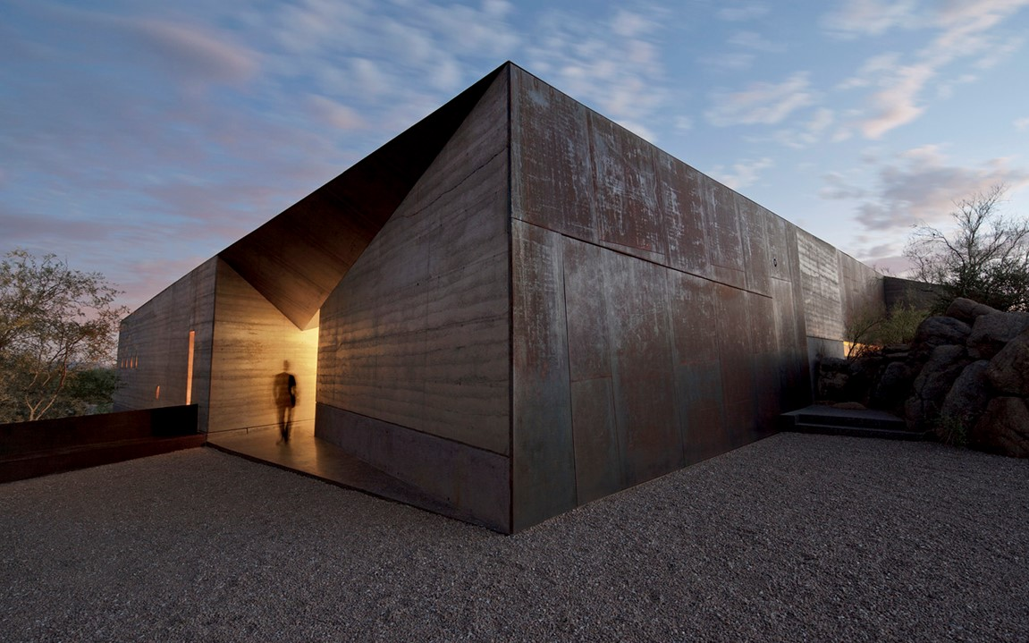
US. Modernist Houses
2014

Slide 2
US Modernist Houses 2014
The purpose of this presentation is to show you the most outstanding Modern Movement inspired houses in the United States by great architects.
Some of them have become icons of contemporary architecture and are recognized and protected as such.
They remain unique either by their constructive principle, or by their location, or by their theoretical importance, or by their perfect integration into the landscape.

Slide 3
US Modernist Houses
Many of the houses presented in this slide show (after the year 2000) were found on the archdaily website which is the world’s largest architecture platform : it lists houses with architectural interest or singular architecture around the world with many illustrations. If they are shown here, it is because they are already considered as iconic.

Slide 4
US Modernist Houses
Roadrunner Residence, North Arrow Studio, TX.
Moose Road, Mork-Ulnes, CA.
Vault House, Johnston & MarkLee , CA.
PV14 House, M Gooden Design, TX.
Desert Courtyard House, Wendell Burnette, AZ.
C Glass House, Deegan Day Design, CA.
Element House, H. Sample & M. Meredith, NM.
Guest House, Janson & Goldstein, NY.
Lakeside House, Jeffrey & Miller, MA.
Capitol Reef Residence, Imbue Design, UT.

Slide 5
US Modernist Houses 2
Corbett Residence, In Situ Studio, NC.
Flying Point House, Steven Harris, NY.
36SML, Leven & Betts, NY.
Rimrock, Olson Kundig, WA.
Independence Pass, Bohlin, Cywinski & Jacob, CO.

Slide 6
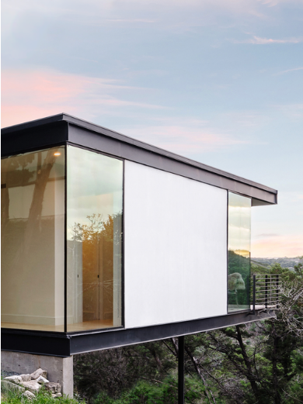
Roadrunner Residence, Austin, TX (2014)
Francisco Arredondo
Alicia Pierce

Slide 7
Roadrunner Residence, Austin, TX (2014)
It is the work of North Arrow Studio firm.
From its hillside perch, the Mies van der Rohe-inspired Roadrunner Residence looks out over the Wild Basin Wilderness Preserve. The façade facing the Preserve is mostly glass with minimal interruptions, providing a stunning view of the Texas hill country. White stucco highlights the dancing shadows of the surrounding tree canopies. The residence maintains a strong connection to the surrounding environment, with a large living space that opens directly to a wide deck for relaxing with friends and family while surrounded by wilderness.

Slide 8
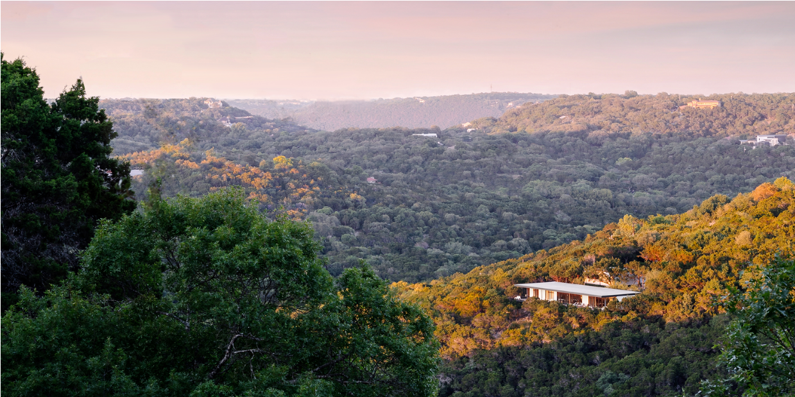
Roadrunner Residence, Austin, TX (2014)

Slide 9
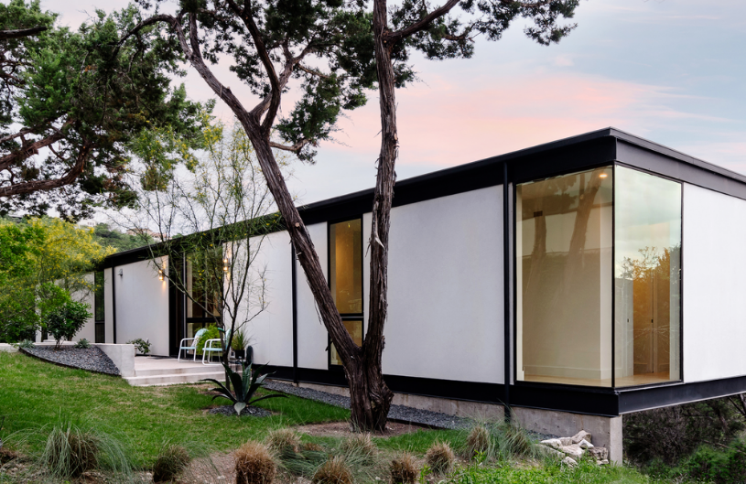
Roadrunner Residence, Austin, TX (2014)

Slide 10
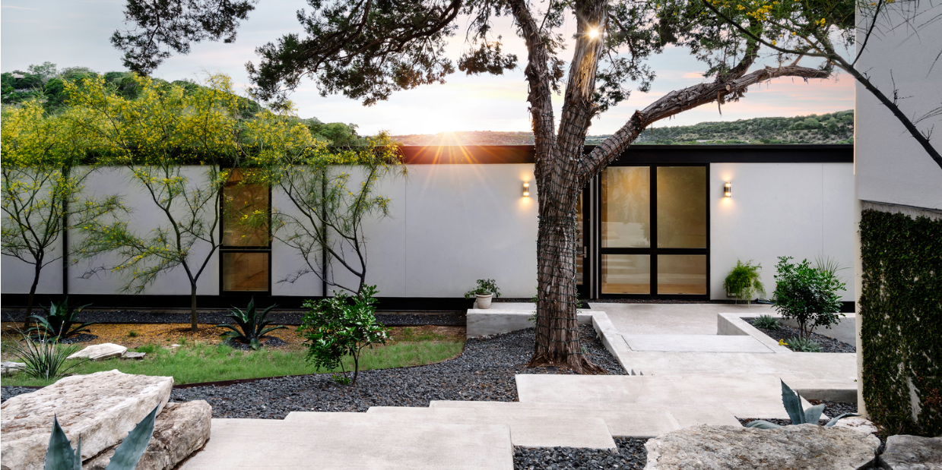
Roadrunner Residence, Austin, TX (2014)

Slide 11
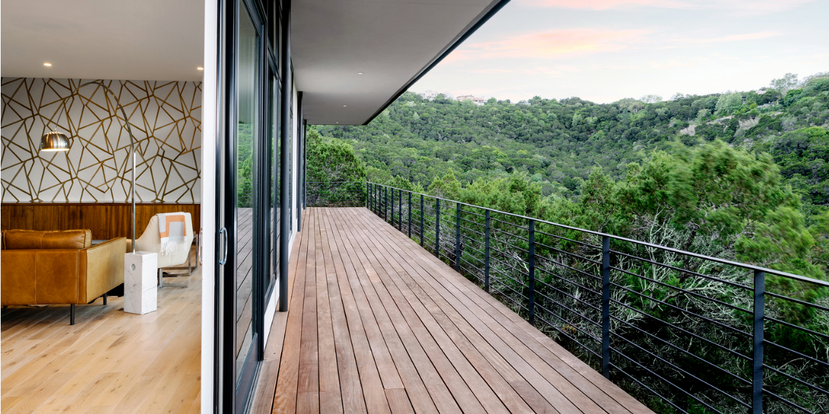
Roadrunner Residence, Austin, TX (2014)

Slide 12
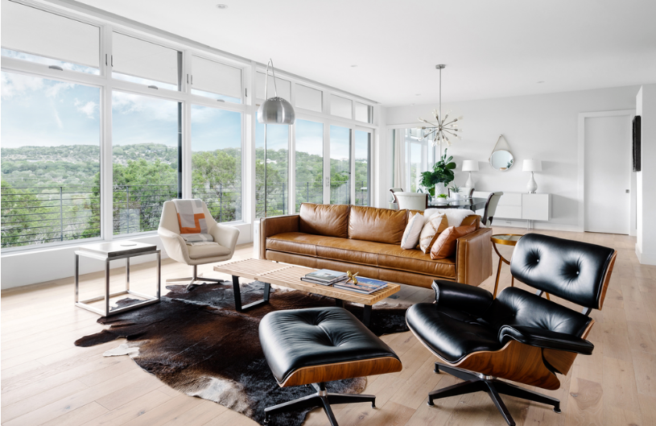
Roadrunner Residence, Austin, TX (2014)

Slide 13
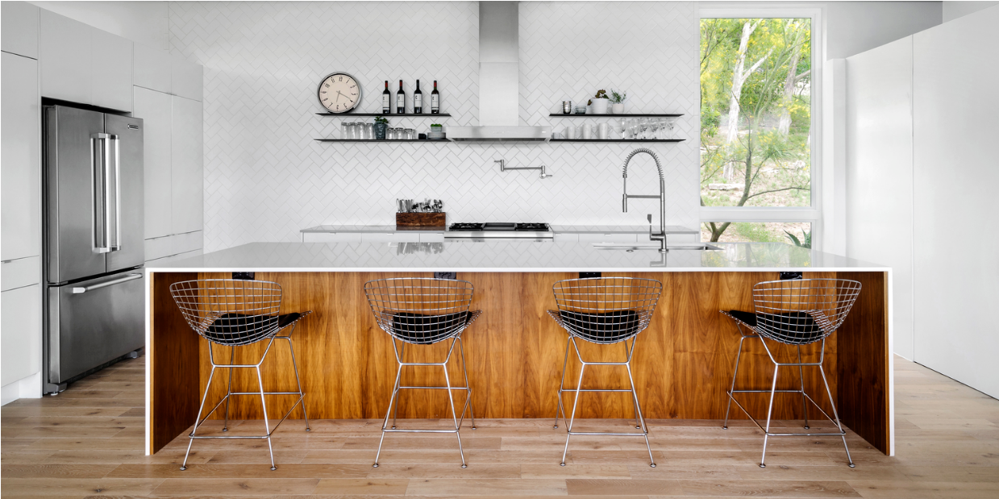
Roadrunner Residence, Austin, TX (2014)

Slide 14
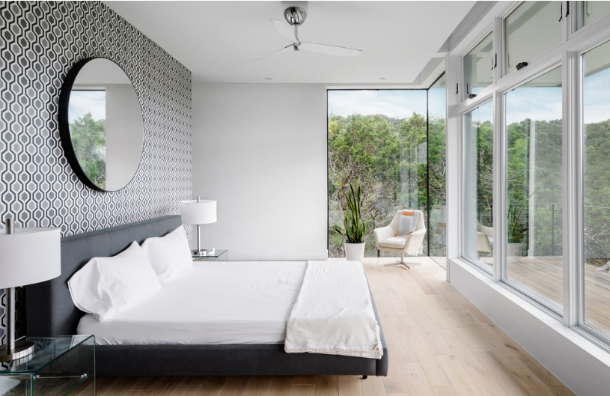
Roadrunner Residence, Austin, TX (2014)

Slide 15
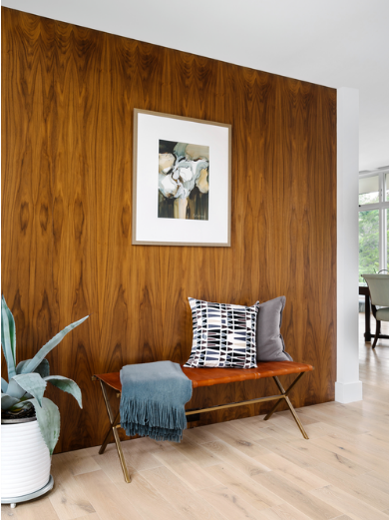
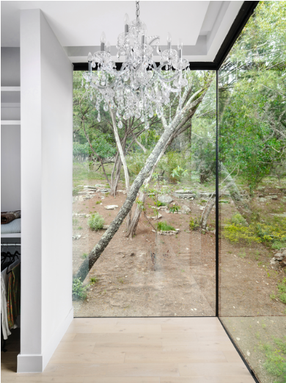
Roadrunner Residence, Austin, TX (2014)

Slide 16
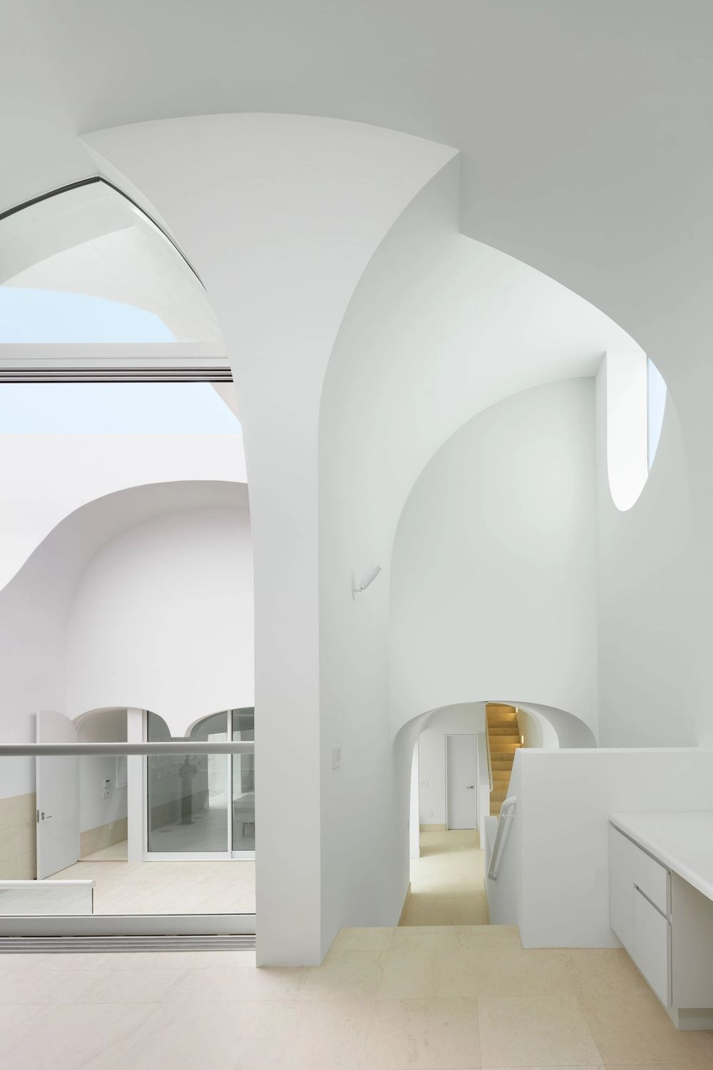
Vault House, Oxnard, CA (2014)
Sharon Johnston
Mark Lee

Slide 17
Vault House, Oxnard, CA (2014)
It is the work of Sharon Johnston & Mark Lee.
With a series of stacked and unidirectional vaults contained within a simple solid mass, the parallel orientation of the rooms within the house becomes a filter that emphasizes the continuation of the oceanfront view from the beachfront facade to the street.
Similar to the paradigm of a shotgun-house, the singular direction of the vaults maximizes the connection of all spaces within a deep building, meanwhile incorporating the ideal exterior landscape of the ocean and horizon.

Slide 18
Vault House, Oxnard, CA (2014)
Three floor levels – first floor, split level, second floor – are grouped around a courtyard that serves both as the main entrance to the house and as a central outdoor room.
A single-run stair located along the Northern side of the house connects all three levels and leads to a roof deck that offers panoramic views of the beach and the ocean.
Limestone is used for all floors and as wainscots, both inside and outside, while an elastomeric, cementitious membrane called “Grailcoat" wraps the exterior façade. The membrane eliminates the need for metal flashing and control joints, rendering the façade scaleless and forming an abstract backdrop for the play of light and shadow.

Slide 19
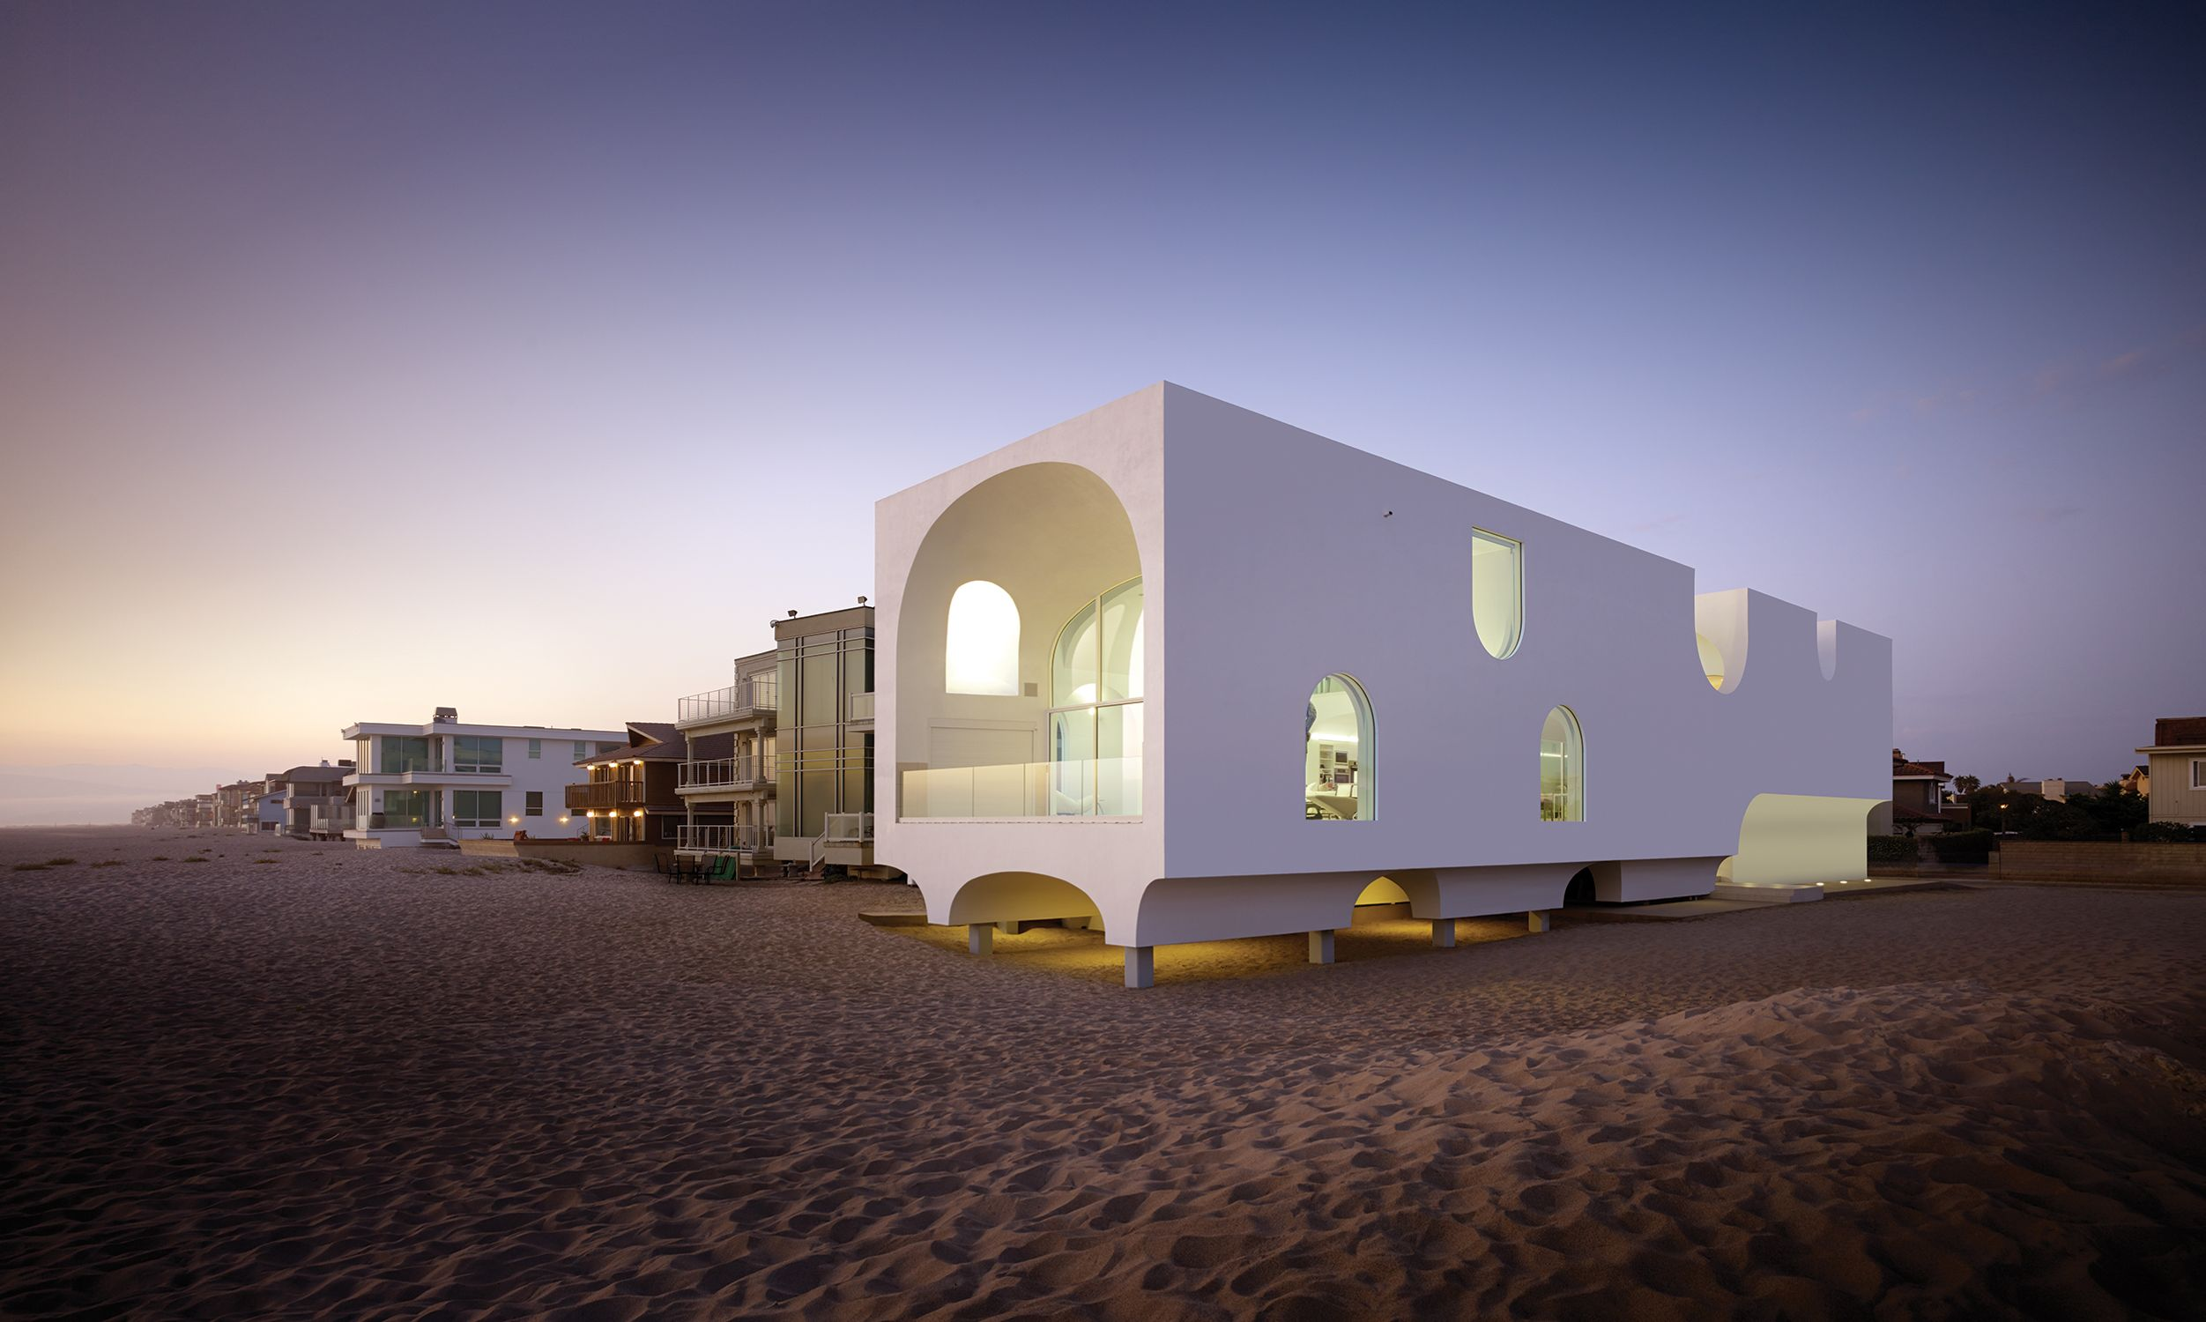
Vault House, Oxnard, CA (2014)

Slide 20
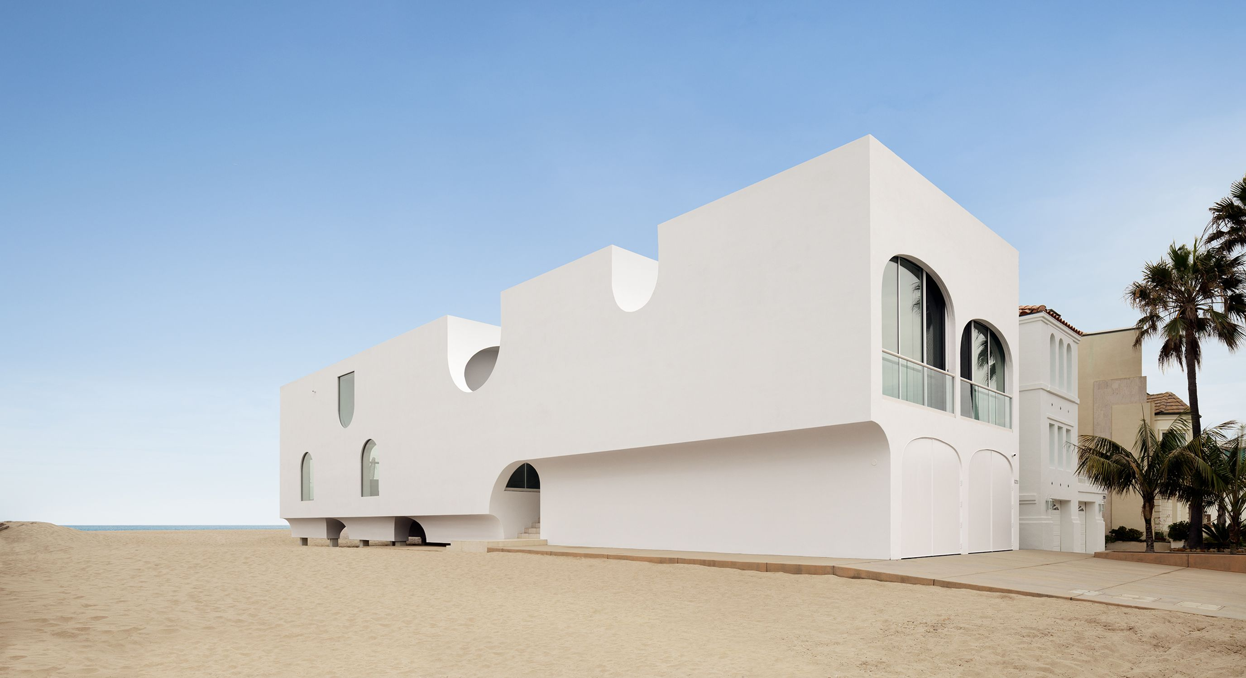
Vault House, Oxnard, CA (2014)

Slide 21
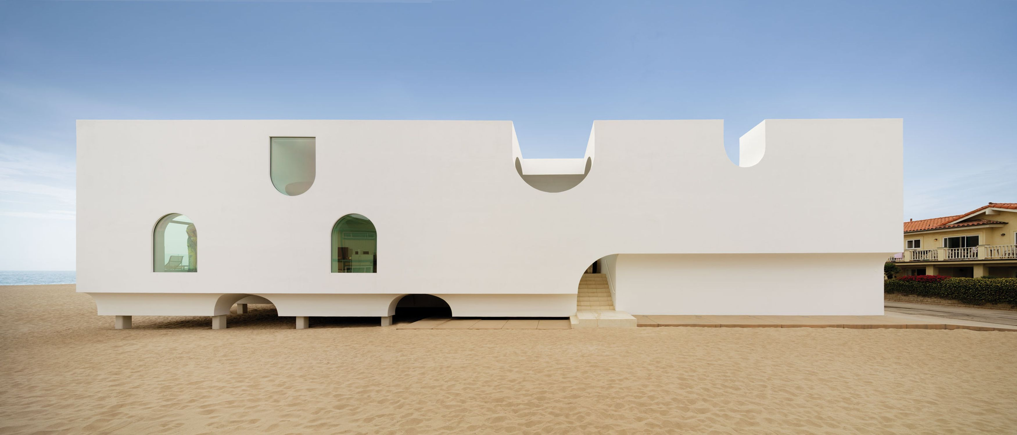
Vault House, Oxnard, CA (2014)

Slide 22
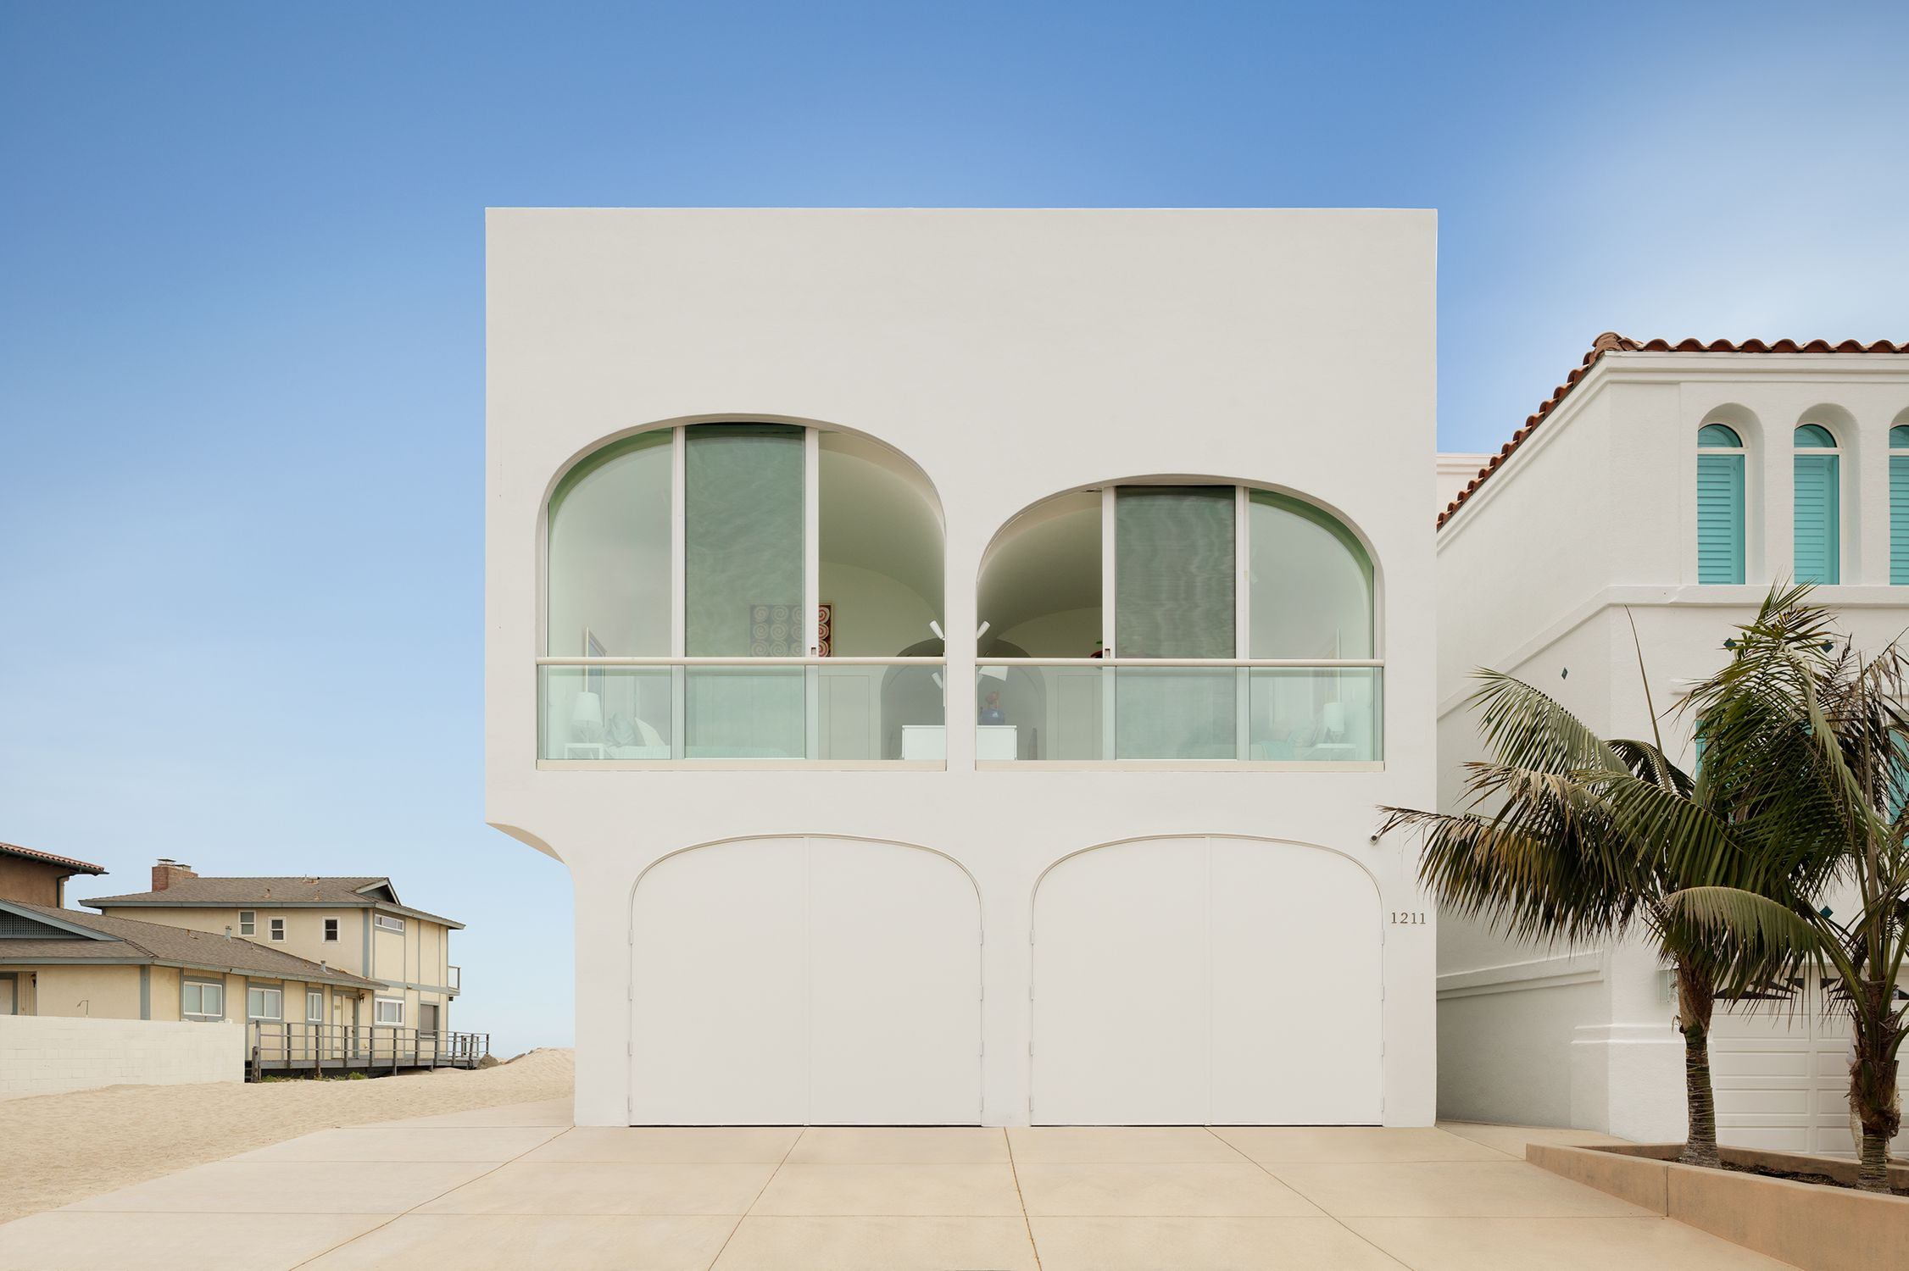
Vault House, Oxnard, CA (2014)

Slide 23
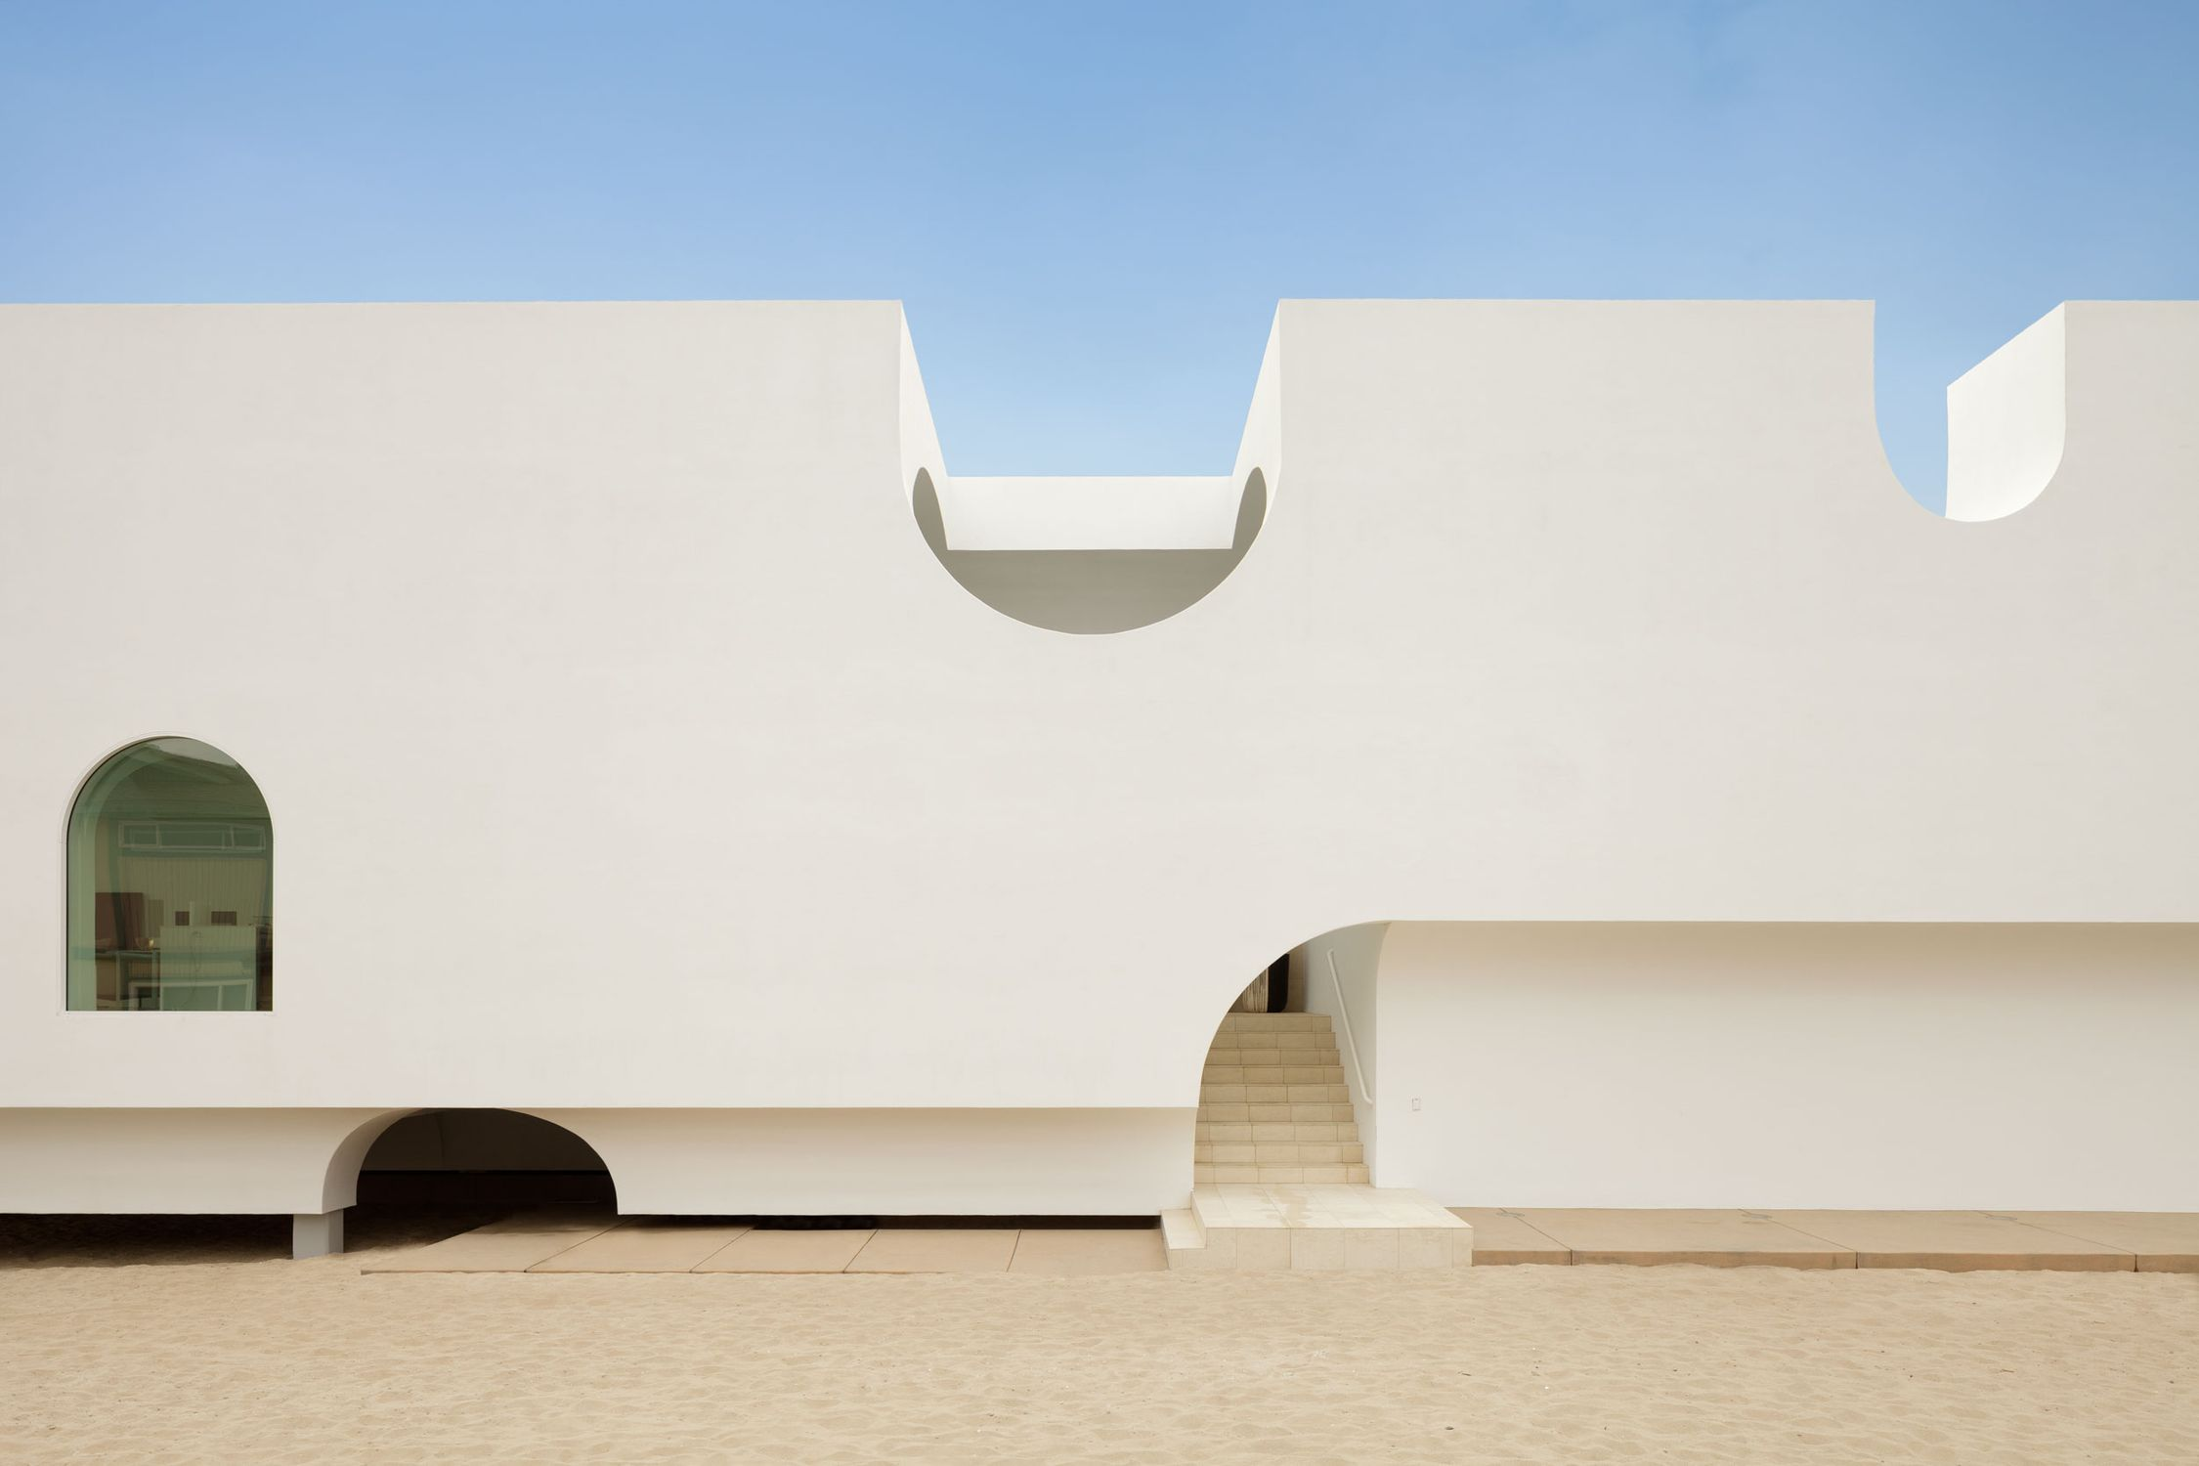
Vault House, Oxnard, CA (2014)

Slide 24
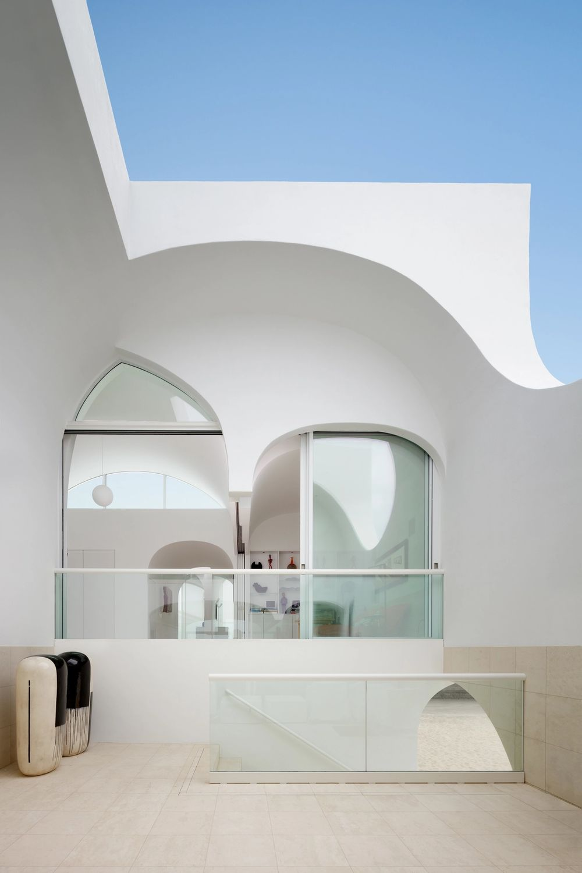
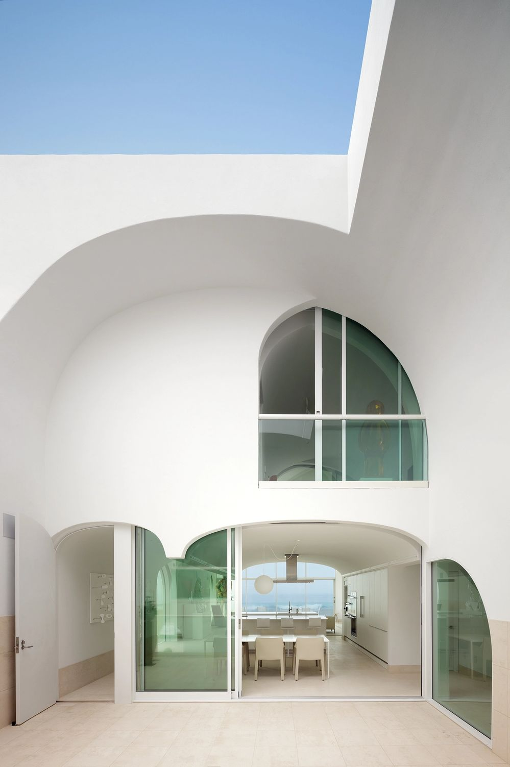
Vault House, Oxnard, CA (2014)

Slide 25
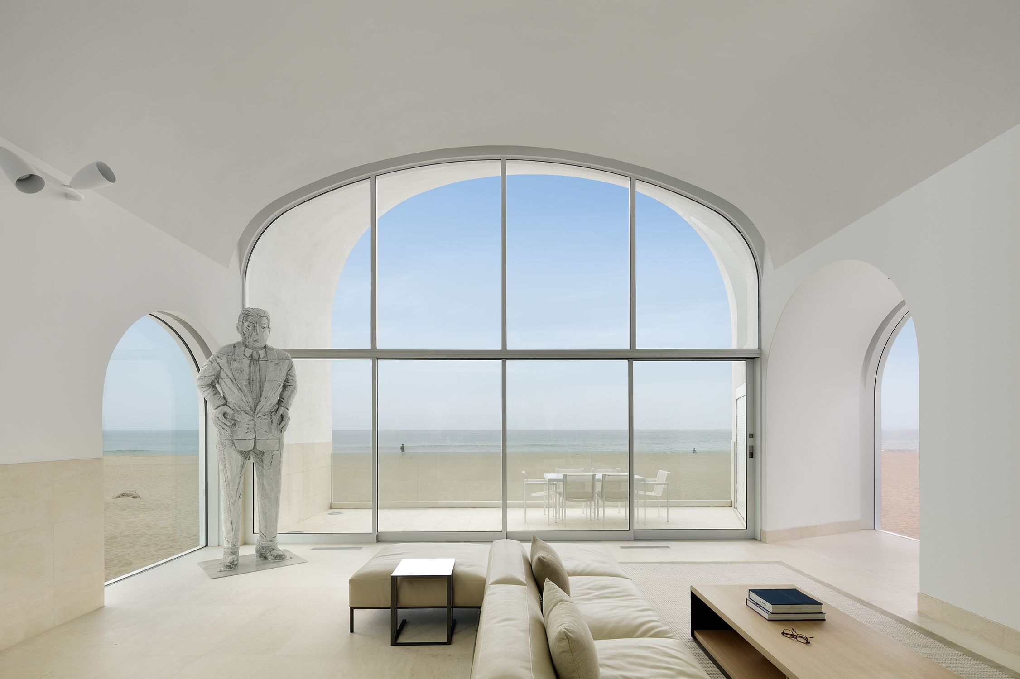
Vault House, Oxnard, CA (2014)

Slide 26
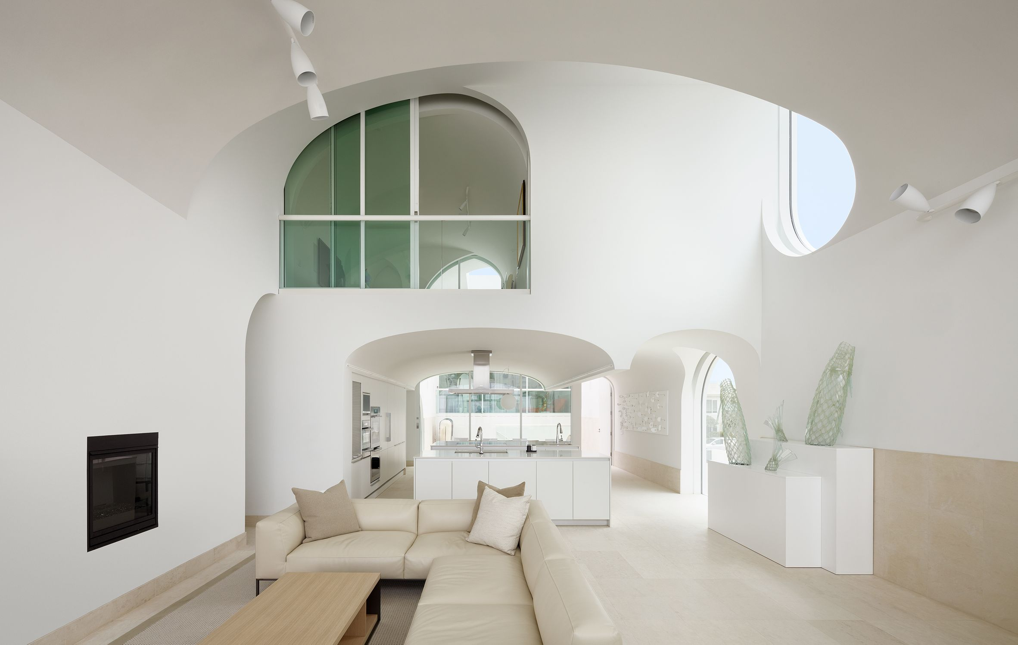
Vault House, Oxnard, CA (2014)

Slide 27
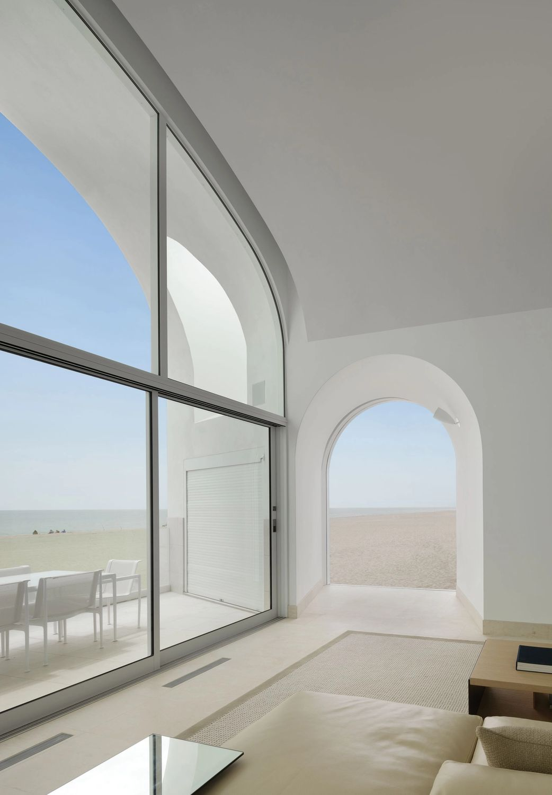
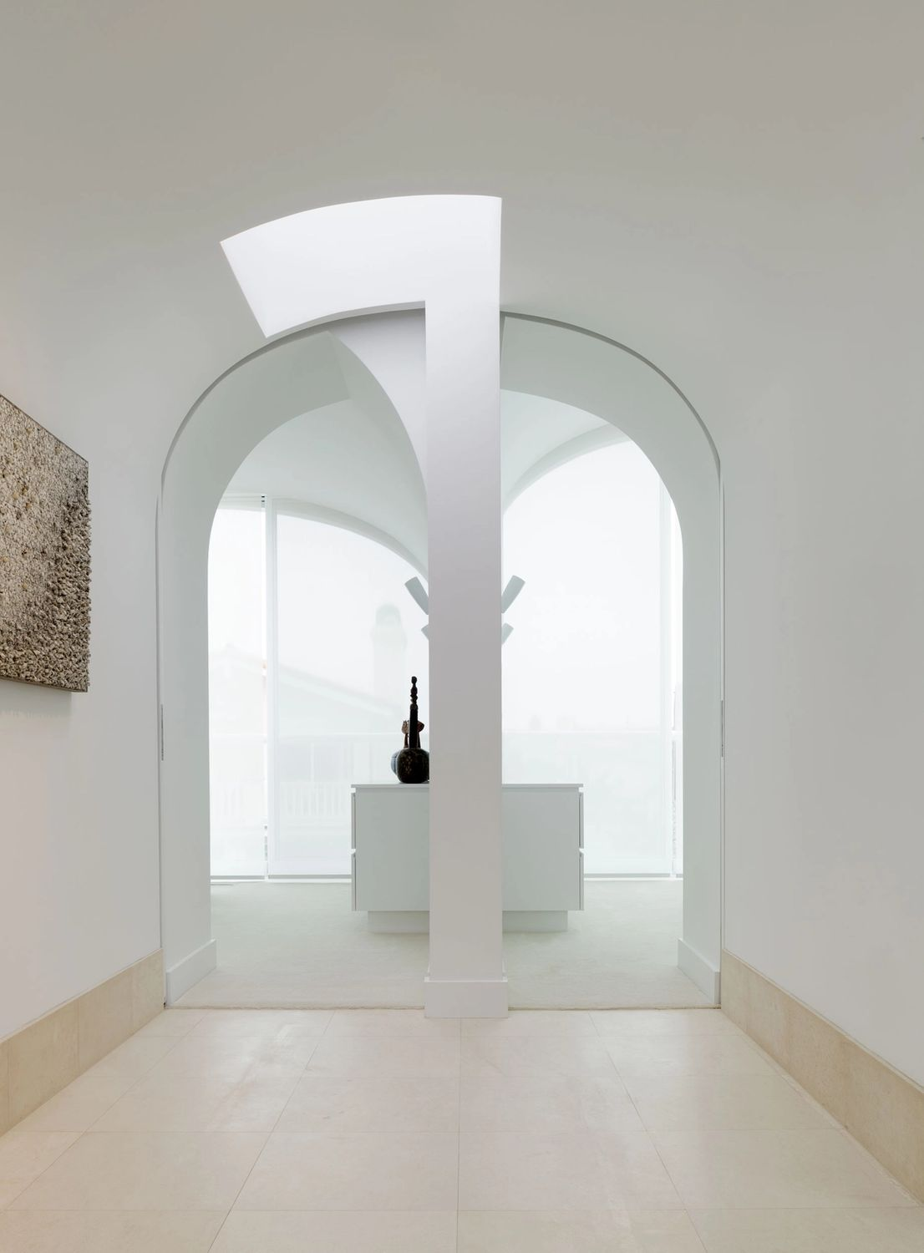
Vault House, Oxnard, CA (2014)

Slide 28
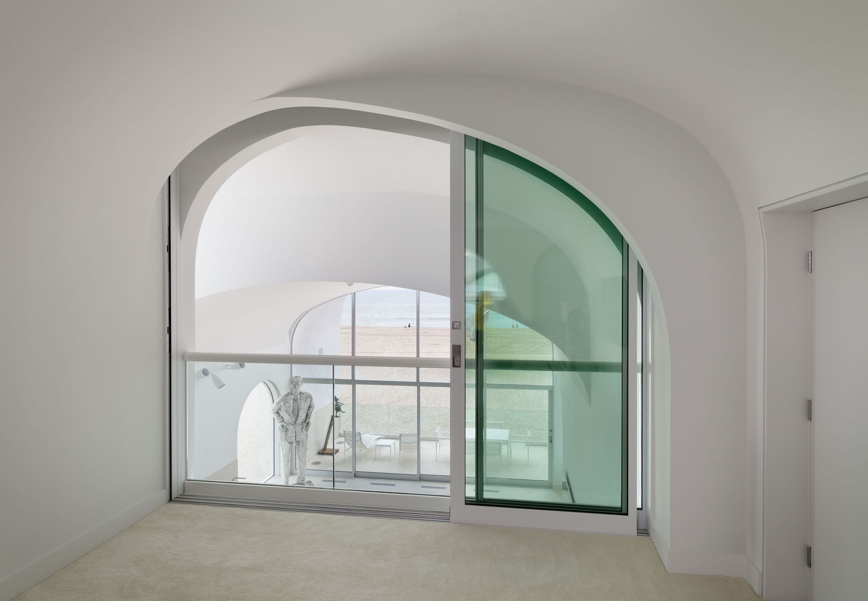
Vault House, Oxnard, CA (2014)

Slide 29
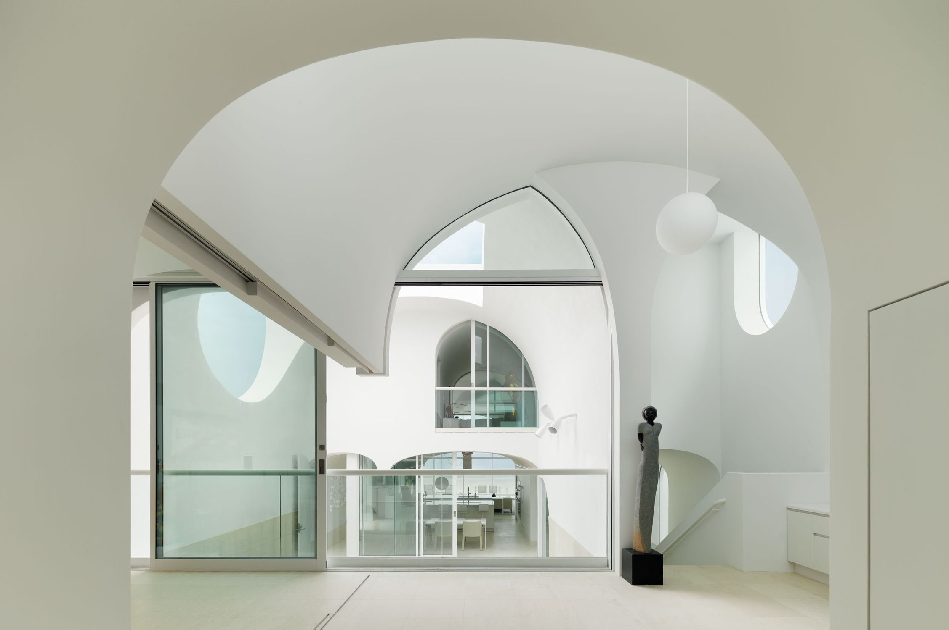
Vault House, Oxnard, CA (2014)

Slide 30
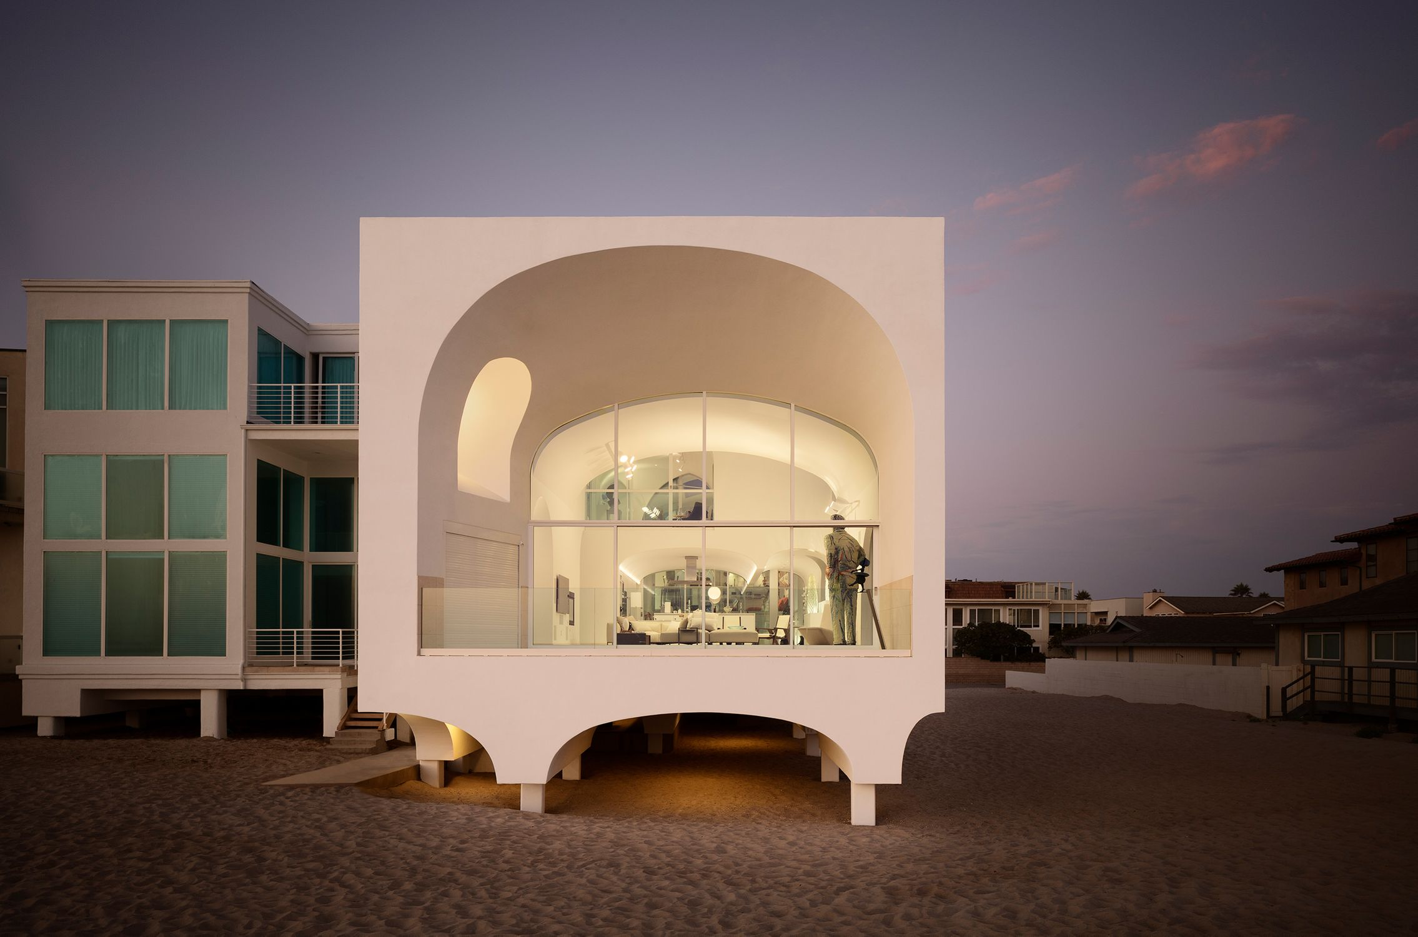
Vault House, Oxnard, CA (2014)

Slide 31
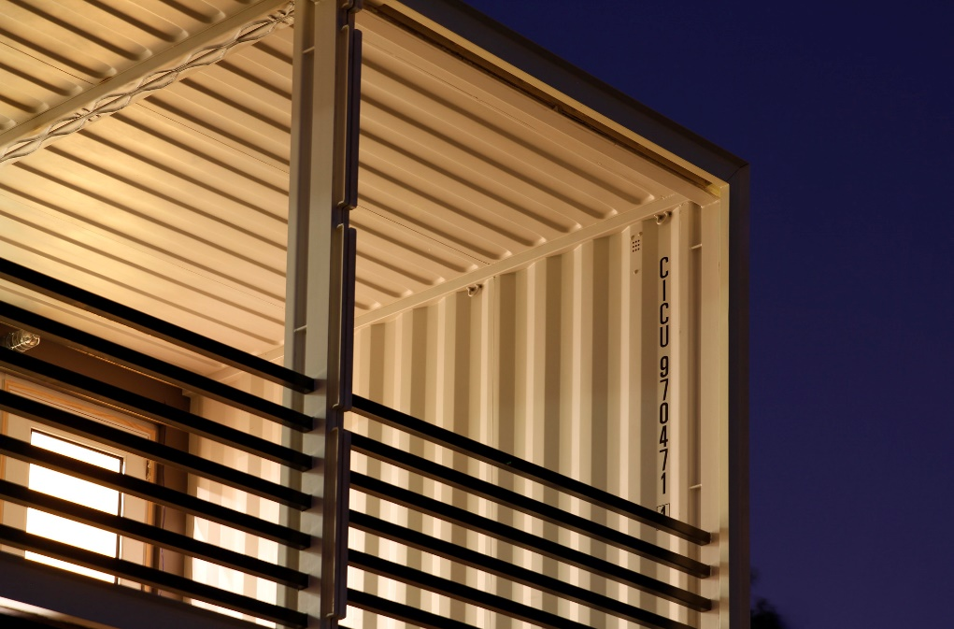
PV14 House, Dallas, TX (2014)
Kevan Russell, Michael Gooden, Joy Han

Slide 32
PV14 House, Dallas, TX (2014)
It is the work of M Gooden Design firm.
Primary living areas were elevated to take advantage of the views and to separate them from the street traffic activity below. Extensive use of overhangs and porches shield windows from direct sunlight, (reducing energy costs) while still capturing natural light and not obstructing the beautiful views. The house is intended to express honesty from which it is built, with concrete floors, exposed steel structure, masonry, glass, and (14) steel shipping containers as primary elements.

Slide 33
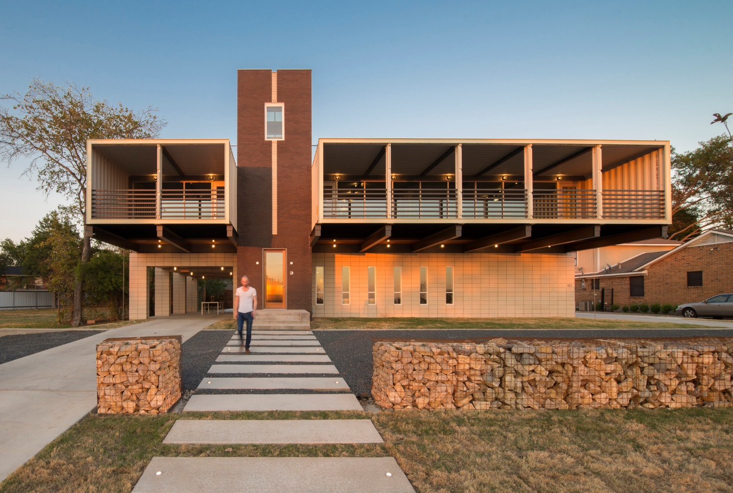
PV14 House, Dallas, TX (2014)

Slide 34
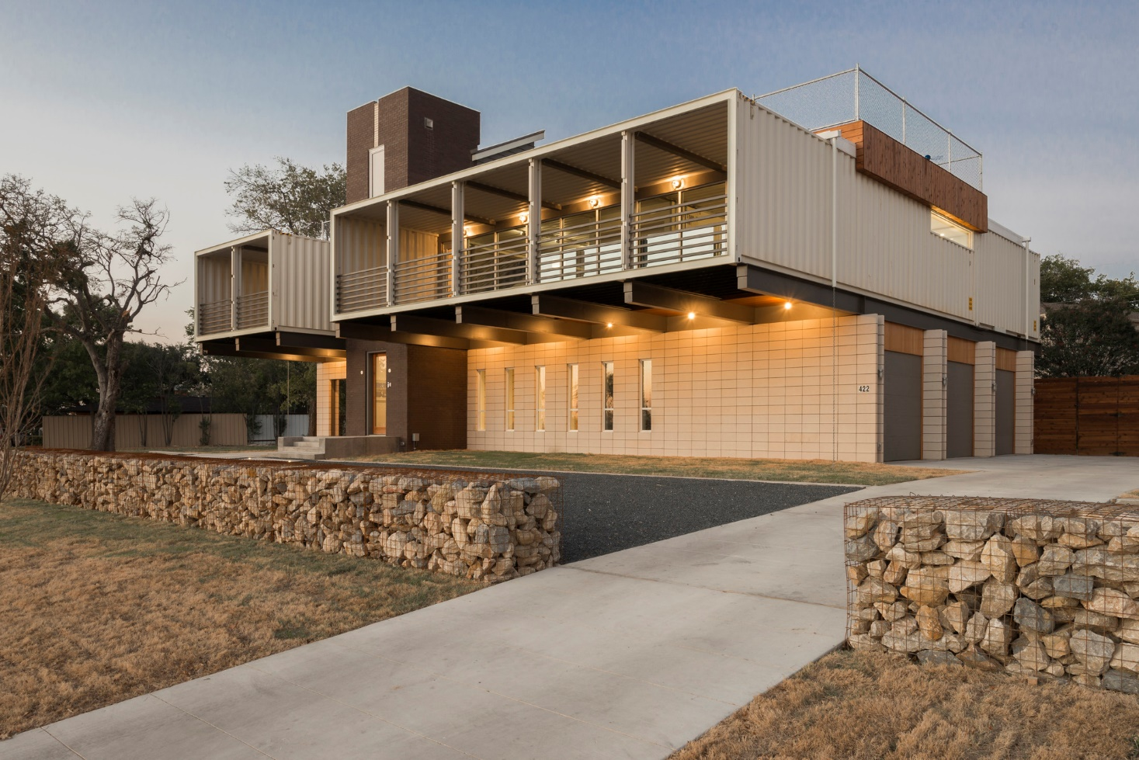
PV14 House, Dallas, TX (2014)

Slide 35
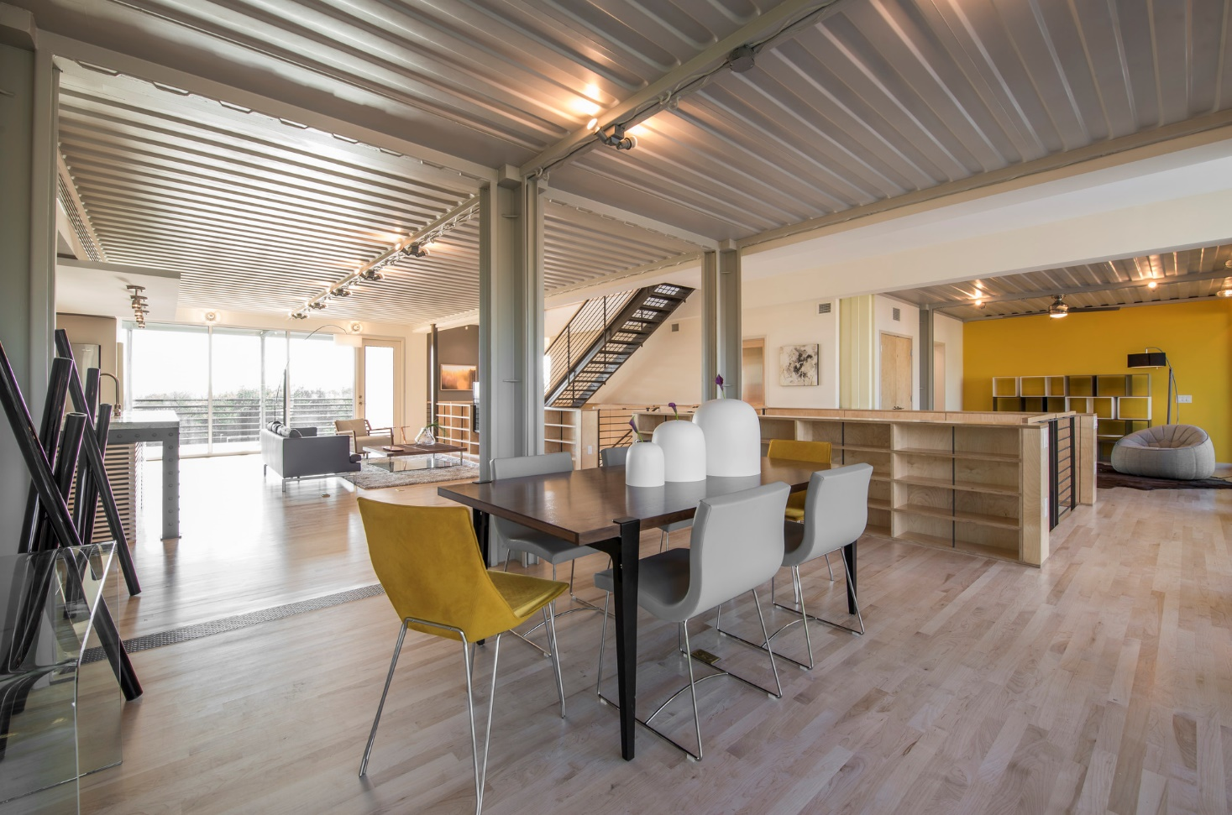
PV14 House, Dallas, TX (2014)

Slide 36
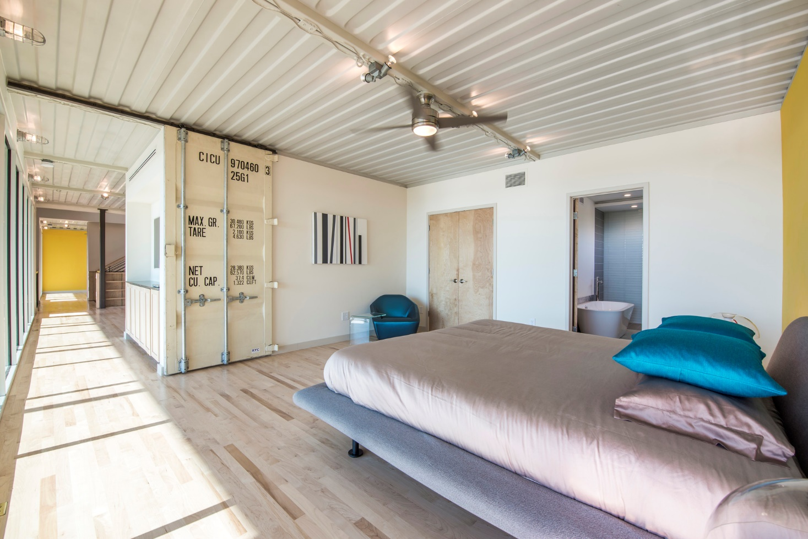
PV14 House, Dallas, TX (2014)

Slide 37
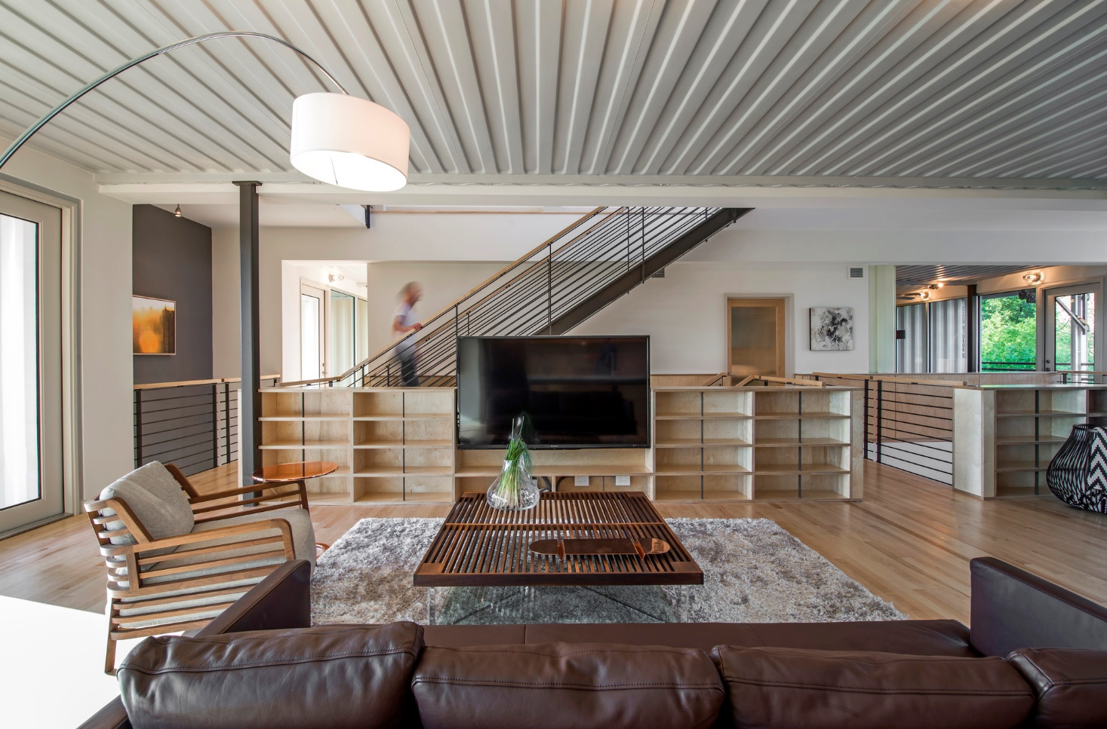
PV14 House, Dallas, TX (2014)

Slide 38
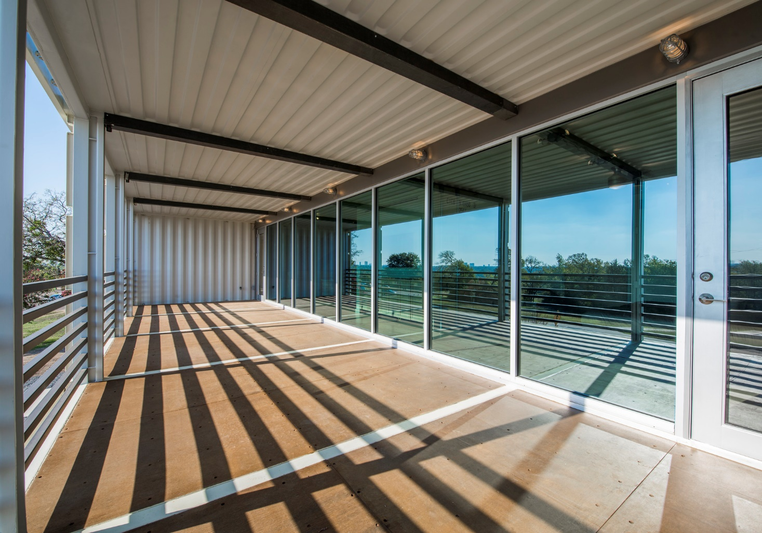
PV14 House, Dallas, TX (2014)

Slide 39
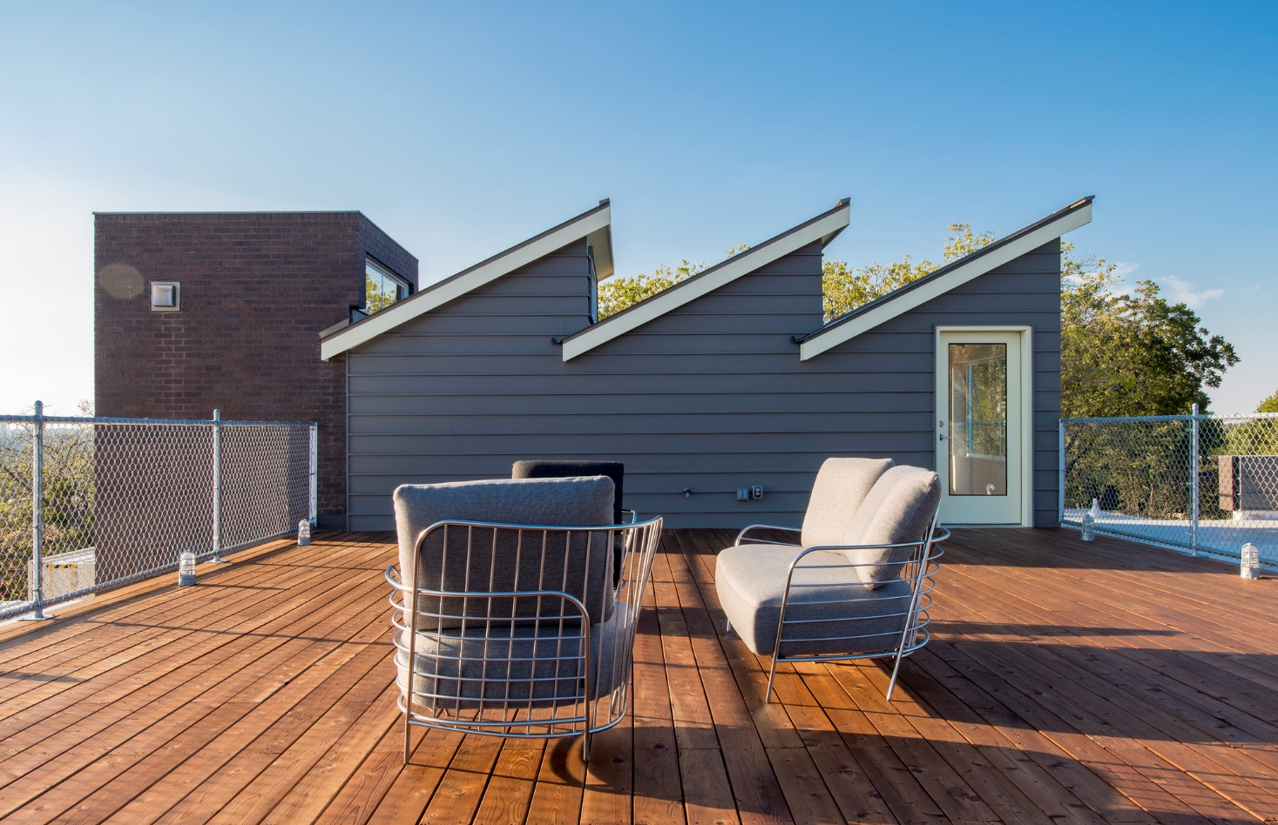
PV14 House, Dallas, TX (2014)

Slide 40
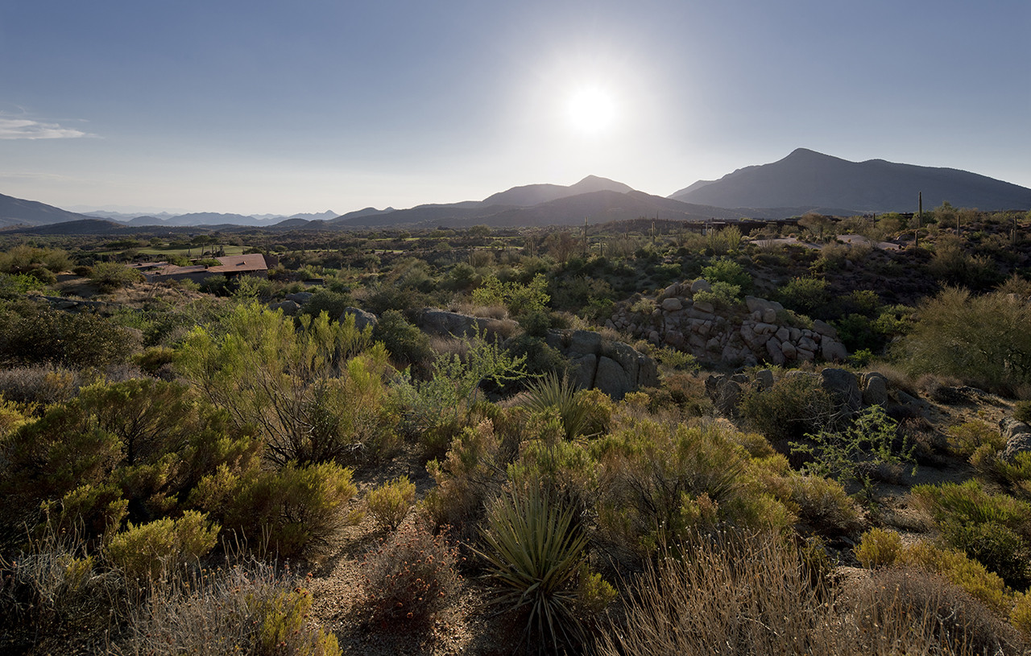
Desert Courtyard, Scottsdale, AZ (2014)
Wendell Burnette

Slide 41
Desert Courtyard, Scottsdale, AZ (2014)
It is the work of the architect Wendell Burnette.
Constructed from soil excavated from the site, the house is a mass of concrete and rammed earth walls that meet the sky without termination. The battered walls envelop and protect conditioned spaces that surround a central courtyard.
During the daytime, the courtyard is defined by a continuous ribbon of glass, the desert floor and sky.
At night, the glass dissolves and the steel plate ceiling of the interior spaces merges with the dark sky. The roof is clad in weathered steel.

Slide 42
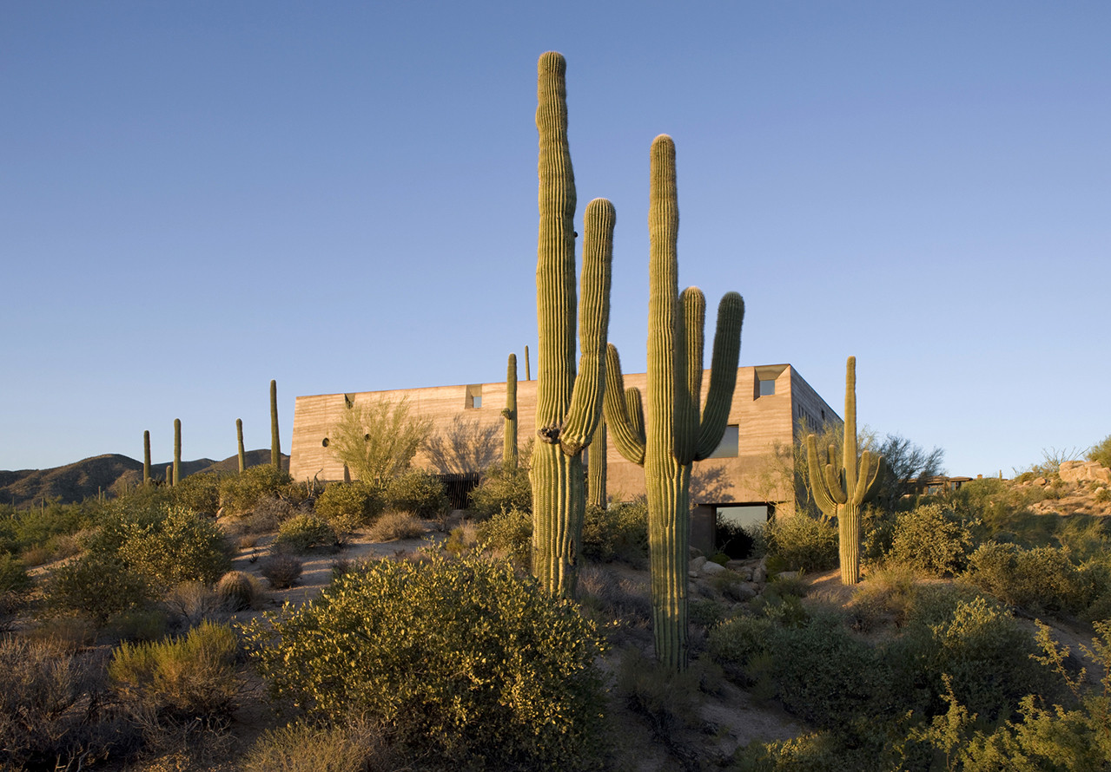
Desert Courtyard, Scottsdale, AZ (2014)

Slide 43
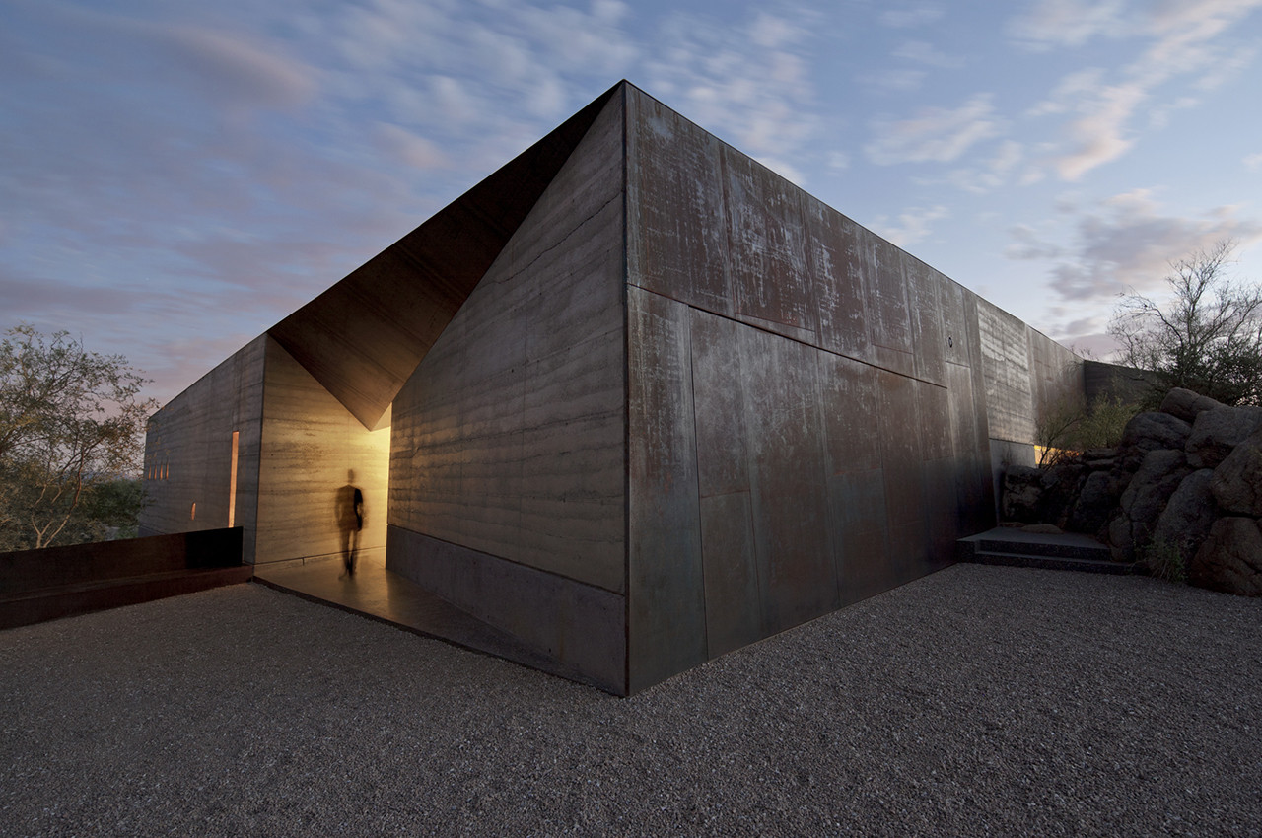
Desert Courtyard, Scottsdale, AZ (2014)

Slide 44
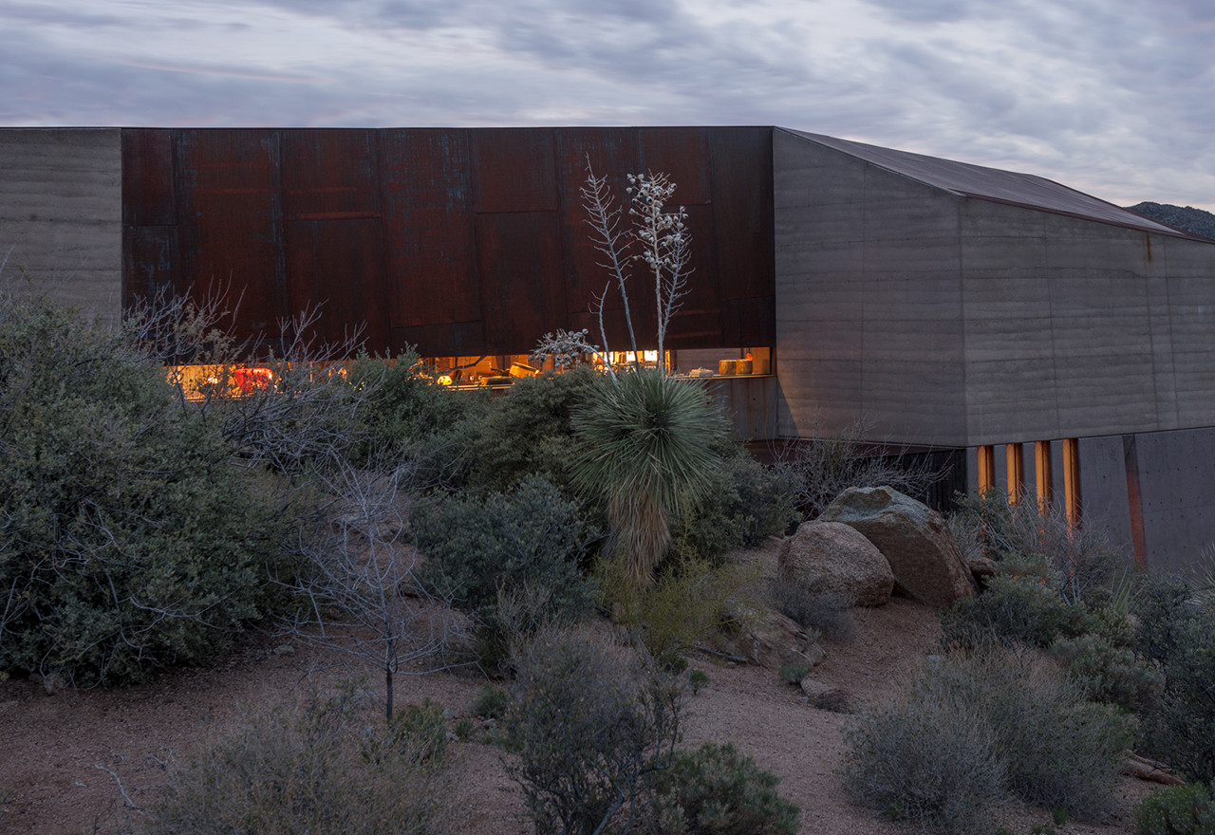
Desert Courtyard, Scottsdale, AZ (2014)

Slide 45
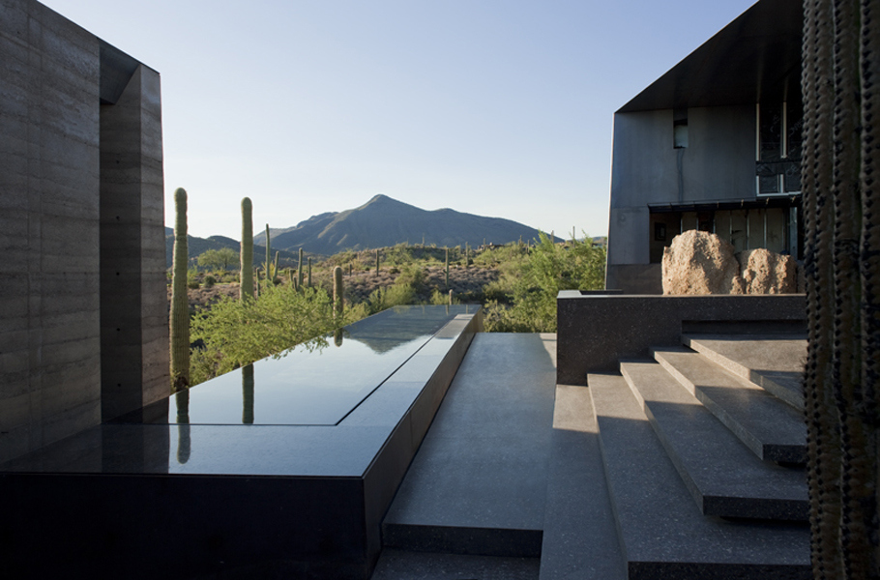
Desert Courtyard, Scottsdale, AZ (2014)

Slide 46
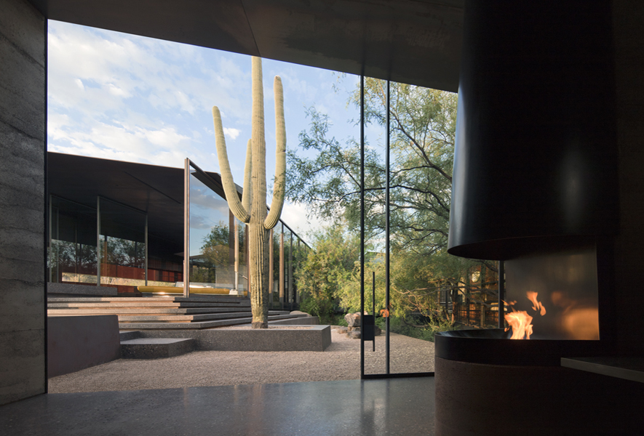
Desert Courtyard, Scottsdale, AZ (2014)

Slide 47
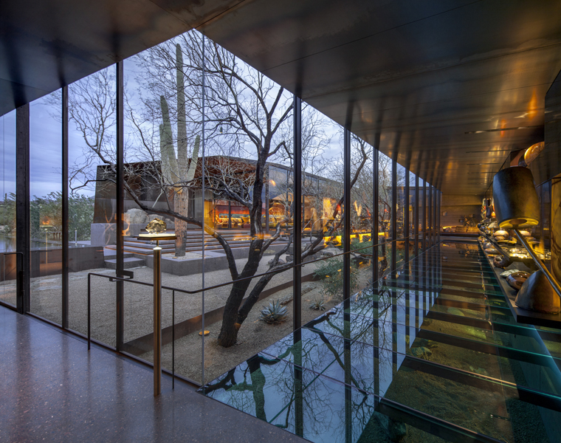
Desert Courtyard, Scottsdale, AZ (2014)

Slide 48
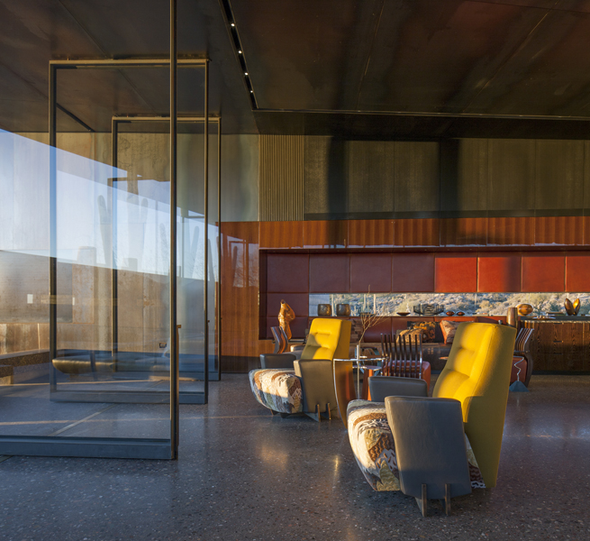
Desert Courtyard, Scottsdale, AZ (2014)

Slide 49
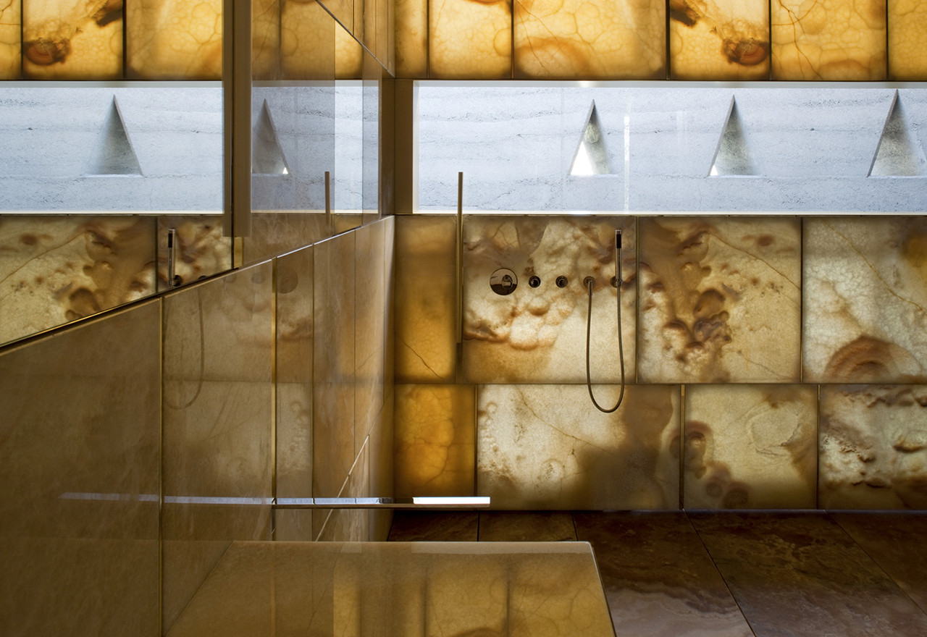
Desert Courtyard, Scottsdale, AZ (2014)

Slide 50
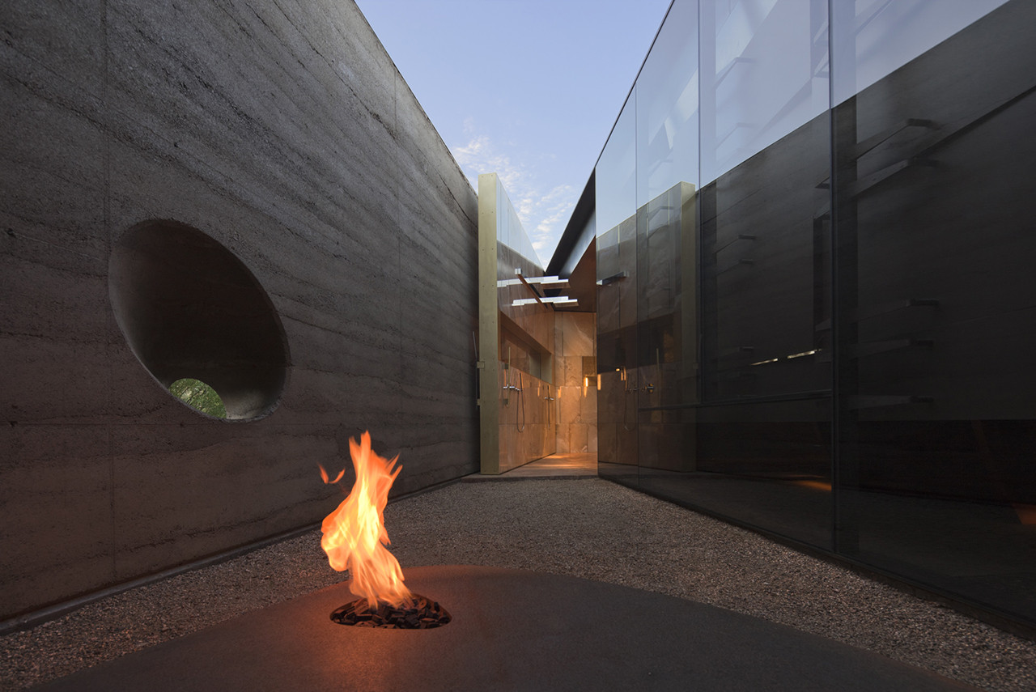
Desert Courtyard, Scottsdale, AZ (2014)

Slide 51
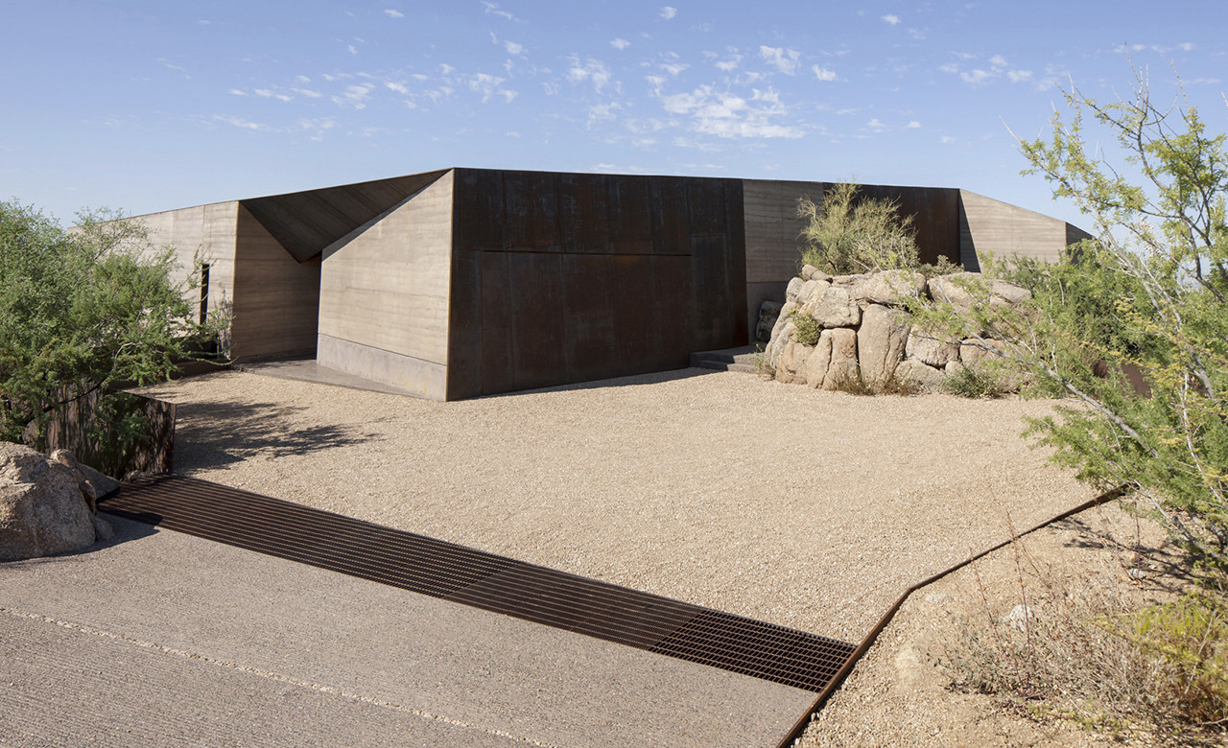
Desert Courtyard, Scottsdale, AZ (2014)

Slide 52
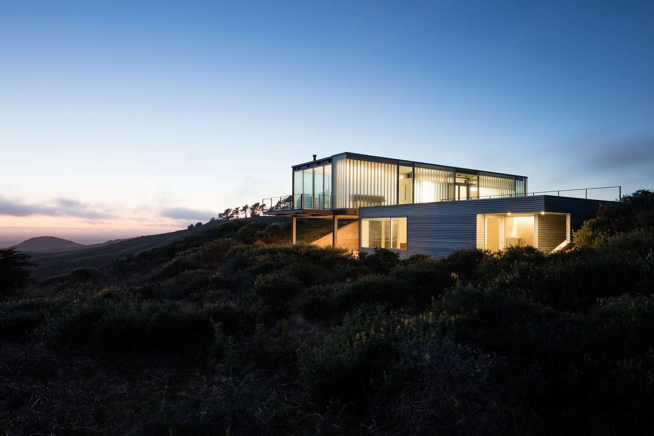
C Glass House, Dillon Beach, CA (2014)
Joe Day

Slide 53
C Glass House, Dillon Beach, CA (2014)
It is the work of the architect Joe Day.
The C-Glass House is a 2100sf retreat in northern California. Set on a spectacular but periodically wind-swept site, the C-Glass House opens to a panoramic view of Tomales Bay and the open ocean.
The main house is a single 60’x25’ open space, punctuated by two service volumes containing a full and half bath, galley kitchen and service and storage space.
The surprisingly robust thermal performance of both glazing systems minimize the house’s energy consumption.

Slide 54
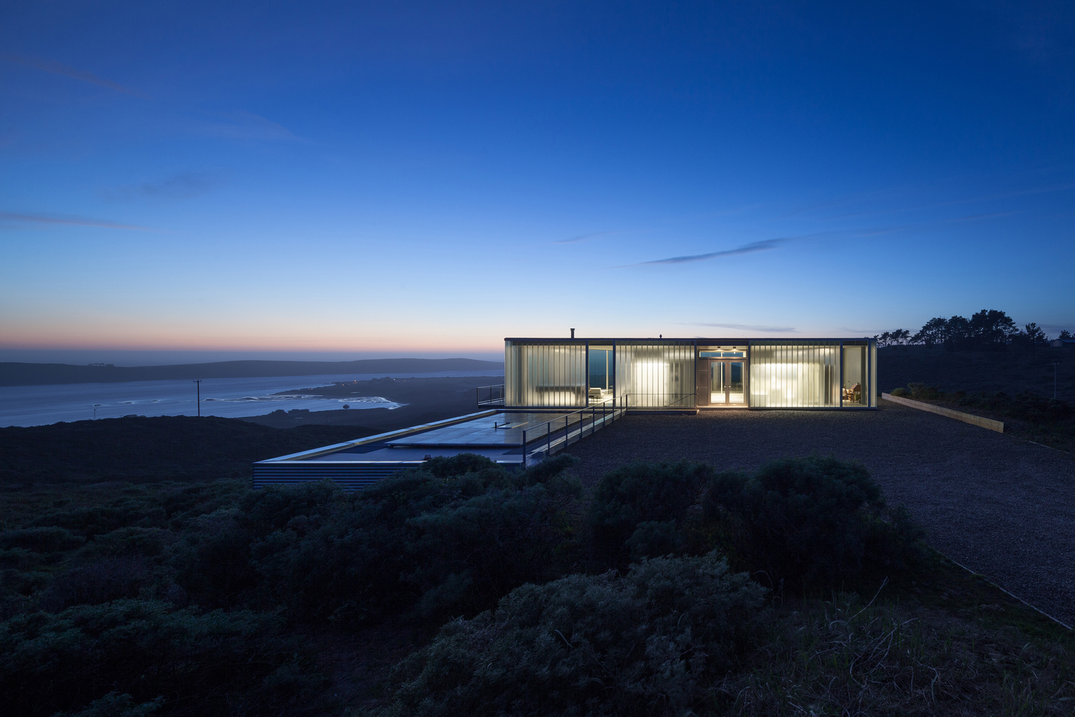
C Glass House, Dillon Beach, CA (2014)

Slide 55
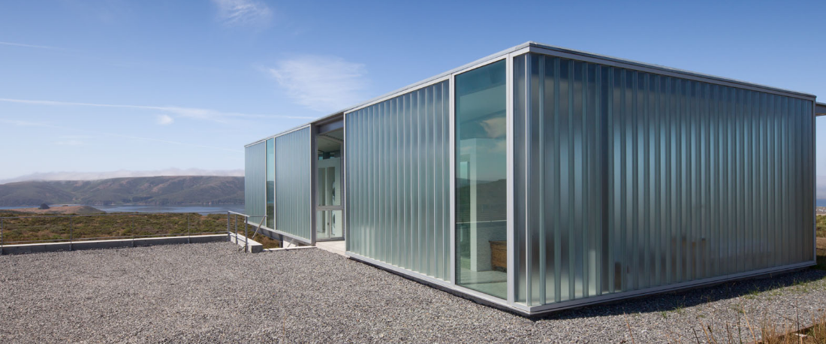
C Glass House, Dillon Beach, CA (2014)

Slide 56
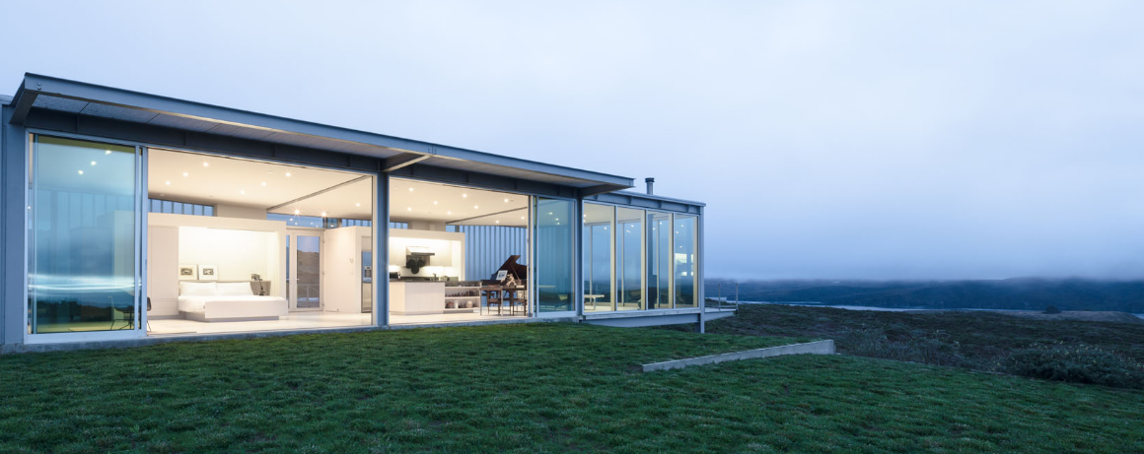
C Glass House, Dillon Beach, CA (2014)

Slide 57
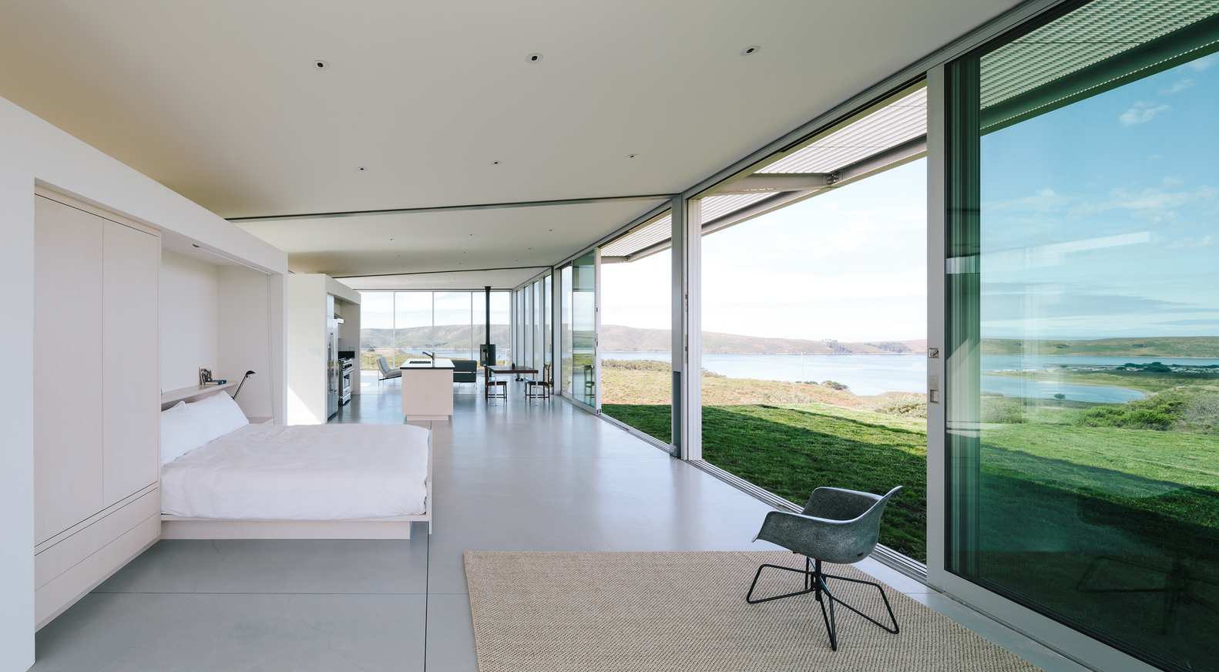
C Glass House, Dillon Beach, CA (2014)

Slide 58
C Glass House, Dillon Beach, CA (2014)

Slide 59
C Glass House, Dillon Beach, CA (2014)

Slide 60
C Glass House, Dillon Beach, CA (2014)

Slide 61
Capitol Reef Residence,Torrey,UT (2014)
Christopher J. Talvy
Hunter Gundersen

Slide 62
Capitol Reef Residence,Torrey,UT (2014)
It is the work of Imbue Design firm.
The volumes ends are open in expansive glass walls to highlight views of the specified formations, while horizontal windows along the lengths of the volumes frame panoramic views of everything between.
Reflecting the red rock megaliths that protrude out of the horizontal landscape, the sharp lines of the house rise above a shroud of vegetation to stand in contrast to ancient, twisted juniper trees. Like the native rock and trees, corrugated Corten panels and cedar siding naturally age to a self-protective patina baked on by the arid heat and desert sun.

Slide 63
Capitol Reef Residence,Torrey,UT (2014)

Slide 64
Capitol Reef Residence,Torrey,UT (2014)

Slide 65
Capitol Reef Residence,Torrey,UT (2014)

Slide 66
Capitol Reef Residence,Torrey,UT (2014)

Slide 67
Capitol Reef Residence,Torrey,UT (2014)

Slide 68
Capitol Reef Residence,Torrey,UT (2014)

Slide 69
Capitol Reef Residence,Torrey,UT (2014)

Slide 70
Capitol Reef Residence,Torrey,UT (2014)

Slide 71
Capitol Reef Residence,Torrey,UT (2014)

Slide 72
Capitol Reef Residence,Torrey,UT (2014)

Slide 73
Capitol Reef Residence,Torrey,UT (2014)

Slide 74
Corbett Residence, Bahama, NC (2014)
Erin Sterling Lewis
Matthew Henning

Slide 75
Corbett Residence, Bahama, NC (2014)
It is the work of In Situ Studio
The rectilinear home rests on a base made of concrete block, with the upper portion clad in glass and blackened wood. The house is a low black box that strikes a line across a sloping, wooded site, mimicking the horizon. It is placed at the edge of a descent to a creek and is oriented to admit ample natural light and capture views of the forest. The east end, where the master bedroom is located, is glass, framing a view of a large red oak tree and a forest floor blanketed with ferns.

Slide 76
Corbett Residence, Bahama, NC (2014)

Slide 77
Corbett Residence, Bahama, NC (2014)

Slide 78
Corbett Residence, Bahama, NC (2014)

Slide 79
Corbett Residence, Bahama, NC (2014)

Slide 80
Corbett Residence, Bahama, NC (2014)

Slide 81
Corbett Residence, Bahama, NC (2014)

Slide 82
Flying Point House, Water Mill, NY (2014)

Slide 83
Flying Point House, Water Mill, NY (2014)
It is the work of the architect Stevens Harris.
A spectacular glass box floating atop the oceanfront dunes in the Hamptons, this ultra-modern luxury residence is uniquely constructed with beautifully formed concrete boxes set on top of two piers. One pier of this architectural marvel is faceted, tapering to its smallest possible footprint. The other, partially embedded in the natural fall of a sand dune, is large enough to contain the garage. Created as a stunning 4 bedroom, modern stone edifice with unobstructed vista views looking out across both the Atlantic Ocean and Mecox Bay, the structure is simplistic in itself and practically monastic.

Slide 84
Flying Point House, Water Mill, NY (2014)

Slide 85
Flying Point House, Water Mill, NY (2014)

Slide 86
Flying Point House, Water Mill, NY (2014)

Slide 87
Flying Point House, Water Mill, NY (2014)

Slide 88
Flying Point House, Water Mill, NY (2014)

Slide 89
Flying Point House, Water Mill, NY (2014)

Slide 90
Flying Point House, Water Mill, NY (2014)

Slide 91
Flying Point House, Water Mill, NY (2014)

Slide 92
Flying Point House, Water Mill, NY (2014)

Slide 93
Flying Point House, Water Mill, NY (2014)

Slide 94
Flying Point House, Water Mill, NY (2014)

Slide 95
Flying Point House, Water Mill, NY (2014)

Slide 96
Flying Point House, Water Mill, NY (2014)

Slide 97
Element House,Anton Chico, NM (2014)
Hilary Sample & Michael Meredith

Slide 98
Element House,Anton Chico, NM (2014)
It is the work of Hilary Sample & Michael Meredith.
The Museum of Outdoor Arts Element House is a structural insulated panel (SIPS) modular building designed to operate independently of public utilities by integrating passive systems and on-site energy-generation.
The Element House shape is derived from the Fibonacci sequence, which is a describer of developmental patterns in living organisms. This mathematical series was applied in order to explore the idea of recombinatory growth in building forms and the economics of spatial compartmentalization.

Slide 99
Element House,Anton Chico, NM (2014)

Slide 100
Element House,Anton Chico, NM (2014)

Slide 101
Element House,Anton Chico, NM (2014)

Slide 102
Element House,Anton Chico, NM (2014)

Slide 103
Element House,Anton Chico, NM (2014)

Slide 104
Element House,Anton Chico, NM (2014)

Slide 105
Element House,Anton Chico, NM (2014)

Slide 106
Element House,Anton Chico, NM (2014)

Slide 107
Element House,Anton Chico, NM (2014)

Slide 108
Element House,Anton Chico, NM (2014)

Slide 109
Element House,Anton Chico, NM (2014)

Slide 110
Element House,Anton Chico, NM (2014)

Slide 111
36SML, Stone Ridge, NY (2014)
Stella Betts & David Leven

Slide 112
36SML, Stone Ridge, NY (2014)
It is the work of the architects David Leven and Stella Betts.
Dividing a 1-1/4 acre square lot into 3 yards, the house becomes a 3 spoke division between these yards. At the ground floor the 3 spokes divide into a living wing, kitchen wing and garage wing; whereas the 2nd floor is divided into a guest wing, a children wing and parent wing. The house is clad in concrete panels: GFRC custom formed panels at the lower level and smooth cement board panels on the upper level. The windows have sliding perforated aluminum screens for sun shading and privacy. Inside the finishes are concrete with white oak floors and cabinets. The braced steel structure is designed to resist gravity loads as well as the intense lateral wind loads that occur near the beach. These structural elements are visible throughout the house through the large glass openings at the ground level.

Slide 113
36SML, Stone Ridge, NY (2014)

Slide 114
36SML, Stone Ridge, NY (2014)

Slide 115
36SML, Stone Ridge, NY (2014)

Slide 116
36SML, Stone Ridge, NY (2014)

Slide 117
36SML, Stone Ridge, NY (2014)

Slide 118
36SML, Stone Ridge, NY (2014)

Slide 119
36SML, Stone Ridge, NY (2014)

Slide 120
36SML, Stone Ridge, NY (2014)

Slide 121
36SML, Stone Ridge, NY (2014)

Slide 122
36SML, Stone Ridge, NY (2014)

Slide 123
36SML, Stone Ridge, NY (2014)

Slide 124
Rimrock, Spokane, WA (2014)
Tom Kundig

Slide 125
Rimrock, Spokane, WA (2014)
It is the work of Olson Kundig architectural firm.
The particular form of Rimrock – a T-shaped structure – responds to the unique typography of the bluff upon which it is situated. At the edge of a cliff, the house straddles 2 sides of wash atop a stable outcropping of tough, slow-cooled volcanic basalt. The upper portion of the building, which is most transparent, is actually more private. The lower portion―the more public family and gathering area―has more transparency and contains a bridge element that spans across the game path. This transparent main level, which consists of the kitchen, dining and living area. Tough, durable building materials, mostly mild steel and glass, were used to stand up to harsh environmental conditions and will weather naturally.

Slide 126
Rimrock, Spokane, WA (2014)

Slide 127
Rimrock, Spokane, WA (2014)

Slide 128
Rimrock, Spokane, WA (2014)

Slide 129
Rimrock, Spokane, WA (2014)

Slide 130
Rimrock, Spokane, WA (2014)

Slide 131
Rimrock, Spokane, WA (2014)

Slide 132
Rimrock, Spokane, WA (2014)

Slide 133
Rimrock, Spokane, WA (2014)

Slide 134
Rimrock, Spokane, WA (2014)

Slide 135
Rimrock, Spokane, WA (2014)

Slide 136
Rimrock, Spokane, WA (2014)

Slide 137
Rimrock, Spokane, WA (2014)

Slide 138
Rimrock, Spokane, WA (2014)

Slide 139
Rimrock, Spokane, WA (2014)

Slide 140
Independence Pass, Aspen, CO (2014)
Peter Bohlin

Slide 141
Independence Pass, Aspen, CO (2014)
It is the work of Bohlin, Cywinski, Jacob firm.
The lower level is expressed as a series of stone-clad walls that extend into the landscape and the upper level is a sleek box with a metal roof that floats on slender columns. A wall of black-stained cedar boards marks the main entry and extends through the house into a double-height space with a floating stair. Cantilevered wood stair treads lead to the upper level and main living pavilion, where full-height walls of glass reveal panoramic views of the nature preserve. The living room, dining room and kitchen occupy the center of the linear floor plan, with a master bedroom suite to the west and a family room and outdoor courtyard to the east. Ground level spaces include three bedrooms.

Slide 142
Independence Pass, Aspen, CO (2014)

Slide 143
Independence Pass, Aspen, CO (2014)

Slide 144
Independence Pass, Aspen, CO (2014)

Slide 145
Independence Pass, Aspen, CO (2014)

Slide 146
Independence Pass, Aspen, CO (2014)

Slide 147
Independence Pass, Aspen, CO (2014)

Slide 148
Independence Pass, Aspen, CO (2014)

Slide 149
Independence Pass, Aspen, CO (2014)

Slide 150
Independence Pass, Aspen, CO (2014)

Slide 151
Independence Pass, Aspen, CO (2014)
THE END

