Slide 1
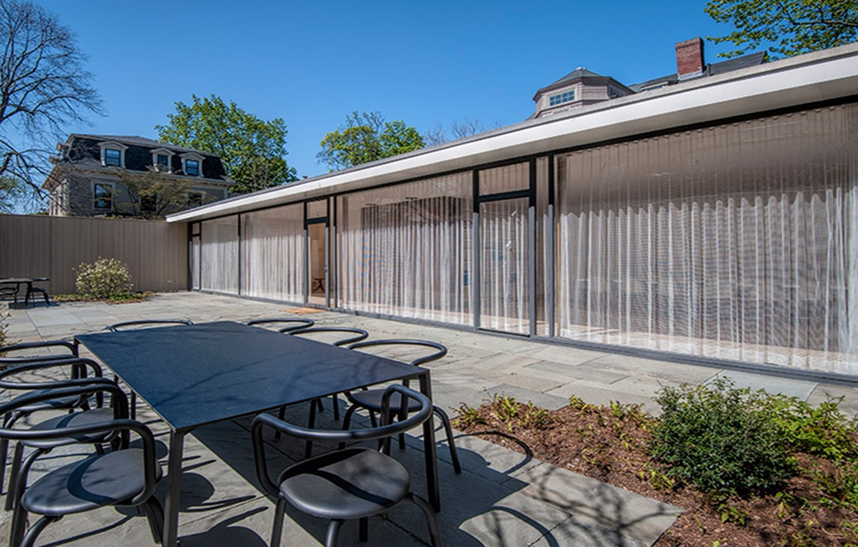
US. Modernist Houses
1941-1946

Slide 2
US Modernist Houses 1941 - 1946
The purpose of this presentation is to show you the most outstanding Modern Movement inspired houses in the United States by great architects.
Some of them have become icons of contemporary architecture (members of the iconic.org network) and are recognized and protected as such.
They remain unique either by their constructive principle, or by their location, or by their theoretical importance, or by their perfect integration into the landscape.

Slide 3
US Modernist Houses
Many of the houses presented in this slide show (before the year 2000) were found on the OfHouses website (Old Forgotten Houses) which lists houses with architectural interest or singular architecture around the world with many illustrations. If they are shown here, it is because they are already considered as iconic.

Slide 4
US Modernist Houses
Alden Dow House, Alden Dow, MI.
Havens House, Harwell H. Harris, CA.
Thesis House, Philip Johnson, MA.
Scheuler House, Paul Hayden Kirk, PA.
Jacobs House II, Frank Lloyd Wright, WI.
Geller House I, M. Breuer & H. Beckhard, NY.
Kaufmann House, Richard Neutra, CA.
The Booth House, Philip Johnson, NY.
Loewy House, Albert Frey, CA.
Haines Hall House, Callister & Hillmer, CA.

Slide 5
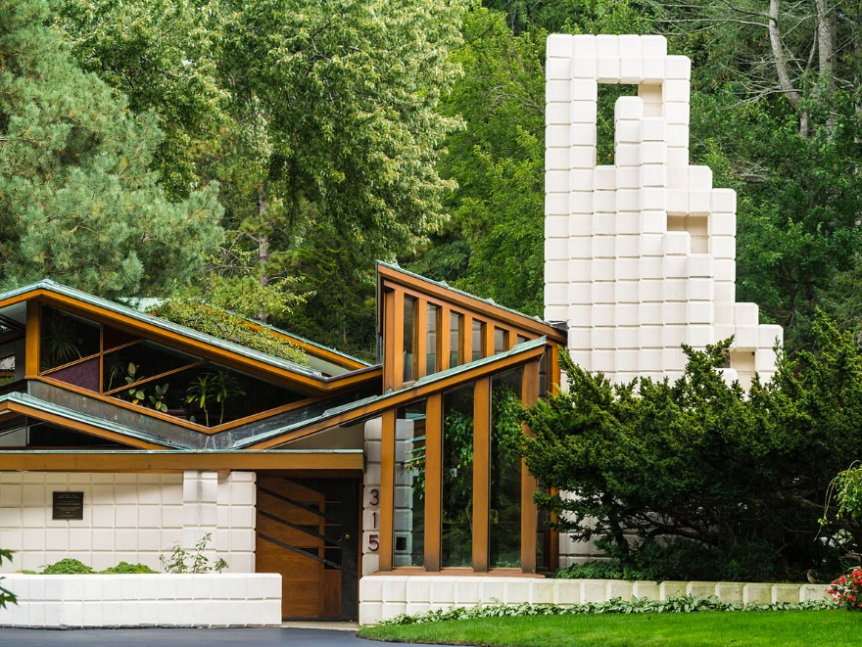
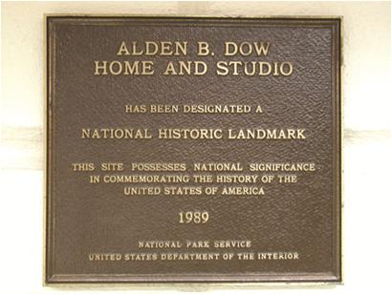
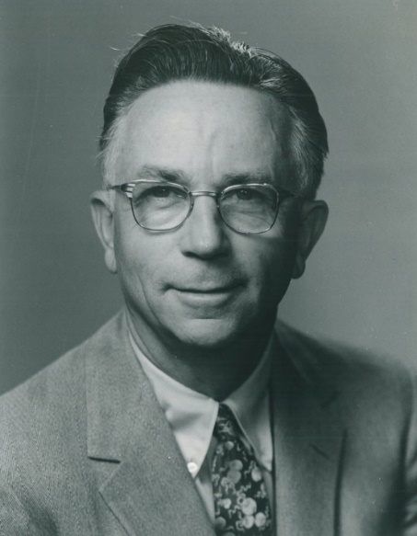
Alden Dow House, Midland, MI (1941)
Alden Dow

Slide 6
Alden Dow House, Midland, MI (1941)
It is the work of architect Alden Dow for his own house and workshop.
The house looks like a garden in every room. Born of organic architecture, reflecting the colors, textures, shapes and balance of nature, the house opens onto a variety of fluid and colorful spaces of great scope while conveying intimacy and comfort. When you enter a low, sheltered entrance, your first view from the inside is breathtaking: two window walls, color, a vaulted ceiling and an unobstructed view of the garden.

Slide 7
Alden Dow House, Midland, MI (1941)
Throughout the house, there are visible building materials, including the building blocks patented in 1935, "Unit Blocks".
Alden Dow and Robert Goodall, a designer by Frank Lloyd Wright, created a diamond block, mostly with a square face in 16 different sizes. This became known as the Alden B unit block construction system. Dow used them to form walls and terraces, as well as decorative elements such as stepping stones in the surrounding pond.

Slide 8
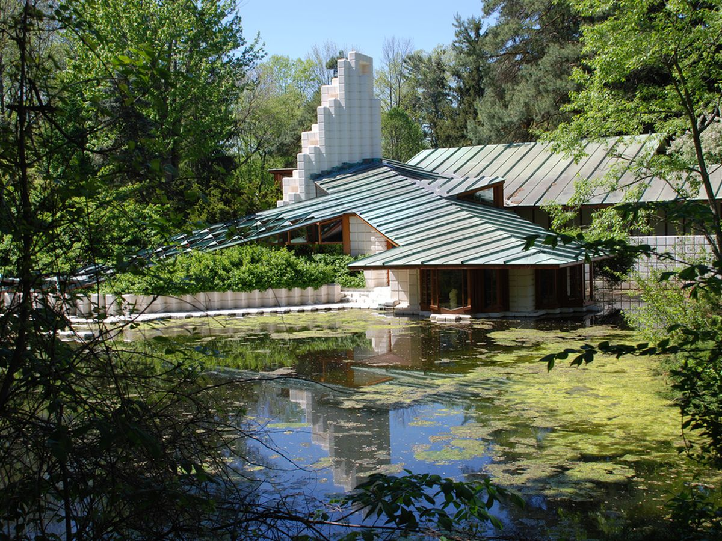
Alden Dow House, Midland, MI (1941)

Slide 9
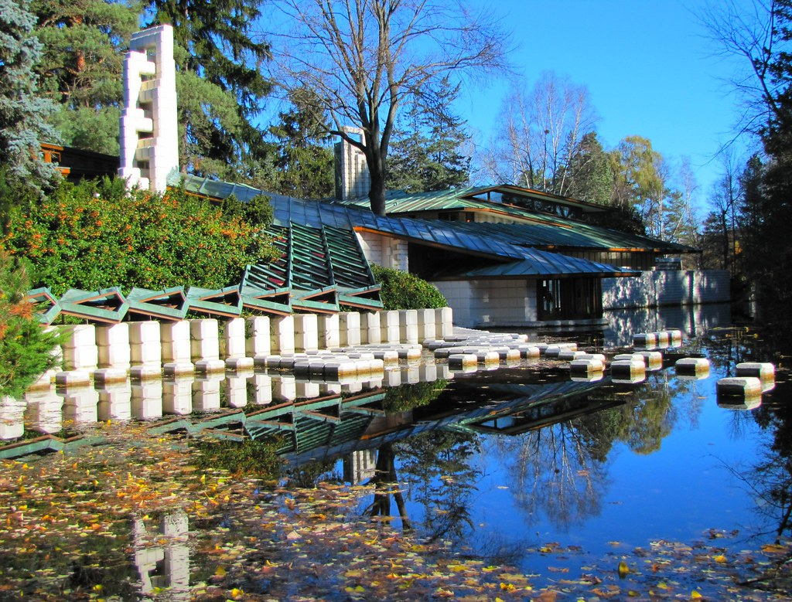
Alden Dow House, Midland, MI (1941)

Slide 10
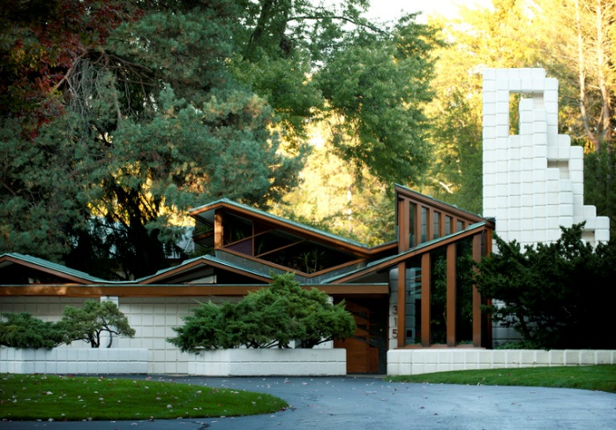
Alden Dow House, Midland, MI (1941)

Slide 11
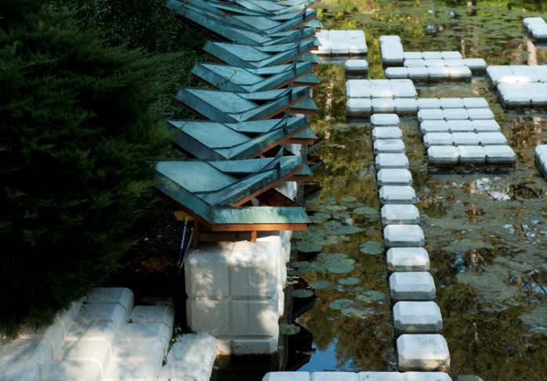
Alden Dow House, Midland, MI (1941)

Slide 12
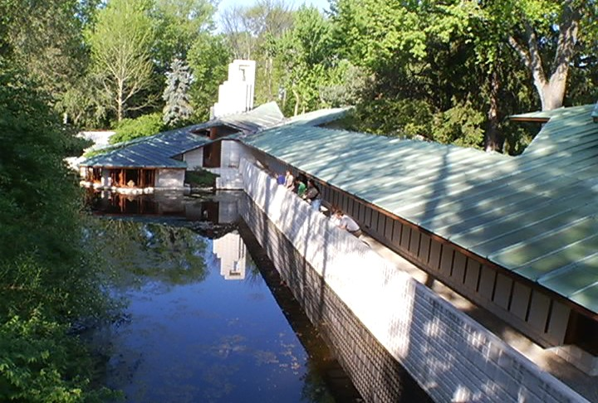
Alden Dow House, Midland, MI (1941)

Slide 13
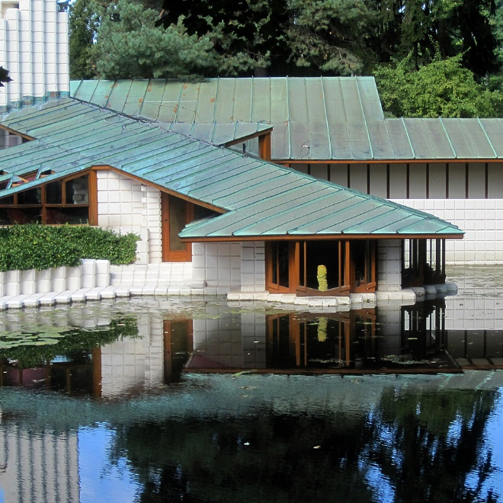
Alden Dow House, Midland, MI (1941)

Slide 14
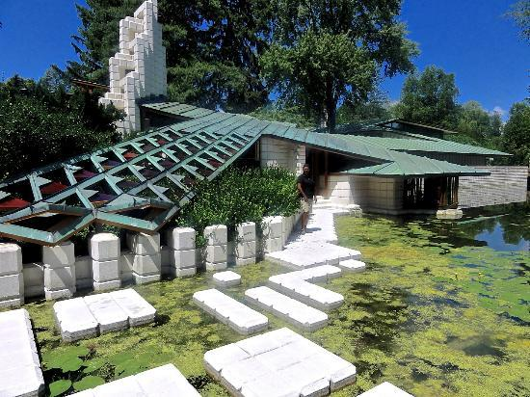
Alden Dow House, Midland, MI (1941)

Slide 15
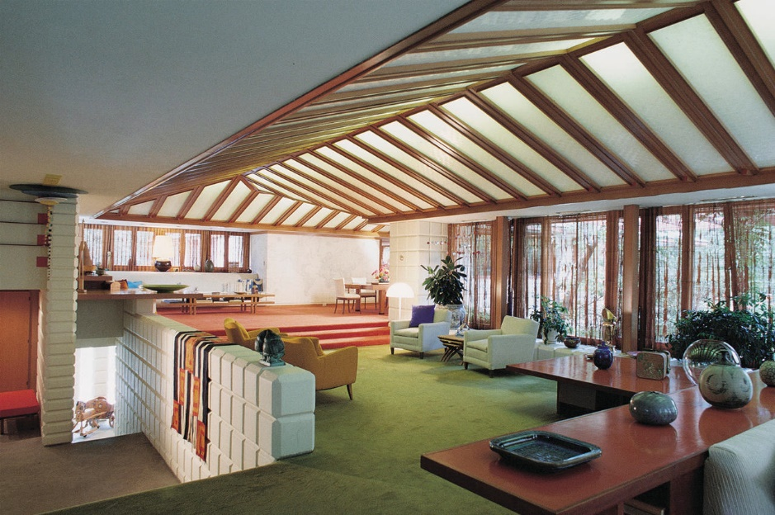
Alden Dow House, Midland, MI (1941)

Slide 16
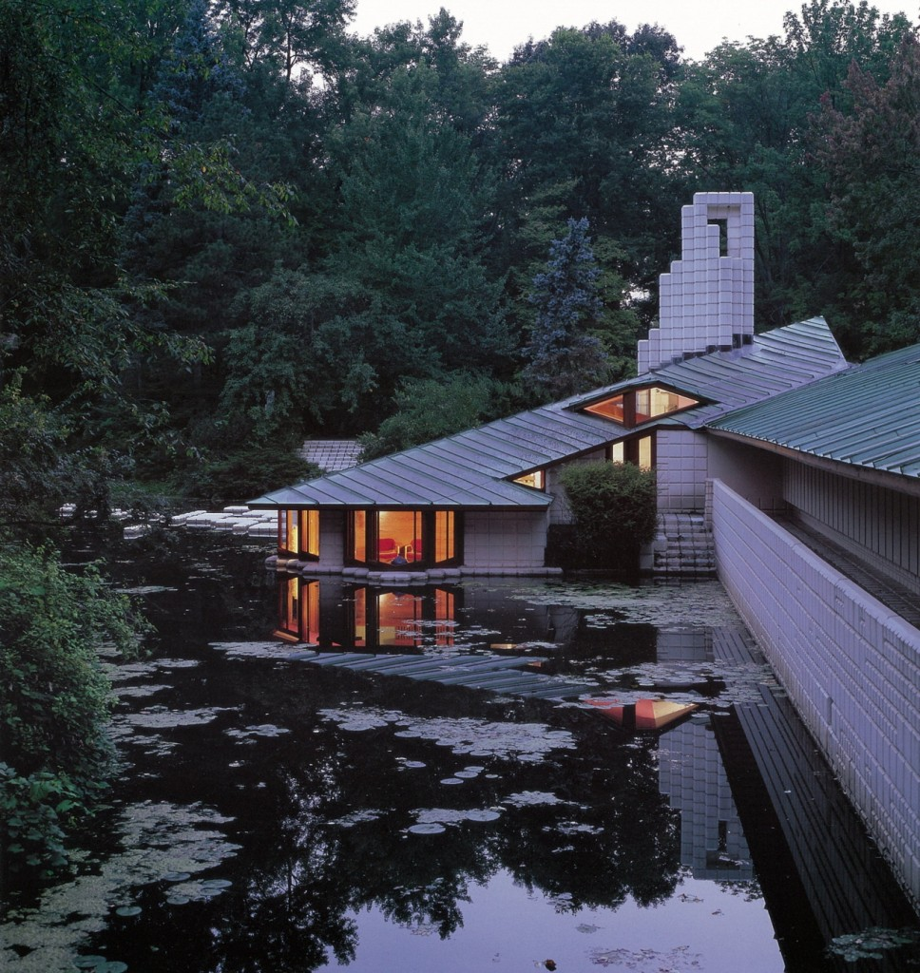
Alden Dow House, Midland, MI (1941)

Slide 17
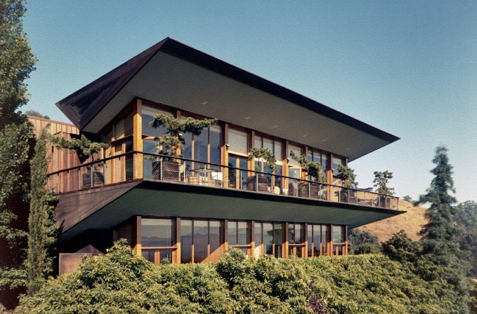
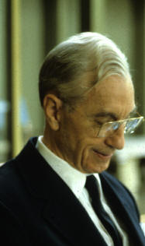
Havens House, Berkeley, CA (1941)
H. H. Harris

Slide 18
Havens House, Berkeley, CA (1941)
It was designed by the architect Harwell H. Harris.
The most striking features of the house are the three inverted triangular trusses supporting the roof, the main and lower floors - a very original concept that makes the house float above the hill and, inside, projects the viewer into the panoramic view.
The main floor includes the entrance, bedroom, bathroom, kitchen with its original appliances, and lounge and dining room.
The lower floor has 2 additional bedrooms and adjoining bathrooms.

Slide 19
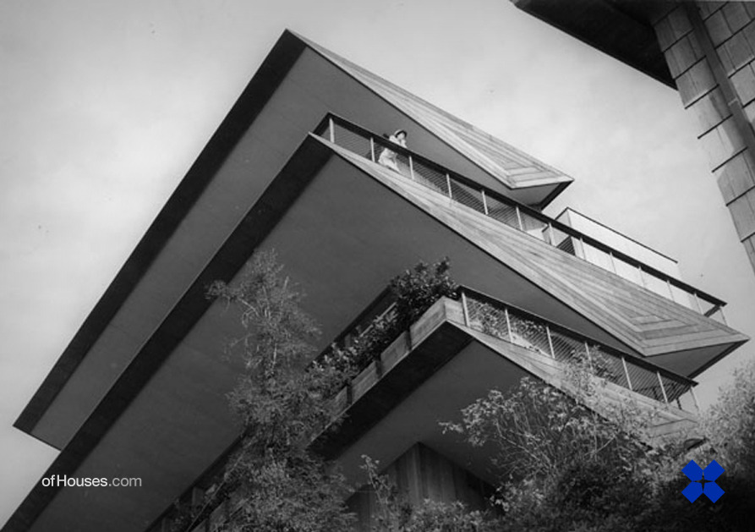
Havens House, Berkeley, CA (1941)

Slide 20
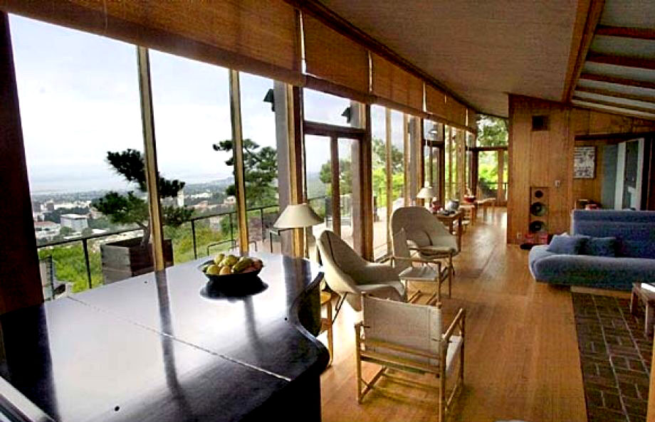
Havens House, Berkeley, CA (1941)

Slide 21
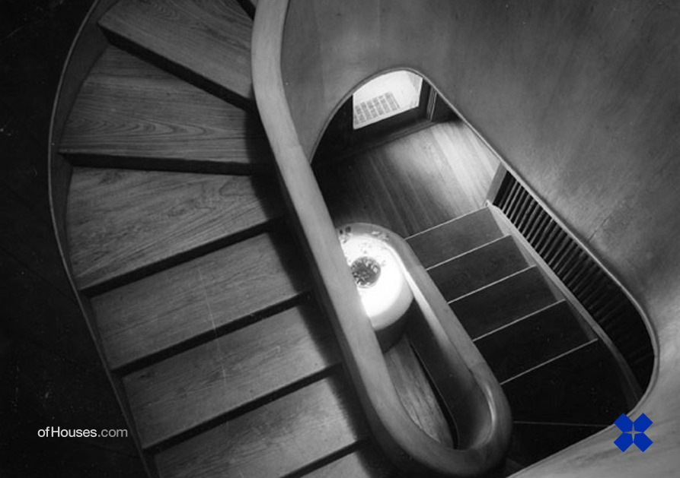
Havens House, Berkeley, CA (1941)

Slide 22
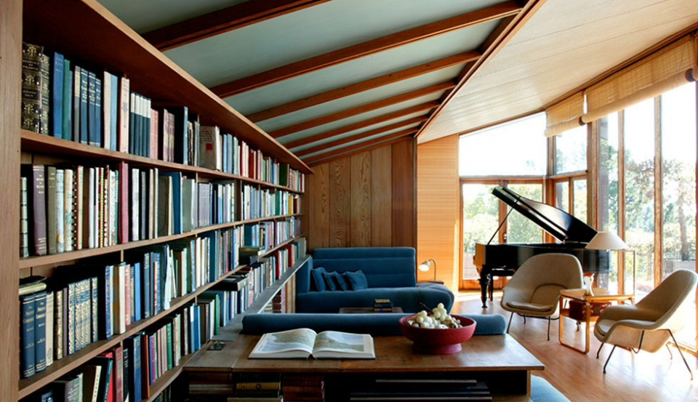
Havens House, Berkeley, CA (1941)

Slide 23
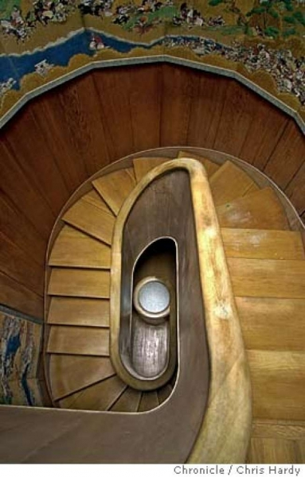
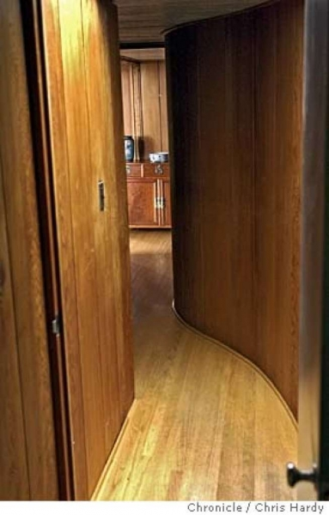
Havens House, Berkeley, CA (1941)

Slide 24
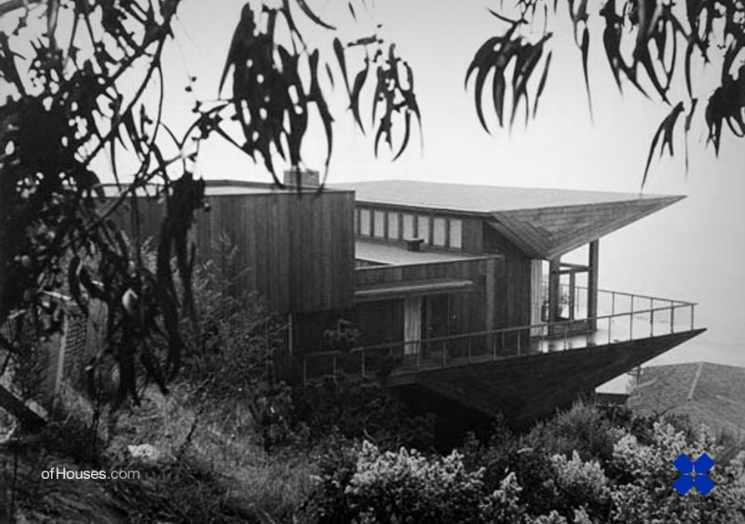
Havens House, Berkeley, CA (1941)

Slide 25
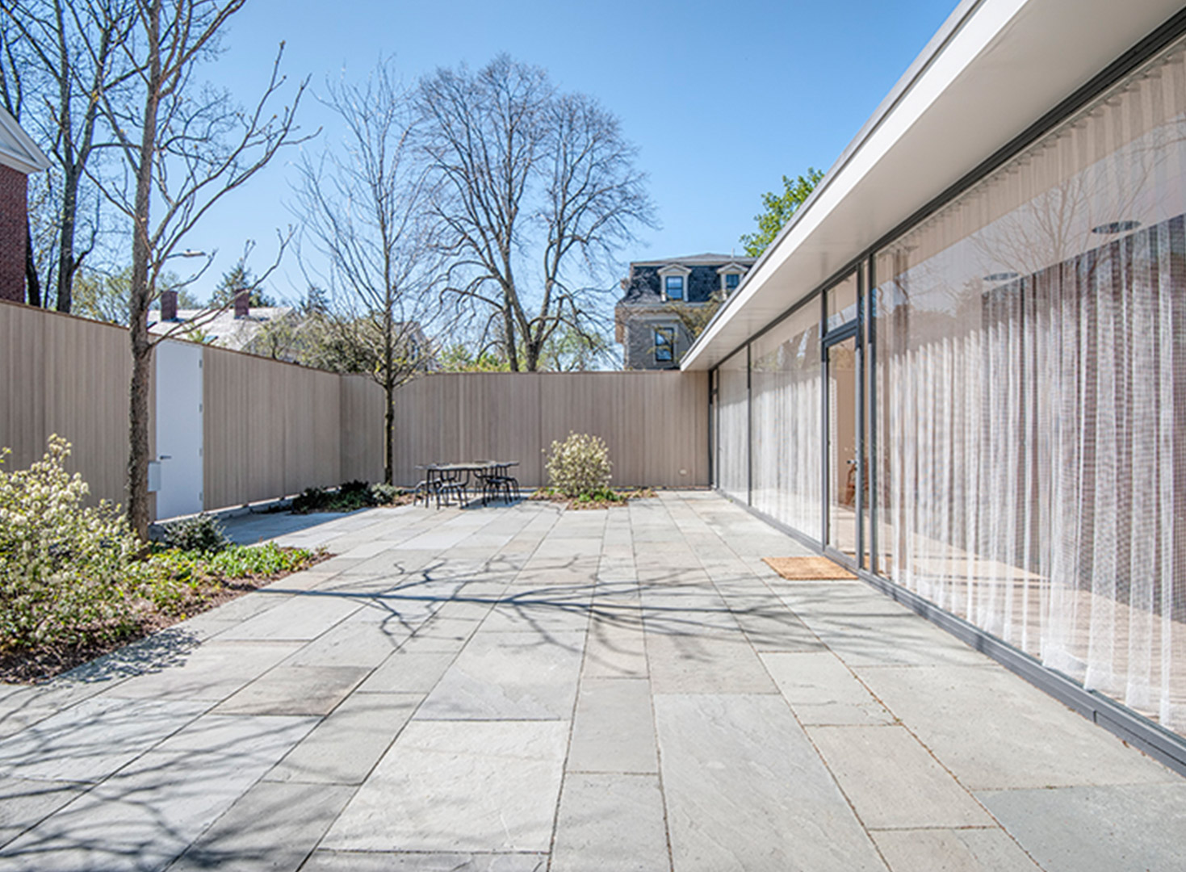
Thesis House, Cambridge, MA (1942)
Philip Johnson

Slide 26
Thesis House, Cambridge, MA (1942)
It is the 1st residence of the architect Philip Johnson as his graduate thesis at the Harvard GSD.
Behind the ten-foot-high perimeter wall, Johnson devoted two-thirds of the site to garden. The remaining third he divided into sleeping, utility, and social areas separated from the garden by a wall of glass under a flat roof. Because of material restrictions in place during World War II, Johnson made extensive use of plywood, including the striated Weldtex panels of the exterior.

Slide 27
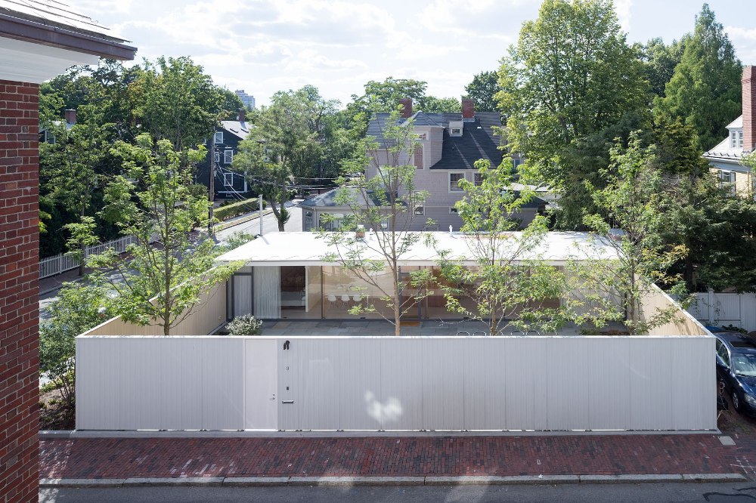
Thesis House, Cambridge, MA (1942)

Slide 28
Thesis House, Cambridge, MA (1942)

Slide 29
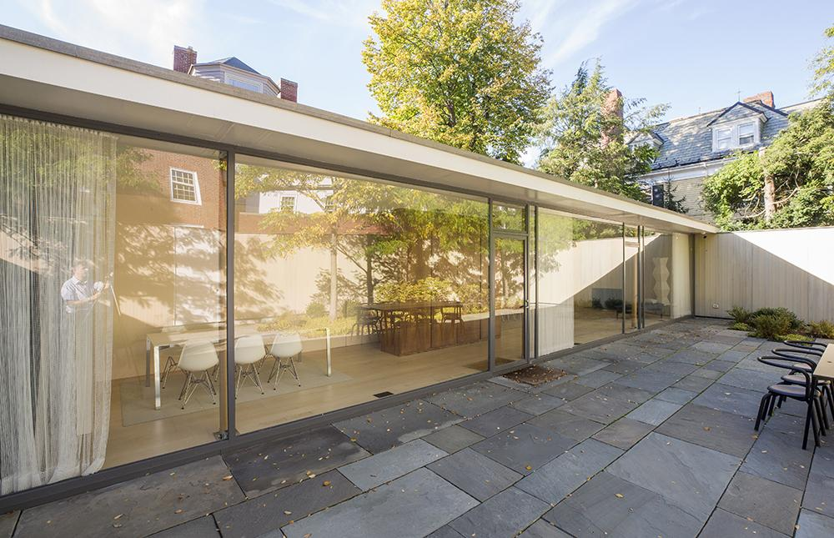
Thesis House, Cambridge, MA (1942)

Slide 30
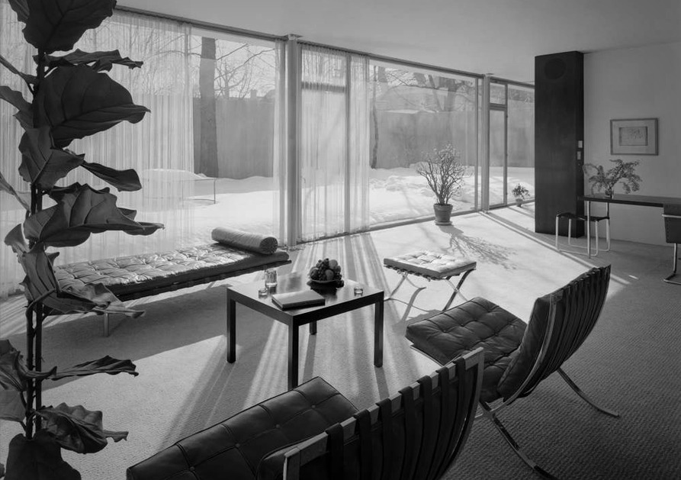
Thesis House, Cambridge, MA (1942)

Slide 31
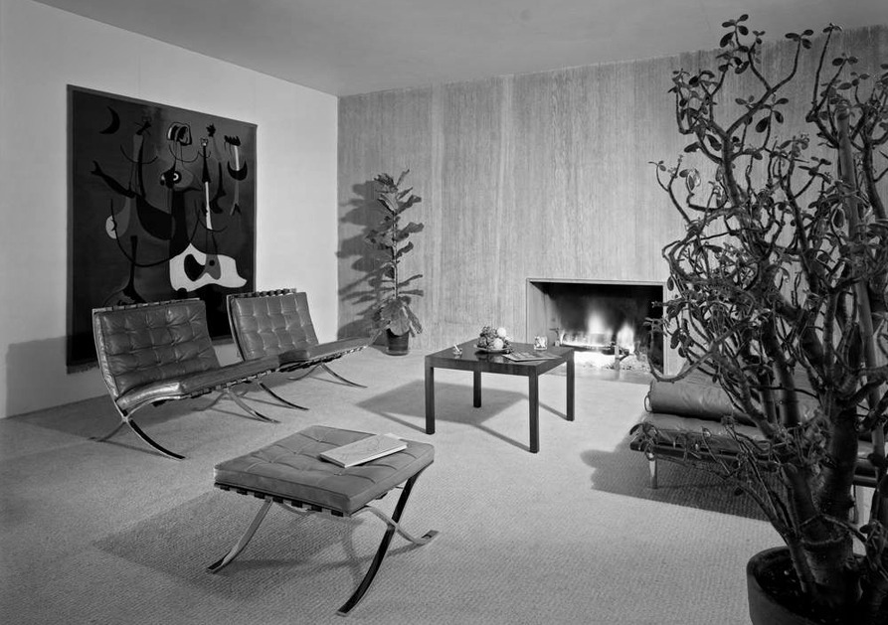
Thesis House, Cambridge, MA (1942)

Slide 32
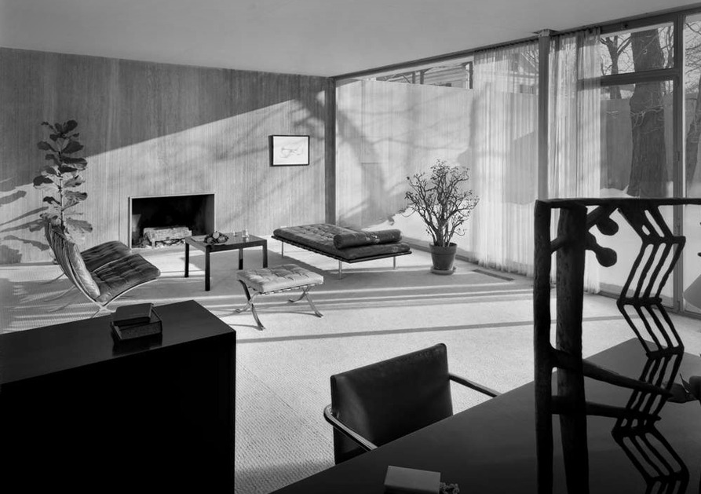
Thesis House, Cambridge, MA (1942)

Slide 33
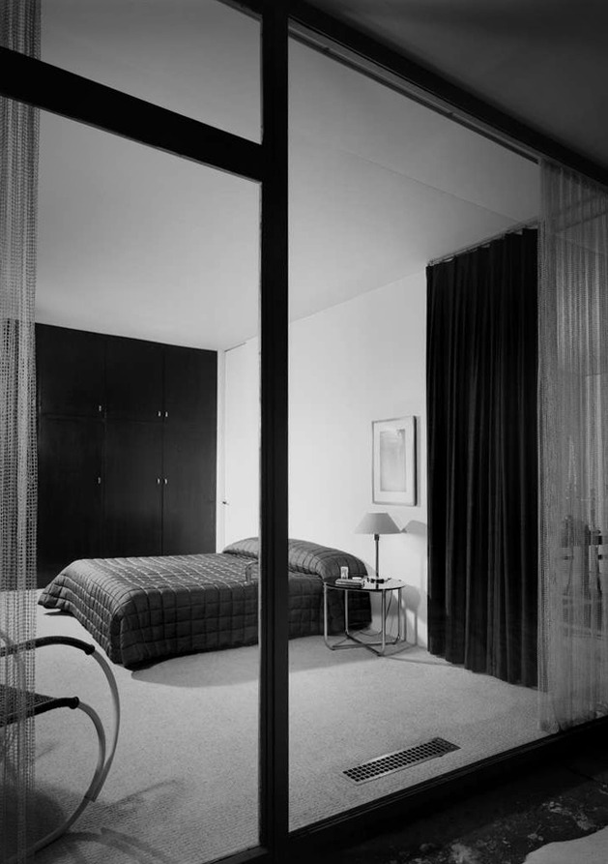
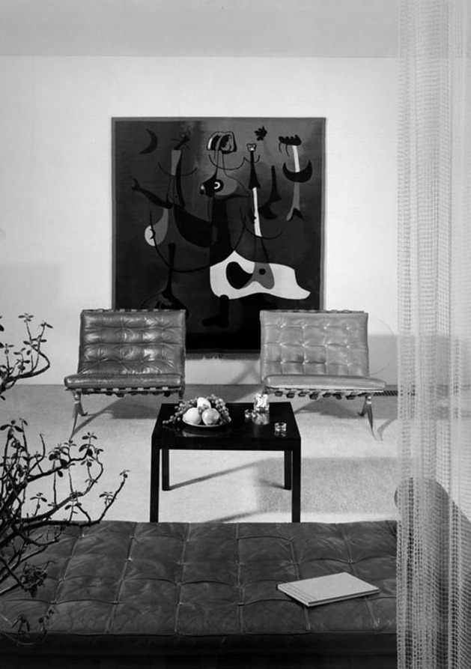
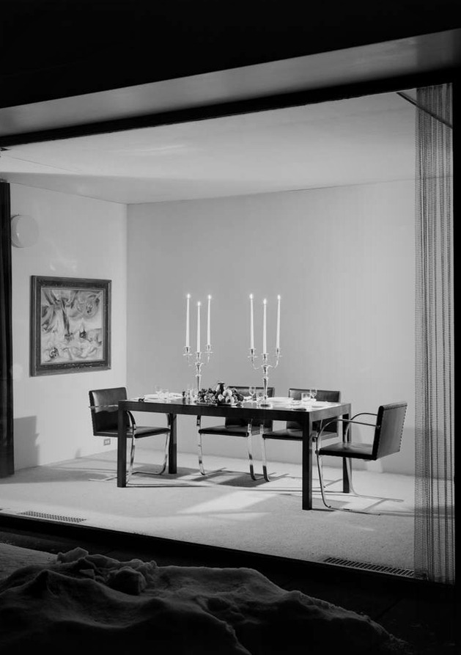
Thesis House, Cambridge, MA (1942)

Slide 34
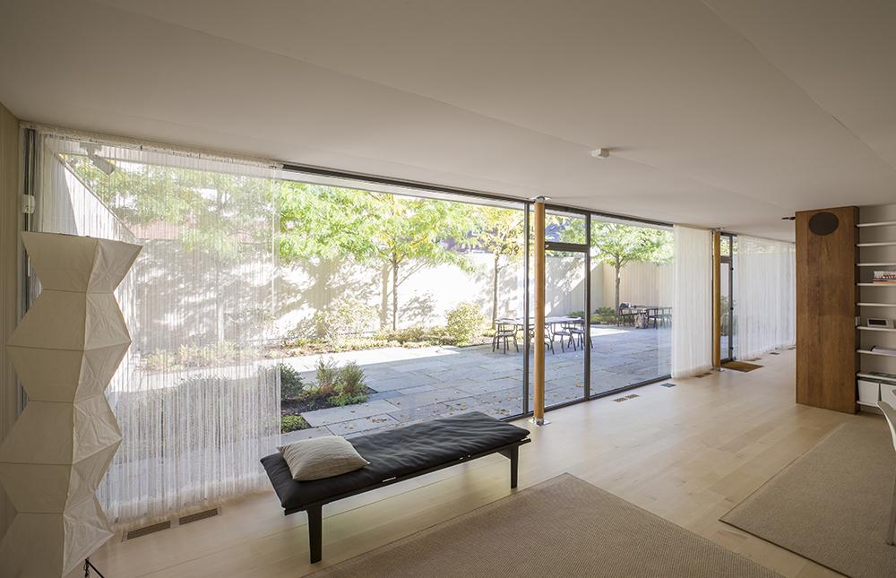
Thesis House, Cambridge, MA (1942)

Slide 35
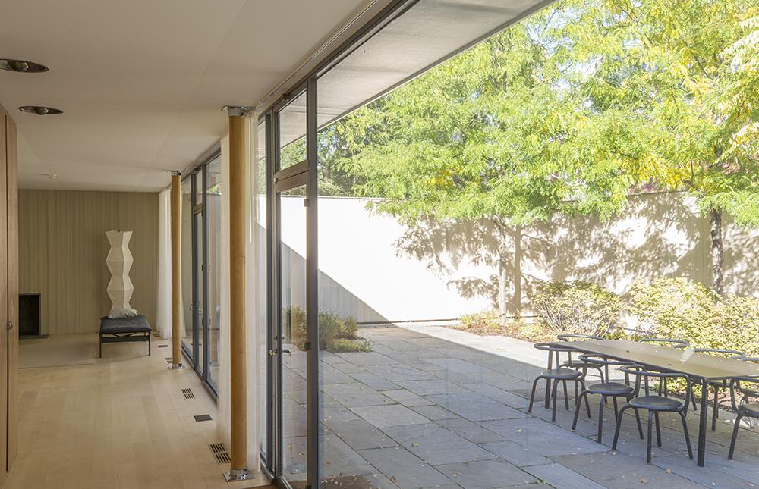
Thesis House, Cambridge, MA (1942)

Slide 36
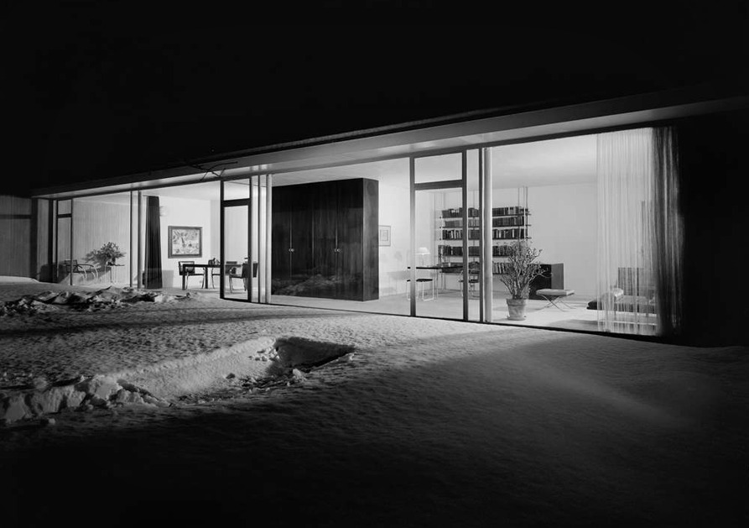
Thesis House, Cambridge, MA (1942)

Slide 37
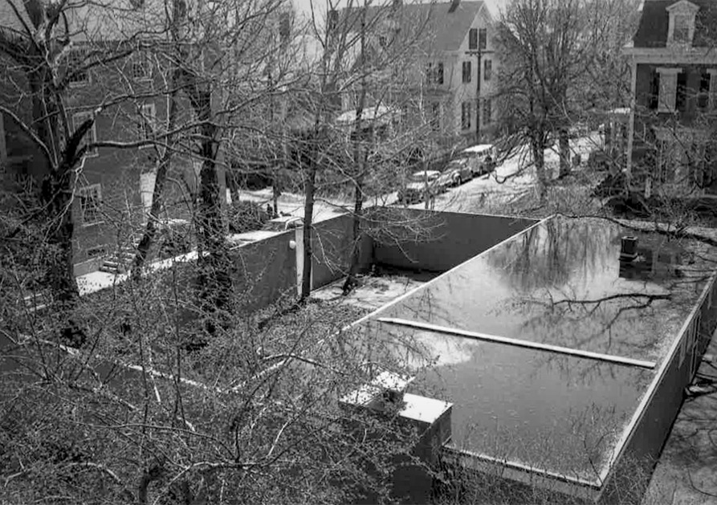
Thesis House, Cambridge, MA (1942)

Slide 38
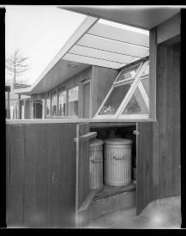
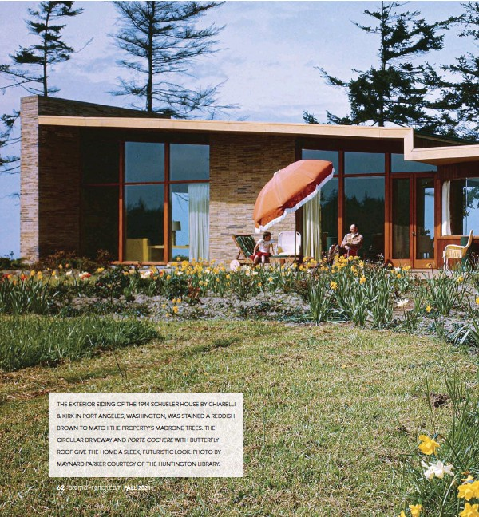
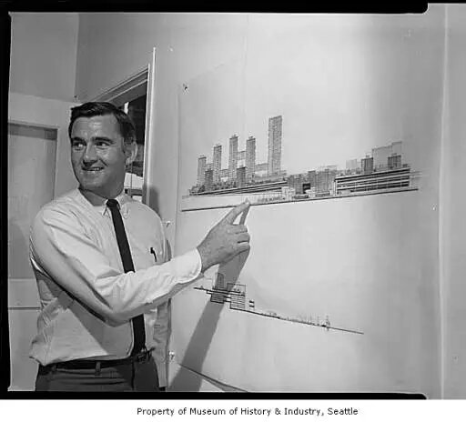
Scheuler House,Port Angeles, PA (1944)
Paul Hayden Kirk

Slide 39
Scheuler House,Port Angeles, PA (1944)
It is the work of the architect Paul Hayden Kirk.
The T-shaped house was a one-story residence with long lines, flat roof and expansive window bands, that had an arc-shaped driveway passing under a butterfly-roofed porte-cochere. The stem of the T, housing the kitchen and service rooms, connected the porte-cochere with the main living areas of the house. A long covered walk, a favorite motif of Kirk, stretched the length of the stem. An interior wall echoed the exterior arc, serving as a curving boundary for the living and dining rooms.

Slide 40
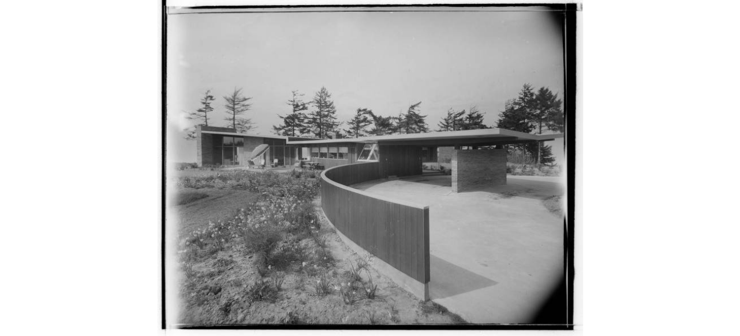
Scheuler House,Port Angeles, PA (1944)

Slide 41
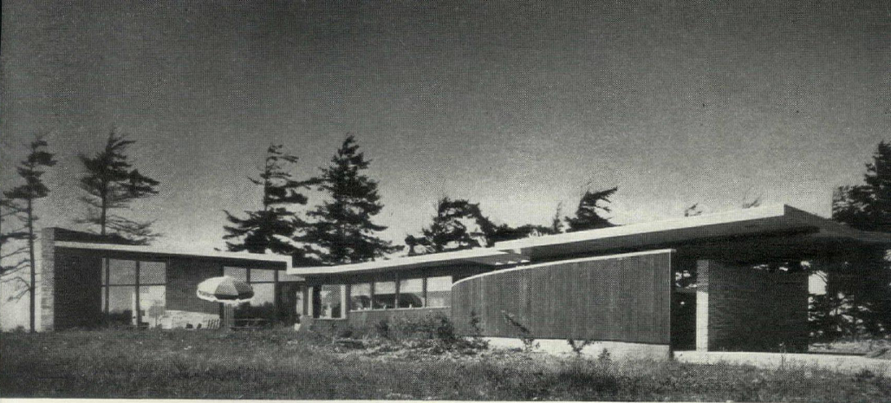
Scheuler House,Port Angeles, PA (1944)

Slide 42
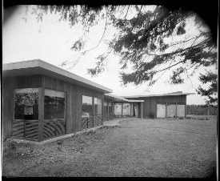
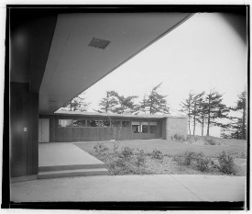
Scheuler House,Port Angeles, PA (1944)

Slide 43
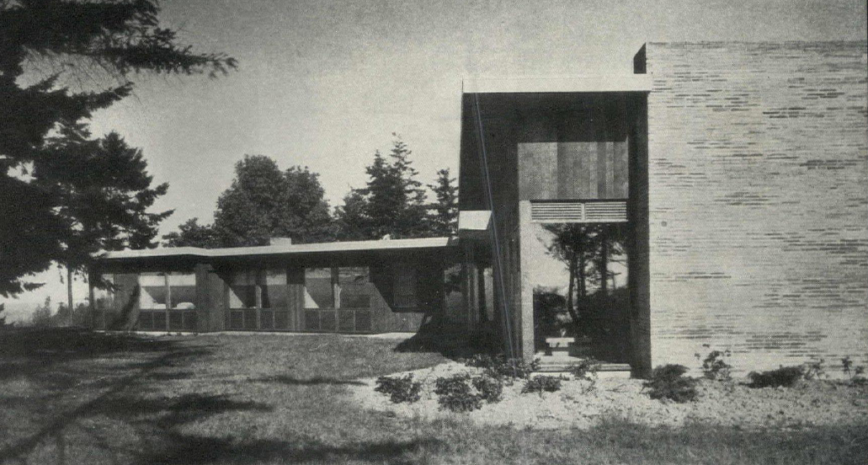
Scheuler House,Port Angeles, PA (1944)

Slide 44
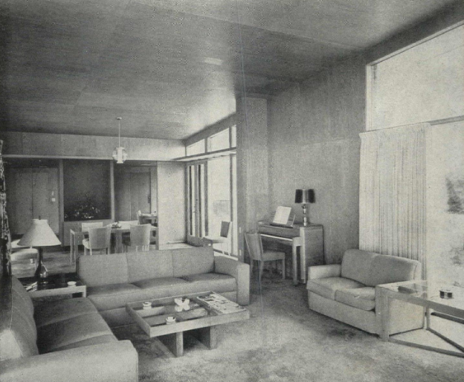
Scheuler House,Port Angeles, PA (1944)

Slide 45
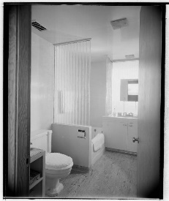
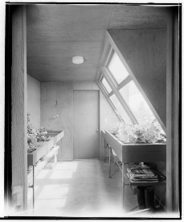
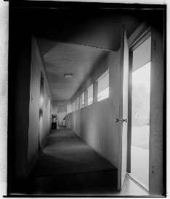
Scheuler House,Port Angeles, PA (1944)

Slide 46
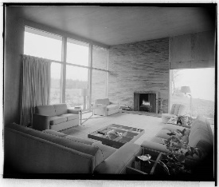
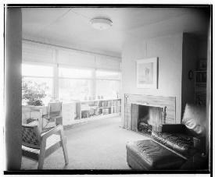
Scheuler House,Port Angeles, PA (1944)

Slide 47
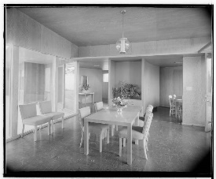
Scheuler House,Port Angeles, PA (1944)

Slide 48
Scheuler House,Port Angeles, PA (1944)

Slide 49
Scheuler House,Port Angeles, PA (1944)

Slide 50
Scheuler House,Port Angeles, PA (1944)

Slide 51
Jacobs House II, Middleton, WI (1944)
F.L. Wright

Slide 52
Jacobs House II, Middleton, WI (1944)
Frank Lloyd Wright designed a passively solar heated and naturally cooled building , which he termed the “Solar Hemicycle”. The Solar Hemicycle is semicircular in plan, featuring a single concave arc of fourteen-foot high glass spanning the two stories both vertically and horizontally, and opening southward to a circular sunken garden and the Wisconsin prairie beyond.
Wright had the house built from stone, concrete, and wood, materials which would allow the house to retain solar energy; the design represents an early attempt at energy-efficient architecture.

Slide 53
Jacobs House II, Middleton, WI (1944)
The north, east, and west sides are bermed up to the height of the clerestory windows on the second floor, protecting the house from cold winter north wind.
Due to their weight, the house's stone walls were not built on the concrete floor, rather, deep foundations filled with crushed stone supported the walls.
The interior lower level features a concrete floor slab for direct absorption and conversion of the incoming radiant solar energy. Imbedded within the floor is a radiant boiler-heated system for back-up heating that emulates and supplements the solar-warmed floor.

Slide 54
Jacobs House II, Middleton, WI (1944)
All interior walls are Wisconsin limestone, providing an irregular and enhanced mass surface area for thermal energy exchange and interior temperature stabilization.
The second floor is a five-bedroom balcony, suspended from the roof joists and hence not requiring obstructing support from below. The front of the balcony is pulled away from the south glazing by several feet, enabling the solar-heated air from below to rise up onto the second floor and into the bedrooms over the full balcony width.

Slide 55
Jacobs House II, Middleton, WI (1944)

Slide 56
Jacobs House II, Middleton, WI (1944)

Slide 57
Jacobs House II, Middleton, WI (1944)

Slide 58
Jacobs House II, Middleton, WI (1944)

Slide 59
Jacobs House II, Middleton, WI (1944)

Slide 60
Jacobs House II, Middleton, WI (1944)

Slide 61
Geller House I, Lawrence, NY (1945)
Herbert Beckhard Marcel Breuer

Slide 62
Geller House I, Lawrence, NY (1945)
It is the work of the architects Marcel Breuer & Herbert Beckhard.
The concept consisted of two elements which have been joined, roughly in the shape of an H. The center of the H divides the daytime and nighttime uses. The exterior was clad in vertical cedar siding, relieved by large expanses of floor to ceiling windows and fieldstone walls. A long, thin rectangle contained the living and dining rooms, along with the kitchen, utility and maid's room. Another wing housed the bedrooms and children's playrooms. The sills, posts, plates, and braces were also constructed from wood (fir).

Slide 63
Geller House I, Lawrence, NY (1945)
The main house interior walls were constructed of weld board while the interior of the garage was constructed of wood. All roofs are flat and were constructed using asphalt and gravel. Rafters are 2”x10” and are spaced 16” on center. The main house was constructed to use dry wells to dispose of roof water, while the garage was designed to use a copper leader to do the same. One of the most prominent technical features that Breuer incorporated into the home’s design was the butterfly-pitched roof, which eliminated gutters and drains at the roof edge.

Slide 64
Geller House I, Lawrence, NY (1945)
The full-height windows on both sides of the living area were frosted on the lower sections so that both light and privacy could be incorporated into the space. These glass walls were double thickness, providing insulation and eliminating heat loss. Outside the house, horizontal louvers in front of the upper panels further reduce glare inside the living room from glare from the sky and helped to create a more even distribution of daylight. Marcel Breuer’s Geller House, for its innovative bi-nuclear design, was a major contributor to the modern aesthetic which developed on Long Island during that time period. Has been demolished in January 2022.

Slide 65
Geller House I, Lawrence, NY (1945)

Slide 66
Geller House I, Lawrence, NY (1945)

Slide 67
Geller House I, Lawrence, NY (1945)

Slide 68
Geller House I, Lawrence, NY (1945)

Slide 69
Geller House I, Lawrence, NY (1945)

Slide 70
Kaufmann House, Palm Springs, CA (1946)
R. Neutra
Marmol Radziner
Mr Ms Kaufman

Slide 71
Kaufmann House, Palm Springs, CA (1946)
Richard Neutra built this house in the Palm Springs desert for the same owner as Fallingwater, Edgar J. Kaufmann.
It is a private home, which can not be part of the network ¨Iconic Houses¨. This house of 5 bedrooms (and 5 bathrooms) of 297 m2 is built from a metal structure with very fine pillars giving total transparency with the surrounding desert. In 1992, the house was completely restored with the architects Marmol and Radziner. A stone quarry in Utah has even been reopened occasionally. The aluminum joinery and sun shades have been redone according to the original plans.

Slide 72
Kaufmann House, Palm Springs, CA (1946)

Slide 73
Kaufmann House, Palm Springs, CA (1946)

Slide 74
Kaufmann House, Palm Springs, CA (1946)

Slide 75
Kaufmann House, Palm Springs, CA (1946)

Slide 76
Kaufmann House, Palm Springs, CA (1946)

Slide 77
Kaufmann House, Palm Springs, CA (1946)

Slide 78
Kaufmann House, Palm Springs, CA (1946)

Slide 79
Kaufmann House, Palm Springs, CA (1946)

Slide 80
Kaufmann House, Palm Springs, CA (1946)

Slide 81
Kaufmann House, Palm Springs, CA (1946)

Slide 82
Kaufmann House, Palm Springs, CA (1946)

Slide 83
Kaufmann House, Palm Springs, CA (1946)

Slide 84
Kaufmann House, Palm Springs, CA (1946)

Slide 85
Kaufmann House, Palm Springs, CA (1946)

Slide 86
Kaufmann House, Palm Springs, CA (1946)

Slide 87
Kaufmann House, Palm Springs, CA (1946)

Slide 88
Kaufmann House, Palm Springs, CA (1946)

Slide 89
Kaufmann House, Palm Springs, CA (1946)

Slide 90
Kaufmann House, Palm Springs, CA (1946)

Slide 91
The Booth House, Bedford, NY (1946)
Philip Johnson

Slide 92
The Booth House, Bedford, NY (1946)
It is the work and the 1st commission of the architect Philip Johnson .
Single storey house located at the top of a hill, it includes a ground floor with a living / dining room with large bay windows and a large brick fireplace separating the public space from the kitchen, 2 bedrooms, and 2 bathrooms.
It also includes a basement and an independent studio with the same architectural type.
Steel beams and columns support masonry walls and full-height bay windows.

Slide 93
The Booth House, Bedford, NY (1946)

Slide 94
The Booth House, Bedford, NY (1946)

Slide 95
The Booth House, Bedford, NY (1946)
The Studio

Slide 96
The Booth House, Bedford, NY (1946)

Slide 97
Loewy House, Palm Springs, CA (1946)
Albert Frey
Raymond Loewy

Slide 98
Loewy House, Palm Springs, CA (1946)
It is the work of the architect Albert Frey.
The Loewy House consists of 2 long, narrow rectangles at right angles to each other which surround a pool that passes under one of the sides of the house. The only strong vertical element is the back of the fireplace, which denotes the entry, located at the intersection of the 2 rectangles.
At this junction, the walls become static, and separate and differentiate the outside from inside. On entering the house, one passes through another wall to find oneself outside again. To enter a room, one must again pass through one of the wall planes. The pool comes into the house, also blurring the distinction between the outside and inside.

Slide 99
Loewy House, Palm Springs, CA (1946)

Slide 100
Loewy House, Palm Springs, CA (1946)

Slide 101
Loewy House, Palm Springs, CA (1946)

Slide 102
Loewy House, Palm Springs, CA (1946)

Slide 103
Loewy House, Palm Springs, CA (1946)

Slide 104
Loewy House, Palm Springs, CA (1946)

Slide 105
Loewy House, Palm Springs, CA (1946)

Slide 106
Loewy House, Palm Springs, CA (1946)

Slide 107
Loewy House, Palm Springs, CA (1946)

Slide 108
Haines Hall House, Kentfield, CA (1946)
Warren Callister
Warren Callister & Jack Hillmer
Jack Hillmer

Slide 109
Haines Hall House, Kentfield, CA (1946)
It is the work of the architects Warren Callister & Jack Hillmer.
It includes a dramatic cantilevered deck, mountain and valley views. The house is very much still as-built and well-maintained, plus it's easy to see the joy these two young architects took in both the materials (made with steel, concrete, glass and reclaimed redwood) they were using and the exuberance of that cantilever.

Slide 110
Haines Hall House, Kentfield, CA (1946)

Slide 111
Haines Hall House, Kentfield, CA (1946)

Slide 112
Haines Hall House, Kentfield, CA (1946)

Slide 113
Haines Hall House, Kentfield, CA (1946)

Slide 114
Haines Hall House, Kentfield, CA (1946)

Slide 115
Haines Hall House, Kentfield, CA (1946)

Slide 116
Haines Hall House, Kentfield, CA (1946)

Slide 117
Haines Hall House, Kentfield, CA (1946)

Slide 118
Haines Hall House, Kentfield, CA (1946)

Slide 119
Haines Hall House, Kentfield, CA (1946)

Slide 120
Haines Hall House, Kentfield, CA (1946)

Slide 121
Geller House I, Lawrence, NY (1945)
THE END

