Slide 1
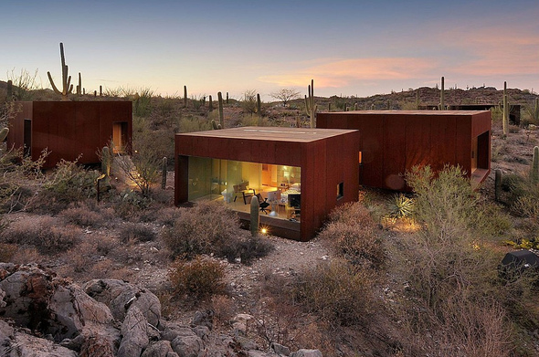
US. Modernist Houses
2000-2002

Slide 2
US Modernist Houses 2000 – 2002
The purpose of this presentation is to show you the most outstanding Modern Movement inspired houses in the United States by great architects.
Some of them have become icons of contemporary architecture (members of the iconic.org network) and are recognized and protected as such.
They remain unique either by their constructive principle, or by their location, or by their theoretical importance, or by their perfect integration into the landscape.

Slide 3
US Modernist Houses
Many of the houses presented in this slide show (after the year 2000) were found on the archdaily website which is the world’s largest architecture platform : it lists houses with architectural interest or singular architecture around the world with many illustrations. If they are shown here, it is because they are already considered as iconic.

Slide 4
US Modernist Houses
Jackson Retreat, Anne Fougeron, CA.
Tubac House, Rick Joy, AZ.
Cube House, Simon Ungers, NY.
Desert Nomad House, Rick Joy, AZ.
Sherman Residence, TOLO firm, CA.
View Silo House, Michael Rotondi, MT.
Pfanner House, Zoka Zola, IL.
Portabello Estate, Brion Jeannette, CA.
Scorpion House, Jones Studio, AZ.

Slide 5
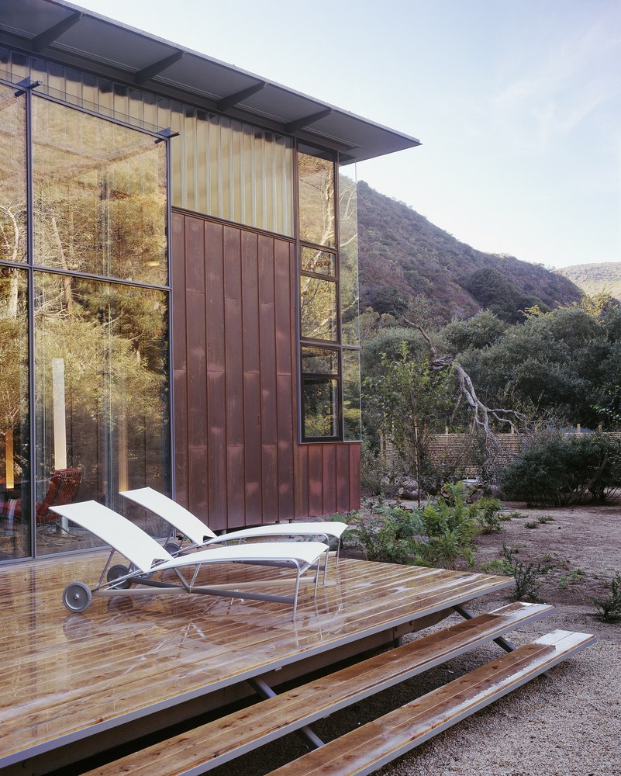
Jackson Retreat, Big Sur, CA (2000)
Anne Fougeron

Slide 6
Jackson Retreat, Big Sur, CA (2000)
It is the work of the architect Anne Fougeron.
The house is composed of 4 volumes, all made of different materials, that are interwoven and interconnected to create visually and spatially complex exterior and interior spaces.
The main volume of the house runs parallel to the canyon with a butterfly roof and glass corners that reach out to the sky and the light at the open ends. The thin roof sits delicately above a band of extruded glass, connecting to the roof structure with extremely thin rods that are invisible on the exterior.

Slide 7
Jackson Retreat, Big Sur, CA (2000)
At the corners of the house, two story clear windows frame the views of the redwoods and the sky at the ridge of the canyon.
This volume is clad in standing seam copper. On the ground floor, 2 bedrooms at the opposing ends of the house enclose in the middle the 2 story communal living space, the fireplace room and the loft library above. A combination of transparent glass and extruded channel glass reflects and dapples the light on the inside, creating an ever-changing interior with a warm play of light and shadow throughout the day.

Slide 8
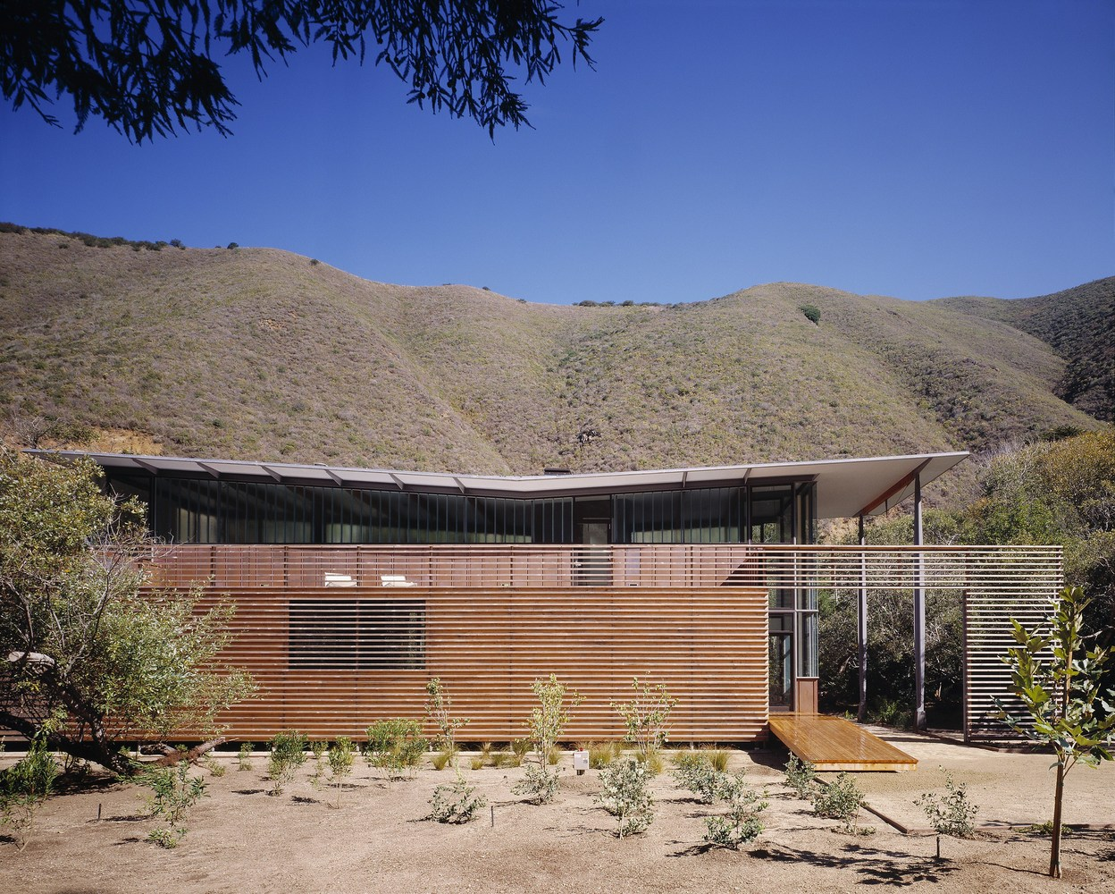
Jackson Retreat, Big Sur, CA (2000)

Slide 9
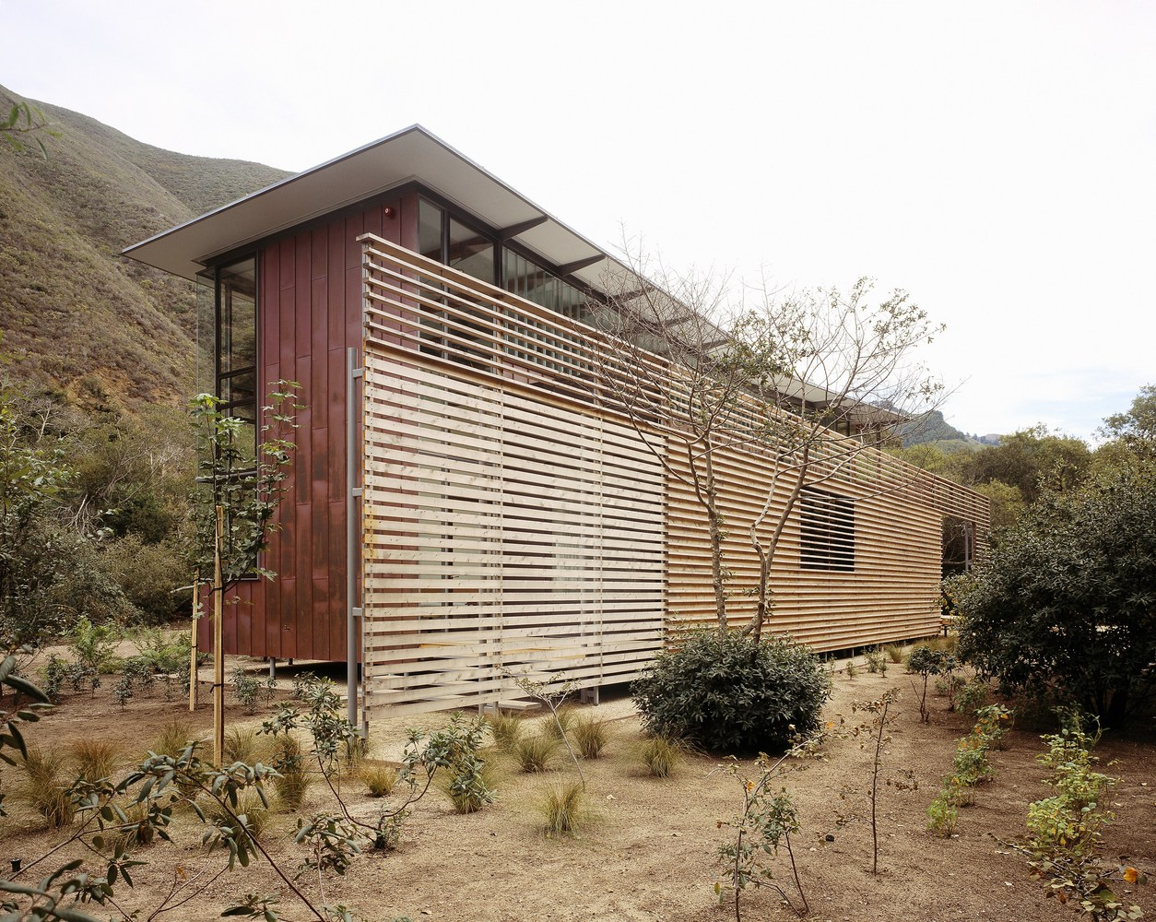
Jackson Retreat, Big Sur, CA (2000)

Slide 10
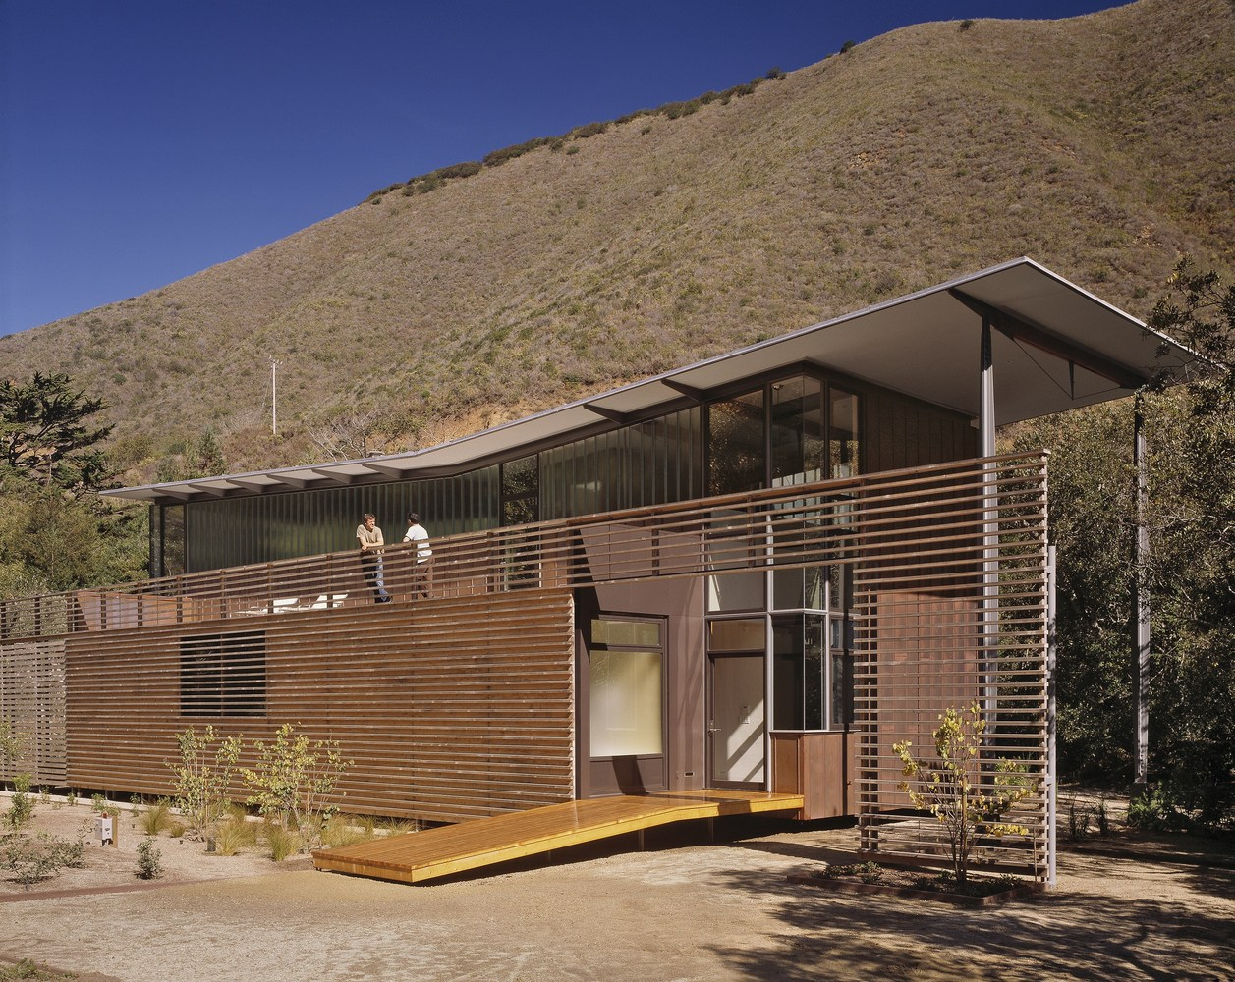
Jackson Retreat, Big Sur, CA (2000)

Slide 11
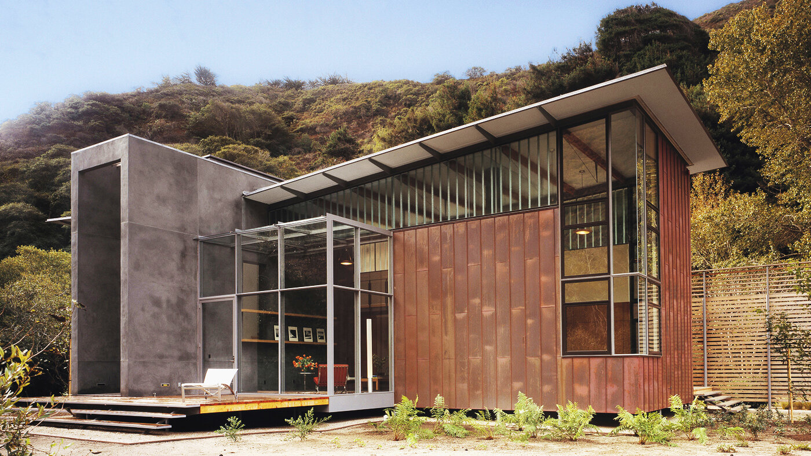
Jackson Retreat, Big Sur, CA (2000)

Slide 12
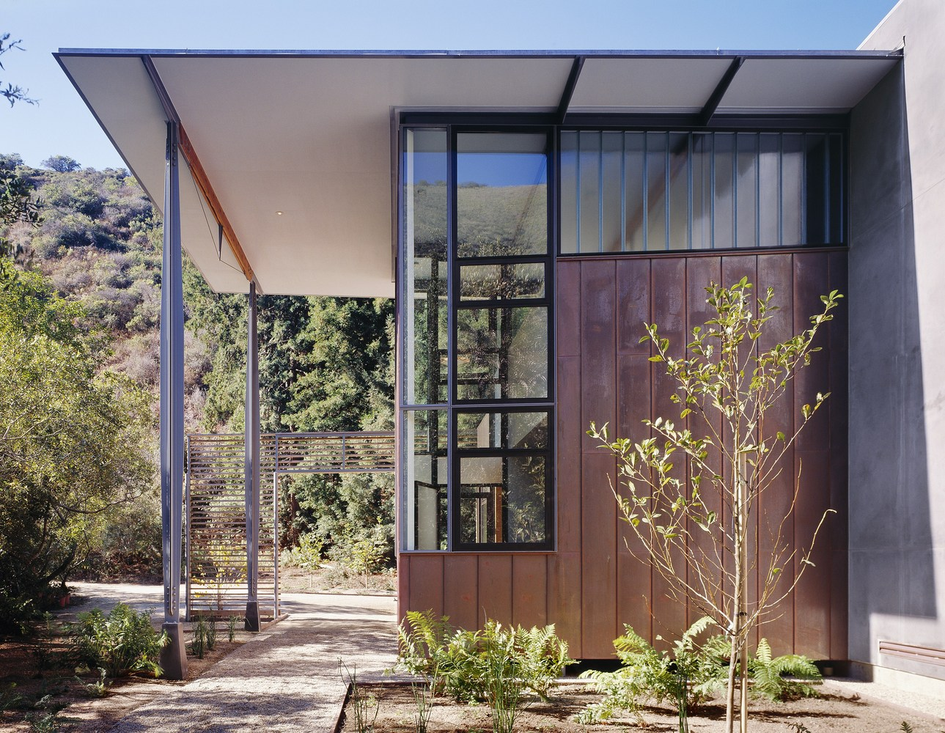
Jackson Retreat, Big Sur, CA (2000)

Slide 13
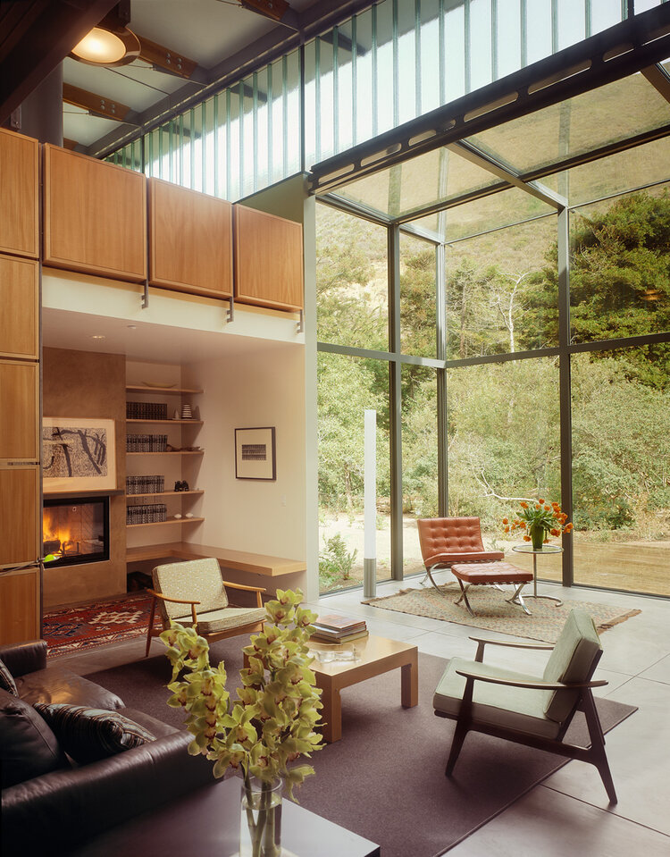
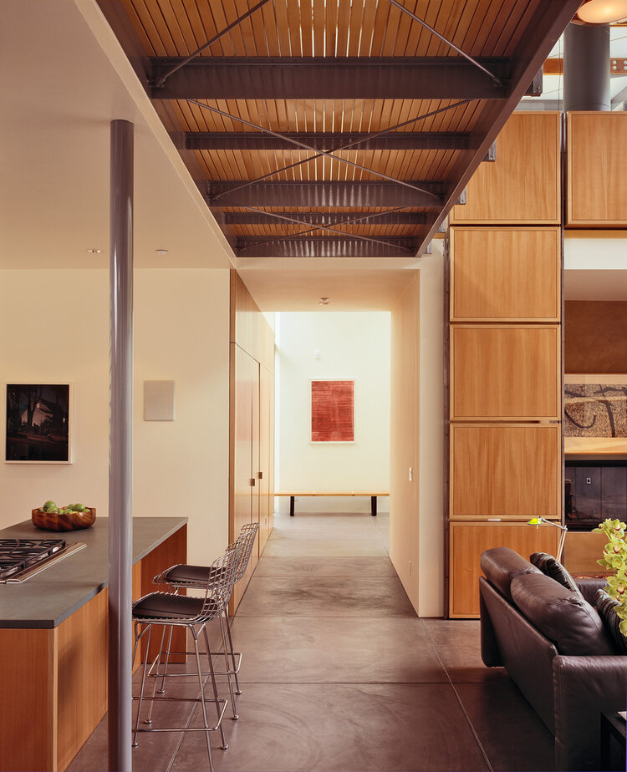
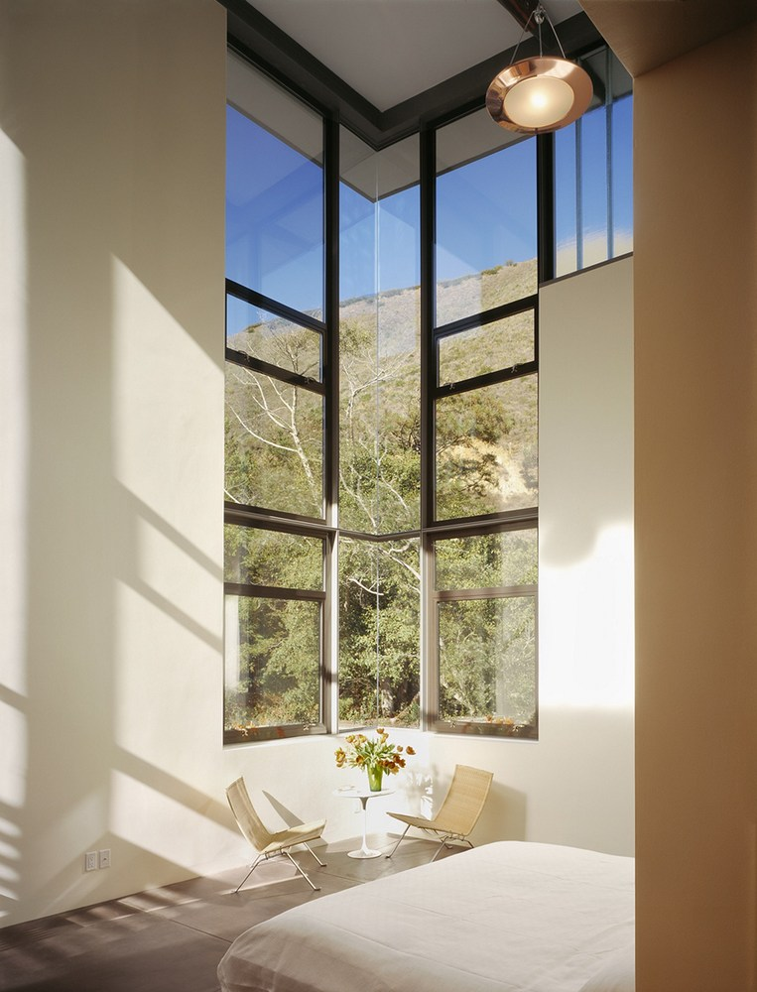
Jackson Retreat, Big Sur, CA (2000)

Slide 14
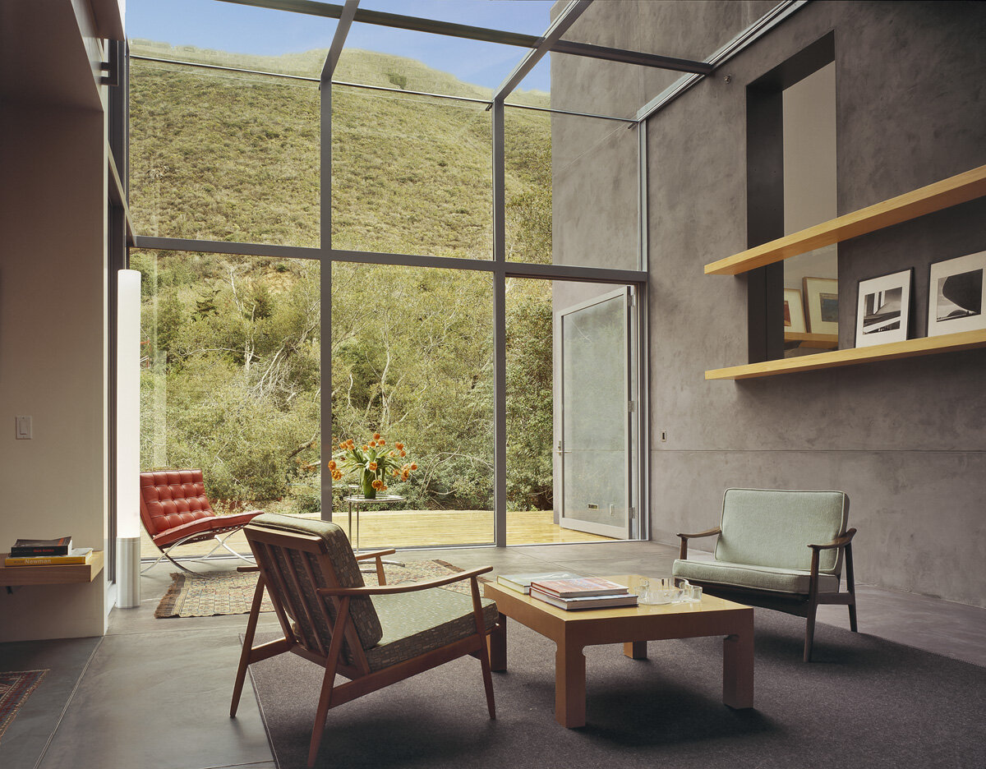
Jackson Retreat, Big Sur, CA (2000)

Slide 15
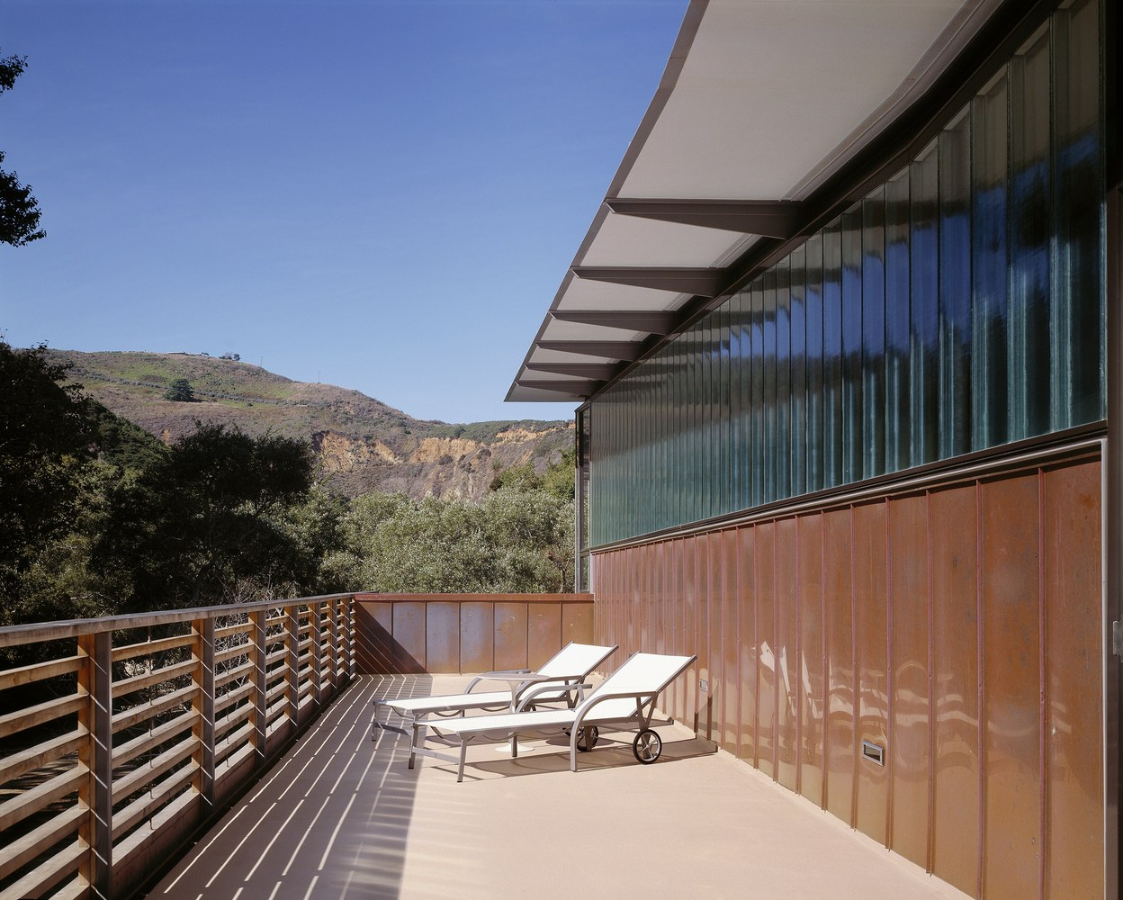
Jackson Retreat, Big Sur, CA (2000)

Slide 16
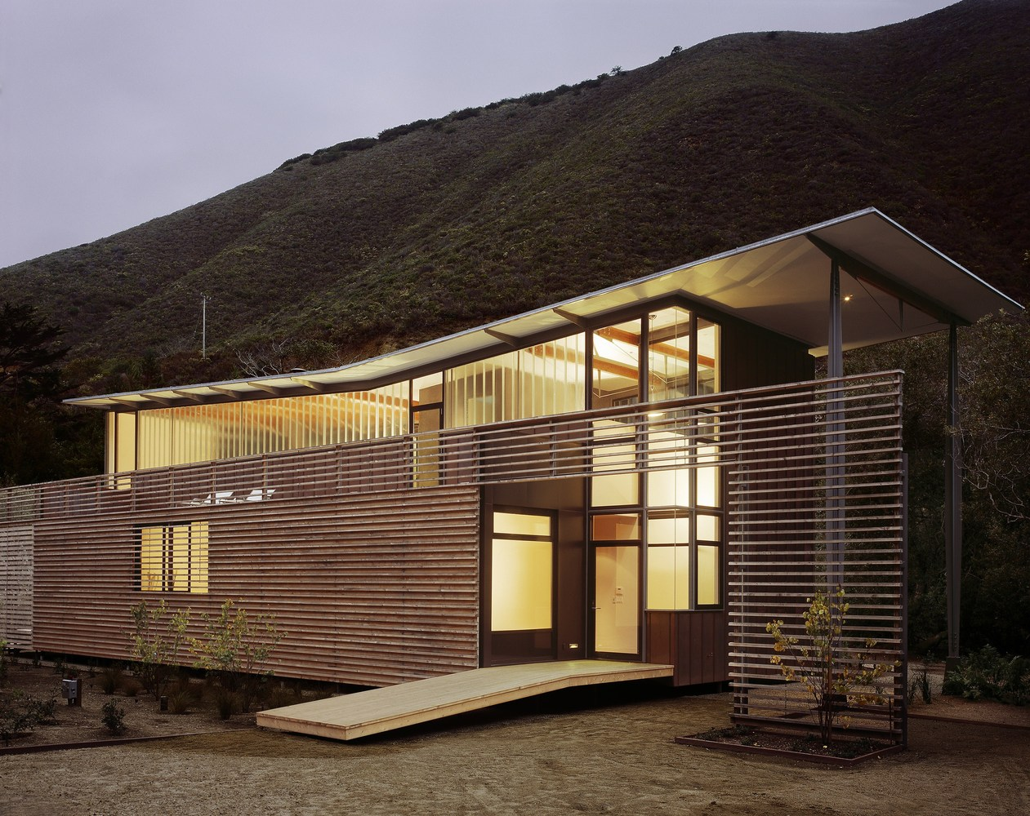
Jackson Retreat, Big Sur, CA (2000)

Slide 17
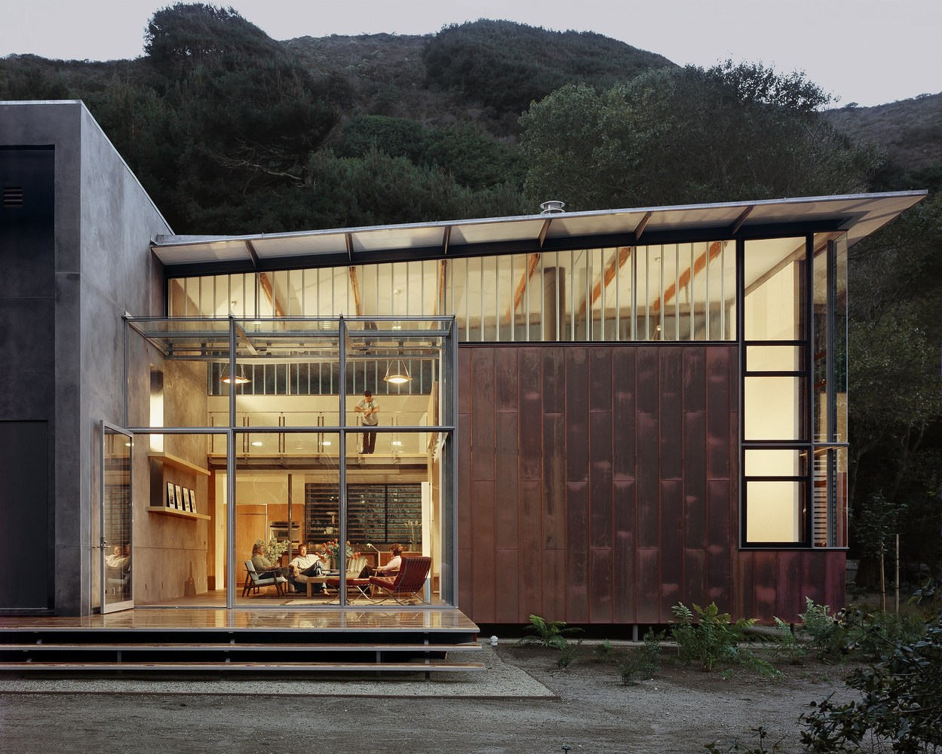
Jackson Retreat, Big Sur, CA (2000)

Slide 18
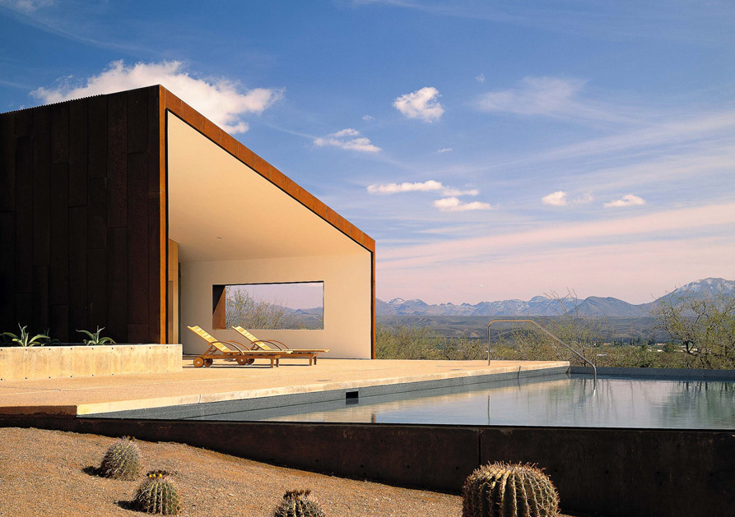
Tubac House, Tubac, AZ (2000)
Rick Joy
Rick Joy Architects

Slide 19
Tubac House, Tubac, AZ (2000)
It is the work of the architect Rick Joy.
On approach, the gravel drive reveals the glazed ends of two forms and a garden of barrel cactuses. The co-positioning of the two simple shed volumes creates a large linear courtyard below which provides relief from the expansive setting and offers a framed views of Tumacacori Peak. The descent down gives way to the protected courtyard, where cool, shaded areas, reflections, trickling water, hummingbirds, and the smells of fresh sage and flowers provide respite from the wild beyond. The coarseness of the rough steel exterior contrasts with the refinement of the interior palette, and protruding steel box window forms frame specific views of lightning storms and numerous iconic distant mountain forms

Slide 20
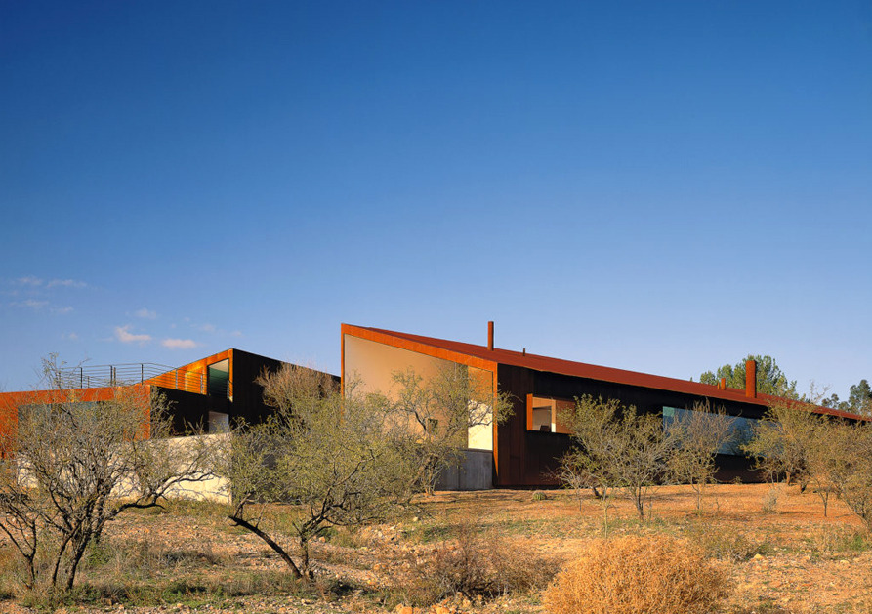
Tubac House, Tubac, AZ (2000)

Slide 21
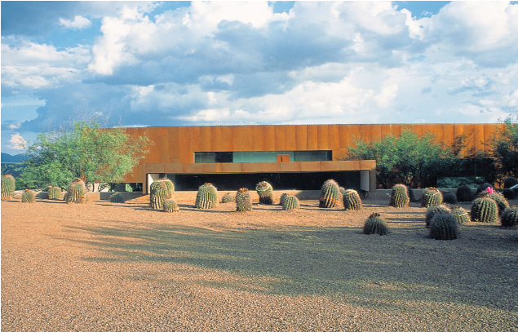
Tubac House, Tubac, AZ (2000)

Slide 22
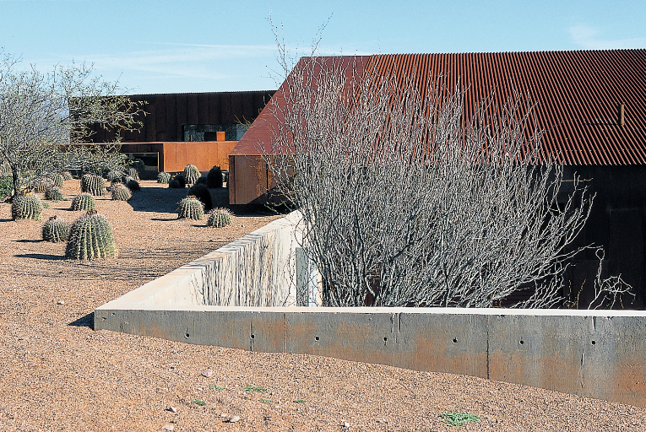
Tubac House, Tubac, AZ (2000)

Slide 23
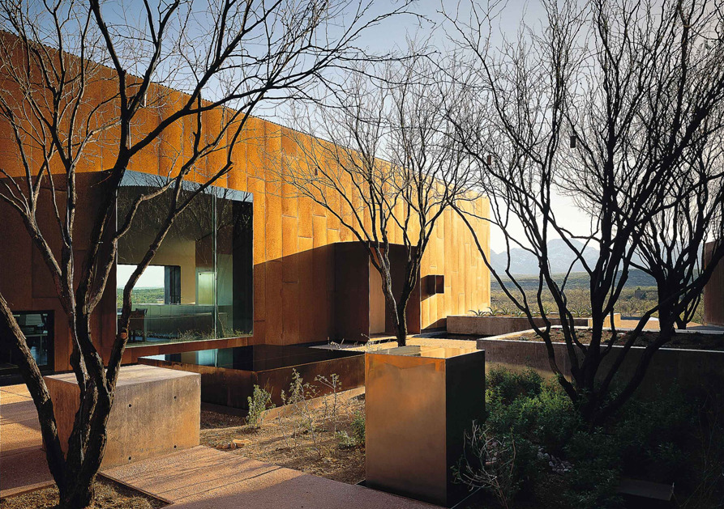
Tubac House, Tubac, AZ (2000)

Slide 24
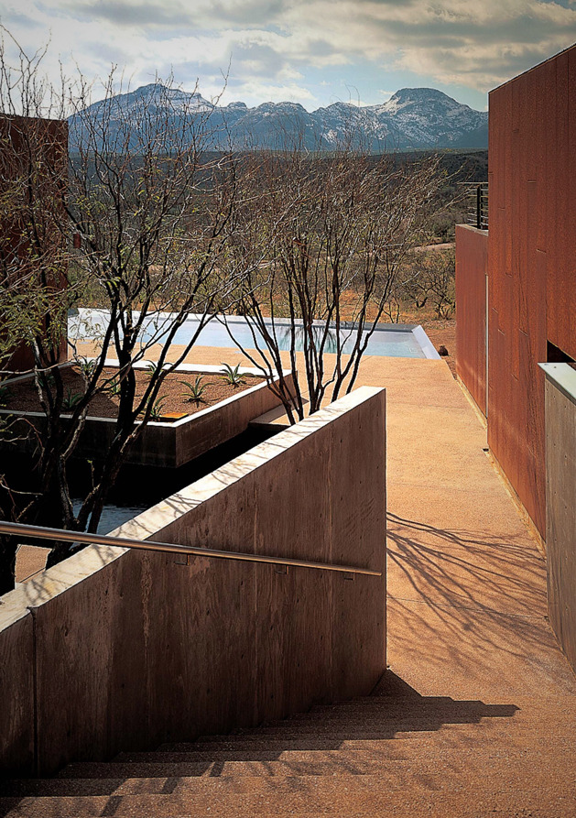
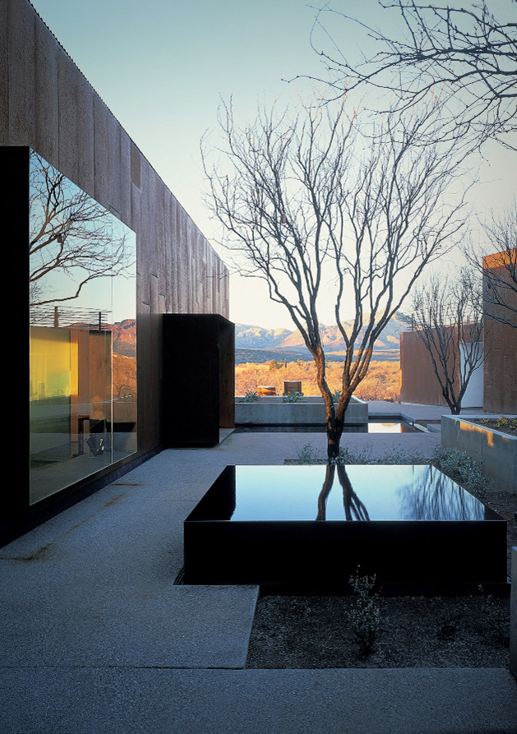
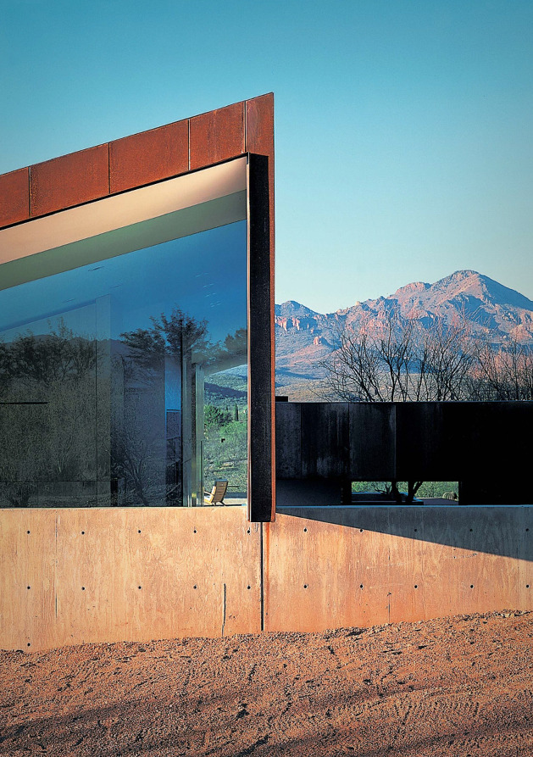
Tubac House, Tubac, AZ (2000)

Slide 25
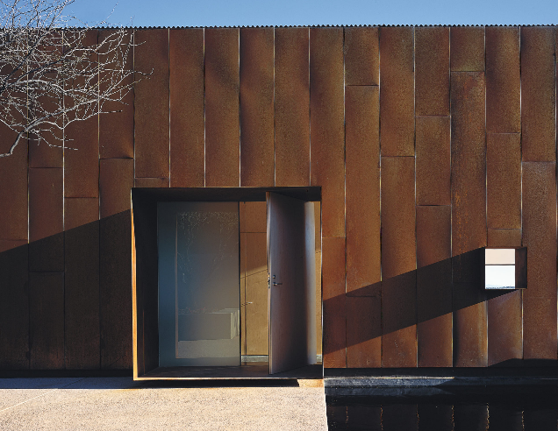
Tubac House, Tubac, AZ (2000)

Slide 26
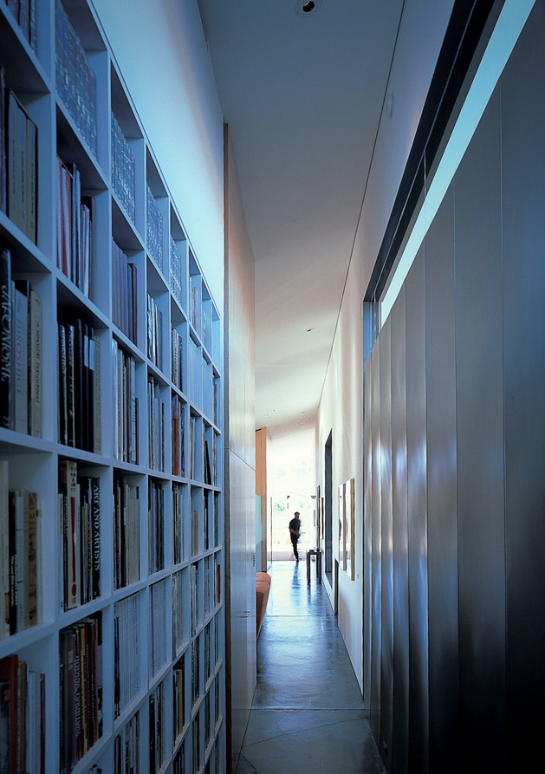
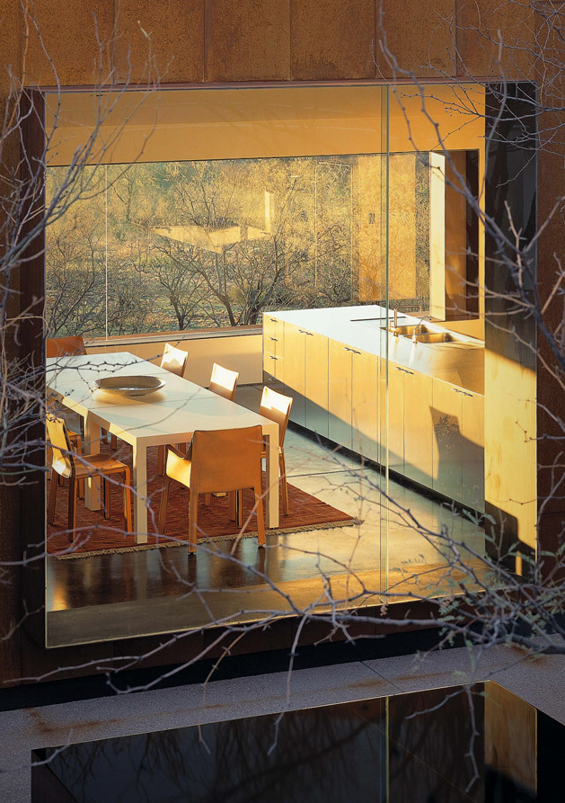
Tubac House, Tubac, AZ (2000)

Slide 27
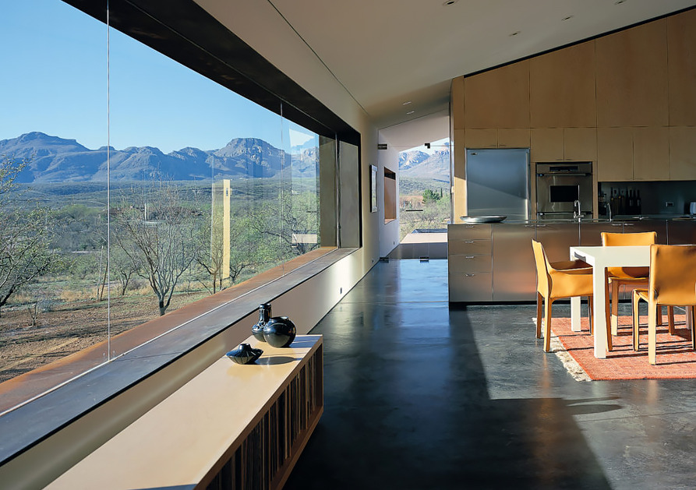
Tubac House, Tubac, AZ (2000)

Slide 28
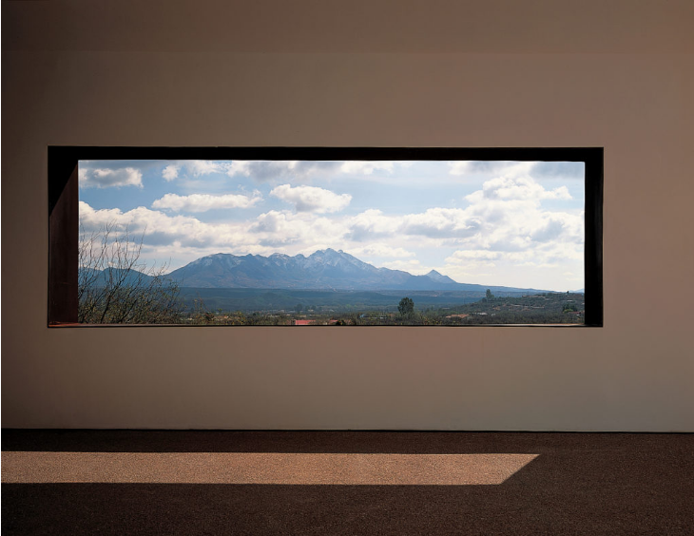
Tubac House, Tubac, AZ (2000)

Slide 29
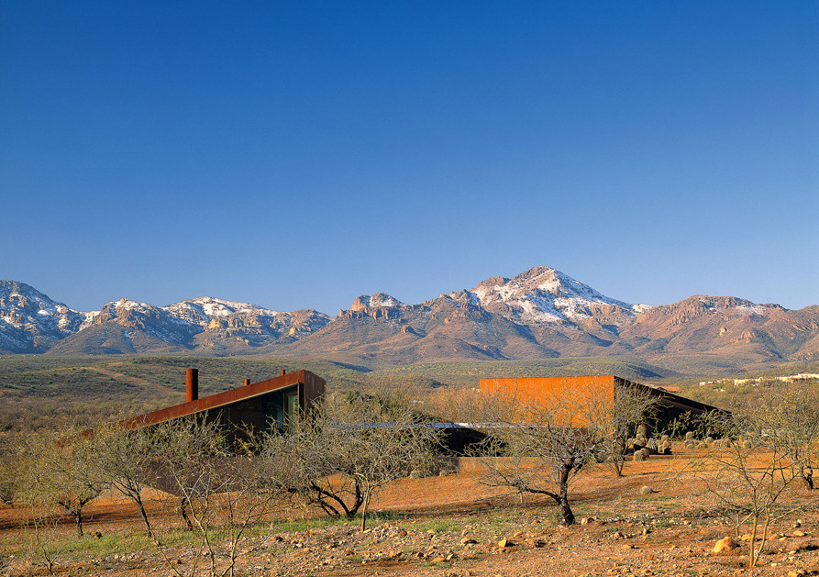
Tubac House, Tubac, AZ (2000)

Slide 30
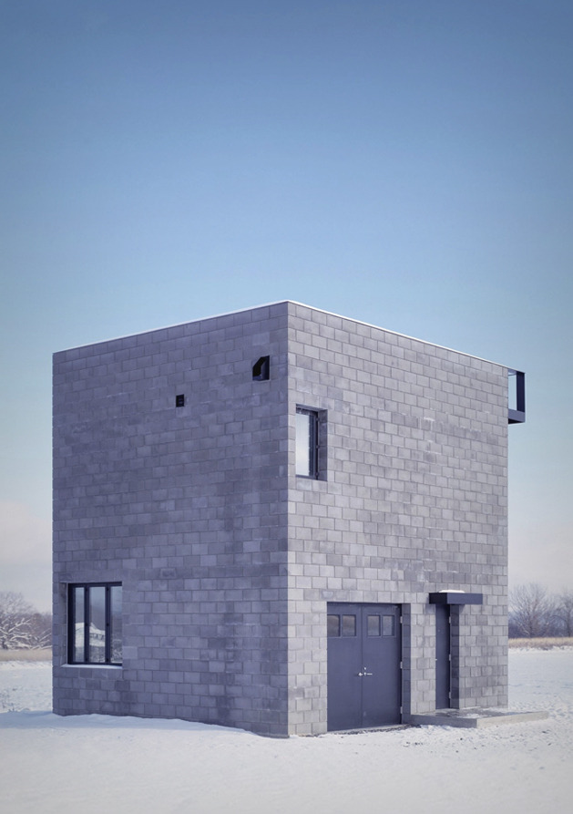
Cube House, Ithaca, NY (2000)
Simon Ungers

Slide 31
Cube House, Ithaca, NY (2000)
It is the work of the architect Simon Ungers.
Cube House has a simple, monolithic appearance that combines minimalism and utilitarian design. This prism of almost cubic proportions houses the simple program: a garage and a small studio on the ground floor and a living room area and kitchen on the 1st floor, barely separated from the bedroom by a low bookcase. Instead of the typical pitched roof which is common to the rural constructions of the area, a flat deck crowns the building, accentuating its character as a viewpoint. The house is raised as a vantage point from which it is possible to contemplate the landscape sheltered from the weather.

Slide 32
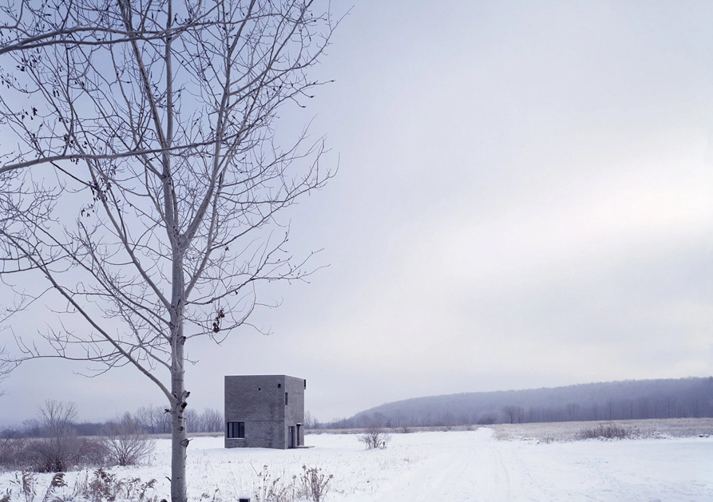
Cube House, Ithaca, NY (2000)

Slide 33
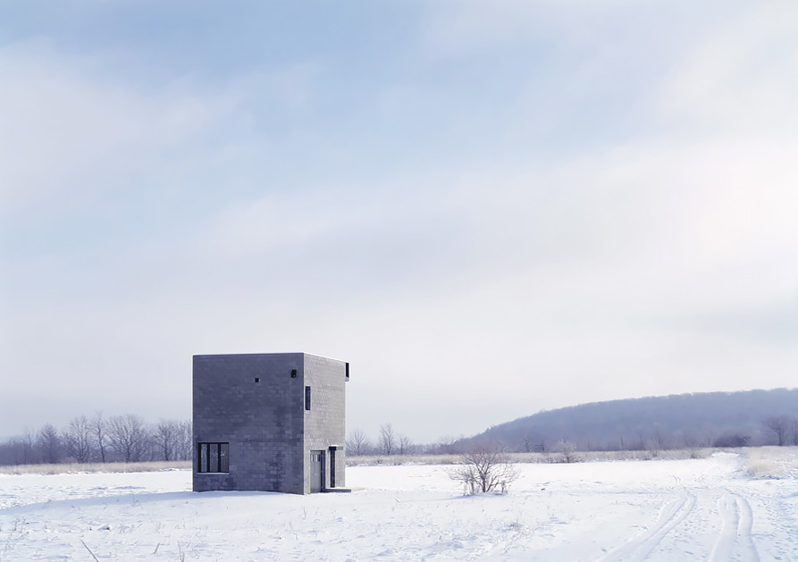
Cube House, Ithaca, NY (2000)

Slide 34
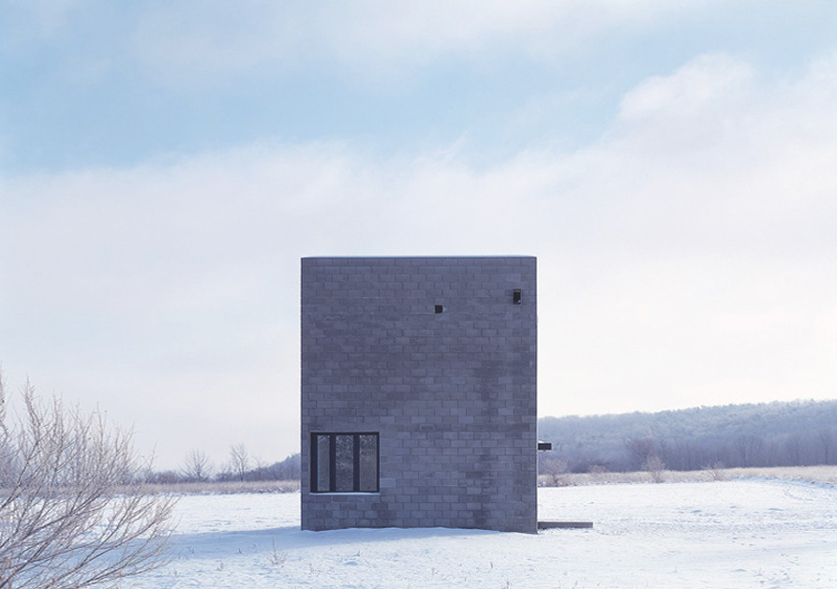
Cube House, Ithaca, NY (2000)

Slide 35
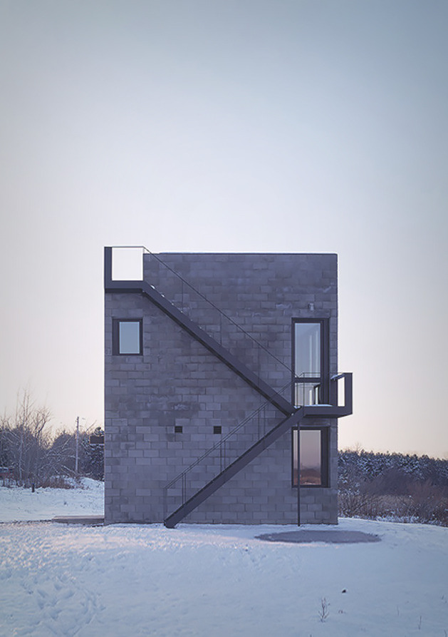
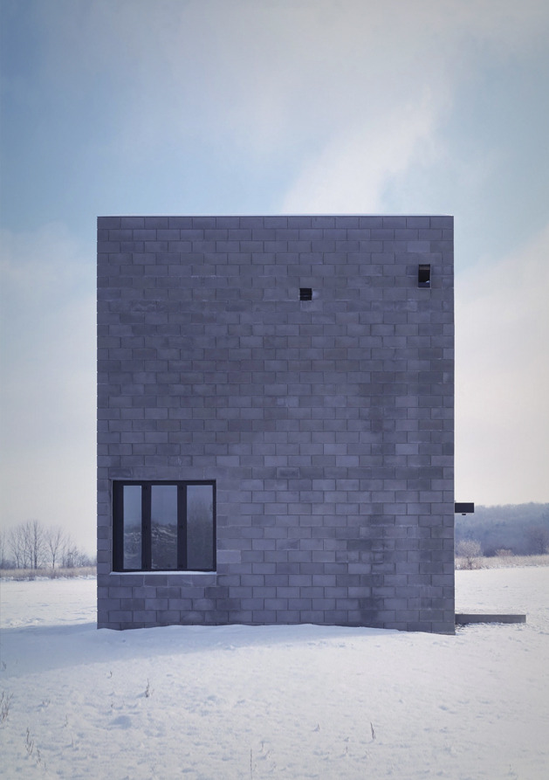
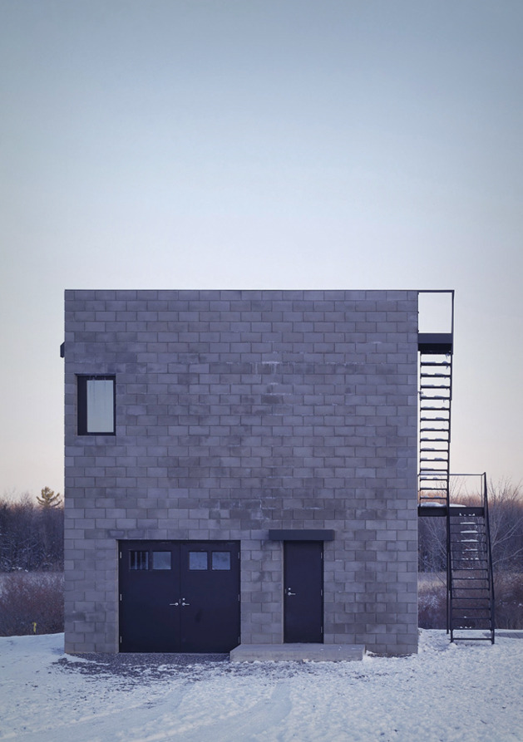
Cube House, Ithaca, NY (2000)

Slide 36
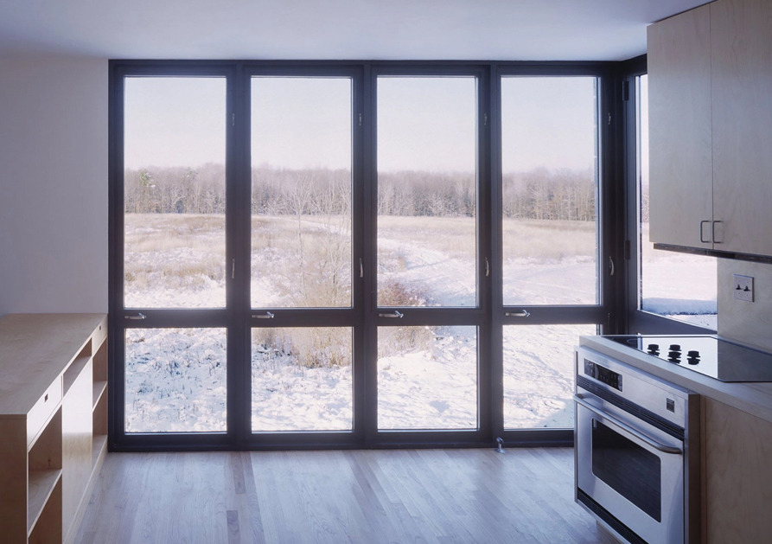
Cube House, Ithaca, NY (2000)

Slide 37
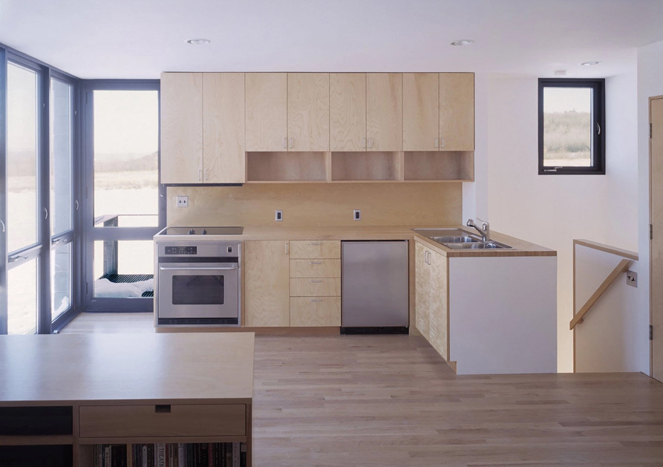
Cube House, Ithaca, NY (2000)

Slide 38
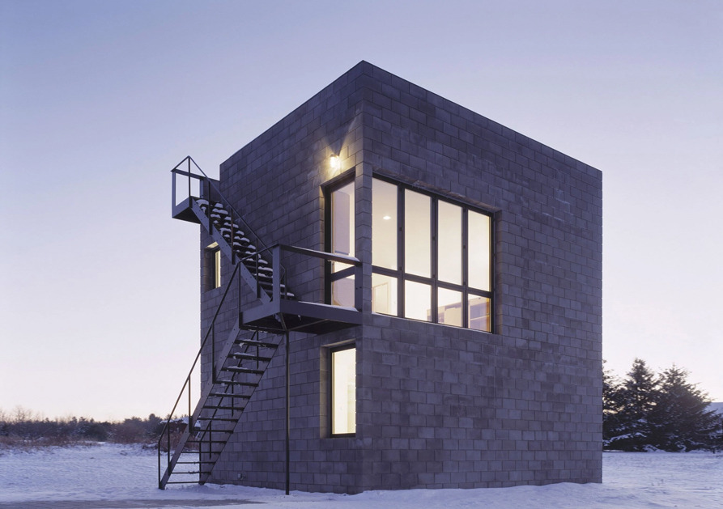
Cube House, Ithaca, NY (2000)

Slide 39
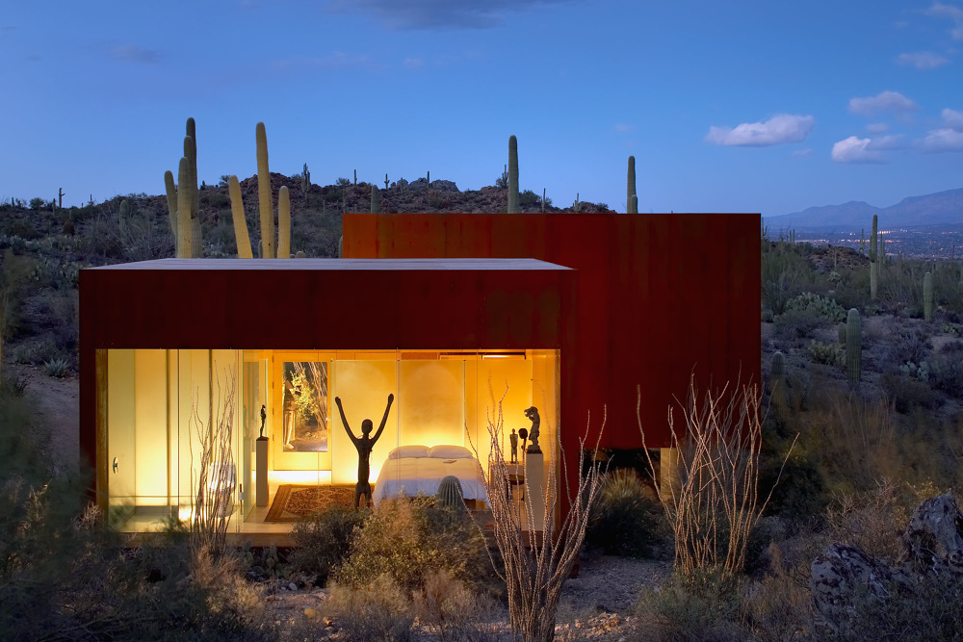
Desert Nomad House, Tucson, AZ (2001)
Rick Joy
Rick Joy Architects

Slide 40
Desert Nomad House, Tucson, AZ (2001)
An integration model, built in the middle of the desert, in the middle of the Saguarra cactus, this house shows the know-how of its architect Rick Joy, who uses the materials closest to their environment (Corten steel, pisé).
Cradled into the curve of a secluded, bowl-like land formation, three squared volumes come together into a home that provides unique, singular vantage points out onto a landscape dotted with Saguaro and Ocotillo.
The elevation of these boxes to respect the vegetation, the fragmentation into boxes to avoid the mass effect, everything is done to minimize the effects on the surrounding landscape. Each box contains one or more openings that frame the landscape.

Slide 41
Desert Nomad House, Tucson, AZ (2001)
Light defines each space: from the bedroom, the rising sun illuminates a rock face at the top of mountains, while from the living space, the early evening sun draws the eye toward the base of the mountain closest to the house.
Warmly finished in plate steel on the exterior and maple veneer on the interior, the three volumes create an architecture through their relationship with each other and the Desert Southwest.

Slide 42
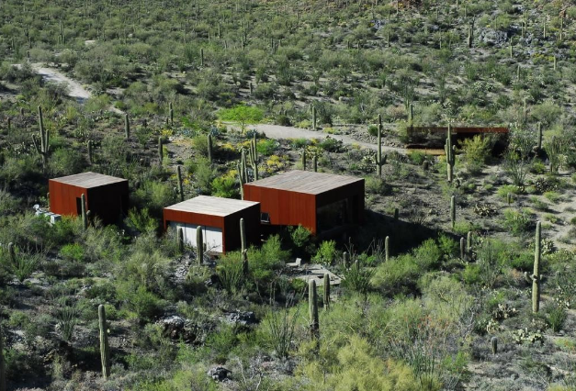
Desert Nomad House, Tucson, AZ (2001)

Slide 43
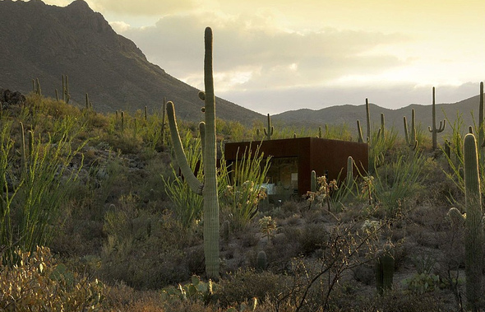
Desert Nomad House, Tucson, AZ (2001)

Slide 44
Desert Nomad House, Tucson, AZ (2001)

Slide 45
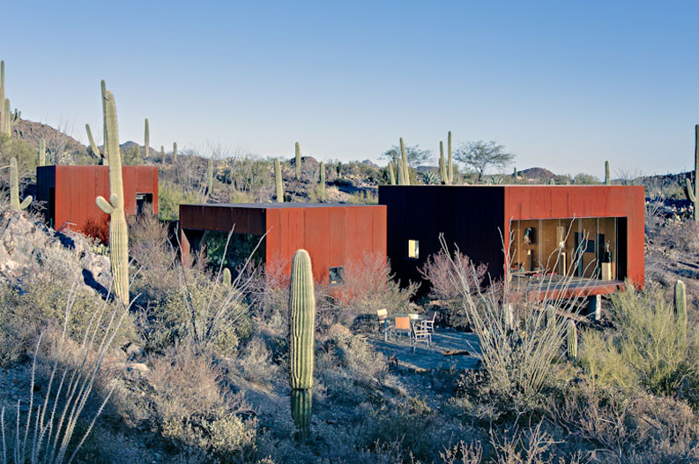
Desert Nomad House, Tucson, AZ (2001)

Slide 46
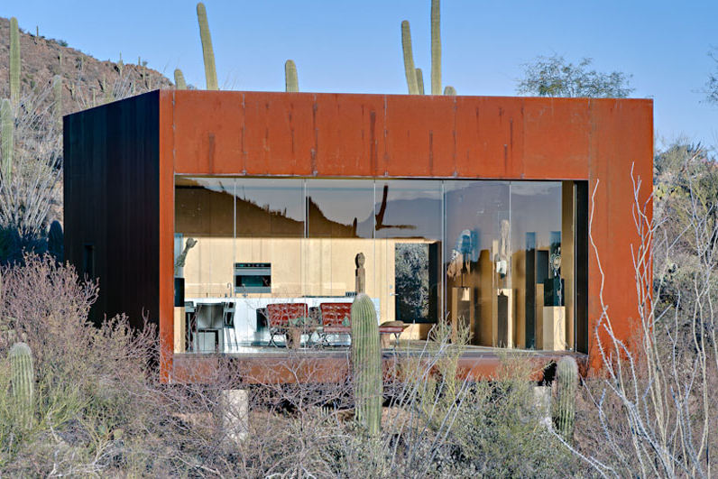
Desert Nomad House, Tucson, AZ (2001)

Slide 47
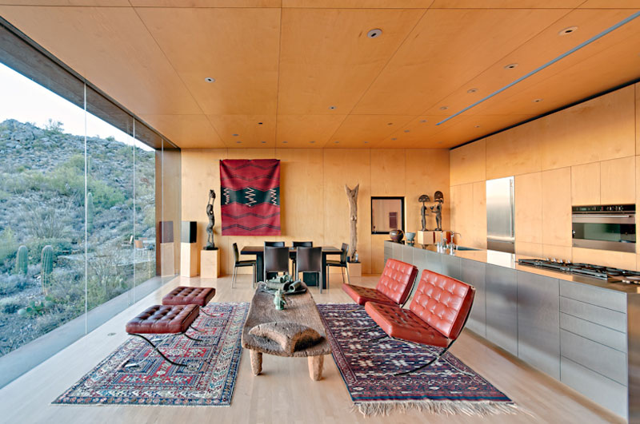
Desert Nomad House, Tucson, AZ (2001)

Slide 48
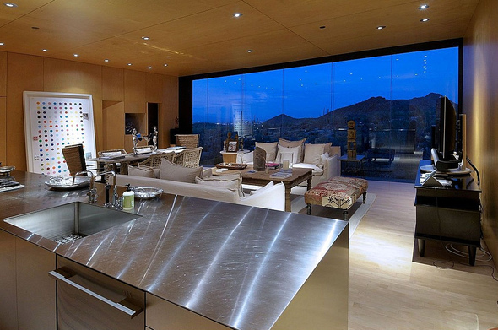
Desert Nomad House, Tucson, AZ (2001)

Slide 49
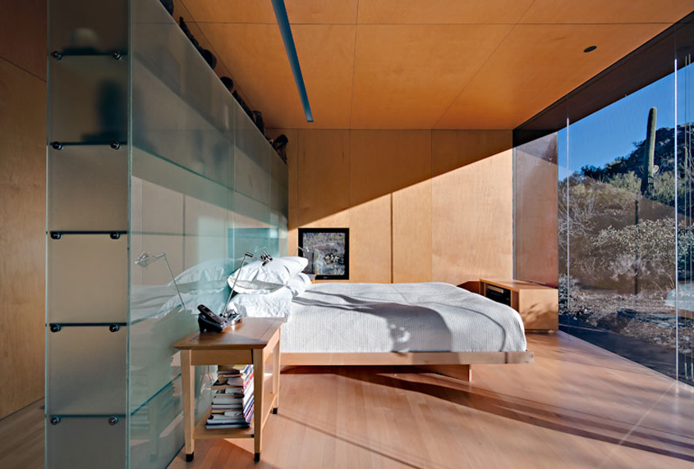
Desert Nomad House, Tucson, AZ (2001)

Slide 50
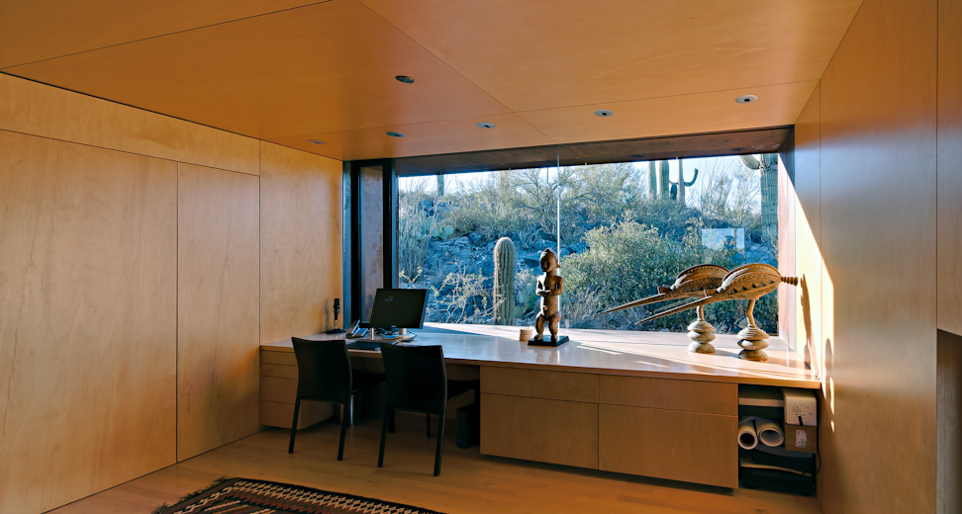
Desert Nomad House, Tucson, AZ (2001)

Slide 51
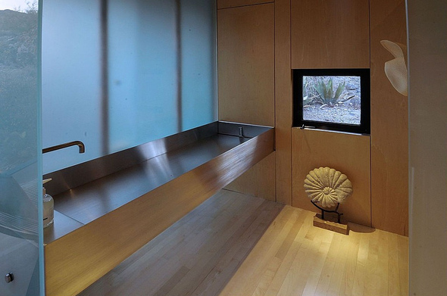
Desert Nomad House, Tucson, AZ (2001)

Slide 52
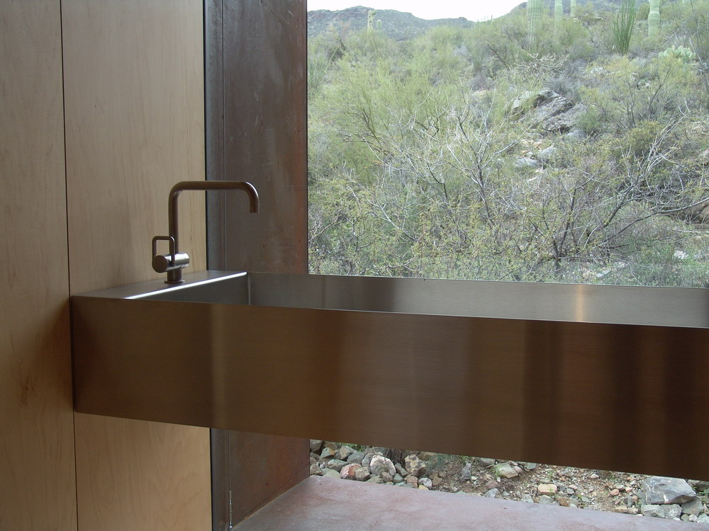
Desert Nomad House, Tucson, AZ (2001)

Slide 53
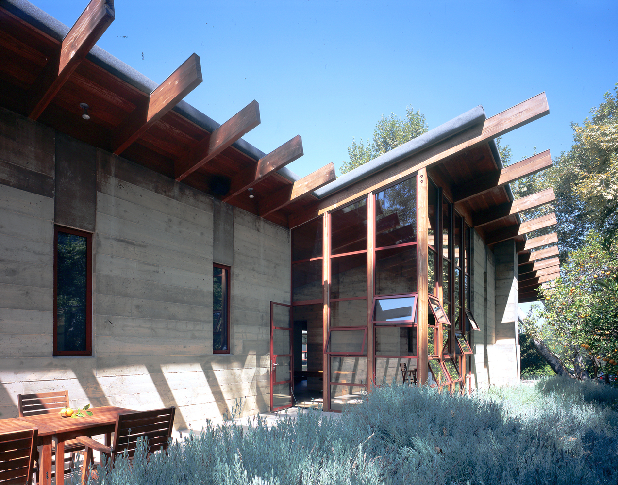
Sherman Residence, Encino, CA (2001)
Peter Tolkin
Sarah Lorenzen

Slide 54
Sherman Residence, Encino, CA (2001)
It is the work of the architects Peter Tolkin & Sarah Lorenzen (TOLO firm).
The house is made up of a series of board-formed concrete, wood and glass pavilions connected via interstitial gallery spaces that together define a central courtyard. From each room one can see the rich and varied landscape, which includes indigenous large oaks, sycamores, “working” plants such as orange and avocado trees, palms and succulents. A singular low-slung wood roof with deep overhangs shades and unifies the overall composition. The horseshoe-shape configuration of the pavilions maximizes views of the extraordinary landscape.

Slide 55
Sherman Residence, Encino, CA (2001)

Slide 56
Sherman Residence, Encino, CA (2001)

Slide 57
Sherman Residence, Encino, CA (2001)

Slide 58
Sherman Residence, Encino, CA (2001)

Slide 59
Sherman Residence, Encino, CA (2001)

Slide 60
Sherman Residence, Encino, CA (2001)

Slide 61
Sherman Residence, Encino, CA (2001)

Slide 62
Sherman Residence, Encino, CA (2001)

Slide 63
Sherman Residence, Encino, CA (2001)

Slide 64
Sherman Residence, Encino, CA (2001)

Slide 65
Sherman Residence, Encino, CA (2001)

Slide 66
Sherman Residence, Encino, CA (2001)

Slide 67
Sherman Residence, Encino, CA (2001)

Slide 68
Sherman Residence, Encino, CA (2001)

Slide 69
Sherman Residence, Encino, CA (2001)

Slide 70
Sherman Residence, Encino, CA (2001)

Slide 71
Sherman Residence, Encino, CA (2001)

Slide 72
View Silo House, Livingston, MT (2001)
Michael Rotondi

Slide 73
View Silo House, Livingston, MT (2001)
It is the work of the architect Michael Rotondi.
The house sits on the edge of the only sheltering feature in a valley famous for its winds, Marlboro country views, and storms. The view silo was designed to occupy the smallest practical footprint of earth and the narrowest possible sliver of sky. The building tapers and appears to twist in a form generated in a mirroring of the ancient Yellowstone River bank. The 1,500 sf program is organized vertically.

Slide 74
View Silo House, Livingston, MT (2001)

Slide 75
View Silo House, Livingston, MT (2001)

Slide 76
View Silo House, Livingston, MT (2001)

Slide 77
View Silo House, Livingston, MT (2001)

Slide 78
View Silo House, Livingston, MT (2001)

Slide 79
Pfanner House, Chicago, IL (2002)
Zoka Zola

Slide 80
Pfanner House, Chicago, IL (2002)
It is the work of the architect Zoka Zola.
The house has 3000 sq. ft. including garage and exterior spaces, which is about 2/3 of its allowable building area. Not an opening that merely extends the space, or a continuously transitioning space, instead an opening of one space to another space.
House is constructed with wood frame wall composition with high insulation value. Heating is radiant floor heating. Air-conditioning use is reduced by using cross ventilation and living in open air spaces.

Slide 81
Pfanner House, Chicago, IL (2002)

Slide 82
Pfanner House, Chicago, IL (2002)

Slide 83
Pfanner House, Chicago, IL (2002)

Slide 84
Pfanner House, Chicago, IL (2002)

Slide 85
Pfanner House, Chicago, IL (2002)

Slide 86
Pfanner House, Chicago, IL (2002)

Slide 87
Pfanner House, Chicago, IL (2002)

Slide 88
Pfanner House, Chicago, IL (2002)

Slide 89
Portabello Estate, Corona, CA (2002)
Brion Jeannette

Slide 90
Portabello Estate, Corona, CA (2002)
It is the work of Brion Jeannette architect.
It is located on 3 oceanfront lots with a nearly one acre site of private beach cove access. Almost every room in the house offers stunning views of the Pacific ocean.
In addition to the 2,044 sq meters of interior space is an additional 743 sq meters of covered terraces and garaging space.
The oceanfront behemoth features 8 bedrooms, 10 bathrooms (and 5 half baths) and 2 saltwater pools surrounded by 3-storey high grotto cliffs. Of course there’s your standard 10-pin bowling lanes, 16-car garage, state-of-the-art movie theatre.

Slide 91
Portabello Estate, Corona, CA (2002)

Slide 92
Portabello Estate, Corona, CA (2002)

Slide 93
Portabello Estate, Corona, CA (2002)

Slide 94
Portabello Estate, Corona, CA (2002)

Slide 95
Portabello Estate, Corona, CA (2002)

Slide 96
Portabello Estate, Corona, CA (2002)

Slide 97
Portabello Estate, Corona, CA (2002)

Slide 98
Portabello Estate, Corona, CA (2002)

Slide 99
Portabello Estate, Corona, CA (2002)

Slide 100
Portabello Estate, Corona, CA (2002)

Slide 101
Portabello Estate, Corona, CA (2002)

Slide 102
Portabello Estate, Corona, CA (2002)

Slide 103
Portabello Estate, Corona, CA (2002)

Slide 104
Portabello Estate, Corona, CA (2002)

Slide 105
Scorpion House, Scottsdale, AZ (2002)
Eddie Jones
Nail Jones

Slide 106
Scorpion House, Scottsdale, AZ (2002)
It is the work of Jones Studio (Eddie & Neal Jones).
Hillside contours, boulder field, distant views, and stands of old saguaro, shape the cast-in-place concrete ledge. Interlocking the curvilinear retaining walls, a protective shell of oxidized titanium plates integrates the “scorpion” forms with desert shadow.
An inverted conical shape roof unifies the continuous interior, defends against a western solar exposure and responds to the incline of the land. Multiple center points are subordinate to the radial joint grid generated by the hemispherical pool.

Slide 107
Scorpion House, Scottsdale, AZ (2002)
Program elements are directed to, across, and beyond the seemingly suspended disk of blue water leaking through a coping sieve of two-hundred and fifty-four stainless steel nipples.
Although the entry sequence straddles a small, yet significant canyon, the resulting upper landing bridge allows the existing drainage pattern to continue undisturbed. The beautiful arroyo view is only revealed after stair ascension and passage through the creature’s concrete backbone.

Slide 108
Scorpion House, Scottsdale, AZ (2002)

Slide 109
Scorpion House, Scottsdale, AZ (2002)

Slide 110
Scorpion House, Scottsdale, AZ (2002)

Slide 111
Scorpion House, Scottsdale, AZ (2002)

Slide 112
Scorpion House, Scottsdale, AZ (2002)

Slide 113
Scorpion House, Scottsdale, AZ (2002)
THE END

