Slide 1
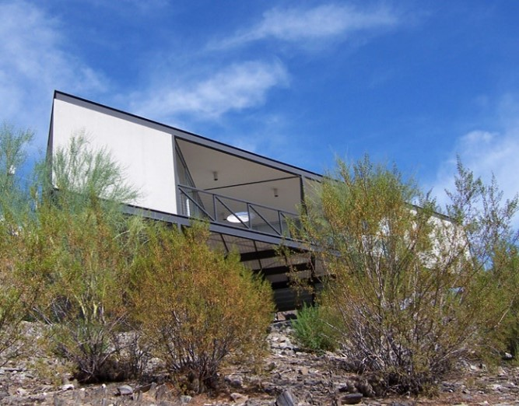
US. Modernist Houses
1995-1999

Slide 2
US Modernist Houses 1995 – 1999
The purpose of this presentation is to show you the most outstanding Modern Movement inspired houses in the United States by great architects.
Some of them have become icons of contemporary architecture (members of the iconic.org network) and are recognized and protected as such.
They remain unique either by their constructive principle, or by their location, or by their theoretical importance, or by their perfect integration into the landscape.

Slide 3
US Modernist Houses
Many of the houses presented in this slide show (before the year 2000) were found on the OfHouses website (Old Forgotten Houses) which lists houses with architectural interest or singular architecture around the world with many illustrations. If they are shown here, it is because they are already considered as iconic.

Slide 4
US Modernist Houses
Theisen House, Guy Peterson, FL.
Novak Residence, Alfred Newman Beadle, AZ.
Burnette Residence, Wendell Burnette, AZ.
Spiral House, Dean & Wolf, NY.
Rachofsky House, Richard Meier, TX.
La Casa, Elizabeth Wright Ingraham, CO.
64 Wakefield House, Scogin & Elam, GA.
Cobb House, Eric Cobb, WA.
Landa Residence, Thom Mayne, CA.
Waldman House, Peter Waldman, VA.

Slide 5
US Modernist Houses 2
Neugebauer House, Richard Meier, FL.
Byrne Residence, Will Bruder, AZ.
Y House, Steven Holl, NY.
Mataja Residence, Hagy Belzberg, CA.
Waterfall House, James Howard Fox, SC.

Slide 6
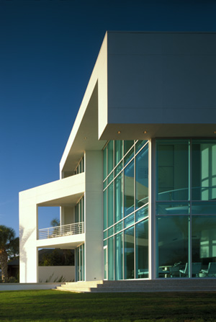
Theisen House, Sarasota, FL (1995)
Guy Peterson

Slide 7
Theisen House, Sarasota, FL (1995)
It is the work of the architect Guy Peterson.
A three-story structural curtain wall system is used in areas where maximum views are available. The program calls for a main house and a guesthouse. The main house contains the living area for the client as well as a separate area for a live-in caretaker. A separate guest building is located east of the main house and is connected with an internal vaulted gallery. Between the main house and the guesthouse is a private pool area and garden. Both the main house and the guesthouse enjoy views into this area as well as from the connecting gallery.

Slide 8
Theisen House, Sarasota, FL (1995)
This area enjoys complete privacy from the street. Behind the guesthouse is a large private courtyard anchored by two majestic Live Oak trees. A fifteen-foot grid was established between the oak trees to create an interactive garden containing thirty-seven silver reflecting gazing balls all located at precisely the same height. This house represents a calmness and peacefulness through its palette of nine shades of white, blue tinted glass reflecting the Florida sky and water, and white polished porcelain floors to reflect the water and sky within the house.

Slide 9
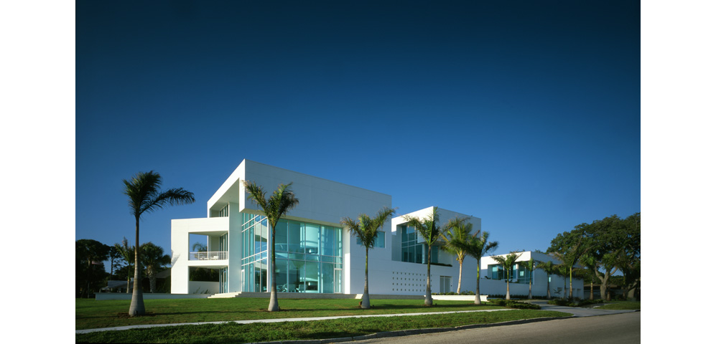
Theisen House, Sarasota, FL (1995)

Slide 10
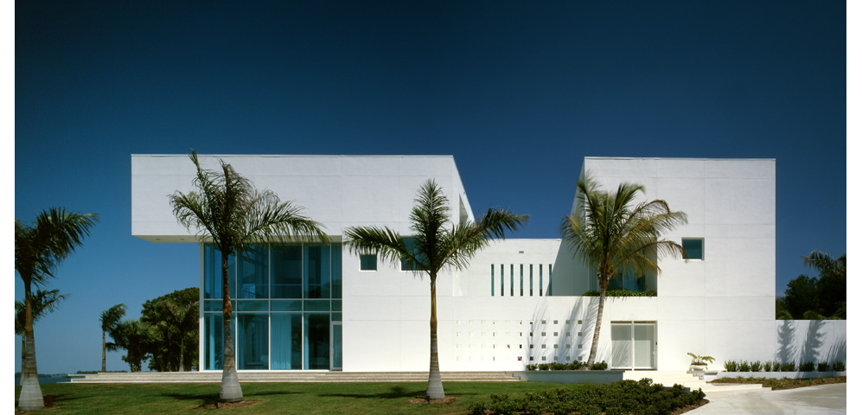
Theisen House, Sarasota, FL (1995)

Slide 11
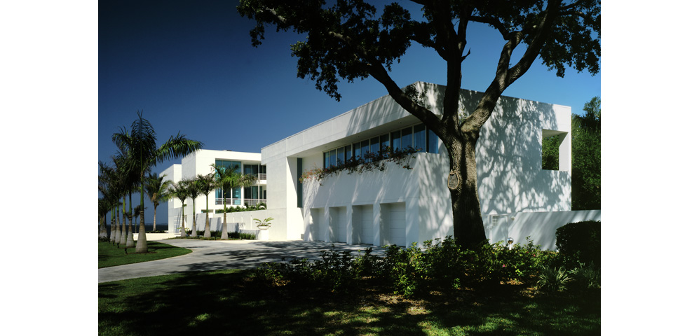
Theisen House, Sarasota, FL (1995)

Slide 12
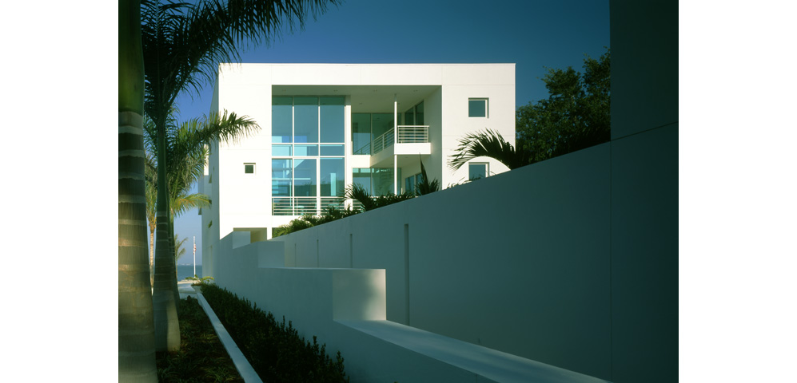
Theisen House, Sarasota, FL (1995)

Slide 13
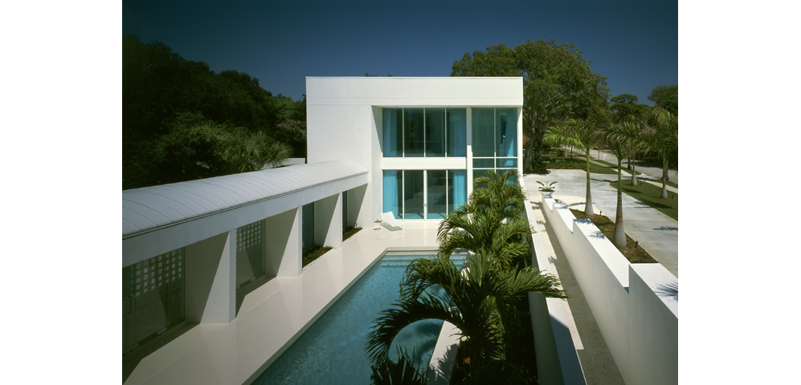
Theisen House, Sarasota, FL (1995)

Slide 14
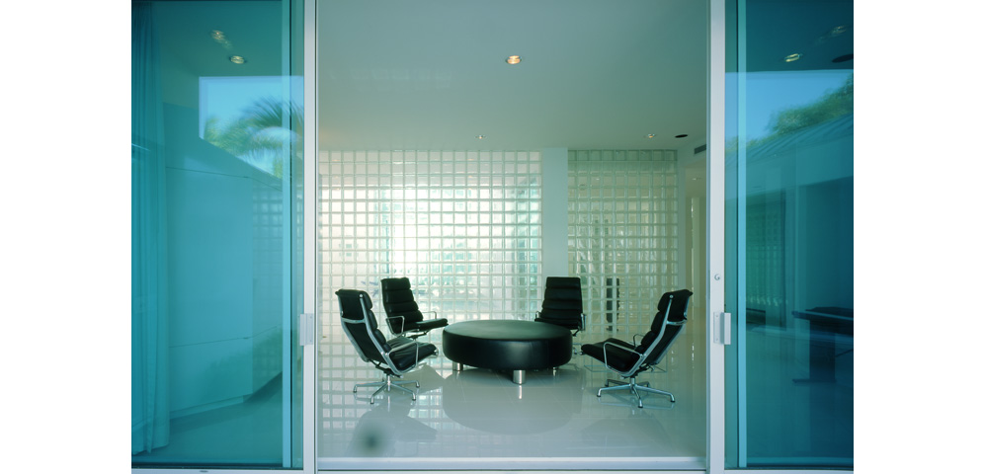
Theisen House, Sarasota, FL (1995)

Slide 15
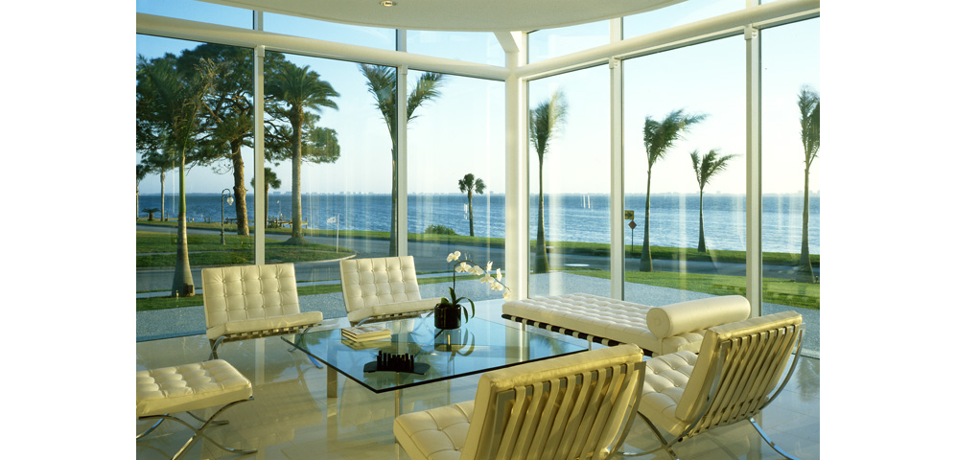
Theisen House, Sarasota, FL (1995)

Slide 16
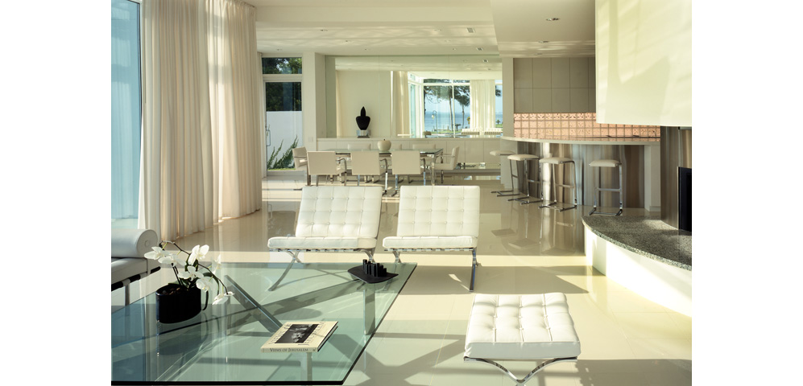
Theisen House, Sarasota, FL (1995)

Slide 17
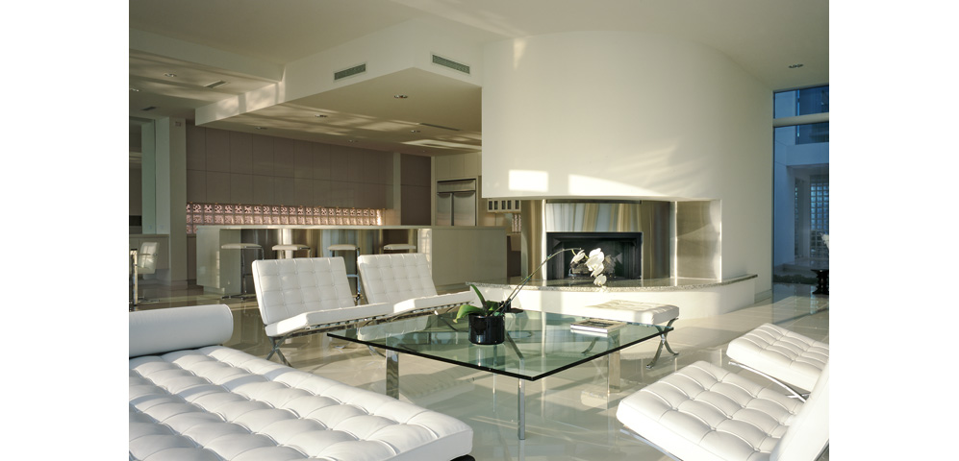
Theisen House, Sarasota, FL (1995)

Slide 18
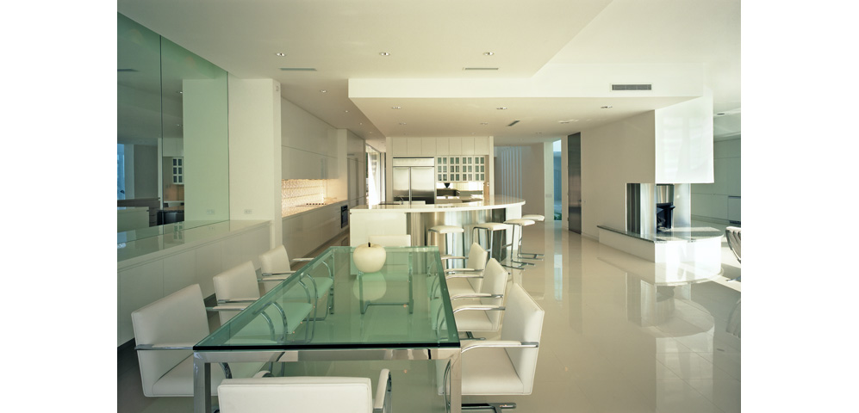
Theisen House, Sarasota, FL (1995)

Slide 19
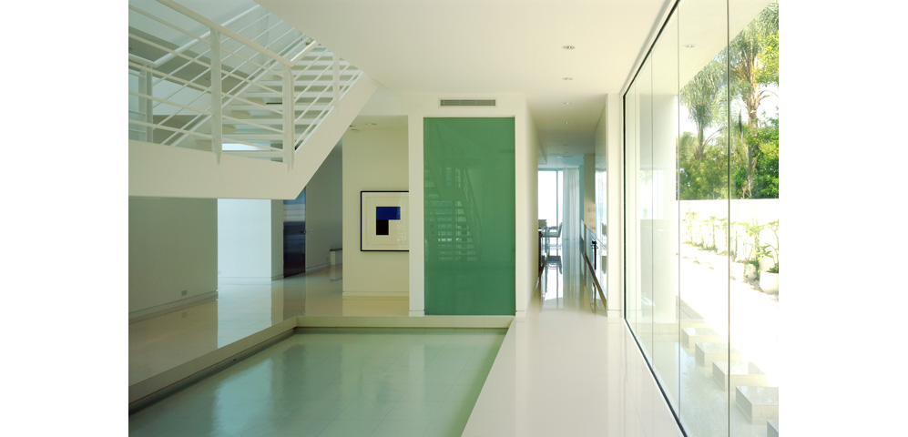
Theisen House, Sarasota, FL (1995)

Slide 20
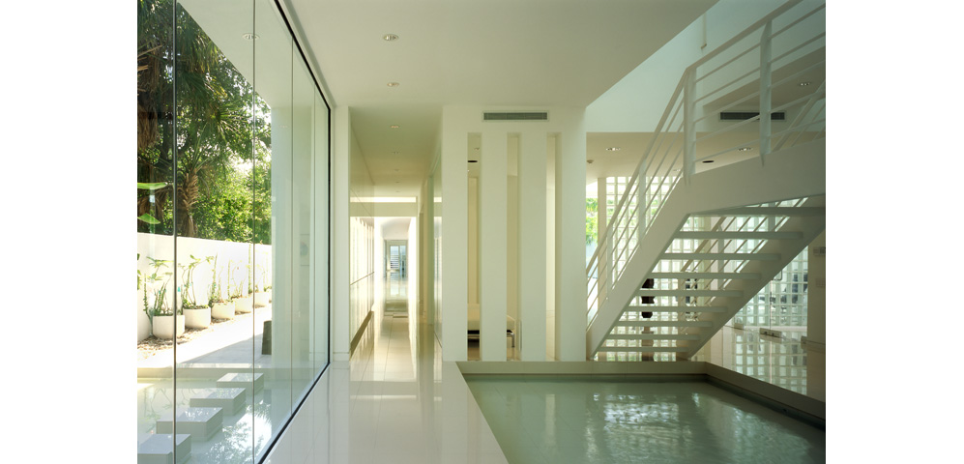
Theisen House, Sarasota, FL (1995)

Slide 21
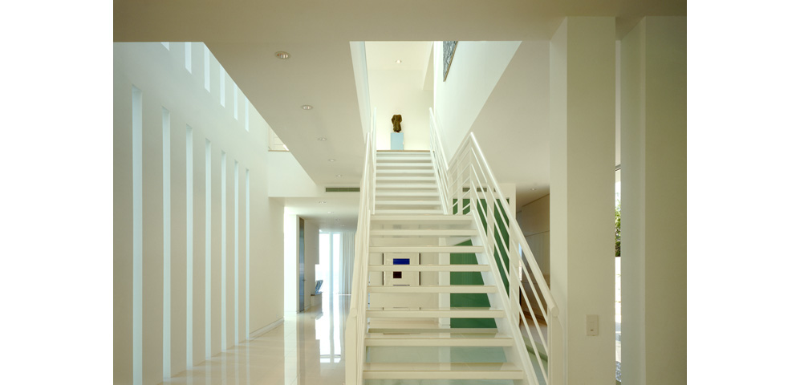
Theisen House, Sarasota, FL (1995)

Slide 22
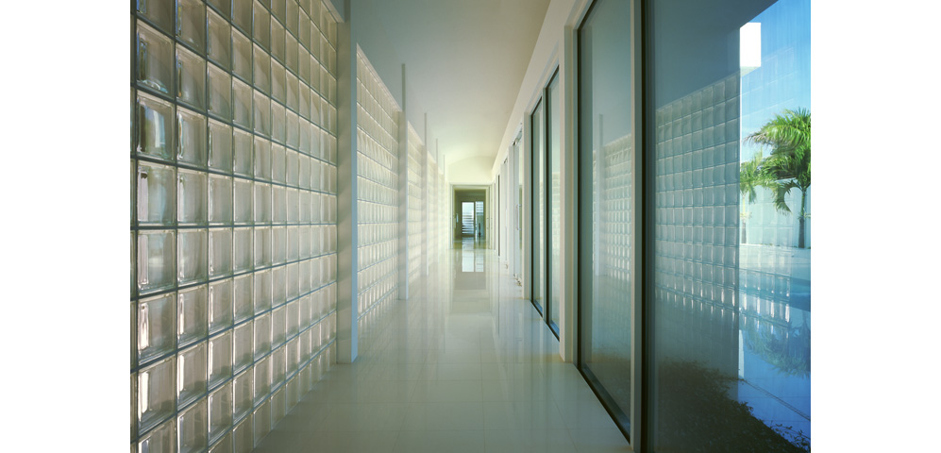
Theisen House, Sarasota, FL (1995)

Slide 23
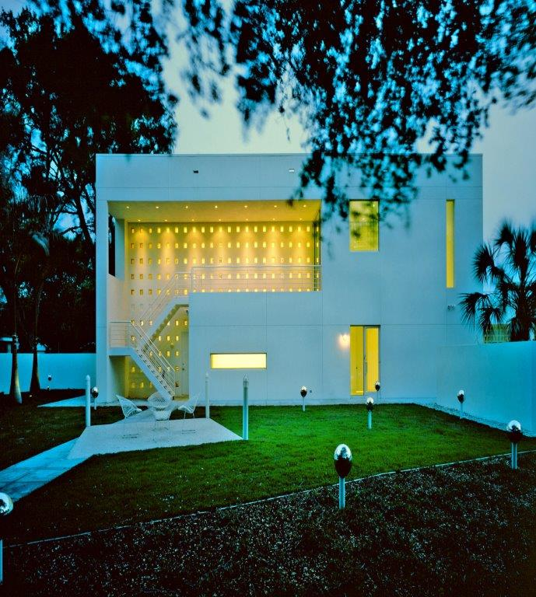
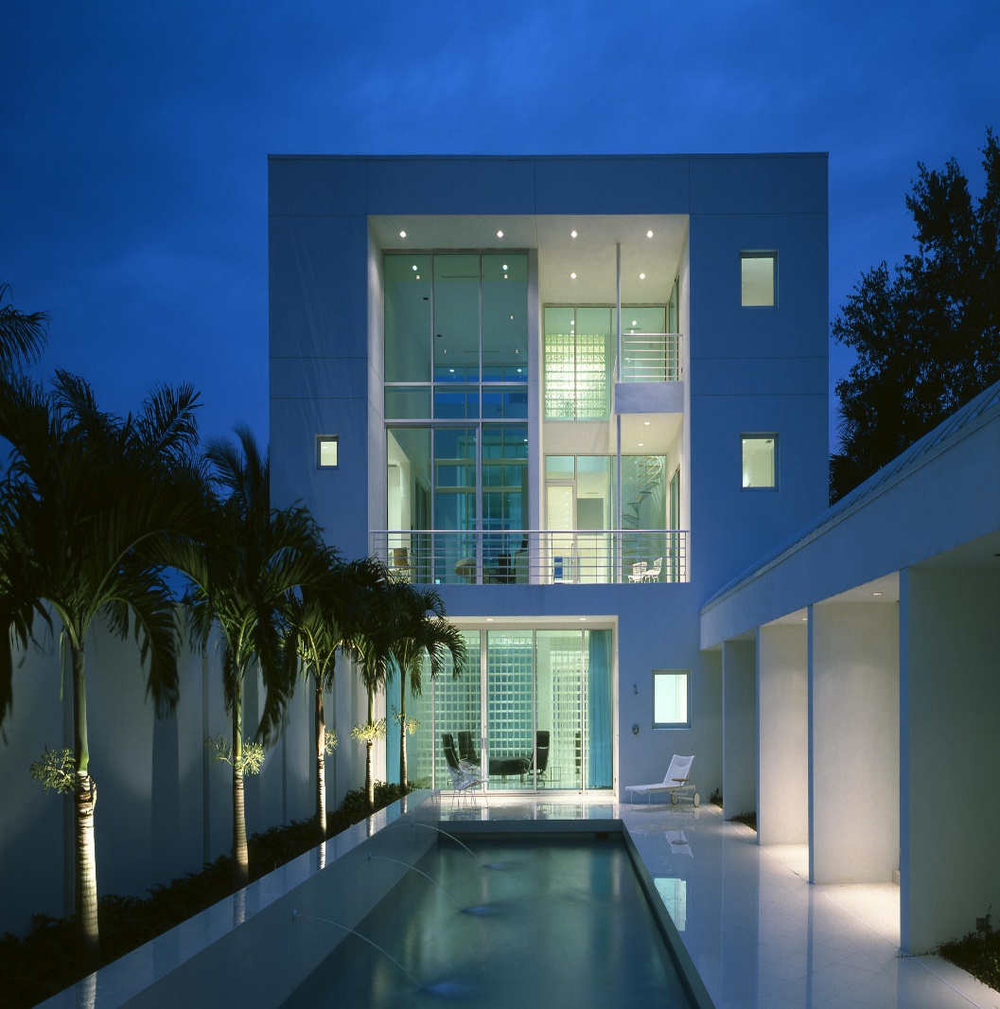
Theisen House, Sarasota, FL (1995)

Slide 24
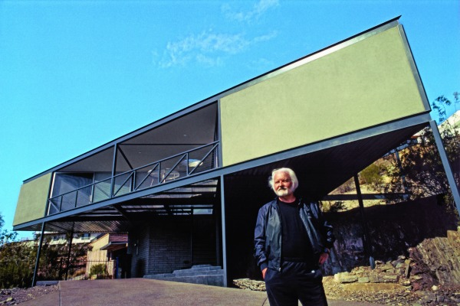
Novak Residence, Phoenix, AZ (1995)
Alfred Newman Beadle

Slide 25
Novak Residence, Phoenix, AZ (1995)
It is the work of Alfred Newman Beadle.
A precisely placed triangle perched on a tight mountain site, the house maximises the views of the surrounding mountains and cityscape, and a same time eliminates less serene vistas.
With a few simple strokes, Beadle created both a gorgeus form (not a symmetrical triangle) and an effective solution to the cramped site.

Slide 26
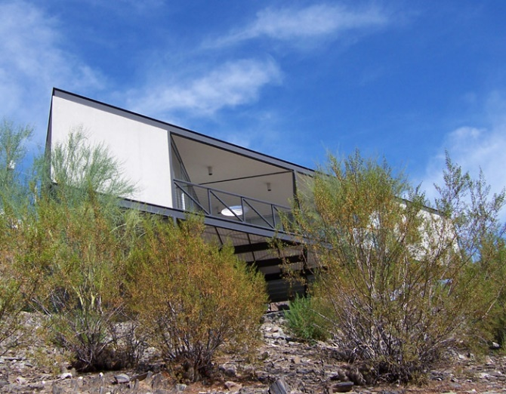
Novak Residence, Phoenix, AZ (1995)

Slide 27
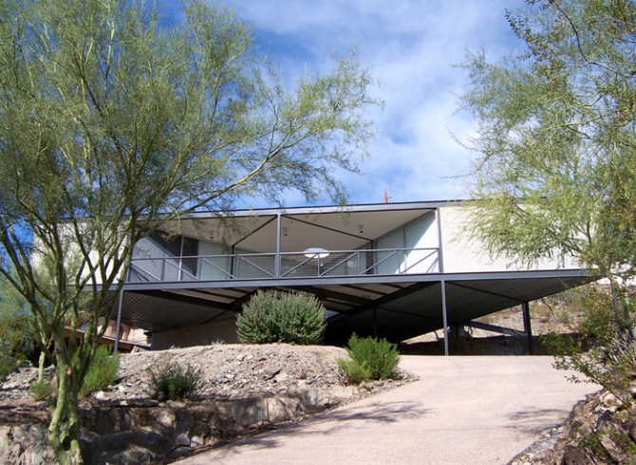
Novak Residence, Phoenix, AZ (1995)

Slide 28
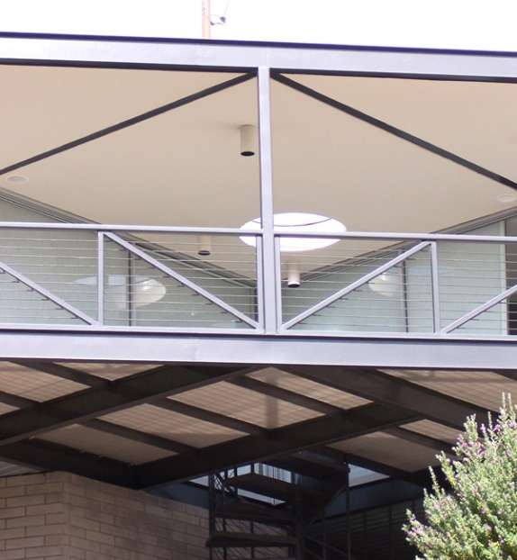
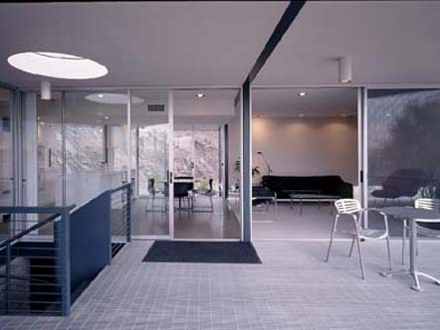
Novak Residence, Phoenix, AZ (1995)

Slide 29
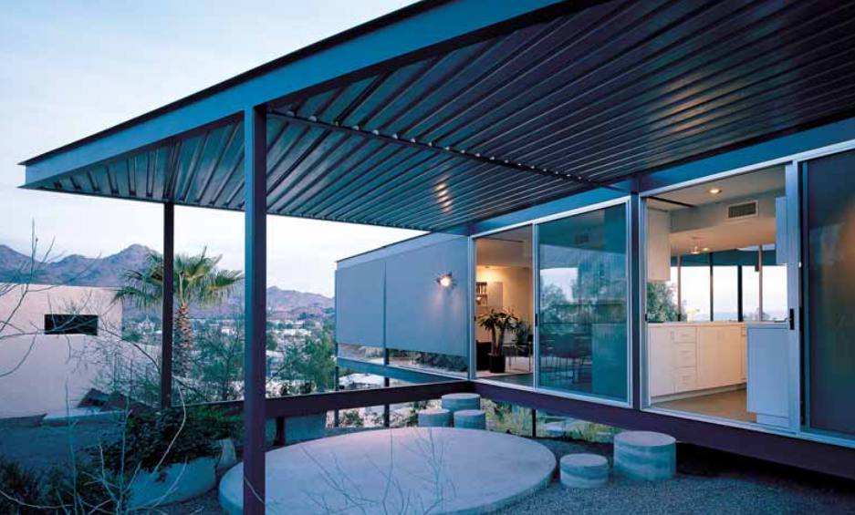
Novak Residence, Phoenix, AZ (1995)

Slide 30
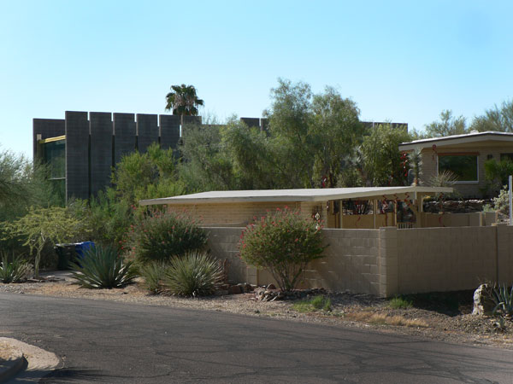
Burnette Residence, Sunnyslope, AZ (1995)
Wendell Burnette

Slide 31
Burnette Residence, Sunnyslope, AZ (1995)
It is the architect Wendell Burnette's own house.
The residence is located on a small plot of land of 1000 m2 cut in half by a fault 3 m wide.
The project consists of a kind of dressing applied on the fault that focuses attention on the view by creating an artificial canyon and redirecting the view of the mountains.
The canyon’s scale and proportions extend the topography of the site, amplify the sound of falling water that fills the evaporative plunge pool, increases the effect of a breeze cooling the skin, while providing circulation and pause between spaces, promoting the whiff of creosote after a rain.

Slide 32
Burnette Residence, Sunnyslope, AZ (1995)
2 rows of masonry monoliths act as silts between which 4.80 m wide concrete slabs form floating levels above the natural slope. This principle has made it possible to avoid foundations.
The vertical walls separated by 15 cm wide glass slits consist of 2.44 m wide slabs in the south limiting the penetration of sunlight and 1.22 m wide slabs in the north that are more open to the northern light.
All the North-South partitions are made of semi-translucent glass that allows sunsets and sunrises to invade the entire house.

Slide 33
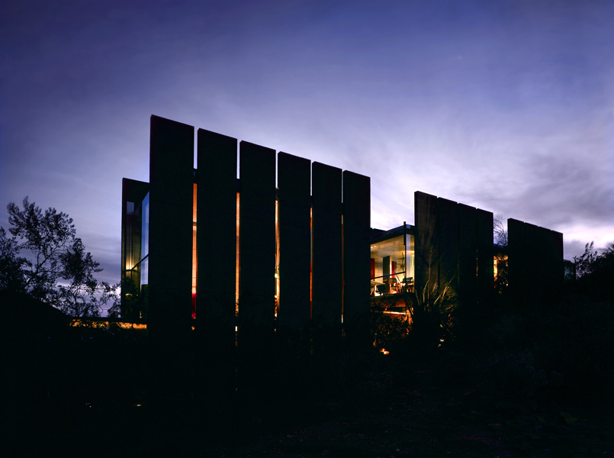
Burnette Residence, Sunnyslope, AZ (1995)

Slide 34
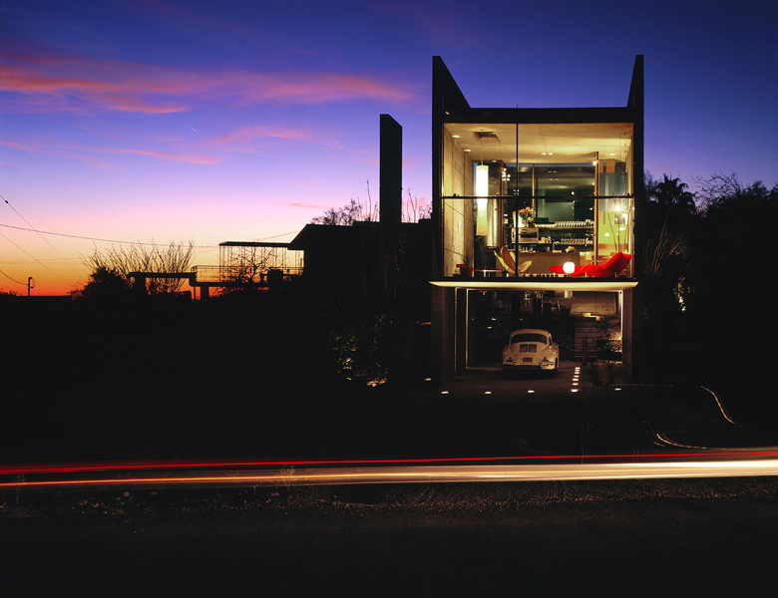
Burnette Residence, Sunnyslope, AZ (1995)

Slide 35
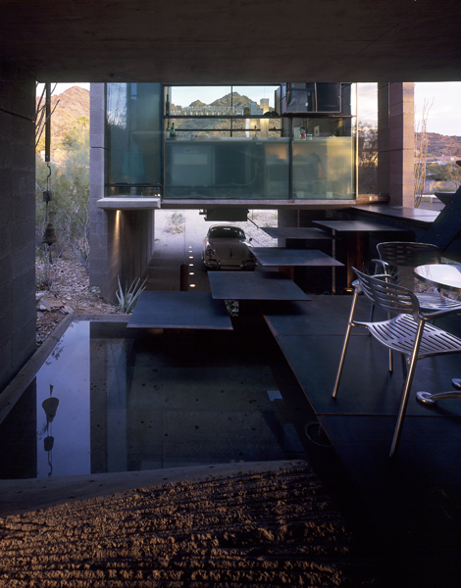
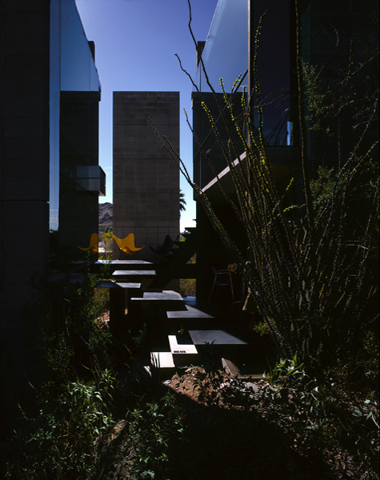
Burnette Residence, Sunnyslope, AZ (1995)

Slide 36
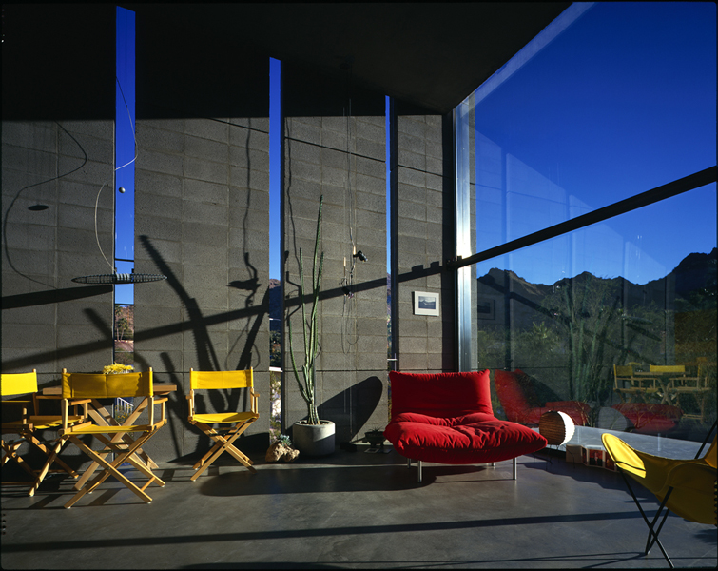
Burnette Residence, Sunnyslope, AZ (1995)

Slide 37
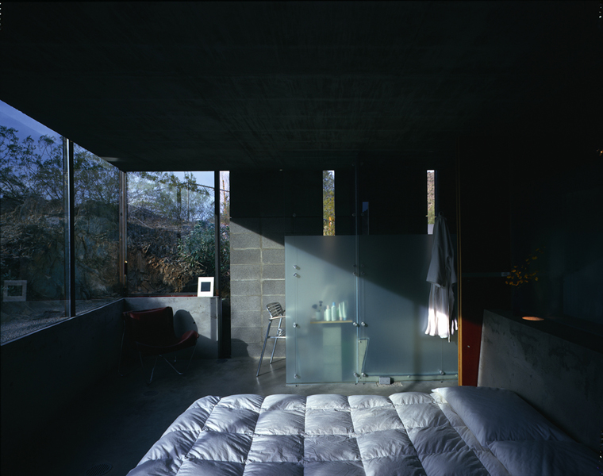
Burnette Residence, Sunnyslope, AZ (1995)

Slide 38
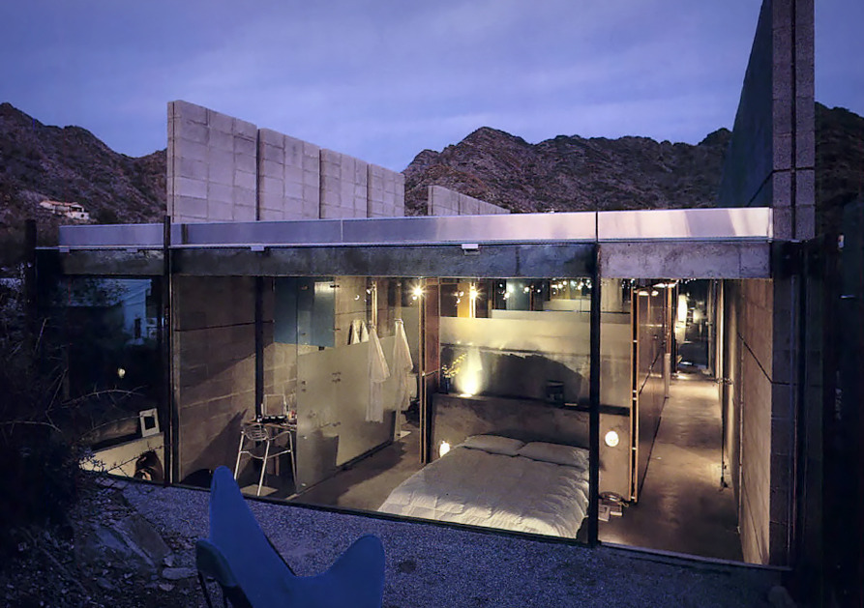
Burnette Residence, Sunnyslope, AZ (1995)

Slide 39
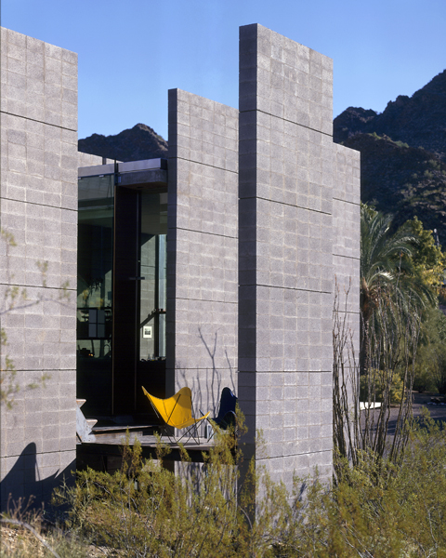
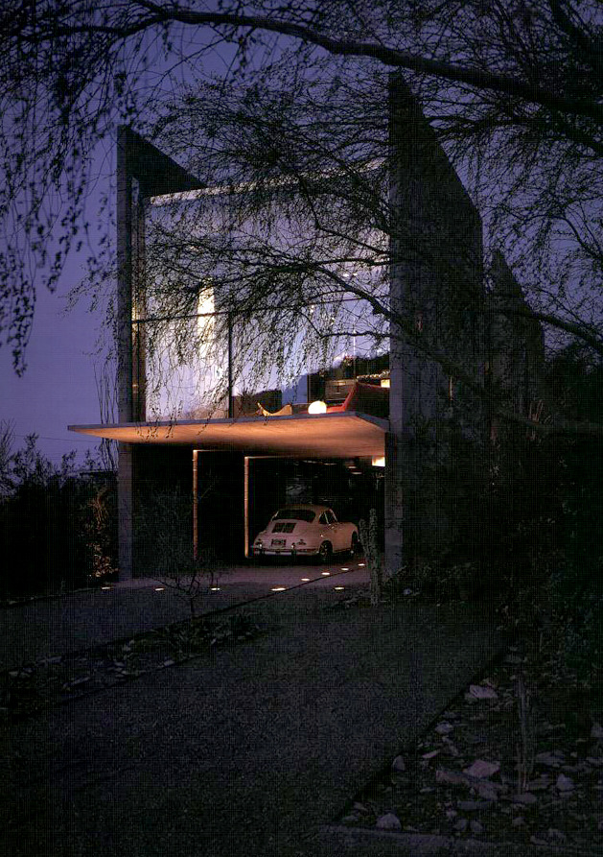
Burnette Residence, Sunnyslope, AZ (1995)

Slide 40
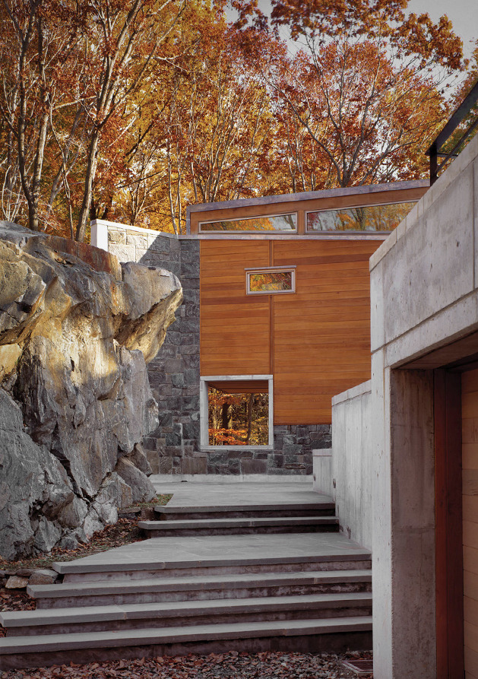
Spiral House, North Castle, NY (1995)
Katherine Dean

Slide 41
Spiral House, North Castle, NY (1995)
It is the work of Dean/Wolf architectural firm.
The incline of the driveway, where it ends at a U-turn, carries through in the angle of flanking concrete screen walls, which gradually rise from the ground to meet the house. There, the ascent continues along the top of a cedar-clad screen wall above the 1st floor, then under the 2nd floor windows, where it terminates in a tall stone-faced fin wall. After the concrete, came a steel-frame structure for the 2nd floor and, finally, finishes, including windows framed in marine-grade teak outside and ash within. The end of the living room is cantilevered 14 ft out from a cliff to bring stream views closer. Concrete transverse fin walls along the north wall provide lateral structural support and are hidden from view outside by cedar screen walls.

Slide 42
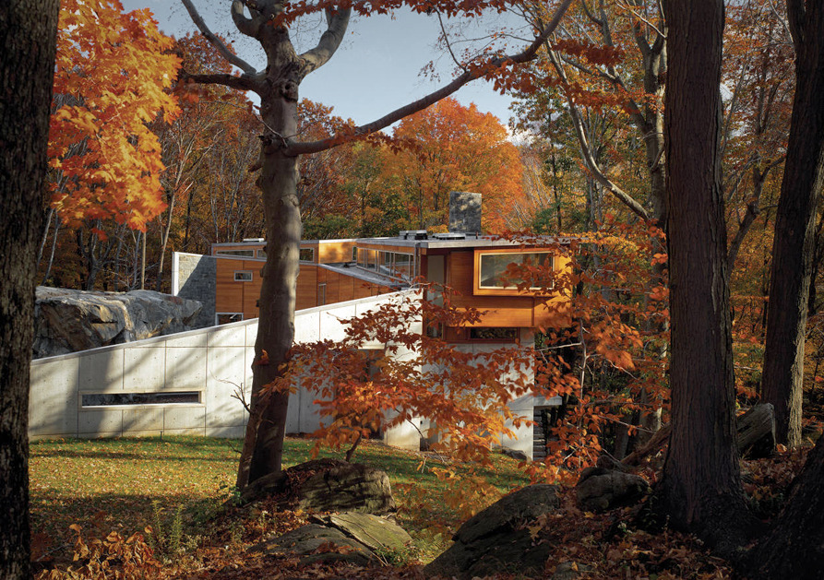
Spiral House, North Castle, NY (1995)

Slide 43
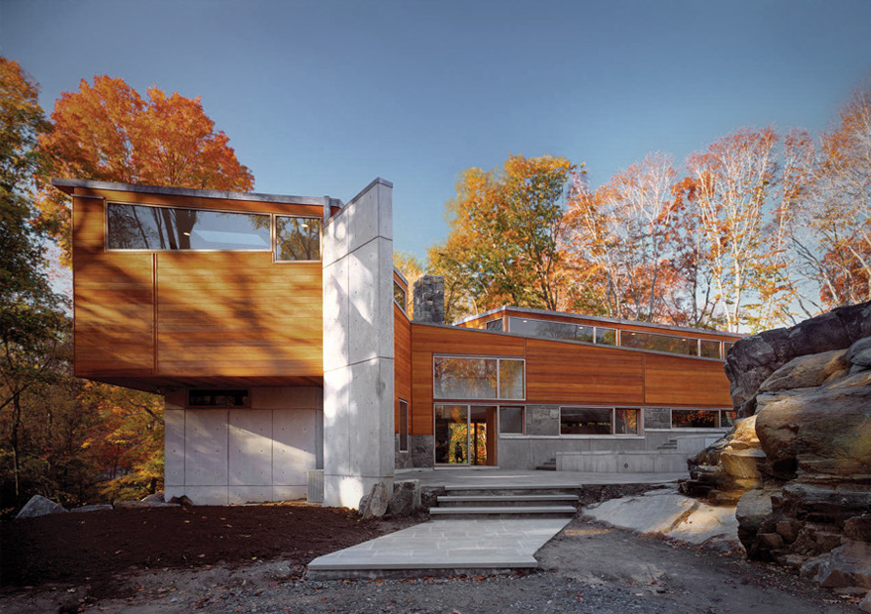
Spiral House, North Castle, NY (1995)

Slide 44
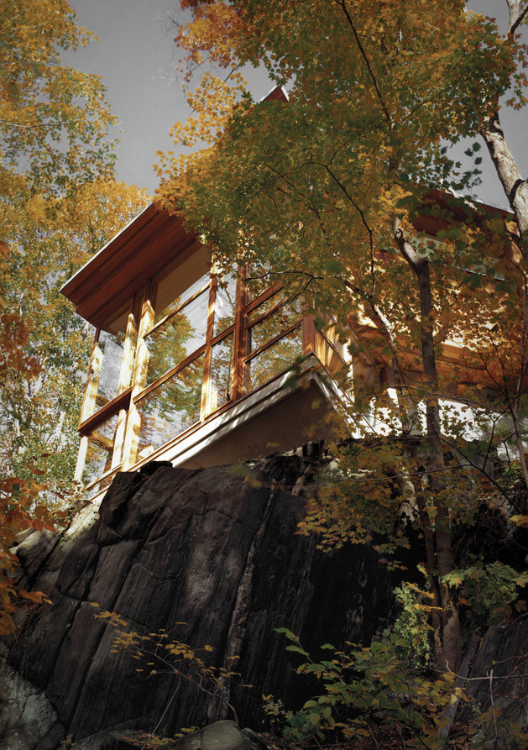
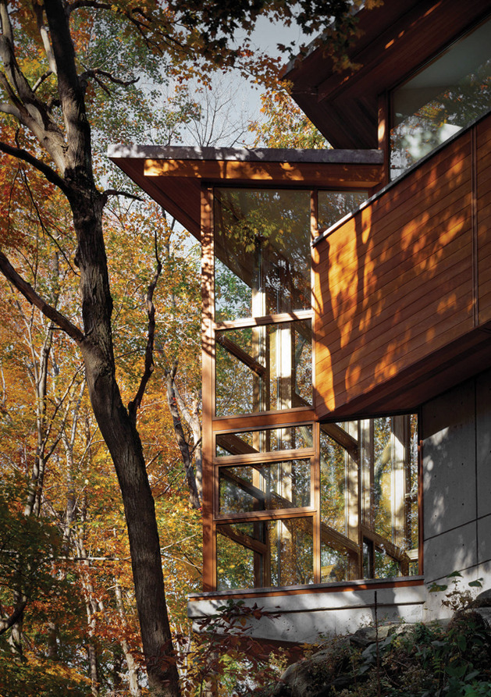
Spiral House, North Castle, NY (1995)

Slide 45
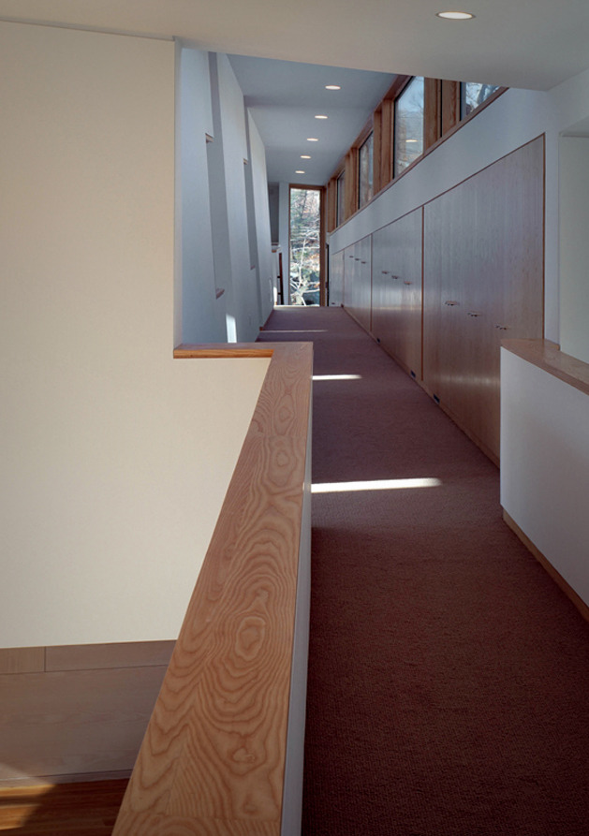
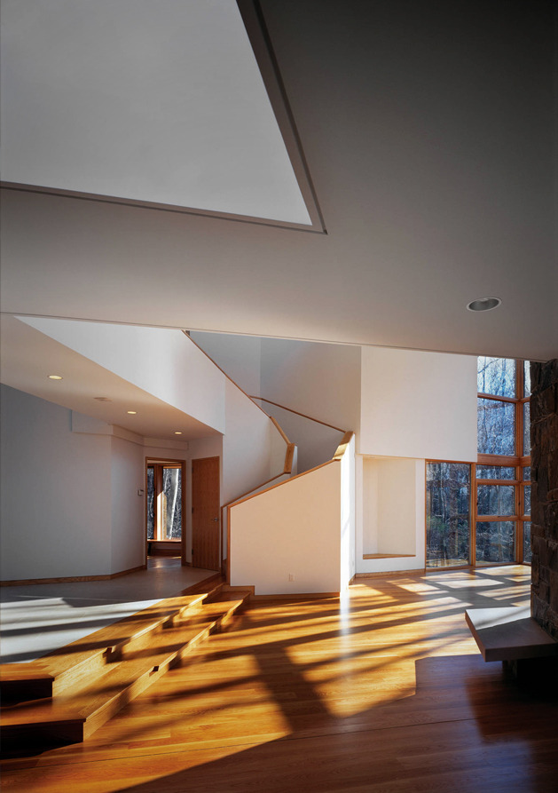
Spiral House, North Castle, NY (1995)

Slide 46
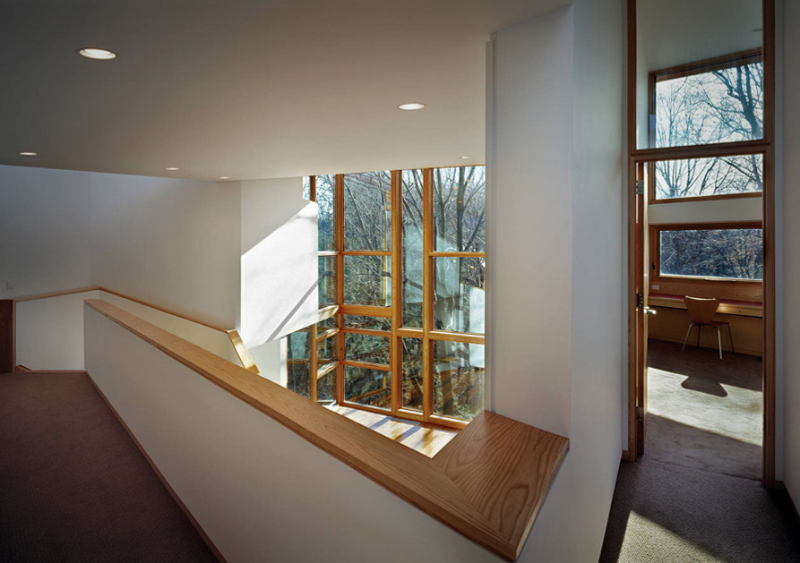
Spiral House, North Castle, NY (1995)

Slide 47
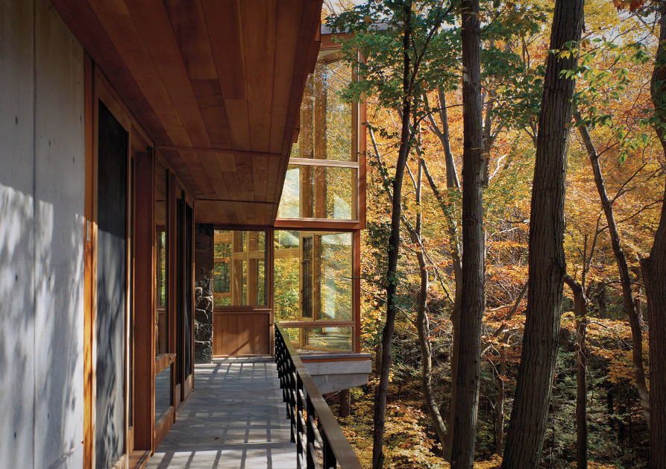
Spiral House, North Castle, NY (1995)

Slide 48
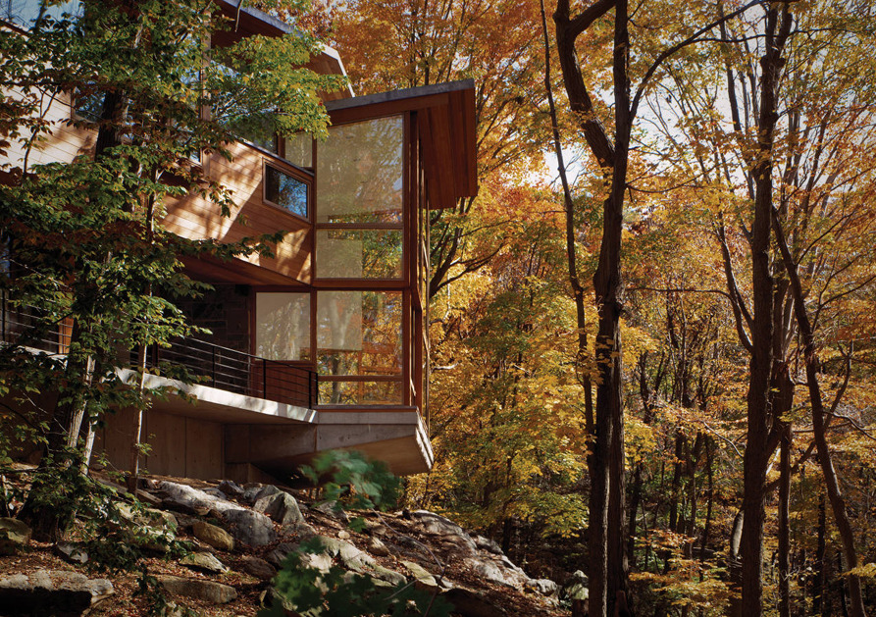
Spiral House, North Castle, NY (1995)

Slide 49
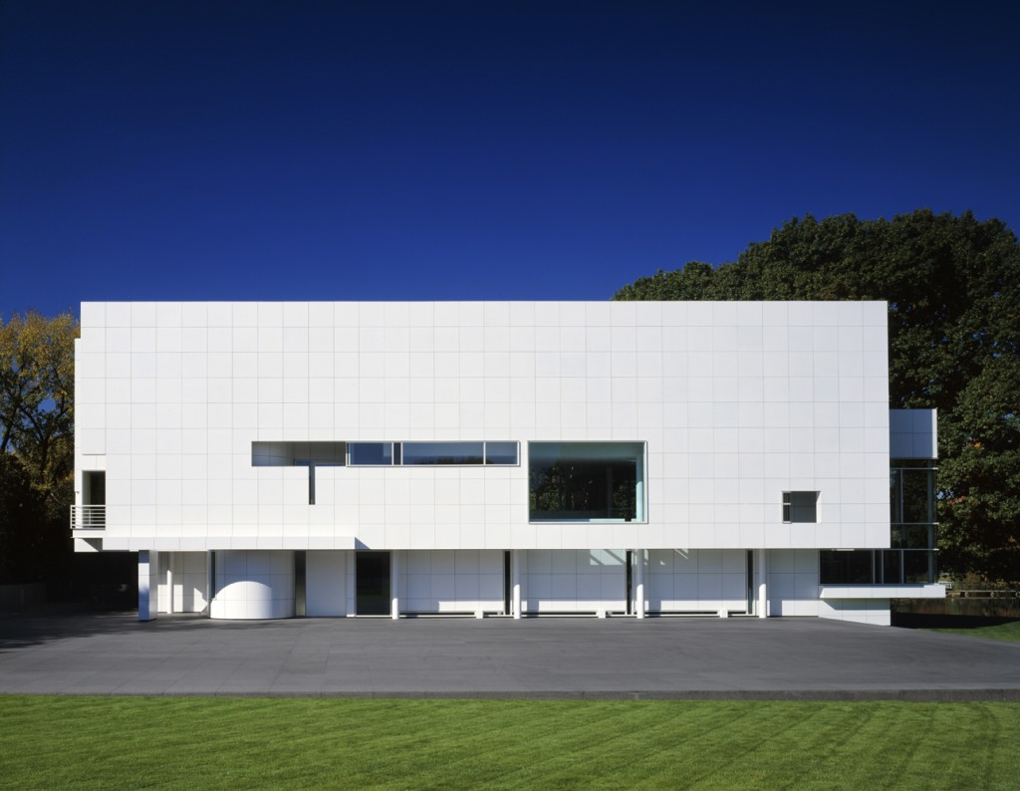
Rachofsky House, Dallas, TX (1996)
Richard Meier

Slide 50
Rachofsky House, Dallas, TX (1996)
It is the work of Richard Meier.
Set in a suburban landscape, this house/private museum is anchored to the ground by a podium faced in black granite that extends both in front of and behind the main body of the building.
The white form of the house hovers on pilotis above the podium like an opaque plane, pierced by a number of discrete openings. A succession of spatial layers recedes from this taut surface to accommodate the house’s principal volumes.

Slide 51
Rachofsky House, Dallas, TX (1996)
The metal-faced front elevation that shields the living volume gives way on the north and west elevations to taut curtain walls that, together with the opaque front, inflect the interior layered space toward a small body of water to the southwest.
Two separate stairs provide access to the three floors of the house: an enclosed spiral stair to the south and an open switchback stair to the north.
The exterior of the house is clad in white-enameled aluminum panels with aluminum fenestration and insulated glazing.

Slide 52
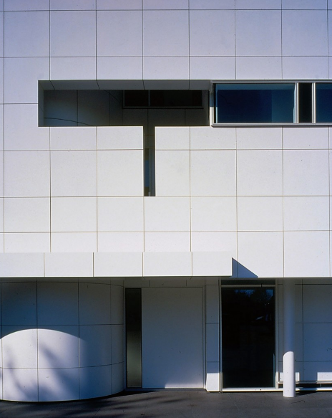
Rachofsky House, Dallas, TX (1996)

Slide 53
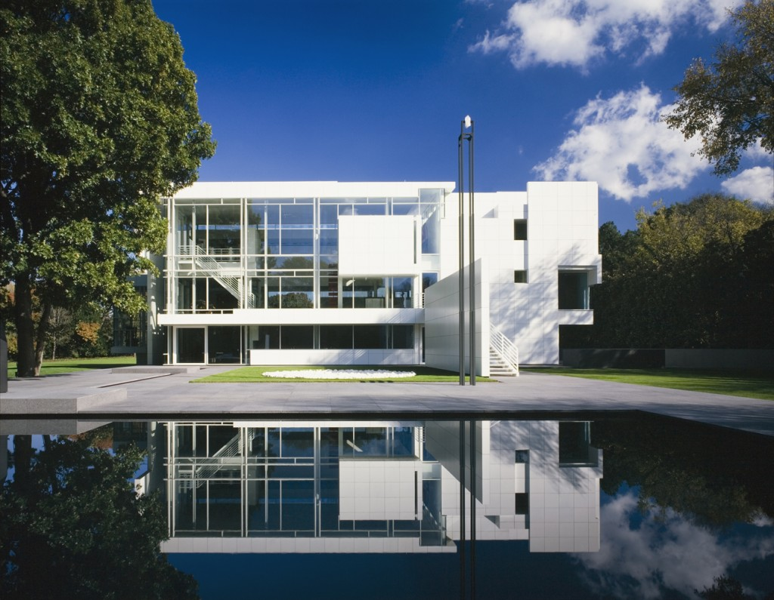
Rachofsky House, Dallas, TX (1996)

Slide 54
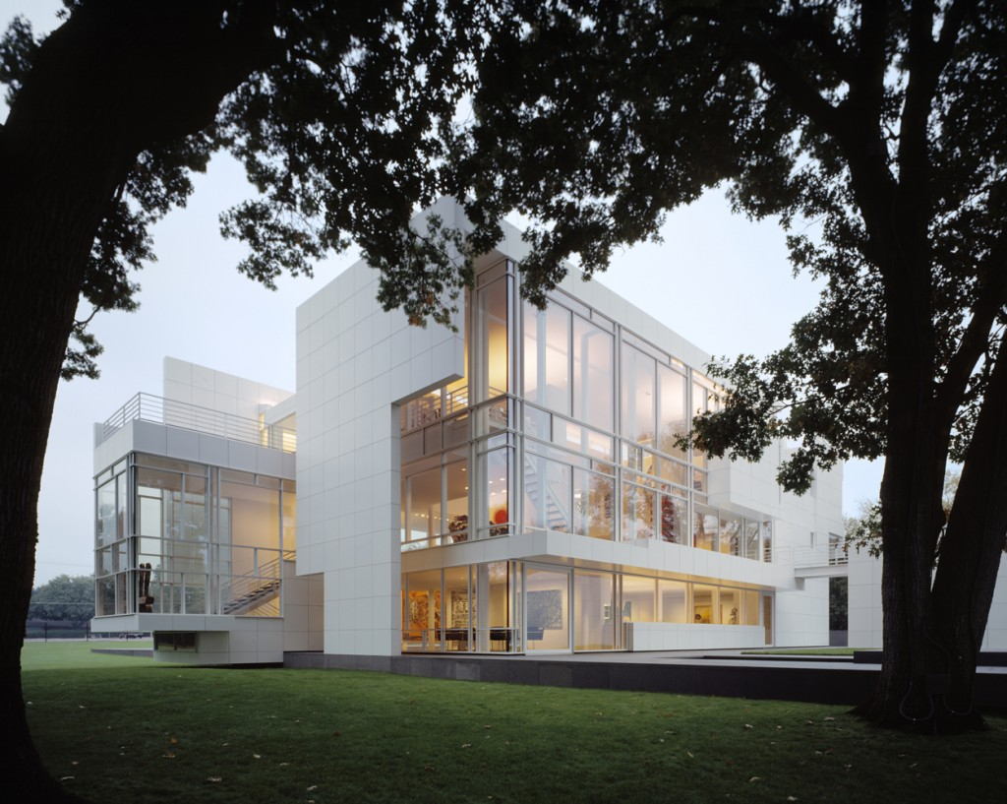
Rachofsky House, Dallas, TX (1996)

Slide 55
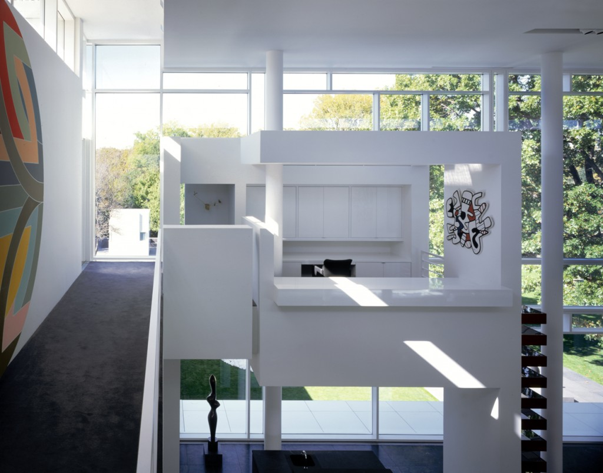
Rachofsky House, Dallas, TX (1996)

Slide 56
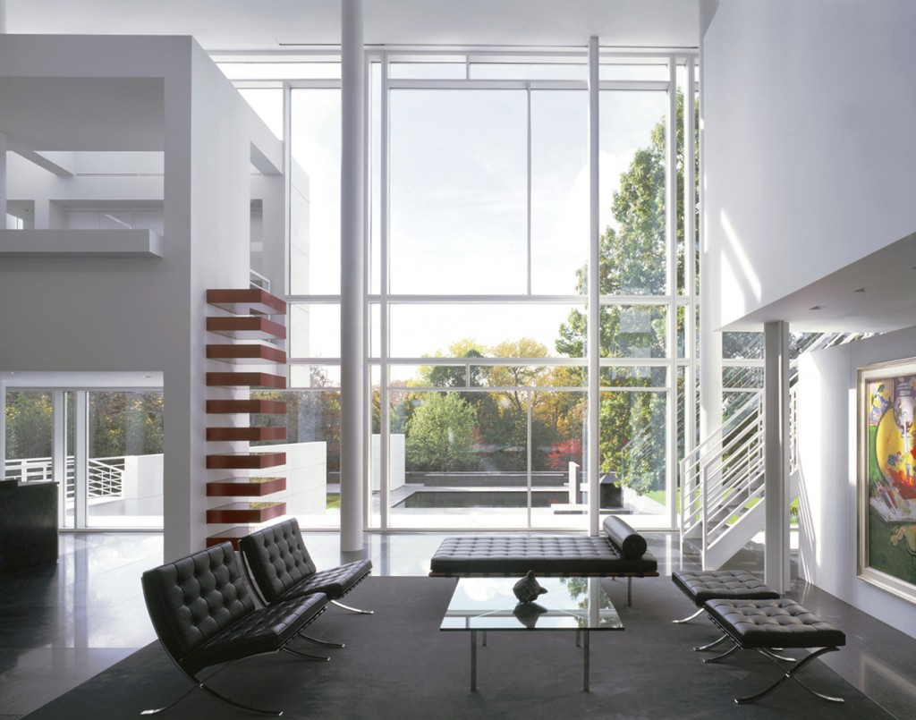
Rachofsky House, Dallas, TX (1996)

Slide 57
Rachofsky House, Dallas, TX (1996)

Slide 58
Rachofsky House, Dallas, TX (1996)

Slide 59
Rachofsky House, Dallas, TX (1996)

Slide 60
La Casa, Pueblo West, CO (1996)
Elizabeth Wright Ingraham

Slide 61
La Casa, Pueblo West, CO (1996)
It is the work of the architect Elizabeth Wright Ingraham.
The 5,017-sqf house sits on a soaring cliff outside Colorado Springs, where winds have been clocked at 110 miles per hour. The continuous erosion of the cliff forced Ingraham to place the house back from the edge, but she recaptured the drama of the steep drop with a 27-foot skywalk supported by a 58-foot steel truss and cantilevered from the 2nd floor. Glazed concrete-block walls, concrete terraces, and radiant-heated floors insulate the interior against the extreme temperature changes throughout the day.

Slide 62
La Casa, Pueblo West, CO (1996)

Slide 63
La Casa, Pueblo West, CO (1996)

Slide 64
La Casa, Pueblo West, CO (1996)

Slide 65
La Casa, Pueblo West, CO (1996)

Slide 66
64 Wakefield House, Atlanta, GA (1996)
Mark Scogin
Merrill Elam

Slide 67
64 Wakefield House, Atlanta, GA (1996)
It is the own house of the architects Mack Scogin & Merrill Elam.
The house is a wood frame structure with a stucco and glass enclosing surfaces. Interior materials include painted gypsum wall board, cementitious board flooring and stairs and minor details of raw steel. The pool went to the 2nd floor, spanning the spaces of the floor below and gathering in the south light. Shielded from the street by a translucent glass wall but open to the sky and air, the roof deck and pool challenge the very notion of public/private. The outdoor pool, surrounded by a deck crowns 2-floor master-bedroom suite, with dressing rooms and closets downstairs and a sleeping area, bathroom, and bathing above.

Slide 68
64 Wakefield House, Atlanta, GA (1996)

Slide 69
64 Wakefield House, Atlanta, GA (1996)

Slide 70
64 Wakefield House, Atlanta, GA (1996)

Slide 71
64 Wakefield House, Atlanta, GA (1996)

Slide 72
64 Wakefield House, Atlanta, GA (1996)

Slide 73
64 Wakefield House, Atlanta, GA (1996)

Slide 74
64 Wakefield House, Atlanta, GA (1996)

Slide 75
64 Wakefield House, Atlanta, GA (1996)

Slide 76
Cobb House, Seattle, WA (1997)
Eric Cobb

Slide 77
Cobb House, Seattle, WA (1997)
It is the architect Eric Cobb's own house.
Located in a subdivision on a sloping plot, this house is built in a wooden frame of prefabricated elements stiffened to the south by a steel frame. The main body of the house is closed on 3 sides while the south-eastern facade is as open as possible, thanks in particular to a window band more than 15 m long composed of a repetition of glass and aluminium elements.
There is also a garden terrace decorated with potted plants.

Slide 78
Cobb House, Seattle, WA (1997)

Slide 79
Cobb House, Seattle, WA (1997)

Slide 80
Cobb House, Seattle, WA (1997)

Slide 81
Landa Residence, Manhattan Beach, CA (1997)
Thom Mayne

Slide 82
Landa Residence, Manhattan Beach, CA (1997)
It is the work of the architect Thom Mayne.
A distorted cube hovers above the existing plinth of the 1st floor volume. It acts as a primary site/volume boundary of the new addition, acknowledging the limits of the given property. This splayed orthogonal wall surface of concrete panels wraps around 3 sides of the newly enclosed 2nd and 3rd floor volume, with a single piece folded down for the main entrance. A 2nd surface element, a fragment of a truncated cone, also sits above the 1st floor, inside of the splayed surface boundary. A distorted cylinder, it provides another layer and type of enclosure, intersecting and penetrating the splayed walls of the cube creating voids of natural light and ventilation in the rooms below.

Slide 83
Landa Residence, Manhattan Beach, CA (1997)
2 vertical elements sit within the confines of both surface structures; a wall of steel shelving along the centerline of the cone, and a stair. The shelving wall divides the studio from the stair and bedroom above, while the stair itself is a kind of hybrid tower incorporating fragments of foundation, HVAC, structure, and storage. At the 3rd floor, it expands as a horizontal plane to become a bedroom loft. These 2 elements anchor the new surface volumes to the body of the existing house below,

Slide 84
Landa Residence, Manhattan Beach, CA (1997)

Slide 85
Landa Residence, Manhattan Beach, CA (1997)

Slide 86
Landa Residence, Manhattan Beach, CA (1997)

Slide 87
Landa Residence, Manhattan Beach, CA (1997)

Slide 88
Landa Residence, Manhattan Beach, CA (1997)

Slide 89
Landa Residence, Manhattan Beach, CA (1997)

Slide 90
Landa Residence, Manhattan Beach, CA (1997)

Slide 91
Waldman House, Charlottesville, VA (1998)
Peter Waldman

Slide 92
Waldman House, Charlottesville, VA (1998)
It is the architect Peter Waldman's own house: it is an experimental house also called Parcel X.
The South and North facades have only a few openings: most of the light is brought by 2 large East and West bays: the North facade has a translucent glass-block wall, allowing a large amount of natural light.
Outside, the house is entirely covered with copper plates for a better integration into the landscape. Inside, it is a large loft with two bedrooms on the main level are topped by a loft like third. The house is surmounted by a skylight which is shaped like a teepee.

Slide 93
Waldman House, Charlottesville, VA (1998)

Slide 94
Waldman House, Charlottesville, VA (1998)

Slide 95
Waldman House, Charlottesville, VA (1998)

Slide 96
Waldman House, Charlottesville, VA (1998)

Slide 97
Waldman House, Charlottesville, VA (1998)

Slide 98
Neugebauer House, Naples, FL (1998)
Richard Meier

Slide 99
Neugebauer House, Naples, FL (1998)
It is the work of Richard Meier.
The horizontal façade of the house itself is cladded in two by three foot limestone slabs backed by a concrete frame and masonry structure. Pierced at regular intervals by vertical slot windows, the façade conceals a wide, top-lit access corridor running the length of the house. The linear organization consists of five parallel layers from front to back: access, service, living, sun terrace, and lap pool.

Slide 100
Neugebauer House, Naples, FL (1998)
A fifteen-foot module controls the structural bay and the incremental dimensions of all the cellular spaces. The principal rooms and their attendant bathing and dressing areas as well as the kitchen are covered by a steel-frame butterfly roof cantilevered off paired steel stanchions at 15-foot centers. This roof, finished with a stone-paneled rain screen, satisfies the community requirement for a pitched roof while reinforcing the house’s orientation toward the water.

Slide 101
Neugebauer House, Naples, FL (1998)

Slide 102
Neugebauer House, Naples, FL (1998)

Slide 103
Neugebauer House, Naples, FL (1998)

Slide 104
Neugebauer House, Naples, FL (1998)

Slide 105
Neugebauer House, Naples, FL (1998)

Slide 106
Byrne House, North Scottsdale, AZ (1998)
Will Bruder

Slide 107
Byrne House, North Scottsdale, AZ (1998)
It is the work of the architect Will Bruder.
The residence is a series of abstract canyon walls and spaces that emerge as metaphoric geological gestures from its steep south facing desert site. With dramatically corbelled concrete tilting and raking masonry and metal clad frame walls, the architectural embrace of the residence’s main entry, living and circulation gallery spaces is both original and invigorating. The structure’s angular geometry grows from the asymmetrical, tapering alignment of ‘canyon’. The purple/black patinaed copper, acid etched galvanized metal clad frame-well and fascia elements complement the undisturbed Sonoran desert surround. Large window walls, patios and courtyards of shade and sun allow indoor /outdoor living throughout the desert calendar.

Slide 108
Byrne House, North Scottsdale, AZ (1998)

Slide 109
Byrne House, North Scottsdale, AZ (1998)

Slide 110
Byrne House, North Scottsdale, AZ (1998)

Slide 111
Byrne House, North Scottsdale, AZ (1998)

Slide 112
Byrne House, North Scottsdale, AZ (1998)

Slide 113
Byrne House, North Scottsdale, AZ (1998)

Slide 114
Byrne House, North Scottsdale, AZ (1998)

Slide 115
Byrne House, North Scottsdale, AZ (1998)

Slide 116
Byrne House, North Scottsdale, AZ (1998)

Slide 117
Y House, Catskill Mountains, NY (1999)
Steven Holl

Slide 118
Y House, Catskill Mountains, NY (1999)
It is the work of Steven Holl architect.
The "Y" House ascends the hill, splitting to form two arms, ending in balconies.
The geometry contains a sectional flip of public/private and day/night with bedrooms below and living above.
Deep balconies facing nearly due south act as passive solar devices allowing the winter sun to penetrate the interiors while excluding the hot summer sun. Steel framing and roof are iron-oxide red, siding is stained cedar while interiors are white with ash floors.

Slide 119
Y House, Catskill Mountains, NY (1999)

Slide 120
Y House, Catskill Mountains, NY (1999)

Slide 121
Y House, Catskill Mountains, NY (1999)

Slide 122
Y House, Catskill Mountains, NY (1999)

Slide 123
Y House, Catskill Mountains, NY (1999)

Slide 124
Y House, Catskill Mountains, NY (1999)

Slide 125
Mataja Residence, Malibu, CA (1999)
Hagy Belzberg

Slide 126
Mataja Residence, Malibu, CA (1999)
It is the work of Hagy Belzberg architect.
The house is wrapping an existing granite boulder outcropping using the California courtyard house typology to organize the sequence of spaces. The boulders form and complete the courtyard which make architectural use of this extraordinary natural feature, shielding it and the interior from strong northerly winds and weather as well as camouflaging the house from those hiking in the adjacent National Park.

Slide 127
Mataja Residence, Malibu, CA (1999)
Exposed steel moment framing, expansive glass panels and 12 feet long x 8-inch thick concrete cantilevers speak of high technology.
In addition, a “butterfly” roof is directed south and angled at 32 degrees to achieve maximum solar collection; it also collects and channels water for site irrigation.
Trombe exterior walls of formed concrete and an “air floor” created by honeycombed double concrete slabs provide enough thermal massing to allow for 67% of the interior space to be glazed. Cantilevered concrete and glass curtain walls angle at 8 degrees towards significant sight lines, axes and over Mulholland Canyon.

Slide 128
Mataja Residence, Malibu, CA (1999)

Slide 129
Mataja Residence, Malibu, CA (1999)

Slide 130
Mataja Residence, Malibu, CA (1999)

Slide 131
Mataja Residence, Malibu, CA (1999)

Slide 132
Mataja Residence, Malibu, CA (1999)

Slide 133
Mataja Residence, Malibu, CA (1999)

Slide 134
Mataja Residence, Malibu, CA (1999)

Slide 135
Waterfall House, Westminster, SC (1999)
James Howard Fox

Slide 136
Waterfall House, Westminster, SC (1999)
It is the work of the architect James Howard Fox.
The waterfall house is tucked away on 60 acres of land. The house is made of 2 enormous concrete columns and between 3 concrete supports. To get to it, you first go down a long driveway, park, then walk down a long path. At the end of the path is the home’s entrance, which is located on the top level of the house. There is a welcoming vestibule, made up of a flat, copper-covered, wooden overhang with poured concrete pillars on each side. Step inside : wood and glass abound. The fireplace is enormous. The tree-shaped opening is so big you can stand inside of it! Windows often make up walls. Below they are underneath the kitchen cabinets, making it seem like they are floating.

Slide 137
Waterfall House, Westminster, SC (1999)

Slide 138
Waterfall House, Westminster, SC (1999)

Slide 139
Waterfall House, Westminster, SC (1999)

Slide 140
Waterfall House, Westminster, SC (1999)

Slide 141
Waterfall House, Westminster, SC (1999)

Slide 142
Waterfall House, Westminster, SC (1999)

Slide 143
Waterfall House, Westminster, SC (1999)

Slide 144
Waterfall House, Westminster, SC (1999)

Slide 145
Waterfall House, Westminster, SC (1999)

Slide 146
Waterfall House, Westminster, SC (1999)

Slide 147
Waterfall House, Westminster, SC (1999)

Slide 148
Waterfall House, Westminster, SC (1999)

Slide 149
Waterfall House, Westminster, SC (1999)

Slide 150
Mataja Residence, Malibu, CA (1999)
THE END

