Slide 1
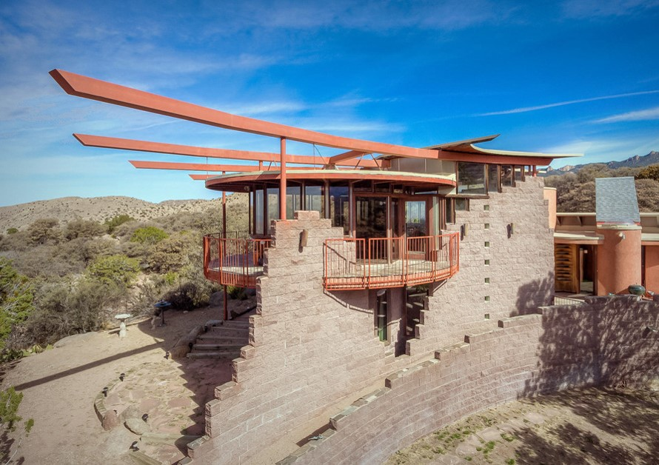
US. Modernist Houses
1988-1990

Slide 2
US Modernist Houses 1988 – 1990
The purpose of this presentation is to show you the most outstanding Modern Movement inspired houses in the United States by great architects.
Some of them have become icons of contemporary architecture (members of the iconic.org network) and are recognized and protected as such.
They remain unique either by their constructive principle, or by their location, or by their theoretical importance, or by their perfect integration into the landscape.

Slide 3
US Modernist Houses
Many of the houses presented in this slide show (before the year 2000) were found on the OfHouses website (Old Forgotten Houses) which lists houses with architectural interest or singular architecture around the world with many illustrations. If they are shown here, it is because they are already considered as iconic.

Slide 4
US Modernist Houses
Copley House, Nancy Copley, NY.
Schnabel House, Frank Gehry, CA.
Rieveschl House, Judith Chafee, AZ.
Prince House, Bart Prince, NM.
Zuber House, Antoine Predock, AZ.
Croffead House, W.G. Clark & Charles Menefee, SC.
Price House, Bart Prince, CA.
Mill Road House, John Black Lee, CT.
Ohio Street House, Valerio & Searl, IL.
Lawrence House, Rafael Viñoly, CT.

Slide 5
US Modernist Houses 2
Hemicycle House, Donald Chandler, VA.
The Monument House, Josh Schweitzer, CA.

Slide 6
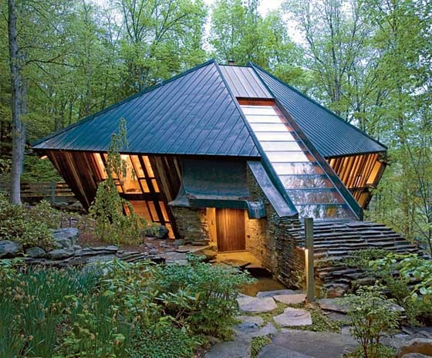
Copley House, Accord, NY (1988)
Nancy Copley

Slide 7
Copley House, Accord, NY (1988)
The architect Nancy Copley built an extraordinary house for herself in Accord, New York, in the foothills of the Catskills. Building the stone tower that anchors the house, 8 feet wide and 43 feet high, took six years : she selected individual rubble stones from a local quarry that had supplied bluestone slabs for the sidewalks of New York. The house has 4 triangular planes folding into a diamond : Its redwood siding has been recycled from old wine vats.

Slide 8
Copley House, Accord, NY (1988)
Two floors of glass-paneled walls slope outward from the cellar at a 63-degree angle, and the angle where the copper roofing meets the walls is greater than 90 degrees. The house's 2nd level is 3 feet wider than the 1st. One path takes you to a counterweighted glass pivot door that opens into the kitchen, under a three-foot-wide skylight running from the roof's eaves to its peak, on the second level of the house. Beyond the kitchen, a great room comprising the living, dining and music areas occupies half of the second level—two triangular quadrants, with a grand piano, floods of sunlight and a soaring sense of space.

Slide 9
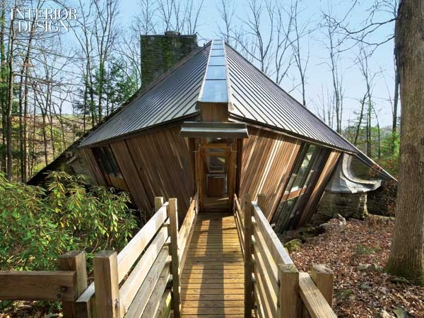
Copley House, Accord, NY (1988)

Slide 10
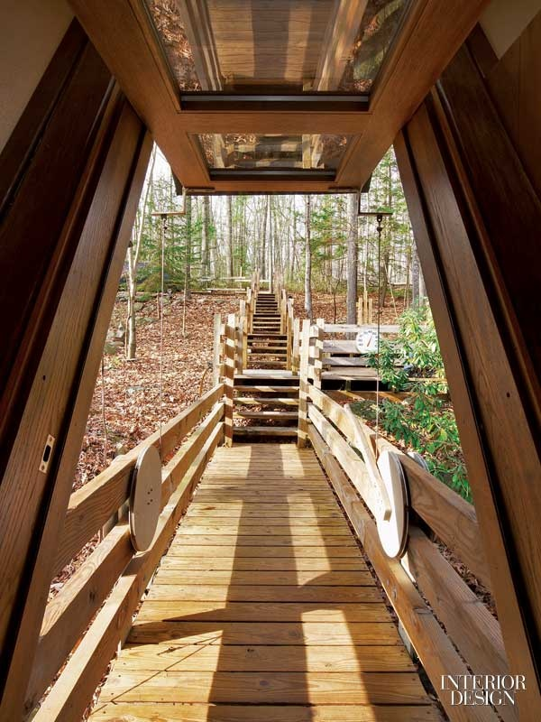
Copley House, Accord, NY (1988)

Slide 11
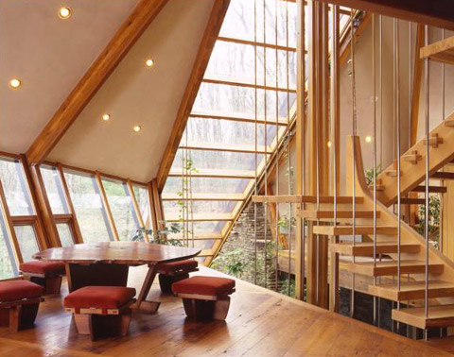
Copley House, Accord, NY (1988)

Slide 12
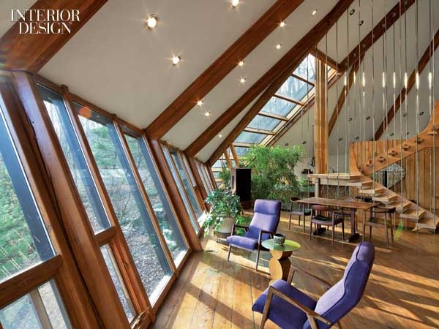
Copley House, Accord, NY (1988)

Slide 13
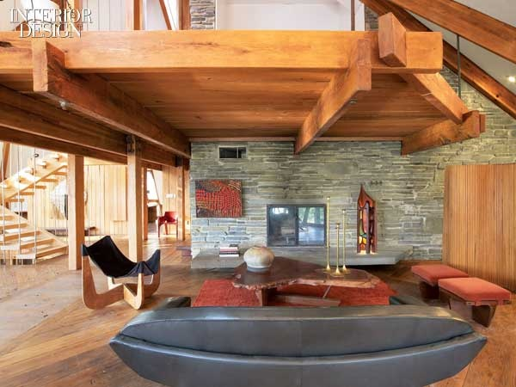
Copley House, Accord, NY (1988)

Slide 14
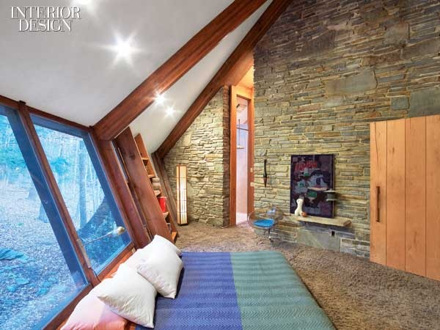
Copley House, Accord, NY (1988)

Slide 15
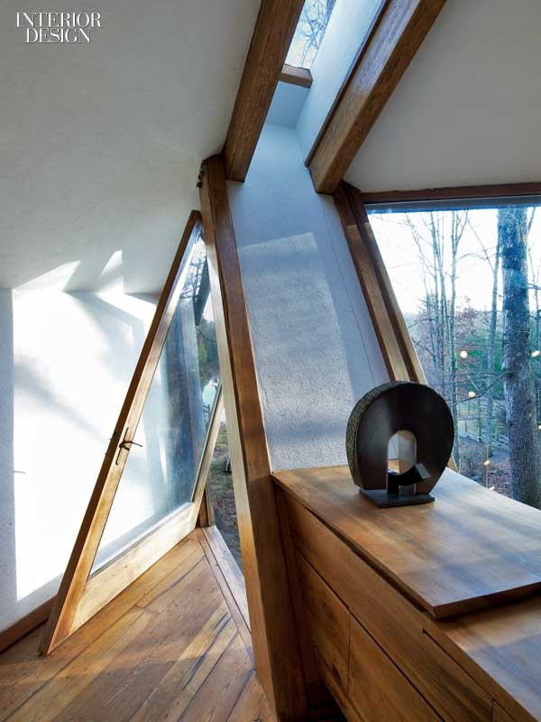
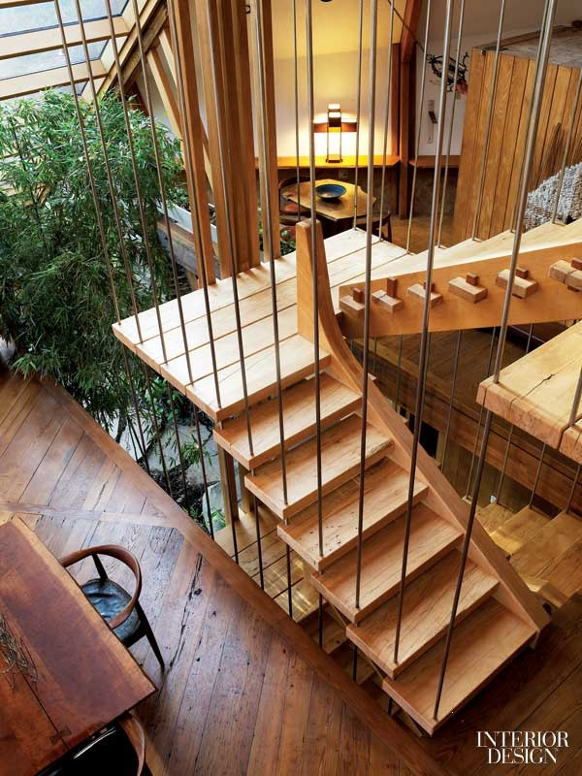
Copley House, Accord, NY (1988)

Slide 16
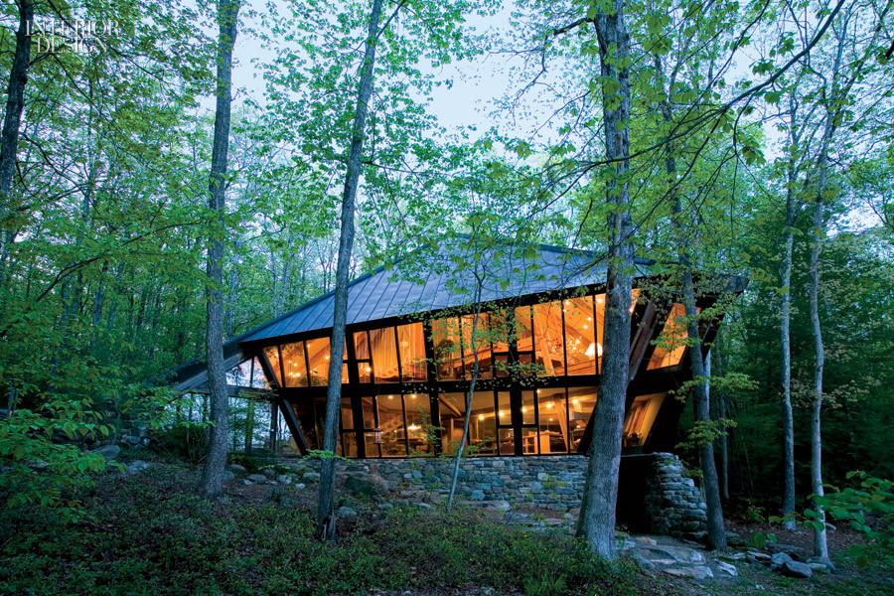
Copley House, Accord, NY (1988)

Slide 17
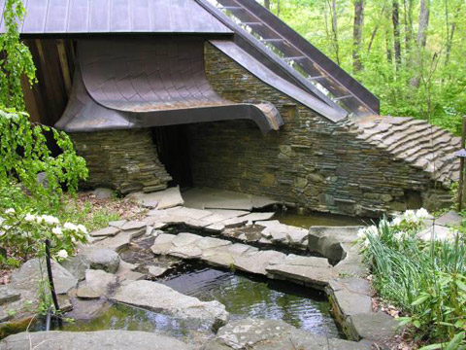
Copley House, Accord, NY (1988)

Slide 18
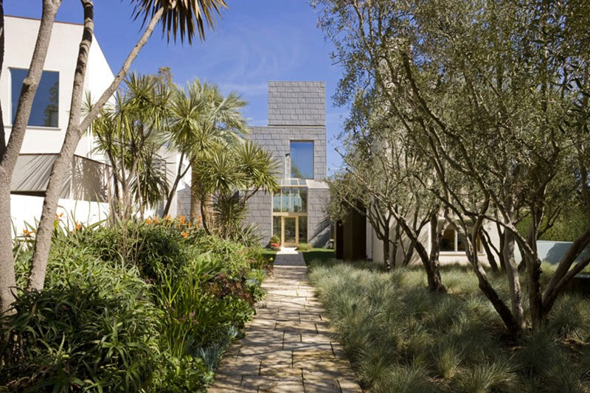
Schnabel House, Los Angeles, CA (1988)
Frank Gehry

Slide 19
Schnabel House, Los Angeles, CA (1988)
It was designed by Frank Gehry.
Schnabel House is a “village” of sculptural forms encompassing spaces that are multi-dimensional and complex : this house involves 4 structures constituted of stucco, wood, glass, lead and copper. The structure with the sphere on the top is a freestanding office, and was inspired by the Griffith Observatory. The lower level water feature is a reflecting pond that surrounds the master bedroom pavilion. Surrounding the back and master bedroom are outdoor pools with copper pillars standing alone to repeat the same shapes.

Slide 20
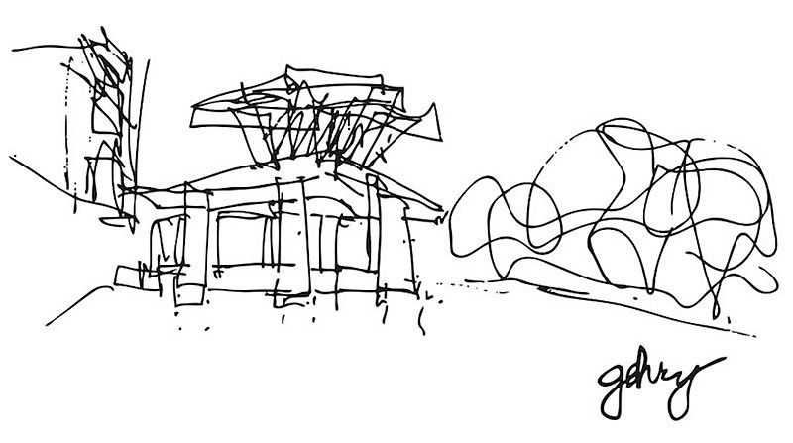
Schnabel House, Los Angeles, CA (1988)

Slide 21
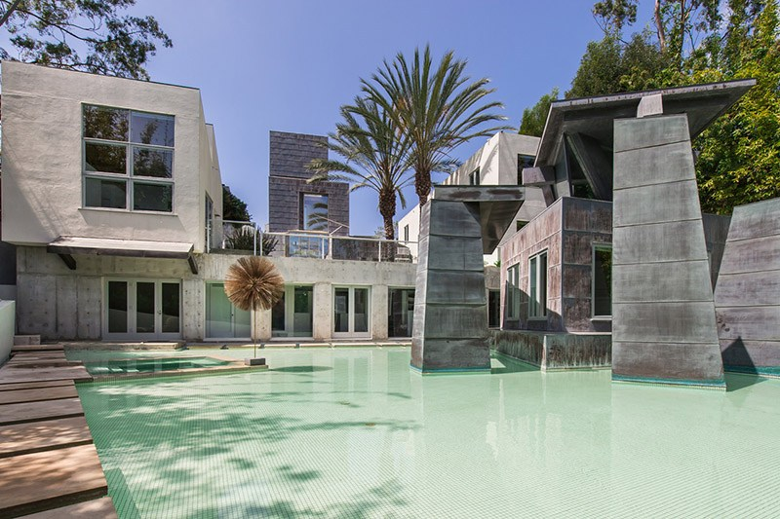
Schnabel House, Los Angeles, CA (1988)

Slide 22
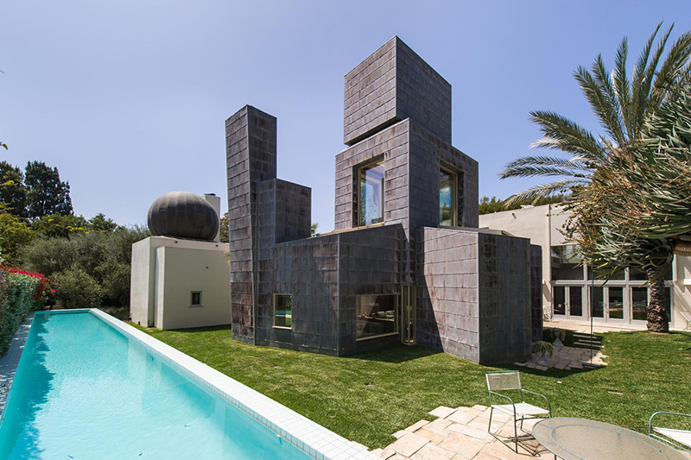
Schnabel House, Los Angeles, CA (1988)

Slide 23
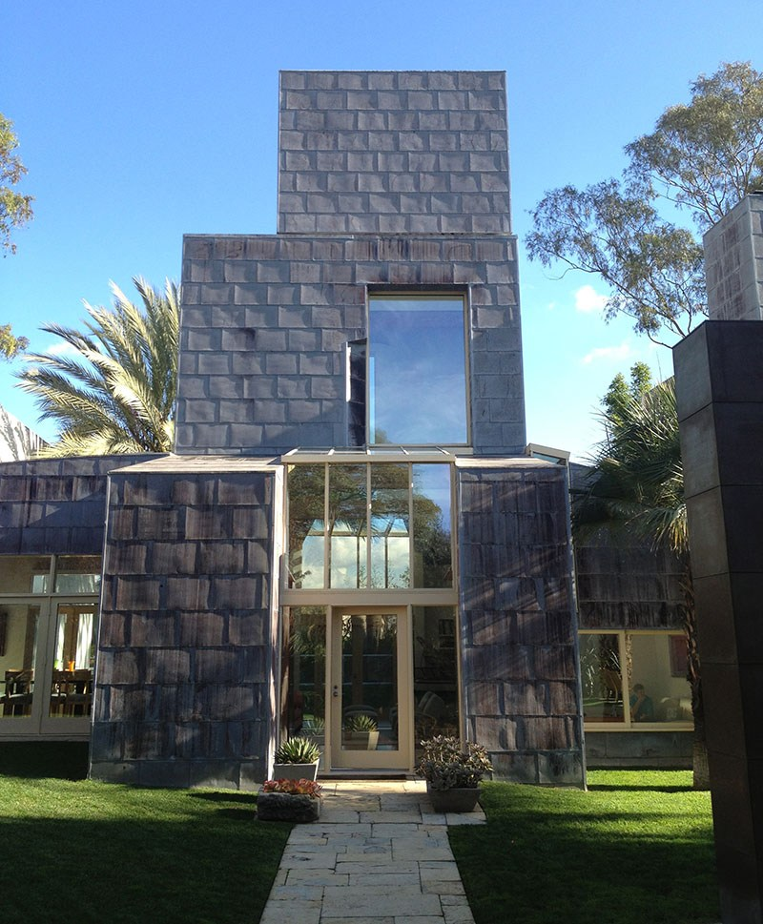
Schnabel House, Los Angeles, CA (1988)

Slide 24
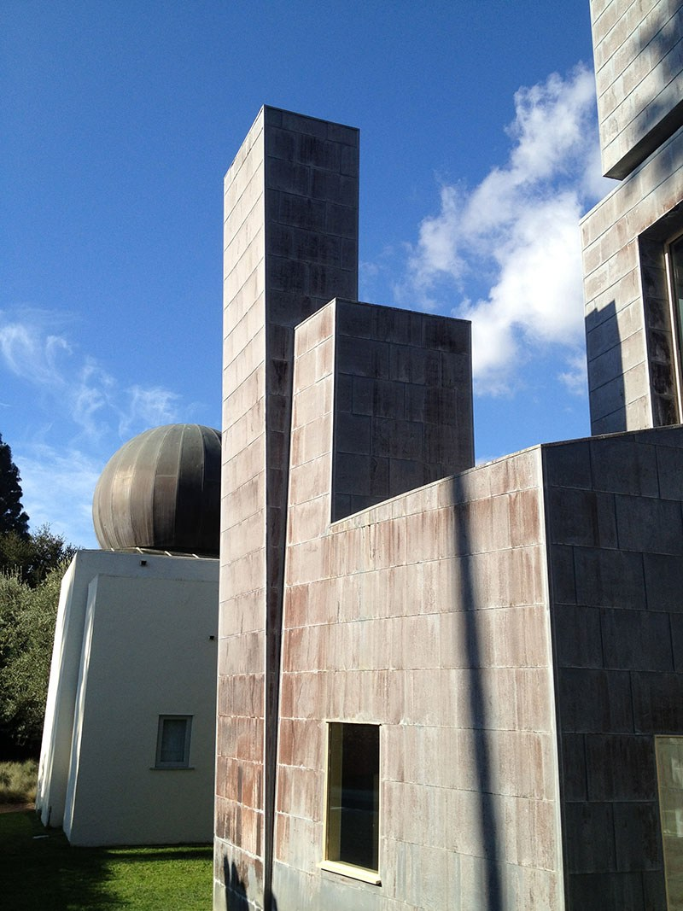
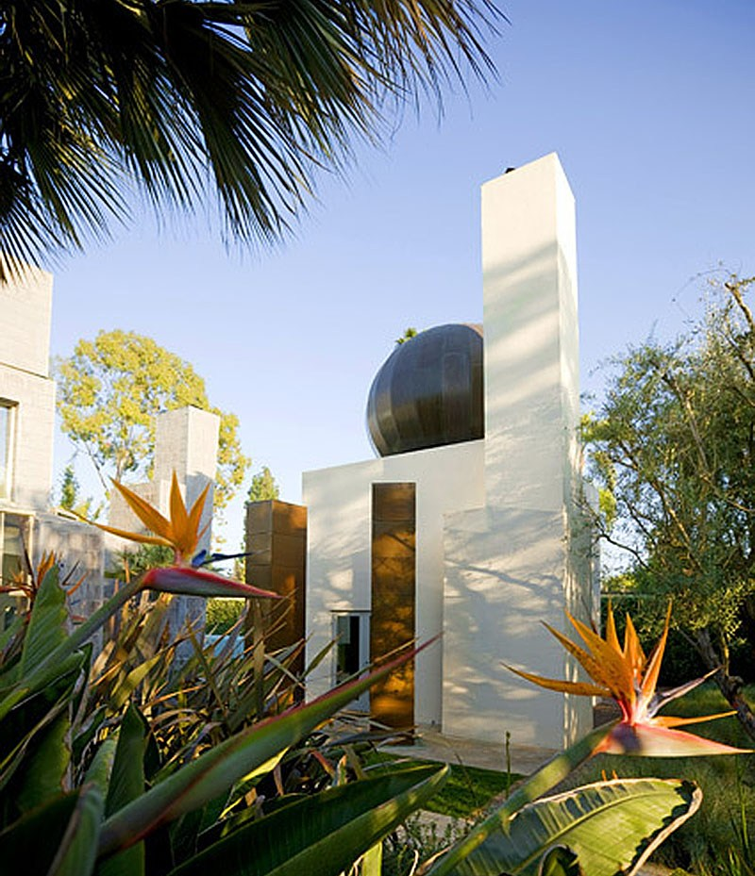
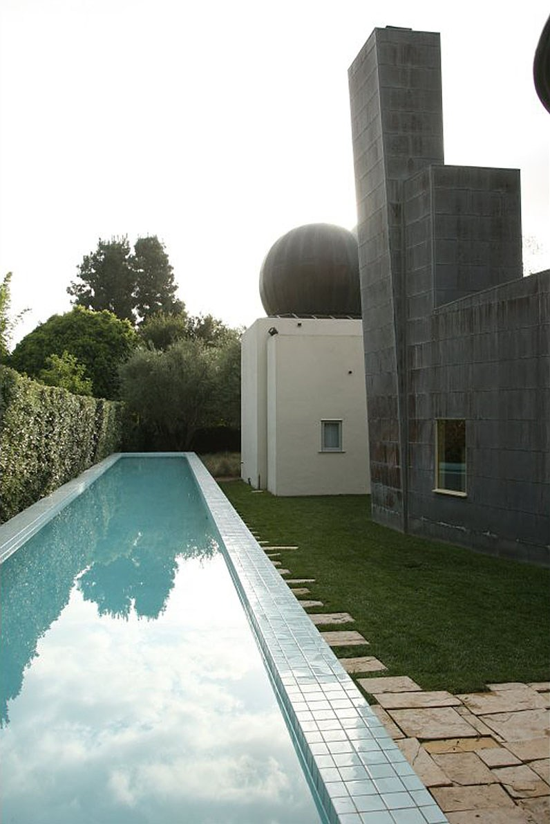
Schnabel House, Los Angeles, CA (1988)

Slide 25
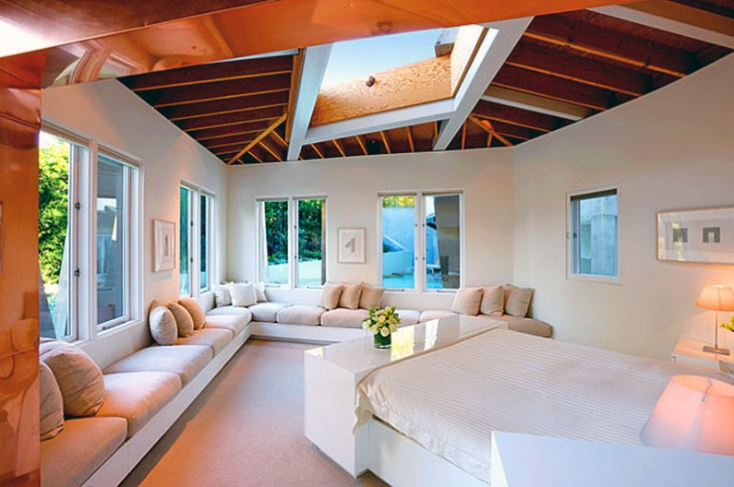
Schnabel House, Los Angeles, CA (1988)

Slide 26
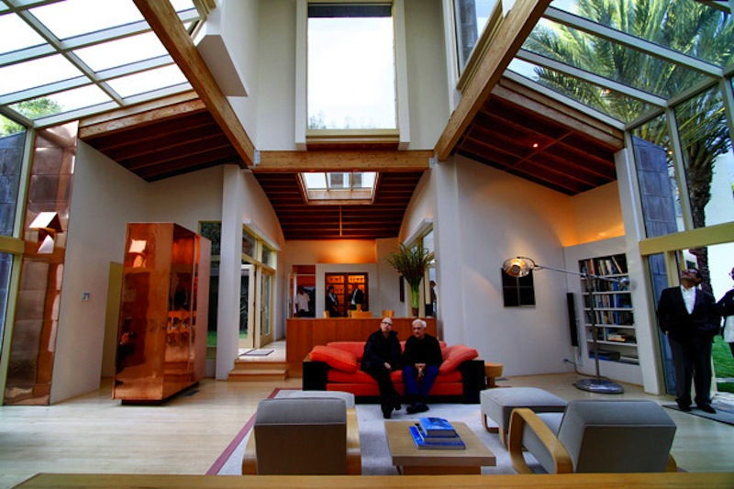
Schnabel House, Los Angeles, CA (1988)

Slide 27
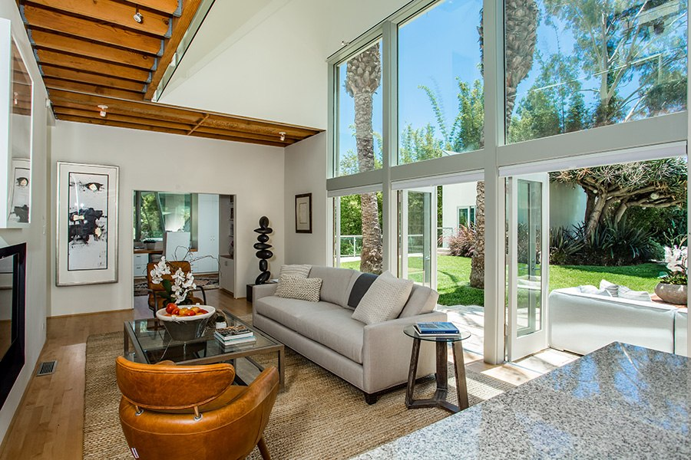
Schnabel House, Los Angeles, CA (1988)

Slide 28
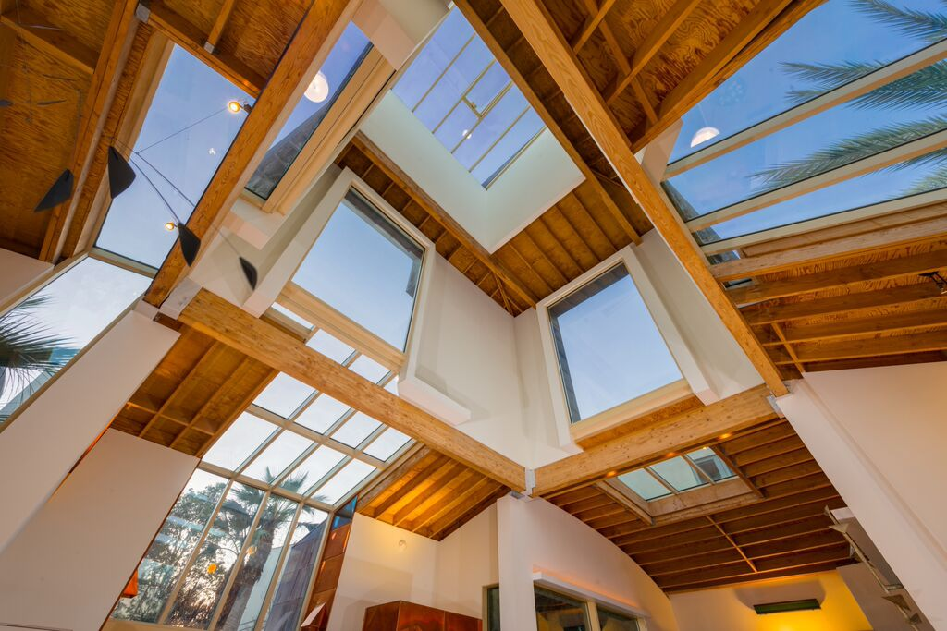
Schnabel House, Los Angeles, CA (1988)

Slide 29
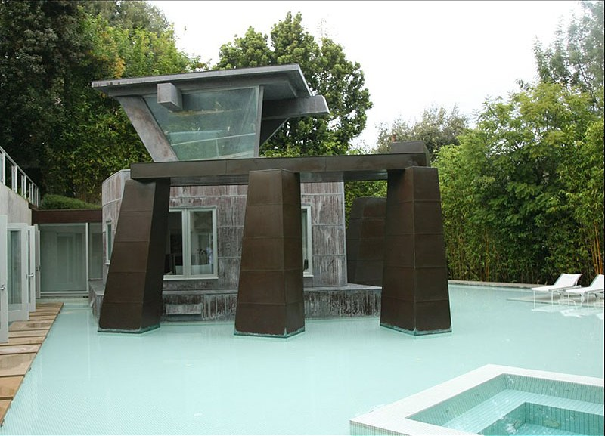
Schnabel House, Los Angeles, CA (1988)

Slide 30
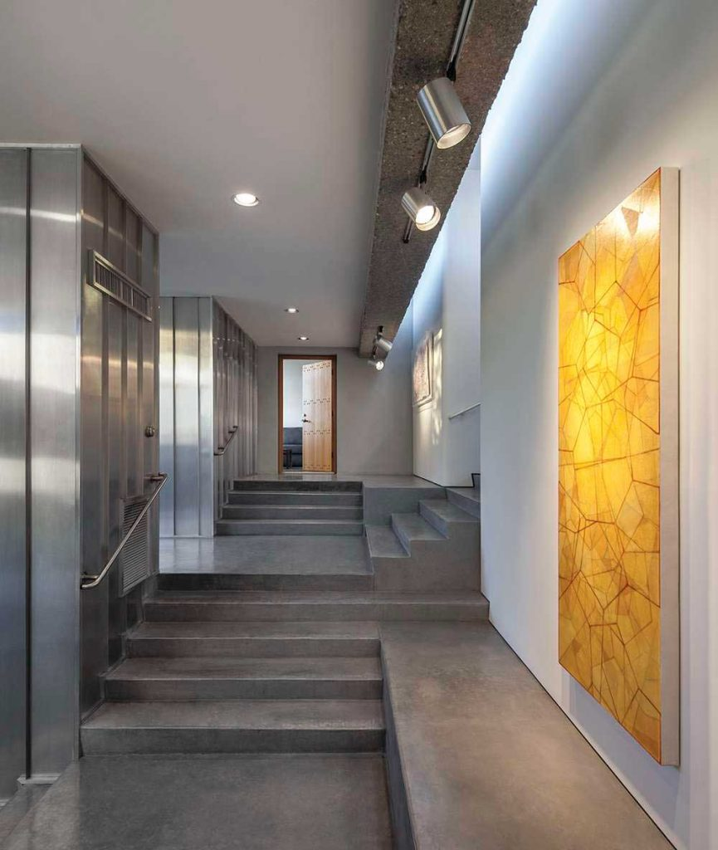
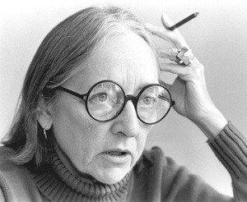
Rieveschl House, Tucson AZ (1988)
Judith Chafee

Slide 31
Rieveschl House, Tucson AZ (1988)
It is the work of the architect Judith Chafee.
It is a large compound of interlocking concrete frames and horizontal platforms jutting from the hillside and affording spectacular views in all directions. The eastern portion of the home protrudes from a granite hillock over the sloped terrain of Tucson’s Santa Catalina foothills. Architect Judith Chafee used concrete columns to support the structure without disturbing the pristine site. A covered walkway leads from the garage to the main entry on the west side of the house.

Slide 32
Rieveschl House, Tucson AZ (1988)
The living area and intimate “coyote den” are anchored by a stacked-stone wall and fireplace formed of stones gathered from the building site. The feature is reminiscent of ancient native ruins.
The central entry is an intricate juxtaposition of concrete steps and landings that are revealed in stages of consciously paced experiences. The entry offers a choice of directions. Concrete stairs lead to the guest suite to the west or a large studio to the north. The standing-seam wall covering system of terne-plate stainless steel is used inside and out. Chafee called it the home’s “pinstripe suit.”

Slide 33
Rieveschl House, Tucson AZ (1988)
The gallery corridor opens to the master suite as it transitions between levels into the library space and the naturally lit living areas, which are defined by a formation of masonry work using colorful rocks gathered from the site.
The main glass-enveloped living areas are bound on two sides by lower concrete terraces that hover over the site and offer cool breezes and seasonal experiences of sun and shade. This patio on the south side of the home overlooks the twinkling lights of Tucson.

Slide 34
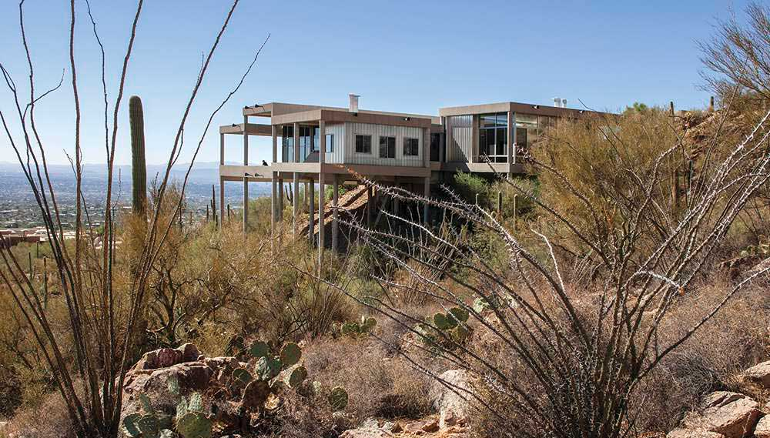
Rieveschl House, Tucson AZ (1988)

Slide 35
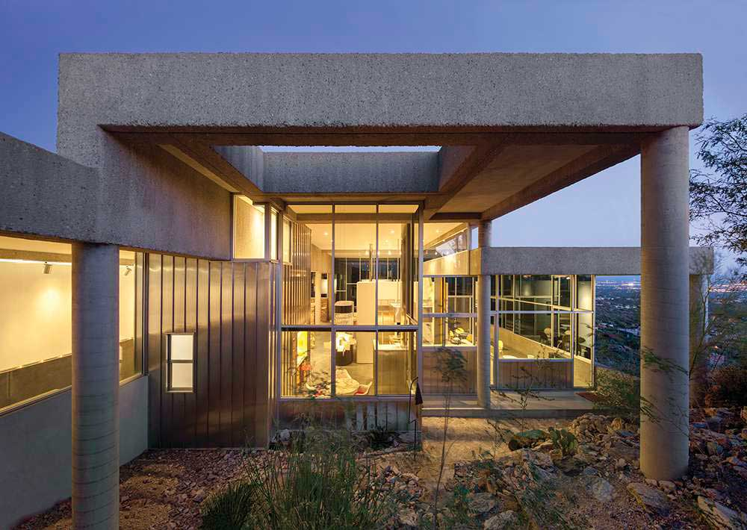
Rieveschl House, Tucson AZ (1988)

Slide 36
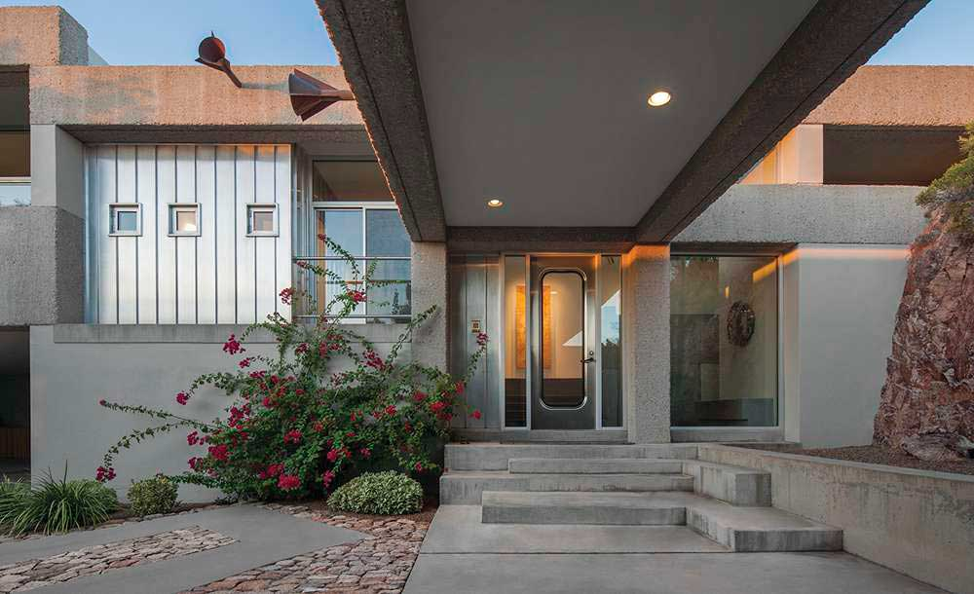
Rieveschl House, Tucson AZ (1988)

Slide 37
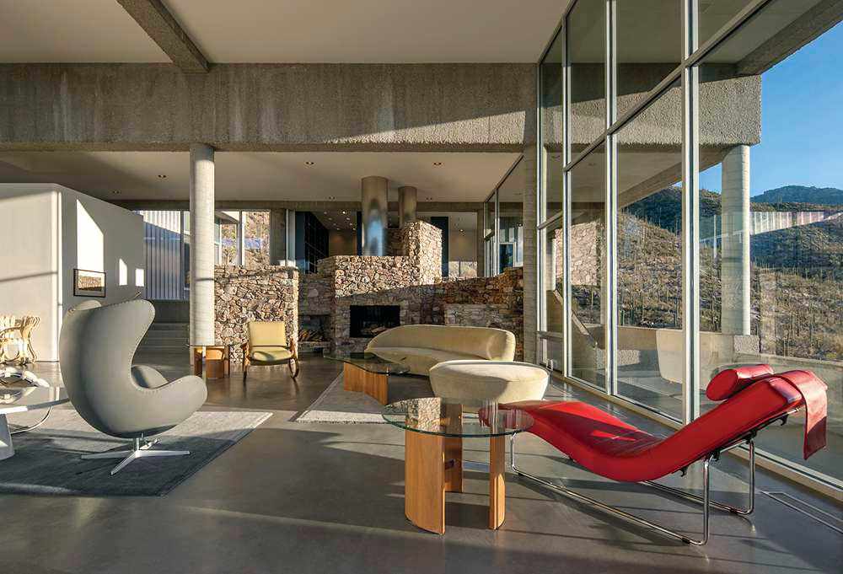
Rieveschl House, Tucson AZ (1988)

Slide 38
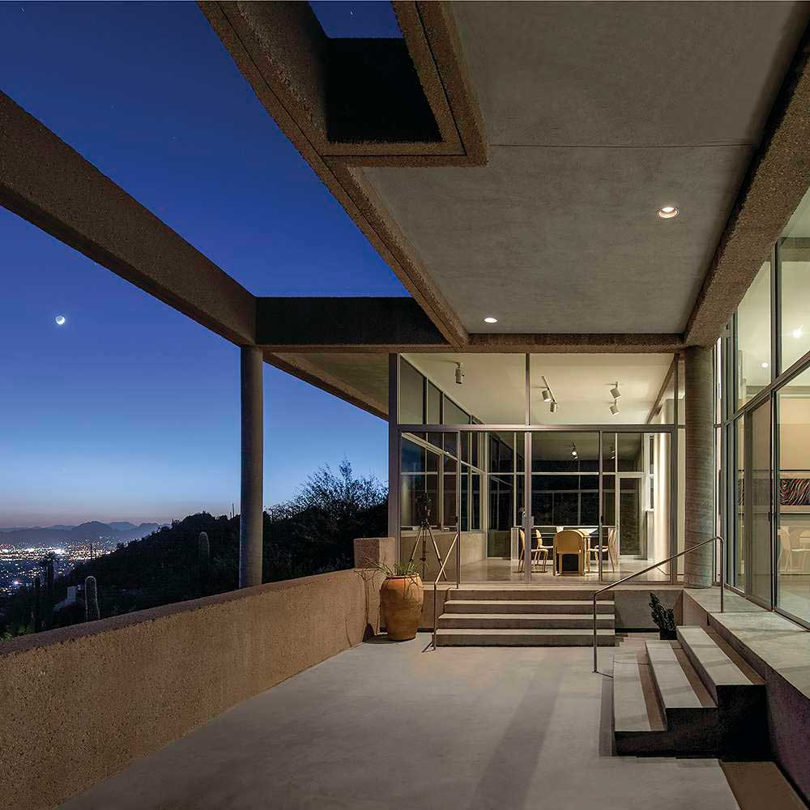
Rieveschl House, Tucson AZ (1988)

Slide 39
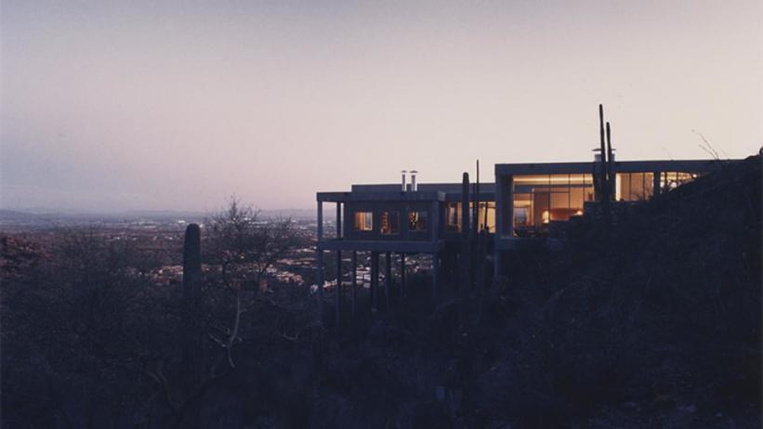
Rieveschl House, Tucson AZ (1988)

Slide 40
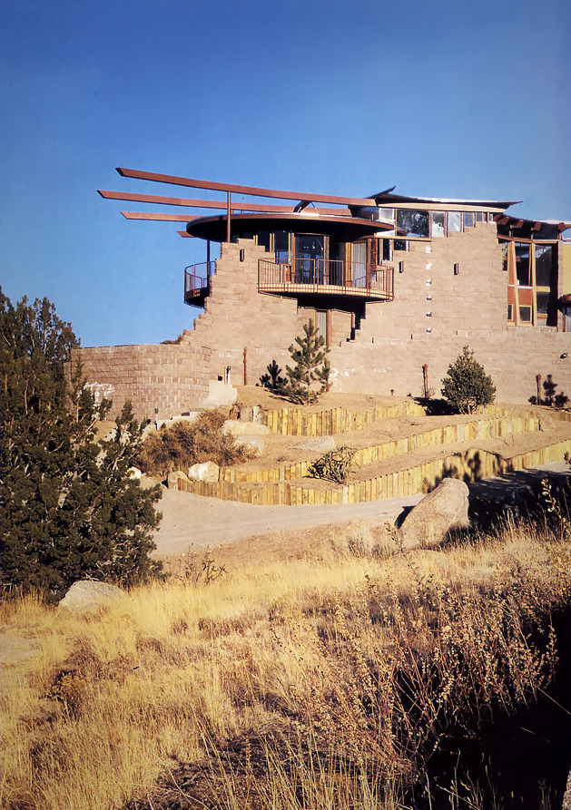
Prince House, Albuquerque, NM (1988)
Bart Prince

Slide 41
Prince House, Albuquerque, NM (1988)
It is the house of the architect Bart Prince for his parents.
Prince devised a plan of 3 overlapping cylinders that rise from sloping -a shape echoed by cantilevered steel beams that support mushroom-cap-like roofs. The house is finished in an earth-colored stucco reminiscent of adobe pueblos. A south-facing curved wall of split-face concrete block partially screens the 3 cylinders that enclose the public rooms of the Prince House. One cylinder breaks through the wall, providing a balcony from which to admire the mountains.

Slide 42
Prince House, Albuquerque, NM (1988)
Inside, the structure of the house is as attention-getting as its dramatic setting. The spatially overlapping "public" rooms-kitchen, living room, and dining room-occupy two levels underneath three wood and steel-framed disks, which are supported on the exterior by metal columns. The second-story living room is tucked beneath what appears to be a 30-foot-diameter open parasol, which is topped by a faceted skylight. The room's massive .fireplace was constructed from granite rocks culled during site excavation

Slide 43
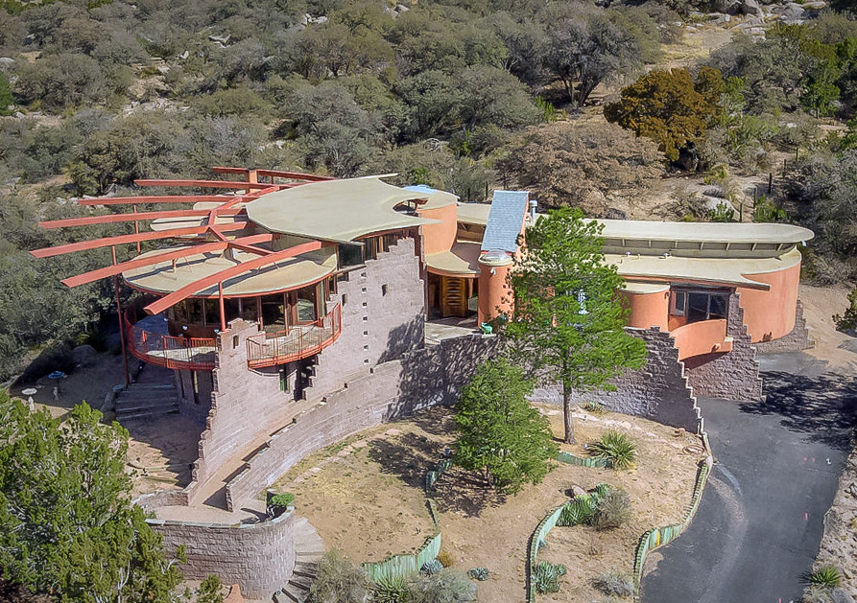
Prince House, Albuquerque, NM (1988)

Slide 44
Prince House, Albuquerque, NM (1988)

Slide 45
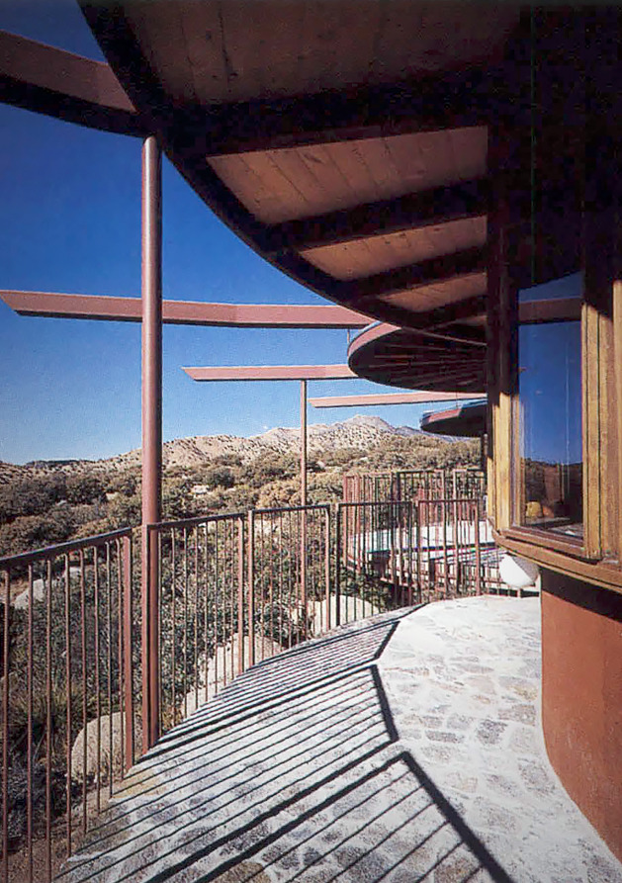
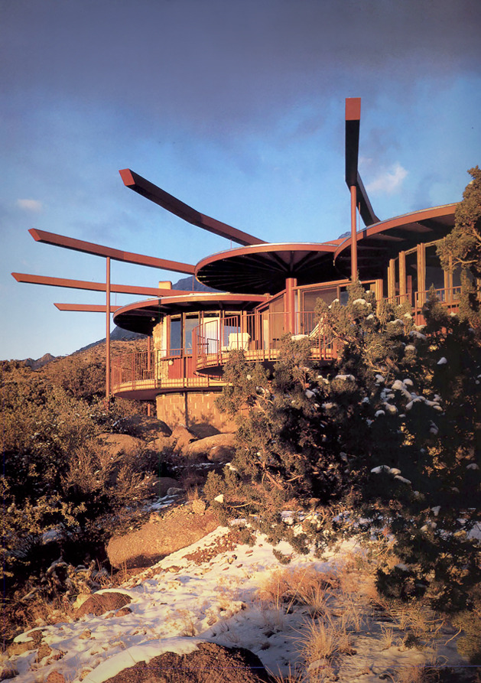
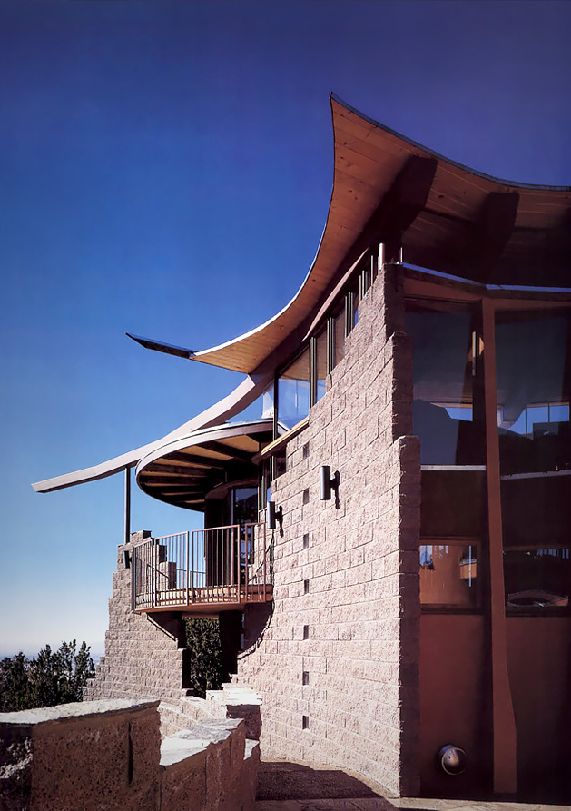
Prince House, Albuquerque, NM (1988)

Slide 46
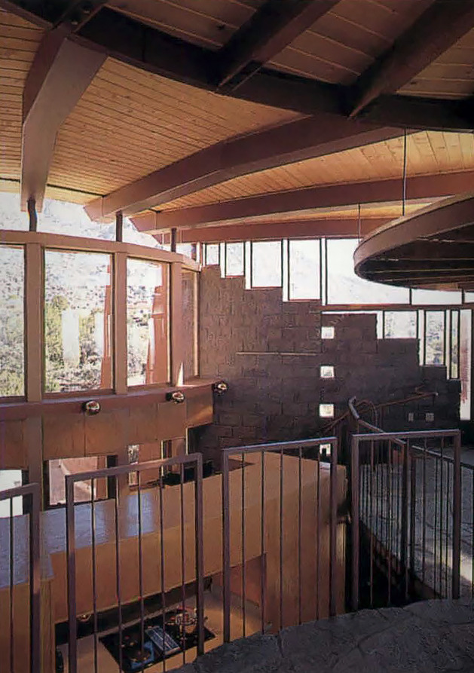
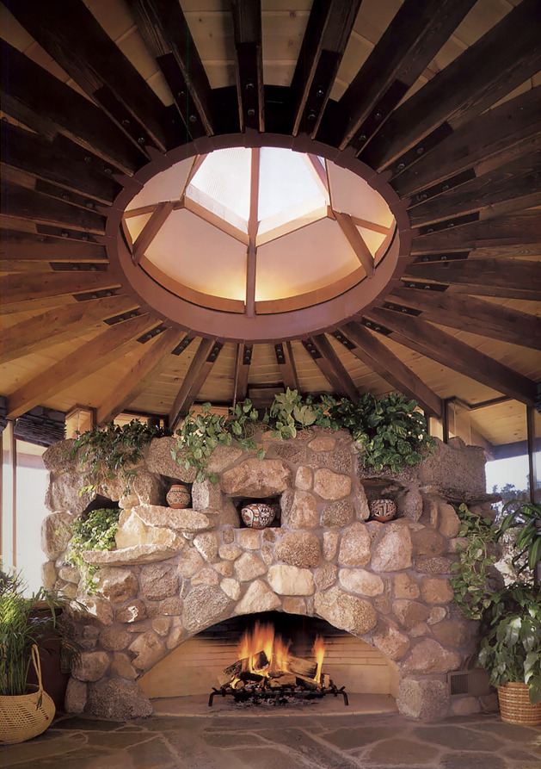
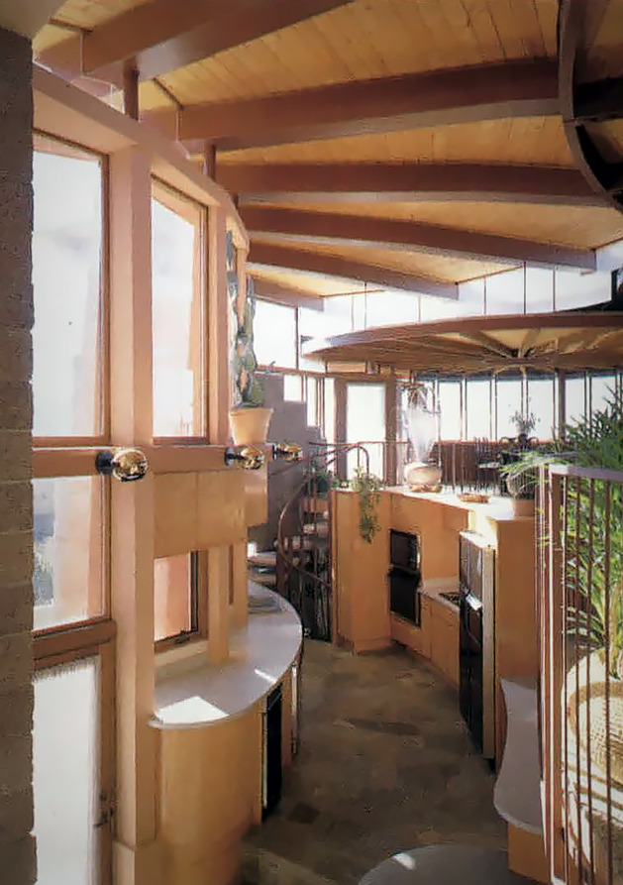
Prince House, Albuquerque, NM (1988)

Slide 47
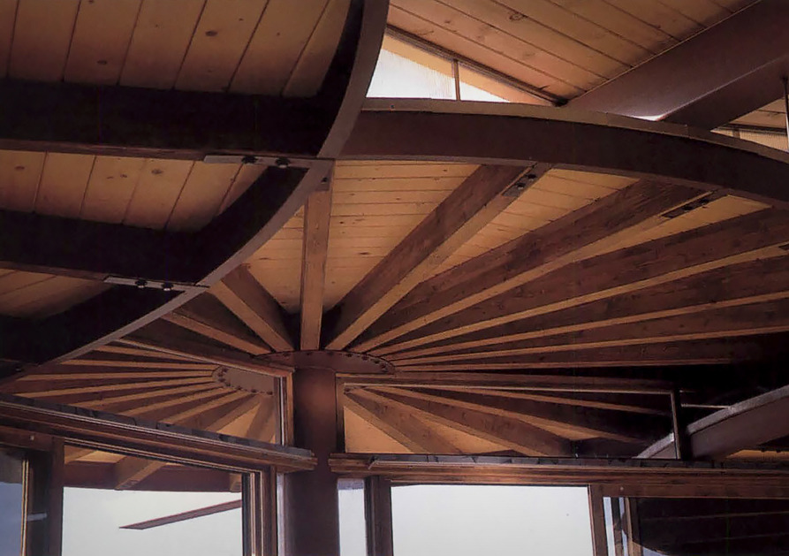
Prince House, Albuquerque, NM (1988)

Slide 48
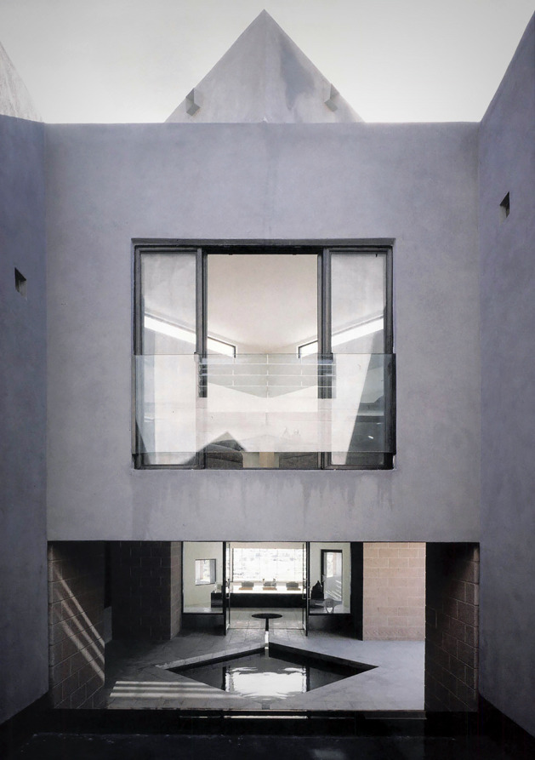
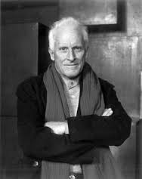
Zuber House, Paradise Valley, AZ (1989)
Antoine Predock

Slide 49
Zuber House, Paradise Valley, AZ (1989)
It is the work of the architect Antoine Predock.
Predock fashioned a well-protected structure that emerges like a bunker out of a rocky outcropping and expands into a stately Wrightian horizontal bar punctuated by vertical observation posts and an eggplant-colored steel balcony /bridge. He located the living room, dining room, and kitchen/breakfast room along the south-facing front facade to exploit dramatic views of the valley and the city of Phoenix beyond, and set the more private study into the slope of the site. In order to soften the effects of Arizona's harsh summer sun, Predock recessed the windows into two-foot-thick walls of stucco-covered concrete block and added fixed louvers for additional screening.

Slide 50
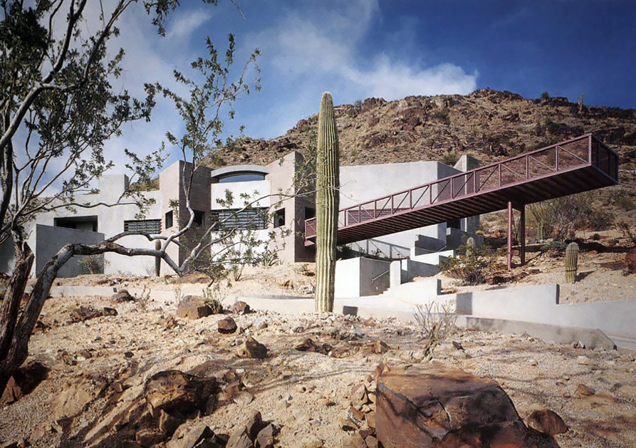
Zuber House, Paradise Valley, AZ (1989)

Slide 51
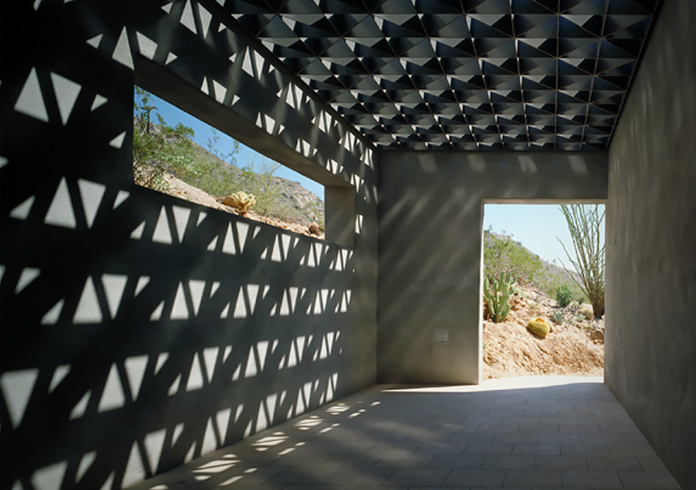
Zuber House, Paradise Valley, AZ (1989)

Slide 52
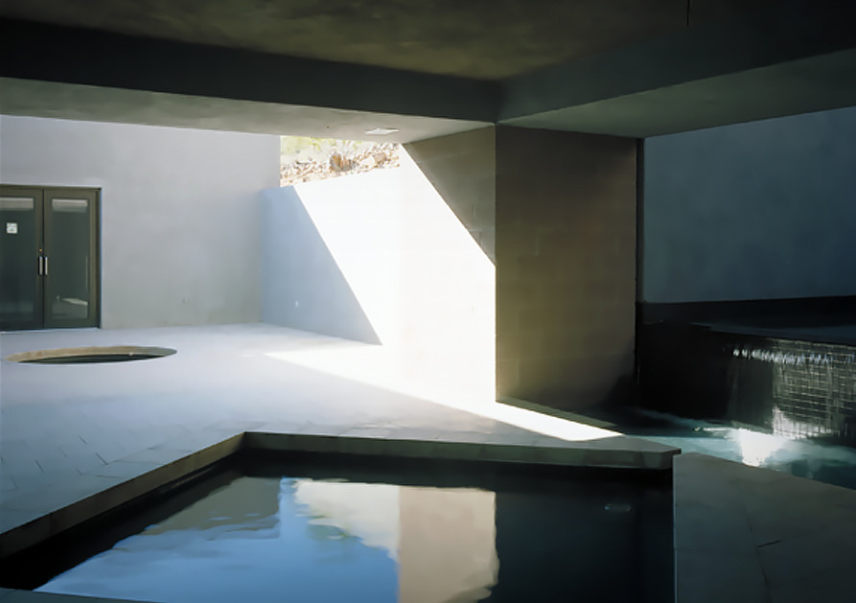
Zuber House, Paradise Valley, AZ (1989)

Slide 53
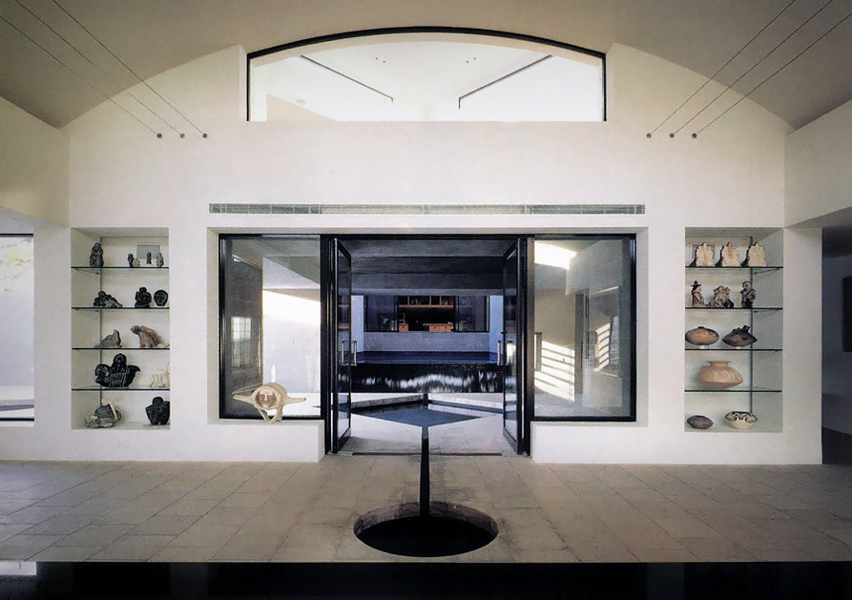
Zuber House, Paradise Valley, AZ (1989)

Slide 54
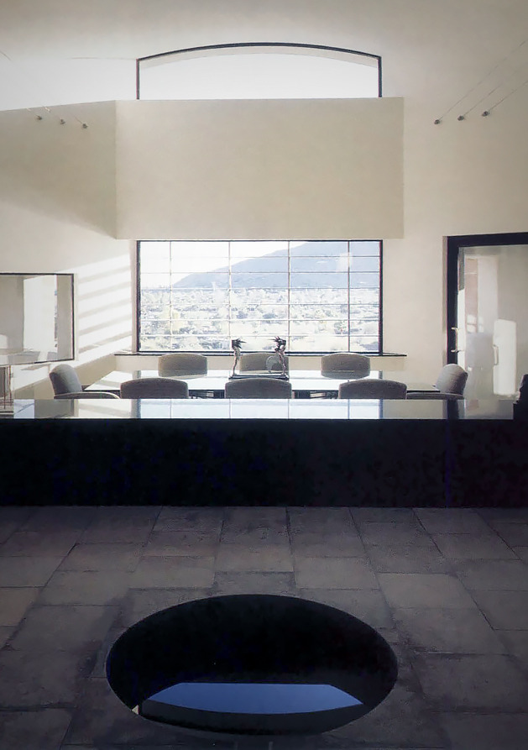
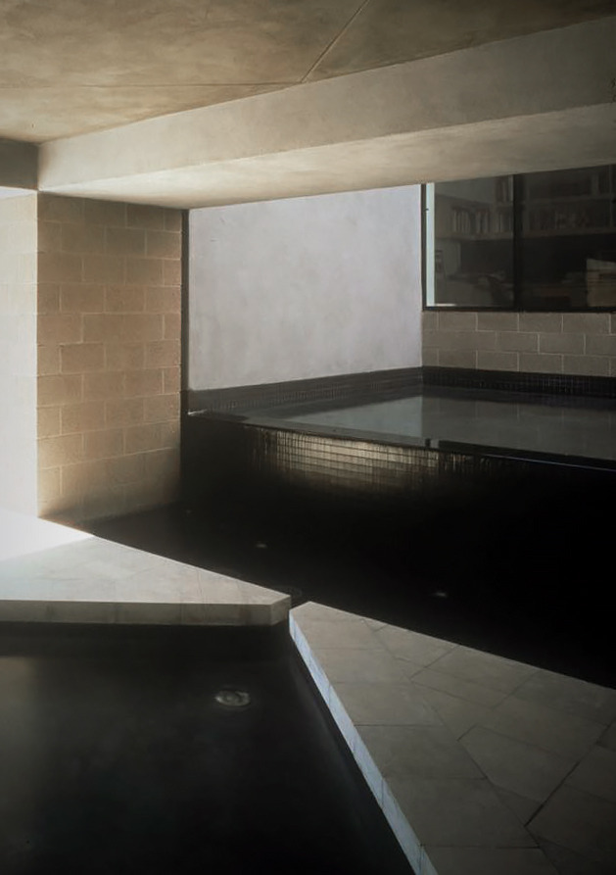
Zuber House, Paradise Valley, AZ (1989)

Slide 55
Zuber House, Paradise Valley, AZ (1989)

Slide 56
Zuber House, Paradise Valley, AZ (1989)

Slide 57
Croffead House, Charleston, SC (1989)
W.G. Clark
Charles Menefee

Slide 58
Croffead House, Charleston, SC (1989)
It is the work of the architects W.G. Clark & Charles Menefee.
The 3000 sqf house comprises 2 principal components : a 32 ft square, 3 story high cube enclosing all public and private living areas and a poured concrete and glass block loggia that contains entrances and the interior stair. The architects organized the plan around a single masonry pier that divides the house in equal halves. The low ceilinged southern half of the main floor accomodates the kitchen and the dining room and the northern half contains a double height living room. A balcony level above the kitchen and the dining room contains a master bedroom suite. Throughout the house, rooms are defined by painted wood cabinetry and bookcases and interior walls are sheathed in 1/2 inch thick coating of off white stucco.

Slide 59
Croffead House, Charleston, SC (1989)

Slide 60
Croffead House, Charleston, SC (1989)

Slide 61
Croffead House, Charleston, SC (1989)

Slide 62
Croffead House, Charleston, SC (1989)

Slide 63
Croffead House, Charleston, SC (1989)

Slide 64
Croffead House, Charleston, SC (1989)

Slide 65
Croffead House, Charleston, SC (1989)

Slide 66
Price House, Orange County, CA (1989)
Bart Prince

Slide 67
Price House, Orange County, CA (1989)
It is the work of the architect Bart Prince.
Bulging with rooms that over-look the ocean, the Price House is framed in composite red-wood members fastened with red-painted steel bolts and clad in layers of shingles and copper. Instead of orthogonal roofs, floors, and walls, a continuous membrane of laminated wood beams forms an undulating shell. Beyond this public realm is another world of bedrooms tucked be-neath rolling eaves and arched redwood frames. Separated into three worlds, the house gives new meaning to the term split-level.

Slide 68
Price House, Orange County, CA (1989)

Slide 69
Price House, Orange County, CA (1989)

Slide 70
Price House, Orange County, CA (1989)

Slide 71
Price House, Orange County, CA (1989)

Slide 72
Price House, Orange County, CA (1989)

Slide 73
Price House, Orange County, CA (1989)

Slide 74
Price House, Orange County, CA (1989)

Slide 75
Price House, Orange County, CA (1989)

Slide 76
Mill Road House, New Canaan, CT (1990)
John Black Lee

Slide 77
Mill Road House, New Canaan, CT (1990)
It is the personal home of John Black Lee architect.
Built into the side of the hill, it’s topped off with an A-frame entrance : It is the only house in New Canaan that you enter through a skylight. It stands proud with its original architecture built entirely of concrete and glass. It cantilevers over the Silvermine River. The interior hosts an open floor plan and looks out over a balcony that runs the length of the structure along the river side.

Slide 78
Mill Road House, New Canaan, CT (1990)

Slide 79
Mill Road House, New Canaan, CT (1990)

Slide 80
Mill Road House, New Canaan, CT (1990)

Slide 81
Mill Road House, New Canaan, CT (1990)

Slide 82
Mill Road House, New Canaan, CT (1990)

Slide 83
Mill Road House, New Canaan, CT (1990)

Slide 84
Mill Road House, New Canaan, CT (1990)

Slide 85
Ohio Street House, Chicago, IL (1990)
Joe Valerio
Linda Searl

Slide 86
Ohio Street House, Chicago, IL (1990)
It is the own house of the architects Joe Valerio & Linda Searl.
In both elevation and plan, the corner serves as the dominant theme. For the entry to the house, the architects carved out the corner, then erected a wood frame Structurally, the house is traditional, with load-bearing masonry walls and wood corner elements. To add texture to the concrete-block walls and highlight their masonry structure, the architects turned a few of the blocks perpendicular to the wall plane. The rear of the house opens onto an enclosed yard defined by a 6-ft-high privacy wall and a detached garage. By forsaking an axial layout for one based on an L-shaped living-dining area, the architects were able to eliminate corridors on the ground floor. And by popping out corners with lots of glass at the top the interior was flooded with light.

Slide 87
Ohio Street House, Chicago, IL (1990)

Slide 88
Ohio Street House, Chicago, IL (1990)

Slide 89
Ohio Street House, Chicago, IL (1990)

Slide 90
Ohio Street House, Chicago, IL (1990)

Slide 91
Ohio Street House, Chicago, IL (1990)

Slide 92
Ohio Street House, Chicago, IL (1990)

Slide 93
Lawrence House, Ridgefield, CT (1990)
Rafael Viñoly

Slide 94
Lawrence House, Ridgefield, CT (1990)
It is the work of the architect Rafael Viñoly.
Working with slabs of pre-cast concrete and glass windows, Viñoly assembled the house on a 35 ton steel frame, resulting in clean, open spaces. Built to display Lawrence's vast art collection, the house contains expansive, light-filled areas that include a living room, a dining room, a custom kitchen, and a sitting room. The house also features a penthouse office, indoor and outdoor heated pools, and an observation deck offering views of the Hudson River.

Slide 95
Lawrence House, Ridgefield, CT (1990)

Slide 96
Lawrence House, Ridgefield, CT (1990)

Slide 97
Lawrence House, Ridgefield, CT (1990)

Slide 98
Lawrence House, Ridgefield, CT (1990)

Slide 99
Lawrence House, Ridgefield, CT (1990)

Slide 100
Lawrence House, Ridgefield, CT (1990)

Slide 101
Lawrence House, Ridgefield, CT (1990)

Slide 102
Lawrence House, Ridgefield, CT (1990)

Slide 103
Lawrence House, Ridgefield, CT (1990)

Slide 104
Lawrence House, Ridgefield, CT (1990)

Slide 105
Lawrence House, Ridgefield, CT (1990)

Slide 106
Hemicycle House, Great Falls, VA (1990)
Don Chandler

Slide 107
Hemicycle House, Great Falls, VA (1990)
This solar hemicycle was designed by Don Chandler and built by and for his son Charles around 1990. It is a sprawling and large house compared to Frank Lloyd Wright’s Jacobs II solar hemicycle by which it was clearly influenced. The accommodation is logically organized with the living areas open plan and oriented to receive south-south westerly sun.
The concave shape of the hemicycle form here coupled with the studio extension the other side of the carport creates a garden courtyard that is nearly surrounded by the house.

Slide 108
Hemicycle House, Great Falls, VA (1990)
The large oaks would give cooling shade to the house in the summer and in winter allow the sun to penetrate deep into the house when the leaves fall.
All of the south elevations appear to be fully glazed from ground to eaves, while the north elevations have relatively small openings. All in all a very elegant, clean and stylish use of the solar hemicycle form : open planning of living areas promote natural distribution of solar heat.

Slide 109
Hemicycle House, Great Falls, VA (1990)

Slide 110
Hemicycle House, Great Falls, VA (1990)

Slide 111
Hemicycle House, Great Falls, VA (1990)

Slide 112
Hemicycle House, Great Falls, VA (1990)

Slide 113
Hemicycle House, Great Falls, VA (1990)

Slide 114
Hemicycle House, Great Falls, VA (1990)

Slide 115
Monument House, Joshua Tree, CA (1990)
Josh Schweitzer

Slide 116
Monument House, Joshua Tree, CA (1990)
It is the work of the architect Josh Schweitzer.
An outside porch-like structure, painted a rich burnt orange, provides a shady outdoor space during the day as well as a vantage point for beautiful sunsets over a distant ridge. The living room is enclosed by 24 foot high olive green walls punctured by irregular openings which provide fractured views of the rocks and sky. An L-shaped volume, painted purple-blue, contains in one leg a small dining area and a kitchen with sleeping lofts overhead, and in the other, the bathroom and the single enclosed bedroom.

Slide 117
Monument House, Joshua Tree, CA (1990)
The house is constructed of simple materials, painted stucco walls, exposed aggregate concrete floors, and windows framed with redwood. The colors are the colors of the desert; the orange is that of desert flowers, the blue is the color of distant ridges, and the olive green is the color of the cactus and yucca plants. The interior colors are subtle variations on the exterior theme which enhance the monastic solemnity that imbues the space. It is simplicity of form, and a creation of a symbiotic relationship with the desert that is the goal of the architecture.

Slide 118
Monument House, Joshua Tree, CA (1990)

Slide 119
Monument House, Joshua Tree, CA (1990)

Slide 120
Monument House, Joshua Tree, CA (1990)

Slide 121
Monument House, Joshua Tree, CA (1990)

Slide 122
Monument House, Joshua Tree, CA (1990)

Slide 123
Monument House, Joshua Tree, CA (1990)
THE END

