Slide 1
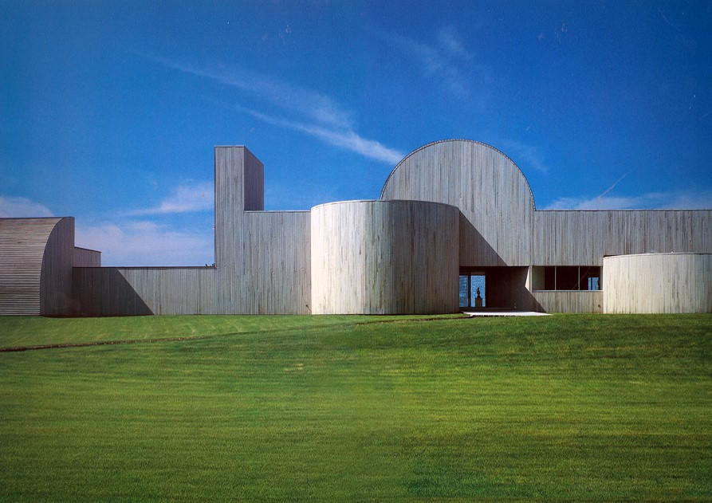
US. Modernist Houses
1980-1984

Slide 2
US Modernist Houses 1980 – 1984
The purpose of this presentation is to show you the most outstanding Modern Movement inspired houses in the United States by great architects.
Some of them have become icons of contemporary architecture (members of the iconic.org network) and are recognized and protected as such.
They remain unique either by their constructive principle, or by their location, or by their theoretical importance, or by their perfect integration into the landscape.

Slide 3
US Modernist Houses
Many of the houses presented in this slide show (before the year 2000) were found on the OfHouses website (Old Forgotten Houses) which lists houses with architectural interest or singular architecture around the world with many illustrations. If they are shown here, it is because they are already considered as iconic.

Slide 4
US Modernist Houses
Fultz House, Hammond, Beeby and Babka, IN.
Sands Point House, Myron Goldfinger, NY.
Abrams House, Robert Venturi, MA.
Schwimmer House, John Lautner, CA.
Petal House, Eric Owen Moses, CA.
Wright Residence, Eric Lloyd Wright, CA.
DeMenil House, Charles Gwathmey & Robert Siegel, NY.
Greenlay House, Edward Larrabee Barnes, TX.
Norton House, Frank Gehry, CA.
Prince House, Bart Prince, NM.
Hoekstra House, David Hovey, IL.

Slide 5
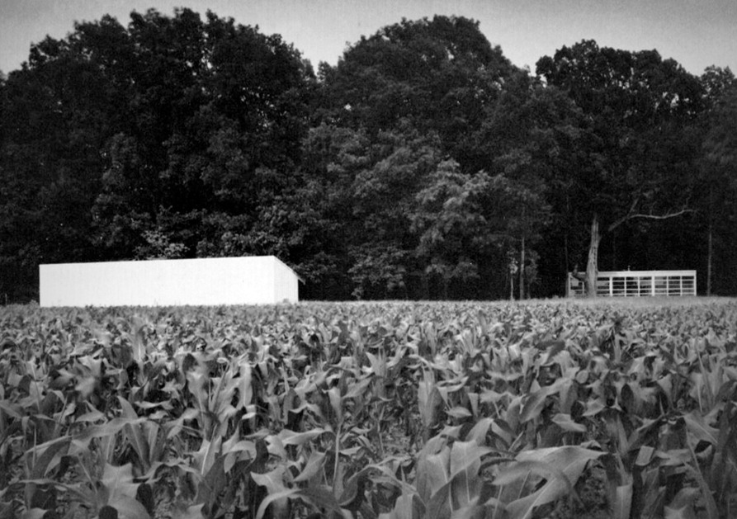
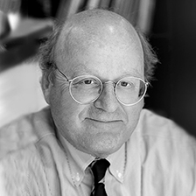
Fultz House, Chesterton, IN (1980)
Thomas Beeby

Slide 6
Fultz House, Chesterton, IN (1980)
It is the work of the architects Hammond, Beeby and Babka.
Disciplined by a strict 4-ft grid, the 36-ft square plan encapsulates a 12- by 28-ft rectangle, which itself encapsulates a square kitchen lighted by a skylight in the exact center of the roof. Virtually all of the house's elements appear in duplicate, set as mirror images of each other: 2 entrances, 2 bathrooms, 2 wood stoves, 2 kitchen counters, a pair of painted crossed tie rods on the front facade - and on the identical back façade. Standard industrial components figure largely in the house' s construction : metal panels and industrial glazing are all painted an even white. On the interior, materials are easily maintained: exposed steel decking on the ceiling and exposed steel panels on the walls.

Slide 7
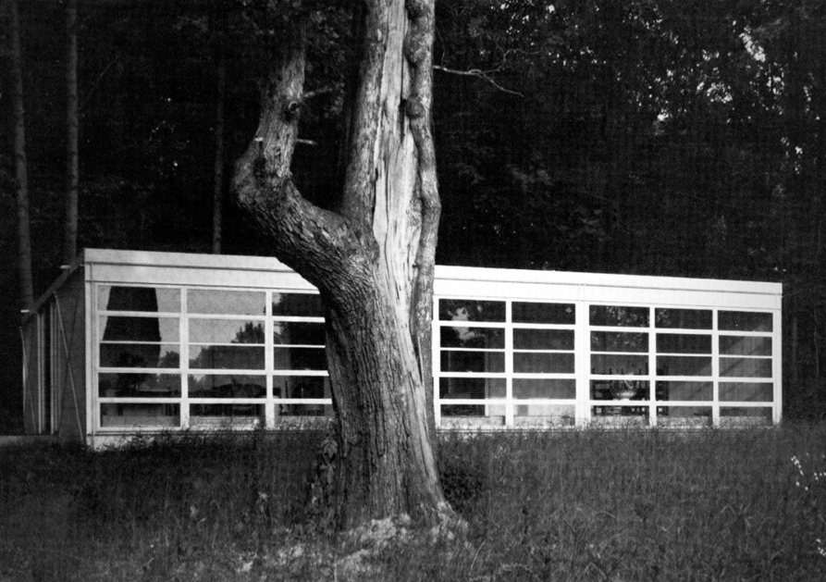
Fultz House, Chesterton, IN (1980)

Slide 8
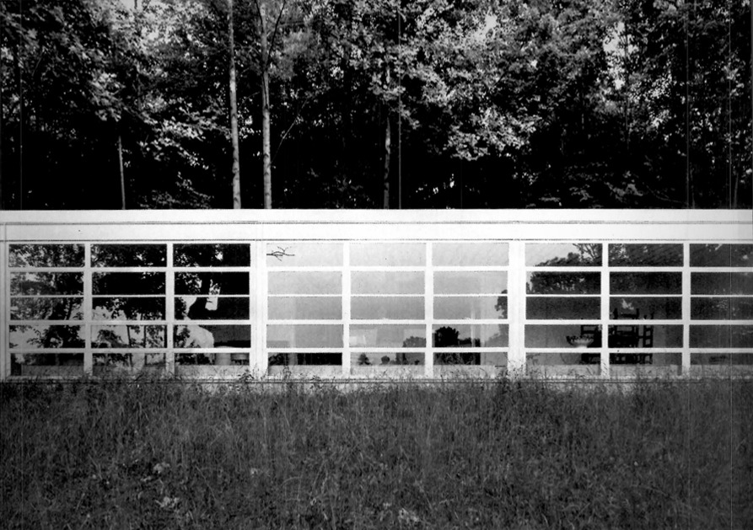
Fultz House, Chesterton, IN (1980)

Slide 9
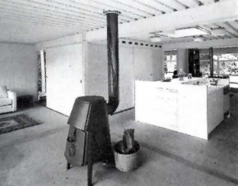
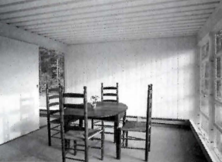
Fultz House, Chesterton, IN (1980)

Slide 10
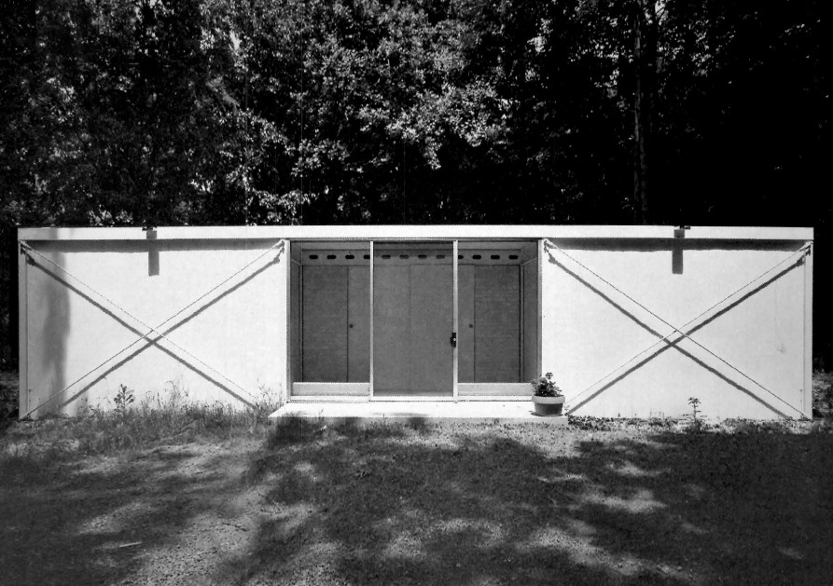
Fultz House, Chesterton, IN (1980)

Slide 11
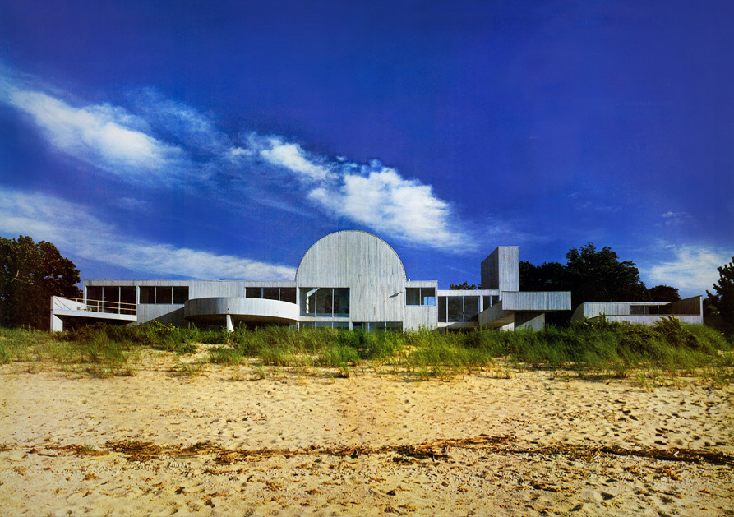
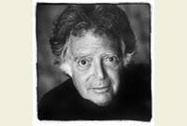
Sands Point House, Long Island, NY (1981)
M. Goldfinger

Slide 12
Sands Point House, Long Island, NY (1981)
It is the work of the architect Myron Goldfinger.
The structure shows the simplest elements of geometry : circles, squares, triangles with the possibilities for their combination and juxtaposition. The main volumetric motif on the entry side is a series of half cylinders. The mass of these forms is emphasized by an uniform treatment of the cedar board surfaces. Traditional distinctions between roof and wall disappear. On the water side, the house assumes a different character : a glassy openness inviting light in. The central special event is the vault, split barreled.

Slide 13
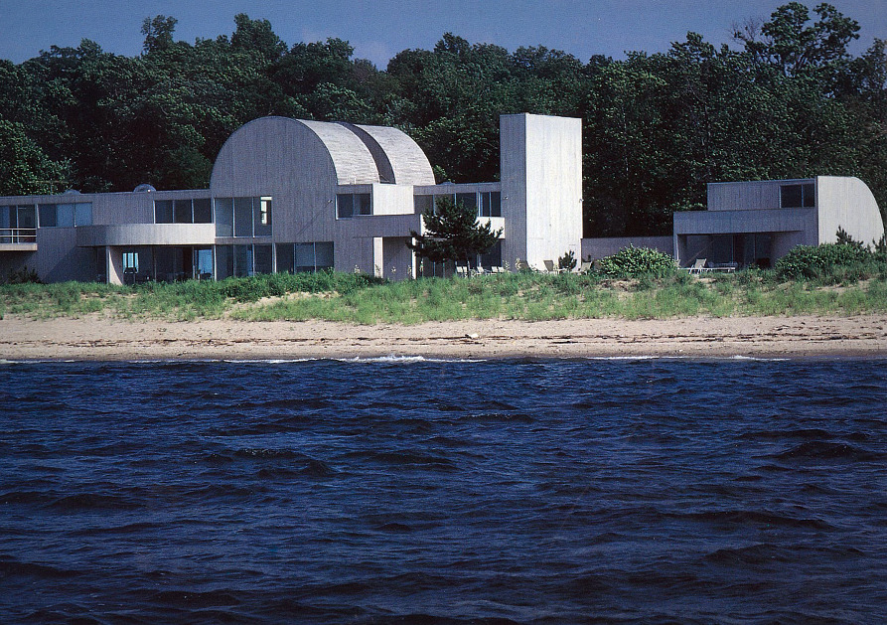
Sands Point House, Long Island, NY (1981)

Slide 14
Sands Point House, Long Island, NY (1981)

Slide 15
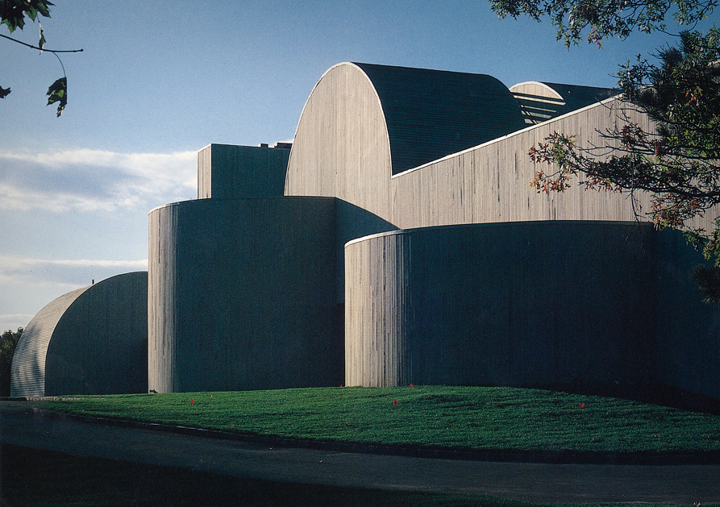
Sands Point House, Long Island, NY (1981)

Slide 16
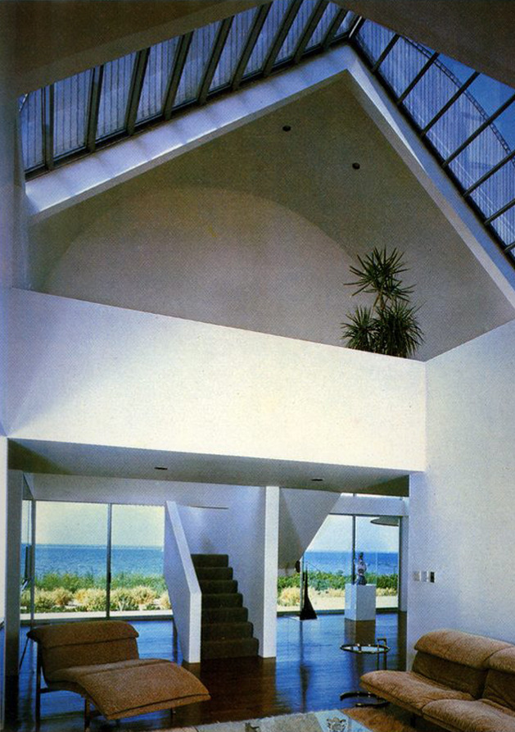
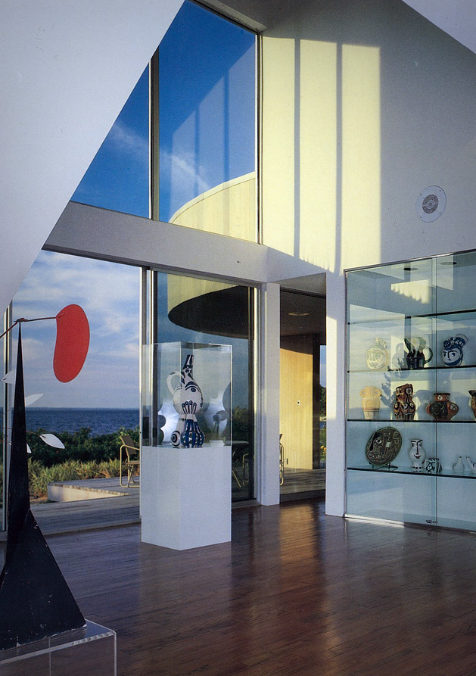
Sands Point House, Long Island, NY (1981)

Slide 17
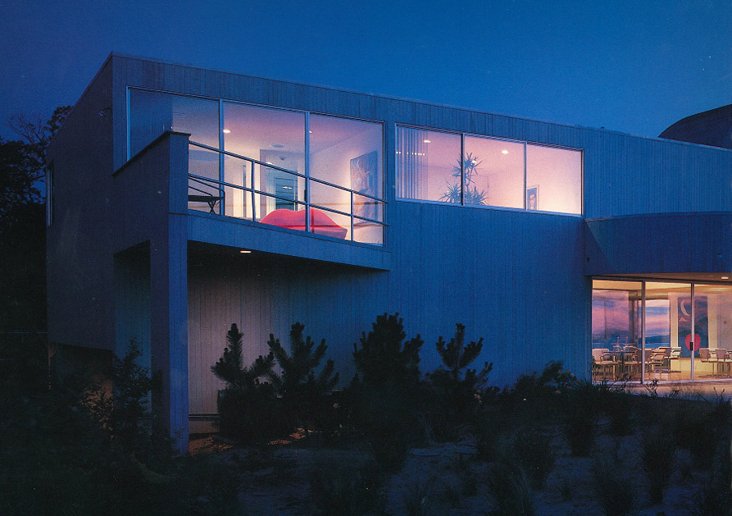
Sands Point House, Long Island, NY (1981)

Slide 18
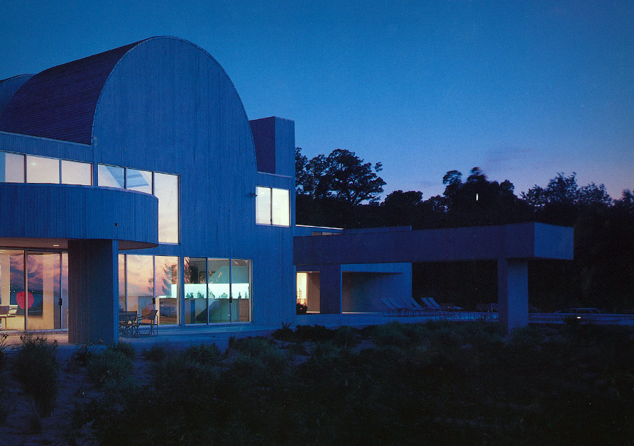
Sands Point House, Long Island, NY (1981)

Slide 19
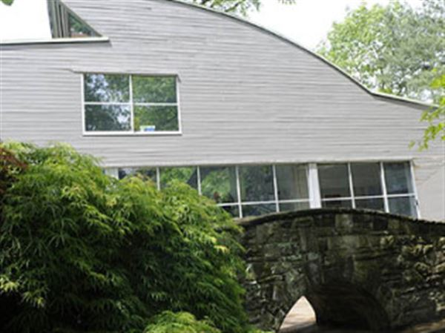
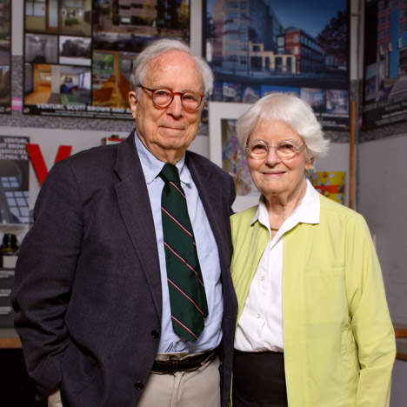
Abrams House, Pittsburgh, MA (1982)
Robert Venturi & Denise Scott Brown

Slide 20
Abrams House, Pittsburgh, MA (1982)
It is the work of the architects Robert Venturi & Denise Scott Brown.
The grey house with multi-hued radiating green stripes features an arched roofline that breaks midway through its curve and returns to a flat profile, creating an angled clerestory window that lights a dramatic twenty-foot high living space. Rectilinear windows jockey for position among arches and curves. It’s a brainy rumination on sun, landscape, and the adjacent bridge.

Slide 21
Abrams House, Pittsburgh, MA (1982)
The Abrams House’s half-round focal window, intersection of forms, and asymmetry are hallmarks of Venturi, Rauch, and Scott Brown’s design aesthetic.
This vibrant building integrates architecture and art through the inclusion of a significant mural by Roy Lichtenstein in the ground floor that reinforces the pop art-influenced sensibilities of the residence.
The Abrams House similarly breaks from conventional symmetry and pared-back order, opting instead for a curving roof reminiscent of a cresting wave and windows of dramatic proportions segmented by sunrise “rays”—or a ship’s wheel if that’s how you choose to see it.

Slide 22
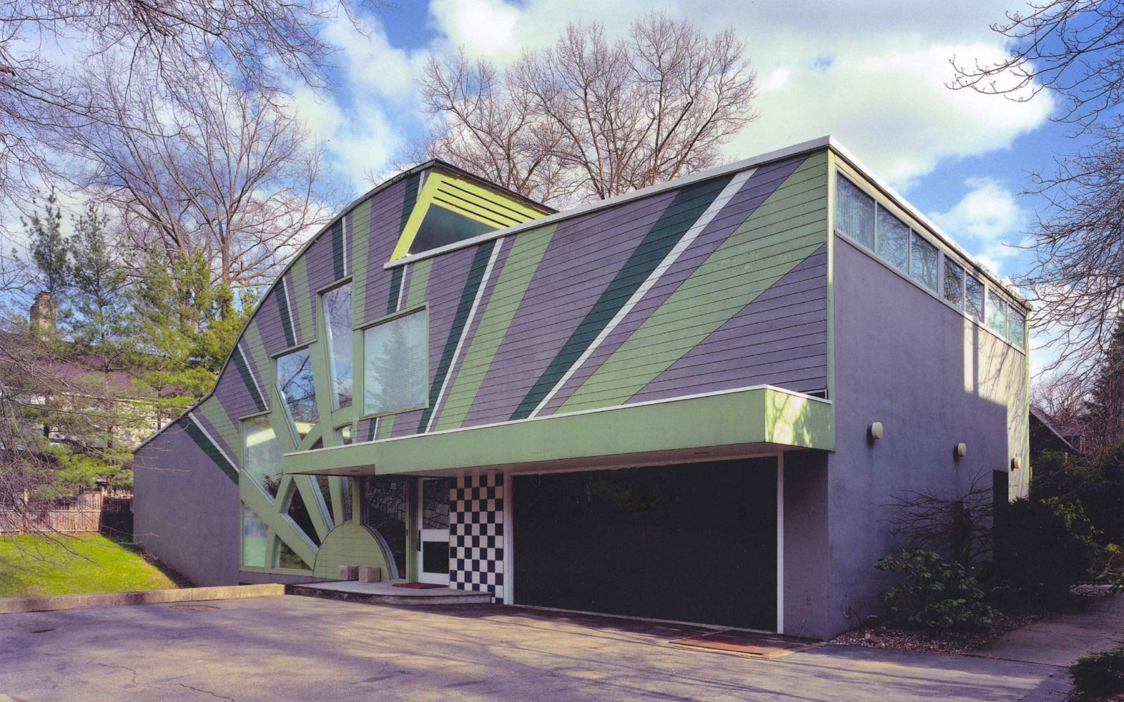
Abrams House, Pittsburgh, MA (1982)

Slide 23
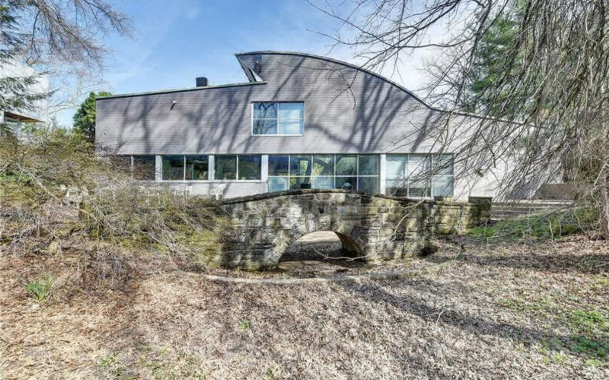
Abrams House, Pittsburgh, MA (1982)

Slide 24
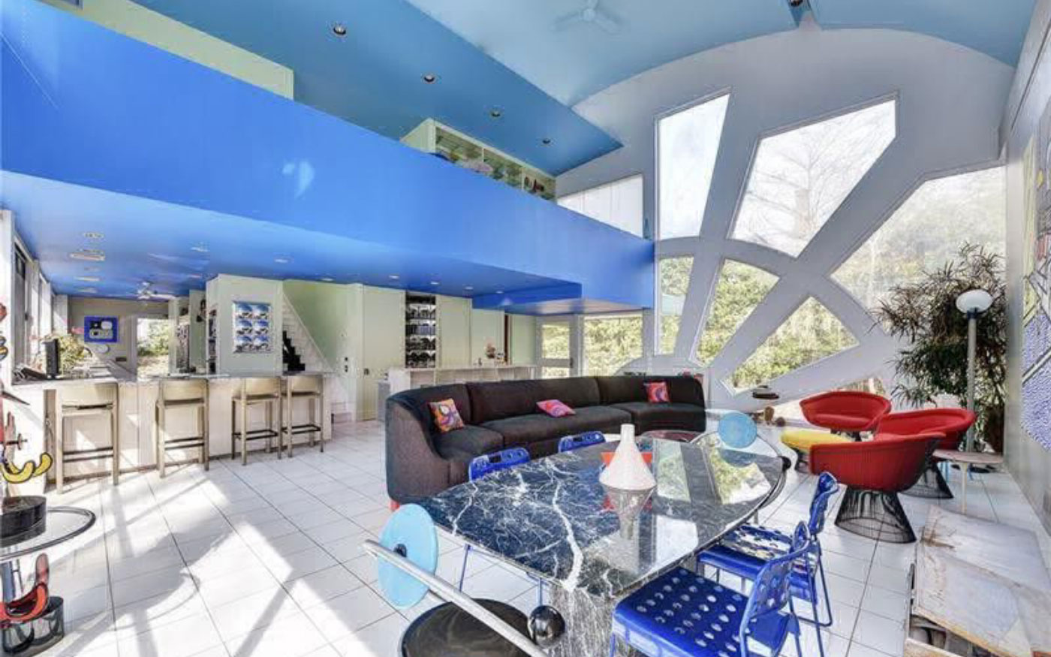
Abrams House, Pittsburgh, MA (1982)

Slide 25
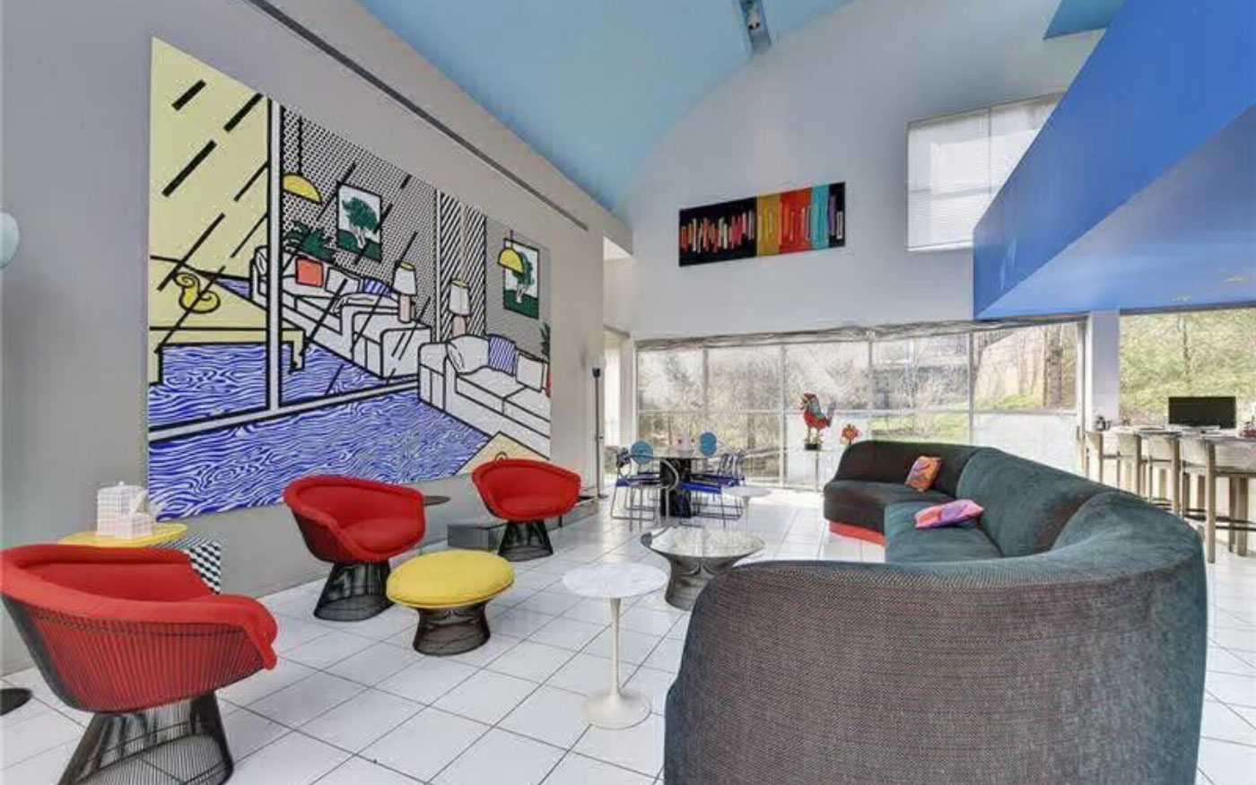
Abrams House, Pittsburgh, MA (1982)

Slide 26
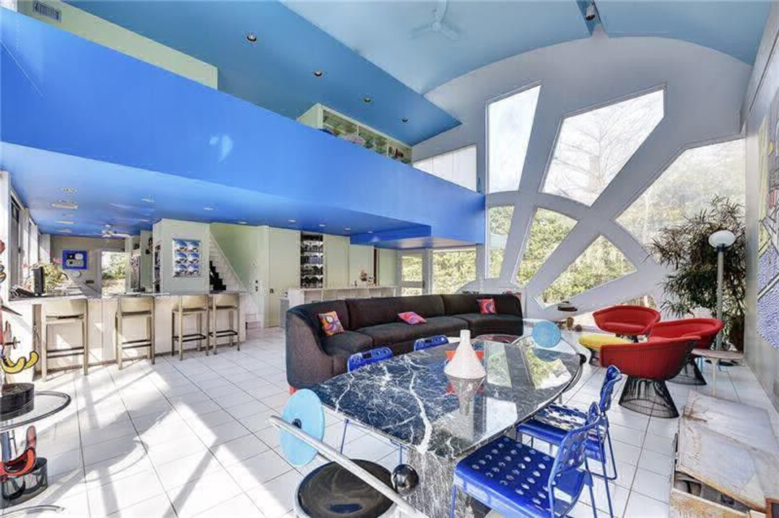
Abrams House, Pittsburgh, MA (1982)

Slide 27
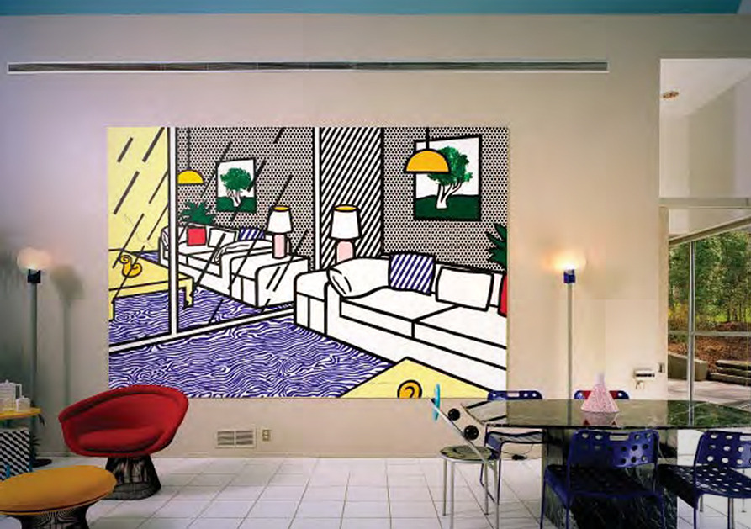
Abrams House, Pittsburgh, MA (1982)

Slide 28
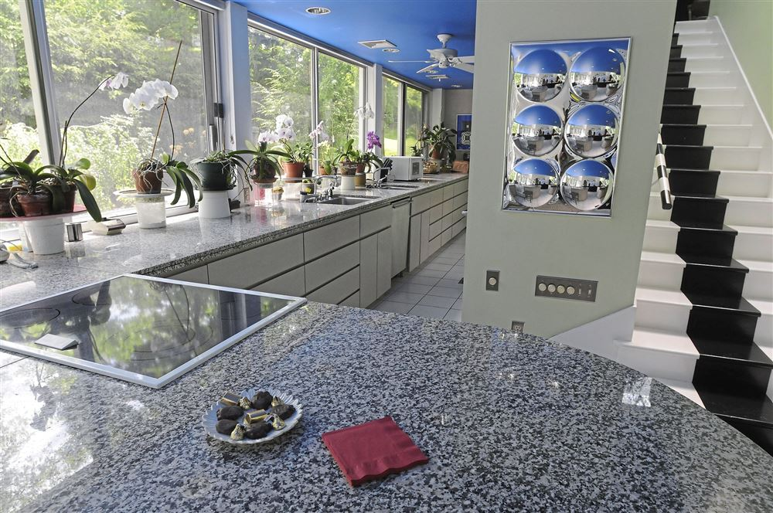
Abrams House, Pittsburgh, MA (1982)

Slide 29
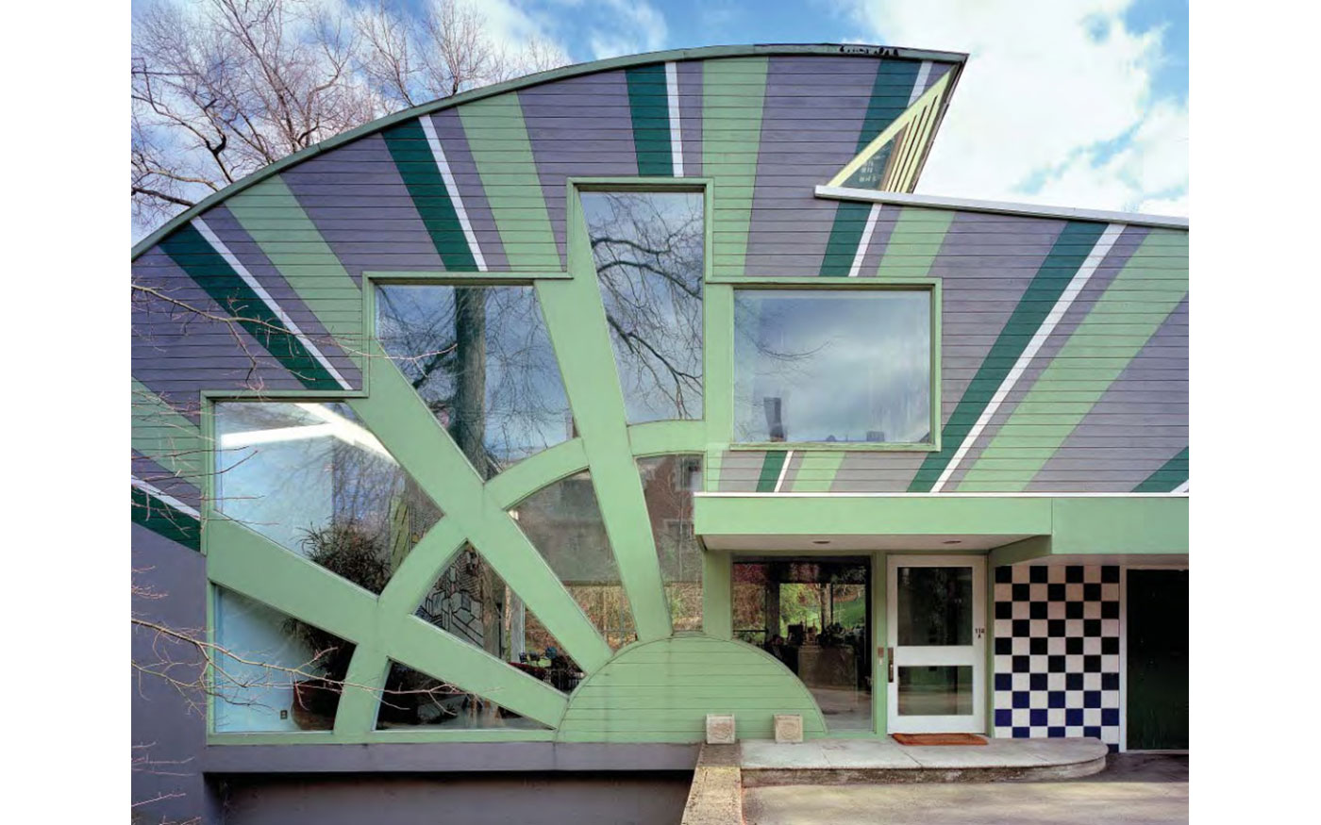
Abrams House, Pittsburgh, MA (1982)

Slide 30
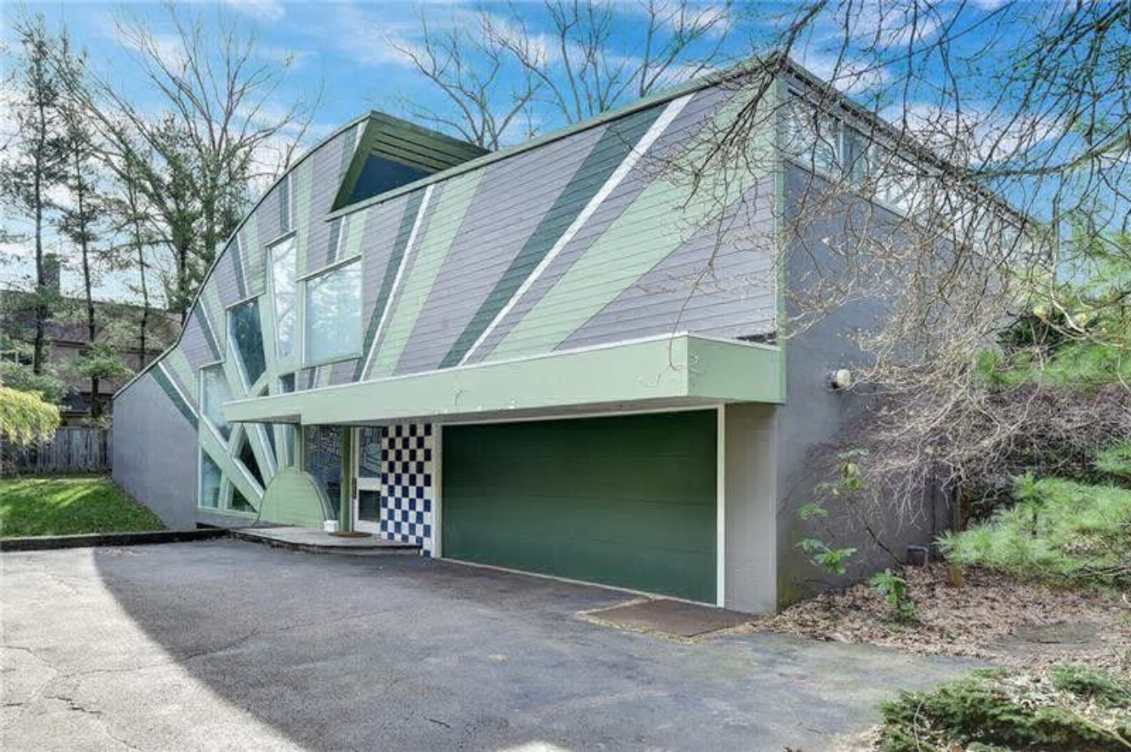
Abrams House, Pittsburgh, MA (1982)

Slide 31
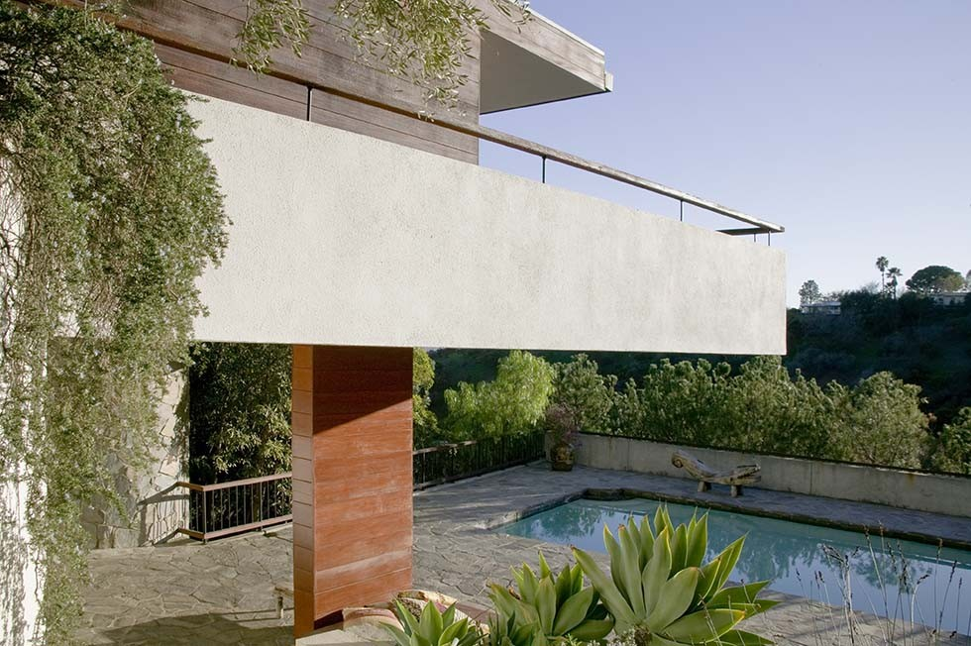
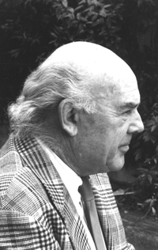
Schwimmer House, Los Angeles, CA (1982)
John Lautner

Slide 32
Schwimmer House, Los Angeles, CA (1982)
It is the work of John Lautner.
It was commissioned to represent a modern day castle : throughout the eave, there are 6 stones towers that creates the castle-like feel to the house.
Schwimmer House is a sort of rainbow shape, with a hallway hugging the hillside, then an arc of public spaces and master suite, a row of huge stone towers, and a long terrace curved around the outside. One of the castle-like features that dominates the home’s design is the use of massive stone columns that look like turrets spread evenly across the front of the structure. Their cylindrical shape complements the overall arc-shaped lines of the home.

Slide 33
Schwimmer House, Los Angeles, CA (1982)
The floors inside, just like the walls are covered with natural stones and massive woodwork paneling divide the spaces within : whether looking at your feet or overhead, there is a craftsmanship in every detail. It hard to stop looking at the ceiling, which creates a sense of drama with its soaring, ribbed-like pattern of curved rafters. Curved wood beams adorns the ceiling creating a dramatic effect : the theme of the home is curved and cylindrical. Just outside the living room, there is a stone covered terrace with a swimming pool that has the curve theme incorporated.

Slide 34
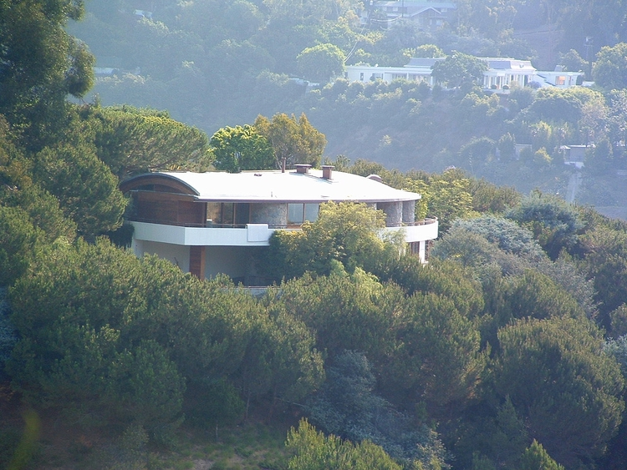
Schwimmer House, Los Angeles, CA (1982)

Slide 35
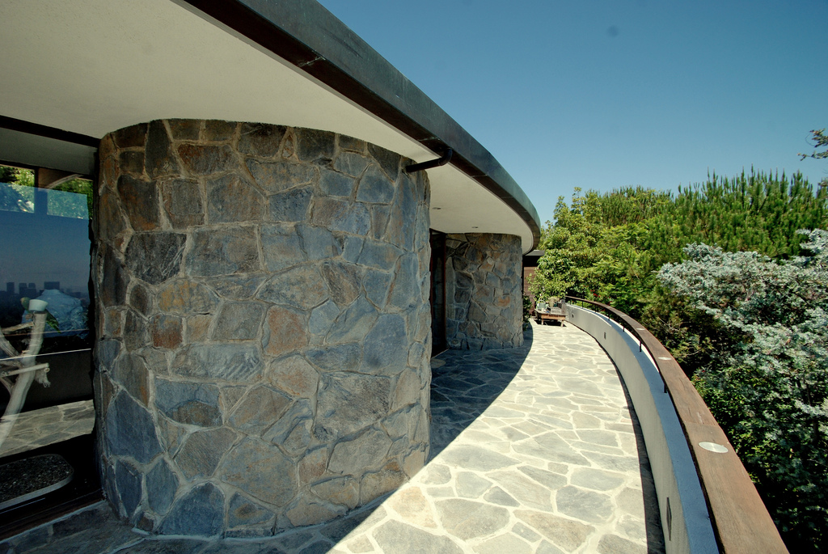
Schwimmer House, Los Angeles, CA (1982)

Slide 36
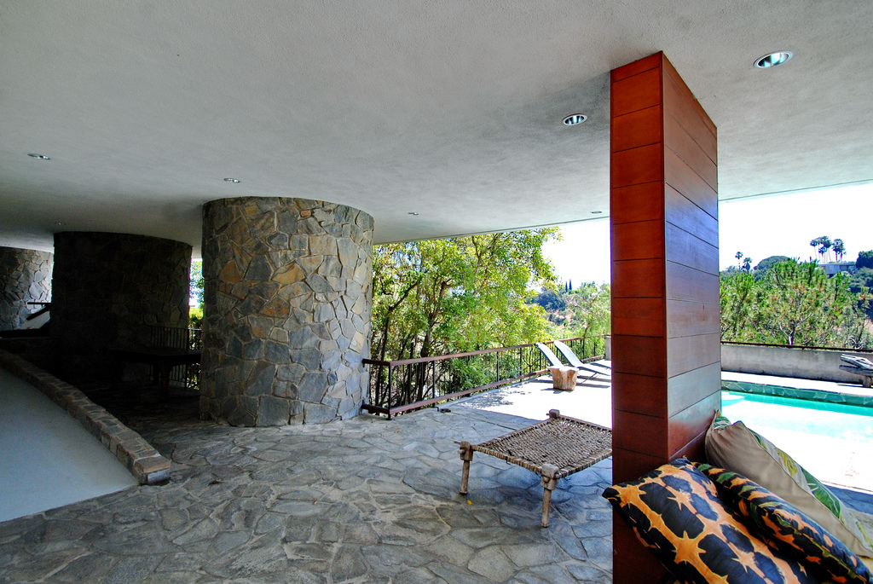
Schwimmer House, Los Angeles, CA (1982)

Slide 37
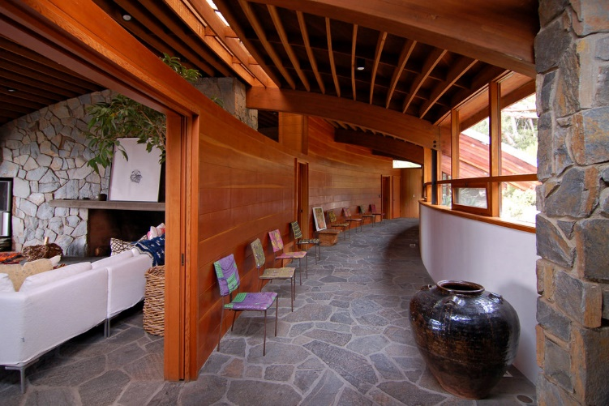
Schwimmer House, Los Angeles, CA (1982)

Slide 38
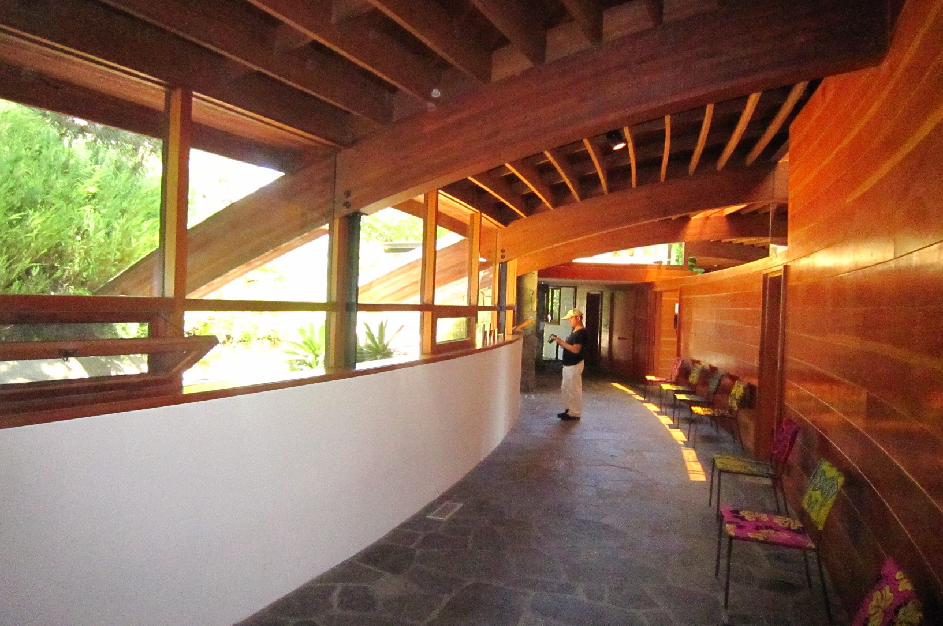
Schwimmer House, Los Angeles, CA (1982)

Slide 39
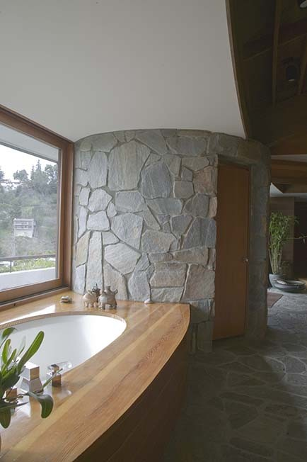
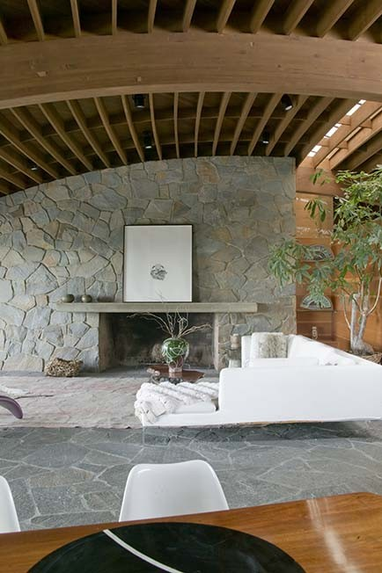
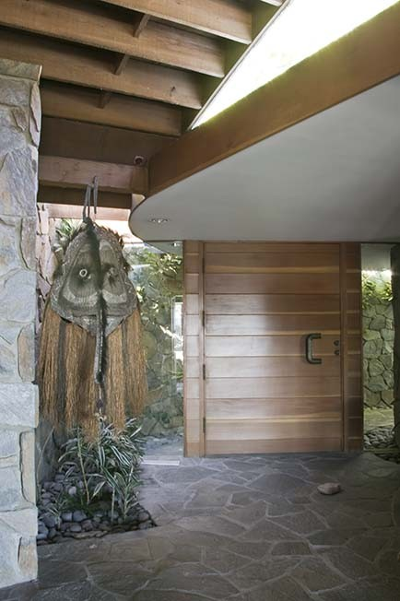
Schwimmer House, Los Angeles, CA (1982)

Slide 40
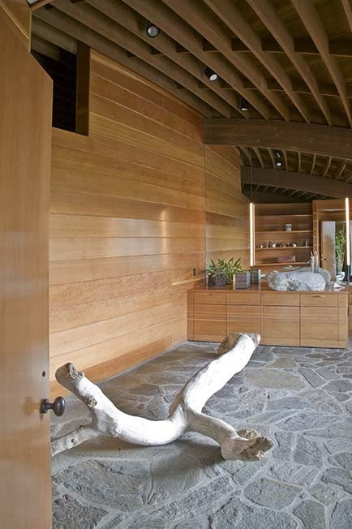
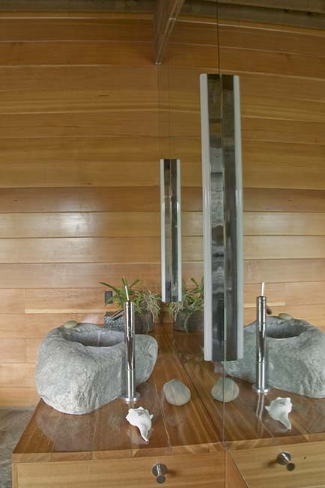
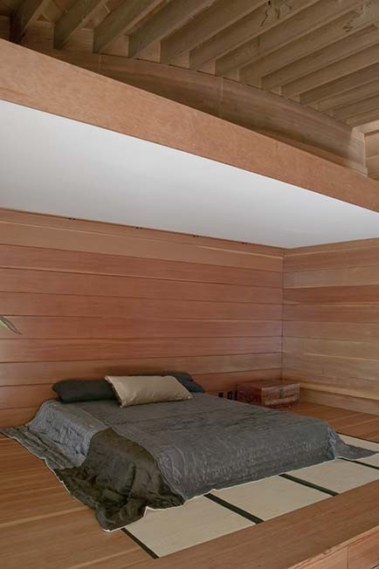
Schwimmer House, Los Angeles, CA (1982)

Slide 41
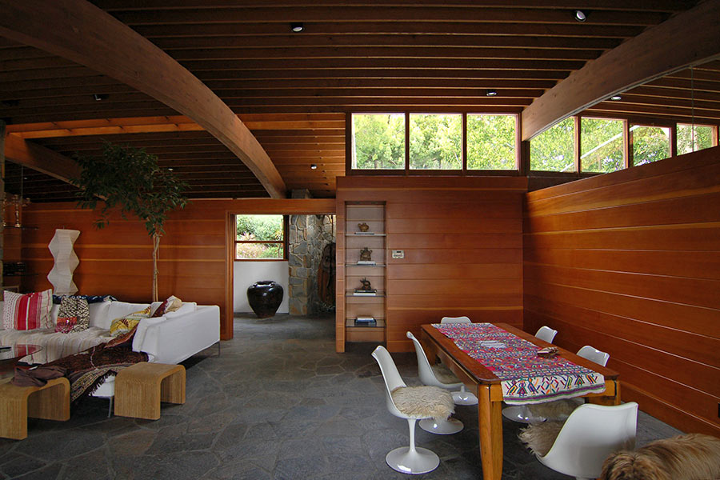
Schwimmer House, Los Angeles, CA (1982)

Slide 42
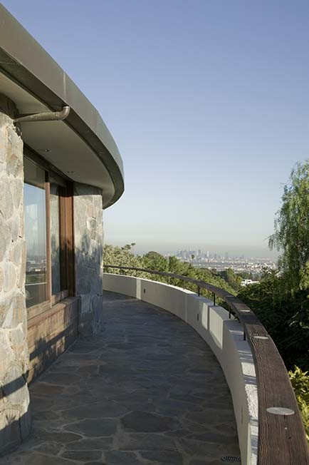
Schwimmer House, Los Angeles, CA (1982)

Slide 43
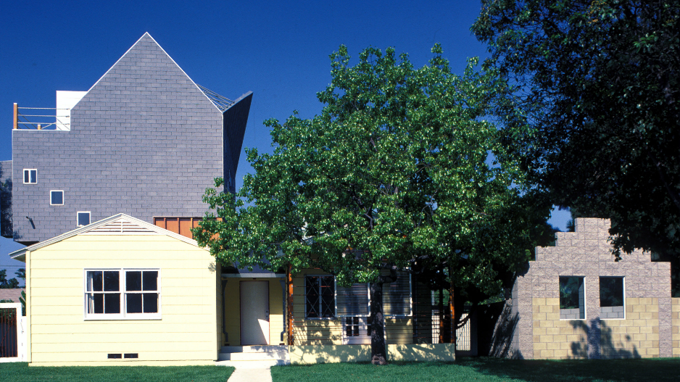
Petal House, Los Angeles, CA (1982)
Eric Owen Moss

Slide 44
Petal House, Los Angeles, CA (1982)
It is the work of the architect Eric Owen Moss.
Originally, the house was a one-story house built in the 1950’s. The plywood and the wood stud zone that connected old roof to the new floor above was exposed : hand rails were constructed of rope, a crucial column that combined rotation and vertical loading became a steel and wood expression of these structural forces. Each room, each wall, each space, each surface in the project became an opportunity for the exploration of shape, light and fabrications techniques.

Slide 45
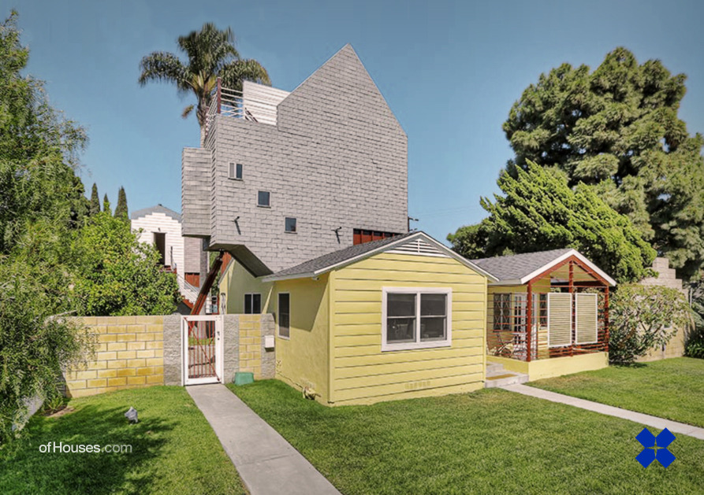
Petal House, Los Angeles, CA (1982)

Slide 46
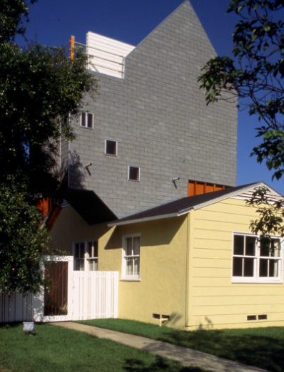
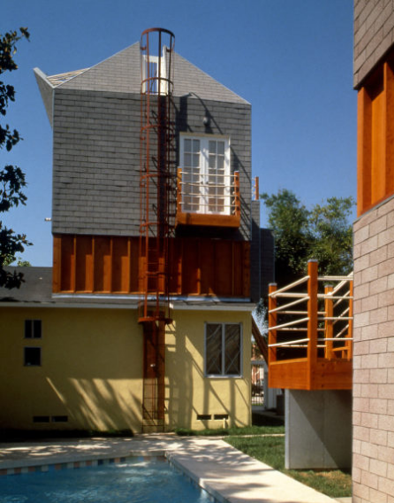
Petal House, Los Angeles, CA (1982)

Slide 47
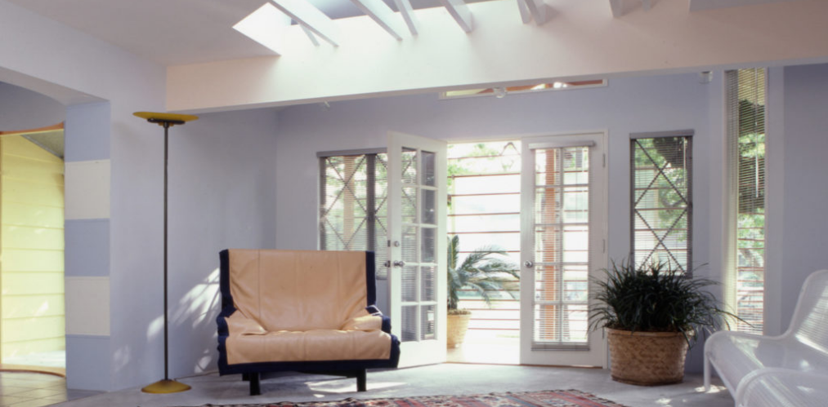
Petal House, Los Angeles, CA (1982)

Slide 48
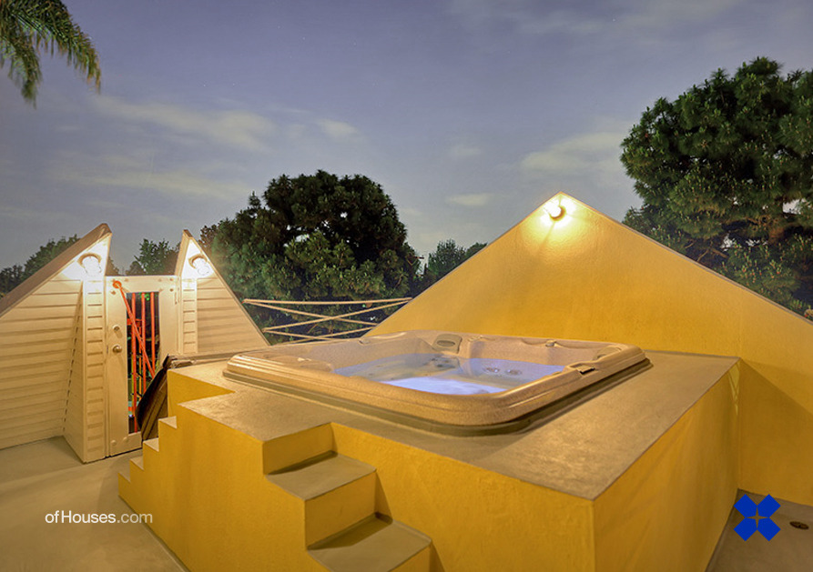
Petal House, Los Angeles, CA (1982)

Slide 49
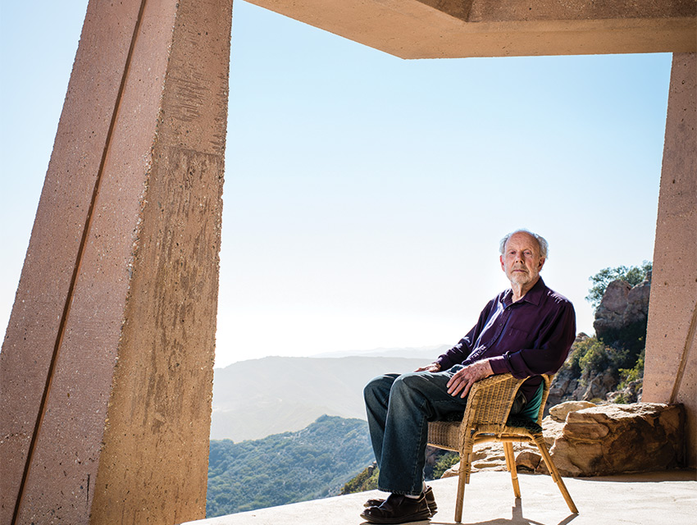
Wright Residence, Malibu, CA (1983)
Eric Lloyd Wright

Slide 50
Wright Residence, Malibu, CA (1983)
It is the own house of the architect Eric Lloyd Wright.
On the edge of the sprawling parcel is his own two-story home, which has somehow eluded completion for 25 years, its angled concrete frame sculpted into a cliff high above the Pacific.
Even if it is not finished, the will of the architect was to protect the documents from fire because many of his personal and architectural records were burned in a 1993 fire at his home.

Slide 51
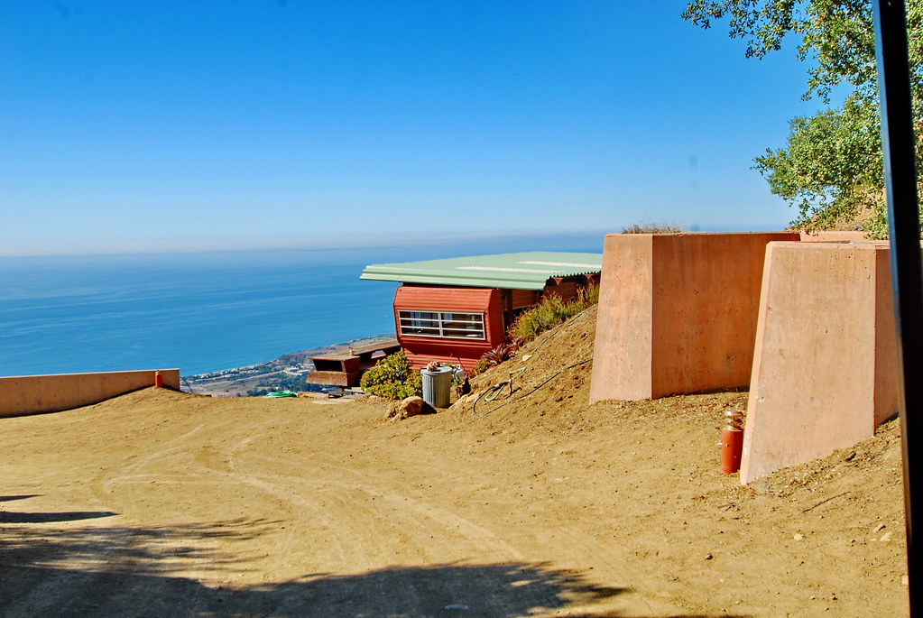
Wright Residence, Malibu, CA (1983)

Slide 52
Wright Residence, Malibu, CA (1983)

Slide 53
Wright Residence, Malibu, CA (1983)

Slide 54
Wright Residence, Malibu, CA (1983)

Slide 55
Wright Residence, Malibu, CA (1983)

Slide 56
Wright Residence, Malibu, CA (1983)

Slide 57
Wright Residence, Malibu, CA (1983)

Slide 58
Wright Residence, Malibu, CA (1983)

Slide 59
Wright Residence, Malibu, CA (1983)

Slide 60
Wright Residence, Malibu, CA (1983)

Slide 61
Wright Residence, Malibu, CA (1983)

Slide 62
Wright Residence, Malibu, CA (1983)

Slide 63
DeMenil House, East Hampton, NY (1983)
Charles Gwathmey & Robert Siegel

Slide 64
DeMenil House, East Hampton, NY (1983)
It is the work of the architects Charles Gwathmey & Robert Siegel.
This project involved developing seven acres on a private dune site, with access from the north, dense woods on the east and west, and a half-mile-deep dune and ocean to the south. The driveway passes through the woods and a gate. To the west, a pink stucco wall seemingly floats in a half-acre pond, a landscaped water element in counterpoint to the ocean beyond. Turning south, one passes through the stucco wall.

Slide 65
DeMenil House, East Hampton, NY (1983)

Slide 66
DeMenil House, East Hampton, NY (1983)

Slide 67
DeMenil House, East Hampton, NY (1983)

Slide 68
DeMenil House, East Hampton, NY (1983)

Slide 69
DeMenil House, East Hampton, NY (1983)

Slide 70
DeMenil House, East Hampton, NY (1983)

Slide 71
Greenlay House, Dallas, TX (1984)
Edward L. Barnes

Slide 72
Greenlay House, Dallas, TX (1984)
It is the work of the architects Edward Larrabee Barnes & Armand P. Avakian.
From the entrance court, dominated by a big spreading oak, the house appears as four smallish structures, connected by the breezeways and long covered porches-dog runs in Texas. From the back gardens, careful articulation of the cascading units gives an impression of a small hillside village, with intimate view-terraces and plazas, pools and a waterfall fountain. Most windows and screens slide into pockets to turn spaces into garden pavilions when the weather is right. Inside, the plan is also a cluster of houses, giving children and parents separate and private suites (with separate entrances).

Slide 73
Greenlay House, Dallas, TX (1984)
The four building blocks of the entry level rise into two towers on the level above; and all interconnect on the bottom floor, so that the house can function as a unit. Poured-in-place reinforced concrete is used for floor slabs, and for walls at grade changes and hill embankments. The remaining load-bearing walls are reinforced concrete block, finished with white stucco outside, and metal studs, insulation, and painted gypsum board on the interiors. Other materials are high quality and precisely detailed: limestone paving, copper roofing over cedar planking, black-framed metal pocket windows.

Slide 74
Greenlay House, Dallas, TX (1984)

Slide 75
Greenlay House, Dallas, TX (1984)

Slide 76
Greenlay House, Dallas, TX (1984)

Slide 77
Greenlay House, Dallas, TX (1984)

Slide 78
Greenlay House, Dallas, TX (1984)

Slide 79
Greenlay House, Dallas, TX (1984)

Slide 80
Greenlay House, Dallas, TX (1984)

Slide 81
Norton House, Venice, CA (1984)
Frank Gehry

Slide 82
Norton House, Venice, CA (1984)
It is the work of the architect Frank Gehry.
The Norton House is a sculptural assemblage of everyday materials. Formally, the building is a group of offset boxes connected by interior and exterior staircases, each with a deck area above. The ground floor, which houses 2 bedrooms, a studio, and a garage, is subtly set back from the street wall. The volume itself is wrapped in bright blue tiles. The 2nd floor, which contains the main living spaces including a kitchen and living space, is set farther back in an effort to maintain privacy. This space opens onto a terrace overlooking the ocean. The 3rd floor, which includes another bedroom and an external staircase to the roof terrace, has its own deck as well.

Slide 83
Norton House, Venice, CA (1984)
The most notable form of the building, however, is the studio: a purple box perched on a pillar towards the front of the main terrace, accessible only by an exterior stairway. The studio faces the ocean and fashions a large panoramic window at its front. Wooden shutters and timber pieces that rest geometrically on top of it contribute to its resemblance of a lifeguard station, a reference applicable to both the location, as it is on a beach where lifeguard perches are commonplace. Walls rendered with stucco are painted in different colors to accentuate geometric shapes, whereas other sections are faced with contrasting tiling. A tall, red chimney, visible through the glazing, rises through the house to pierce a glass canopy at roof level.

Slide 84
Norton House, Venice, CA (1984)

Slide 85
Norton House, Venice, CA (1984)

Slide 86
Norton House, Venice, CA (1984)

Slide 87
Norton House, Venice, CA (1984)

Slide 88
Norton House, Venice, CA (1984)

Slide 89
Norton House, Venice, CA (1984)

Slide 90
Norton House, Venice, CA (1984)

Slide 91
Norton House, Venice, CA (1984)

Slide 92
Prince House, Albuquerque, NM (1984)
Bart Prince

Slide 93
Prince House, Albuquerque, NM (1984)
It is the own house of the architect Bart Prince.
Two cylindrical spaces, with cast-in-place concrete walls and piers, occupy the site at the front and back. The larger forward cylinder houses the studio behind a protective berm that shelters it from the noisy street. Inside, a radial roof spirals upward on steel pipes ringed by a continuous clerestory, bathing the studio with an even light even as it preserves the sense of an enclosed, contemplative space for work and thought. Four structural towers, sheathed in plywood and ceramic tile, contain stairs or utility spines. The long horizontal private living space at the top is framed in steel pipes and sheathed with tongue-in-groove boards below and cement stucco above.

Slide 94
Prince House, Albuquerque, NM (1984)
A south-facing circulation hall is shaded against the summer sun by overhanging steel studs, and lined with tubes of water to collect warmth from the lower sun in winter. Off that hall are alcoves for living and sleeping, inward looking yet opening to the sky with walls that peel back to let in light through a concealed clerestory. In 1990, Prince added a library tower. Organized on three floors, the tower’s inclined profile results from the diminishing circumference of each course of split-faced concrete block, so that the tower adapts to the existing structure by stepping back from a wide base to a narrow crown. In 2006, he added a gallery above the 1946 adobe house he owns next door. From the street it appears as a seemingly random intermingling of color, shape and texture but each design decision reflects an inner programmatic decision.

Slide 95
Prince House, Albuquerque, NM (1984)

Slide 96
Prince House, Albuquerque, NM (1984)

Slide 97
Prince House, Albuquerque, NM (1984)

Slide 98
Prince House, Albuquerque, NM (1984)

Slide 99
Prince House, Albuquerque, NM (1984)

Slide 100
Prince House, Albuquerque, NM (1984)

Slide 101
Prince House, Albuquerque, NM (1984)

Slide 102
Hoekstra House, Homewood, IL (1984)
David Hovey

Slide 103
Hoekstra House, Homewood, IL (1984)
It is the work of the architect David Hovey.
A plan was quickly developed, based on eleven welded-steel modules of 10-by 24-ft-9 ft tall. Stepping down with the hillside, the house lightly rests on columns set in minimal concrete foundations. The off-set of the levels also creates a bedroom wing and permits clerestory windows in the big open living-dining-kitchen area. Fenestration is designed to provide privacy from the street side with solid panels and high windows, and glazed openness to the woods. Solid exterior panels are cement board with a limestone appearance. Roof and ceilings are exposed steel; the interiors were with walls of painted plasterboard.

Slide 104
Hoekstra House, Homewood, IL (1984)

Slide 105
Hoekstra House, Homewood, IL (1984)

Slide 106
Hoekstra House, Homewood, IL (1984)

Slide 107
Hoekstra House, Homewood, IL (1984)

Slide 108
Hoekstra House, Homewood, IL (1984)

Slide 109
Hoekstra House, Homewood, IL (1984)

Slide 110
Hoekstra House, Homewood, IL (1984)

Slide 111
Greenlay House, Dallas, TX (1984)
THE END

