Slide 1
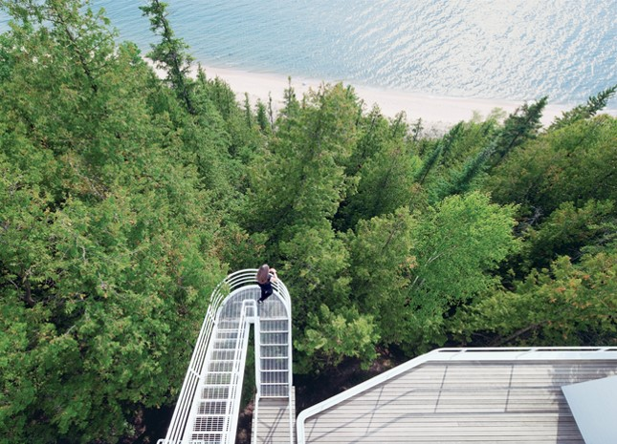
US. Modernist Houses
1973-1975

Slide 2
US Modernist Houses 1973 - 1975
The purpose of this presentation is to show you the most outstanding Modern Movement inspired houses in the United States by great architects.
Some of them have become icons of contemporary architecture (members of the iconic.org network) and are recognized and protected as such.
They remain unique either by their constructive principle, or by their location, or by their theoretical importance, or by their perfect integration into the landscape.

Slide 3
US Modernist Houses
Many of the houses presented in this slide show (before the year 2000) were found on the OfHouses website (Old Forgotten Houses) which lists houses with architectural interest or singular architecture around the world with many illustrations. If they are shown here, it is because they are already considered as iconic.

Slide 4
US Modernist Houses
Douglas House, Richard Meier, MI.
Larson Residence, Jon Condoret, NC.
Cohn Residence, Charles Gwathmey, NY.
Bruder House, Will Bruder, AZ.
Hot Dog House, Stanley Tigerman, IL.
Netsch House, Walter Netsch, IL.
Dune House, William Morgan, FL.
Frank House, Peter Eisenman, CT.
Forest House, Peter Bohlin, CT.
Plastic Tent House, John Johansen, NY.

Slide 5
US Modernist Houses 2
Jake Kittle House, Steve Baer, CA.
Ramada House, Judith Chafee, AZ.
Hilltop House, William Morgan, FL.
Owen House, Christopher Owen, RI.
Tube House, John M. Johansen, CT.
Domus Solaris, Donald Hensman, CA.

Slide 6
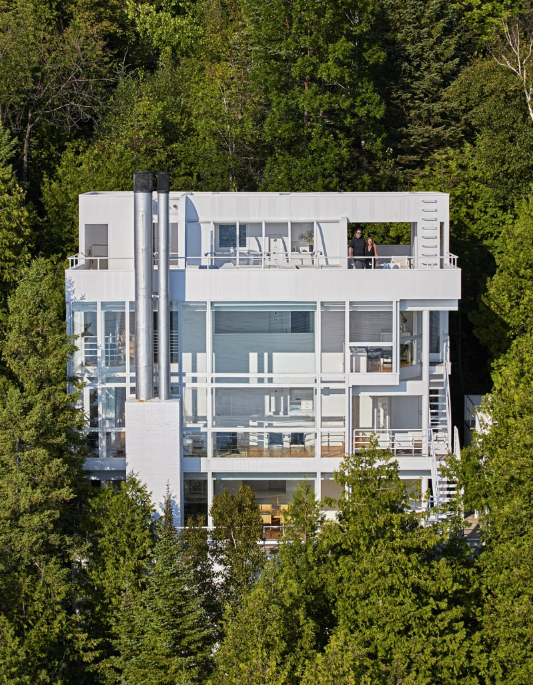
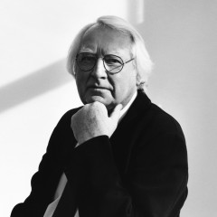
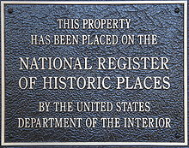
Douglas House, Harbor Springs, MI (1973)
Richard Maier

Slide 7
Douglas House, Harbor Springs, MI (1973)
Mixing the immaculate white walls contrasting with the surrounding forest and large windows on several levels, main characteristics of the style of the great architect Richard Maier, this unique house will become an icon of modern architecture.
Overlooking Lake Michigan, it offers exceptional views of the lake and seems to float above the trees.
The footbridges and aerial stairs are close to Le Corbusier's achievements.

Slide 8
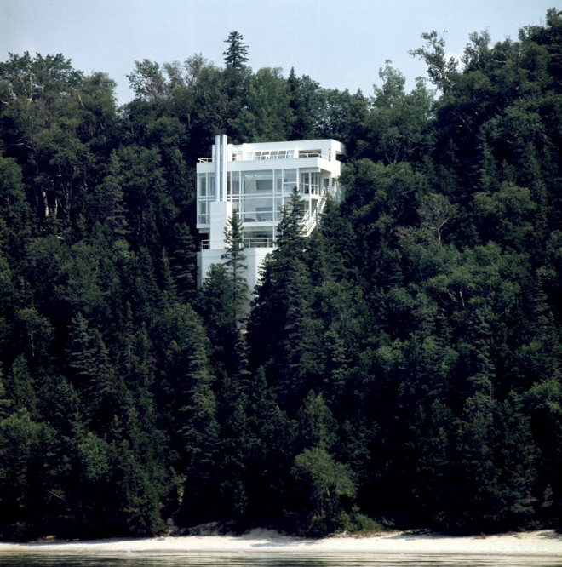
Douglas House, Harbor Springs, MI (1973)

Slide 9
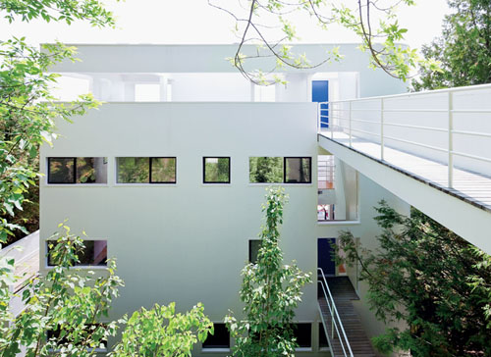
Douglas House, Harbor Springs, MI (1973)

Slide 10
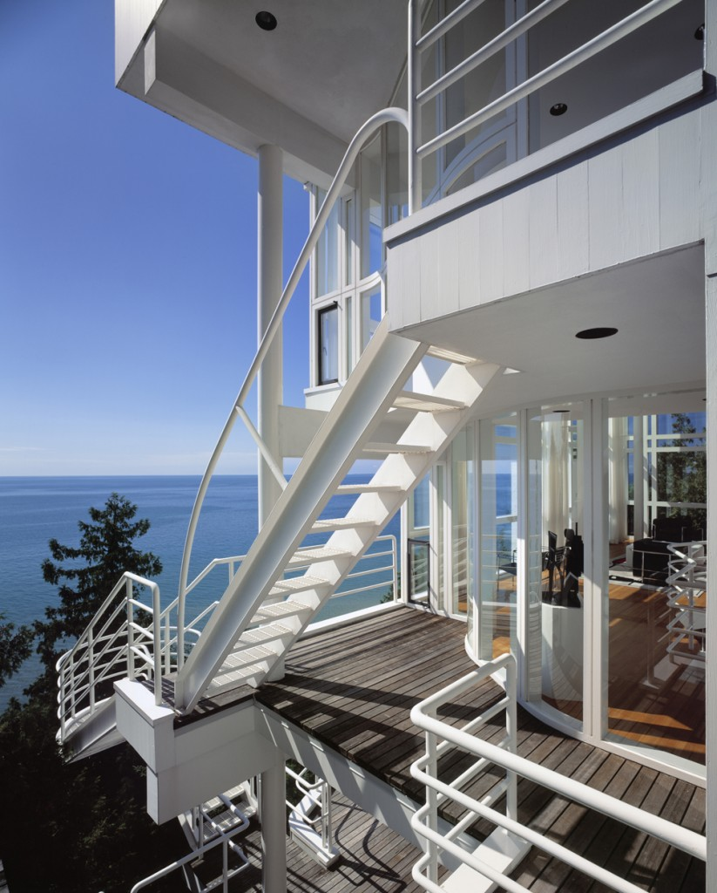
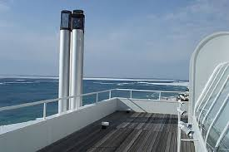
Douglas House, Harbor Springs, MI (1973)

Slide 11
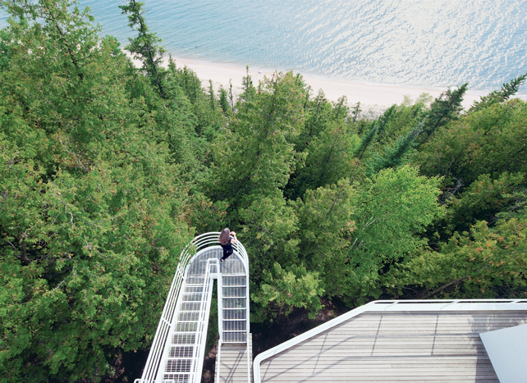
Douglas House, Harbor Springs, MI (1973)

Slide 12
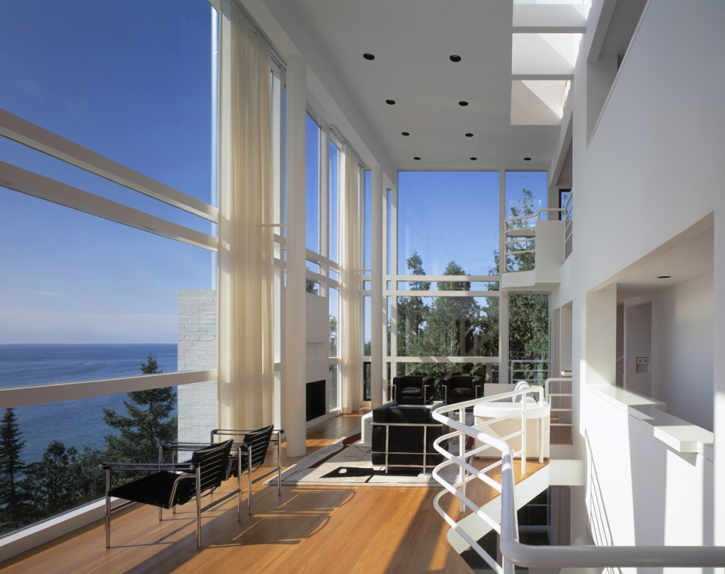
Douglas House, Harbor Springs, MI (1973)

Slide 13
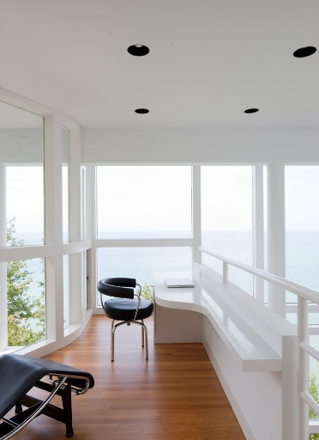
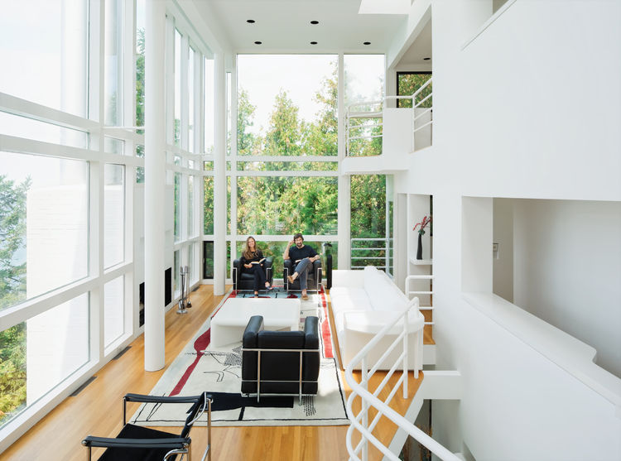
Douglas House, Harbor Springs, MI (1973)

Slide 14
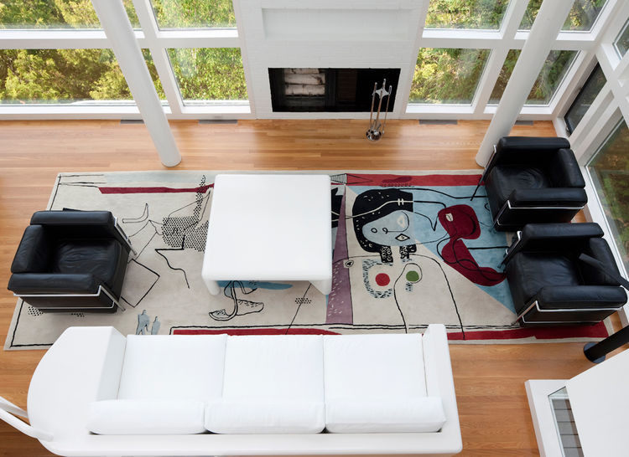
Douglas House, Harbor Springs, MI (1973)

Slide 15
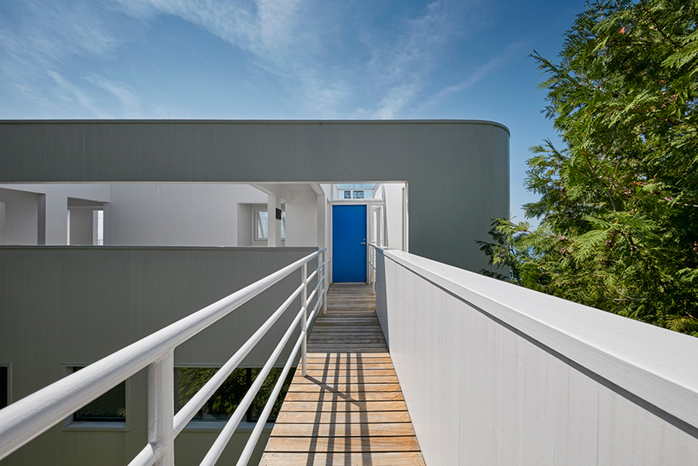
Douglas House, Harbor Springs, MI (1973)

Slide 16
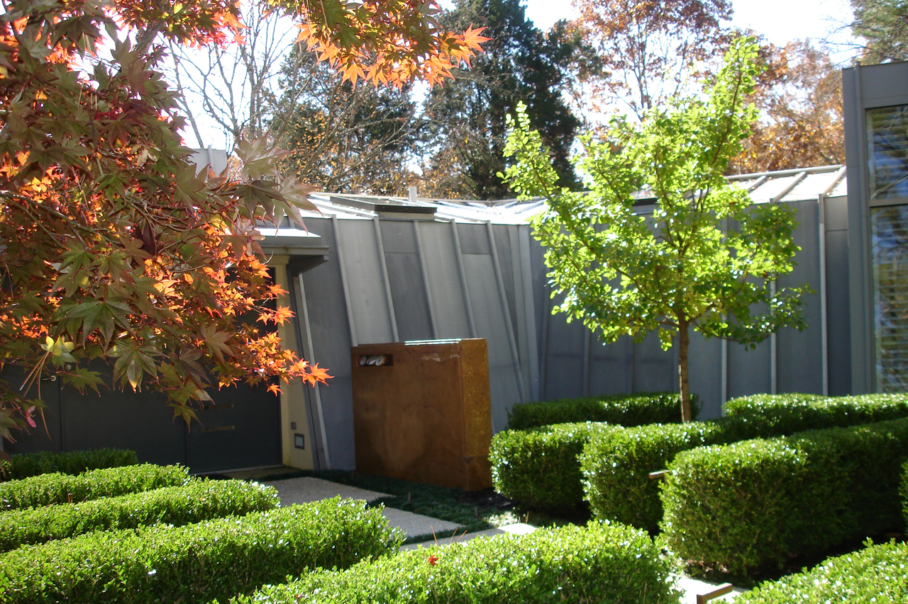
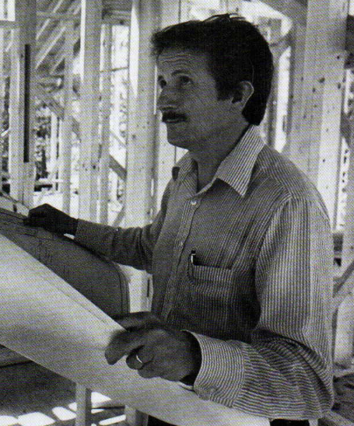
Larson Residence, Durham, NC (1973)
Jon Condoret

Slide 17
Larson Residence, Durham, NC (1973)
It is the work of the architect Jon Condoret.
The expansive walls and ceilings, combined with exposed beams, echo the angular exterior. The house is filled with natural light and views of the wooded surroundings. The living room is a large, soaring space. All the other spaces are smaller and more personal. This home, with its funky bunker exterior and contrasting large open spaces and hidden nooks inside, was the favorite house of the architect.

Slide 18
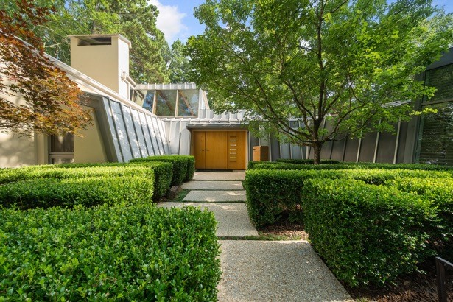
Larson Residence, Durham, NC (1973)

Slide 19
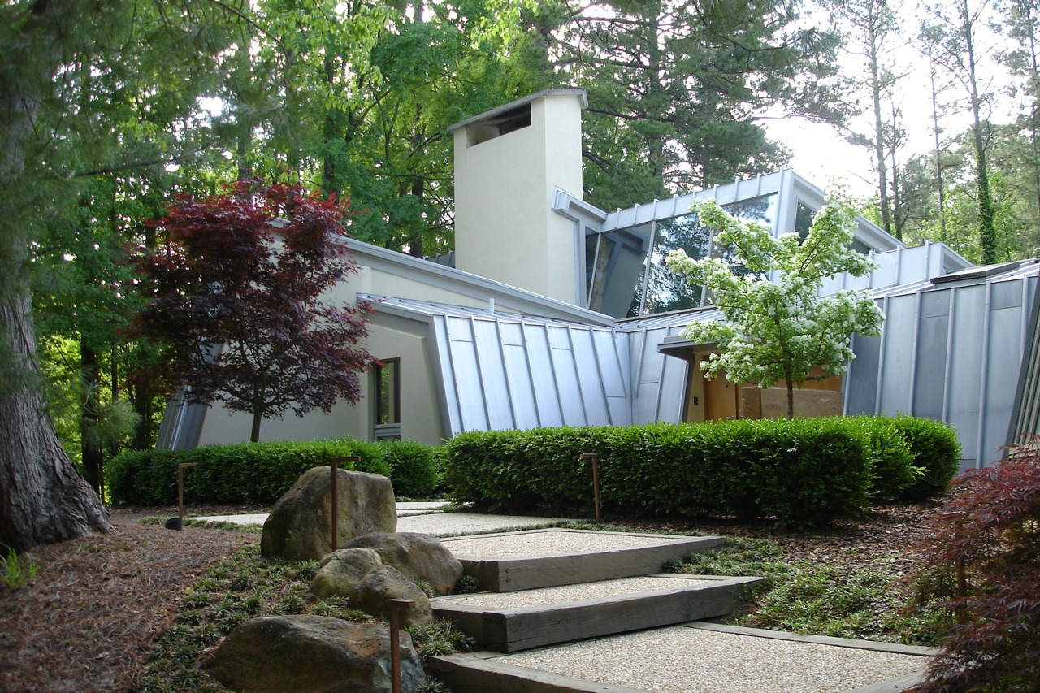
Larson Residence, Durham, NC (1973)

Slide 20
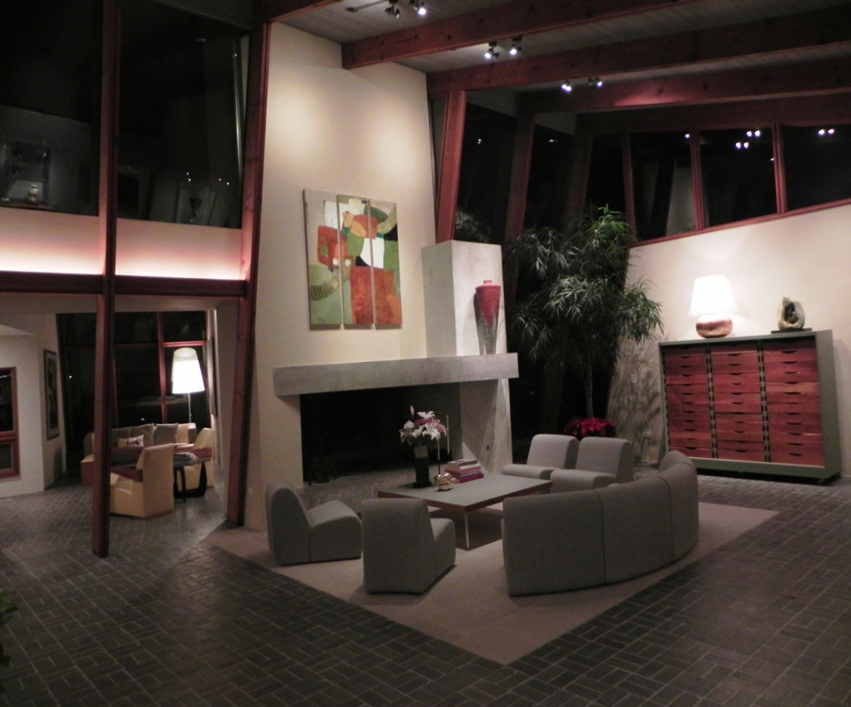
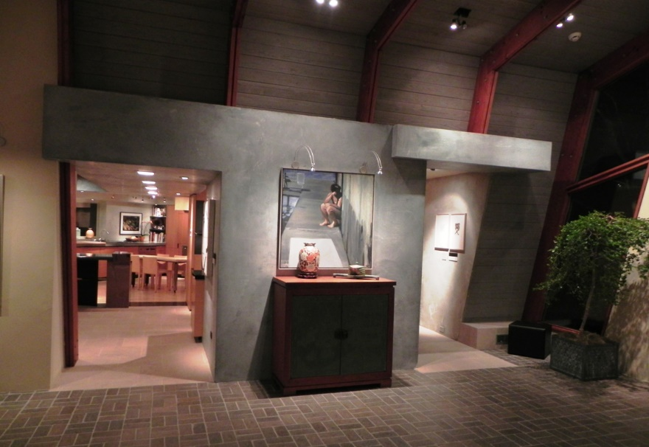
Larson Residence, Durham, NC (1973)

Slide 21
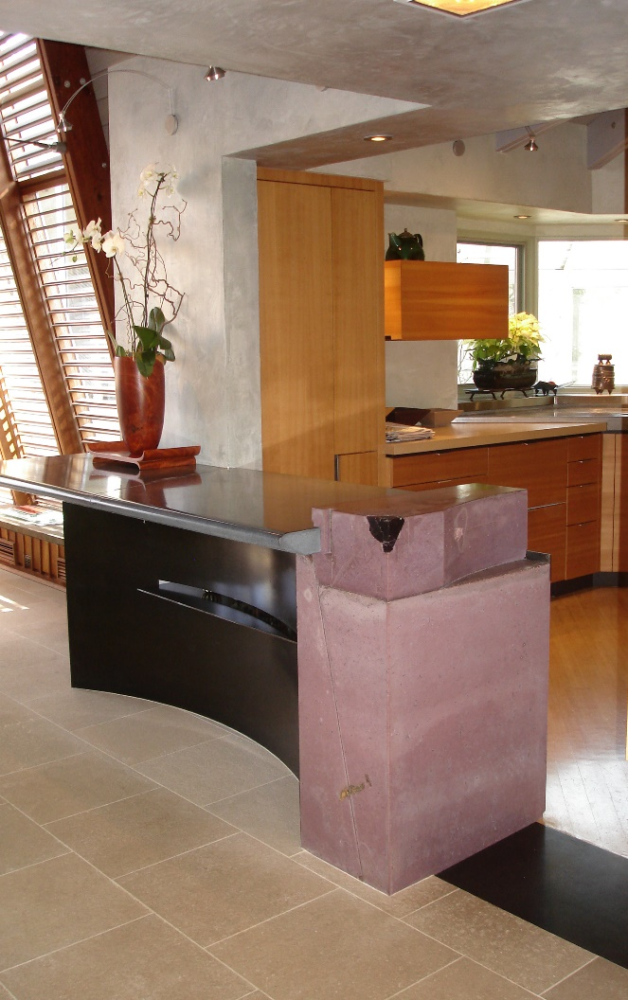
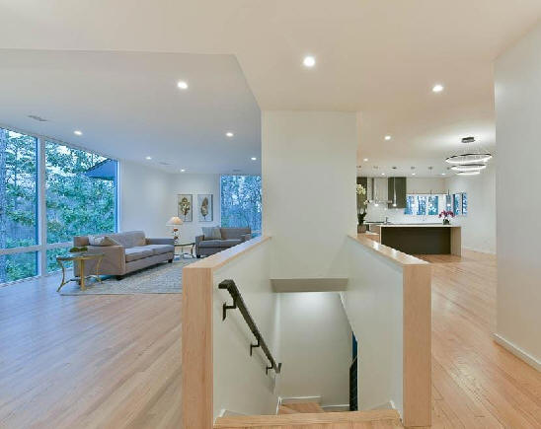
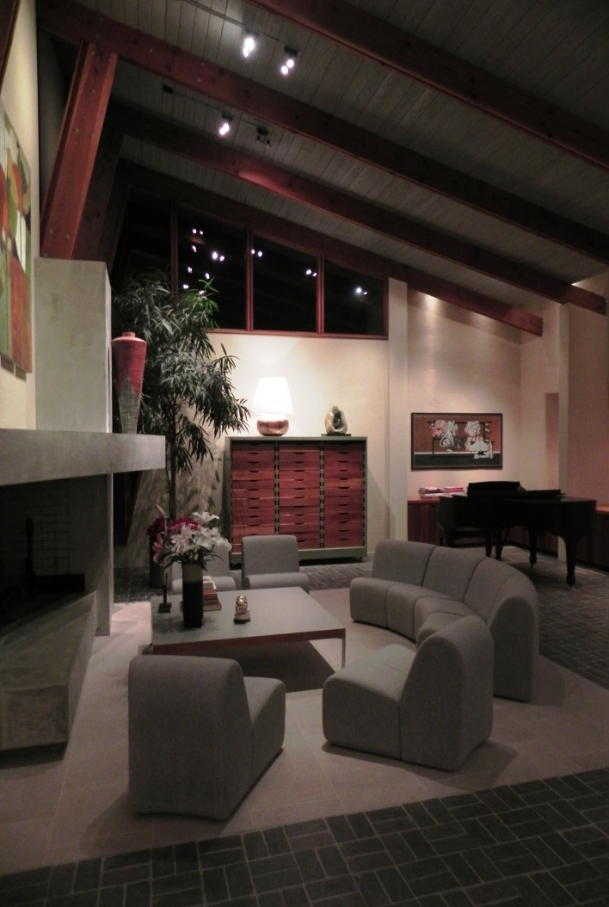
Larson Residence, Durham, NC (1973)

Slide 22
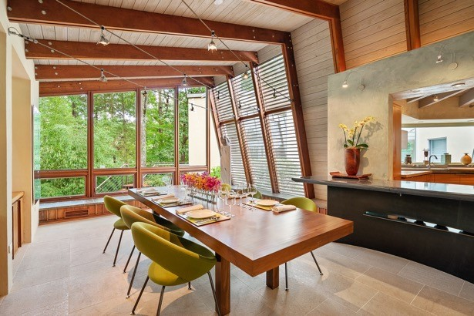
Larson Residence, Durham, NC (1973)

Slide 23
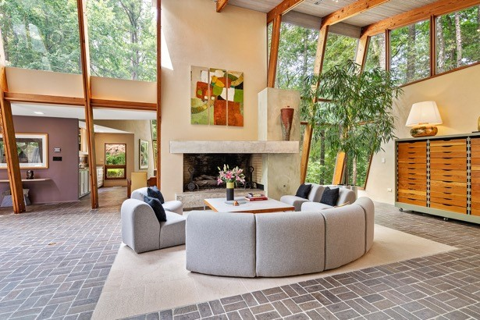
Larson Residence, Durham, NC (1973)

Slide 24
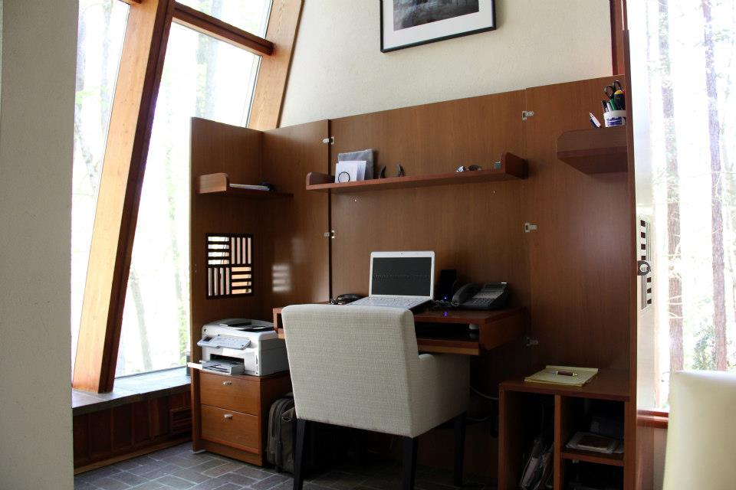
Larson Residence, Durham, NC (1973)

Slide 25
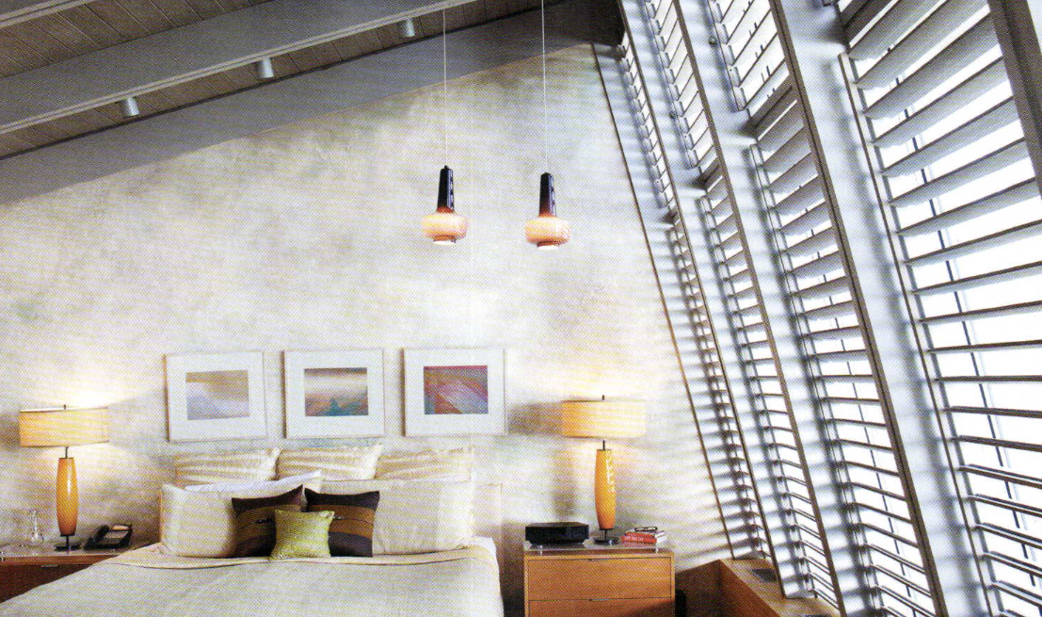
Larson Residence, Durham, NC (1973)

Slide 26
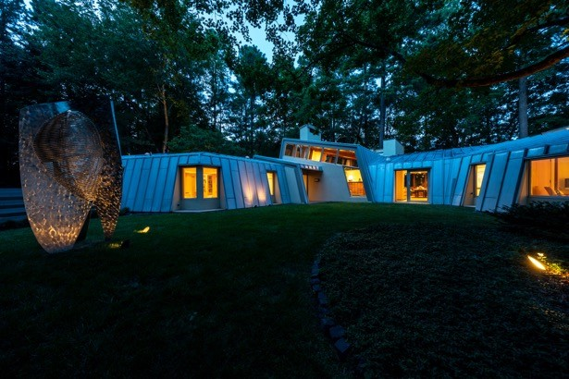
Larson Residence, Durham, NC (1973)

Slide 27
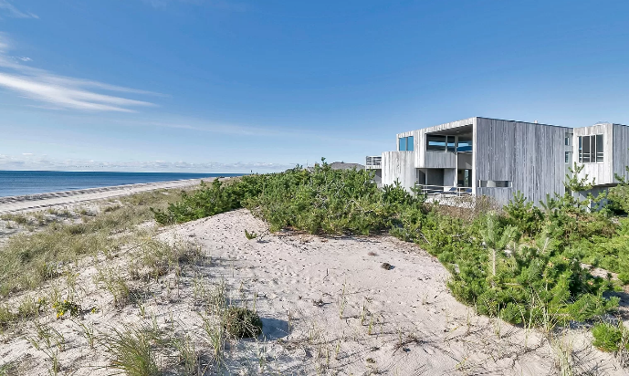
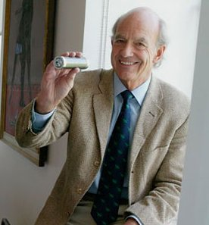
Cohn Residence,Amagansett, NY (1973)
Charles Gwathmey

Slide 28
Cohn Residence,Amagansett, NY (1973)
It is the unique oceanfront residence was designed by Charles Gwathmey.
The home sits on one acre amid the dunes of Amagansett. The home features three decks with breathtaking oceanfront views. There is a two-story living room with floor to ceiling sliders that open to the decks.

Slide 29
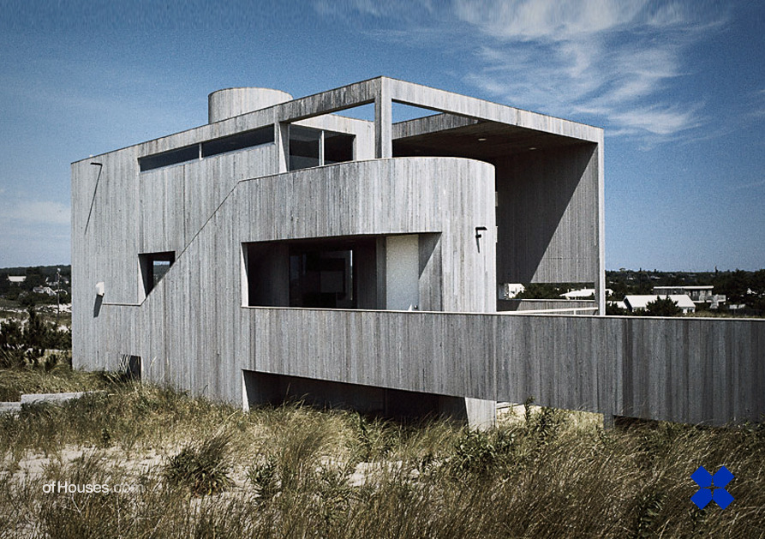
Cohn Residence,Amagansett, NY (1973)

Slide 30
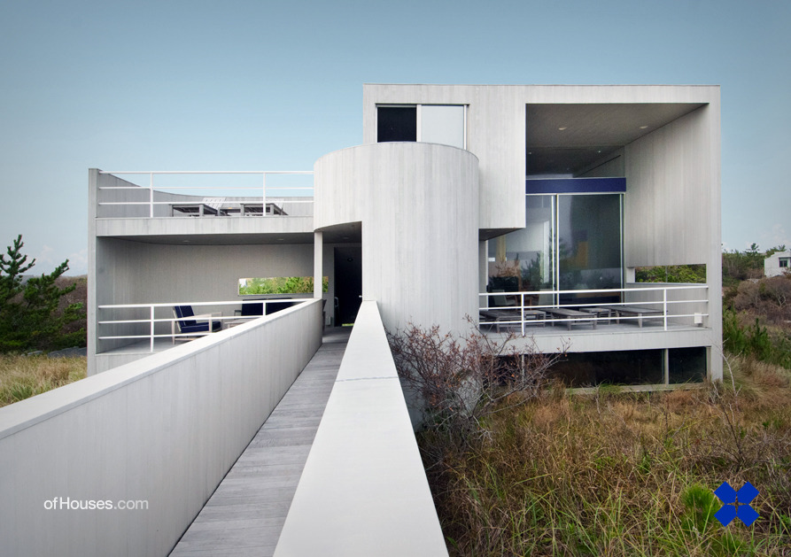
Cohn Residence,Amagansett, NY (1973)

Slide 31
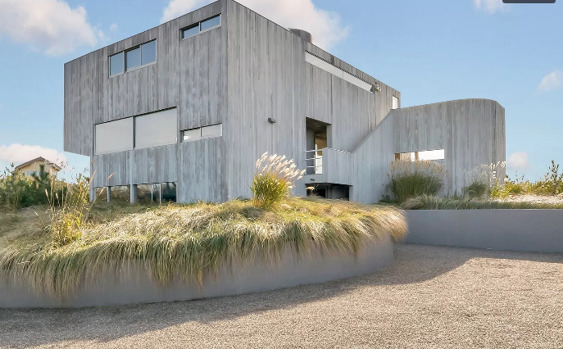
Cohn Residence,Amagansett, NY (1973)

Slide 32
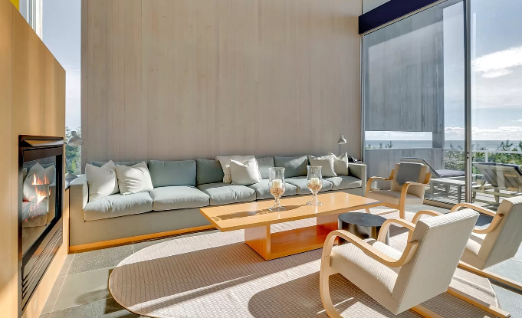
Cohn Residence,Amagansett, NY (1973)

Slide 33
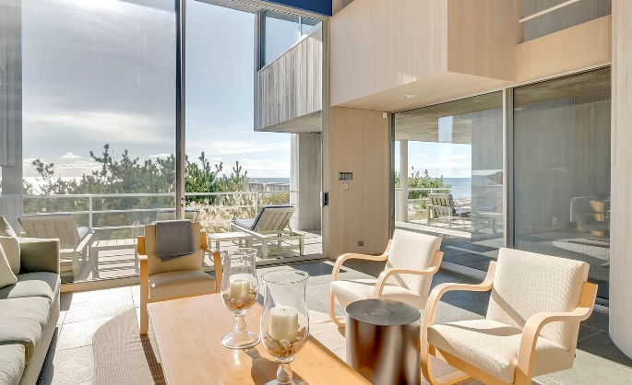
Cohn Residence,Amagansett, NY (1973)

Slide 34
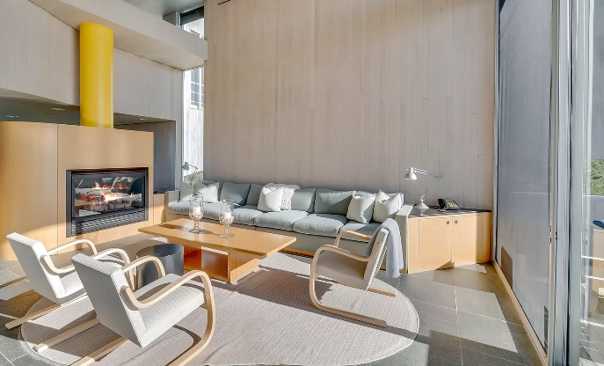
Cohn Residence,Amagansett, NY (1973)

Slide 35
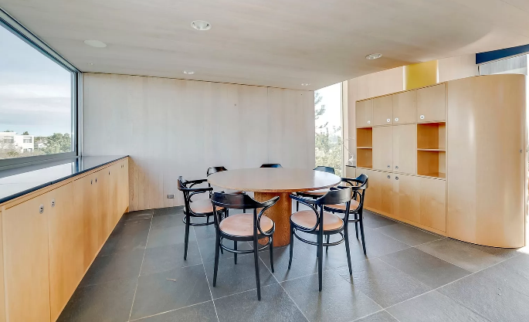
Cohn Residence,Amagansett, NY (1973)

Slide 36
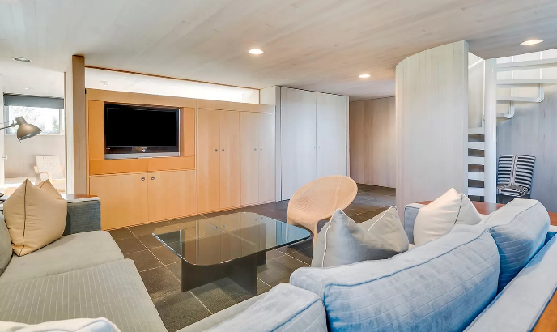
Cohn Residence,Amagansett, NY (1973)

Slide 37
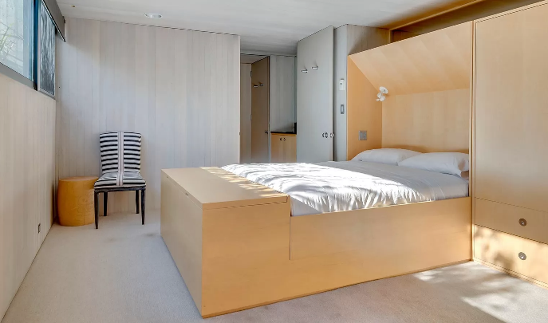
Cohn Residence,Amagansett, NY (1973)

Slide 38
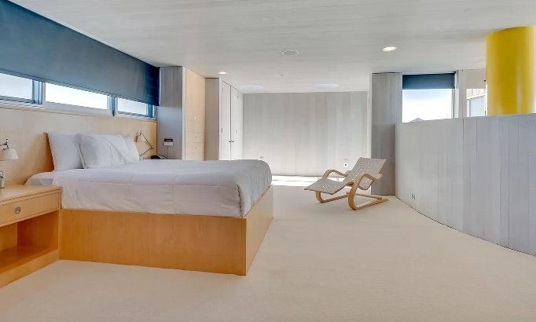
Cohn Residence,Amagansett, NY (1973)

Slide 39
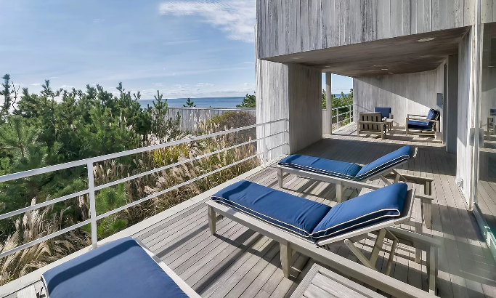
Cohn Residence,Amagansett, NY (1973)

Slide 40
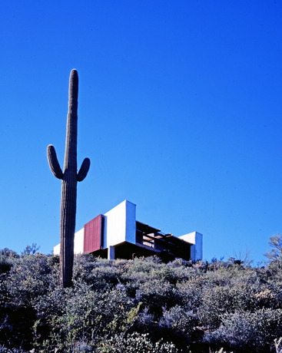
Bruder House, New River, AZ (1974)
Will Bruder

Slide 41
Bruder House, New River, AZ (1974)
It is the own house and studio of the architect Will Bruder.
3 buildings stand as an exemple of Bruder’s manner of conceiving and making architecture. The house uses the typology of lateral saddle bags framing interior space, the studio plays on the dynamics of trapezoid plan and the guest room reveals the architect’s interest in curved geometries. All 3 celebrate the scenery of the desert, use its light to articulate spatial experience, and display strict economy of means.

Slide 42
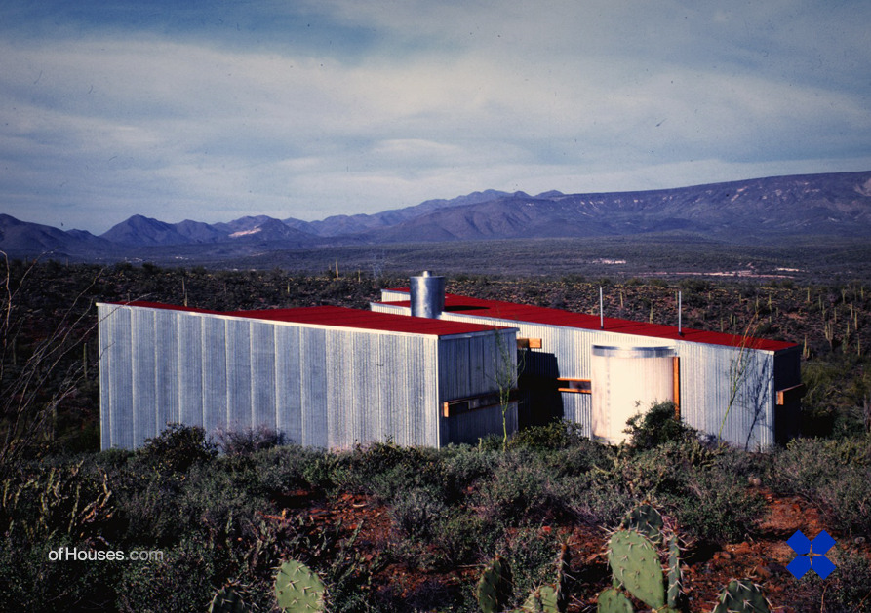
Bruder House, New River, AZ (1974)

Slide 43
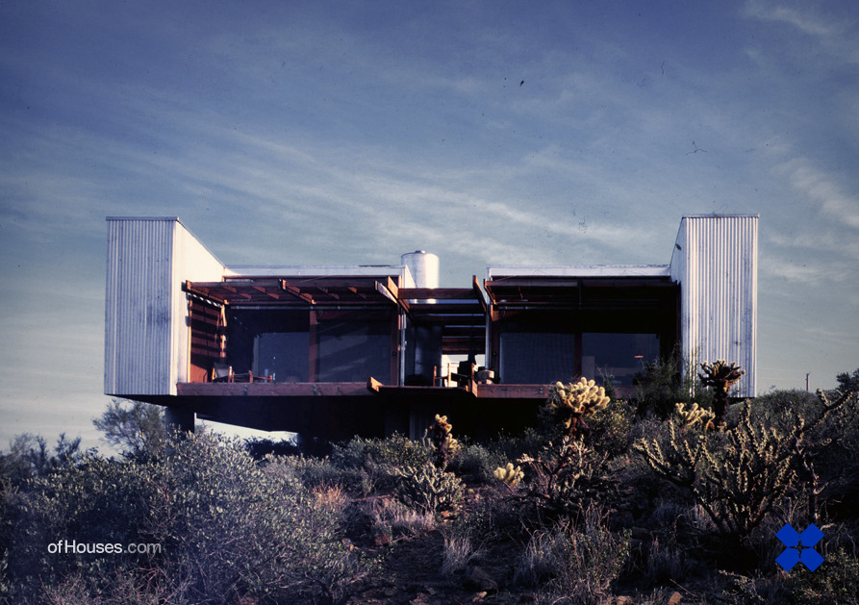
Bruder House, New River, AZ (1974)

Slide 44
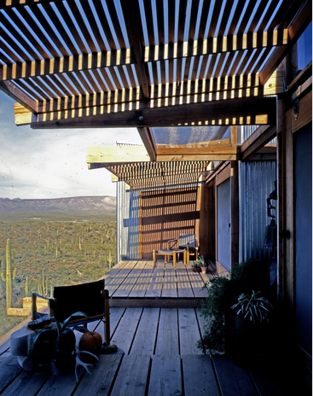
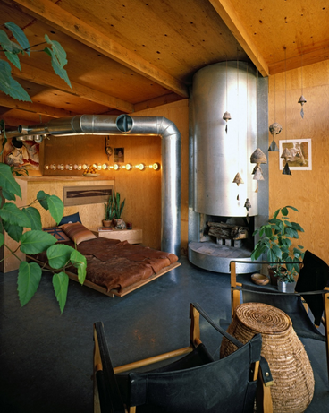
Bruder House, New River, AZ (1974)

Slide 45
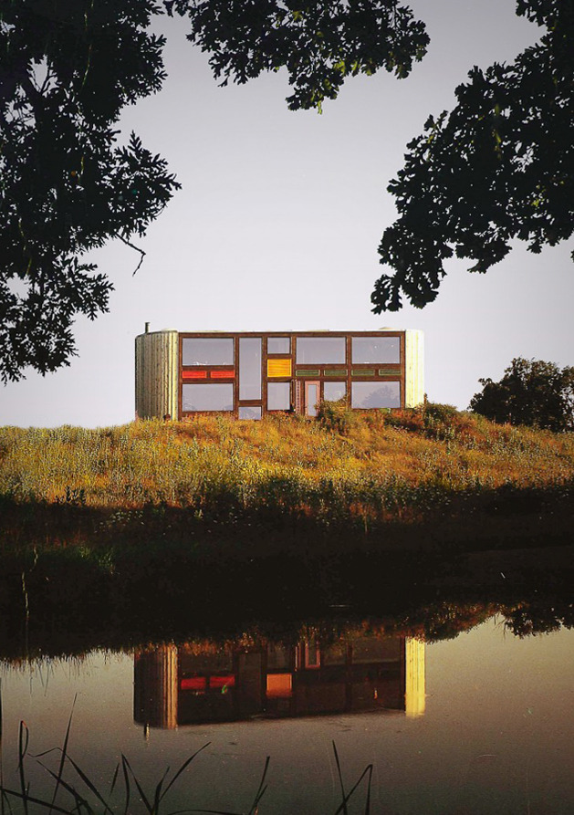
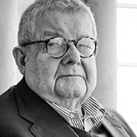
Hot Dog House, Harvard, IL (1974)
Stanley Tigerman

Slide 46
Hot Dog House, Harvard, IL (1974)
It is the work of the architect Stanley Tigerman.
Named by the architect after the shape of the plan, the Hot Dog House was developed for a client as a Michigan summer house. The two sides of the narrow home react to the environment—the side facing the highway has a blank facade while the opposite, private side opens up to the natural landscape. While this act could be read as tongue-in-cheek, for Tigerman humor is used seriously as a symbolic statement to draw attention to the core issues of a project.

Slide 47
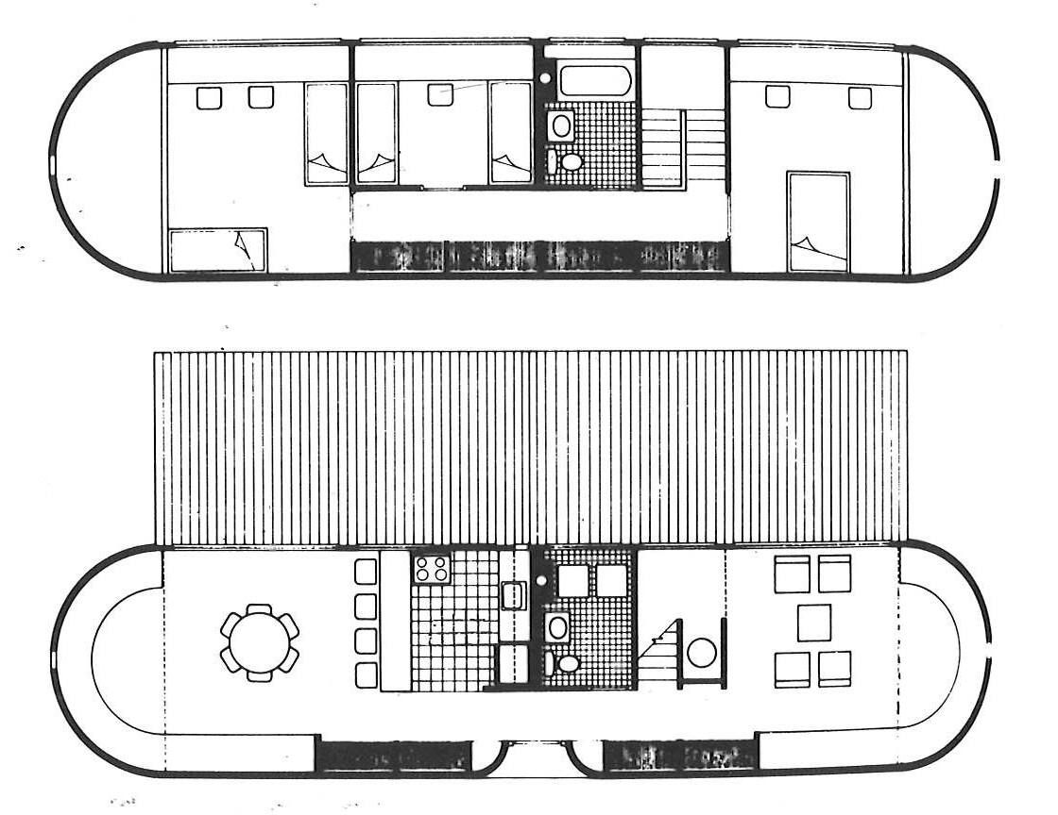
Hot Dog House, Harvard, IL (1974)

Slide 48
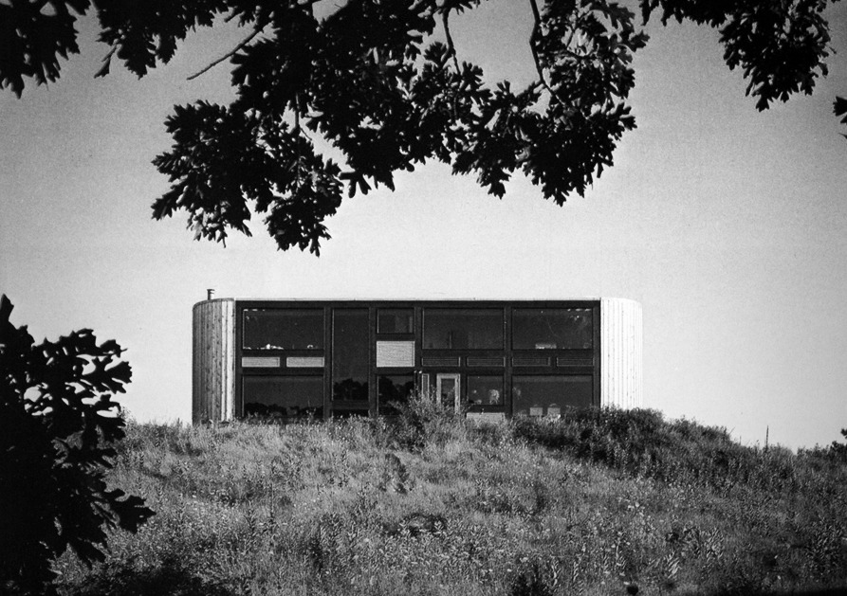
Hot Dog House, Harvard, IL (1974)

Slide 49
Hot Dog House, Harvard, IL (1974)

Slide 50
Hot Dog House, Harvard, IL (1974)

Slide 51
Hot Dog House, Harvard, IL (1974)

Slide 52
Netsch House, Chicago, IL (1974)
Walter Netsch

Slide 53
Netsch House, Chicago, IL (1974)
It is the own house of the architect Walter Netsch.
The home appears as a deceptively simple box with its brick facade from the outside, but contains a rich variety of spaces within, with multiple interior levels connected by open-riser stairs. Inside, multistory ceiling heights create the illusion of a much larger house. Skylights that at first seem strangely placed are soon revealed as highly calculated decisions, framing views and illuminating specific spaces at certain times of the day and year. Netsch’s application of field theory creates expansive sightlines between rooms; indeed, the only spaces in the entire house with doors are the bathrooms.

Slide 54
Netsch House, Chicago, IL (1974)

Slide 55
Netsch House, Chicago, IL (1974)

Slide 56
Netsch House, Chicago, IL (1974)

Slide 57
Netsch House, Chicago, IL (1974)

Slide 58
Netsch House, Chicago, IL (1974)

Slide 59
Netsch House, Chicago, IL (1974)

Slide 60
Netsch House, Chicago, IL (1974)

Slide 61
Netsch House, Chicago, IL (1974)

Slide 62
Netsch House, Chicago, IL (1974)

Slide 63
Netsch House, Chicago, IL (1974)

Slide 64
Netsch House, Chicago, IL (1974)

Slide 65
Netsch House, Chicago, IL (1974)

Slide 66
Dune House, Atlantic Beach, FL (1975)
William Morgan

Slide 67
Dune House, Atlantic Beach, FL (1975)
William Morgan built Dune House in 1975 to serve as a holiday rental. As he himself lived right next door, he didn't want the new house to obstruct his view of the ocean and preferred to keep the natural landscape. Morgan's solution was to bury the house in an existing sand dune; it is barely visible from the street above.
It is in fact a duplex, 2 almost identical houses of (69.7 m 2) each. The building was built using pool technology, a unit concrete shell anchored to a poured concrete floor, all covered with a layer of earth stabilized by native landscaping that helps maintain an interior temperature of 21°.

Slide 68
Dune House, Atlantic Beach, FL (1975)

Slide 69
Dune House, Atlantic Beach, FL (1975)

Slide 70
Dune House, Atlantic Beach, FL (1975)

Slide 71
Dune House, Atlantic Beach, FL (1975)

Slide 72
Dune House, Atlantic Beach, FL (1975)
Wooden terraces have been added on the top of the hill

Slide 73
Frank House, Cornwall, CT (1975)
Peter Eisenman

Slide 74
Frank House, Cornwall, CT (1975)
It's the work of architect Peter Eisenman.
Rather than form following function or an aesthetic design, the design emerged from a conceptual process, and remains pinned to that conceptual framework : the envelope and structure of the building are just a manifestation of the changed elements of the original four slabs.
Consequently, the use of the building was intentionally ignored : a glass strip originally divided the bedroom, preventing the installation of a double bed.

Slide 75
Frank House, Cornwall, CT (1975)

Slide 76
Frank House, Cornwall, CT (1975)

Slide 77
Frank House, Cornwall, CT (1975)

Slide 78
Frank House, Cornwall, CT (1975)

Slide 79
Frank House, Cornwall, CT (1975)

Slide 80
Frank House, Cornwall, CT (1975)

Slide 81
Frank House, Cornwall, CT (1975)

Slide 82
Frank House, Cornwall, CT (1975)

Slide 83
Frank House, Cornwall, CT (1975)

Slide 84
Forest House, West Cornwall, CT (1975)
Peter Bohlin

Slide 85
Forest House, West Cornwall, CT (1975)
It is the work of the architect Peter Bohlin.
Camouflaged among the trees, the green-stained wood house hovers above a boulder-strewn landscape, resting on concrete piers. Rather than removing a large granite boulder or moving the building, a telling accommodation was made by scribing a platform to the boulder, psychologically anchoring the house in the landscape. The entrance sequence is superbly controlled. The visitor walks along the bridge, down a few steps to an enclosed breezeway within the mass of the house. The two story living room is glass wrapped through red industrial glazing.

Slide 86
Forest House, West Cornwall, CT (1975)

Slide 87
Forest House, West Cornwall, CT (1975)

Slide 88
Forest House, West Cornwall, CT (1975)

Slide 89
Forest House, West Cornwall, CT (1975)

Slide 90
Forest House, West Cornwall, CT (1975)

Slide 91
Forest House, West Cornwall, CT (1975)

Slide 92
Forest House, West Cornwall, CT (1975)

Slide 93
Plastic Tent House, Stanfordville, NY (1975)
John Johansen

Slide 94
Plastic Tent House, Stanfordville, NY (1975)
It is the own house of the architect John Johansen.
The Plastic Tent House, made from translucent plastic, with cantilevered staircase and three suspended floors, was shelter as seemingly improvised and temporary.
The building materials set up a tension which is almost palpable; low-tech ponderous stonework at the base represents ties with the past, as contrasted with the lightweight high-tech stainless steel and plastic. With constant light shining through the translucent plastic siding and with sunlight entering through clear glass areas, the house may be thought of as a “light modulator.”

Slide 95
Plastic Tent House, Stanfordville, NY (1975)

Slide 96
Plastic Tent House, Stanfordville, NY (1975)

Slide 97
Plastic Tent House, Stanfordville, NY (1975)

Slide 98
Plastic Tent House, Stanfordville, NY (1975)

Slide 99
Plastic Tent House, Stanfordville, NY (1975)

Slide 100
Jake Kittle House, Gaviota, CA (1975)
Steve Baer

Slide 101
Jake Kittle House, Gaviota, CA (1975)
It is the work of Steve Baer.
Recognizing the limitations of a geometric structure based on the sphere, S. Baer decided that polyhedra were more flexible and invented a three-dimensional, dome-like structure based on a convex polyhedron called the zonohedron, whose faces are all polygons with equal edges in parallel pairs. This combination of zonohedron and dome produced the Zome. Also called “exploded rhombic dodecahedra,” Zomes consist of a network of 120-degree angles, need not be symmetrical, and can be easily clustered, producing a system that is infinitely additive and variable.

Slide 102
Jake Kittle House, Gaviota, CA (1975)

Slide 103
Jake Kittle House, Gaviota, CA (1975)

Slide 104
Jake Kittle House, Gaviota, CA (1975)

Slide 105
Jake Kittle House, Gaviota, CA (1975)

Slide 106
Jake Kittle House, Gaviota, CA (1975)

Slide 107
Jake Kittle House, Gaviota, CA (1975)

Slide 108
Ramada House, Tucson, AZ (1975)
Judith Chafee

Slide 109
Ramada House, Tucson, AZ (1975)
It is the work of the architect Judith Chafee.
It is a desert residence in the Catalina Mountain foothills capped with a lofted grid of wood slats (known as a ramada, from the Spanish word for branches, rama, a technique mastered by the Tohono O'odham tribe).
The lofted wooden grid is an aesthetic marvel, with the exposed support beams (simple telephone poles) becoming part of the interior design while providing shade and focusing the breeze to cool the home. The ramada was designed to cast intriguing shadows at different times of the day.

Slide 110
Ramada House, Tucson, AZ (1975)
The home beneath the canopy appears to be made of adobe, but it's actually built with mortar-washed slump block, which, like adobe, keeps the air inside cool in the summer and warm in the winter.
Floors in the four-bedroom home are tile and concrete, and natural wood is used for accents throughout the house.
There are multiple patios, decks, and oversize windows providing lovely vistas, connecting the indoors and out. Outside, there's a pool finished with an earth-colored plaster, the better to blend into the scenery and reflect the night sky.

Slide 111
Ramada House, Tucson, AZ (1975)

Slide 112
Ramada House, Tucson, AZ (1975)

Slide 113
Ramada House, Tucson, AZ (1975)

Slide 114
Ramada House, Tucson, AZ (1975)

Slide 115
Ramada House, Tucson, AZ (1975)

Slide 116
Ramada House, Tucson, AZ (1975)

Slide 117
Ramada House, Tucson, AZ (1975)

Slide 118
Ramada House, Tucson, AZ (1975)

Slide 119
Ramada House, Tucson, AZ (1975)

Slide 120
Ramada House, Tucson, AZ (1975)

Slide 121
Ramada House, Tucson, AZ (1975)

Slide 122
Ramada House, Tucson, AZ (1975)

Slide 123
Ramada House, Tucson, AZ (1975)

Slide 124
Ramada House, Tucson, AZ (1975)

Slide 125
Ramada House, Tucson, AZ (1975)

Slide 126
Ramada House, Tucson, AZ (1975)

Slide 127
Ramada House, Tucson, AZ (1975)

Slide 128
Ramada House, Tucson, AZ (1975)

Slide 129
Ramada House, Tucson, AZ (1975)

Slide 130
Hilltop House, Brooksville, FL (1975)
William Morgan

Slide 131
Hilltop House, Brooksville, FL (1975)
It was designed by William Morgan.
The house draws the massive heaviness of the hill up into a pyramidal form, its corners oriented to the cardinal points, and its spaces framed by earth-retaining walls of geometric precision : Cast-in-place concrete with sloped retaining earth berm walls and laminated wood beams support low-slung, pyramidal roof made from planked wood.
The rooms of the house open in 4 directions, fronted by protected terraces cut into ground, so that this most earth-bound of houses is paradoxically, cross-ventilated by all 4 winds.

Slide 132
Hilltop House, Brooksville, FL (1975)
The upper level, named “the Observatory”, is a single, central room, crowned by a pyramidal roof that brings the lines of the house and hill to its peak, and from which one is afforded uninterrupted views of the surrounding landscape.
Inspired by prehistoric earth architecture, this house provides its occupants both modern spatial freedoms and an intensely spiritual connection to earth.

Slide 133
Hilltop House, Brooksville, FL (1975)

Slide 134
Hilltop House, Brooksville, FL (1975)

Slide 135
Hilltop House, Brooksville, FL (1975)

Slide 136
Hilltop House, Brooksville, FL (1975)

Slide 137
Hilltop House, Brooksville, FL (1975)

Slide 138
Hilltop House, Brooksville, FL (1975)

Slide 139
Hilltop House, Brooksville, FL (1975)

Slide 140
Hilltop House, Brooksville, FL (1975)

Slide 141
Hilltop House, Brooksville, FL (1975)

Slide 142
Owen House, Block Island, RI (1975)
C.H.L. Owen

Slide 143
Owen House, Block Island, RI (1975)
It is the own house of the architect Christopher H. L. Owen.
The design is also intriguing—curving, elongated towers sit on either side of walls of windows that make the center of the home look like a glassy jewelry box. The living room features double-height ceilings and an open layout with views out to a patio for lounging or dining. The bedrooms are long and narrow with windows to let in light, and the home sits on 3.2 acres of mature trees and a grassy lawn.

Slide 144
Owen House, Block Island, RI (1975)

Slide 145
Owen House, Block Island, RI (1975)

Slide 146
Owen House, Block Island, RI (1975)

Slide 147
Owen House, Block Island, RI (1975)

Slide 148
Owen House, Block Island, RI (1975)

Slide 149
Tube House, Salisbury, CT (1975)
John M. Johansen

Slide 150
Tube House, Salisbury, CT (1975)
It is the work of the architect John M. Johansen.
Johansen developed a fragmented plan , piling up rock foundations for each of the three main elements of the plan, then cantilevering the house over these foundations. The house is framed in a combination of light steel and wood stud and clad in an asbestos-cement panel with a factory finish used here in several contrasting colors. Bringing the parts of the house together are tubes made structural by bar joists under the floor, and are finished in corrugated aluminum sheet that serves as a foil against the site. The interiors of the main spaces are dressed in gypsum board, slate , field stone and wood plank.

Slide 151
Tube House, Salisbury, CT (1975)

Slide 152
Tube House, Salisbury, CT (1975)

Slide 153
Tube House, Salisbury, CT (1975)

Slide 154
Tube House, Salisbury, CT (1975)

Slide 155
Tube House, Salisbury, CT (1975)

Slide 156
Domus Solaris, Los Angeles, CA (1975)
Donald Hensman

Slide 157
Domus Solaris, Los Angeles, CA (1975)
It is the own house of the architect Donald Hensman.
Carefully drawn across the highest ridge above Mulholland, Donald Hensman’s, personal residence each day recalls the experience of ascending the mountain. Access appears blocked from below, but then through the hidden cleft, stairs lead upward. The pool, like a small lake at the base of the summit is crossed over by a bridge. There is pristine shelter at the top, with panoramic views of both the Valley and Hollywood through the broad Nichols Canyon. Interiors are one space for living indoors-outdoors in freedom and privacy on top of the world and beneath the sun.

Slide 158
Domus Solaris, Los Angeles, CA (1975)

Slide 159
Domus Solaris, Los Angeles, CA (1975)

Slide 160
Domus Solaris, Los Angeles, CA (1975)

Slide 161
Domus Solaris, Los Angeles, CA (1975)

Slide 162
Domus Solaris, Los Angeles, CA (1975)

Slide 163
Domus Solaris, Los Angeles, CA (1975)

Slide 164
Domus Solaris, Los Angeles, CA (1975)

Slide 165
Domus Solaris, Los Angeles, CA (1975)

Slide 166
Domus Solaris, Los Angeles, CA (1975)

Slide 167
Domus Solaris, Los Angeles, CA (1975)

Slide 168
Bruder House, New River, AZ (1974)
THE END

