Slide 1
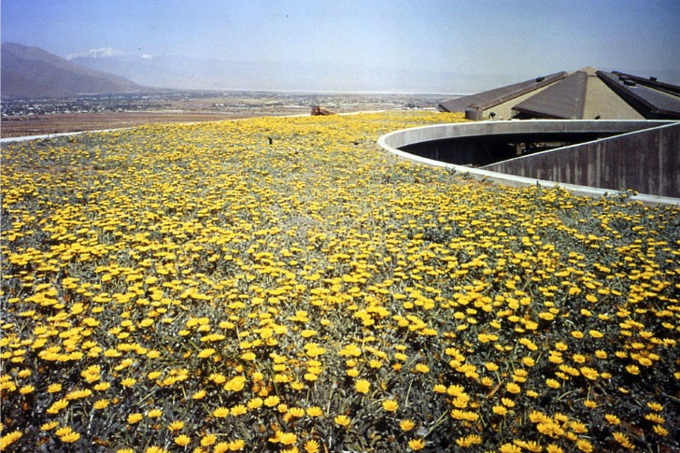
US. Modernist Houses
1969-1970

Slide 2
US Modernist Houses 1969 - 1970
The purpose of this presentation is to show you the most outstanding Modern Movement inspired houses in the United States by great architects.
Some of them have become icons of contemporary architecture (members of the iconic.org network) and are recognized and protected as such.
They remain unique either by their constructive principle, or by their location, or by their theoretical importance, or by their perfect integration into the landscape.

Slide 3
US Modernist Houses
Many of the houses presented in this slide show (before the year 2000) were found on the OfHouses website (Old Forgotten Houses) which lists houses with architectural interest or singular architecture around the world with many illustrations. If they are shown here, it is because they are already considered as iconic.

Slide 4
US Modernist Houses
Geller House II, Marcel Breuer, NY.
Elrod House, John Lautner, CA.
Graham House, Eliot Noyes, CT.
Haas House, Mark Mills, CA.
Harvey House, Buff, Straub & Hensman, CA.
Deane Residence, Paul Rudolph, NY.
Cogswell House, Arthur Cogswell, NC.
Scoren House, Donald Knorr, CA.
Bass Residence, Paul Rudolph, TX.
Sabel House, Julian & Barbara Neski, NY.

Slide 5
US Modernist Houses 2
Perlbinder House, Norman Jaffe, NY.
Lovett Cabin, Wendell Harper Lovett, WA.
Goldfinger House, Myron Goldfinger, NY.
Pack House, Martin Growald & Harry Bates, NY.
Falk House, Peter Eisenman, VT.
Shafer House, James B. Baker, NY.
Menkick House, Charles Haertling, CO.
Kahn House, Charles Haertling, CO.

Slide 6
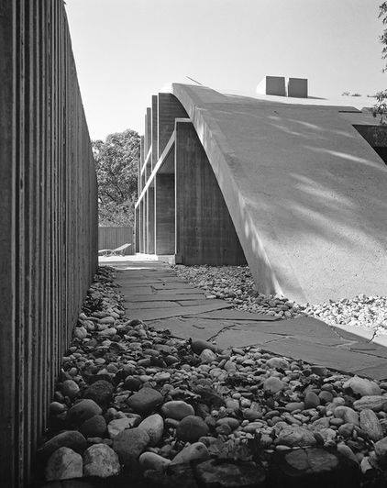
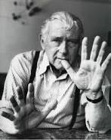
Geller House II, Lawrence, NY (1969)
M. Breuer

Slide 7
Geller House II, Lawrence, NY (1969)
It is the work of Marcel Breuer architect.
It is a very different house from the 1st Geller House which was a binuclear house (two wings of the house are connected by an entrance hallway) and a butterfly roof which slope inward and centrally drained.
In this case, a parabolic arch-shaped concrete roof covers a square plan of concrete and stucco walls, with the sides open. A gentle shell, resting on four abutments, frames a soaring yet peaceful interior space.

Slide 8
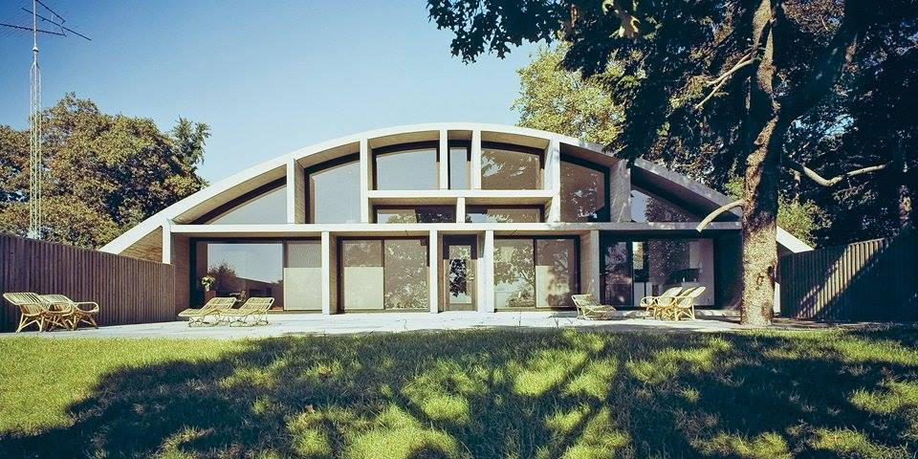
Geller House II, Lawrence, NY (1969)

Slide 9
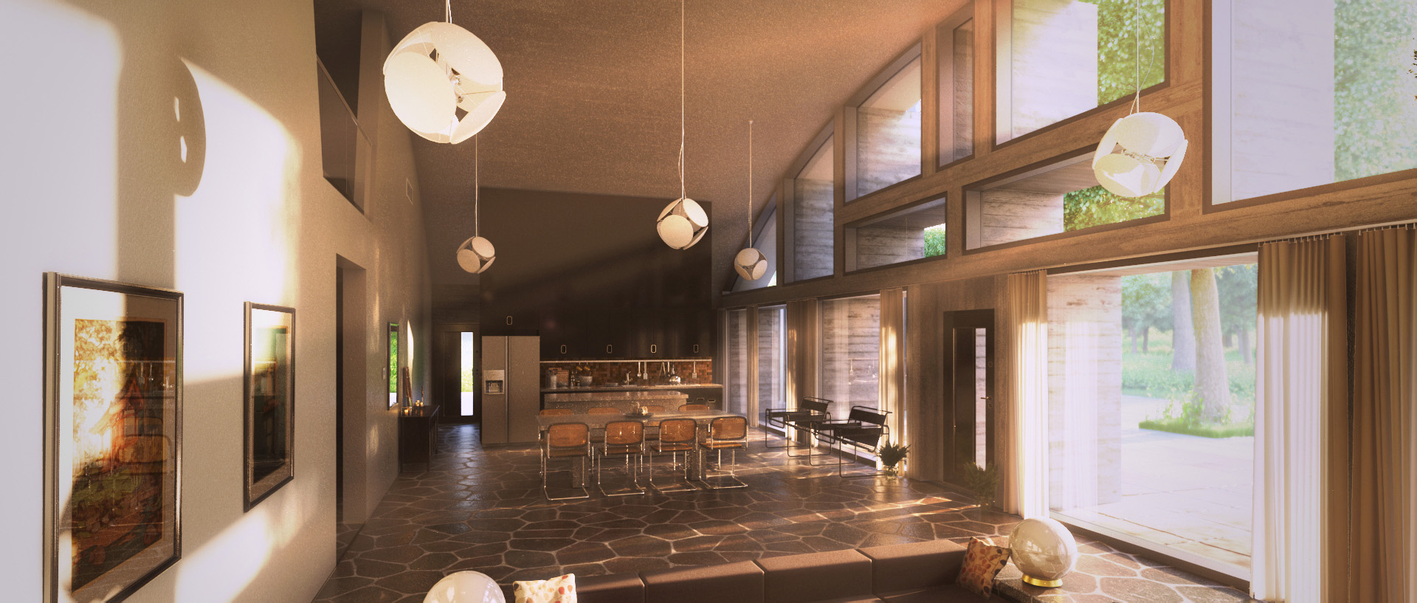
Geller House II, Lawrence, NY (1969)

Slide 10
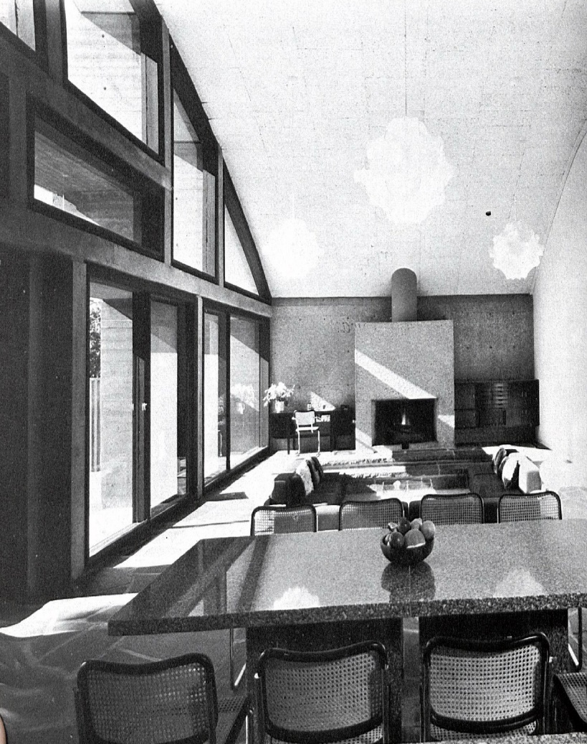
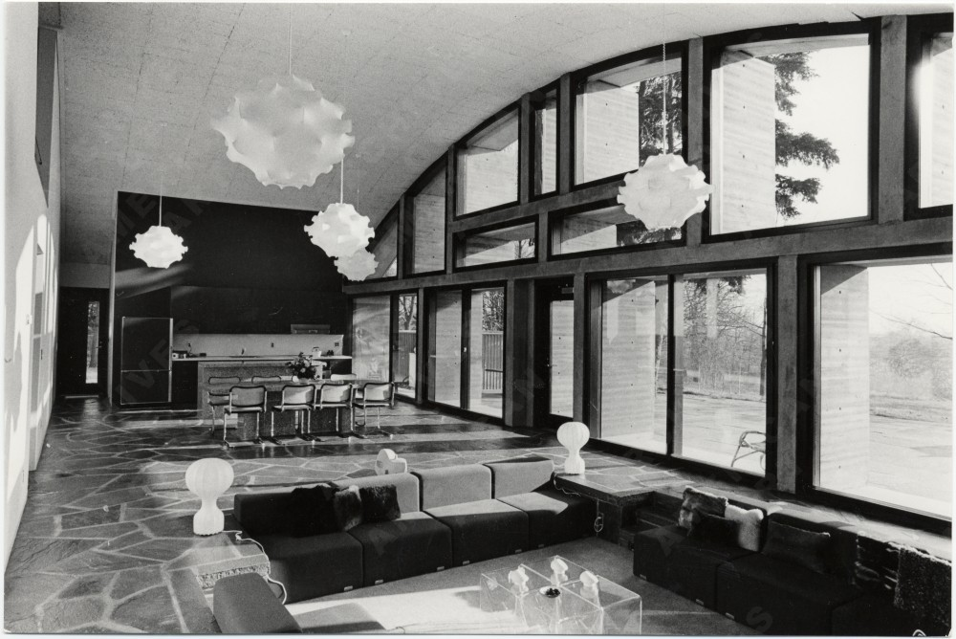
Geller House II, Lawrence, NY (1969)

Slide 11
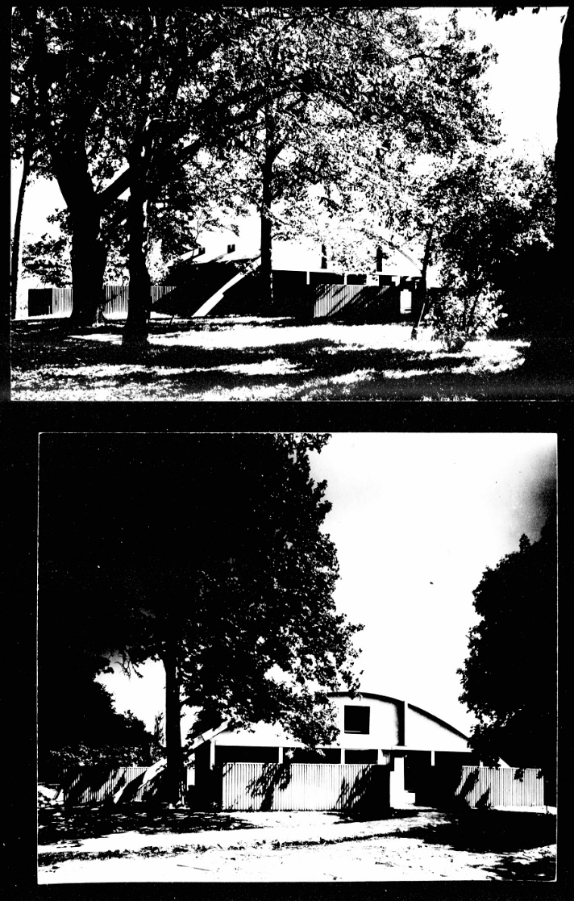
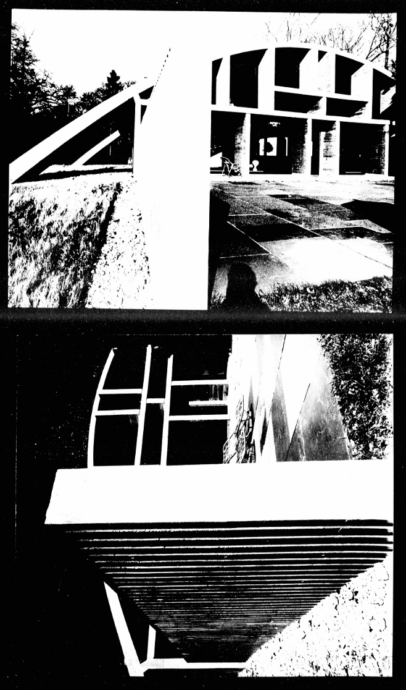
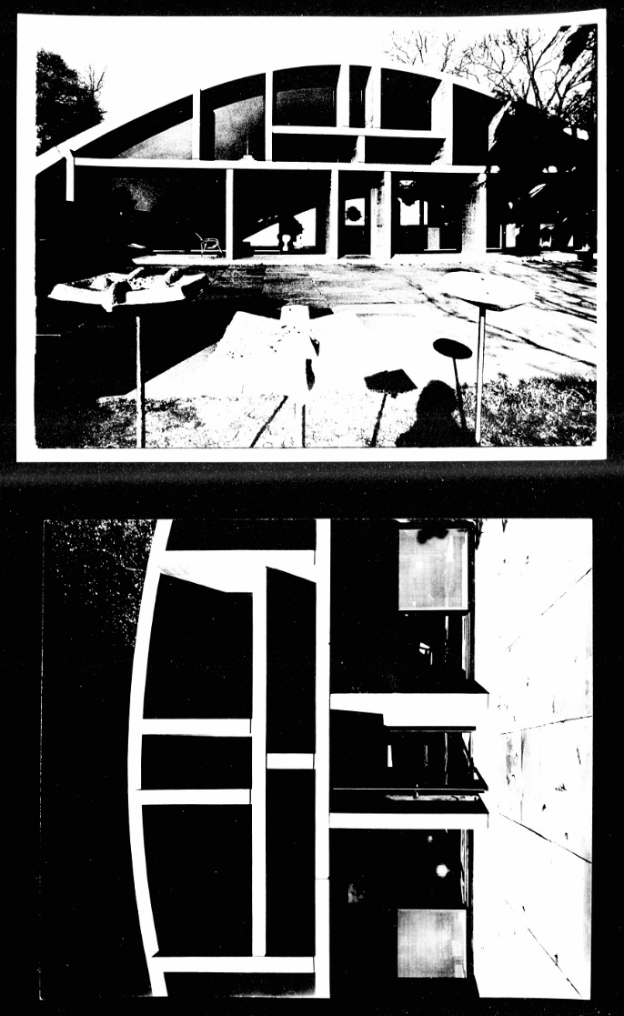
Geller House II, Lawrence, NY (1969)

Slide 12
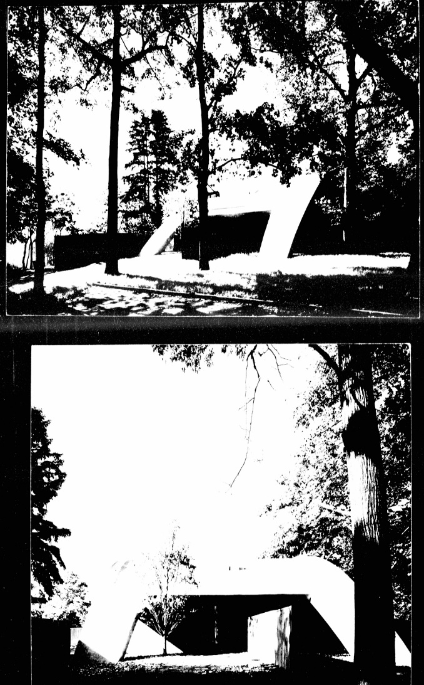
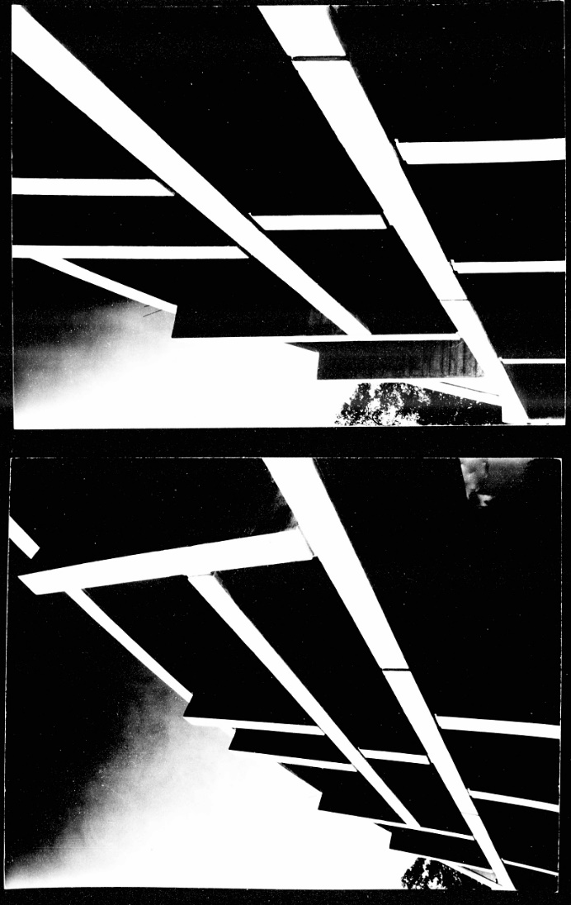
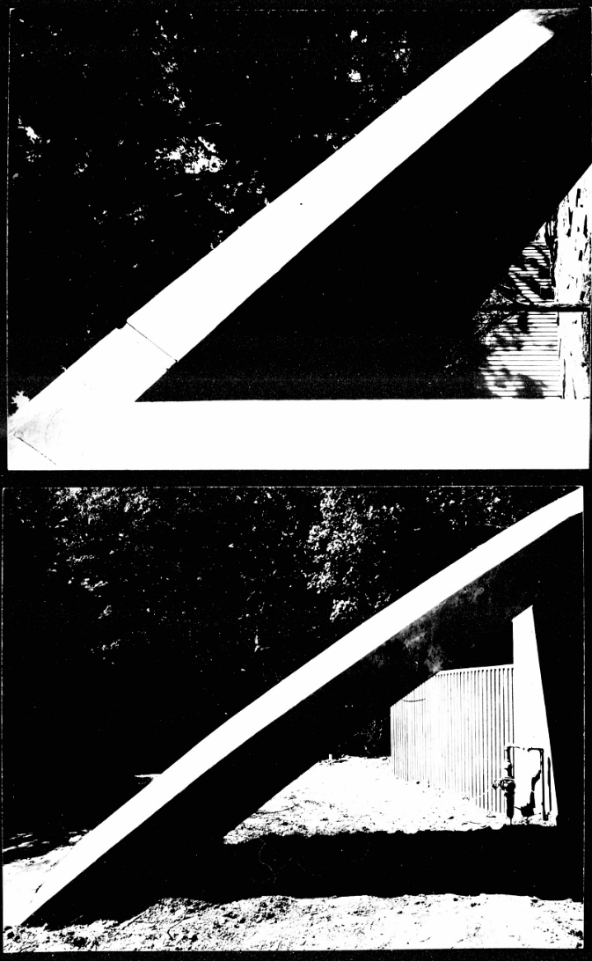
Geller House II, Lawrence, NY (1969)

Slide 13
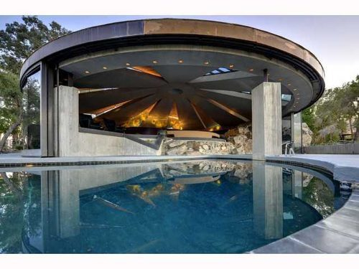
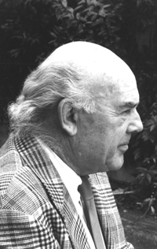
Elrod House, Palm Springs, CA (1969)
John Lautner

Slide 14
Elrod House, Palm Springs, CA (1969)
A student of F.L. Wright, John Lautner is one of his most exemplary creations, combining organic architecture, monumental concrete construction and (retractable) glass walls: ¨Architecture intemporelle¨ according to his designer.
One of the striking things about this house is the huge curved concrete roof formed by a conical dome covering nine inclined triangles above the circular living room.(Appears in the movie Diamonds are forever)

Slide 15
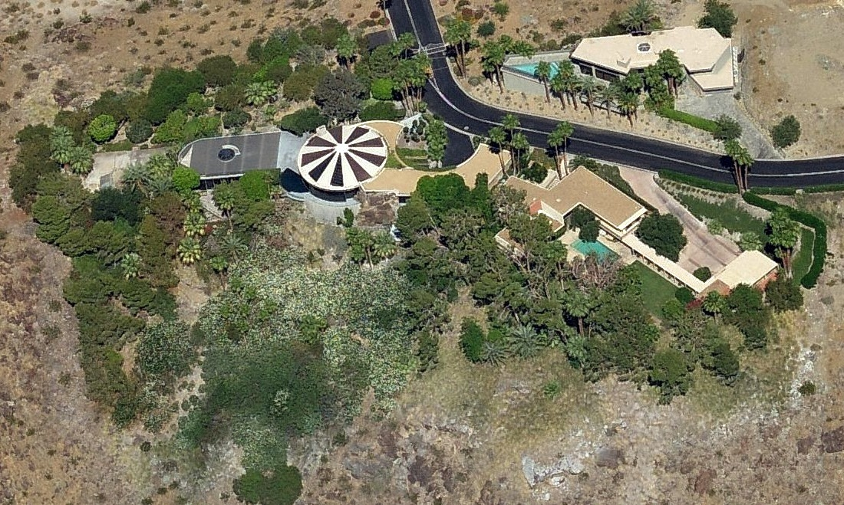
Elrod House, Palm Springs, CA (1969)

Slide 16
Elrod House, Palm Springs, CA (1969)

Slide 17
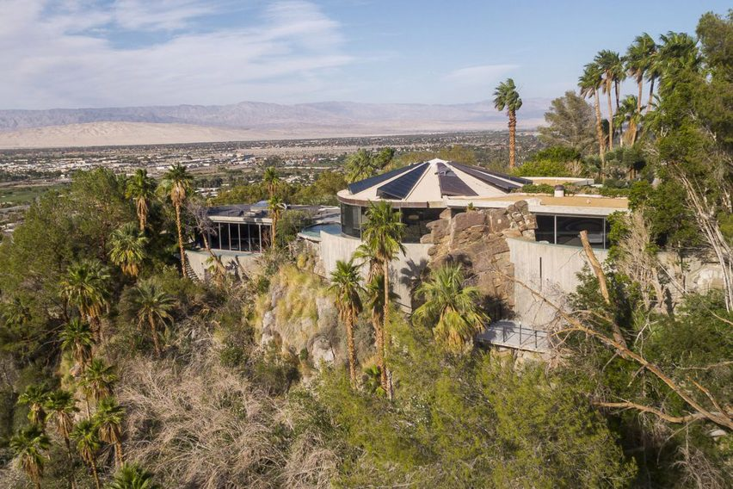
Elrod House, Palm Springs, CA (1969)

Slide 18
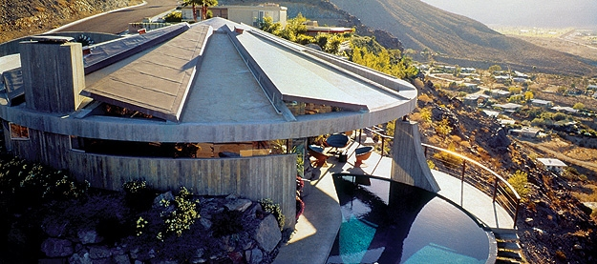
Elrod House, Palm Springs, CA (1969)

Slide 19
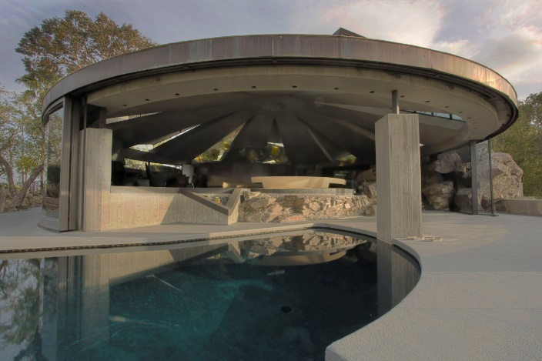
Elrod House, Palm Springs, CA (1969)

Slide 20
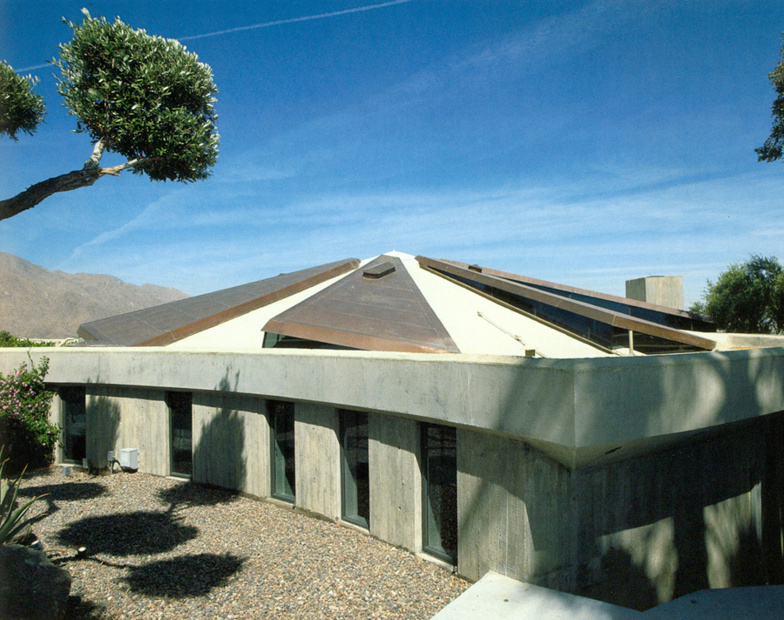
Elrod House, Palm Springs, CA (1969)

Slide 21
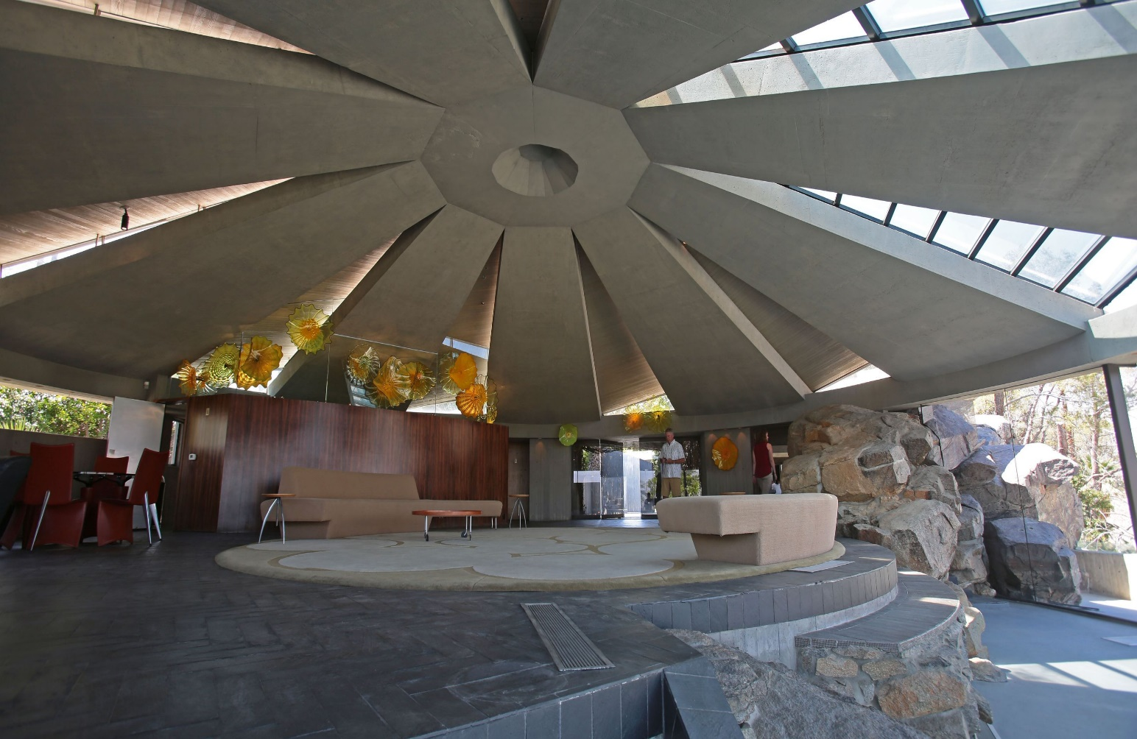
Elrod House, Palm Springs, CA (1969)

Slide 22
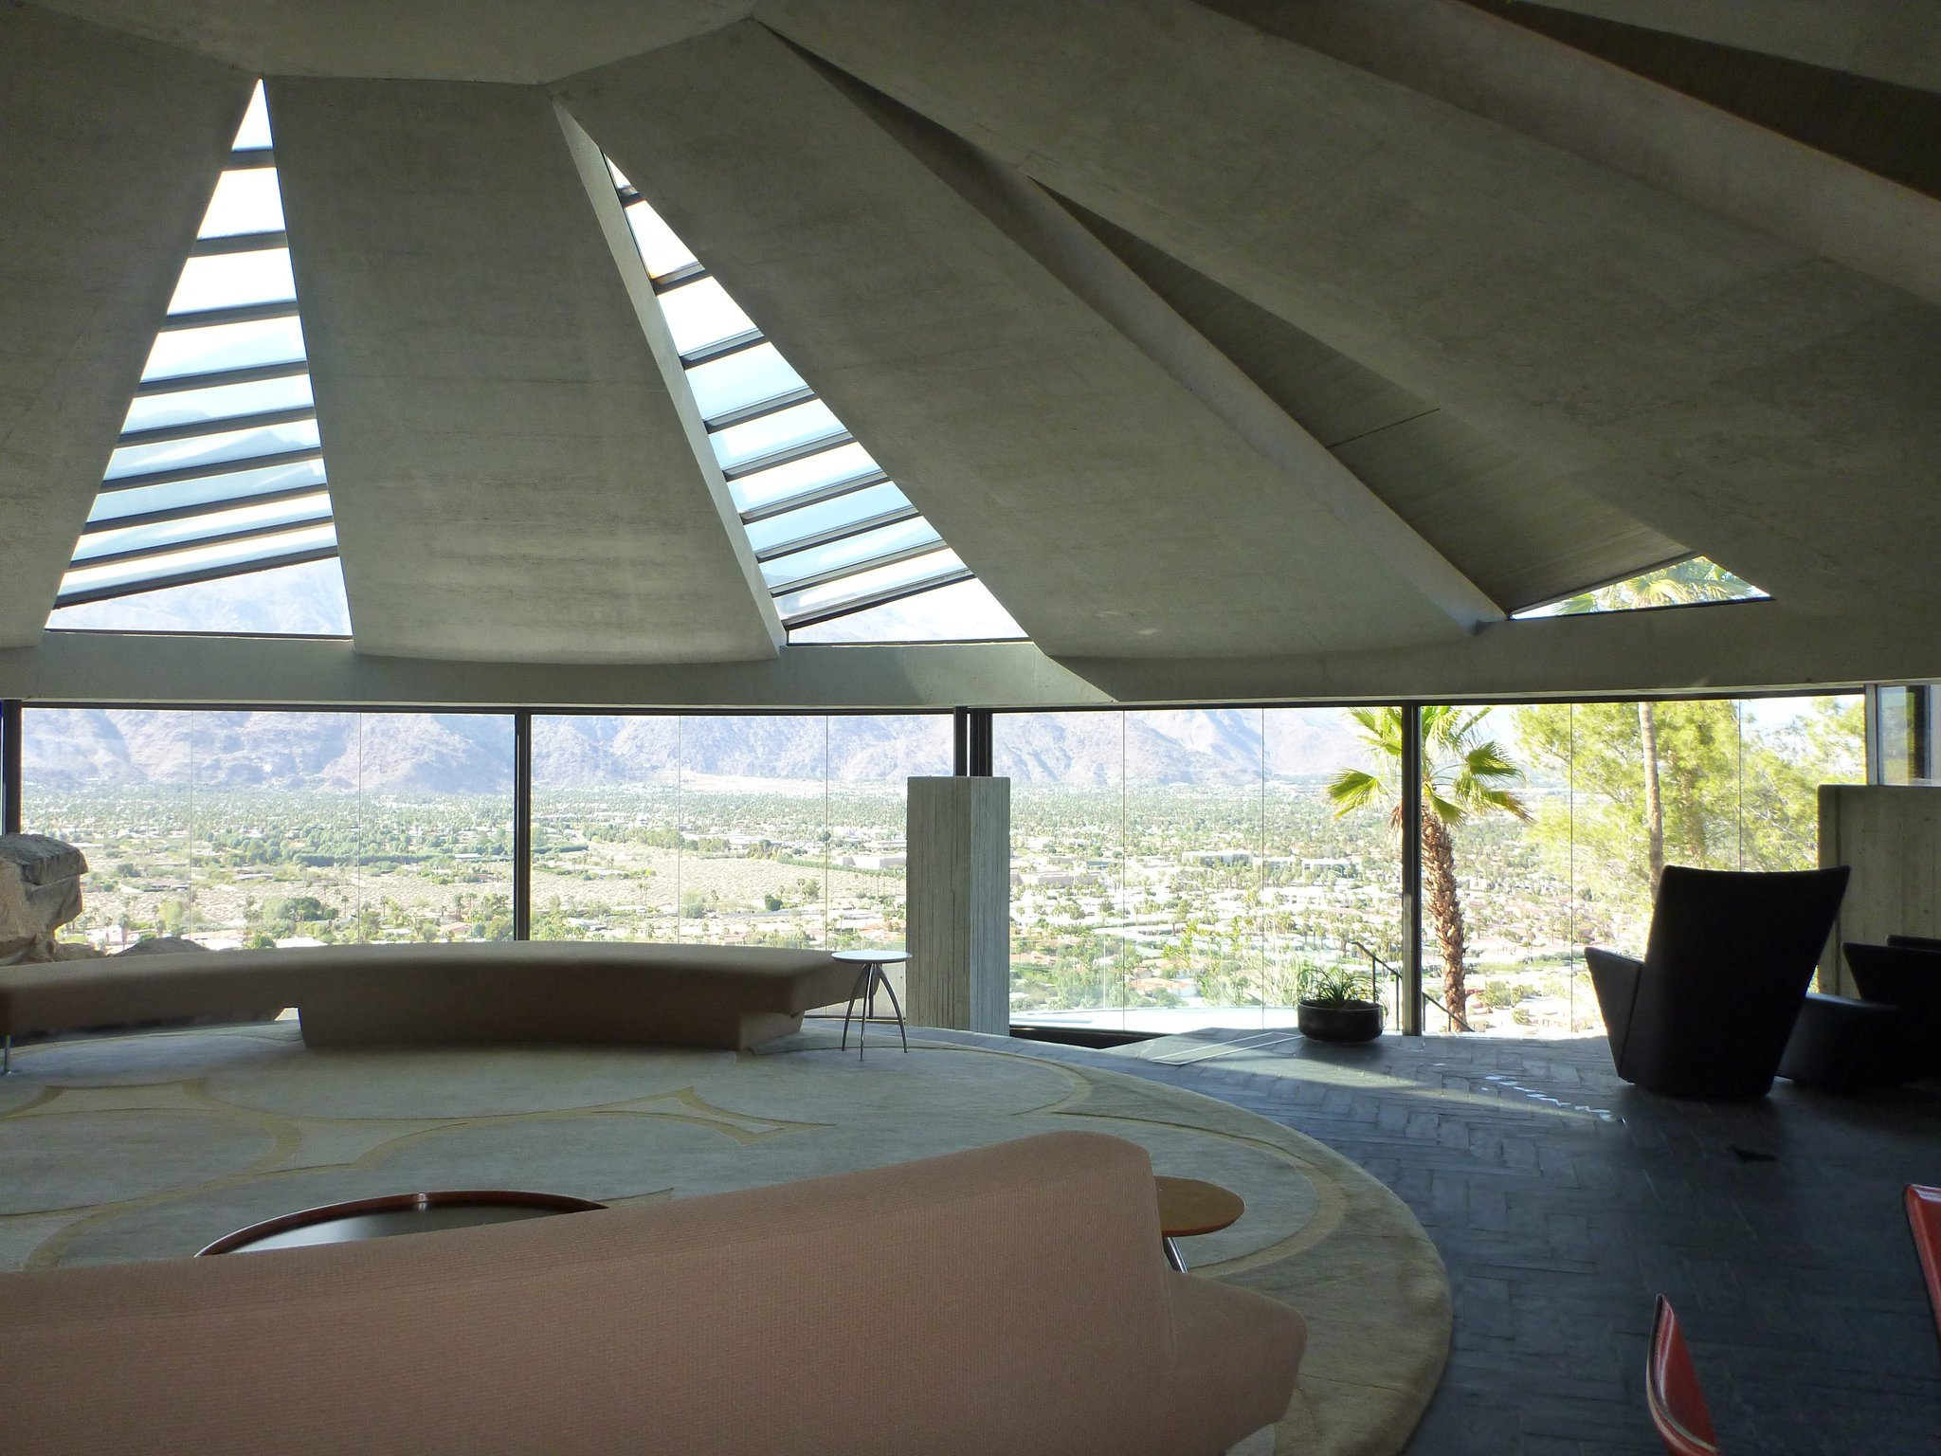
Elrod House, Palm Springs, CA (1969)

Slide 23
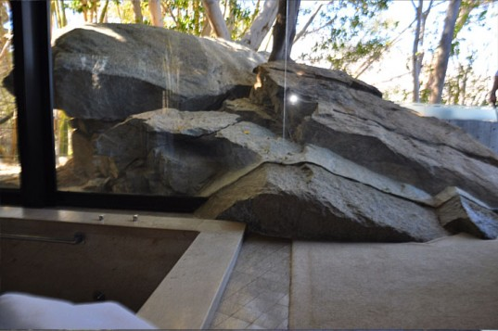
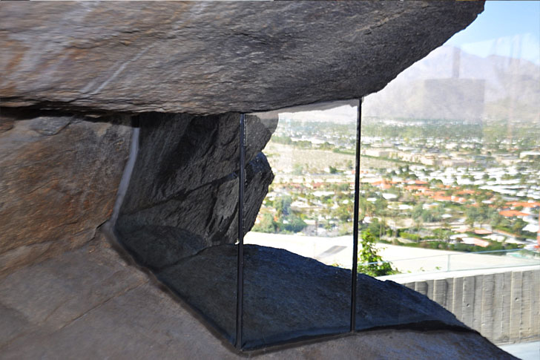
Elrod House, Palm Springs, CA (1969)

Slide 24
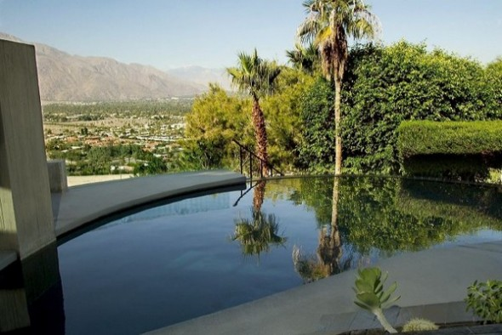
Elrod House, Palm Springs, CA (1969)

Slide 25
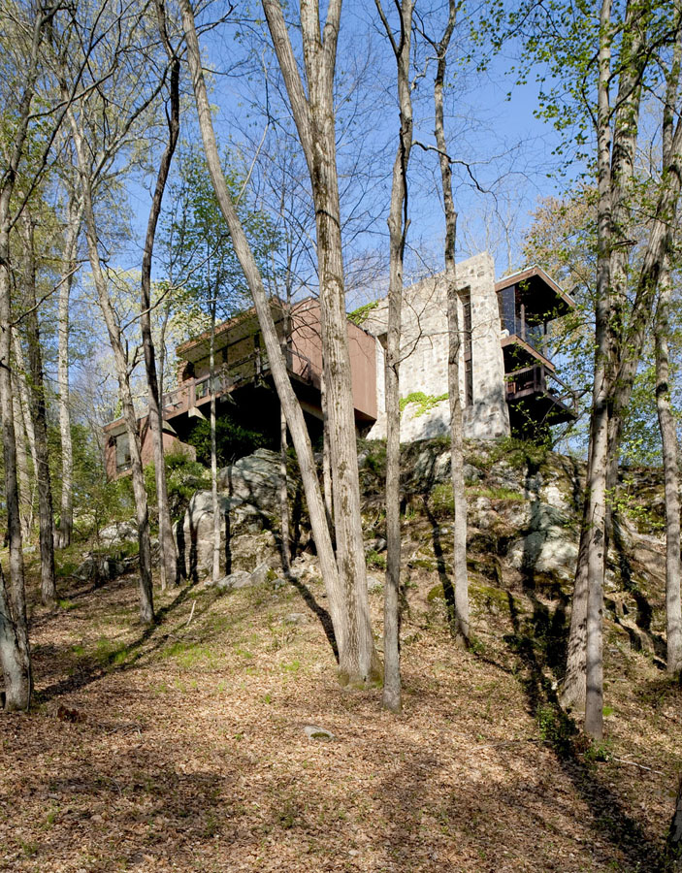
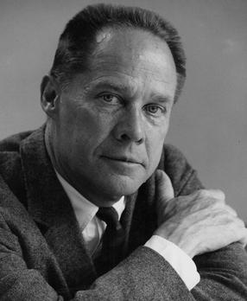
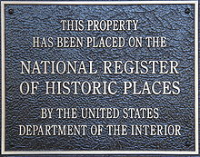
Graham House, Stamford, CT (1969)
Eliot Noyes

Slide 26
Graham House, Stamford, CT (1969)
It is the work of the architect Eliot Noyes.
The house consists of two stone and concrete walls that create a central corridor with cantilevered rooms outside the walls, floating over the landscape with views defined by carefully placed windows.
The exterior appears to emerge from the natural rock outcrop of the site and incorporates stone from the old field stone walls on the property, large windows and dark green paneling.

Slide 27
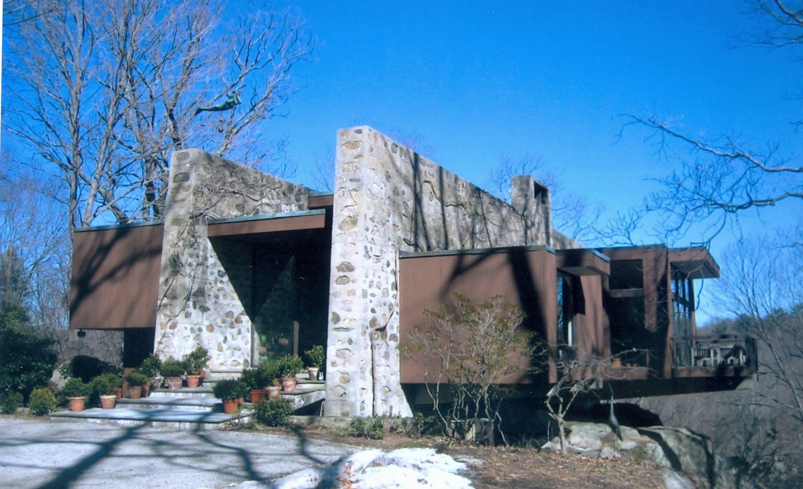
Graham House, Stamford, CT (1969)

Slide 28
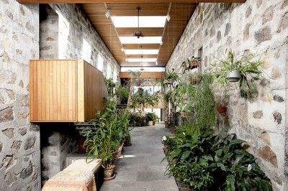
Graham House, Stamford, CT (1969)

Slide 29
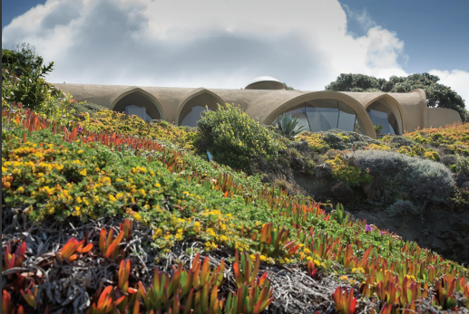
Haas House, Carmel, CA (1969)
Mark Mills

Slide 30
Haas House, Carmel, CA (1969)
It is the work of the architect Mark Mills.
June Haas, the former owner, requested plenty of natural light, and views of the rugged terrain, tide pools, sunsets and the open ocean. Mills’ solution was a cruciform plan of intersecting barrel vaults and large bay windows.
The architect used a more economical technique of spraying gunite 3 inches thick over elastomeric webbing. The shell was then coated with a preservative mixture containing rough-ground walnut shells for texture, providing unique and effective insulation.

Slide 31
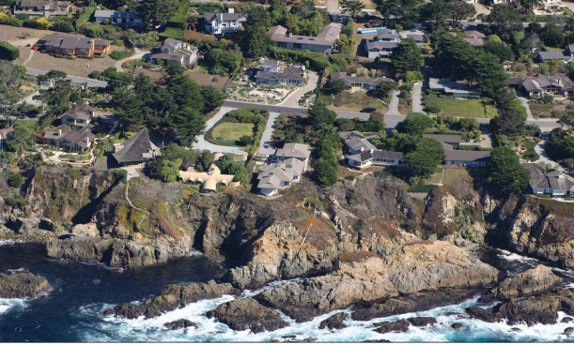
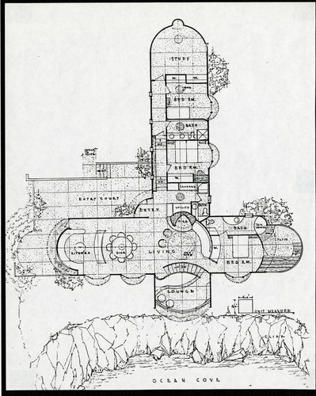
Haas House, Carmel, CA (1969)

Slide 32
Haas House, Carmel, CA (1969)

Slide 33
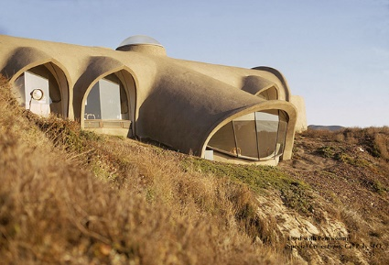
Haas House, Carmel, CA (1969)

Slide 34
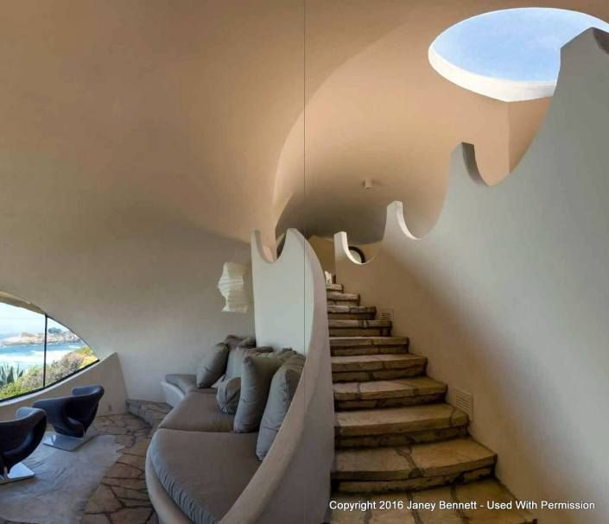
Haas House, Carmel, CA (1969)

Slide 35
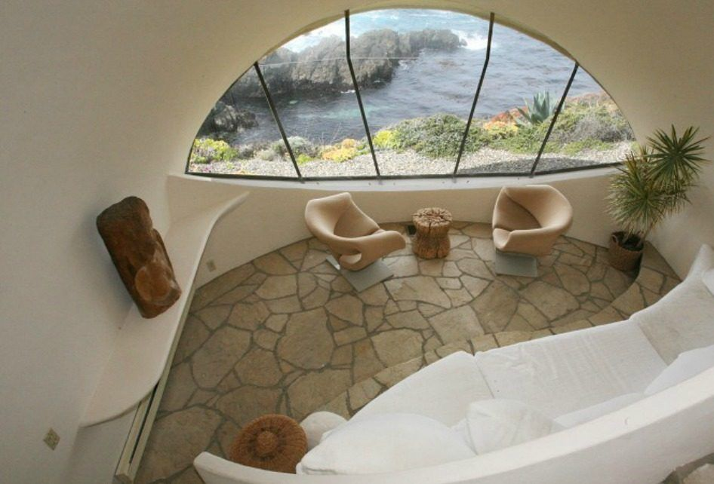
Haas House, Carmel, CA (1969)

Slide 36
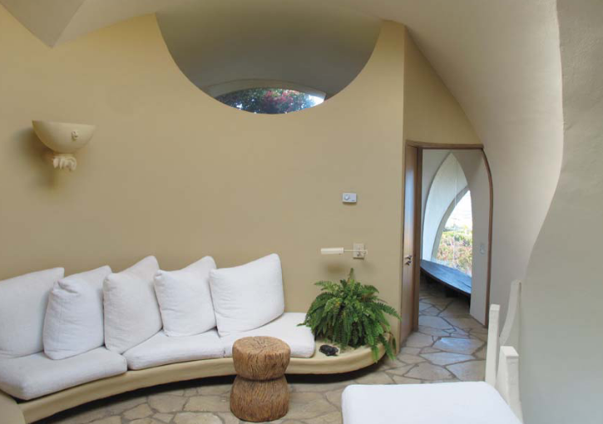
Haas House, Carmel, CA (1969)

Slide 37
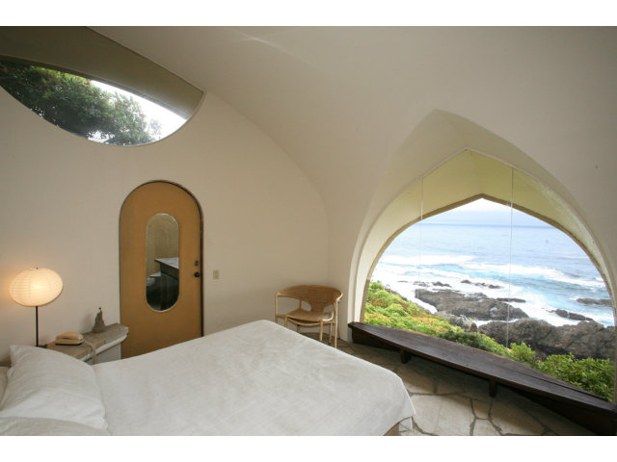
Haas House, Carmel, CA (1969)

Slide 38
Haas House, Carmel, CA (1969)

Slide 39
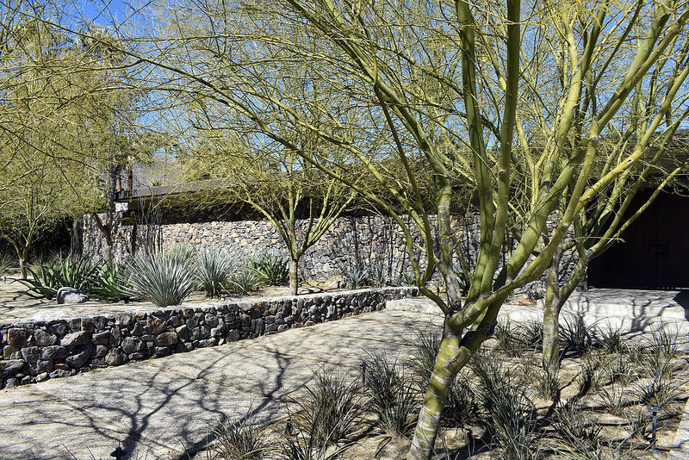
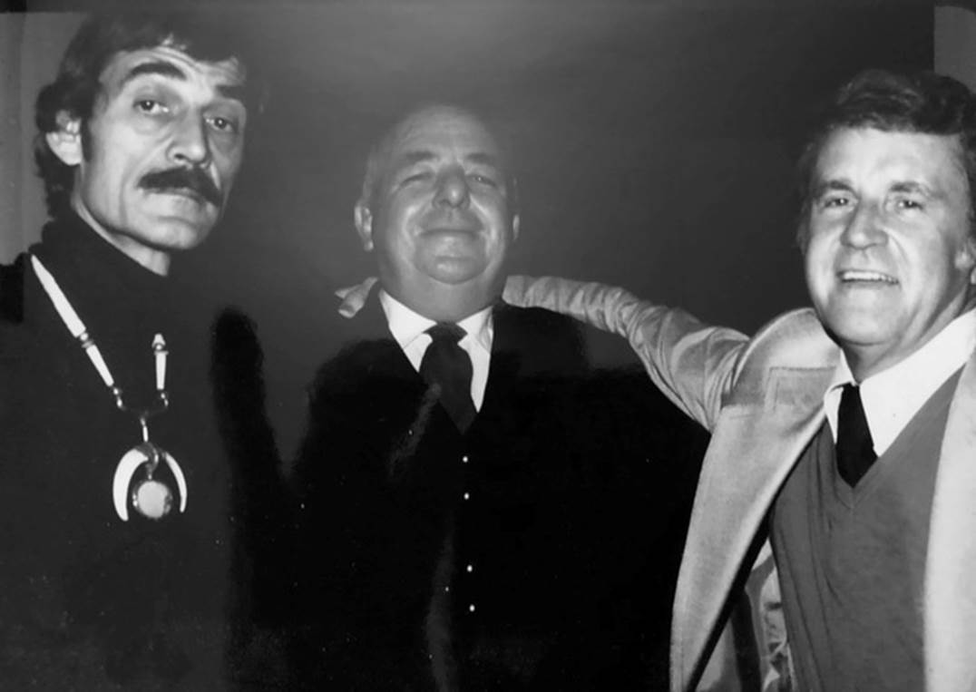
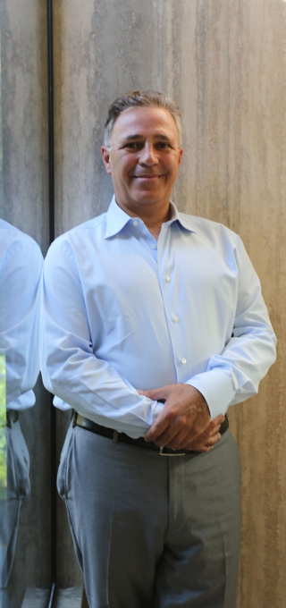
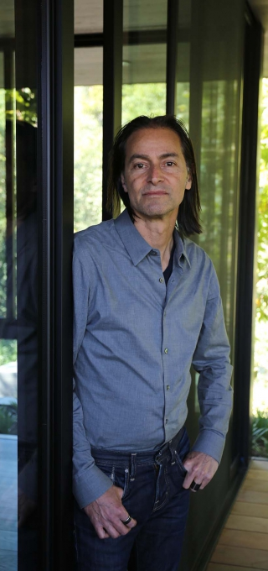
Harvey House, Palm Springs, CA (1969)
Buff, Straub, Hensman
L. Marmol
R. Radziner

Slide 40
Harvey House, Palm Springs, CA (1969)
It is the work of the architects Conrad Buff, Dennis Straub, and Don Hensman. Its original design was restored by Marmol Radziner firm.
As big as the compound is, little of it can be seen from the street—only a long, low stone wall and two seemingly impenetrable front doors.
Buff & Hensman were known for post-and-beam houses, so the spirit of this home lay in the rhythm of its skeleton, which Marmol Radziner emphasized by changing its outlines from white to brown-black. Radziner was also fascinated by how the plan pushed indoor-outdoor living “to the limit.” By using the same terrazzo floor inside and out, Radziner wove the two together more tightly than ever.

Slide 41
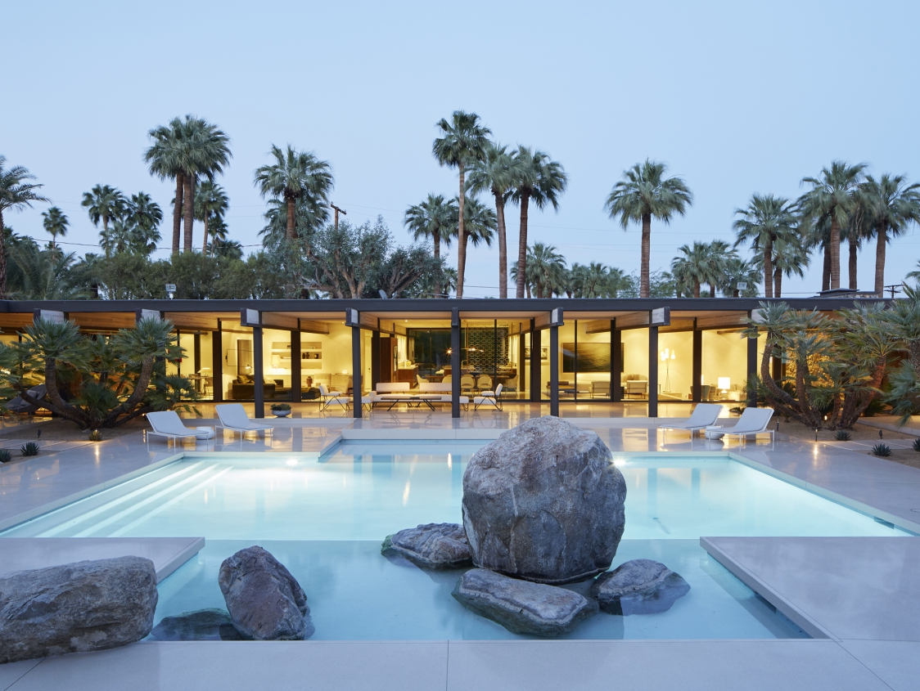
Harvey House, Palm Springs, CA (1969)

Slide 42
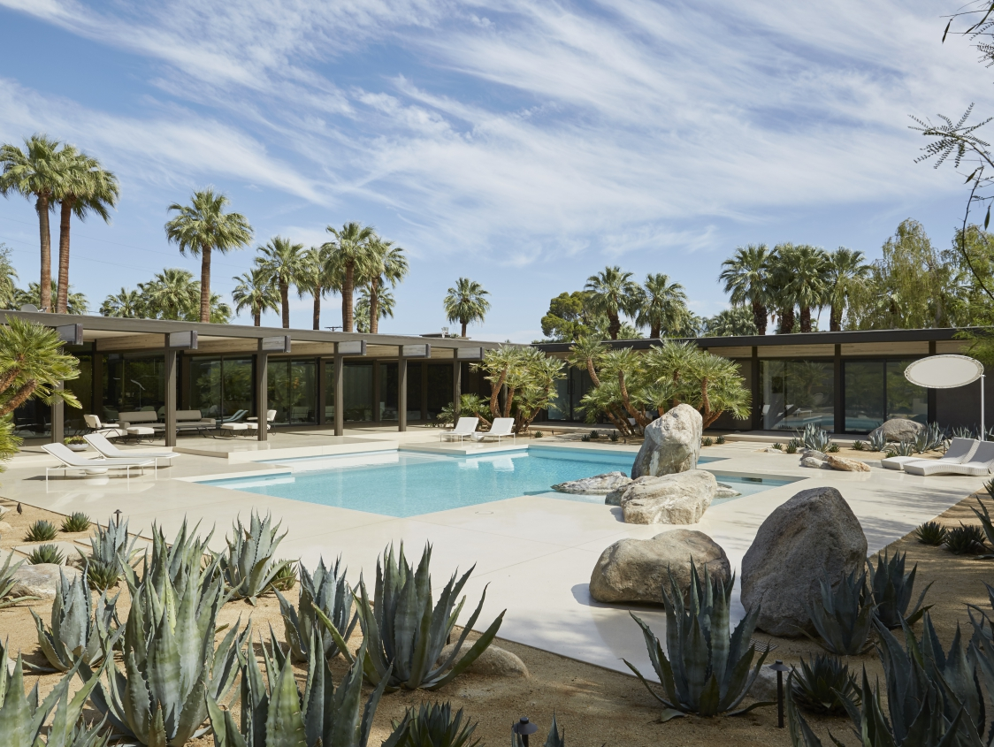
Harvey House, Palm Springs, CA (1969)

Slide 43
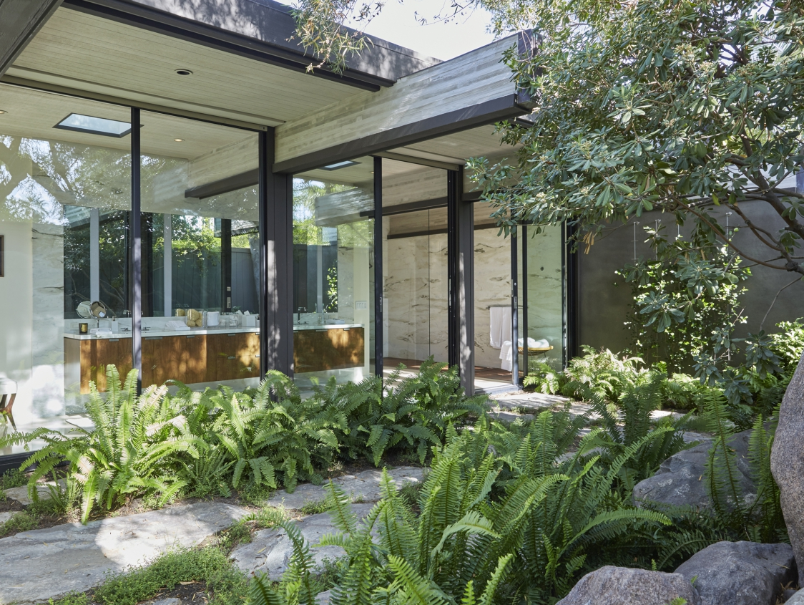
Harvey House, Palm Springs, CA (1969)

Slide 44
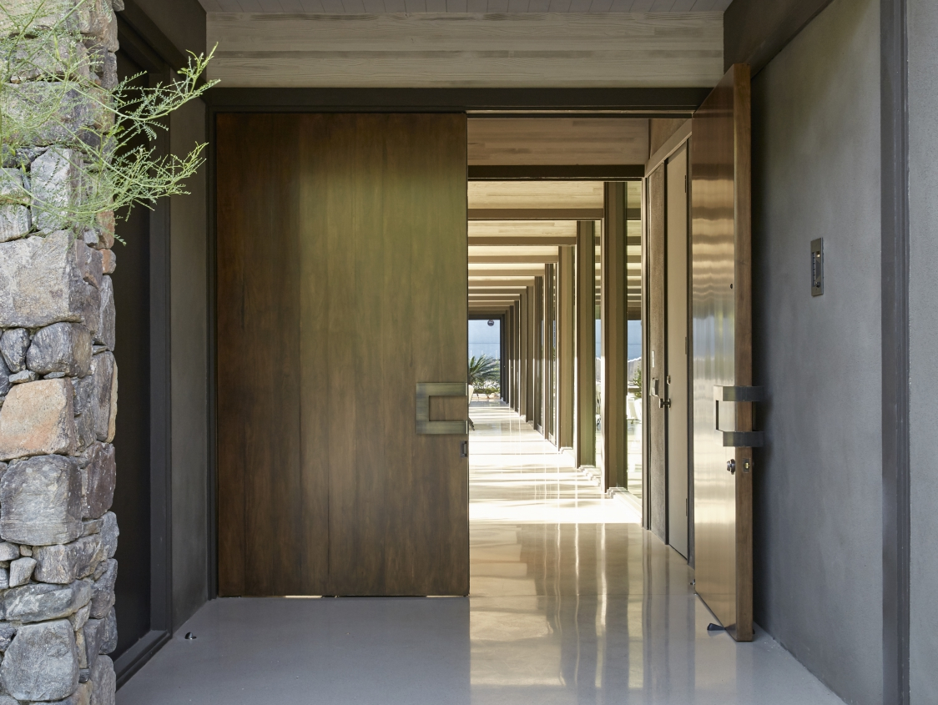
Harvey House, Palm Springs, CA (1969)

Slide 45
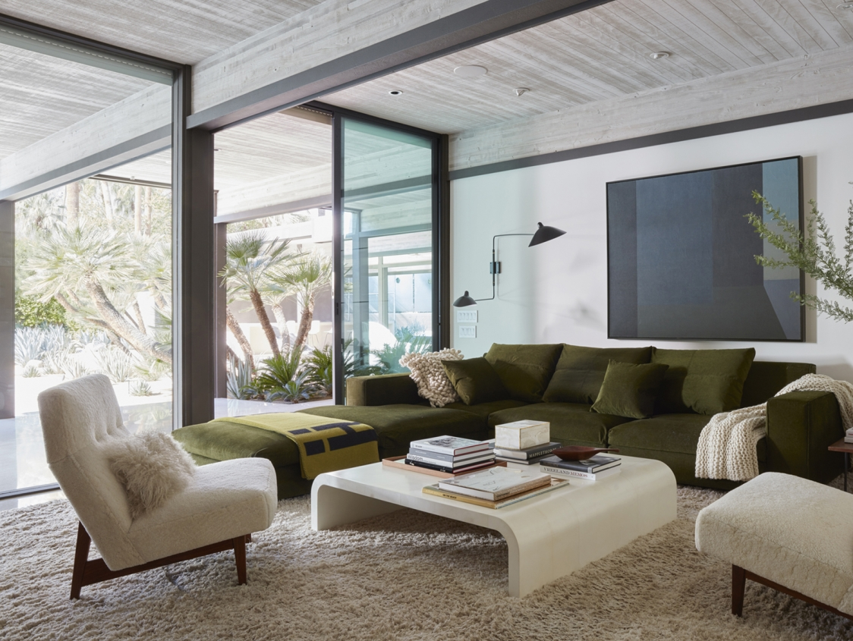
Harvey House, Palm Springs, CA (1969)

Slide 46
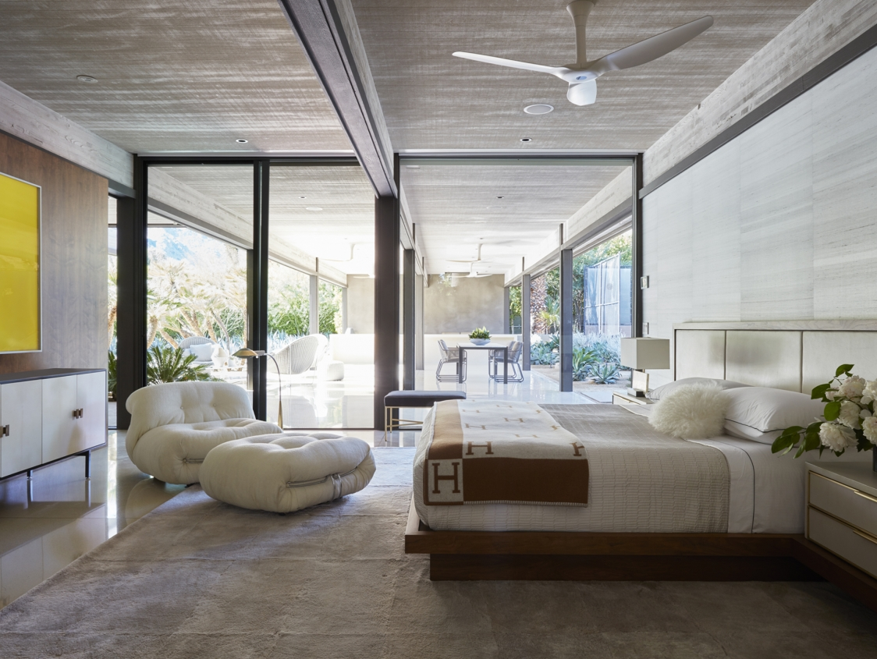
Harvey House, Palm Springs, CA (1969)

Slide 47
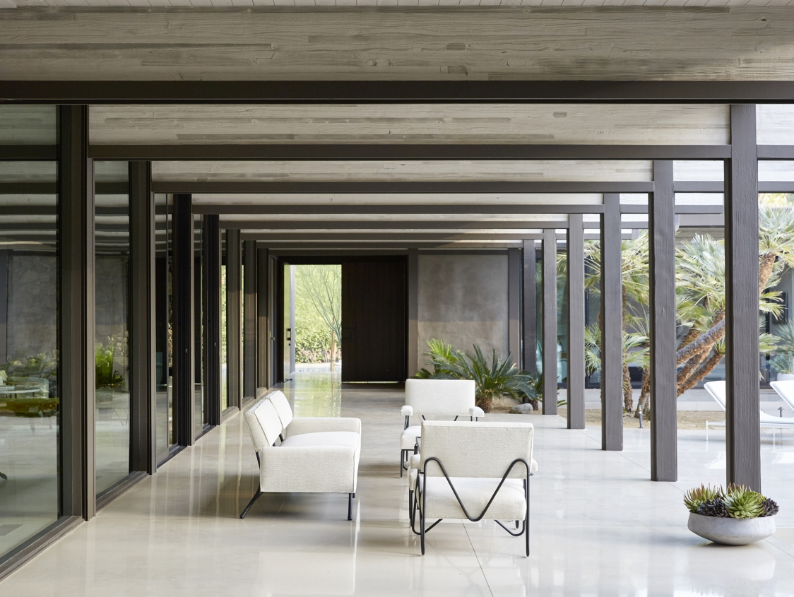
Harvey House, Palm Springs, CA (1969)

Slide 48
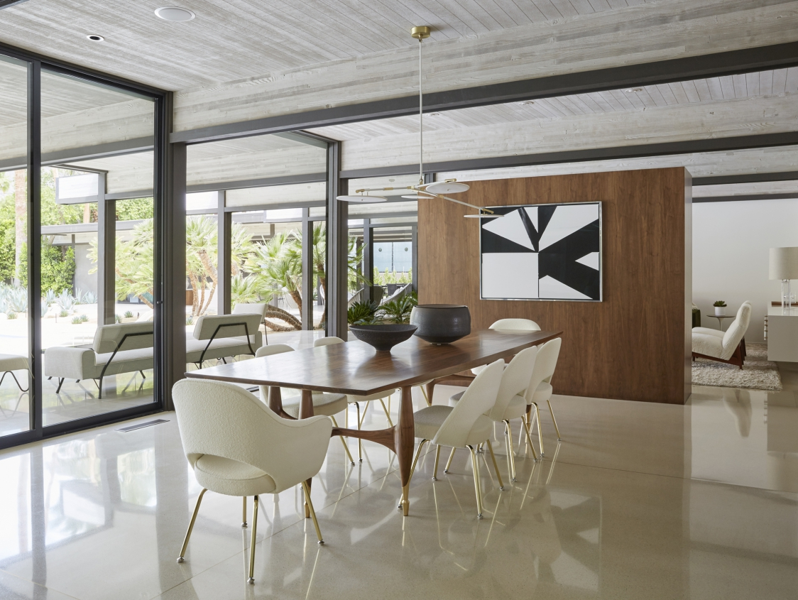
Harvey House, Palm Springs, CA (1969)

Slide 49
Harvey House, Palm Springs, CA (1969)

Slide 50
Harvey House, Palm Springs, CA (1969)

Slide 51
Harvey House, Palm Springs, CA (1969)

Slide 52
Harvey House, Palm Springs, CA (1969)

Slide 53
Deane Residence, Great Neck, NY (1969)
Paul Rudolph

Slide 54
Deane Residence, Great Neck, NY (1969)
It is the work of the architect Paul Rudolph.
All aspects of its design come from a single geometric figure. Each module is built with 2x12 bolted wood. The frame is repeated at regular intervals of 4 feet along its entire length and rests on vertical Y-shaped supports. The walls are made of plywood coated with a cementitious binder.
The interior spaces are divided into 3 distinct zones: family rooms on one side, kitchen on the other surround a central living space.

Slide 55
Deane Residence, Great Neck, NY (1969)
Two bars of smaller programmatic elements (bedrooms, kitchen, and service area) frame an expansive central living space. Family bedrooms form one side of the house, with a master suite below and children’s rooms above. Kitchen and service areas—the house was designed for live-in help—form the opposite volume.
All wall surfaces are coated with the same plaster and aggregate, both inside and outside. Richly embellished surfaces dominate the living room, where an irregular pattern of mirrors reflects light from the clerestory window, and continues into the master suite, with its ribbed copper ceiling.

Slide 56
Deane Residence, Great Neck, NY (1969)

Slide 57
Deane Residence, Great Neck, NY (1969)

Slide 58
Deane Residence, Great Neck, NY (1969)

Slide 59
Deane Residence, Great Neck, NY (1969)

Slide 60
Deane Residence, Great Neck, NY (1969)

Slide 61
Cogswell House, Chapel Hill, NC (1969)
Arthur Cogswell

Slide 62
Cogswell House, Chapel Hill, NC (1969)
It is the own house of the architect Arthur Cogswell
The front living and dining space remain open for entertaining with floor to ceiling views of the courtyard and pool. Uninterrupted wall and ceiling surfaces are made possible by a series of kiosks throughout the home that consolidate equipment and other technology. The addition of ipe, white oak, glass block, and copper amongst others work in concert with the existing steel and concrete to create a balanced material and textural composition.

Slide 63
Cogswell House, Chapel Hill, NC (1969)

Slide 64
Cogswell House, Chapel Hill, NC (1969)

Slide 65
Cogswell House, Chapel Hill, NC (1969)

Slide 66
Cogswell House, Chapel Hill, NC (1969)

Slide 67
Cogswell House, Chapel Hill, NC (1969)

Slide 68
Cogswell House, Chapel Hill, NC (1969)

Slide 69
Cogswell House, Chapel Hill, NC (1969)

Slide 70
Scoren House, Woodside, CA (1969)
Donald Knorr

Slide 71
Scoren House, Woodside, CA (1969)
It is the work of the architect Donald Knorr.
The door is decorated in a distinctly designed pattern, and featuring the letters of Scoren’s surname, in white, black, red and blue, and arranged in a decidedly sixties modernist style. Zooming out, the doors are flanked by two floor-to-ceiling windows, offering full view of the entrance hall and the lounge in the distance. And zooming out further, the entrance is reached across a wide-open courtyard. The minimalist black and white fireplace is set in a chunky dark-polished wooden timber frame—which also provides the structure for the rest of the house. Thanks to the large windows running throughout the property, the corridors are dappled with shadows from the wooded grove surrounding the three-acre property.

Slide 72
Scoren House, Woodside, CA (1969)

Slide 73
Scoren House, Woodside, CA (1969)

Slide 74
Scoren House, Woodside, CA (1969)

Slide 75
Scoren House, Woodside, CA (1969)

Slide 76
Scoren House, Woodside, CA (1969)

Slide 77
Scoren House, Woodside, CA (1969)

Slide 78
Scoren House, Woodside, CA (1969)

Slide 79
Scoren House, Woodside, CA (1969)

Slide 80
Scoren House, Woodside, CA (1969)

Slide 81
Scoren House, Woodside, CA (1969)

Slide 82
Bass Residence, Fort Worth, TX (1970)
Paul Rudolph

Slide 83
Bass Residence, Fort Worth, TX (1970)
It is the work of the architect Paul Rudolph.
The residence was designed to house a complex space program as well as a large contemporary art gallery. Its 4 storeys are broken down into 12 different levels, the interlocking volumes defined by white steel frames and porcelain enamelled aluminium panels. By extending the natural slope of the site inwards, the main living standard is organized into a series of cascading terraces that extend from the kitchen at one end to a suspended pit, the descent of the platforms corresponding to the slope of the site.

Slide 84
Bass Residence, Fort Worth, TX (1970)

Slide 85
Bass Residence, Fort Worth, TX (1970)

Slide 86
Bass Residence, Fort Worth, TX (1970)

Slide 87
Bass Residence, Fort Worth, TX (1970)

Slide 88
Bass Residence, Fort Worth, TX (1970)

Slide 89
Bass Residence, Fort Worth, TX (1970)

Slide 90
Bass Residence, Fort Worth, TX (1970)

Slide 91
Bass Residence, Fort Worth, TX (1970)

Slide 92
Sabel House, Bridgehampton, NY (1970)
Julian & B. Neski
Barbara Neski

Slide 93
Sabel House, Bridgehampton, NY (1970)
It is the work of the architects Julian & Barbara Neski.
The stucco construction, carefully detailed to minimize window and door trim, presents a building whose actual size is revealed only at close range. The elevation, facing the road, is dominated by a flying stairway from the 2nd floor. The two horizontal window bands, assumed to be at eye level, actually are 3 to 4 feet above the floor. The one large room, expressed on the exterior as glazing wrapped around the balcony, seems very spacious. The angled wall on the left side not only helps to increase the mass of t he house from the exterior but substantially extends the sweeping view of the ocean from the living room.

Slide 94
Sabel House, Bridgehampton, NY (1970)

Slide 95
Sabel House, Bridgehampton, NY (1970)

Slide 96
Sabel House, Bridgehampton, NY (1970)

Slide 97
Sabel House, Bridgehampton, NY (1970)

Slide 98
Sabel House, Bridgehampton, NY (1970)

Slide 99
Sabel House, Bridgehampton, NY (1970)

Slide 100
Sabel House, Bridgehampton, NY (1970)

Slide 101
Sabel House, Bridgehampton, NY (1970)

Slide 102
Perlbinder House, Sagaponack, NY (1970)
Norman Jaffe

Slide 103
Perlbinder House, Sagaponack, NY (1970)
It is the work of the architect Norman Jaffe.
All this is sheathed-roof and walls-in cedar shakes, which helps to unify the appearance. To anchor the house solidly to its site, rough-hewn granite is used as a podium, extended to form an entrance court and retaining wall for the living room terrace at the top of the dune. Very out-of-the-ordinary windows are used to give daylight and good views to this rising succession of spaces. At the front of the house, a large window is notched into the facade to give a long down-slope vista from the main stair, and another window /skylight is set in to front wall and roof to give sky views and Iight.

Slide 104
Perlbinder House, Sagaponack, NY (1970)

Slide 105
Perlbinder House, Sagaponack, NY (1970)

Slide 106
Perlbinder House, Sagaponack, NY (1970)

Slide 107
Perlbinder House, Sagaponack, NY (1970)

Slide 108
Perlbinder House, Sagaponack, NY (1970)

Slide 109
Perlbinder House, Sagaponack, NY (1970)

Slide 110
Lovett Cabin, Crane Island, WA (1970)
Wendell Harper Lovett

Slide 111
Lovett Cabin, Crane Island, WA (1970)
It is the work of the architect Wendell Harper Lovett.
The waterfront and view cabins are moved back into the trees with discrete decks and large windows. The cabin is perched above a beach on mossy basalt with the requisite grasses, Doug firs, and peeling madronas. This retreat has lowered its drawbridge of a deck, yet the small cabin itself seems to shyly, yet jauntily, lean back into the forest. A madrona even grows up through the deck. The living space is small; the view maximized.

Slide 112
Lovett Cabin, Crane Island, WA (1970)

Slide 113
Lovett Cabin, Crane Island, WA (1970)

Slide 114
Lovett Cabin, Crane Island, WA (1970)

Slide 115
Lovett Cabin, Crane Island, WA (1970)

Slide 116
Lovett Cabin, Crane Island, WA (1970)

Slide 117
Lovett Cabin, Crane Island, WA (1970)

Slide 118
Goldfinger House, Waccabuc, NY (1970)
Myron Goldfinger

Slide 119
Goldfinger House, Waccabuc, NY (1970)
It is the own house of the architect Myron Goldfinger.
The cedar clad house is so intensely sculptural , inside and out, and so dramatically related to its rocky, wooded site that technical considerations seem to matter little. Since the basic module, 15 ft square was determined by the standard 8x15 ft sliding glass door, Goldfinger has necessarily used one here. This fenestration contributes to the monumental scale of the house. Other modules, if needed, may be added just as gracefully in the future. The clockwise descending spiral of space is shown as is the modular construction.

Slide 120
Goldfinger House, Waccabuc, NY (1970)

Slide 121
Goldfinger House, Waccabuc, NY (1970)

Slide 122
Goldfinger House, Waccabuc, NY (1970)

Slide 123
Goldfinger House, Waccabuc, NY (1970)

Slide 124
Goldfinger House, Waccabuc, NY (1970)

Slide 125
Pack House, Denning, NY (1970)
M. Growald
H. Bates

Slide 126
Pack House, Denning, NY (1970)
It is the work of the architects Martin Growald & Harry Bates.
The house is of monolithic reinforced concrete. The forms were untreated 4-by 8-f sheets of plywood, although the several horizontal pour lines are not necessarily 8 f apart. No attempt was made to smooth away the beads caused by seepage between forms and tie rods were simply snapped off and the holes left unfilled. The central skylight also serves as a ventilator since the house is not air-conditioned. The interiors are finished simply but with elegant materials. All interior walls and ceilings are sand-textured unpainted plaster. The ground floor is covered wit h 3/4-inch thick travertine and the second floor with wool carpeting.

Slide 127
Pack House, Denning, NY (1970)

Slide 128
Pack House, Denning, NY (1970)

Slide 129
Pack House, Denning, NY (1970)

Slide 130
Falk House, Harwick, VT (1970)
Peter Eisenman

Slide 131
Falk House, Harwick, VT (1970)
It is the work of the architect Peter Eisenman.
The structure consists of steel columns and girders with non-bearing wood-frame walls, as for House I. The exterior wood siding is painted white, as are the plaster walls, ceilings and wood of the interior. The ground floor is the living area. The second level, the private level, is divided into three areas of identical width, each area being two steps higher than the previous one. All of the second floor rooms have skylights.

Slide 132
Falk House, Harwick, VT (1970)

Slide 133
Falk House, Harwick, VT (1970)

Slide 134
Falk House, Harwick, VT (1970)

Slide 135
Falk House, Harwick, VT (1970)

Slide 136
Falk House, Harwick, VT (1970)

Slide 137
Falk House, Harwick, VT (1970)

Slide 138
Falk House, Harwick, VT (1970)

Slide 139
Shafer House, Annandale, NY (1970)
James Baker

Slide 140
Shafer House, Annandale, NY (1970)
It is the work of the architect James B. Baker.
The powerful geometry of the cube, unexpected in a rural place, overrides simple construction techniques plywood on a steel and wood frame. The 45-degree glazed corners enable a person standing next to the center-post o f the house on the mezzanine to look out of the dining room window and see the stream approaching. From the entry, one goes down half-a-flight on the suspended plywood stair, top to the living room or up to the dining room.

Slide 141
Shafer House, Annandale, NY (1970)

Slide 142
Shafer House, Annandale, NY (1970)

Slide 143
Shafer House, Annandale, NY (1970)

Slide 144
Shafer House, Annandale, NY (1970)

Slide 145
Shafer House, Annandale, NY (1970)

Slide 146
Menkick House, Boulder, CO (1970)
Charles Haertling

Slide 147
Menkick House, Boulder, CO (1970)
It is the work of the architect Charles Haertling.
This 5,780-sqf property has earned its legendary reputation from the home’s seamless integration with Gyp Rock, a natural rock formation that looms large on the 1.1-acre site. Haertling masterfully matched the 4-story home to the boulder’s three peaks and used a natural material palette to reinforce ties with the landscape. Drawing from Usonian influences, the Menkick House embraces the indoor/outdoor lifestyle with a variety of exterior living spaces, as well as full-height glazed windows and doors. The light-filled family home is faced with southern exposure glass as well as clerestory windows on the west and north sides of the property.

Slide 148
Menkick House, Boulder, CO (1970)

Slide 149
Menkick House, Boulder, CO (1970)

Slide 150
Menkick House, Boulder, CO (1970)

Slide 151
Menkick House, Boulder, CO (1970)

Slide 152
Menkick House, Boulder, CO (1970)

Slide 153
Menkick House, Boulder, CO (1970)

Slide 154
Menkick House, Boulder, CO (1970)

Slide 155
Menkick House, Boulder, CO (1970)

Slide 156
Kahn House, Boulder, CO (1970)
Charles Haertling

Slide 157
Kahn House, Boulder, CO (1970)
It is the work of the architect Charles Haertling.
The living and dining rooms cantilever out the slope. Straw-colored eaves and ledges match the interior paint, emphasizing the flow between inside and outside. The Kahn house’s monumental, dominant view over Boulder is more akin to a raptor nest in the Flatirons than any suburban front porch.

Slide 158
Kahn House, Boulder, CO (1970)

Slide 159
Kahn House, Boulder, CO (1970)

Slide 160
Kahn House, Boulder, CO (1970)

Slide 161
Kahn House, Boulder, CO (1970)

Slide 162
Kahn House, Boulder, CO (1970)

Slide 163
Kahn House, Boulder, CO (1970)

Slide 164
Haas House, Carmel, CA (1969)
THE END

