Slide 1
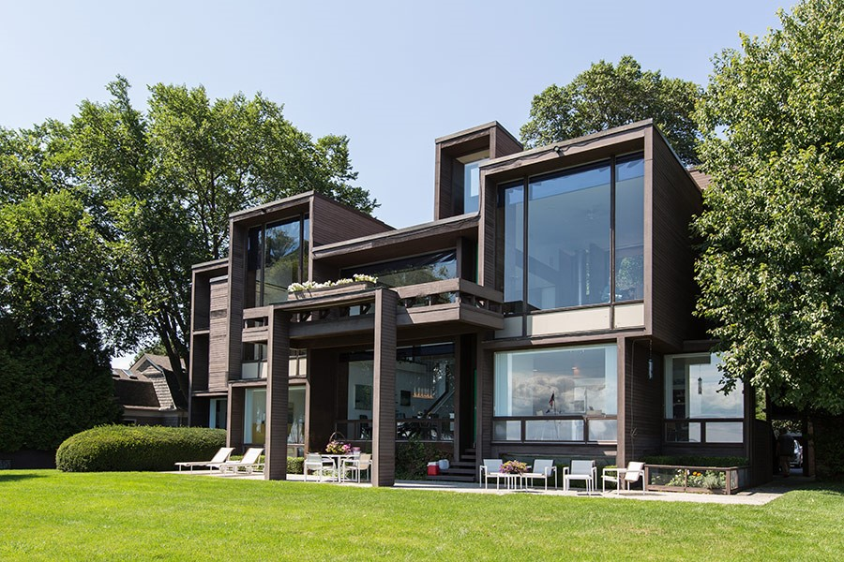
US. Modernist Houses
1967

Slide 2
US Modernist Houses 1967
The purpose of this presentation is to show you the most outstanding Modern Movement inspired houses in the United States by great architects.
Some of them have become icons of contemporary architecture (members of the iconic.org network) and are recognized and protected as such.
They remain unique either by their constructive principle, or by their location, or by their theoretical importance, or by their perfect integration into the landscape.

Slide 3
US Modernist Houses
Many of the houses presented in this slide show (before the year 2000) were found on the OfHouses website (Old Forgotten Houses) which lists houses with architectural interest or singular architecture around the world with many illustrations. If they are shown here, it is because they are already considered as iconic.

Slide 4
US Modernist Houses
Hoffman House, Richard Meier, NY.
Melvin Dwork House, Harry Bates, NY.
Kappe House, Ray Kappe, CA.
Parcells House, Paul Rudolph, MI.
Epstein House, Tony Grunsfeld, IL.
Avery House, Haywood & Oxenfeld, NC.
Fisher House, Louis Kahn, PA.

Slide 5
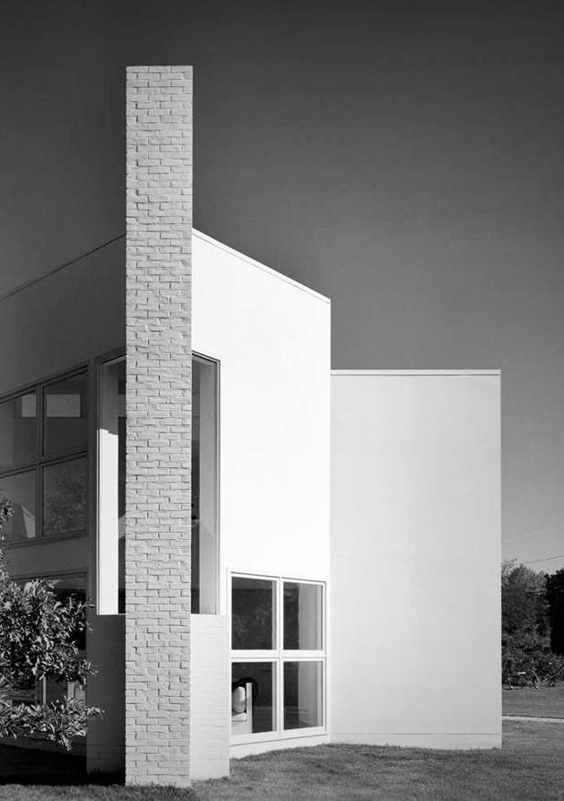
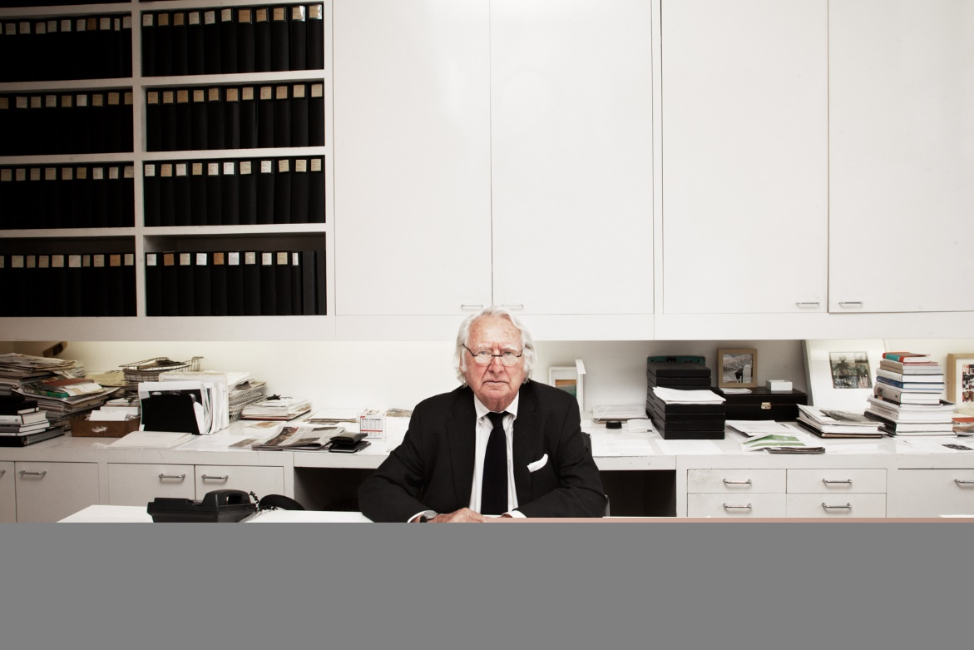
Hoffman House, East Hampton, NY (1967)
Richard Meier

Slide 6
Hoffman House, East Hampton, NY (1967)
It is the work of the architect Richard Meier.
Two sets of double squares make up the plan: one set orthogonal, the other rotated 45 degrees at the entry point. This produces 2 interlocking forms, one parallel to the road, and the other diagonal to it. The intersecting wall planes facing the road serve as an opaque screen, concealing the living space from passing traffic. To the west, the fireplace with its freestanding chimney is pulled out from the glazed corner of the house. The living room is a triangular space defined by columns supporting a balcony, which acts as a canopy over the main seating area. Light enters this space from three sources: the main glazing and two clerestory windows set above the second-story bedrooms.

Slide 7
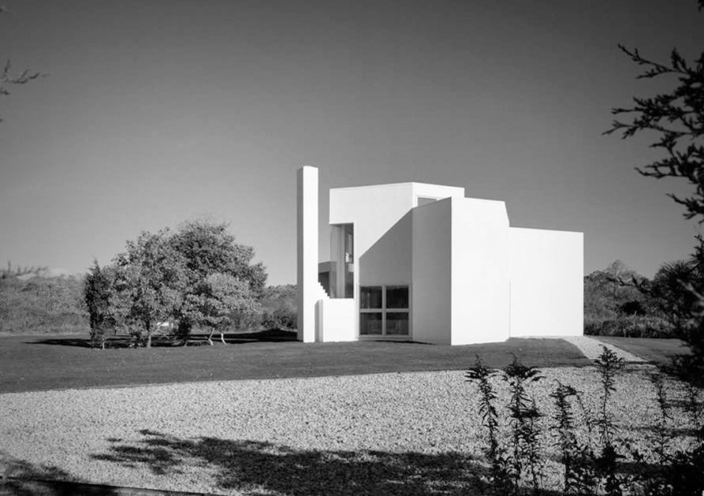
Hoffman House, East Hampton, NY (1967)

Slide 8
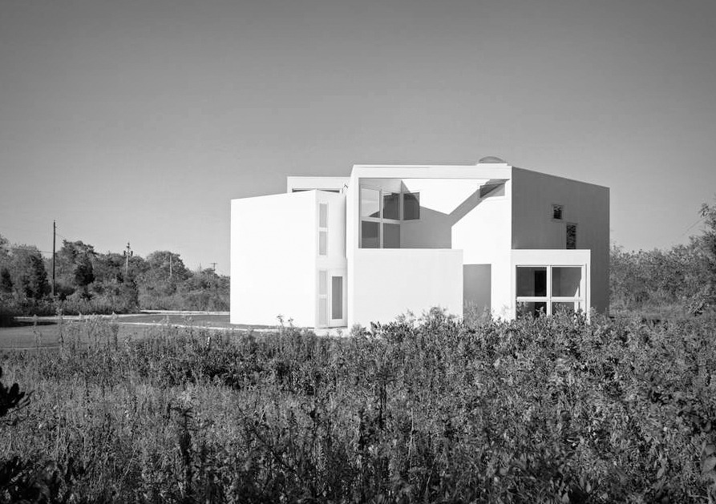
Hoffman House, East Hampton, NY (1967)

Slide 9
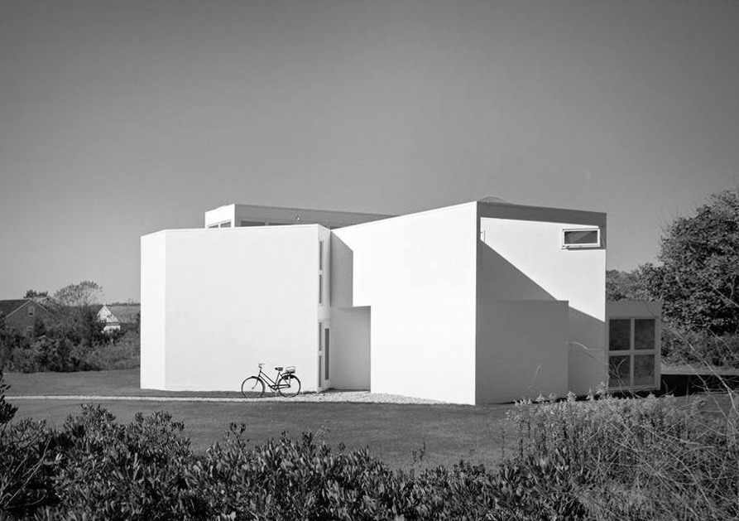
Hoffman House, East Hampton, NY (1967)

Slide 10
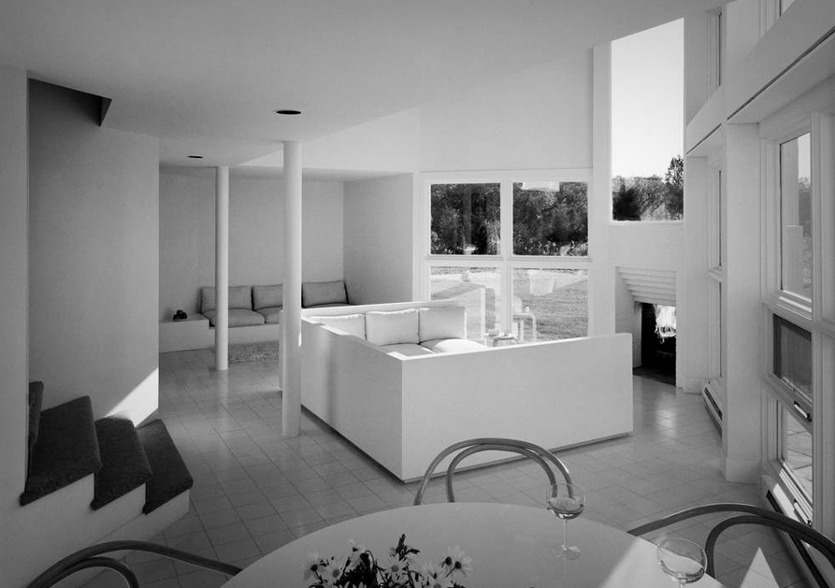
Hoffman House, East Hampton, NY (1967)

Slide 11
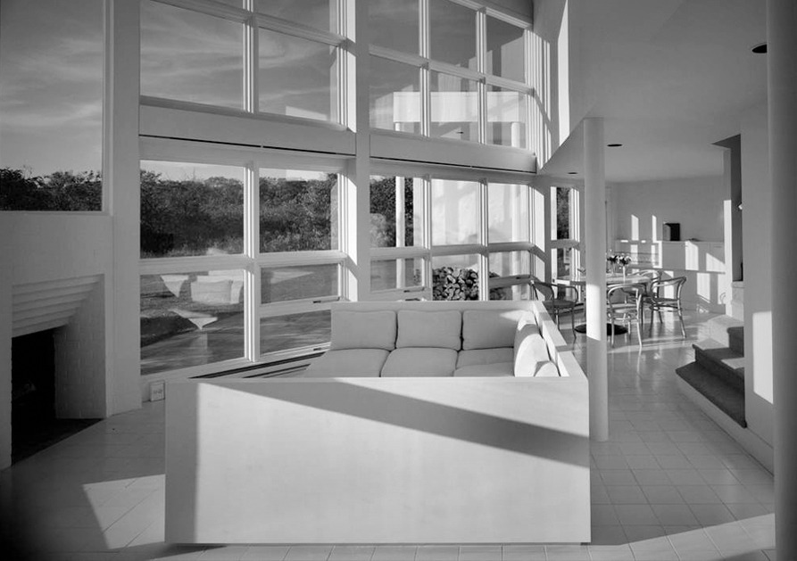
Hoffman House, East Hampton, NY (1967)

Slide 12
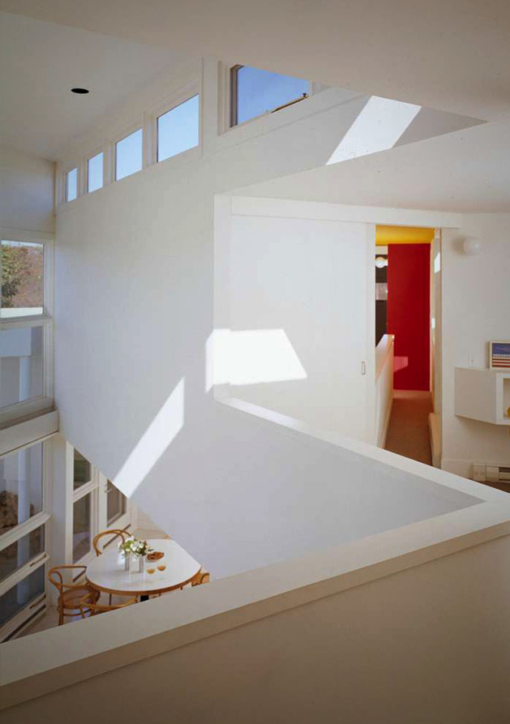
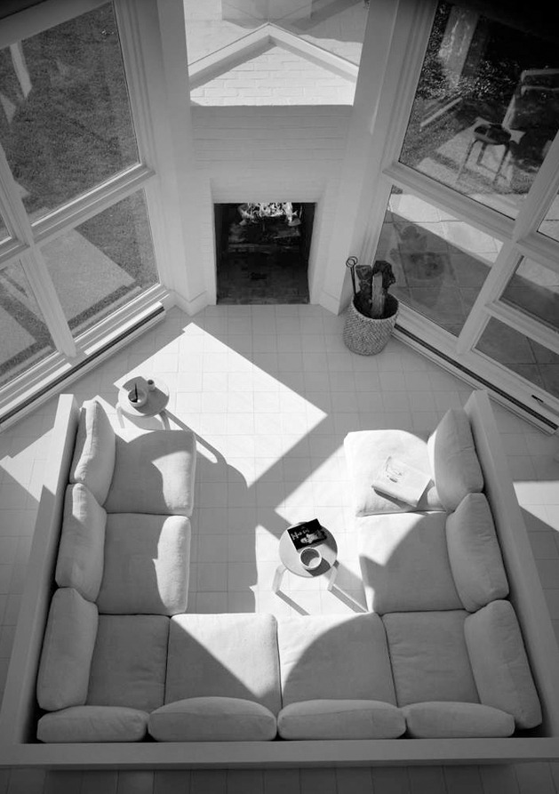
Hoffman House, East Hampton, NY (1967)

Slide 13
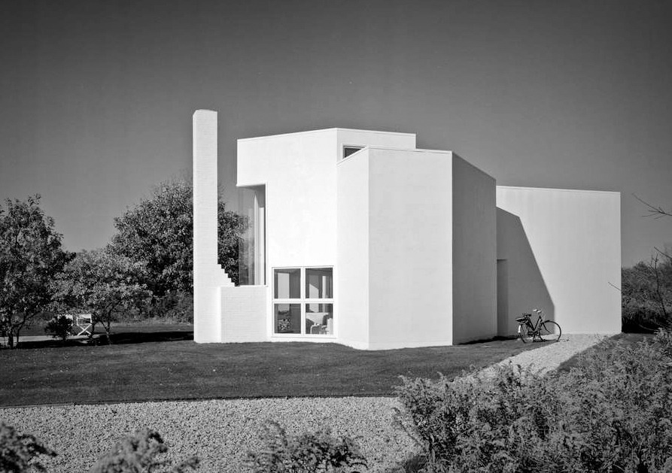
Hoffman House, East Hampton, NY (1967)

Slide 14
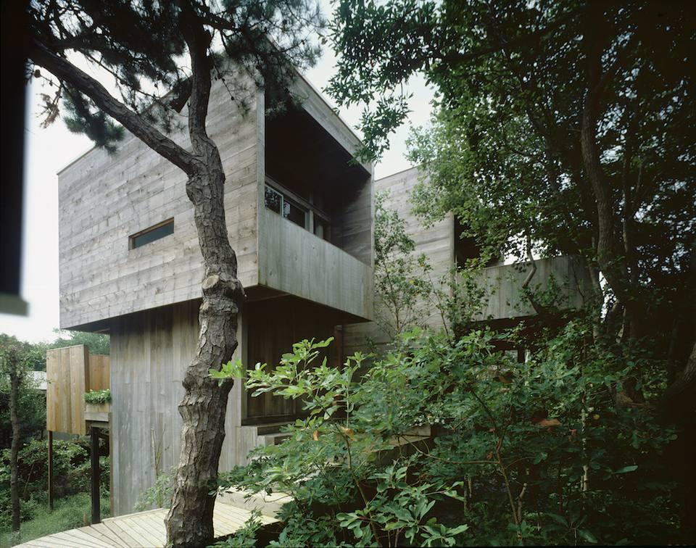
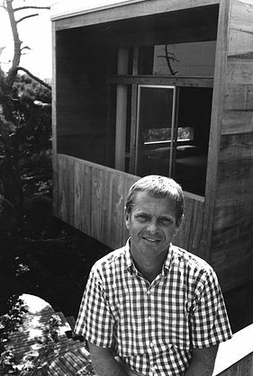
Melvin Dwork House, Fire Island, NY (1967)
Harry Bates

Slide 15
Melvin Dwork House, Fire Island, NY (1967)
It's the work of architect Harry Bates.
In search of privacy and views over the bay on a corner lot dotted with pine and cypress trees, Bates designed a perched cabin with raised public spaces and minimal side windows. What could be likened to a brutalist structure is in fact softened by cypress cladding. Inside, whitened oak floors combined with black and white furniture are in harmony with the elegance of the house.

Slide 16
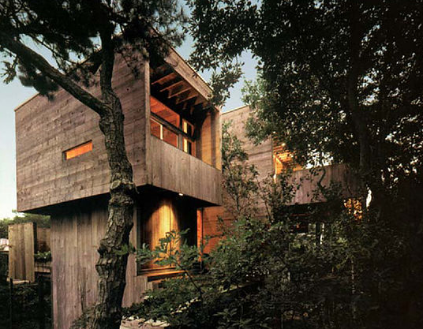
Melvin Dwork House, Fire Island, NY (1967)

Slide 17
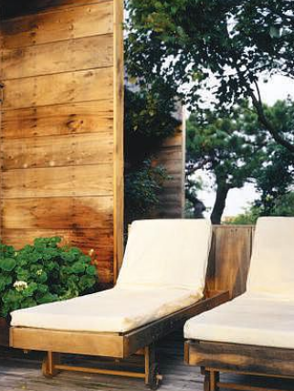
Melvin Dwork House, Fire Island, NY (1967)

Slide 18
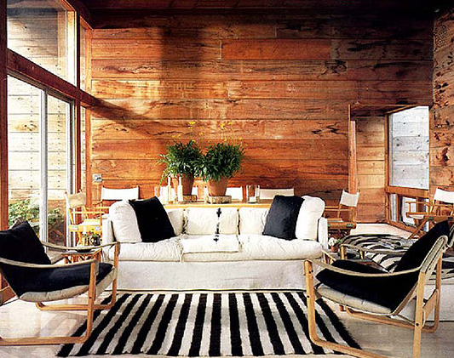
Melvin Dwork House, Fire Island, NY (1967)

Slide 19
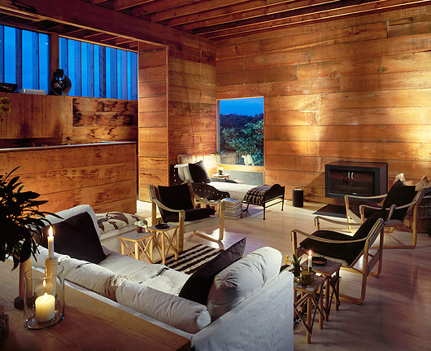
Melvin Dwork House, Fire Island, NY (1967)

Slide 20
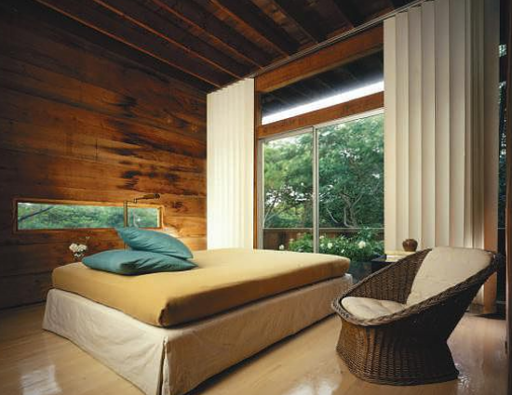
Melvin Dwork House, Fire Island, NY (1967)

Slide 21
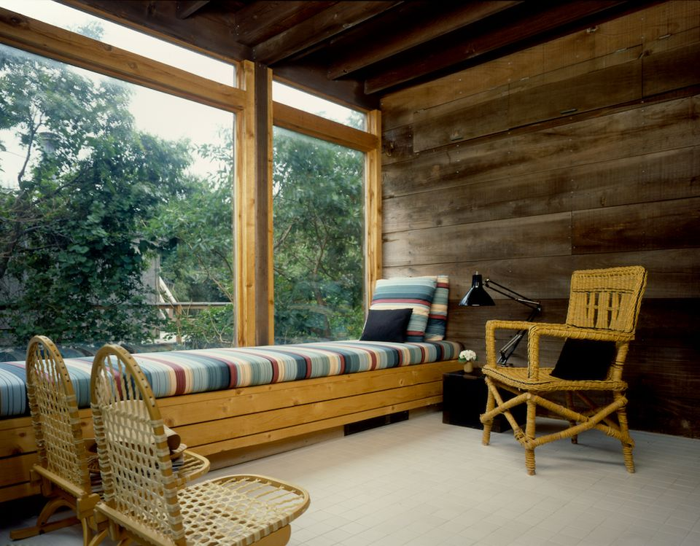
Melvin Dwork House, Fire Island, NY (1967)

Slide 22
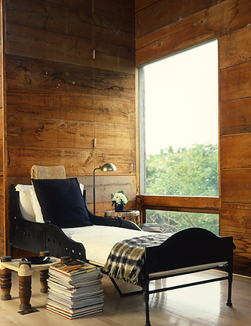
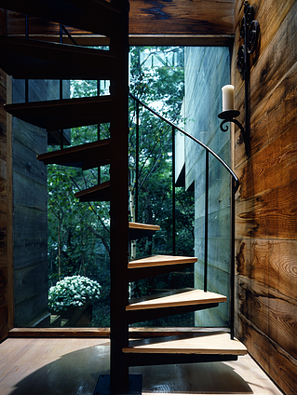
Melvin Dwork House, Fire Island, NY (1967)

Slide 23
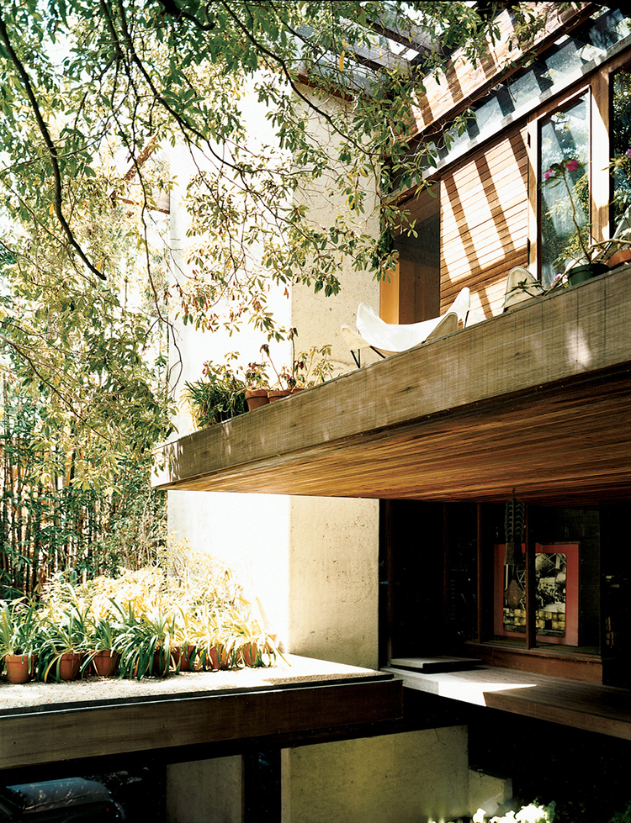
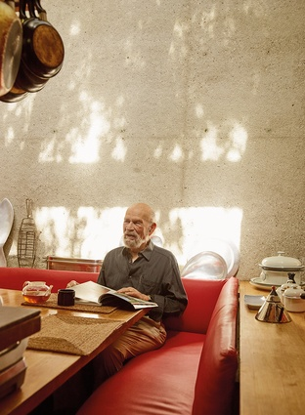
Kappe House, Pacific Palisades, CA (1967)
Raymond Kappe

Slide 24
Kappe House, Pacific Palisades, CA (1967)
It is the personal home of Raymond Kappe.
From the front of the house, visitors enter over a bridge that crosses an above-ground stream and arrive at the stairwell. Kappe raised the house on six concrete towers covering just 600 square feet.
The towers are naturally-lit by skylights and hold their own living spaces: a stairwell, bathrooms, a sunken study and fireplace for the master, and a dining nook.

Slide 25
Kappe House, Pacific Palisades, CA (1967)
Stairs lead up to Kappe's study and then to the multi-sectioned public spaces: there're 2 living rooms, a kitchen, and a dining room, at staggered heights across a 75 foot space. The private living areas run perpendicular to the main area--the children's/guest bedrooms (and now an office) toward the back of the site and the master toward the front.
The outdoor spaces are just as layered: there's a garden off the carport, a cantilevered deck extending from the lower living room. The whole site is dense with sycamore, eucalyptus, and oak trees.

Slide 26
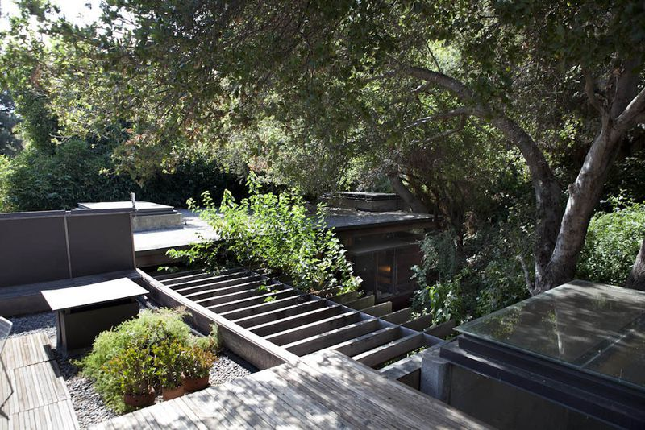
Kappe House, Pacific Palisades, CA (1967)

Slide 27
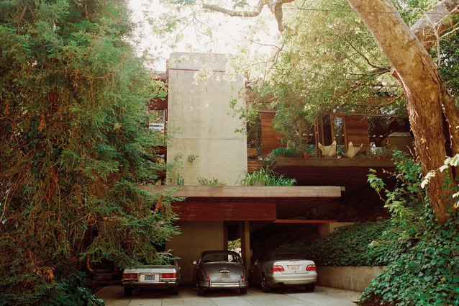
Kappe House, Pacific Palisades, CA (1967)

Slide 28
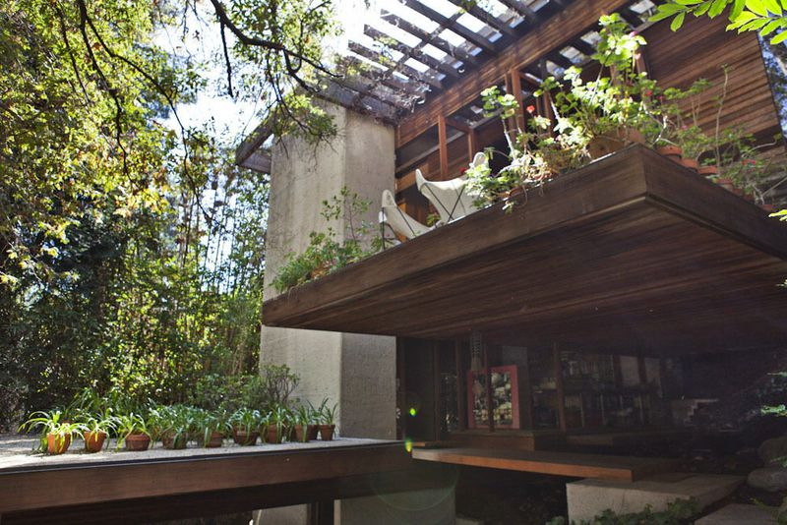
Kappe House, Pacific Palisades, CA (1967)

Slide 29
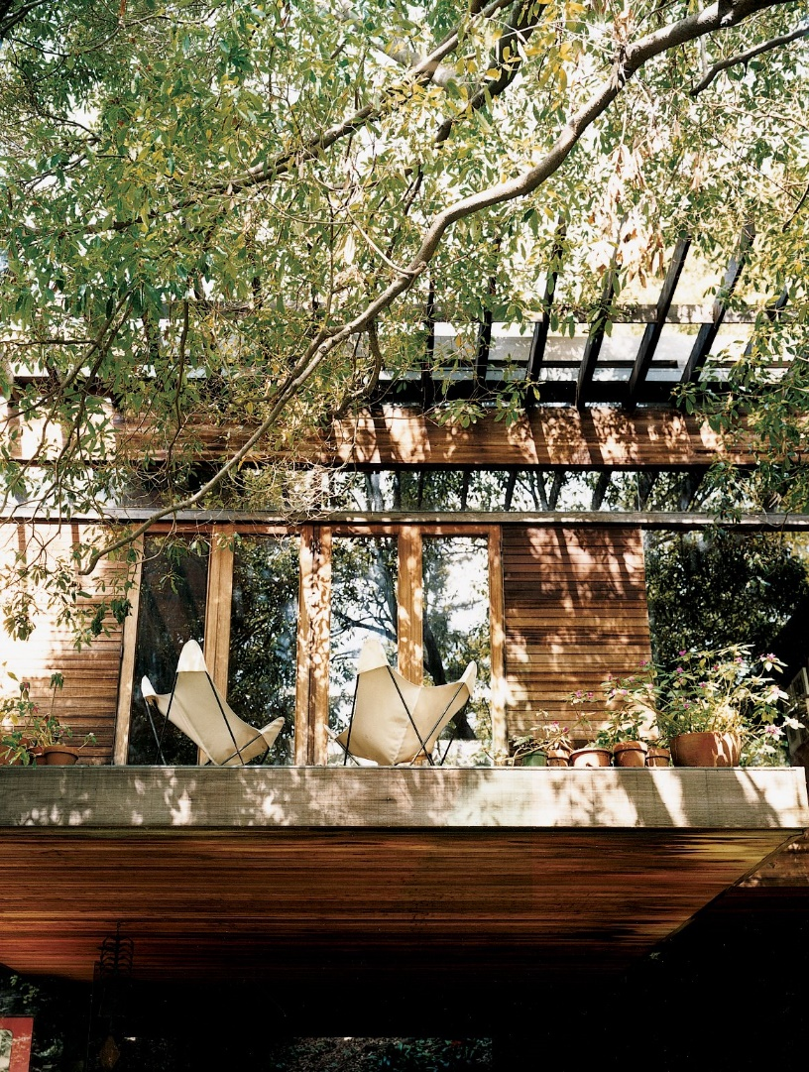
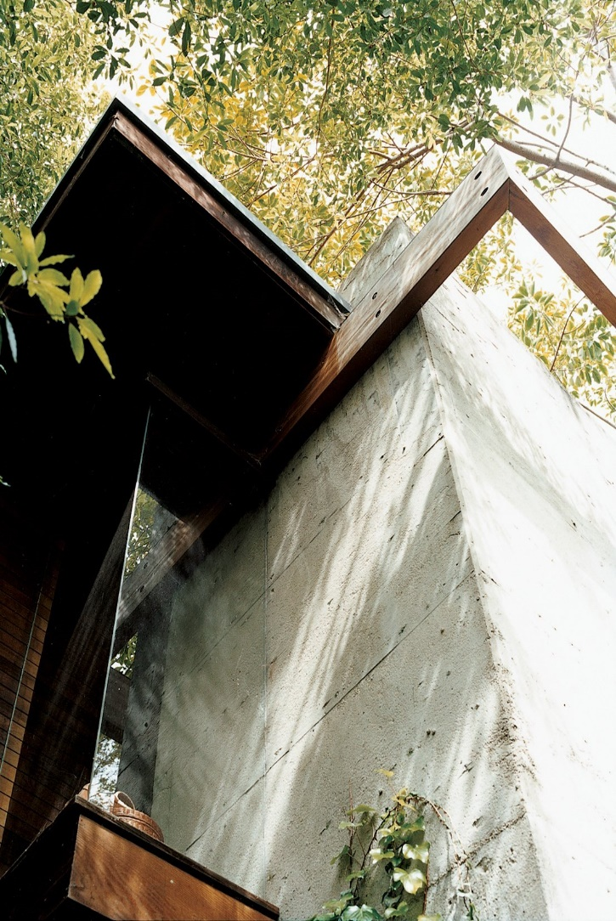
Kappe House, Pacific Palisades, CA (1967)

Slide 30
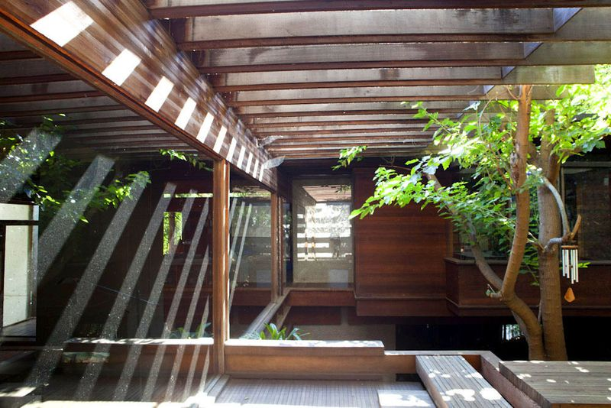
Kappe House, Pacific Palisades, CA (1967)

Slide 31
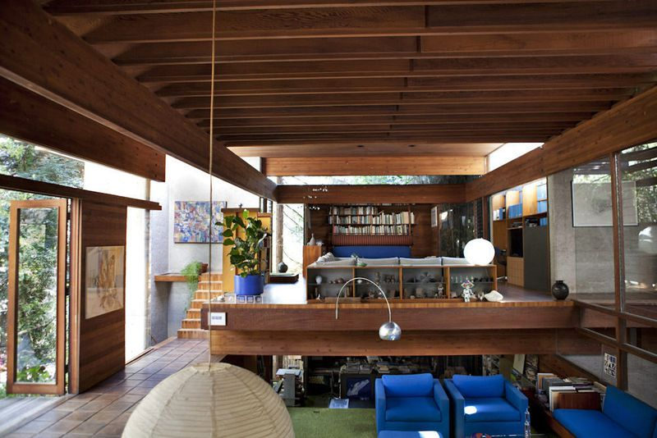
Kappe House, Pacific Palisades, CA (1967)

Slide 32
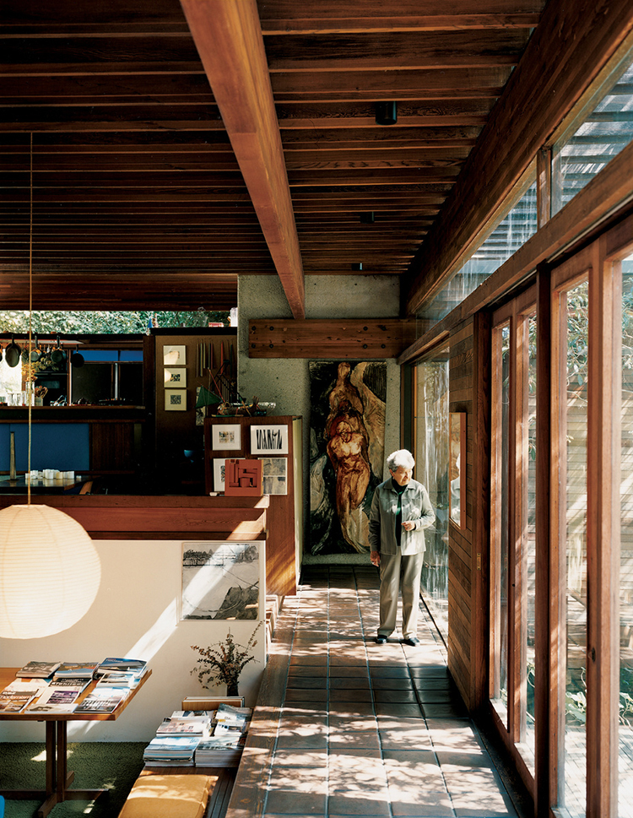
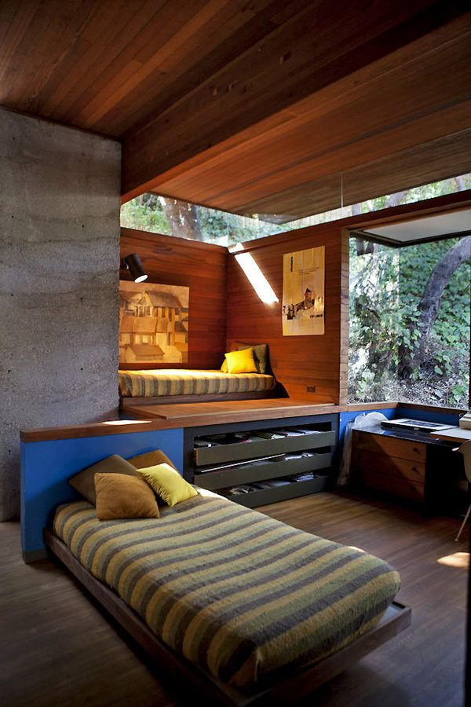
Kappe House, Pacific Palisades, CA (1967)

Slide 33
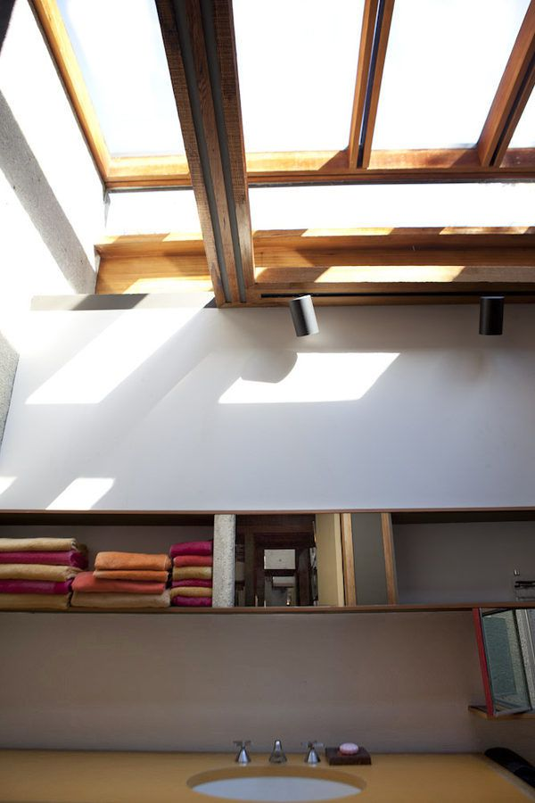
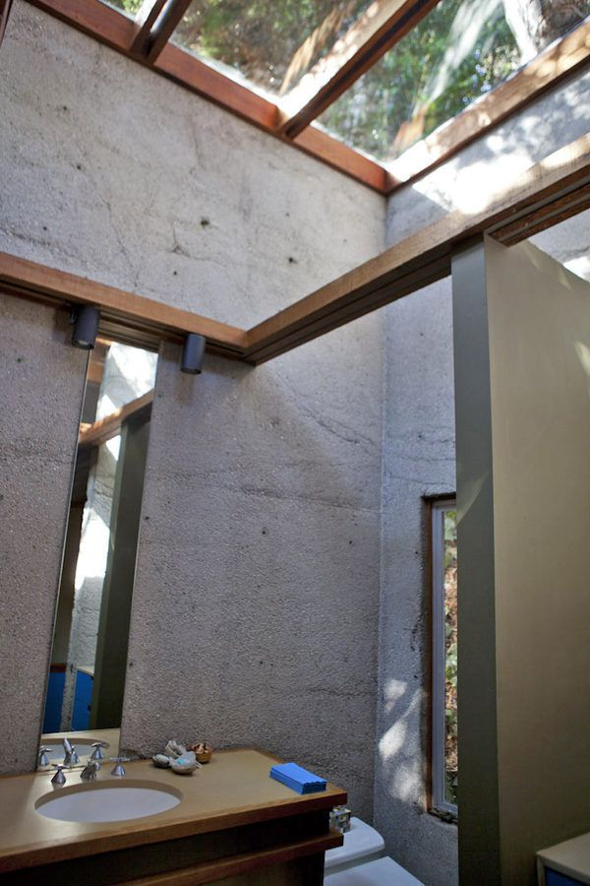
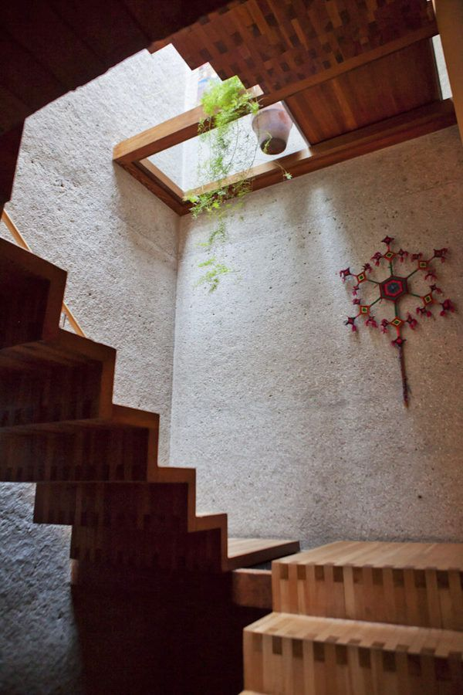
Kappe House, Pacific Palisades, CA (1967)

Slide 34
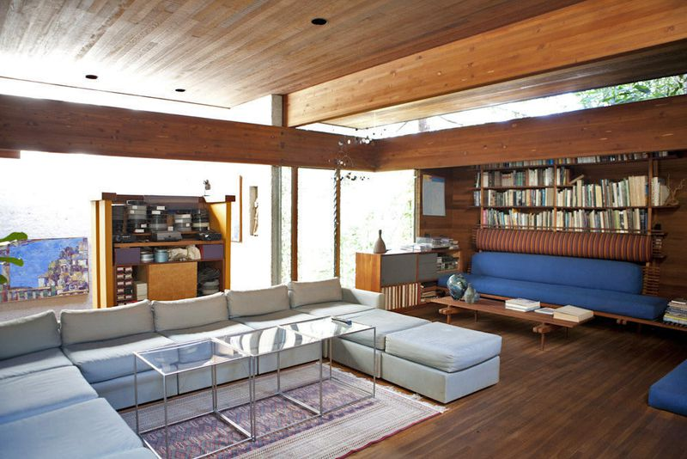
Kappe House, Pacific Palisades, CA (1967)

Slide 35
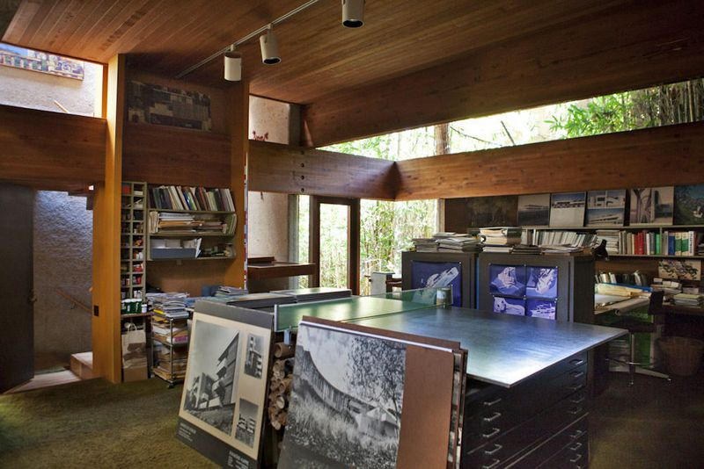
Kappe House, Pacific Palisades, CA (1967)

Slide 36
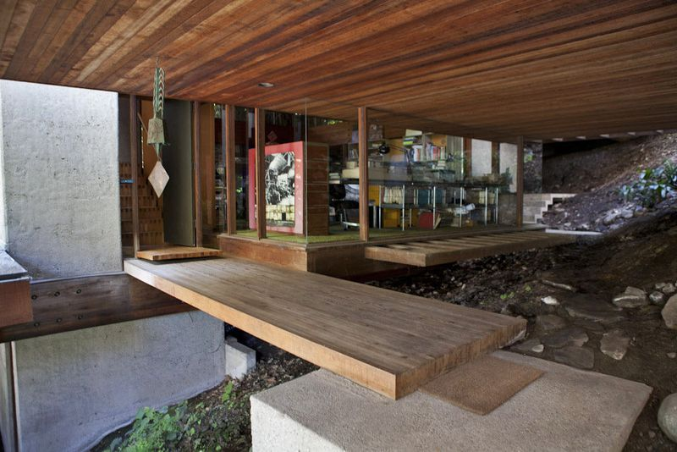
Kappe House, Pacific Palisades, CA (1967)

Slide 37
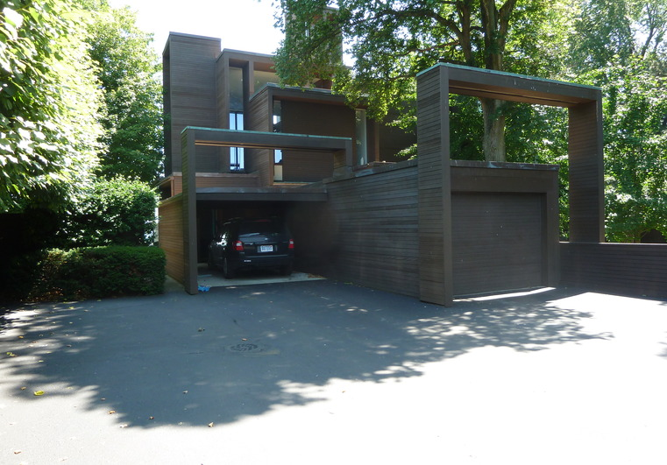
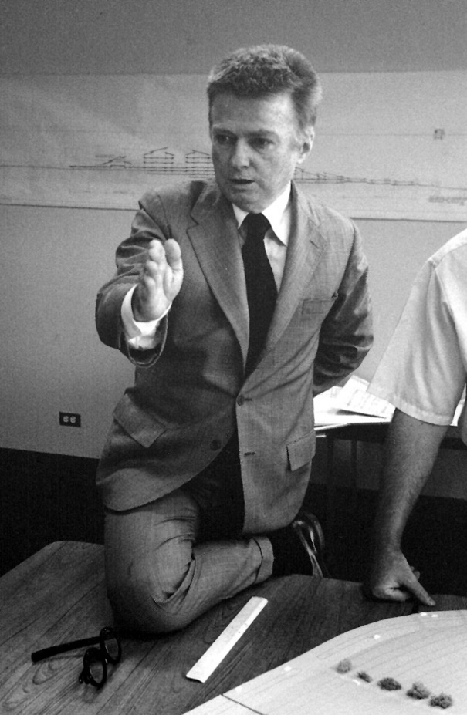
Parcells House, Grosse Pointe, MI (1967)
Paul Rudolph

Slide 38
Parcells House, Grosse Pointe, MI (1967)
It is the work of the architect Paul Rudolph.
The waterfront home faces Lake Saint Clair and was designed to give waterfront views to almost every room.
Upon entry, one looks up a few steps into the dining room and out at the lake; the ceiling rises three floors as stairs and balconies run through the height of the space. While the home is three stories, the two wings have staggered volumes off of the main hall, so that it feels more like five stories.

Slide 39
Parcells House, Grosse Pointe, MI (1967)
Lofty sitting areas with half walls sit off the main space while the bedrooms are tucked into the wings.
The Parcells family requested a lot of wood, so the exterior portions are mainly weathered red wood boards, painted brown, that run horizontally. The rest is all windows. The house looks like a series of stacked boxes of various sizes.

Slide 40
Parcells House, Grosse Pointe, MI (1967)

Slide 41
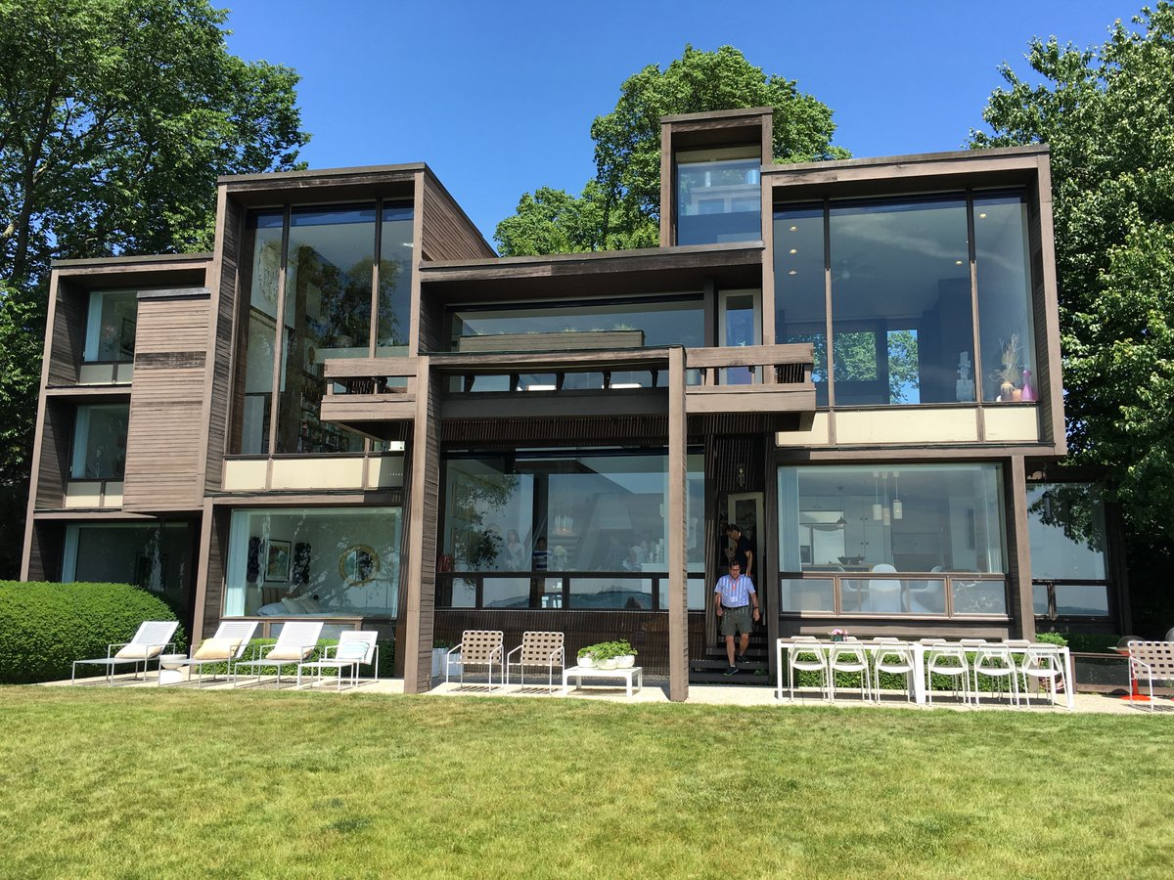
Parcells House, Grosse Pointe, MI (1967)

Slide 42
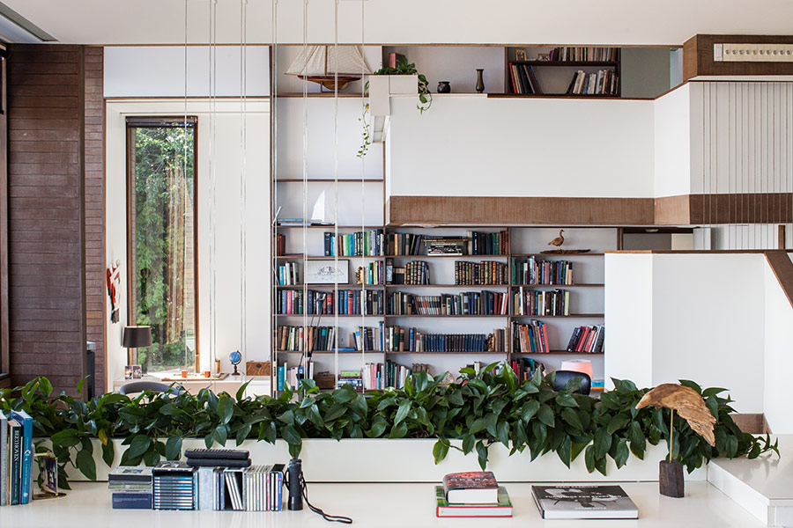
Parcells House, Grosse Pointe, MI (1967)

Slide 43
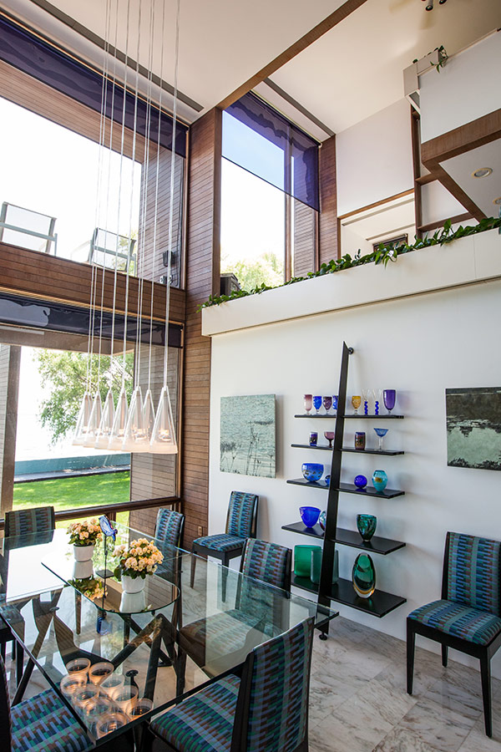
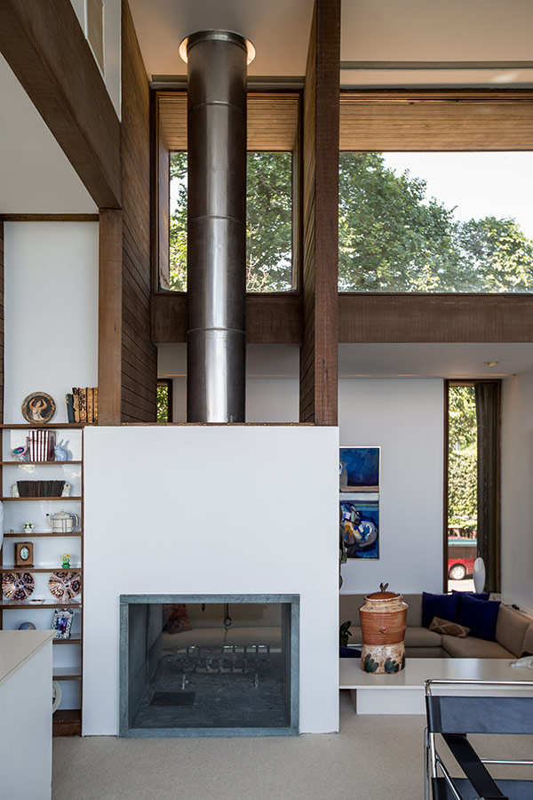
Parcells House, Grosse Pointe, MI (1967)

Slide 44
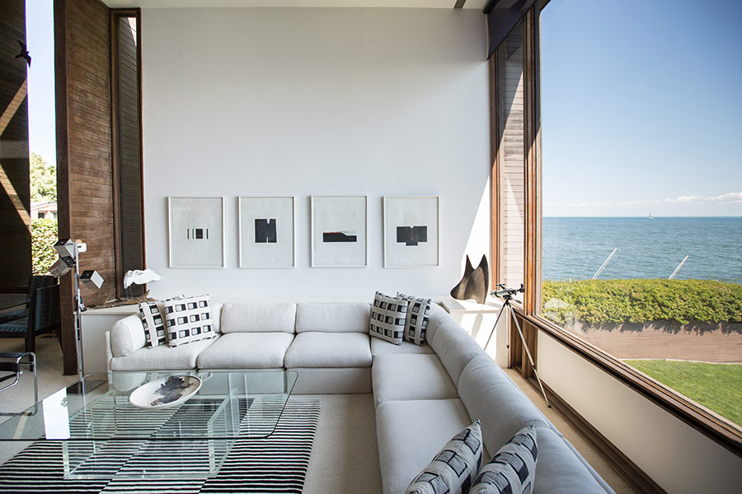
Parcells House, Grosse Pointe, MI (1967)

Slide 45
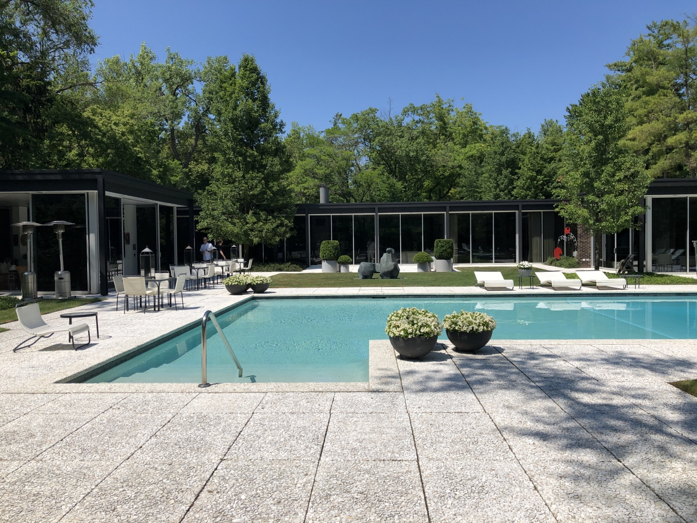
Epstein House, Northfield, IL (1967)
Tony Grunsfeld

Slide 46
Epstein House, Northfield, IL (1967)
It is the work of the architect Tony Grunsfeld.
The design of the house, essentially a low-slung steel box surrounded by glass walls.
The house has four bedrooms and five full baths, ceilings 10 feet high, Carrera marble floors and several pairs of sliding doors for breaking down the barrier between indoors and out.
Tony Grunsfeld's designs were typically a warmer version of modernism, often clad in wood or with ample wood finishes inside. The Epstein house is his one-of-a-kind, all glass, steel and granite.

Slide 47
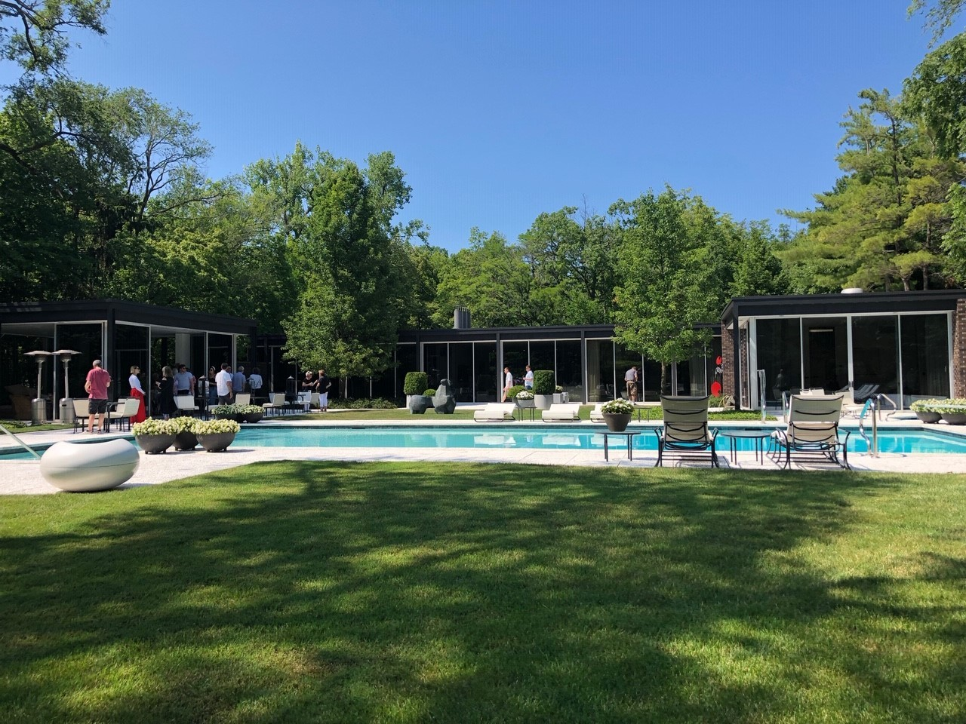
Epstein House, Northfield, IL (1967)

Slide 48
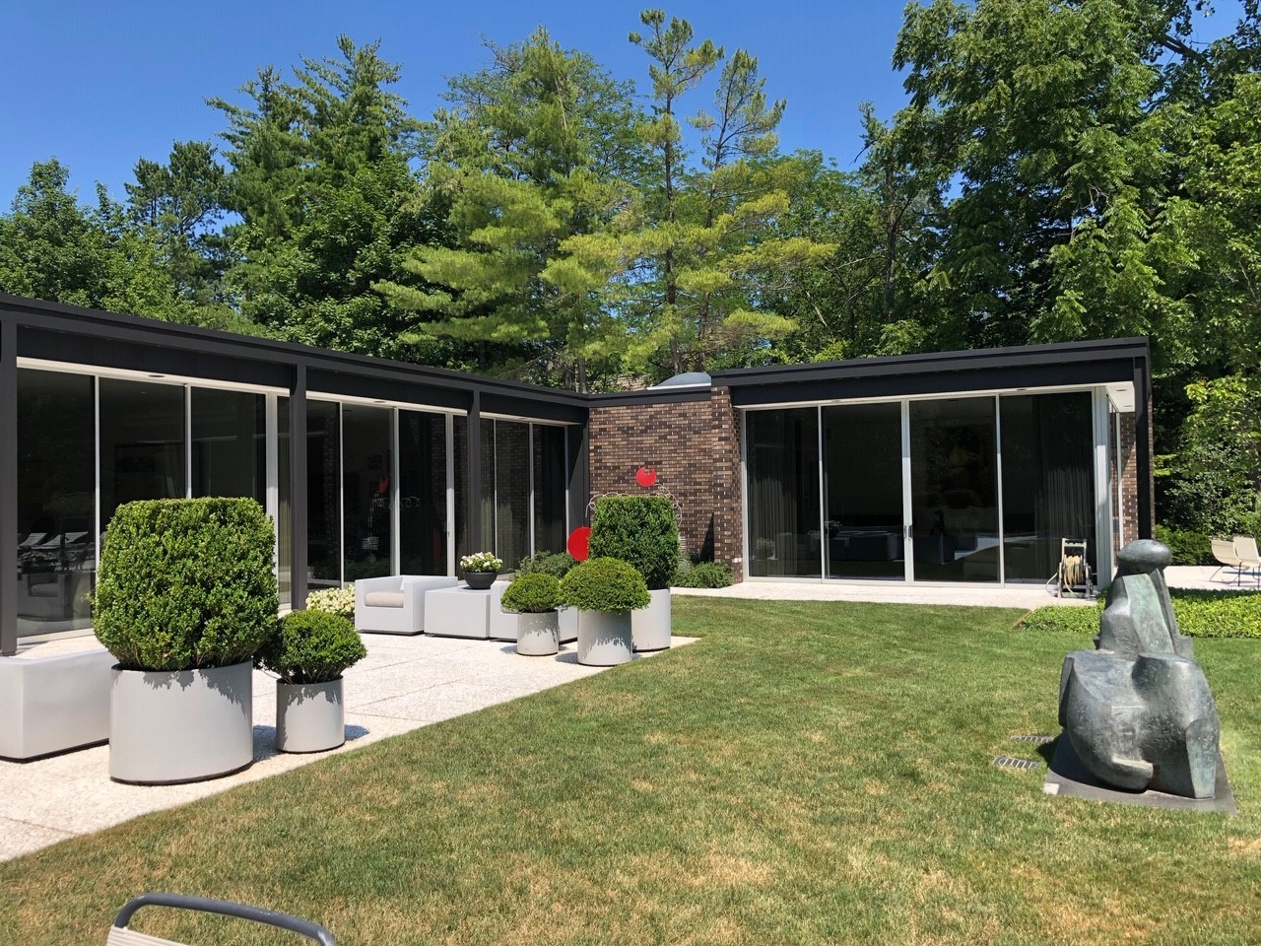
Epstein House, Northfield, IL (1967)

Slide 49
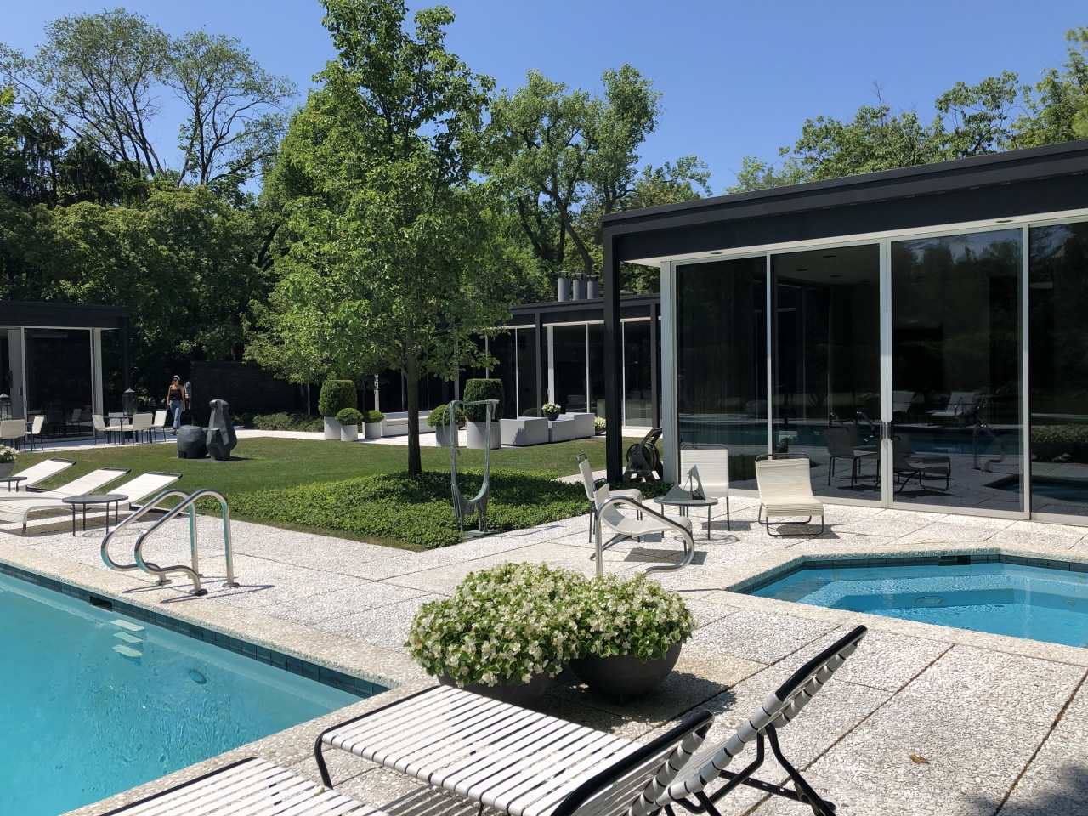
Epstein House, Northfield, IL (1967)

Slide 50
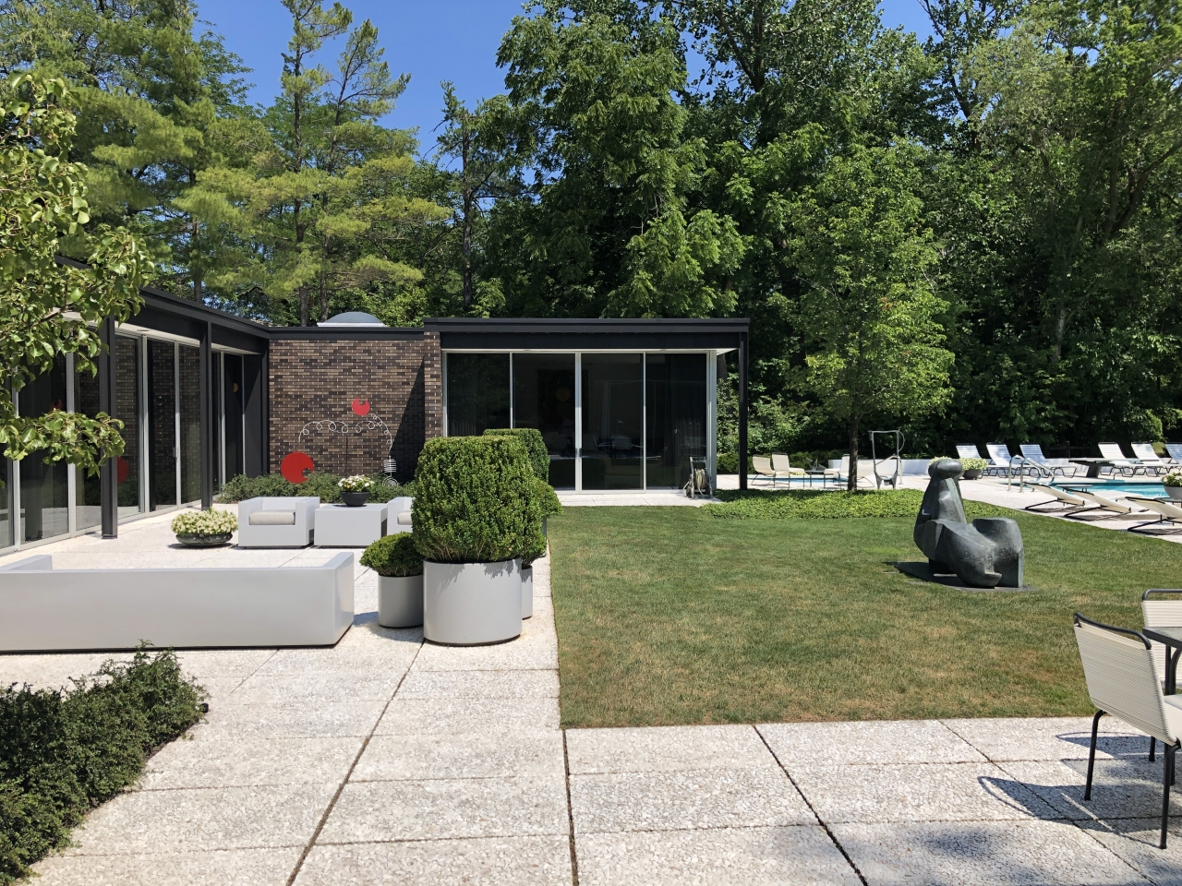
Epstein House, Northfield, IL (1967)

Slide 51
Epstein House, Northfield, IL (1967)

Slide 52
Epstein House, Northfield, IL (1967)

Slide 53
Epstein House, Northfield, IL (1967)

Slide 54
Epstein House, Northfield, IL (1967)

Slide 55
Epstein House, Northfield, IL (1967)

Slide 56
Epstein House, Northfield, IL (1967)

Slide 57
Epstein House, Northfield, IL (1967)

Slide 58
Epstein House, Northfield, IL (1967)

Slide 59
Epstein House, Northfield, IL (1967)

Slide 60
Avery House, Wrightsville Beach, NC (1967)
Robert Oxenfeld
Haywood Newkirk

Slide 61
Avery House, Wrightsville Beach, NC (1967)
It is the work of Robert Oxenfeld & Haywood Newkirk.
The house is built on reclaimed land. Under each of the 4 concrete pads on which the street underpinnings rest are 3 25-ft. wood pilings. From each of these concrete pads, 4 wide flange sections splay out to support the main girders of the house which intersect directly above them. At their base, the wide-flange support sections are beveled and welded to a tubular section which fits on a 2-in. diameter stainless steel pin set into the concrete. The 45 x 61 ft. house cantilevers in two directions from the support points. They are long cantilevers which would not have been practical without steel. The steel structure extends vertically. A series of columns bolted and welded to the main girders support 16B31 beams that span 36 ft. over the living area. Steel gave great flexibility in placing interior partitions. None of them had to be loadbearing.

Slide 62
Avery House, Wrightsville Beach, NC (1967)

Slide 63
Fisher House, Hatboro, PA (1967)
Louis Kahn

Slide 64
Fisher House, Hatboro, PA (1967)
Characterized by its dual cubic volumes, stone foundation and detailed cypress cladding, the Fisher house stands as a clear statement of how Kahn was working at the time.
The Fisher House uses form to separate the different programmatic uses of a home. The public and private are divided between two distinct two story nearly cubic volumes. The private volume is aligned along the north south axis and the public, which is rotated exactly 45 degrees, is aligned along a northeast southwest line which runs parallel to the driveway. The public volume intersects the north face of the private with its southeast corner. The public space, which is perfectly square in plan, holds the entrance corridor and the master bedroom at ground level and two other bedrooms above.

Slide 65
Fisher House, Hatboro, PA (1967)
The second volume is slightly off square, having a rectangular plan, and holds the living, dining and kitchen space in a double height room. Throughout the house there are deeply recessed windows. These allow light in during winter and keep out direct light in summer. The deep recession also allows them to be opened during storms without allowing rain to come into the house. There is a large stone hearth just off center in the living cube that creates a slight separation in the living room and the kitchen area.
To adapt to the slight inclination of the terrain, Kahn gave Fisher the house of a stone base that compensates for the change of slope and offers a lower level overlooking the garden.

Slide 66
Fisher House, Hatboro, PA (1967)

Slide 67
Fisher House, Hatboro, PA (1967)

Slide 68
Fisher House, Hatboro, PA (1967)

Slide 69
Fisher House, Hatboro, PA (1967)

Slide 70
Fisher House, Hatboro, PA (1967)

Slide 71
Fisher House, Hatboro, PA (1967)

Slide 72
Fisher House, Hatboro, PA (1967)

Slide 73
Fisher House, Hatboro, PA (1967)

Slide 74
Fisher House, Hatboro, PA (1967)

Slide 75
Fisher House, Hatboro, PA (1967)

Slide 76
Fisher House, Hatboro, PA (1967)

Slide 77
Fisher House, Hatboro, PA (1967)

Slide 78
Fisher House, Hatboro, PA (1967)

Slide 79
Fisher House, Hatboro, PA (1967)

Slide 80
Fisher House, Hatboro, PA (1967)

Slide 81
Fisher House, Hatboro, PA (1967)

Slide 82
Fisher House, Hatboro, PA (1967)
THE END

