Slide 1
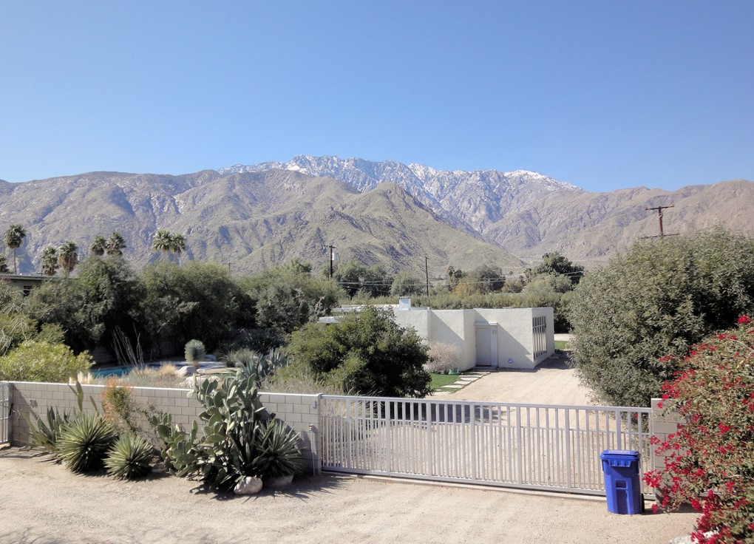
US. Modernist Houses
1934-1937

Slide 2
US Modernist Houses 1934 - 1937
The purpose of this presentation is to show you the most outstanding Modern Movement inspired houses in the United States by great architects.
Some of them have become icons of contemporary architecture (members of the iconic.org network) and are recognized and protected as such.
They remain unique either by their constructive principle, or by their location, or by their theoretical importance, or by their perfect integration into the landscape.

Slide 3
US Modernist Houses
Many of the houses presented in this slide show (before the year 2000) were found on the OfHouses website (Old Forgotten Houses) which lists houses with architectural interest or singular architecture around the world with many illustrations. If they are shown here, it is because they are already considered as iconic.

Slide 4
US Modernist Houses
Sten-Frenke House, Richard Neutra, CA.
Von Sternberg House, Richard Neutra, CA.
Laing House, Harwell H. Harris, CA.
Fitzpatrick House, Rudolf Schindler, CA.
Cedar Street House, Hugh Stubbins, MA.
Ernst House, Gregory Ain, CA.
Kraigher House, Richard Neutra, TX.
Grace Miller House, Richard Neutra, CA.
Schweikher House, Paul Schweikher, IL.
Cahn House, George Fred & William Keck, IL.

Slide 5
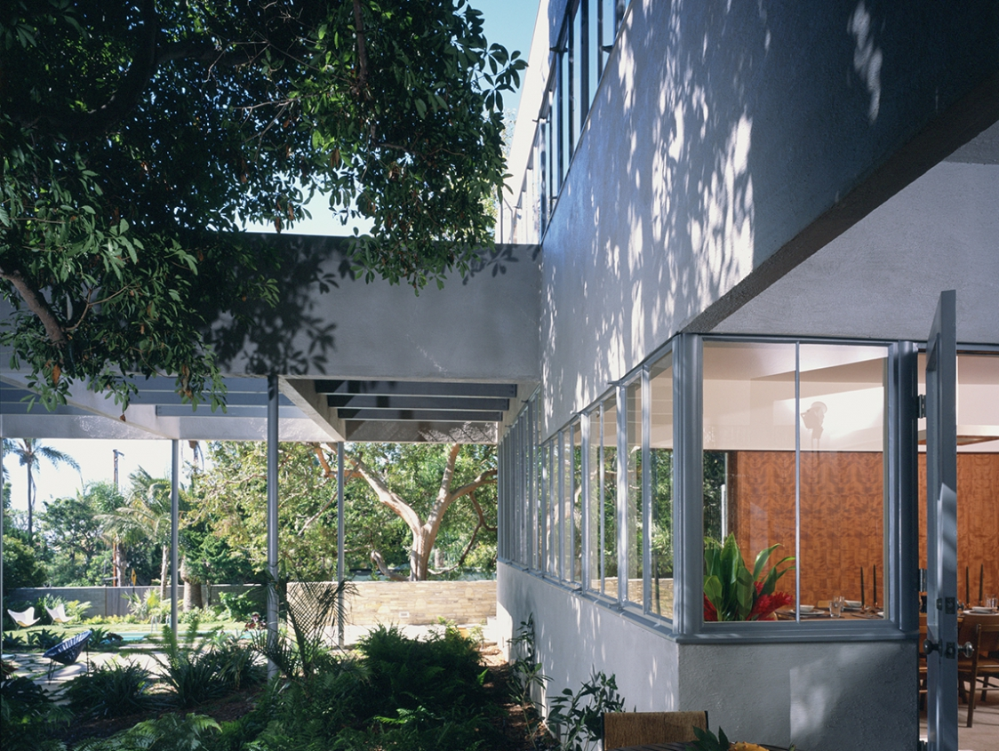
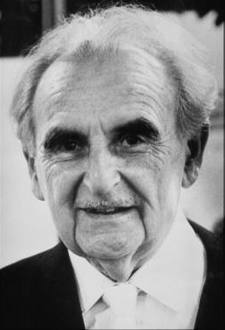
StenFrenke, Santa Monica, CA (1934)
Richard Neutra

Slide 6
StenFrenke, Santa Monica, CA (1934)
It is the work of the architect Richard Neutra.
Sited on a double lot, but occupying only one, the house was surrounded by a wall of rough cast ‘California’ blocks and was washed a light grey cement color. The house is remarkable for the amount of continuous ribbons of glass in a ‘balloon frame’ wooden house.
Measuring 2,959 square feet, the two-story modern has 3 bedrooms, an ovular dining room, a sizable living room, and an office. Among its distinctive architectural details are wrap around steel-frame windows, Douglas fir paneling, hardwood floors, a brick fireplace, and built-in furniture.

Slide 7
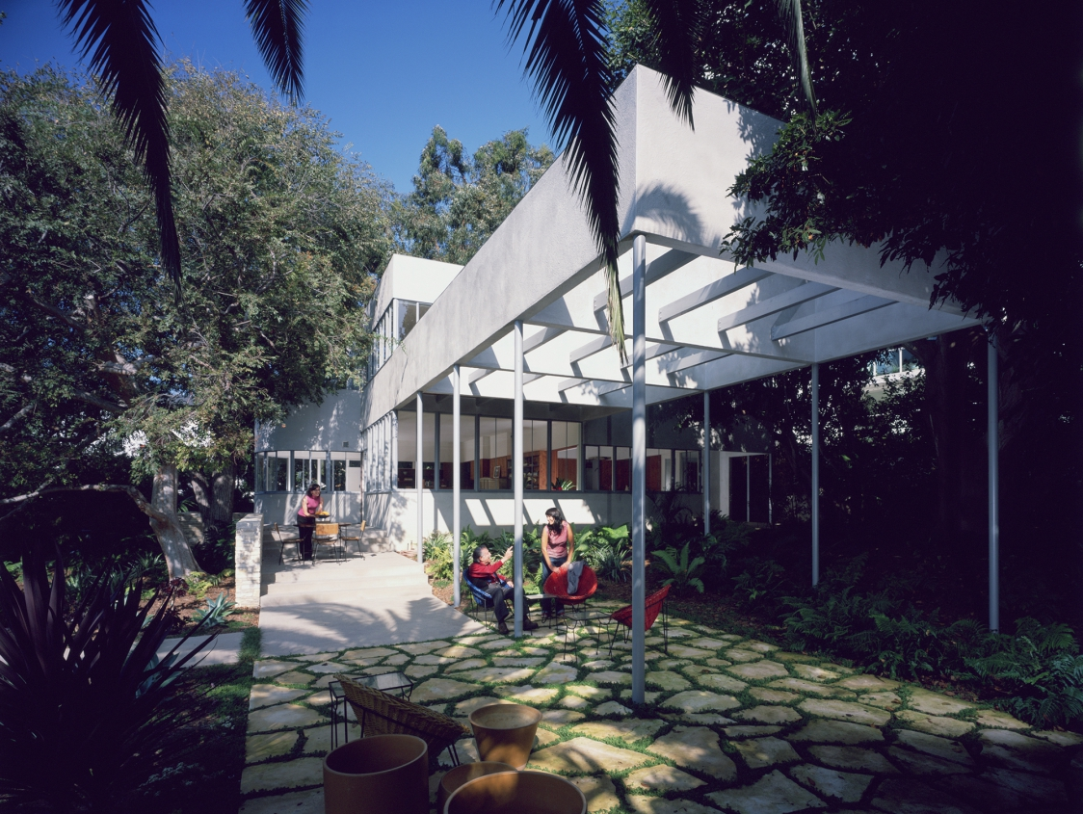
StenFrenke, Santa Monica, CA (1934)

Slide 8
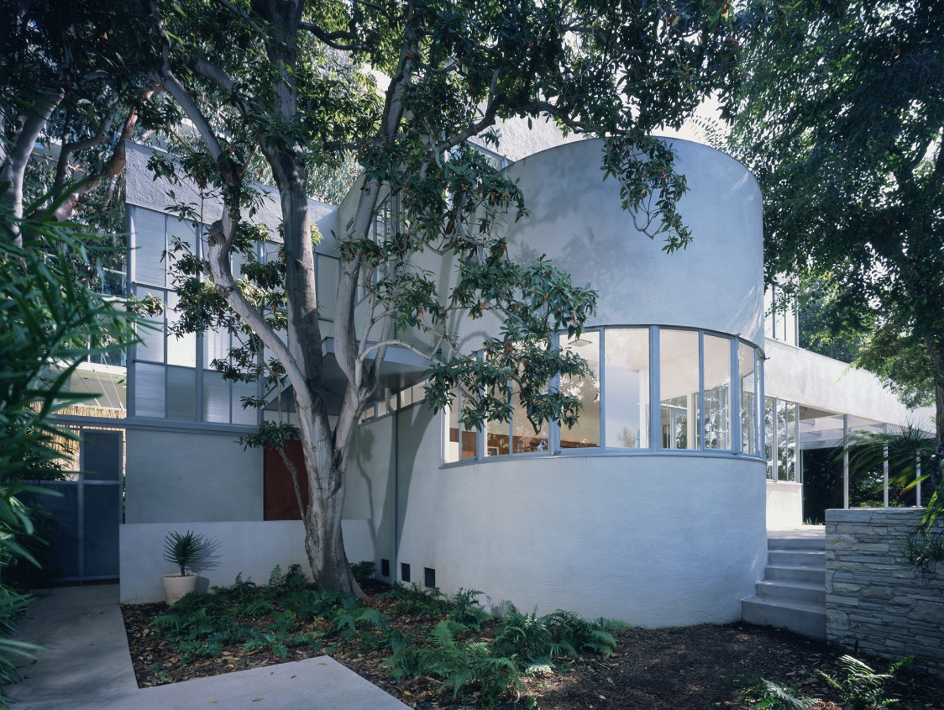
StenFrenke, Santa Monica, CA (1934)

Slide 9
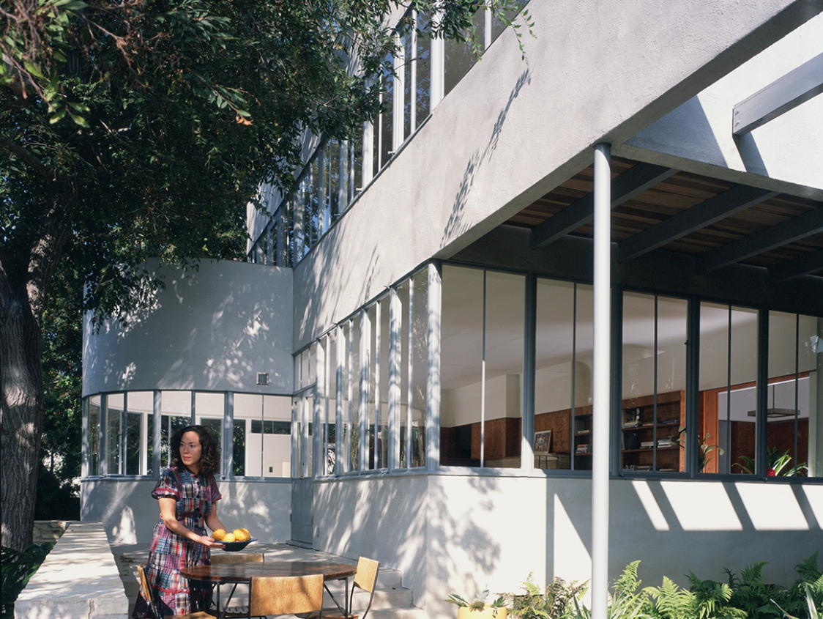
StenFrenke, Santa Monica, CA (1934)

Slide 10
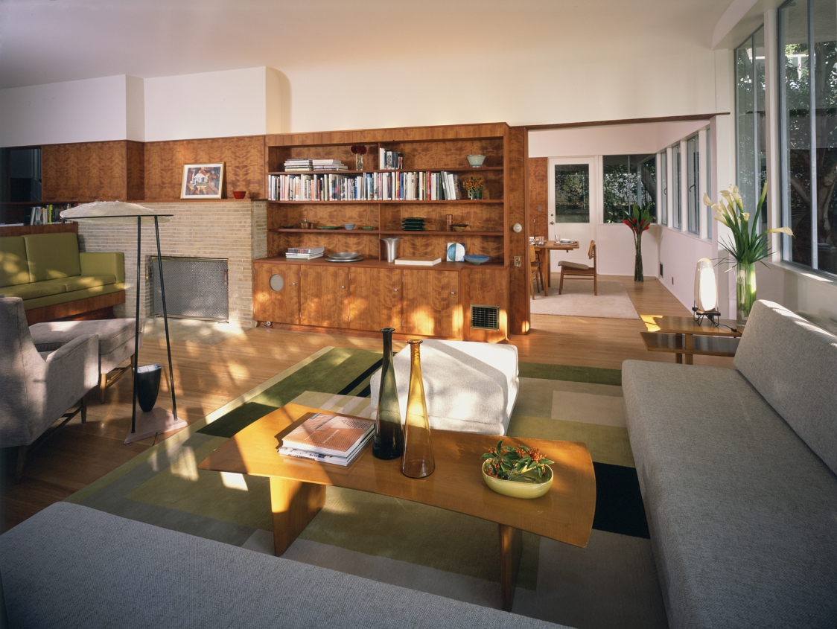
StenFrenke, Santa Monica, CA (1934)

Slide 11
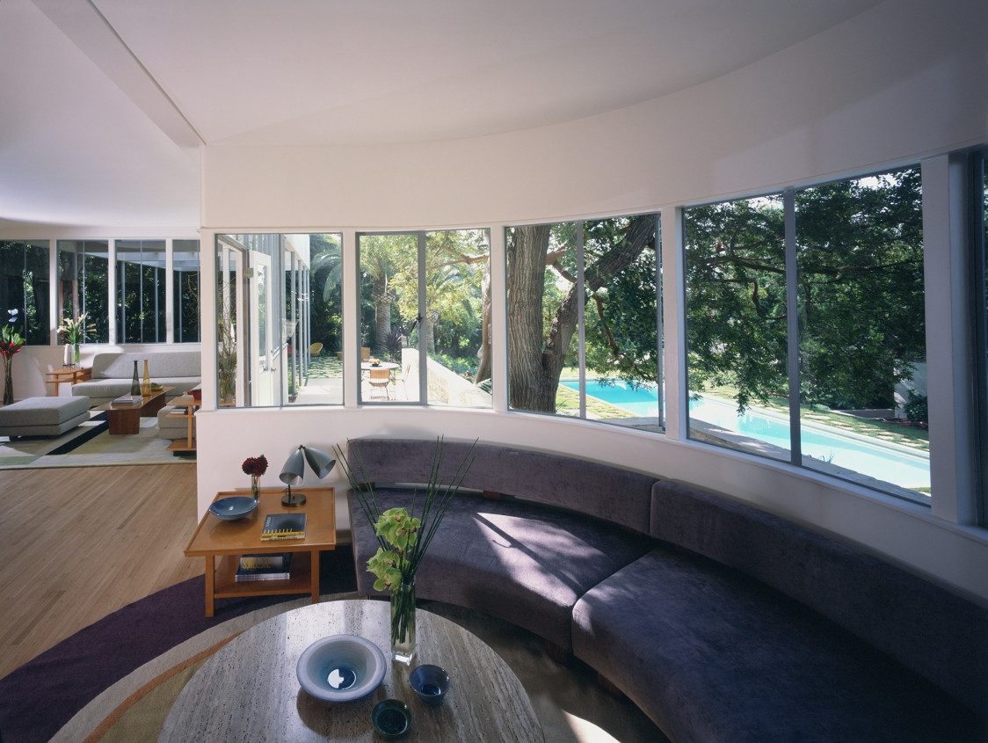
StenFrenke, Santa Monica, CA (1934)

Slide 12
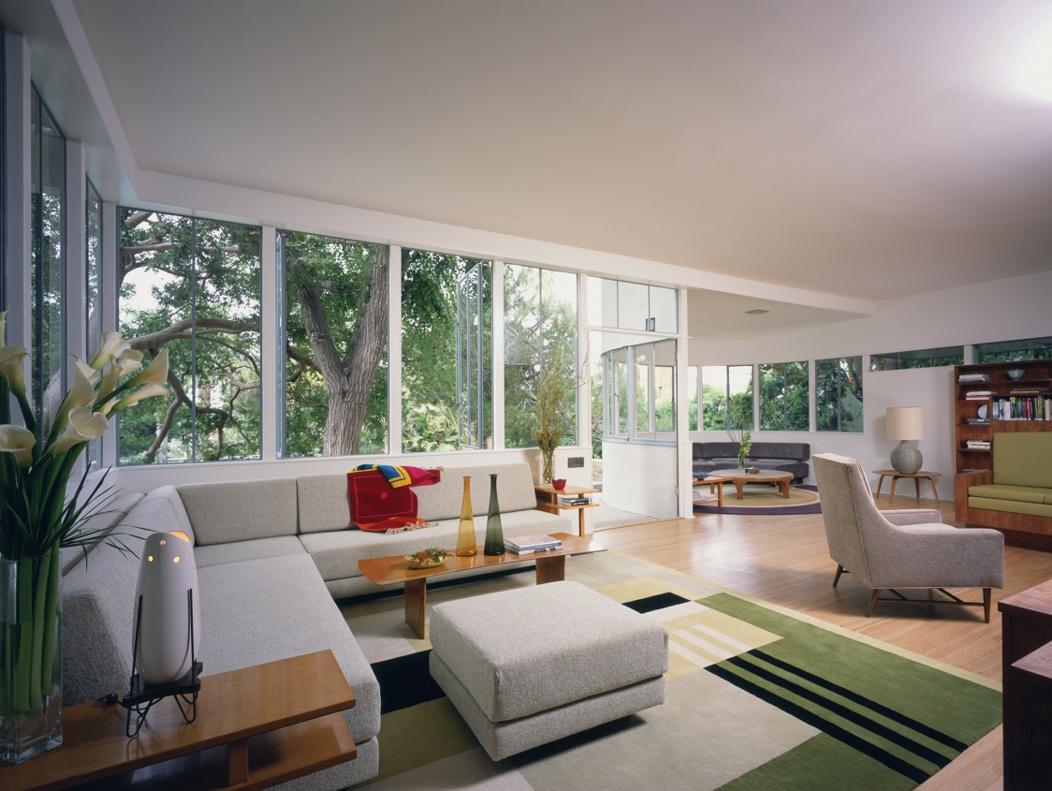
StenFrenke, Santa Monica, CA (1934)

Slide 13
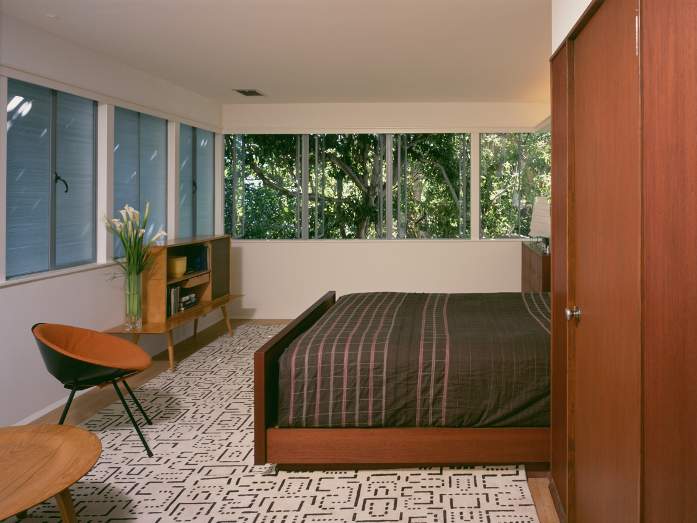
StenFrenke, Santa Monica, CA (1934)

Slide 14
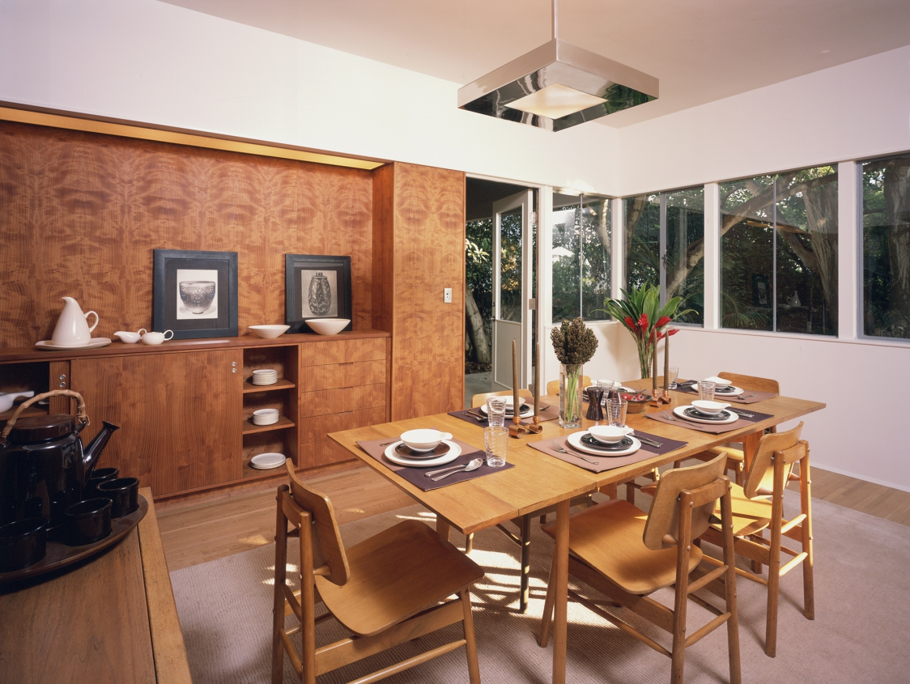
StenFrenke, Santa Monica, CA (1934)

Slide 15
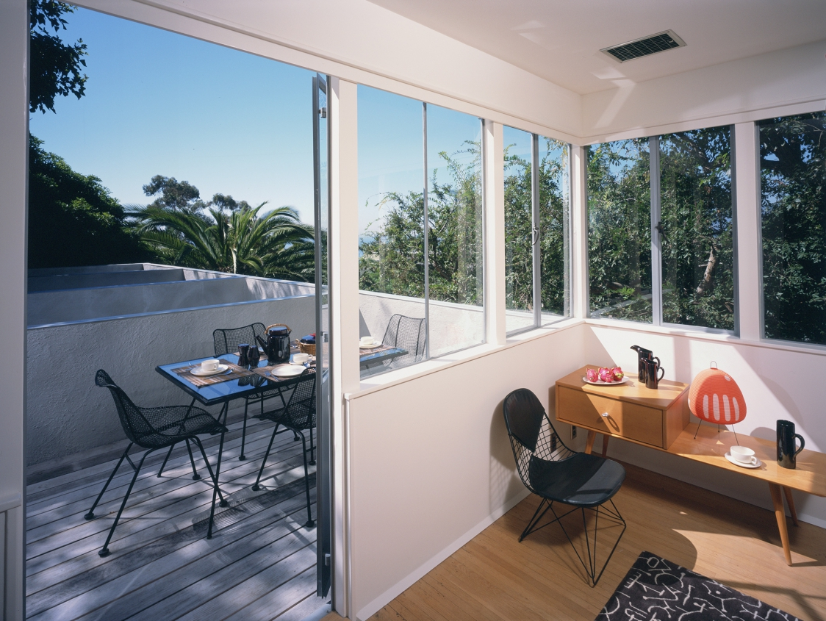
StenFrenke, Santa Monica, CA (1934)

Slide 16
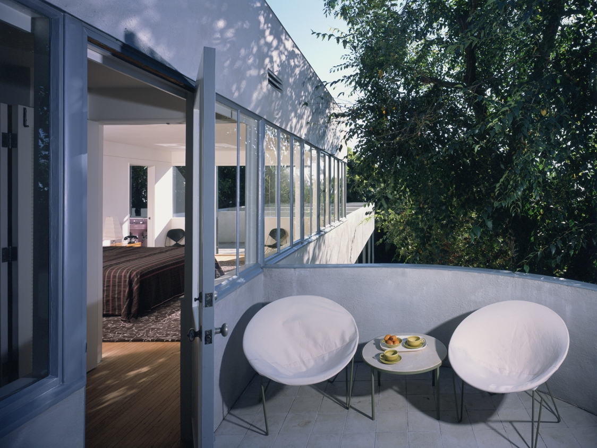
StenFrenke, Santa Monica, CA (1934)

Slide 17
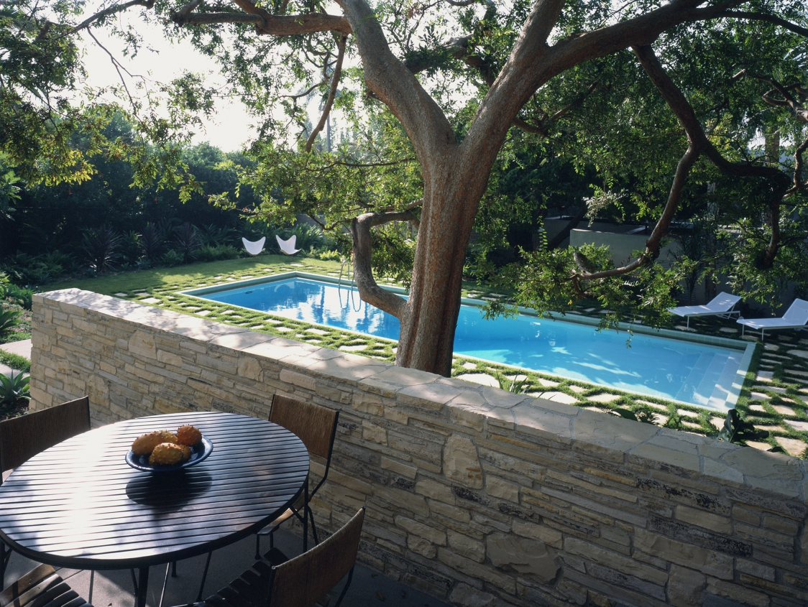
StenFrenke, Santa Monica, CA (1934)

Slide 18
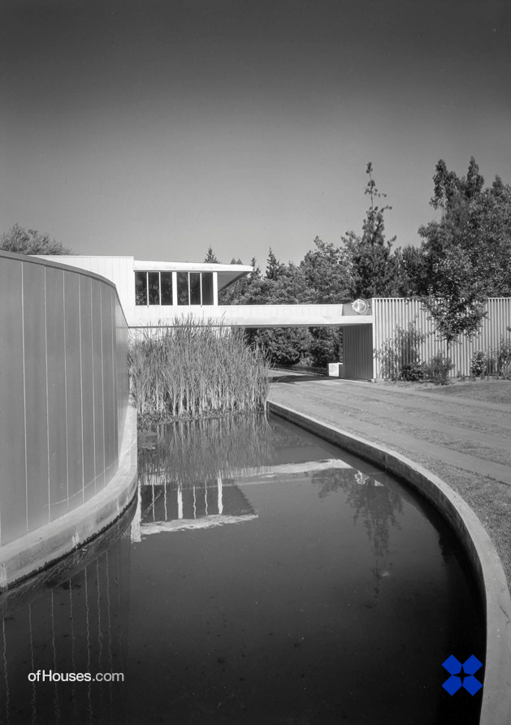
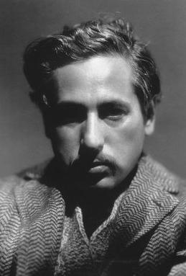
Von Sternberg, Los Angeles, CA (1935)
Richard Neutra
Josef Von Sternberg

Slide 19
Von Sternberg, Los Angeles, CA (1935)
It is the work of the architect Richard Neutra.
It was a mini-mansion for the movie director Josef von Sternberg. The exterior of the house was all steel and glass, and the appearance of the house and of its landscaped surroundings was made of sinuous lines, yet the interiors were orthogonal, making furniture placement simple and easy. As in many others of his domestic designs, Neutra made heavy use of industrial windows and sidings, fulfilling both aesthetic and practical functions, such as making privacy screens and windbreaks.

Slide 20
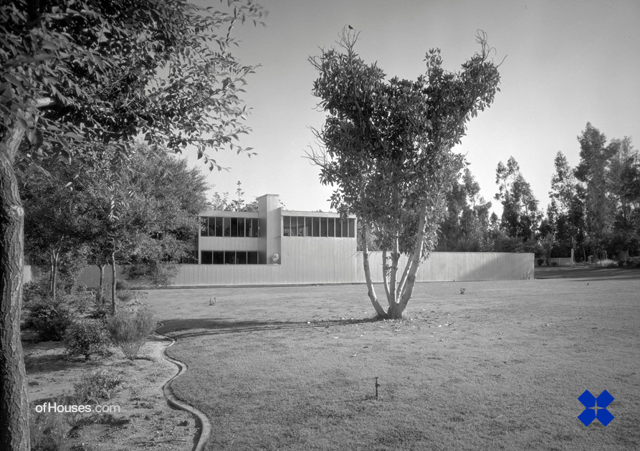
Von Sternberg, Los Angeles, CA (1935)

Slide 21
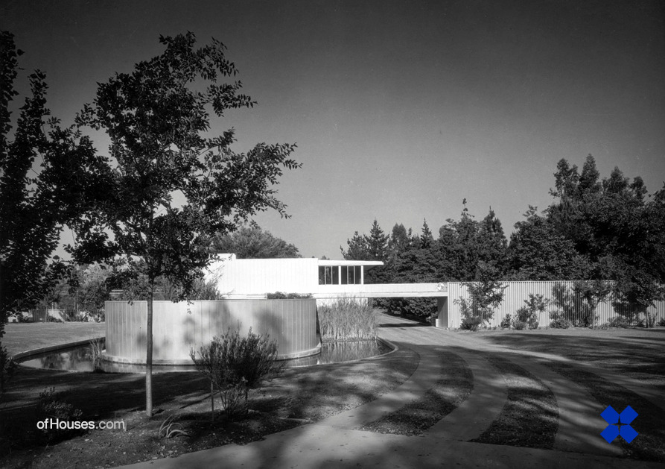
Von Sternberg, Los Angeles, CA (1935)

Slide 22
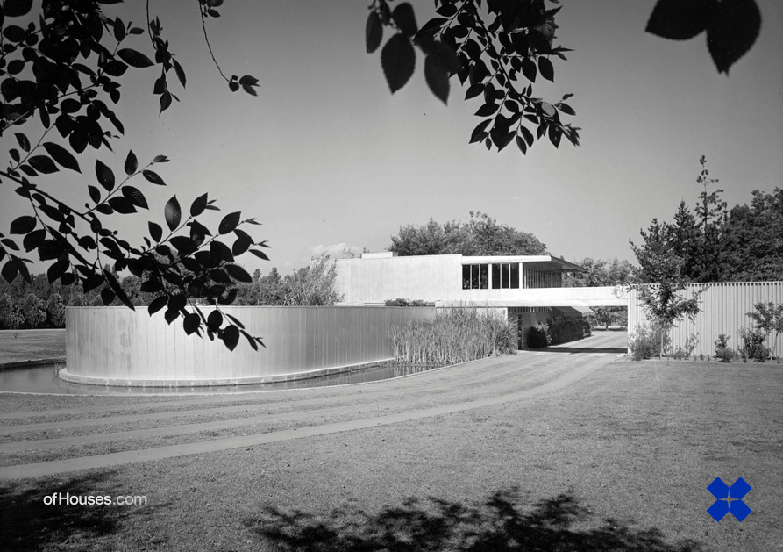
Von Sternberg, Los Angeles, CA (1935)

Slide 23
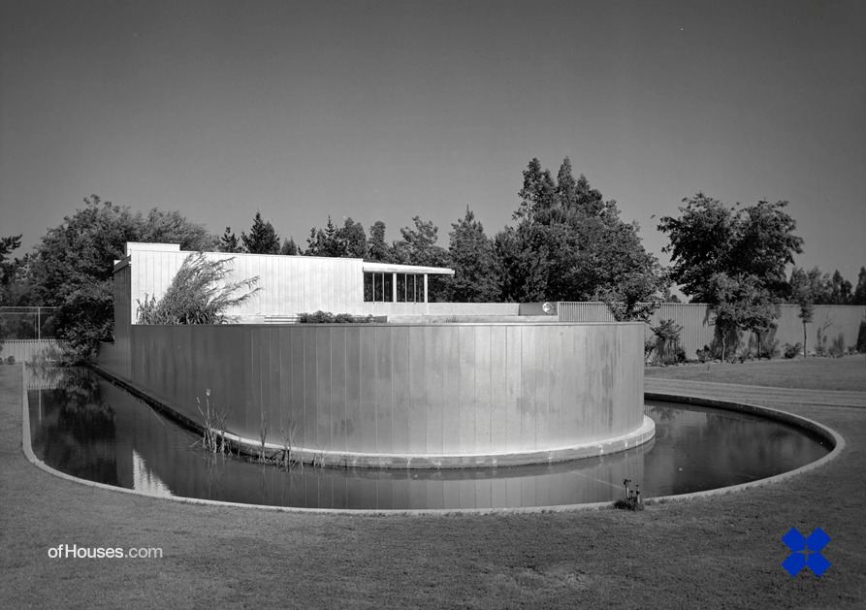
Von Sternberg, Los Angeles, CA (1935)

Slide 24
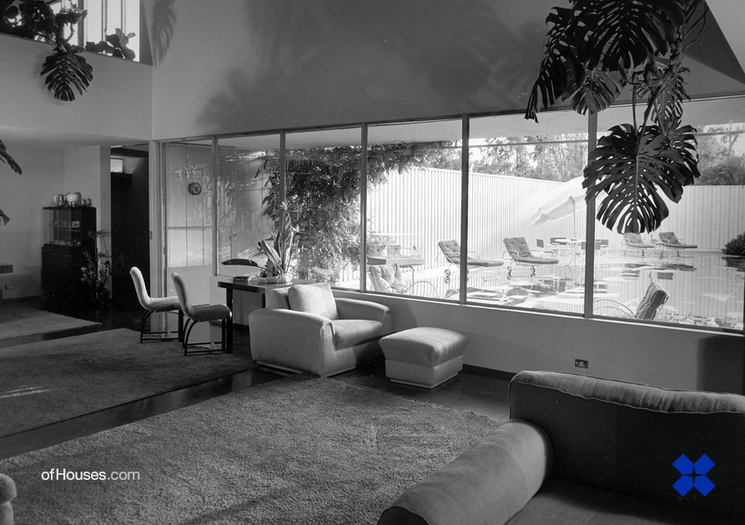
Von Sternberg, Los Angeles, CA (1935)

Slide 25
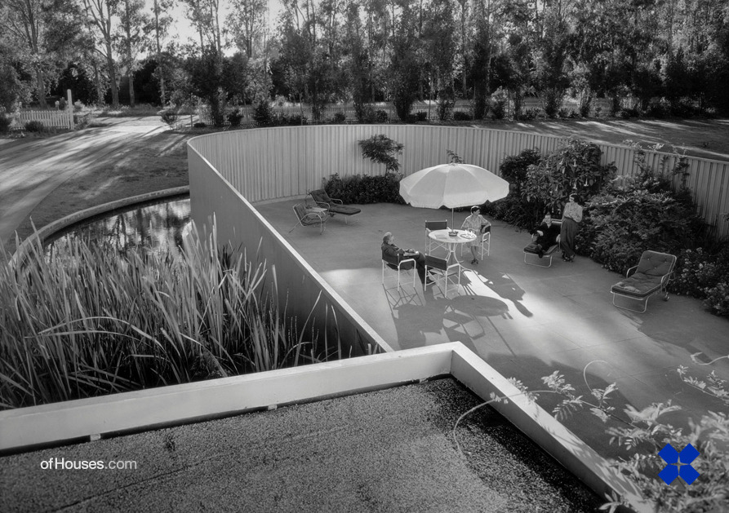
Von Sternberg, Los Angeles, CA (1935)

Slide 26
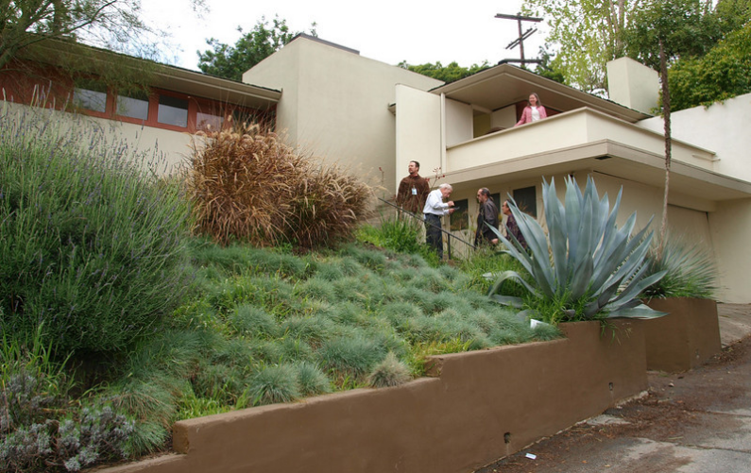
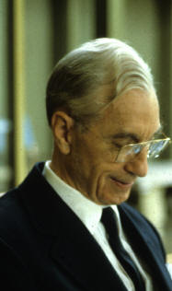
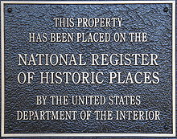
Laing House, Pasadena, CA (1935)
H. H. Harris

Slide 27
Laing House, Pasadena, CA (1935)
It was designed by the architect Harwell H. Harris.
It was built for Graham Laing, a professor at the California Institute of Technology.
Harris adroitly sets the garage into the slope and elevates the main salon above the garage, framing a picturesque view and allocating a portion of the garage roof as an outdoor dining terrace.
Both ground floor bedrooms showcase see-through doors and access brick patios. With its deep overhanging eaves, boxed-in-balcony terrace and ribbon windows the influences of Frank Lloyd Wright are evident throughout.

Slide 28
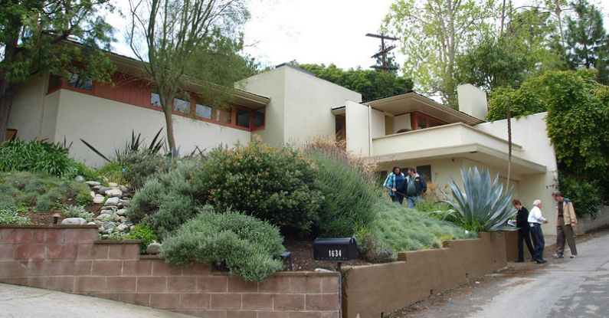
Laing House, Pasadena, CA (1935)

Slide 29
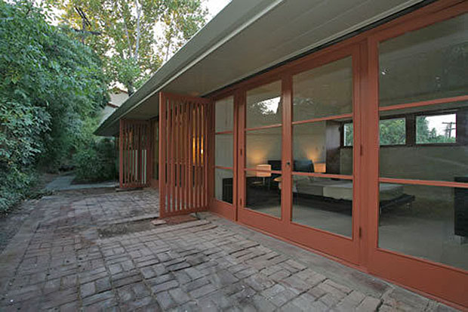
Laing House, Pasadena, CA (1935)

Slide 30
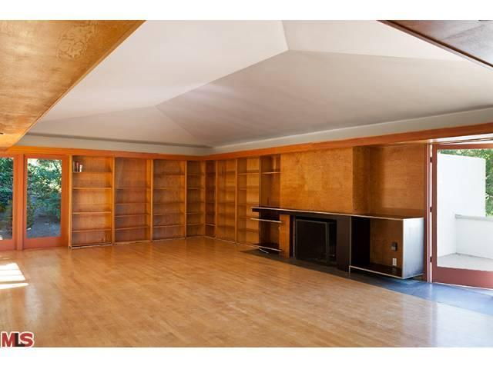
Laing House, Pasadena, CA (1935)

Slide 31
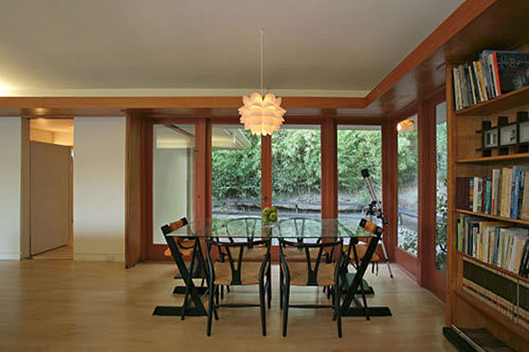
Laing House, Pasadena, CA (1935)

Slide 32
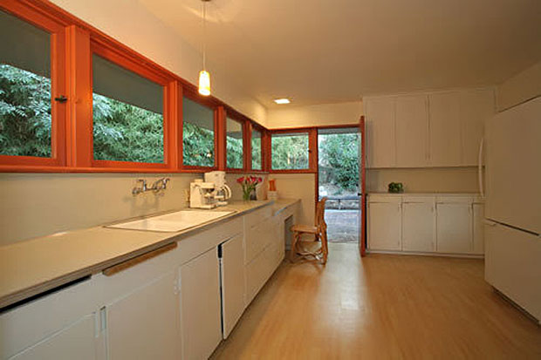
Laing House, Pasadena, CA (1935)

Slide 33
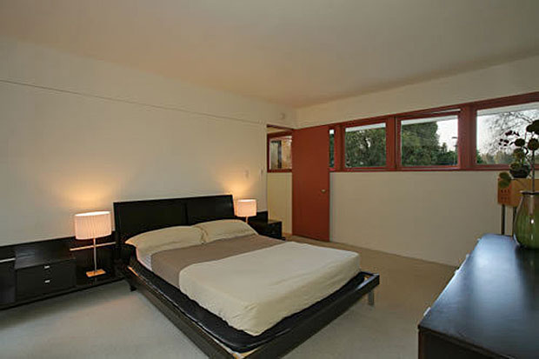
Laing House, Pasadena, CA (1935)

Slide 34
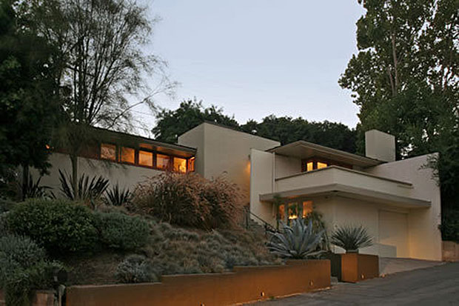
Laing House, Pasadena, CA (1935)

Slide 35
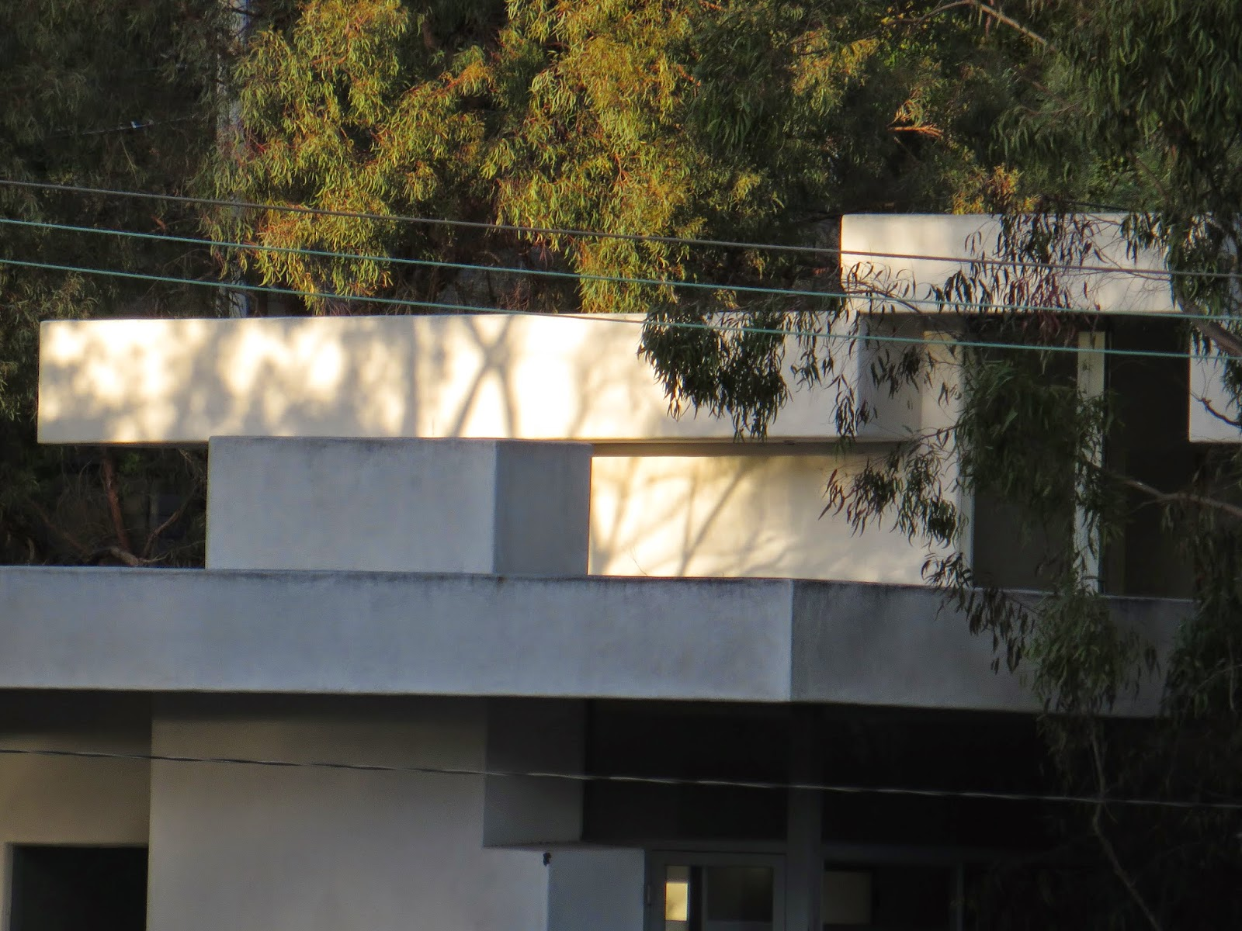
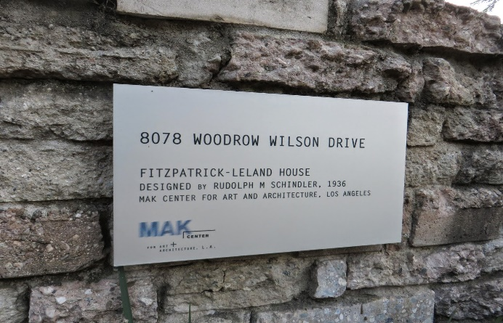
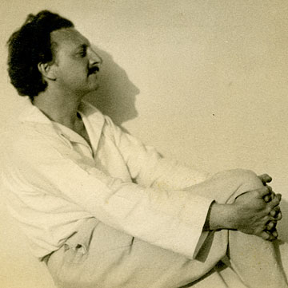
Fitzpatrick House, Los Angeles, CA (1936)
Rudolf Schindler

Slide 36
Fitzpatrick House, Los Angeles, CA (1936)
It is the work of Rudolf Schindler.
The Fitzpatrick-Leland House commands a strong presence along the slope of Laurel Canyon and Mulholland Drive, as the three-story terraced scheme captures the eye with its interplay of protruding canopies beneath. Schindler’s subtle composition of interlocking volumes dominates the experience of interior spaces.
The home’s light-filled spaces and expansive grounds provide an ideal setting for residency and small-scale programs. Its interlocking spaces, spectacularly framed views, seamless flows from indoor to outdoor spaces.

Slide 37
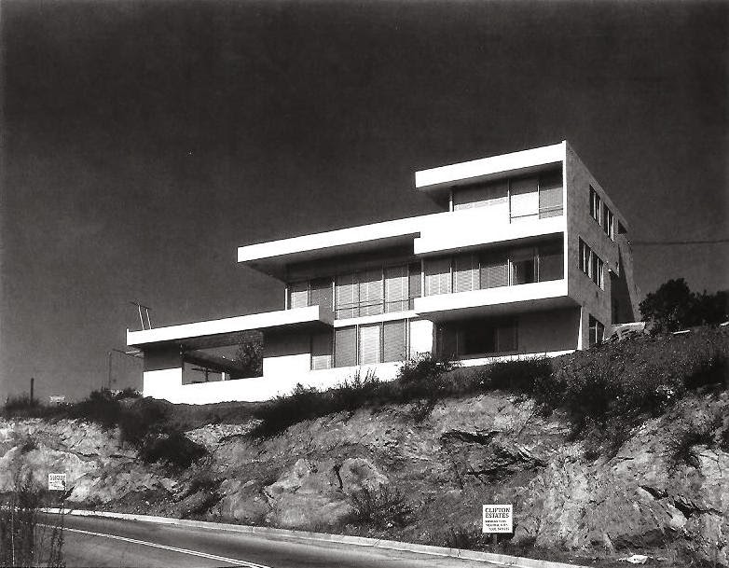
Fitzpatrick House, Los Angeles, CA (1936)

Slide 38
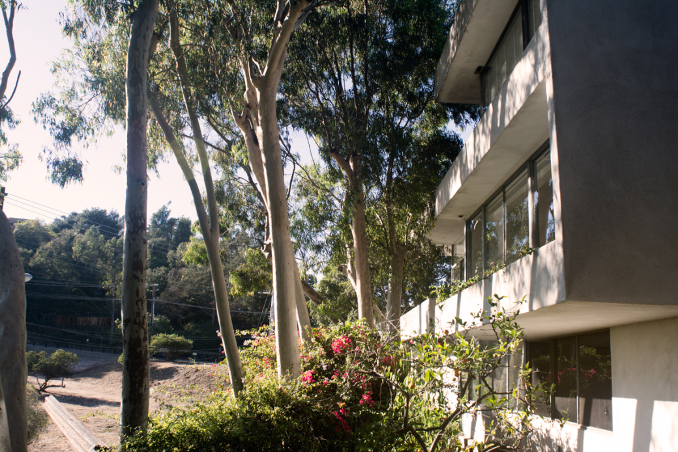
Fitzpatrick House, Los Angeles, CA (1936)

Slide 39
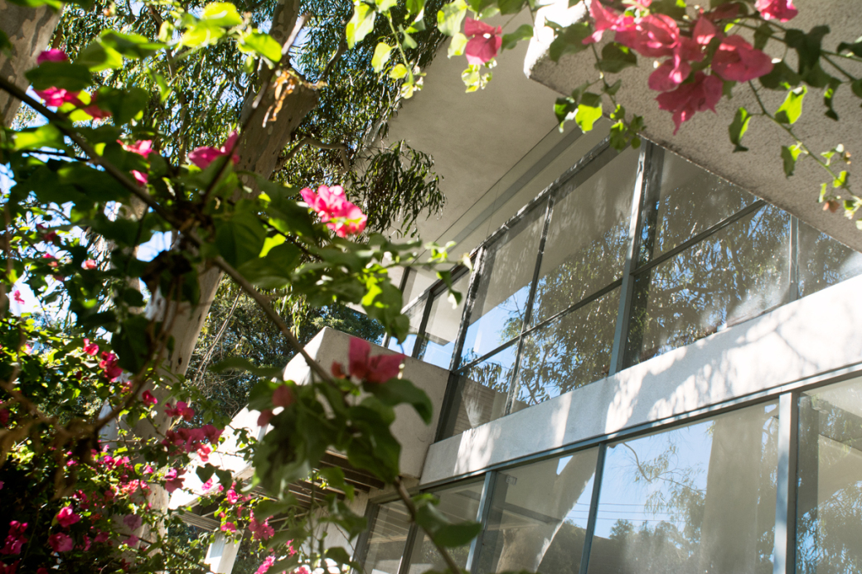
Fitzpatrick House, Los Angeles, CA (1936)

Slide 40
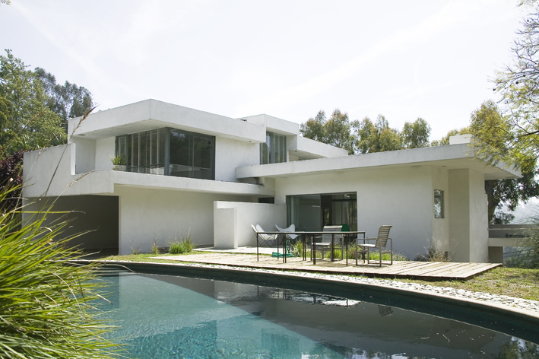
Fitzpatrick House, Los Angeles, CA (1936)

Slide 41
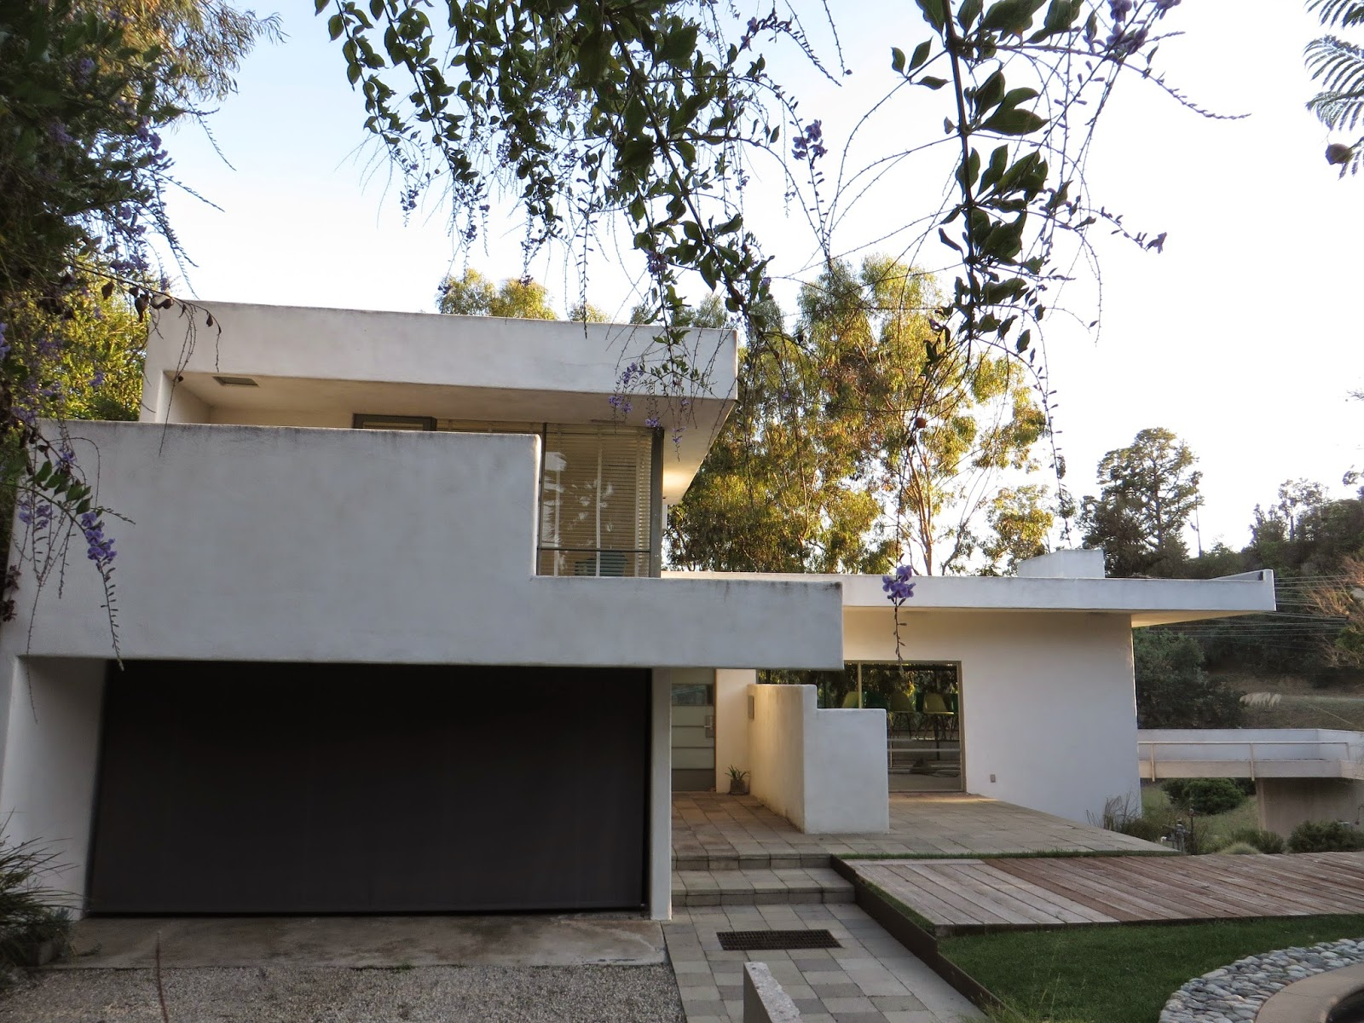
Fitzpatrick House, Los Angeles, CA (1936)

Slide 42
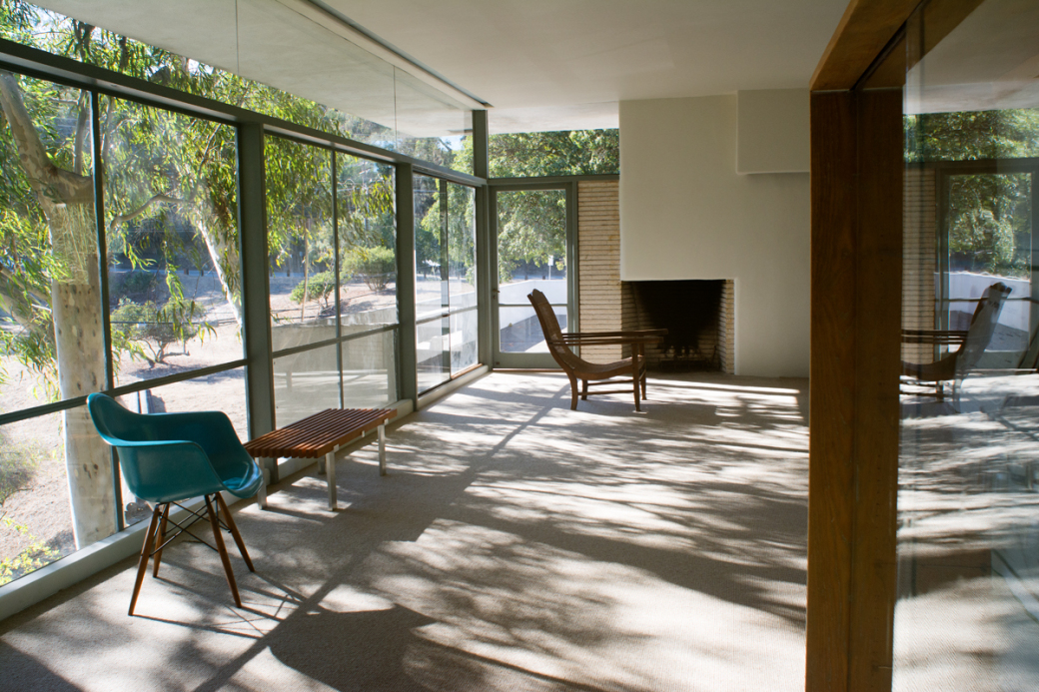
Fitzpatrick House, Los Angeles, CA (1936)

Slide 43
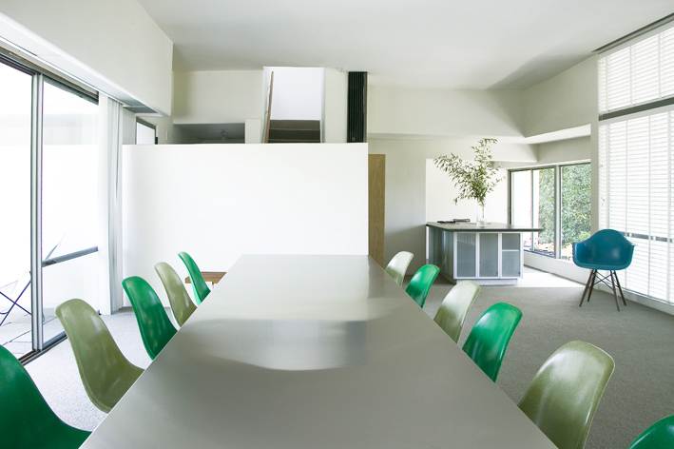
Fitzpatrick House, Los Angeles, CA (1936)

Slide 44
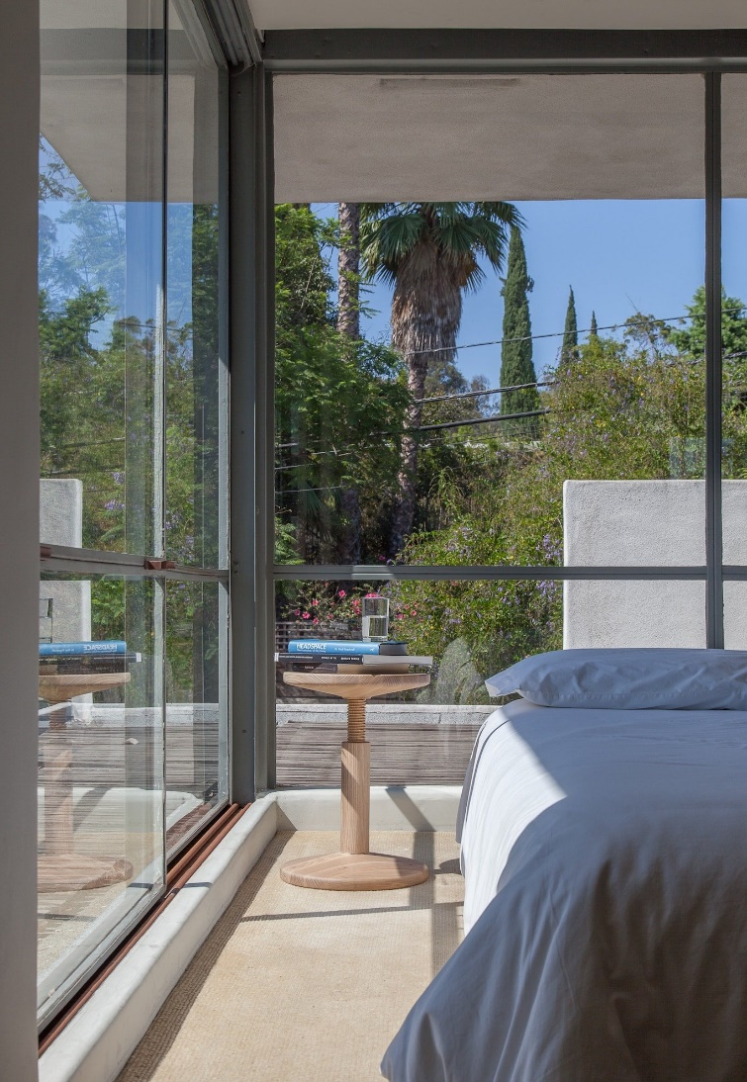
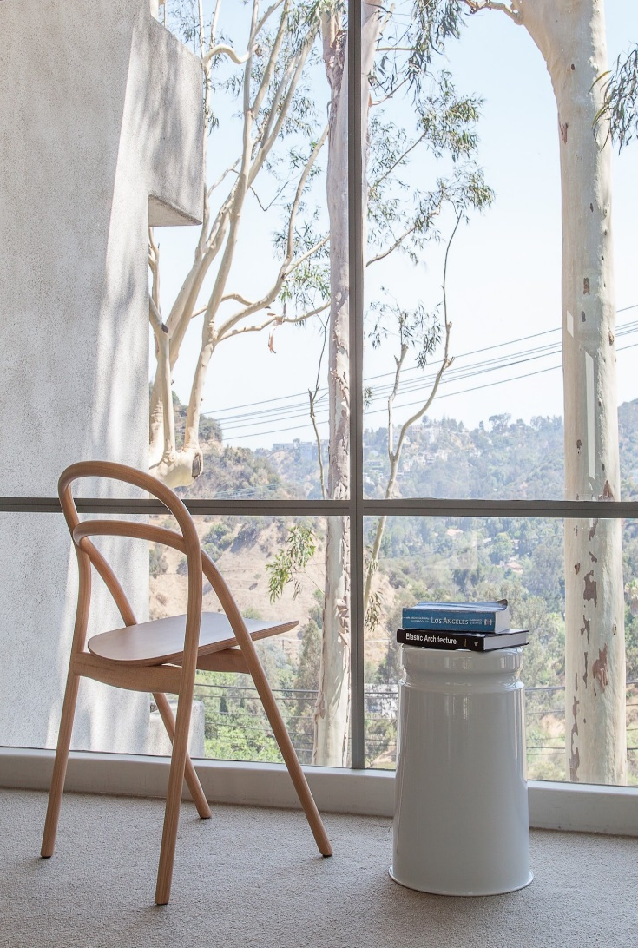
Fitzpatrick House, Los Angeles, CA (1936)

Slide 45
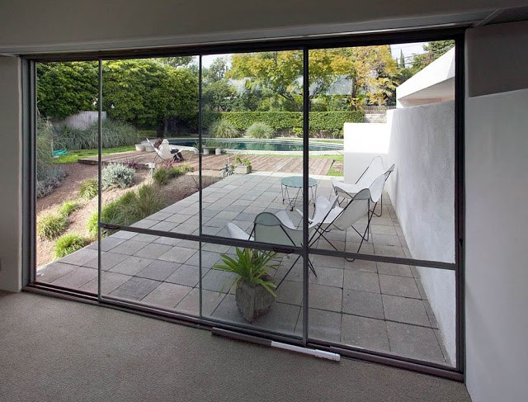
Fitzpatrick House, Los Angeles, CA (1936)

Slide 46
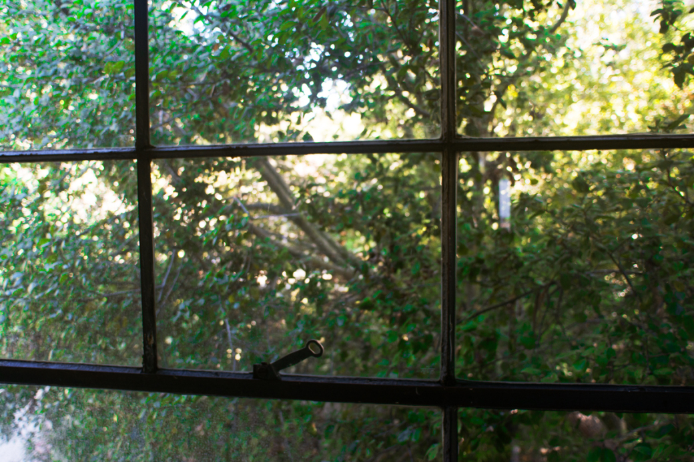
Fitzpatrick House, Los Angeles, CA (1936)

Slide 47
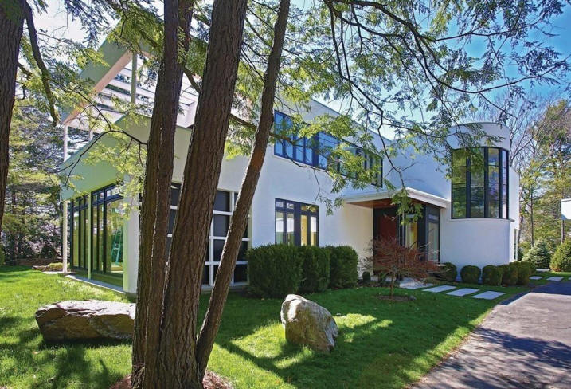
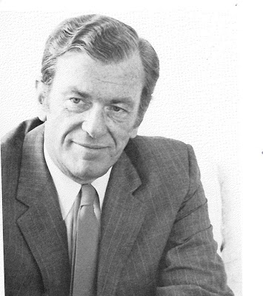
Cedar Street, Brookline, MA (1936)
Hugh Stubbins

Slide 48
Cedar Street, Brookline, MA (1936)
It is the work of the architect Hugh Stubbins.
The original modern house stood in contrast to the neighboring colonial-revival houses built during the same period.
In 2016, this house was completely renovated by Mga architects : the result is a complementary and compatible juxtaposition of existing and new architectural elements that share a common aesthetic sensibility.

Slide 49
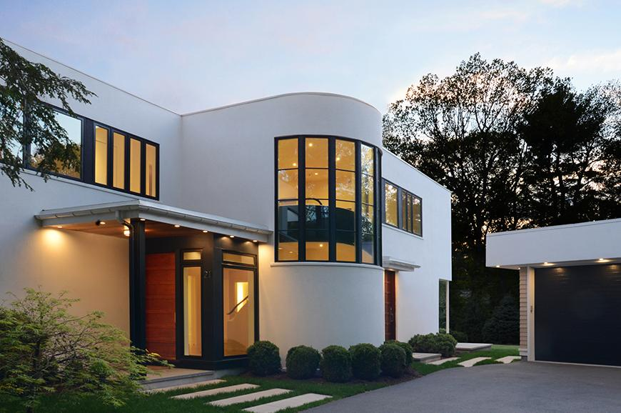
Cedar Street, Brookline, MA (1936)

Slide 50
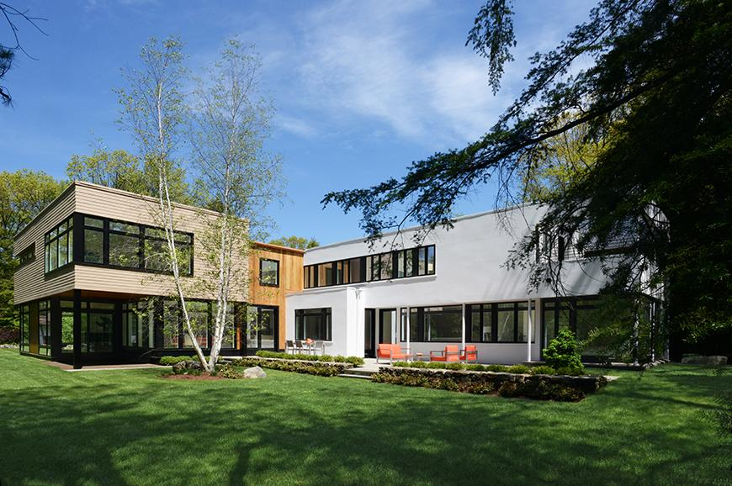
Cedar Street, Brookline, MA (1936)

Slide 51
Cedar Street, Brookline, MA (1936)

Slide 52
Cedar Street, Brookline, MA (1936)

Slide 53
Cedar Street, Brookline, MA (1936)

Slide 54
Cedar Street, Brookline, MA (1936)

Slide 55
Cedar Street, Brookline, MA (2016)

Slide 56
Ernst House, Los Angeles, CA (1937)
Gregory Ain

Slide 57
Ernst House, Los Angeles, CA (1937)
It is the work of the architect Gregory Ain.
The house combines clean lines, glass walls and corner windows to create open, bright formal rooms on the main level. Like many hillside houses of the time, the floor plan has been inverted so that the bedrooms are below the common areas and open to the outside.
On the main level, the under-lit entrance leads to a living room with large glass walls, high

Slide 58
Ernst House, Los Angeles, CA (1937)

Slide 59
Ernst House, Los Angeles, CA (1937)

Slide 60
Ernst House, Los Angeles, CA (1937)

Slide 61
Ernst House, Los Angeles, CA (1937)

Slide 62
Ernst House, Los Angeles, CA (1937)

Slide 63
Ernst House, Los Angeles, CA (1937)

Slide 64
Ernst House, Los Angeles, CA (1937)

Slide 65
Ernst House, Los Angeles, CA (1937)

Slide 66
Kraigher House, Brownsville, TX (1937)
Richard Neutra

Slide 67
Kraigher House, Brownsville, TX (1937)
It is the work of the architect Richard Neutra.
It is a house with 2 levels with wooden structure: on the 1st floor the living spaces (living room, dining room, kitchen) and a bedroom and on the 2nd, a bedroom and a terrace on the roof with modernist features (flat roofs, strip windows, walls covered with white stucco).
The City of Brownsville became the owner and has been faithfully rehabilitated through the University of Brownsville.

Slide 68
Kraigher House, Brownsville, TX (1937)

Slide 69
Kraigher House, Brownsville, TX (1937)

Slide 70
Kraigher House, Brownsville, TX (1937)

Slide 71
Kraigher House, Brownsville, TX (1937)

Slide 72
Kraigher House, Brownsville, TX (1937)

Slide 73
Grace Miller, Palm Springs, CA (1937)
Richard Neutra

Slide 74
Grace Miller, Palm Springs, CA (1937)
It is the work of the architect Richard Neutra.
Located on a two-and-a-half acre piece of property, the 1,100-square-foot house is defined by its unusual program and sparse landscape. A minimalist box with reinforced concrete walls trimmed in aluminum and framed views of the surrounding desert.
A creative and functional design, the Miller House responded to the desert climate with a panel of north-facing windows for light and ventilation and wide overhangs on the south and west for much needed shade.

Slide 75
Grace Miller, Palm Springs, CA (1937)

Slide 76
Grace Miller, Palm Springs, CA (1937)

Slide 77
Grace Miller, Palm Springs, CA (1937)

Slide 78
Grace Miller, Palm Springs, CA (1937)

Slide 79
Grace Miller, Palm Springs, CA (1937)

Slide 80
Grace Miller, Palm Springs, CA (1937)

Slide 81
Grace Miller, Palm Springs, CA (1937)

Slide 82
Grace Miller, Palm Springs, CA (1937)

Slide 83
Grace Miller, Palm Springs, CA (1937)

Slide 84
Schweikher House, Schaumburg, IL (1937)
Paul Schweikher

Slide 85
Schweikher House, Schaumburg, IL (1937)
The brick, wood, and glass house was designed by Paul Schweikher in 1937 and built as his residence and studio.
Moving along the stem of the ‘T’ between carport and house, one is drawn to the covered void of an open east facing breezeway portal. Brick and horizontal redwood board and batten walls align the southern edge of this formal processional. The entry is pronounced by glazed double doors and a generous sidelight that offer the guest/visitor a vista to the far southern brick wall of the living room, and into the south-facing courtyard. The roof appears to hover over operable clerestory ventilation panels.

Slide 86
Schweikher House, Schaumburg, IL (1937)
Across the entry-paving bricks in the living/dining/piano room awaits a powerful ceiling of heavy re-sawn Douglas fir columns/beams expressed between panels of clear-aged redwood boards.
The carefully coursed south wall brick is softened at its base by a comfortable platform couch lined with colorful pillows. A vertical slot of daylight at the joint between wall and fireplace dramatically lightens the massive stacked bond brick fireplace hood.

Slide 87
Schweikher House, Schaumburg, IL (1937)
Conceived as both home and studio, the ‘T’ plan is completed by the northern arm of the drafting studio workshop. This area offered a place for work and client meetings close to home.
A balanced composition of common “Chicago sewer brick,” exotic first growth redwood (unheard of at the time), Douglas fir and newly invented plywood planes; the house is an exquisite invention in all respects.
The bedroom suite for Paul Jr. is inserted in the southwestern portion of the ‘T’ past the master bedroom. North of the existing studio a cantilevered conference room with the unexpected ceiling height of 6’3″ plays against the full north facing glazed aperture that overlooks Salt Creek.

Slide 88
Schweikher House, Schaumburg, IL (1937)

Slide 89
Schweikher House Schaumburg, IL (1937)

Slide 90
Schweikher House, Schaumburg, IL (1937)

Slide 91
Schweikher House, Schaumburg, IL (1937)

Slide 92
Schweikher House, Schaumburg, IL (1937)

Slide 93
Schweikher House, Schaumburg, IL (1937)

Slide 94
Schweikher House, Schaumburg, IL (1937)

Slide 95
Schweikher House, Schaumburg, IL (1937)

Slide 96
Schweikher House, Schaumburg, IL (1937)

Slide 97
Schweikher House, Schaumburg, IL (1937)

Slide 98
Cahn House, Lake Forest, IL (1937)
George Fred Keck

Slide 99
Cahn House, Lake Forest, IL (1937)
It is the work of the architects George Fred & William Keck.
The house was crescent shaped with the north-facing concave curve embracing a circular drive to create an entrance court.
To ensure privacy from the drive, Keck designed a hallway running the length of the interior curve to serve as a buffer between the other spaces. Glass block windows along the hallway’s exterior wall allowed for the exchange of light while maintaining privacy. The living room and bedrooms were positioned in the rear of the house, which followed the convex curve; all the walls had large clear glass glazed walls facing south.

Slide 100
Cahn House, Lake Forest, IL (1937)
Broad eaves and external, chain-driven Venetian blinds shaded the glass openings, protecting the interior of the house from overheating in the summer, while allowing the sun to penetrate and warm the interior in the winter.
The living room projected out from the southern curve of the house, with 3 glazed walls providing both morning and afternoon light as well as dramatic views of the meadow.
The living room was the home’s most dramatic space, with a high ceiling painted cobalt blue, walls and furniture in yellow, and black rubber flooring.

Slide 101
Cahn House, Lake Forest, IL (1937)

Slide 102
Cahn House, Lake Forest, IL (1937)

Slide 103
Cahn House, Lake Forest, IL (1937)

Slide 104
Cahn House, Lake Forest, IL (1937)

Slide 105
Cahn House, Lake Forest, IL (1937)

Slide 106
Cahn House, Lake Forest, IL (1937)
THE END

