Slide 1
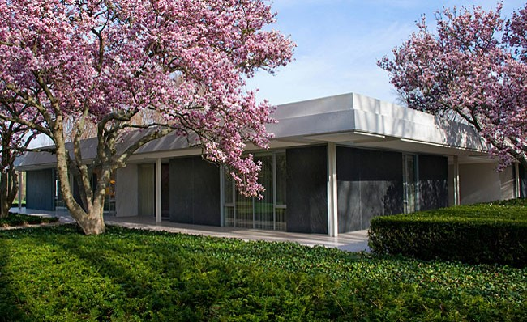
US. Modernist Houses
1957
US. Modernist Houses
1955-1960

Slide 2
US Modernist Houses 1957
The purpose of this presentation is to show you the most outstanding Modern Movement inspired houses in the United States by great architects.
Some of them have become icons of contemporary architecture (members of the iconic.org network) and are recognized and protected as such.
They remain unique either by their constructive principle, or by their location, or by their theoretical importance, or by their perfect integration into the landscape.

Slide 3
US Modernist Houses
Many of the houses presented in this slide show (before the year 2000) were found on the OfHouses website (Old Forgotten Houses) which lists houses with architectural interest or singular architecture around the world with many illustrations. If they are shown here, it is because they are already considered as iconic.

Slide 4
US Modernist Houses
Towers Residence, Ulrich Franzen, CT.
Sam Herron House, Victor Lundy, FL.
Cecil Alexander House, Cecil Alexander, GA.
Frank House, Buff/Straub/Hensman, CA.
Gavello House, Robert Anshen & Stephen Allen, CA.
Alexander House, William Krisel, CA.
Miller House, Eero Saarinen, IN.
Shepherd House, Ralph Rapson, MN.
Wild Bird, N. Owings & M. Mills, CA.
Hunt House, Craig Ellwood, CA.

Slide 5
US Modernist Houses 2
Weese House, Harry Weese, IL.
Alcoa House, Charles Goodman, MI.
Cove Way House, Alfred T. Wilkes, CA.
Blair House, George Nemeny, NY.
Sherrill House, James Sherrill, NC.

Slide 6
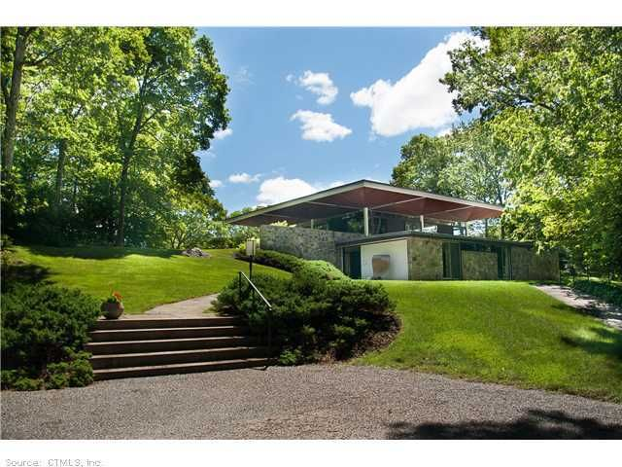
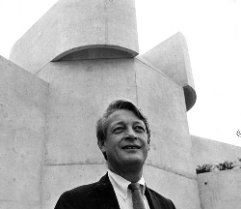
Towers Residence, Essex, CT (1957)
Ulrich Franzen

Slide 7
Towers Residence, Essex, CT (1957)
It is the work of the architect Ulrich Franzen.
The house was developed with a lower level set into the hillside, retained by walls of granite found on the site. This level contains sleeping and service rooms. The active areas , living room, dining room and kitchen are place in the open glass pavillion set above the stone podium. The roof structure is entirely free standing and self bracing. It is composed of 9 inverted steel-frame umbrellas, which are linked together as 3 hinged arches. The steel frame is clad in wood, and the ceiling is of treated natural cypress. The floors of the pavillion are oak blocks, and on the lower level, the floors is a concrete slab.

Slide 8
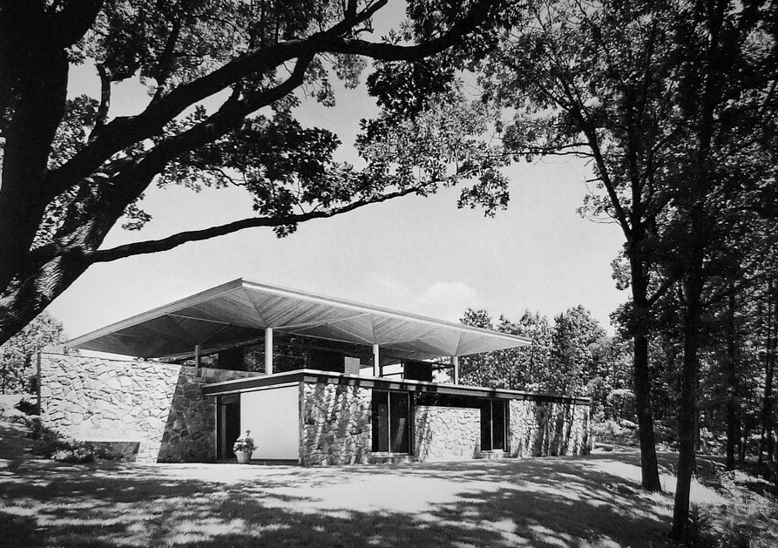
Towers Residence, Essex, CT (1957)

Slide 9
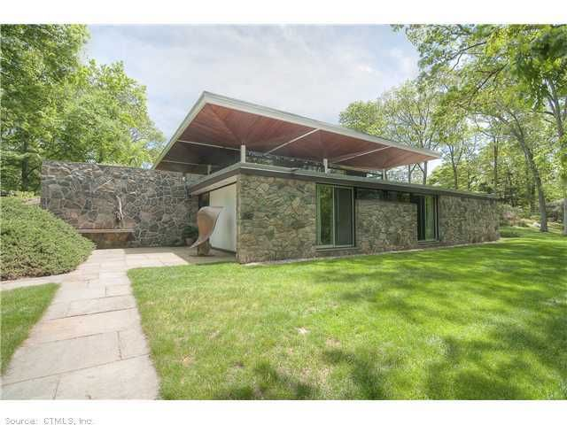
Towers Residence, Essex, CT (1957)

Slide 10
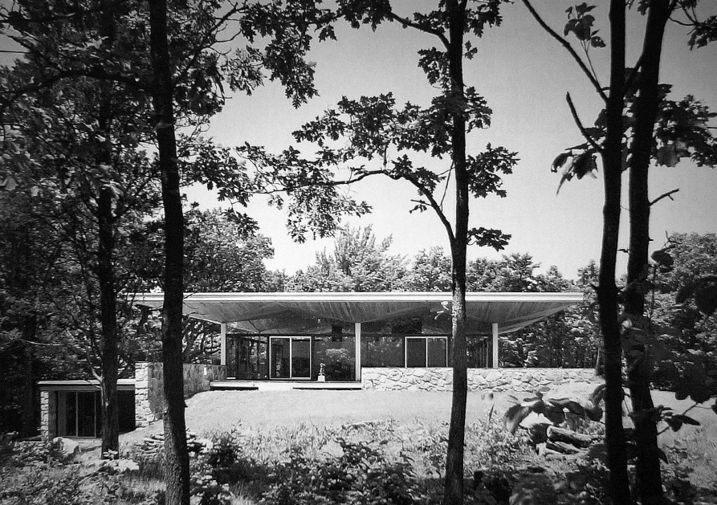
Towers Residence, Essex, CT (1957)

Slide 11
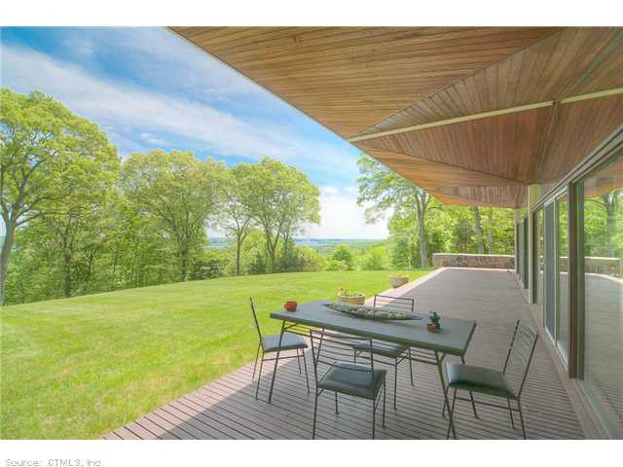
Towers Residence, Essex, CT (1957)

Slide 12
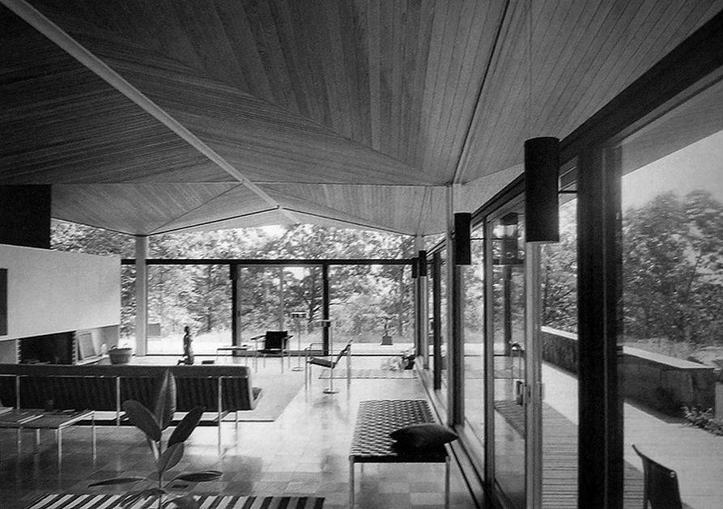
Towers Residence, Essex, CT (1957)

Slide 13
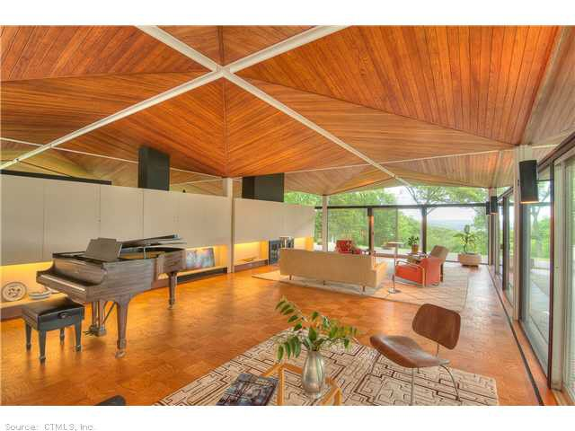
Towers Residence, Essex, CT (1957)

Slide 14
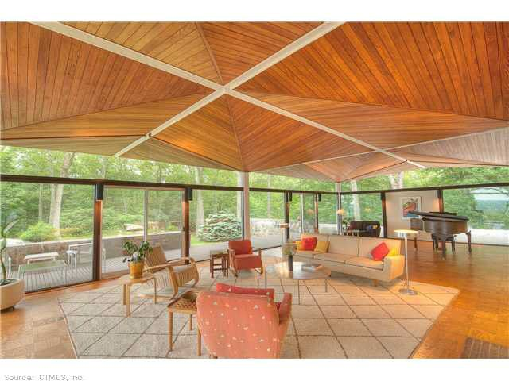
Towers Residence, Essex, CT (1957)

Slide 15
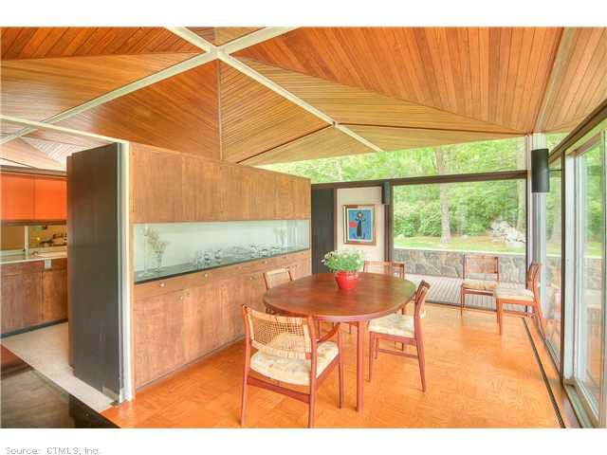
Towers Residence, Essex, CT (1957)

Slide 16
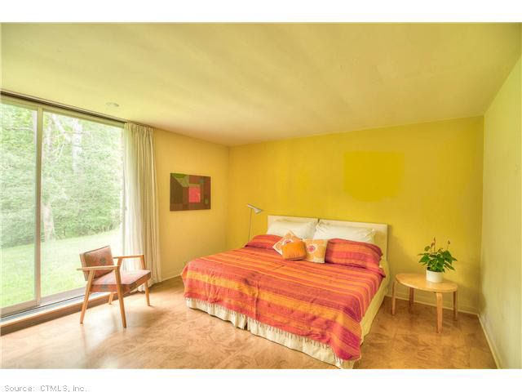
Towers Residence, Essex, CT (1957)

Slide 17
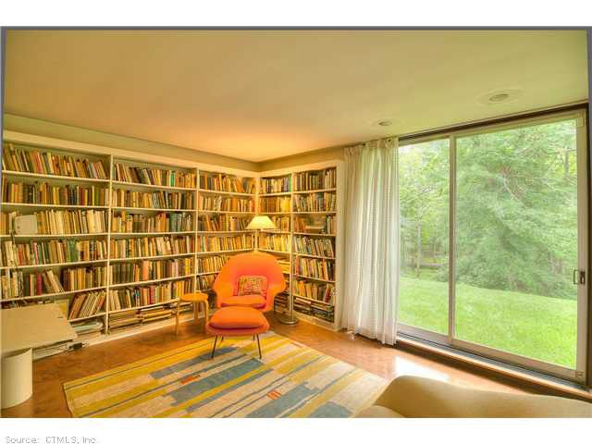
Towers Residence, Essex, CT (1957)

Slide 18
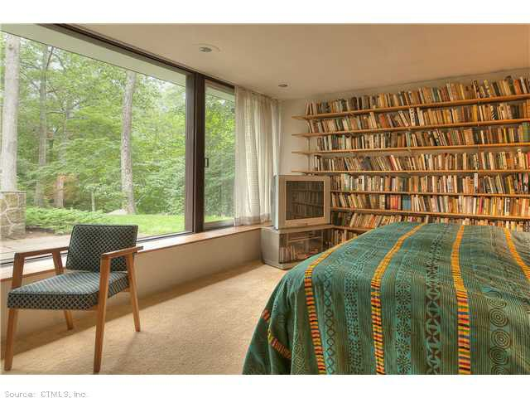
Towers Residence, Essex, CT (1957)

Slide 19
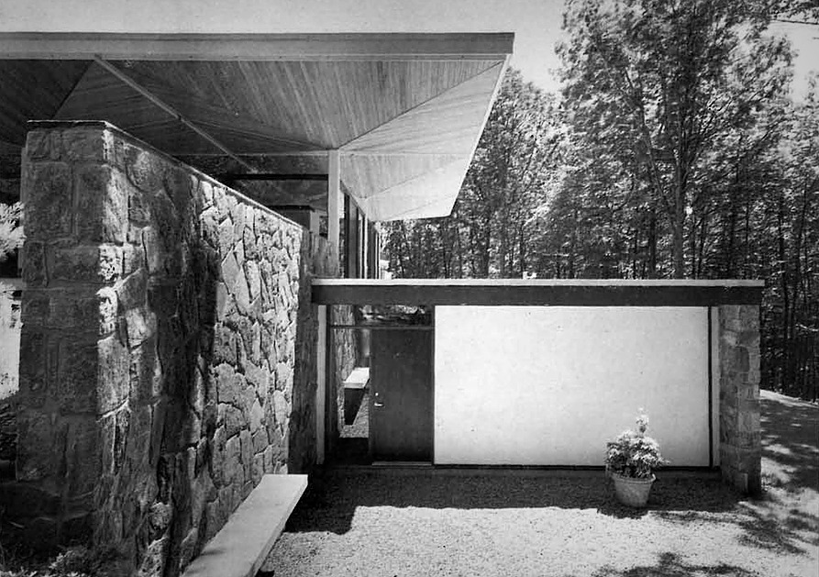
Towers Residence, Essex, CT (1957)

Slide 20
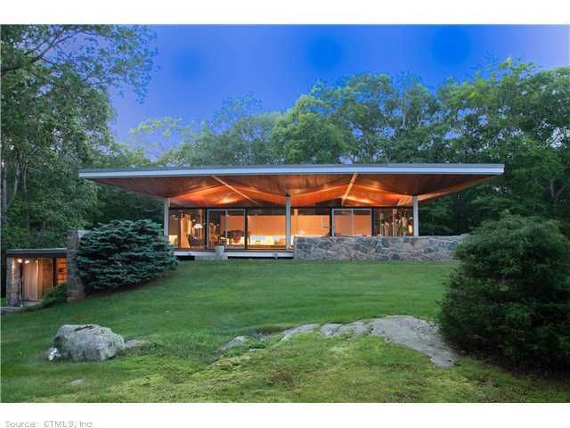
Towers Residence, Essex, CT (1957)

Slide 21
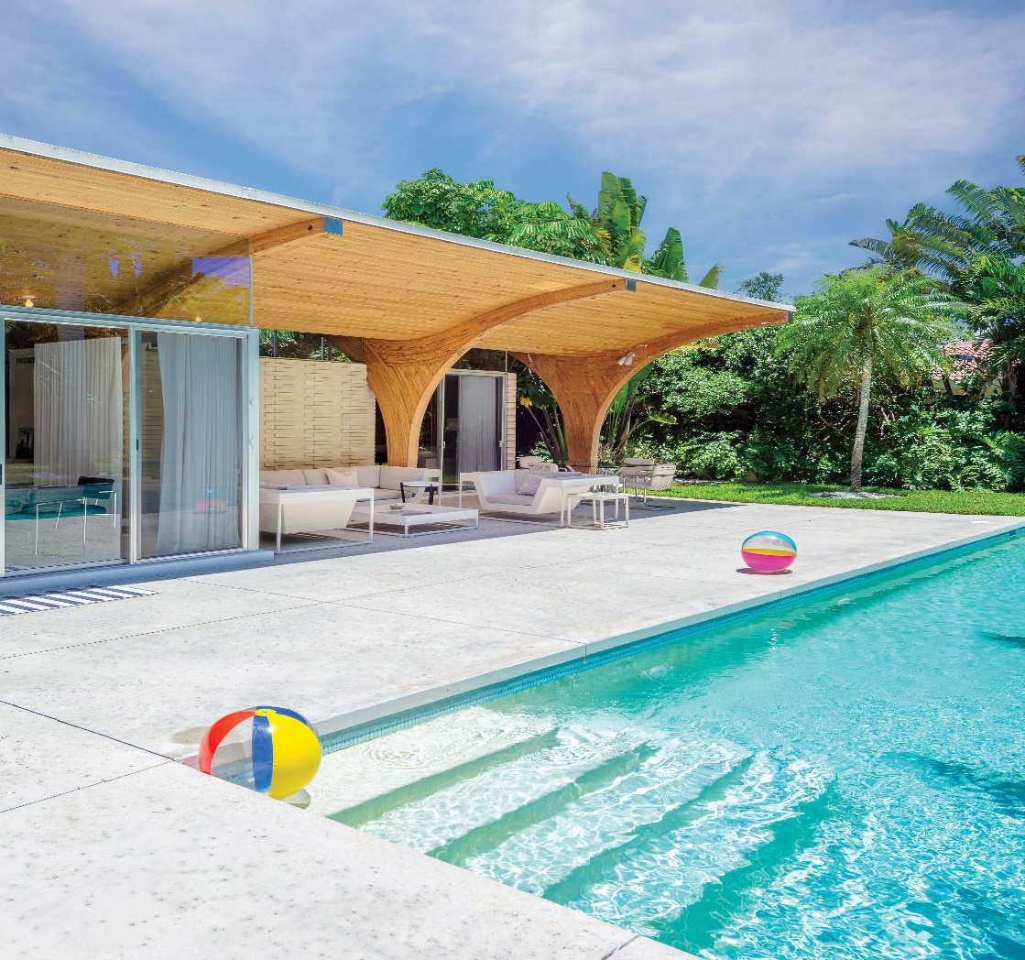
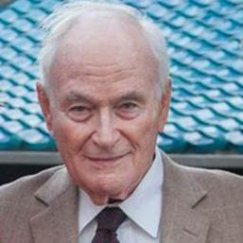
Sam Herron House, Venice, FL (1957)
Victor Lundy

Slide 22
Sam Herron House, Venice, FL (1957)
It is the work of the architect Victor Lundy.
The Herron house is all curves and circles. The house is known for its defining feature : wavy posts and beams that in one fluid motion shade the patios on the east and west side of the central pavilion and enclose the core of the structure. The cruciform interior include bedrooms and bathrooms at each corner, a great room and a kitchen in 3.200 sqf.

Slide 23
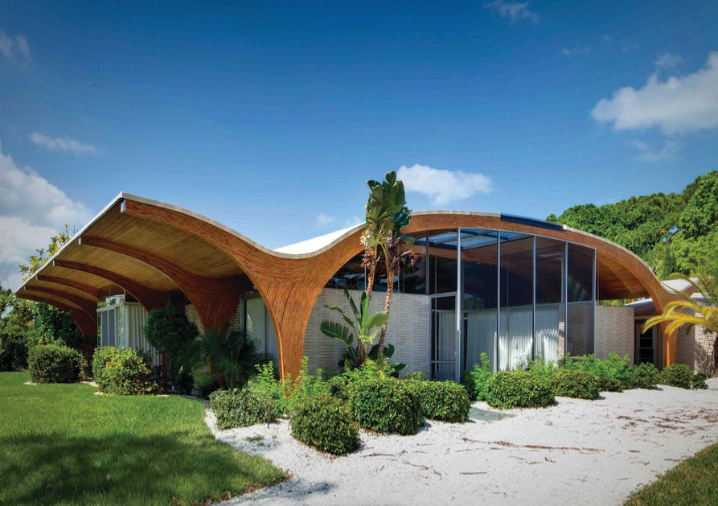
Sam Herron House, Venice, FL (1957)

Slide 24
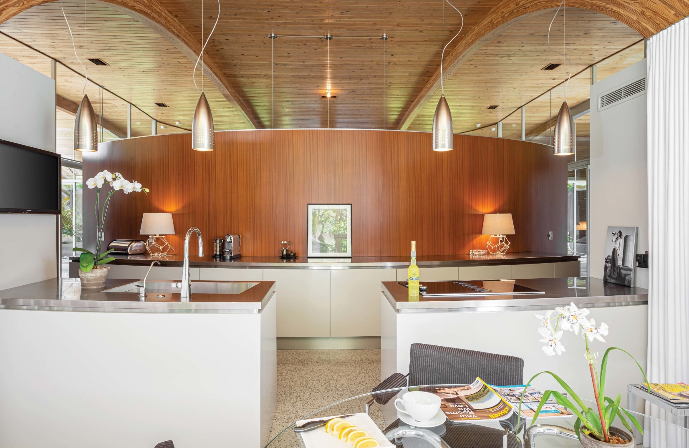
Sam Herron House, Venice, FL (1957)

Slide 25
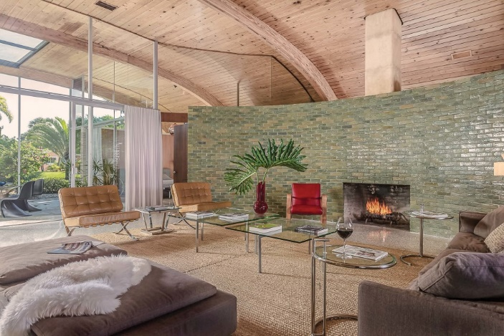
Sam Herron House, Venice, FL (1957)

Slide 26
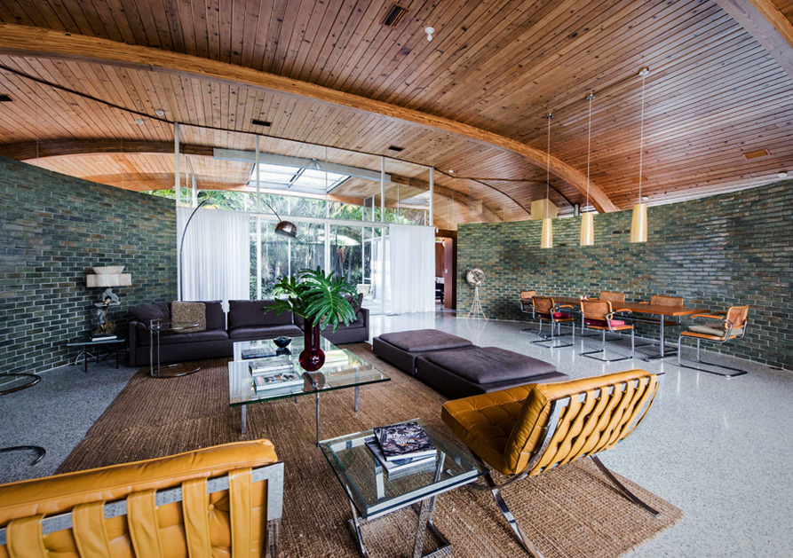
Sam Herron House, Venice, FL (1957)

Slide 27
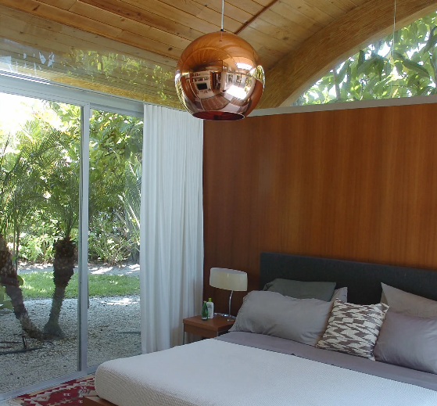
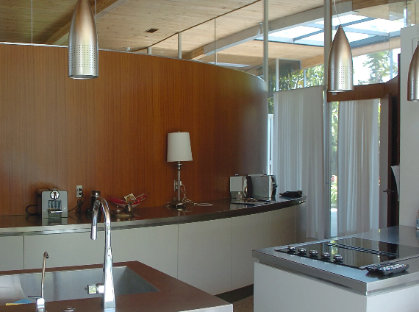
Sam Herron House, Venice, FL (1957)

Slide 28
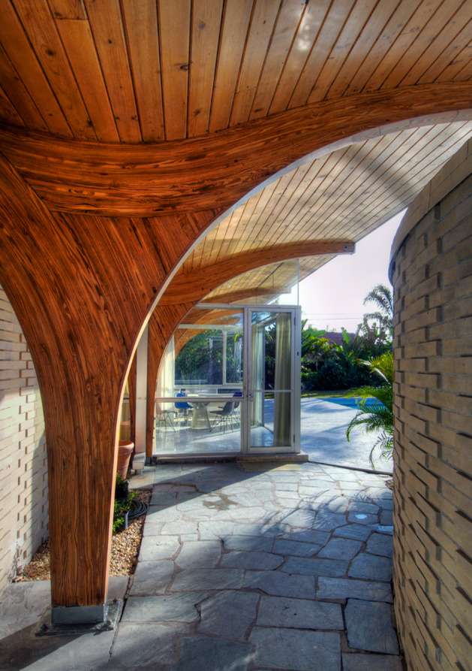
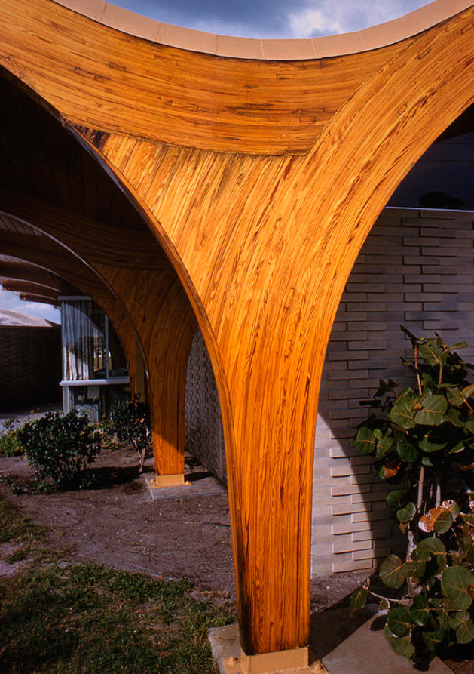
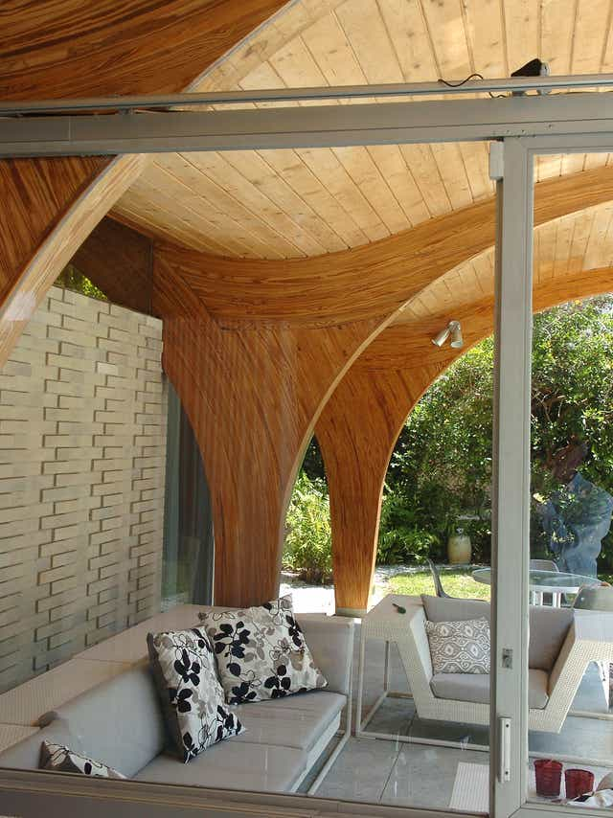
Sam Herron House, Venice, FL (1957)

Slide 29
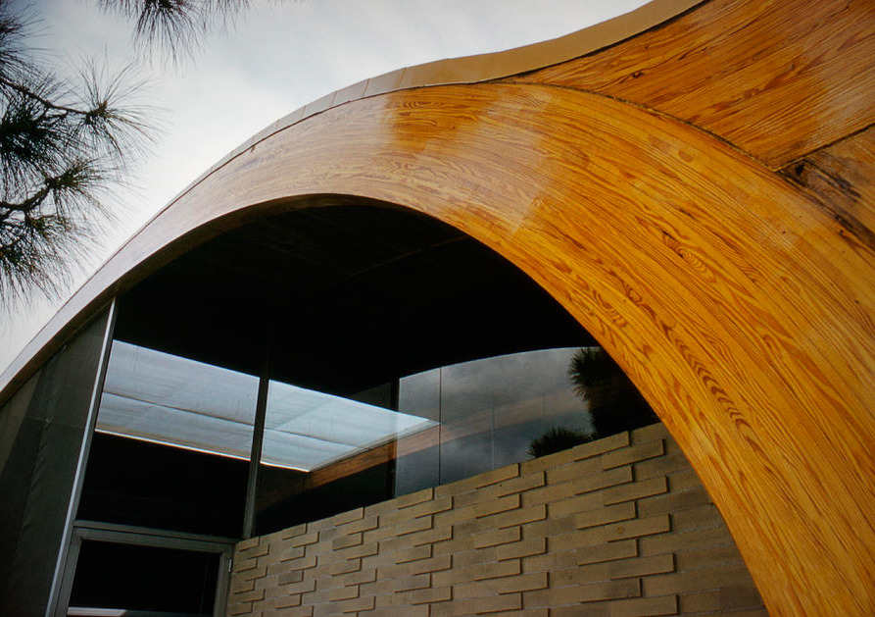
Sam Herron House, Venice, FL (1957)

Slide 30
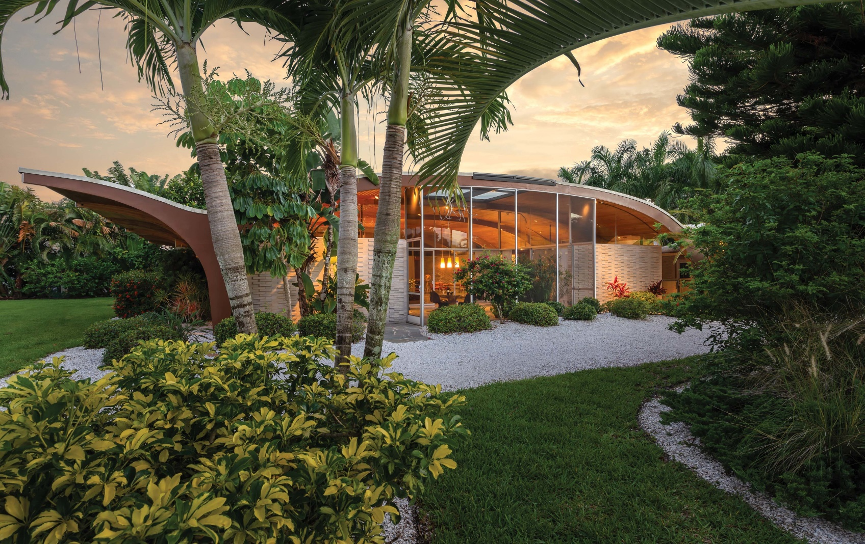
Sam Herron House, Venice, FL (1957)

Slide 31
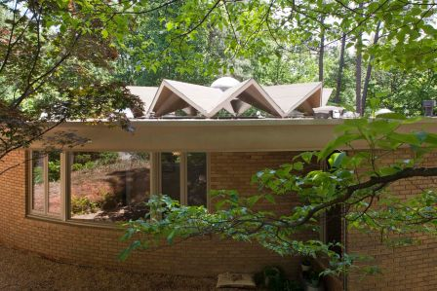
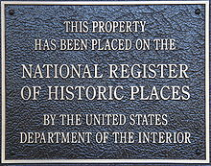
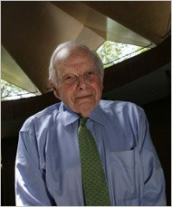
Cecil Alexander House, Atlanta, GA (1957)
Cecil Alexander

Slide 32
Cecil Alexander House, Atlanta, GA (1957)
It is the architect Cecil Alexander's own residence
It has a circular plan with an inner courtyard. This central space is covered by a pleated plate roof punctuated by dormers that flood the interior space with light. Meanwhile, the wedge-shaped rooms radiate outwards from the inner courtyard. The rooms in the north and east parts of the house have curved bay windows from floor to ceiling, while panoramic windows in 3 parts punctuate the west wall of the house.

Slide 33
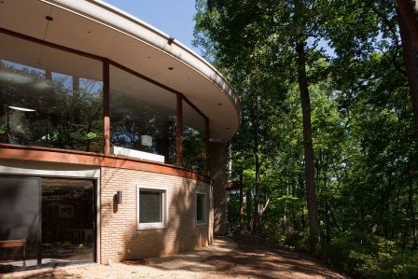
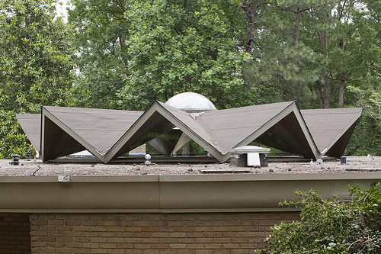
Cecil Alexander House, Atlanta, GA (1957)

Slide 34
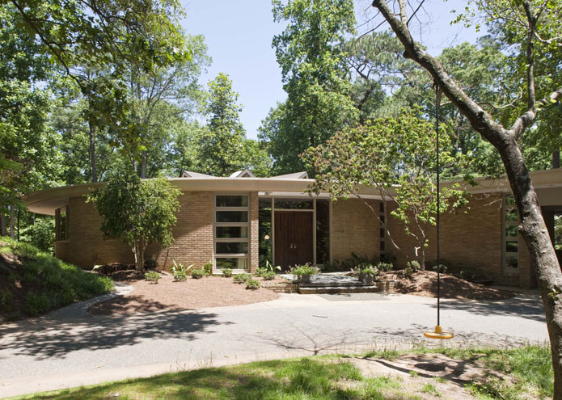
Cecil Alexander House, Atlanta, GA (1957)

Slide 35
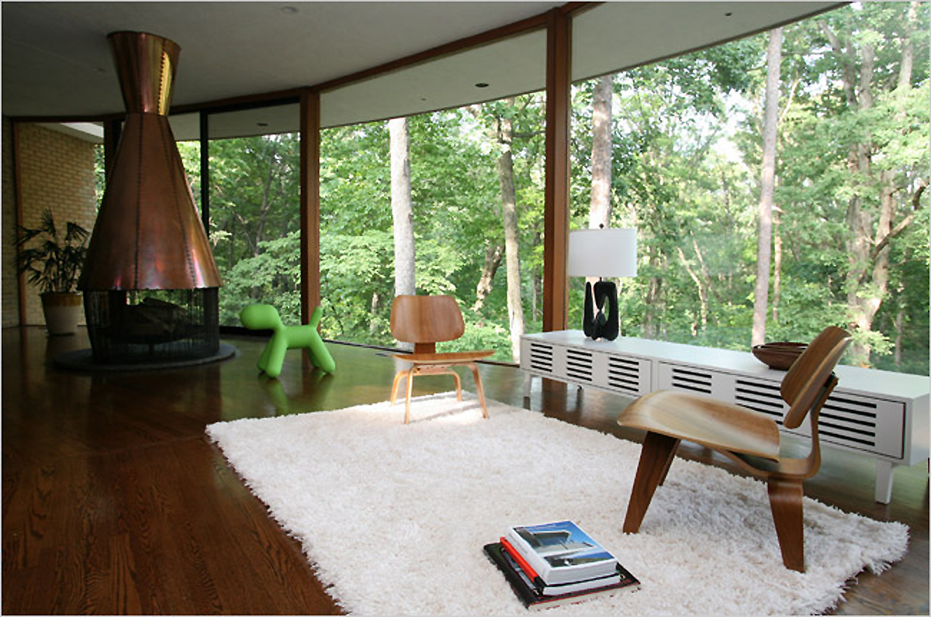
Cecil Alexander House, Atlanta, GA (1957)

Slide 36
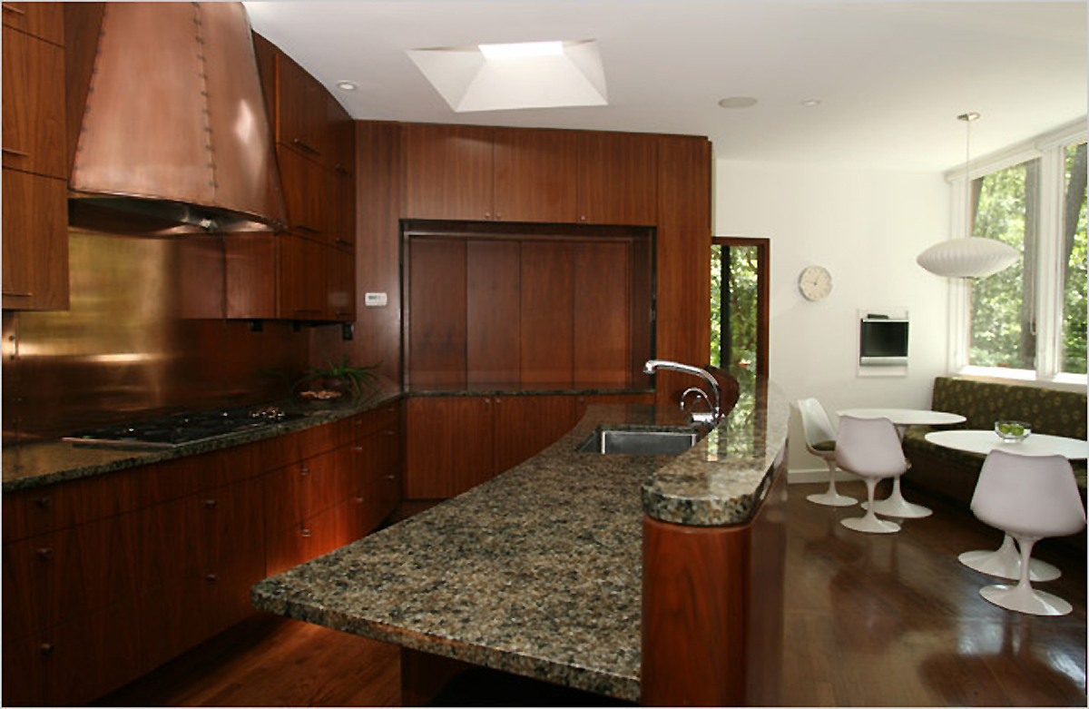
Cecil Alexander House, Atlanta, GA (1957)

Slide 37
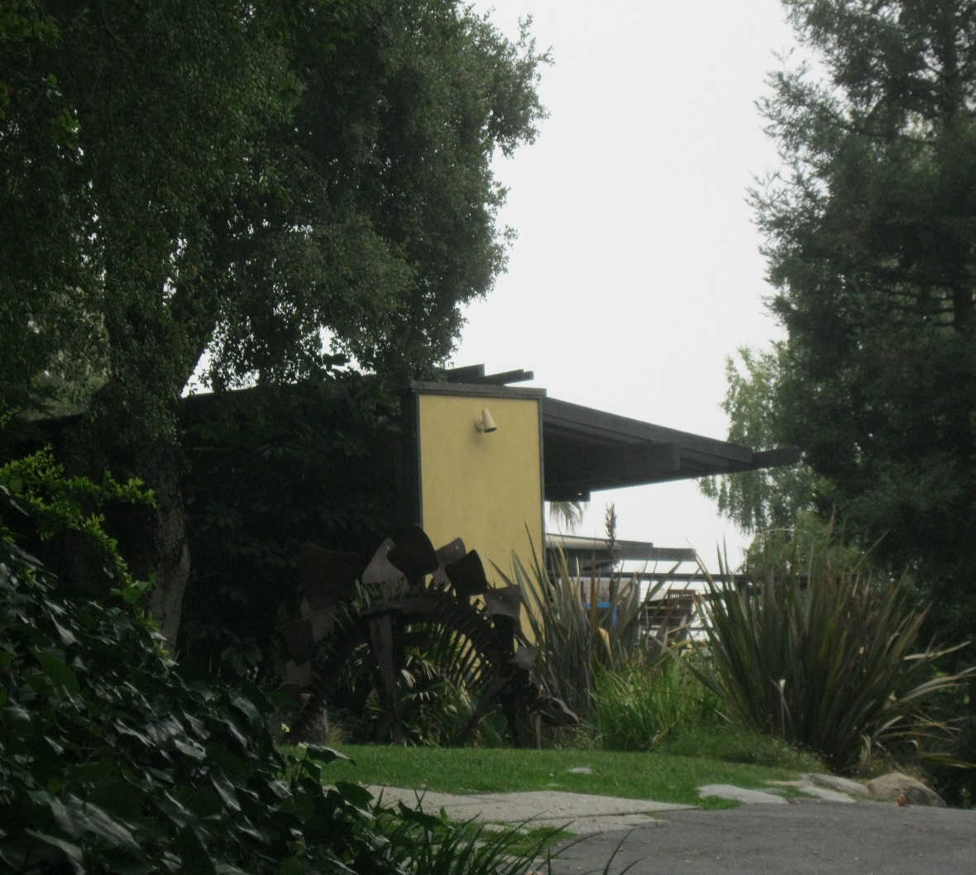
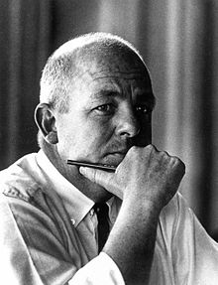
Frank House, Pasadena, CA (1957)
Conrad Buff
Donald Hensman
Calvin Straub

Slide 38
Frank House, Pasadena, CA (1957)
It is the work of Buff/Straub/Hensman firm.
The home's design features gently sloped roofs with tongue-and-groove overhangs, an exterior with wide glass panels interspersed with thin wood and stucco sections, and exposed wooden framing. It is a T shape building : the stem of the T is the tall living room, whose prominent ridge beam extends well past the wood tongue-and-groove overhang protecting the full lenght porch. A secondary vertical volume has a roof identical to that of the living room with shallow angle and protruding outrigger ridge beam.

Slide 39
Frank House, Pasadena, CA (1957)
Outdoor desks extend all major volumes into the landscape. In contrast with the forceful east facade, the public entrance is discreet. On the interior, as on the exterior, the wood framing members are stained dark. Common brick is used for the fireplace; steps leading from the living room down to the pool and play /work /servant rooms, and as the coping for stucco-clad low walls that appear as transitional elements between the living room and pool elevations.

Slide 40
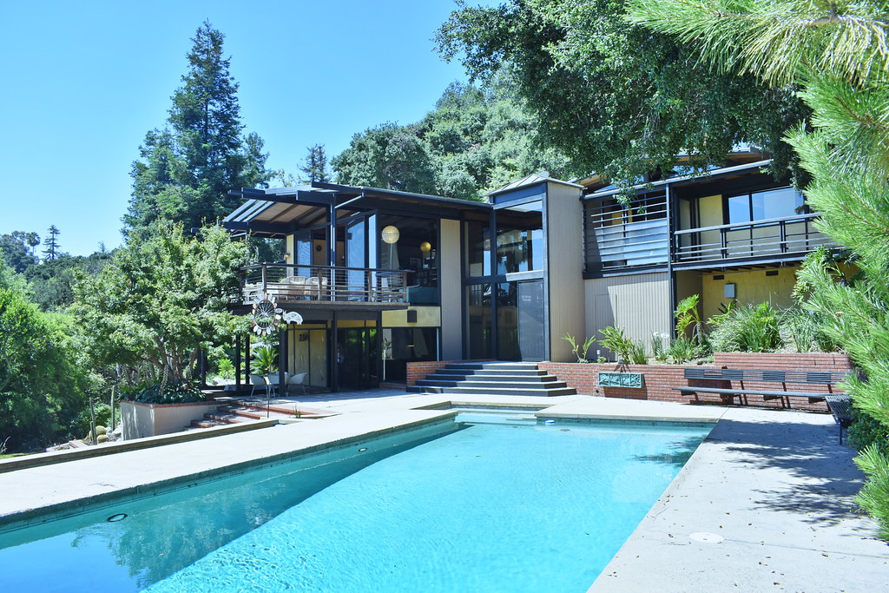
Frank House, Pasadena, CA (1957)

Slide 41
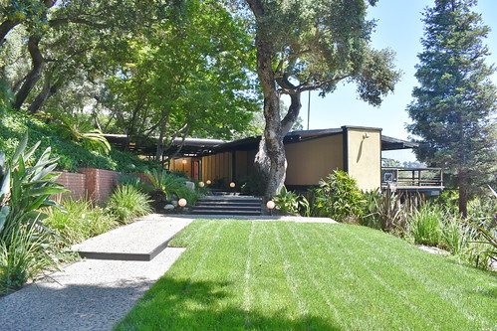
Frank House, Pasadena, CA (1957)

Slide 42
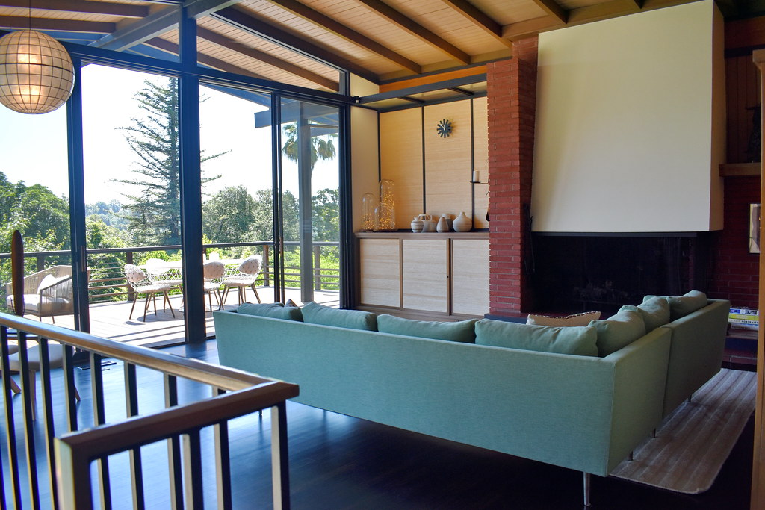
Frank House, Pasadena, CA (1957)

Slide 43
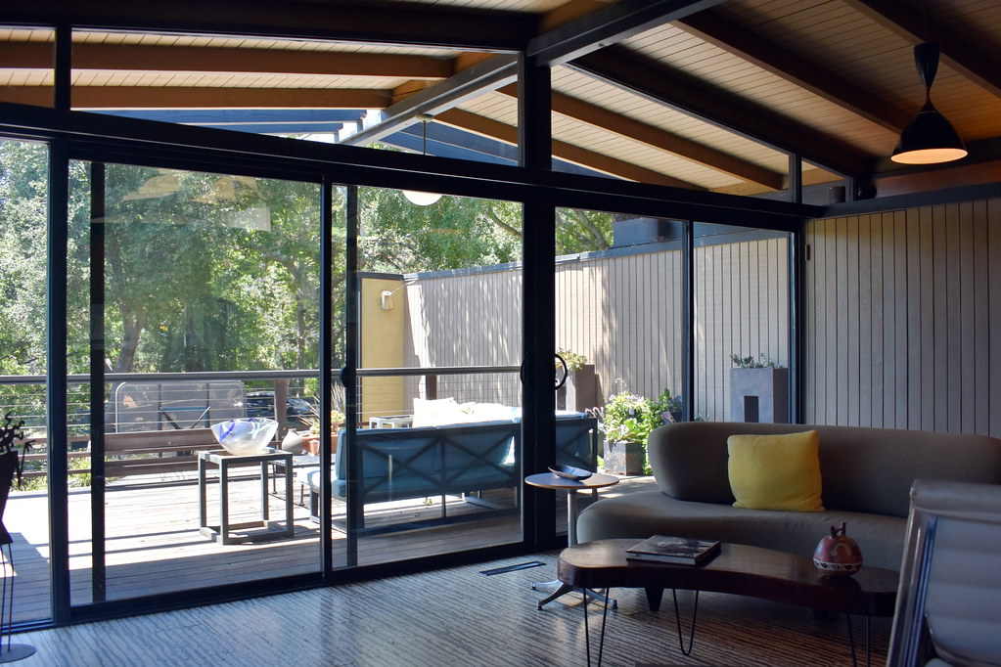
Frank House, Pasadena, CA (1957)

Slide 44
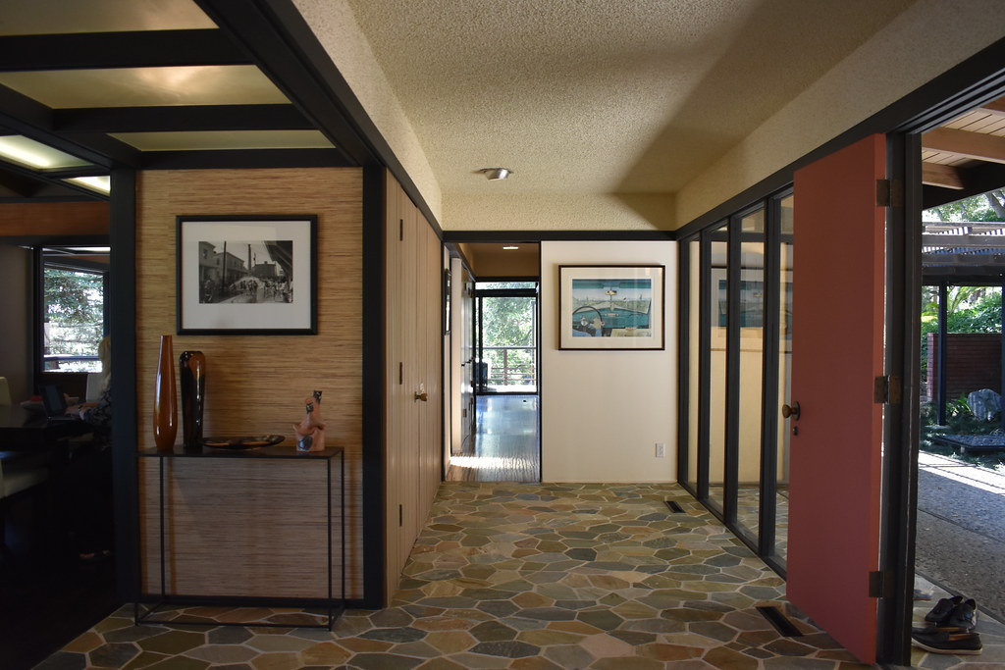
Frank House, Pasadena, CA (1957)

Slide 45
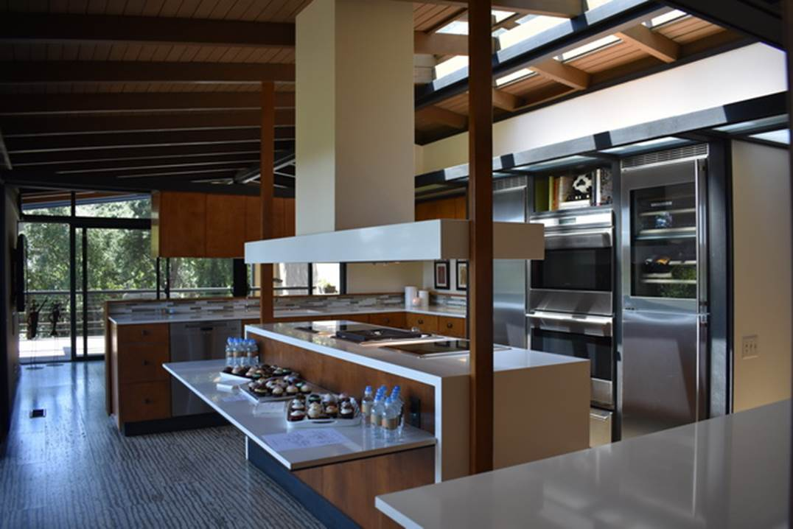
Frank House, Pasadena, CA (1957)

Slide 46
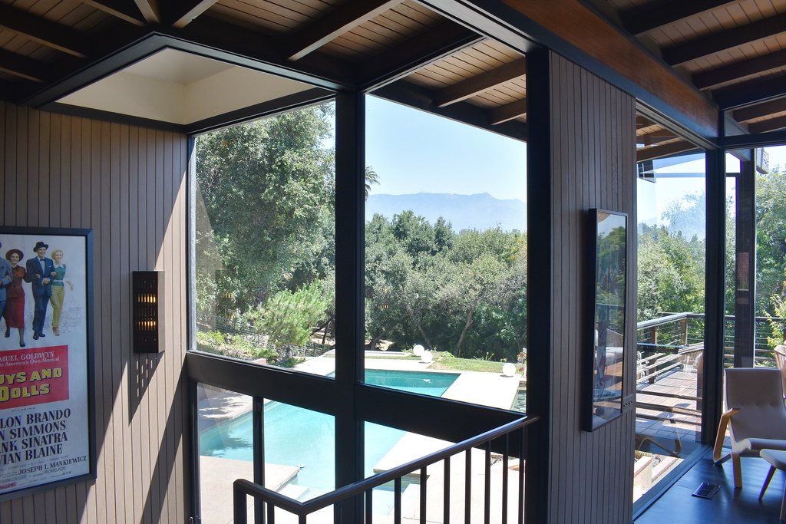
Frank House, Pasadena, CA (1957)

Slide 47
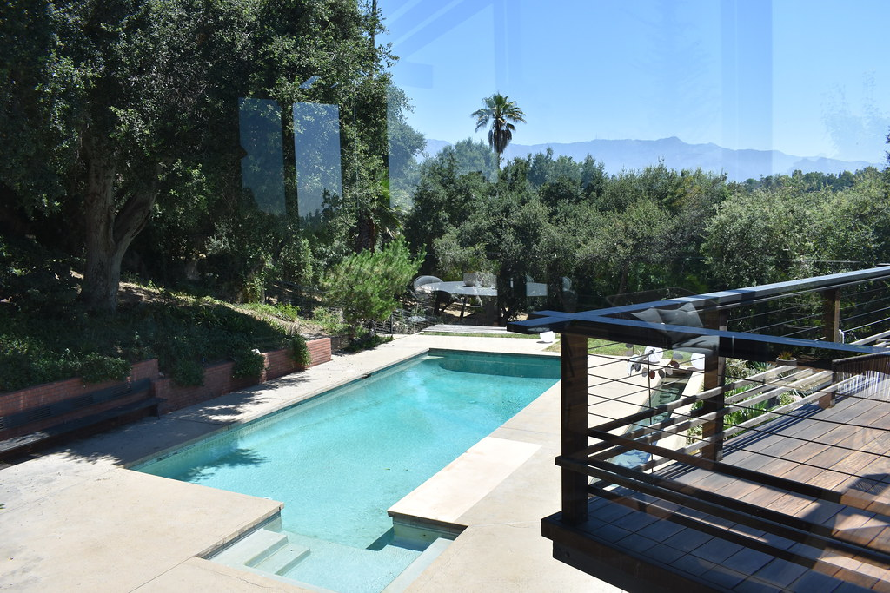
Frank House, Pasadena, CA (1957)

Slide 48
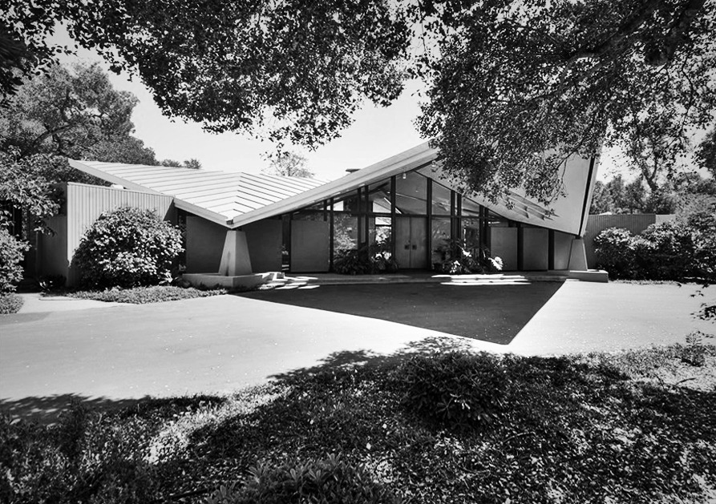
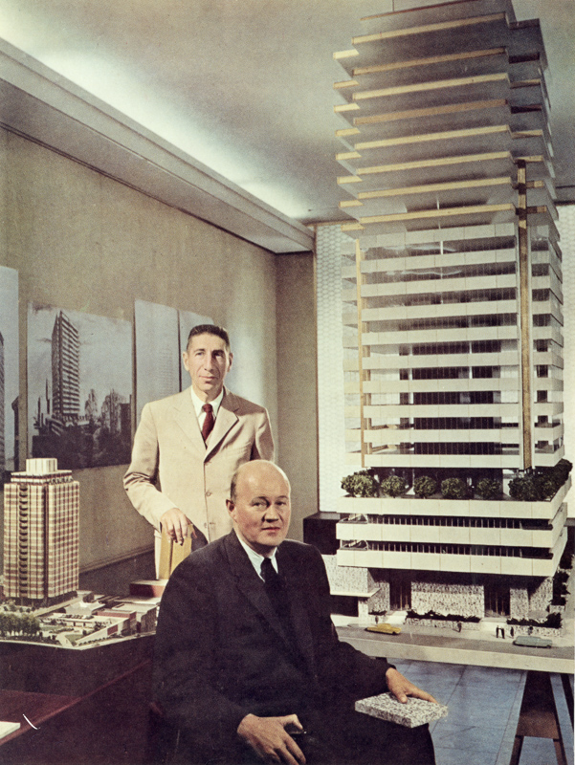
Gavello House, Atherton, CA (1957)
R. Anshen (L) & S. Allen (R)

Slide 49
Gavello House, Atherton, CA (1957)
It is the work of the architects Robert Anshen & Stephen Allen.
The main feature is a broad, floating cross-gable roof on steel points at four concrete bastions. The steel roof was coated with an alloy called terne to prevent rust. Inside, the house had walls that made it only halfway up towards the 16-foot ceiling. The living room is centered on a hexagonal multi-colored tile enlivened fireplace. This house was torn down in 2015.

Slide 50
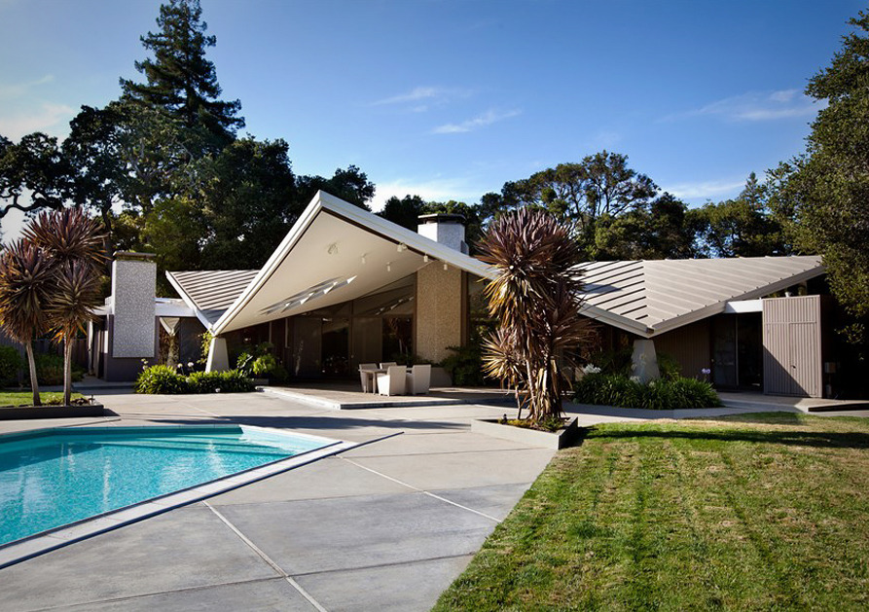
Gavello House, Atherton, CA (1957)

Slide 51
Gavello House, Atherton, CA (1957)

Slide 52
Gavello House, Atherton, CA (1957)

Slide 53
Gavello House, Atherton, CA (1957)

Slide 54
Gavello House, Atherton, CA (1957)

Slide 55
Gavello House, Atherton, CA (1957)

Slide 56
Alexander House, Palm Springs, CA (1957)
William Krisel

Slide 57
Alexander House, Palm Springs, CA (1957)
William Krisel is best known for Modernist developments created for the Alexander Company, one of the first Modernist builders in the US : this Company built more than 2500 homes.
It was a post-and-beam house with a butterfly-roof : each one in Twin Palms, although they appear custom-built, has the same basic floor plan. Simple features contribute to the timeless appeal of these houses. The clerestory windows give a hint of the outdoors, the light, the weather, and the surrounding mountains and palm trees.

Slide 58
Alexander House, Palm Springs, CA (1957)

Slide 59
Alexander House, Palm Springs, CA (1957)

Slide 60
Alexander House, Palm Springs, CA (1957)

Slide 61
Alexander House, Palm Springs, CA (1957)

Slide 62
Alexander House, Palm Springs, CA (1957)

Slide 63
Miller House, Columbus, IN (1957)
Eeero Saarinen

Slide 64
Miller House, Columbus, IN (1957)
It is the work of the architect Eero Saarinen.
This house encompasses some of the most fundamental aspects of the international Modernist aesthetic, including an open and flowing layout, flat roof and vast stone and glass walls. Totaling around 6,800 sqf, the one-story house comprised of glass and gray-blue-slate panels is supported by steel cruciform columns and illuminated by a grid of skylights. The exposed edges eliminate a sense of separation between interior and nature through use of huge panes of glass. Inside the house, 4 non-public areas separate from a central space, which includes a conversation pit. These 4 branches include rooms for parents, children, guests and servants, as well as utility areas (kitchen and laundry): the geometry of the plan of the house is similar to Andrea Palladio's 16th century Villa Rotunda in its organization of rooms around a central space.

Slide 65
Miller House, Columbus, IN (1957)

Slide 66
Miller House, Columbus, IN (1957)

Slide 67
Miller House, Columbus, IN (1957)

Slide 68
Miller House, Columbus, IN (1957)

Slide 69
Miller House, Columbus, IN (1957)

Slide 70
Miller House, Columbus, IN (1957)

Slide 71
Miller House, Columbus, IN (1957)

Slide 72
Miller House, Columbus, IN (1957)

Slide 73
Shepherd House, St Paul, MN (1957)
Ralph Rapson

Slide 74
Shepherd House, St Paul, MN (1957)
It's the work of architect Ralph Rapson.
This house, located in the University Grove district is included in an enclave of 103 houses made by architects at the request of the University for professors. The slope was utilized to provide second-level living facilities, with direct access to the street, and take advantage of the view. Bedrooms and play- oms are below. The foundations and lower level are concrete block with wood studs the level above. While the exterior is characterized by glass walls and colored laminated panels, the interior is characterized by open spaces that are easy to live in and by the omnipresent light in all the rooms of the house.

Slide 75
Shepherd House, St Paul, MN (1957)

Slide 76
Shepherd House, St Paul, MN (1957)

Slide 77
Shepherd House, St Paul, MN (1957)

Slide 78
Shepherd House, St Paul, MN (1957)

Slide 79
Shepherd House, St Paul, MN (1957)

Slide 80
Shepherd House, St Paul, MN (1957)

Slide 81
Wild Bird, Big Sur, CA (1957)
Nathaniel A. Owings
Mark Mills

Slide 82
Wild Bird, Big Sur, CA (1957)
It is the work of the architects Nathaniel Owings & Mark Mills.
Proudly sitting 600 feet high above the Pacific Ocean with red-tailed hawks sweeping gracefully below, this stunning property was suitably named Wild Bird, as it gives a wonderful sensation of flying. The concrete A-frame house has an almost sacrificial quality, with nearly all of its edges laid in glass and open to the whim of its surroundings. Wild Bird contains three main components: the main house, the separate guest house and a self-contained apartment, with a total of 4 bedrooms which can accommodate up to 8 guests.

Slide 83
Wild Bird, Big Sur, CA (1957)
The main house consists of three levels. The ground/entry level is made up of a great room, study, kitchen and dining area, with passage to a magnificent outside patio that has a 180 degree view of the Pacific Ocean, together with a spa hot tub, and a luxurious outdoor south facing barbecue deck and dining area. The upper level consists of the master bedroom suite with a fireplace and private deck and copper spa hot tub. The lower level provides a fitness area and a bedroom suite with a southern coastal view. The guest house is separate from the main house, sitting below the main house patio on the cliff edge, with one double bedroom and a round bathroom. The apartment and garage are nestled within a small hill on the property and has a southern exposure.

Slide 84
Wild Bird, Big Sur, CA (1957)

Slide 85
Wild Bird, Big Sur, CA (1957)

Slide 86
Wild Bird, Big Sur, CA (1957)

Slide 87
Wild Bird, Big Sur, CA (1957)

Slide 88
Wild Bird, Big Sur, CA (1957)

Slide 89
Wild Bird, Big Sur, CA (1957)

Slide 90
Wild Bird, Big Sur, CA (1957)

Slide 91
Wild Bird, Big Sur, CA (1957)

Slide 92
Wild Bird, Big Sur, CA (1957)

Slide 93
Wild Bird, Big Sur, CA (1957)

Slide 94
Wild Bird, Big Sur, CA (1957)

Slide 95
Wild Bird, Big Sur, CA (1957)

Slide 96
Wild Bird, Big Sur, CA (1957)

Slide 97
Hunt House, Malibu, CA (1957)
Craig Ellwood

Slide 98
Hunt House, Malibu, CA (1957)
It is the work of the architect Craig Ellwood.
The Hunt House appears as a solid rectangular volume with unornamented plaster walls framed by a heavy roofline and slender vertical posts. Two small, enclosed patios extend inward from the east and west sides of the building, resulting in a roughly H-shaped interior floor plan. The building is elevated and supported by 12-inch wood piles and 3-inch-by-8- inch wood bracing/whalers.

Slide 99
Hunt House, Malibu, CA (1957)
It is capped by a flat roof covered in built-up asphalt roofing. The roof eave at the south façade forms a wide canopy and partially shelters a full-width balcony with a wood railing and deck that overlooks the ocean. Eaves are flush at the north, east, and west façades.
The south façade consists entirely of glazing. Fixed panes of glass and fully glazed aluminum sliding doors are separated by thick painted wood mullions. A horizontal wood beam extending the length of the façade separates the fixed glazing and doors from a clerestory of fixed windows.

Slide 100
Hunt House, Malibu, CA (1957)
The interior of the house retains an east-west-oriented, H-shaped floor plan. The north leg of the H contains 2 bedrooms of approximately the same square footage. The south leg has an open kitchen at the west end, which overlooks a living room to the east. A central entrance hallway provides access to the bedrooms and the kitchen and living room. To the west of the hallway are two small bathrooms, and to the east is the larger of the two internal patios. This patio is enclosed by fixed floor-to-ceiling windows and fully glazed sliding aluminum doors.

Slide 101
Hunt House, Malibu, CA (1957)

Slide 102
Hunt House, Malibu, CA (1957)

Slide 103
Hunt House, Malibu, CA (1957)

Slide 104
Hunt House, Malibu, CA (1957)

Slide 105
Hunt House, Malibu, CA (1957)

Slide 106
Hunt House, Malibu, CA (1957)

Slide 107
Hunt House, Malibu, CA (1957)

Slide 108
Hunt House, Malibu, CA (1957)

Slide 109
Hunt House, Malibu, CA (1957)

Slide 110
Hunt House, Malibu, CA (1957)

Slide 111
Hunt House, Malibu, CA (1957)

Slide 112
Weese House, Barrington, IL (1957)
Harry Weese

Slide 113
Weese House, Barrington, IL (1957)
It is the own house of the architect Harry Weese.
The basic structure is composed of prefabricated panels of 4-in cedar planking. The exterior roof is cedar-shingled. The planking is left exposed as interior finish for both the roof and walls. The structure is basically a twin gabled one with the pitched ceiling of the main living room suspended between, not framed into them in the conventional way. It is a big, with a pitched ceiling which rises the full story at its peak.

Slide 114
Weese House, Barrington, IL (1957)
The wings house secondary living rooms and service areas on the main level, bedrooms above. It is divided visually into living and dining areas by a double fireplace. The 2 story gabled wings are connected by a dramatic bridge suspended by cables across the room. A catwalk gives access to one child’s bedroom. Each bedroom has balcony reached from outside by a ladder. Materials are informal : slate floor and birch planking on all sides and overhead.

Slide 115
Weese House, Barrington, IL (1957)

Slide 116
Weese House, Barrington, IL (1957)

Slide 117
Weese House, Barrington, IL (1957)

Slide 118
Weese House, Barrington, IL (1957)

Slide 119
Weese House, Barrington, IL (1957)

Slide 120
Weese House, Barrington, IL (1957)

Slide 121
Alcoa House, Grand Rapids, MI (1957)
Charles M. Goodman

Slide 122
Alcoa House, Grand Rapids, MI (1957)
The house was designed by Charles M. Goodman and constructed to demonstrate the wonders of aluminum. It was built with post and beam construction and combines decorative and structural aluminum with oak, redwood and cypress. With 7,500 pounds of aluminum used in walls, roof, window framing, and hardware (even nails), Alcoa home was designed to require minimum maintenance for home owners. With a symmetrical layout, the house is a classic mid-century modern ranch, with large expanses of floor-to-ceiling glass capping off either end of its peaked structure. A soaring, vaulted roof clad in cypress creates a sense of vastness for the 1,900 sqf main floor, where walls of tongue-in-groove teak add a sense of warmth and enclosure to the space.

Slide 123
Alcoa House, Grand Rapids, MI (1957)

Slide 124
Alcoa House, Grand Rapids, MI (1957)

Slide 125
Alcoa House, Grand Rapids, MI (1957)

Slide 126
Alcoa House, Grand Rapids, MI (1957)

Slide 127
Alcoa House, Grand Rapids, MI (1957)

Slide 128
Alcoa House, Grand Rapids, MI (1957)

Slide 129
Alcoa House, Grand Rapids, MI (1957)

Slide 130
Alcoa House, Grand Rapids, MI (1957)

Slide 131
Alcoa House, Grand Rapids, MI (1957)

Slide 132
Alcoa House, Grand Rapids, MI (1957)

Slide 133
Cove Way House, Los Angeles, CA (1957)
Alfred T. Wilkes

Slide 134
Cove Way House, Los Angeles, CA (1957)
It is the work of the architect Alfred T Wilkes.
It is a low-slung villa laid out on a single floor, and contains 4 bedrooms. It features several design elements that were novel at the time, such as floor-to-ceiling glazing in the living spaces, a flat roof, and an open concept for the kitchen, living, and dining rooms. The home's four bedrooms are laid out along a corridor in a separate wing. It is a true example of mid-century post and beam construction, allowing for the wide-open flow of space from room to room, and the feature of a curved glass exterior wall. The house has been totally renovated by the architectural firm Enclosures Architects.

Slide 135
Cove Way House, Los Angeles, CA (1957)

Slide 136
Cove Way House, Los Angeles, CA (1957)

Slide 137
Cove Way House, Los Angeles, CA (1957)

Slide 138
Cove Way House, Los Angeles, CA (1957)

Slide 139
Cove Way House, Los Angeles, CA (1957)

Slide 140
Cove Way House, Los Angeles, CA (1957)

Slide 141
Cove Way House, Los Angeles, CA (1957)

Slide 142
Cove Way House, Los Angeles, CA (1957)

Slide 143
Cove Way House, Los Angeles, CA (1957)

Slide 144
Cove Way House, Los Angeles, CA (1957)

Slide 145
Cove Way House, Los Angeles, CA (1957)

Slide 146
Cove Way House, Los Angeles, CA (1957)

Slide 147
Blair House, Long Island, NY (1957)
George Nemeny

Slide 148
Blair House, Long Island, NY (1957)
It is the work of the architect George Nemeny.
A secluded studio for work or quiet repose away from the bustle of normal family activity. The master bedroom and studio wing, paneled with crisp, off-white cypress boards, is raised on stilts to separate it from the main ground floor living quarters. Connection is by way of a glass entrance hall and U-shaped stone stairwell. The raised wing is composed of one large, open space with bedroom located nearest the stairway, and studio at far end. L-shaped massing of the Blair house creates a private garden to the south. Living room wing of the house is divided into three main elements : living, kitchen-dining, and children's quarters.

Slide 149
Blair House, Long Island, NY (1957)
All three elements have a view of the garden, for the entire wall along the south side of the wing is glass. Exterior siding is cypress board stained dark brown to contrast with the natural white siding of the raised wing. Kitchen-dining area, with skylight, is located in the center of the wing and is open to both the living area and the children's play area. Structural frame of the house is steel and wood. Stilts that raise the studio-bedroom wing are 4 in. round columns. Beneath the wing is shaded sitting area.

Slide 150
Blair House, Long Island, NY (1957)

Slide 151
Blair House, Long Island, NY (1957)

Slide 152
Blair House, Long Island, NY (1957)

Slide 153
Blair House, Long Island, NY (1957)

Slide 154
Blair House, Long Island, NY (1957)

Slide 155
Sherrill House, Hickory, NC (1957)
James Sherrill

Slide 156
Sherrill House, Hickory, NC (1957)
It is the own house of the architect James Sherrill.
This cantilevered structure appears to "float" over its basement walls and offers one-level living with partial unfinished basement. Inside, the open-concept design was decades ahead of its time, and offers a two-sided fireplace facing both a living room and den with adjoining dining area and kitchen. A central hallway leads to three bedrooms and two bathrooms, one with elevated tub for ease of "bathing babies."

Slide 157
Sherrill House, Hickory, NC (1957)

Slide 158
Sherrill House, Hickory, NC (1957)

Slide 159
Sherrill House, Hickory, NC (1957)

Slide 160
Sherrill House, Hickory, NC (1957)

Slide 161
Sherrill House, Hickory, NC (1957)

Slide 162
Sherrill House, Hickory, NC (1957)

Slide 163
Sherrill House, Hickory, NC (1957)

Slide 164
Sherrill House, Hickory, NC (1957)

Slide 165
Sherrill House, Hickory, NC (1957)

Slide 166
Hunt House, Malibu, CA (1957)
THE END

