Slide 1
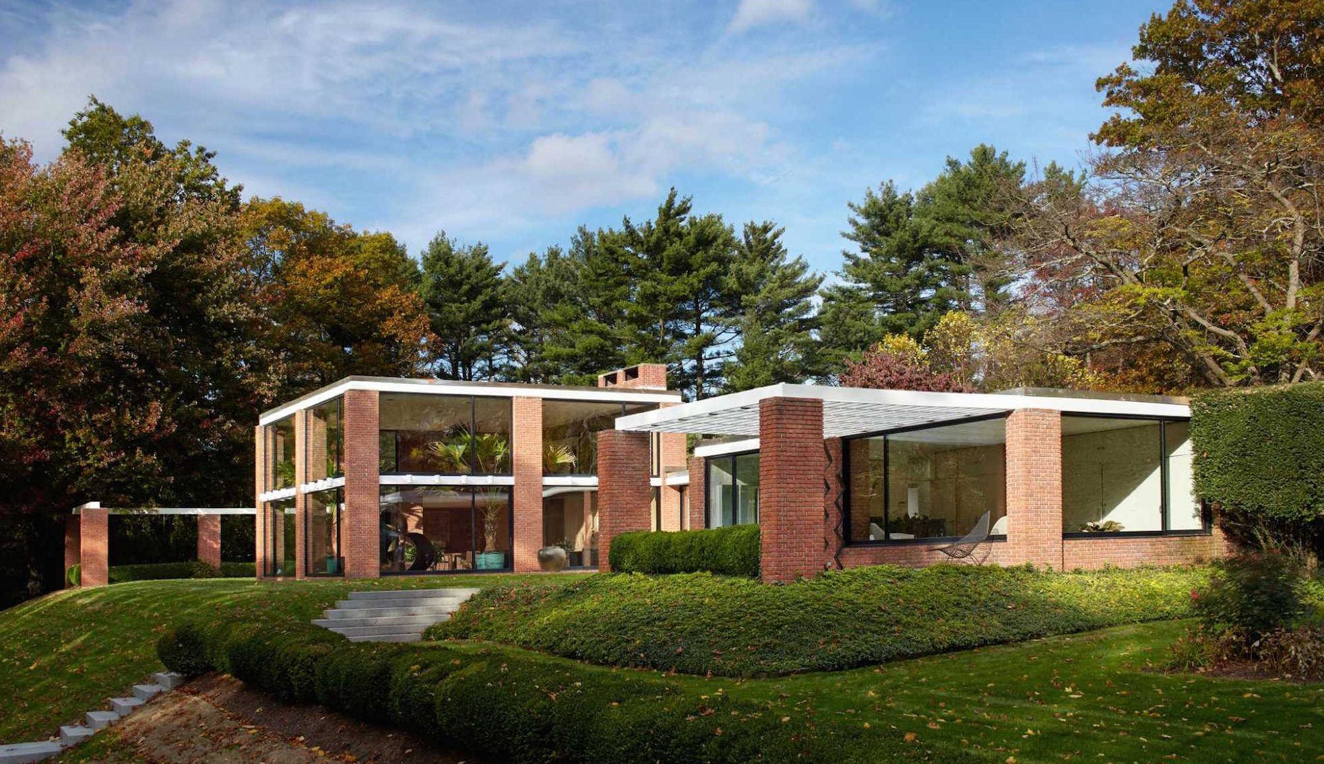
US. Modernist Houses
1956
US. Modernist Houses
1955-1960

Slide 2
US Modernist Houses 1956
The purpose of this presentation is to show you the most outstanding Modern Movement inspired houses in the United States by great architects.
Some of them have become icons of contemporary architecture (members of the iconic.org network) and are recognized and protected as such.
They remain unique either by their constructive principle, or by their location, or by their theoretical importance, or by their perfect integration into the landscape.

Slide 3
US Modernist Houses
Many of the houses presented in this slide show (before the year 2000) were found on the OfHouses website (Old Forgotten Houses) which lists houses with architectural interest or singular architecture around the world with many illustrations. If they are shown here, it is because they are already considered as iconic.

Slide 4
US Modernist Houses
Glass Wood House, John Black Lee, CT.
Lambert Road House, Eliot Noyes, CT.
Leedy House, Gene Leedy, FL.
Holden House, John Peter Clark, CA.
Straub House, Calvin Straub, CA.
Bridge House, John Johansen, CT.
Boissonnas House, Philip Johnson, CT.
X-100 House, Quincy Jones & Emmons, CA.
Franzen House, Ulrich Franzen, NY.
RaveOn House, Fehr & Granger, TX.
Swiss Miss House, Charles DuBois, CA.

Slide 5
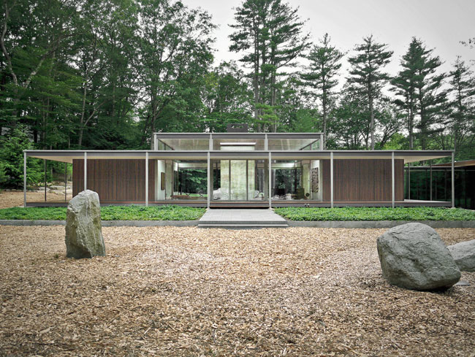
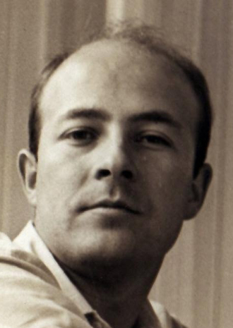
Glass Wood House, New Canaan, CT (1956)
John Black Lee
Kengo Kuma

Slide 6
Glass Wood House, New Canaan, CT (1956)
It is the work of the architects John Black Lee for the 1st pavilion and Kengo Kuma for the 2nd.
The original pavilion is located on the horizontal part of the lot while the 2nd is located on the steeply sloping section. It has an axially symmetrical single storey structure with 2 glass walls to the north and south allowing views over the wood. To the east and west, 2 bedrooms flank the main space with a veranda and a generous roof overlooking the house on four sides supported by vertical columns.

Slide 7
Glass Wood House, New Canaan, CT (1956)
In 2010, Kengo Kuma adds a 2nd L-shaped pavilion to the west of the 1st: the interior is almost entirely open, with very few walls. Instead, stainless steel mesh screens differentiate the circulation space from other parts of the program. The structure is composed of steel columns only 3 p wide and 6 p deep, with steel beams also minimal, and a roof supported by exposed laminated spruce joists. The extension has an enclosed veranda at the same height as the original.

Slide 8
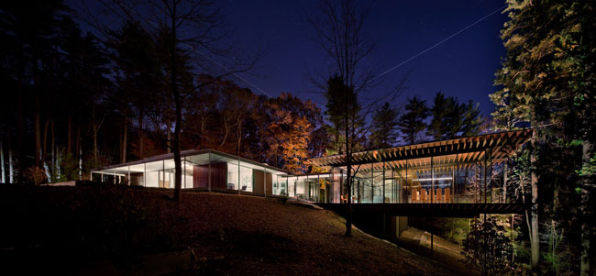
Glass Wood House, New Canaan, CT (1956)

Slide 9
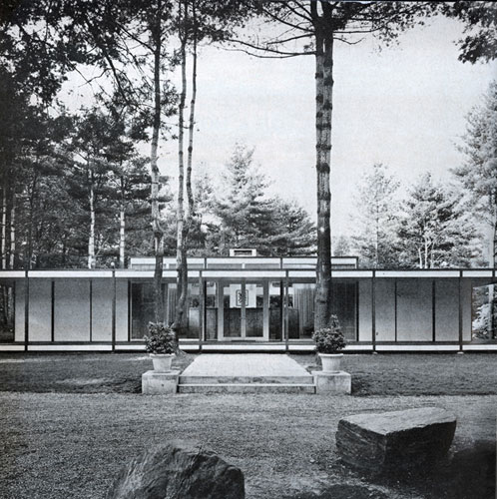
Glass Wood House, New Canaan, CT (1956)

Slide 10
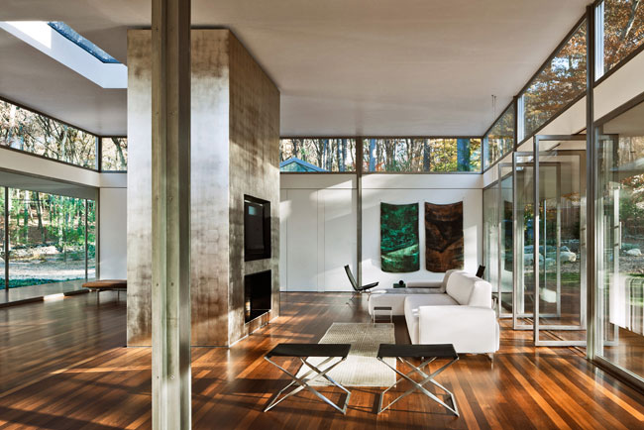
Glass Wood House, New Canaan, CT (1956)

Slide 11
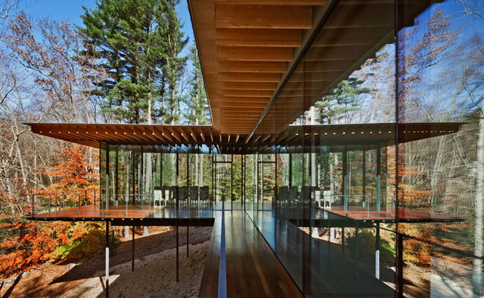
Glass Wood House, New Canaan, CT (2010)

Slide 12
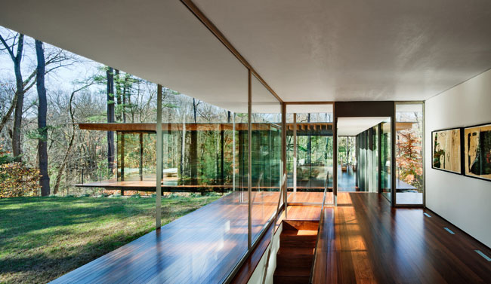
Glass Wood H.,New Canaan,CT (2010)

Slide 13
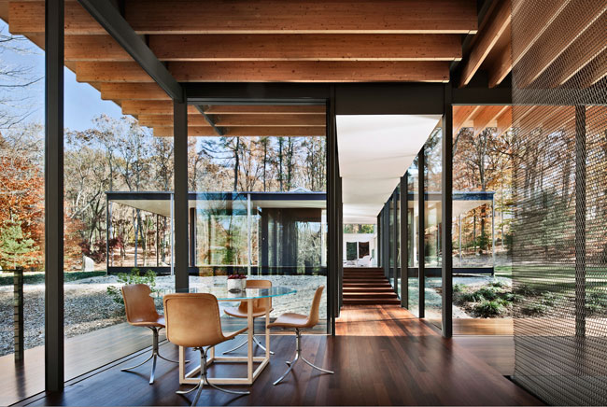
Glass Wood House, New Canaan, CT (2010)

Slide 14
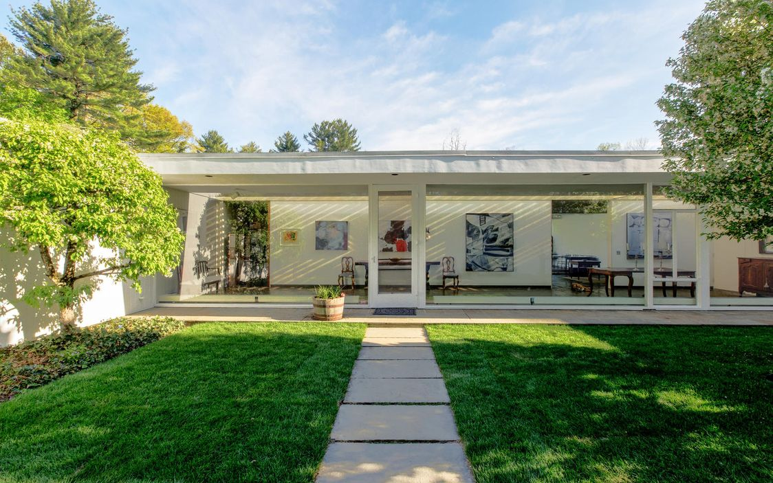
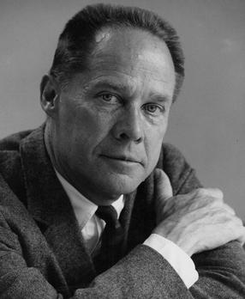
Lambert Road House, New Canaan, CT (1956)
Eliot Noyes

Slide 15
Lambert Road House, New Canaan, CT (1956)
It is the work of the architect Eliot Noyes.
Thanks to its glazed walls, this house is characterized by its absence of obstacles between inside and outside: the green environment, sunlight and moonlight truly invite themselves inside.
With a spectacular sense of timelessness and elegance, this house is designed to live and with its guest house to receive.

Slide 16
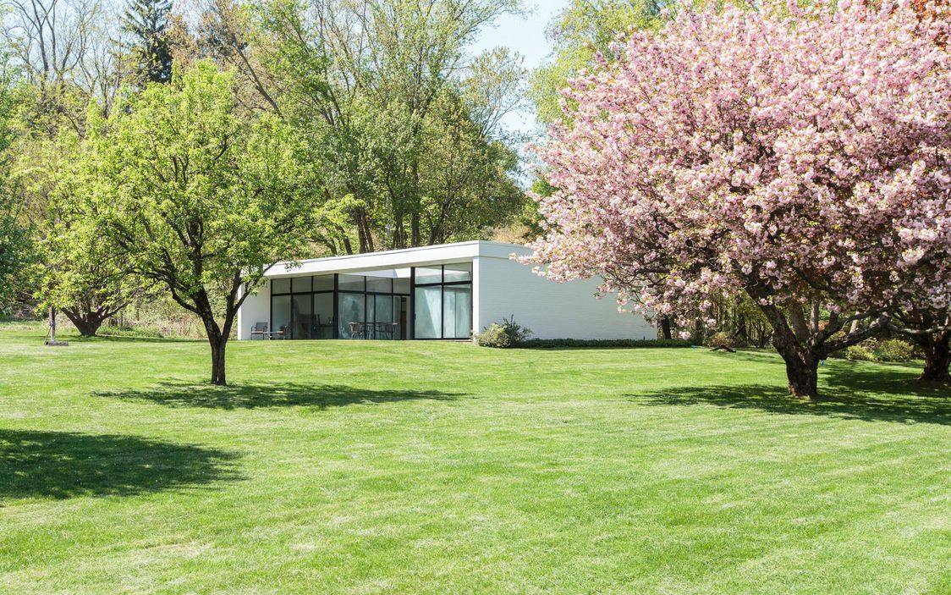
Lambert Road House, New Canaan, CT (1956)

Slide 17
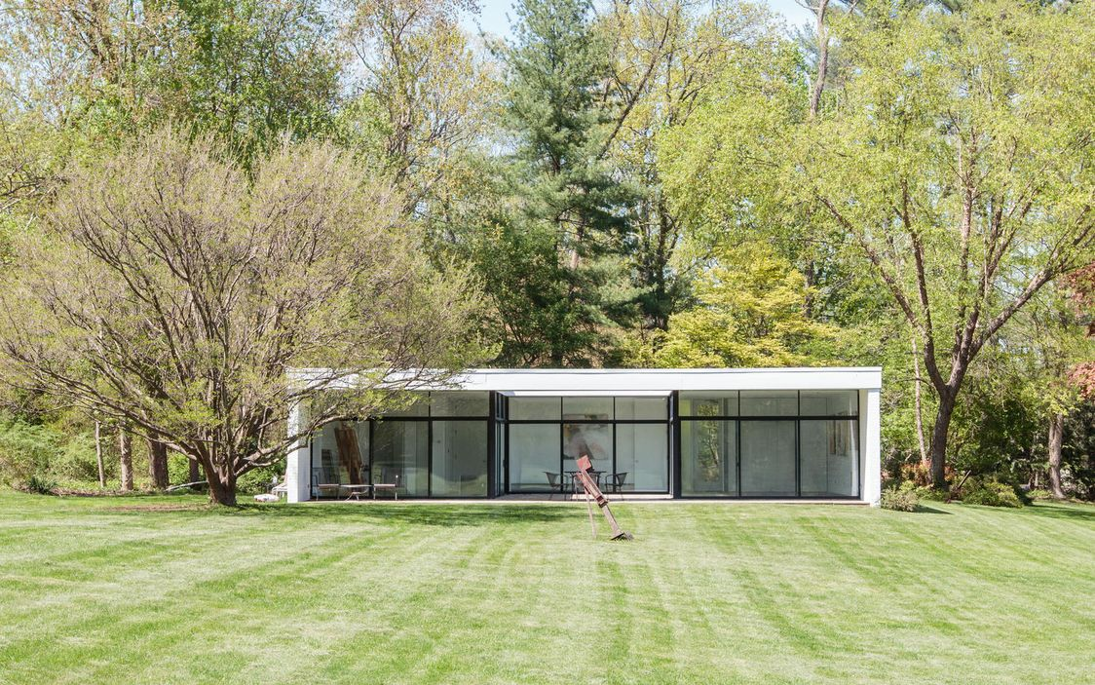
Lambert Road House, New Canaan, CT (1956)

Slide 18
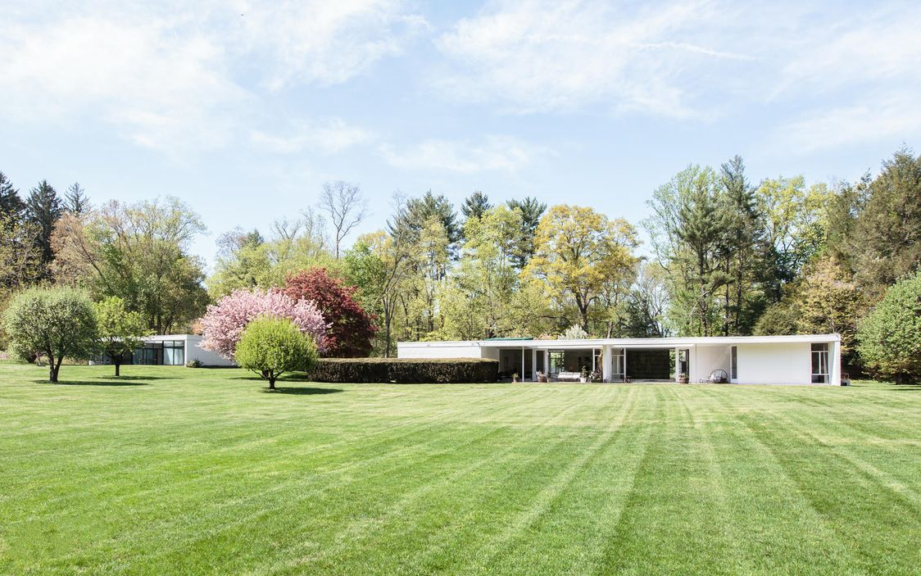
Lambert Road House, New Canaan, CT (1956)

Slide 19
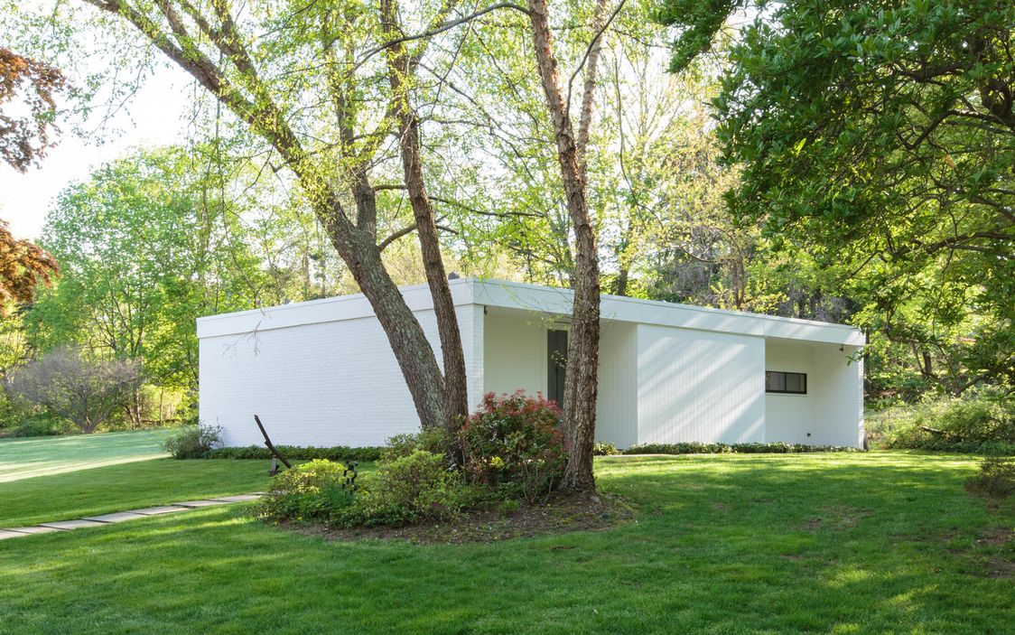
Lambert Road House, New Canaan, CT (1956)

Slide 20
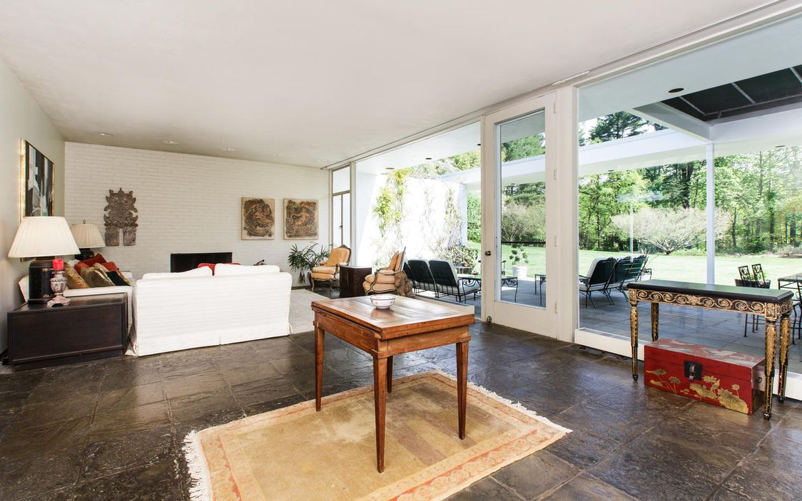
Lambert Road House, New Canaan,CT (1956)

Slide 21
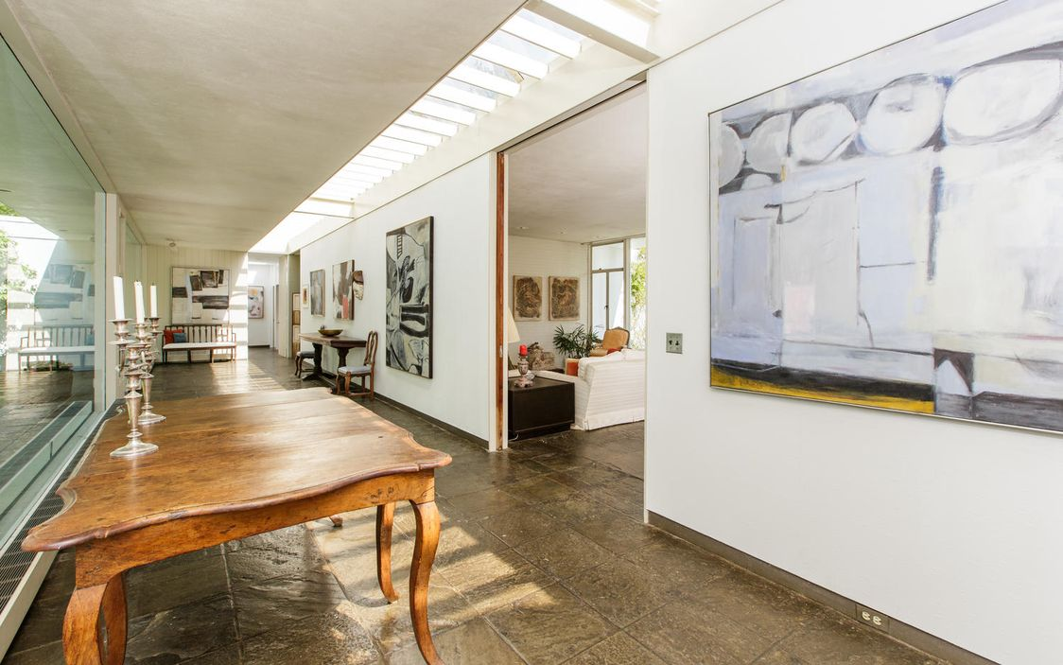
Lambert Road House, New Canaan, CT (1956)

Slide 22
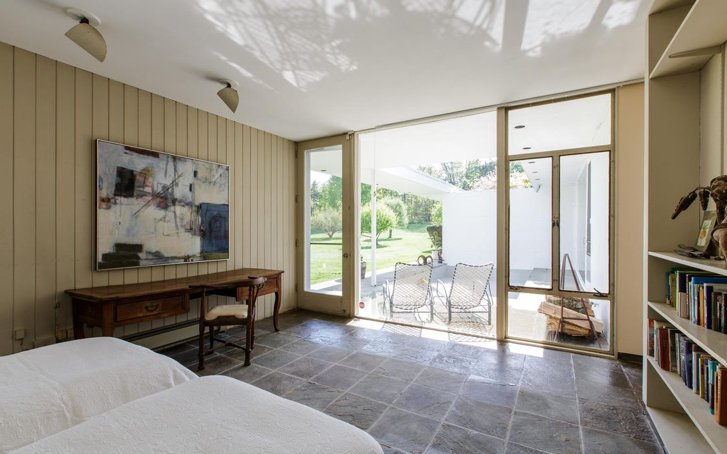
Lambert Road House, New Canaan, CT (1956)

Slide 23
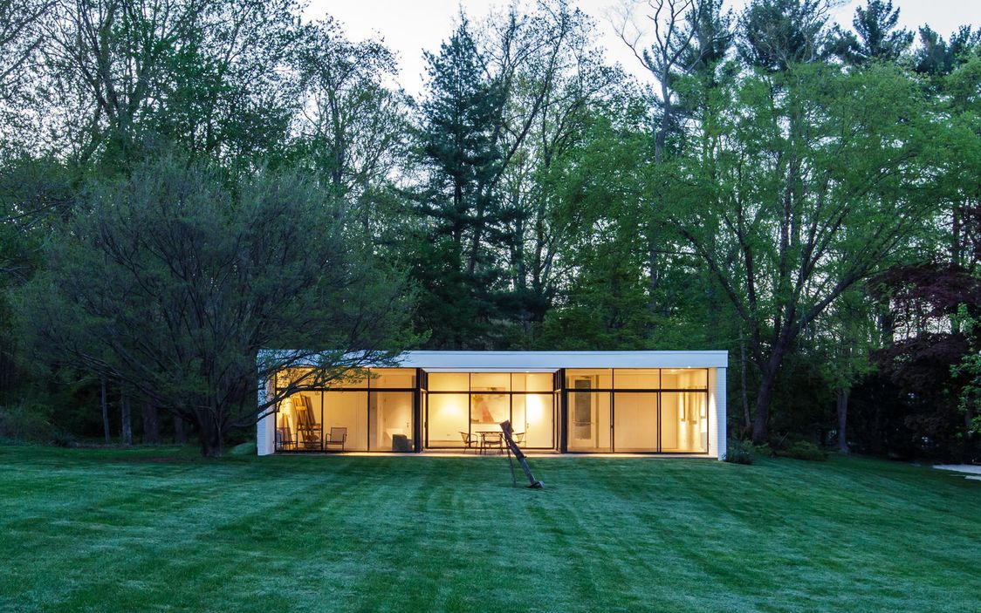
Lambert Road House, New Canaan, CT (1956)

Slide 24
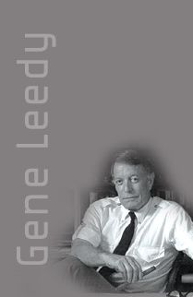
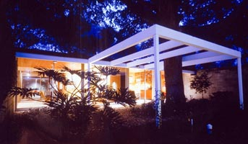
Leedy House, Winter Haven, FL (1956)

Slide 25
Leedy House, Winter Haven, FL (1956)
It is the own house of the architect Gene Leedy.
This prototypical house is modular in design. Leedy's design used all wood post and beam construction, and the structural system of 4-inch wood decking was very avant-garde for the time. So was the first use of sliding glass doors in central Florida, which allowed Gene to create his famous glass walls in these small homes. Subdued and snug under the large oaks, you see that the exteriors are unpainted concrete-block.

Slide 26
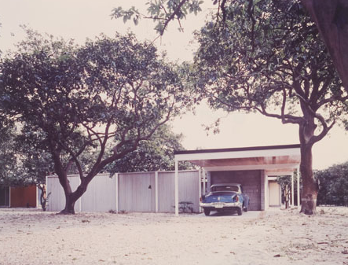
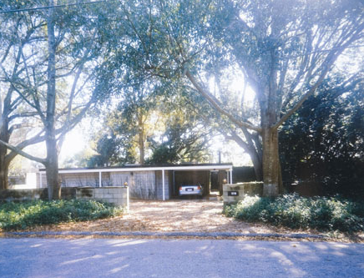
Leedy House, Winter Haven, FL (1956)

Slide 27
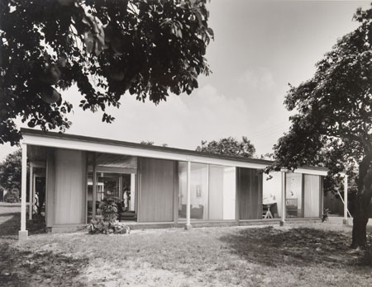
Leedy House, Winter Haven, FL (1956)

Slide 28
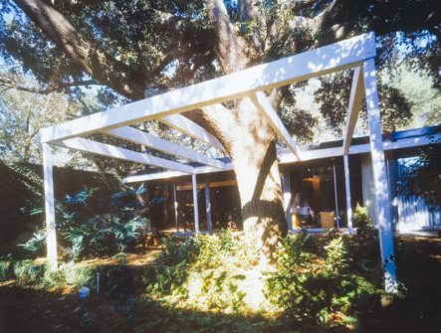
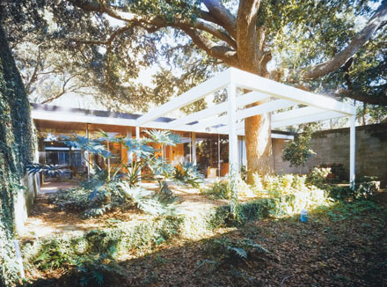
Leedy House, Winter Haven, FL (1956)

Slide 29
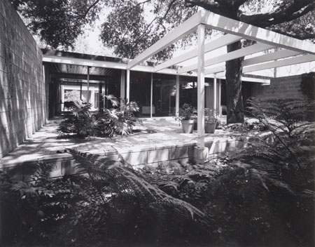
Leedy House, Winter Haven, FL (1956)

Slide 30
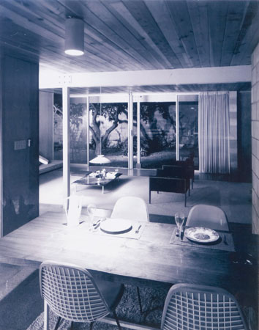
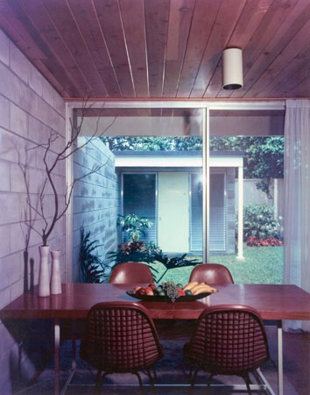
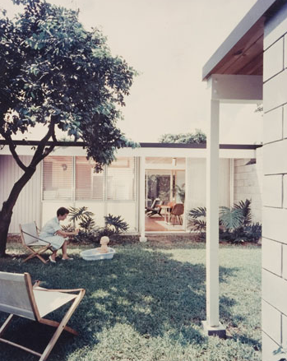
Leedy House, Winter Haven, FL (1956)

Slide 31
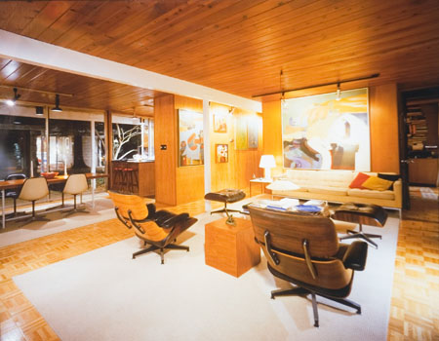
Leedy House, Winter Haven, FL (1956)

Slide 32
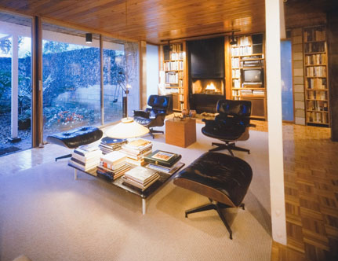
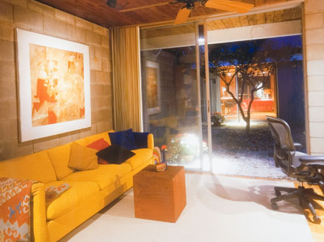
Leedy House, Winter Haven, FL (1956)

Slide 33
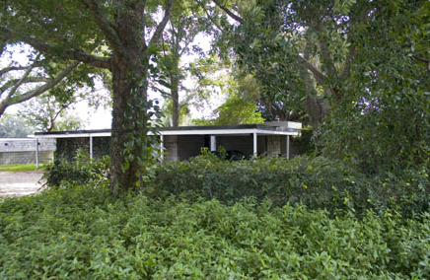
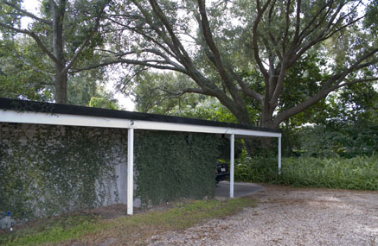
Leedy House, Winter Haven, FL (1956)

Slide 34
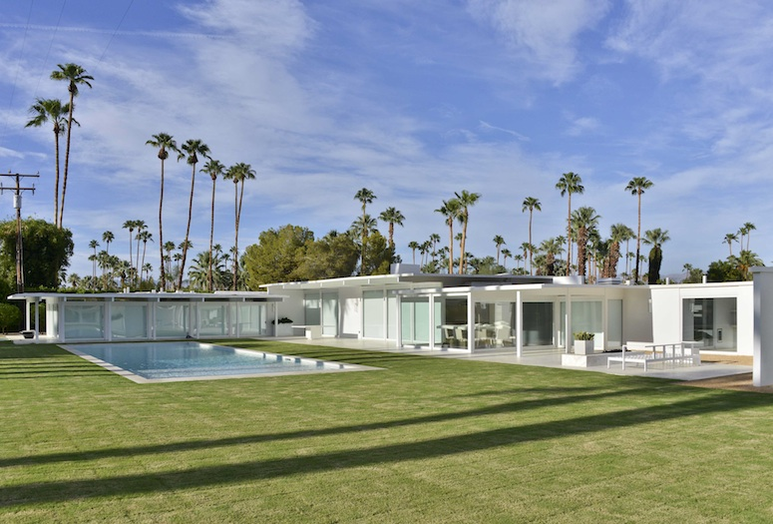
Holden House, Palm Springs, CA (1956)
William Holden
John Porter Clark

Slide 35
Holden House, Palm Springs, CA (1956)
It's the work of architect John Porter Clark.
This emblematic house for the actor William Holden is the perfect combination of clean lines and modern comfort. Built following the post and beam system, it is also remarkable for its pivoting glass walls that allow living rooms and 5 bedrooms to access the lawn and pool. Entirely renovated, white is on the agenda of the beams in the foyer of the living room.

Slide 36
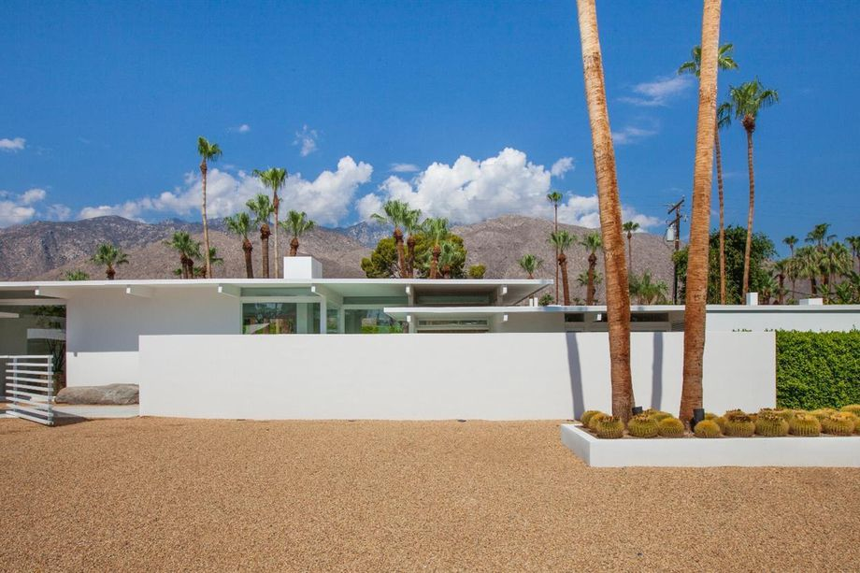
Holden House, Palm Springs, CA (1956)

Slide 37
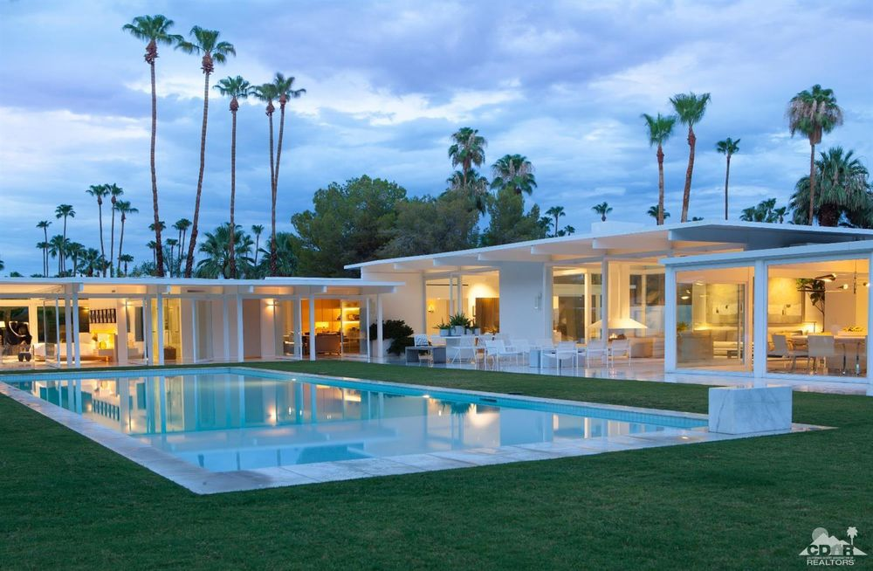
Holden House, Palm Springs, CA (1956)

Slide 38
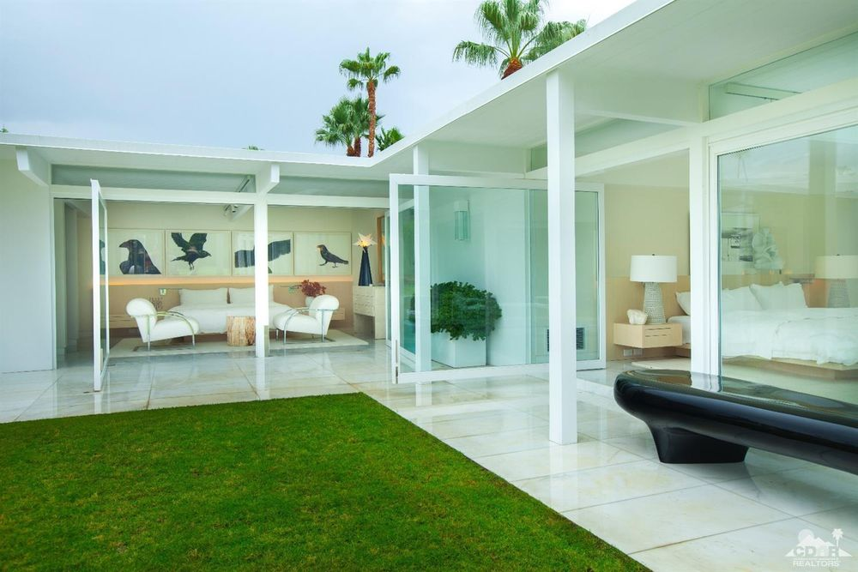
Holden House, Palm Springs, CA (1956)

Slide 39
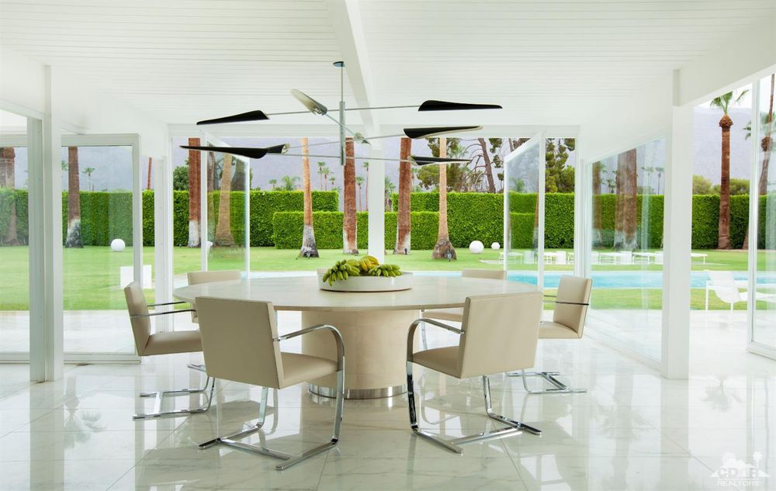
Holden House, Palm Springs, CA (1956)

Slide 40
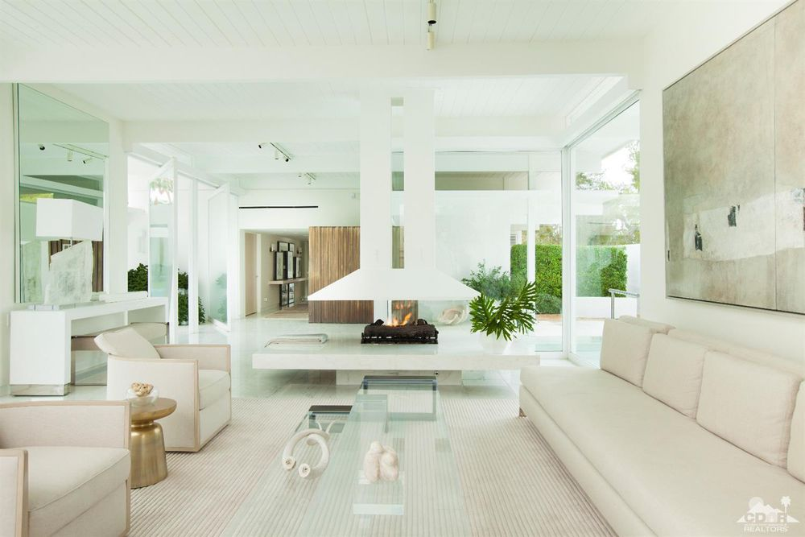
Holden House, Palm Springs, CA (1956)

Slide 41
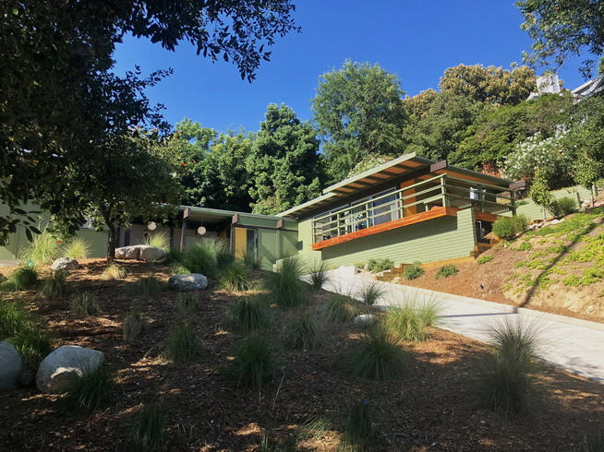
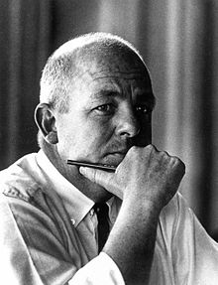
Straub House, Pasadena, CA (1956)
Calvin Straub

Slide 42
Straub House, Pasadena, CA (1956)
It is the own house of the architect Calvin Straub.
The U-shaped home sits on a neatly landscaped quarter-acre lot, with a long driveway in the front and an enclosed yard and patio space in the back. Inside are 3 bedrooms and 2 bathrooms, spread across 2,090 sqf of floor space.
Interior features include cork floors, beamed ceilings, walls of glass, and a large brick fireplace in the living room. The open kitchen has stone countertops and freshly installed appliances. The master bedroom opens directly to the back patio and includes an ensuite bathroom and a walk-in closet.

Slide 43
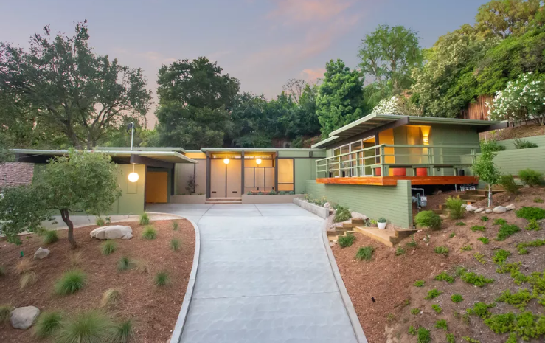
Straub House, Pasadena, CA (1956)

Slide 44
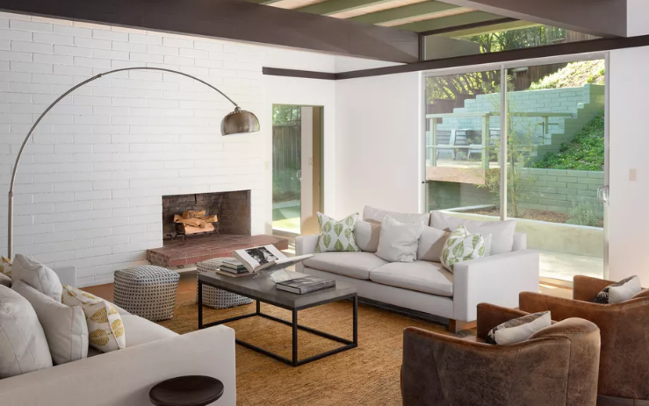
Straub House, Pasadena, CA (1956)

Slide 45
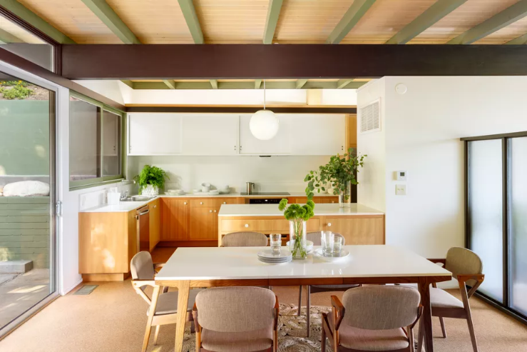
Straub House, Pasadena, CA (1956)

Slide 46
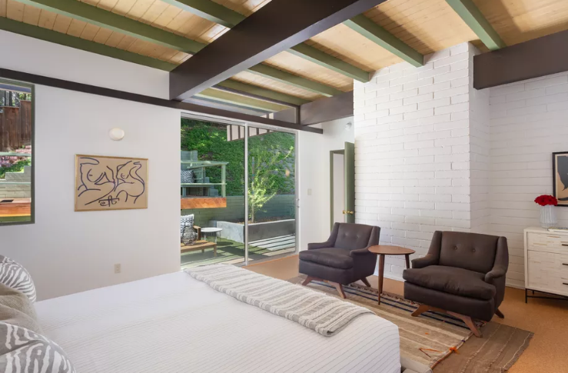
Straub House, Pasadena, CA (1956)

Slide 47
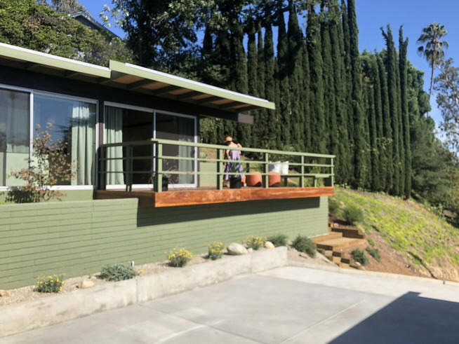
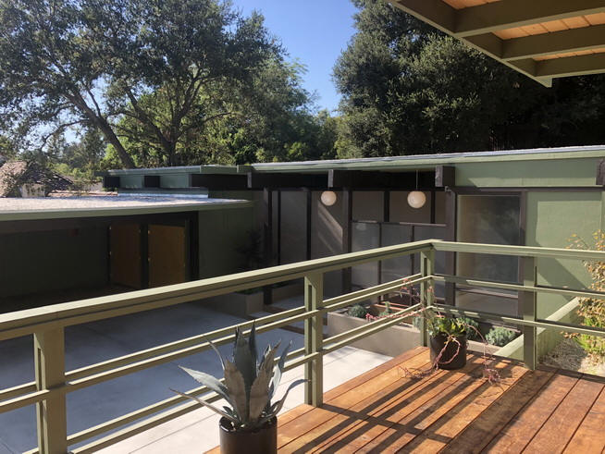
Straub House, Pasadena, CA (1956)

Slide 48
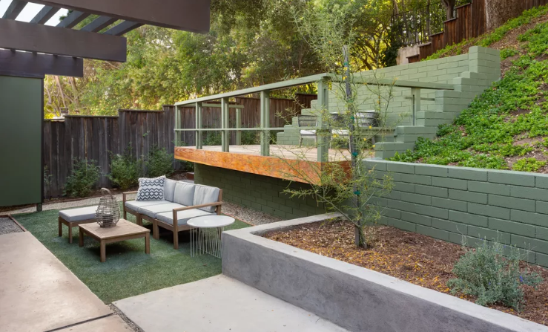
Straub House, Pasadena, CA (1956)

Slide 49
Bridge House, New Canaan, CT (1956)
John Johansen

Slide 50
Bridge House, New Canaan, CT (1956)
It is the work of the architect John Johansen.
Sited so that the Rippowam River bisects the lofty living room in a way that perfectly aligns with a vault in barrel-vaulted ceiling. On five landscaped acres, the 4,500-sqf Bridge House has 6 bedrooms, four full bathrooms and a gorgeous stone pool and terrace. The bridge is the transitional area between the different domestic zones of the house - kitchen, master bedroom.

Slide 51
Bridge House, New Canaan, CT (1956)

Slide 52
Bridge House, New Canaan, CT (1956)

Slide 53
Bridge House, New Canaan, CT (1956)

Slide 54
Bridge House, New Canaan, CT (1956)

Slide 55
Bridge House, New Canaan, CT (1956)

Slide 56
Bridge House, New Canaan, CT (1956)

Slide 57
Bridge House, New Canaan, CT (1956)

Slide 58
Bridge House, New Canaan, CT (1956)

Slide 59
Bridge House, New Canaan, CT (1956)

Slide 60
Boissonnas House, New Canaan, CT (1956)
Philip Johnson

Slide 61
Boissonnas House, New Canaan, CT (1956)
It's the work of architect Philip Johnson.
The original house was designed as a series of pavilions built of steel, brick and glass. The plan of the house has been divided into 3 areas: a bedroom wing containing 4 bedrooms, 3 full bathrooms, and half a bath; a service wing containing the kitchen, 2 maid rooms and a bath; and a social wing containing the living room and dining room. The three wings were joined by an entrance hall.

Slide 62
Boissonnas House, New Canaan, CT (1956)

Slide 63
Boissonnas House, New Canaan, CT (1956)

Slide 64
Boissonnas House, New Canaan, CT (1956)

Slide 65
Boissonnas House, New Canaan, CT (1956)

Slide 66
Boissonnas House, New Canaan, CT (1956)

Slide 67
X-100 House, San Mateo, CA (1956)
Joseph Eichler
A Quincy Jones & F. Emmons E

Slide 68
X-100 House, San Mateo, CA (1956)
It is the work of Archibald Quincy Jones & Frederick Emmons for a real estate developer Joseph Eichler.
X-100 is an experimental steel house : the structure consists of 6 bents of 4-inch H-section columns approximately 13 feet apart supporting 8-inch I-beams.
The beams protrude under the roof at the front of the house; Jones turned down the steel decking to form a fascia.
The house has 3 bedrooms, 2 living rooms, and a kitchen grouped around the perimeter, with a central utility core containing 2 bathrooms and utility and laundry areas.

Slide 69
X-100 House, San Mateo, CA (1956)
Instead of the open atrium of many Eichler houses of the period, it has two interior gardens, dubbed the "entry garden" and the "game garden" .
The house's underfloor heating system extended to the garden pads.
The beams and columns are painted deep brownish red ("deep-tone cinnamon") and the corrugated metal ceiling light grey. For privacy, the side walls have panels of the high-density plywood used for concrete forms.
Inside, in addition to track lighting on both sides, the X-100 has plastic skylights ("skydomes") in each room

Slide 70
X-100 House, San Mateo, CA (1956)

Slide 71
X-100 House, San Mateo, CA (1956)

Slide 72
X-100 House, San Mateo, CA (1956)

Slide 73
X-100 House, San Mateo, CA (1956)

Slide 74
X-100 House, San Mateo, CA (1956)

Slide 75
X-100 House, San Mateo, CA (1956)

Slide 76
Franzen House, Rye, NY (1956)
Ulrich Franzen

Slide 77
Franzen House, Rye, NY (1956)
It is the own house of the architect Ulrich Franzen.
A pavilion home, Franzen House features a concrete base that supports a double-diamond roof that appears to float lightly like a butterfly’s wing. The cantilever roof shades a pair of twin decks and caps walls of glass that peek out onto two acres of private woodland. Inside rooms are free-flowing to connect the four-bedroom home with its natural setting. Franzen House adheres to the architect’s original vision with exposed fir ceilings and hardwood floors and a wood burning stove.

Slide 78
Franzen House, Rye, NY (1956)

Slide 79
Franzen House, Rye, NY (1956)

Slide 80
Franzen House, Rye, NY (1956)

Slide 81
Franzen House, Rye, NY (1956)

Slide 82
Franzen House, Rye, NY (1956)

Slide 83
Franzen House, Rye, NY (1956)

Slide 84
Franzen House, Rye, NY (1956)

Slide 85
Franzen House, Rye, NY (1956)

Slide 86
Franzen House, Rye, NY (1956)

Slide 87
Franzen House, Rye, NY (1956)

Slide 88
RaveOn, Austin, TX (1956-2021)
Fehr and Granger
Nick Deaver

Slide 89
RaveOn, Austin, TX (1956-2021)
It is the work of the architects Fehr and Granger.
The emphatic lines, limestone base and gracefully pitched roof of the 2,680 ft² structure embodied the modern architecture of the day. Sixty years later, the house is completely renovated by the architect Nick Deaver. The house re-clad in insulated glass and vertical cedar siding left to weather, returned to its original form. Eliminating an upper terrace door and adopting a straight-run open riser hanging stair; made of plywood, relieves the bottleneck in the home’s circulation and leads directly to a new pool terrace. This south facing terrace, a concrete, wood and steel improvisation of the original structure, cantilevers over the hill and completes the missing backyard.

Slide 90
RaveOn, Austin, TX (1956)

Slide 91
RaveOn, Austin, TX (2021)

Slide 92
RaveOn, Austin, TX (2021)

Slide 93
RaveOn, Austin, TX (1956-2021)

Slide 94
RaveOn, Austin, TX (1956-2021)

Slide 95
RaveOn, Austin, TX (1956-2021)

Slide 96
RaveOn, Austin, TX (1956-2021)

Slide 97
RaveOn, Austin, TX (1956-2021)

Slide 98
Swiss Miss House, Palm Springs, CA (1956)

Slide 99
Swiss Miss House, Palm Springs, CA (1956)
It is the work of the architect Charles Dubois.
It is a low-lying, one-storey residence sliced by dramatic A-frame roofs that rise straight from the ground. The pitched frames span the full width of the residence, creating covered porch areas at the entrance and shaded terraces at the rear facing towards the pool. Inside, the structure forms a double-height spaces for the main living areas, while the rest of the facilities occupy the single story volumes on either side. An abundance of glazing and the use of natural materials to blend in with the surroundings – like stone used for chimney stacks are both traits shared with the Modern movement.

Slide 100
Swiss Miss House, Palm Springs, CA (1956)

Slide 101
Swiss Miss House, Palm Springs, CA (1956)

Slide 102
Swiss Miss House, Palm Springs, CA (1956)

Slide 103
Swiss Miss House, Palm Springs, CA (1956)

Slide 104
Swiss Miss House, Palm Springs, CA (1956)

Slide 105
Swiss Miss House, Palm Springs, CA (1956)

Slide 106
Swiss Miss House, Palm Springs, CA (1956)

Slide 107
RaveOn, Austin, TX (1956-2021)
THE END

