Slide 1
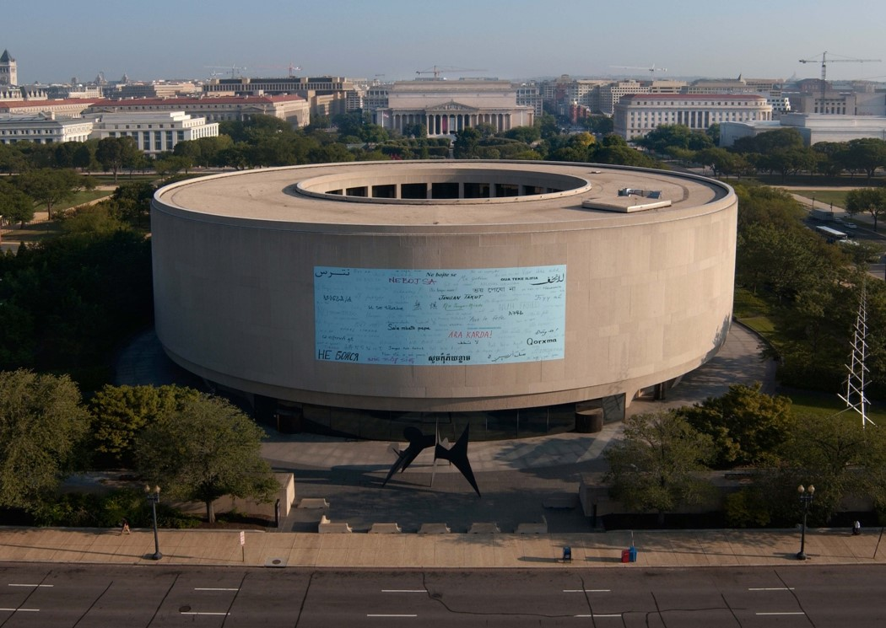
US Contemporary Museums III
1971-1975

Slide 2
US Contemporary Museums III
The aim is to show you different museums public or private of contemporary architecture throughout the U.S.A. : these do not only house contemporary art but also science.
The greatest architects of the 20th century contributed to the building of these museums with architectures certainly different but also adapted to the place and sometimes to the works they contain.

Slide 3
US Contemporary Museums
Denver Art Museum, Denver CO 1971.
Walker Art Center, Minneapolis, IN 1971.
Cleveland Museum of Art, Cleveland, OH 1971-2015.
Kimbell Art Museum, Fort Worth, TX 1972.
Contemporary Art Museum, Houston, TX 1972.
Center for Arts, Middletown, CT 1973.
Hirshhorn Museum, Washington D.C., 1974.
Fine Arts Center, Amherst, MA 1974.
M.F.A.H., Houston, TX 1974.
Carnegie Art Museum, Pittsburgh, PA 1974.
Herbert Johnson Museum, Ithaca, NY 1975.

Slide 4
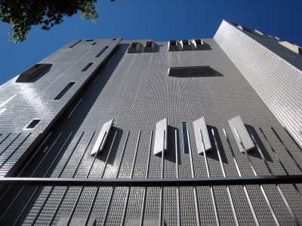
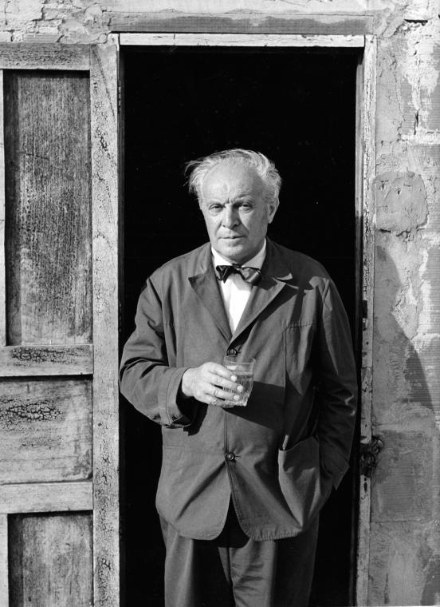
Denver Art Museum, Denver, CO (1971)
Gio Ponti

Slide 5
Denver Art Museum, Denver, CO (1971)
The Denver Art Museum’s North Building was designed by Italian architect Gio Ponti.
Many visitors have said that the North Building looks like a castle or fortress. These comparisons complement how Ponti understood the function of art museums: to protect treasures.
Ponti was also interested in creating a building that would reflect light. He chose to cover the building with gray tiles (in several different shades of gray) because the neutral color picks up the sky’s reflections better than a strong color would.

Slide 6
Denver Art Museum, Denver, CO (1971)
Instead of walking through gallery after gallery on one floor, collections are divided into seven floors. Ponti emphasized this verticality in his building design. He overlapped vertical wall segments, arranged the outside wall tiles vertically, and used vertical, narrow windows.
The walls within the galleries were designed so that they could be moved around to suit the needs of different curators and their collections. Because of this, there is great variety in gallery design among the different floors of the building.

Slide 7
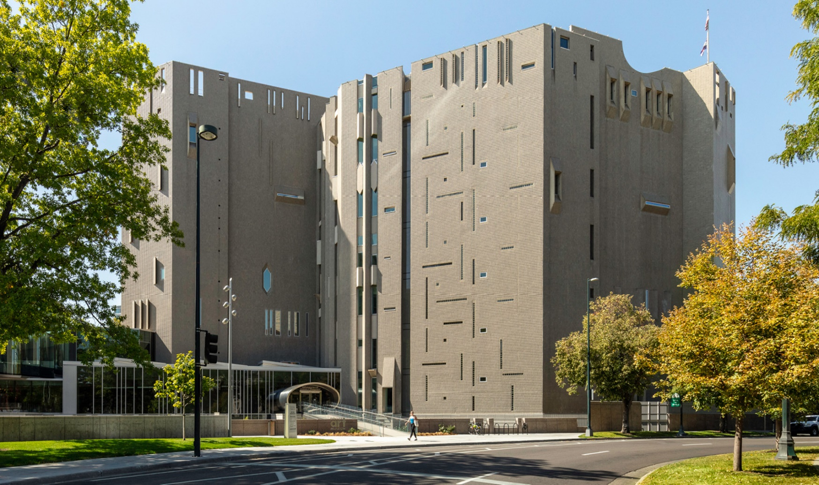
Denver Art Museum, Denver, CO (1971)

Slide 8
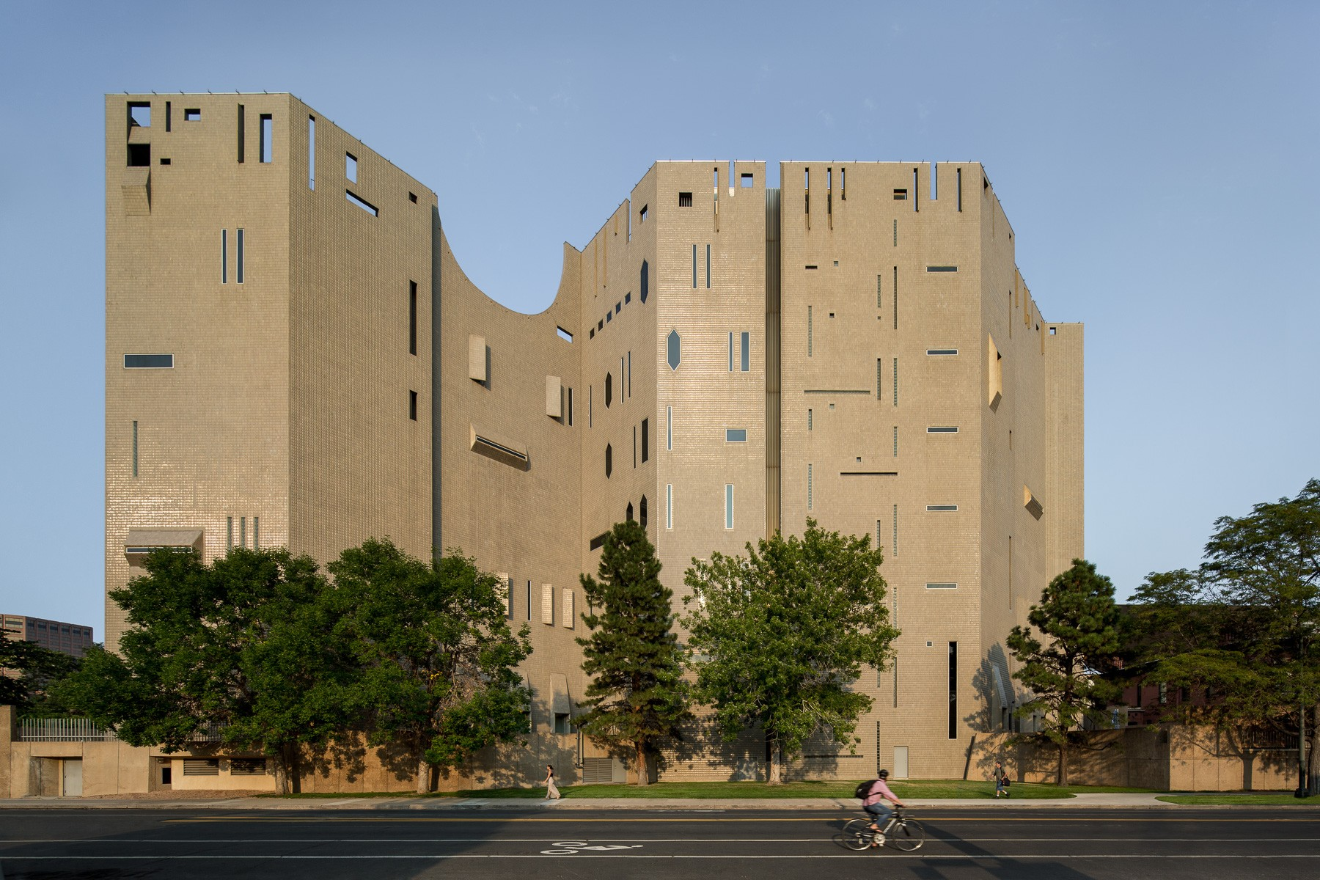
Denver Art Museum, Denver, CO (1971)

Slide 9
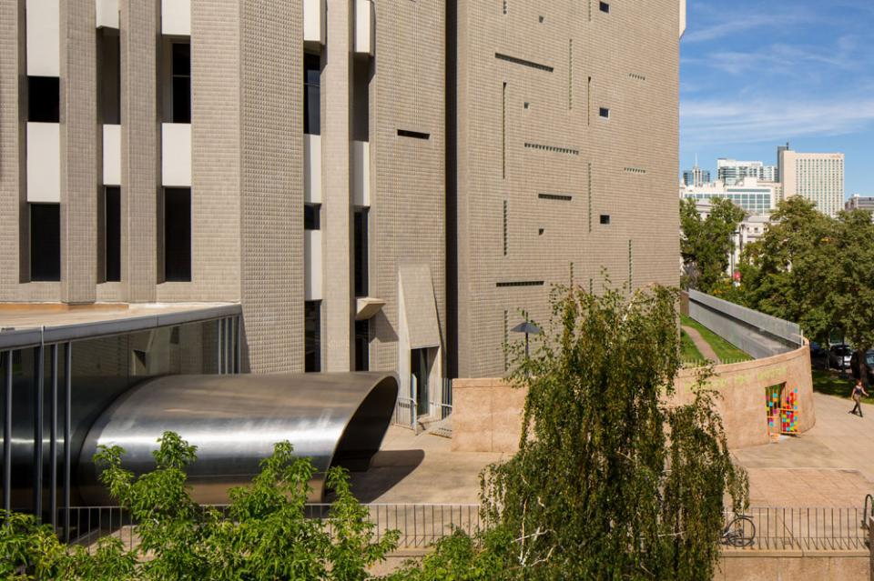
Denver Art Museum, Denver, CO (1971)

Slide 10
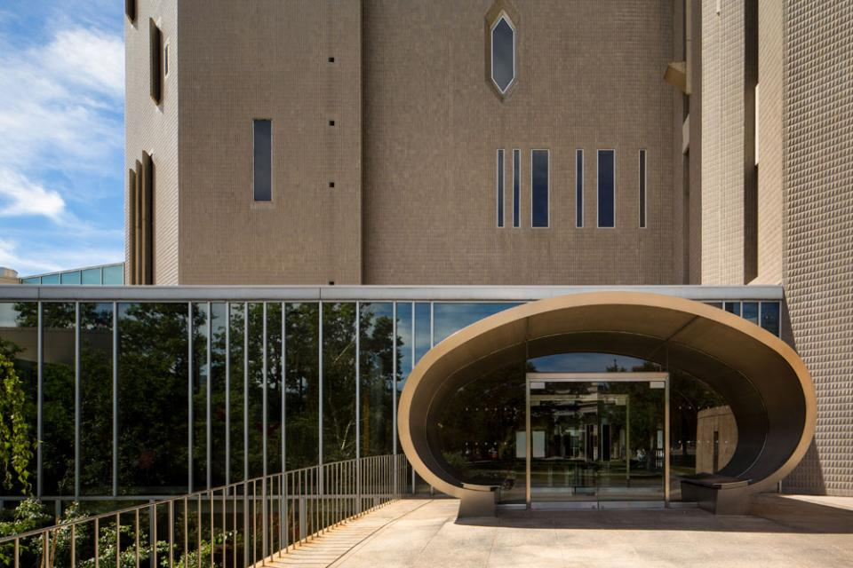
Denver Art Museum, Denver, CO (1971)

Slide 11
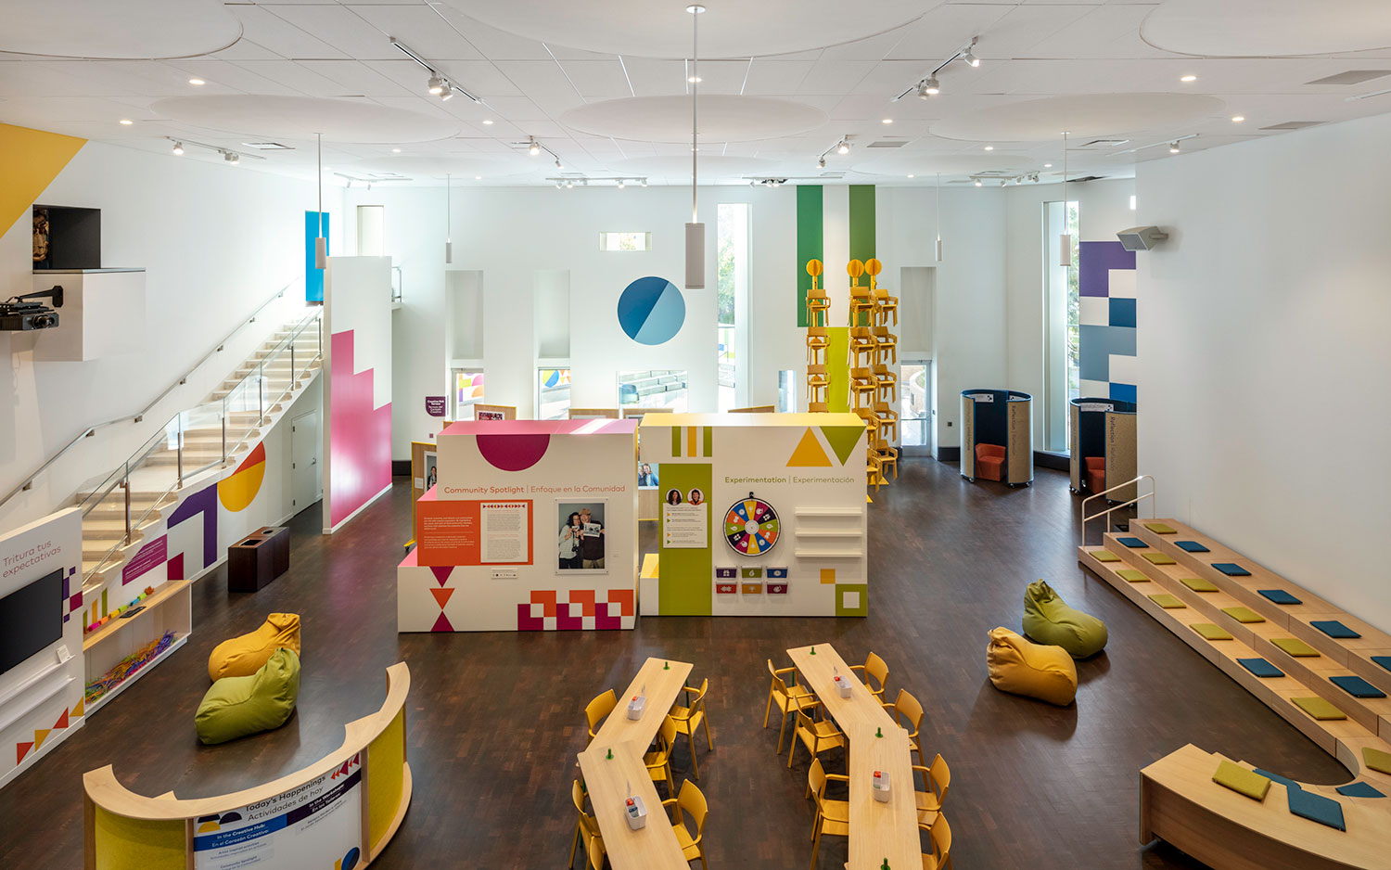
Denver Art Museum, Denver, CO (1971)

Slide 12
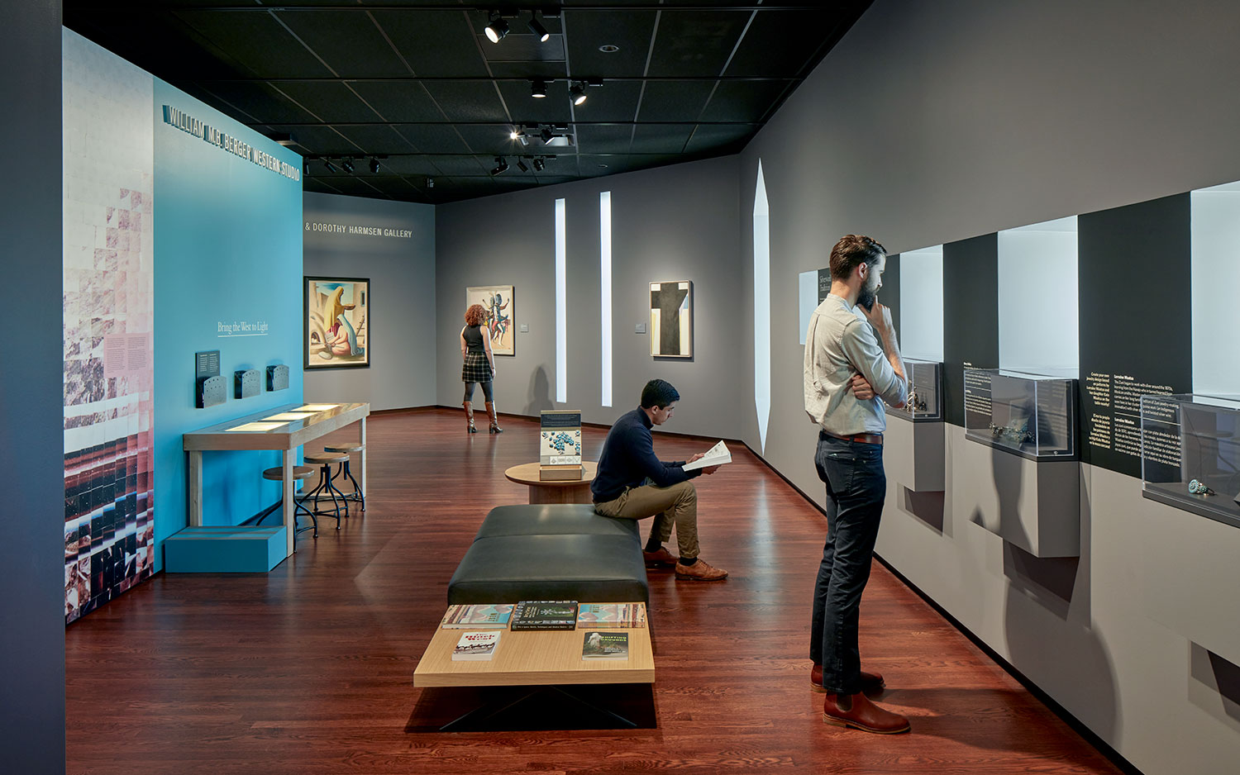
Denver Art Museum, Denver, CO (1971)

Slide 13
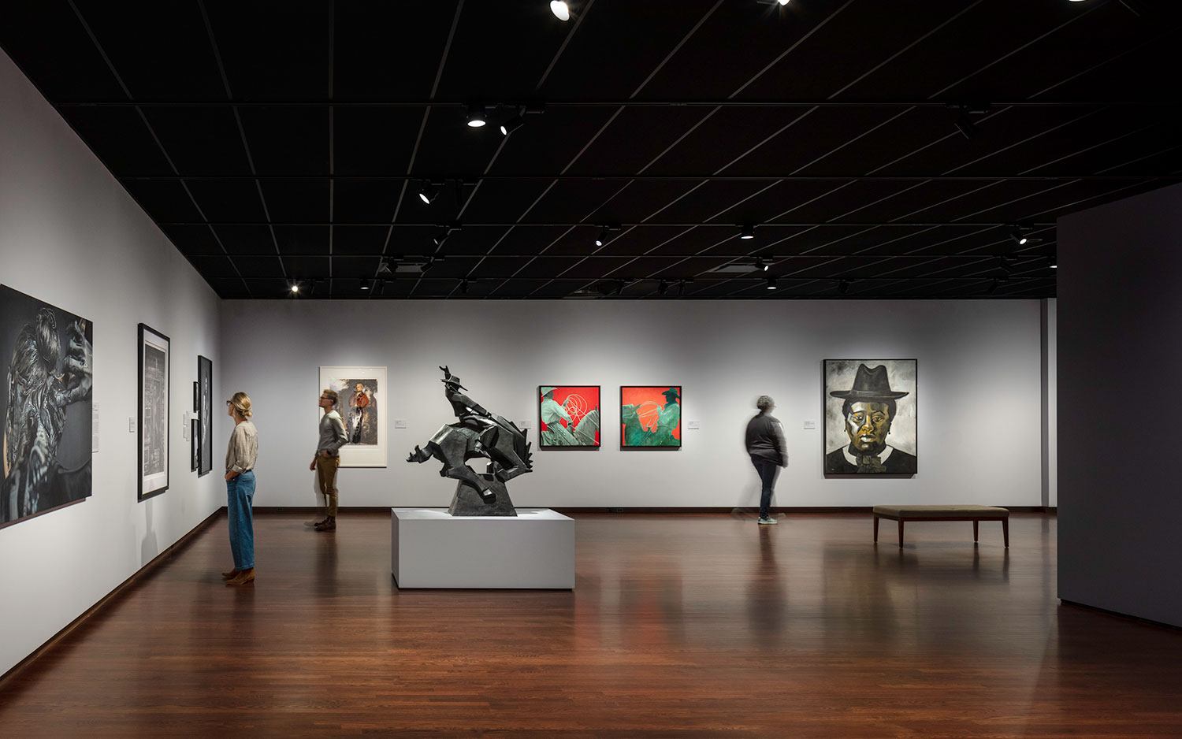
Denver Art Museum, Denver, CO (1971)

Slide 14
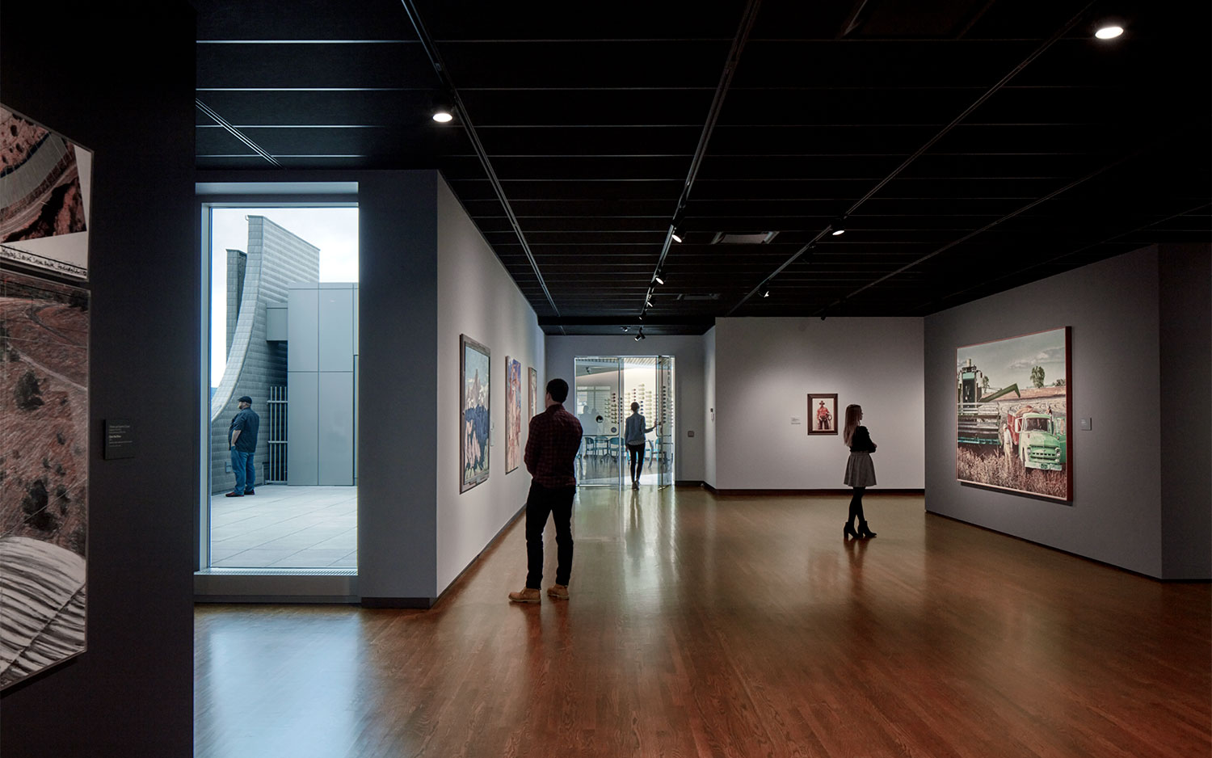
Denver Art Museum, Denver, CO (1971)

Slide 15
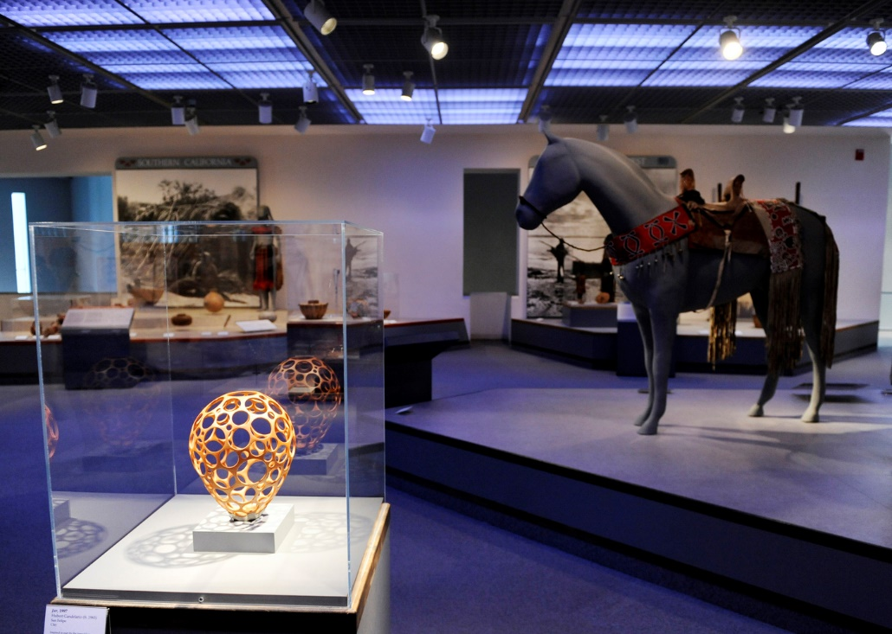
Denver Art Museum, Denver, CO (1971)

Slide 16
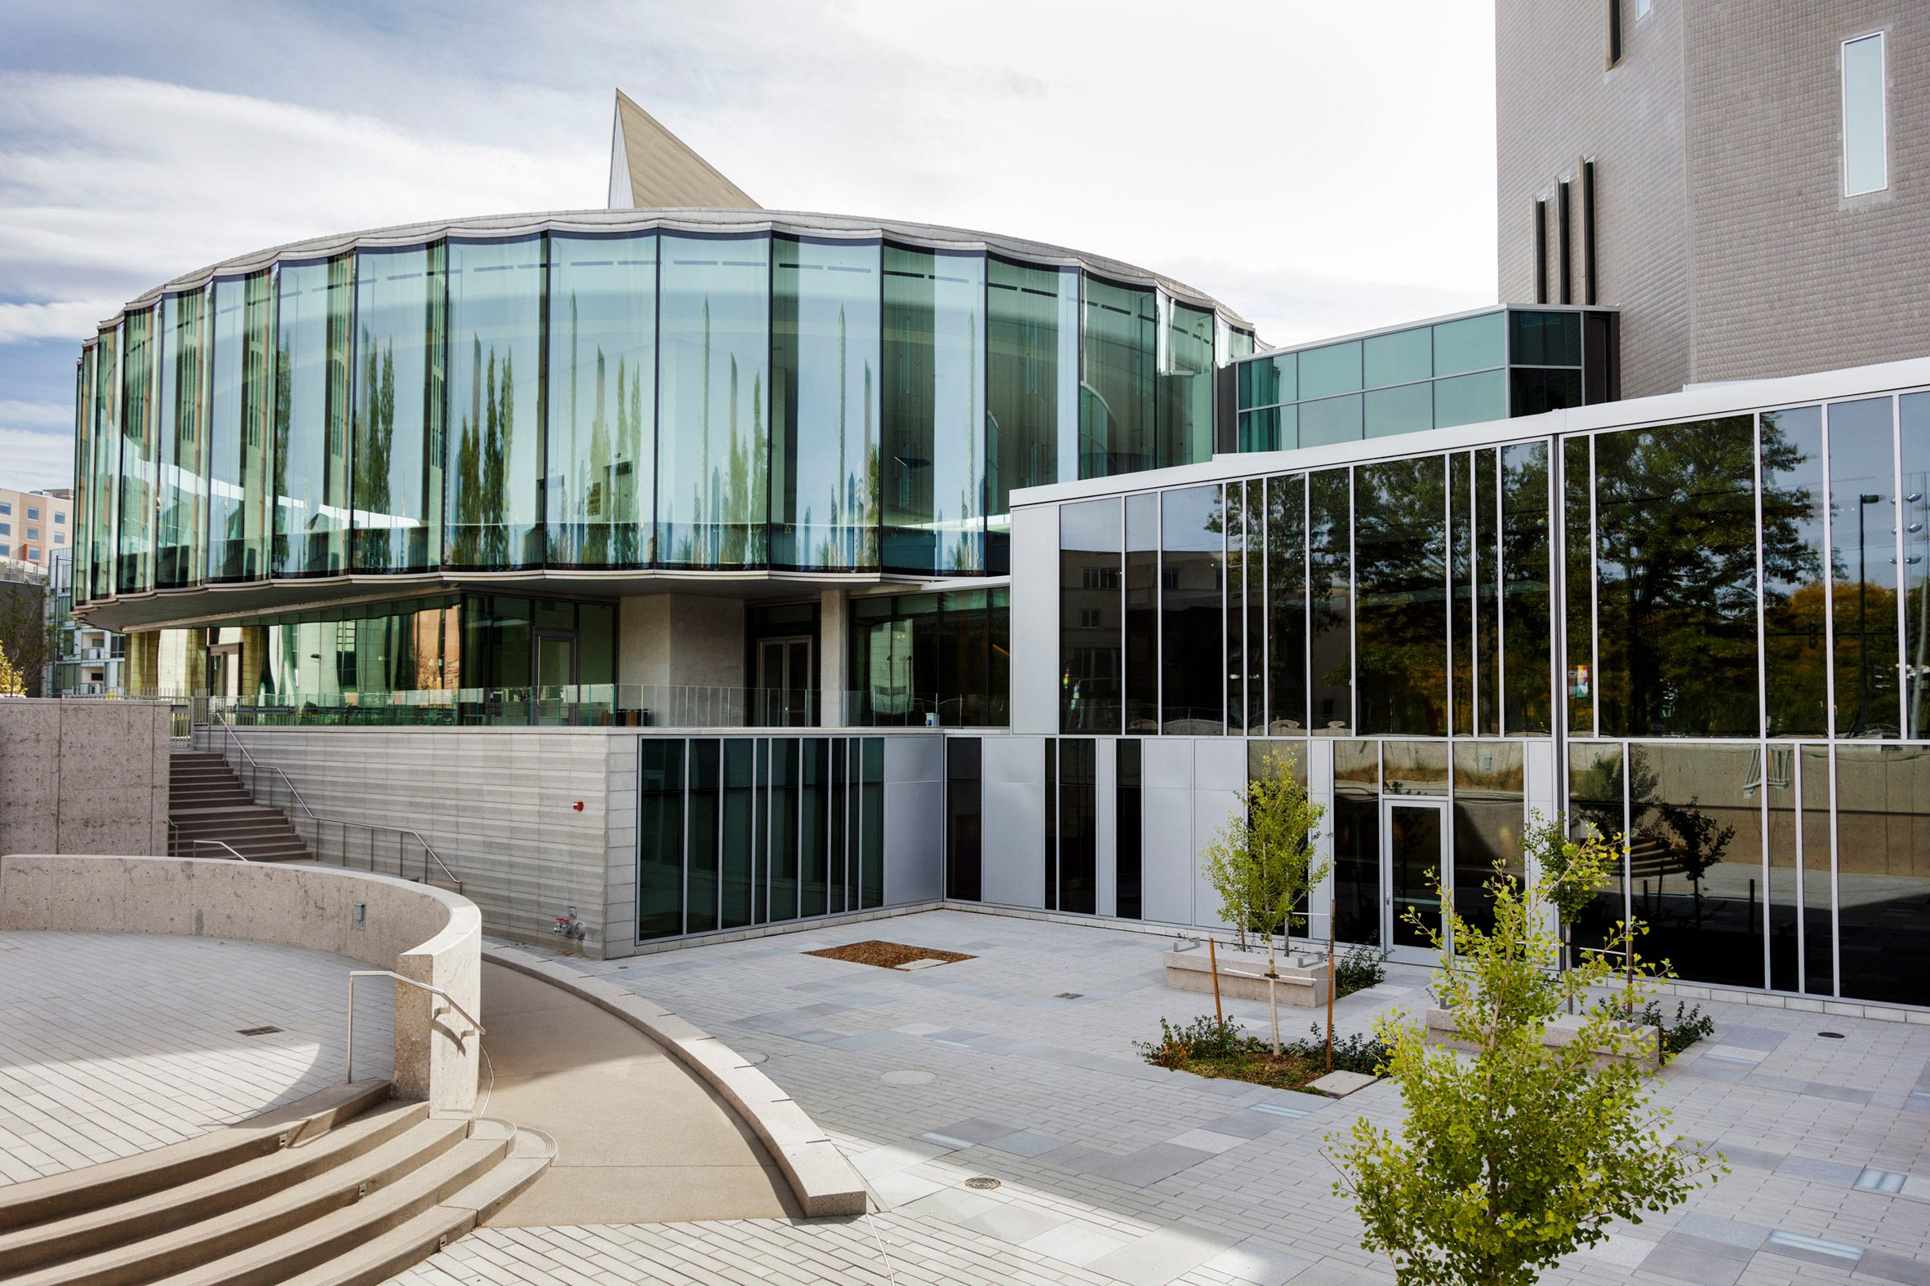
Denver Art Museum, Denver, CO (2021)

Slide 17
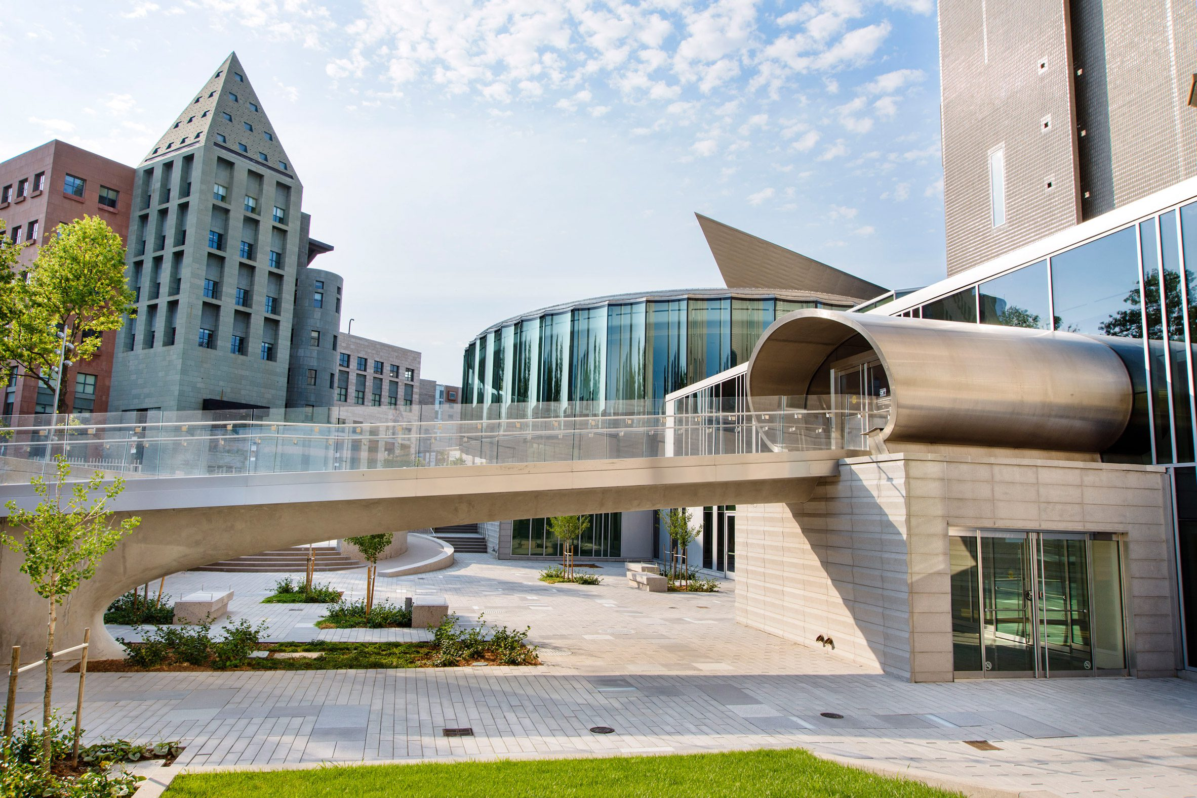
Denver Art Museum, Denver, CO (2021)

Slide 18
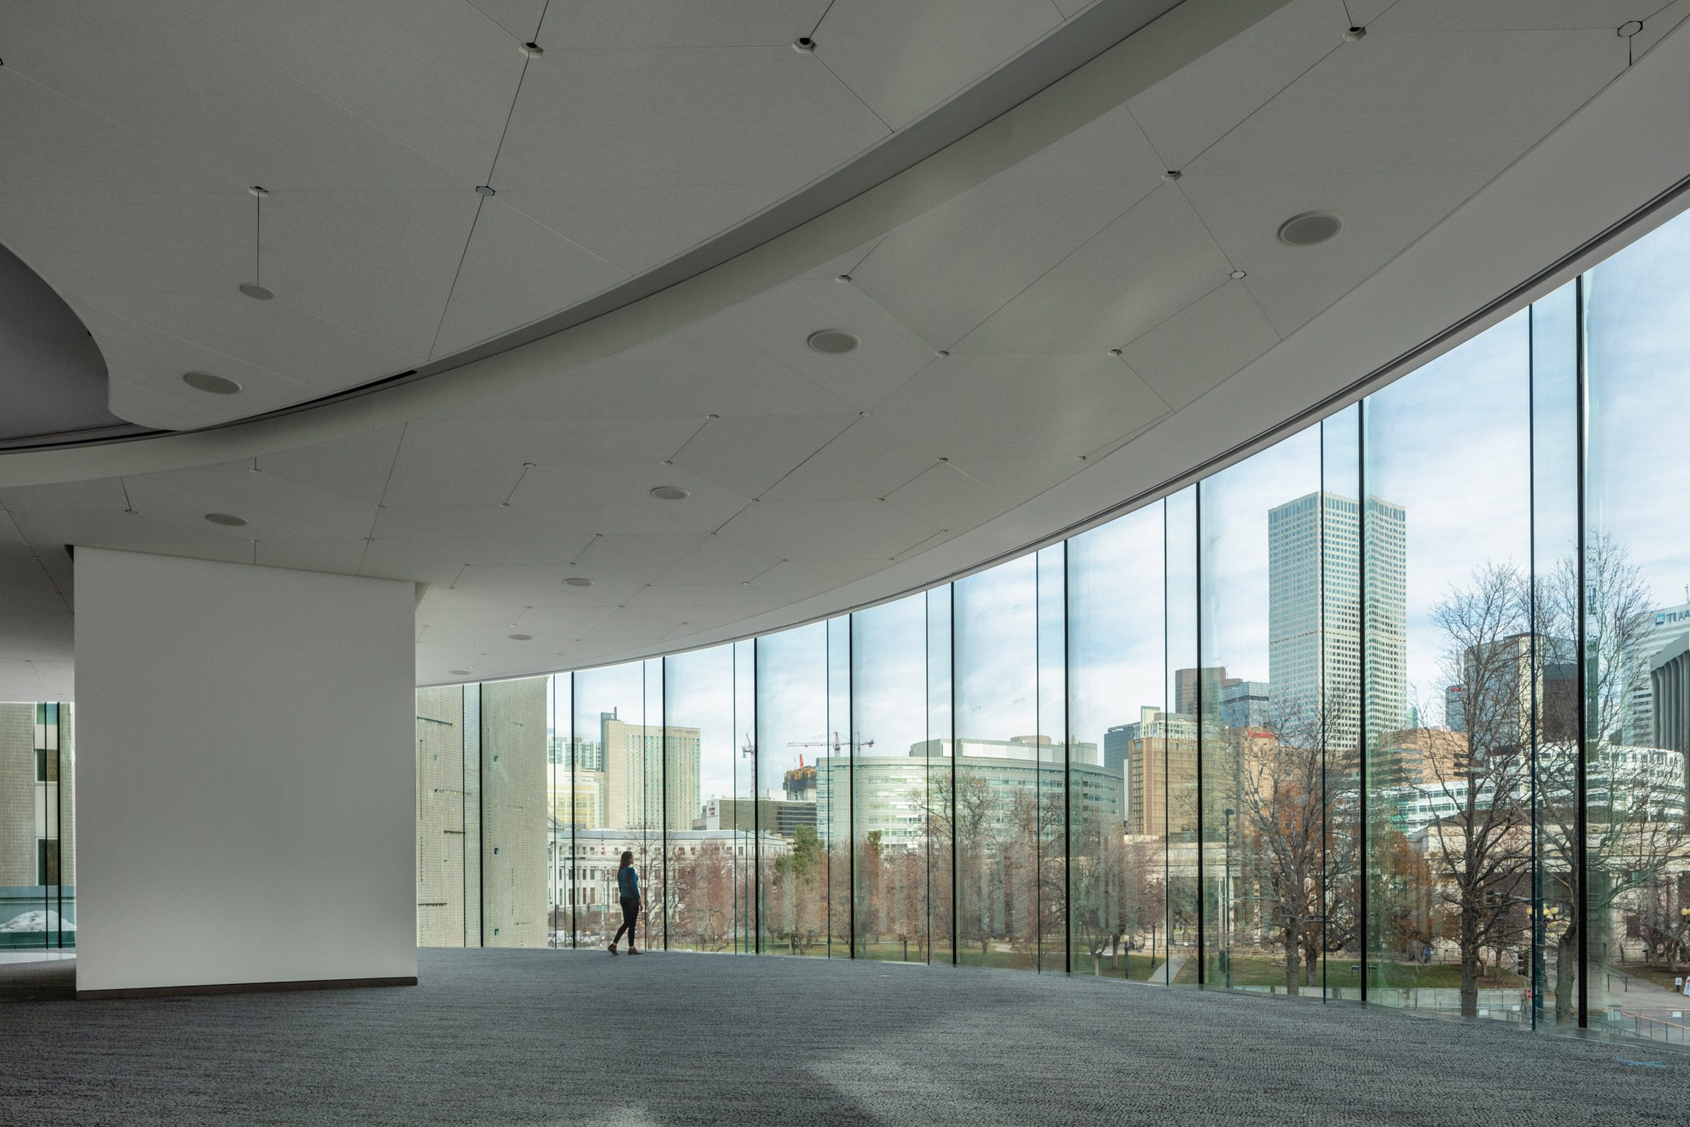
Denver Art Museum, Denver, CO (2021)

Slide 19
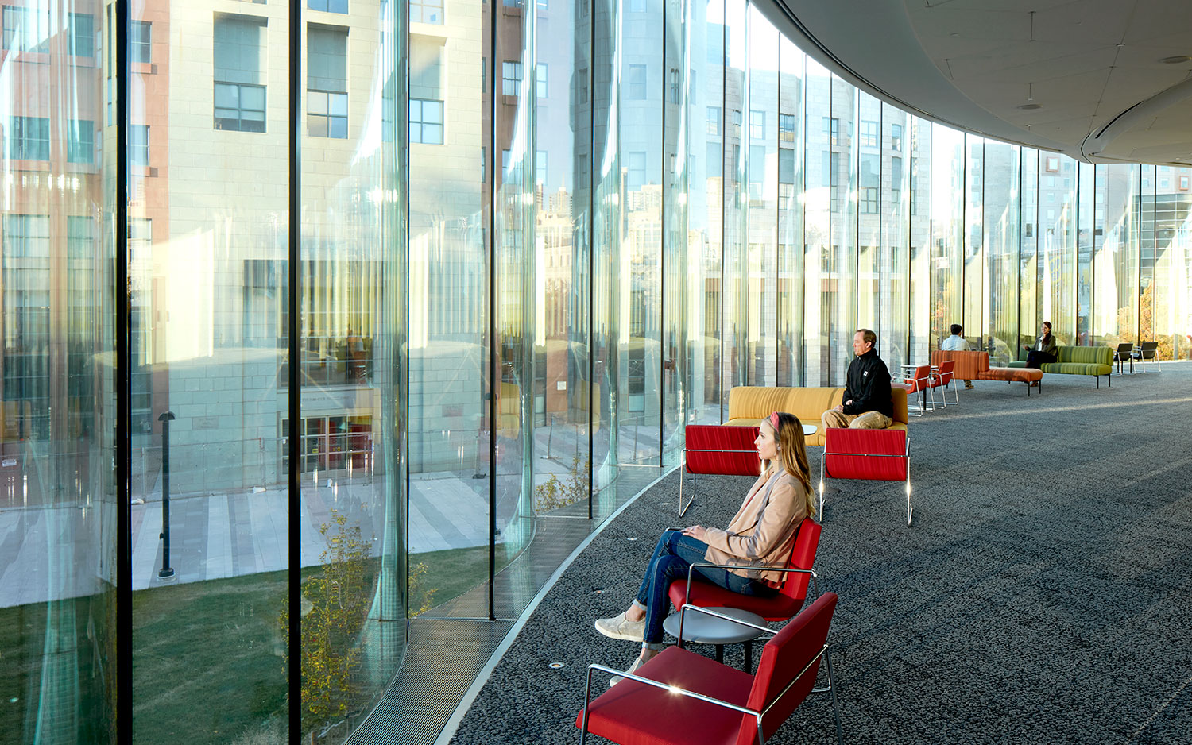
Denver Art Museum, Denver, CO (2021)

Slide 20
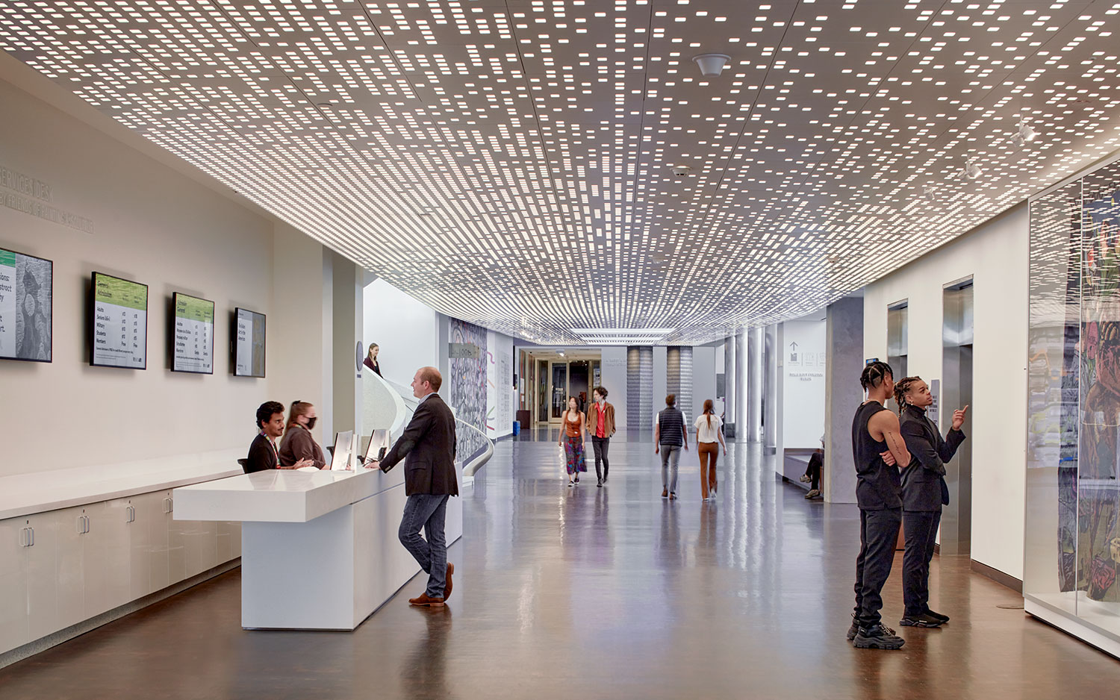
Denver Art Museum, Denver, CO (2021)

Slide 21
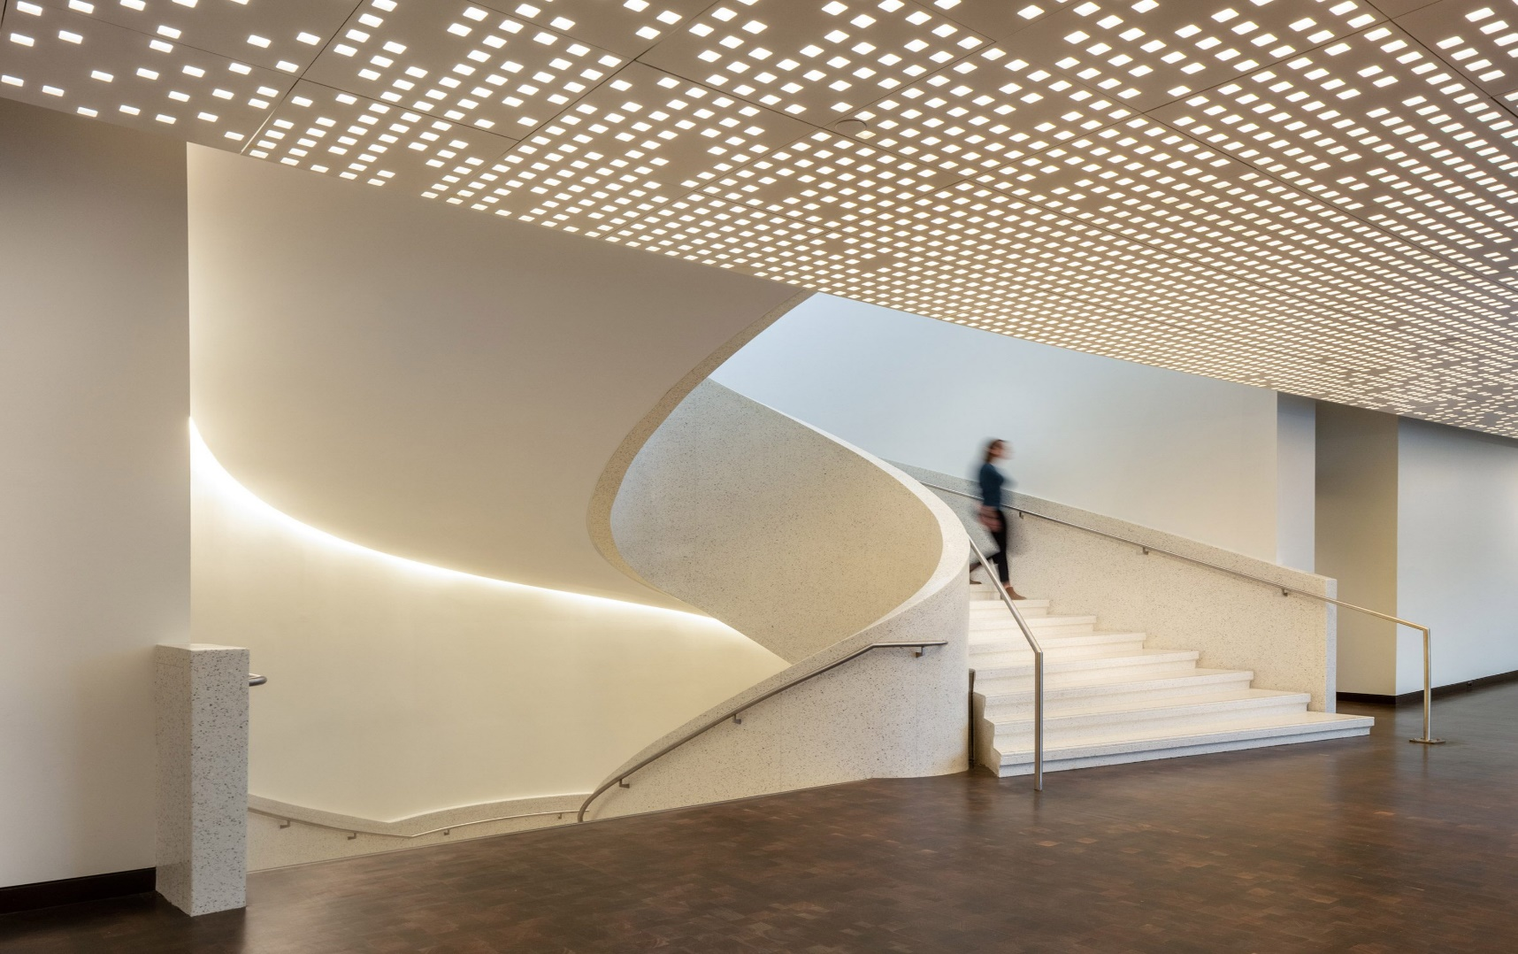
Denver Art Museum, Denver, CO (2021)

Slide 22
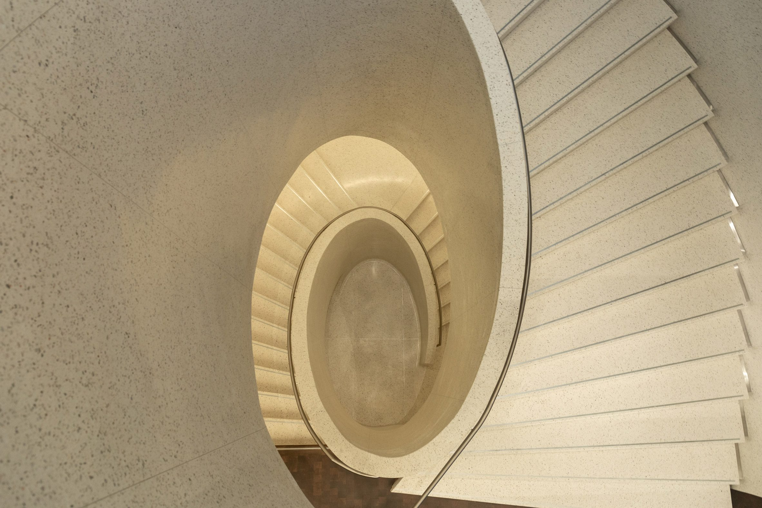
Denver Art Museum, Denver, CO (2021)

Slide 23
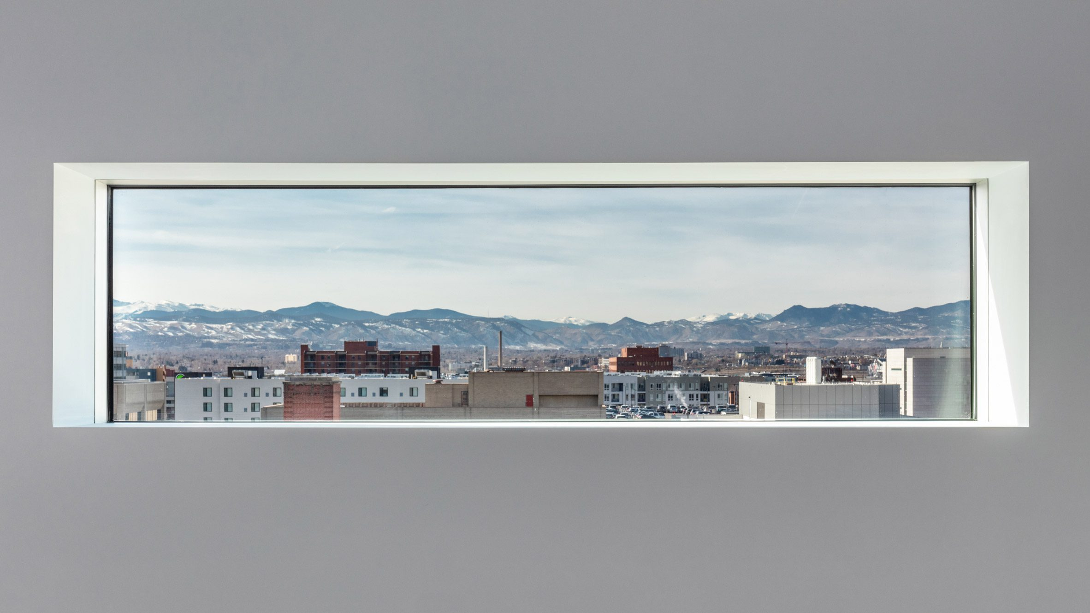
Denver Art Museum, Denver, CO (1971)

Slide 24
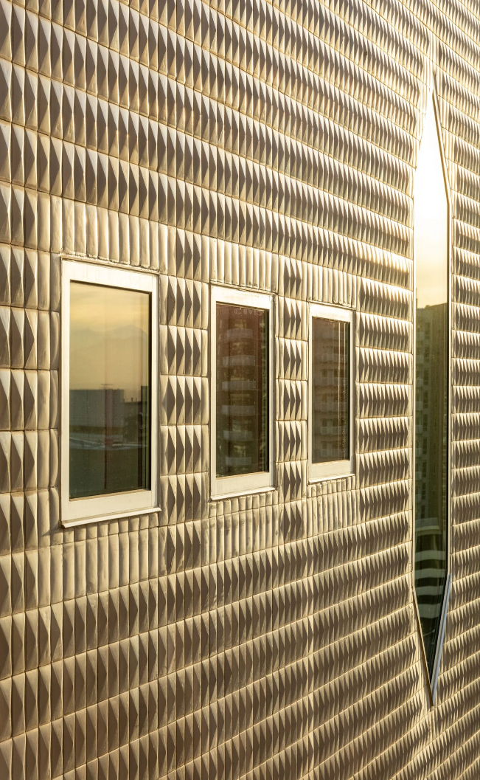
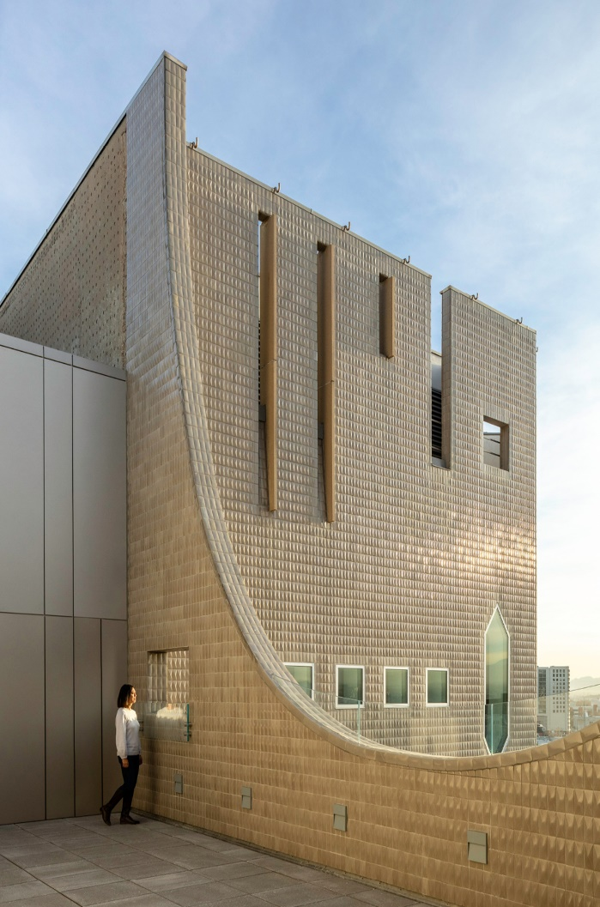
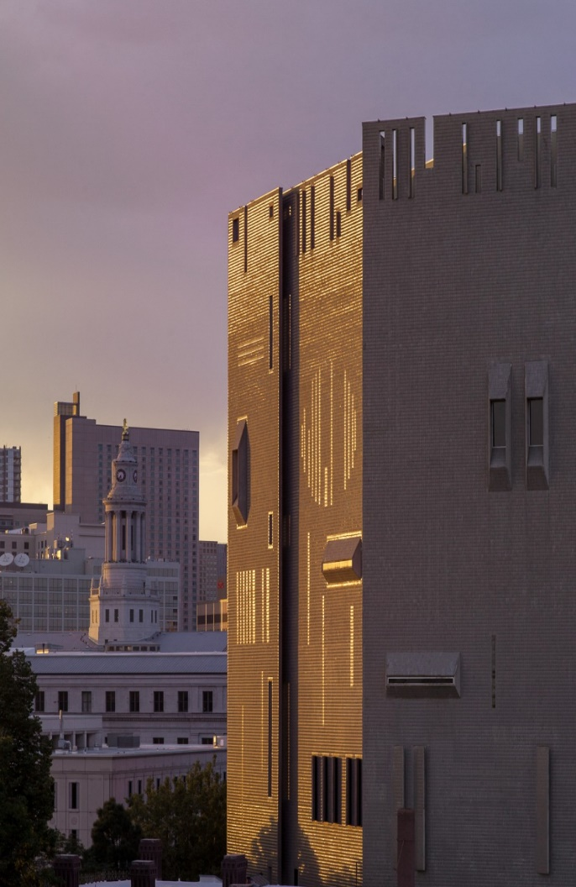
Denver Art Museum, Denver, CO (1971)

Slide 25
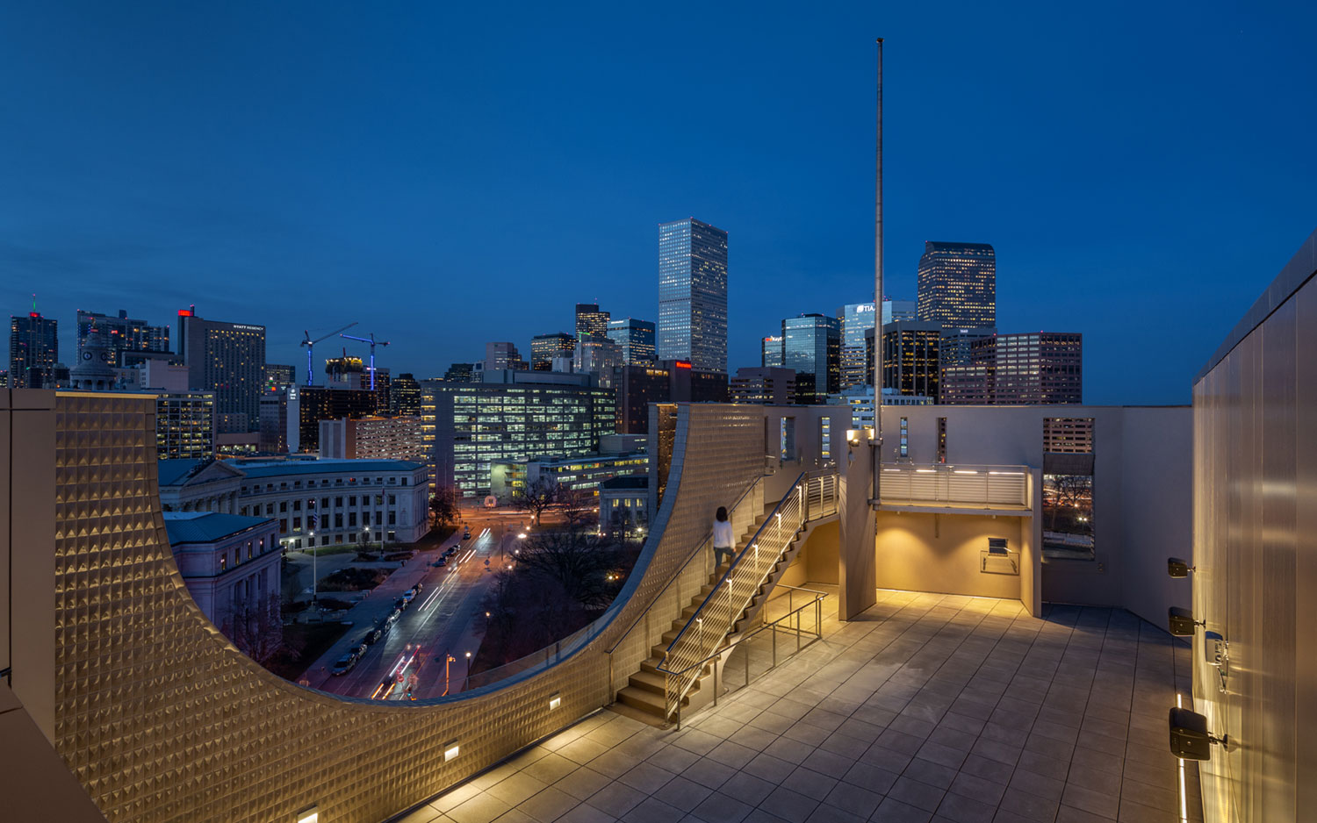
Denver Art Museum, Denver, CO (1971)

Slide 26
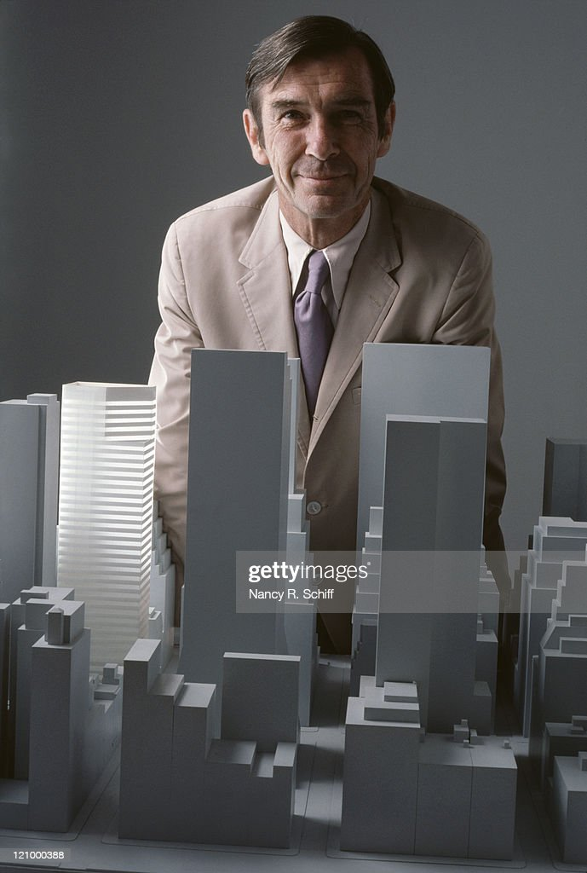
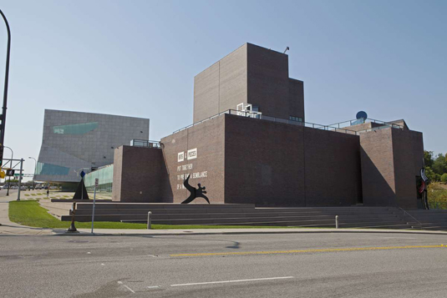
Walker Art Center, Minneapolis, IN (1971)
Edward Larrabee Barne

Slide 27
Walker Art Center, Minneapolis, IN (1971)
It is the work of Edward Larrabee Barne.
The distinctive Barnes-designed tower, which opened in 1971, is clad in a brown, plum-spotted brick. Like a rectangular helix, its seven boxlike galleries radiate from a central circulation core. Inside, Barnes iconic design with its white walls, terrazzo floors, and loft like spaces replicated the white cube galleries that have become the presentation hallmarks of modern and contemporary art. The large column less and spacious galleries vary in volume from 2,300 to 11,000 sqf with ceiling heights as high as 17.5 feet. Three outdoor terraces, dubbed “pedestals” by Barnes.

Slide 28
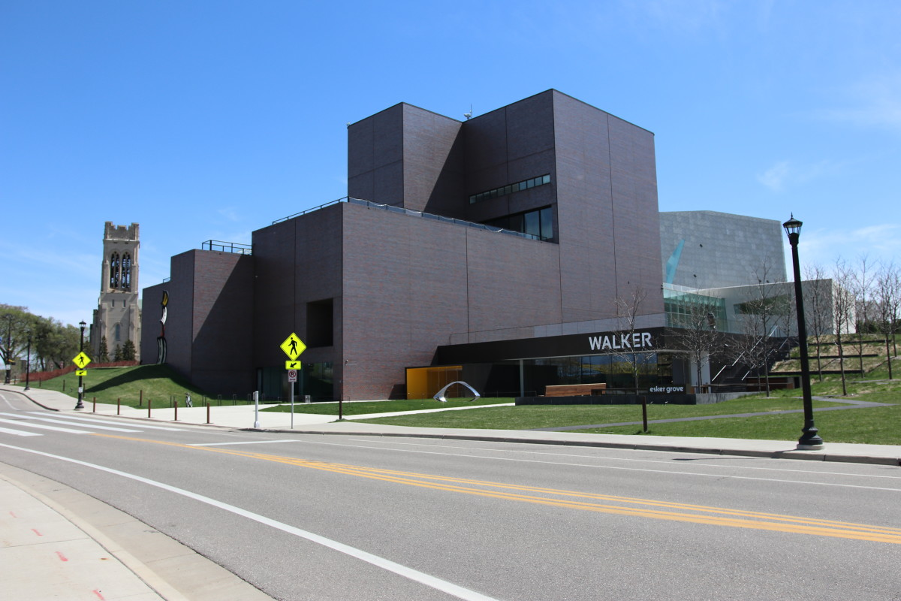
Walker Art Center, Minneapolis, IN (1971)

Slide 29
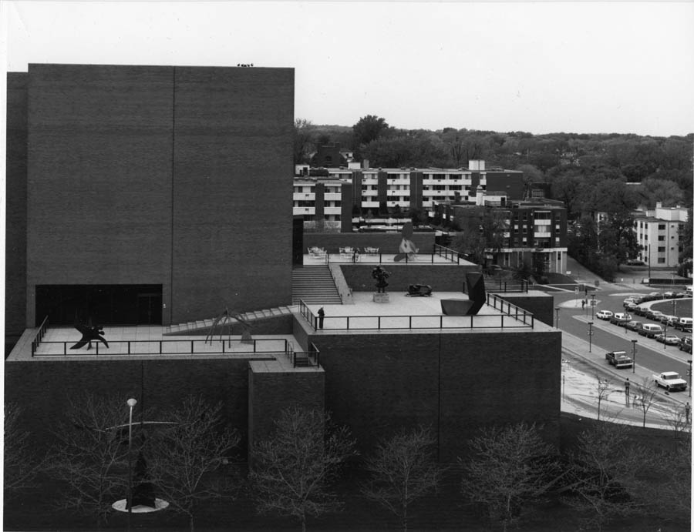
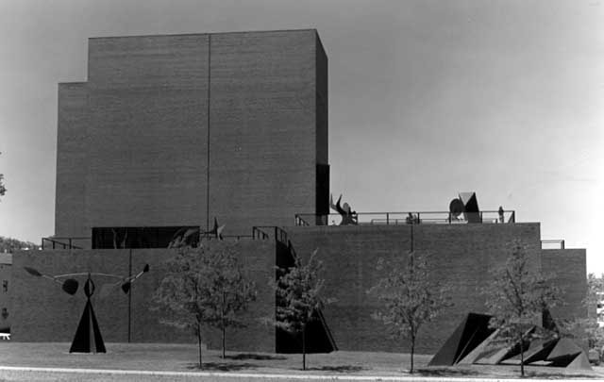
Walker Art Center, Minneapolis, IN (1971)

Slide 30
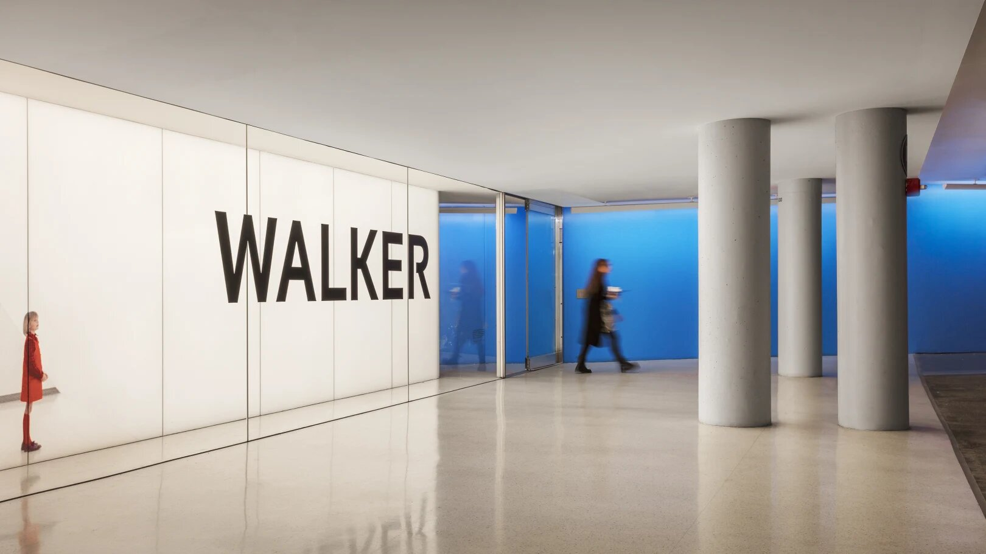
Walker Art Center, Minneapolis, IN (1971)

Slide 31
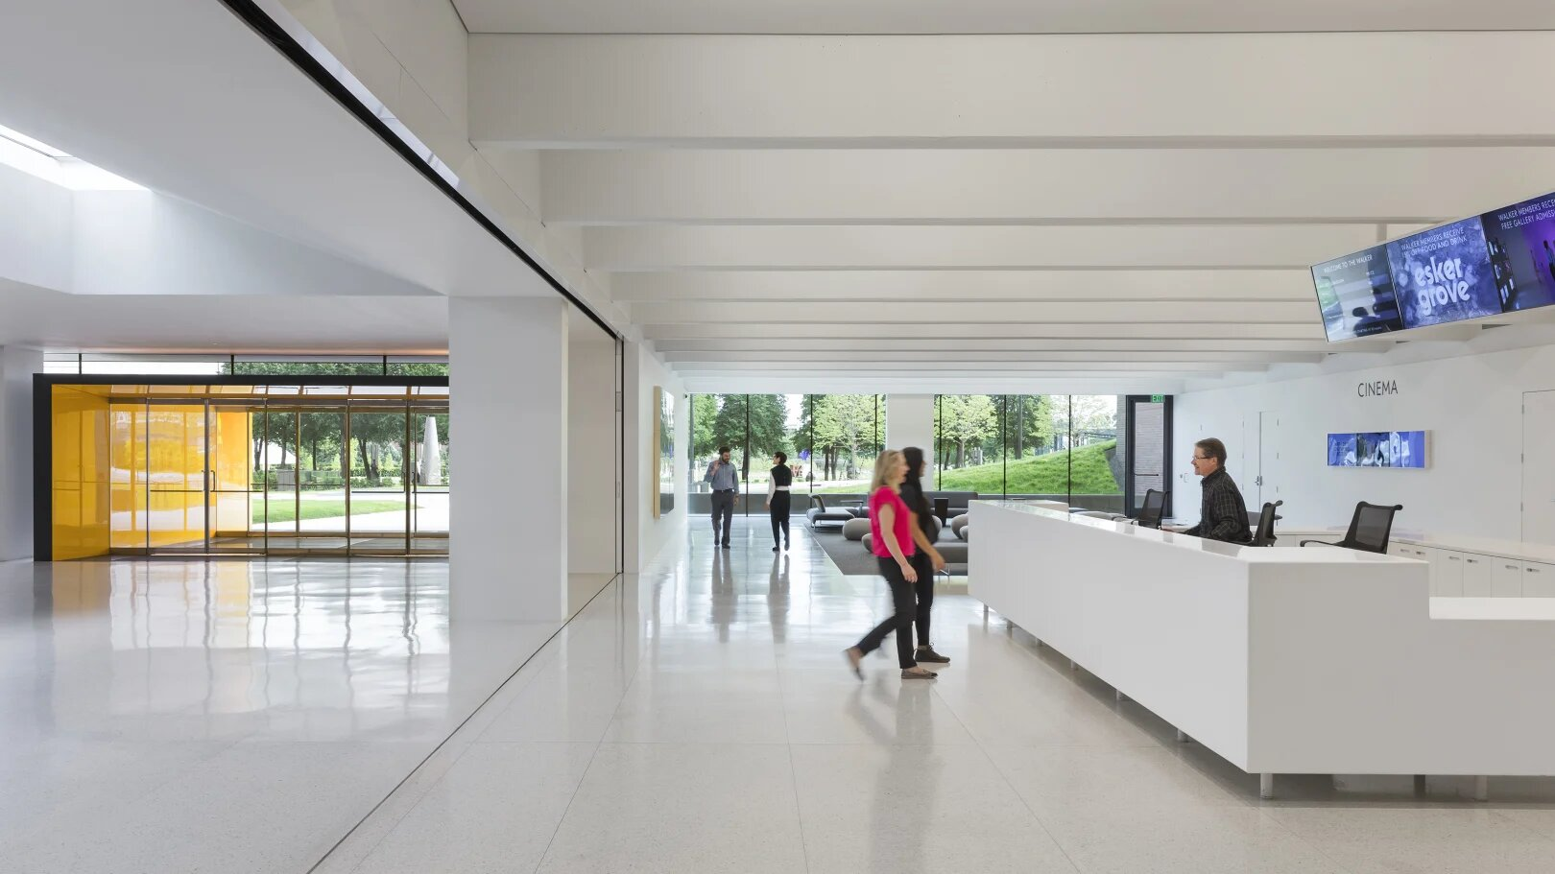
Walker Art Center, Minneapolis, IN (1971)

Slide 32
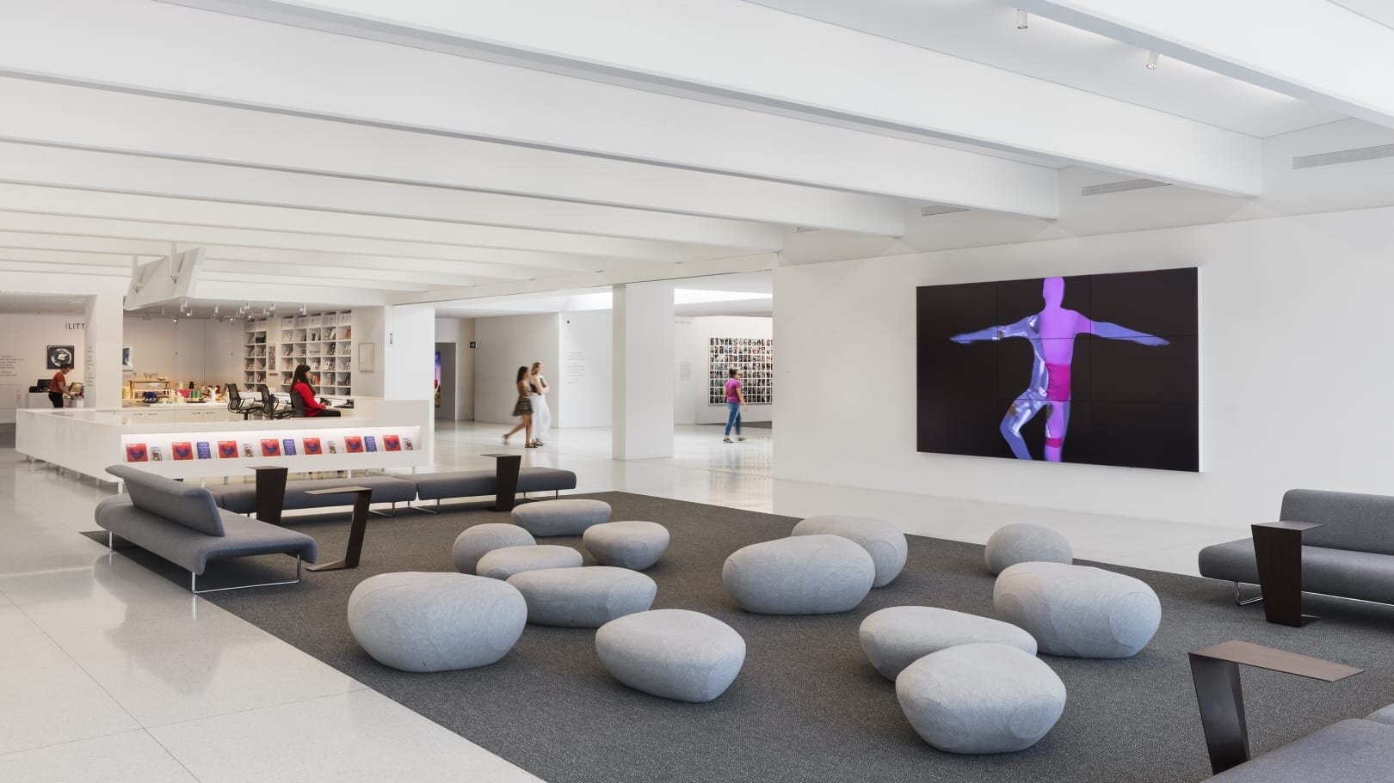
Walker Art Center, Minneapolis, IN (1971)

Slide 33
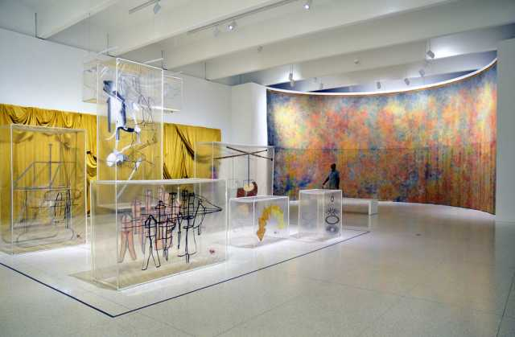
Walker Art Center, Minneapolis, IN (1971)

Slide 34
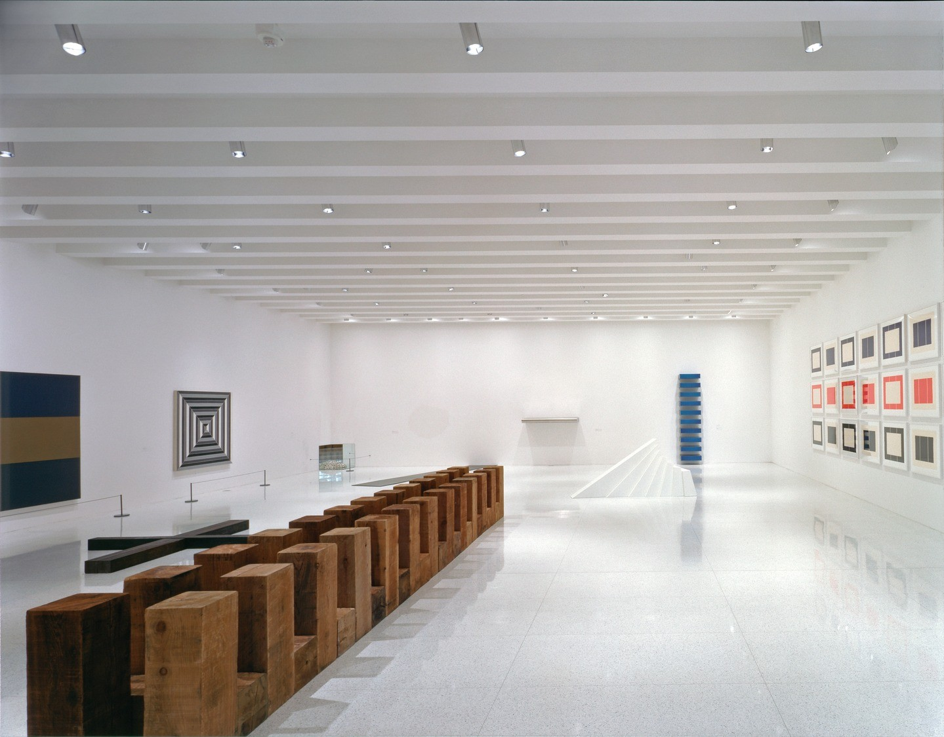
Walker Art Center, Minneapolis, IN (1971)

Slide 35
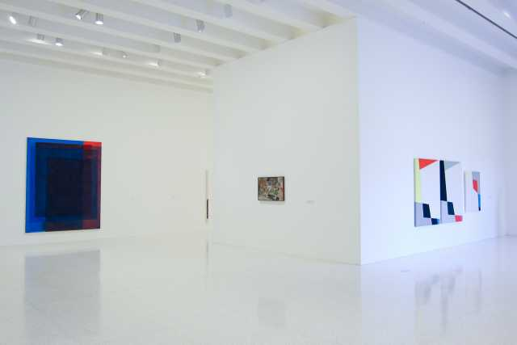
Walker Art Center, Minneapolis, IN (1971)

Slide 36
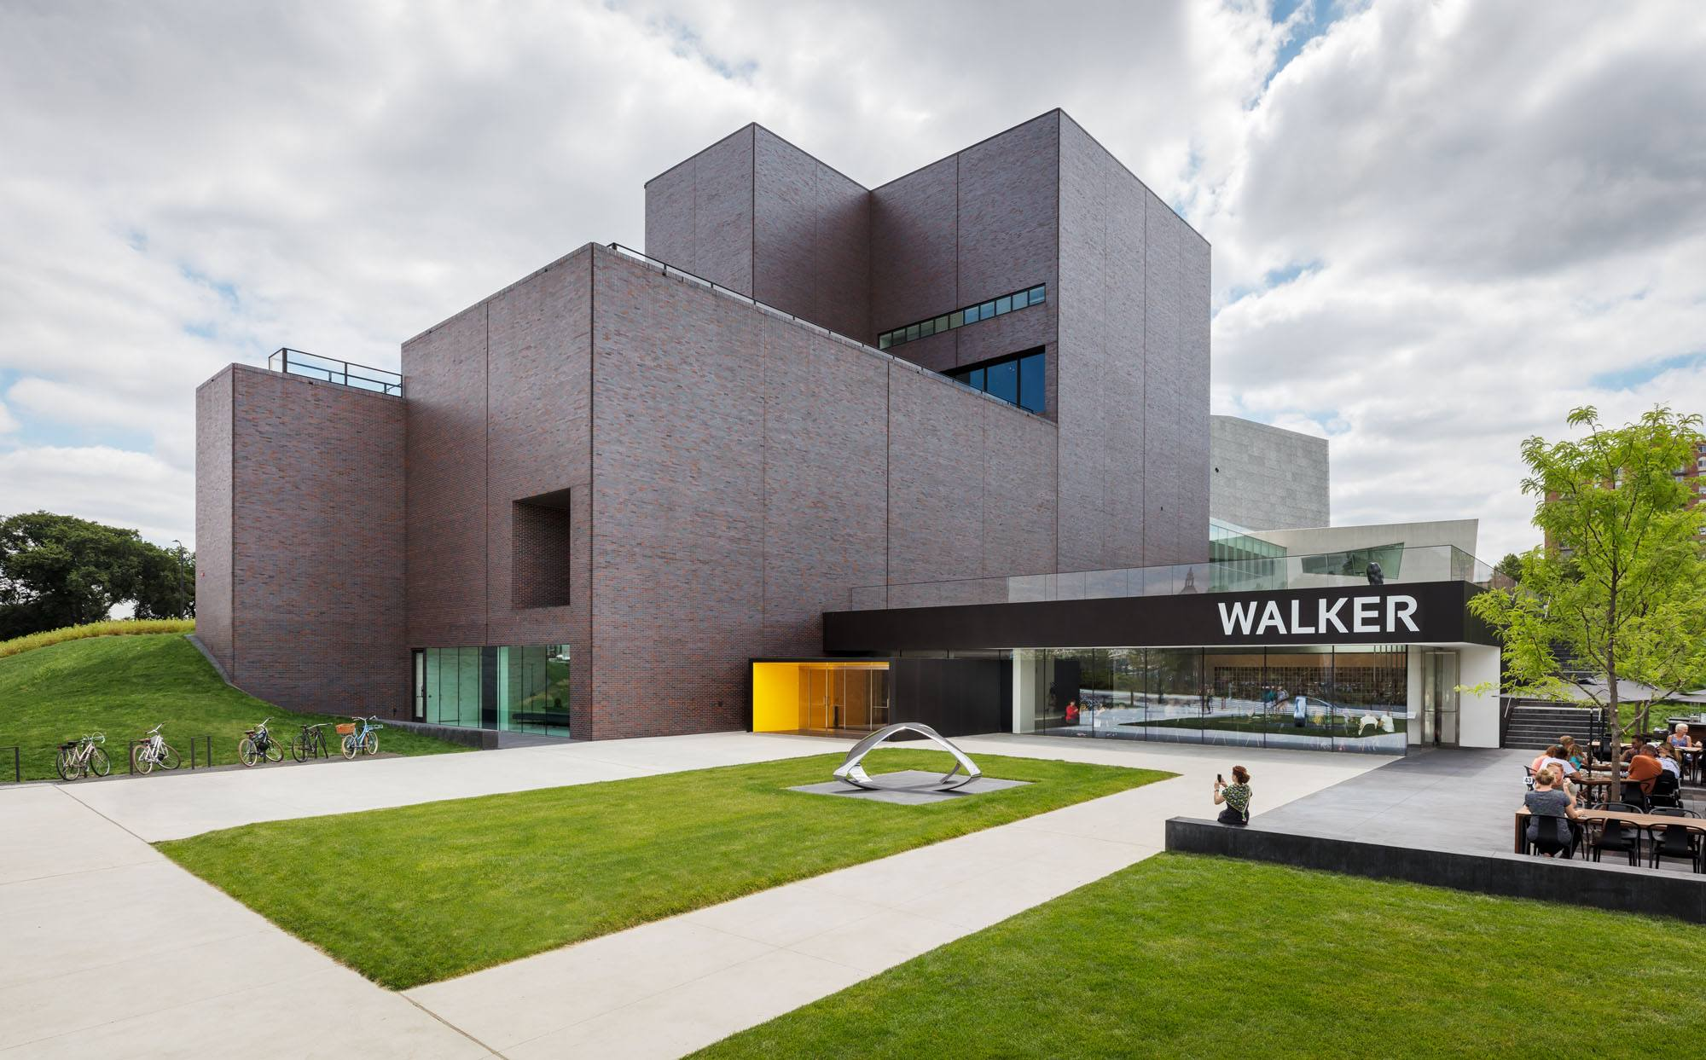
Walker Art Center, Minneapolis, IN (2021)

Slide 37
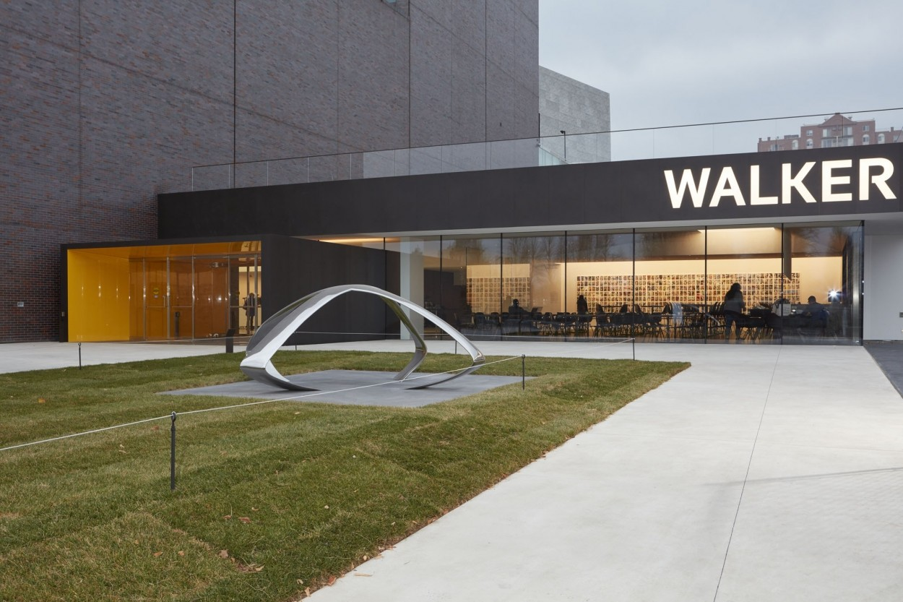
Walker Art Center, Minneapolis, IN (2021)

Slide 38
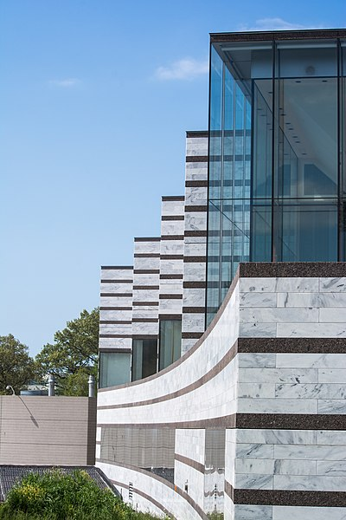
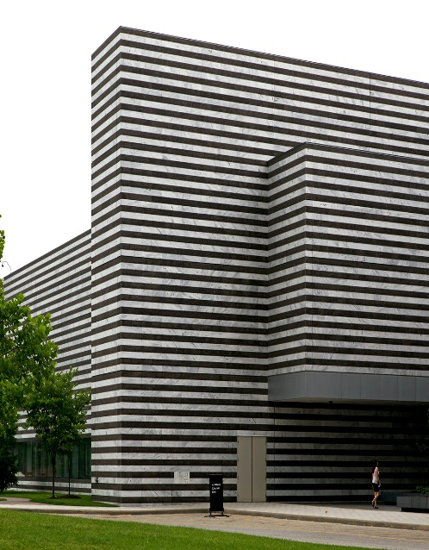
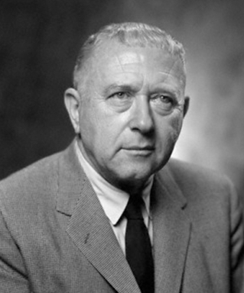
Museum of Art, Cleveland, OH (1971-2015)
Marcel Breuer
Rafael Vinoly

Slide 39
Museum of Art, Cleveland, OH (1971)
It is the work of the architect Marcel Breuer.
The modern addition has no connection with the neo-classical design of the original building--complete with Ionic temple portico.
Light and dark granite bands clad the walls in contrast to the white Georgian marble of the original Beaux-Arts building.
New gallery wings designed by R. Vinoly to the east and west enclose the piazza and taper toward the 1916 building, where they culminate in fully transparent, glazed galleries and pedestrian bridges that permit unobstructed views of the sides of the historic pavilion.

Slide 40
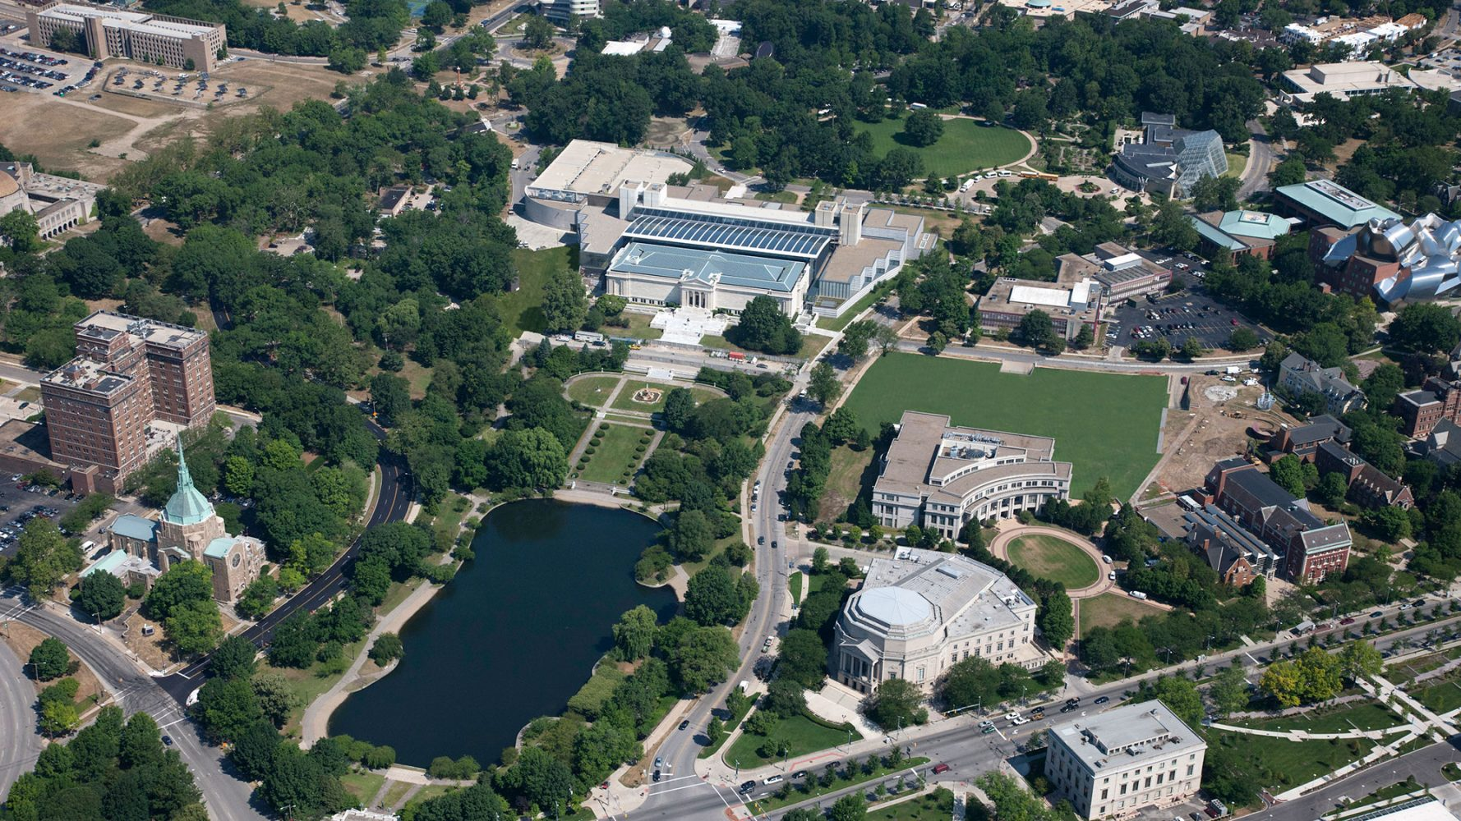
Museum of Art,Cleveland, OH (1971-2015)

Slide 41
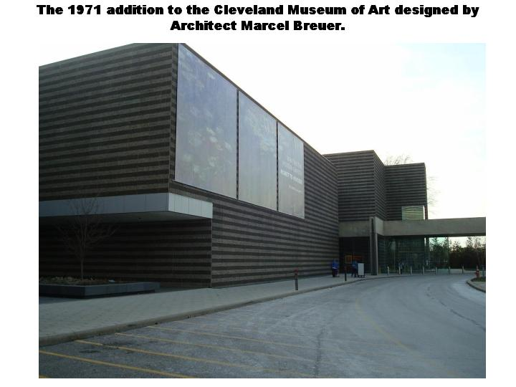
Museum of Art, Cleveland, OH (1971)

Slide 42
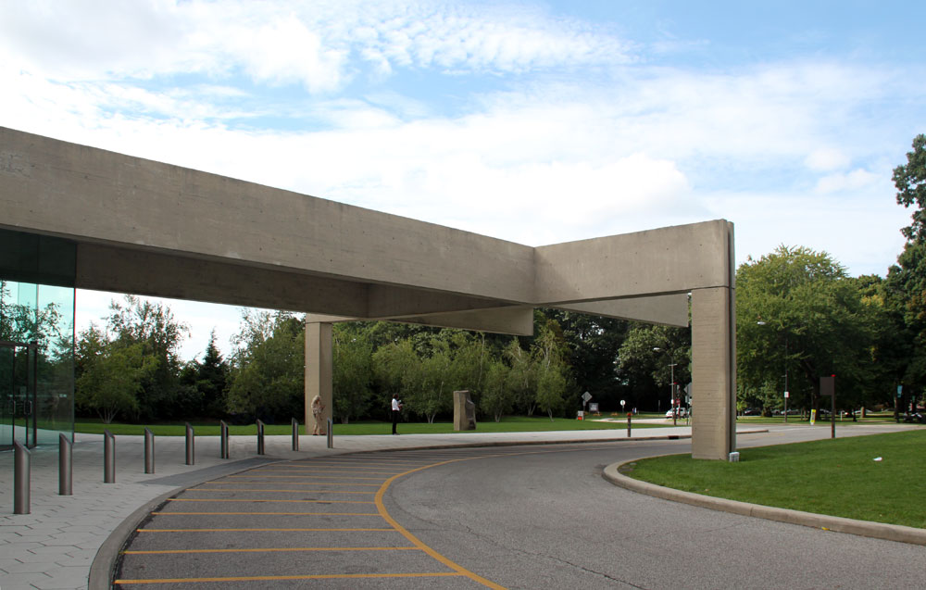
Museum of Art, Cleveland, OH (1971)

Slide 43
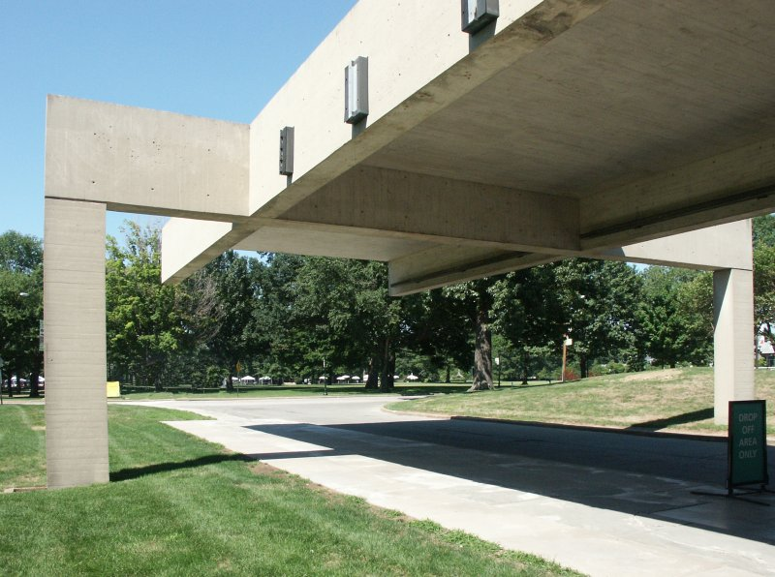
Museum of Art, Cleveland, OH (1971)

Slide 44
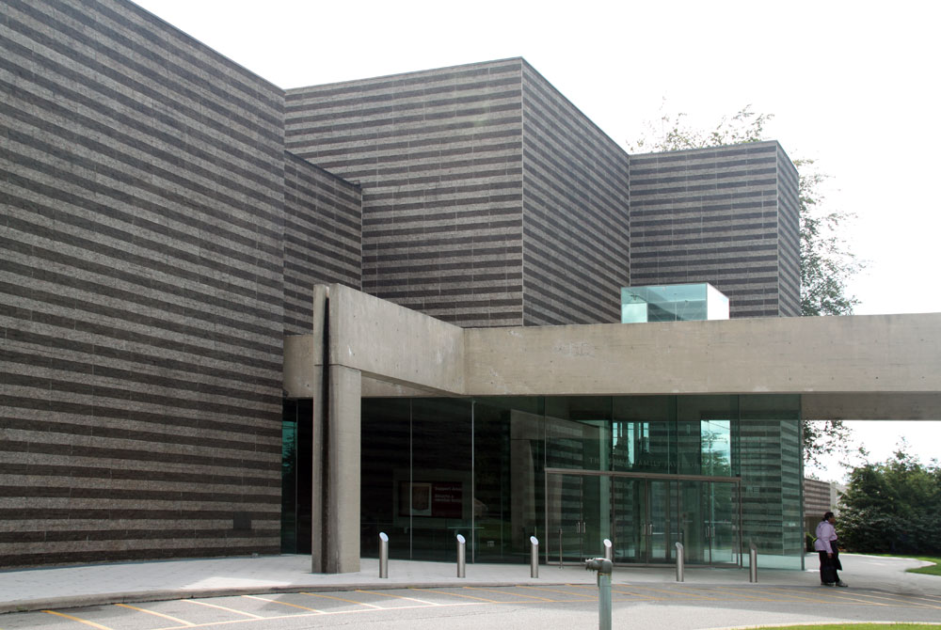
Museum of Art, Cleveland, OH (1971)

Slide 45
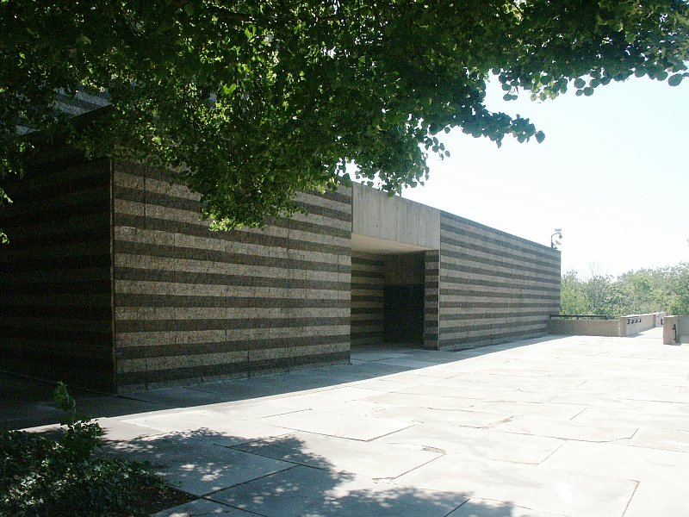
Museum of Art, Cleveland, OH (1971)

Slide 46
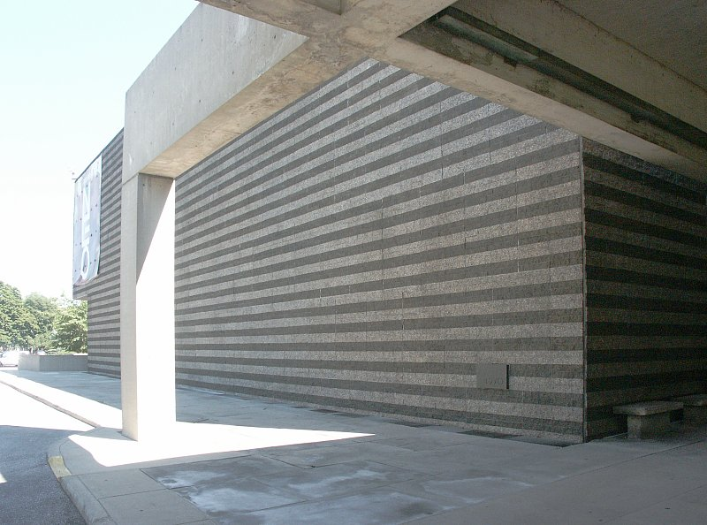
Museum of Art, Cleveland, OH (1971)

Slide 47
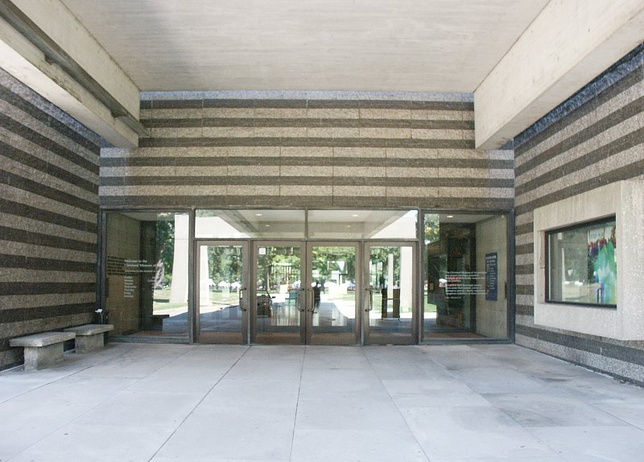
Museum of Art, Cleveland, OH (1971)

Slide 48
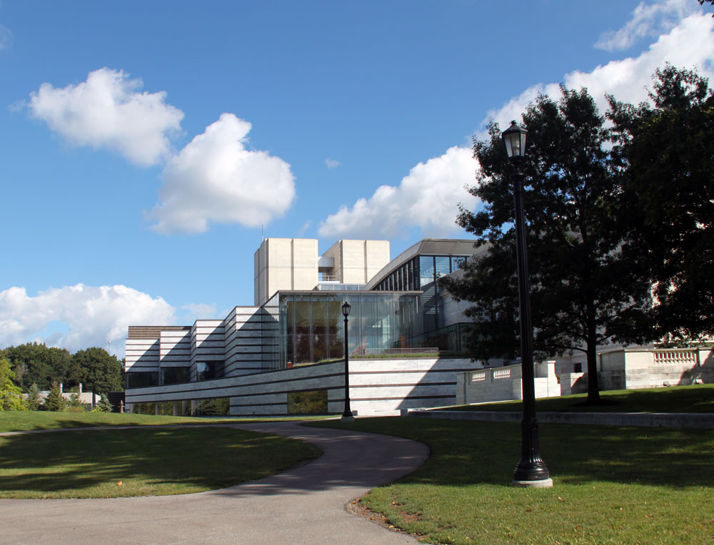
Museum of Art, Cleveland, OH (2009)

Slide 49
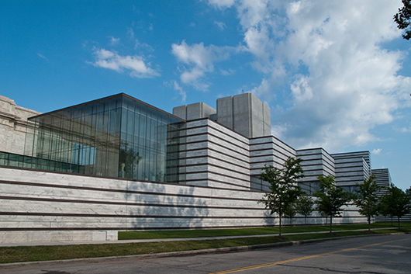
. Museum of Art, Cleveland, OH (2009)

Slide 50
Museum of Art, Cleveland, OH (2009)

Slide 51
Museum of Art, Cleveland, OH (2009)

Slide 52
Museum of Art, Cleveland, OH (2009)

Slide 53
Museum of Art, Cleveland, OH (1971)

Slide 54
Museum of Art, Cleveland, OH (1971)

Slide 55
Museum of Art, Cleveland, OH (1971)

Slide 56
Museum of Art, Cleveland, OH (2015)

Slide 57
Museum of Art, Cleveland, OH (2009)

Slide 58
Museum of Art, Cleveland, OH (2009)

Slide 59
Kimbell Art Museum, Fort Worth, TX (1972)
Kimbell Art Museum, Louis Kahn, 1972.
Extension Kimbell Art M., Renzo Piano, 2013.
Louis Kahn
Renzo Piano

Slide 60
Kimbell Art Museum, Fort Worth, TX (1972)

Slide 61
Kimbell Art Museum, Fort Worth, TX (1972)
The building designed by Louis Kahn is characterized by its shape, which consists of 16 barrel vaults with Plexiglas skylights at the top: the natural light, essential in this museum, penetrates in this way and is diffused by wing-shaped perforated aluminum reflectors that hang, giving a silvery glow to the smooth concrete. It is made of solid and durable materials : grey concrete, Tivoli travertine, white oak, metal and glass. The main (west) facade of the building consists of 3 100-foot bays, each fronted by an open, barrel-vaulted portico, with the central, entrance bay recessed and glazed. The porticos express on the exterior the light-filled vaulted spaces that are the defining feature of the interior, which are five deep behind each of the side porticos and three deep behind the central one.

Slide 62
Kimbell Art Museum, Fort Worth, TX (1972)

Slide 63
Kimbell Art Museum, Fort Worth, TX (1972)

Slide 64
Kimbell Art Museum, Fort Worth, TX (1972)
Joan Miro : Woman Addressing the Public 1981

Slide 65
Kimbell Art Museum, Fort Worth, TX (1972)

Slide 66
Kimbell Art Museum, Fort Worth, TX (1972)

Slide 67
Kimbell Art Museum, Fort Worth, TX (1972)

Slide 68
Kimbell Art Museum, Fort Worth, TX (1972)

Slide 69
Kimbell Art Museum, Fort Worth, TX (1972)

Slide 70
Kimbell Art Museum, Fort Worth, TX (2013)
The pavilion is made up of 2 sections connected by a glass passageway. The front, or easternmost, section conveys an impression of weightlessness: a glass roof system seems to float high above wooden beams and concrete posts. Sleek, square concrete columns flank the central, recessed glass entrance and wrap around three sides of the building. The tripartite facade articulates the interior, with a spacious entrance lobby and large galleries to the north and south. Like the original building, natural light is at the heart of Renzo Piano's extension: it comes through a high-performance sintered glass roof (with photovoltaic cells) supported by douglas pine beams and concrete columns. The materials used are identical: soft concrete and light grey, white oak floor, glass and metal.

Slide 71
Kimbell Art Museum, Fort Worth, TX (2013)

Slide 72
Kimbell Art Museum, Fort Worth, TX (2013)

Slide 73
Kimbell Art Museum, Fort Worth, TX (2013)

Slide 74
Kimbell Art Museum, Fort Worth, TX (2013)

Slide 75
Kimbell Art Museum, Fort Worth, TX (2013)

Slide 76
Kimbell Art Museum, Fort Worth, TX (2013)

Slide 77
Kimbell Art Museum, Fort Worth, TX (2013)

Slide 78
Kimbell Art Museum, Fort Worth, TX (2013)

Slide 79
Contemporary Art Museum, Houston, TX (1972)
Gunnar Birkerts

Slide 80
Contemporary Art Museum, Houston, TX (1972)
It is the work of the architect Gunnar Birkerts.
The museum is a parallelogram coated in ribbed, stainless steel. Most visitors walk right past its front door hidden between two panels of steel reflecting with that day's sky. Though surrounded by larger, more impressive structures, the sharpened steel edges allow this building to exist on its own without making apologies to the environment around it.
It chooses not to evoke the columns and ivy of its lateral surroundings, but rather merge with the sky above.

Slide 81
Contemporary Art Museum, Houston, TX (1972)

Slide 82
Contemporary Art Museum, Houston, TX (1972)

Slide 83
Contemporary Art Museum, Houston, TX (1972)

Slide 84
Contemporary Art Museum, Houston, TX (1972)

Slide 85
Contemporary Art Museum, Houston, TX (1972)

Slide 86
Contemporary Art Museum, Houston, TX (1972)

Slide 87
Center for Arts, Middletown, CT (1973)
Kevin Roche
John Dinkeloo

Slide 88
Center for Arts, Middletown, CT (1973)
It is the work of the architects Kevin Roche and John Dinkeloo.
On the perimeter of the Wesleyan University campus is an orderly arrangement of 11 small white limestone clad buildings that are gracefully stepped down the landscape's terrain. In fact, the open spaces between the buildings came to serve as visual frames that allowed the complex to play with the surrounding natural landscape, ingeniously exploiting the trees’ shapes, colors and shadows and integrating them into the design. The exhibition rooms are grouped together in the Ezra and Cecile Zilkha Gallery.

Slide 89
Center for Arts, Middletown, CT (1973)

Slide 90
Center for Arts, Middletown, CT (1973)

Slide 91
Center for Arts, Middletown, CT (1973)

Slide 92
Center for Arts, Middletown, CT (1973)

Slide 93
Center for Arts, Middletown, CT (1973)

Slide 94
Center for Arts, Middletown, CT (1973)

Slide 95
Center for Arts, Middletown, CT (1973)

Slide 96
Center for Arts, Middletown, CT (1973)

Slide 97
Center for Arts, Middletown, CT (1973)

Slide 98
Center for Arts, Middletown, CT (1973)

Slide 99
Hirshhorn Museum, Washington D.C. (1974)
Gordon Bunshaft

Slide 100
Hirshhorn Museum, Washington D.C. (1974)
It's the work of architect Gordon Bunshaft.
The design allows visitors to pass in circular form and extend the visual experience to adjacent buildings. It is a cylinder of 3 floors supported by 4 massive feet containing the gallery of paintings having a whole wall of windows opening towards the interior and towards a central fountain.
Only one opening underlined by a balcony gives onto the sculpture garden.

Slide 101
Hirshhorn Museum, Washington D.C. (1974)

Slide 102
Hirshhorn Museum, Washington D.C. (1974)

Slide 103
Hirshhorn Museum, Washington D.C. (1974)

Slide 104
Hirshhorn Museum, Washington D.C. (1974)

Slide 105
Hirshhorn Museum, Washington D.C. (1974)

Slide 106
Hirshhorn Museum, Washington D.C. (1974)

Slide 107
Hirshhorn Museum, Washington D.C. (1974)

Slide 108
Hirshhorn Museum, Washington D.C. (1974)

Slide 109
Hirshhorn Museum, Washington D.C. (1974)

Slide 110
Fine Arts Center, Amherst, MA (1974)
Kevin Roche
John Dinkeloo

Slide 111
Fine Arts Center, Amherst, MA (1974)
It is the work of the architects Kevin Roche and John Dinkeloo.
This uncompromisingly modernist, poured concrete building consists of several distinctly different units that were intended to combine to form a powerful architectural sculpture. The Fine Arts Center was conceived as a gateway to the campus. The building is stretched across the entire front of the inner campus forming a gateway and, by elevating the art studios, an arcade of open book piers.
The complex has 2 scales: one, the super scale of the entry side; the other, a smaller scale, more appropriate to pedestrian movement on the campus side.

Slide 112
Fine Arts Center, Amherst, MA (1974)
The super scale is made up of a series of planes at right angles in plan and normal and sloping to the vertical plane in section so that as the sun passes over the south surface of the building, a series of strong geometrical shadows are developed on the dihedral columns in the foreground and beyond on the layers of surfaces in the middle and background, making the building lively and interesting and very powerful in its expression.
The Performance Arts Center Lobby (2000) offers light and transparency, elements that contrast strongly with the opaque volumes. The project is conceived of as 3 glass boxes arranged to create a transparent link between upper and lower campuses.

Slide 113
Fine Arts Center, Amherst, MA (1974)

Slide 114
Fine Arts Center, Amherst, MA (1974)

Slide 115
Fine Arts Center, Amherst, MA (1974)

Slide 116
Fine Arts Center, Amherst, MA (1974)

Slide 117
Fine Arts Center, Amherst, MA (1974)

Slide 118
Fine Arts Center, Amherst, MA (1974)

Slide 119
Fine Arts Center, Amherst, MA (1974)

Slide 120
Fine Arts Center, Amherst, MA (1974)

Slide 121
Fine Arts Center, Amherst, MA (1974)

Slide 122
Fine Arts Center, Amherst, MA (1974)

Slide 123
Fine Arts Center, Amherst, MA (1974)

Slide 124
Fine Arts Center, Amherst, MA (1974)

Slide 125
Fine Arts Center, Amherst, MA (1974)

Slide 126
Fine Arts Center, Amherst, MA (2000)

Slide 127
Fine Arts Center, Amherst, MA (2000)

Slide 128
Museum of Fine Arts, Houston, TX (1974)
Caroline Wiess Law Building : Mies Van der Rohe (1958, 1974)
Audrey Jones Beck Building : Rafael Moneo (2000)
Mies Van Der Rohe
Rafael Moneo

Slide 129
Museum of Fine Arts, Houston, TX (1974)
Mies Van der Rohe is the author of 2 extensions of the Museum of Fine Arts of Houston (M.F.A.H.): Cullinan Hall in 1958 and Brown Hall in 1974 now linked under the name Caroline Wiess Law Building.
These 2 buildings have a rounded shape, with oversized windows, framed in thin steel columns with massive, almost transparent white curtains, protecting light, and inside white plaster walls, suspended ceiling panels and exposed steel columns.

Slide 130
M.F.A.H., Houston, TX (1974)

Slide 131
Museum of Fine Arts, Houston, TX (1974)
Brown Hall

Slide 132
Museum of Fine Arts, Houston, TX (1974)

Slide 133
Museum of Fine Arts, Houston, TX (1974)

Slide 134
Museum of Fine Arts, Houston, TX (1974)

Slide 135
Museum of Fine Arts, Houston, TX (1974)

Slide 136
Museum of Fine Arts, Houston, TX (1958)
Cullinan Hall

Slide 137
Museum of Fine Arts, Houston, TX (2000)
A new extension, the Audrey Jones Beck Building is the work of Rafael Moneo.
The architect will oppose the 2 extensions of Mies Van der Rohe with transparency by building an imposing concrete building with few openings, the rooms being essentially lit zenithally thanks to a series of roof skylights.
Between these two architectural works there is an underground tunnel The Light Inside in which the artist James Turrell has installed an installation based on light.

Slide 138
Museum of Fine Arts, Houston, TX (2000)

Slide 139
Museum of Fine Arts, Houston, TX (2000)

Slide 140
Museum of Fine Arts, Houston, TX (2000)

Slide 141
Museum of Fine Arts, Houston, TX (2000)

Slide 142
Museum of Fine Arts, Houston, TX (2000)

Slide 143
Museum of Fine Arts, Houston, TX (2000)

Slide 144
Museum of Fine Arts, Houston, TX (2000)

Slide 145
Museum of Fine Arts, Houston, TX (1986)
Roy Cullen Sculpture Garden Architect : Isamu Noguchi

Slide 146
Museum of Fine Arts, Houston, TX (2000)
James Turrell

Slide 147
Carnegie Museum, Pittsburgh, PA (1974)
E. L. Barnes

Slide 148
Carnegie Museum, Pittsburgh, PA (1974)
It is the work of Edward Larrabee Barnes.
The building's powerful facade is frankly monumental : it consists largely of a huge horizontal mass of granite spanning a first floor of glass. Not only are the huge blocks of Norwegian granite perfectly joined, but even the glass wall, which encloses most of the first floor including sections looking out to a sculpture garden, is a masterpiece of glass detailing. It is a combination of large panes joined together without metal mullions, or divider strips, and smaller glass “fins” set perpendicular to the wall to serve as wind bracing.

Slide 149
Carnegie Museum, Pittsburgh, PA (1974)
The galleries are well lighted by natural light through clerestories, and their white walls and floor and neutral shapes do not try to grab attention from the art : they are arranged in a series of elongated U's, to give the visitor a serpentine path.
Galleries upstairs are reached by a long, leisurely stairway that glides gently up a granite wall, with the glass wall overlooking the sculpture court always opposite.

Slide 150
Carnegie Museum, Pittsburgh, PA (1974)

Slide 151
Carnegie Museum, Pittsburgh, PA (1974)

Slide 152
Carnegie Museum, Pittsburgh, PA (1974)

Slide 153
Carnegie Museum, Pittsburgh, PA (1974)

Slide 154
Carnegie Museum, Pittsburgh, PA (1974)

Slide 155
Carnegie Museum, Pittsburgh, PA (1974)
Jacqueline Humphries

Slide 156
Carnegie Museum, Pittsburgh, PA (1974)

Slide 157
Carnegie Museum, Pittsburgh, PA (1974)

Slide 158
Herbert Johnson Museum, Ithaca, NY (1975)
Ieoh Ming Pei

Slide 159
Herbert Johnson Museum, Ithaca, NY (1975)

Slide 160
Herbert Johnson Museum, Ithaca, NY (1975)
It is the work of the architect Ieoh Ming Pei.
Functions were grouped into above-grade and below-grade categories; those above grade were further split into gallery (low zone) and “other” (high zone). The areas were compared and the uses assessed for stack ability (convenience and appropriateness).
To preserve much of the landscape and surrounding views, the museum contains 9 floors above ground and one floor below.
To the east and west, 2 vertical recessed slots offer views of the upper levels.

Slide 161
Herbert Johnson Museum, Ithaca, NY (1975)
From an entry court, one would ascend in gradual levels through the permanent collection galleries, and descend in similar steps through the temporary exhibition galleries. The upward sequence would conclude with the exterior sculpture terrace, and the downward circuit with the experimental gallery and lecture room.
The large gallery for temporary exhibits was placed a half-level below the lobby, and the main galleries for the permanent collection were to be a half-level above it.

Slide 162
Herbert Johnson Museum, Ithaca, NY (1975)
This concrete museum is perforated by long horizontal strips of windows that run along the upper floors, inserted directly into the concrete shell .
It is also characterized by cantilevered spaces by means of projected horizontal beams.
There is a selection of the buff-colored mix for all exposed concrete surfaces.
A system of narrow (three-inch) tongue-and-groove boards of Douglas fir was used for the Museum formwork to create a light pattern which would not compete with the building form or details.

Slide 163
Herbert Johnson Museum, Ithaca, NY (1975)

Slide 164
Herbert Johnson Museum, Ithaca, NY (1975)

Slide 165
Herbert Johnson Museum, Ithaca, NY (1975)

Slide 166
Herbert Johnson Museum, Ithaca, NY (1975)

Slide 167
Herbert Johnson Museum, Ithaca, NY (1975)

Slide 168
Herbert Johnson Museum, Ithaca, NY (1975)

Slide 169
Herbert Johnson Museum, Ithaca, NY (1975)

Slide 170
Herbert Johnson Museum, Ithaca, NY (1975)

Slide 171
Herbert Johnson Museum, Ithaca, NY (1975)

Slide 172
Herbert Johnson Museum, Ithaca, NY (1975)

Slide 173
Herbert Johnson Museum, Ithaca, NY (2011)

Slide 174
Herbert Johnson Museum, Ithaca, NY (2011)

Slide 175
Herbert Johnson Museum, Ithaca, NY (2011)

Slide 176
Herbert Johnson Museum, Ithaca, NY (2011)

Slide 177
Herbert Johnson Museum, Ithaca, NY (2011)

Slide 178
Herbert Johnson Museum, Ithaca, NY (2011)

Slide 179
Herbert Johnson Museum, Ithaca, NY (1975)

Slide 180
Herbert Johnson Museum, Ithaca, NY (1975)
THE END

